Slide 1
Chehalis Basin Strategy
Notes:
A suite of actions is being evaluated to help address two major challenges in the Chehalis River Basin – extreme flooding and the declining health of the river and its aquatic species. The good news is, basin communities and the state are in a position to do something about it.

Slide 2
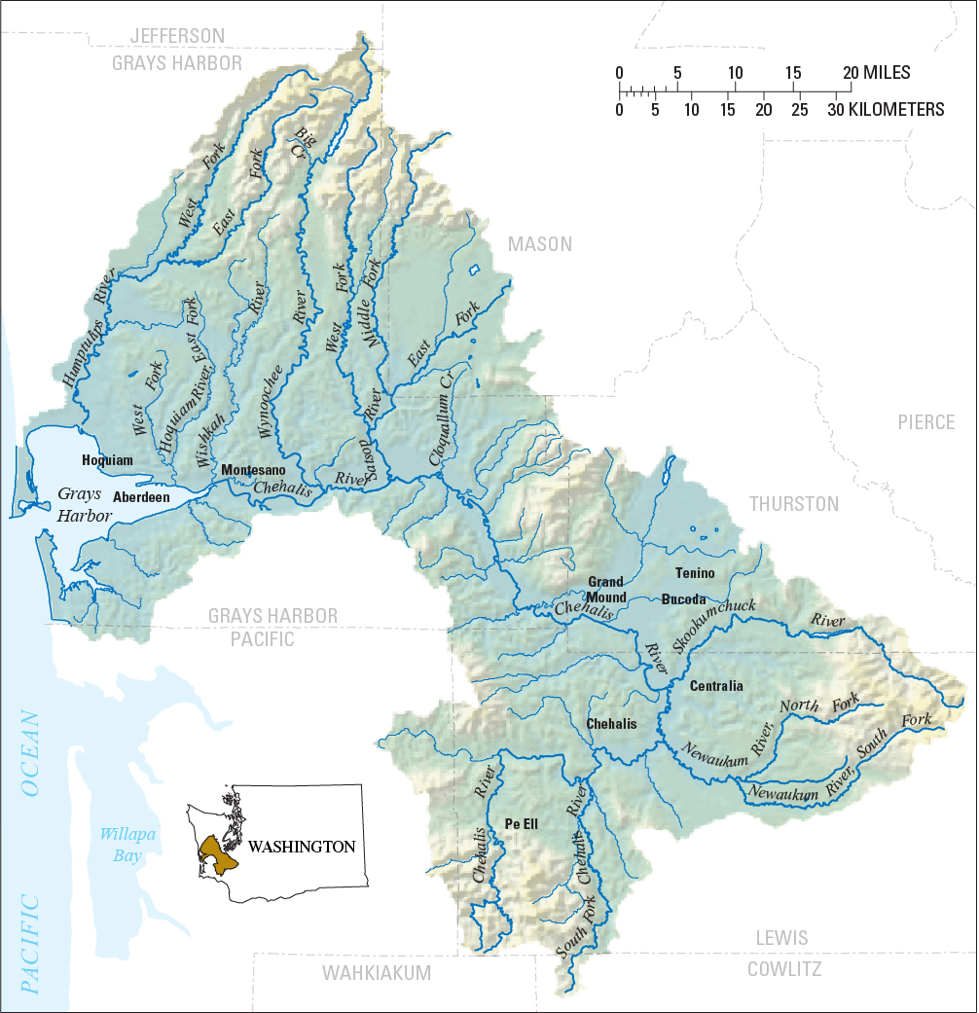
The Chehalis Basin
Notes:
The Chehalis Basin, which covers areas of Grays Harbor, Thurston, and Lewis Counties, is the second largest river basin in Washington.

Slide 3
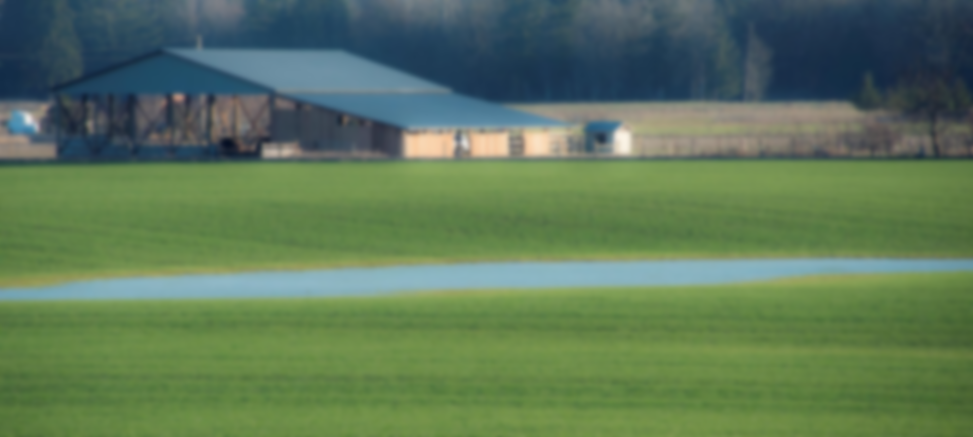
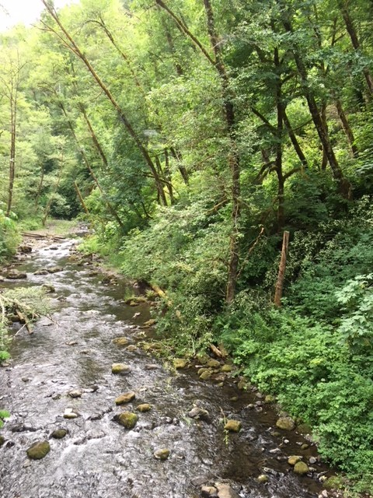
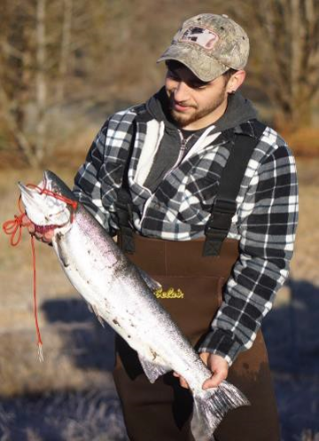
A Fertile & Bucolic Region …

Slide 4
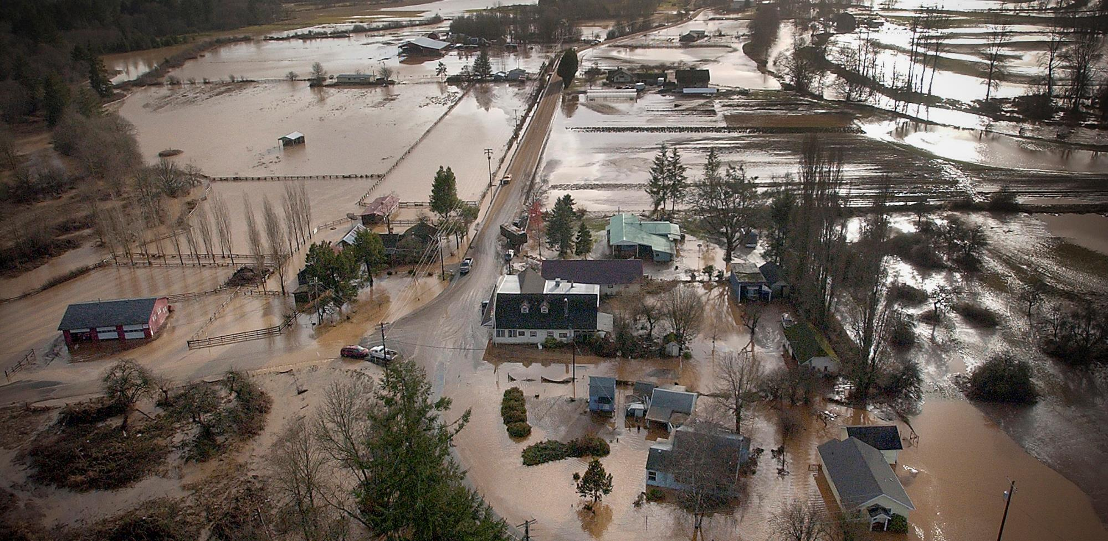
… With Extreme Flooding
Notes:
But as you likely know, the Basin has suffered from devastating flooding for decades, which deal a blow to the health and safety of the community. Five of the largest floods in the basin’s history have occurred in the last 30 years. Summers are becoming drier as well. One local business owner said, “We take one step forward, a major flood hits and its two steps back.”

Slide 5
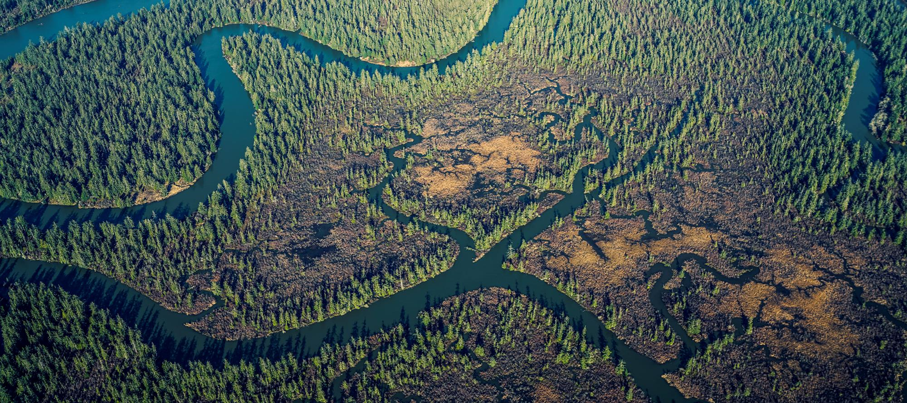
An Abundant River Basin…
Notes:
The Chehalis is a diverse, abundant basin for plants and animals also. Many different species of fish are found in the basin including steelhead and several types of salmon. The rivers and streams in the basin are also home to many amphibians like frogs and salamanders. In fact, the Chehalis Basin is the most diverse basin in Washington for amphibians.

Slide 6
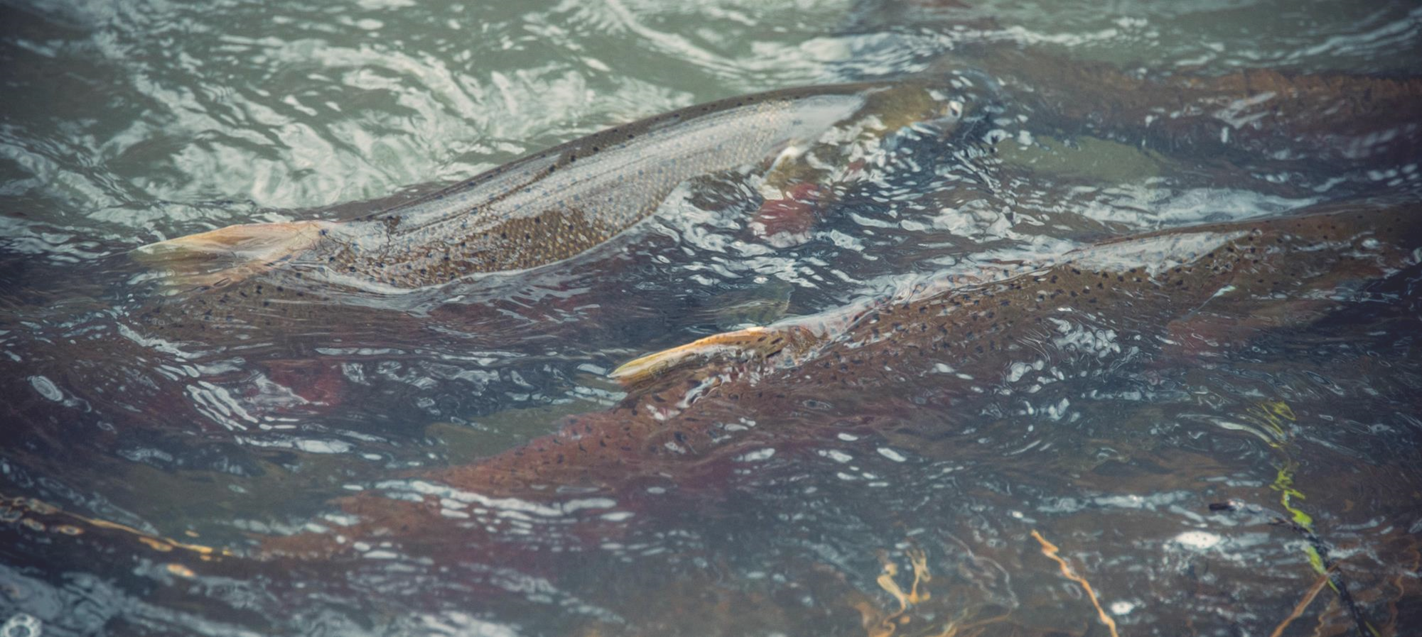
Aquatic Species are Struggling
Harvest limited by poor runs over the last 30 years
Habitat productivity degraded by up to 80 percent
Notes:
Although there have been robust runs of different types of salmon every year for the last 30 years, poor returns of one or more species of salmon have significantly limited tribal and nontribal harvest. The productivity of the current habitat has been degraded by as much as 80 percent for some species. Predictions show populations are threatened if we don’t do anything.
Historically, the Chehalis Basin has experienced a lack of attention and limited investment in comparison to other large basins in the state. The Chehalis Basin is the only major river basin in Washington that does not have any federally listed endangered species. We know that if something isn’t done and the situation continues to decline, we could see several species placed on the federal endangered species list. That could severely limit options in the basin for people. “Listing” is about avoiding extinction for species, but it can also mean difficult restrictions on private and public land and the harvest of salmon.

Slide 7
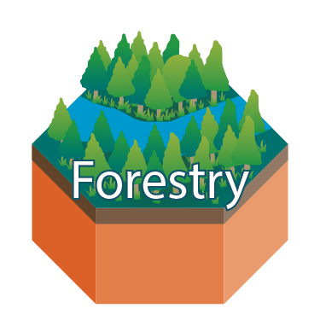
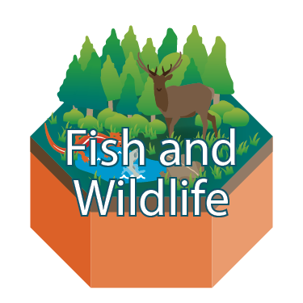
The Basin’s Foundation
Notes:
In this diagram, the Basin’s foundation is represented by these orange symbols, each depicting key environmental, economic, and cultural values of the Chehalis Basin.
You’ll notice the forests, agriculture, and fisheries, along with symbols representing fish & wildlife and outdoor recreation, as well as the homes & businesses, and communities that make up the Basin.
All of these contribute to and are affected by floods and environmental conditions. These are all attributes that need to be protected into the future.

Slide 8
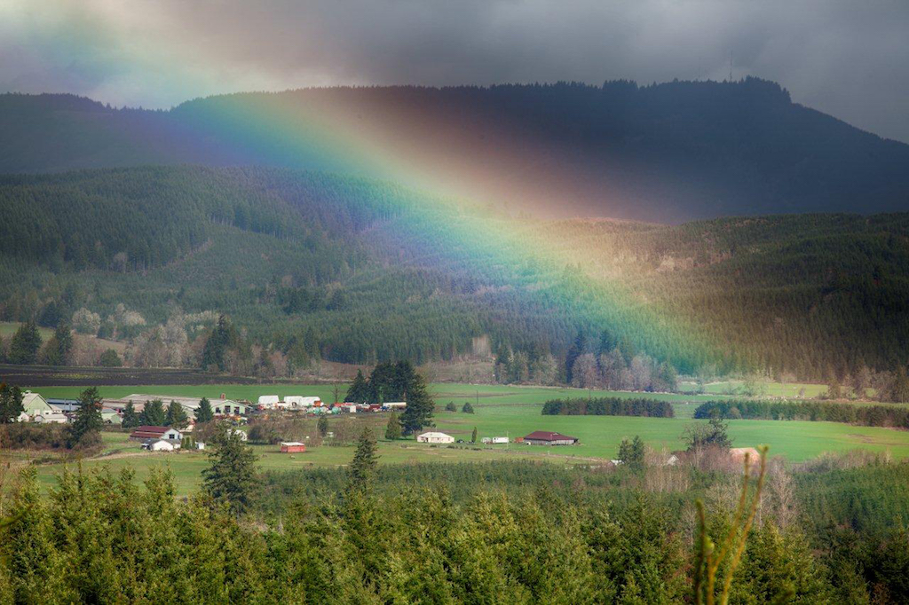
OCB MISSION
To aggressively pursue an integrated strategy & funding for:
long-term flood damage reduction
aquatic species restoration
Notes:
The Office of Chehalis Basin, and the Chehalis Basin Board, are tasked by the legislature to aggressively pursue a suite of actions to address the dual mission of reducing flood damage and restoring aquatic species in the basin.
Inherent in that mission is the need to protect and enhance all these fundamental attributes through the actions they choose to invest in.

Slide 9
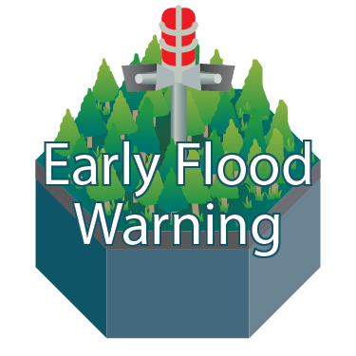
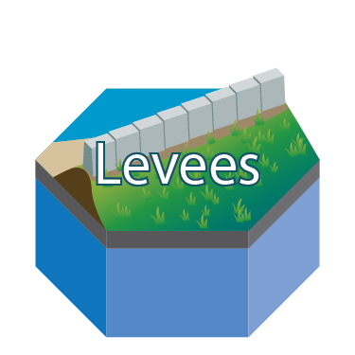
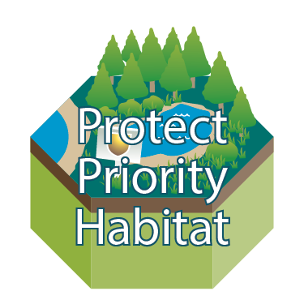
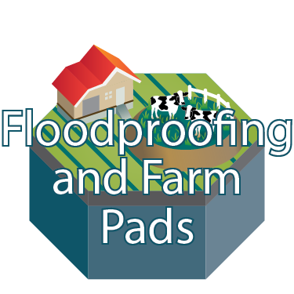
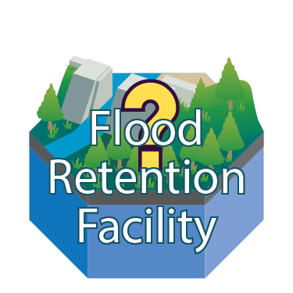
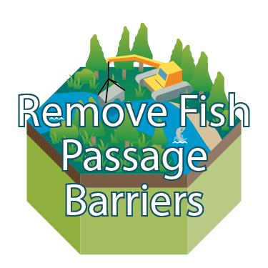
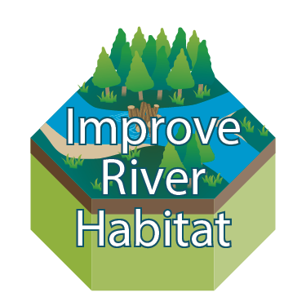
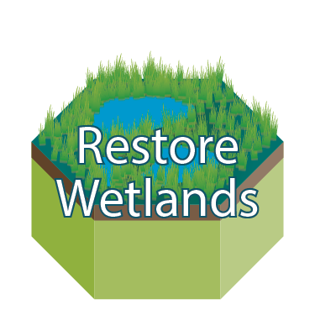
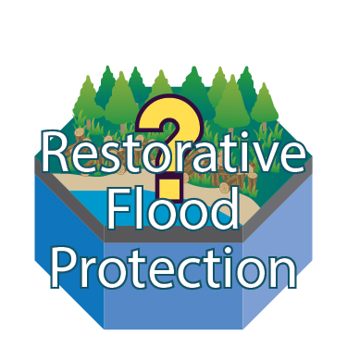
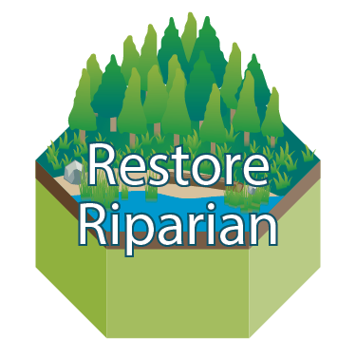
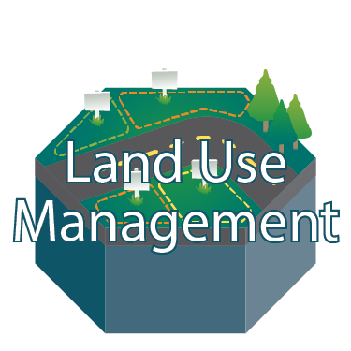
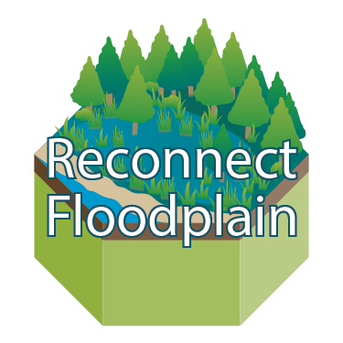
Our Mission in Action
Notes:
To fulfill its mission, the Board is currently investing tens of millions of dollars in the Basin, including $50 million in state capital construction dollars this biennium. This is money that the Chehalis Basin Board, and the Governor’s Work Group before it, succeeded in securing from the State Legislature with the help and support of Basin Legislators.
The green tiles on the left side of this diagram represent the types of habitat restoration work that is already underway or planned for the Basin as part of the Strategy …

Slide 10
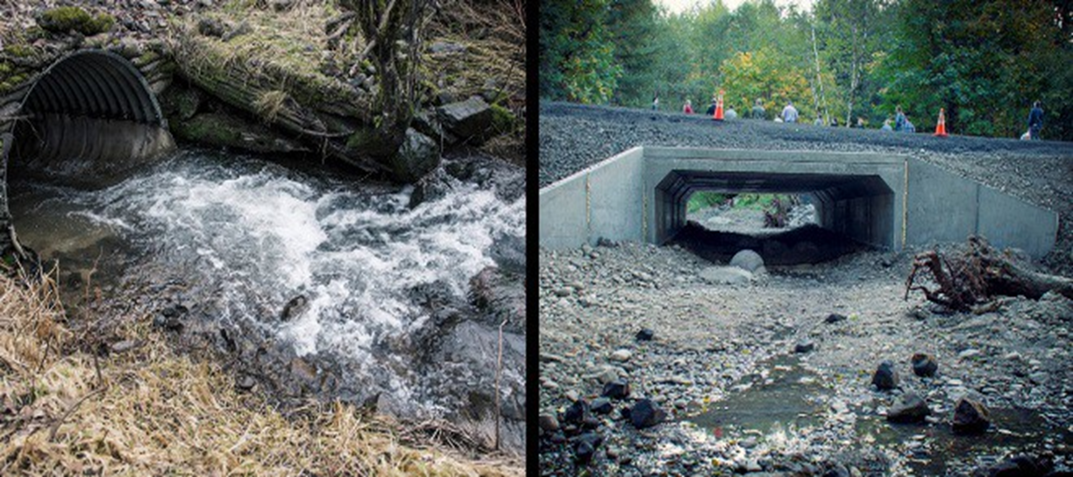
Correcting Fish Barriers
Notes:
Things like removing fish passage barriers…

Slide 11
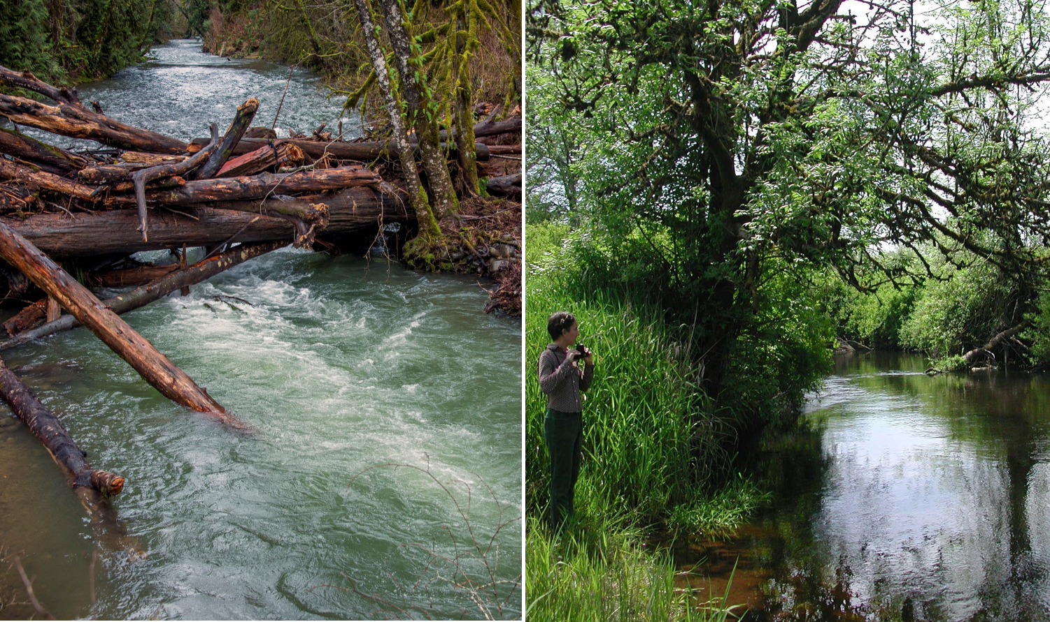
Habitat Protection & Restoration
Notes:
Improving river habitat by installing wood and restoring riparian areas and wetlands…

Slide 12
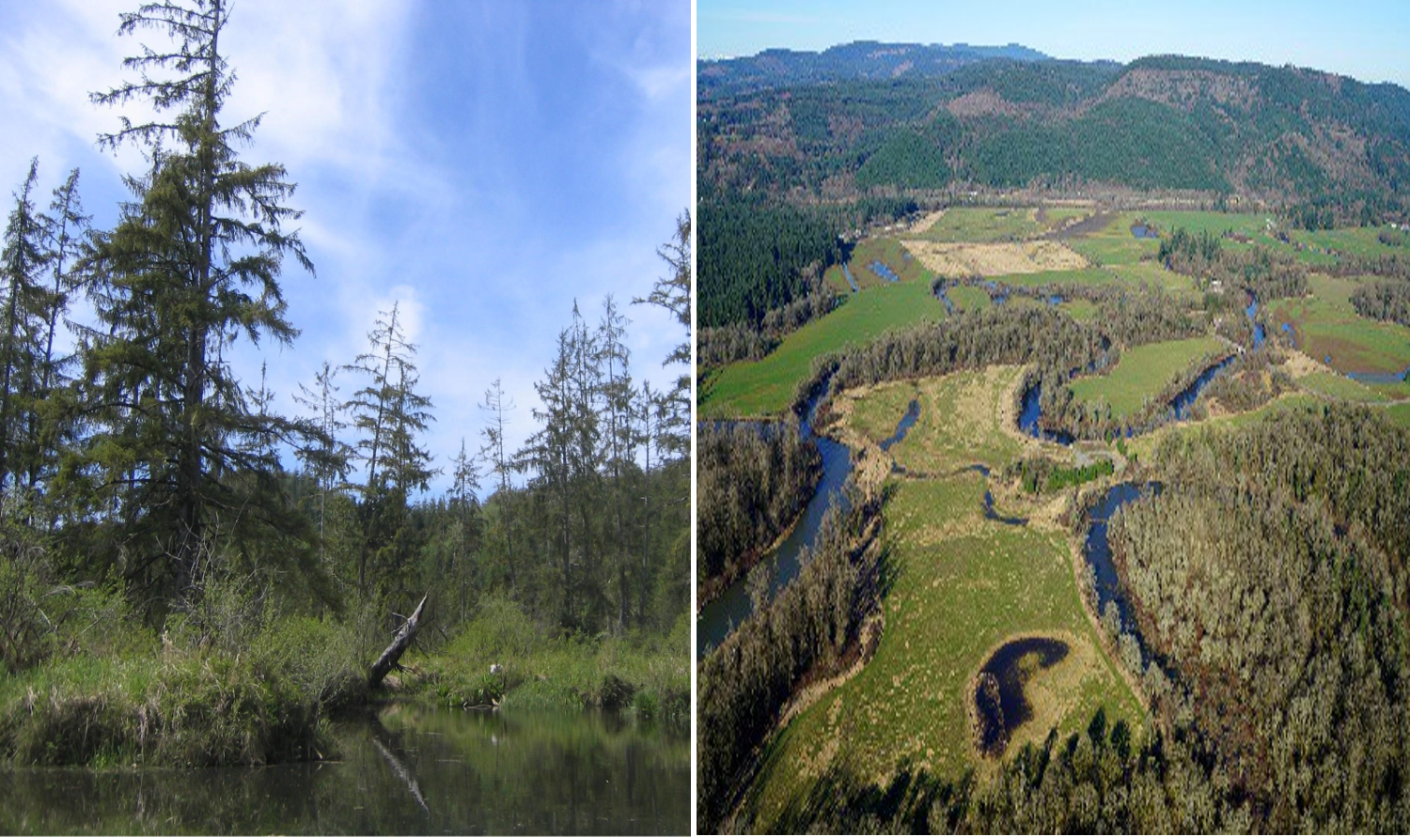
Uplands & Floodplains
Notes:
And protecting priority upland habitat, and reconnecting the floodplain where feasible.

Slide 13
Our Mission in Action
Notes:
The dark blue tiles in the middle of the diagram depict the types of near-term, local flood damage reduction actions that are also underway, with more in the planning stages, across the basin as part of the Strategy.

Slide 14
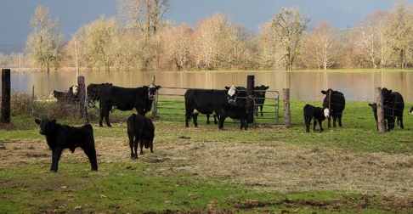
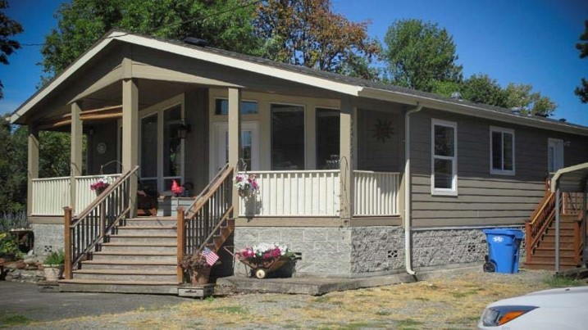
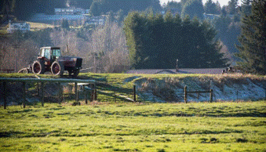
Floodproofing & Farm Pads
Notes:
These include local projects identified by the Chehalis Basin Flood Authority, such as elevating structures and other flood proofing measures like constructing elevated farm pads for equipment & animals.

Slide 15
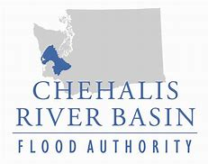
Local Projects & Land Use
Cities & Counties
Notes:
They also include other local projects identified by the Flood Authority, as well as changes to local land use regulations and practices. Many of these actions are already being implemented and will need to be part of your long-term strategy. Questions remain about how much and where, and you will be asked to make decisions about those in the coming months and years.

Slide 16
Our Mission in Action
Notes:
On the far right, depicted by lighter blue tiles, are large-scale flood damage reduction actions under consideration as part of the Long-Term Strategy. The yellow question marks over the top of three of these blue tiles, are meant to emphasize that some of the large-scale actions are still being analyzed . Decisions about whether or how to proceed are still being considered.

Slide 17
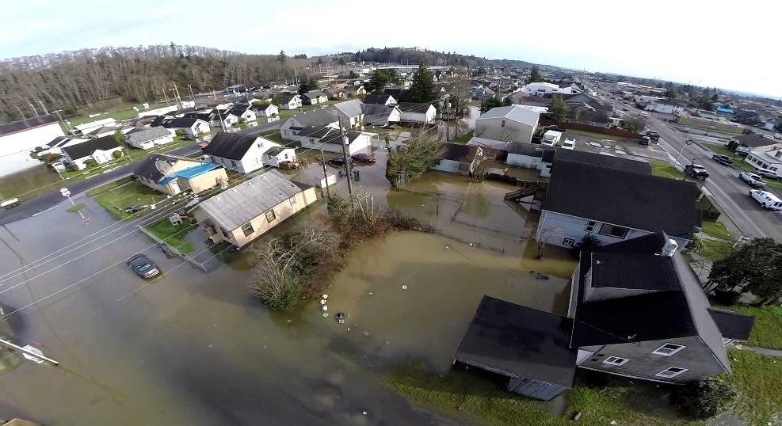
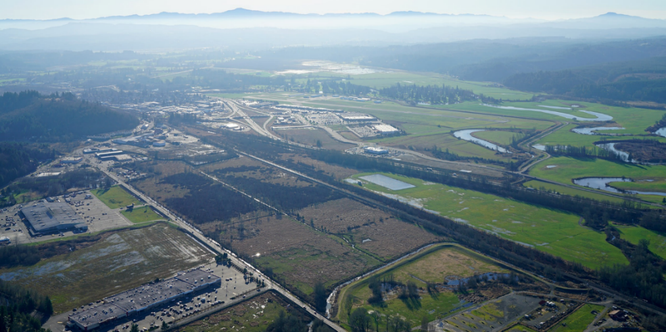
Large-Scale Actions & Proposals
Aberdeen/Hoquiam
North Shore Levee
Chehalis/Centralia
Airport Levee
Notes:
These include plans for shoring up and constructing a new levee, which are already in process, such as the Aberdeen/Hoquiam North Shore Levee project.
Other planning is underway to improve flood protection walls and levees along I-5 and around the Chehalis/Centralia airport.

Slide 18
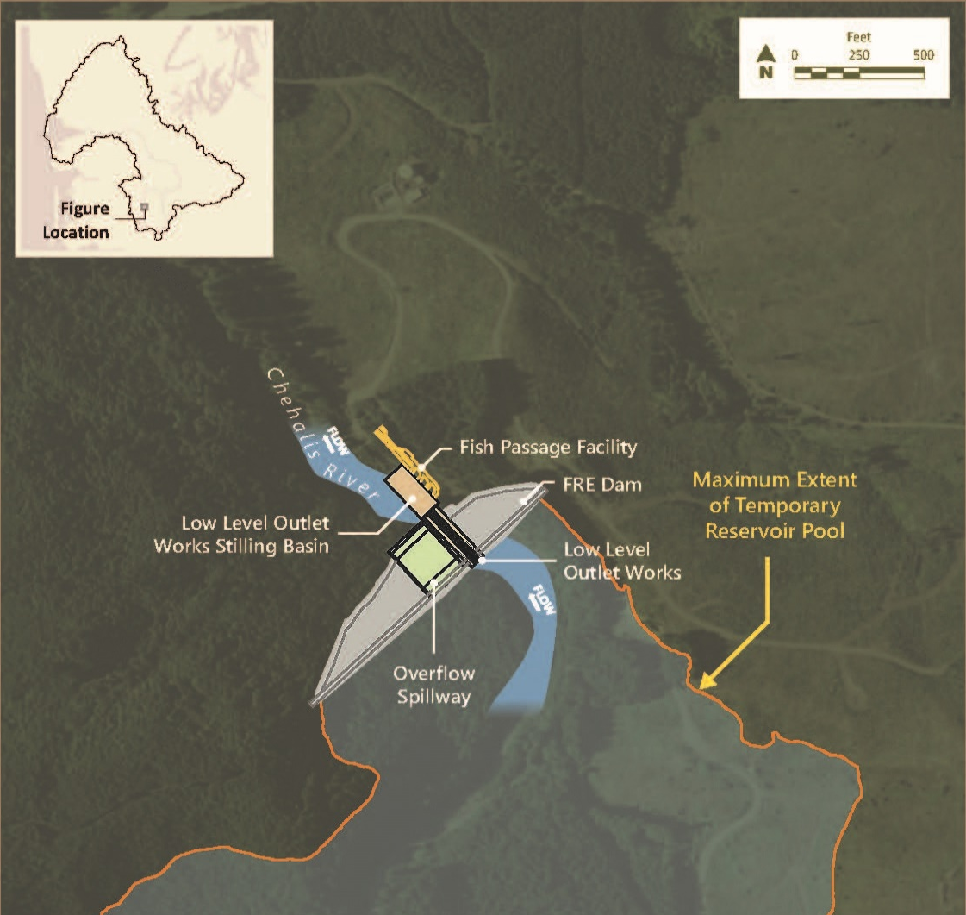
Large-Scale Actions & Proposals
Notes:
One the largest-scale actions being considered is the Flood Control Zone District’s proposal to construct a flood retention facility near the headwaters of the Chehalis River, above Pe Ell. This facility would operate as a run-of-the-river facility most of the time, but the gates would close to temporarily hold back water during extreme weather events such as the flood that occurred in 2007.

Slide 19
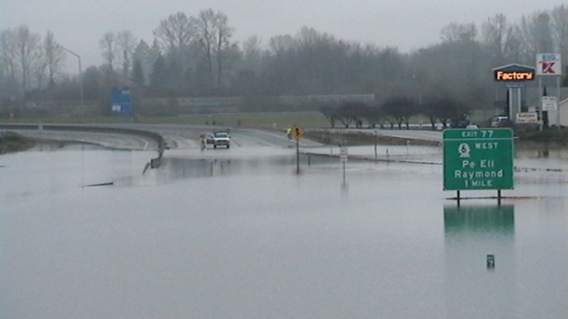
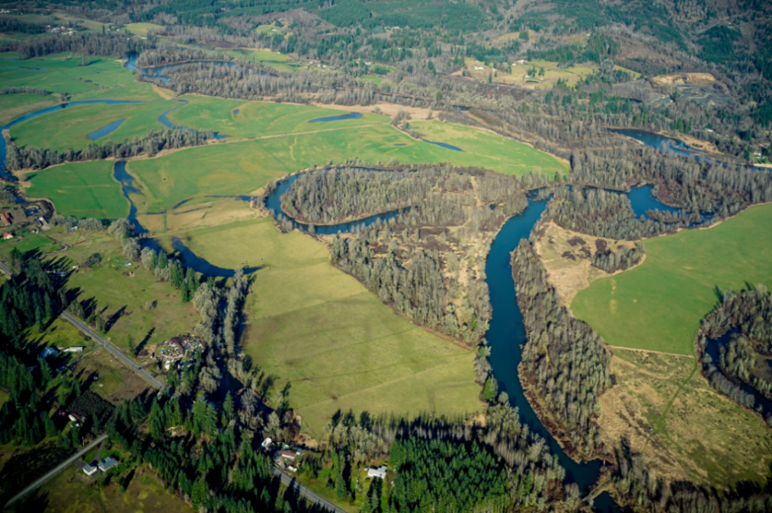
Large-Scale, cont.
Notes:
These include plans for shoring up and constructing a new levee, which are already in process, such as the Aberdeen/Hoquiam North Shore Levee project.
Other planning is underway to improve flood protection walls and levees along I-5 and around the Chehalis/Centralia airport.

Slide 20
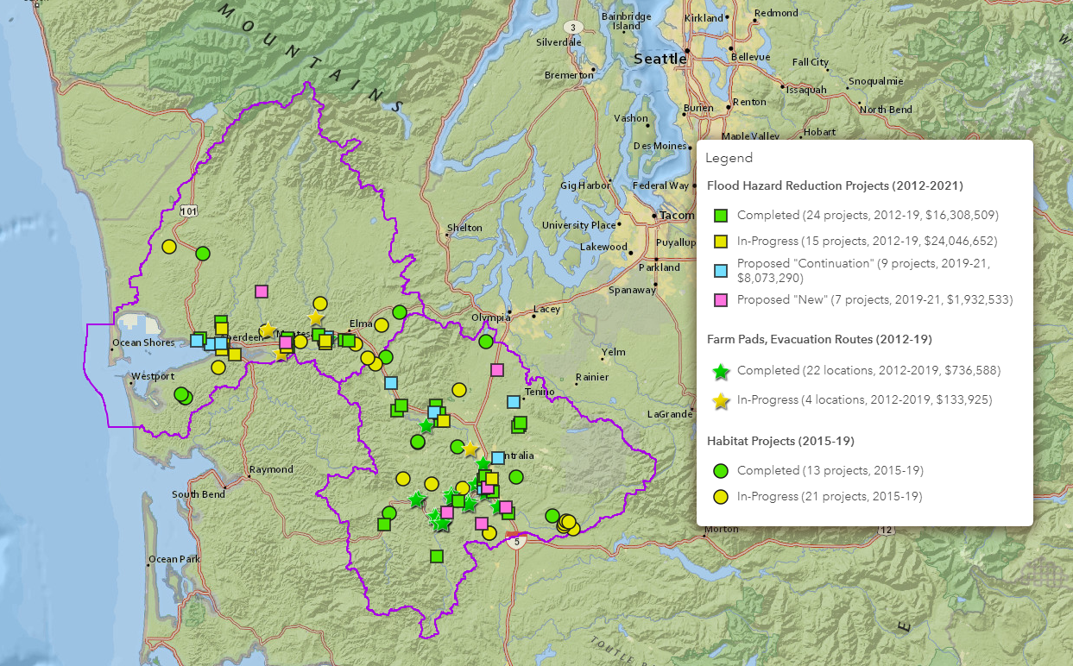
Accomplishments So Far
Notes:
Since the Chehalis Basin Strategy effort began in 2012, accomplishments throughout the Basin have been significant.
Over $50M has been invested in the design and construction of a number of flood damage reduction, farm pad, and aquatic species habitat restoration projects.
This map shows the dozens of projects throughout the basin that have been completed, are under construction, and currently proposed. When viewed online, this dynamic GIS map allows the viewer to link to details of each and every project.

Slide 21
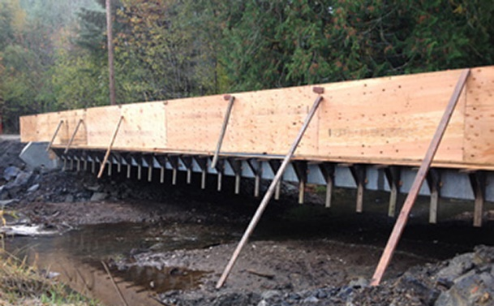
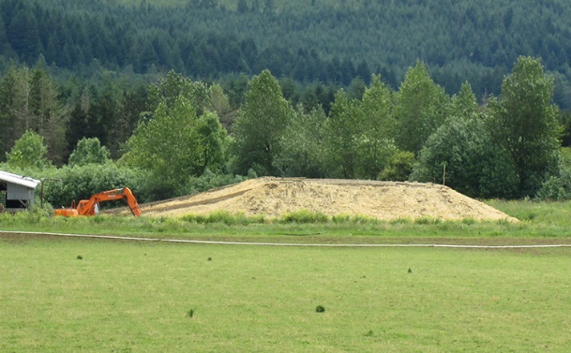
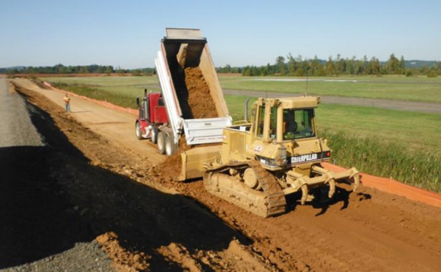
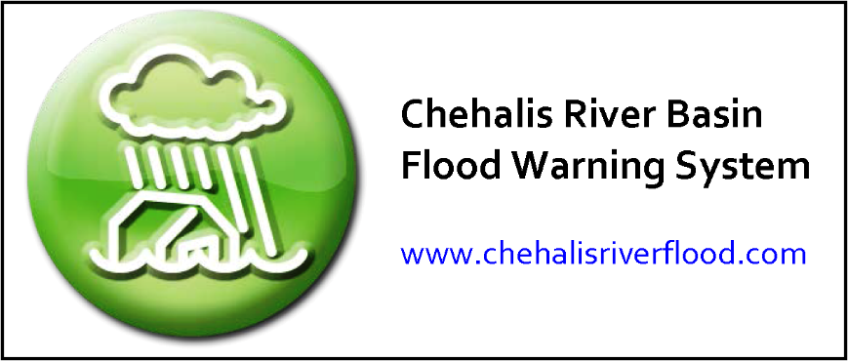
Accomplishments So Far
34 Fish Barrier Removal Projects
26 Farm Pads
55 Local Flood Damage Reduction Projects
Notes:
34 fish barrier projects = 91 miles of river habitat + 75 construction jobs
26 farm pads: 14:1 ROI
55 local flood damage reduction projects to protect key pieces of infrastructure, like wastewater treatments plants & roads, from future flooding.
Flood Warning System – uses network of stream gauges to automatically notify residents & businesses of rising floodwaters.
All funded through Chehalis Basin Strategy.
!

Slide 22
2017-19 Work Plan
On-the-ground work to be accomplished this biennium:
Construction of current list + ranking of 17 new projects
17 new projects to open 32.5 more miles
Design of 5 mile+ long reaches for construction in 2020
Construction of up to 5 more priority pads

Slide 23
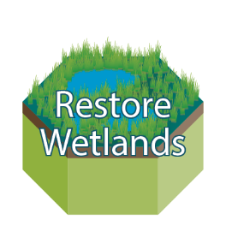
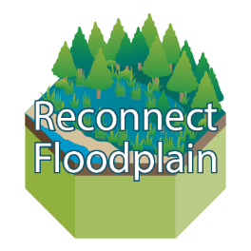
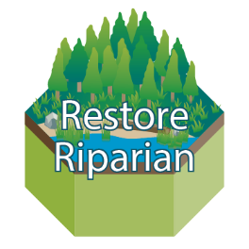
2017-19 Work Plan, cont…
Long-Term Strategy Activities this biennium:
Final design of North Shore Levee
Final report on RFP feasibility
Public review of FINAL ASRP
Community Flood Assistance & Resilience Program
SEPA/NEPA EIS scoping & technical studies
Notes:
Also underway this biennium are several activities designed to advance the long-term strategy, including:
* Public review of the final Aquatic Species Restoration Plan, expected in summer 2019
* Moving from final design to permitting & ROW acquisition for the Aberdeen/ Hoquiam North Shore Levee,
* Writing up the results of the feasibility analysis for the restorative flood protection pilot project in Newaukum sub-basin
* Also this biennium, preparation of a draft basin-wide floodproofing strategy will be completed
*Finally, environmental review of the Flood Control Zone District’s proposed flood retention facility and airport levee improvements. These environmental reviews will be happening through concurrent State & Federal processes under the state & national environmental policy acts, commonly referred to as SEPA & NEPA. The current plan is for formal scoping to begin in late September, while technical studies needed for the EIS that are already underway will continue into next year.

Slide 24
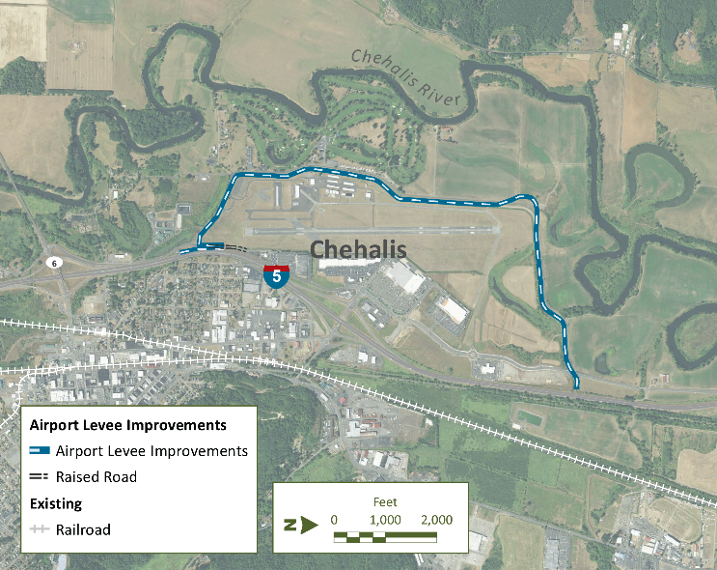
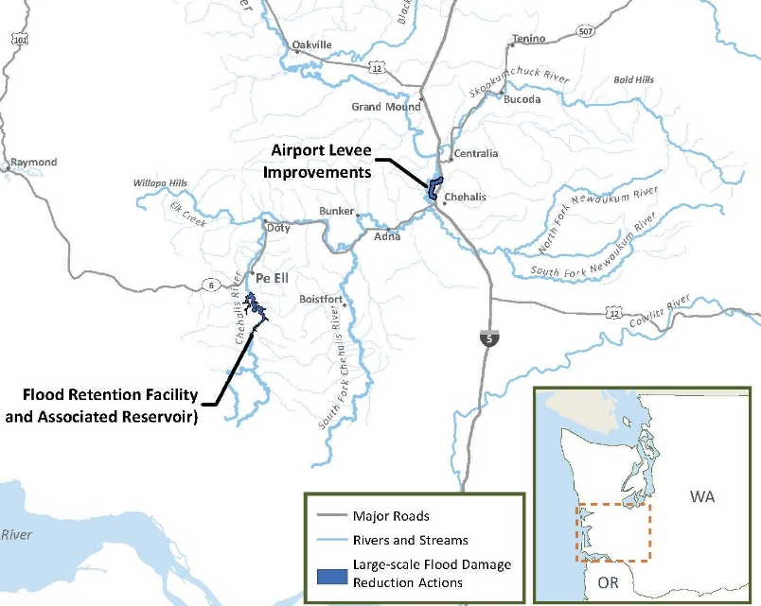
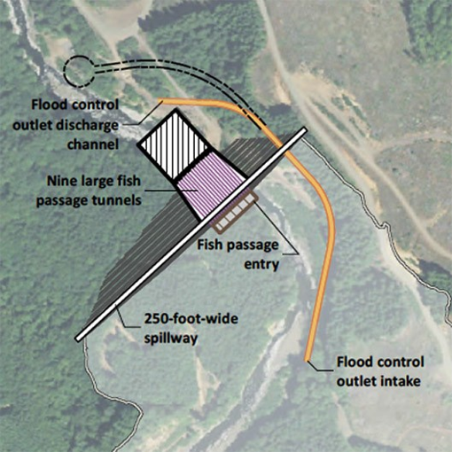
FCZD Project Proposal

Slide 25
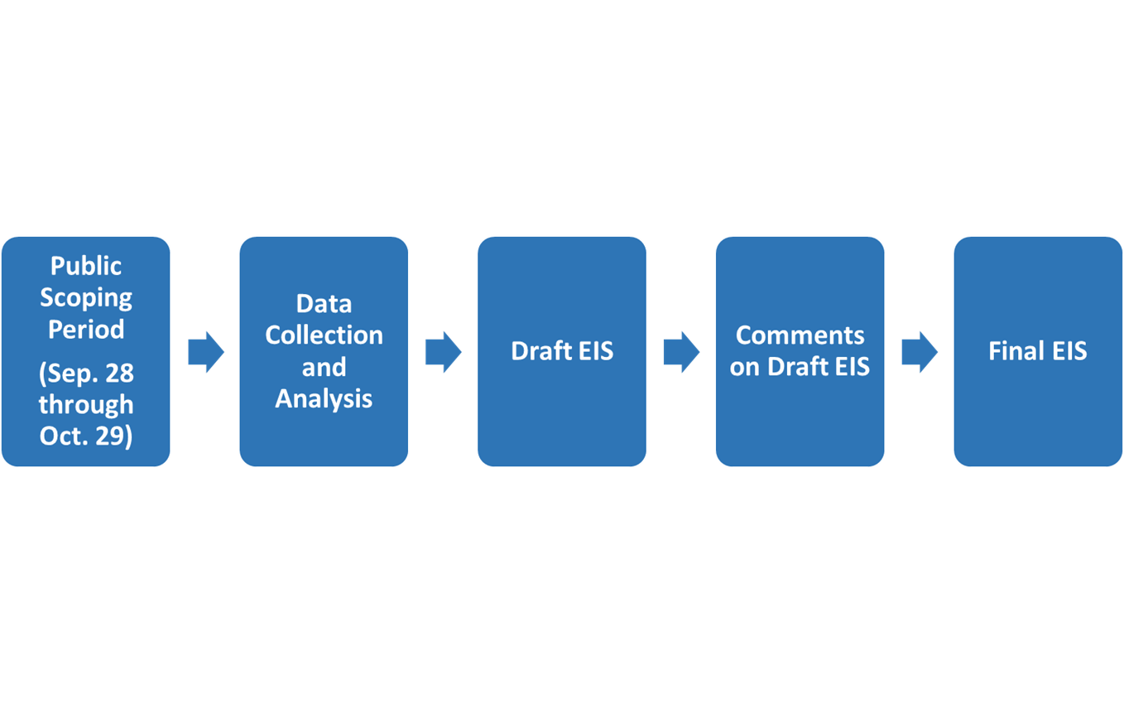
Flood Retention Facility & Airport Levee SEPA/NEPA EIS Process
Public Comment
Public Comment
Public Meetings:
October 16, 5 - 8 pm at Montesano City Hall
October 17, 5 – 8 pm at Centralia College
Notes:
Typical steps in the SEPA and NEPA processes after initial scoping include data collection and analysis, preparation of draft EIS documents that will be released for public comment, and then revised final EIS reports.
Final EISs must be issued before agencies can issue permits related to any of the proposed actions.

Slide 26
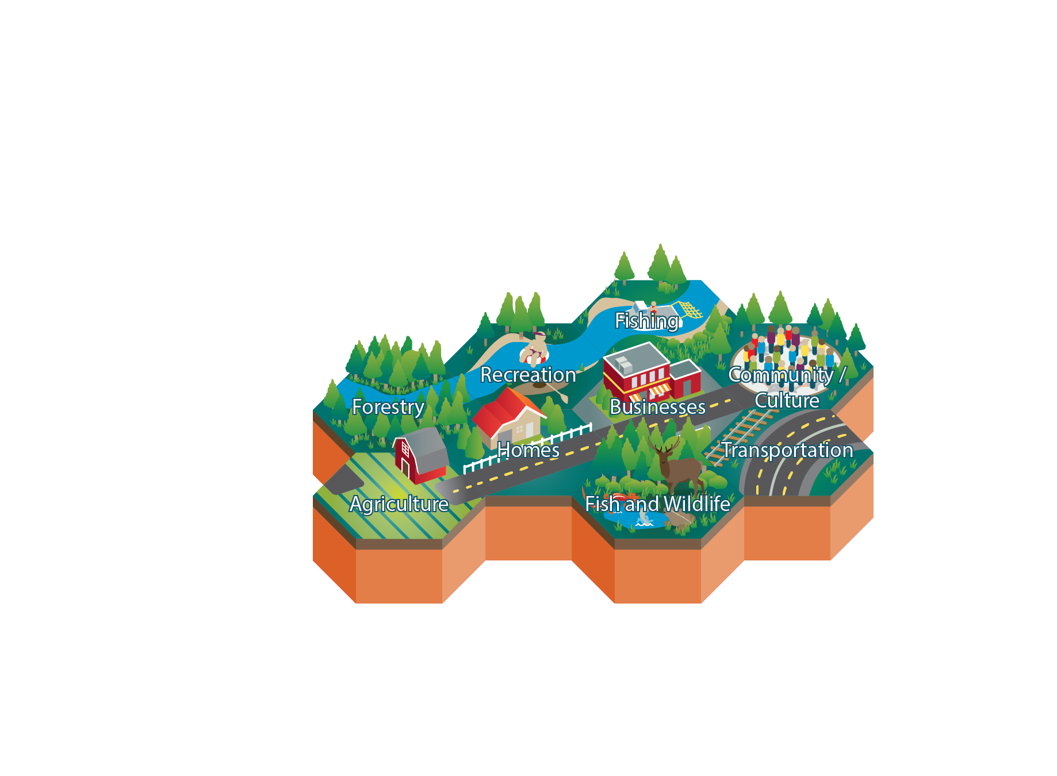
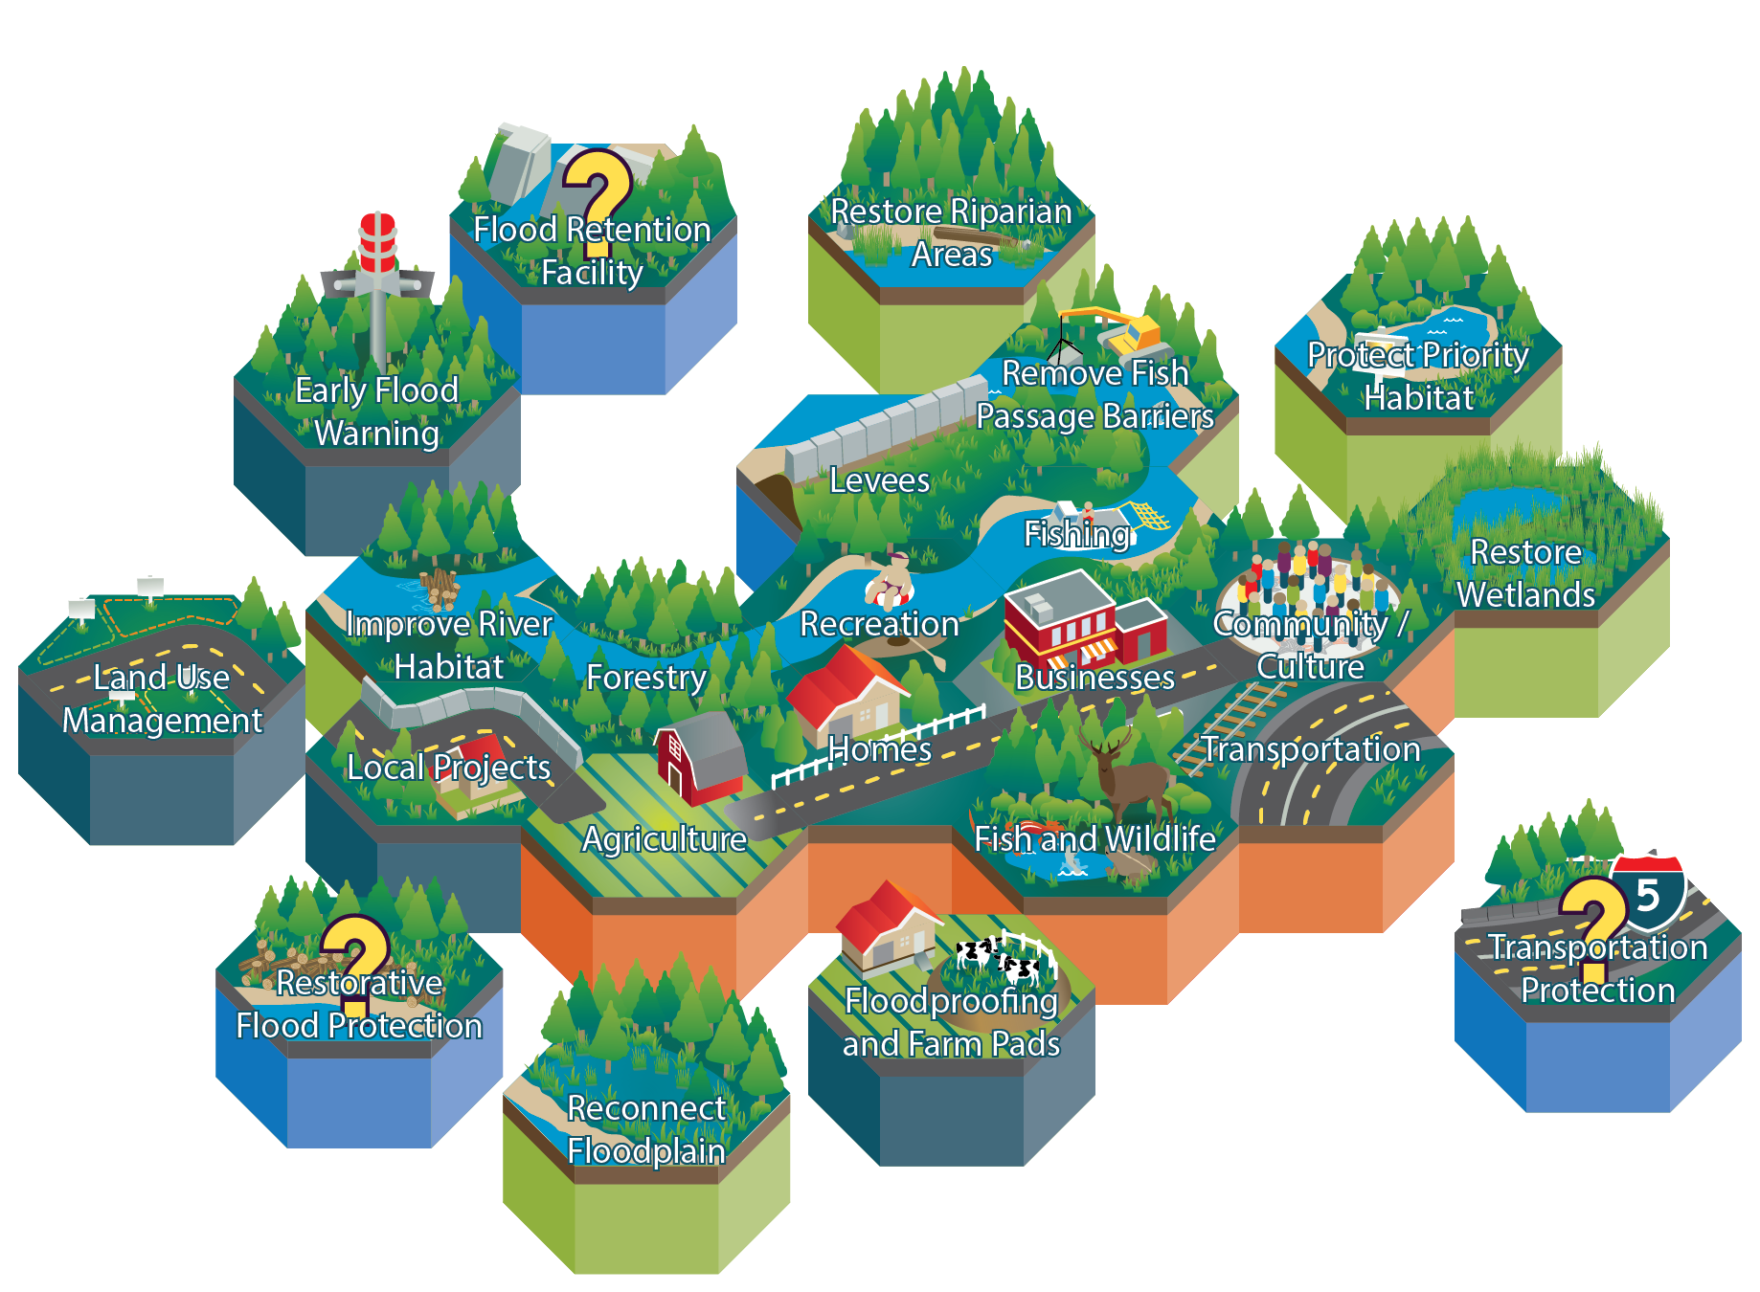
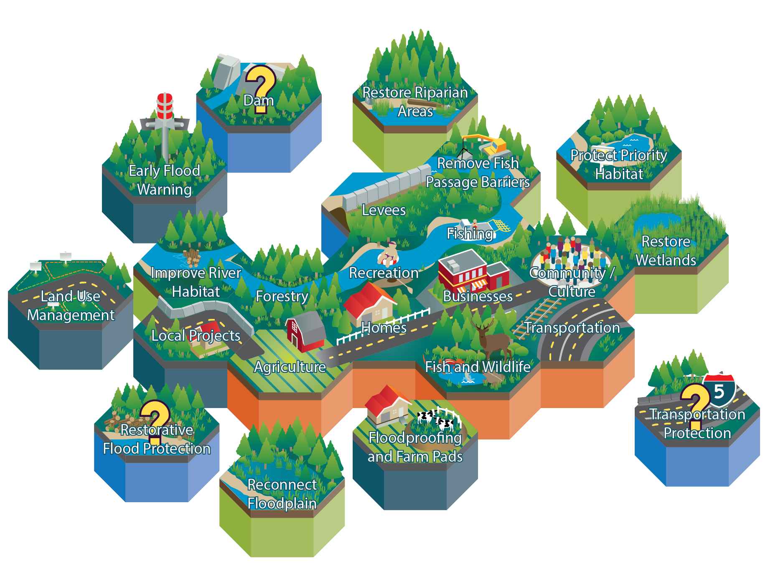
Integrated Strategy
Notes:
The law creating the Chehalis Basin Board tasked it with formulating a Long-Term Strategy that will integrate actions designed to address flooding and aquatic habitat degradation in a way that achieves the best possible solutions for both humans and the environment in the Basin. There is no one right way to assemble all these tiles, and it will likely be challenging to reach consensus on some of the specific elements of the strategy, particularly the large-scale actions.
Reaching consensus on a long-term, integrated strategy is necessary, however, for the Basin to continue receiving the millions of dollars of state capital money that has been flowing into the basin in the past six years.$142 million has been provided since former Governor Gregoire first established a working group of tribal and local leaders to begin this effort..
The goal of the Long-Term Strategy is to create significant, measurable results from both a habitat restoration perspective and a flood-damage reduction perspective, by prioritizing and sequencing the continued investment of tens of millions more dollars over the next several years.
Several more installment of significant investment will be needed to implement on the ground projects and to advance the dual objectives of the integrated strategy in the long term. Presently, there continues to be broad, bi-partisan support in the state legislature for this integrated approach, which is essential if we are to succeed in truly supporting and enhancing the economic, environmental, and cultural values of the Basin and all of its people.

Slide 27
A Safe, Resilient & Prosperous Region

Slide 28
www.chehalisbasinstrategy.com info@chehalisbasinstrategy.com
THANK YOU!!!

