Slide 1
Chehalis Basin Strategy Community Flood Assistance & Resilience (CFAR) Program
Chehalis River Basin Flood Authority
January 23, 2020
Notes:
In September and December, we provided the FA with some info on CFAR. Goals, objectives, timelines, etc.
Purpose of the presentation today is to remind you of why the OCB is developing this program, and to present a high level summary of the program framework we have developed so far. At the end of the presentation, we would like to discuss ideas related to how to start defining the relationship between this program and local projects, and to get the process going.

Slide 2
Why CFAR?
Element of multiple reports and recommendations:
Work Group OFM report (Ruckelshaus Center), December 2012
Work Group recommendations report (Ruckelshaus Center), November 2014
Bucoda Foundation Flood Opening Lessons Learned (Flood Authority), July 2016
Work Group budget recommendations to the Governor, December 2016
“Reduce the cost of repetitive damage to residences in the floodplain through a strategic program of buyouts and flood proofing, and encourage a comprehensive effort to prevent new development in the Basin from increasing flood damages.”
“Further enhancements to state and local land use policies will help ensure new development and other land management activities do not increase the risk of additional flood-related damages and, to the extent possible, reduce damages and costs to existing development affected by flooding.”
Notes:
Actions we have been referring to as “floodproofing” or “land use management” have been a recommended part of the recommended integrated strategy since at least 2012.
Listed on the screen are examples of reports or recommendations that made statements about floodproofing, structure retrofits, acquisition, and policies aimed at minimizing flood damage, as well as some excerpts
This program is intended to be both preventative (avoid future flood damage) and corrective (address areas with existing flood damage risks) - elements of both.

Slide 3
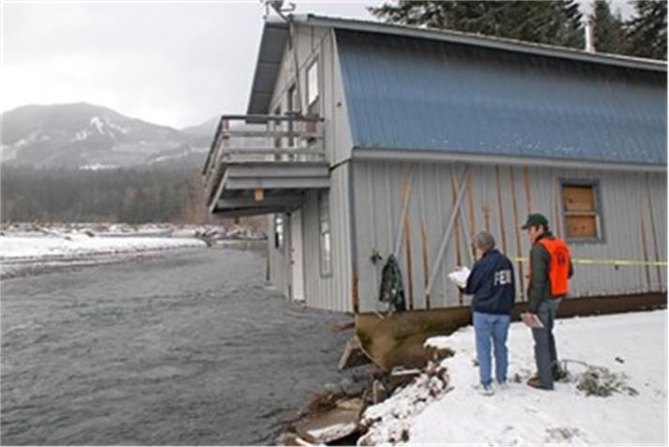
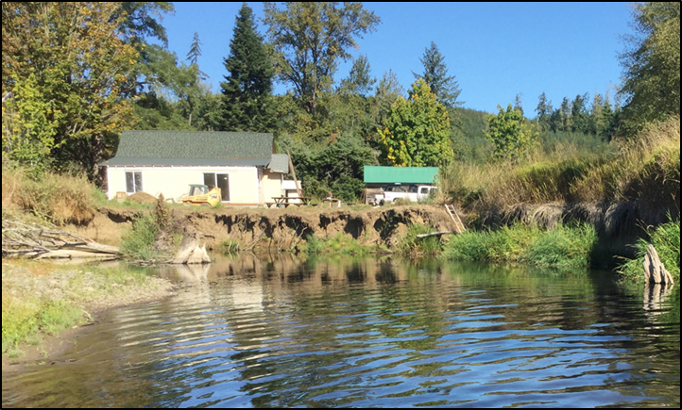
Why CFAR?
Chehalis Basin Board - Fall 2018
“In addition to damage caused by rising flood waters, damage also occurs in a number of places in the Chehalis Basin as a result of river channels migrating, eroding land and damaging structures and beneficial uses of the land. The CFAR program will need to address damage from both of these issues, rising flood waters and channel migration.”
Cowlitz River, 2007
Newaukum River, 2017
Notes:
Last fall, the Board acknowledged that in addition to structure retrofits and floodplain land use management, the CFAR program needed to consider Channel Migration Zones. Recognizing flood damage does not occur only from inundation in parts of the basin. So there are two parts: structure retrofits and addressing CMZ/erosion hazards.
In summary, this is not a new idea. It will include actions similar to those Flood Authority members have taken in the past. This program is bringing investment down to individual citizens, using known techniques. Filling gaps.

Slide 4
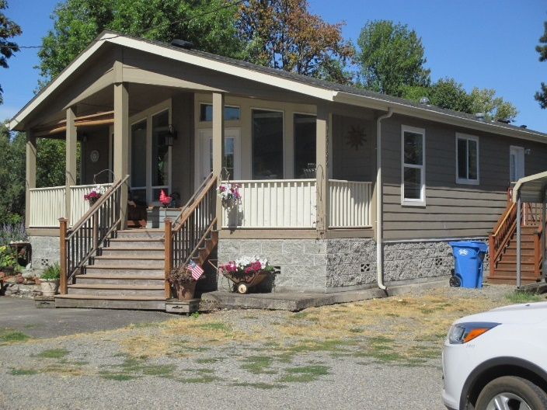
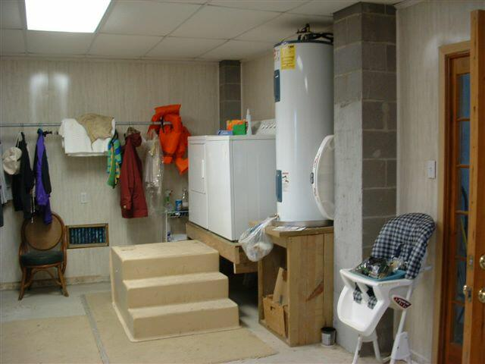
Why CFAR?
Wet floodproofing floodable areas
Home Elevation, Thurston County
Draft Economics Study Update (EES Consulting)
June 2017
“The greatest flood damage reduction benefit from most action alternatives comes from eliminating damage to structures and their contents.
The avoided damages due to floodproofing buildings or buying out properties over 100 years is significant.”
Notes:
Economic assessment looked at variables like flood damage to structures, content, and inventory; cleanup costs for buildings; and temporary relocation costs for evacuated residents during flood events. All of these costs went down when structure retrofits were implemented.
Changes in climate have the potential to accelerate increases in flood severity; as floods get bigger, the benefits of this program are anticipated to increase.

Slide 5
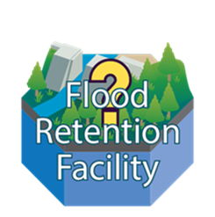
Chehalis Basin Strategy
Notes:
Many have seen presentations with tiles used to illustrate potential elements being evaluated for the Chehalis Basin Strategy. This just highlights how the CFAR program, and potentially flood hazard reduction or floodplain management elements, fit in.

Slide 6
Roles and Responsibilities
Office of Chehalis Basin (OCB)
Program administration and management
Project approval
Contracting with project contractors
Community
Publicize the program, talk to property owners
Review and comment on project applications
Project permitting, inspections, approval
Monitor owner compliance with non-conversion or re-use agreement
Notes:
So now on to some highlights of the framework. Acknowledge this is a summary, many of the mechanics are still being discussed, considered or developed. We anticipate a project agreement signed by three parties (OCB, community & landowner) that would include details.
OCB: Program administration and procedures, financial management, approving projects for funding (may utilize input from a review or technical advisory committee), managing contractors
Community: participant in good standing in the National Flood Insurance Program, lead publicizing program and explaining procedures to property owners, review and comment on applications (code violations, unpermitted structures), Ensure projects are built to code and program requirements through plan review, permitting and construction inspections, and monitor property owner compliance with signed agreements related to altering the structure and reuse of an acquired property. At their option, communities may request to assume some of OCB’s administrative tasks to facilitate program administration at the local level.

Slide 7
Roles and Responsibilities
Property Owners
Contribute to the project
Agree to not convert the property to negate the protection provided
Agree to keep flood insurance on the building
Flood Authority
Help publicize the program
Review and comment on applications
Notes:
Owners : commit to maintaining flood insurance for the life of the structure if it will remain in a floodprone location, sign non-conversion agreement, that project will be maintained, and allowing community access to verify. Also provide commitment in the form of a contribution like a cash or in-kind match.
FA: Similar to communities, help publicize the program. Anything to add to community review comments, overall perception on pool of candidate projects
Other entities may be signatories as appropriate. For example, organizations that would like to take title to an acquired property would sign those agreement provisions related to reuse restrictions. Organizations that would like to provide financial assistance would work with OCB to participate in the cost-share.

Slide 8
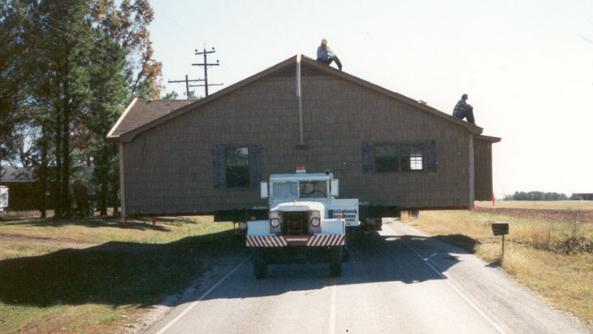
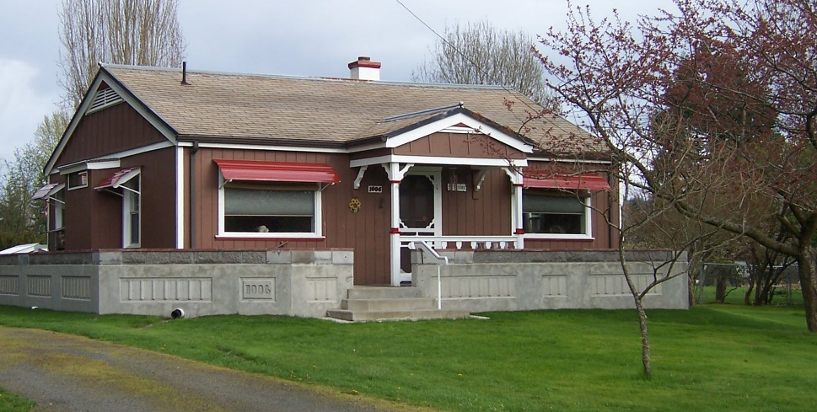
Eligible Actions
Technical assistance
Residential and commercial properties
Acquisition, relocation of buildings, and/or clearance of a parcel, with deed restriction
Elevation, dry floodproofing, other retrofitting measures, with non-conversion agreement
Channel migration zone easements, small habitat friendly, permittable bank protection
Not eligible: Properties to be protected by another Strategy flood damage reduction project
Not eligible for retrofitting: accessory structures and dilapidated buildings
Notes:
VOLUNTARY
Tech assistance: things like ordinance reviews
All types of properties, but may choose to start with one type (residential), to see what we learn and may need to improve upon
CMZ bank protection: scale of one property or a reach - not talking large levees or revetments
Not eligible: things that would be removed from FIRM SFHA (may end up with timelines or other sidebars on this)

Slide 9
Project Priorities
Properties facing the greatest flood or erosion risk
Least costly technique that provides equivalent protection
Projects with cost sharing from other sources
Projects that provide a clear benefit to the Aquatic Species Restoration Plan (ASRP)
Notes:
These are not in any order, and have not been “ranked” or assigned criterion, point values, etc. To be developed. This is summary of types of projects that would be priorities, which would be reflected in ranking/scoring criteria TBD.
The least costly technique: for example, adding flood vents to a building facing shallow flood levels rather than acquiring or elevating the entire structure
(ASRP) or that include priority protection or restoration actions in ASRP priority areas. Other projects that restore areas to their natural state or otherwise protect or restore natural floodplain functions would be credited, but to a lesser degree
Projects in communities that have adopted regulations higher than the applicable State and FEMA minimum standards.

Slide 10
Relationship to Local Projects
“Design and construct local projects that will provide immediate flood damage reduction including the protection of critical infrastructure, wellheads, wastewater treatment plants, roads, homes, and businesses. Concurrent with these projects, develop and implement a long-term strategy for localized flood damage reduction actions.”
Notes:
Make this a discussion topic. Questions to pose to help define relationship and get process going.
I see the CFAR program as being informed by lessons learned by the FA through its engagement on similar projects. CFAR will address a subset of the elements/actions the Work Group has previously recommended. The program will be basin wide and systematic, and outcomes will be based on the approach the FA and Board helps define over the next few months.
Thoughts on how to access program (target areas with known issues) in addition to how we are developing it.
Solicitation – help get word out, bring draft and details to March meeting. Use projects committee for additional screen of submitted ideas.

Slide 11
Next Steps
Define mechanics for program administration
Continued coordination with local governments to guage community and property owner interest
Draft project solicitation forms and criteria
Fund projects in 2 or 3 communities that are ready to proceed

