Slide 1
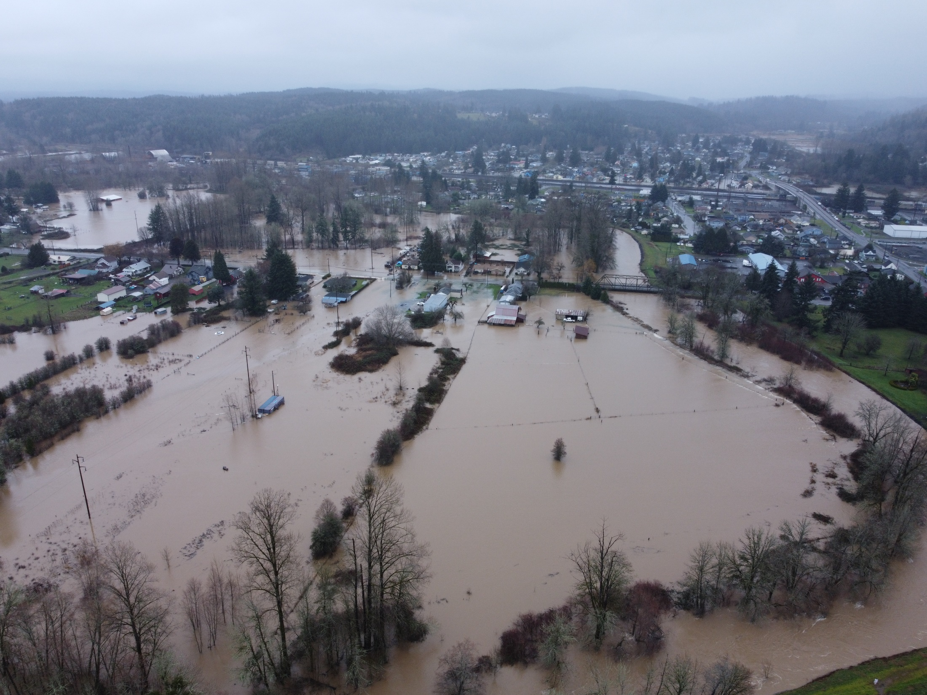
January 2022 Flood Stats

Slide 2
“100 year/1996 flood flow peaks” Newaukum = 13 cfs Skookumchuck = 11 cfs Chehalis River = 49 cfs ______________________________________ Chehalis River = 35 cfs (2022) 199r w/Retention 29 cfs

Slide 3
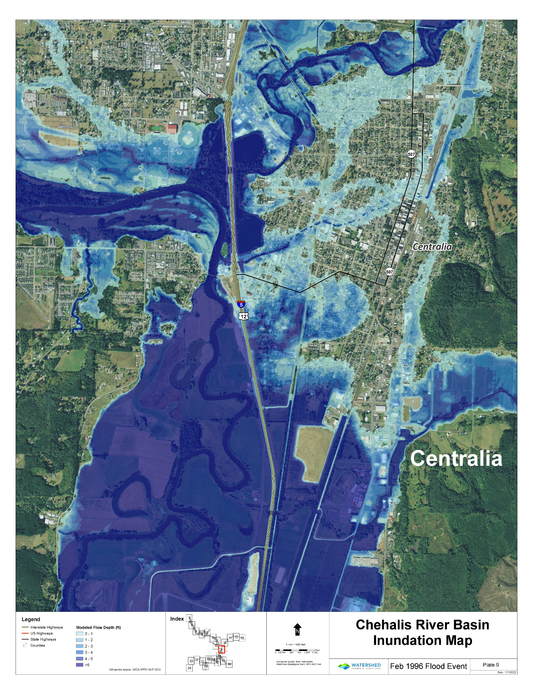

Slide 4
Properties not affected if an upstream dam would have been constructed based on a 1996 flood event. Utilizing the 2022 flood stats
Washington Elementary School
Jefferson Lincoln Elementary school
Fairway shopping center area (Salzer able to release water to Chehalis)
Kresky/Gold streets commercial area (Salzer able to release water to Chehalis)
Fairgrounds (Salzer able to release water to Chehalis)
Tree Streets neighborhood (Chehalis river water didn’t follow railroad tracks)
Long Road neighborhood – future commercial (Chehalis river water didn’t follow railroad tracks)

Slide 5
Properties not affected if an upstream dam would have been constructed based on a 1996 flood event. Utilizing the 2022 flood stats
South/Woodland Streets neighborhood (Chehalis river water didn’t follow railroad tracks or top Long road levee)
Mellen Street commercial area (Chehalis river water low enough to allow China Creek to release into it)
Mellen Street police training facility
Borst Park – Chehalis river water didn’t go as high in Borst Park resulting in damaging ballfields
Oakview neighborhood – west of Borst Park
Centralia High School - no water (hit in 2007)
Between Centralia/Chehalis – 1996 Security state bank HQ, 9 inches of water, Fairway shopping center, Roses Furniture, KELA, KITI, Sunbirds 2022 – none of these structures flooded

