Slide 1
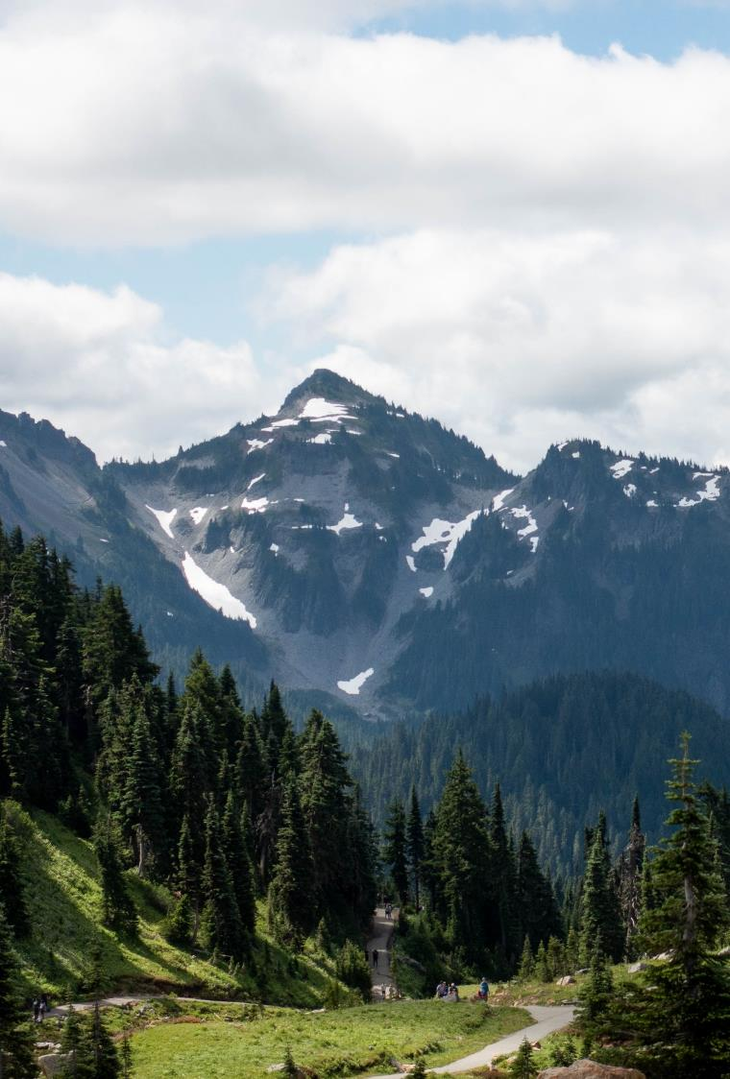
The meeting will begin shortly
Resource Damage Assessment Committee Meeting
Please keep your microphone muted unless speaking
Webcam is optional

Slide 2
Resource Damage Assessment Committee Meeting
Geoff Baran
March 8, 2023
Notes:
Welcome to the RDA Committee Meeting. Today’s date is February 8, 2023.

Slide 3
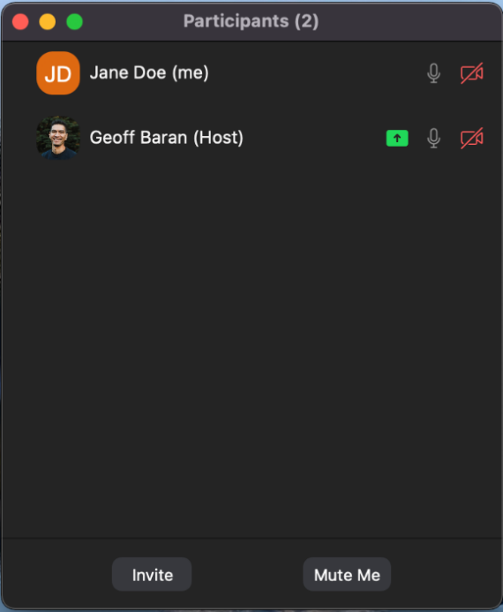
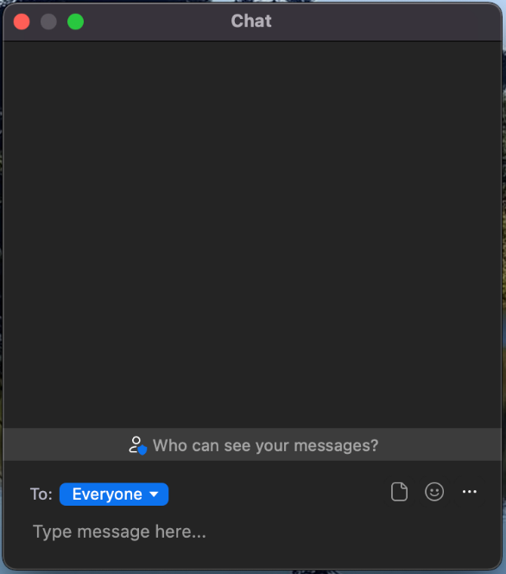
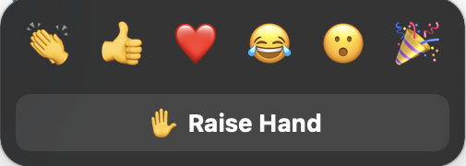
Welcome to Zoom
Please mute your microphone to reduce background noise
Callers:
Dial *6 to mute and unmute
Dial *9 to Raise Hand
Online attendees please use the mute button
Notes:
Provide basic Zoom instructions.

Slide 4
Table of Contents
1
Welcome, Roll Call, Agenda Review
2
Introduction
3
New Business
4
Old Business
6
Announcements
Notes:
Brief Agenda Review
Roll Call
Agenda Review
Intro: Review the purpose of our meeting today and the rules of this commmittee

Slide 5
Resource Damage Assessment Committee
Notes:
INTRODUCTION
Purpose:
This committee is responsible for conducting preassessment screenings for natural resource damage assessments for oil spill that impact the waters of Washington State.
The committee is defined in statute, and comprised of representatives of the Washington State Department of Fish and Wildlife, The Department of Natural Resources, Department of Archeology and History Preservation, Department of Health, and the Washington State Parkas and Recreation Commission
We are NOT assigning liability at this meeting. The purpose of this meeting is to evaluate the natural resource injuries from the spill, review available data, and work cooperatively with potentially liable parties to assess the harm to the environment from oil spills.
Goal:
Work cooperatively with the potentially liable party to determine whether detailed damage assessment studies should be conducted, or whether the compensation schedule will be used to assess the damages.
The ultimate goal of this process is to restore publically owned resources that have been damaged by oil spills.
Objectives:
Conduct preassessment screenings of all oil spills that impact Washington State waters.
Evaluate each case and consider whether damages are quantifiable at a reasonable cost
Whether restoration or enhancement is technically feasible.
Evaluate any projects proposed in lieu of a damage claim.
The committee will vote yes or no on those questions, and if the answer is no, the Compensation Schedule is authorized to assess damages
Rules
Committee bylaws state the meeting will be carried out under parliamentary procedure. Motion, second, all in favor.
After hearing discussion from the attendees, the each present RDA Committee Member will vote on two things:
Whether damages are quantifiable at a reasonable cost
And whether restoration or enhancement is technically feasible

Slide 6
New Business
Preassessment Screenings
ERTS# 717517 P/C Crab N Jazz
ERTS# 719397 Clover Island Marina Fire and Spill

Slide 7
ERTS# 717517 P/C Crab N Jazz
September 8, 2022 sinking and spill to Budd Inlet

Slide 8
Spill Location

Slide 9
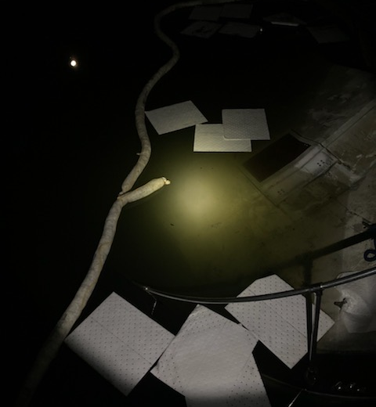
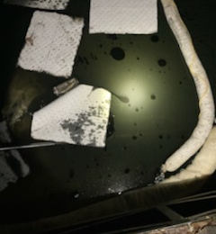
ERTS# 717517 P/C Crab N Jazz
Notes:
January 16, 2023

Slide 10
ERTS# 717517 P/C Crab N Jazz

Slide 11
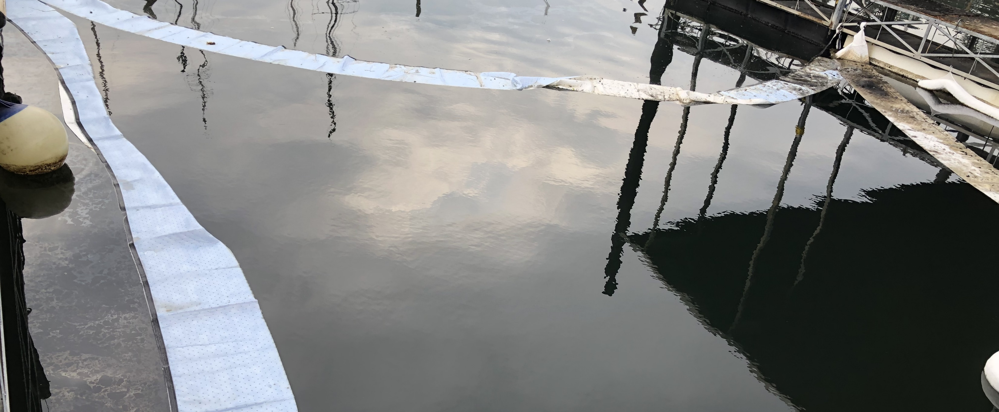
Preassessment Screening
ERTS# 717517 P/C Crab N Jazz
Estimated spill to water volume: 111 gallons
Oil Type: 110 gallons gasoline, 1 gallon motor oil
Geographic Extent of Impacts: Budd Inlet
Volume of oil recovered within the first 24-hours: None

Slide 12
ERTS# 719397 Clover Island Marina Fire
December 7, 2022 spill to the Columbia River

Slide 13
Spill Location

Slide 14
ERTS# 719397 Clover Island Marina Fire
Notes:
January 16, 2023

Slide 15
Preassessment Screening
ERTS# 719397 Clover Island Marina Fire
Estimated spill to water volume: 160 gallons
Oil Type: Gasoline
Geographic Extent of Impacts: Columbia River
Volume of oil recovered within the first 24-hours: None

Slide 16
Old Business
Open Case Updates
Notes:
720988 – Feb 22, 2023 – Tug Tulalip Sinking and Spill into East Sound
721010 – Feb 23, 2023 – Kenan Advantage Semi-Truck Wreck and Spill into Deschutes River

Slide 17
Announcements
Ecology in initial stages of automating damages calculation
Next meeting Wednesday, April 12, 2023 in Room R0A-32 (Zoom)

Slide 18
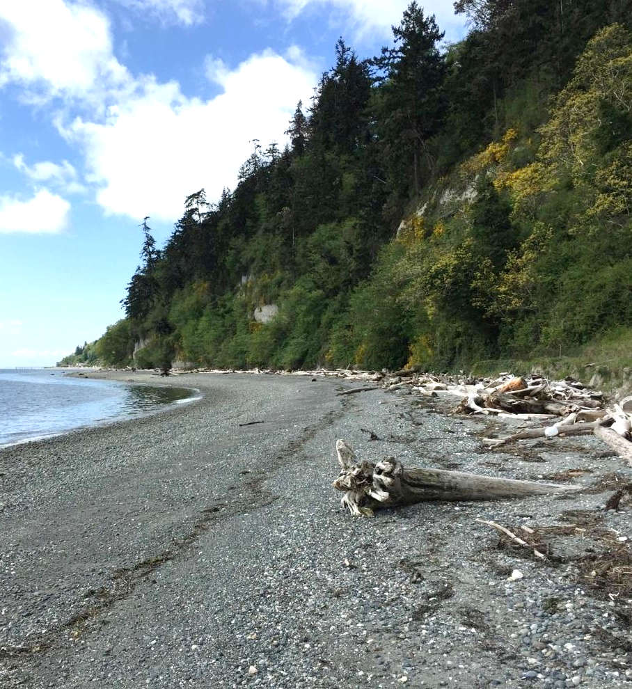
Meeting Adjourned
Geoff Baran Washington State Department of Ecology
360-790-9725
Geoff.Baran@ecy.wa.gov

Slide 19
Lake Chelan GRP Update
Washington State Department of Ecology
Kaitlin Lebon and David Prater

Slide 20
Comparison Slide headline
Column 1
Column 2
Bullet items
Bullet items
Bullet items
Bullet items
Bullet items
Bullet items
Bullet items
Bullet items

Slide 21
Chart slide title 2
Optional summary or explanation of chart

Slide 22
Ecology’s strategic priorities
Support and engage our communities, customers, and employees
Reduce and prepare for climate impacts
Prevent and reduce toxic threats and pollution
Protect and manage our state's waters
Protect and restore Puget Sound

Slide 23
Presentation Title Option 2
Name
Date

Slide 24
Timeline slide title
Optional summary or explanation of timeline information
Year
Year
Year
Year
Event description or information
Event description or information
Event description or information
Event description or information

Slide 25
Table slide title
Optional summary or explanation of table information
Heading | Heading | Heading | Heading | Heading
Content | Content | Content | Content | Content
Content | Content | Content | Content | Content
Content | Content | Content | Content | Content
Content | Content | Content | Content | Content
Content | Content | Content | Content | Content
Content | Content | Content | Content | Content

Slide 26
Chart slide title
Optional summary or explanation of bar chart

Slide 27
Chart slide title 2
Optional summary or explanation of chart

Slide 28
Venn diagram title
Optional text explanation
Category 1
Category 2
Item 1
Item 1
Item 1
Item 2
Item 2
Item 2
Item 3
Item 3
Item 3
Item 4
Item 4

