Slide 1
Source Control Inspection Program Guidance Manual and Training Update
Presented by
Rebecca Dugopolski, PE

Slide 2
Outline
Project overview
Source Control Inspection Program Guidance Manual update
Education and outreach materials
Training update

Slide 3
Project Overview
Information Search
4 interviews (summary report)
Online Guidance Manual
Communication Plan
Business Inspection Training
Training outline/agenda
BIG report information gap summary (tech memo)
Online resource directory
3 priority sections (Chapters 1-3)
Draft Manual
Final Manual
Training curriculum
Online training module
In-person training
Training video
Manual outline
Notes:
Three main tasks with 3-5 subtasks each

Slide 4
Manual Updates
Chapter Number | Chapter Name | Updates
Chapter 1 | Background and Regulatory Requirements | Minor updates posted in Apr. 2022
Chapter 2 | Developing Source Control Code/ Ordinances and Enforcement Policies | Minor updates posted in Apr. 2022
Chapter 3 | Source Control Inventory Development, Updates, and Prioritization | Minor updates posted in Apr. 2022
Notes:
Originally posted in Dec. 2021

Slide 5
Manual Updates
Chapter Number | Chapter Name | Updates
Chapter 4 | Developing a Business/Site Inspection Program | Business letter templates posted in Nov. 2022
Chapter 5 | Conducting Business/Site Inspections | Example inspection form (Survey123) posted in July 2022; Word version posted in Nov. 2022
Chapter 6 | Data Management and Recordkeeping
Chapter 7 | Education and Outreach Materials | Additional spill plan resources posted in July 2022
Chapter 8 | Training | Training resources posted in Nov. 2022
Notes:
Originally posted in Apr. 2022

Slide 6
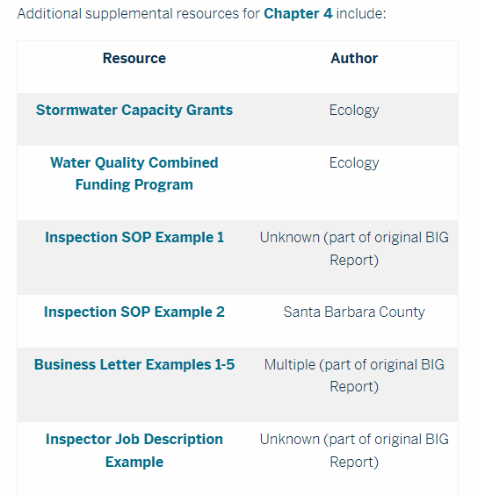
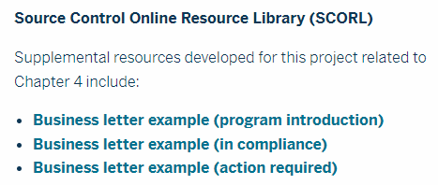
Chapter 4 Update
From project research
From original BIG Report
Developed for this project
From project research
From original BIG Report

Slide 7
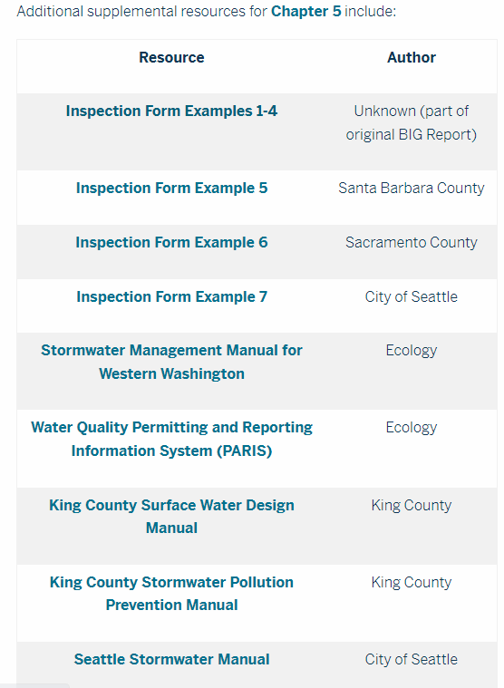
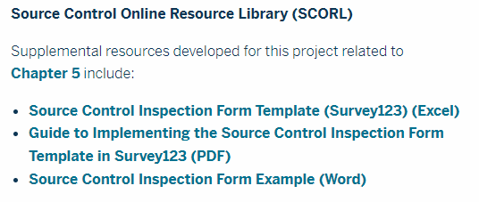
Chapter 5 Update
From original BIG Report
From project research
Developed for this project

Slide 8
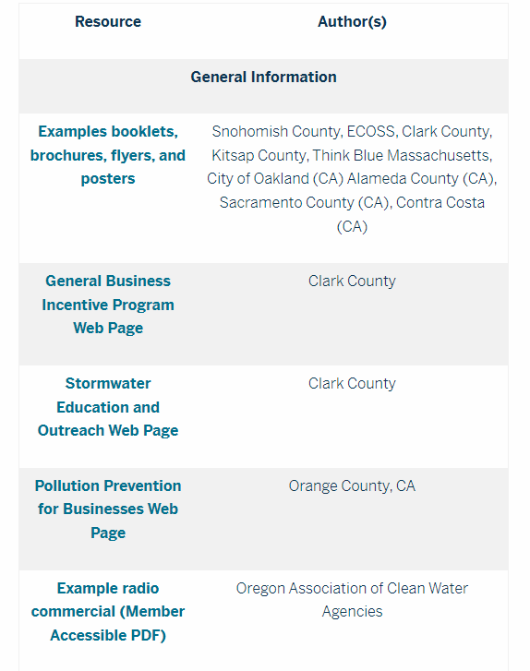
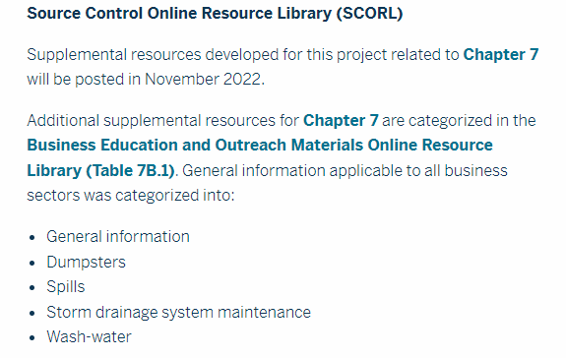
Chapter 7 Update
From original BIG Report and supplemental research
Additional spill plan resources posted in July 2022

Slide 9
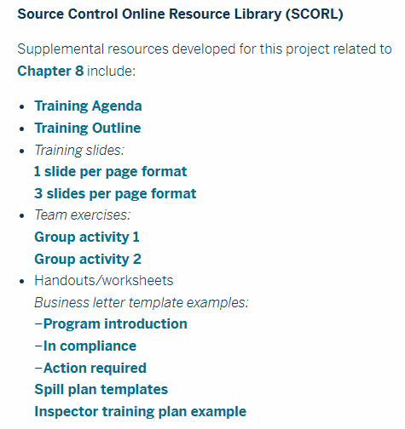
Chapter 8 Update
Developed for this project

Slide 10
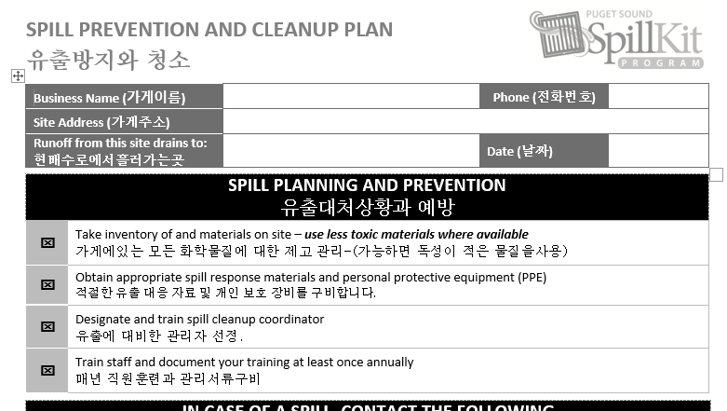
Education and Outreach Materials
Technical Assistance
Spill Plan Template
(available in multiple languages)
Source: ECOSS
Category: Spills
Resources: 7D3 through 7D10
Languages: English, Cambodian, Chinese, Korean, Somali, Spanish, and Vietnamese
Notes:
This spill plan template (developed by ECOSS) is available in multiple languages (listed here)
ECOSS has also developed a spill kit poster that is available in multiple languages
The spill plan template is not currently available in Russian, but the spill kit poster is

Slide 11
New
Education and Outreach Materials
Resources developed for this project
Automotive Source Control BMPs
1-page flyer for business owners
Four half-page sheets for employee education
Restaurant Source Control BMPs
1-page flyer for business owners
Secondary Containment
1-page flyer for business owners
Notes:
Currently in draft format (incorporating comments from the TAC)

Slide 12
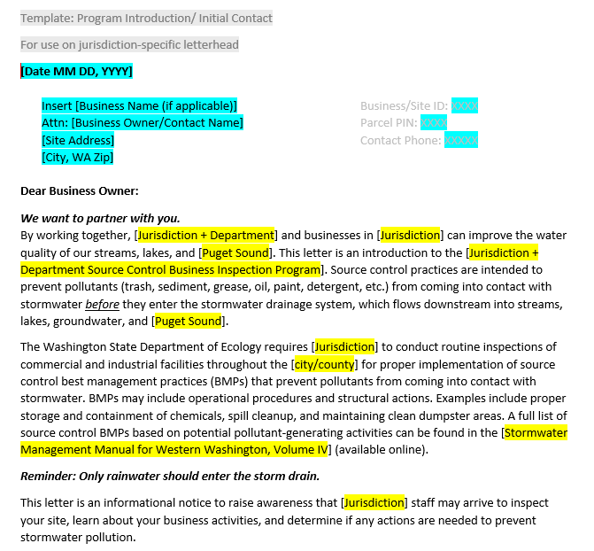
New
Education and Outreach Materials
Resources developed for this project
Business Letter Templates
Inspection Program Introduction/Overview
In Compliance
Action Required
Notes:
Posted along with Chapter 4 resources

Slide 13
Education and Outreach Materials
Resources transcreated for this project
List of common actions required following an inspection
Notes:
In progress
2 page form showing the English and other language.
Spill Plan templates already available in multiple languages
Spill Kit posters already available in multiple languages
Common actions will be translated into multiple languages

Slide 14
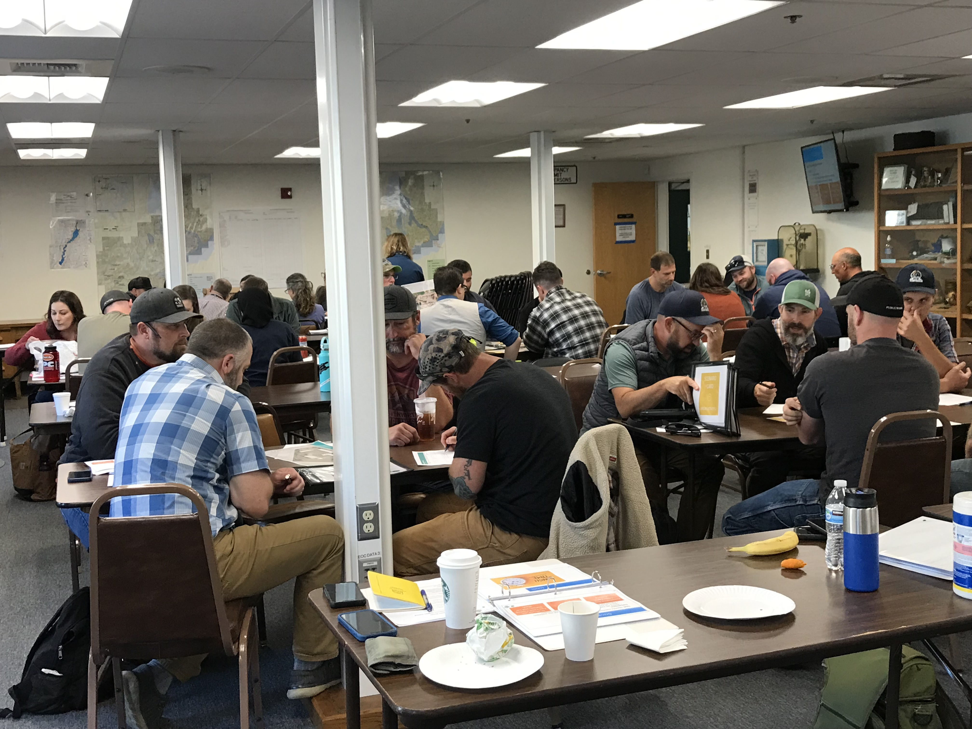
Training Update
In-person training sessions
October 6: Bremerton – 38 attendees
October 11: Centralia – 26 attendees
October 19: Skagit County – 32 attendees
October 25: Federal Way – 52 attendees
Notes:
Bremerton – Heidi Z presented her case study in person
Skagit County – Brad W presented his case study in person

Slide 15
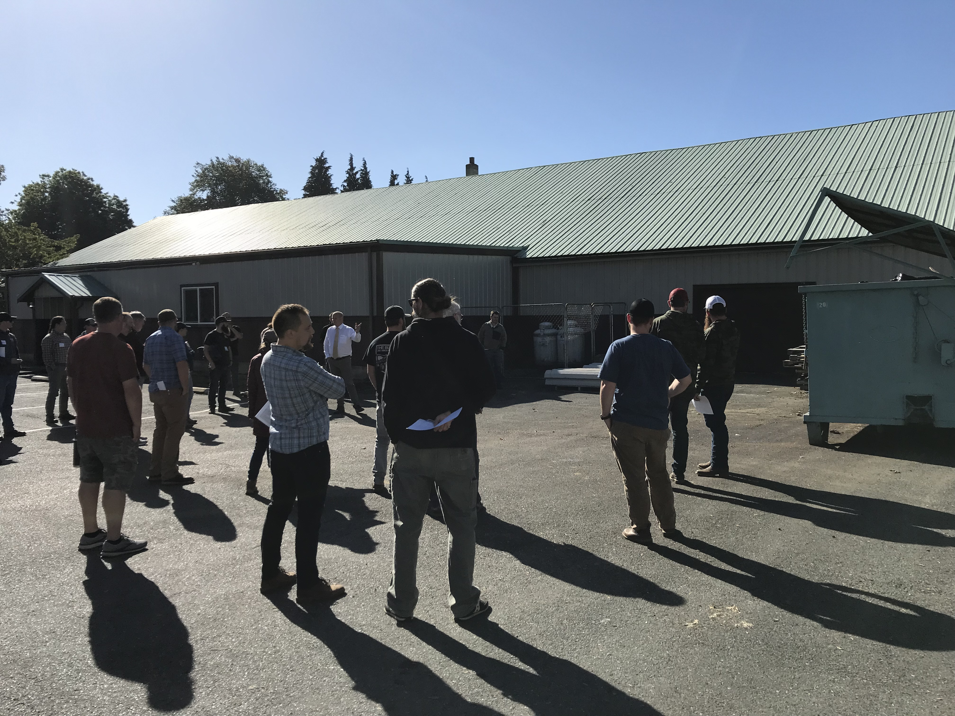
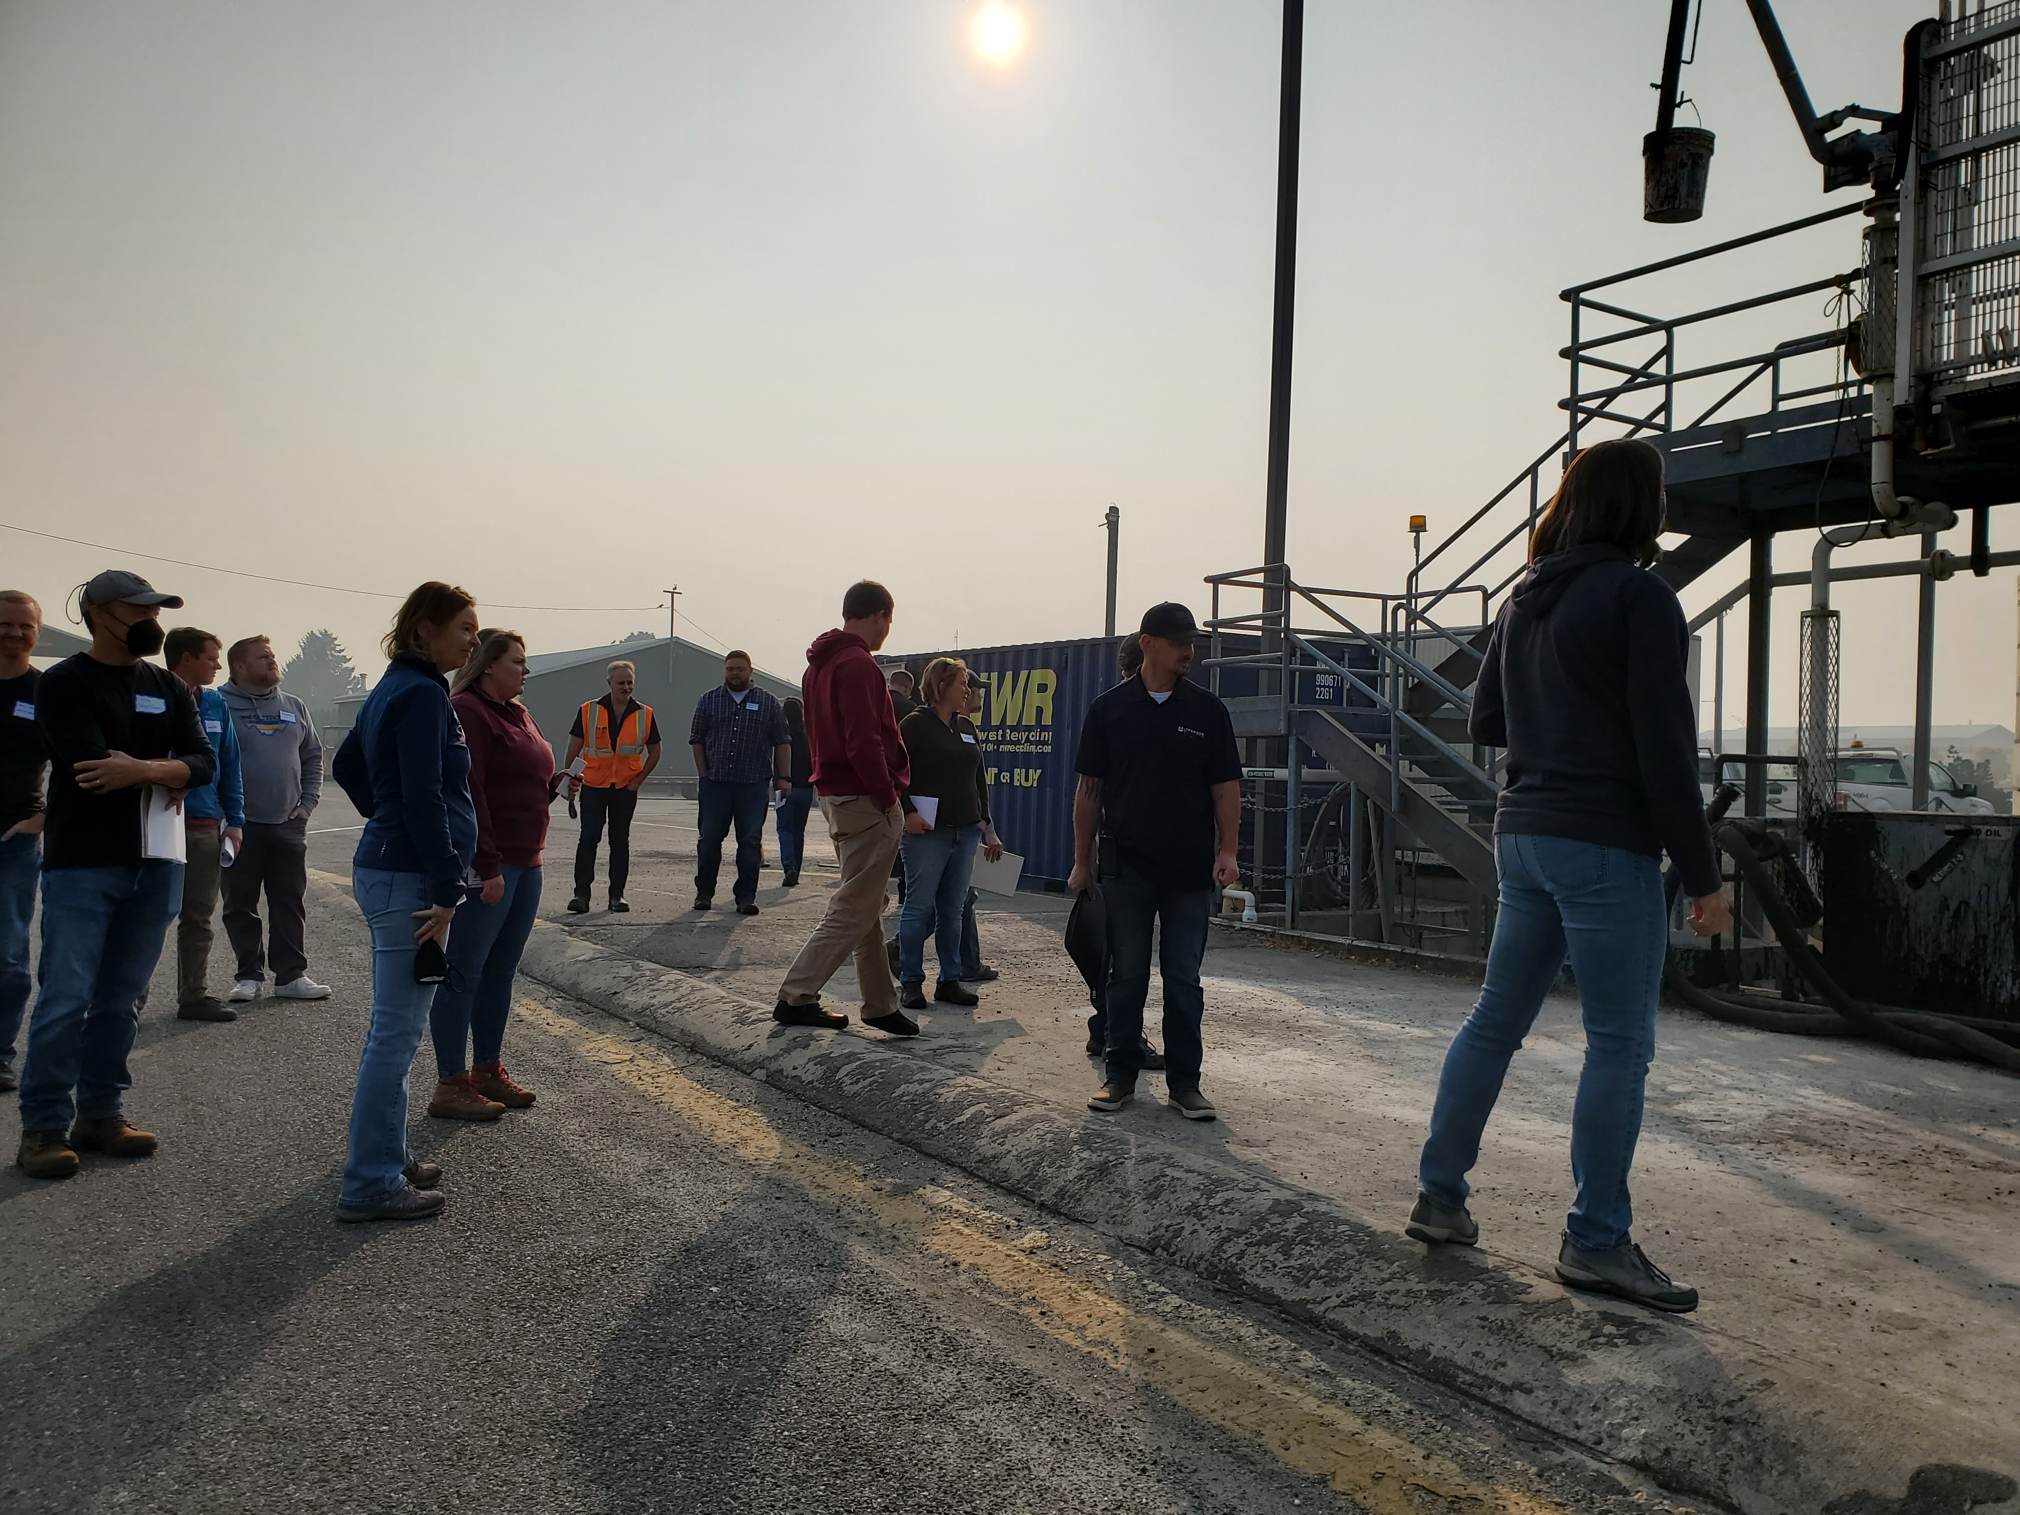
Training Update

Slide 16
Training Update
Next steps
Develop online training module (Thinkific)
Record video segments for online training
Classroom content
Field content
Integrate interactive exercises

Slide 17
Acknowledgements
Stormwater Action Monitoring (project funding)
Washington Stormwater Center (project lead)
Department of Ecology
Technical Advisory Committee (TAC)
Business Inspection Group (BIG)
Pollution Prevention Assistance (PPA)

Slide 18
Questions?

Slide 19
Contact
Rebecca Dugopolski
Herrera Environmental Consultants
Associate Engineer
206.441.9080
rdugopolski@herrerainc.com
Laurie Larson-Pugh
WSU Puyallup Research Center
& Washington Stormwater Center
253.445.4593
laurie.larson-pugh@wsu.edu

