Slide 1
Welcome to the Water Quality Partnership
Please connect your audio and join.
We will do a sound check at 9:50 a.m.
Connect & Join
Participate
1
Connect Audio
*REMEMBER TO UPDATE*:
Toll free number
Code
Turn on Chat box and Participant list at the bottom right side of your screen.
2
Join Meeting
Audio Options
Tip Try your computer audio first.
A
Use computer for audio
B
Webex calls you. You listen through phone.
Enter YOUR phone #
C
Call in (using your phone)
Call US Toll: 415-655-0001
Enter code: 2458 522 3153
Nothing working? Use the chat box to send us a message.
Notes:
Webinar starting slide

Slide 2
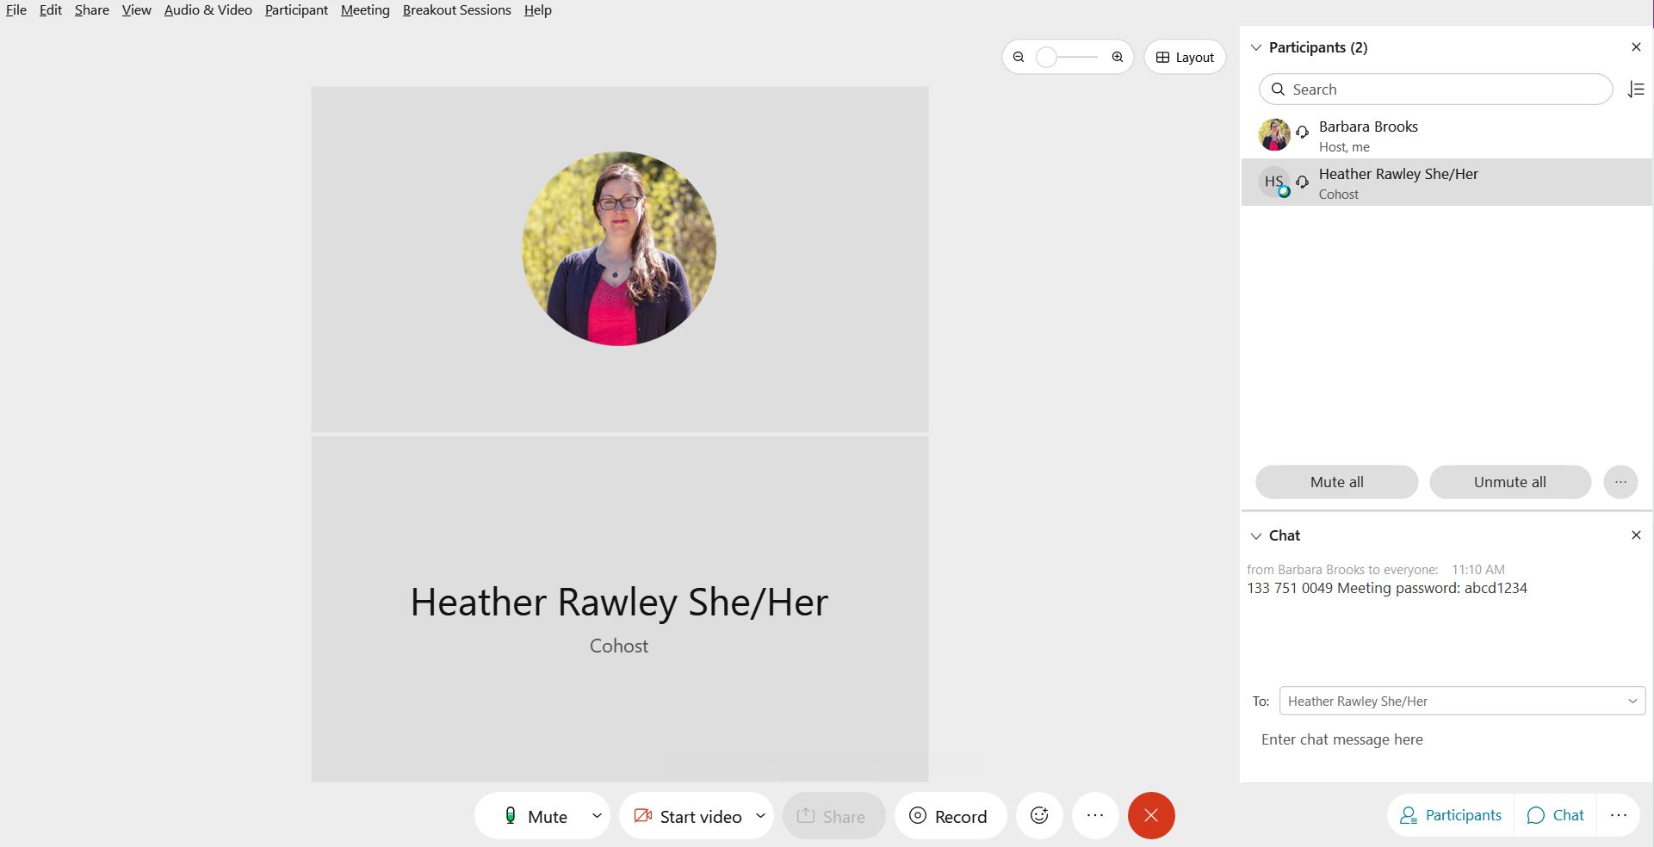
Navigating webinar features
Webex
How to Participate
“Host” and “Cohost” will help with technical issues.
Change the TO “Everyone” to ask questions
Click on this symbol
to open the chat box
Click on this symbol
to “raise and lower your hand”
Notes:
Use this slide to let people know the best way to ask questions.
Chat? Raise their hand and host calls on them?

Slide 3
Water Quality Partnership December 10, 2020
Welcome - Introductions & Program Updates | Vince McGowan | 10:00 –10:10
Wastewater Discharge Permit Fees | David Giglio | 10:10 – 10:25
Current work on Tires and 6PPD | Frances Bothfeld | 10:25 – 10:45
General Permit Updates | Nate Lubliner | 11:45 - 11:05
Watershed Management Updates | Melissa Gildersleeve | 11:05 – 11:25
Water Quality Assessment | Jeremy Reiman | 11:25 – 11:45
Roundtable | All | 11:45 – 11:55
Wrap Up – Future agenda topics | Colleen Keltz | 11:55 –12:00

Slide 4
Water Quality Program Updates
Vince McGowan

Slide 5
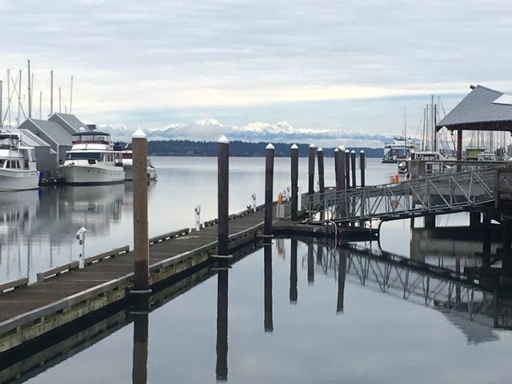
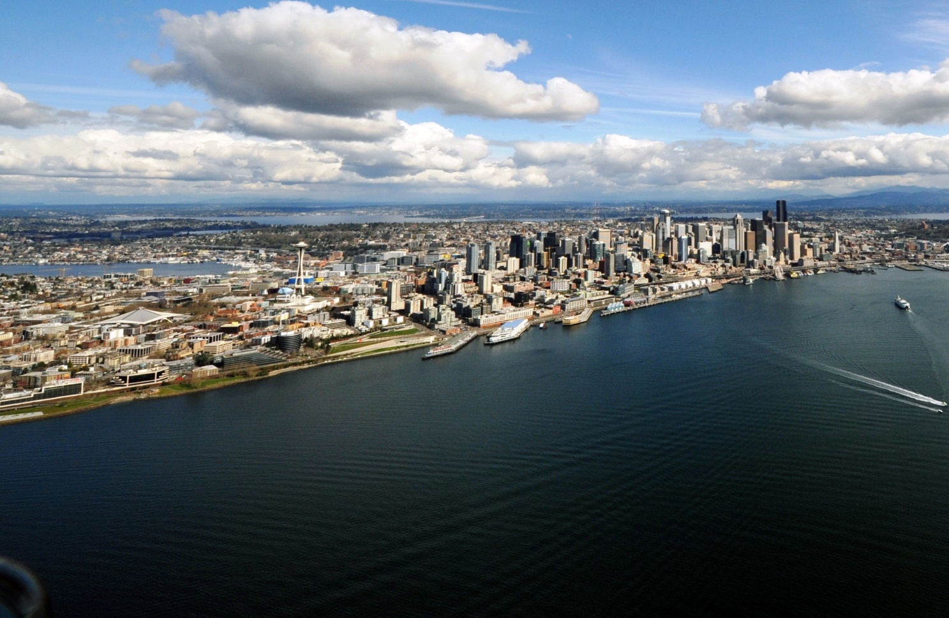
Wastewater Discharge Permit Fees
David Giglio

Slide 6
Background: Water Quality Permit Fees
RCW 90.48.465(1) creates the framework for water quality permit fees:
Fees shall align with workload
Fees shall fully recover the costs of permit administration
Notes:
Key concepts here: fees reflect the workload and should fully cover the costs of the permits.

Slide 7
The exception to the rule
Municipal wastewater permit fees are not aligned with the workload and costs to implement because of the municipal permit fee cap.
“The annual fee paid by a municipality, as defined in 33 U.S.C. Sec. 1362, for all domestic wastewater facility permits issued under RCW 90.48.162 and 90.48.260 shall not exceed the total of a maximum of eighteen cents per month per residence or residential equivalent contributing to the municipality's wastewater system.”
RCW 90.48.465(2)

Slide 8
The exception: domestic wastewater permits
The cap means permit fee revenue covers only 2/3 of current staffing costs.
This staffing level is not adequate to keep permits up to date.
Notes:
As the principle cost in permit administration is staffing, Wage Growth is the better reflection of inflation. Offshore manufacturing is a significant reducer of consumer price inflation, but does not apply to professional work performed locally. Consequently, the actual inflation rate for the costs of teachers, health care workers, and state employees is higher than the CPI inflation rate that includes goods, like computers.
Lower fee revenue has created a gap in permit staffing. We estimate fees would at most need to double to align with the permitting workload, which is below both Wage and CPI Growth since 1991.

Slide 9
The cost to rate payers
The current fees are 18 cents per household per month.
What does Ecology need to recover costs?
We estimate raising the fee to the equivalent 35 cents per household would allow Ecology to provide better service to municipalities and other permittees.
This is an early estimate, with more work to be done with permittees and stakeholders. We would not expect a new fee to cost rate payers more than $4-5 per year.
The cost to rate payers can remain low and solve cascading problems for permittees and Ecology.

Slide 10
Problem #1 – Revenue Shortfall
Stagnant fees mean the permit program is underfunded.
The results of underfunding:
Eliminating wastewater permit writer positions while the work becomes more complex.
Outdated permits – over 70% of wastewater permits are no longer current; some are 13 years out of date.
Permits need updates to reflect changes in regulatory requirements, new treatment technologies, and upgrades at the plants. Permits must reflect the current plant design and capabilities.
Staffing and service shortfall puts the environment at risk, as well as the permittees.

Slide 11
Problem #1 – Revenue Shortfall
Stagnant fees mean the permit program is underfunded.
What we’ve heard from municipalities:
Frustrations: They need more responsiveness and consistency from Ecology.
Outdated permits put them at risk.
Municipalities have struggled to get bonds for projects without Ecology engineering reviews
They are vulnerable to third-party lawsuits associated with outdated permit conditions

Slide 12
Problem #2 – Fee Inequities
In order to protect the environment and serve local communities, Ecology uses about $2 million in fees each year paid by other permittees to cover the cost of writing and overseeing municipal wastewater permits.
This approach is not sustainable for the permittees or permit program.
We adjust fees each biennium, aligning permit fees with the costs of administering that permit category, per RCW 90.48.465(1). Except for domestic wastewater permits, because of the cap.

Slide 13
Problem #3 – Nutrient Pollution
We cannot charge the new Puget Sound Nutrient General Permit fee due to the statutory cap. The Nutrient General Permit only applies – with appropriate funding - will help salmon and orca recovery in Puget Sound.
Notes:
Over the last decade, the science on how nutrient loading in Puget Sound has become clear, how anthropogenic nutrients primarily from wastewater discharge are increasing algae blooms, dead zones (areas with so little oxygen in the water that fish suffocate), ocean acidification, and food chain disruption leading to more jellyfish and fewer salmon.

Slide 14
Our Legislative Proposal
2022
Remove the cap (this doesn’t change the fees)
Work with stakeholders on a fee structure:
Gather input from municipal permittees on how we can best support their work
Assess the permit program workload and staffing needs
Develop an equitable fee structure that aligns revenue with the staffing and support need
2023
Set municipal wastewater fees in rule using a public process, as we do for all other water quality permit fee categories

Slide 15
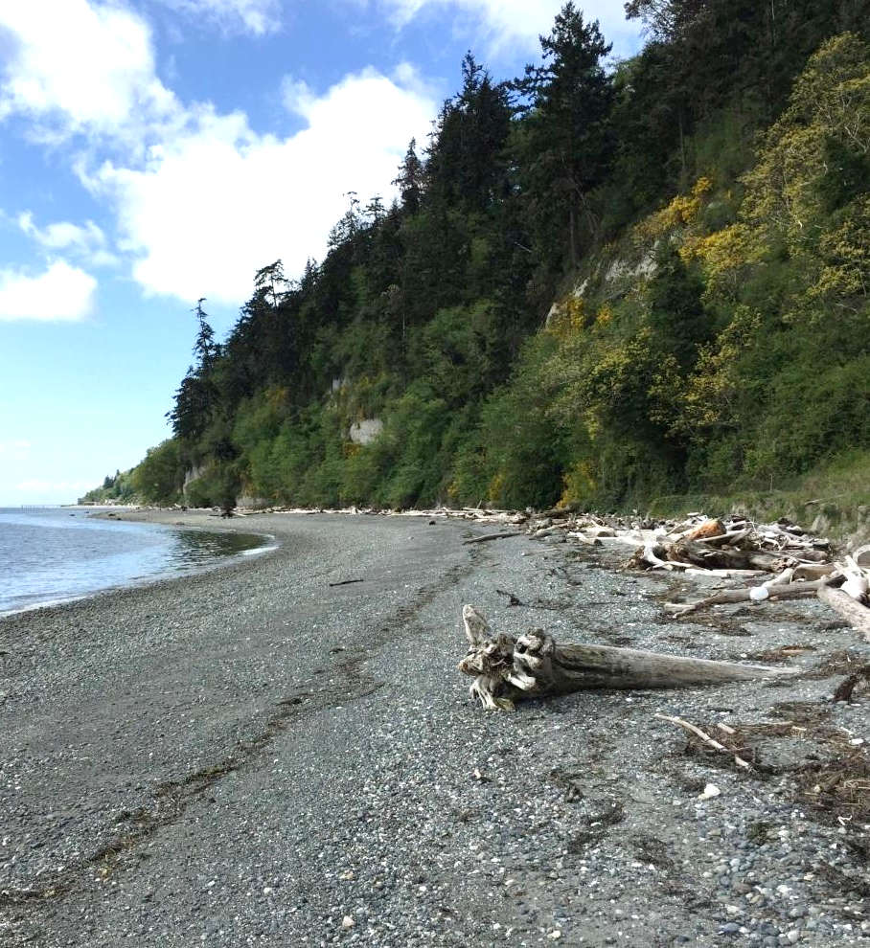
Thank you
Questions or comments?
David Giglio
WQ Deputy Program Manager
david.giglio@ecy.wa.gov
360-480-2141

Slide 16
Background: Water Quality Permit Fees
RCW 90.48.465(1) …All fees charged shall be based on factors relating to the complexity of permit issuance and compliance and may be based on pollutant loading and toxicity and be designed to encourage recycling and the reduction of the quantity of pollutants. Fees shall be established in amounts to fully recover and not to exceed expenses incurred by the department in processing permit applications and modifications, monitoring and evaluating compliance with permits, conducting inspections, securing laboratory analysis of samples taken during inspections, reviewing plans and documents directly related to operations of permittees, overseeing performance of delegated pretreatment programs, and supporting the overhead expenses that are directly related to these activities.
Notes:
For reference

Slide 17
Current work on Tires and 6PPD
Frances Bothfeld

Slide 18
6PPD “lines of inquiry” and active groups*
Product Replacement
Ecology HWTR
Interstate (CA, others)
USEPA
USTMA
Salmon Safe
Geography/
Priorities
NOAA/USFWS WDFW/WDNR
UW Tacoma
Ecology EAP
Tribes
PSEMP Stormwater
Stormwater Management
Ecology WQP
SAM
WSDOT
WA Stormwater Center
PS Recovery SIL
PSEMP Stormwater
Analytical Methods
UW Tacoma
Ecology MEL
USEPA
Private labs
Biological Effects
WSU Puyallup
NOAA
USFWS WDFW
PSEMP Toxics
* Not an exhaustive list!
EAP: Environmental Assessment Program HWTR: Hazardous Waste and Toxics Reduction MEL: Manchester Environmental Laboratory PSEMP: Puget Sound Ecosystem Monitoring Program
SAM: Stormwater Action Monitoring
SIL: Strategic Initiative Lead (for Puget Sound recovery)
USTMA: US Tire Manufacturers Association WQP: Water Quality Program
Notes:
Lay of the land- Ecology and our partners are making progress in all of these areas. Proviso (#22) is focused on Product Replacement. (#23) is focused on Analytical methods, stormwater management, and geography.

Slide 19
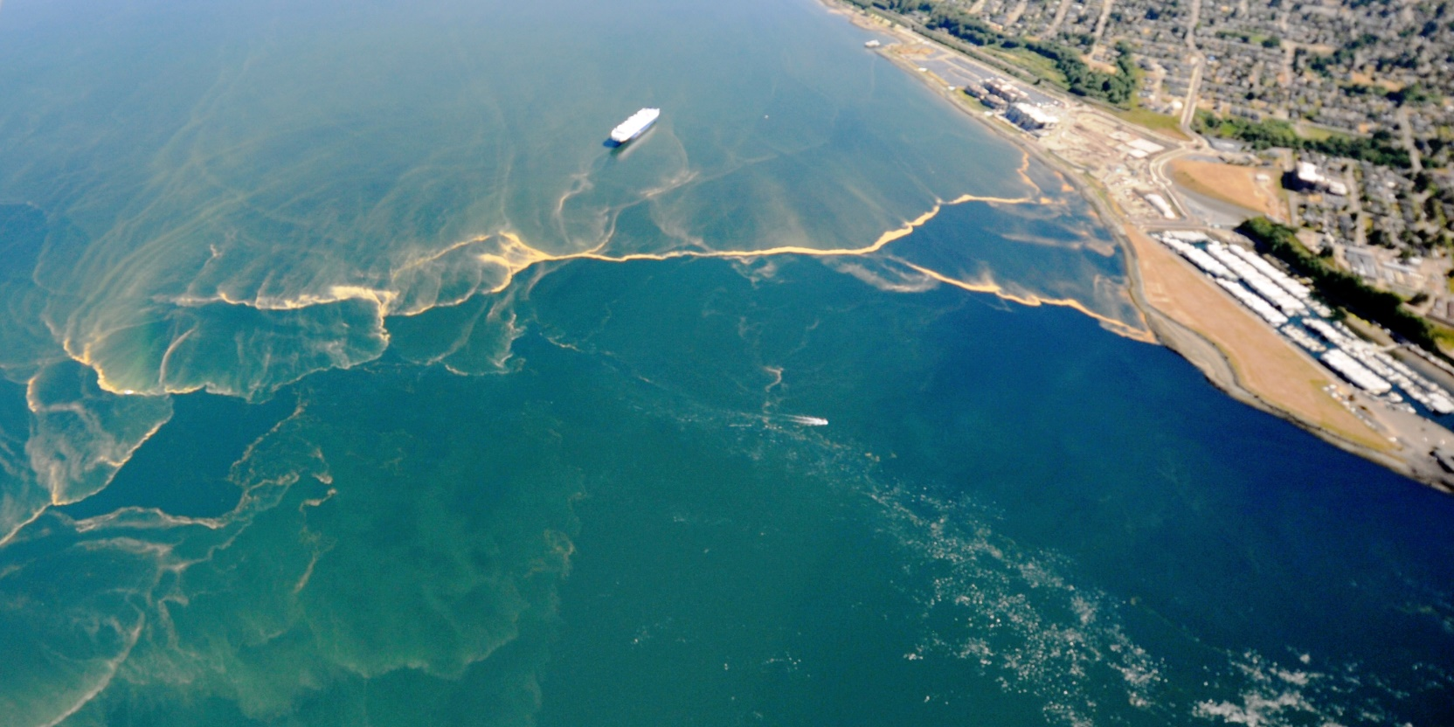
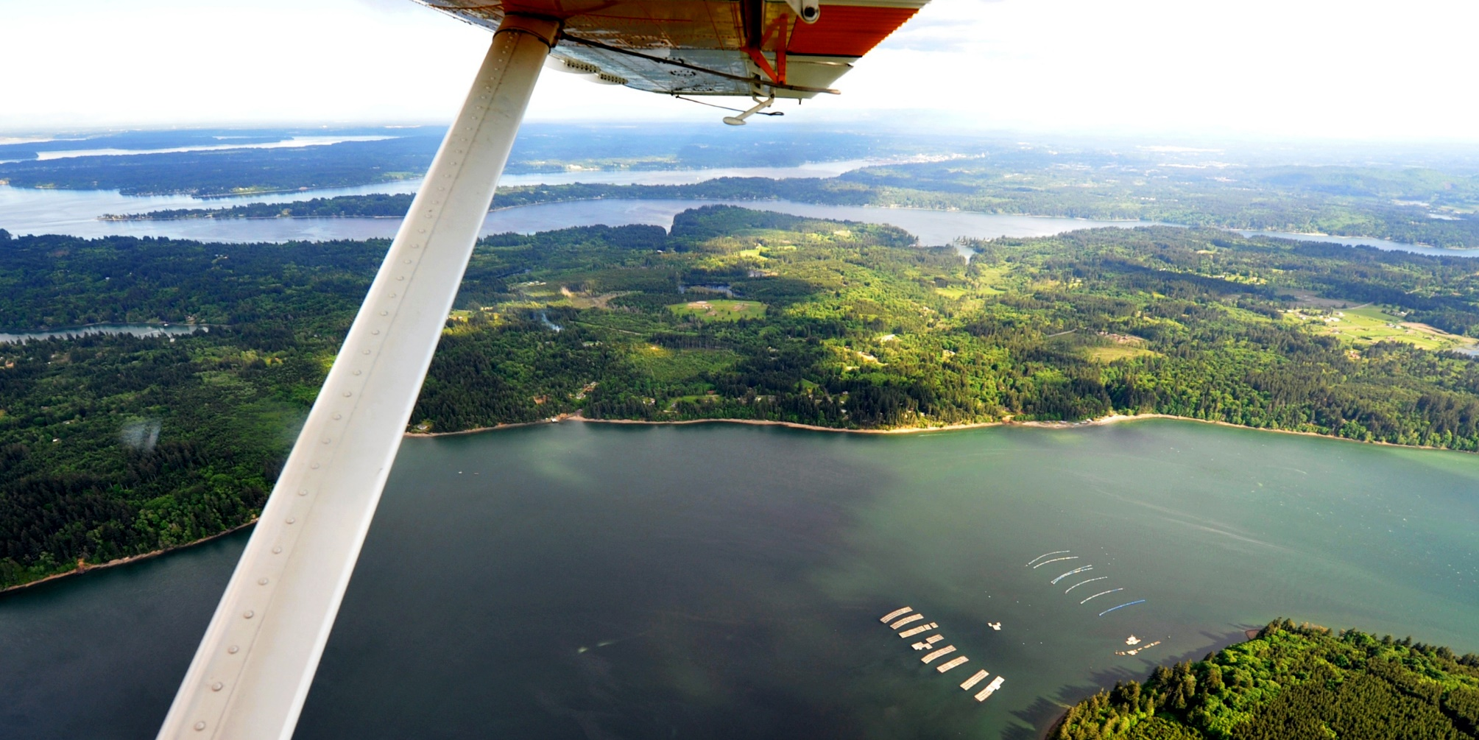
General Permit Updates – Fact Sheet
Nate Lubliner

Slide 20
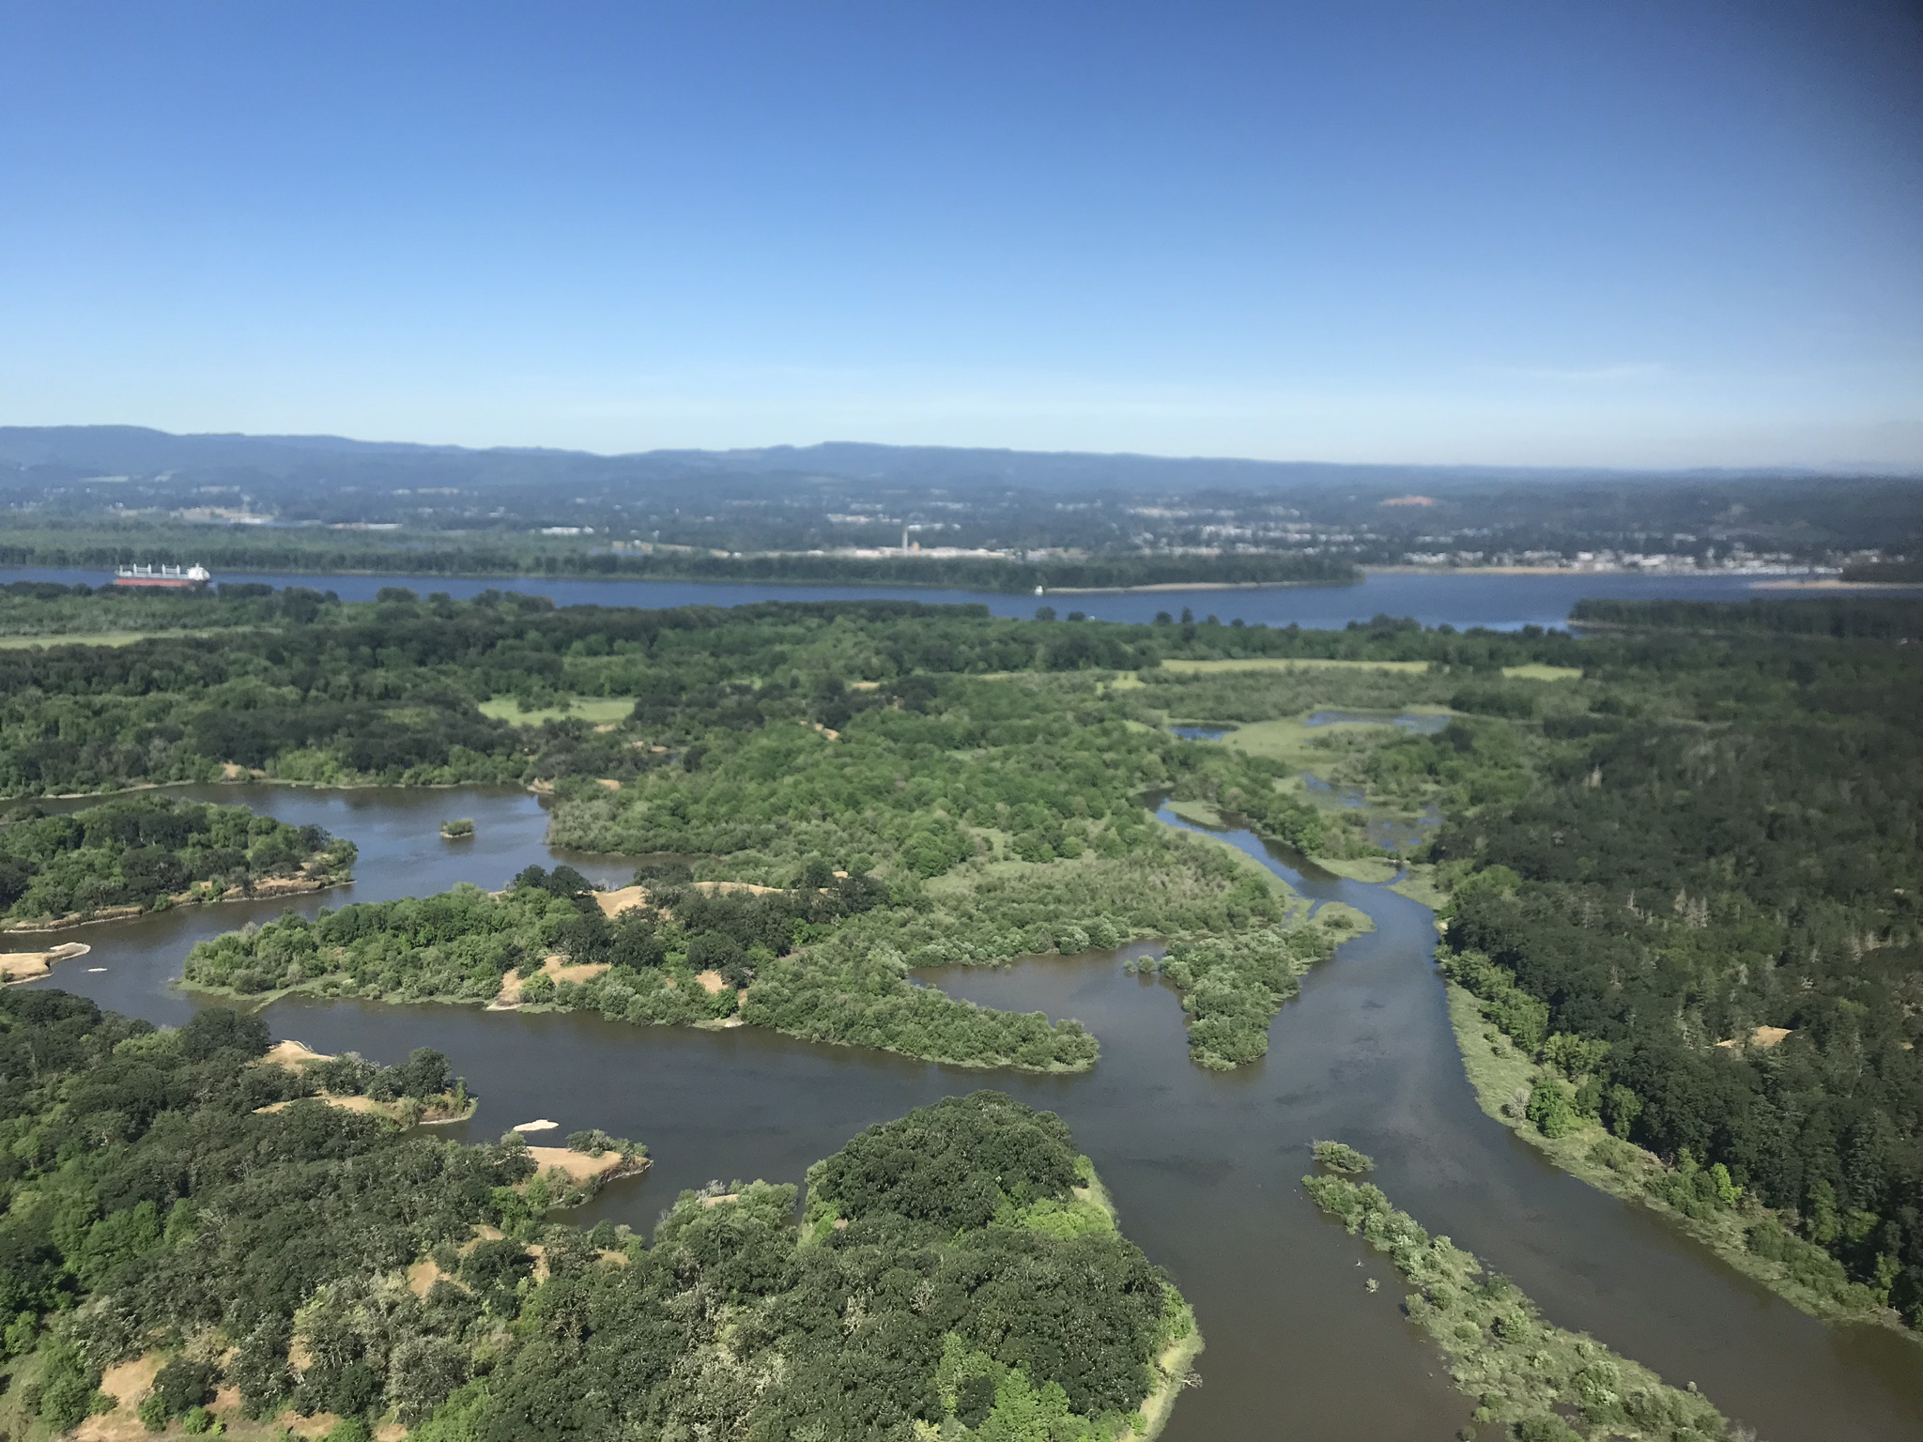
Watershed Management Updates
Melissa Gildersleeve

Slide 21
Watershed Management Section Updates
Water Quality Assessment— Submitted to EPA on August 31, 2021 Package is on our website and includes:
response to comments document
supporting information document
Water Quality Standards
Chelan UAA rule adopted and submitting to EPA in October
Salmon Spawning Rule – hope to have draft rule out in October. Held a workshop on the rule on September 21, 2021.
Triennial Review- pulling together the EPA package for EPA this will include comments we received and an updated proposed schedule of rule work.

Slide 22
Watershed Management Section Updates
Puget Sound Nutrient Reduction Project –
Held a Nutrient Forum Webinar this week to walk through the results of the Year 1 optimization model runs.
Getting ready for another Nutrient Forum this fall to select Year 2 optimization runs.
Columbia River Temperature TMDL Implementation
Other items?

Slide 23
Washington’s 2018 Water Quality Assessment Updates
Jeremy Reiman

Slide 24
What is the Water Quality Assessment?
Clean Water Act requirement to provide “Integrated Report” on Water Quality to EPA every two years
303(d) – Impaired waters not supporting designated uses
305(b) – General report on water quality
Comprehensive assessment of health of Washington’s surface waters based on all readily available data
Goal: Prioritize protection and improvement of water quality
Required prioritize and develop Total Maximum Daily Loads (TMDLs)
Notes:
Not sampling every waterbody, gathering all data we can find

Slide 25
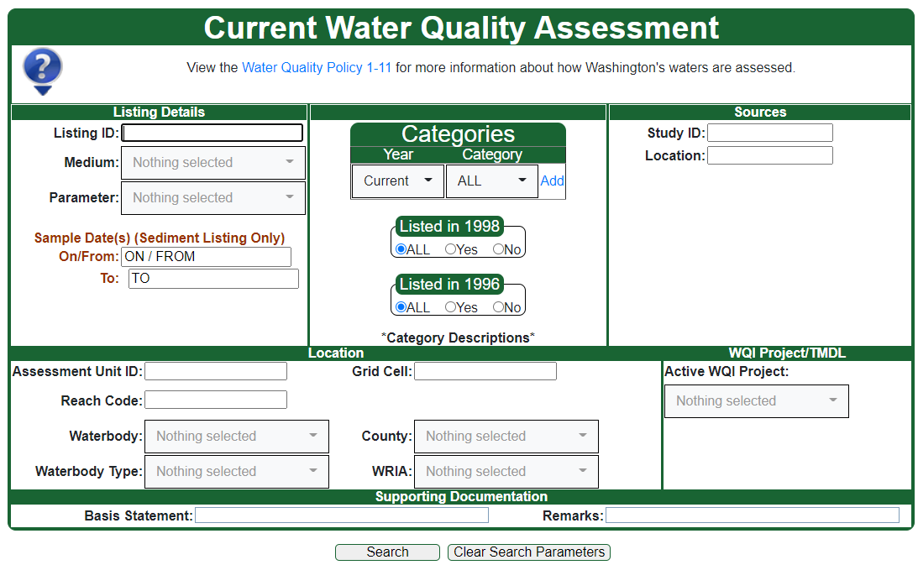
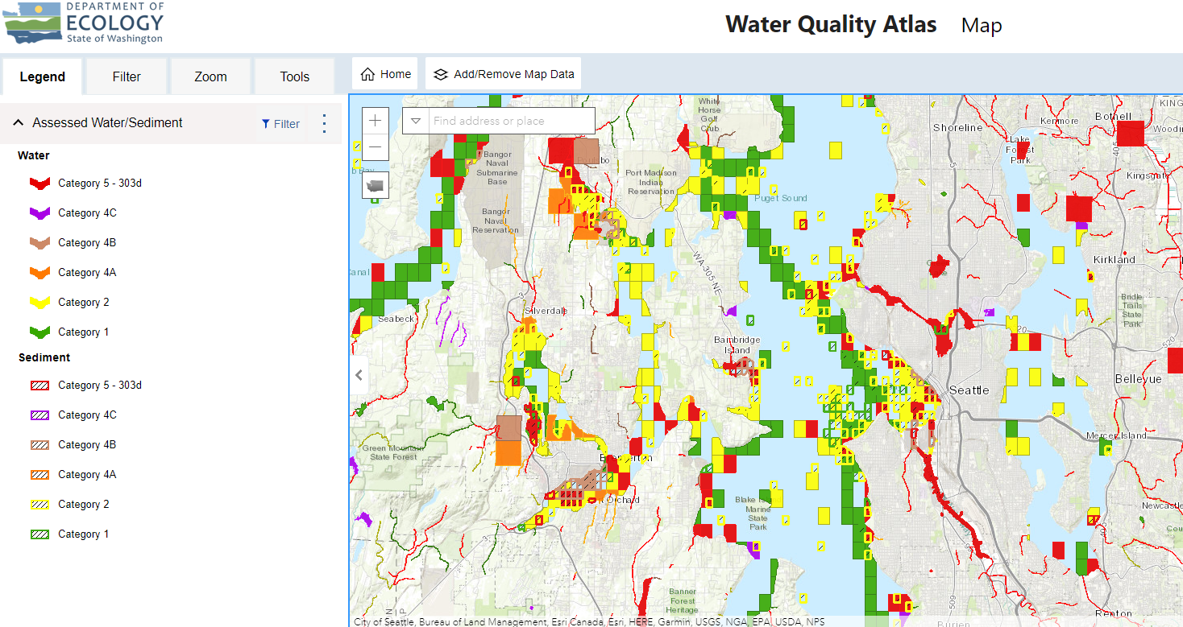
WQA results publicly accessible
ecology.wa.gov/303d
Approved Water Quality Assessment
Water Quality Atlas

Slide 26
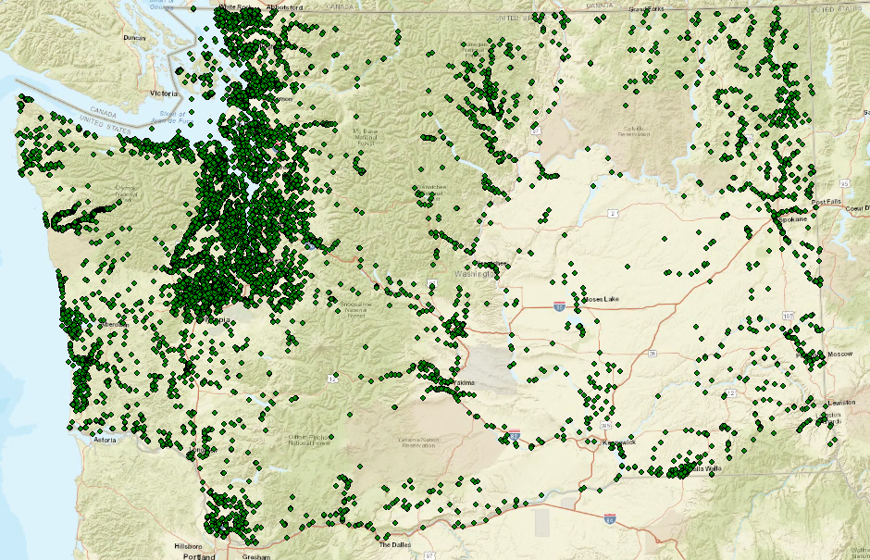
2018 Water Quality Assessment
Represents 2014, 2016, & 2018 lists
Fresh & marine waters
Data window: 2006-2017
Updates WQ standards and Policy 1-11
High-level statistics
66 million records
134 parameters, 297 unique data analyses
9,291 mi streams, 433 lakes, 614 mi² marine waters
41,988 water quality determinations (41% increase)
Notes:
Statistics do not include contaminated sediment statistics
Large waterbodies in urbanized area
An increase in targeted monitoring
Around 15% of Washington’s waters

Slide 27
Internal Review: January – February 2021
Target Audience: Regional TMDL and other Ecology staff
Tribal/EPA Preview: February – March 2021
Target Audience: Tribes and EPA
Public Review: April 2021 – June 2021
Target Audience: Any concerned party
Comments focus: new 303(d) listings in approved TMDLS
Webinars: Statewide and NWIFC
Received few comments
Met individually with Tribes
Public notified via listserv, press release, State register
State-wide public webinar
Comments from 34 unique entities
Response to comments provided on website
Corresponded directly with EPA to address concerns

Slide 28
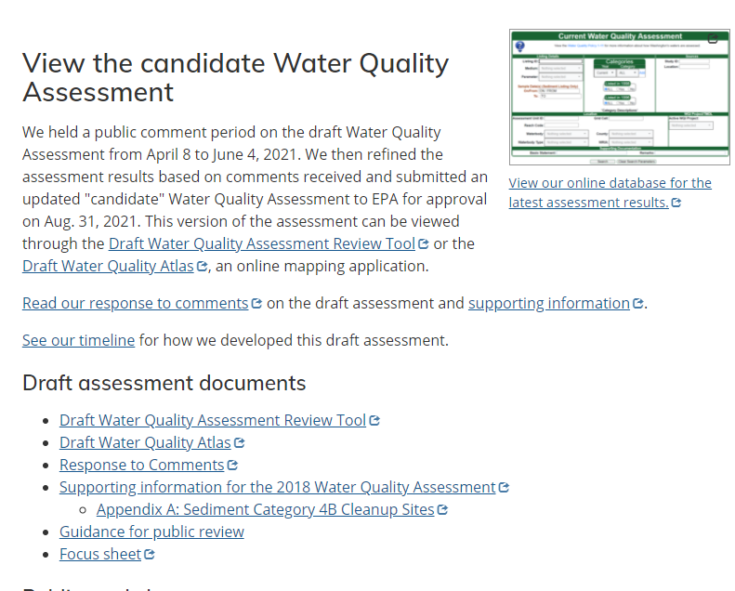
Candidate WQA and 303(d) List Submittal
Submitted to EPA August 31, 2021
ATTAINS
Ecology application updates
Draft WQA Search Tool
Draft WQ Atlas
Website updates:
ecology.wa.gov/303d
Response to comments
Supporting information

Slide 29
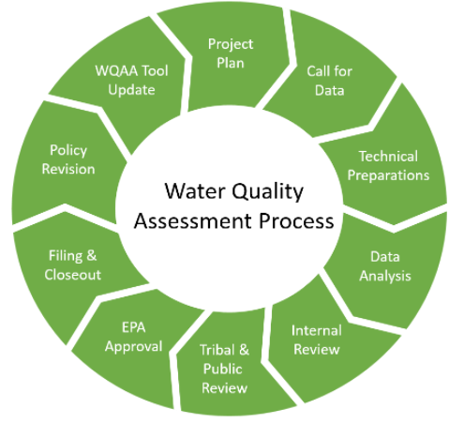
Next Steps
EPA 30 days to take action
Approved –new 303(d) list for CWA regulatory purposes
EPA’s “How’s My Waterway”
Update Ecology applications/website
Updates to Policy 1-11 for Salmon Spawning Habitat Protection Rule
Call for Data for 2020-2022 WQA

Slide 30
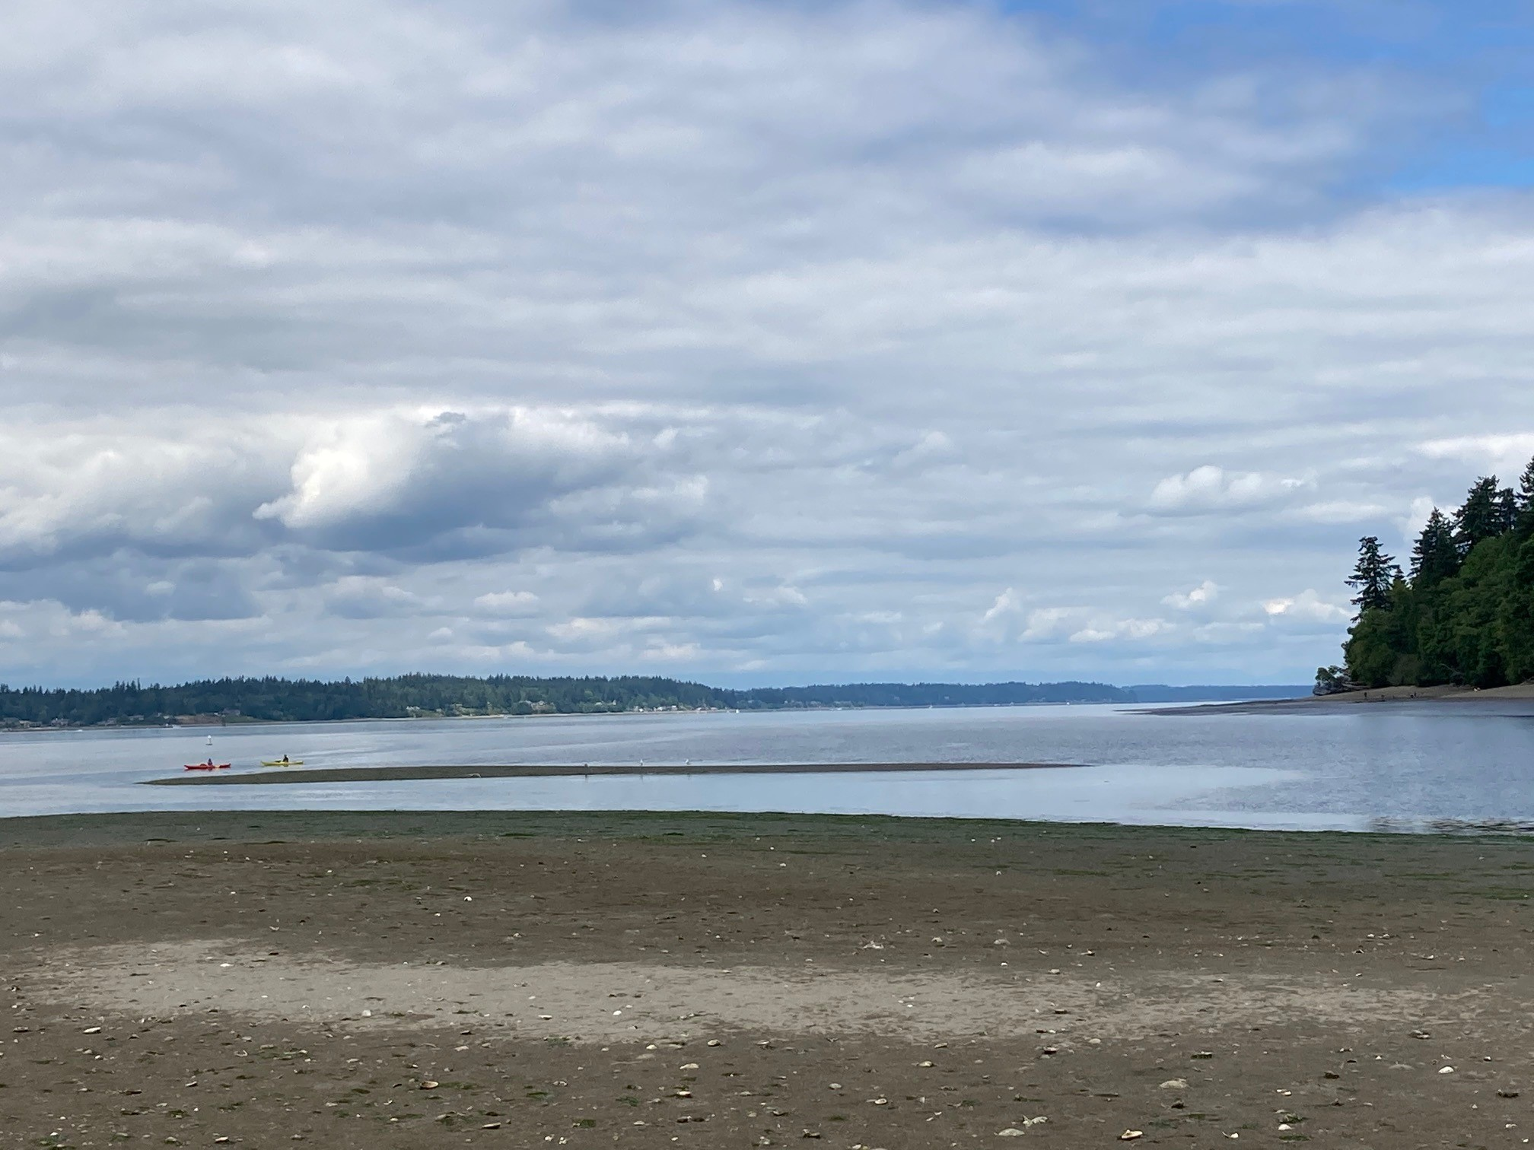
Wrap Up
Colleen Keltz

