Slide 1
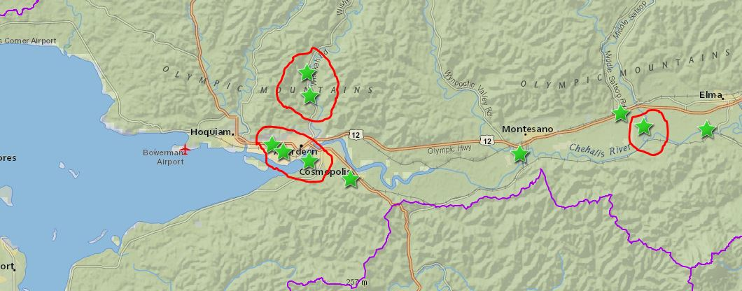
TimberWorks (Aberdeen/Hoquiam/GHC)
PRESENTATION #1
www.ezview.wa.gov/aberdeenfloodrelief
www.ezview.wa.gov/site/alias__1492/34489/local_projects.aspx

Slide 2
Resiliency and Restoration Master Plan
TimberWorks
Partnership: Cities of Aberdeen and Hoquiam
Purpose: Reduce floods, improve fish habitat, improve community spaces, stimulate economy
Outcomes:
Comprehensive, broadly supported approach
Prioritized set of projects
Funding and implementation strategy

Slide 3
Current Status
Task 1: Defining the Problem
Task 2: Exploring Opportunities
Task 3: Action Plan
Advisory Group Meeting 1- Kickoff
2.1 Identify Universe of Opportunities
Locations and Conceptual Project Typologies
3.1 Priority Project List and Implementation Strategy
1.1 Stakeholder Interviews & Walking Tour
3.2 Community Open House 2
2.2 Community Open House 1
1.2 Flood Risk Assessment
Advisory Group Meeting 4 - Priorities and Implementation
Advisory Group Meeting 3-Refine Potential Solutions
1.3 Infrastructure Assessment
3.3 Master Plan with Implementation Strategy
1.4 Fish Habitat Needs and Opportunities
1.5 Community Spaces Evaluation
We Are Here
Advisory Group Meeting 2 – Review Existing Conditions, Discuss Potential Solutions

Slide 4
Upcoming Planned Activities: Implementation

Slide 5
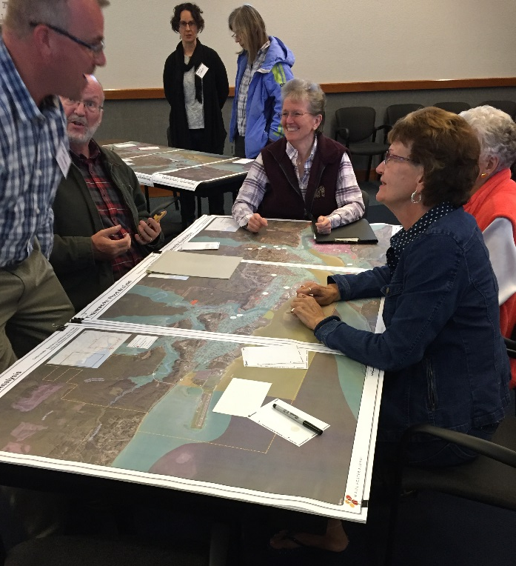
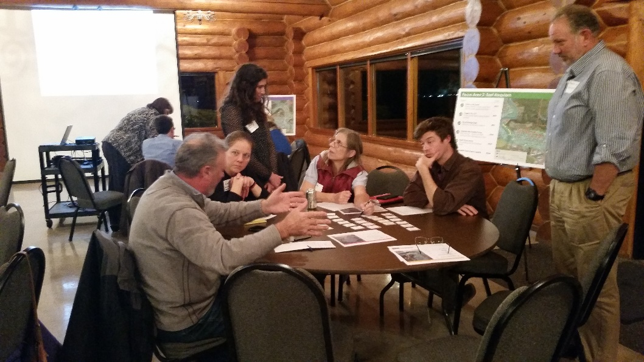
Controversies and/or Complexities:
Coordination: Master Plan and North Shore Levee
Community Support: Different interests, history
Data Gaps: Storm system

Slide 6
Key Outcomes and Further Information:
Action Plan: Priorities and Funding Strategies
Strong Partnerships and Community Support
Mutual support and trust
Consensus in communities
Phasing: On-the-ground projects, further design studies
See EZ View Website for Final Report
Michael Stringer, mstringer@maulfoster.com
Jordan Rash, jrash@Forterra.org
Kris Koski, kkoski@aberdeenwa.org

