Slide 1


Chehalis River Basin Flood Authority
Reducing Flood Damage and
Restoring Aquatic Species
City of Chehalis
July 11, 2022
Scott Boettcher
Staff, Chehalis River Basin Flood Authority
360/480-6600⏐scottb@sbgh-partners.com

Slide 2




Today’s Presentation
Describe the “Flood Authority”
  #1 -- Local Projects
  #2 -- Flood Warning System
  #3 – Role
Touch on “Office of Chehalis Basin” and “Chehalis Basin Strategy”
Allow time for discussion
State Law
“The primary purpose of the office is to aggressively pursue implementation of an integrated strategy and administer funding for long-term flood damage reduction and aquatic species restoration in the Chehalis river basin.” (RCW 43.21A.730)
Office of Chehalis Basin | Chehalis Basin Board
https://chehalisbasinstrategy.com/
.

Slide 3
Chehalis River Basin Flood Authority
Formed in 2008
Focused on flood hazard mitigation
Decision-making
  informed by science
  protective of Basin residents/communities
  environmentally appropriate
Jurisdictions represented (see inter-local agreement)
Grays Harbor County (2008)
  City of Aberdeen (2008)
  City of Cosmopolis(2011)
  City of Hoquiam (2017)
  City of Montesano (2008)
  City of Oakville (2008)
Lewis County (2008)
  City of Centralia (2008)
  City of Chehalis (2008)
  City of Napavine (2011)
  Town of Pe Ell (2008)
Thurston County (2008)
  Town of Bucoda (2008)

Slide 4
Local Projects (#1)
Reduce flood damage.
Protect people, property, infrastructure.
Improve readiness, response, resiliency.
  Drinking Water (Boistfort, Bucoda).
  Wastewater (Montesano, Pe Ell).
  Emergency Response (Grays Harbor County, Chehalis-Centralia Airport).
  Regional Economic Infrastructure (Montesano, Port of Chehalis, Port of Grays Harbor).
  Community Protection (Aberdeen, Adna, Bucoda, Centralia, Chehalis, Chehalis Tribe, Cosmopolis, Hoquiam, Oakville).
  Flood Warning (Basin-wide).
State Capital Budget:
2012-13 -- $ 5.0M
2013-15 -- $10.7M
2015-17 -- $15.7M
2017-19 -- $ 9.6M
2019-21 -- $ 6.3M
2021-23 -- $ 4.1M
$51.4M

Slide 5
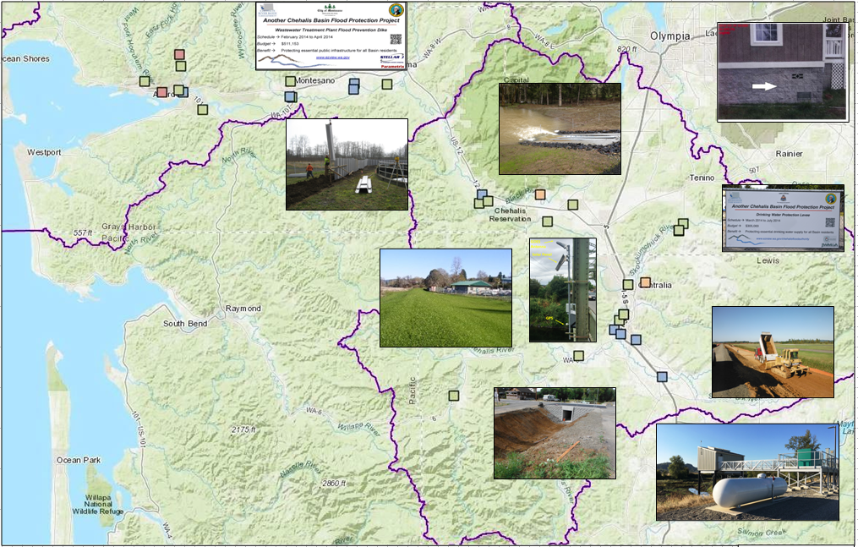
Local Projects (Completed 2012-23)
Cost: $694,152 (average)
Timeframe: 647 days (average)
Sequence:
1st = “Plan/Study/Design” project (24 completed)
2nd = “Construction” project (27 completed)

Slide 6
COMPLETED – Chehalis-Centralia Airport
Local Projects (Chehalis)
New Pump -- 2017
January 2022
New Pump Cost = $1.1M
Widening Levee = $1.2M
ROI = Substantial (~$9M annual in local and state tax revenues)
1/2022 High-water event = Airport stayed operational
Old Pump – 1940s
Widening/Repairing Levee – 2014

Slide 7
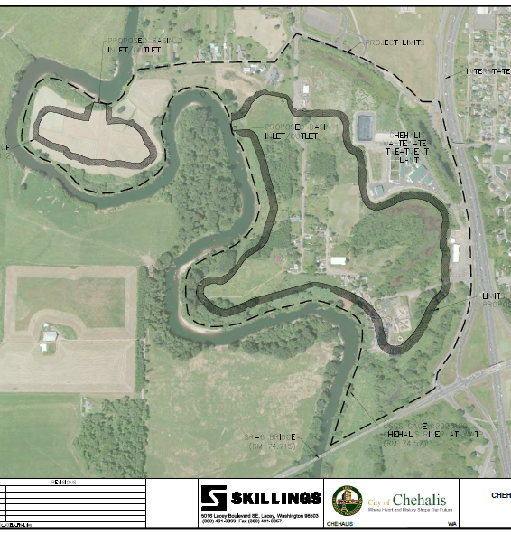
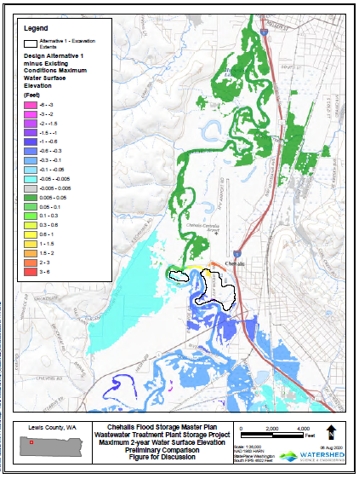
UNDERWAY – Flood Storage Project
Local Projects (Chehalis)

Slide 8
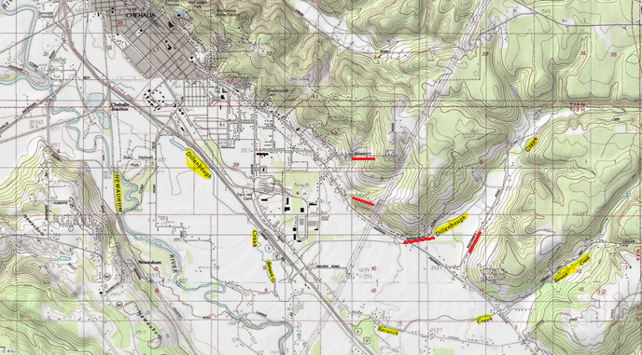
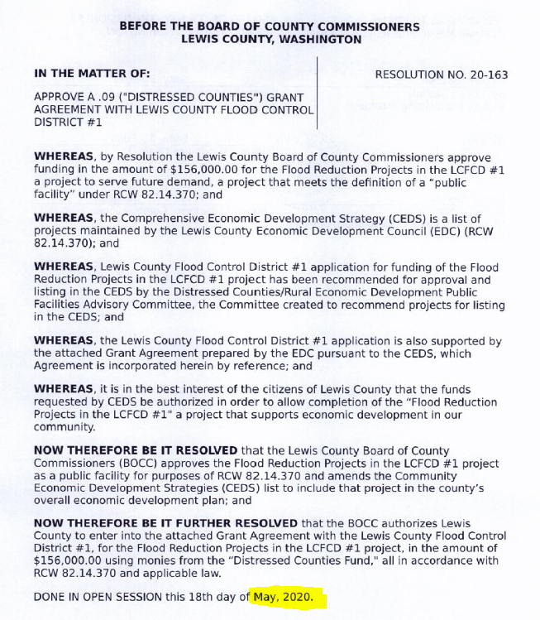
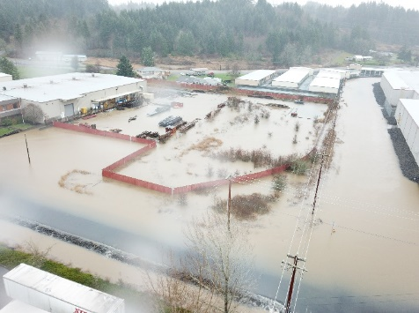
UNDERWAY – Chehalis Industrial Park:
“Regionalized Floodwater Management Approach”
Local Projects (Chehalis Industrial Park)
Vicinity Topography, Lewis County GIS Web Map
2019 Flooding, Rick Rouse

Slide 9
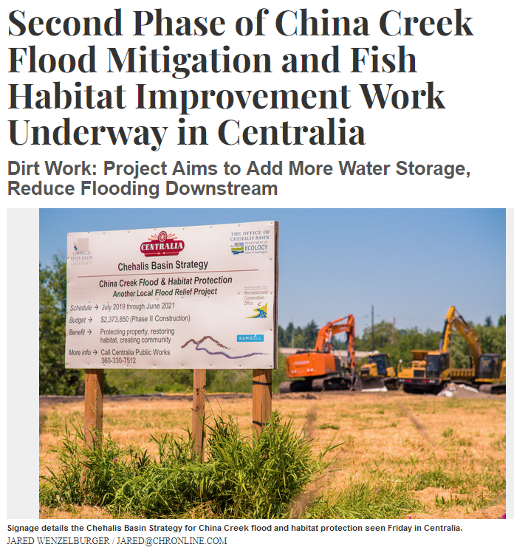
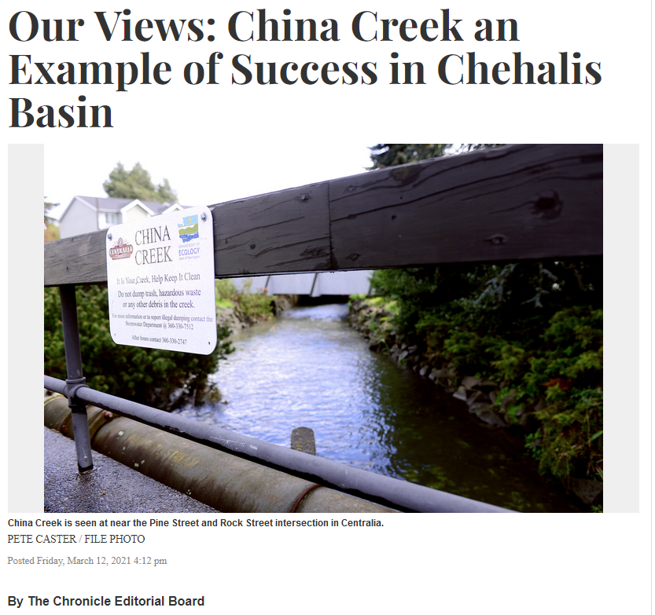
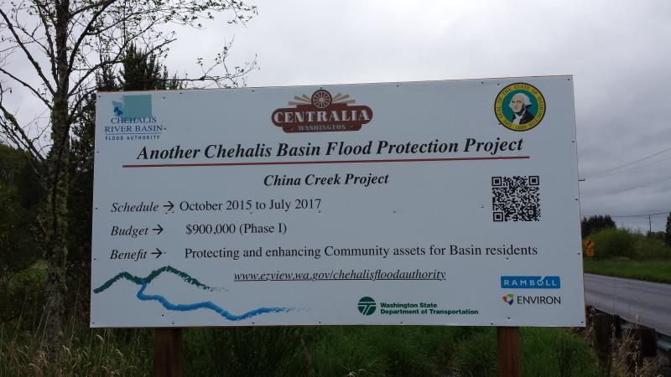
COMPLETED – China Creek
Local Projects (Centralia)
June 28, 2021
March 12, 2021

Slide 10
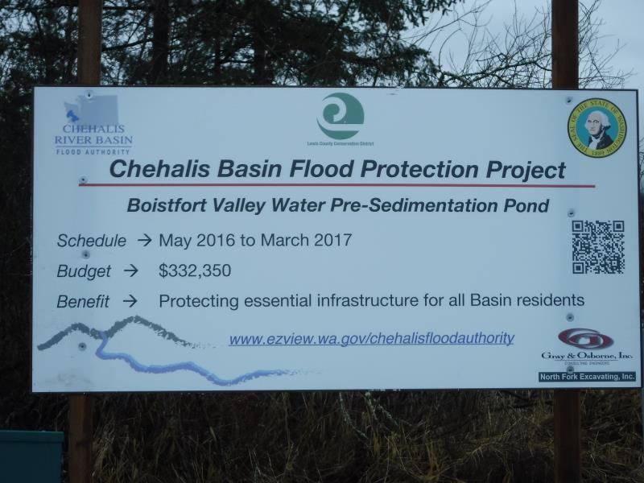
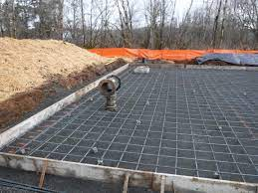
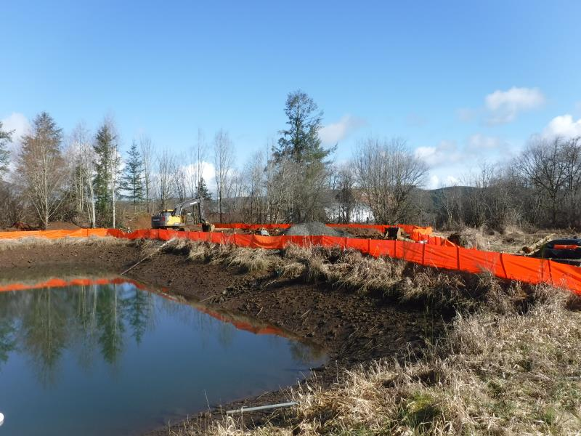
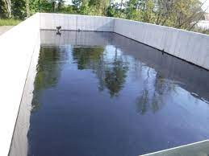
COMPLETED – Boistfort Valley Water Pre-Sedimentation Pond
Local Projects (Boistfort Valley)

Slide 11
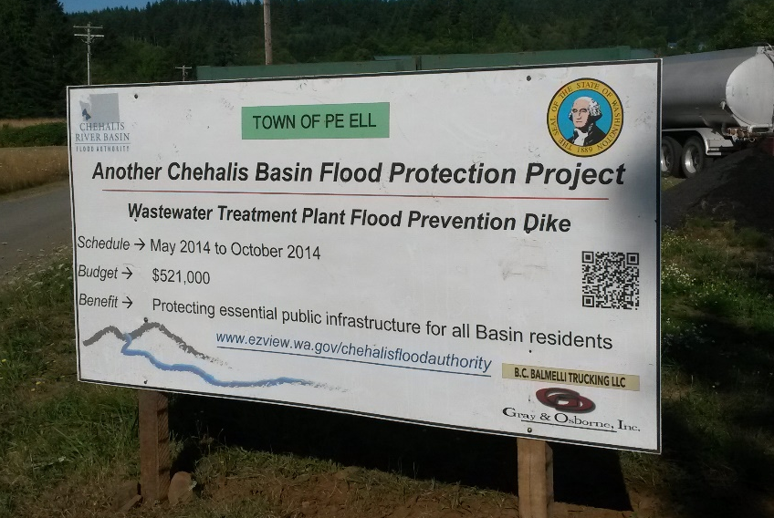
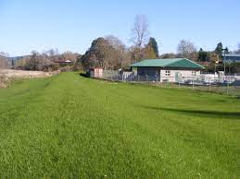
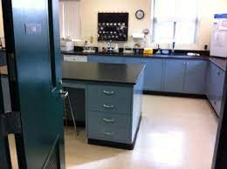
COMPLETED (2014) – WWTP Flood Prevention Dike Project
Local Projects (Pe Ell)
Project = Design/construct 900’ dike (between Chehalis r. and WWTP).
Cost = $521,000.
Photos = https://www.ezview.wa.gov/site/alias__1492/35040/default.aspx#peell.
Website = https://www.ezview.wa.gov/site/alias__1782/34858/overview.aspx

Slide 12
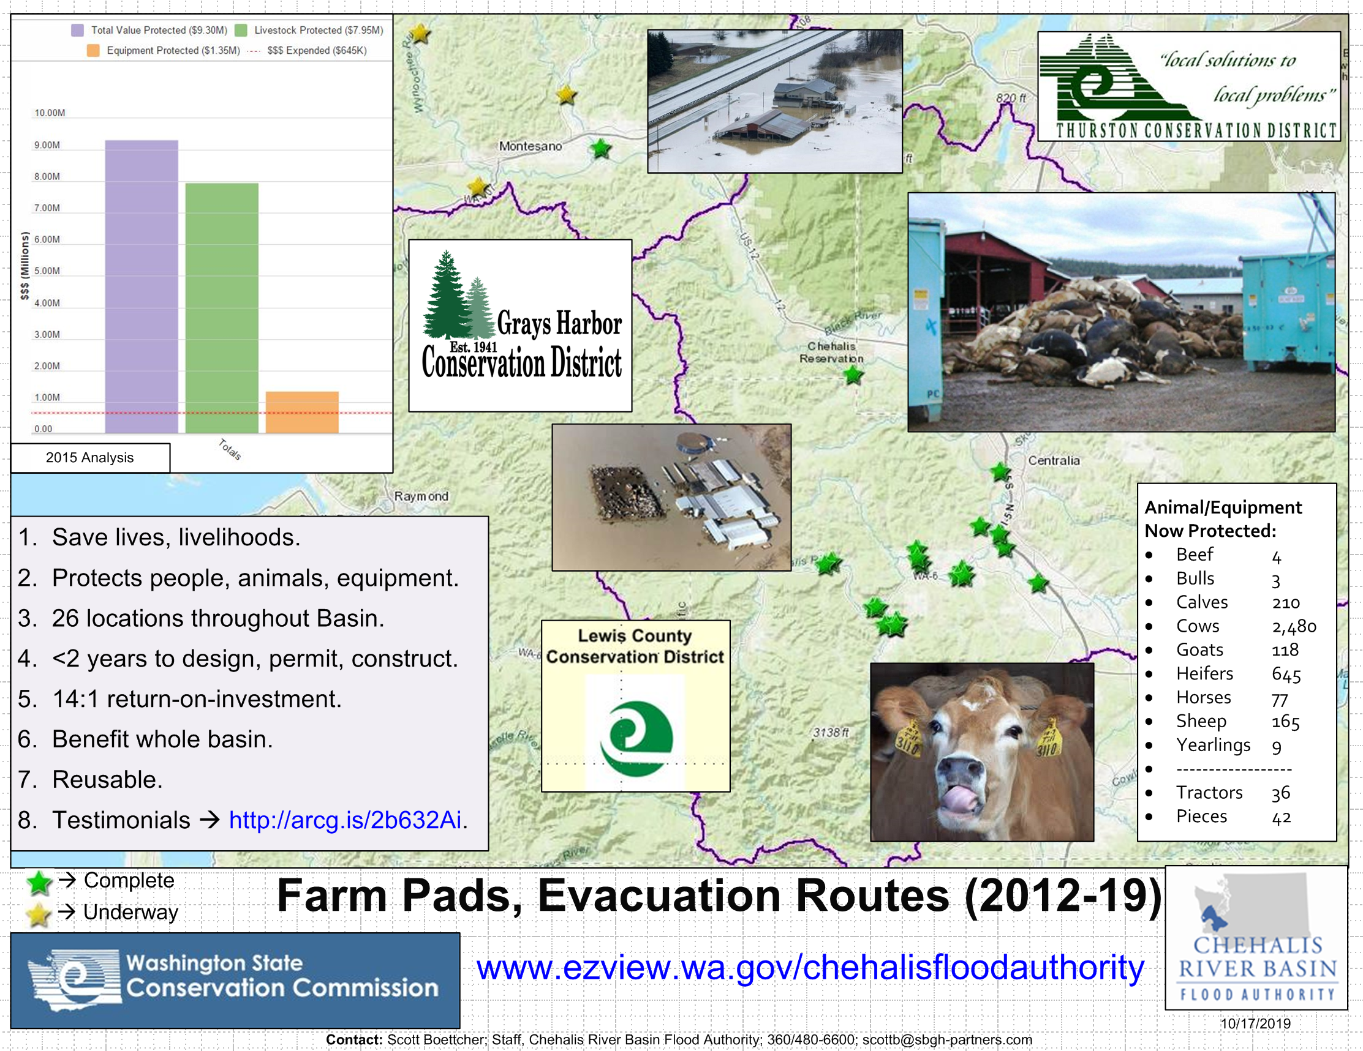
COMPLETED – Farm Pads (Lewis and Grays Harbor counties)
Local Projects (Farm Pads)
January 2022 Flood Event (Bob Amrine, Lewis CD):
Farm pads worked for those who used their pads (animals did not drown like in 2007 and
equipment was saved).
Farmers were grateful that their livelihoods could continue, and their animals were out of
harm’s way (though in some cases they wish they had larger pads for more equipment).

Slide 13

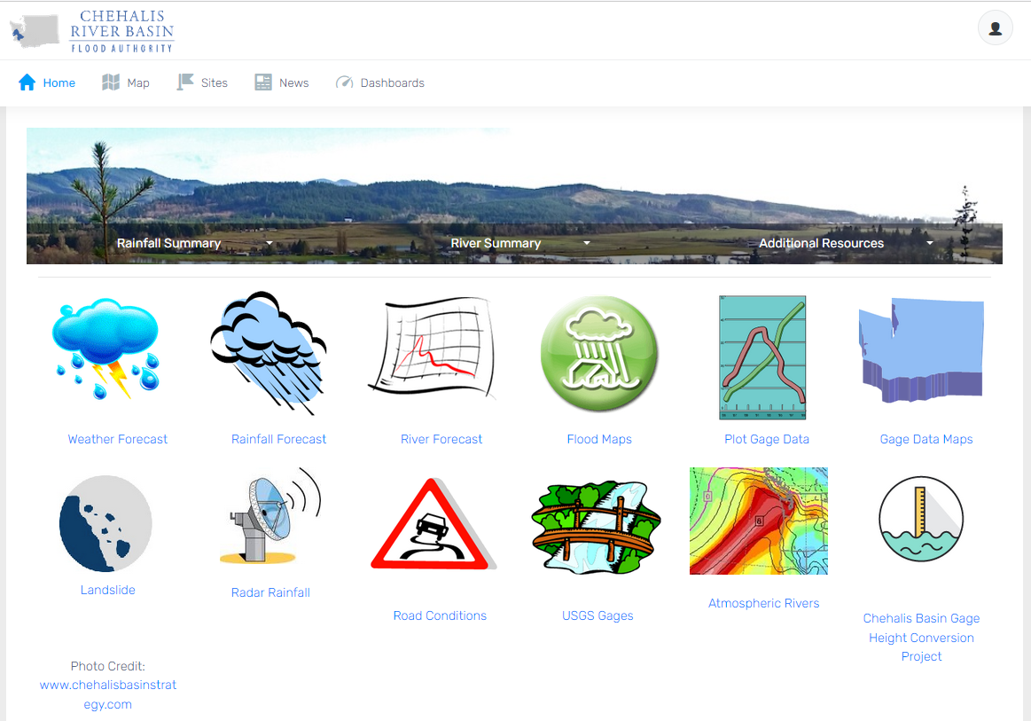
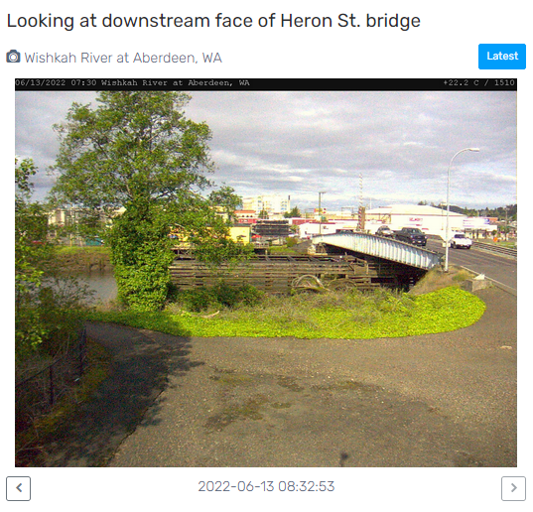
Click icon to sign-up for email gage alerts.
Flood Warning System (#2)
www.chehalisriverflood.com
Developed with State Capital Budget $.
Maintained with local $.

Slide 14

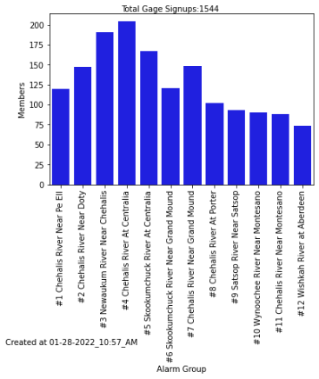
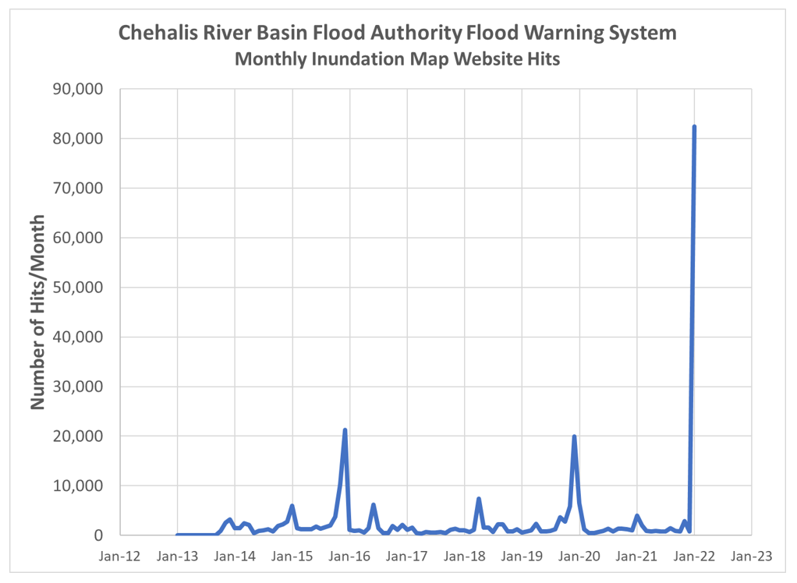
Click icon to sign-up for email gage alerts.
Flood Warning System (2022 Flood Event)
Flood Warning System Works!
Dave Curtis, West Consultants, 2/01/2022
Survey Respondent, 2/01/2022

Slide 15
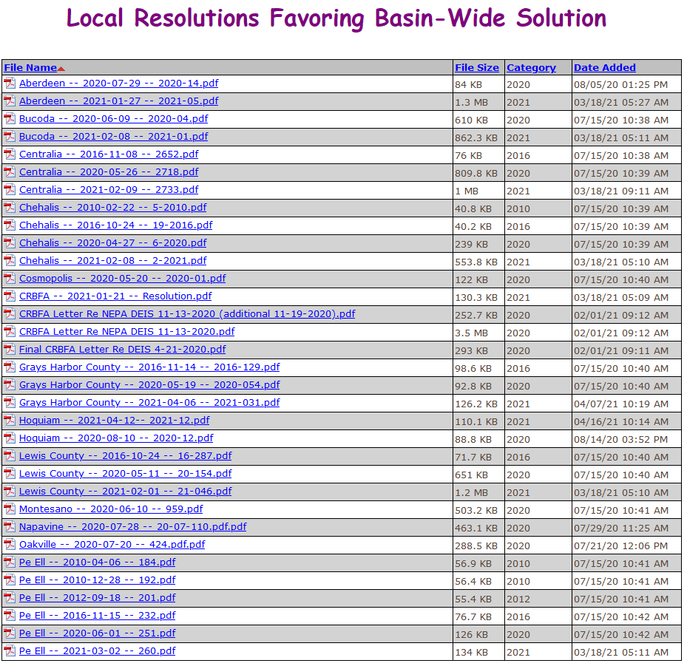
Flood Authority Role (#3)
Help local communities identify, develop, implement local flood hazard solutions.
Appoint 3 of 7 members to Chehalis Basin Board (current appointees are Vickie Raines, Edna Fund, Jay Gordon).
Provide local perspective to Basin-Wide solution discussions.
Advocate for balanced basin-wide fish and flood solutions (see local resolutions library here).
Work as a team.

Slide 16







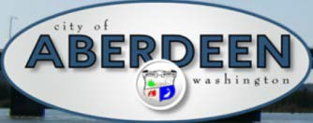
















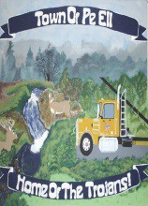


Office of Chehalis Basin, Chehalis Basin Strategy
Office of Chehalis Basin | Chehalis Basin Board
https://chehalisbasinstrategy.com/

Slide 17
Looking Ahead
Proposed Flood Retention Facility – DRAFT EISs were issued February 2020 (SEPA) and September 2020 (NEPA). Chehalis River Basin Flood Control Zone District (project proponent) working diligently to provide refinements and clarifications for FINAL EIS. Final EISs are currently scheduled for release in late 2022/early 2023.
Local Projects – 2023-25 call for local projects issued June 30, 2022 (due 8/03/2022).
  https://www.ezview.wa.gov/site/alias__1492/37773/2023-25-local-projects-recruitment-process.aspx
Sign-Up For Email Gage Alerts – www.chehalisriverflood.com
Click icon to sign-up for email gage alerts.

Slide 18
Key Contacts
Vickie Raines, Grays Harbor County Representative
Chair, Chehalis River Basin Flood Authority
Chair, Chehalis Basin Board
360/249-3731
vraines@co.grays-harbor.wa.us
Edna Fund, Lewis County Representative
Vice-Chair, Chehalis River Basin Flood Authority
Member, Chehalis Basin Board
360/269-7514
dutch@localaccess.com
Tony Ketchum, Chehalis Representative
Member, Chehalis River Basin Flood Authority
360/269-2818
tketchum@ci.chehalis.wa.us
Scott Boettcher
Staff, Chehalis River Basin Flood Authority
360/480-6600
scottb@sbgh-partners.com

Slide 19
Thank You!
This Presentation:
Available at “Chehalis River Basin Flood Authority” Website at https://www.ezview.wa.gov/site/alias__1492/34490/outreach__education.aspx
Email Distribution Lists:
Megan Sathre (Flood Authority) megan.sathre@lewiscountywa.gov Cindy Bradley (Office of Chehalis Basin) Cindy.Bradley@ecy.wa.gov

Slide 20
Also -- Key Links
Key Organizations:
Chehalis River Basin Flood Authority -- www.ezview.wa.gov/chehalisfloodauthority
Office of Chehalis Basin -- https://ecology.wa.gov/About-us/Get-to-know-us/Our-Programs/Office-of-Chehalis-Basin
Chehalis Basin Board -- https://www.ezview.wa.gov/site/alias__1962/37068/chehalis_basin_board.aspx
Key Activity Areas:
Local Projects -- https://www.ezview.wa.gov/site/alias__1492/34489/local_projects.aspx
Flood Warning System -- www.chehalisriverflood.com
Chehalis Basin Strategy -- www.chehalisbasinstrategy.com
  ASRP -- https://chehalisbasinstrategy.com/asrp/
  CFAR -- https://chehalisbasinstrategy.com/cfar/
  Proposed Retention Project -- https://chehalisbasinstrategy.com/proposed-project/
    Chehalis River Basin Flood Control Zone District -- https://www.chehalisriverbasinfczd.com/
    State EIS (SEPA) -- https://chehalisbasinstrategy.com/sepa-process/
    Federal EIS (NEPA) -- https://chehalisbasinstrategy.com/federal-envl-review/
    Flood Retention Facility (visualization) -- https://www.youtube.com/watch?app=desktop&v=cKTejUE3WsU
  Skookumchuck Dam -- https://chehalisbasinstrategy.com/skookumchuck-dam-study/
  LAND -- https://chehalisbasinstrategy.com/local-actions-non-dam-alternative/
Also → Sign-Up for Email Gage Alerts – https://chehalis.onerain.com/upload/files/6a9bf8e2-f04b-4165-8a9f-ce031d5db6b4.pdf

Slide 21
Also -- Background
Ranked high flow events (1932 - 2012) . . .
❑ I-5 closed 1990, 1996, 2007, 2009.
  Five largest events since 1986 -- Frequent floods are getting worse and damage is increasing . . .
  100 year flood estimate -- Increased by 33% in last 30 years.
90000
Chehalis River Flow Rates near Grand Mound (cubic ft./sec.) ₂
1
80000
3
70000
60000
4
5
50000
9
7
6
10
8
13
13
11
16
12
14
40000
30000
20000
10000
0

Slide 22
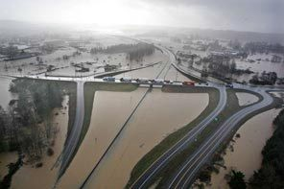
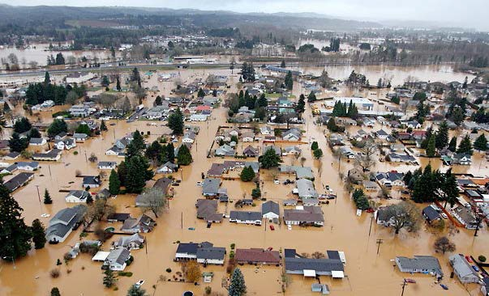
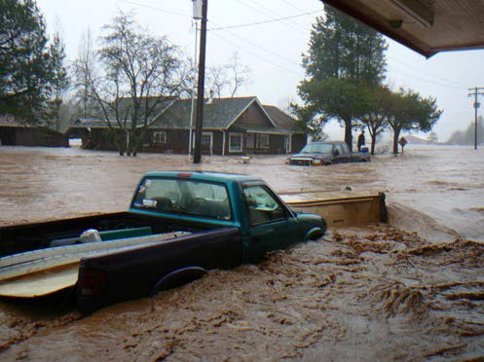
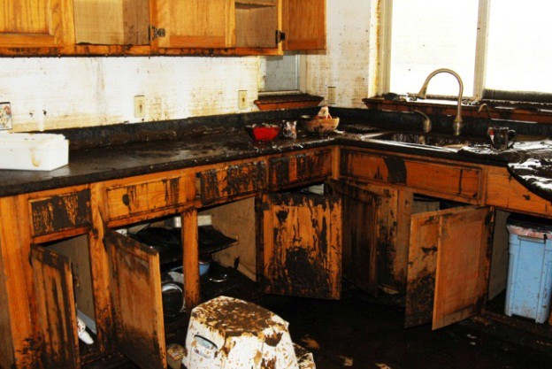
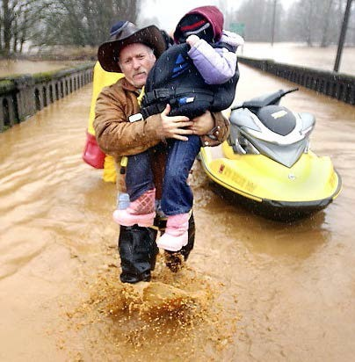
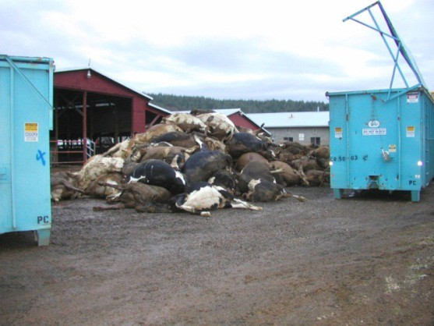

Also -- Background
2007 Storm -- $938M Basin-wide damage, $300M lost economic activity (WA).
Exit 77 (I-5) in Chehalis
STEVE RINGMAN / SEATTLE TIMES
City of Centralia
STEVE RINGMAN / SEATTLE TIMES
State Route 6, West of Adna MIKE SALSBURY / AP
Photos Source: LEWIS COUNTY, DIVISION OF EMERGENCY
MANAGEMENT

