Slide 1


Chehalis River Basin Flood Authority
Reducing Flood Damage and
Restoring Aquatic Species
City of Cosmopolis
September 21, 2022
Scott Boettcher
Staff, Chehalis River Basin Flood Authority
360/480-6600⏐scottb@sbgh-partners.com

Slide 2




Today’s Presentation
Describe the “Flood Authority”
  #1 -- Local Projects
  #2 -- Flood Warning System
  #3 – Role
Touch on “Office of Chehalis Basin” and “Chehalis Basin Strategy”
Allow time for discussion
State Law
“The primary purpose of the office is to aggressively pursue implementation of an integrated strategy and administer funding for long-term flood damage reduction and aquatic species restoration in the Chehalis river basin.” (RCW 43.21A.730)
Office of Chehalis Basin | Chehalis Basin Board
https://chehalisbasinstrategy.com/
.

Slide 3
Chehalis River Basin Flood Authority
Formed in 2008
Focused on flood hazard mitigation
Decision-making
  informed by science
  protective of Basin residents/communities
  environmentally appropriate
Jurisdictions represented (see inter-local agreement)
Grays Harbor County (2008)
  City of Aberdeen (2008)
  City of Cosmopolis (2011)
  City of Hoquiam (2017)
  City of Montesano (2008)
  City of Oakville (2008)
Lewis County (2008)
  City of Centralia (2008)
  City of Chehalis (2008)
  City of Napavine (2011)
  Town of Pe Ell (2008)
Thurston County (2008)
  Town of Bucoda (2008)

Slide 4
Local Projects (#1)
Reduce flood damage.
Protect people, property, infrastructure.
Improve readiness, response, resiliency.
  Drinking Water (Boistfort, Bucoda).
  Wastewater (Montesano, Pe Ell).
  Emergency Response (Grays Harbor County, Chehalis-Centralia Airport).
  Regional Economic Infrastructure (Montesano, Port of Chehalis, Port of Grays Harbor).
  Community Protection (Aberdeen, Adna, Bucoda, Centralia, Chehalis, Chehalis Tribe, Cosmopolis, Hoquiam, Oakville).
  Flood Warning (Basin-wide).
State Capital Budget:
2012-13 -- $ 5.0M
2013-15 -- $10.7M
2015-17 -- $15.7M
2017-19 -- $ 9.6M
2019-21 -- $ 6.3M
2021-23 -- $ 4.1M
$51.4M

Slide 5
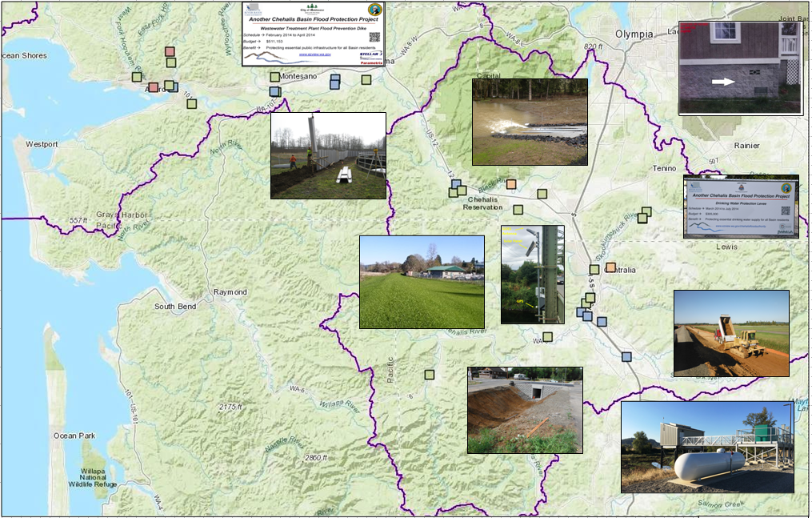
Local Projects (Completed 2012-23)
Cost: $694,152 (average)
Timeframe: 647 days (average)
Sequence:
1st = “Plan/Study/Design” project (24 completed)
2nd = “Construction” project (27 completed)

Slide 6
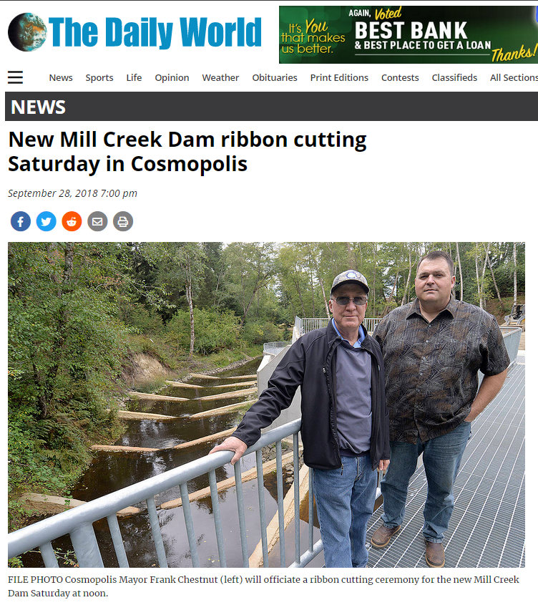
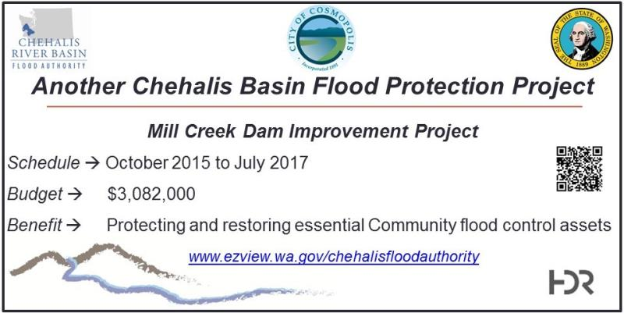
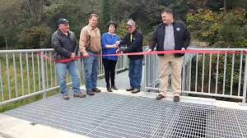
COMPLETED FLOOD AND FISH – Mill Creek Dam
Local Projects (Cosmopolis)
Mill Creek Multi-Objective Implementation Plan:
Part I = Reconstruct Mill Creek Dam (done).
Phase II project = Address 4,500’ of Mill Creek flow, culverts, and flood water evacuation (under development).
City of Cosmopolis, Sep 29, 2018
https://www.thedailyworld.com/news/new-mill-creek-dam-ribbon-cutting-saturday-in-cosmopolis/

Slide 7
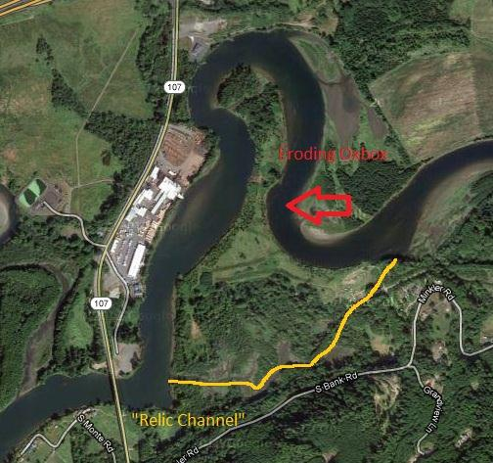
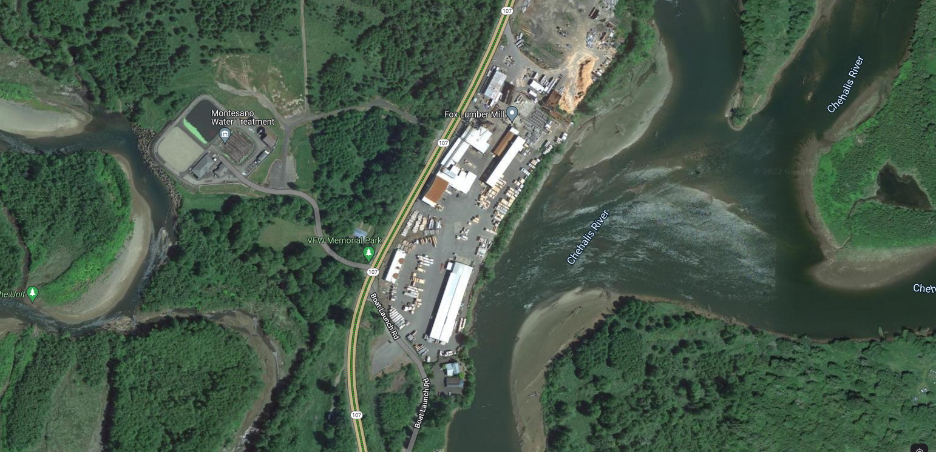
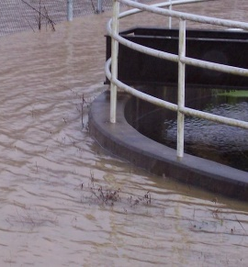
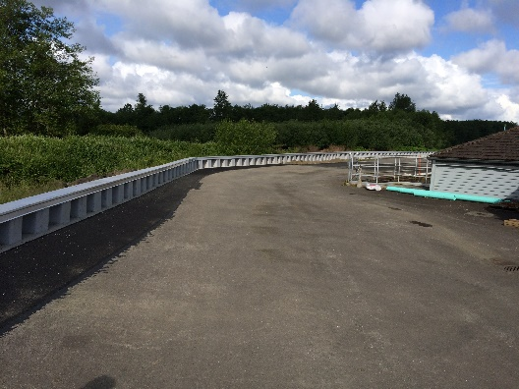
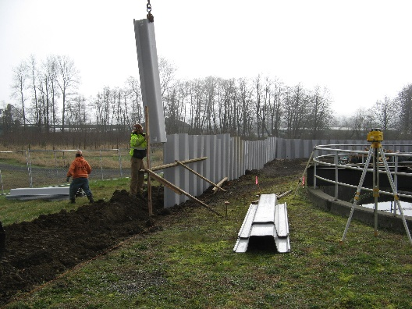
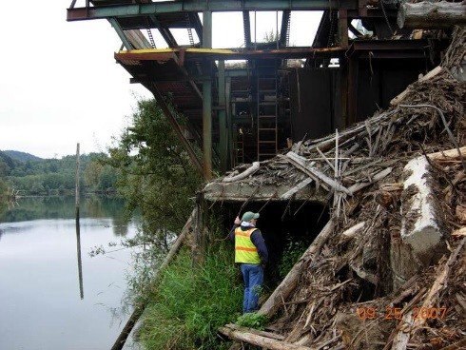
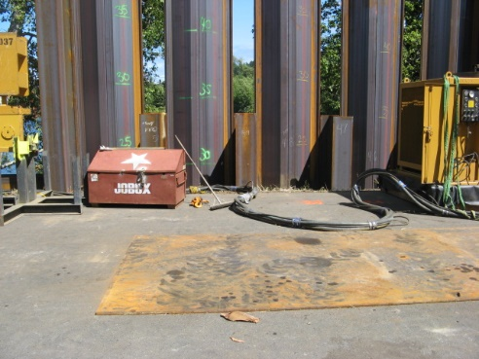
COMPLETED FLOOD – Mary’s River Lumber and Montesano WWTP Chehalis River Protection Projects (2012-15)
Local Projects (Montesano)
2007
2022
2014
2014
2014
~$6M protection against Chehalis River
Funding pooled/shared.
2014
2014

Slide 8
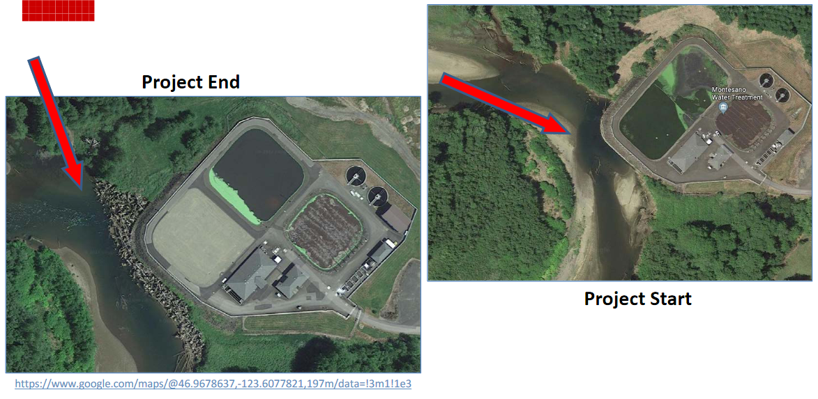
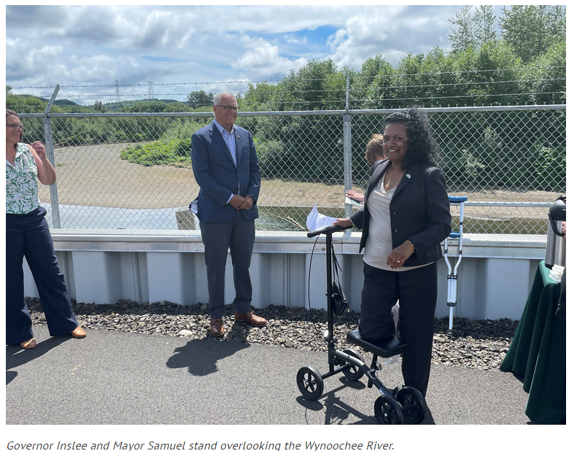
COMPLETED FLOOD AND FISH – Montesano WWTP Protection Project (2017-2020)
Local Projects (Montesano)
Protect WWTP from on-coming Wynoochee river using 220+ “log-jacks.”
$2 million (for “log-jacks”).
Small cost compared to WWTP relocation and environmental cleanup (in event of WWTP breaching).
July 7, 2022 →

Slide 9
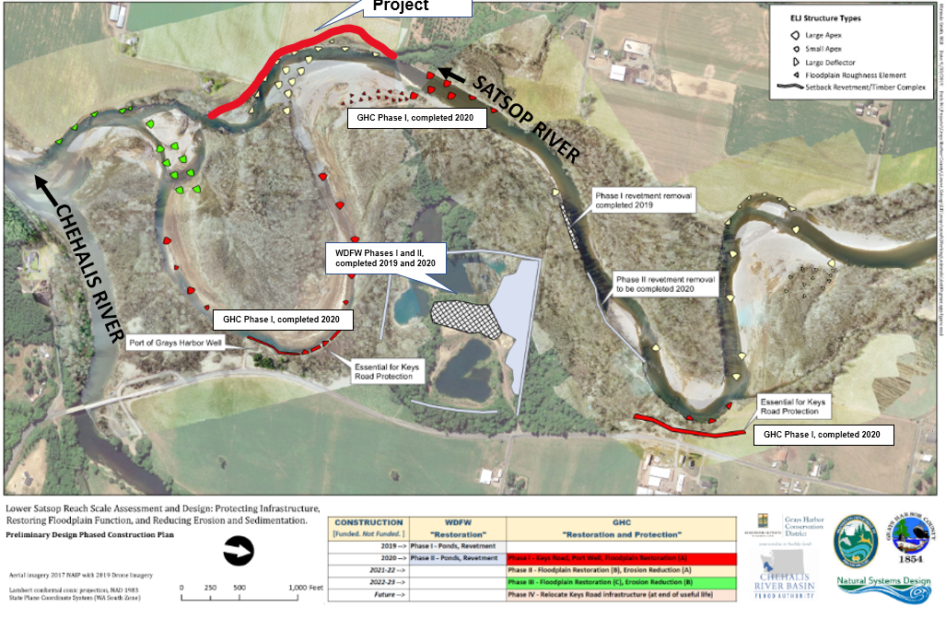
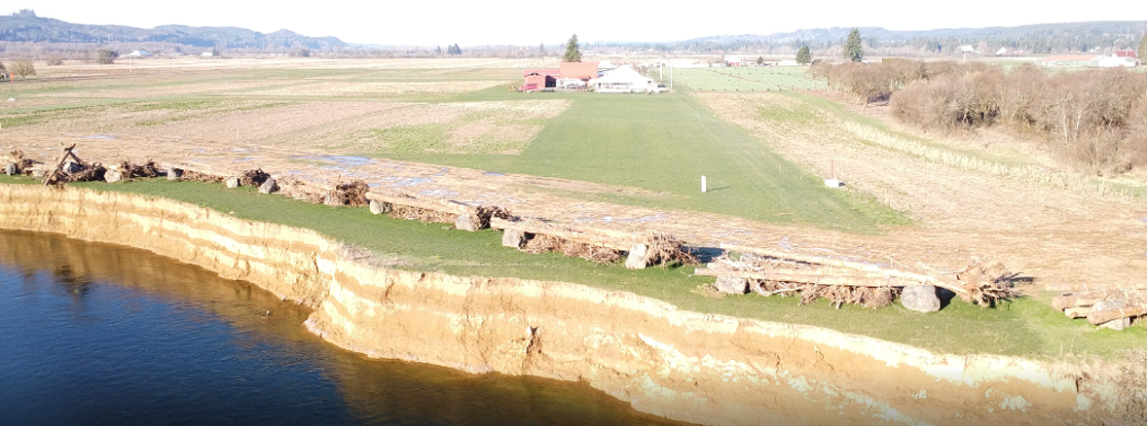
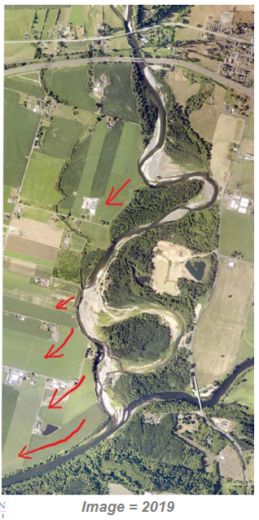
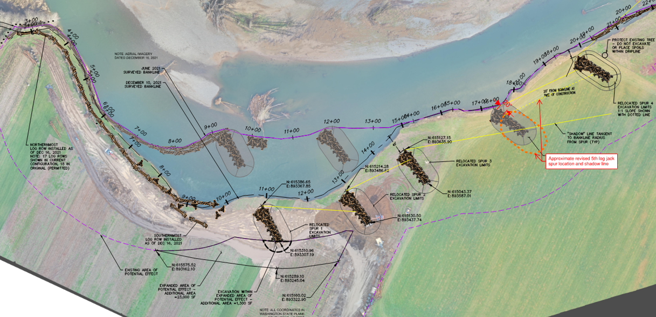
Local Projects (Grays Harbor County, Grays Harbor Conservation District, WDFW)
COMPLETED FLOOD AND FISH –
2022 Right Bank Conservation Project (Phase IB)
2020 Keys Road Infrastructure Protection (Phase IA)
2019-20 WDFW Ponds

Slide 10
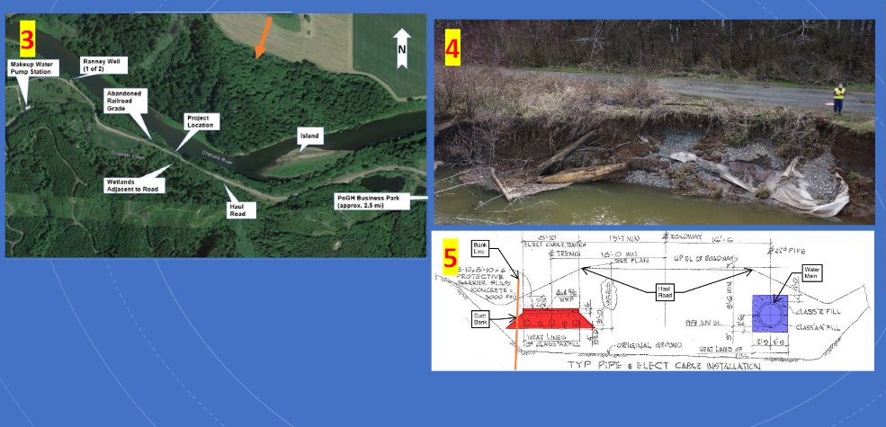
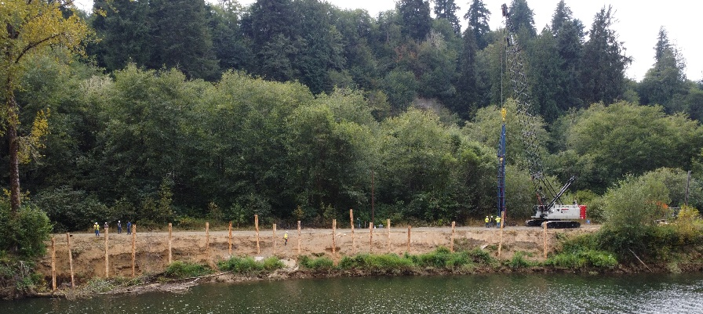
UNDERWAY FLOOD AND FISH – “Haul Road” Emergency Repair (2022)
Local Projects (Port of Grays Harbor)
← 9/14/2022

Slide 11
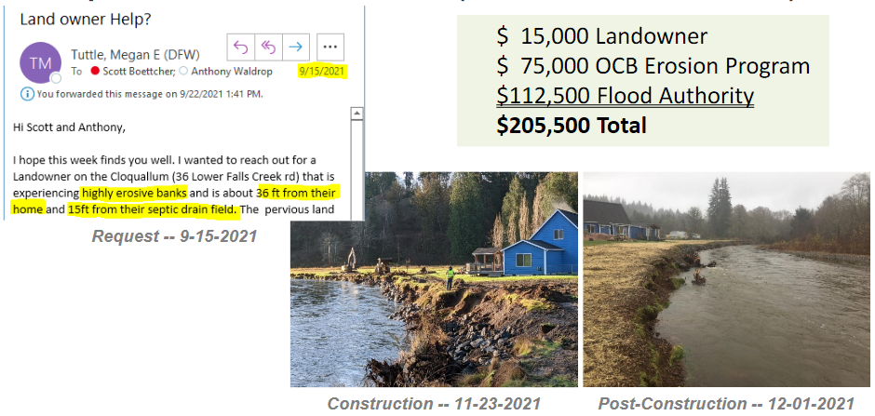
COMPLETED FLOOD AND FISH – Cloquallam Creek Erosion Pilot (36 Lower Falls Creek Rd)
Local Projects (Grays Harbor Conservation District)
Highly-collaborative emergency project to protect property and septic drain field
Property and drain field saved, environmental contamination and clean-up avoided.

Slide 12
COMPLETED FLOOD – Chehalis-Centralia Airport
Local Projects (Chehalis)
Return on investment from protected jobs and revenue during Jan. 2022 flooding:
New Pump -- 2017
January 2022
New Pump Cost = $1.1M
Widening Levee = $1.2M
ROI = Substantial:
  Jobs: 1,658
  Labor income: $68 million
  Value added: $115.3 million
  Business revenues: $186.4 million
  Annual tax revenues (local, state): ~$9M
1/2022 High-water event = Airport stayed operational
Old Pump – 1940s
Widening/Repairing Levee – 2014

Slide 13
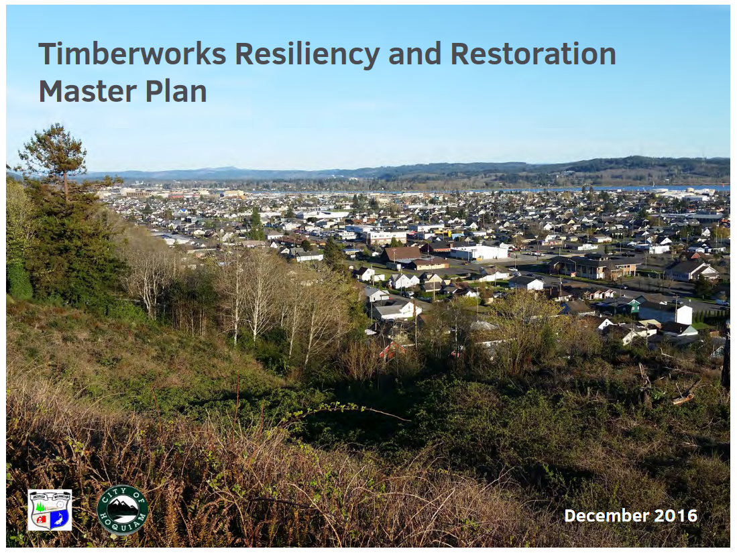
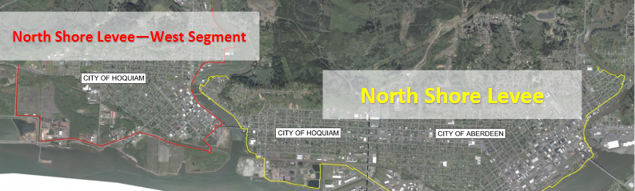
UNDERWAY FLOOD – North Shore Levee and West Segment
Local Projects (Aberdeen, Hoquiam)
COMPLETED 2016 – Timberworks (precursor to currently underway North Shore Levee for Aberdeen and Hoquiam)
← 9/14/2022

Slide 14
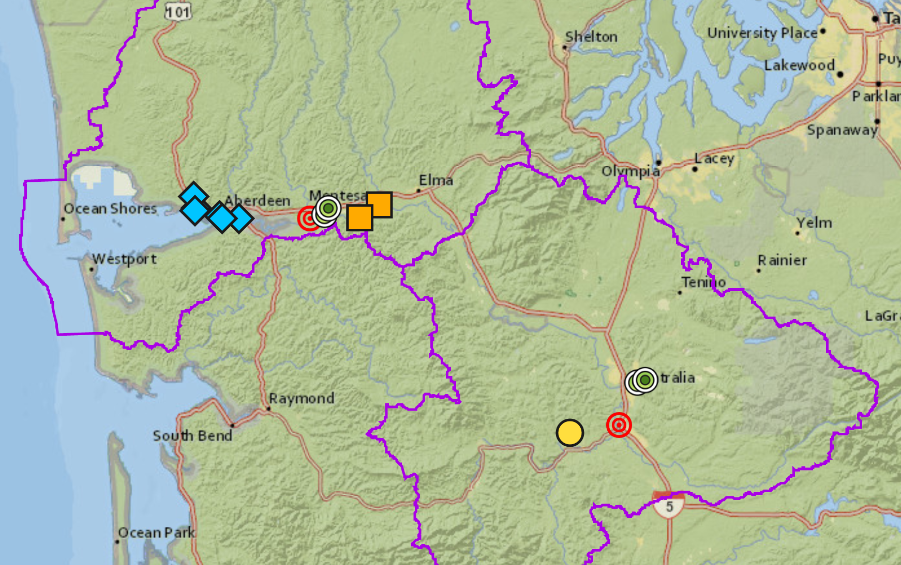
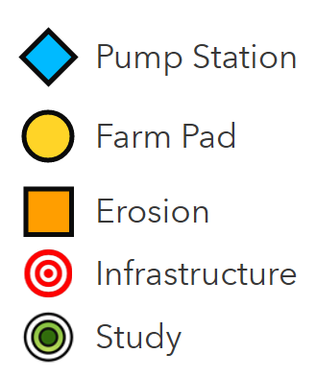

15 Proposed Projects, $25,971,170
Local Projects Under Evaluation For 2023-25
View interactive map
https://arcg.is/0rOj450

Slide 15

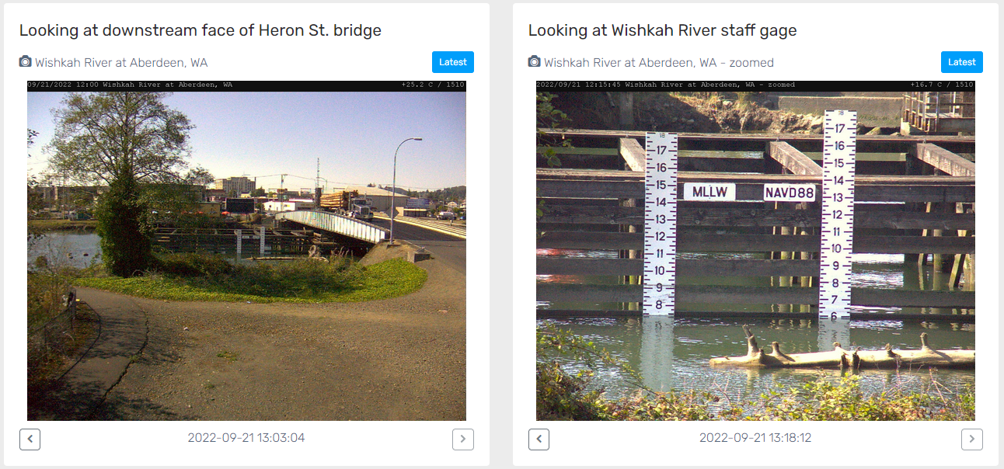
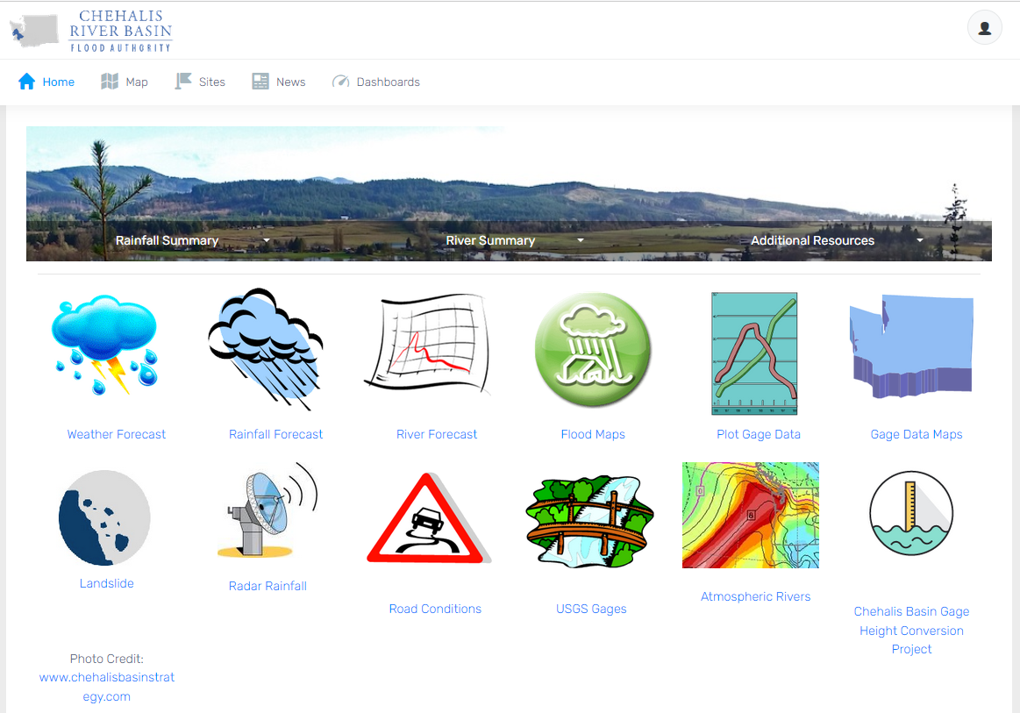
Click icon to sign-up for email gage alerts.
Flood Warning System (#2)
www.chehalisriverflood.com
Developed with State Capital Budget $.
Maintained with local $.

Slide 16

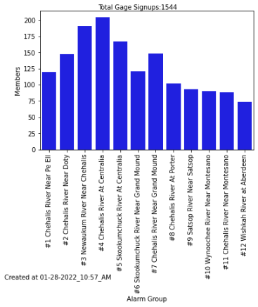
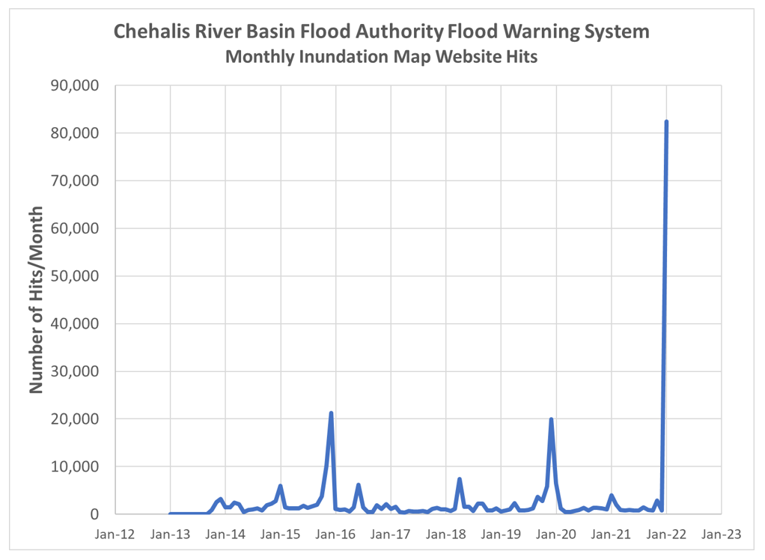
Click icon to sign-up for email gage alerts.
Flood Warning System (2022 Flood Event)
Flood Warning System Works!
Dave Curtis, West Consultants, 2/01/2022
Survey Respondent, 2/01/2022

Slide 17
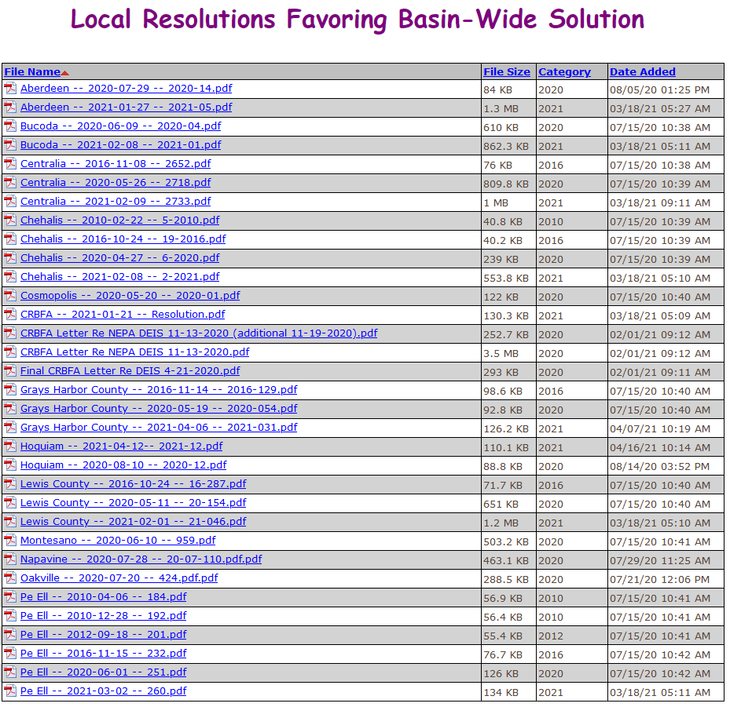
Flood Authority Role (#3)
Help local communities identify, develop, implement local flood hazard solutions.
Appoint 3 of 7 members to Chehalis Basin Board (current appointees are Vickie Raines, Edna Fund, Jay Gordon).
Provide local perspective to Basin-Wide solution discussions.
Advocate for balanced basin-wide fish and flood solutions (see local resolutions library here).
Work as a team.

Slide 18
Chehalis Basin Strategy
appoints 3 member
Chehalis Basin Board
Community leaders, Chehalis and Quinault tribal representatives, local and state government liaisons
Office of Chehalis Basin | Chehalis Basin Board
https://chehalisbasinstrategy.com/
Office of Chehalis Basin
Small team within the WA Department of Ecology
“Network of Partners”
Organizations and local entities who turn ideas into shovel-ready reality

Slide 19







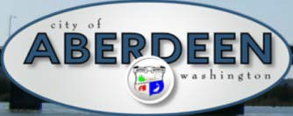
















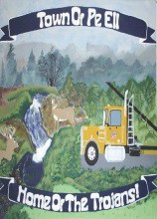


Chehalis Basin Strategy
“Network of Partners”
Office of Chehalis Basin | Chehalis Basin Board
https://chehalisbasinstrategy.com/

Slide 20
Looking Ahead
Proposed Flood Retention Facility – DRAFT EISs were issued February 2020 (SEPA) and September 2020 (NEPA). Chehalis River Basin Flood Control Zone District (project proponent) working diligently to provide refinements and clarifications for FINAL EIS. Final EISs are currently scheduled for release in late 2022/early 2023.
Local Projects – 2023-25 call for local projects issued June 30, 2022. Evaluation underway now.
Sign-Up For Email Gage Alerts – www.chehalisriverflood.com
Click icon to sign-up for email gage alerts.

Slide 21
Key Contacts
Vickie Raines, Grays Harbor County Representative
Chair, Chehalis River Basin Flood Authority
Chair, Chehalis Basin Board
360/249-3731
vraines@co.grays-harbor.wa.us
Edna Fund, Lewis County Representative
Vice-Chair, Chehalis River Basin Flood Authority
Member, Chehalis Basin Board
360/269-7514
dutch@localaccess.com
Darrin Raines, Cosmopolis Representative
Member, Chehalis River Basin Flood Authority
360/532-9230
draines@cosmopoliswa.gov
Scott Boettcher
Staff, Chehalis River Basin Flood Authority
360/480-6600
scottb@sbgh-partners.com

Slide 22
Thank You!
This Presentation:
Available at “Chehalis River Basin Flood Authority” Website at https://www.ezview.wa.gov/site/alias__1492/34490/outreach__education.aspx
Email Distribution Lists:
Megan Sathre (Flood Authority) megan.sathre@lewiscountywa.gov Cindy Bradley (Office of Chehalis Basin) Cindy.Bradley@ecy.wa.gov

Slide 23
Also -- Key Links
Key Organizations:
Chehalis River Basin Flood Authority -- www.ezview.wa.gov/chehalisfloodauthority
Office of Chehalis Basin -- https://ecology.wa.gov/About-us/Get-to-know-us/Our-Programs/Office-of-Chehalis-Basin
Chehalis Basin Board -- https://www.ezview.wa.gov/site/alias__1962/37068/chehalis_basin_board.aspx
Key Activity Areas:
Local Projects -- https://www.ezview.wa.gov/site/alias__1492/34489/local_projects.aspx
Flood Warning System -- www.chehalisriverflood.com
Chehalis Basin Strategy -- www.chehalisbasinstrategy.com
  ASRP -- https://chehalisbasinstrategy.com/asrp/
  CFAR -- https://chehalisbasinstrategy.com/cfar/
  Proposed Retention Project -- https://chehalisbasinstrategy.com/proposed-project/
    Chehalis River Basin Flood Control Zone District -- https://www.chehalisriverbasinfczd.com/
    State EIS (SEPA) -- https://chehalisbasinstrategy.com/sepa-process/
    Federal EIS (NEPA) -- https://chehalisbasinstrategy.com/federal-envl-review/
    Flood Retention Facility (visualization) -- https://www.youtube.com/watch?app=desktop&v=cKTejUE3WsU
  Skookumchuck Dam -- https://chehalisbasinstrategy.com/skookumchuck-dam-study/
  LAND -- https://chehalisbasinstrategy.com/local-actions-non-dam-alternative/
Also → Sign-Up for Email Gage Alerts – https://chehalis.onerain.com/upload/files/6a9bf8e2-f04b-4165-8a9f-ce031d5db6b4.pdf

Slide 24
Also -- Background
Ranked high flow events (1932 - 2012) . . .
❑ I-5 closed 1990, 1996, 2007, 2009.
  Five largest events since 1986 -- Frequent floods are getting worse and damage is increasing . . .
  100 year flood estimate -- Increased by 33% in last 30 years.
90000
Chehalis River Flow Rates near Grand Mound (cubic ft./sec.) ₂
1
80000
3
70000
60000
4
5
50000
9
7
6
10
8
13
13
11
16
12
14
40000
30000
20000
10000
0

Slide 25
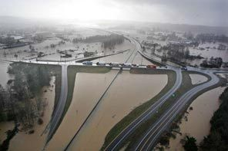
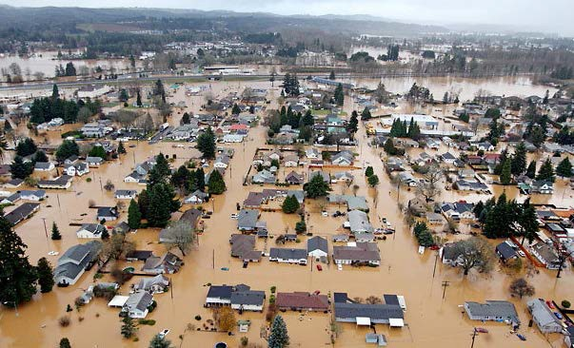
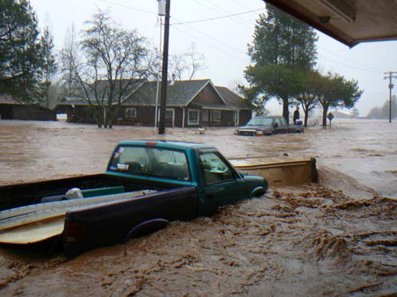
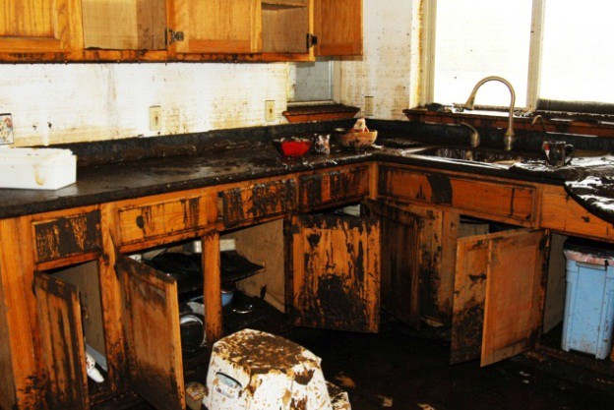
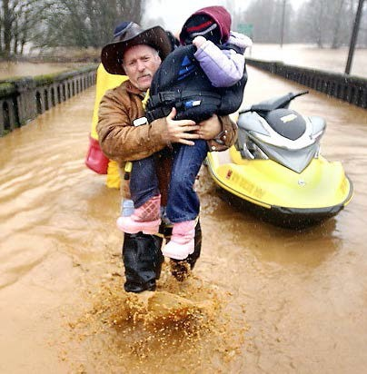
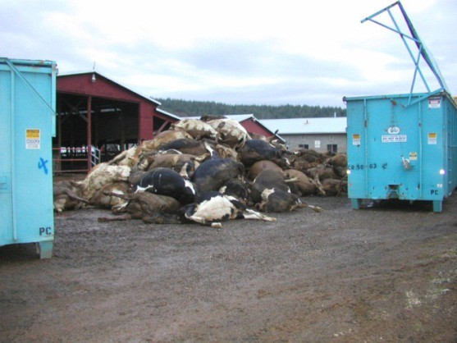

Also -- Background
2007 Storm -- $938M Basin-wide damage, $300M lost economic activity (WA).
Exit 77 (I-5) in Chehalis
STEVE RINGMAN / SEATTLE TIMES
City of Centralia
STEVE RINGMAN / SEATTLE TIMES
State Route 6, West of Adna MIKE SALSBURY / AP
Photos Source: LEWIS COUNTY, DIVISION OF EMERGENCY
MANAGEMENT

