Slide 1


Chehalis River Basin Flood Authority
Reducing Flood Damage and
Restoring Aquatic Species
Grays Harbor County
June 21, 2022
Scott Boettcher
Staff, Chehalis River Basin Flood Authority
360/480-6600⏐scottb@sbgh-partners.com

Slide 2



Today’s Presentation
Describe the “Flood Authority.”
  #1 -- Local Projects
  #2 -- Flood Warning System
  #3 – Role
Touch on “Chehalis Basin Strategy.”
Allow time for discussion.
Office of Chehalis Basin | Chehalis Basin Board
https://chehalisbasinstrategy.com/
.

Slide 3
Chehalis River Basin Flood Authority
Formed in 2008
Focused on flood hazard mitigation
Decision-making
  informed by science
  protective of Basin residents/communities
  environmentally appropriate
Jurisdictions represented (see inter-local agreement)
Grays Harbor County (2008)
  City of Aberdeen (2008)
  City of Cosmopolis(2011)
  City of Hoquiam (2017)
  City of Montesano (2008)
  City of Oakville (2008)
Lewis County (2008)
  City of Centralia (2008)
  City of Chehalis (2008)
  City of Napavine (2011)
  Town of Pe Ell (2008)
Thurston County (2008)
  Town of Bucoda (2008)

Slide 4
Local Projects (#1)
Reduce flood damage.
Protect people, property, infrastructure.
Improve readiness, response, resiliency.
  Drinking Water (Boistfort, Bucoda).
  Wastewater (Montesano, Pe Ell).
  Emergency Response (Grays Harbor County, Chehalis-Centralia Airport).
  Regional Economic Infrastructure (Montesano, Port of Chehalis, Port of Grays Harbor).
  Community Protection (Aberdeen, Adna, Bucoda, Centralia, Chehalis, Chehalis Tribe, Hoquiam, Oakville).
  Flood Warning (Basin-wide).
State Capital Budget:
2012-13 -- $ 5.0M
2013-15 -- $10.7M
2015-17 -- $15.7M
2017-19 -- $ 9.6M
2019-21 -- $ 6.3M
2021-23 -- $ 4.1M
$51.4M

Slide 5
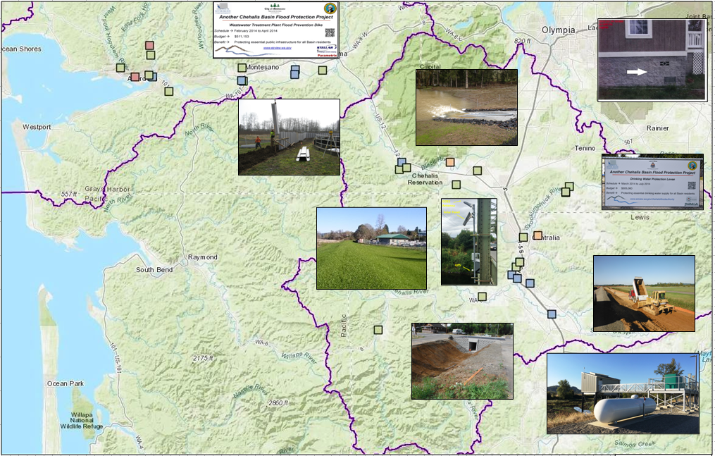
Local Projects (Completed 2012-23)
Cost: $694,152 (average)
Timeframe: 647 days (average)
Sequence:
1st = “Plan/Study/Design” project (24 completed)
2nd = “Construction” project (27 completed)

Slide 6
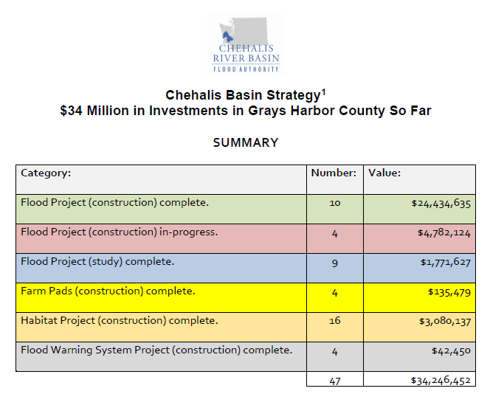
Local Projects (Grays Harbor County)
2020 Analysis

Slide 7
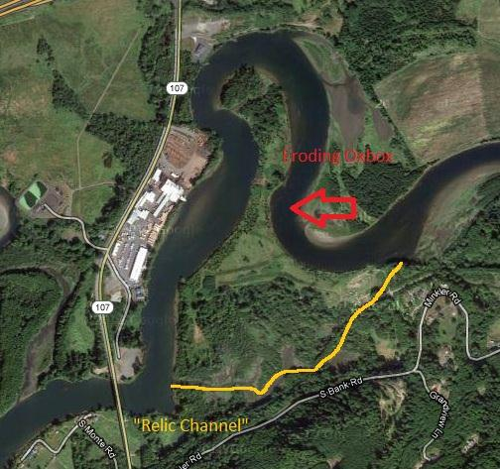
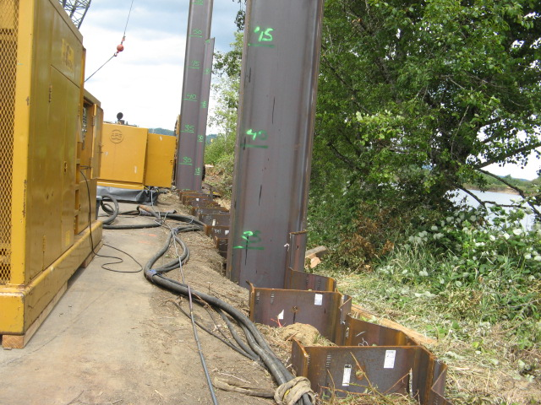
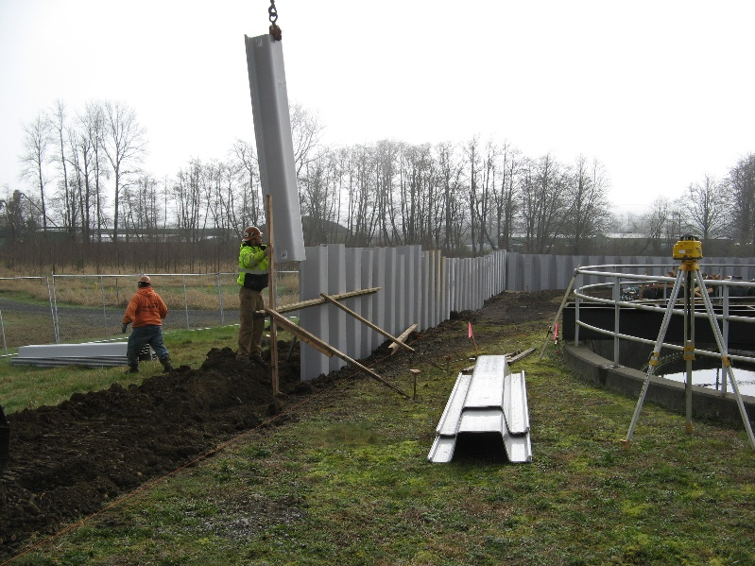
Local Projects (Grays Harbor County)
COMPLETED 2015 – Mary’s River Lumber Industrial Site and Montesano WWTP Protection Project

Slide 8
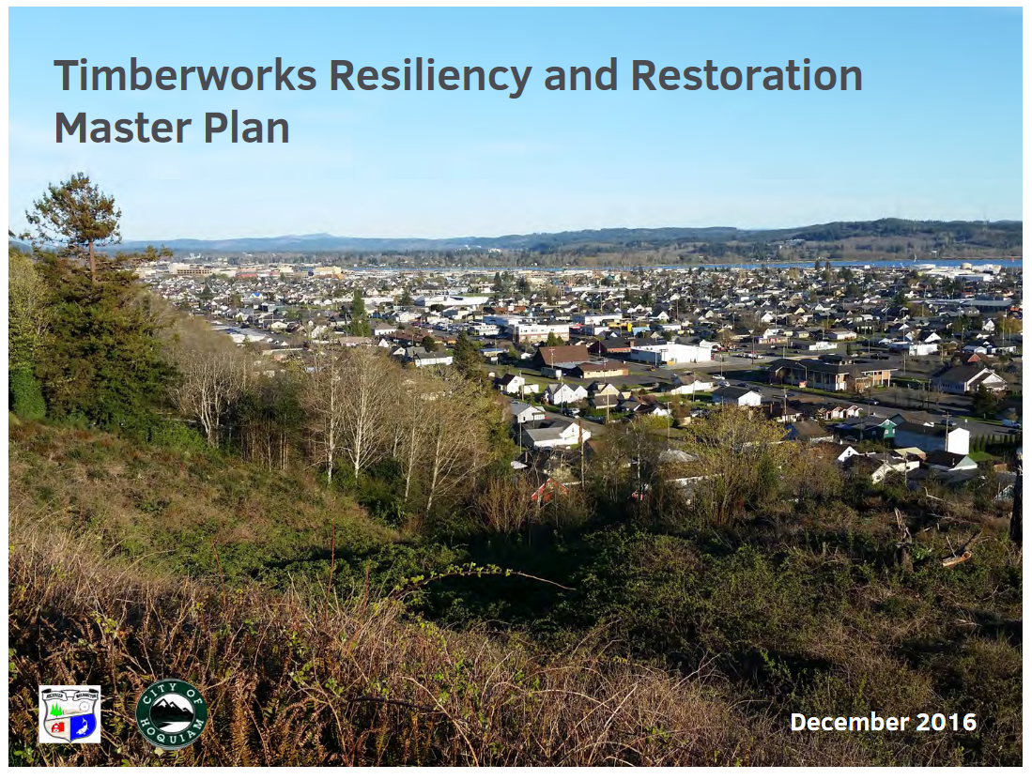
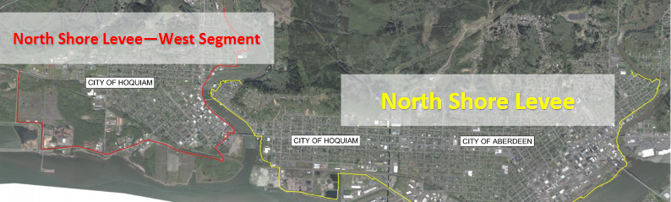
Local Projects (Grays Harbor County)
COMPLETED 2016 – Timberworks (precursor to currently underway North Shore Levee for Aberdeen and Hoquiam)

Slide 9
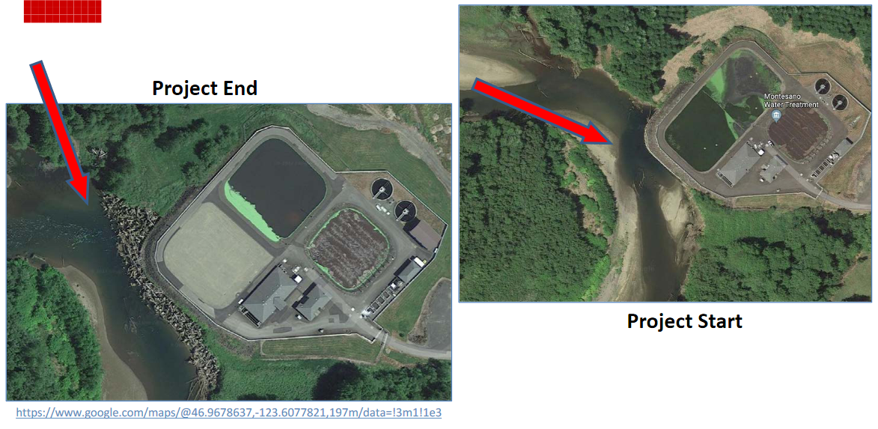
Local Projects (Grays Harbor County)
COMPLETED 2020 – Montesano WWTP Protection Project

Slide 10
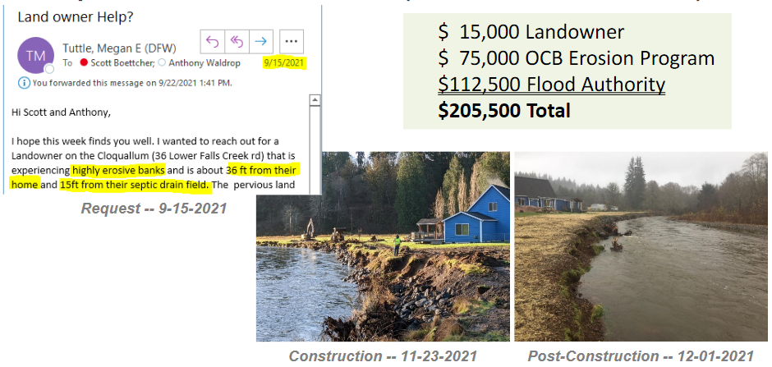
Local Projects (Grays Harbor County)
COMPLETED 2021 – Cloquallam Creek Erosion Pilot (36 Lower Falls Creek Rd)

Slide 11
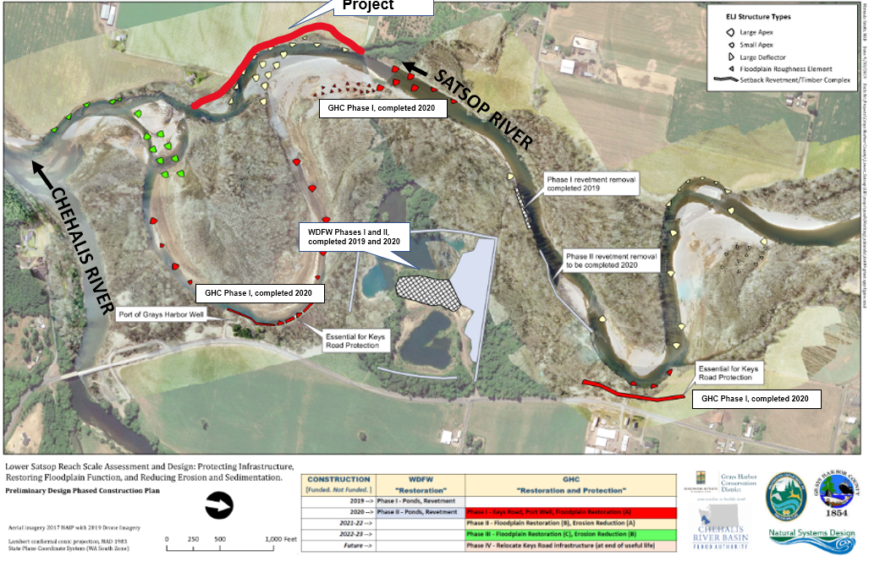
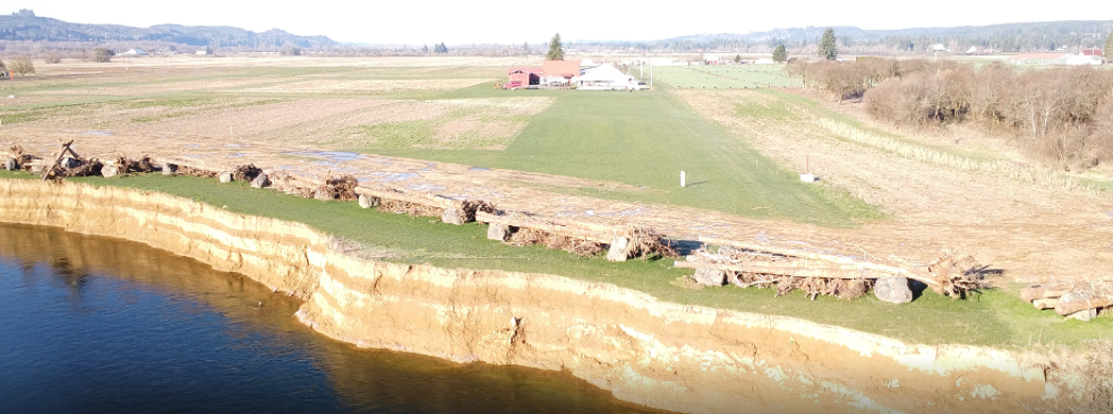
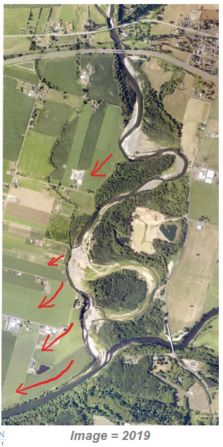
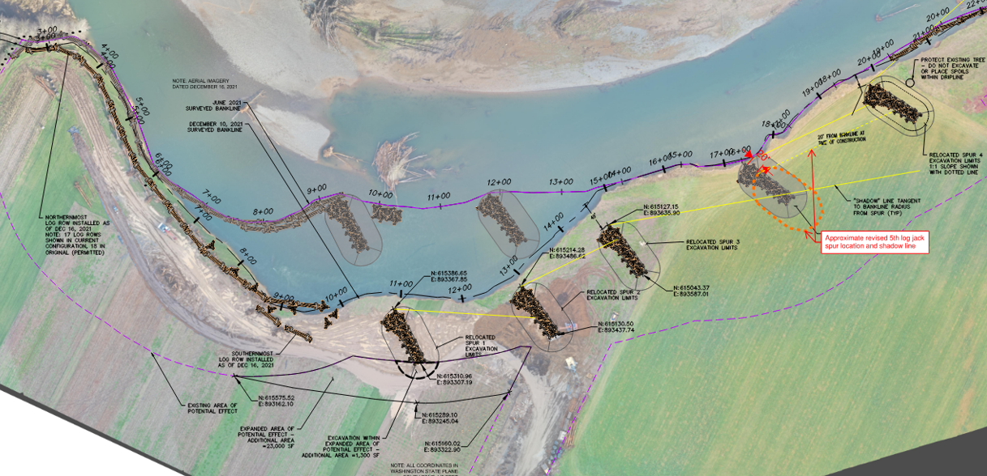
Local Projects (Grays Harbor County)
COMPLETED –
2022 Right Bank Conservation Project (Phase IB)
2020 Keys Road Infrastructure Protection (Phase IA)
WDFW Ponds

Slide 12
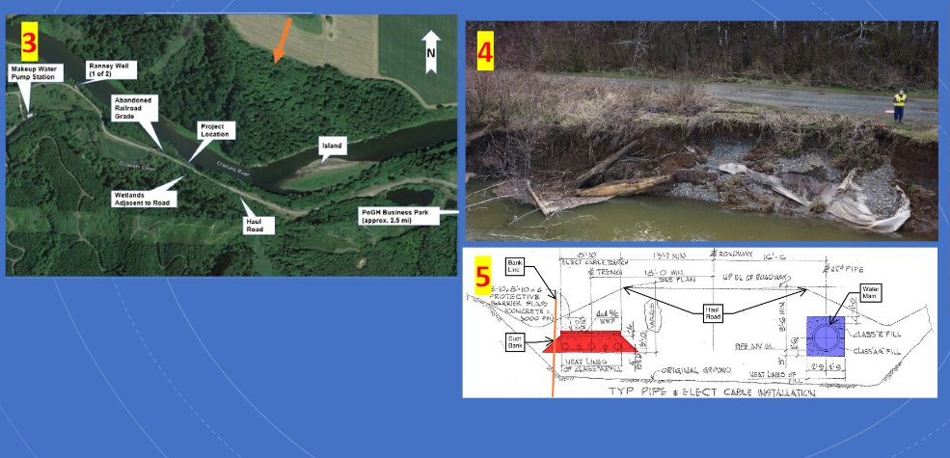
Local Projects (Grays Harbor County)
NEW 2022 – Port of Grays Harbor “Haul Road” Project.

Slide 13
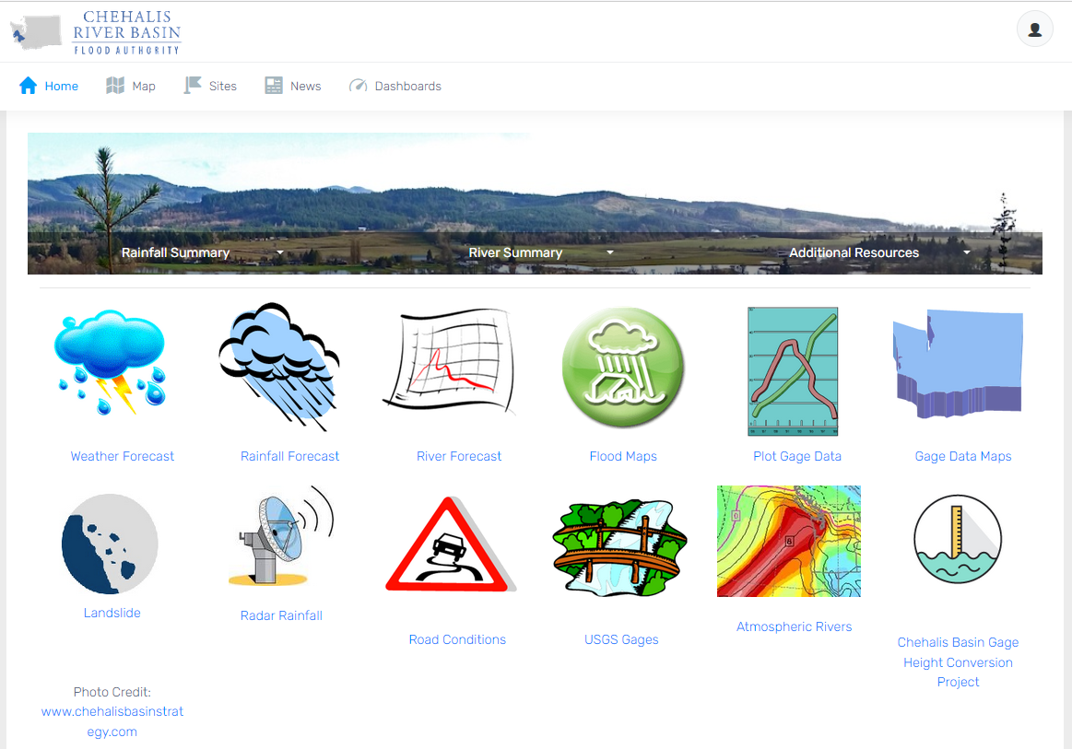
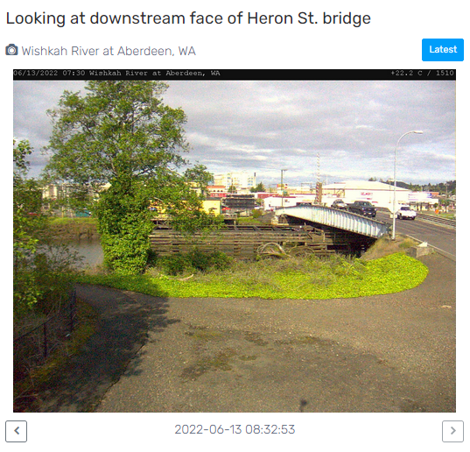
Flood Warning System (#2)
www.chehalisriverflood.com
Developed with State Capital Budget $.
Maintained with local $.

Slide 14

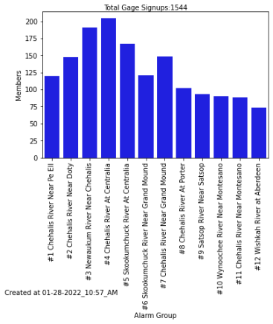
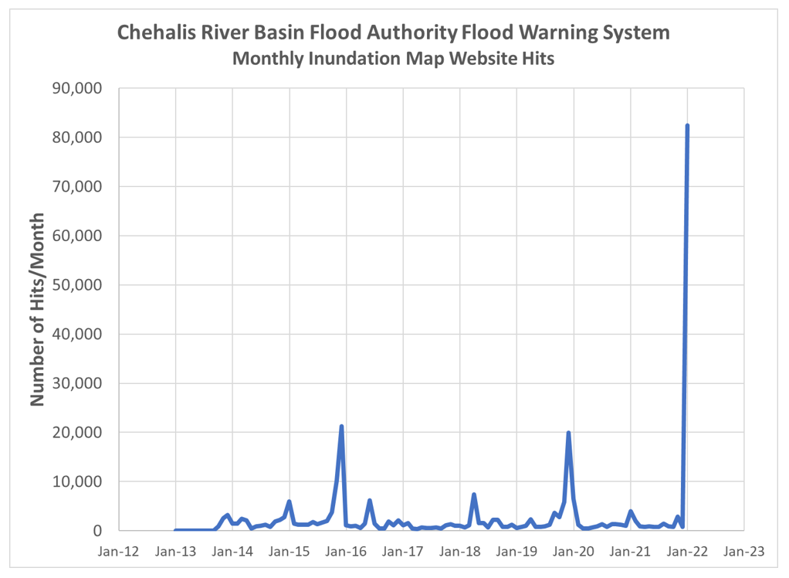
Flood Warning System (2022 Flood Event)
Flood Warning System Works!
Dave Curtis, West Consultants, 2/01/2022
Survey Respondent, 2/01/2022

Slide 15
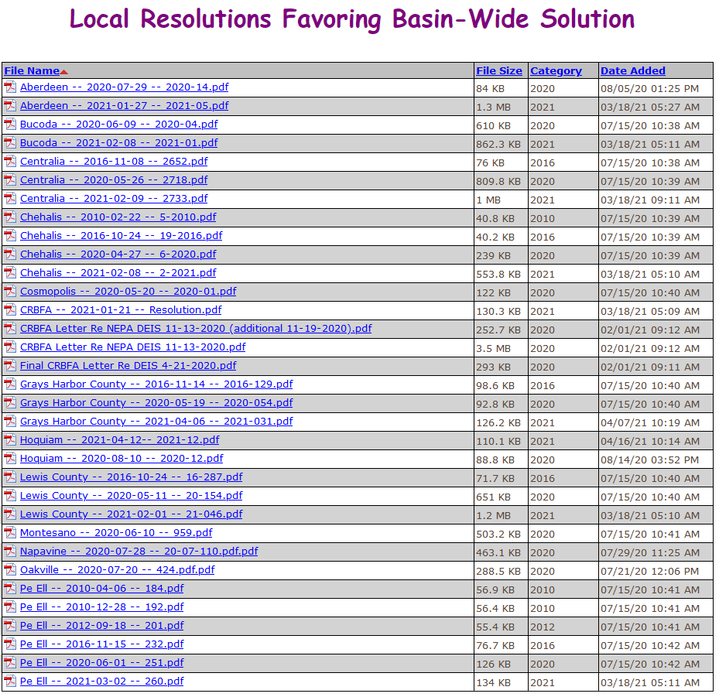
Flood Authority Role (#3)
Help local communities identify, develop, implement local flood hazard solutions.
Appoint 3 of 7 members to Chehalis Basin Board (current appointees are Vickie Raines, Edna Fund, Jay Gordon).
Provide local perspective to Basin-Wide solution discussions.
Advocate for balanced basin-wide fish and flood solutions (see local resolutions library here).

Slide 16








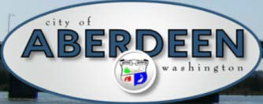















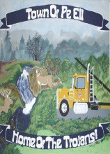


Chehalis Basin Strategy
Office of Chehalis Basin | Chehalis Basin Board
https://chehalisbasinstrategy.com/

Slide 17
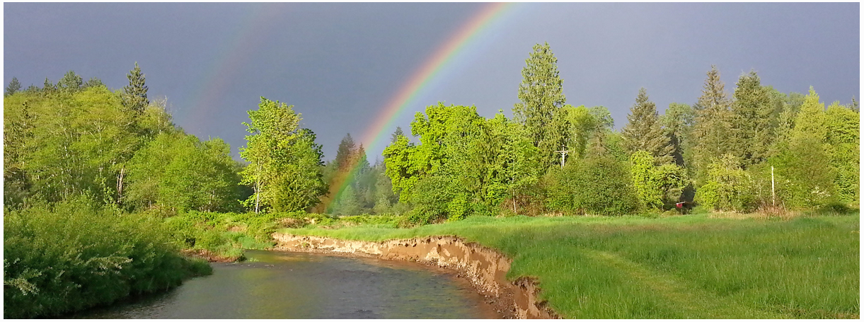
Today vs 2007
Today, we are substantially more aware, better prepared for catastrophic flooding than ever before.
We have a state-of-the art flood warning system.
We’ve completed many cost-efficient local projects and habitat projects.
We’re serving people, local governments, emergency responders, agriculture, fish and habitat.
We have a governance, administrative, and funding structure that’s delivering results.
https://chehalisbasinstrategy.com/office-of-chehalis-basin/

Slide 18
Looking Ahead
Proposed Flood Retention Facility – DRAFT EISs were issued February 2020 (SEPA) and September 2020 (NEPA). Chehalis River Basin Flood Control Zone District (project proponent) working diligently to provide refinements and clarifications for FINAL EIS. Final EISs are currently scheduled for release in late 2022/early 2023.
Local Projects -- 2023-25 call for local projects will follow July 7, 2022 Chehalis Basin Board meeting.
Flood Authority Meetings – Third Thursday of January, February, March, May, July, September, and November from 10 AM to 11:15 AM (11:30 AM).
Chehalis Basin Board Meetings – First Thursday of every month from 9 AM to 2 PM.

Slide 19
Key Contacts
Vickie Raines, Grays Harbor County Representative
Chair, Chehalis River Basin Flood Authority
Chair, Chehalis Basin Board
360/249-3731
vraines@co.grays-harbor.wa.us
Edna Fund, Lewis County Representative
Vice-Chair, Chehalis River Basin Flood Authority
Member, Chehalis Basin Board
360/269-7514
dutch@localaccess.com
Scott Boettcher
Staff, Chehalis River Basin Flood Authority
360/480-6600
scottb@sbgh-partners.com

Slide 20
Thank You!
This Presentation:
Available at “Chehalis River Basin Flood Authority” Website at https://www.ezview.wa.gov/site/alias__1492/34490/outreach__education.aspx
Email Distribution Lists:
Megan Sathre (Flood Authority) megan.sathre@lewiscountywa.gov Cindy Bradley (Office of Chehalis Basin) Cindy.Bradley@ecy.wa.gov

Slide 21
Also -- Key Links
Key Organizations:
Chehalis River Basin Flood Authority -- www.ezview.wa.gov/chehalisfloodauthority
Office of Chehalis Basin -- https://ecology.wa.gov/About-us/Get-to-know-us/Our-Programs/Office-of-Chehalis-Basin
Chehalis Basin Board -- https://www.ezview.wa.gov/site/alias__1962/37068/chehalis_basin_board.aspx
Key Activity Areas:
Local Projects -- https://www.ezview.wa.gov/site/alias__1492/34489/local_projects.aspx
Flood Warning System -- www.chehalisriverflood.com
Chehalis Basin Strategy -- www.chehalisbasinstrategy.com
  ASRP -- https://chehalisbasinstrategy.com/asrp/
  CFAR -- https://chehalisbasinstrategy.com/cfar/
  Proposed Retention Project -- https://chehalisbasinstrategy.com/proposed-project/
    Chehalis River Basin Flood Control Zone District -- https://www.chehalisriverbasinfczd.com/
    State EIS (SEPA) -- https://chehalisbasinstrategy.com/sepa-process/
    Federal EIS (NEPA) -- https://chehalisbasinstrategy.com/federal-envl-review/
    Flood Retention Facility (visualization) -- https://www.youtube.com/watch?app=desktop&v=cKTejUE3WsU
  Skookumchuck Dam -- https://chehalisbasinstrategy.com/skookumchuck-dam-study/
  LAND -- https://chehalisbasinstrategy.com/local-actions-non-dam-alternative/
Also → Sign-Up for Email Gage Alerts – https://chehalis.onerain.com/upload/files/6a9bf8e2-f04b-4165-8a9f-ce031d5db6b4.pdf

Slide 22
Also -- Background
Ranked high flow events (1932 - 2012) . . .
❑ I-5 closed 1990, 1996, 2007, 2009.
  Five largest events since 1986 -- Frequent floods are getting worse and damage is increasing . . .
  100 year flood estimate -- Increased by 33% in last 30 years.
90000
Chehalis River Flow Rates near Grand Mound (cubic ft./sec.) ₂
1
80000
3
70000
60000
4
5
50000
9
7
6
10
8
13
13
11
16
12
14
40000
30000
20000
10000
0

Slide 23
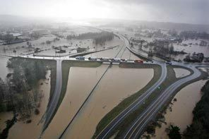
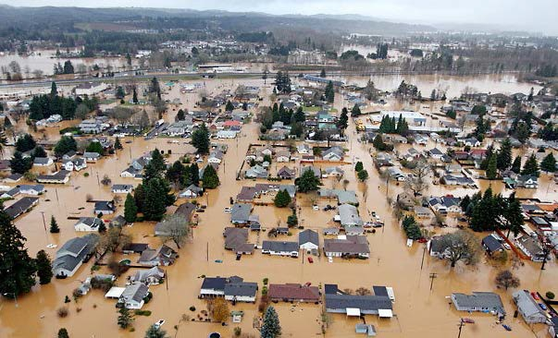
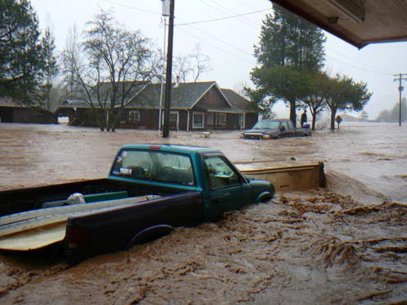
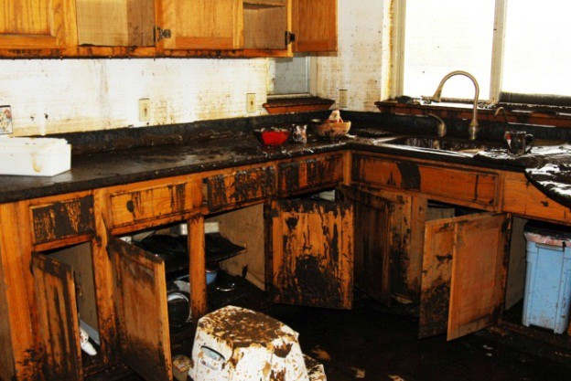
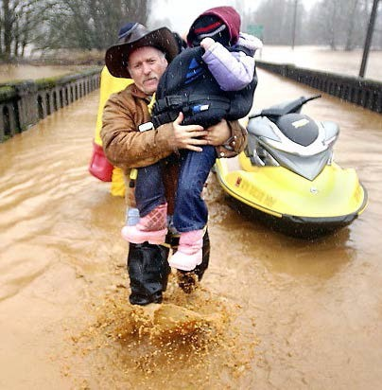
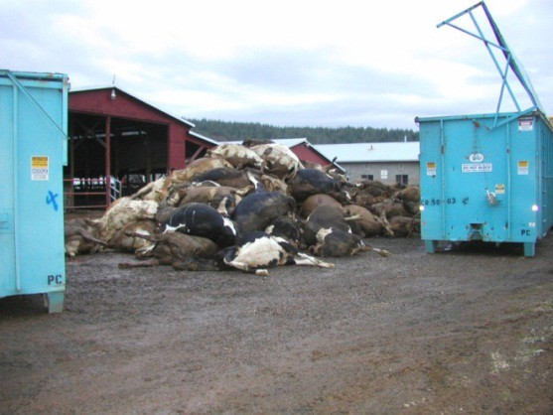

Also -- Background
2007 Storm -- $938M Basin-wide damage, $300M lost economic activity (WA).
Exit 77 (I-5) in Chehalis
STEVE RINGMAN / SEATTLE TIMES
City of Centralia
STEVE RINGMAN / SEATTLE TIMES
State Route 6, West of Adna MIKE SALSBURY / AP
Photos Source: LEWIS COUNTY, DIVISION OF EMERGENCY
MANAGEMENT

