Slide 1


Chehalis River Basin Flood Authority
Reducing Flood Damage and
Restoring Aquatic Species
Pe Ell
July 5, 2022
Scott Boettcher
Staff, Chehalis River Basin Flood Authority
360/480-6600⏐scottb@sbgh-partners.com

Slide 2




Today’s Presentation
Describe the “Flood Authority”
  #1 -- Local Projects
  #2 -- Flood Warning System
  #3 – Role
Touch on “Office of Chehalis Basin” and “Chehalis Basin Strategy”
Allow time for discussion
State Law
“The primary purpose of the office is to aggressively pursue implementation of an integrated strategy and administer funding for long-term flood damage reduction and aquatic species restoration in the Chehalis river basin.” (RCW 43.21A.730)
Office of Chehalis Basin | Chehalis Basin Board
https://chehalisbasinstrategy.com/
.

Slide 3
Chehalis River Basin Flood Authority
Formed in 2008
Focused on flood hazard mitigation
Decision-making
  informed by science
  protective of Basin residents/communities
  environmentally appropriate
Jurisdictions represented (see inter-local agreement)
Grays Harbor County (2008)
  City of Aberdeen (2008)
  City of Cosmopolis(2011)
  City of Hoquiam (2017)
  City of Montesano (2008)
  City of Oakville (2008)
Lewis County (2008)
  City of Centralia (2008)
  City of Chehalis (2008)
  City of Napavine (2011)
  Town of Pe Ell (2008)
Thurston County (2008)
  Town of Bucoda (2008)

Slide 4
Local Projects (#1)
Reduce flood damage.
Protect people, property, infrastructure.
Improve readiness, response, resiliency.
  Drinking Water (Boistfort, Bucoda).
  Wastewater (Montesano, Pe Ell).
  Emergency Response (Grays Harbor County, Chehalis-Centralia Airport).
  Regional Economic Infrastructure (Montesano, Port of Chehalis, Port of Grays Harbor).
  Community Protection (Aberdeen, Adna, Bucoda, Centralia, Chehalis, Chehalis Tribe, Cosmopolis, Hoquiam, Oakville).
  Flood Warning (Basin-wide).
State Capital Budget:
2012-13 -- $ 5.0M
2013-15 -- $10.7M
2015-17 -- $15.7M
2017-19 -- $ 9.6M
2019-21 -- $ 6.3M
2021-23 -- $ 4.1M
$51.4M

Slide 5
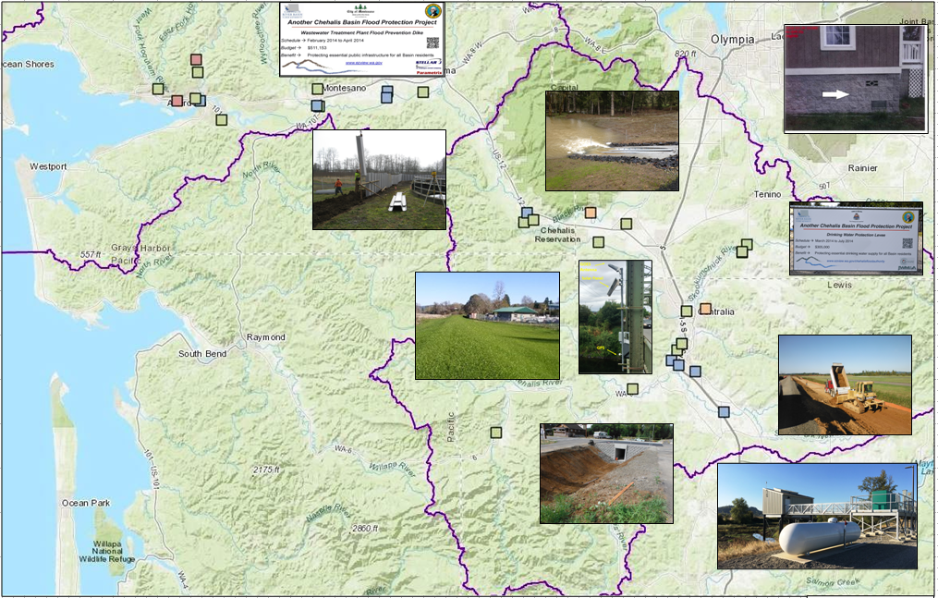
Local Projects (Completed 2012-23)
Cost: $694,152 (average)
Timeframe: 647 days (average)
Sequence:
1st = “Plan/Study/Design” project (24 completed)
2nd = “Construction” project (27 completed)

Slide 6
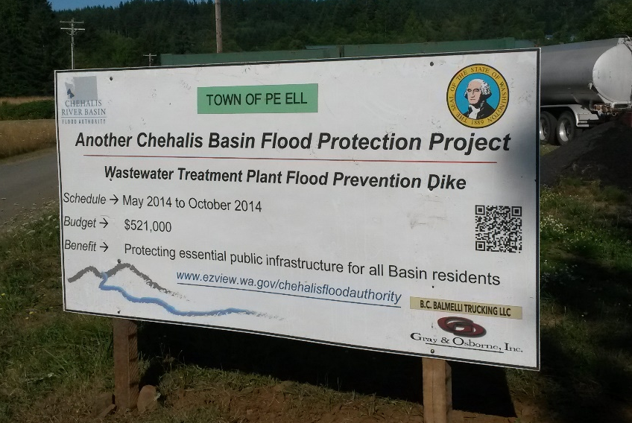
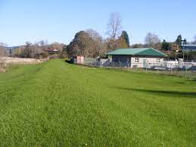
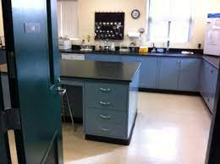
COMPLETED (2014) – WWTP Flood Prevention Dike Project
Local Projects (Pe Ell)
Project = Design/construct 900’ dike (between Chehalis r. and WWTP).
Cost = $521,000.
Photos = https://www.ezview.wa.gov/site/alias__1492/35040/default.aspx#peell.
Website = https://www.ezview.wa.gov/site/alias__1782/34858/overview.aspx

Slide 7
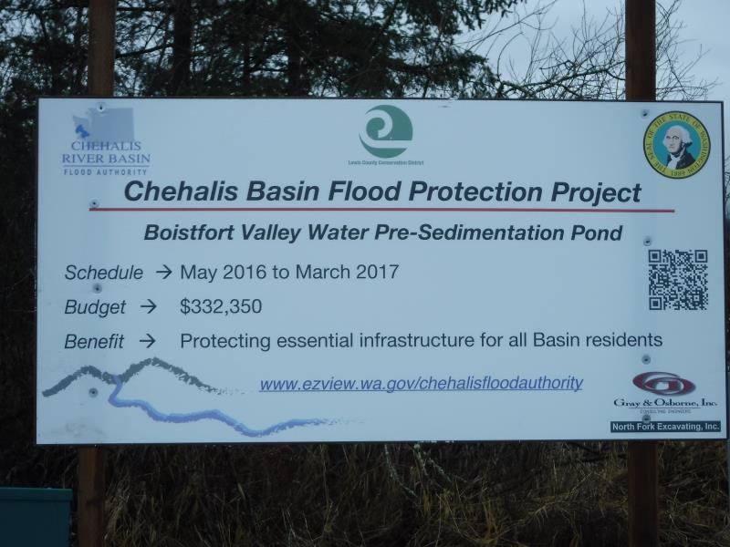
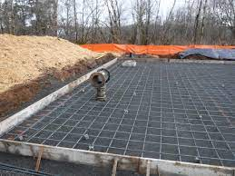
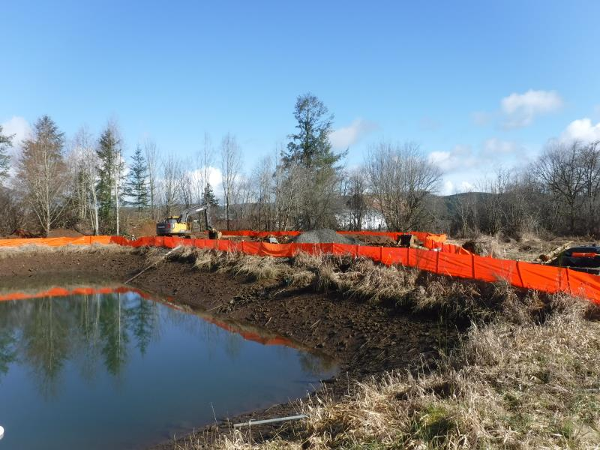
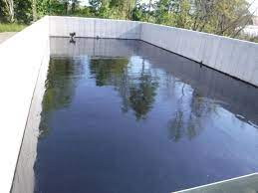
COMPLETED – Boistfort Valley Water Pre-Sedimentation Pond
Local Projects (Boistfort Valley)

Slide 8
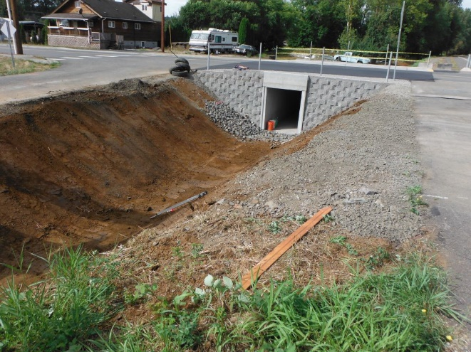
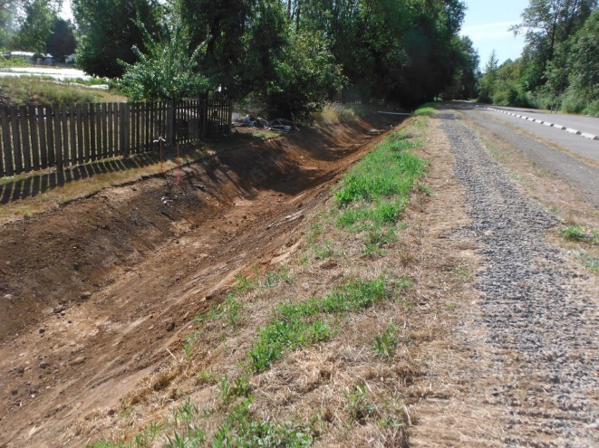
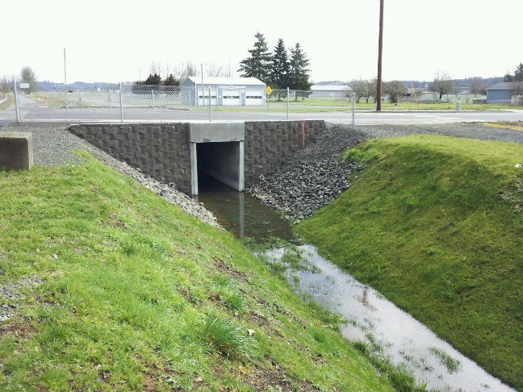
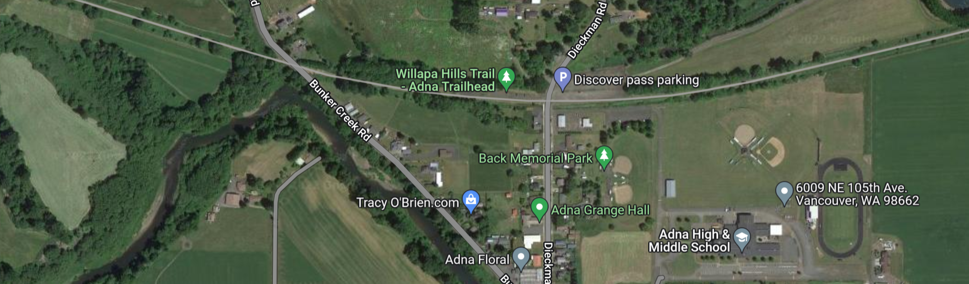
COMPLETED – Adna Levee Project (2013)
Local Projects (Adna)

Slide 9
COMPLETED – Chehalis-Centralia Airport
Local Projects (Chehalis-Centralia)
New Pump -- 2017
January 2022
New Pump Cost = $1.1M
Widening Levee = $1.2M
ROI = Substantial (~$9M annual in local and state tax revenues)
1/2022 High-water event = Airport stayed operational
Old Pump – 1940s
Widening/Repairing Levee – 2014

Slide 10
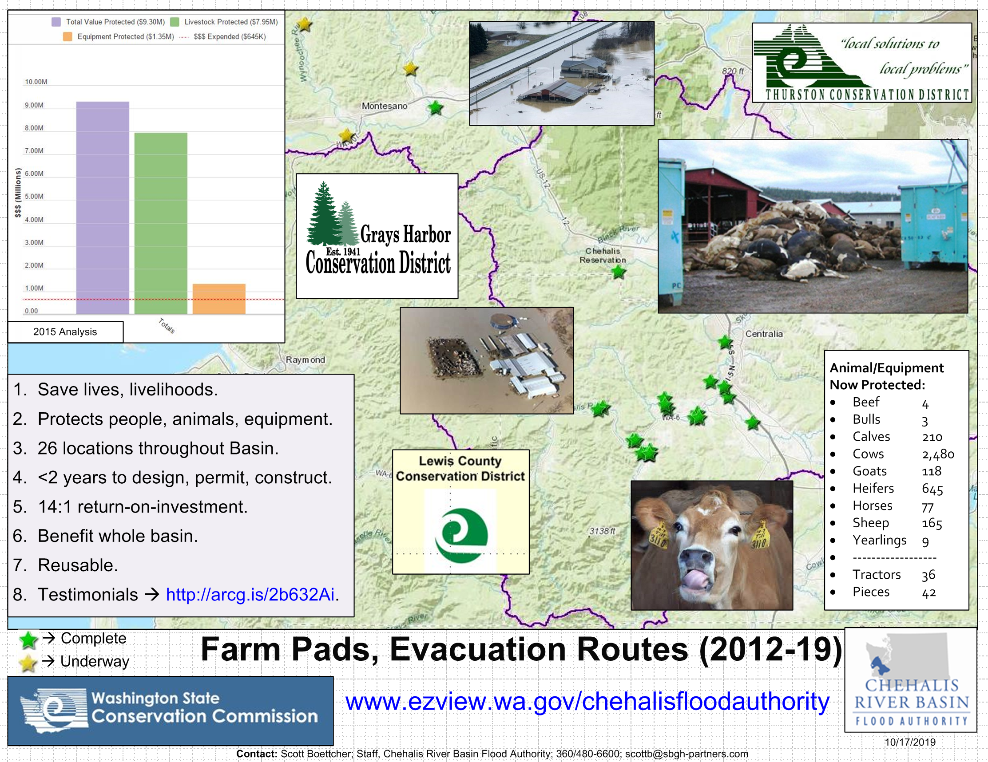
COMPLETED – Farm Pads (Lewis and Grays Harbor counties)
Local Projects (Farm Pads)
January 2022 Flood Event (Bob Amrine, Lewis CD):
Farm pads worked for those who used their pads (animals did not drown like in 2007 and
equipment was saved).
Farmers were grateful that their livelihoods could continue, and their animals were out of
harm’s way (though in some cases they wish they had larger pads for more equipment).

Slide 11

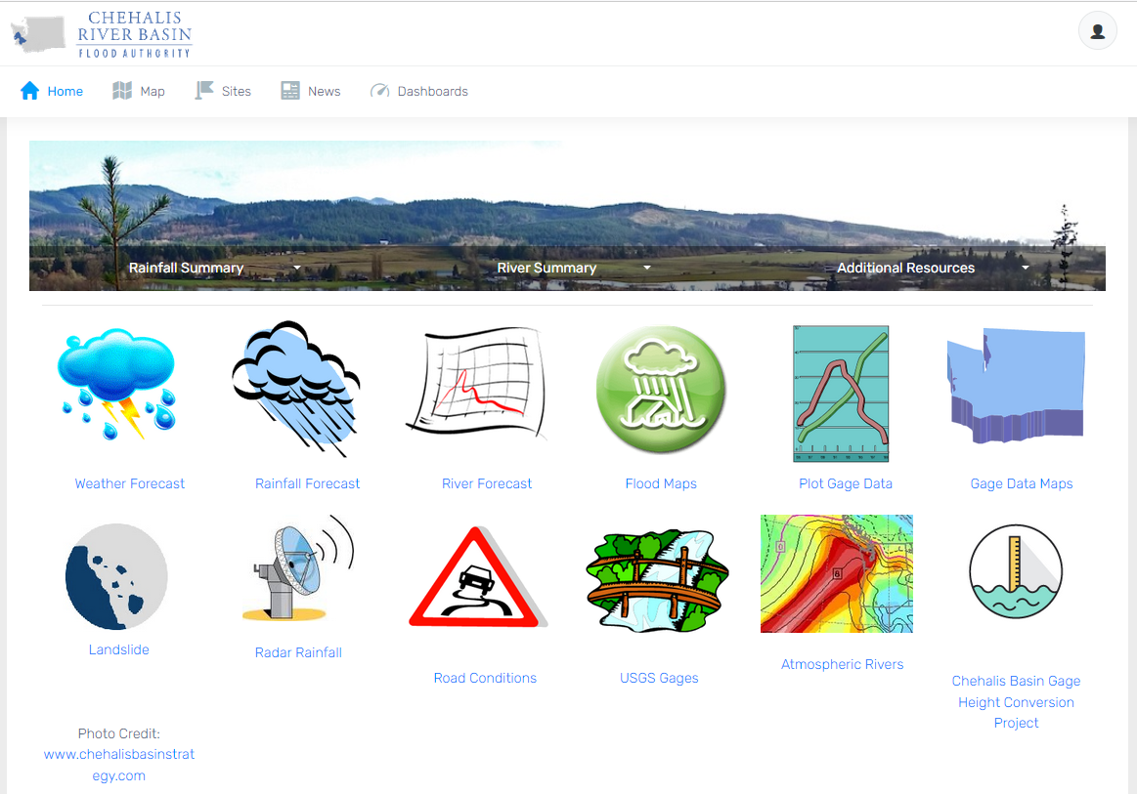
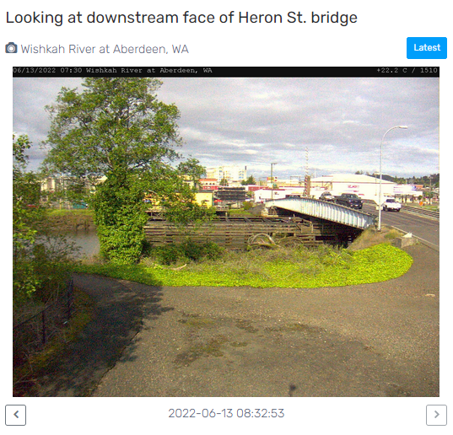
Click icon to sign-up for email gage alerts.
Flood Warning System (#2)
www.chehalisriverflood.com
Developed with State Capital Budget $.
Maintained with local $.

Slide 12

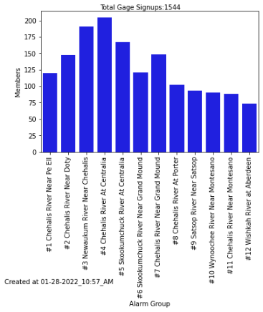
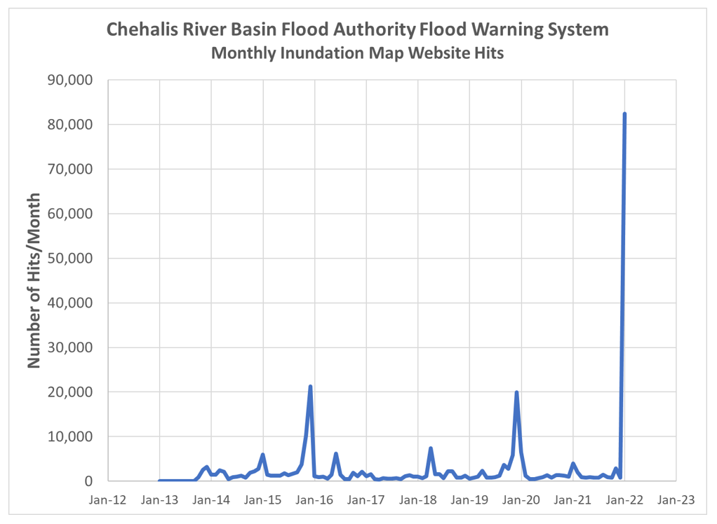
Click icon to sign-up for email gage alerts.
Flood Warning System (2022 Flood Event)
Flood Warning System Works!
Dave Curtis, West Consultants, 2/01/2022
Survey Respondent, 2/01/2022

Slide 13
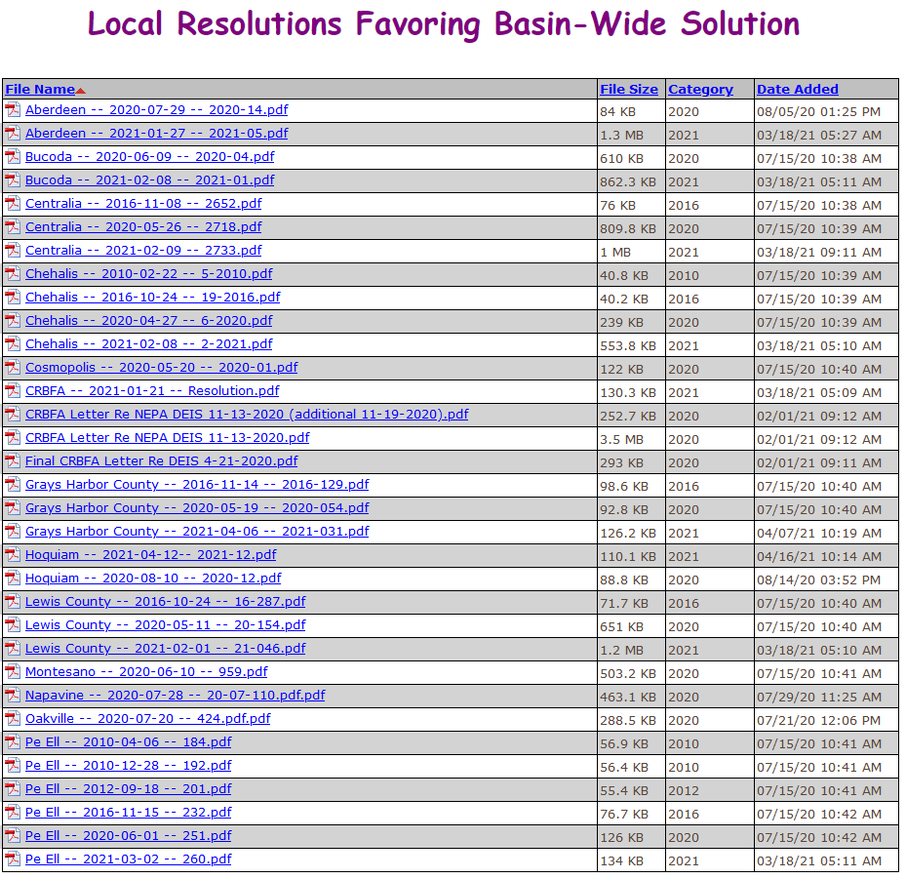
Flood Authority Role (#3)
Help local communities identify, develop, implement local flood hazard solutions.
Appoint 3 of 7 members to Chehalis Basin Board (current appointees are Vickie Raines, Edna Fund, Jay Gordon).
Provide local perspective to Basin-Wide solution discussions.
Advocate for balanced basin-wide fish and flood solutions (see local resolutions library here).
Work as a team.

Slide 14







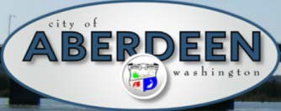
















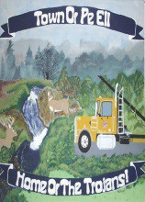


Office of Chehalis Basin, Chehalis Basin Strategy
Office of Chehalis Basin | Chehalis Basin Board
https://chehalisbasinstrategy.com/

Slide 15
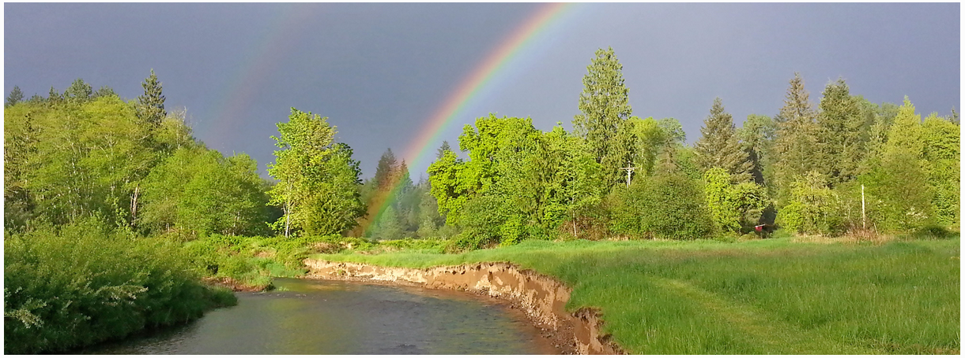
Today vs 2007
Today, we are substantially more aware, better prepared for catastrophic flooding than ever before.
We have a state-of-the art flood warning system.
We’ve completed many cost-efficient local projects and habitat projects.
We’re serving people, local governments, emergency responders, agriculture, fish and habitat.
We have a governance, administrative, and funding structure that’s delivering results.
https://chehalisbasinstrategy.com/office-of-chehalis-basin/

Slide 16
Looking Ahead
Proposed Flood Retention Facility – DRAFT EISs were issued February 2020 (SEPA) and September 2020 (NEPA). Chehalis River Basin Flood Control Zone District (project proponent) working diligently to provide refinements and clarifications for FINAL EIS. Final EISs are currently scheduled for release in late 2022/early 2023.
Local Projects – (1) 2023-25 call for local projects will be issued June 29, 2022.
        (2) Working with LC Public Works to scope out a $60K “Lower Boistfort
        Valley preliminary CMZ study”
Flood Authority Meetings – Third Thursday of January, February, March, May, July, September, and November from 10 AM to 11:15 AM (11:30 AM).
Chehalis Basin Board Meetings – First Thursday of every month from 9 AM to 2 PM.
Sign-Up For Email Gage Alerts – www.chehalisriverflood.com
Click icon to sign-up for email gage alerts.

Slide 17
Key Contacts
Vickie Raines, Grays Harbor County Representative
Chair, Chehalis River Basin Flood Authority
Chair, Chehalis Basin Board
360/249-3731
vraines@co.grays-harbor.wa.us
Edna Fund, Lewis County Representative
Vice-Chair, Chehalis River Basin Flood Authority
Member, Chehalis Basin Board
360/269-7514
dutch@localaccess.com
Lonnie Willey, Pe Ell Representative
Member, Chehalis River Basin Flood Authority
360/324-2132
p-lmayor@centurytel.net
J. Vander Stoep, Pe Ell Representative (Alternate)
Member (Alternate), Chehalis River Basin Flood Authority
Member, Chehalis Basin Board
360/269-0200
jv@vanderstoep.com
Scott Boettcher
Staff, Chehalis River Basin Flood Authority
360/480-6600
scottb@sbgh-partners.com

Slide 18
Thank You!
This Presentation:
Available at “Chehalis River Basin Flood Authority” Website at https://www.ezview.wa.gov/site/alias__1492/34490/outreach__education.aspx
Email Distribution Lists:
Megan Sathre (Flood Authority) megan.sathre@lewiscountywa.gov Cindy Bradley (Office of Chehalis Basin) Cindy.Bradley@ecy.wa.gov

Slide 19
Also -- Key Links
Key Organizations:
Chehalis River Basin Flood Authority -- www.ezview.wa.gov/chehalisfloodauthority
Office of Chehalis Basin -- https://ecology.wa.gov/About-us/Get-to-know-us/Our-Programs/Office-of-Chehalis-Basin
Chehalis Basin Board -- https://www.ezview.wa.gov/site/alias__1962/37068/chehalis_basin_board.aspx
Key Activity Areas:
Local Projects -- https://www.ezview.wa.gov/site/alias__1492/34489/local_projects.aspx
Flood Warning System -- www.chehalisriverflood.com
Chehalis Basin Strategy -- www.chehalisbasinstrategy.com
  ASRP -- https://chehalisbasinstrategy.com/asrp/
  CFAR -- https://chehalisbasinstrategy.com/cfar/
  Proposed Retention Project -- https://chehalisbasinstrategy.com/proposed-project/
    Chehalis River Basin Flood Control Zone District -- https://www.chehalisriverbasinfczd.com/
    State EIS (SEPA) -- https://chehalisbasinstrategy.com/sepa-process/
    Federal EIS (NEPA) -- https://chehalisbasinstrategy.com/federal-envl-review/
    Flood Retention Facility (visualization) -- https://www.youtube.com/watch?app=desktop&v=cKTejUE3WsU
  Skookumchuck Dam -- https://chehalisbasinstrategy.com/skookumchuck-dam-study/
  LAND -- https://chehalisbasinstrategy.com/local-actions-non-dam-alternative/
Also → Sign-Up for Email Gage Alerts – https://chehalis.onerain.com/upload/files/6a9bf8e2-f04b-4165-8a9f-ce031d5db6b4.pdf

Slide 20
Also -- Background
Ranked high flow events (1932 - 2012) . . .
❑ I-5 closed 1990, 1996, 2007, 2009.
  Five largest events since 1986 -- Frequent floods are getting worse and damage is increasing . . .
  100 year flood estimate -- Increased by 33% in last 30 years.
90000
Chehalis River Flow Rates near Grand Mound (cubic ft./sec.) ₂
1
80000
3
70000
60000
4
5
50000
9
7
6
10
8
13
13
11
16
12
14
40000
30000
20000
10000
0

Slide 21
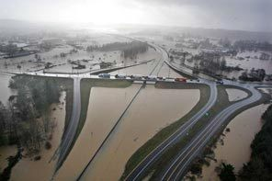
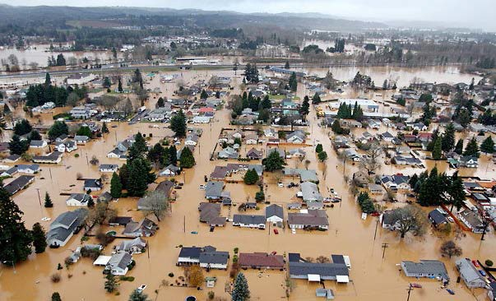
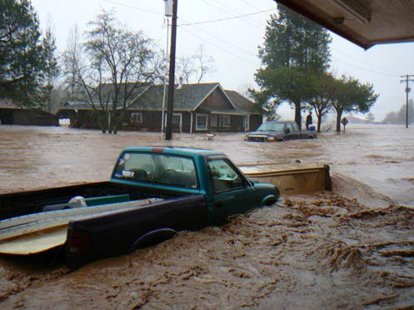
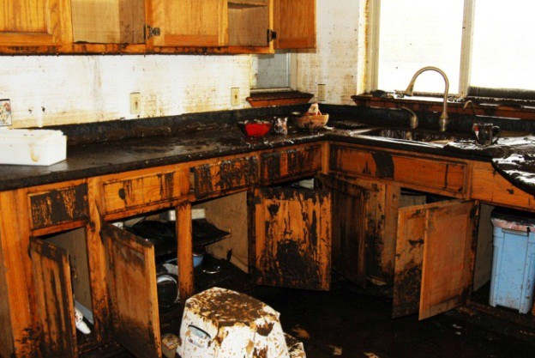
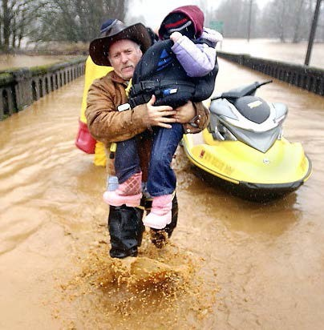
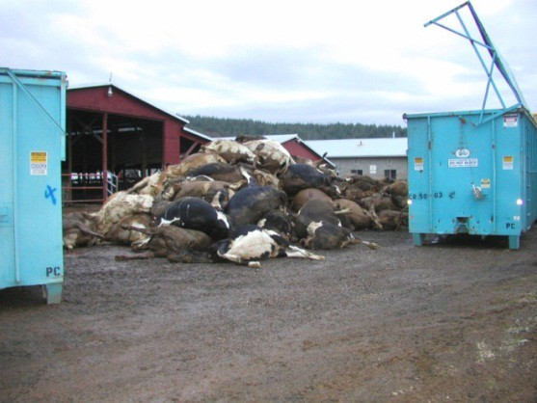

Also -- Background
2007 Storm -- $938M Basin-wide damage, $300M lost economic activity (WA).
Exit 77 (I-5) in Chehalis
STEVE RINGMAN / SEATTLE TIMES
City of Centralia
STEVE RINGMAN / SEATTLE TIMES
State Route 6, West of Adna MIKE SALSBURY / AP
Photos Source: LEWIS COUNTY, DIVISION OF EMERGENCY
MANAGEMENT

