Slide 1
Cover Option #1
Erosion Management
Nat Kale, OCB
January 20, 2022

Slide 2
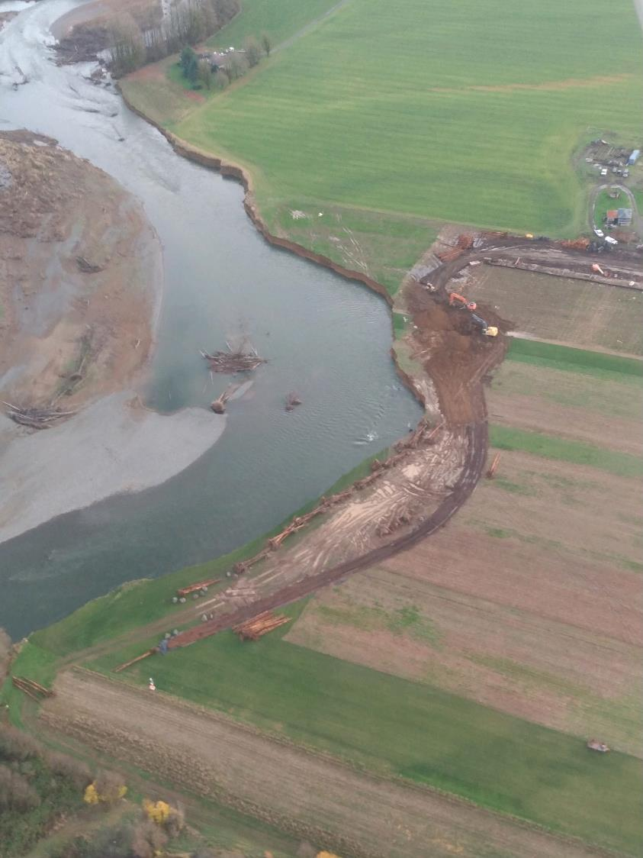
The Problem
Erosion on stream and riverbanks harms property owners
Erosion on stream and riverbanks can harm aquatic species and their habitat
Emergency repairs with rock (hard armoring) are often detrimental for river and stream habitats
  GHCD’s Lower Satsop Right Bank Conservation Project

Slide 3
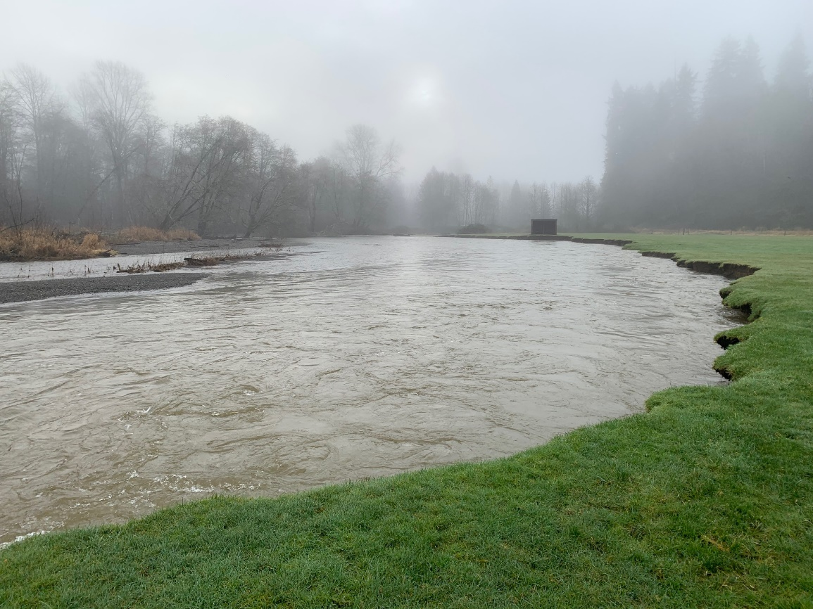
The Program
Will probably include:
Cost-share element
Need to demonstrate balance of habitat and flood damage benefits
TBD:
Emergency vs. non-emergency projects
Public vs. private projects
Additional non-project elements (education, mapping, etc.)

Slide 4
Timeline
Local Actions Program
Background by Anchor QEA
New Program Launches
21-23 Budget Adopted
Workgroup Launches
2020
2021
2022
2023
2024
Pilot Projects

Slide 5
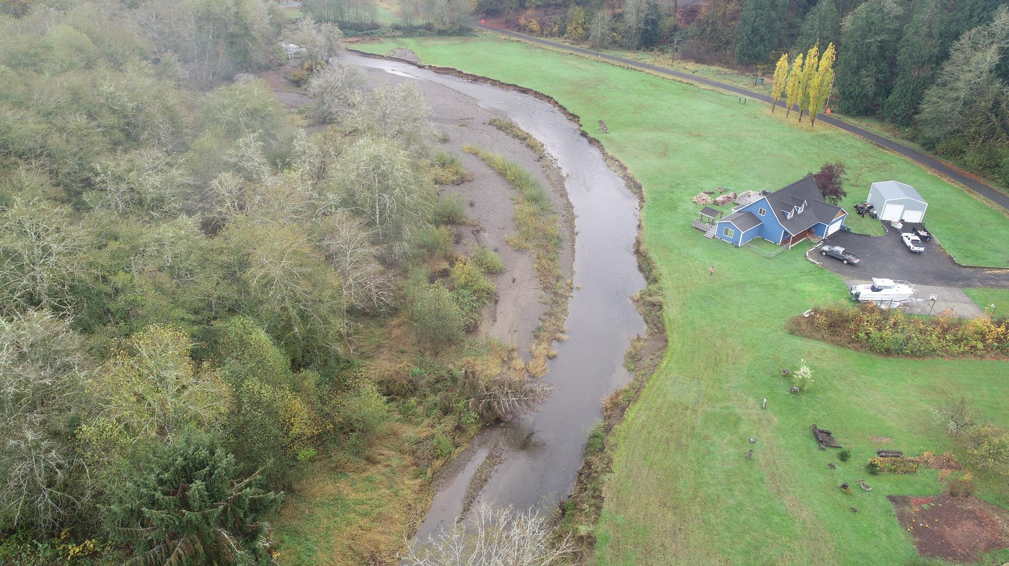
Pilot Project: 36 Lower FALLS Creek Rd
Emergency construction pilot project
First Phase complete
Successful so far
Restoration and Cultural Resources
remaining
$ 15k from Landowner (cost-share)
$ 75k from Erosion Program
$107k from Flood Authority
$197k total

Slide 6
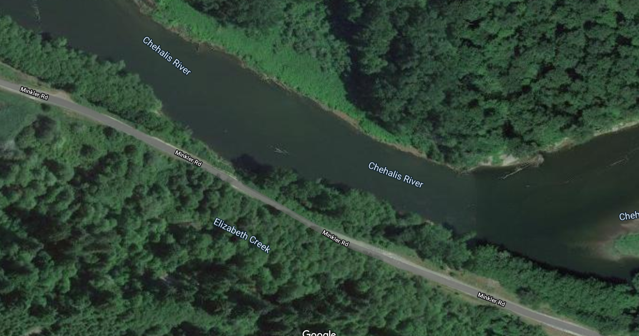
Pilot Project: Port of Grays Harbor Haul Road
Non-emergency design pilot project
Design Phase
$60k from Erosion Program
Construction in 2023

Slide 7
Pilot Project: Satsop 3.5 Willow Planting
Urgent, non-emergency planting pilot project
Just approved funding
$15k from Erosion Program for construction

Slide 8
Next Steps
1. Explore planning pilot with Flood Authority:
  South Fork Chehalis River/Boistfort Valley CMZ ($60k Flood Authority, possibly Erosion Program)
2. Compile lessons learned from pilot projects and other notable, recent erosion projects:
  Lower Satsop Right Bank Conservation Project
  Newaukum Riverbank Stabilization Project
3. Make recommendations to CBB early 2023:
  Project funding criteria, including cost-share
  Projects for funding 2023-25
  Relationship to Flood Authority Local Projects
  Additional Non-Project Elements

Slide 9
Questions?
Nat Kale
Nat.kale@ecy.wa.gov
(360) 706-4277

