Slide 1


Chehalis River Basin Flood Authority
Reducing Flood Damage and
Restoring Aquatic Species
Town of Bucoda
November 12, 2024

Slide 2
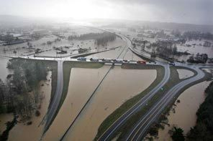
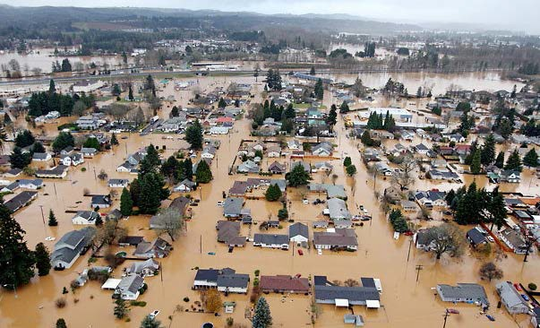
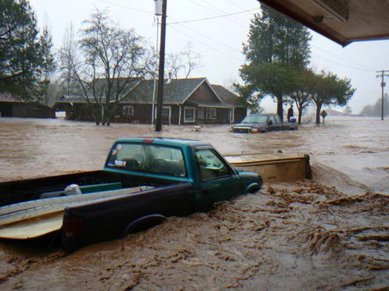
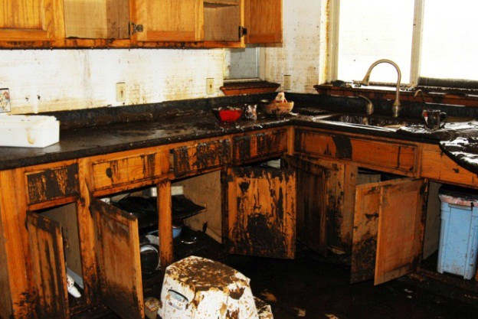
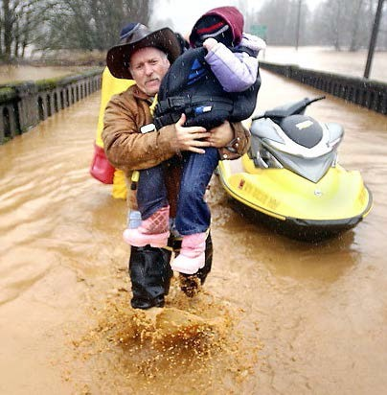
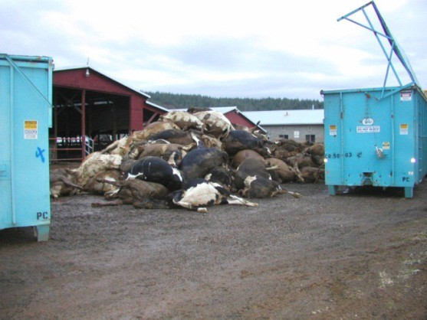


2007 Storm
$938M Basin-wide damage, $300M lost economic activity (WA).
Exit 77 (I-5) in Chehalis
STEVE RINGMAN / SEATTLE TIMES
City of Centralia
STEVE RINGMAN / SEATTLE TIMES
State Route 6, West of Adna MIKE SALSBURY / AP
Photos Source: LEWIS COUNTY, DIVISION OF EMERGENCY
MANAGEMENT

Slide 3



Today’s Presentation
Describe the “Flood Authority”
  #1 -- Local Projects
  #2 -- Flood Warning System
Touch on the “Chehalis River Basin Flood Control Zone District”
  #3 -- Proposed Flow-through Dam for Flood Control
Allow time for discussion.
Office of Chehalis Basin | Chehalis Basin Board
https://chehalisbasinstrategy.com/
.

Slide 4
Chehalis River Basin Flood Authority
Formed in 2008
Focused on flood hazard mitigation
Decision-making
  informed by science
  protective of Basin residents/communities
  environmentally appropriate
Jurisdictions represented (see inter-local agreement)
Grays Harbor County (2008)
  City of Aberdeen (2008)
  City of Cosmopolis(2011)
  City of Hoquiam (2017)
  City of Montesano (2008)
  City of Oakville (2008)
Lewis County (2008)
  City of Centralia (2008)
  City of Chehalis (2008)
  City of Napavine (2011)
  Town of Pe Ell (2008)
Thurston County (2008)
  Town of Bucoda (2008)
Help local communities identify, develop, implement local flood hazard reduction solutions.

Slide 5
Local Projects (#1)
Reduce flood damage.
Protect people, property, infrastructure.
Improve readiness, response, resiliency.
  Drinking Water (Boistfort, Bucoda).
  Wastewater (Montesano, Pe Ell).
  Emergency Response (Grays Harbor County, Chehalis-Centralia Airport).
  Regional Economic Infrastructure (Montesano, Port of Chehalis, Port of Grays Harbor).
  Community Protection (Aberdeen, Adna, Bucoda, Centralia, Chehalis, Chehalis Tribe, Hoquiam, Oakville).
  Flood Warning (Basin-wide).
State Capital Budget:
2012-13 -- $ 5.0M
2013-15 -- $10.7M
2015-17 -- $15.7M
2017-19 -- $ 9.6M
2019-21 -- $ 6.3M
2021-23 -- $ 4.1M
2023-25 -- $ 3.6M
$55.0M
2025-27 -- $ 3.0M
to
$13.0M

Slide 6
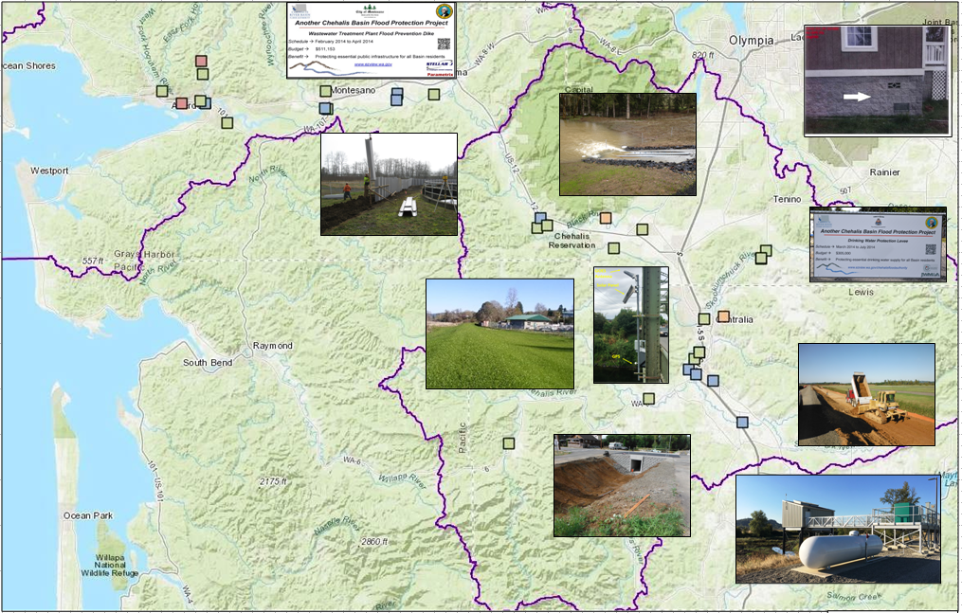
Local Projects (100+ Projects Completed 2012-23)
Cost: ~$450,000 (average)
Timeframe: ~600 days (average)
Sequence:
1st = “Plan/Study/Design” project (~50)
2nd = “Construction” project (~53)

Slide 7
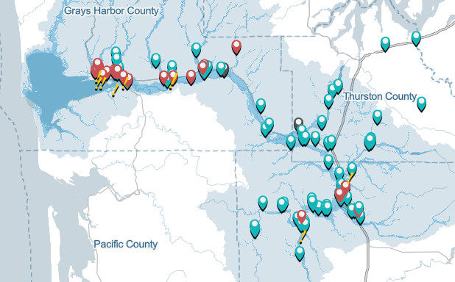
Local Projects (100+ Projects Completed 2012-23)

Slide 8
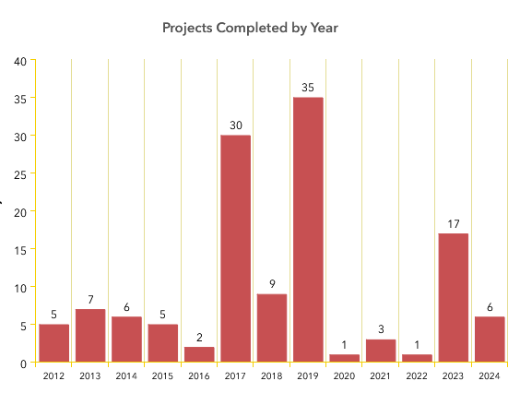
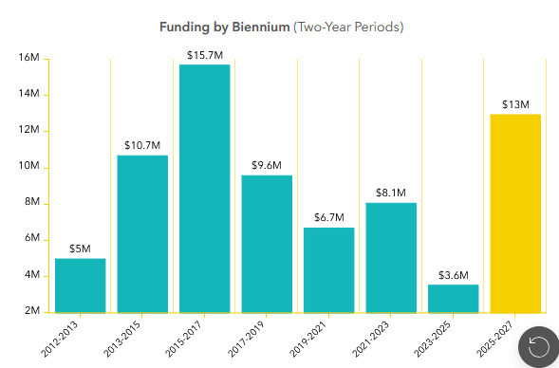
Local Projects (100+ Projects Completed 2012-23)

Slide 9
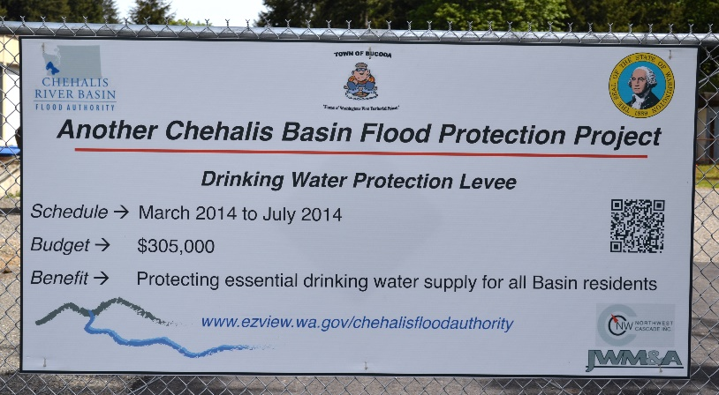
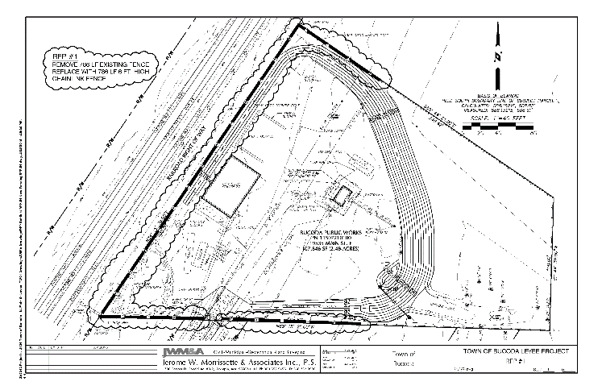
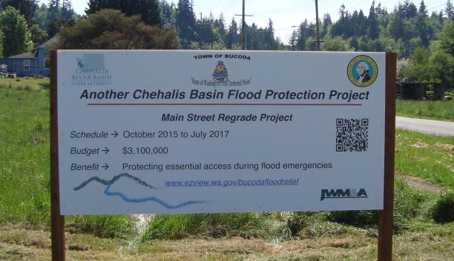
Local Projects (Bucoda)
COMPLETED 2014 Drinking Water Protection Levee – Read more.
COMPLETED 2016 Foundation Flood Opening Pilot (11 properties) – Read more (and here)
ON-HOLD 2016 Main Street Regrade Project – Read more (and here).

Slide 10
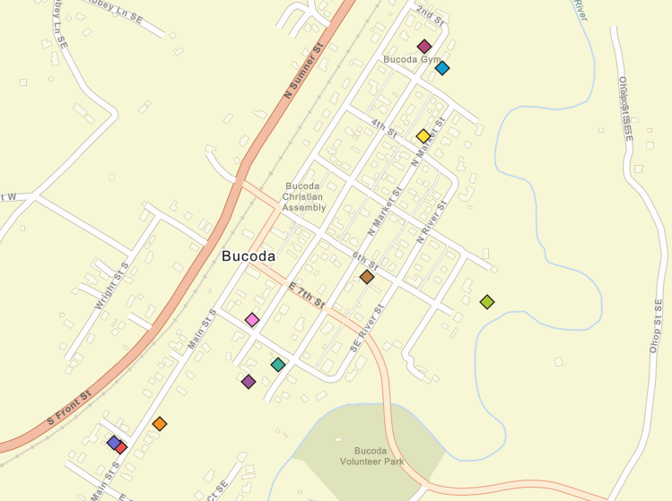
Local Projects (Bucoda)
2016 Properties -- Foundation Flood Openings Pilot

Slide 11
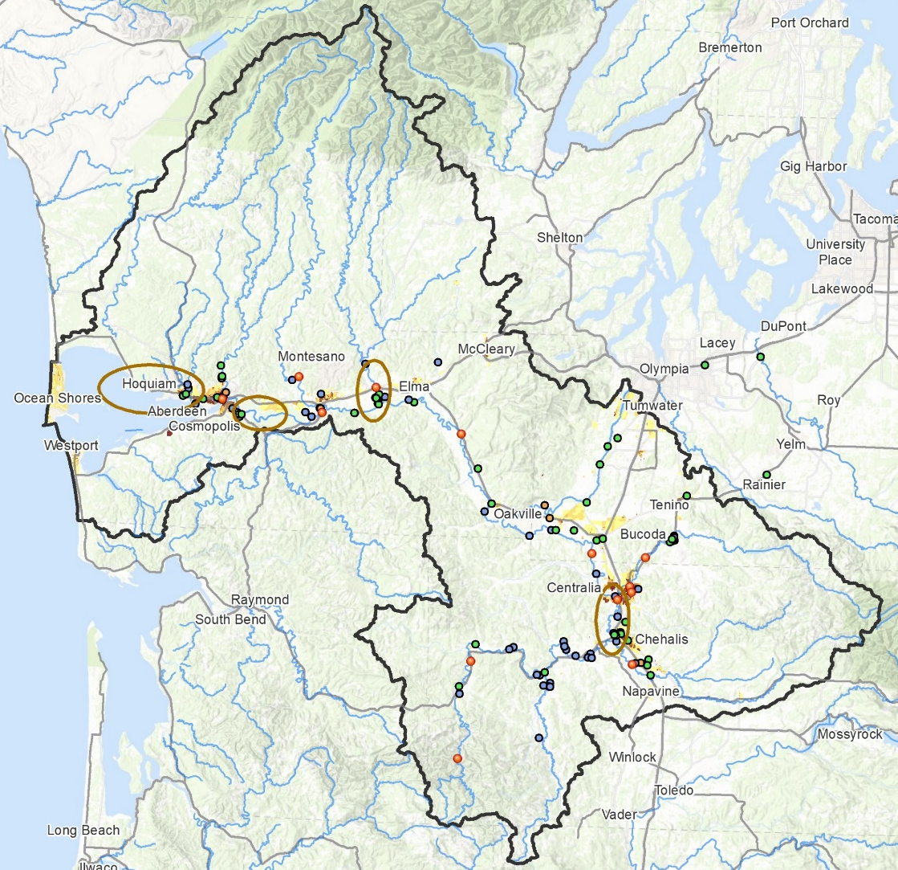
Local Projects (Moving to Geographically-Based)
Identify future local projects through geographically-based, coordinated local investment planning.

Slide 12
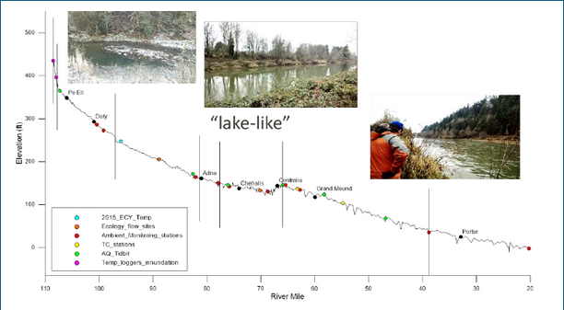
Local Projects (Moving to Geographically-Based)
Basin Geography
Upper = Steep, narrow, fast flowing.
Middle = Flat, “lake like”, slow to drain.
Lower = Flat, coastal, difficult to drain.
Shah, Mohammad. (2021). inland water-dynamics and ecology. 10.5772/intechopen.87463.

Slide 13
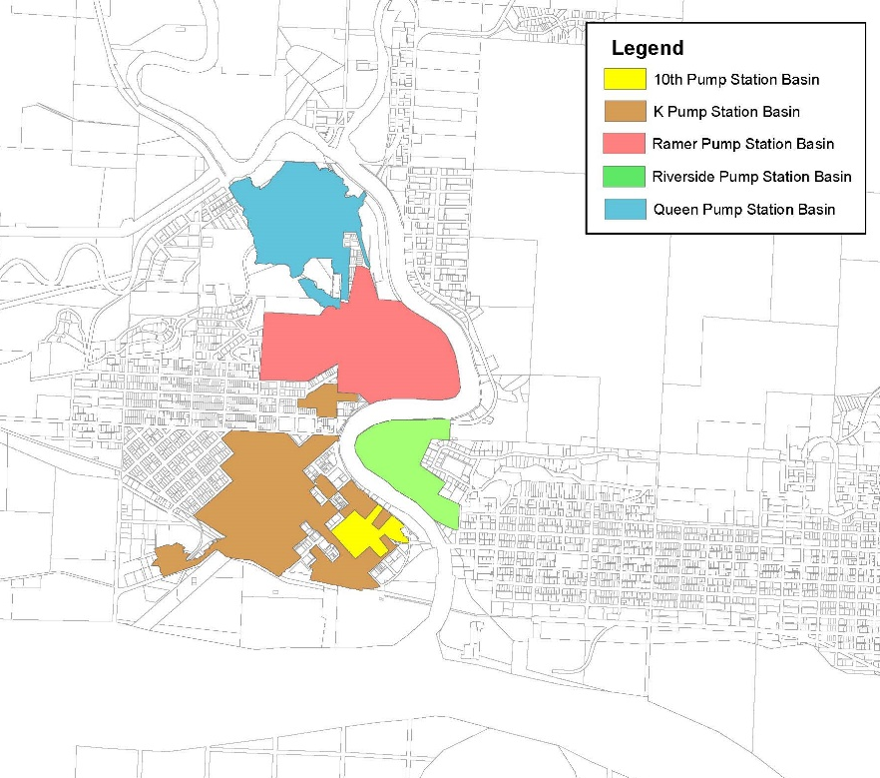
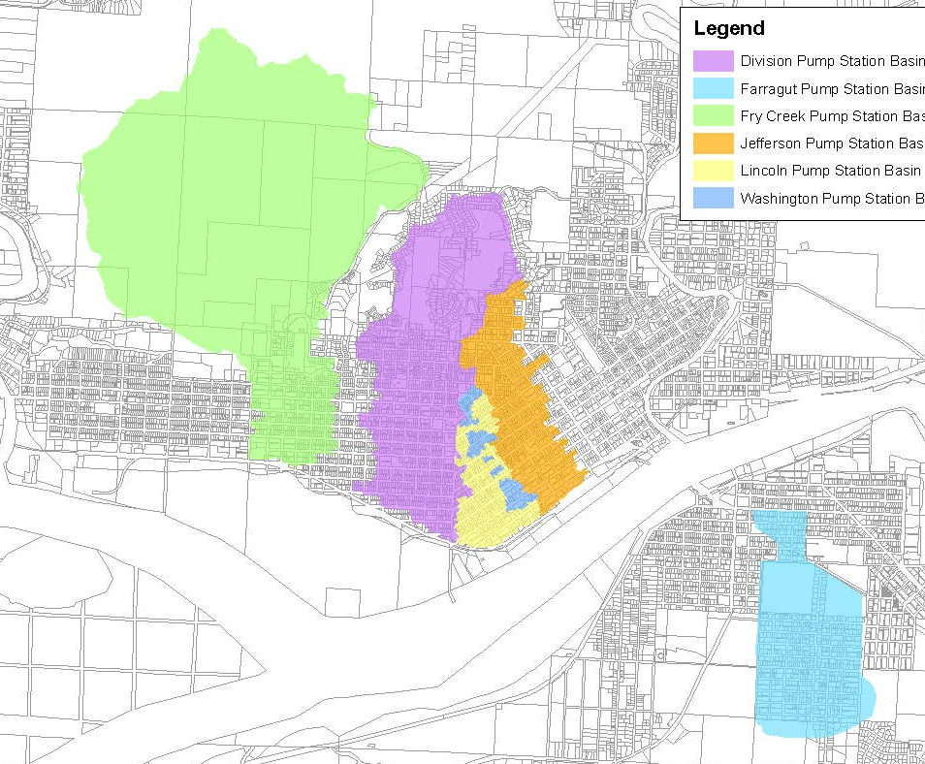
Local Projects (Moving to Geographically-Based)
Sub-Basin | Elevation | Assessed
10th St | 160’ - 10’ | $17M
K St | 20’ - 10’ | $121M
Ramer St | 256’ - 10’ | $72M
Riverside | 305’ - 10’ | $21M
Queen Ave | 255’ - 10’ | $38M
Sub-Basin | Elevation | Assessed
Division | 345’ - 10’ | $300M
Farragut* | 90’ - 10’ | $98M
Fry | 498’ - 4’ | $147M
Jefferson | 344’ - 10’ | $193M
Lincoln | 15’ - 10’ | $66M
Washington | 95’ - 10’ | $27M
11 urbanized low elevation sub-basins | + | Adverse meteorologic conditions -- high tides, heavy rain, bankfull rivers, saturated soils, SW winds | = | Very difficult to drain! ($1.1B assessed value at risk)

Slide 14
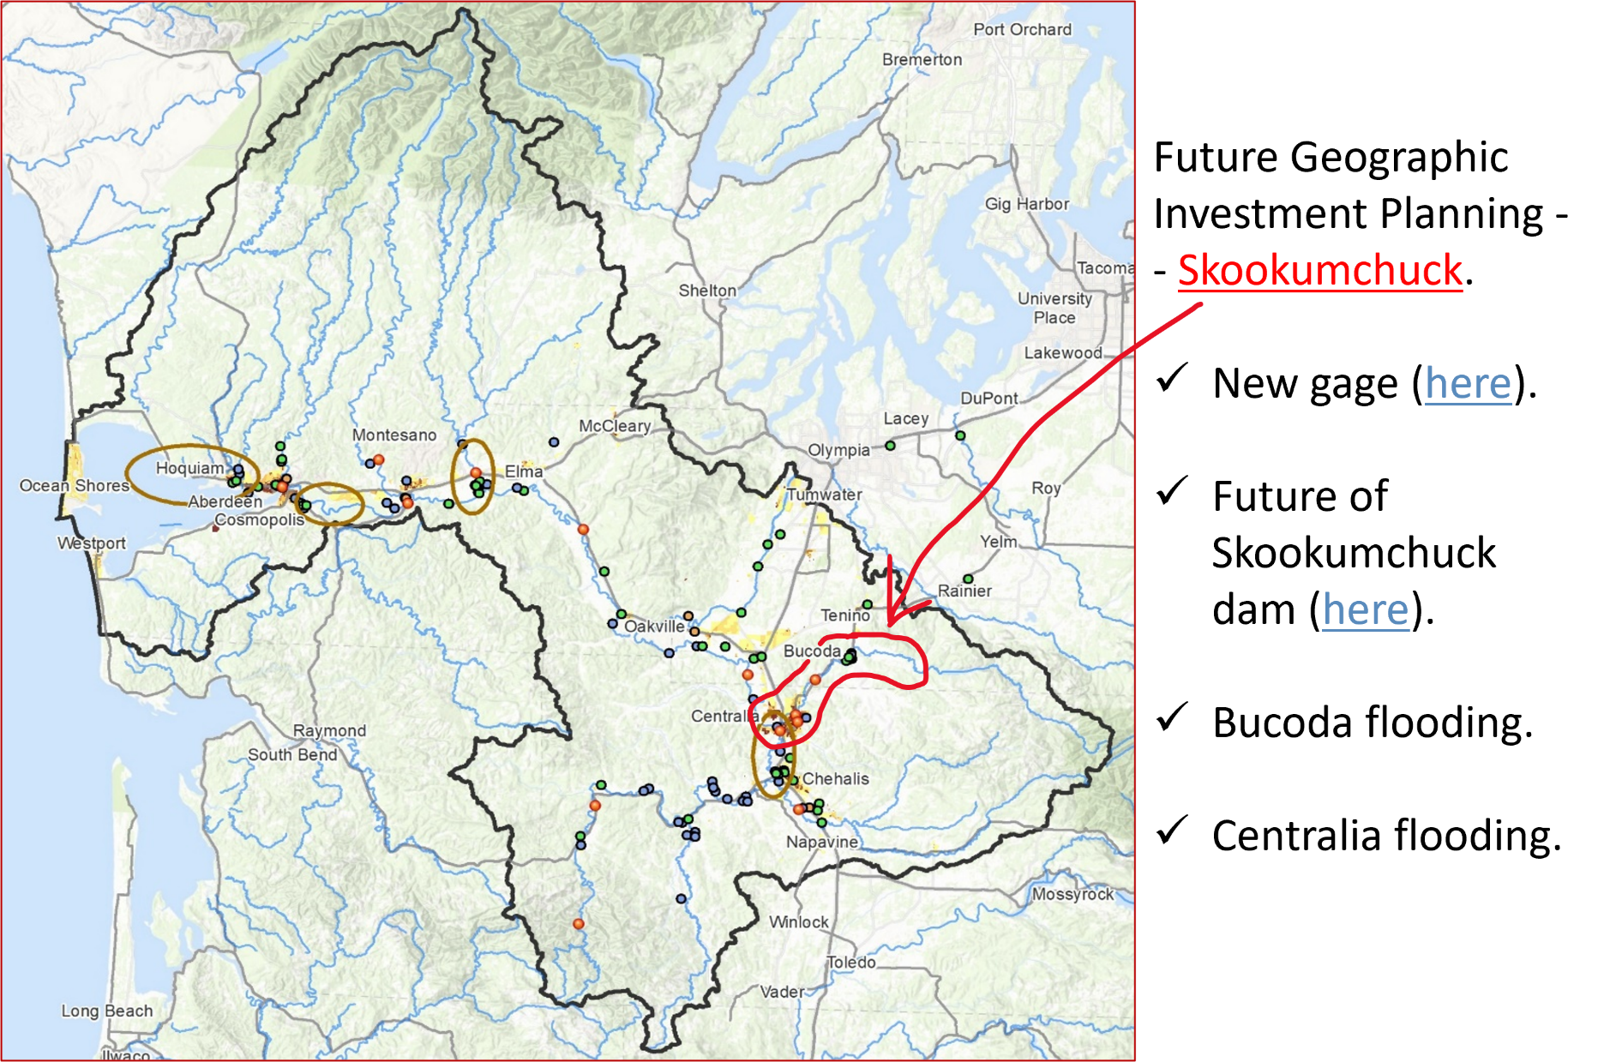
Local Projects (Moving to Geographically-Based)

Slide 15
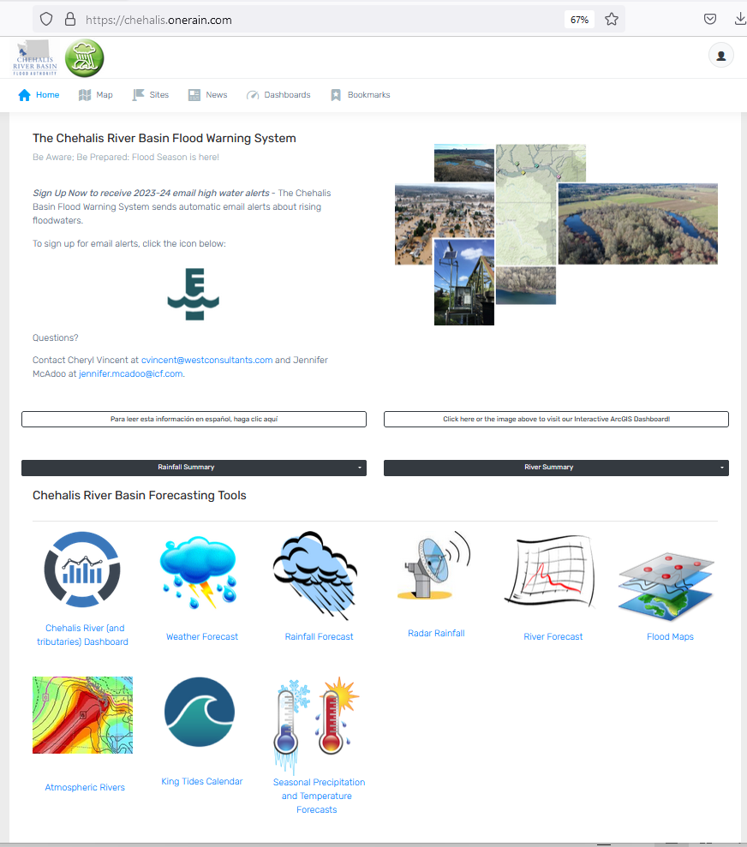
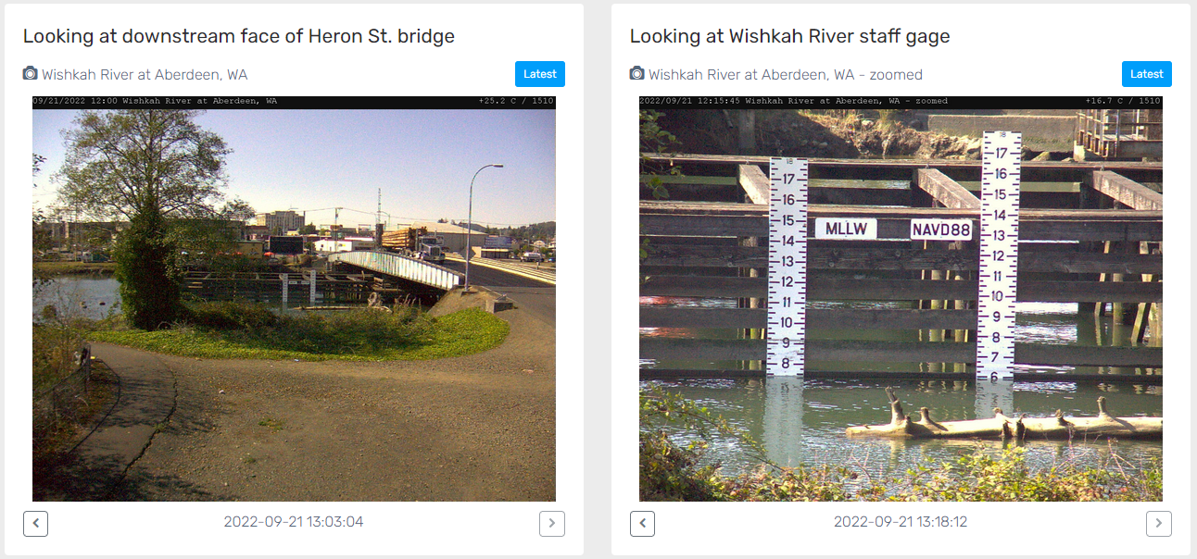
Developed with State Capital Budget $.
Maintained with local $.
Flood Warning System (#2)
www.chehalisriverflood.com

Slide 16
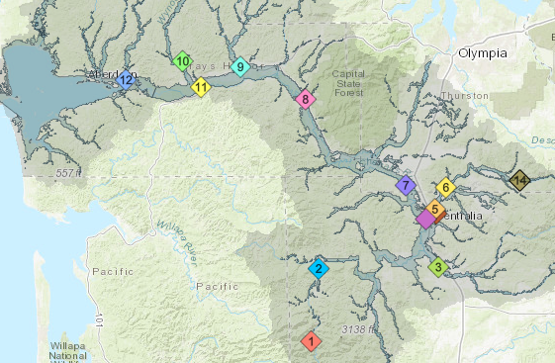
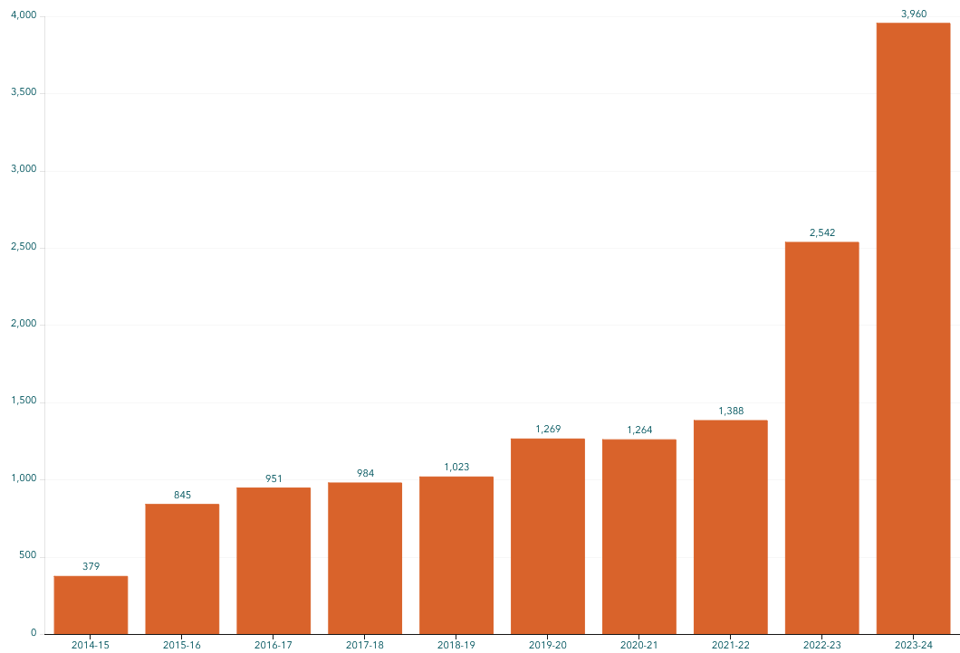
Flood Warning System (Alert Sign-Ups)
Sign-up for email high water alerts here.

Slide 17
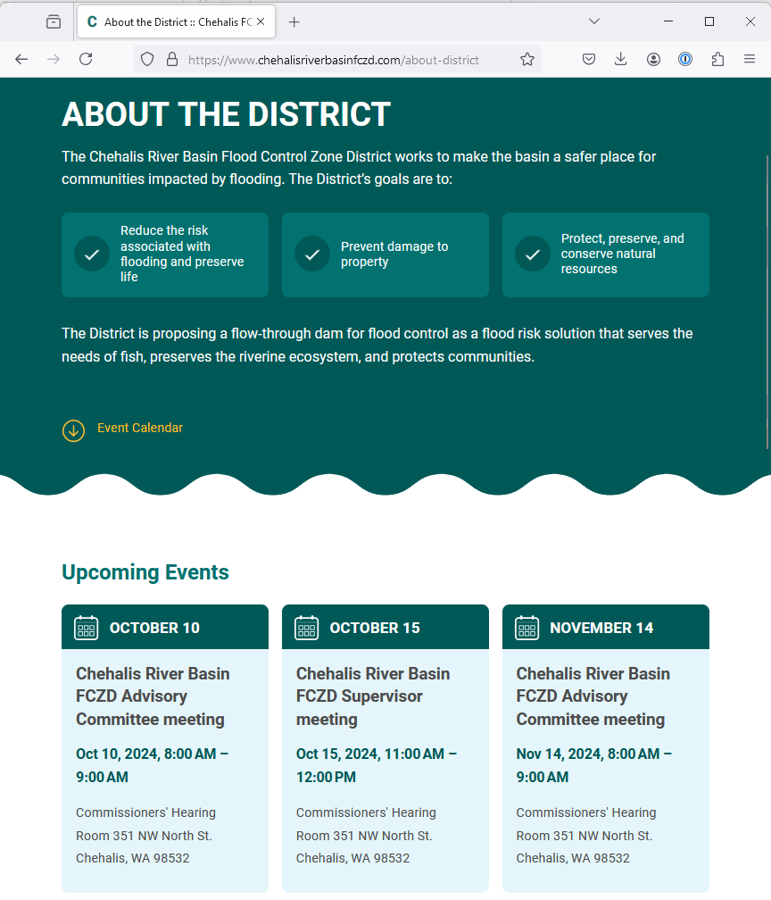
Proposed Flow-through Dam for Flood Control (#3)
www.chehalisriverbasinfczd.com

Slide 18
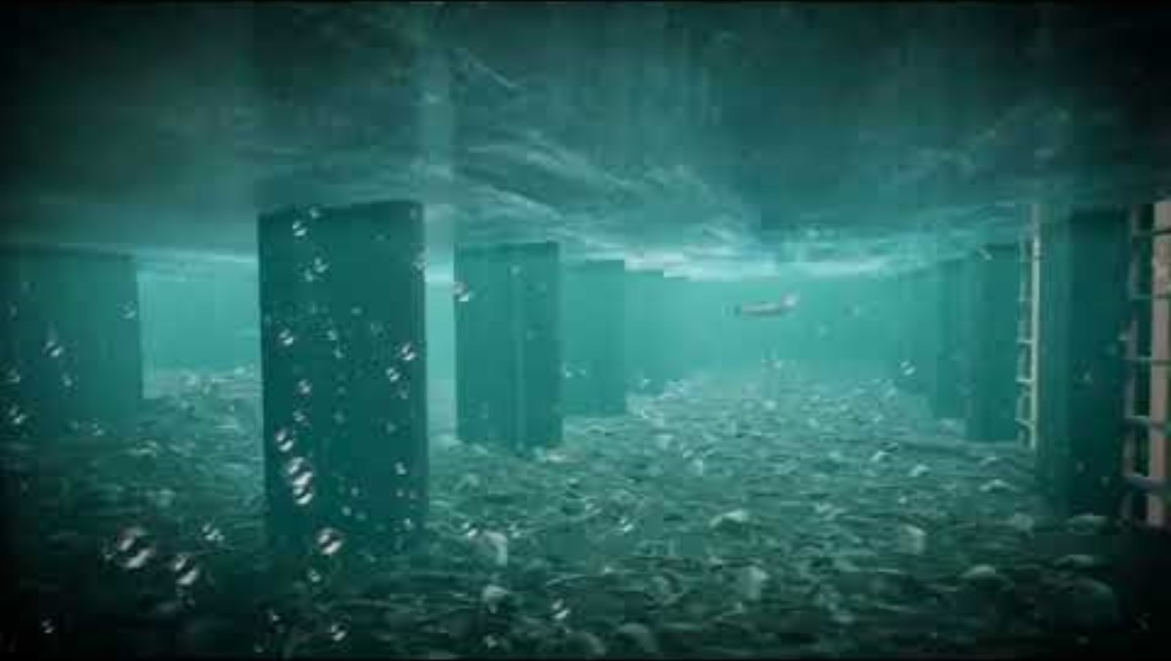
Proposed Flow-Through Dam for Flood Control (#3)
1. Move through unobstructed
Water
Fish
Sediment
2. Delivers top-to-bottom benefit, Pe Ell to Cosmopolis.
3. See recent presentation here.

Slide 19
Chehalis Basin Strategy
appoints 3 member
Chehalis Basin Board
Community leaders, Chehalis and Quinault tribal representatives, local and state government liaisons
Office of Chehalis Basin | Chehalis Basin Board
https://chehalisbasinstrategy.com/
Office of Chehalis Basin
Small team within the WA Department of Ecology
“Network of Partners”
Organizations and local entities who turn ideas into shovel-ready reality

Slide 20








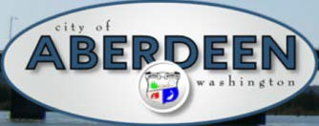















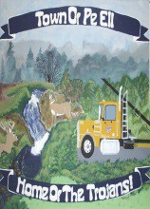


Chehalis Basin Strategy (Network of Partners)

Slide 21
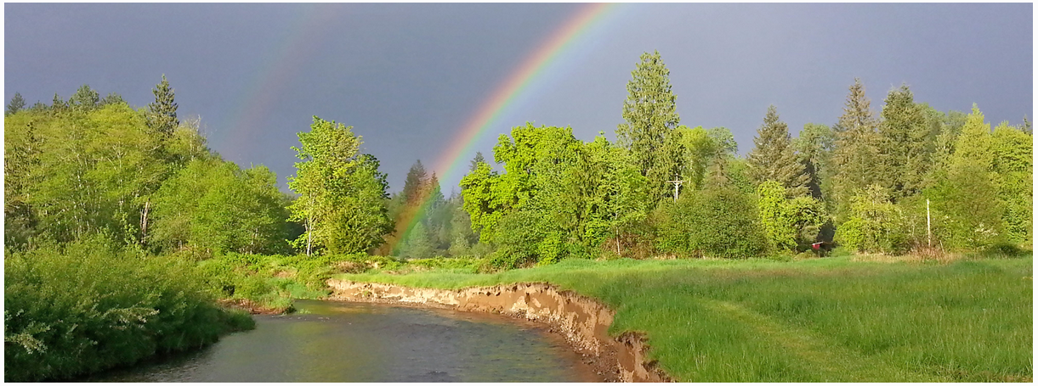
Local Resolutions Library
https://www.ezview.wa.gov/site/alias__1492/37643/local_resolutions.aspx
Today vs 2007
Today, we are substantially more aware, better prepared for catastrophic flooding than ever before.
We have a state-of-the art flood warning system.
We’ve completed many cost-efficient local projects and habitat projects.
We’re serving people, local governments, emergency responders, agriculture, fish, and habitat alike
We have a governance, administrative, and funding structure that’s delivering results, and is committed to a balanced basin-wide flood and fish solution (see Local Resolution Library).
https://chehalisbasinstrategy.com/office-of-chehalis-basin/

Slide 22
Key Contacts
Vickie Raines, Grays Harbor County Representative
Chair, Chehalis River Basin Flood Authority
Chair, Chehalis Basin Board
360/590-4100
vraines@graysharbor.us
Edna Fund, Lewis County Representative
Vice-Chair, Chehalis River Basin Flood Authority
360/269-7515
dutch@localaccess.com
Scott Boettcher
Staff, Chehalis River Basin Flood Authority
360/480-6600
scottb@sbgh-partners.com

