Slide 1


Chehalis River Basin Flood Authority
Reducing Flood Damage and
Restoring Aquatic Species
City of Cosmopolis
November 20, 2024

Slide 2
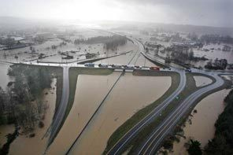
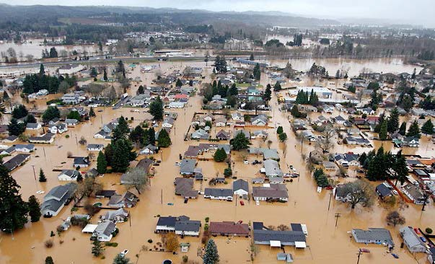
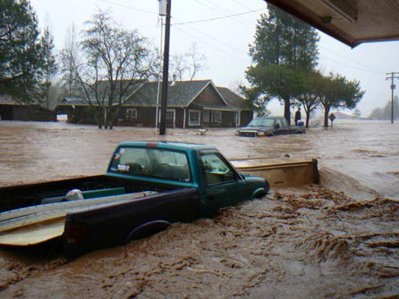
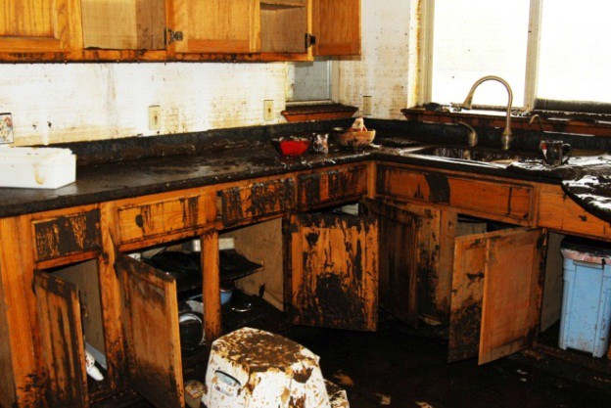
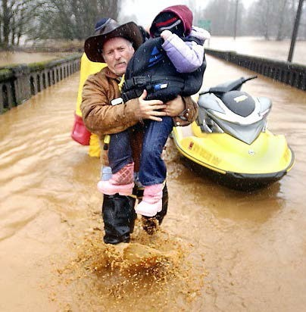
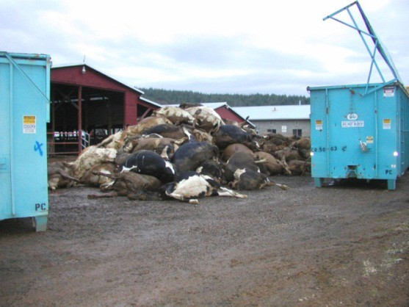


2007 Storm
$938M Basin-wide damage, $300M lost economic activity (WA).
Exit 77 (I-5) in Chehalis
STEVE RINGMAN / SEATTLE TIMES
City of Centralia
STEVE RINGMAN / SEATTLE TIMES
State Route 6, West of Adna MIKE SALSBURY / AP
Photos Source: LEWIS COUNTY, DIVISION OF EMERGENCY
MANAGEMENT

Slide 3



Today’s Presentation
Describe the “Flood Authority”
  #1 -- Local Projects
  #2 -- Flood Warning System
Touch on the “Chehalis River Basin Flood Control Zone District”
  #3 -- Proposed Flow-through Dam for Flood Control
Allow time for discussion.
Office of Chehalis Basin | Chehalis Basin Board
https://chehalisbasinstrategy.com/
.

Slide 4
Chehalis River Basin Flood Authority
Formed in 2008
Focused on flood hazard mitigation
Decision-making
  informed by science
  protective of Basin residents/communities
  environmentally appropriate
Jurisdictions represented (see inter-local agreement)
Grays Harbor County (2008)
  City of Aberdeen (2008)
  City of Cosmopolis(2011)
  City of Hoquiam (2017)
  City of Montesano (2008)
  City of Oakville (2008)
Lewis County (2008)
  City of Centralia (2008)
  City of Chehalis (2008)
  City of Napavine (2011)
  Town of Pe Ell (2008)
Thurston County (2008)
  Town of Bucoda (2008)
Help local communities identify, develop, implement local flood hazard reduction solutions.

Slide 5
Local Projects (#1)
Reduce flood damage.
Protect people, property, infrastructure.
Improve readiness, response, resiliency.
  Drinking Water (Boistfort, Bucoda).
  Wastewater (Montesano, Pe Ell).
  Emergency Response (Grays Harbor County, Chehalis-Centralia Airport).
  Regional Economic Infrastructure (Montesano, Port of Chehalis, Port of Grays Harbor).
  Community Protection (Aberdeen, Adna, Bucoda, Centralia, Chehalis, Chehalis Tribe, Hoquiam, Oakville).
  Flood Warning (Basin-wide).
State Capital Budget:
2012-13 -- $ 5.0M
2013-15 -- $10.7M
2015-17 -- $15.7M
2017-19 -- $ 9.6M
2019-21 -- $ 6.3M
2021-23 -- $ 4.1M
2023-25 -- $ 3.6M
$55.0M
2025-27 -- $ 3.0M
to
$13.0M

Slide 6
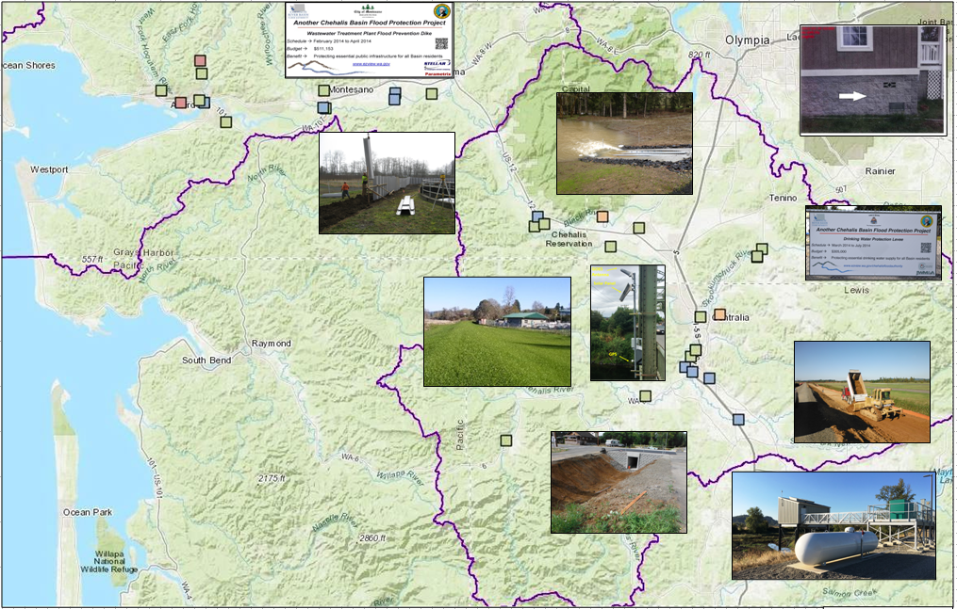
Local Projects (100+ Projects Completed 2012-23)
Cost: ~$450,000 (average)
Timeframe: ~600 days (average)
Sequence:
1st = “Plan/Study/Design” project (~50)
2nd = “Construction” project (~53)

Slide 7
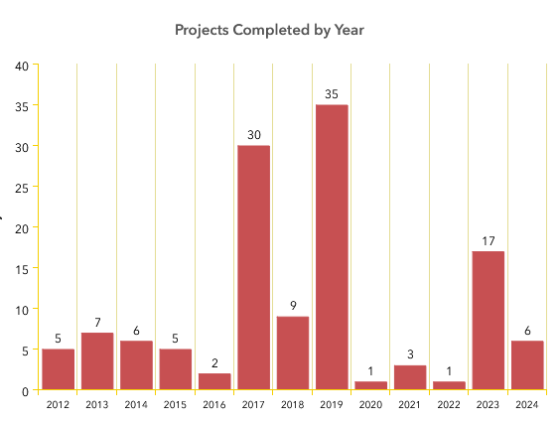
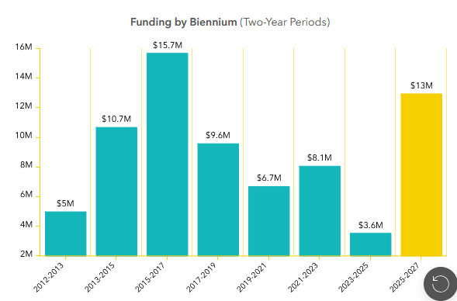
Local Projects (100+ Projects Completed 2012-23)

Slide 8
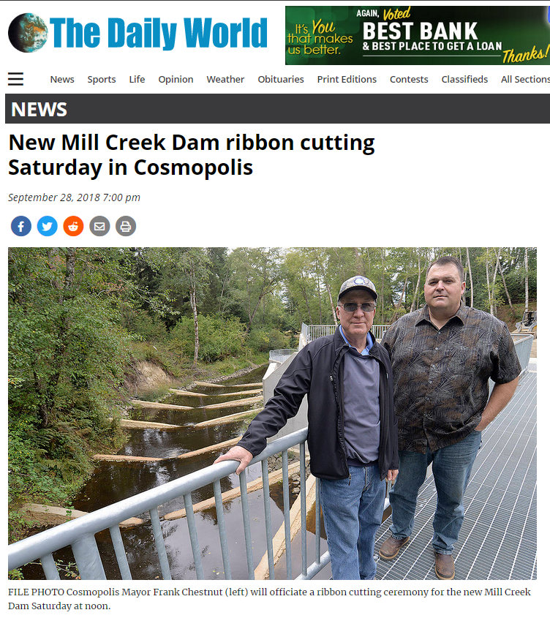
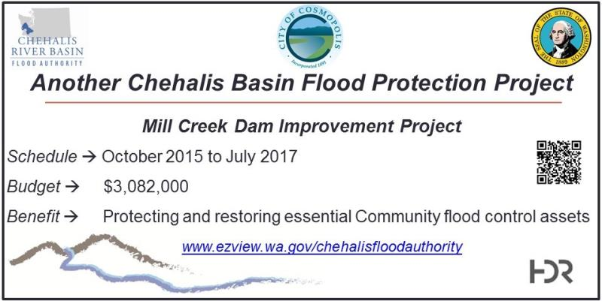
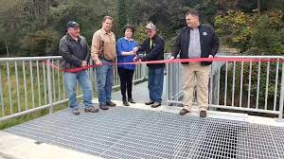
Local Projects (Cosmopolis, 2015-2018)
Mill Creek Multi-Objective Implementation Plan:
Part I = Reconstruct Mill Creek Dam (done).
Phase II project = Address 4,500’ of Mill Creek flow, culverts, and flood water evacuation (under development).
Read 5-24-2024 news article here
City of Cosmopolis, Sep 29, 2018
https://www.thedailyworld.com/news/new-mill-creek-dam-ribbon-cutting-saturday-in-cosmopolis/

Slide 9
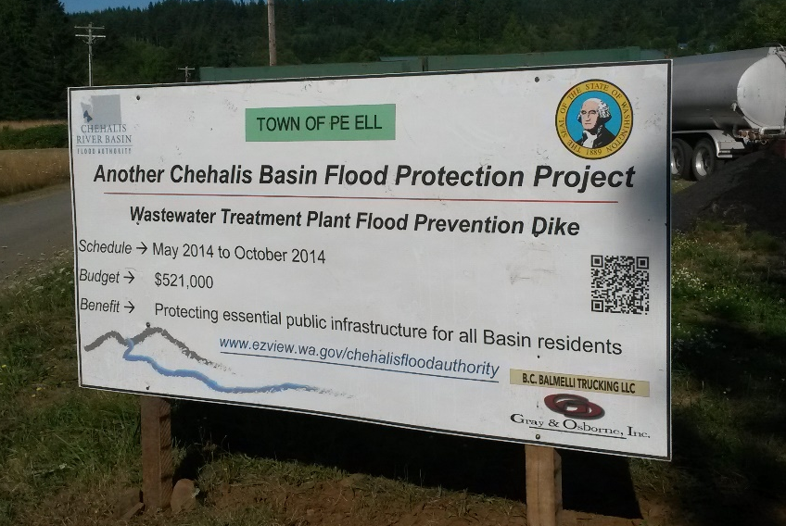
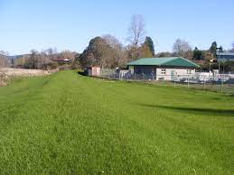
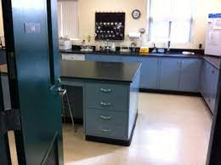
Local Projects (Pe Ell, 2014)
Project = Design/construct 900’ dike (between Chehalis r. and WWTP).
Cost = $521,000.
Photos = https://www.ezview.wa.gov/site/alias__1492/35040/default.aspx#peell.
Website = https://www.ezview.wa.gov/site/alias__1782/34858/overview.aspx

Slide 10
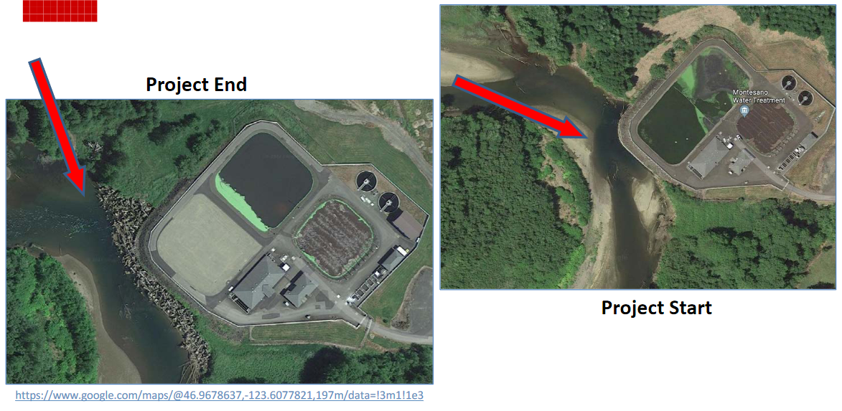
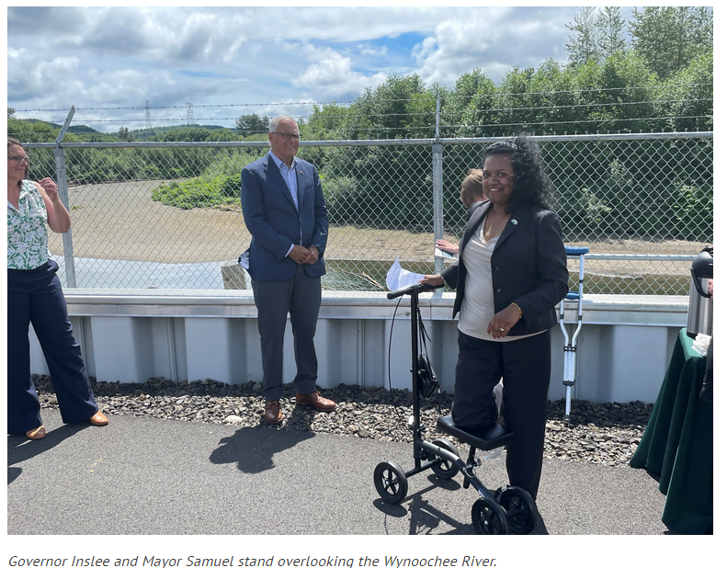
Local Projects (Montesano, 2017-2020)
Protect WWTP from on-coming Wynoochee river using 220+ “log-jacks.”
$2 million (for “log-jacks”).
Small cost compared to WWTP relocation and environmental cleanup (in event of WWTP breaching).
July 7, 2022 →

Slide 11
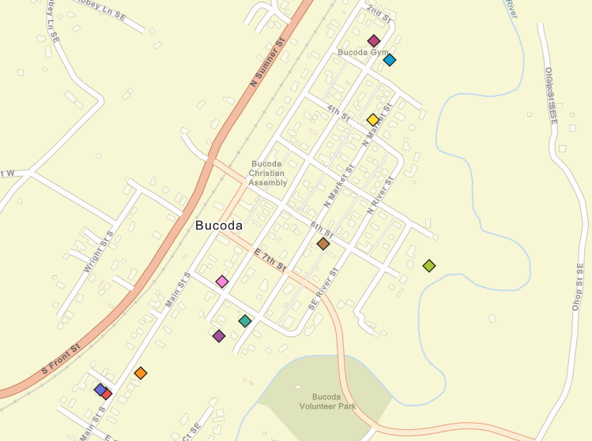
Foundation Flood Openings Pilot
Local Projects (Bucoda, 2016)
11 Properties
Total -- $ 85,465.43.
Average -- $8,550.
Link – here.
Web map – here.

Slide 12
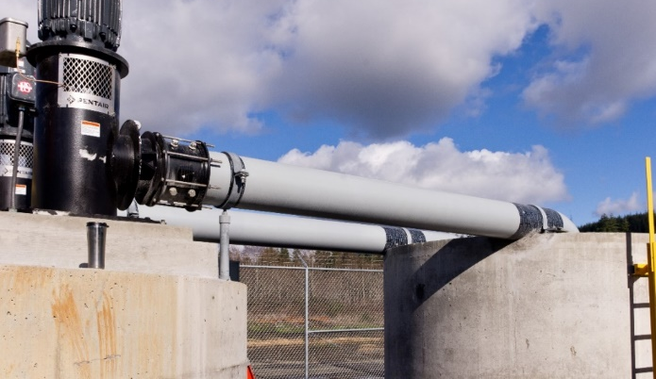
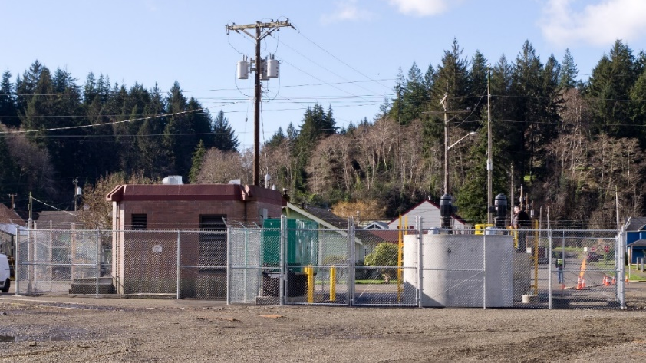
Local Projects (Hoquiam, 2016-2018)
Completed -- February 2018.
Cost -- $1.3M.
January 2022 Flood Event – Ramer basin stayed dry
(51M gallons pumped over 30 hours)
ROI (2024) -- $72M in assets protected.
  ~200 homes
  Lincoln Elementary School
  Commercial yacht builder
  8 acres of prime development property
  Large low-income residential neighborhood
  Coastal Harvest food distribution center
Read More -- Here.

Slide 13
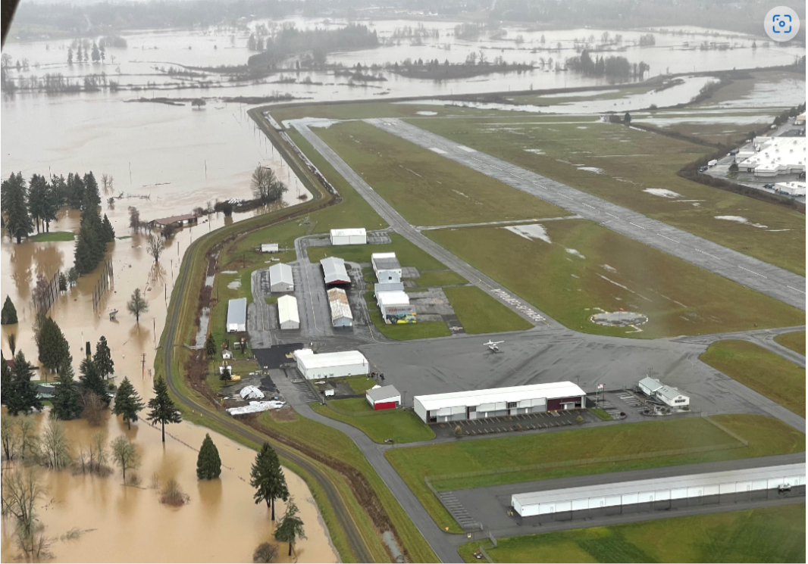
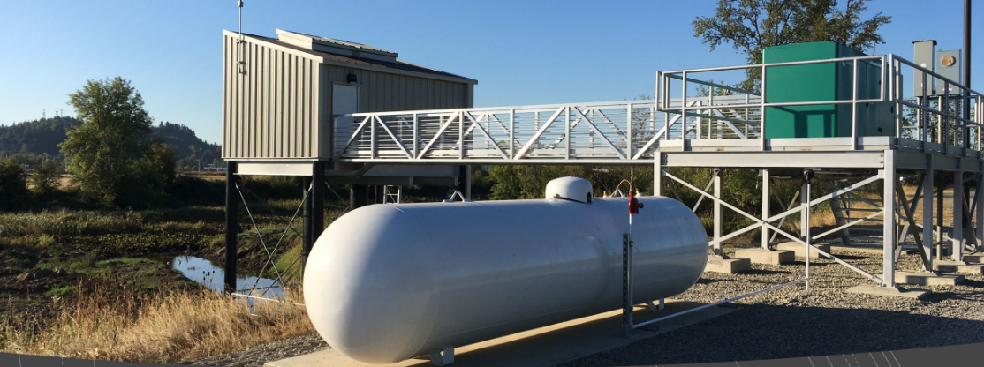
Local Projects (Chehalis-Centralia Airport, 2017)
Completed -- Fall 2017.
Cost -- $1.14M.
January 2022 Flood Event – Pumped
518.4M gallons over many days to keep levee dry.
ROI (2018) -- Protects $45M in assets, ensures $9M in annual tax revenue.
Read More -- Here.

Slide 14
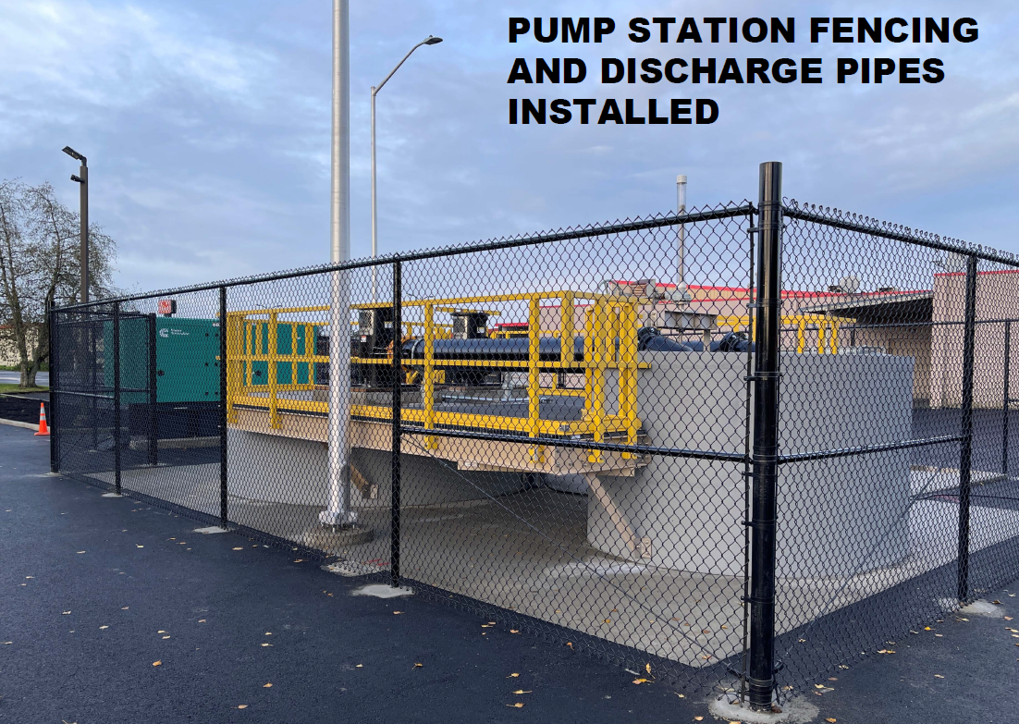
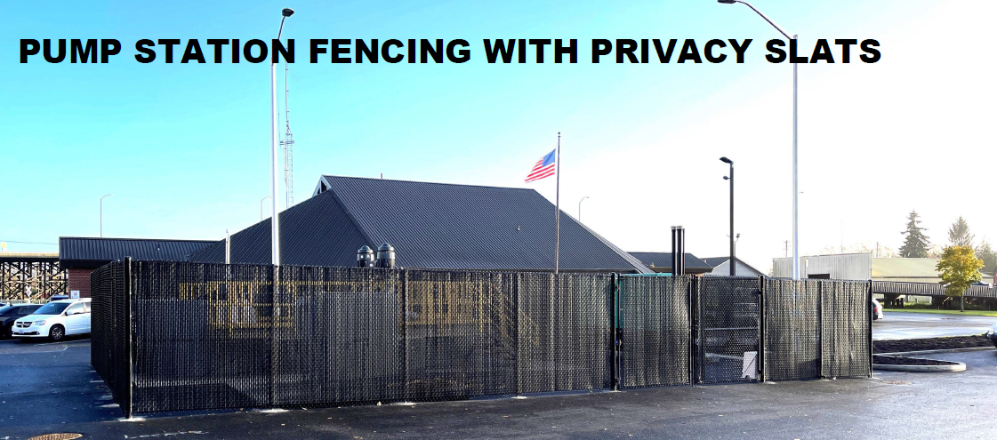
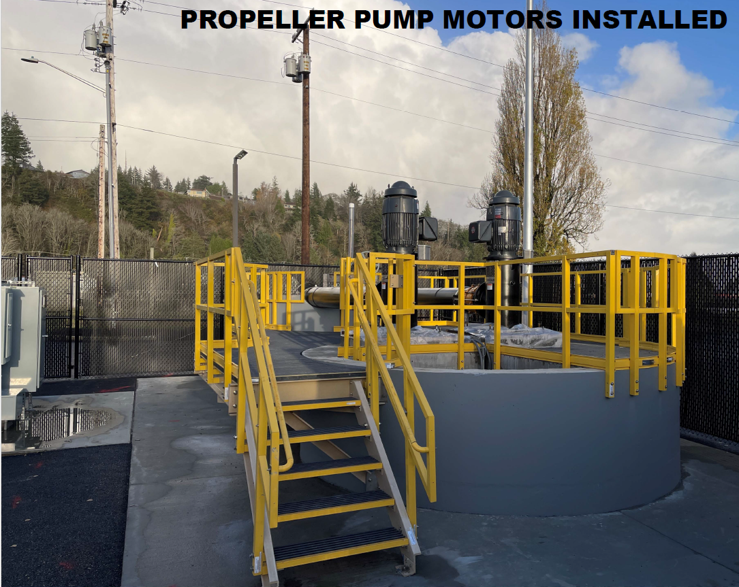
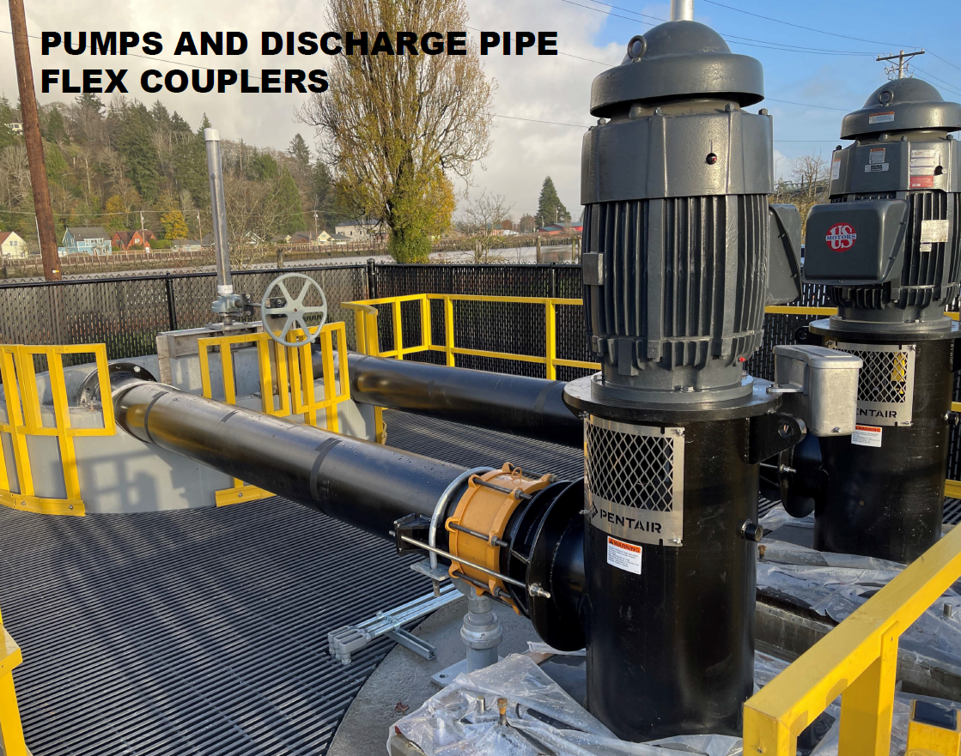
NEW! -- 10th Street Stormwater Pump Station
Local Projects (Sneak Preview -- Hoquiam, 2025)

Slide 15
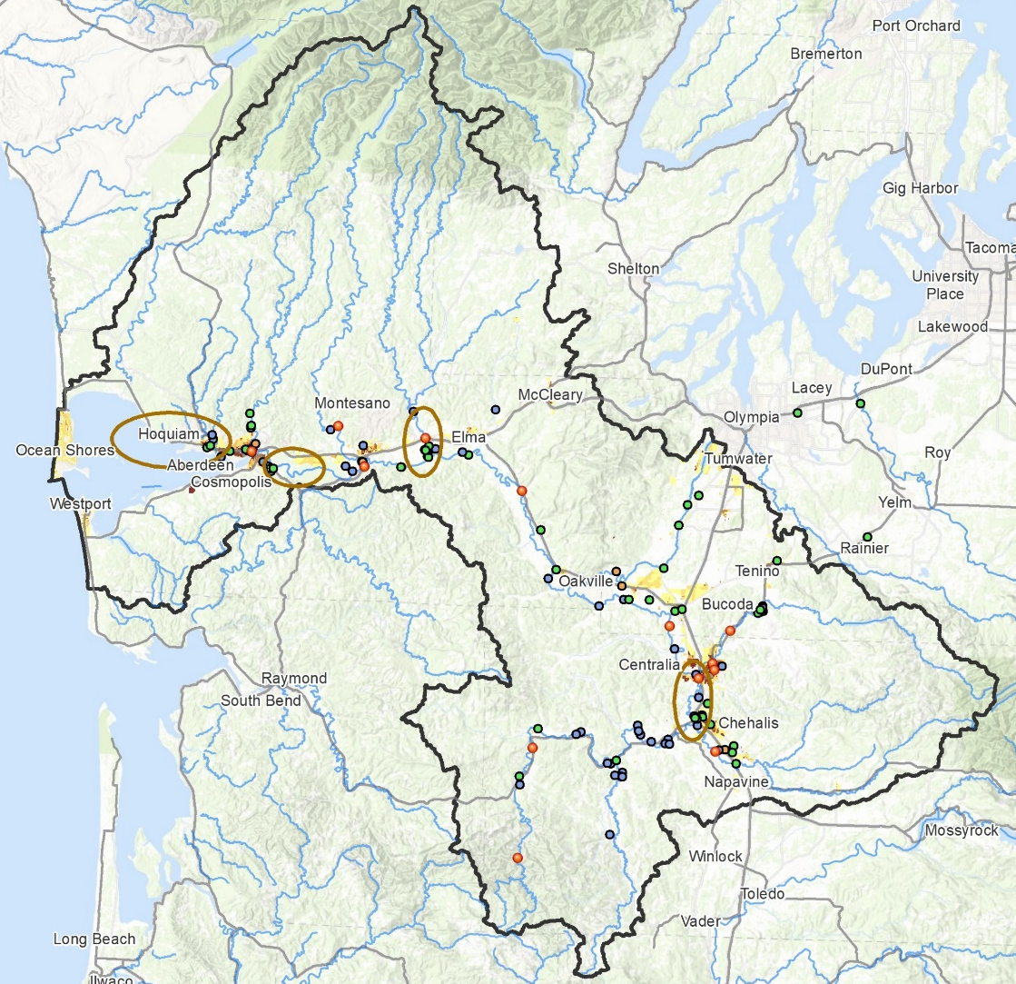
Local Projects (Moving to Geographically-Based)
Identify future local projects through geographically-based, coordinated local investment planning.

Slide 16
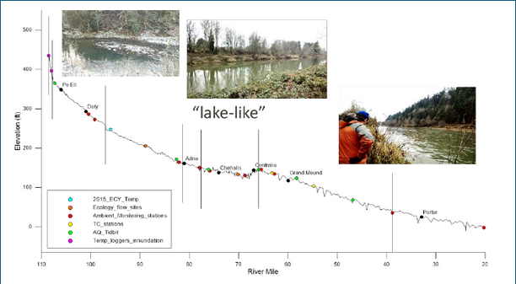
Local Projects (Moving to Geographically-Based)
Basin Geography
Upper = Steep, narrow, fast flowing.
Middle = Flat, “lake like”, slow to drain.
Lower = Flat, coastal, difficult to drain.
Shah, Mohammad. (2021). inland water-dynamics and ecology. 10.5772/intechopen.87463.

Slide 17
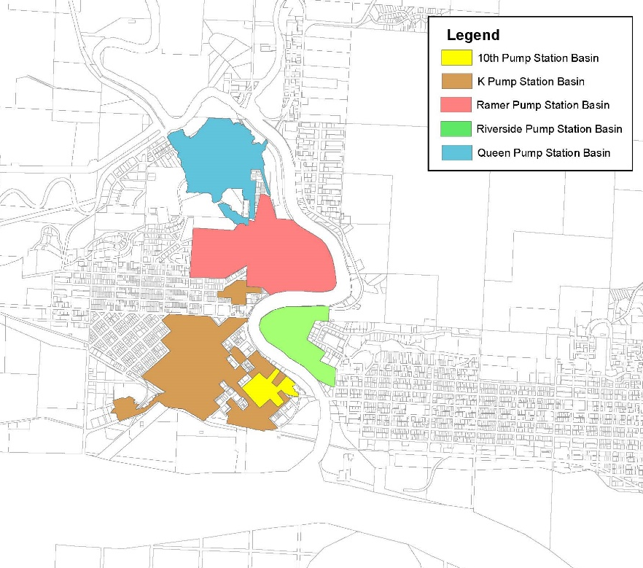
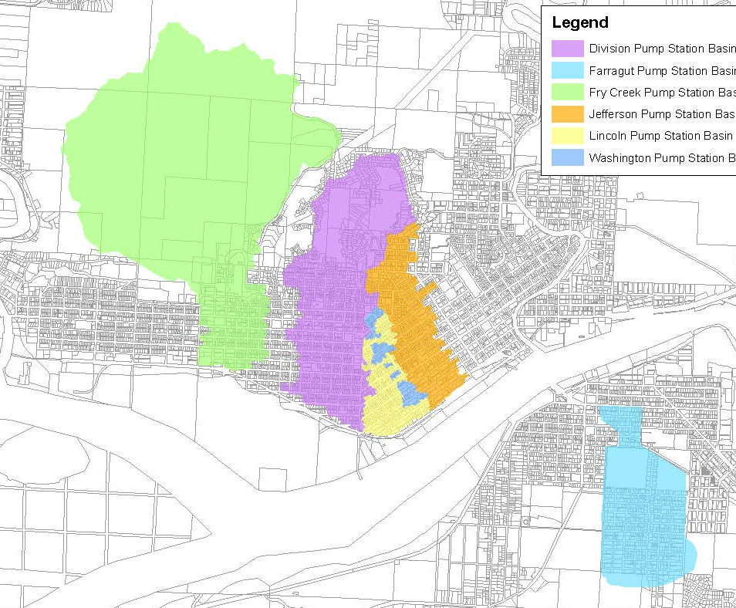
Local Projects (Moving to Geographically-Based)
Sub-Basin | Elevation | Assessed
10th St | 160’ - 10’ | $17M
K St | 20’ - 10’ | $121M
Ramer St | 256’ - 10’ | $72M
Riverside | 305’ - 10’ | $21M
Queen Ave | 255’ - 10’ | $38M
Sub-Basin | Elevation | Assessed
Division | 345’ - 10’ | $300M
Farragut* | 90’ - 10’ | $98M
Fry | 498’ - 4’ | $147M
Jefferson | 344’ - 10’ | $193M
Lincoln | 15’ - 10’ | $66M
Washington | 95’ - 10’ | $27M
11 urbanized low elevation sub-basins | + | Adverse meteorologic conditions -- high tides, heavy rain, bankfull rivers, saturated soils, SW winds | = | Very difficult to drain! ($1.1B assessed value at risk)

Slide 18
Local Projects (Pumps are Key to the Solution)
Read Fall 2022 Joint Resolution on Pumps (Hoquiam, Aberdeen, Cosmopolis)
2,735 acres
4,583 parcels
232 businesses
$1.1B assessed value
18%
24%
58%

Slide 19
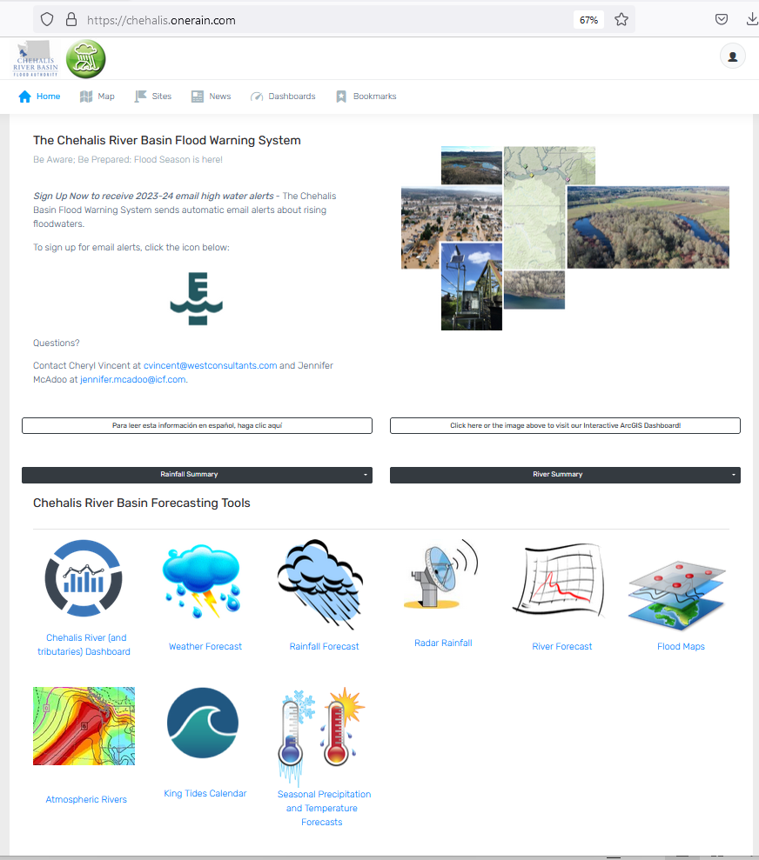
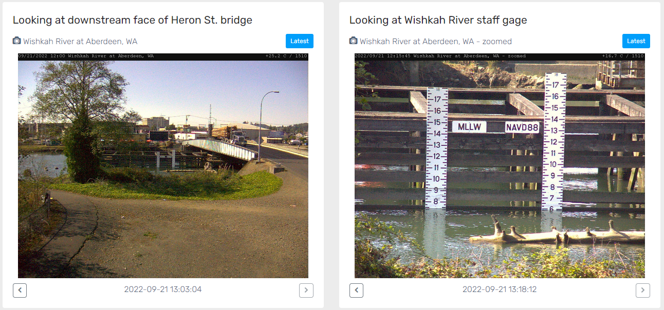
Developed with State Capital Budget $.
Maintained with local $.
Flood Warning System (#2)
www.chehalisriverflood.com

Slide 20
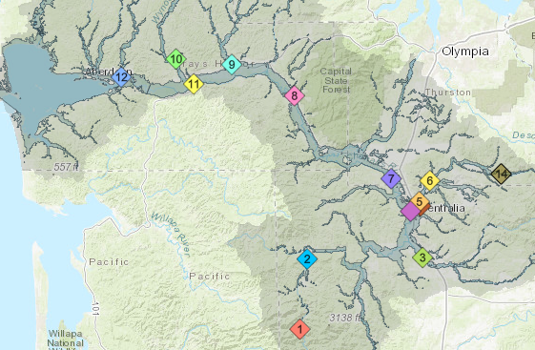
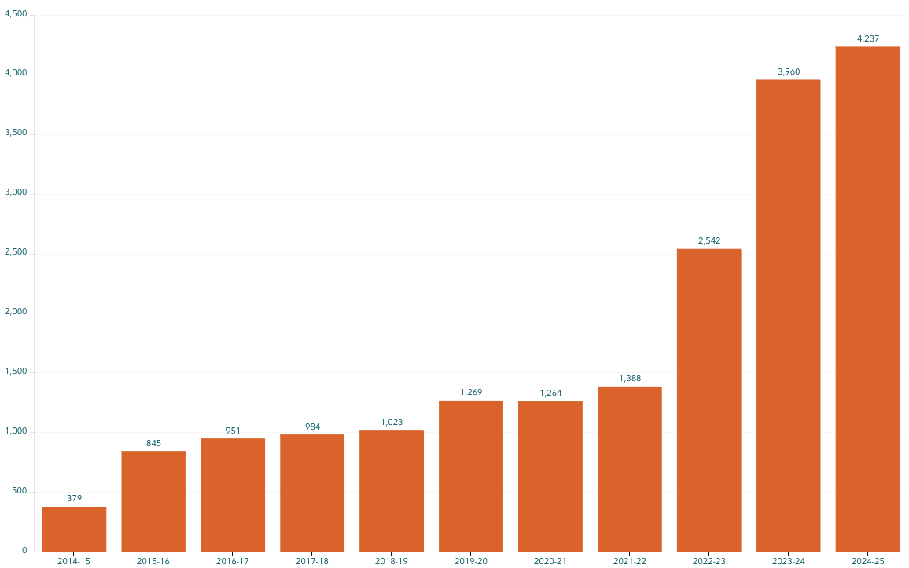
Flood Warning System (Alert Sign-Ups)
Sign-up for email high water alerts here.

Slide 21
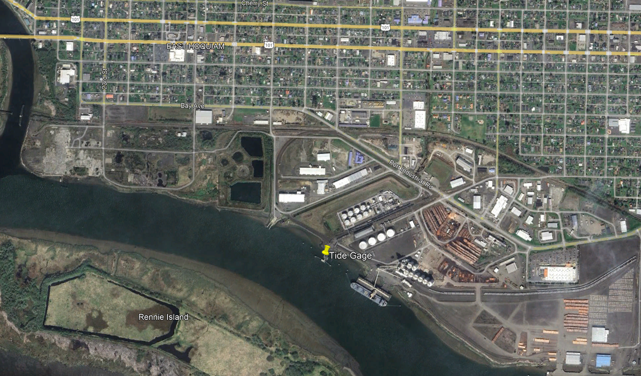
Flood Warning System (New Tide Gage)
Chehalis Basin Board provided funding for new Tide gage.
Working with NWS on lower Chehalis river forecast.
Data could help Aberdeen/Hoquiam manage North Shore Levee.

Slide 22
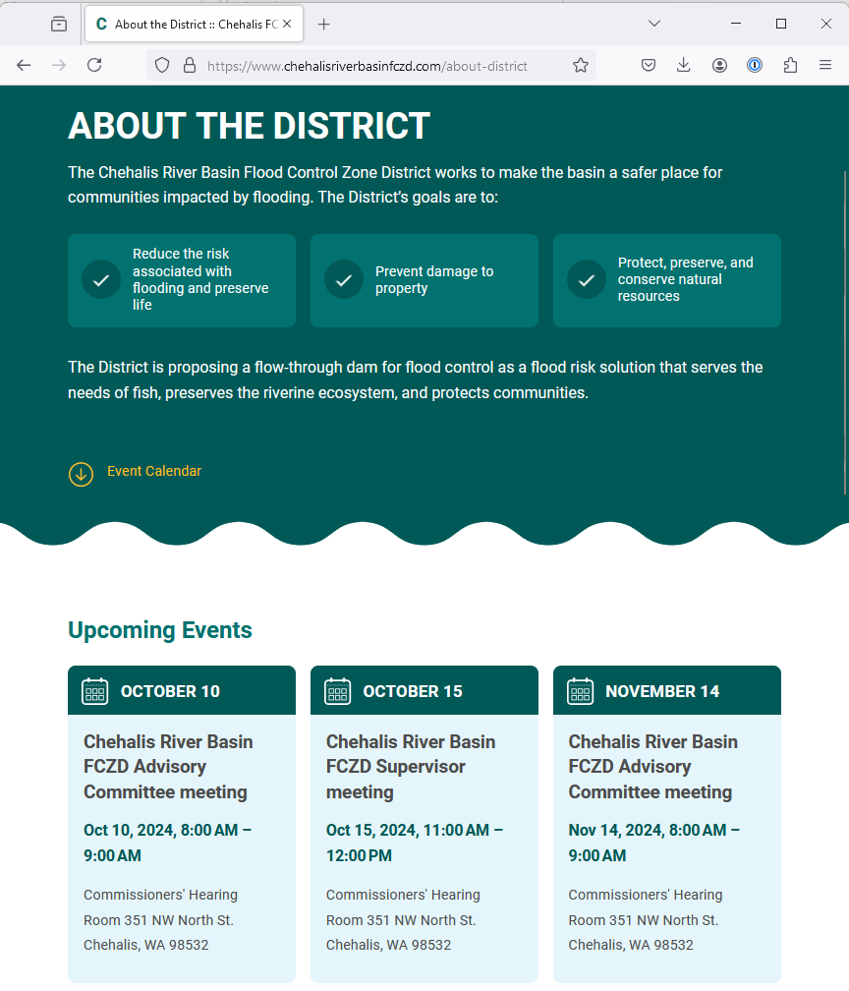
Proposed Flow-through Dam for Flood Control (#3)
www.chehalisriverbasinfczd.com

Slide 23
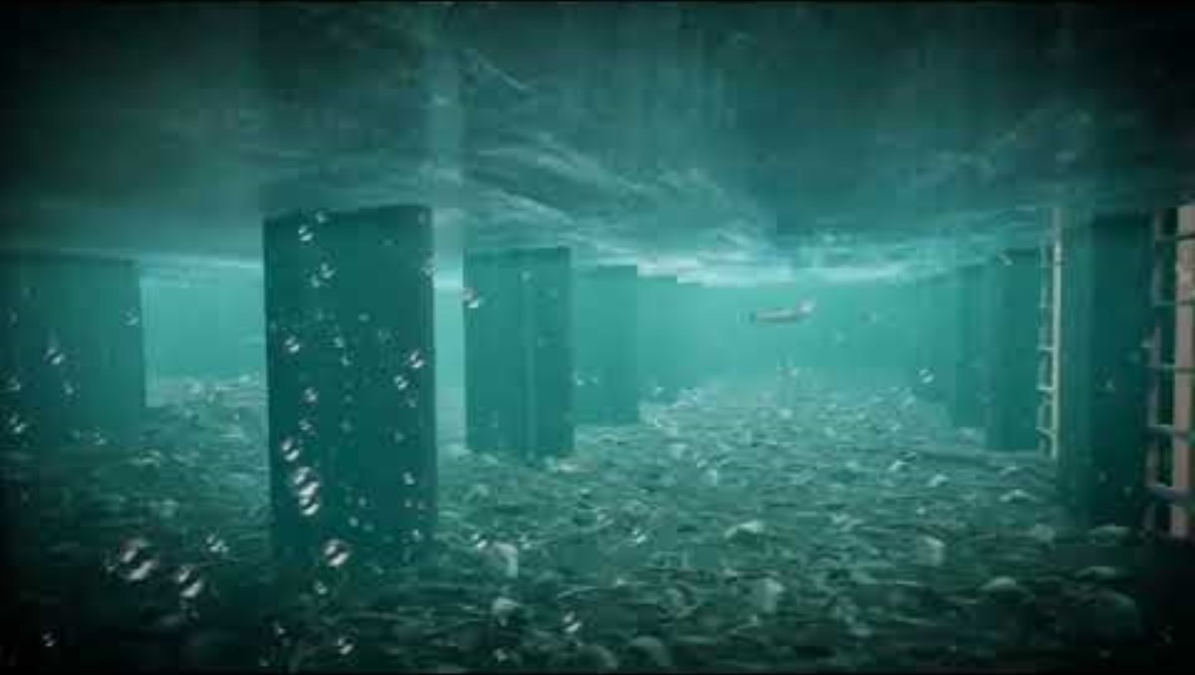
Proposed Flow-Through Dam for Flood Control (#3)
1. Move through unobstructed
Water
Fish
Sediment
2. Delivers top-to-bottom benefit, Pe Ell to Cosmopolis.
3. See recent presentation here.

Slide 24
State Law
“The primary purpose of the office is to aggressively pursue implementation of an integrated strategy and administer funding for long-term flood damage reduction and aquatic species restoration in the Chehalis river basin.” (RCW 43.21A.730)
Chehalis Basin Strategy
appoints 3 member
Chehalis Basin Board
Community leaders, Chehalis and Quinault tribal representatives, local and state government liaisons
Office of Chehalis Basin | Chehalis Basin Board
https://chehalisbasinstrategy.com/
Office of Chehalis Basin
Small team within the WA Department of Ecology
“Network of Partners”
Organizations and local entities who turn ideas into shovel-ready reality

Slide 25








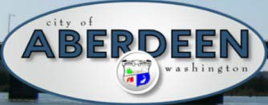















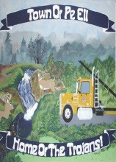


Chehalis Basin Strategy (Network of Partners)

Slide 26
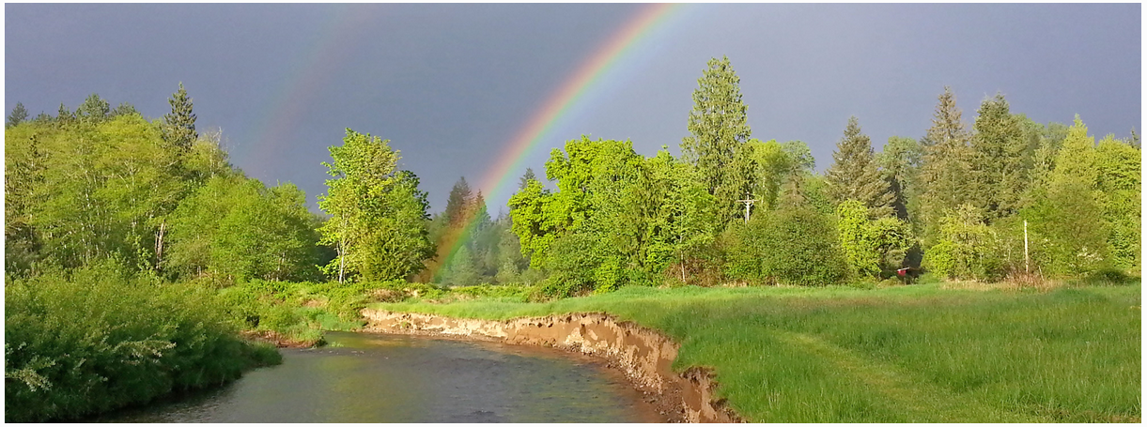
Local Resolutions Library
https://www.ezview.wa.gov/site/alias__1492/37643/local_resolutions.aspx
Today vs 2007
Today, we are substantially more aware, better prepared for catastrophic flooding than ever before.
We have a state-of-the art flood warning system.
We’ve completed many cost-efficient local projects and habitat projects.
We’re serving people, local governments, emergency responders, agriculture, fish, and habitat alike
We have a governance, administrative, and funding structure that’s delivering results, and is committed to a balanced basin-wide flood and fish solution (see Local Resolution Library).
https://chehalisbasinstrategy.com/office-of-chehalis-basin/

Slide 27
Key Contacts
Vickie Raines, Grays Harbor County Representative
Chair, Chehalis River Basin Flood Authority
Chair, Chehalis Basin Board
360/590-4100
vraines@graysharbor.us
Edna Fund, Lewis County Representative
Vice-Chair, Chehalis River Basin Flood Authority
Chair, Chehalis River Basin Flood Control Zone District Advisory Board
360/269-7515
dutch@localaccess.com
Frank Chestnut, Cosmopolis Representative
Member, Chehalis River Basin Flood Authority
360/593-4780
fchestnut@comcast.net
Kim Skinner, Cosmopolis Representative (Alternate)
Member (Alternate), Chehalis River Basin Flood Authority
360/580-5705
council1@cosmopoliswa.gov
Scott Boettcher
Staff, Chehalis River Basin Flood Authority
360/480-6600
scottb@sbgh-partners.com

Slide 28
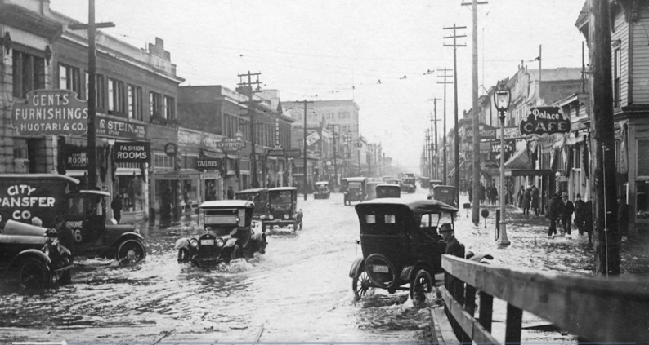
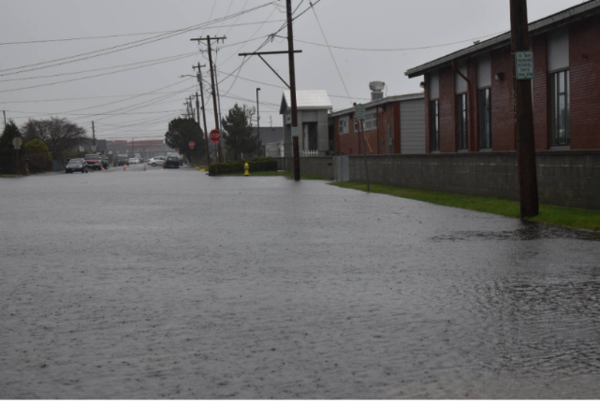
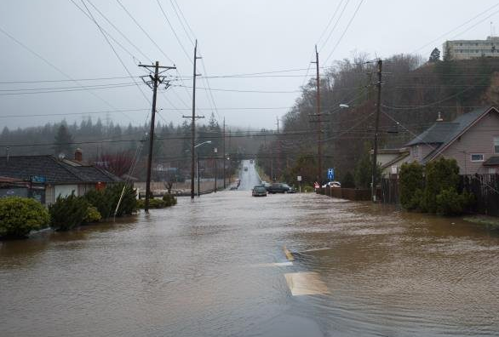
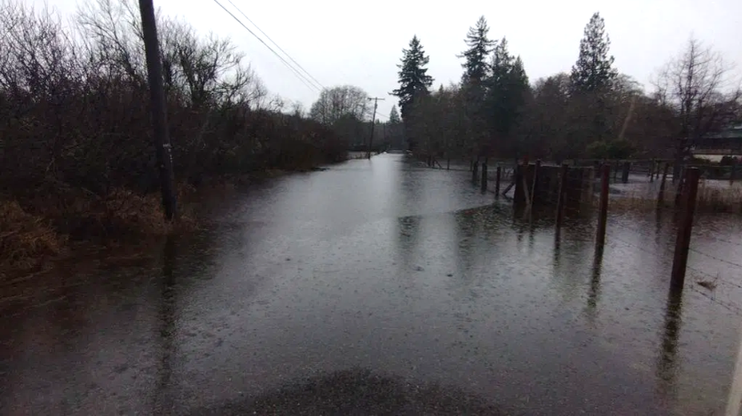
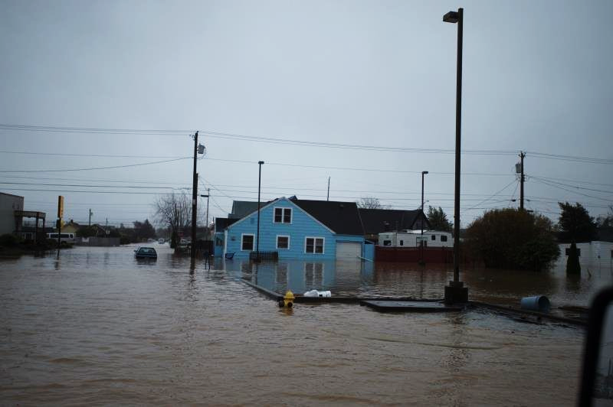
Extra . . .
Hoquiam December 1933
Since the 1960’s Grays Harbor has had 14 federally declared disaster flood events
Aberdeen January 2022
Hoquiam January 2015
Cosmopolis January 2022
Aberdeen January 2015
9-05-2024 -- Lower Basin Flooding; Drivers and Solutions (here).
9-2022 -- Joint Resolution; Aberdeen, Hoquiam, Cosmopolis (here).
RCO 22-2277 -- Joint Surface Water Management Comprehensive Plan (here).

