Slide 1


Chehalis River Basin Flood Authority
Reducing Flood Damage and
Restoring Aquatic Species
City of Hoquiam
September 23, 2024

Slide 2
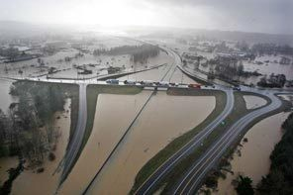
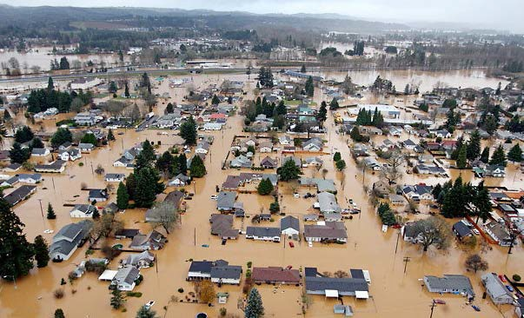
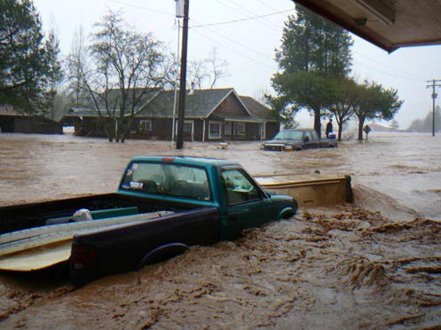
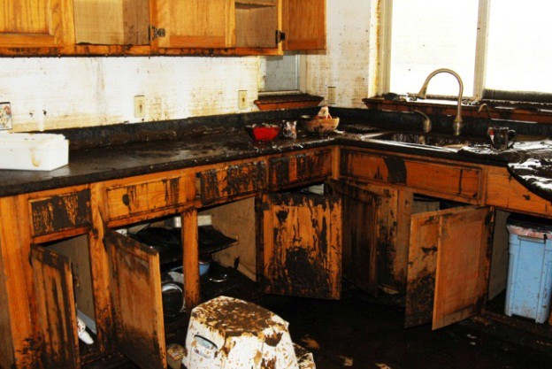
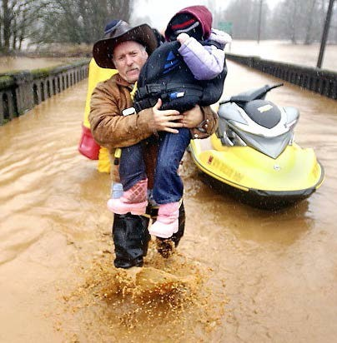
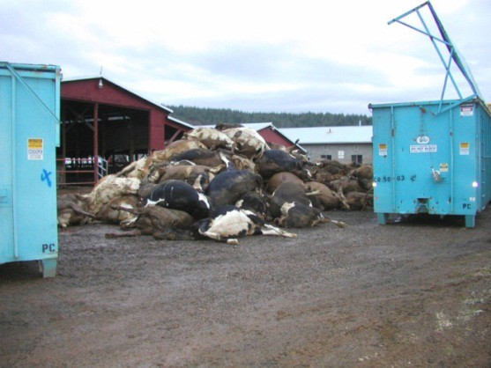


2007 Storm
$938M Basin-wide damage, $300M lost economic activity (WA).
Exit 77 (I-5) in Chehalis
STEVE RINGMAN / SEATTLE TIMES
City of Centralia
STEVE RINGMAN / SEATTLE TIMES
State Route 6, West of Adna MIKE SALSBURY / AP
Photos Source: LEWIS COUNTY, DIVISION OF EMERGENCY
MANAGEMENT

Slide 3



Today’s Presentation
Describe the “Flood Authority”
  #1 -- Local Projects
  #2 -- Flood Warning System
Touch on the “Chehalis River Basin Flood Control Zone District”
  #3 -- Proposed Flow-through Dam for Flood Control
Allow time for discussion.
Office of Chehalis Basin | Chehalis Basin Board
https://chehalisbasinstrategy.com/
.

Slide 4
Chehalis River Basin Flood Authority
Formed in 2008
Focused on flood hazard mitigation
Decision-making
  informed by science
  protective of Basin residents/communities
  environmentally appropriate
Jurisdictions represented (see inter-local agreement)
Grays Harbor County (2008)
  City of Aberdeen (2008)
  City of Cosmopolis(2011)
  City of Hoquiam (2017)
  City of Montesano (2008)
  City of Oakville (2008)
Lewis County (2008)
  City of Centralia (2008)
  City of Chehalis (2008)
  City of Napavine (2011)
  Town of Pe Ell (2008)
Thurston County (2008)
  Town of Bucoda (2008)
Help local communities identify, develop, implement local flood hazard reduction solutions.

Slide 5
Local Projects (#1)
Reduce flood damage.
Protect people, property, infrastructure.
Improve readiness, response, resiliency.
  Drinking Water (Boistfort, Bucoda).
  Wastewater (Montesano, Pe Ell).
  Emergency Response (Grays Harbor County, Chehalis-Centralia Airport).
  Regional Economic Infrastructure (Montesano, Port of Chehalis, Port of Grays Harbor).
  Community Protection (Aberdeen, Adna, Bucoda, Centralia, Chehalis, Chehalis Tribe, Hoquiam, Oakville).
  Flood Warning (Basin-wide).
State Capital Budget:
2012-13 -- $ 5.0M
2013-15 -- $10.7M
2015-17 -- $15.7M
2017-19 -- $ 9.6M
2019-21 -- $ 6.3M
2021-23 -- $ 4.1M
2023-25 -- $ 3.6M
$55.0M

Slide 6
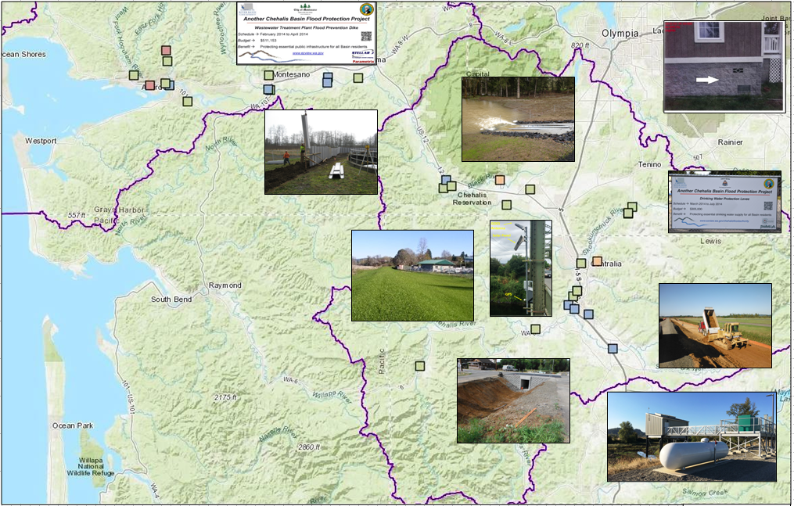
Local Projects (100+ Projects Completed 2012-23)
Cost: ~$450,000 (average)
Timeframe: ~600 days (average)
Sequence:
1st = “Plan/Study/Design” project (~50)
2nd = “Construction” project (~53)

Slide 7
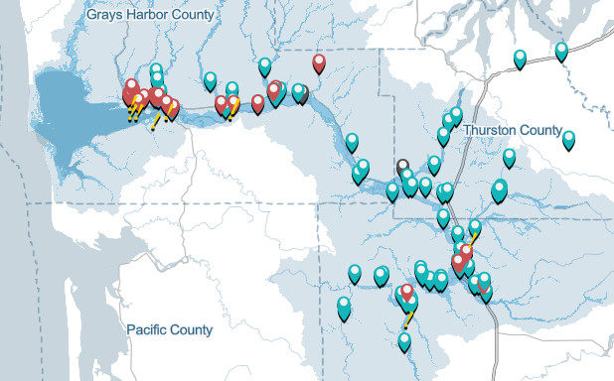
Local Projects (100+ Projects Completed 2012-23)

Slide 8
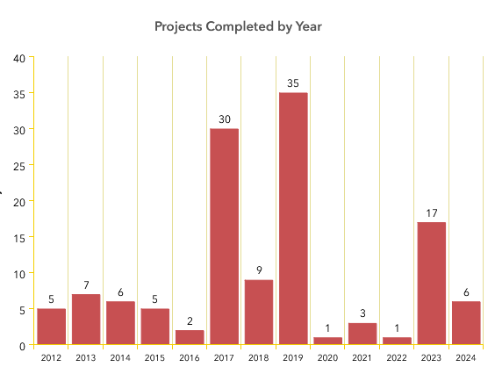
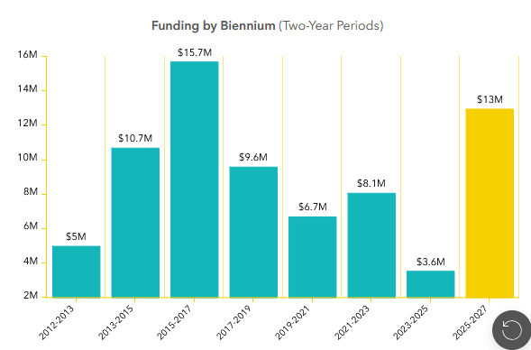
Local Projects (100+ Projects Completed 2012-23)

Slide 9
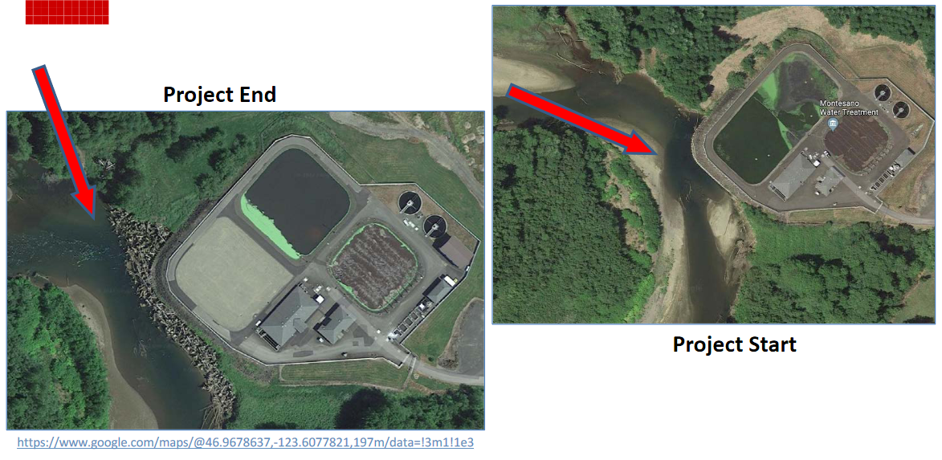
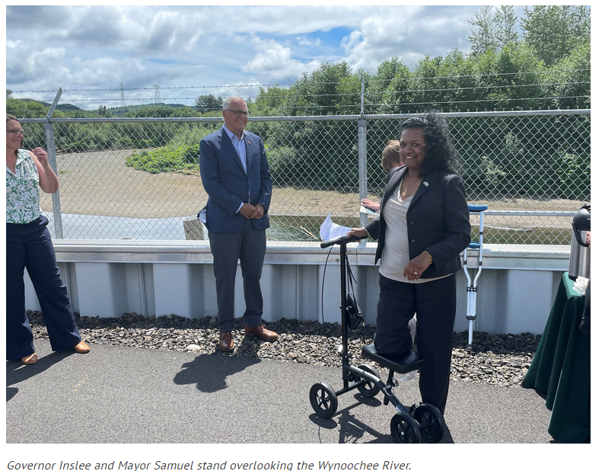
COMPLETED FLOOD AND FISH – Montesano WWTP
Local Projects (Montesano, 2017-2020)
Protect WWTP from on-coming Wynoochee river using 220+ “log-jacks.”
$2 million (for “log-jacks”).
Small cost compared to WWTP relocation and environmental cleanup (in event of WWTP breaching).
July 7, 2022 →

Slide 10
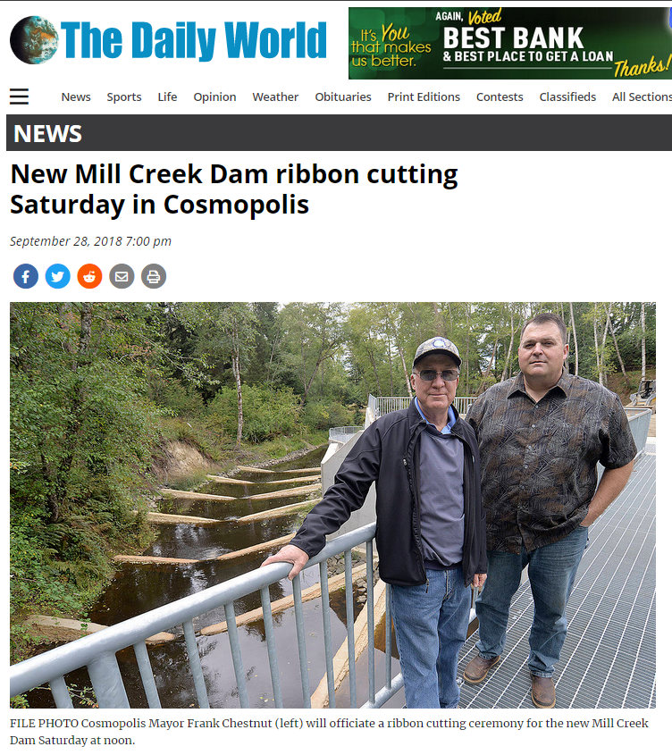
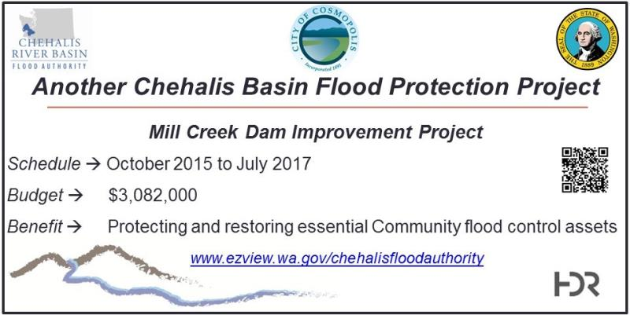
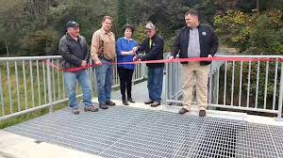
COMPLETED FLOOD AND FISH – Mill Creek Dam
Local Projects (Cosmopolis, 2015-2018)
Mill Creek Multi-Objective Implementation Plan:
Part I = Reconstruct Mill Creek Dam (done).
Phase II project = Address 4,500’ of Mill Creek flow, culverts, and flood water evacuation (under development).
Read 5-24-2024 news article here
City of Cosmopolis, Sep 29, 2018
https://www.thedailyworld.com/news/new-mill-creek-dam-ribbon-cutting-saturday-in-cosmopolis/

Slide 11
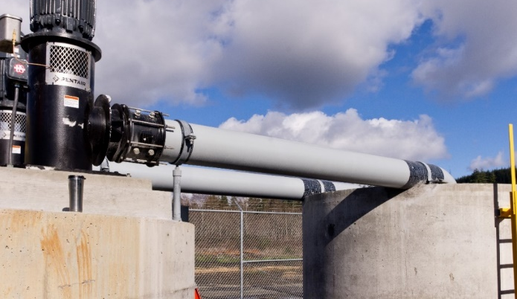
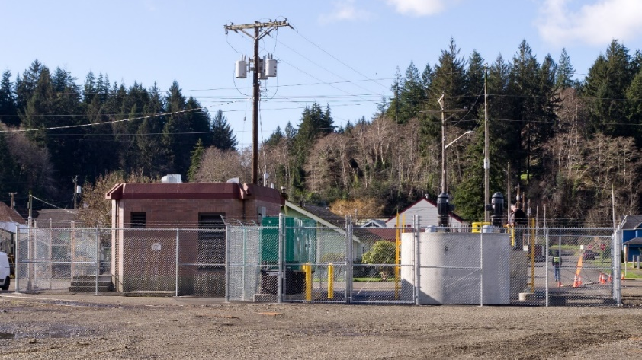
COMPLETED FLOOD – Raymer Street Pump Station
Local Projects (Hoquiam, 2016-2018)
Completed -- February 2018.
Cost -- $1.3M.
January 2022 Flood Event – Ramer basin stayed dry
(51M gallons pumped over 30 hours)
ROI (2024) -- $72M in assets protected.
  ~200 homes
  Lincoln Elementary School
  Commercial yacht builder
  8 acres of prime development property
  Large low-income residential neighborhood
  Coastal Harvest food distribution center
Read More -- Here.

Slide 12
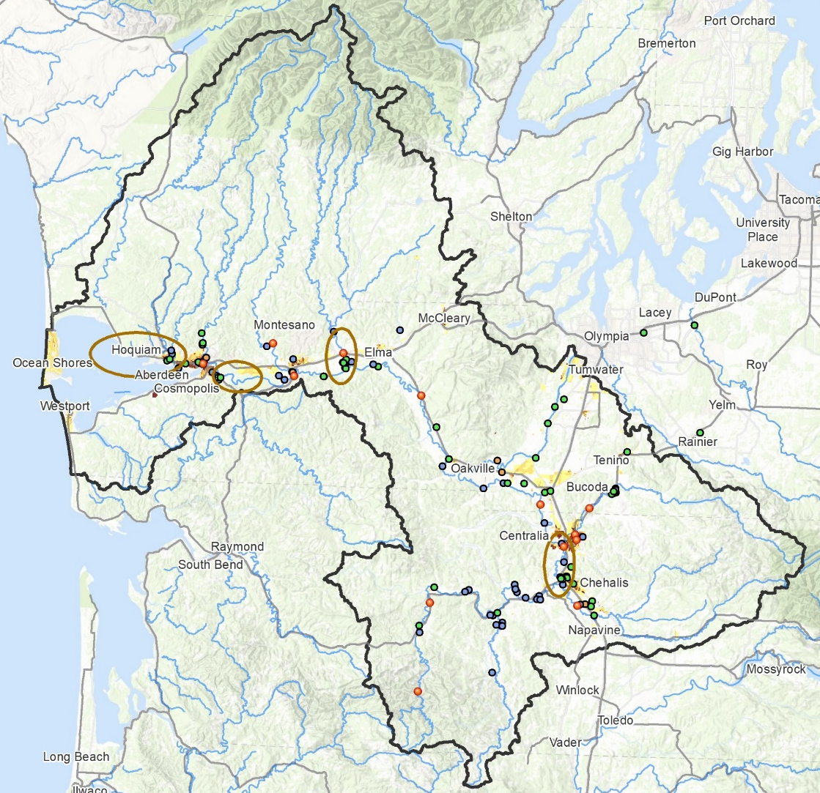
Local Projects (Moving to Geographically-Based)
Identify future local projects through geographically-based, coordinated local investment planning.

Slide 13
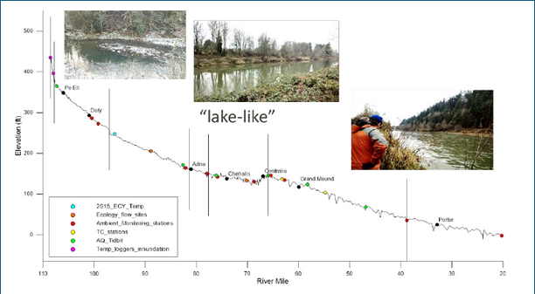
Local Projects (Moving to Geographically-Based)
Basin Geography
Upper = Steep, narrow, fast flowing.
Middle = Flat, “lake like”, slow to drain.
Lower = Flat, coastal, difficult to drain.
Shah, Mohammad. (2021). inland water-dynamics and ecology. 10.5772/intechopen.87463.

Slide 14
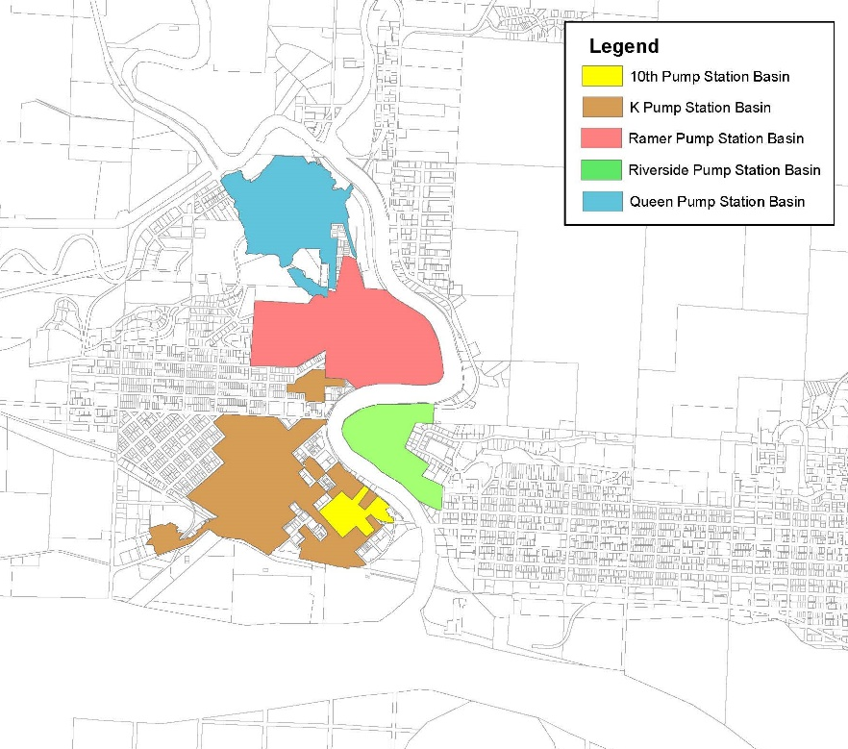
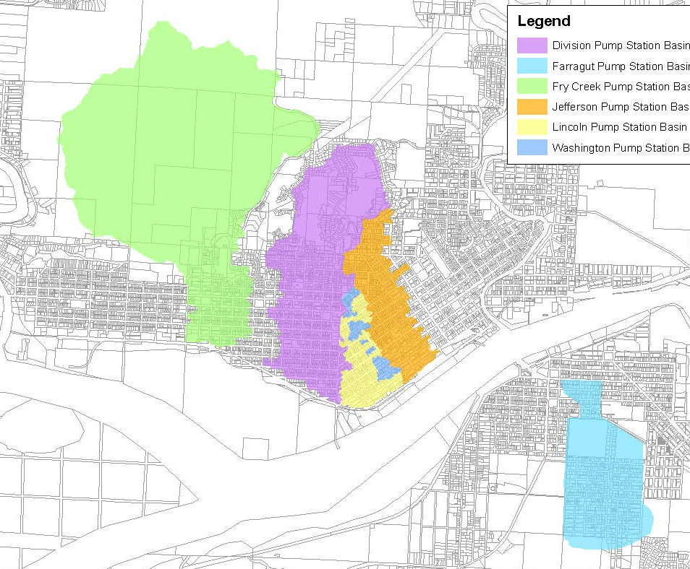
Local Projects (Moving to Geographically-Based)
Sub-Basin | Elevation | Assessed
10th St | 160’ - 10’ | $17M
K St | 20’ - 10’ | $121M
Ramer St | 256’ - 10’ | $72M
Riverside | 305’ - 10’ | $21M
Queen Ave | 255’ - 10’ | $38M
Sub-Basin | Elevation | Assessed
Division | 345’ - 10’ | $300M
Farragut* | 90’ - 10’ | $98M
Fry | 498’ - 4’ | $147M
Jefferson | 344’ - 10’ | $193M
Lincoln | 15’ - 10’ | $66M
Washington | 95’ - 10’ | $27M
11 urbanized low elevation sub-basins | + | Adverse meteorologic conditions -- high tides, heavy rain, bankfull rivers, saturated soils, SW winds | = | Very difficult to drain! ($1.1B assessed value at risk)

Slide 15
Local Projects (Pumps are Key to the Solution)
Read Fall 2022 Joint Resolution on Pumps (Hoquiam, Aberdeen, Cosmopolis)
2,735 acres
4,583 parcels
232 businesses
$1.1B assessed value
18%
24%
58%

Slide 16
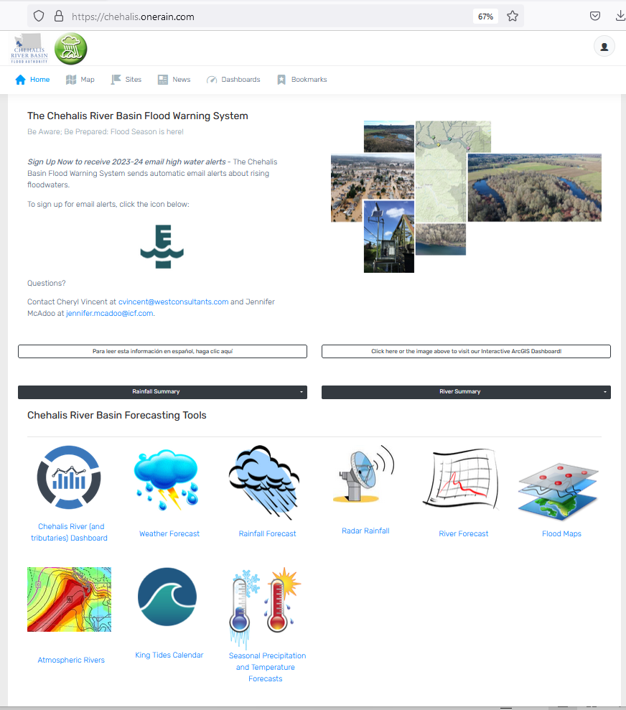
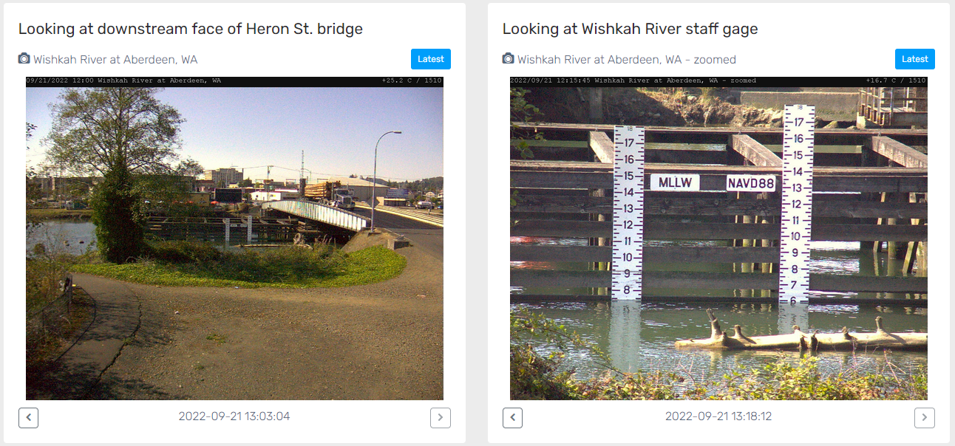
Developed with State Capital Budget $.
Maintained with local $.
Flood Warning System (#2)
www.chehalisriverflood.com

Slide 17
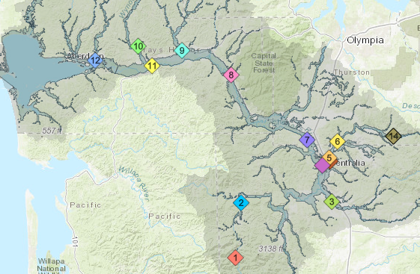
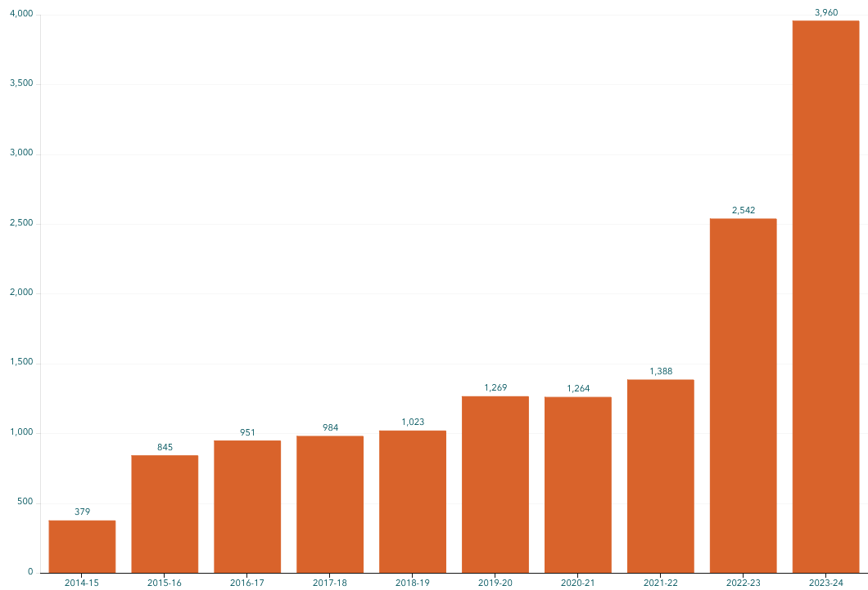
Flood Warning System (Alert Sign-Ups)
Sign-up for email high water alerts here.

Slide 18
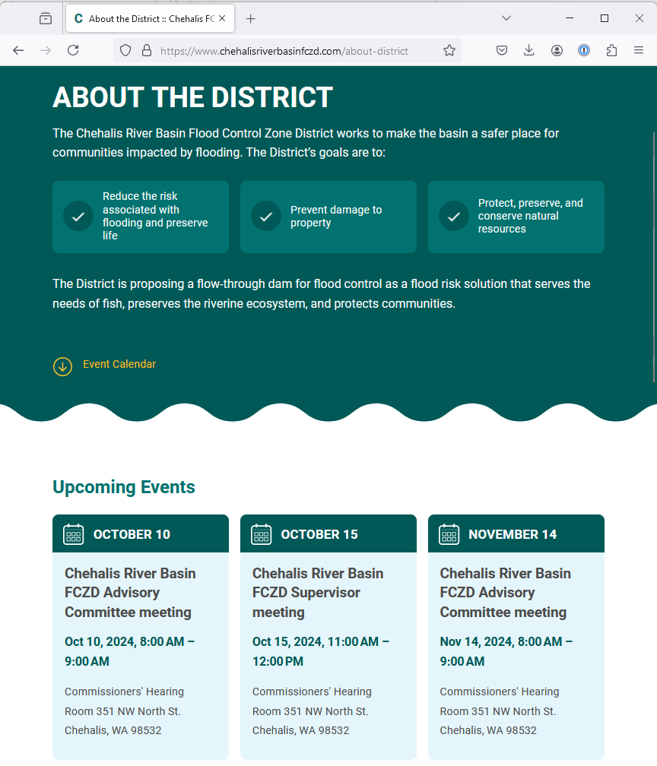
Proposed Flow-through Dam for Flood Control (#3)
www.chehalisriverbasinfczd.com

Slide 19

Proposed Flow-Through Dam for Flood Control (#3)
1. Move through unobstructed
Water
Fish
Sediment
2. Delivers top-to-bottom benefit, Pe Ell to Cosmopolis.
3. See recent presentation here.

Slide 20
Chehalis Basin Strategy
appoints 3 member
Chehalis Basin Board
Community leaders, Chehalis and Quinault tribal representatives, local and state government liaisons
Office of Chehalis Basin | Chehalis Basin Board
https://chehalisbasinstrategy.com/
Office of Chehalis Basin
Small team within the WA Department of Ecology
“Network of Partners”
Organizations and local entities who turn ideas into shovel-ready reality

Slide 21








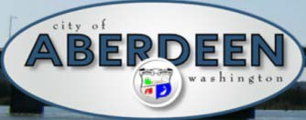















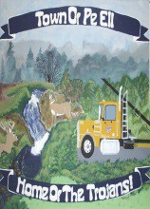


Chehalis Basin Strategy (Network of Partners)

Slide 22
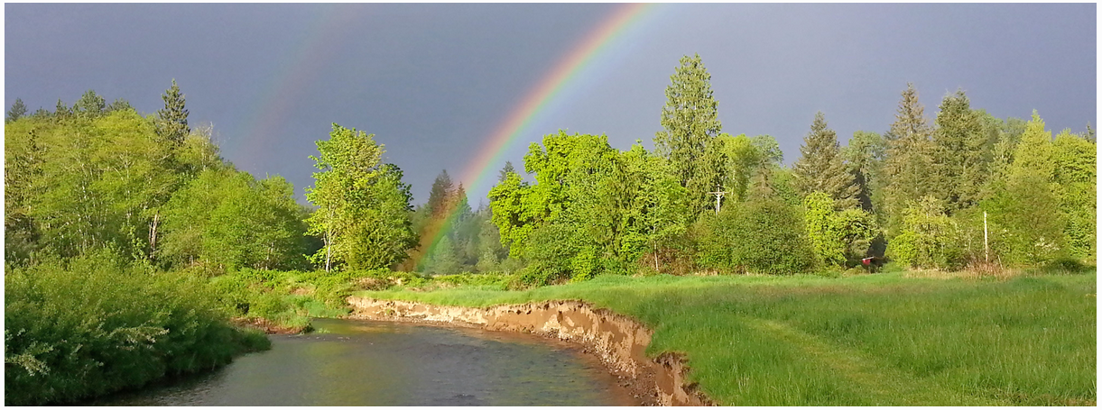
Today vs 2007
Today, we are substantially more aware, better prepared for catastrophic flooding than ever before.
We have a state-of-the art flood warning system.
We’ve completed many cost-efficient local projects and habitat projects.
We’re serving people, local governments, emergency responders, agriculture, fish and habitat.
We have a governance, administrative, and funding structure that’s delivering results.
https://chehalisbasinstrategy.com/office-of-chehalis-basin/

Slide 23
Key Contacts
Vickie Raines, Grays Harbor County Representative
Chair, Chehalis River Basin Flood Authority
Chair, Chehalis Basin Board
360/590-4100
vraines@co.grays-harbor.wa.us
Edna Fund, Lewis County Representative
Vice-Chair, Chehalis River Basin Flood Authority
Member, Chehalis Basin Board
360/269-7515
dutch@localaccess.com
Brian Shay
Member, Chehalis River Basin Flood Authority
360/538-3983
bshay@cityofhoquiam.com
Scott Boettcher
Staff, Chehalis River Basin Flood Authority
360/480-6600
scottb@sbgh-partners.com

Slide 24
Thank You!
This Presentation:
Available at “Chehalis River Basin Flood Authority” Website at https://www.ezview.wa.gov/site/alias__1492/34490/outreach__education.aspx
Email Distribution Lists:
Katie Johnson (Flood Authority) katie.johnson@lewiscountywa.gov Stevie Colson (Office of Chehalis Basin) Stevie.Colson@ecy.wa.gov

Slide 25
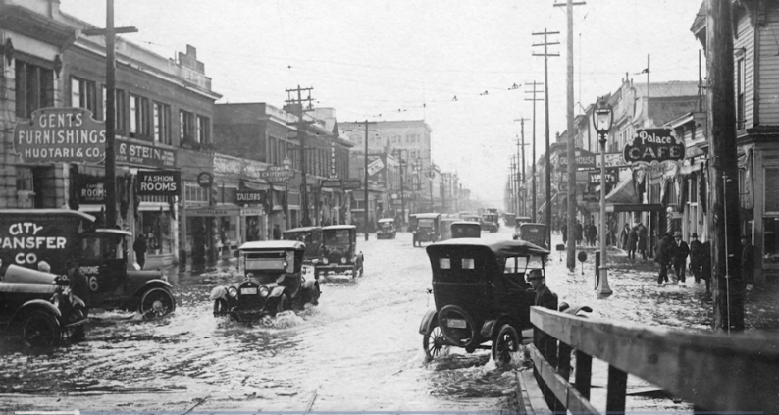
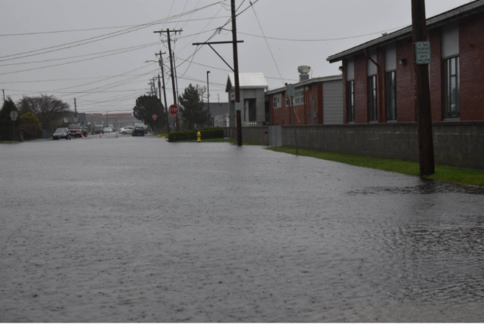
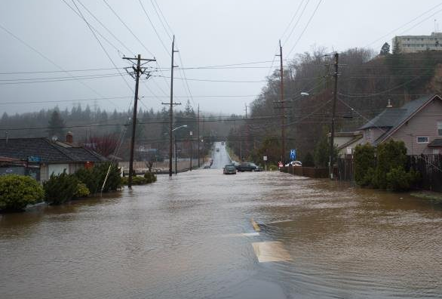
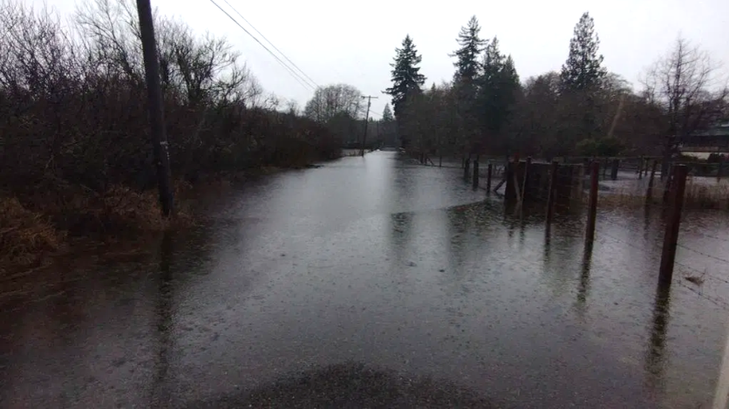
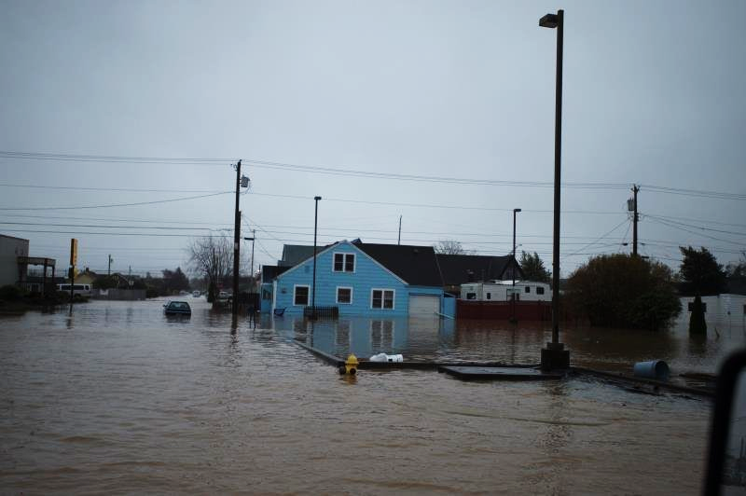
Extra . . .
Hoquiam December 1933
Since the 1960’s Grays Harbor has had 14 federally declared disaster flood events
Aberdeen January 2022
Hoquiam January 2015
Cosmopolis January 2022
Aberdeen January 2015

