Slide 1


Chehalis River Basin Flood Authority
Reducing Flood Damage and
Restoring Aquatic Species
City of Montesano
January 14, 2025

Slide 2
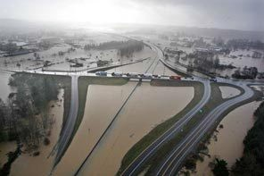
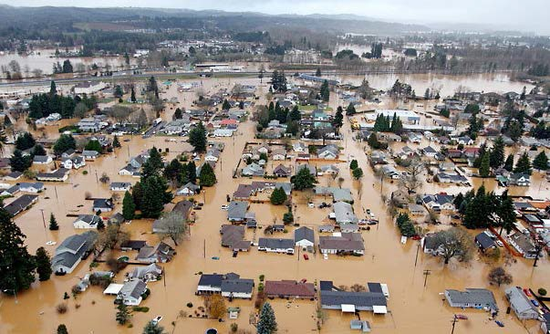
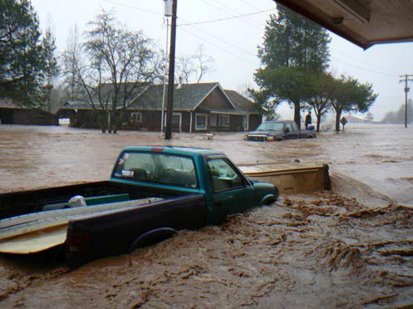
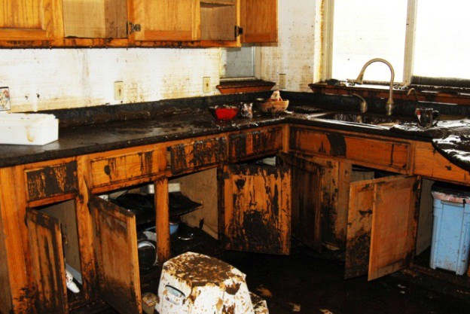
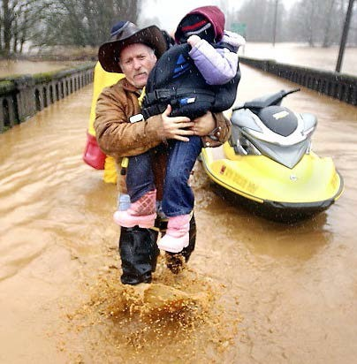
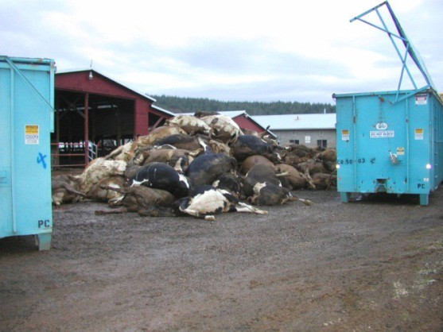


2007 Storm
$938M Basin-wide damage, $300M lost economic activity (WA).
Exit 77 (I-5) in Chehalis
STEVE RINGMAN / SEATTLE TIMES
City of Centralia
STEVE RINGMAN / SEATTLE TIMES
State Route 6, West of Adna MIKE SALSBURY / AP
Photos Source: LEWIS COUNTY, DIVISION OF EMERGENCY
MANAGEMENT

Slide 3
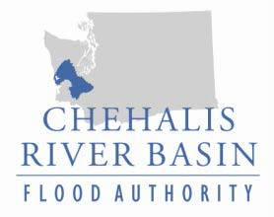


Today’s Presentation
“Flood Authority”
  #1 -- Local Projects
  #2 -- Flood Warning System
“Chehalis River Basin Flood Control Zone District”
  #3 -- Proposed Flow-through Dam for Flood Control
Office of Chehalis Basin | Chehalis Basin Board
https://chehalisbasinstrategy.com/
.

Slide 4
Chehalis River Basin Flood Authority
Formed in 2008
Focused on flood hazard mitigation
Decision-making
  informed by science
  protective of Basin residents/communities
  environmentally appropriate
Jurisdictions represented (see inter-local agreement)
Grays Harbor County (2008)
  City of Aberdeen (2008)
  City of Cosmopolis(2011)
  City of Hoquiam (2017)
  City of Montesano (2008)
  City of Oakville (2008)
Lewis County (2008)
  City of Centralia (2008)
  City of Chehalis (2008)
  City of Napavine (2011)
  Town of Pe Ell (2008)
Thurston County (2008)
  Town of Bucoda (2008)
Help local communities identify, develop, implement local flood hazard reduction solutions.

Slide 5
Local Projects (#1)
Reduce flood damage.
Protect people, property, infrastructure.
Improve readiness, response, resiliency.
  Drinking Water (Boistfort, Bucoda, Montesano).
  Wastewater (Montesano, Pe Ell).
  Emergency Response (Grays Harbor County, Chehalis-Centralia Airport).
  Regional Economic Infrastructure (Montesano, Port of Chehalis, Port of Grays Harbor).
  Community Protection (Aberdeen, Adna, Bucoda, Centralia, Chehalis, Chehalis Tribe, Hoquiam, Oakville).
  Flood Warning (Basin-wide).
State Capital Budget:
2012-13 -- $ 5.0M
2013-15 -- $10.7M
2015-17 -- $15.7M
2017-19 -- $ 9.6M
2019-21 -- $ 6.3M
2021-23 -- $ 4.1M
2023-25 -- $ 3.6M
$55.0M
2025-27 -- $ 3.0M
to
$13.0M

Slide 6
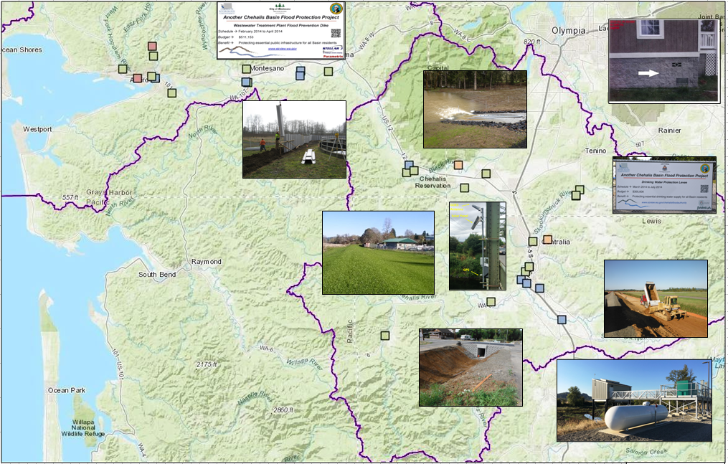
Local Projects (100+ Projects Completed 2012-23)
Cost: ~$450,000 (average)
Timeframe: ~600 days (average)
Sequence:
1st = “Plan/Study/Design” project (~50)
2nd = “Construction” project (~53)

Slide 7
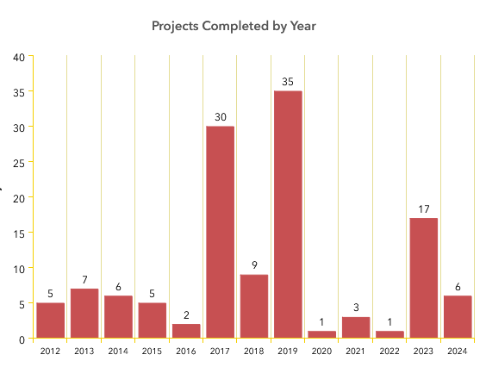
Local Projects (100+ Projects Completed 2012-23)

Slide 8
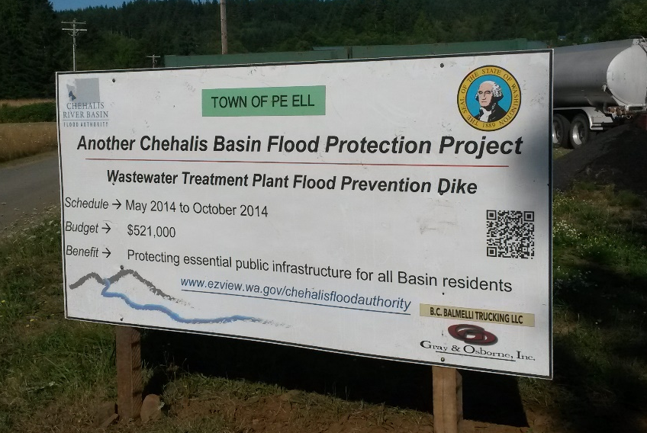
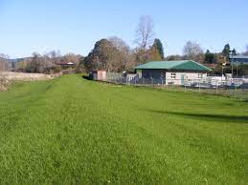
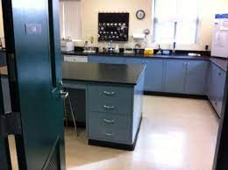
Local Projects (Pe Ell, 2014)
Project = Design/construct 900’ dike (between Chehalis river and WWTP).
Cost = $521,000.
Photos = Here.
Website = Here.

Slide 9
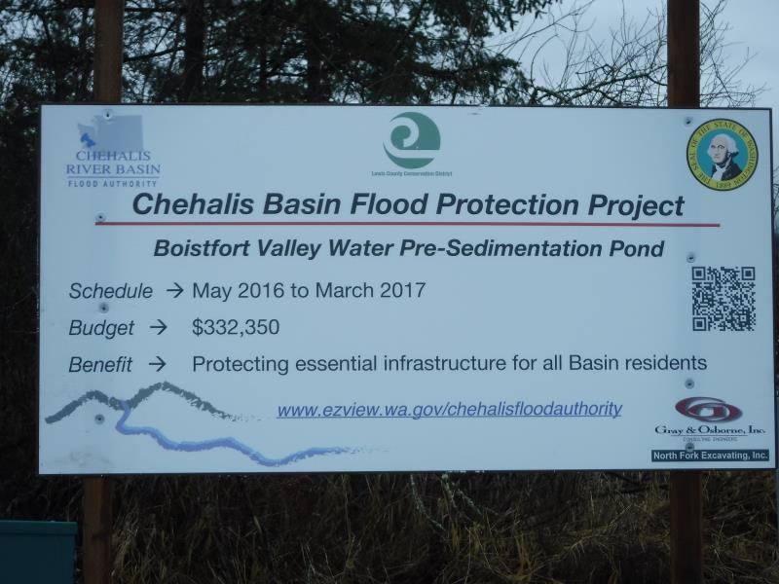
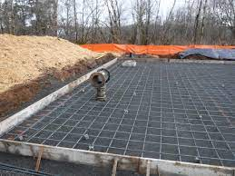
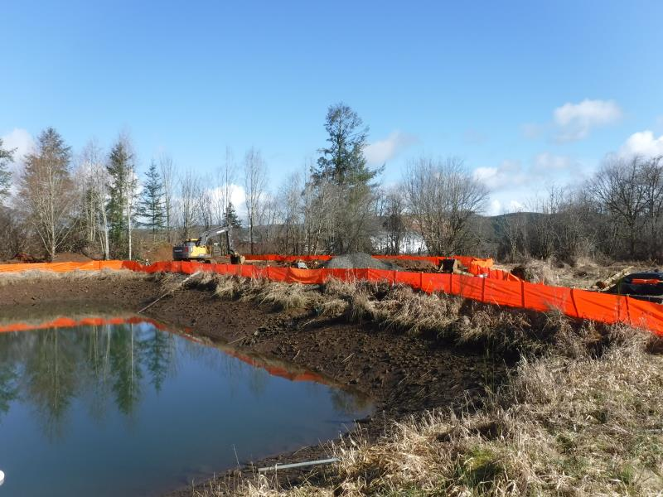
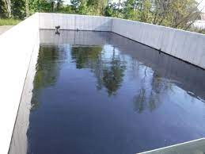
Boistfort Valley Water Pre-Sedimentation Pond
Local Projects (Boistfort Valley)
Construct pre-sedimentation pond to settle-out flood-generated sediment before entering water treatment plant.
Sediment choked-out treatment plant in 2007 for 6 months and drinking water had to be trucked in.
$332,350
More prepared now.

Slide 10
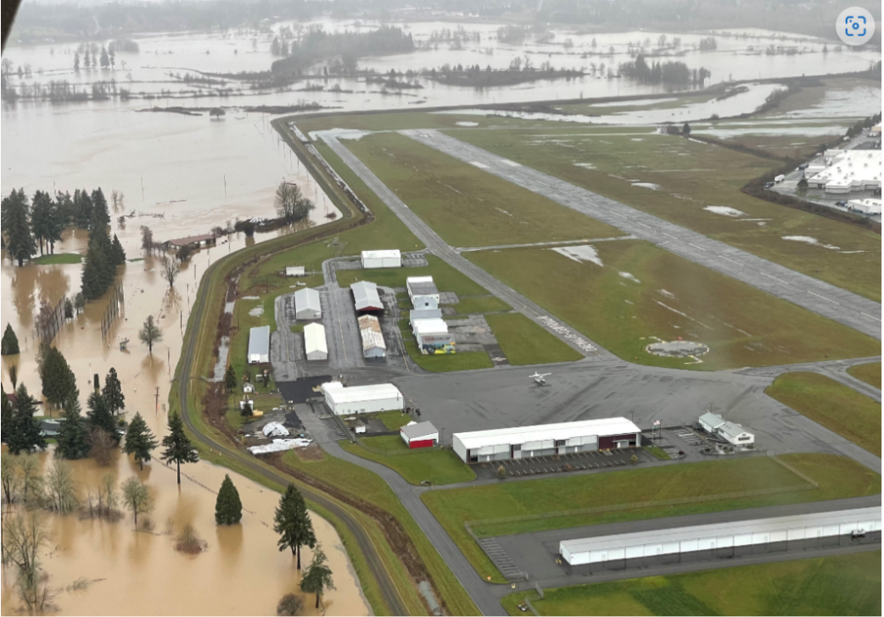
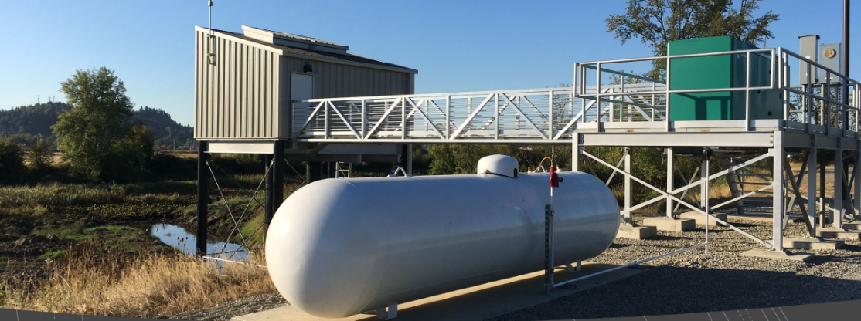
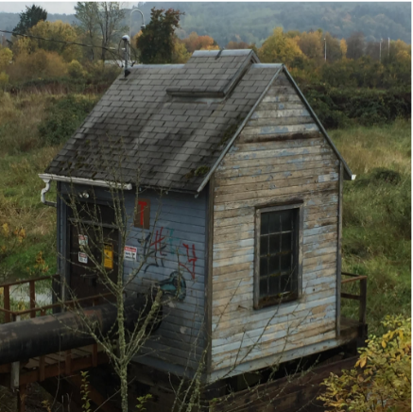
Local Projects (Chehalis-Centralia Airport, 2017)
Completed -- Fall 2017.
Cost -- $1.14M.
January 2022 Flood Event – Pumped 518.4M gallons
over many days to keep levee dry.
ROI (2018) -- Protects $45M in assets, ensures $9M
in annual tax revenue.
Read More -- Here.
← Previous WWII-era pump

Slide 11
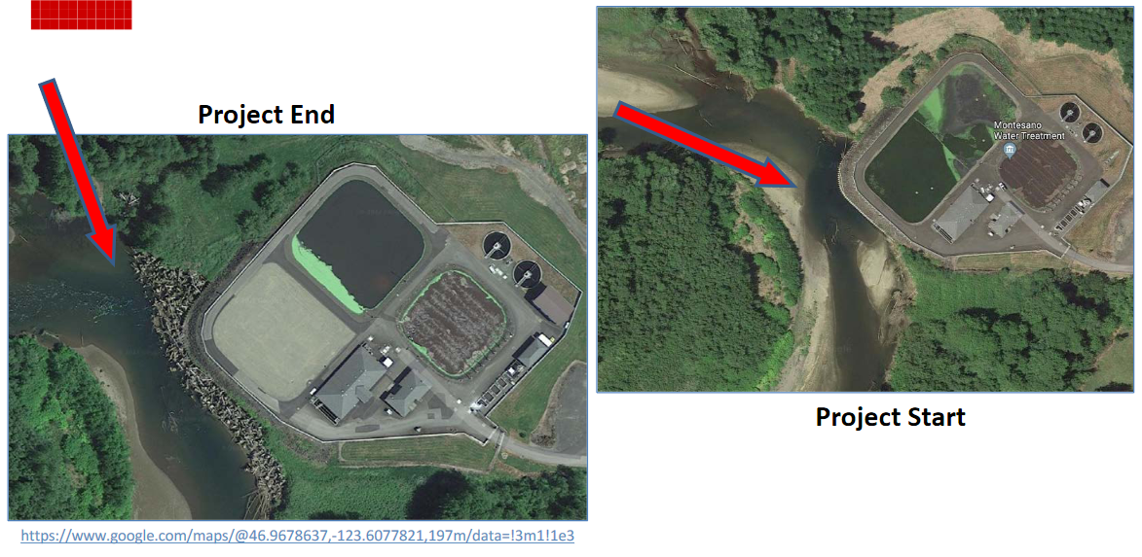
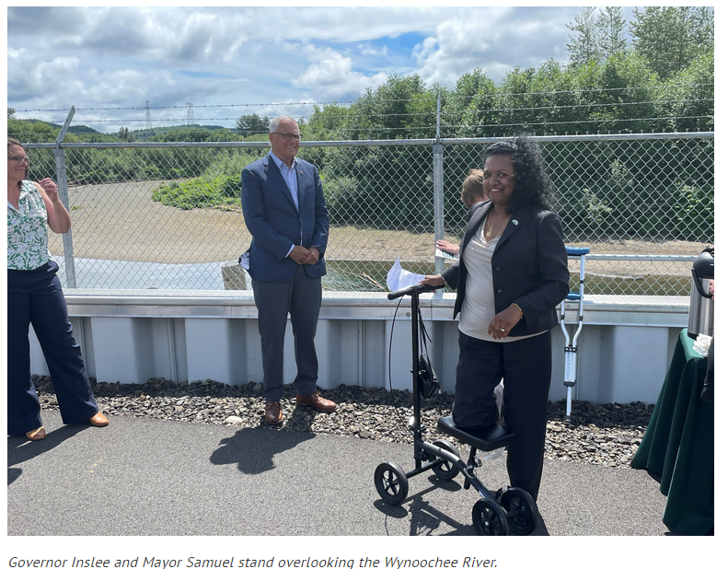
Local Projects (Montesano, 2017-2020)
Protect WWTP from on-coming Wynoochee river using 220+ “log-jacks.”
$2 million (for “log-jacks”).
Small cost compared to WWTP relocation and environmental cleanup (in event of WWTP breaching).
July 7, 2022 →

Slide 12
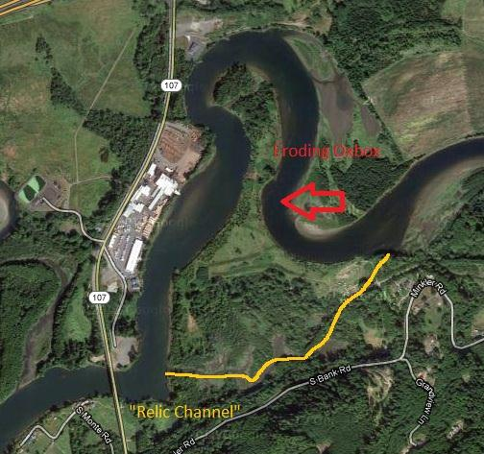
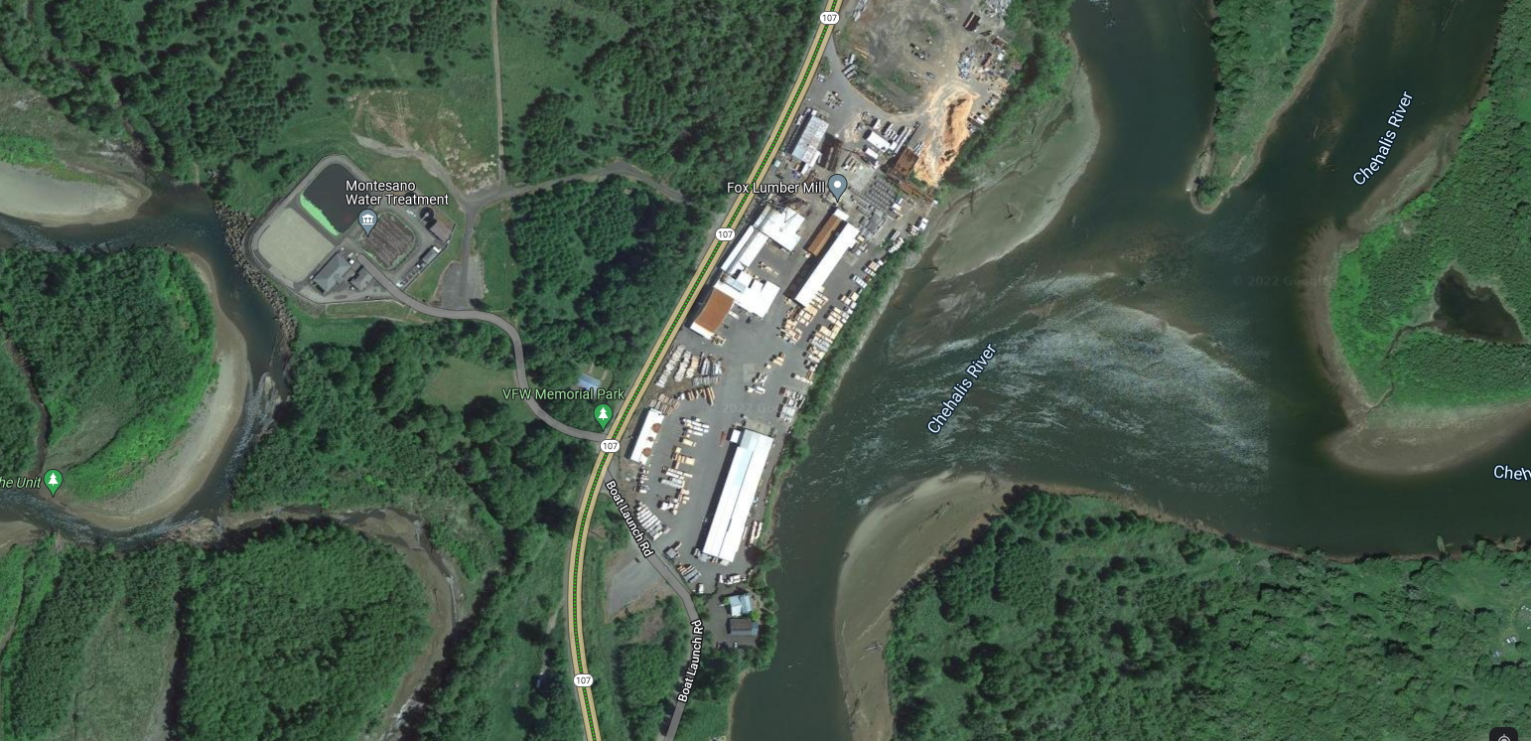
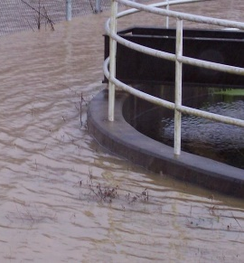
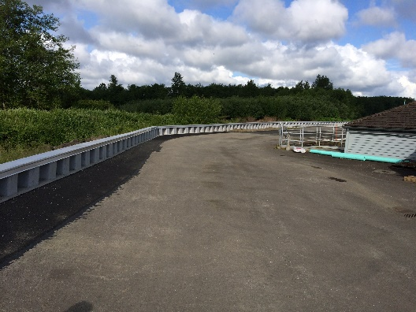
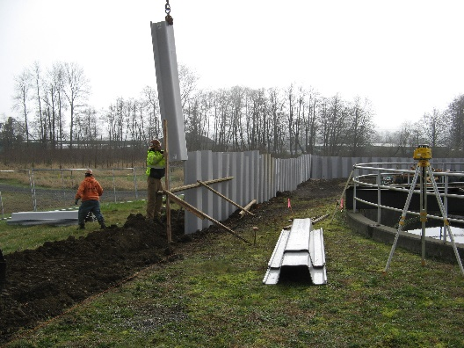
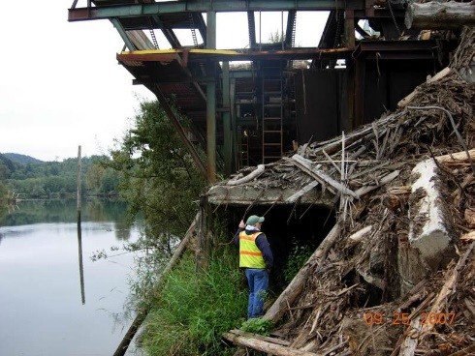
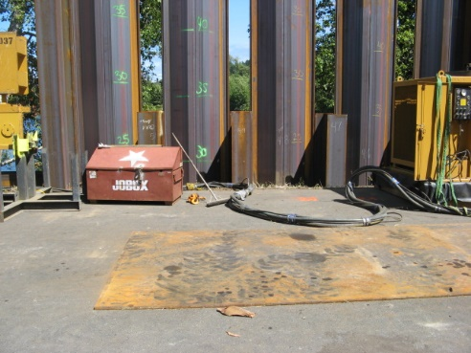
Mary’s River Lumber and Montesano WWTP
Local Projects (Montesano, 2012-15)
2007
2022
2014
2014
2014
~$6M protection against Chehalis River
Funding pooled/shared.
2014
2014

Slide 13
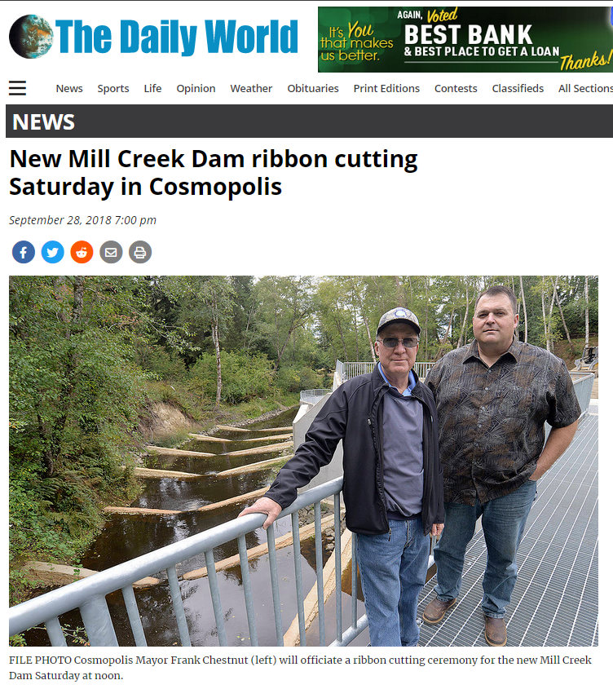
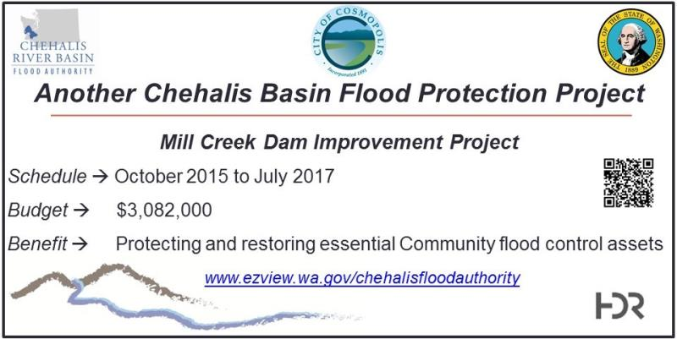
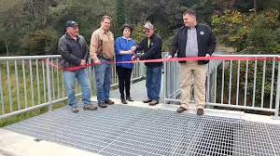
Local Projects (Cosmopolis, 2015-2018)
Mill Creek Multi-Objective Implementation Plan:
Part I = Reconstruct Mill Creek Dam (done).
Phase II project = Address 4,500’ of Mill Creek flow, culverts, and flood water evacuation (under development).
Read 5-24-2024 news article here
City of Cosmopolis, Sep 29, 2018
https://www.thedailyworld.com/news/new-mill-creek-dam-ribbon-cutting-saturday-in-cosmopolis/

Slide 14
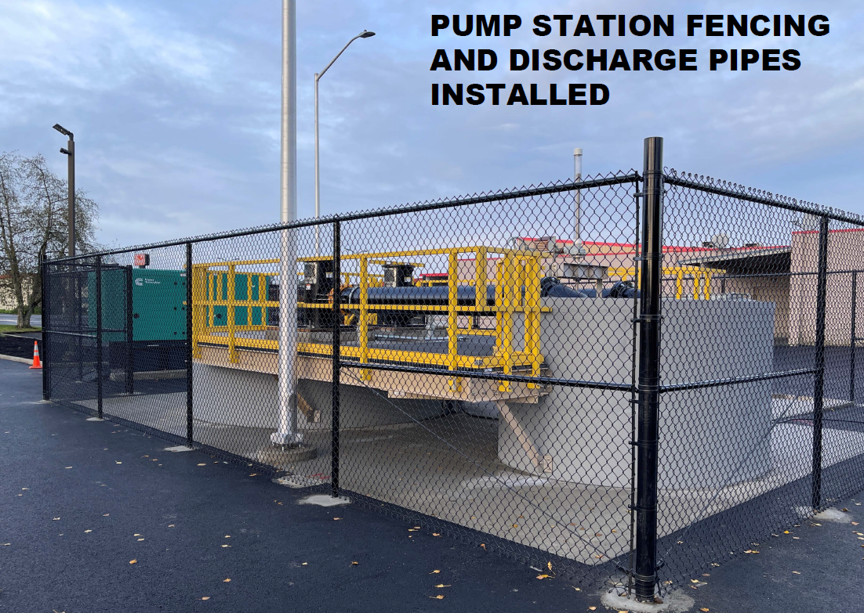
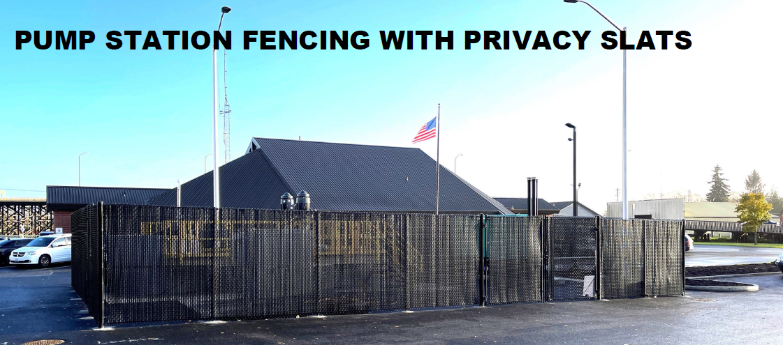
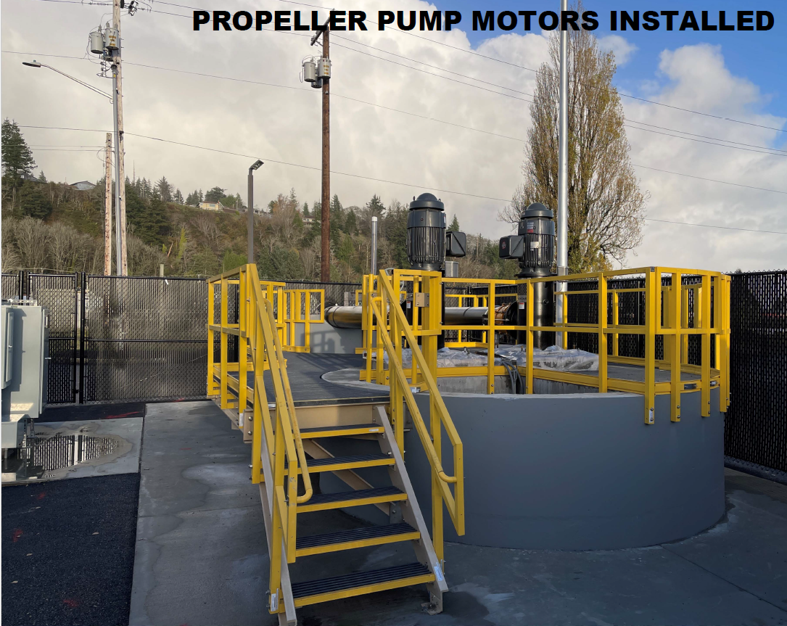
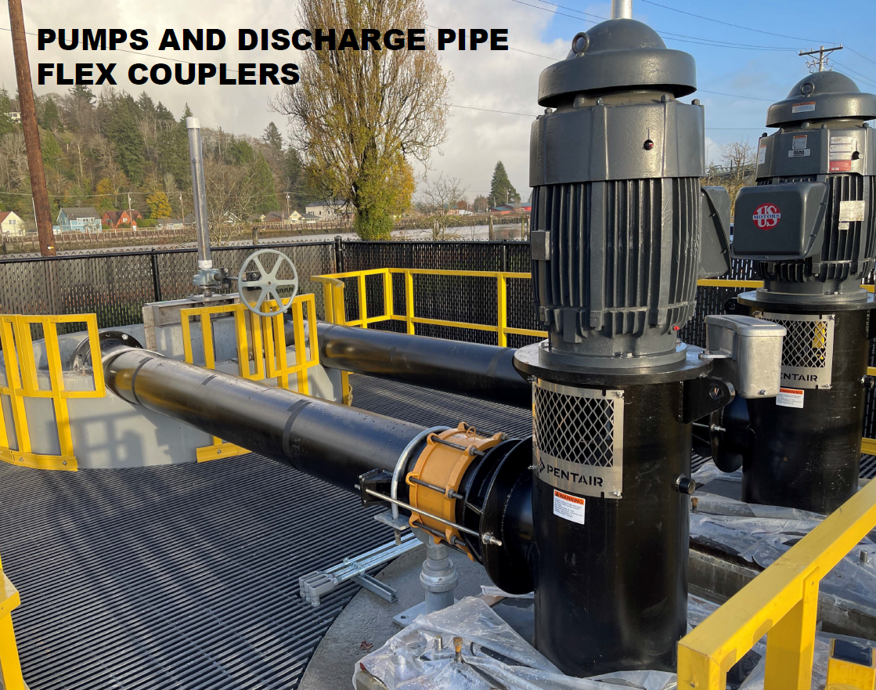
8 pump stations.
$50M cost.
$30M to date (58%).
$12M request (24%).
2,735 acres
4,583 parcels
232 businesses
$1.1B assessed value
EXAMPLE
10th St Pump Station
Local Projects (Hoquiam, 2024)

Slide 15
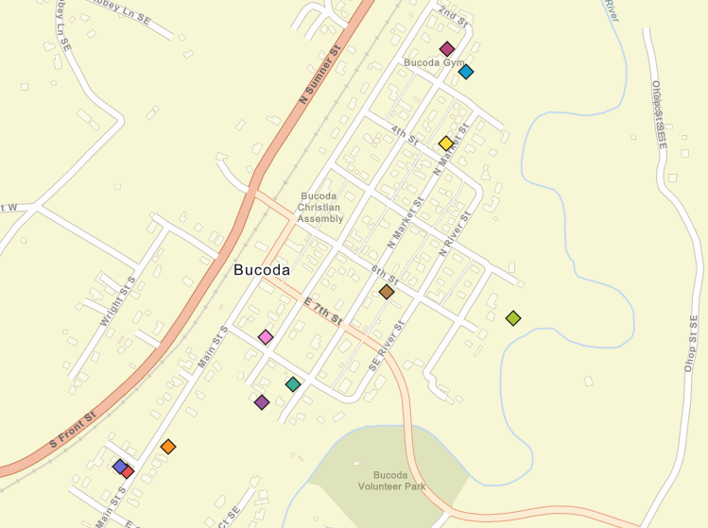
Foundation Flood Openings Pilot
Local Projects (Bucoda, 2016)
11 Properties
Total -- $ 85,465.43.
Average -- $8,550.
Link – here.
Web map – here.

Slide 16
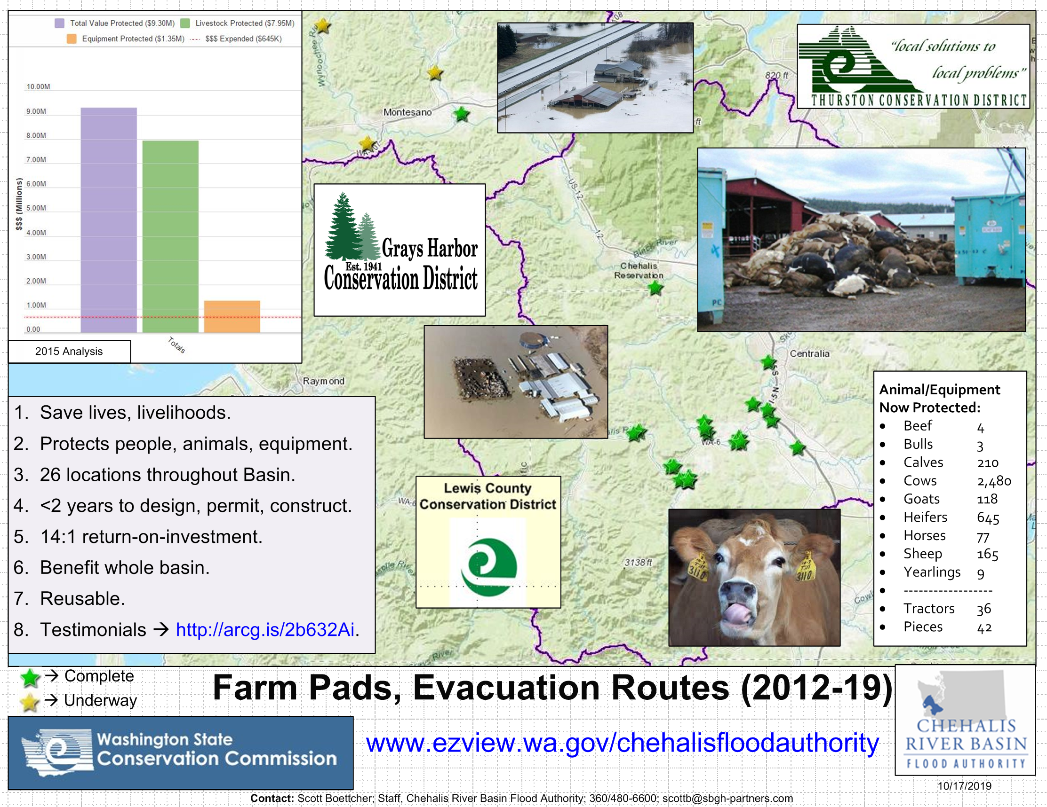
Local Projects (Farm Pads)

Slide 17
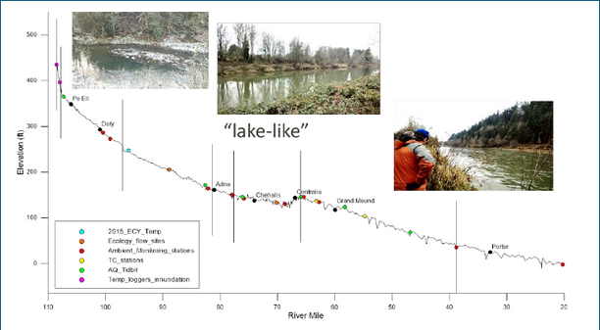
Local Projects (Geographically-Based)
Basin Geography
Upper = Steep, narrow, fast flowing.
Middle = Flat, “lake like”, slow to drain.
Lower = Flat, coastal, difficult to drain.
Shah, Mohammad. (2021). inland water-dynamics and ecology. 10.5772/intechopen.87463.

Slide 18
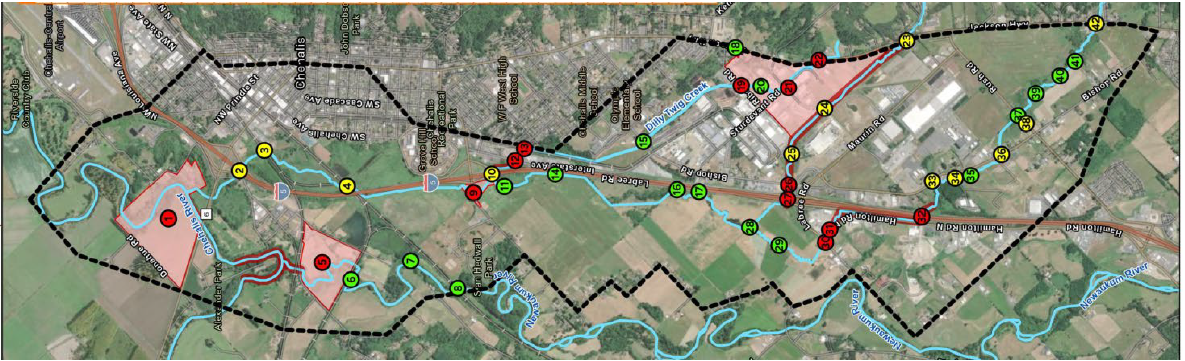
2023-25 Funding -- Flood Storage Investment Plan
Local Projects (Mid-Basin -- Geographically-Based)
South City of Chehalis & Port of Chehalis
Geographic flooding strategy with sequenced investments:
Increase flood storage
Reduce flood levels
Minimize damage, monetary losses
Mar 6th = Community workshop (VL Community Building, 2-6 PM)

Slide 19
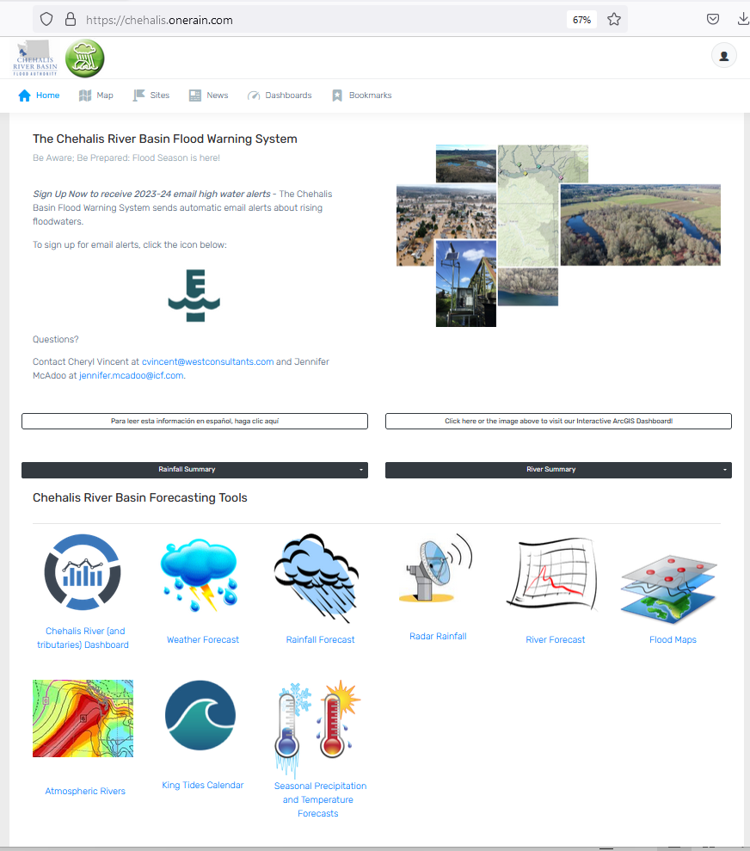
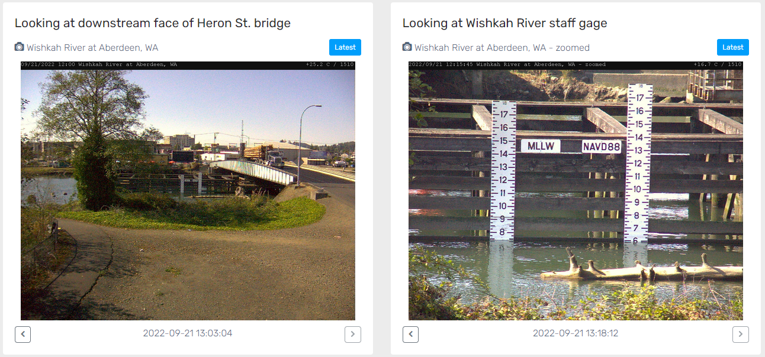
Developed with State Capital Budget $.
Maintained with local $.
Flood Warning System (#2)
www.chehalisriverflood.com

Slide 20
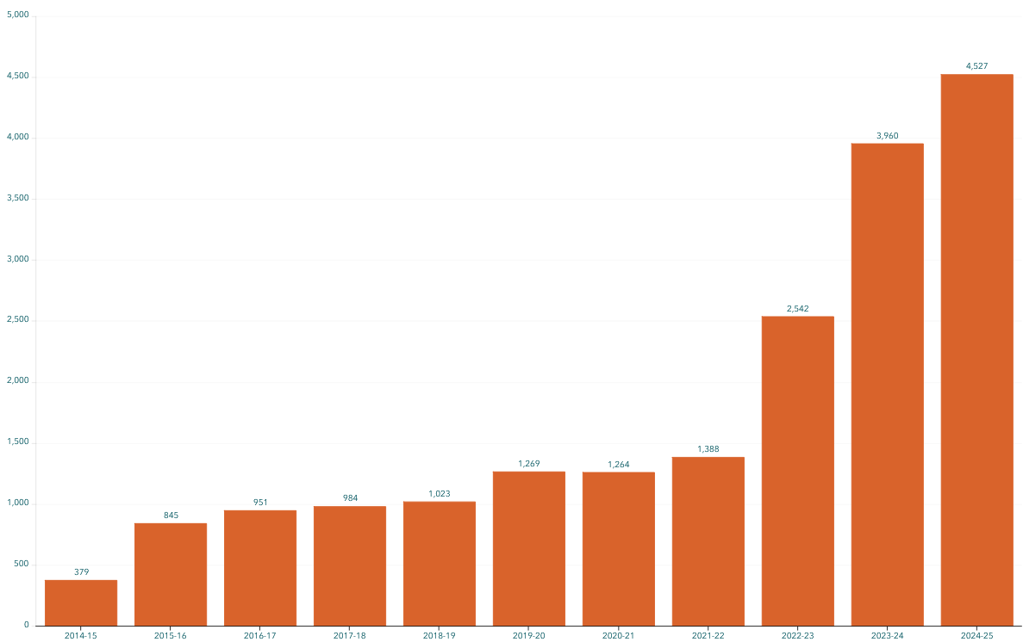
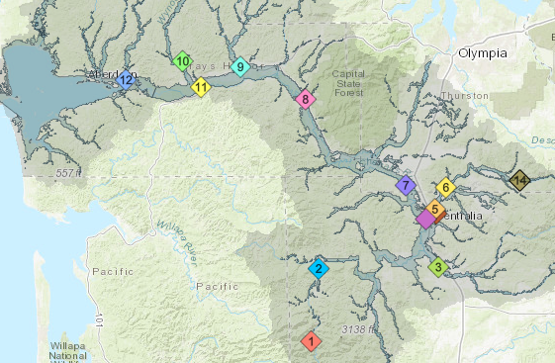
Flood Warning System (Alert Sign-Ups)
Sign-up for email high water alerts here.

Slide 21

Proposed Flow-Through Dam for Flood Control (#3)
1. Move through unobstructed
Water
Fish
Sediment
2. Delivers top-to-bottom benefit, Pe Ell to Cosmopolis.
3. See recent presentation here.
www.chehalisriverbasinfczd.com

Slide 22
State Law
“The primary purpose of the office is to aggressively pursue implementation of an integrated strategy and administer funding for long-term flood damage reduction and aquatic species restoration in the Chehalis river basin.” (RCW 43.21A.730)
Chehalis Basin Strategy
Appoints 3 member
Chehalis Basin Board
Community leaders, Chehalis and Quinault tribal representatives, local and state government liaisons
Office of Chehalis Basin | Chehalis Basin Board
https://chehalisbasinstrategy.com/
Office of Chehalis Basin
Small team within the WA Department of Ecology
“Network of Partners”
Organizations and local entities who turn ideas into shovel-ready reality

Slide 23








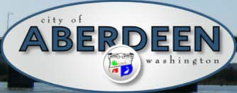















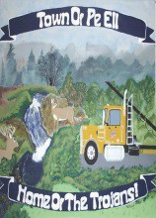


Chehalis Basin Strategy (Network of Partners)

Slide 24
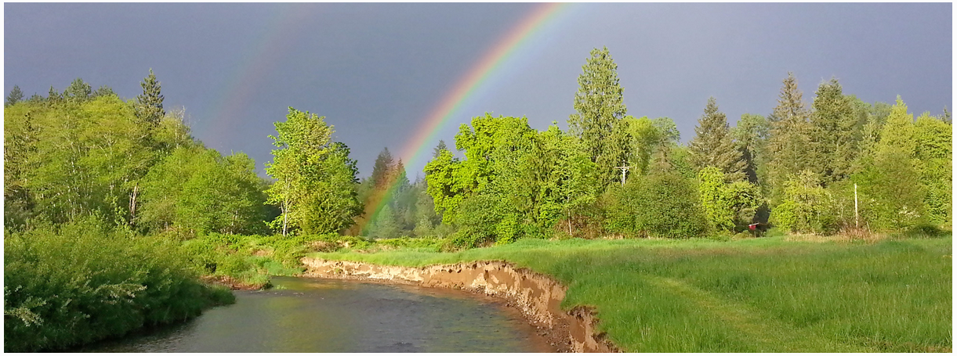
Local Resolutions Library
https://www.ezview.wa.gov/site/alias__1492/37643/local_resolutions.aspx
Today vs 2007
Today, we are substantially more aware, better prepared for catastrophic flooding than ever before.
We have a state-of-the art flood warning system.
We’ve completed many cost-efficient local projects and habitat projects.
We’re serving people, local governments, emergency responders, agriculture, fish, and habitat alike
We have a governance, administrative, and funding structure that’s delivering results, and is committed to a balanced basin-wide flood and fish solution (see Local Resolution Library).
https://chehalisbasinstrategy.com/office-of-chehalis-basin/

Slide 25
Thank You! and Key Contacts
Vickie Raines, Grays Harbor County Representative
Chair, Chehalis River Basin Flood Authority
Flood Authority Appointee & Chair, Chehalis Basin Board
360/590-4100
vraines@graysharbor.us
Edna Fund, Lewis County Representative
Vice-Chair, Chehalis River Basin Flood Authority
Chair, Chehalis River Basin Flood Control Zone District Advisory Board
360/269-7515
dutch@localaccess.com
Mike Olden
Montesano Member, Chehalis River Basin Flood Authority
360/589-0333
molden@montesano.us
Scott Boettcher
Staff, Chehalis River Basin Flood Authority
360/480-6600
scottb@sbgh-partners.com

Slide 26
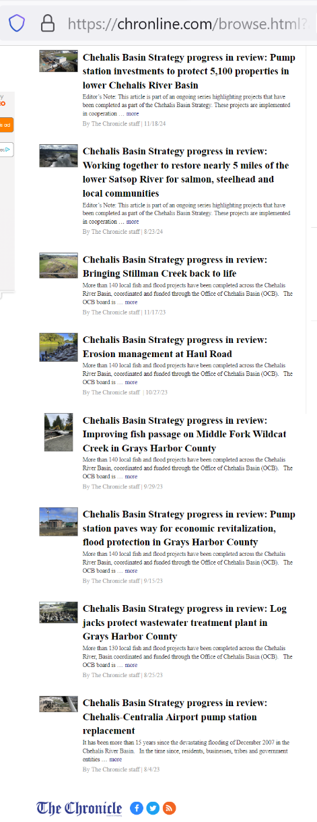
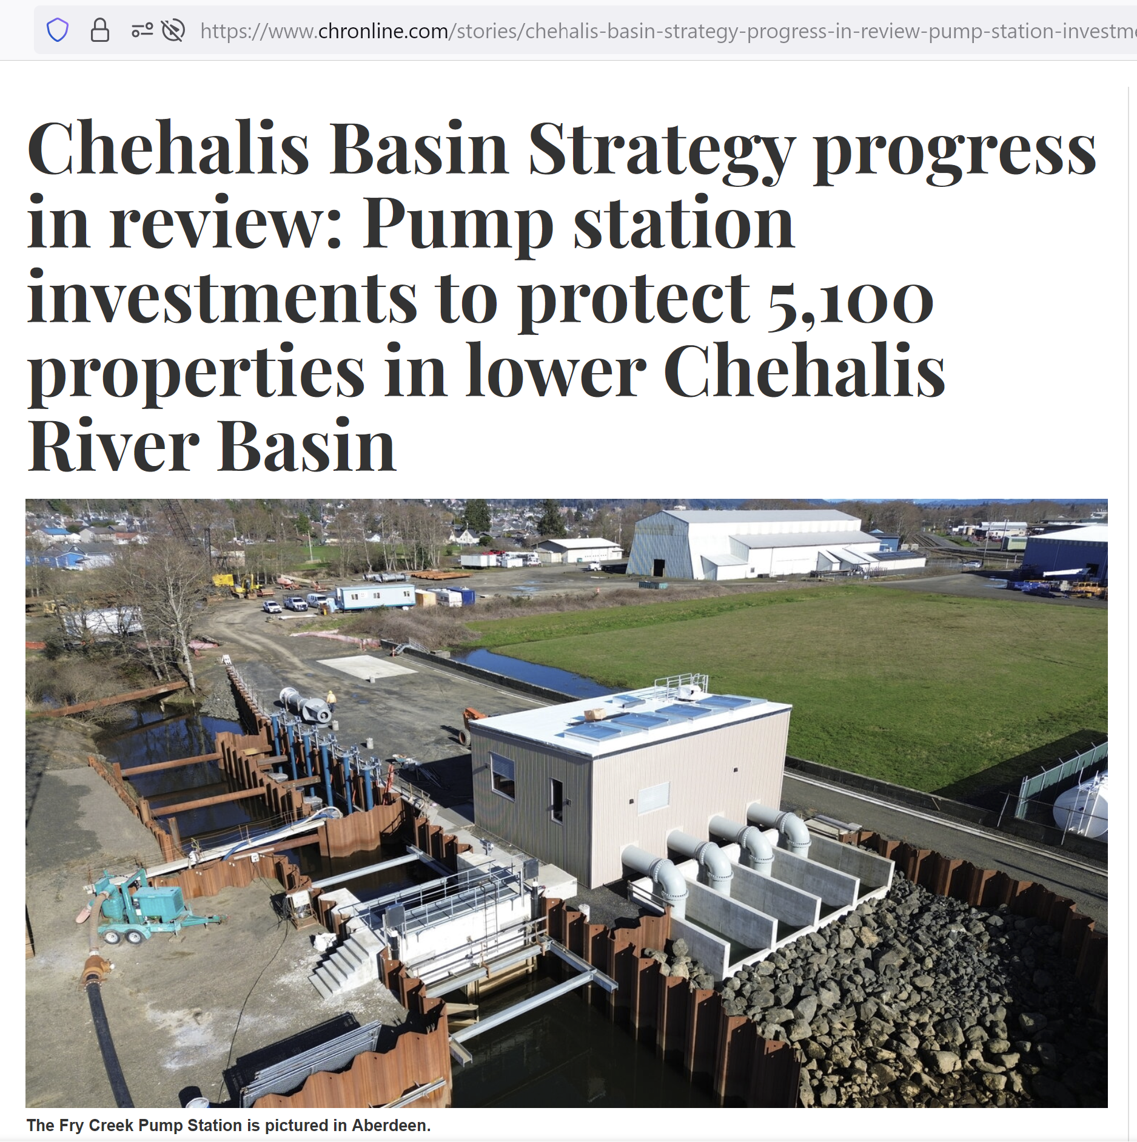

Extra – Flood and Fish Articles

Slide 27
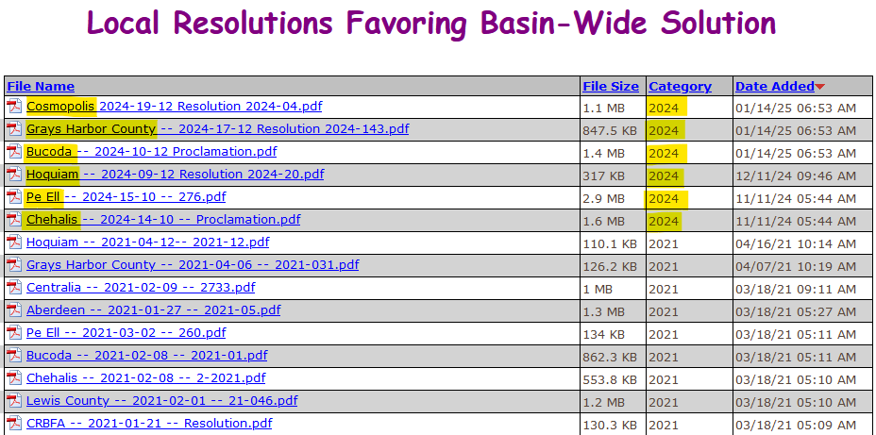
Extra – Local Resolutions
See Local Resolutions Library here.

