Slide 1


Chehalis River Basin Flood Authority
Reducing Flood Damage and
Restoring Aquatic Species
City of Napavine
March 25, 2025

Slide 2
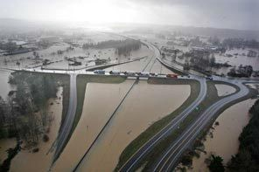
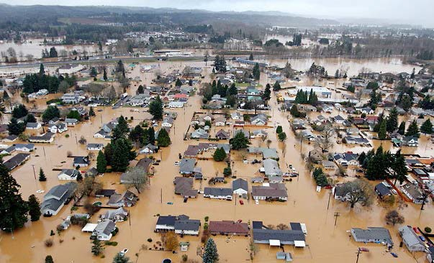
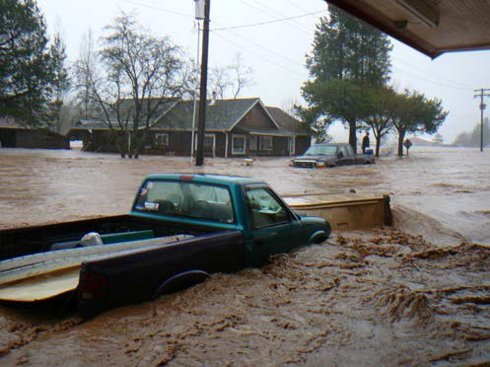
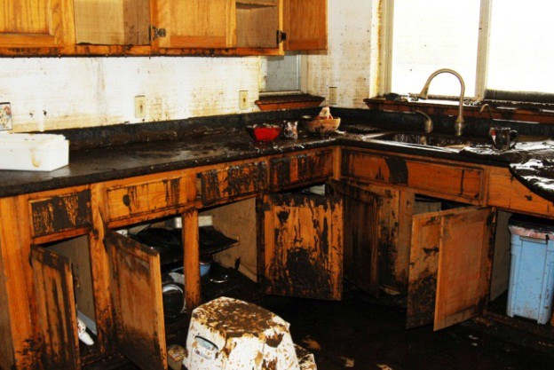
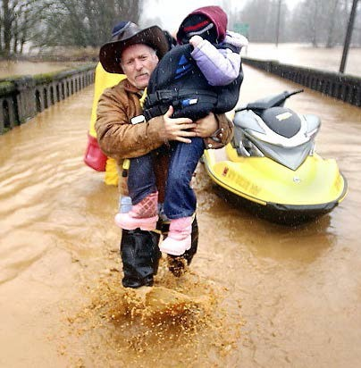
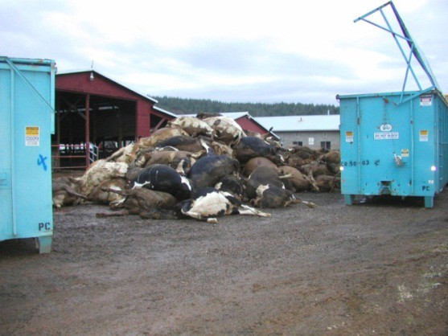


2007 Storm
$938M Basin-wide damage, $300M lost economic activity (WA).
Exit 77 (I-5) in Chehalis
STEVE RINGMAN / SEATTLE TIMES
City of Centralia
STEVE RINGMAN / SEATTLE TIMES
State Route 6, West of Adna MIKE SALSBURY / AP
Photos Source: LEWIS COUNTY, DIVISION OF EMERGENCY
MANAGEMENT

Slide 3
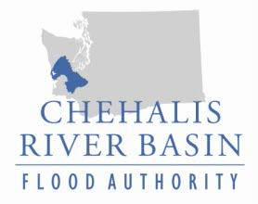


Today’s Presentation
“Flood Authority”
  #1 -- Local Projects
  #2 -- Flood Warning System
“Chehalis River Basin Flood Control Zone District”
  #3 -- Proposed Flow-through Dam for Flood Control
Office of Chehalis Basin | Chehalis Basin Board
https://chehalisbasinstrategy.com/
.

Slide 4
Chehalis River Basin Flood Authority
Formed in 2008
Focused on flood hazard mitigation
Decision-making
  informed by science
  protective of Basin residents/communities
  environmentally appropriate
Jurisdictions represented (see inter-local agreement)
Grays Harbor County (2008)
  City of Aberdeen (2008)
  City of Cosmopolis(2011)
  City of Hoquiam (2017)
  City of Montesano (2008)
  City of Oakville (2008)
Lewis County (2008)
  City of Centralia (2008)
  City of Chehalis (2008)
  City of Napavine (2011)
  Town of Pe Ell (2008)
Thurston County (2008)
  Town of Bucoda (2008)
Help local communities identify, develop, implement local flood hazard reduction solutions.

Slide 5
Local Projects (#1)
Reduce flood damage.
Protect people, property, infrastructure.
Improve readiness, response, resiliency.
  Drinking Water (Boistfort, Bucoda).
  Wastewater (Montesano, Pe Ell).
  Emergency Response (Grays Harbor County, Chehalis-Centralia Airport).
  Regional Economic Infrastructure (Montesano, Port of Chehalis, Port of Grays Harbor).
  Community Protection (Aberdeen, Adna, Bucoda, Centralia, Chehalis, Chehalis Tribe, Hoquiam, Oakville).
  Flood Warning (Basin-wide).
State Capital Budget:
2012-13 -- $ 5.0M
2013-15 -- $10.7M
2015-17 -- $15.7M
2017-19 -- $ 9.6M
2019-21 -- $ 6.3M
2021-23 -- $ 4.1M
2023-25 -- $ 3.6M
$55.0M
2025-27 -- $ 3.0M
to
$13.0M

Slide 6
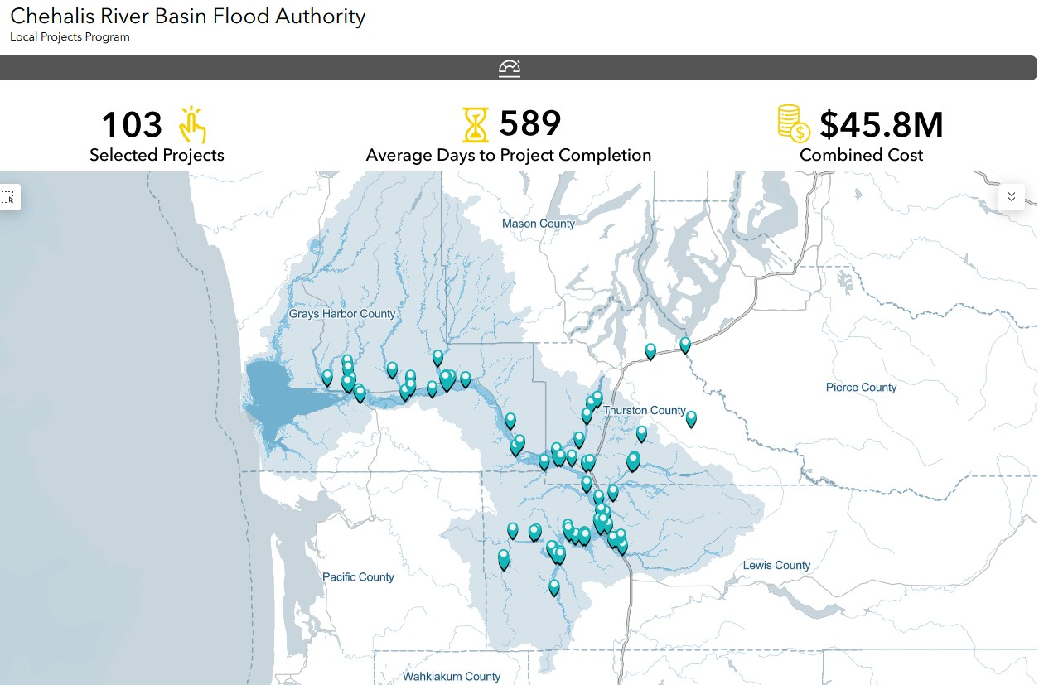
Local Projects (100+ Projects Completed 2012-24)

Slide 7
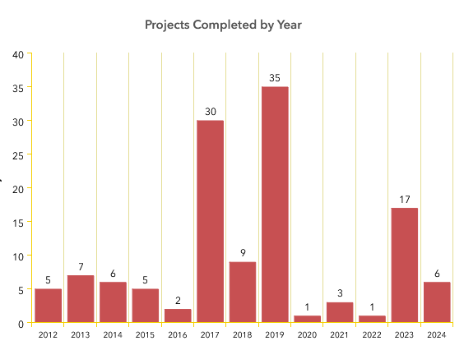
Local Projects (100+ Projects Completed 2012-23)

Slide 8
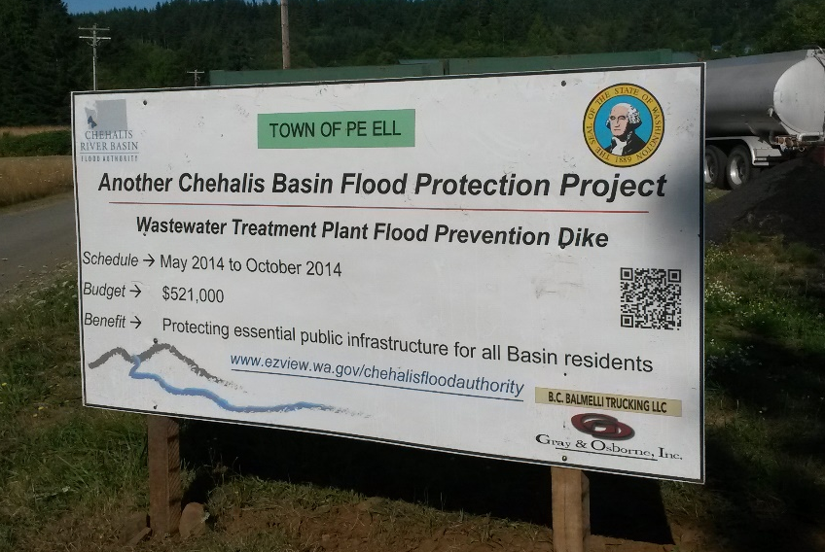
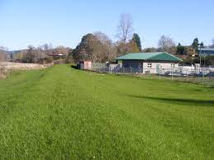

Local Projects (Pe Ell, 2014)
Project = Design/construct 900’ dike (between Chehalis river and WWTP).
Cost = $521,000.
Photos = Here.
Website = Here.

Slide 9
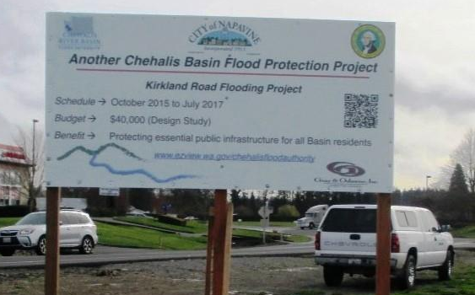
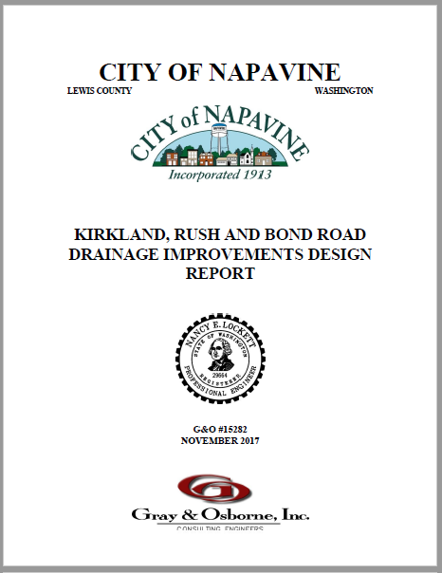
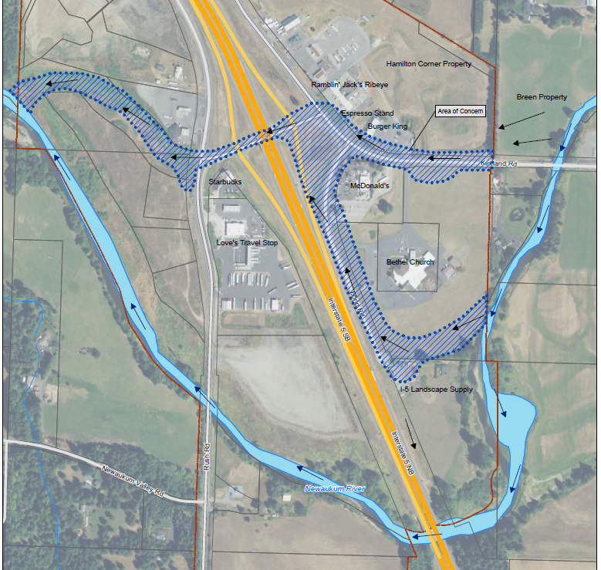
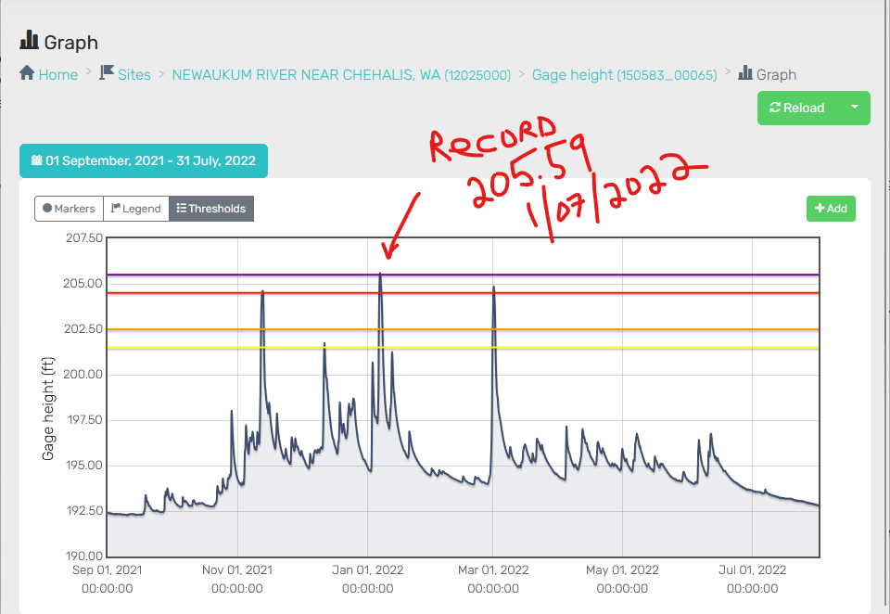
Local Projects (Napavine)
Here (11/2017)
Project = Study drainage improvements.
Cost = $37,684
Conclusion = Focus on:
  maintenance (ditch and culvert cleaning, including minor ditch reshaping, mowing, and clearing vegetation).
  coordination with WSDOT on future drainage infrastructure design.

Slide 10
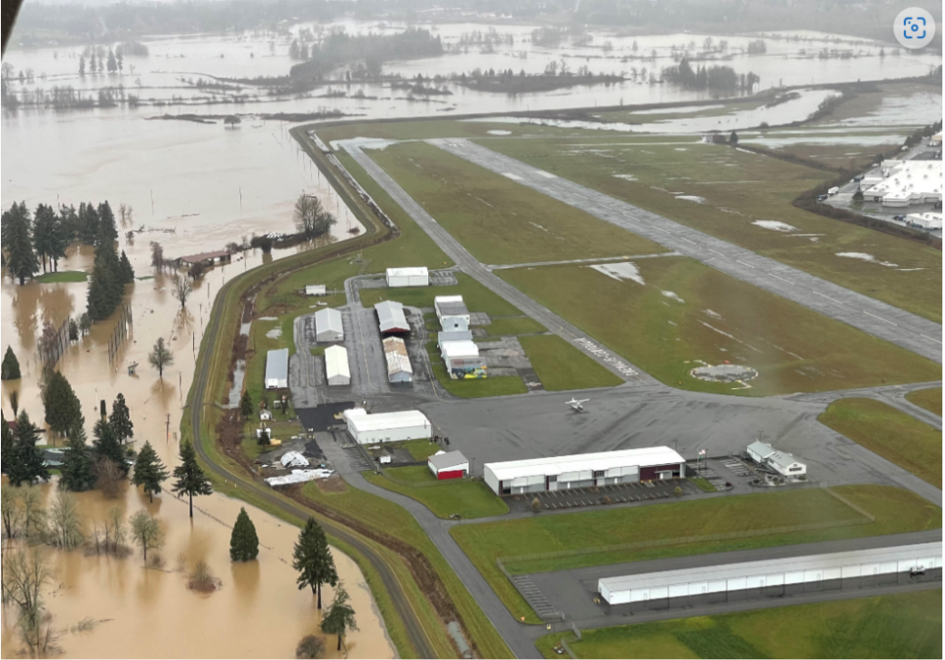
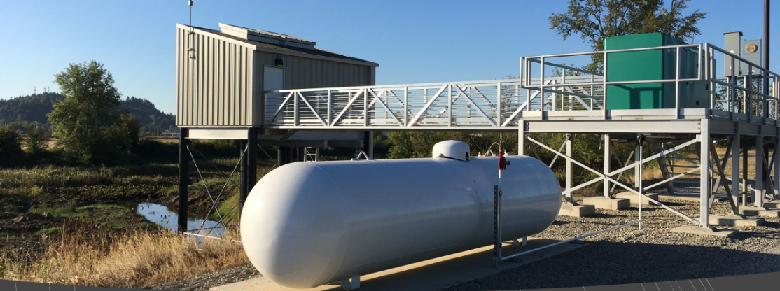
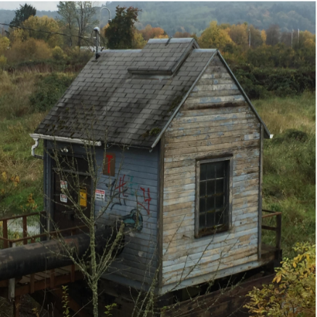
Local Projects (Chehalis-Centralia Airport, 2017)
Completed -- Fall 2017.
Cost -- $1.14M.
January 2022 Flood Event – Pumped 518.4M gallons
over many days to keep levee dry.
ROI (2018) -- Protects $45M in assets, ensures $9M
in annual tax revenue.
Read More -- Here.
← Previous WWII-era pump

Slide 11
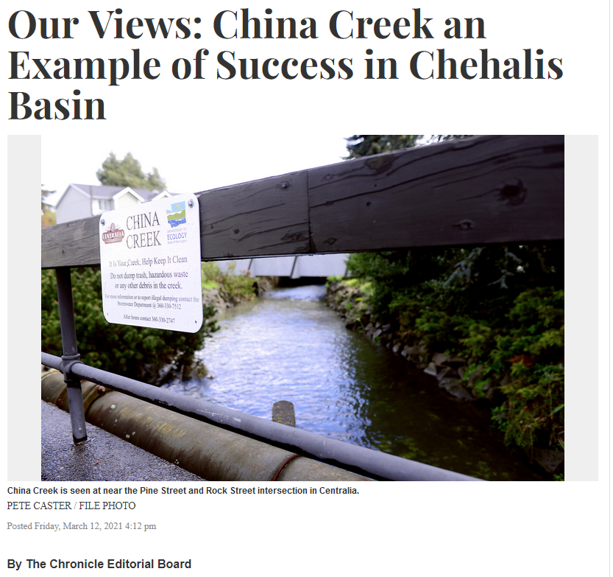
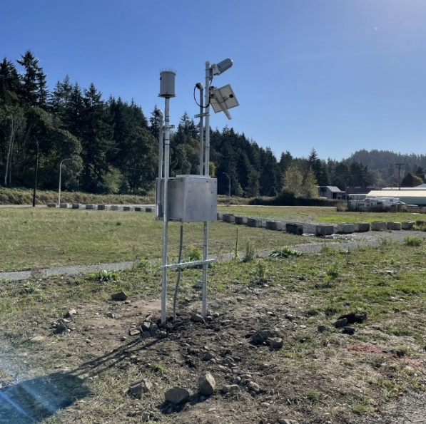
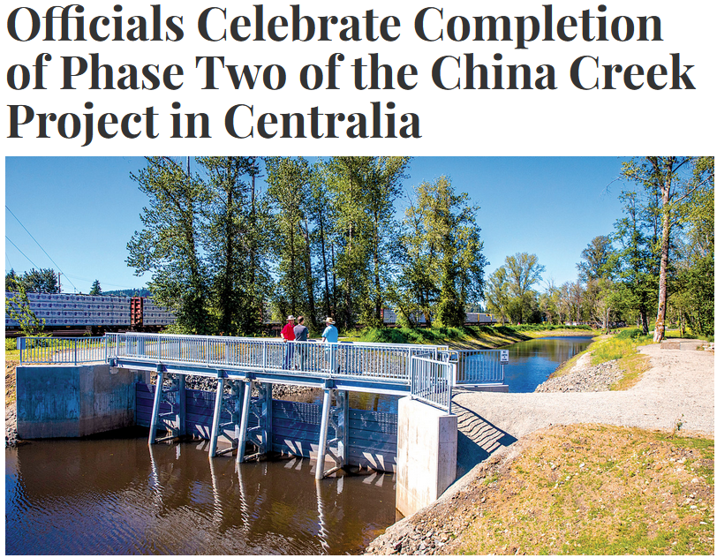
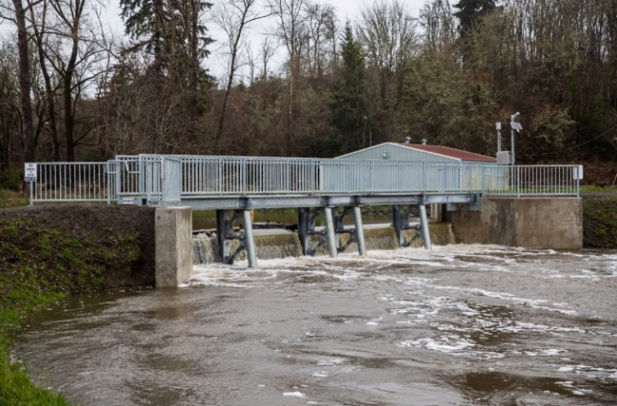
Local Projects (China Creek, 2015-2022)
March 12, 2021 →
← CHINA CREEK ABOVE FCS AT CENTRALIA, WA (CCCW1)
https://chehalis.onerain.com/site/?site_id=24631&site=01fd47cb-3203-4be3-9c68-ba0afb33e72c
$5.2M
Multiple phases
Flood, fish, recreation
Benefits today, tomorrow
July 13, 2022 →
← December 28, 2022

Slide 12
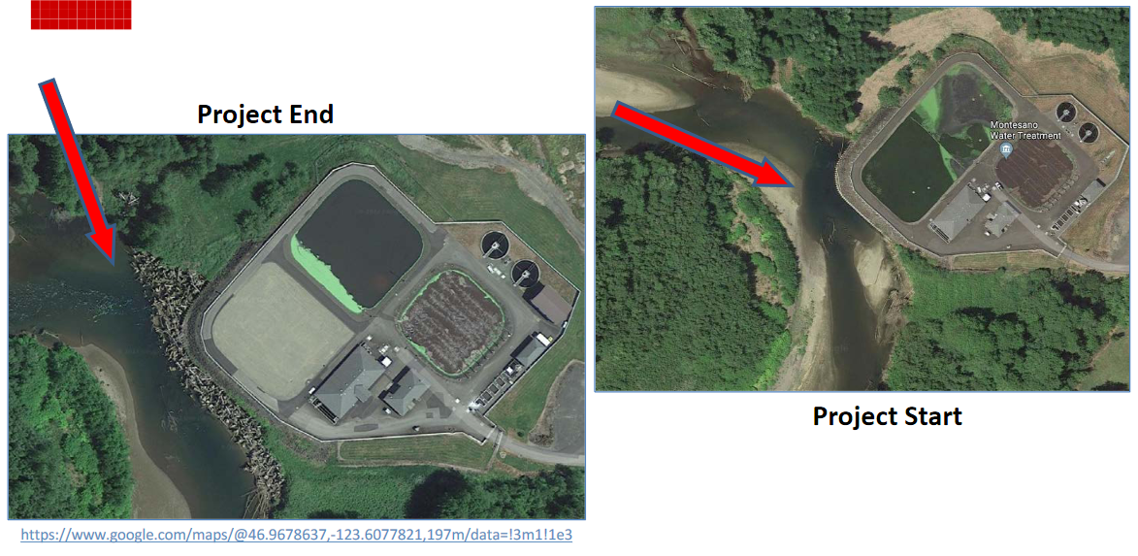
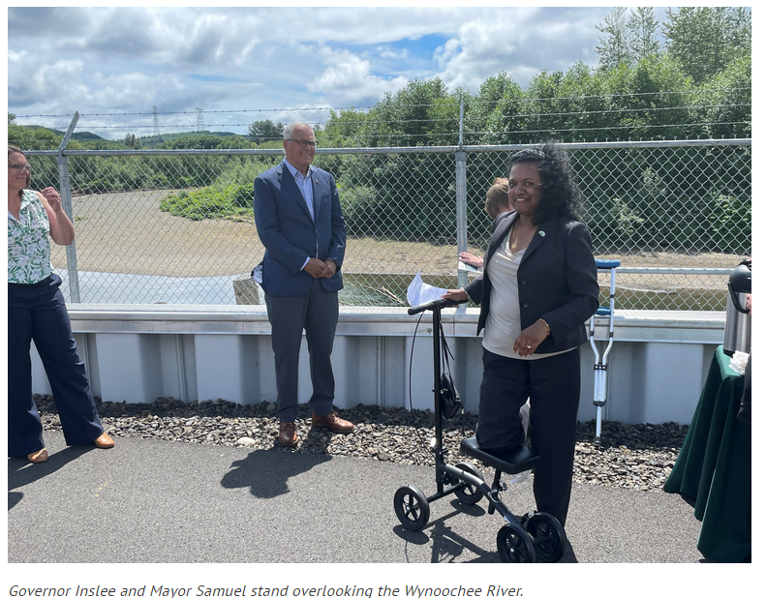
Local Projects (Montesano, 2017-2020)
Protect WWTP from on-coming Wynoochee river using 220+ “log-jacks.”
$2 million (for “log-jacks”).
Small cost compared to WWTP relocation and environmental cleanup (in event of WWTP breaching).
July 7, 2022 →

Slide 13
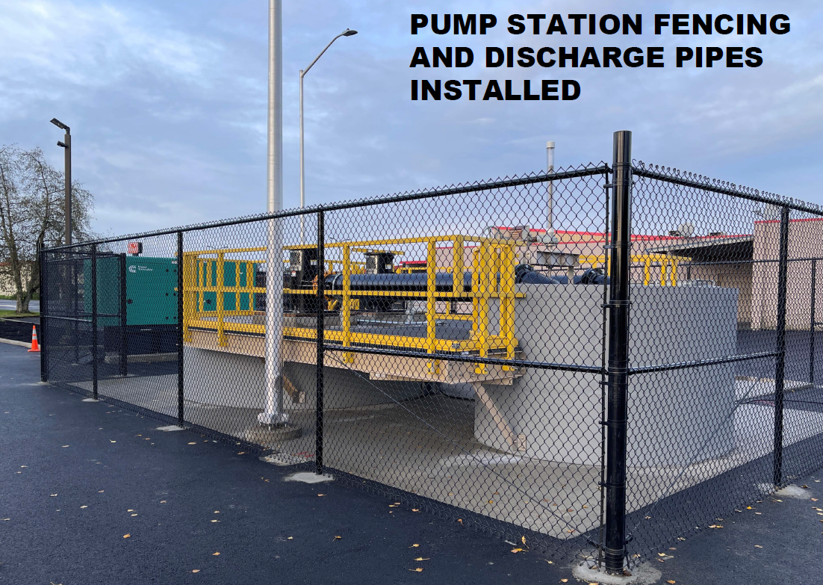
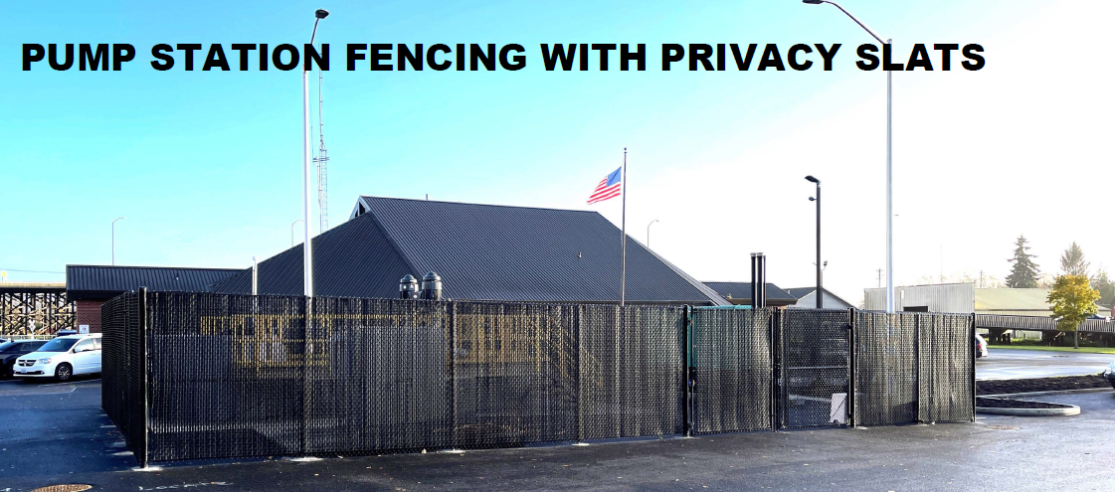
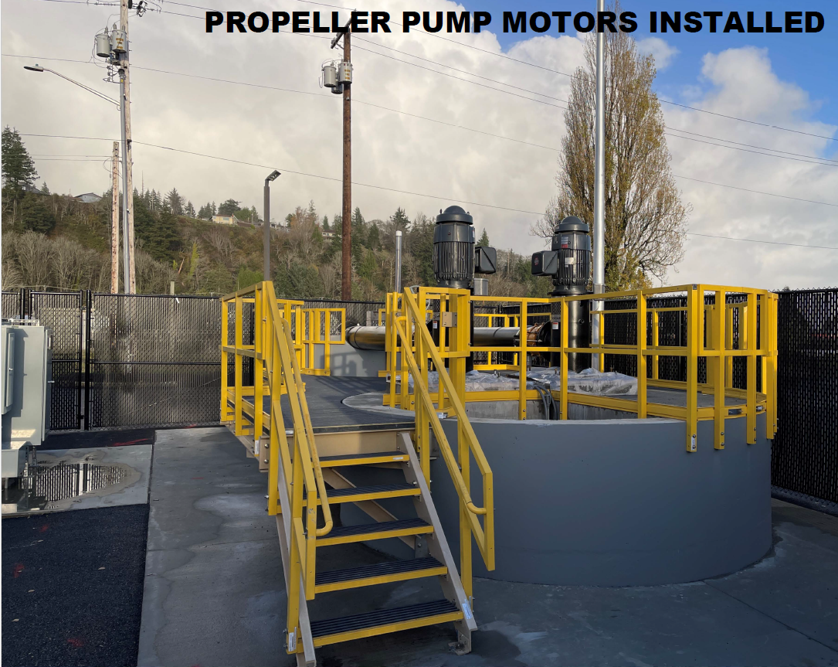
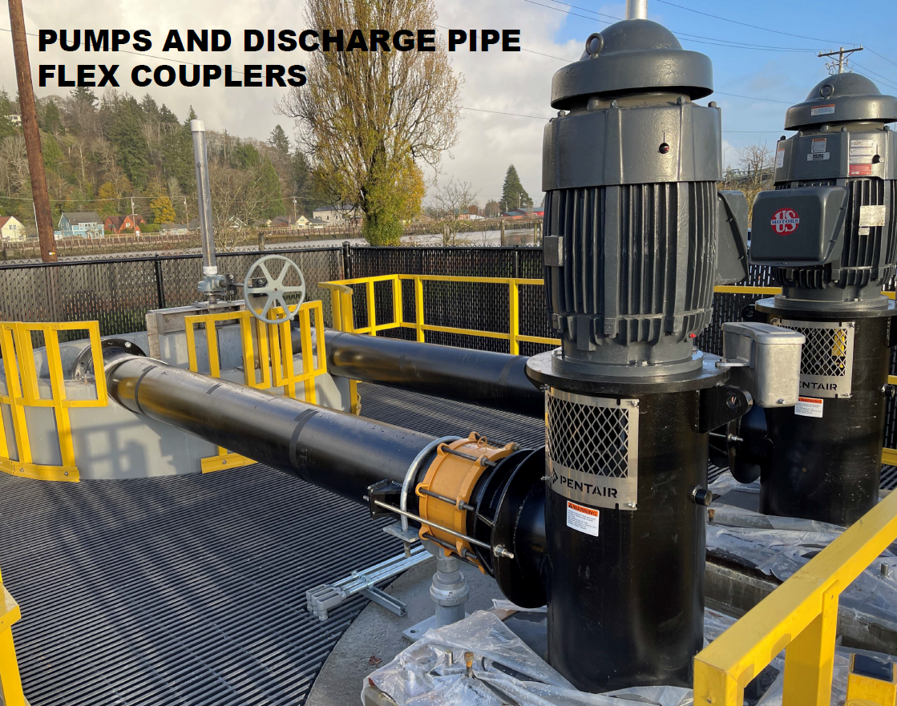
8 pump stations.
$50M cost.
$30M to date (58%).
$12M request (24%).
2,735 acres
4,583 parcels
232 businesses
$1.1B assessed value
EXAMPLE
10th St Pump Station
Local Projects (Hoquiam, 2024)

Slide 14
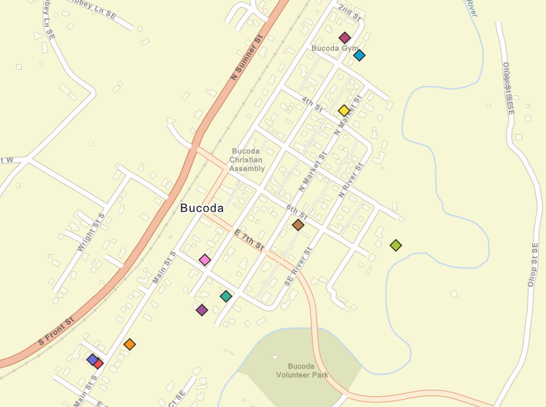
Foundation Flood Openings Pilot
Local Projects (Bucoda, 2016)
11 Properties
Total -- $ 85,465.43.
Average -- $8,550.
Link – here.
Web map – here.

Slide 15
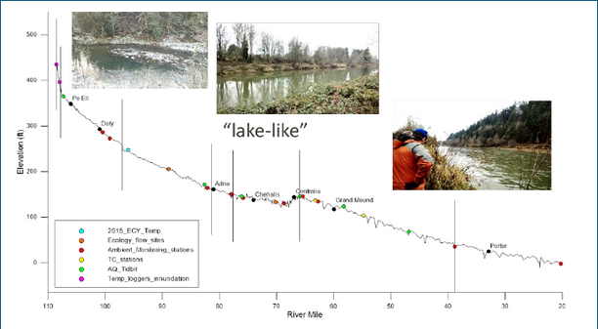
Local Projects (Geographically-Based)
Basin Geography
Upper = Steep, narrow, fast flowing.
Middle = Flat, “lake like”, slow to drain.
Lower = Flat, coastal, difficult to drain.
Shah, Mohammad. (2021). inland water-dynamics and ecology. 10.5772/intechopen.87463.

Slide 16
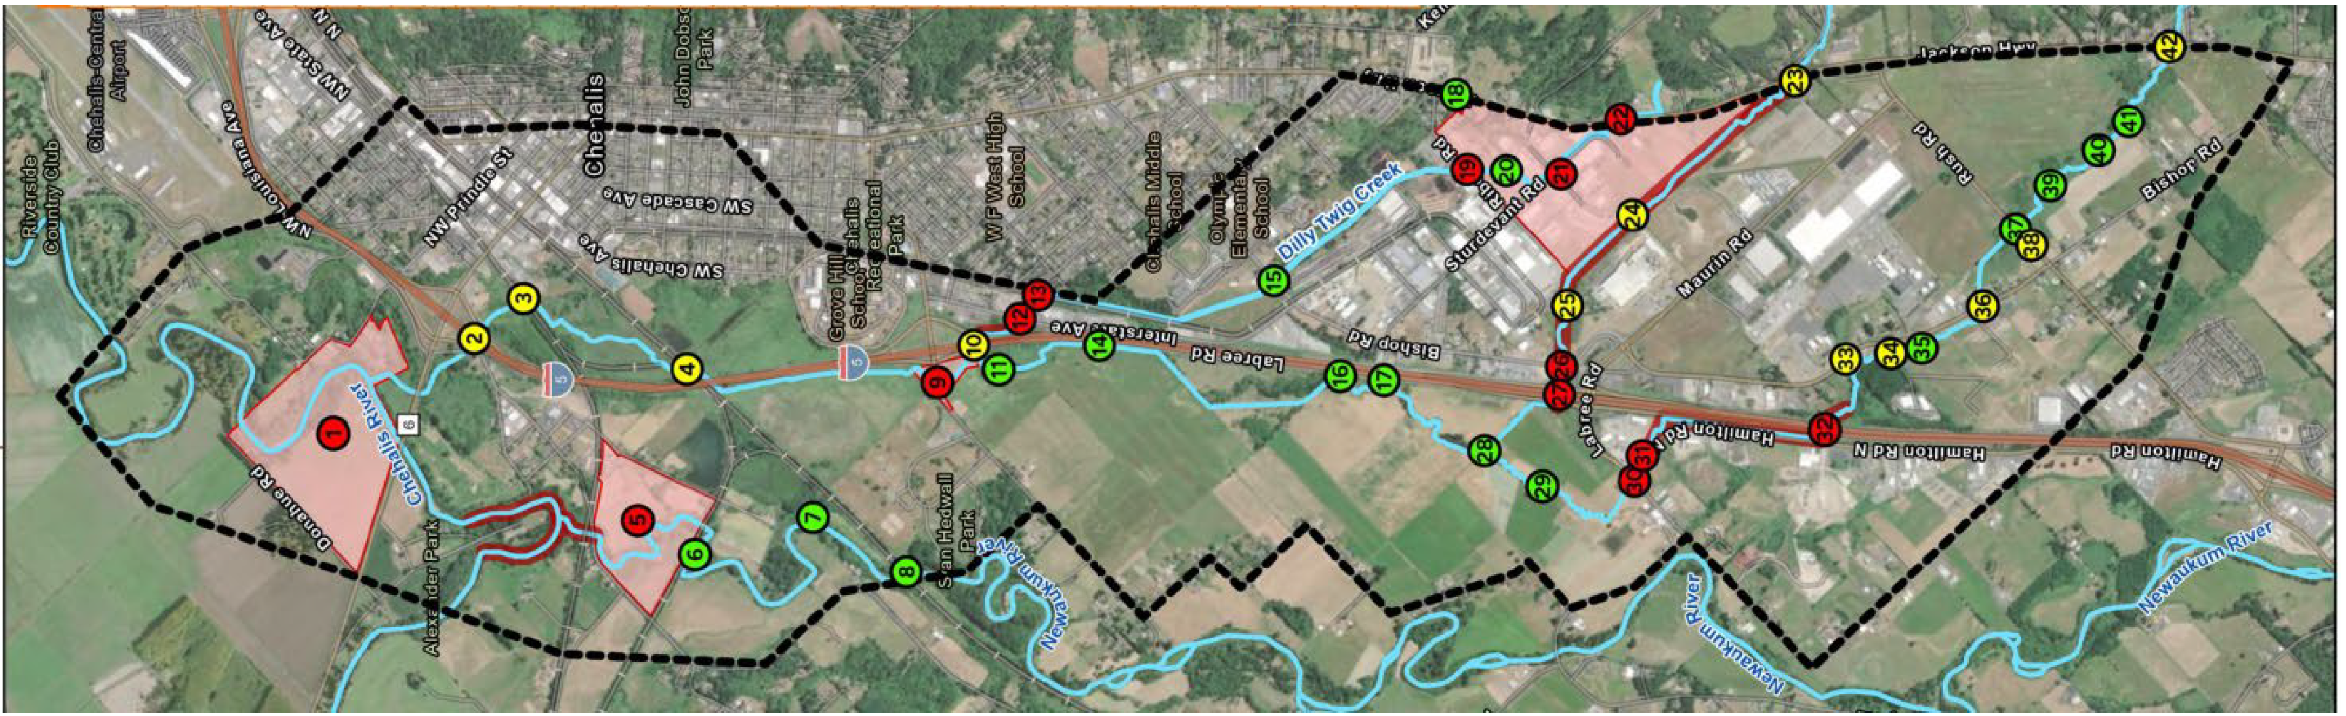
2023-25 Funding -- Flood Storage Investment Plan
Local Projects (Mid-Basin -- Geographically-Based)
South City of Chehalis & Port of Chehalis
Geographic flooding strategy with sequenced investments:
Increase flood storage
Reduce flood levels
Minimize damage, monetary losses

Slide 17
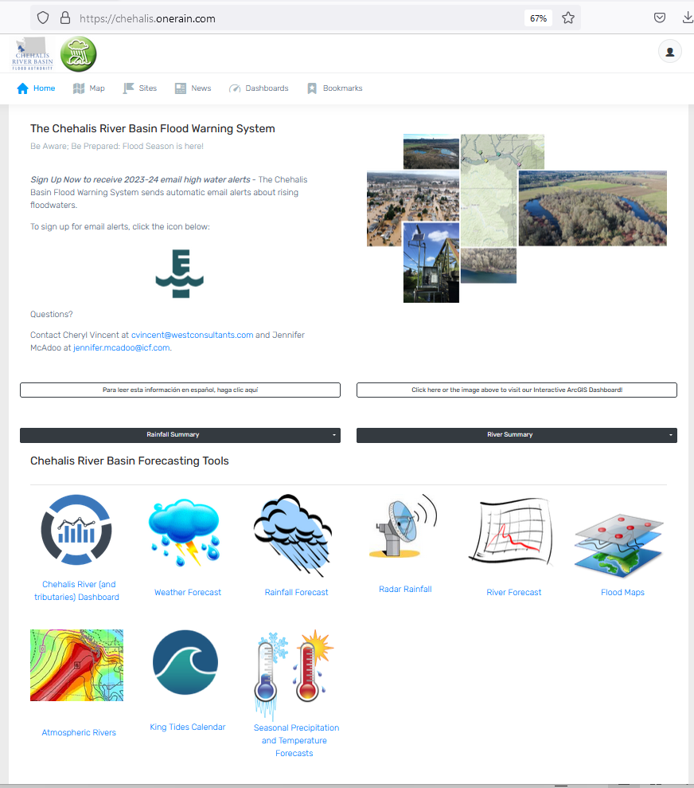
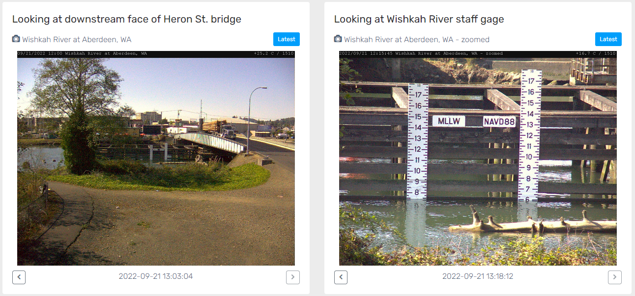
Developed with State Capital Budget $.
Maintained with local $.
Flood Warning System (#2)
www.chehalisriverflood.com

Slide 18
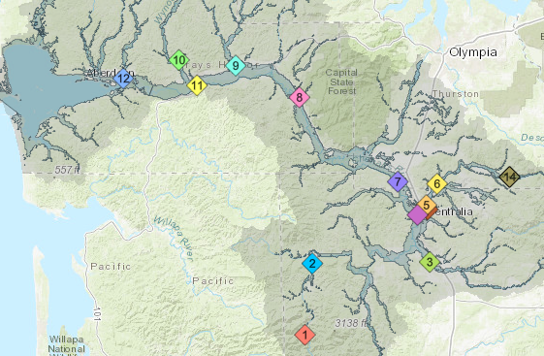
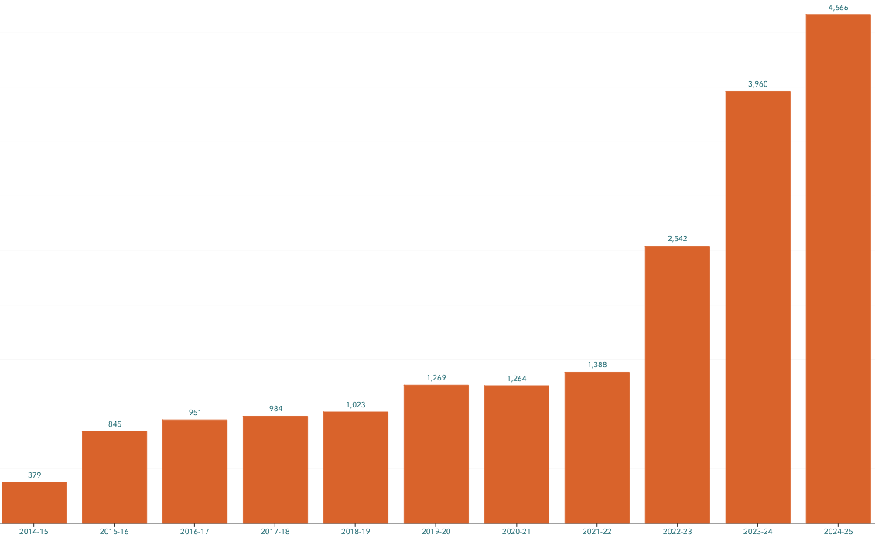
Flood Warning System (Alert Sign-Ups)
Sign-up for email high water alerts here.

Slide 19
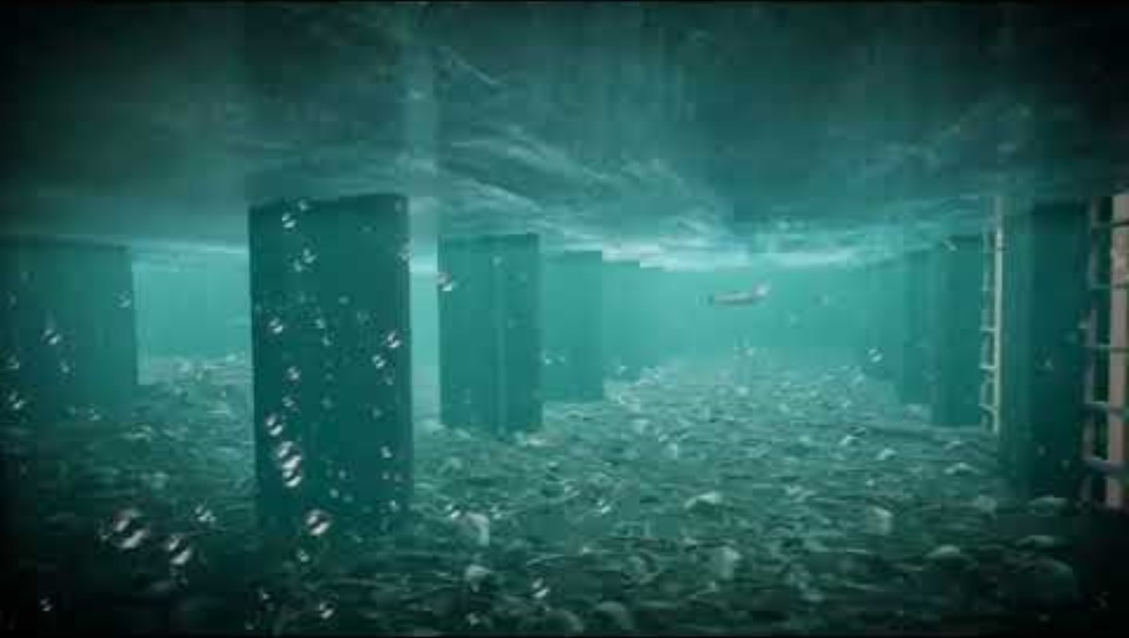
Proposed Flow-Through Dam for Flood Control (#3)
1. Move through unobstructed
Water
Fish
Sediment
2. Delivers top-to-bottom benefit, Pe Ell to Cosmopolis.
3. See recent presentation here.
www.chehalisriverbasinfczd.com

Slide 20
State Law
“The primary purpose of the office is to aggressively pursue implementation of an integrated strategy and administer funding for long-term flood damage reduction and aquatic species restoration in the Chehalis river basin.” (RCW 43.21A.730)
Chehalis Basin Strategy
Appoints 3 member
Chehalis Basin Board
Community leaders, Chehalis and Quinault tribal representatives, local and state government liaisons
Office of Chehalis Basin | Chehalis Basin Board
https://chehalisbasinstrategy.com/
Office of Chehalis Basin
Small team within the WA Department of Ecology
“Network of Partners”
Organizations and local entities who turn ideas into shovel-ready reality

Slide 21








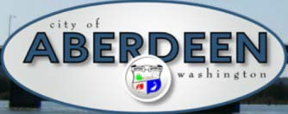















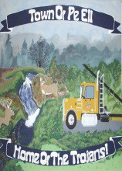


Chehalis Basin Strategy (Network of Partners)

Slide 22
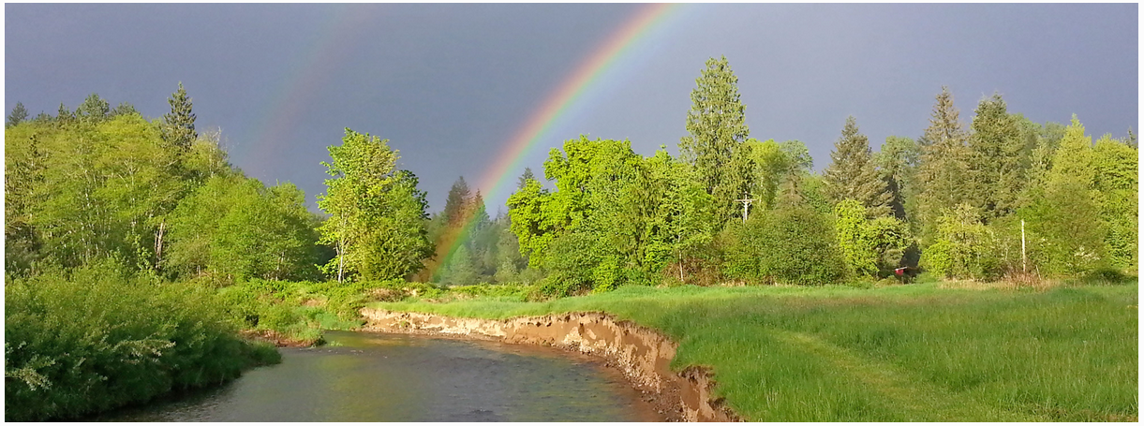
Local Resolutions Library
https://www.ezview.wa.gov/site/alias__1492/37643/local_resolutions.aspx
Today vs 2007
Today, we are substantially more aware, better prepared for catastrophic flooding than ever before.
We have a state-of-the art flood warning system.
We’ve completed many cost-efficient local projects and habitat projects.
We’re serving people, local governments, emergency responders, agriculture, fish, and habitat alike
We have a governance, administrative, and funding structure that’s delivering results, and is committed to a balanced basin-wide flood and fish solution (see Local Resolution Library).
https://chehalisbasinstrategy.com/office-of-chehalis-basin/

Slide 23
Key Contacts
Vickie Raines, Grays Harbor County Representative
Chair, Chehalis River Basin Flood Authority
Flood Authority Appointee & Chair, Chehalis Basin Board
360/590-4100
vraines@graysharbor.us
Edna Fund, Lewis County Representative
Vice-Chair, Chehalis River Basin Flood Authority
Chair, Chehalis River Basin Flood Control Zone District Advisory Board
360/269-7515
dutch@localaccess.com
Duane Crouse, Napavine Representative
Member, Chehalis River Basin Flood Authority
253/961-3030
dcrouse@cityofnapavine.com
Scott Boettcher
Staff, Chehalis River Basin Flood Authority
360/480-6600
scottb@sbgh-partners.com

Slide 24
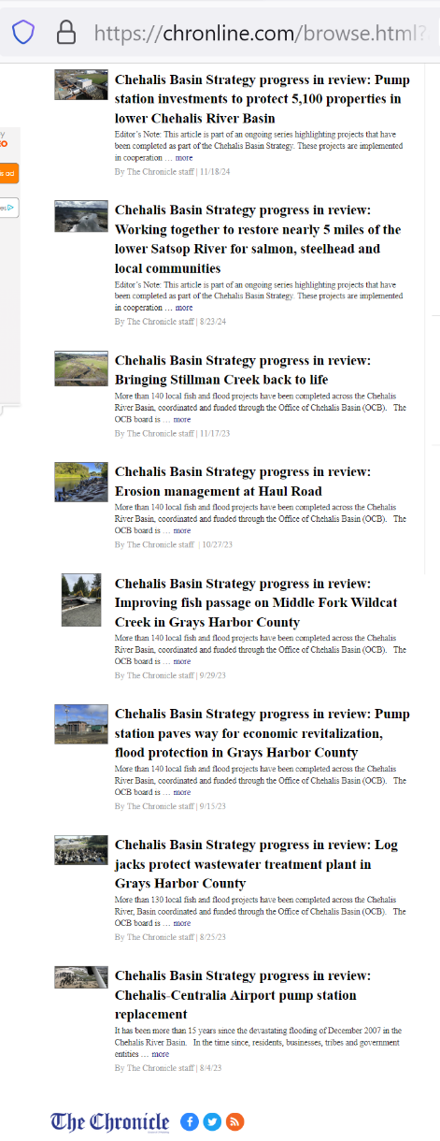
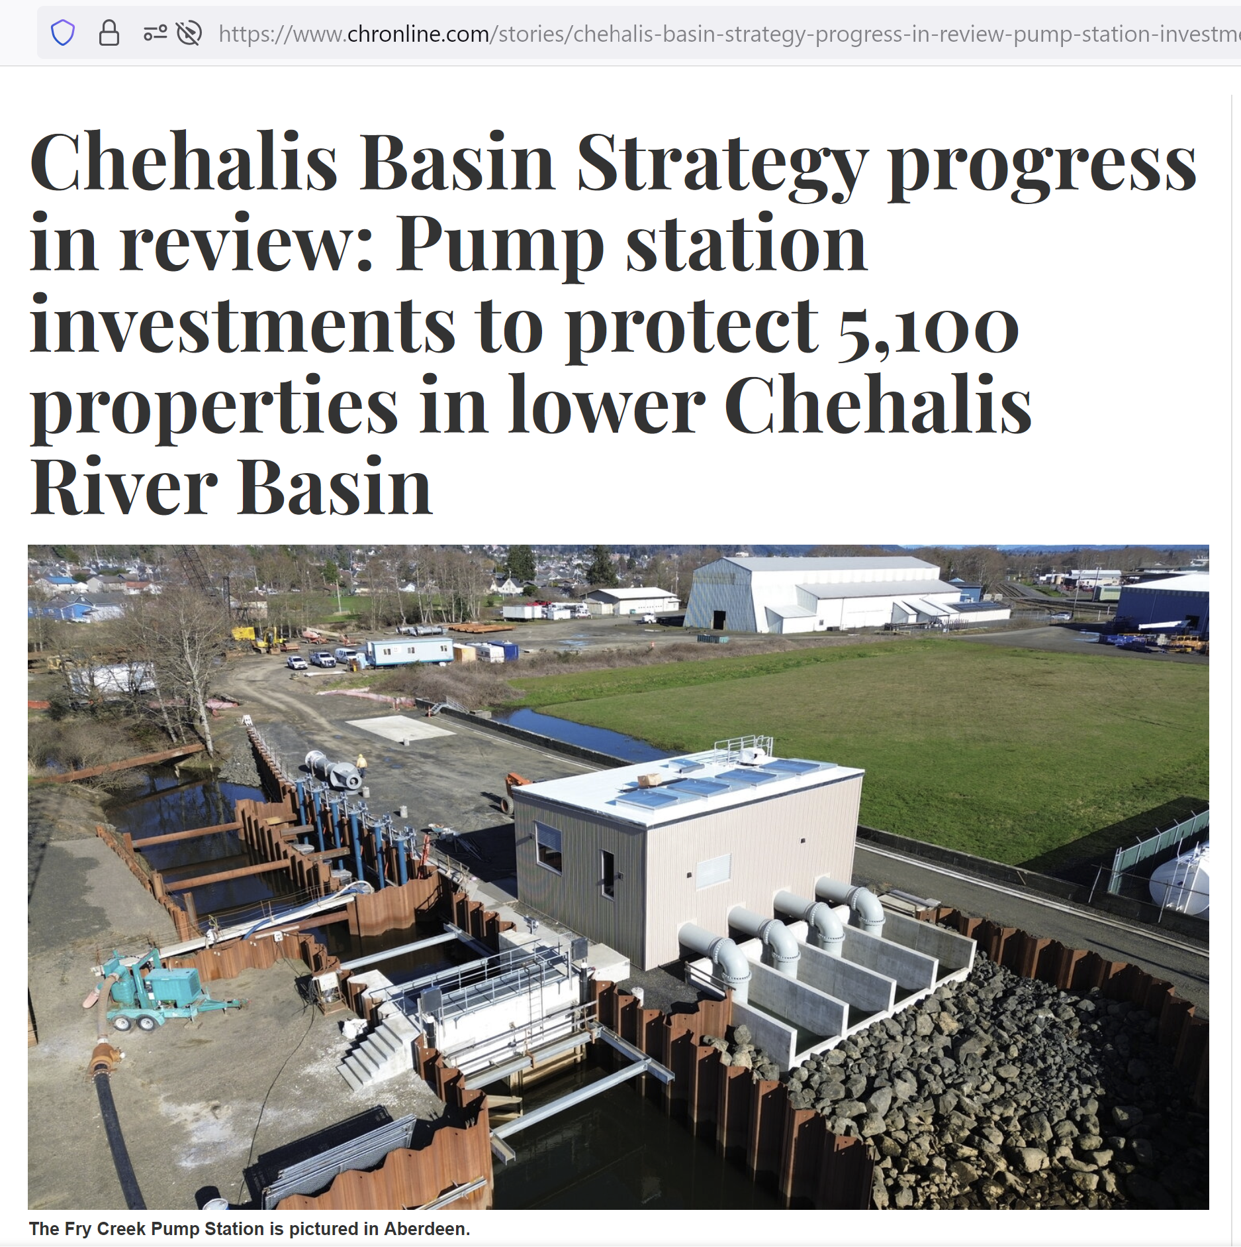

Extra – Flood and Fish Articles

