Slide 1


Chehalis River Basin Flood Authority
Reducing Flood Damage and
Restoring Aquatic Species
Thurston County
July 16, 2025

Slide 2
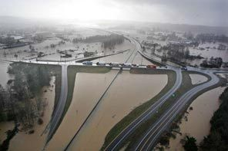
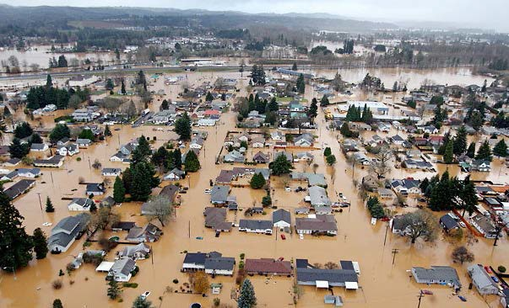
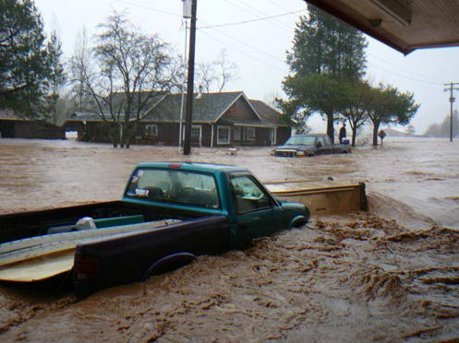
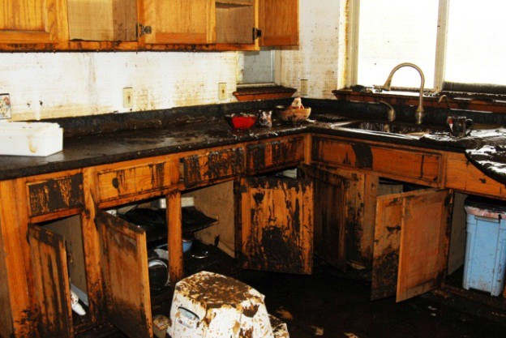
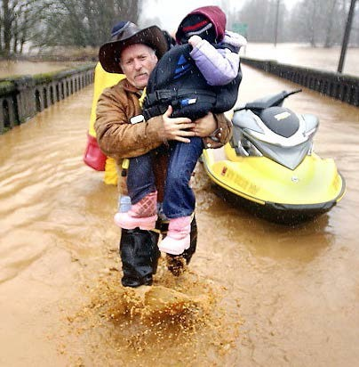
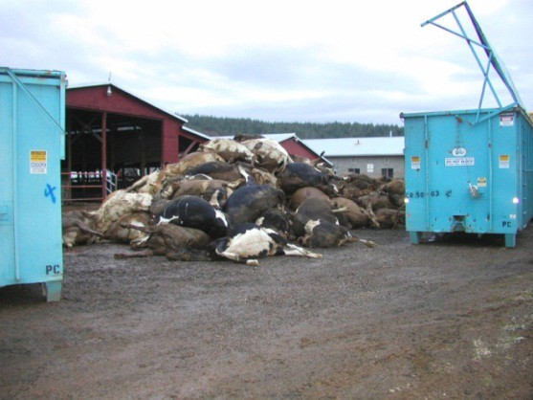


2007 Storm
$938M Basin-wide damage, $300M lost economic activity (WA).
Exit 77 (I-5) in Chehalis
STEVE RINGMAN / SEATTLE TIMES
City of Centralia
STEVE RINGMAN / SEATTLE TIMES
State Route 6, West of Adna MIKE SALSBURY / AP
Photos Source: LEWIS COUNTY, DIVISION OF EMERGENCY
MANAGEMENT

Slide 3



Today’s Presentation
“Flood Authority”
  #1 -- Local Projects
  #2 -- Flood Warning System
“Chehalis River Basin Flood Control Zone District”
  #3 -- Proposed Flow-through Dam for Flood Control
Office of Chehalis Basin | Chehalis Basin Board
https://chehalisbasinstrategy.com/
.

Slide 4
Chehalis River Basin Flood Authority
Formed in 2008
Focused on flood hazard mitigation
Decision-making
  informed by science
  protective of Basin residents/communities
  environmentally appropriate
Jurisdictions represented (see inter-local agreement)
Grays Harbor County (2008)
  City of Aberdeen (2008)
  City of Cosmopolis(2011)
  City of Hoquiam (2017)
  City of Montesano (2008)
  City of Oakville (2008)
Lewis County (2008)
  City of Centralia (2008)
  City of Chehalis (2008)
  City of Napavine (2011)
  Town of Pe Ell (2008)
Thurston County (2008)
  Town of Bucoda (2008)
Help local communities identify, develop, implement local flood hazard reduction solutions.

Slide 5
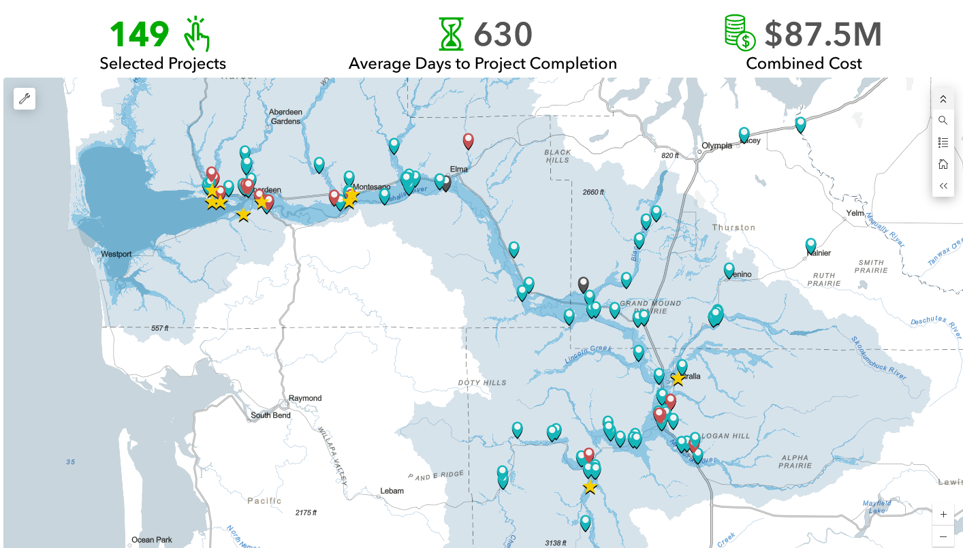
Local Projects Completed 2012-25

Slide 6
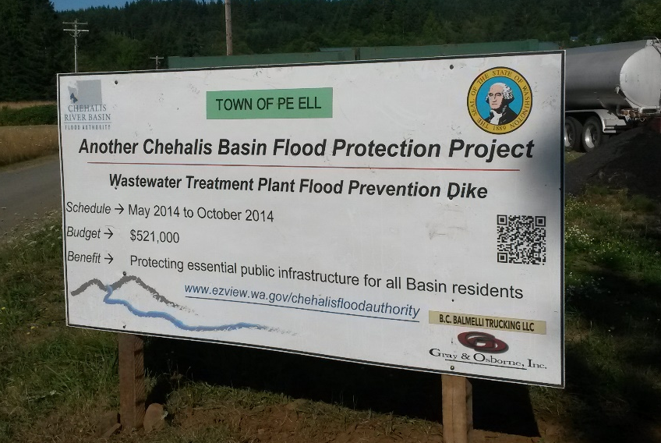
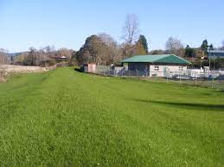

Local Projects (Pe Ell, 2014)
Project = Design/construct 900’ dike (between Chehalis river and WWTP).
Cost = $521,000.
Photos = Here.
Website = Here.

Slide 7
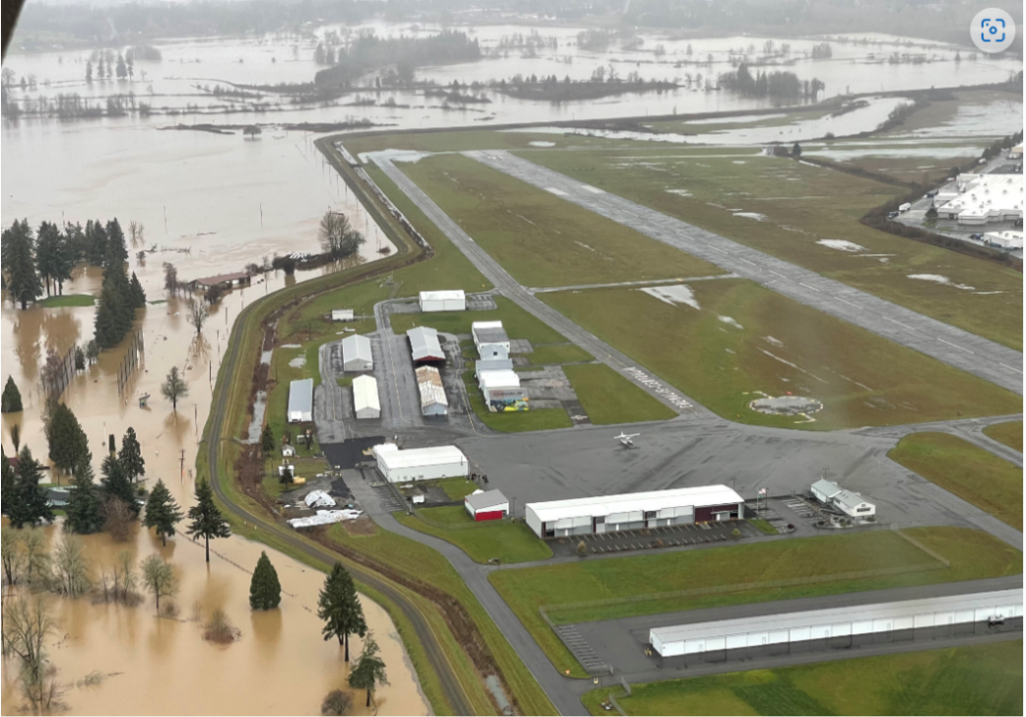
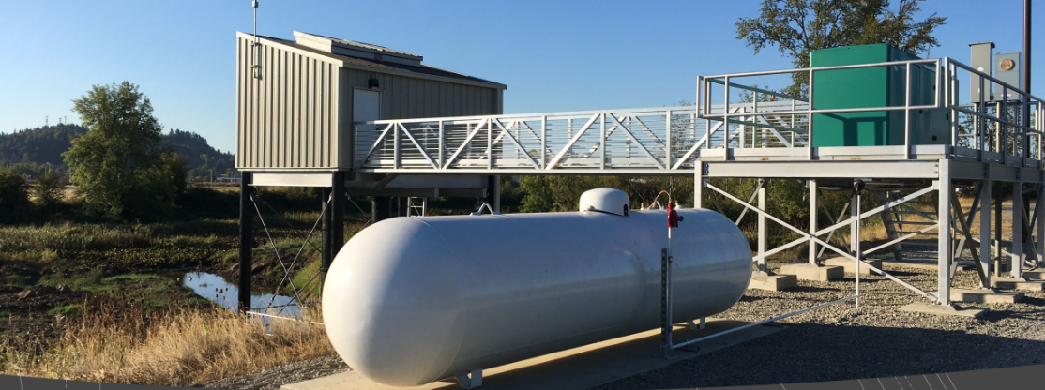
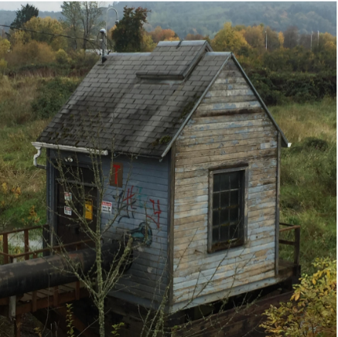
Local Projects (Chehalis-Centralia Airport, 2017)
Completed -- Fall 2017.
Cost -- $1.14M.
January 2022 Flood Event – Pumped 518.4M gallons
over many days to keep levee dry.
ROI (2018) -- Protects $45M in assets, ensures $9M
in annual tax revenue.
Read More -- Here.
← Previous WWII-era pump

Slide 8
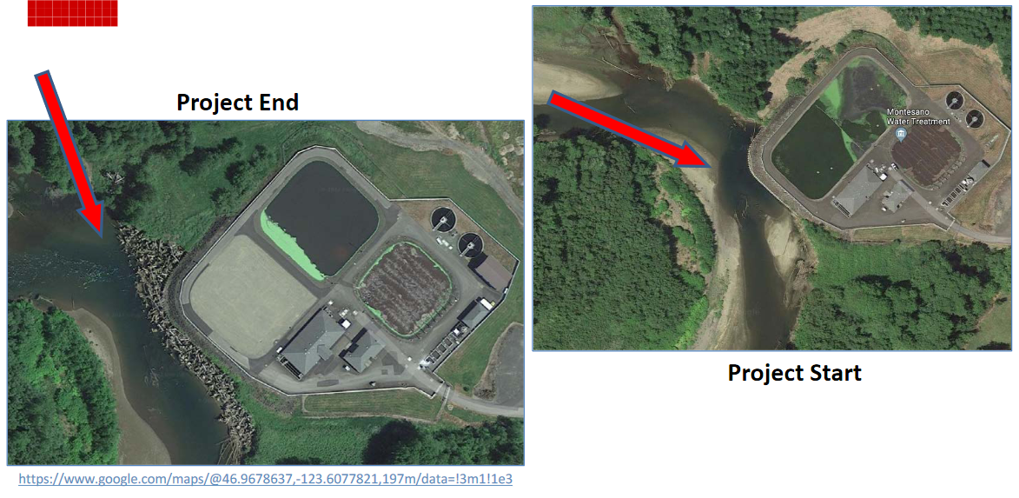
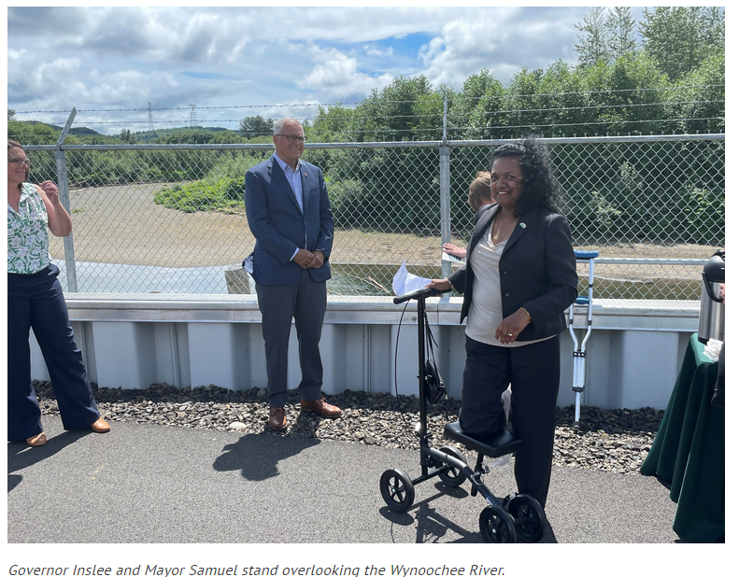
Local Projects (Montesano, 2017-2020)
Protect WWTP from on-coming Wynoochee river using 220+ “log-jacks.”
$2 million (for “log-jacks”).
Small cost compared to WWTP relocation and environmental cleanup (in event of WWTP breaching).
July 7, 2022 →

Slide 9
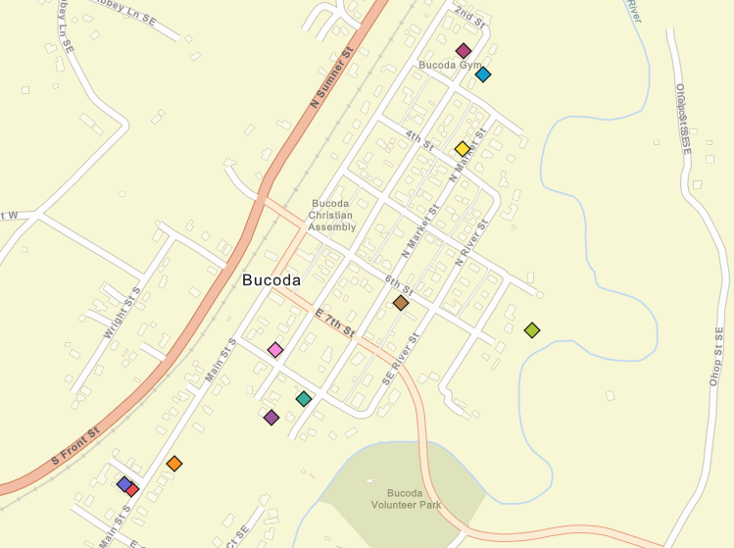
Foundation Flood Openings Pilot
Local Projects (Bucoda, 2016)
11 Properties
Total -- $ 85,465.43.
Average -- $8,550.
Link – here.
Web map – here.

Slide 10
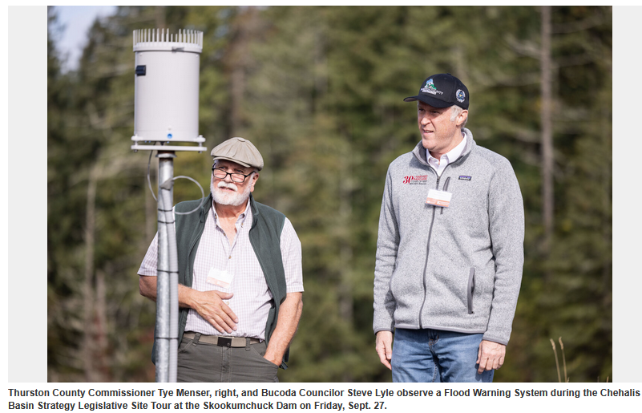
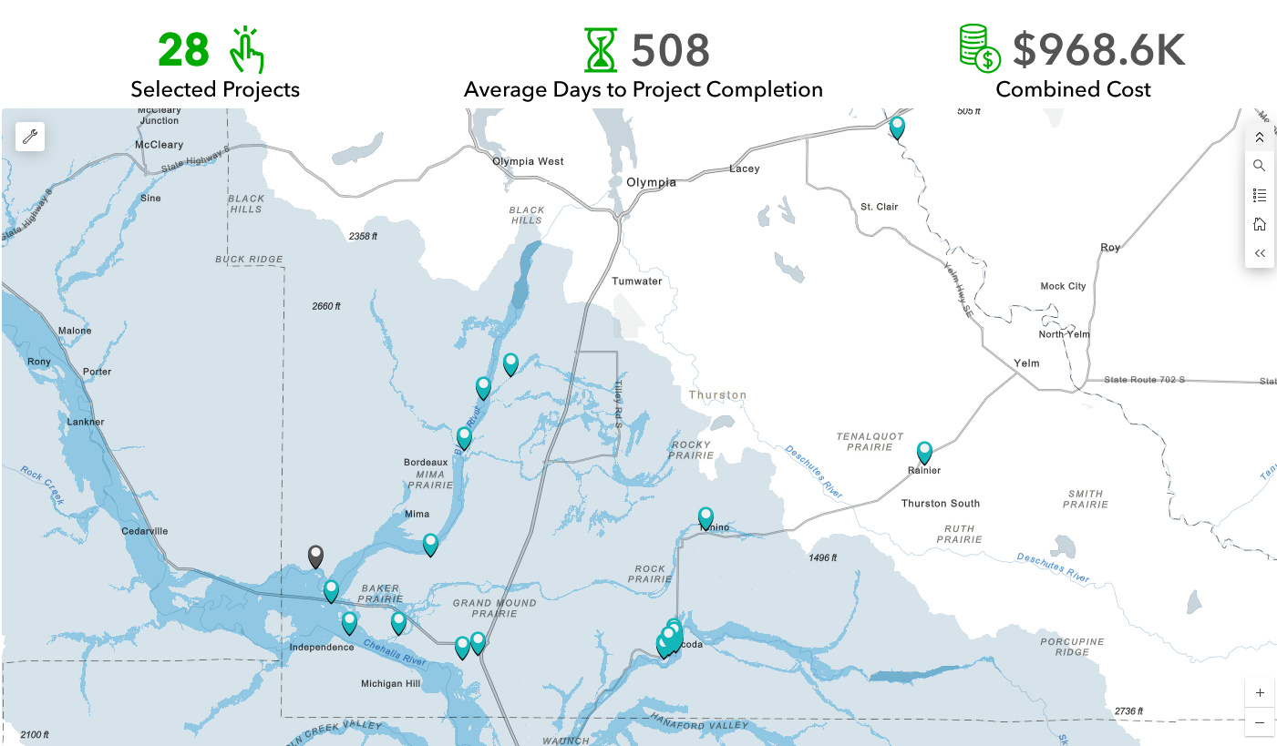
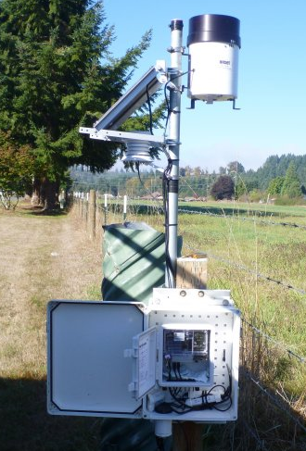
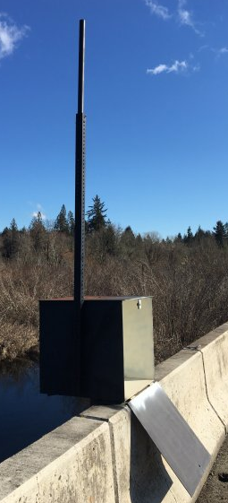
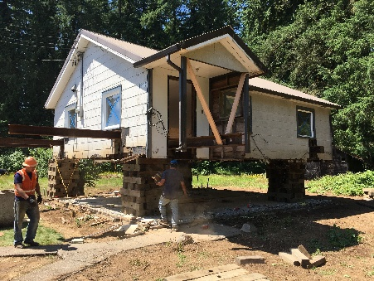
Local Projects (Thurston County)

Slide 11
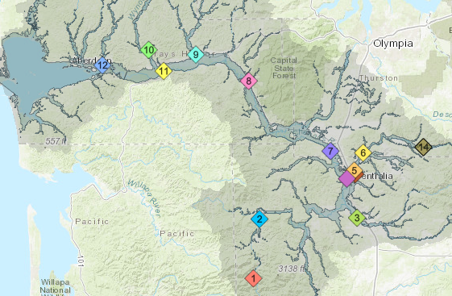
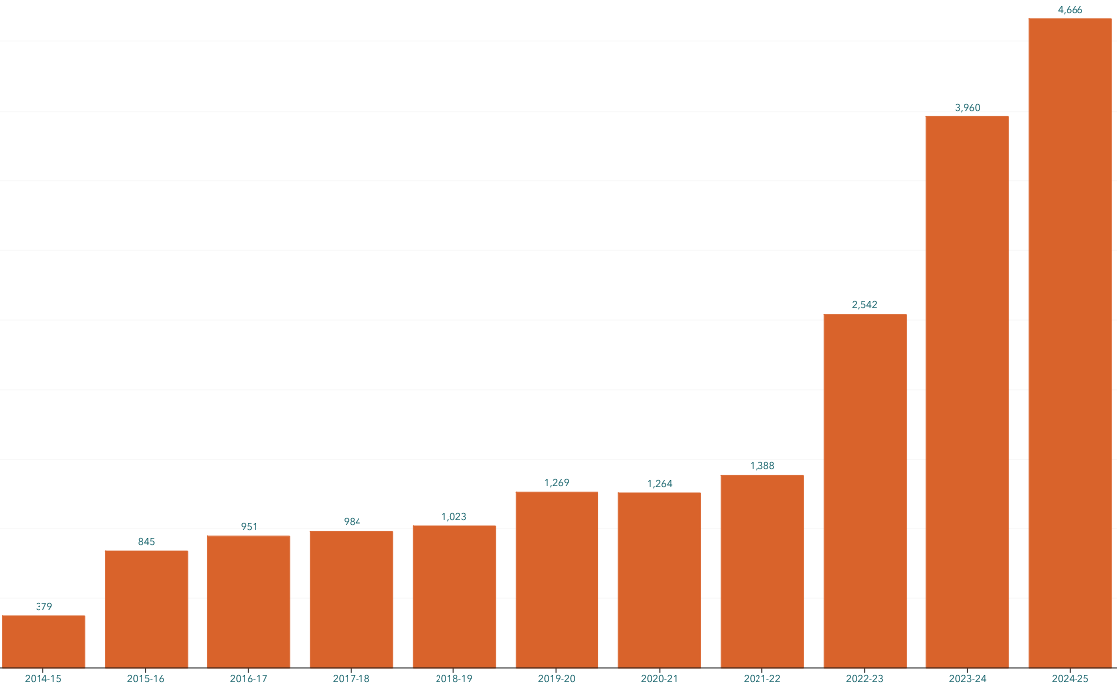
Developed with State Capital Budget $.
Maintained with local $.
Flood Warning System (Alert Sign-Ups)
Sign-up for email high water alerts here.

Slide 12

Proposed Flow-Through Dam for Flood Control (#3)
1. Move through unobstructed
Water
Fish
Sediment
2. Delivers top-to-bottom benefit, Pe Ell to Cosmopolis.
3. See recent presentation here.
www.chehalisriverbasinfczd.com

Slide 13








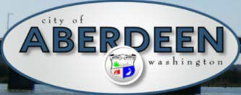


















Chehalis Basin Strategy (Network of Partners)

Slide 14
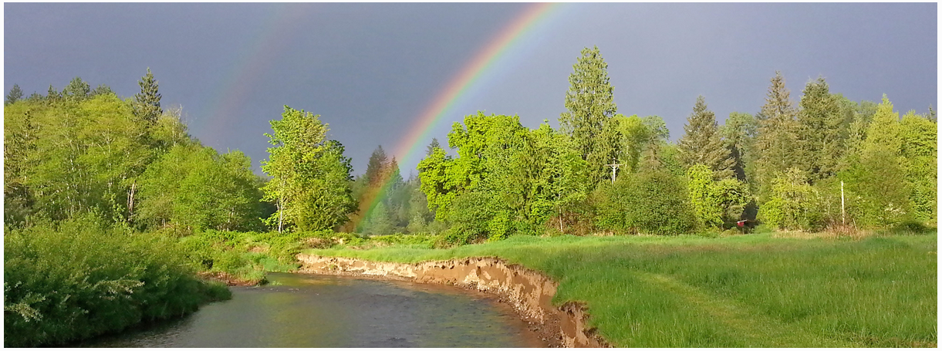
Local Resolutions Library
https://www.ezview.wa.gov/site/alias__1492/37643/local_resolutions.aspx
Today vs 2007
Today, we are substantially more aware, better prepared for catastrophic flooding than ever before.
We have a state-of-the art flood warning system.
We’ve completed many cost-efficient local projects and habitat projects.
We’re serving people, local governments, emergency responders, agriculture, fish, and habitat alike
We have a governance, administrative, and funding structure that’s delivering results, and is committed to a balanced basin-wide flood and fish solution (see Local Resolution Library).
https://chehalisbasinstrategy.com/office-of-chehalis-basin/

Slide 15
Key Contacts
Vickie Raines, Grays Harbor County Representative
Chair, Chehalis River Basin Flood Authority
Flood Authority Appointee & Chair, Chehalis Basin Board
360/590-4100
vraines@graysharbor.us
Edna Fund, Lewis County Representative
Vice-Chair, Chehalis River Basin Flood Authority
Chair, Chehalis River Basin Flood Control Zone District Advisory Board
360/269-7515
dutch@localaccess.com
Wayne Fournier, Thurston County Representative
Member, Chehalis River Basin Flood Authority
360/968-4612
Wayne.Fournier@co.thurston.wa.us
Scott Boettcher
Staff, Chehalis River Basin Flood Authority
360/480-6600
scottb@sbgh-partners.com

Slide 16
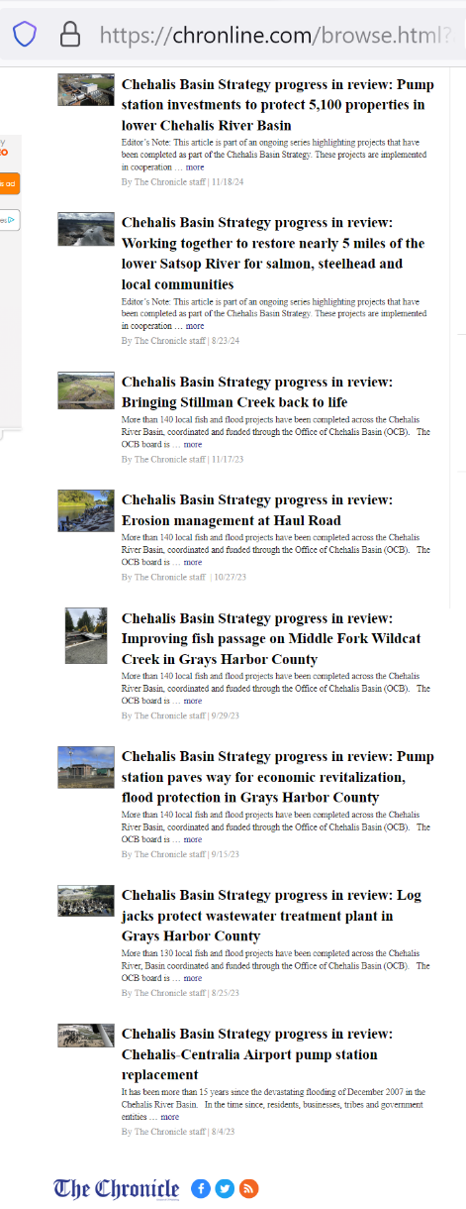
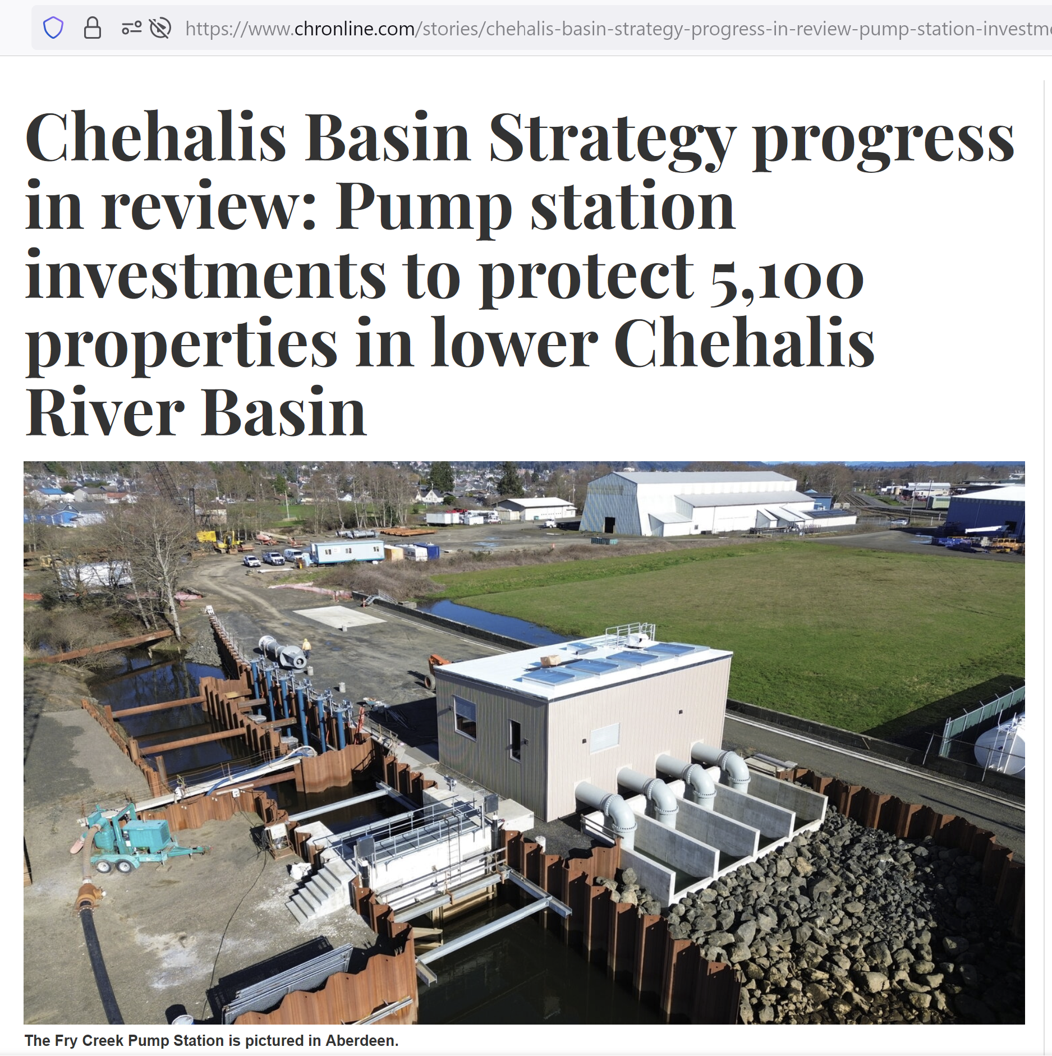

Extra – Flood and Fish Articles

