Slide 1


Chehalis River Basin Flood Authority
Reducing Flood Damage and
Restoring Aquatic Species
Grays Harbor County Citizen Corps
January 10, 2024
Scott Boettcher
Staff, Chehalis River Basin Flood Authority
360/480-6600⏐scottb@sbgh-partners.com

Slide 2



Today’s Presentation
Describe the “Flood Authority”
  #1 -- Local Projects
  #2 -- Flood Warning System
Touch on “Chehalis Basin Strategy”
Allow time for discussion.
Office of Chehalis Basin | Chehalis Basin Board
https://chehalisbasinstrategy.com/
.

Slide 3
Chehalis River Basin Flood Authority
Formed in 2008
Focused on flood hazard mitigation
Decision-making
  informed by science
  protective of Basin residents/communities
  environmentally appropriate
Jurisdictions represented (see inter-local agreement)
Grays Harbor County (2008)
  City of Aberdeen (2008)
  City of Cosmopolis(2011)
  City of Hoquiam (2017)
  City of Montesano (2008)
  City of Oakville (2008)
Lewis County (2008)
  City of Centralia (2008)
  City of Chehalis (2008)
  City of Napavine (2011)
  Town of Pe Ell (2008)
Thurston County (2008)
  Town of Bucoda (2008)
Help local communities identify, develop, implement local flood hazard reduction solutions.

Slide 4
Local Projects (#1)
Reduce flood damage.
Protect people, property, infrastructure.
Improve readiness, response, resiliency.
  Drinking Water (Boistfort, Bucoda).
  Wastewater (Montesano, Pe Ell).
  Emergency Response (Grays Harbor County, Chehalis-Centralia Airport).
  Regional Economic Infrastructure (Montesano, Port of Chehalis, Port of Grays Harbor).
  Community Protection (Aberdeen, Adna, Bucoda, Centralia, Chehalis, Chehalis Tribe, Hoquiam, Oakville).
  Flood Warning (Basin-wide).
State Capital Budget:
2012-13 -- $ 5.0M
2013-15 -- $10.7M
2015-17 -- $15.7M
2017-19 -- $ 9.6M
2019-21 -- $ 6.3M
2021-23 -- $ 4.1M
2023-25 -- $ 3.6M
$55.0M

Slide 5
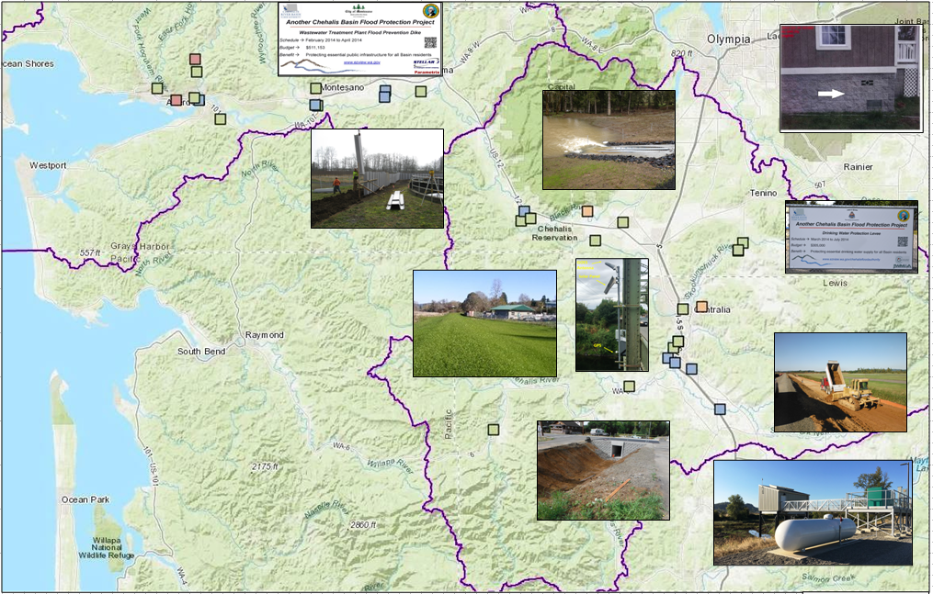
Local Projects (103 Projects Completed 2012-23)
Cost: ~$450,000 (average)
Timeframe: ~600 days (average)
Sequence:
1st = “Plan/Study/Design” project (~50)
2nd = “Construction” project (~53)

Slide 6
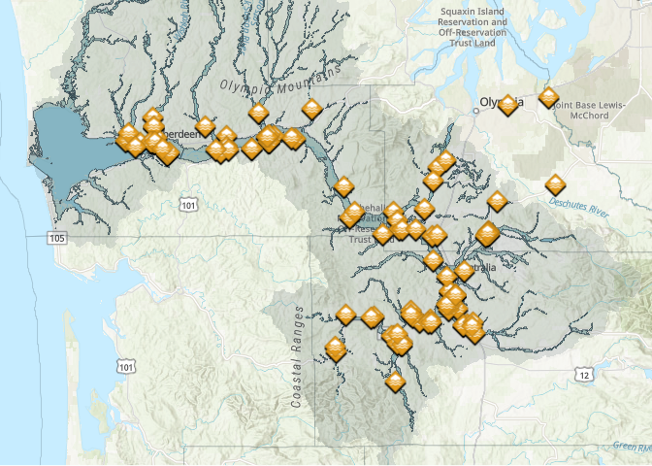
Local Projects (103 Projects Completed 2012-23)

Slide 7
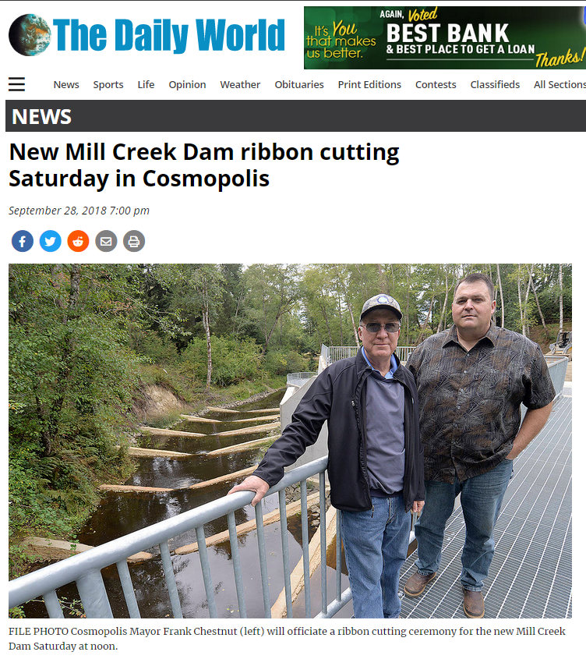
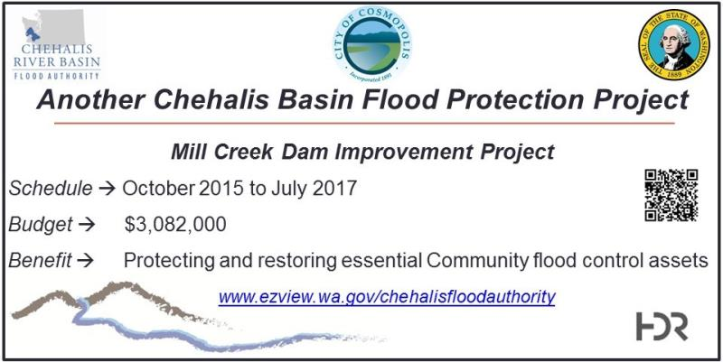
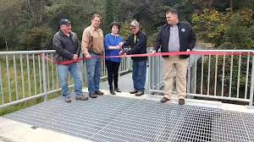
COMPLETED FLOOD AND FISH – Mill Creek Dam
Local Projects (Cosmopolis)
Mill Creek Multi-Objective Implementation Plan:
Part I = Reconstruct Mill Creek Dam (done).
Phase II project = Address 4,500’ of Mill Creek flow, culverts, and flood water evacuation (under development).
City of Cosmopolis, Sep 29, 2018
https://www.thedailyworld.com/news/new-mill-creek-dam-ribbon-cutting-saturday-in-cosmopolis/

Slide 8
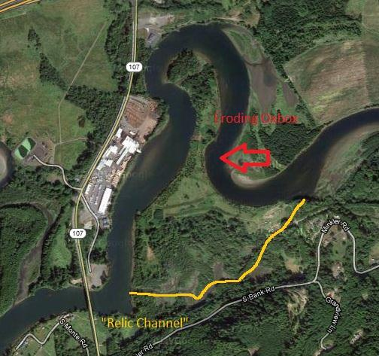
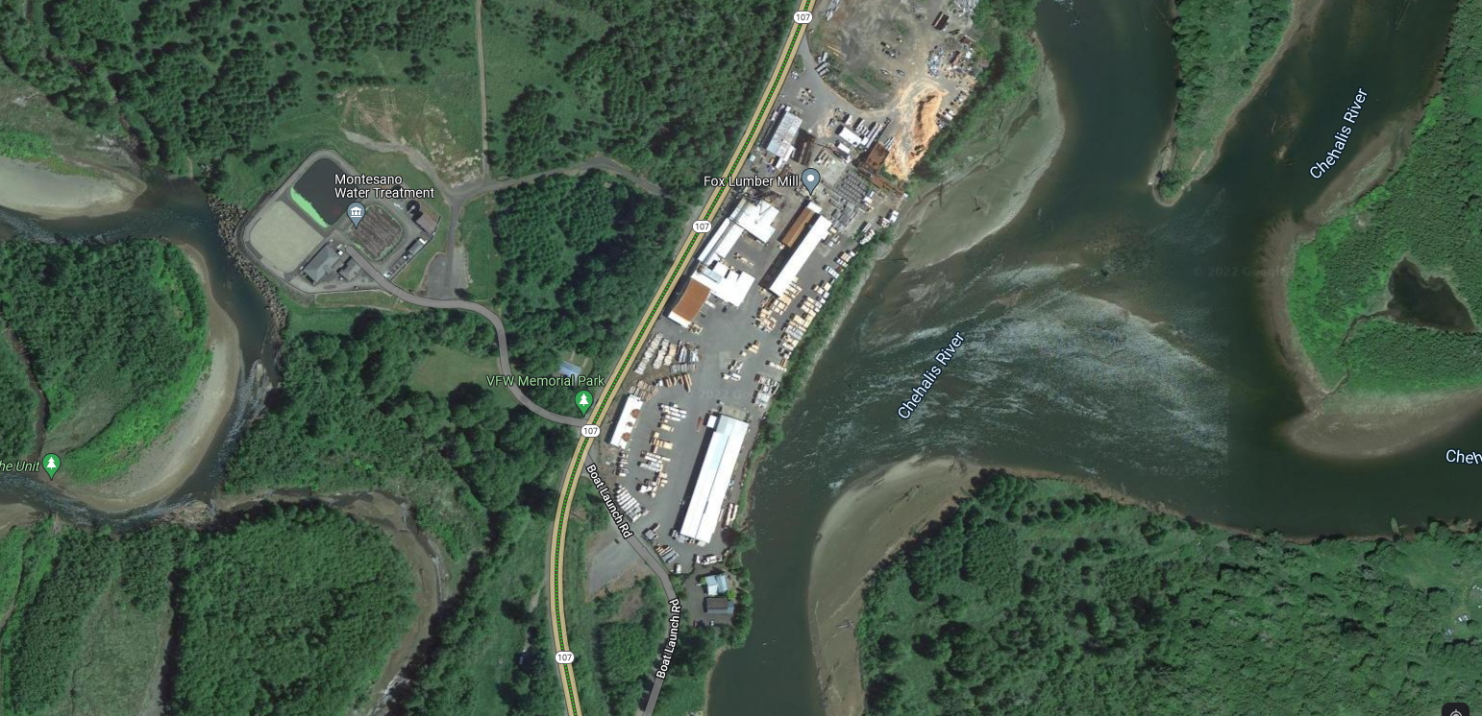
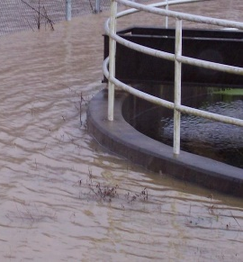
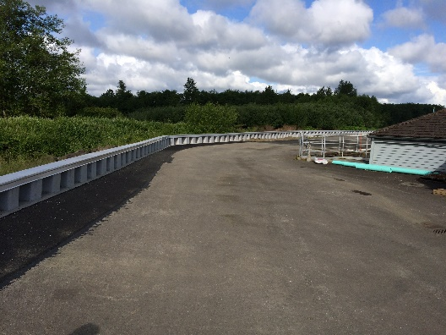
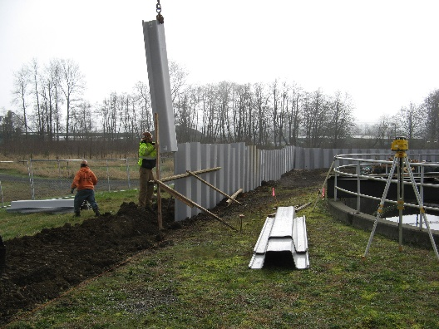
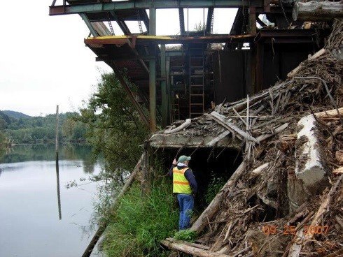
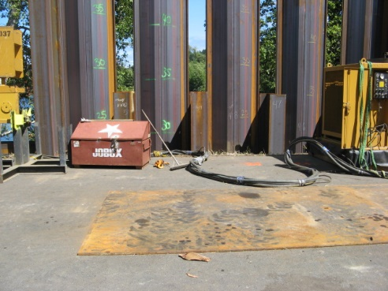
COMPLETED FLOOD – Mary’s River Lumber and Montesano WWTP Chehalis River Protection Projects (2012-15)
Local Projects (Montesano)
2007
2022
2014
2014
2014
~$6M protection against Chehalis River
Funding pooled/shared.
2014
2014

Slide 9
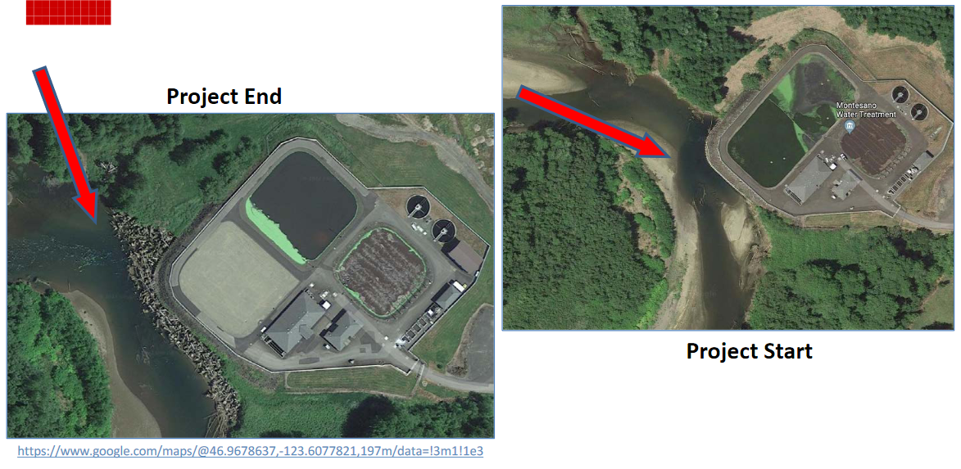
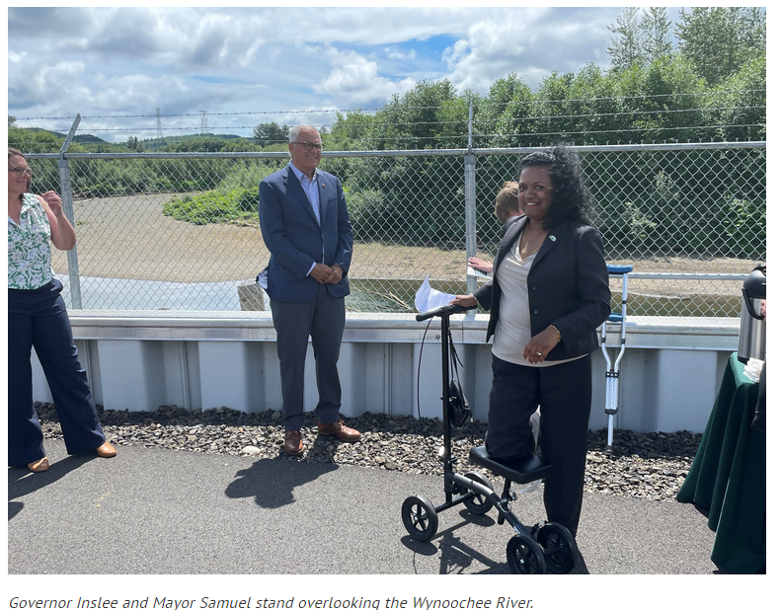
COMPLETED FLOOD AND FISH – Montesano WWTP Protection Project (2017-2020)
Local Projects (Montesano)
Protect WWTP from on-coming Wynoochee river using 220+ “log-jacks.”
$2 million (for “log-jacks”).
Small cost compared to WWTP relocation and environmental cleanup (in event of WWTP breaching).
July 7, 2022 →

Slide 10
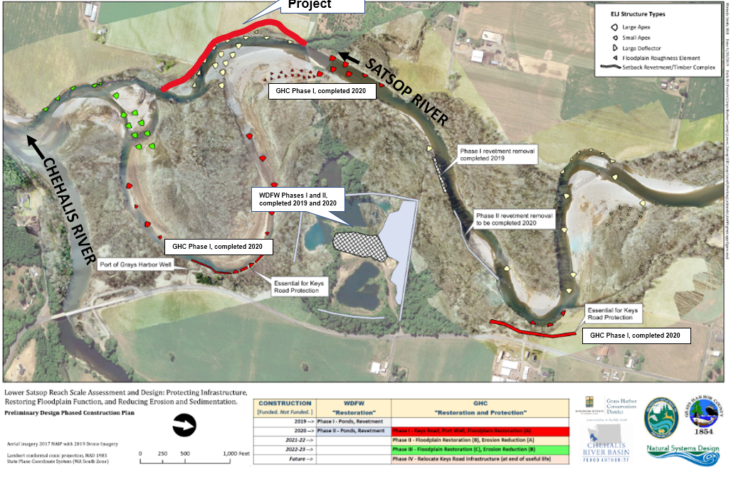
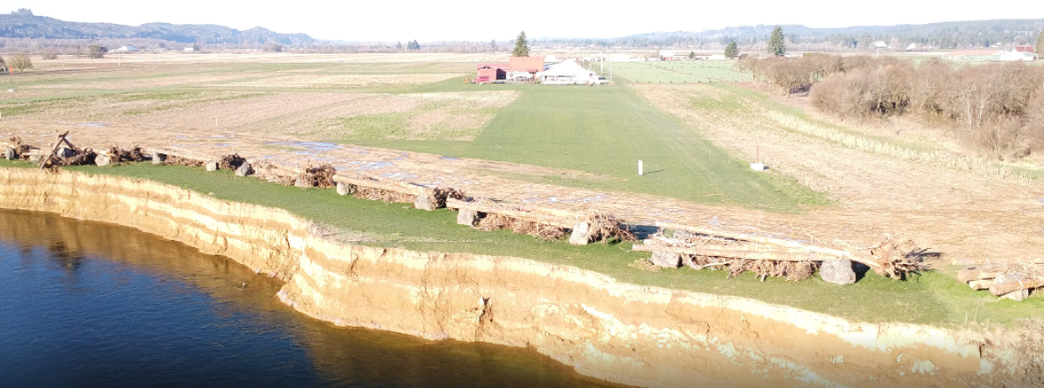
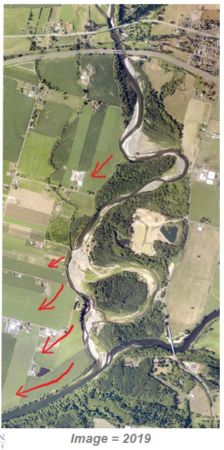
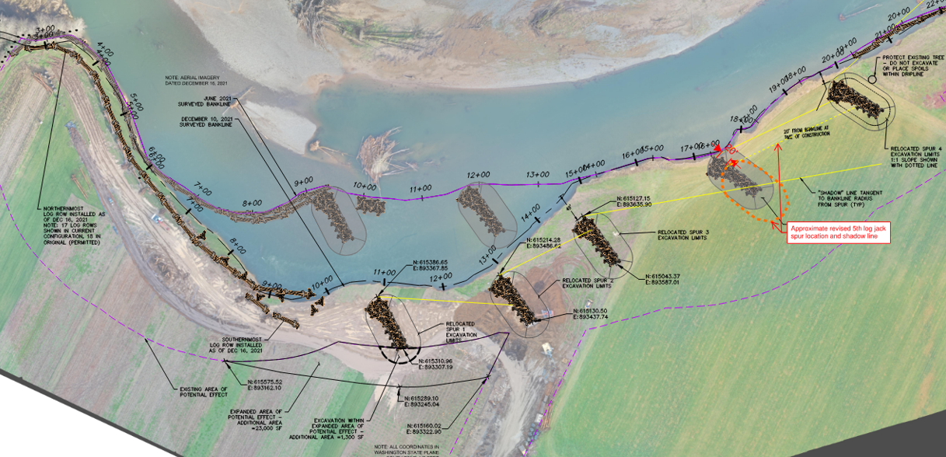
Local Projects (Grays Harbor County, Grays Harbor Conservation District, WDFW)
COMPLETED FLOOD AND FISH –
2022 Right Bank Conservation Project (Phase IB)
2020 Keys Road Infrastructure Protection (Phase IA)
2019-20 WDFW Ponds

Slide 11
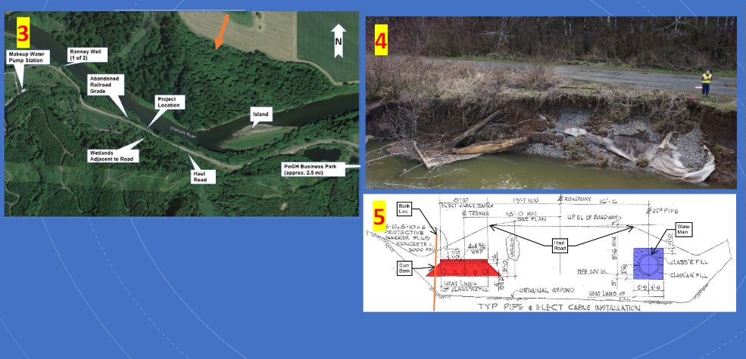
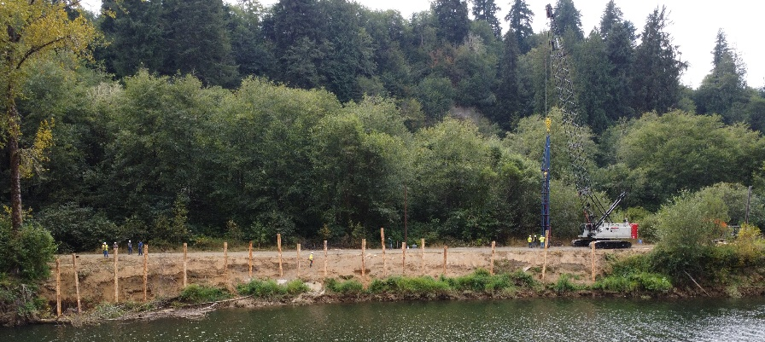
COMPLETED FLOOD AND FISH – “Haul Road” Emergency Repair (2022-23)
Local Projects (Port of Grays Harbor)
← 9/14/2022

Slide 12
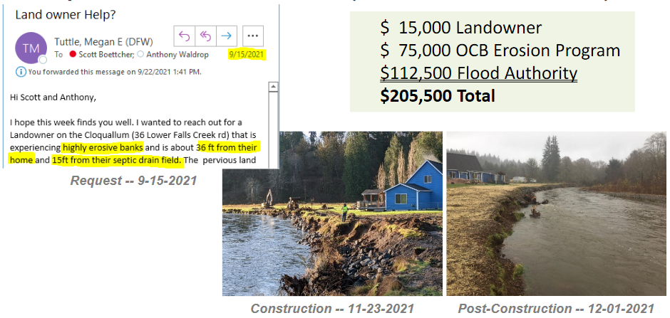
COMPLETED FLOOD AND FISH – Cloquallam Creek Erosion Pilot (36 Lower Falls Creek Rd)
Local Projects (Grays Harbor Conservation District)
Highly-collaborative emergency project to protect property and septic drain field
Property and drain field saved, environmental contamination and clean-up avoided.

Slide 13
COMPLETED FLOOD – Chehalis-Centralia Airport
Local Projects (Chehalis)
Return on investment from protected jobs and revenue during Jan. 2022 flooding:
New Pump -- 2017
January 2022
New Pump Cost = $1.1M
Widening Levee = $1.2M
ROI = Substantial:
  Jobs: 1,658
  Labor income: $68 million
  Value added: $115.3 million
  Business revenues: $186.4 million
  Annual tax revenues (local, state): ~$9M
1/2022 High-water event = Airport stayed operational
Old Pump – 1940s
Widening/Repairing Levee – 2014

Slide 14
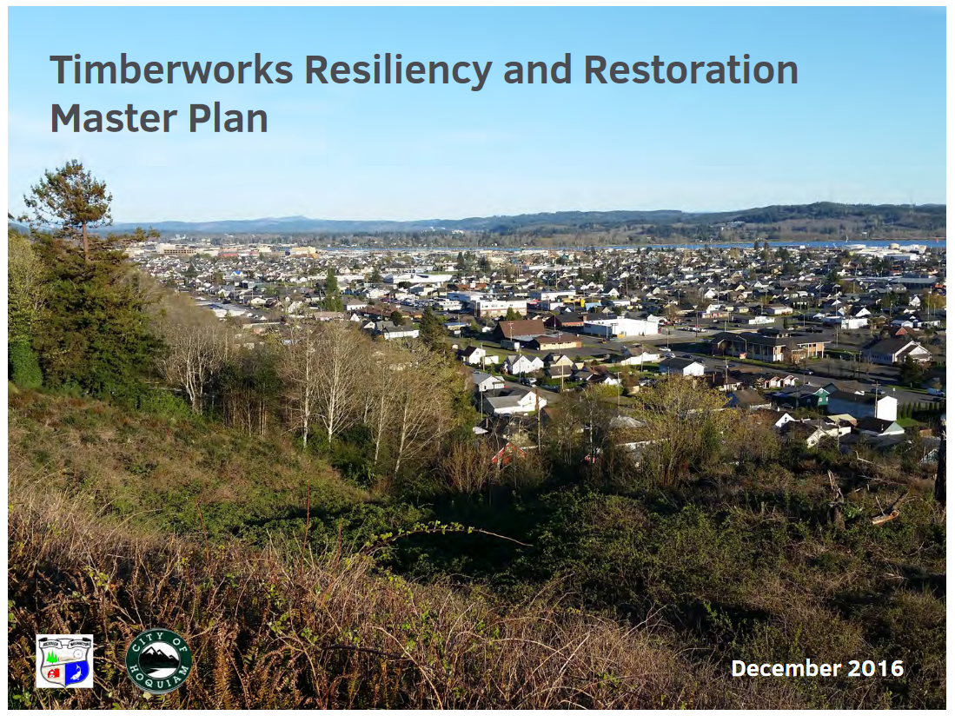
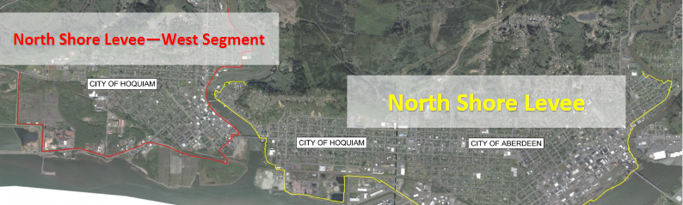
UNDERWAY FLOOD – North Shore Levee and West Segment
Local Projects (Aberdeen, Hoquiam)
COMPLETED 2016 – Timberworks (precursor to currently underway North Shore Levee for Aberdeen and Hoquiam)
← 9/14/2022

Slide 15
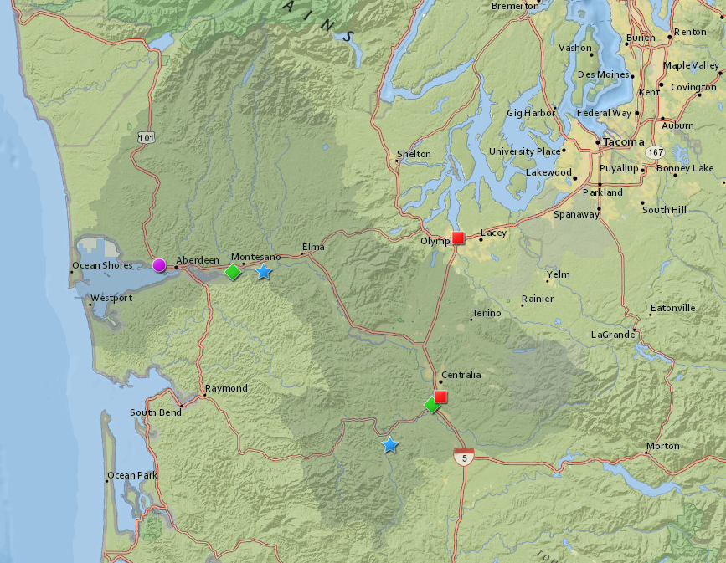
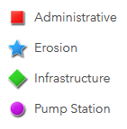

16 Projects, $9,360,965
Local Projects (New and Continuing, 2023-25)
View interactive map
https://arcg.is/08jfjq

Slide 16
16 Projects, $9,360,965
Local Projects (New and Continuing, 2023-25)
Aberdeen | 22-2301 | Aberdeen Pump Stations
 | 22-1728 | Design and Permitting of Farragut Pump Station
 | 23-1219 | Fry Creek Phase 3 Design
Cosmopolis | 22-2277 | Joint Surface Water Management Comp Plan
 | 21-1451 | Mill Creek Multi-Objective Implementation Plan, Ph II
GHCD | 22-2546 | Lower Satsop Right Bank Conservation, Phase 2
Hoquiam | 21-1466 | 10th Street Pump Station Design and Permitting
 | 22-2278 | Hoquiam Pump Stations
 | 21-1467 | Queen Ave Pump Station Design and Permitting
Montesano | 23-1482 | Montesano Water Supply Resiliency
Port of Grays Harbor | 22-2358 | Haul Road Mid Term Project
Lewis County |  | New Skookumchuck Reservoir Gage
 | 23-1483 | S.F. Chehalis /Boistfort CMZ
Chehalis | 23-1221 | Chehalis Flooding Strategy and Investment Plan
 | 23-1481 | Derelict WWTP Demolition and Removal
Port of Chehalis | 18-2614 | Berwick Creek Flood Reduction and Restoration
Plan/Design |  | Construct

Slide 17
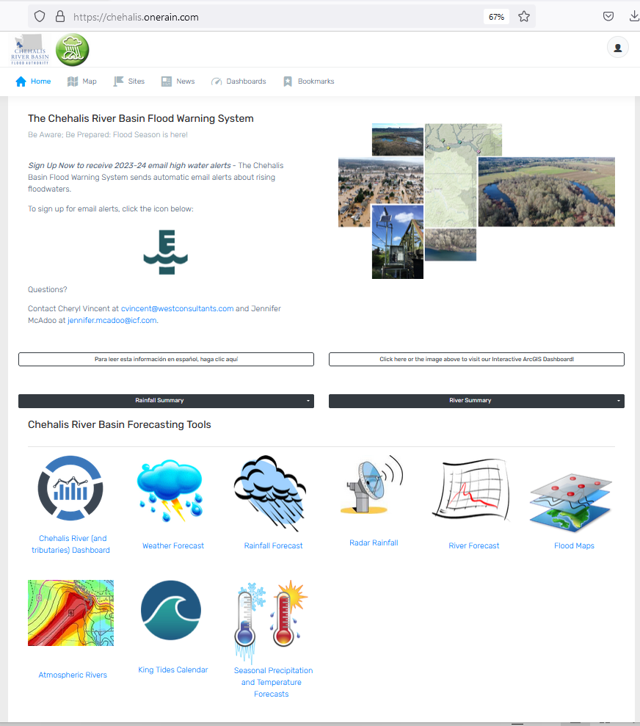
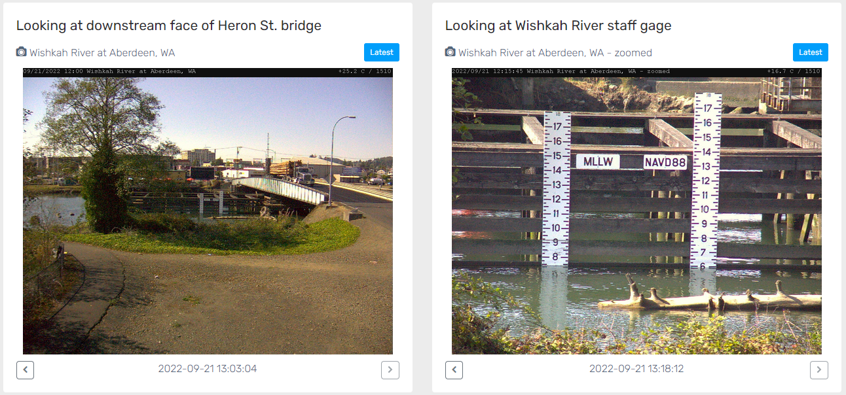
Developed with State Capital Budget $.
Maintained with local $.
Flood Warning System (#2)

Slide 18

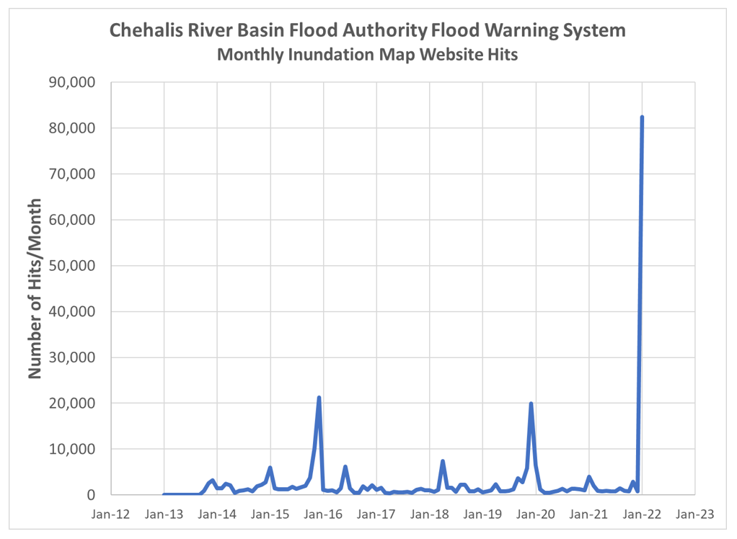
Flood Warning System (2022 Flood Event)
Flood Warning System Works!
Dave Curtis, West Consultants, 2/01/2022
Survey Respondent, 2/01/2022

Slide 19
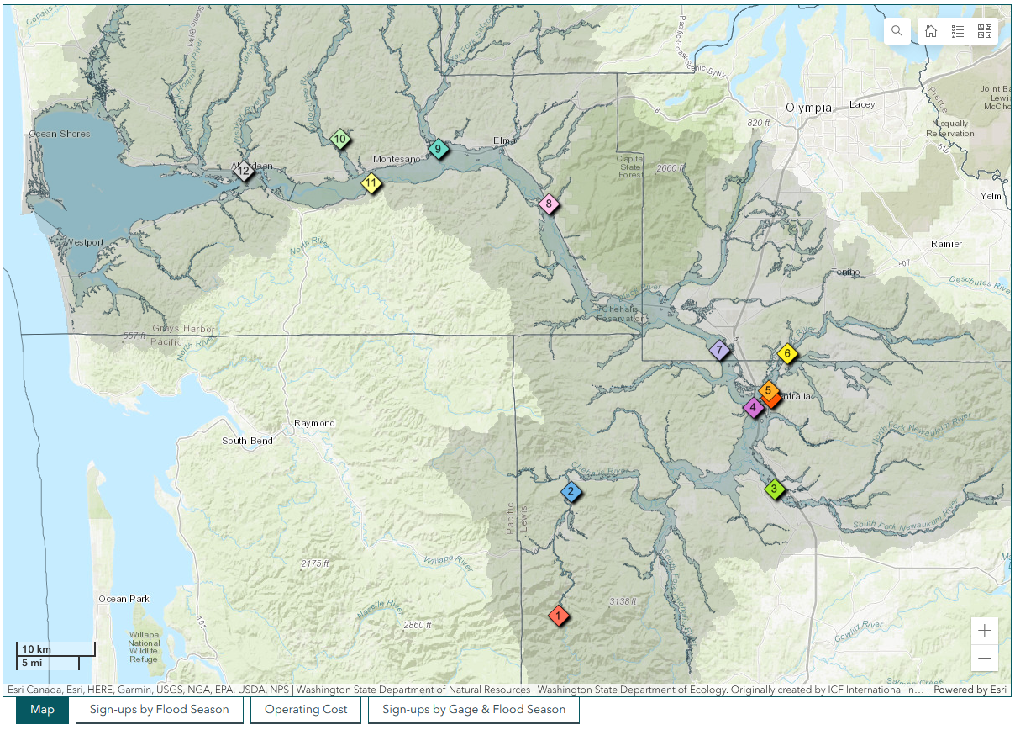
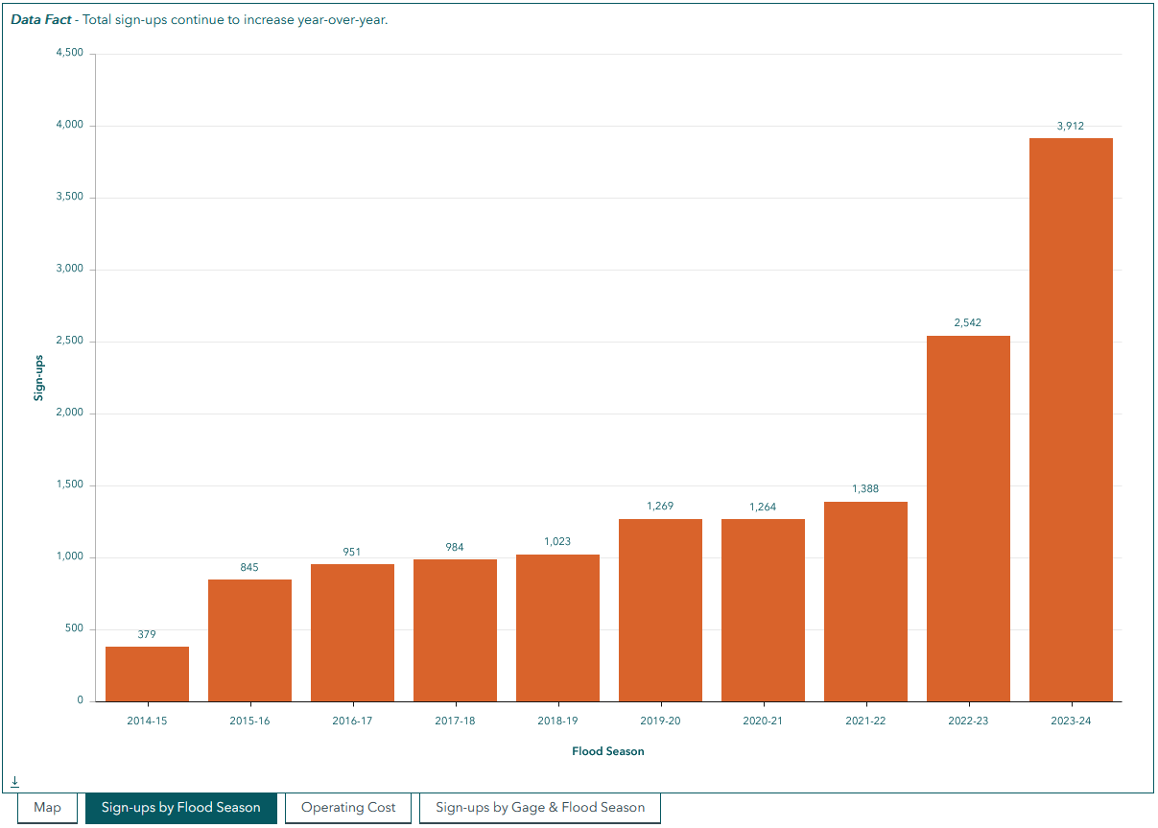
Flood Warning System (Alert Sign-Ups)

Slide 20
Chehalis Basin Strategy
appoints 3 member
Chehalis Basin Board
Community leaders, Chehalis and Quinault tribal representatives, local and state government liaisons
Office of Chehalis Basin | Chehalis Basin Board
https://chehalisbasinstrategy.com/
Office of Chehalis Basin
Small team within the WA Department of Ecology
“Network of Partners”
Organizations and local entities who turn ideas into shovel-ready reality

Slide 21








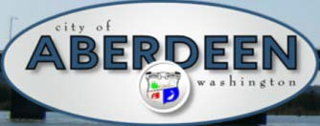















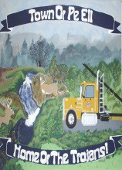


Chehalis Basin Strategy (Network of Partners)

Slide 22
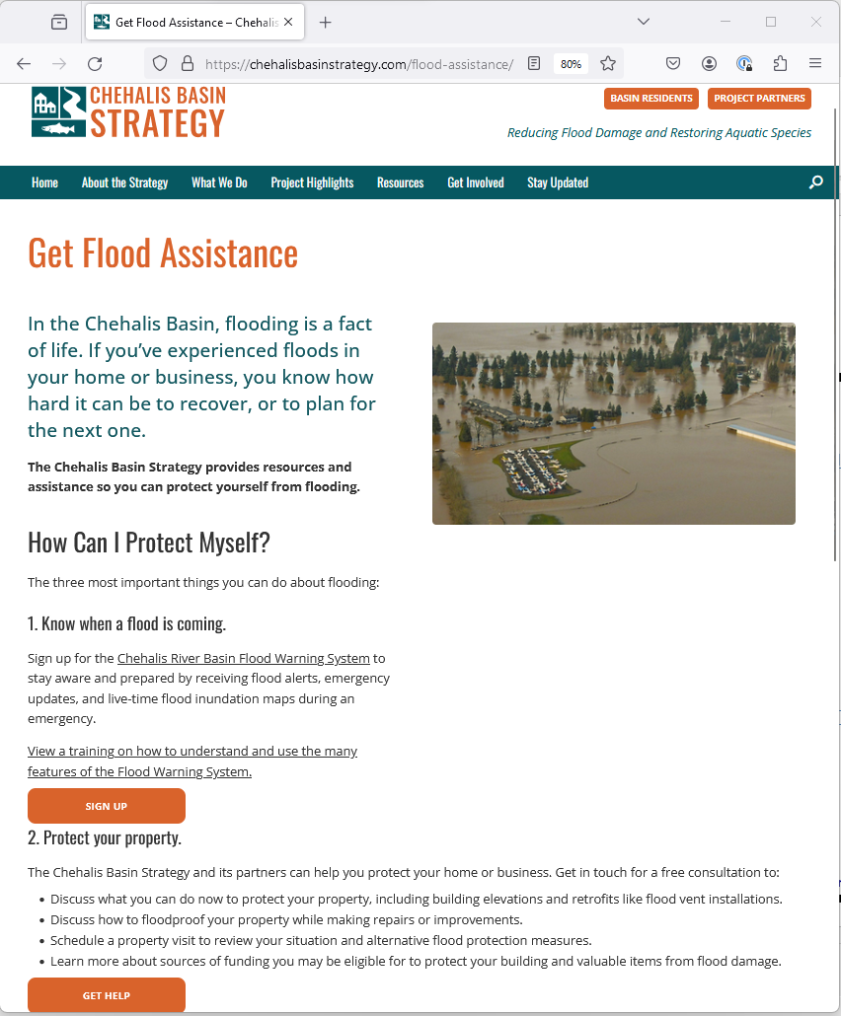


Chehalis Basin Strategy (Helping Individuals)

Slide 23
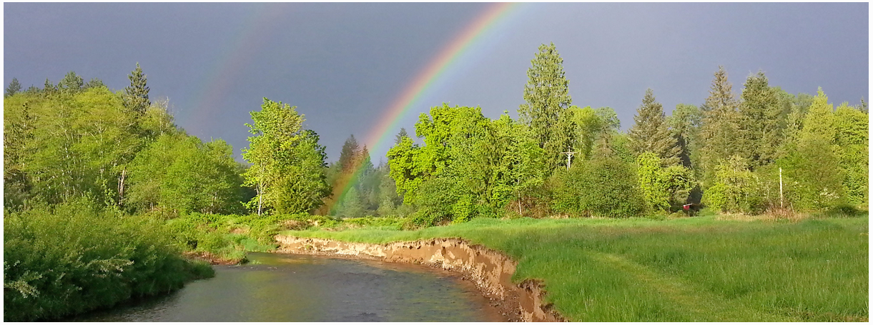
Today vs 2007
Today, we are substantially more aware, better prepared for catastrophic flooding than ever before.
We have a state-of-the art flood warning system.
We’ve completed many cost-efficient local projects and habitat projects.
We’re serving people, local governments, emergency responders, agriculture, fish and habitat.
We have a governance, administrative, and funding structure that’s delivering results.
https://chehalisbasinstrategy.com/office-of-chehalis-basin/

Slide 24
Key Contacts
Vickie Raines, Grays Harbor County Representative
Chair, Chehalis River Basin Flood Authority
Chair, Chehalis Basin Board
360/249-3731
vraines@co.grays-harbor.wa.us
Scott Boettcher
Staff, Chehalis River Basin Flood Authority
360/480-6600
scottb@sbgh-partners.com

Slide 25
Thank You!
This Presentation:
Available at “Chehalis River Basin Flood Authority” Website at https://www.ezview.wa.gov/site/alias__1492/34490/outreach__education.aspx
Email Distribution Lists:
Megan Sathre (Flood Authority) megan.sathre@lewiscountywa.gov Cindy Bradley (Office of Chehalis Basin) Cindy.Bradley@ecy.wa.gov

Slide 26
Also -- Background
Ranked high flow events (1932 - 2012) . . .
❑ I-5 closed 1990, 1996, 2007, 2009.
  Five largest events since 1986 -- Frequent floods are getting worse and damage is increasing . . .
  100 year flood estimate -- Increased by 33% in last 30 years.
90000
Chehalis River Flow Rates near Grand Mound (cubic ft./sec.) ₂
1
80000
3
70000
60000
4
5
50000
9
7
6
10
8
13
13
11
16
12
14
40000
30000
20000
10000
0

Slide 27
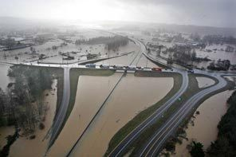
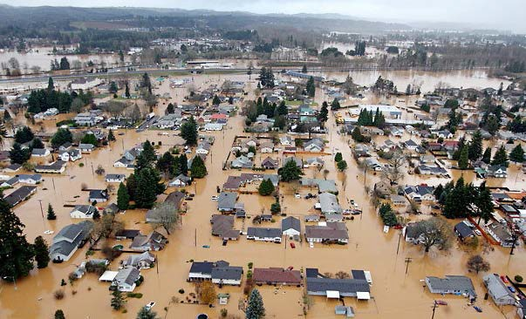
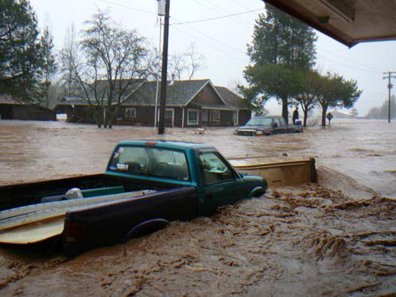
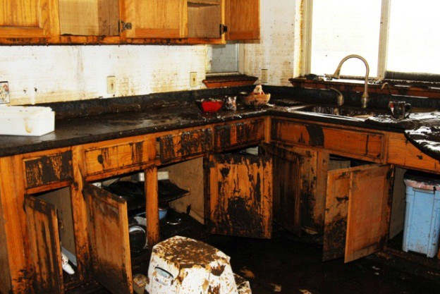
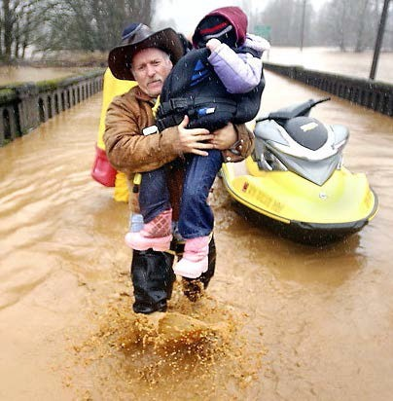
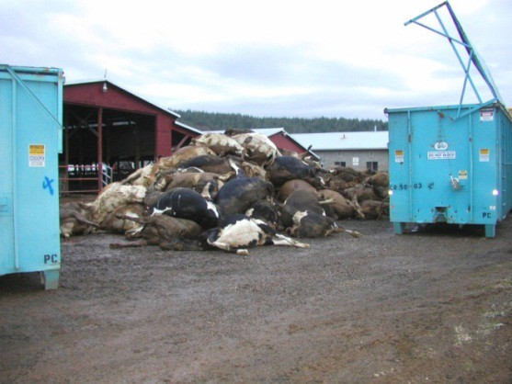

Also -- Background
2007 Storm -- $938M Basin-wide damage, $300M lost economic activity (WA).
Exit 77 (I-5) in Chehalis
STEVE RINGMAN / SEATTLE TIMES
City of Centralia
STEVE RINGMAN / SEATTLE TIMES
State Route 6, West of Adna MIKE SALSBURY / AP
Photos Source: LEWIS COUNTY, DIVISION OF EMERGENCY
MANAGEMENT

