Slide 1
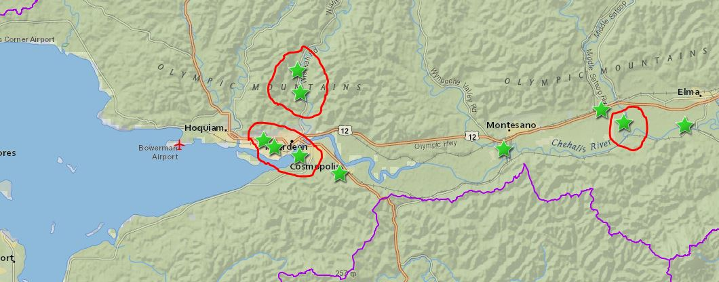
Wishkah Road Floodwall (GHC)
PRESENTATION #5
www.ezview.wa.gov/graysharborfloodrelief
www.ezview.wa.gov/site/alias__1492/34489/local_projects.aspx

Slide 2
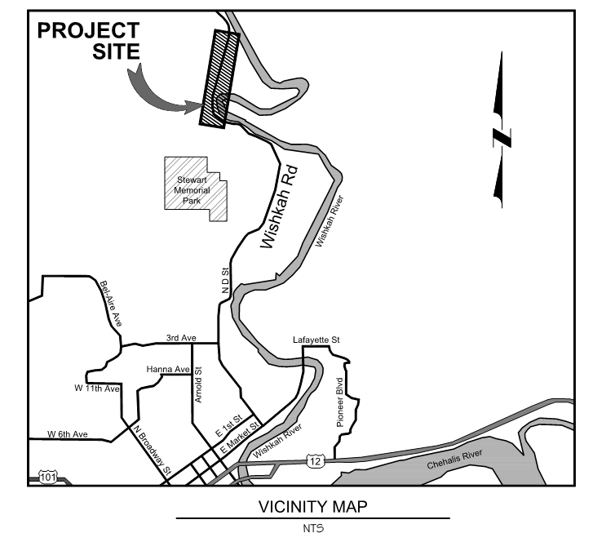
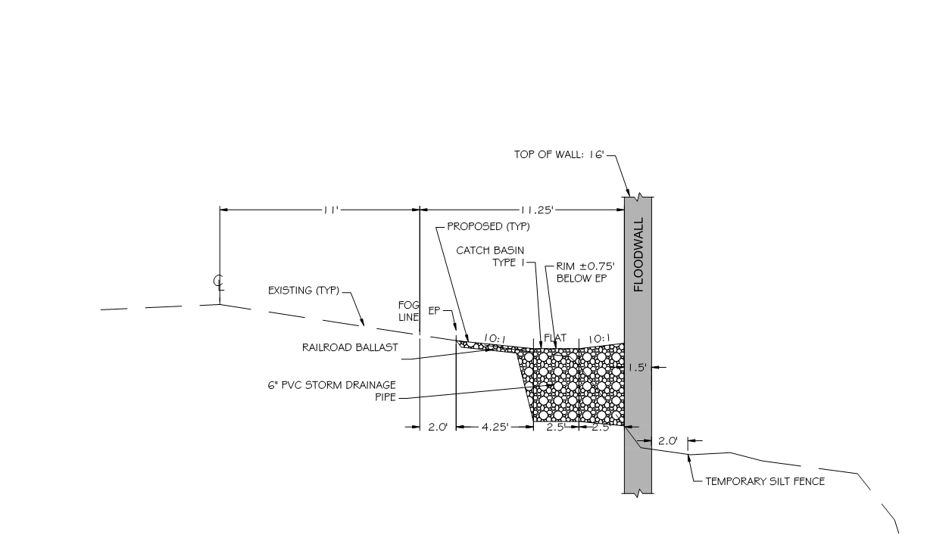
Project Description/Overview:
Wishkah Road Floodwall
Approximately 0.5 miles for Sheet Piling
Replacement of 6 culverts with Tide Gates
Removable Flood Gates at 4 locations
Cleanup & Habitat Improvements
Engineers Estimate ±$5 Million

Slide 3
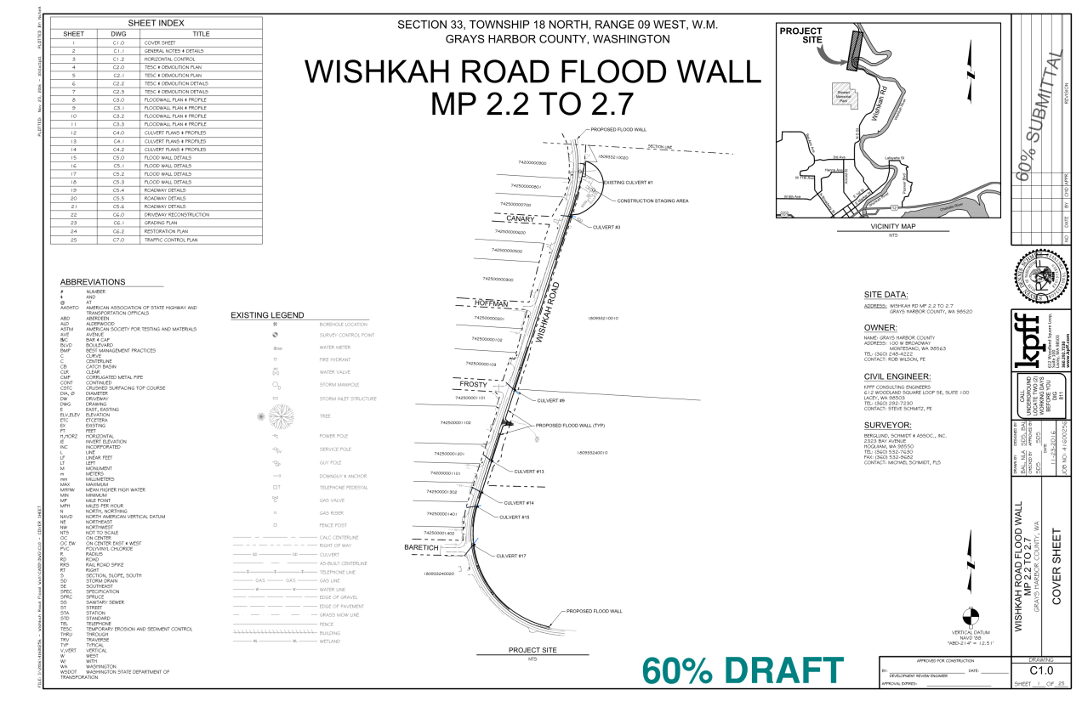
Current Status: On - Track
Completed Activities:
60 % Design Submittal Completed
Draft JARPA, HPA & Biological Assessments read for team review
Coordination with Depts. of Ecology and Fish & Wildlife Complete
On Schedule for Summer 2017 Construction

Slide 4
Upcoming Planned Activities:
Permitting:
JARPA Permit Submission
Hydraulic Project Approval Submission
Shorelines & Critical Areas Application Submission
Biological Assessment Submission
Engineering:
60% Plans, Specifications & Engineer’s Estimates - Review w/ GHC
Incorporation of Permit Approval Requirements & Comments
Completion of Construction Ready Plans, Specs, and Engineer’s Estimate
Project Bid Manual Assembly, Bidding Support, and Construction Support

Slide 5
Controversies and/or Complexities:
Permitting:
Proximity to Wishkah River and Category 1 Wetlands
Determination that drainage to culverts where not fish bearing
Mitigation and Clean Up strategy
Engineering:
Structural design of the sheet pile wall in very poor soils
Design of the South Wall Termination to Existing Concrete Retaining Wall
Check Valve and Self-Regulating Tide gate Design
Removable Flood Gate Design and Alternate Analysis
8-12 Week Lead time required for the necessary sheets to be milled and shipped to the site

Slide 6
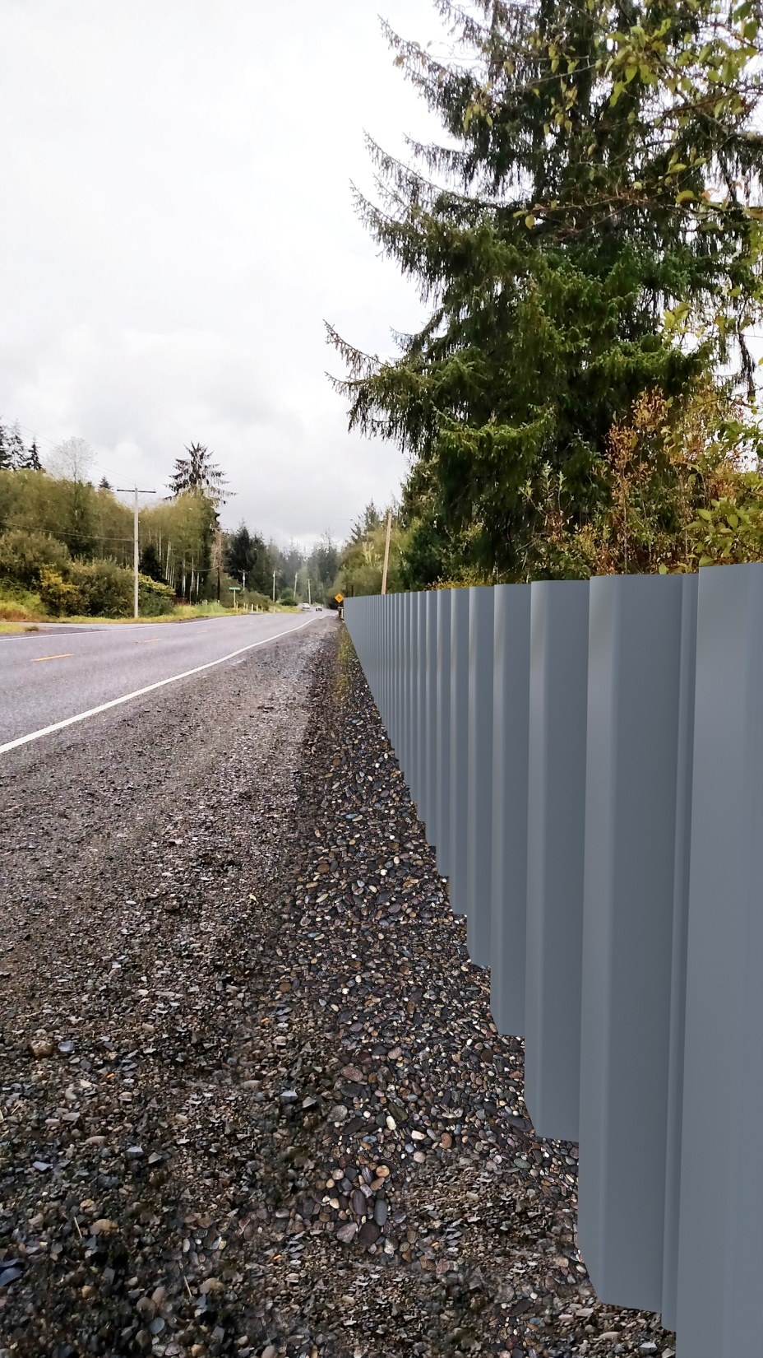
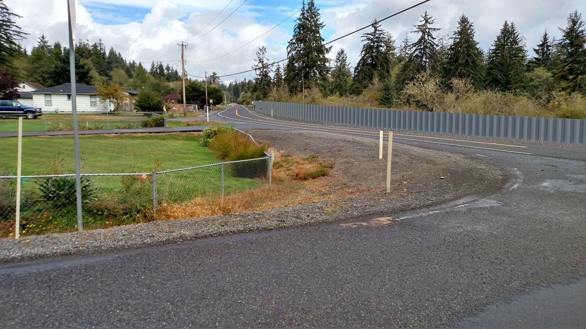
Further Information:
Grays Harbor County Public Works
Rob Wilson, County Engineer – 360 249-4222, rwilson@co.grays-harbor.wa.us

