Slide 1
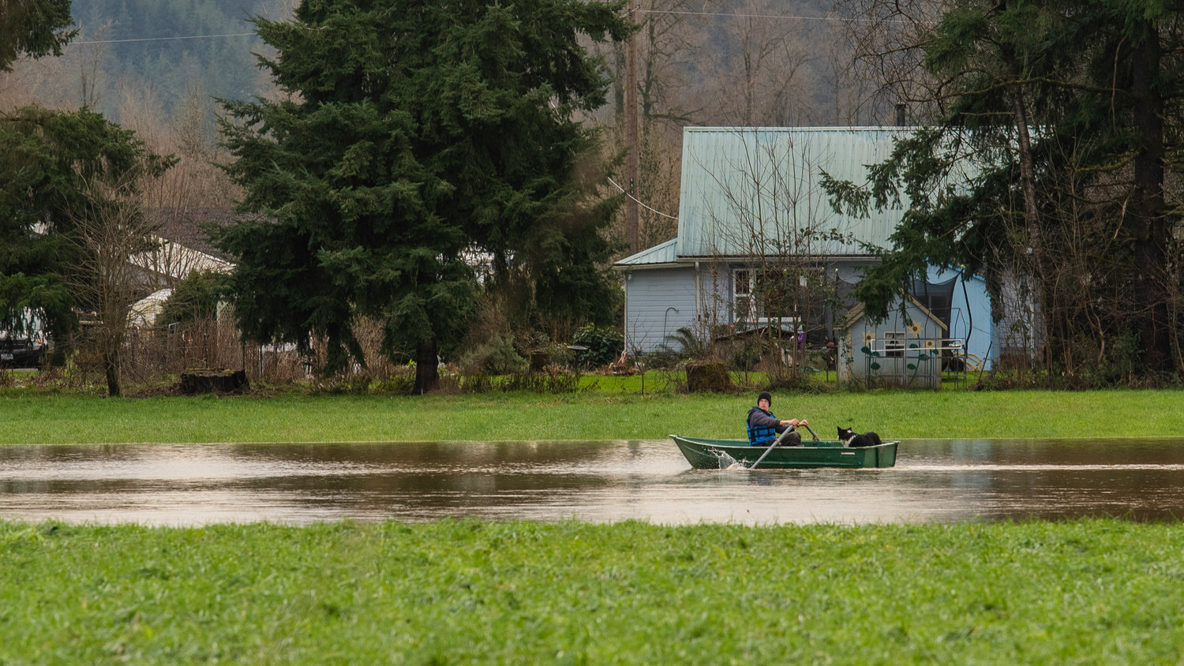

Chehalis River Basin Flood Warning System
Update
September 15, 2022
David C. Curtis, PhD, F.EWRI

Slide 2
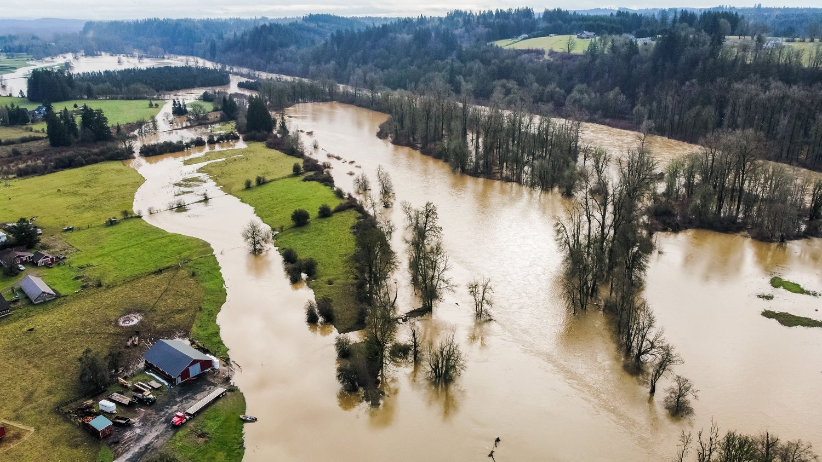
Flood Recap
January 2022
Chehalis River Basin Flood Authority
JARED WENZELBURGER / JARED@CHRONLINE.COM

Slide 3
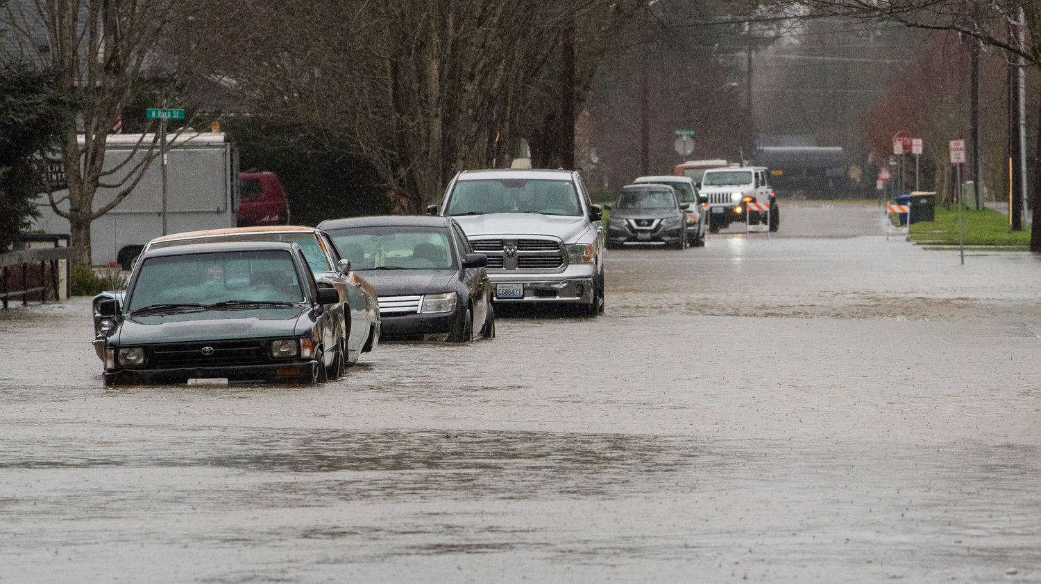
January 2022 Peak Flood Stages
Record
Newaukum near Chehalis
Major
  Skookumchuck near Bucoda
  (near record)
  Chehalis River at Porter
  Chehalis River at Grand Mound
Moderate
  Chehalis at Centralia (near major)
  Satsop near Satsop (near major)
  Skookumchuck at Centralia
Minor
  Chehalis near Doty
JARED WENZELBURGER / JARED@CHRONLINE.COM

Slide 4
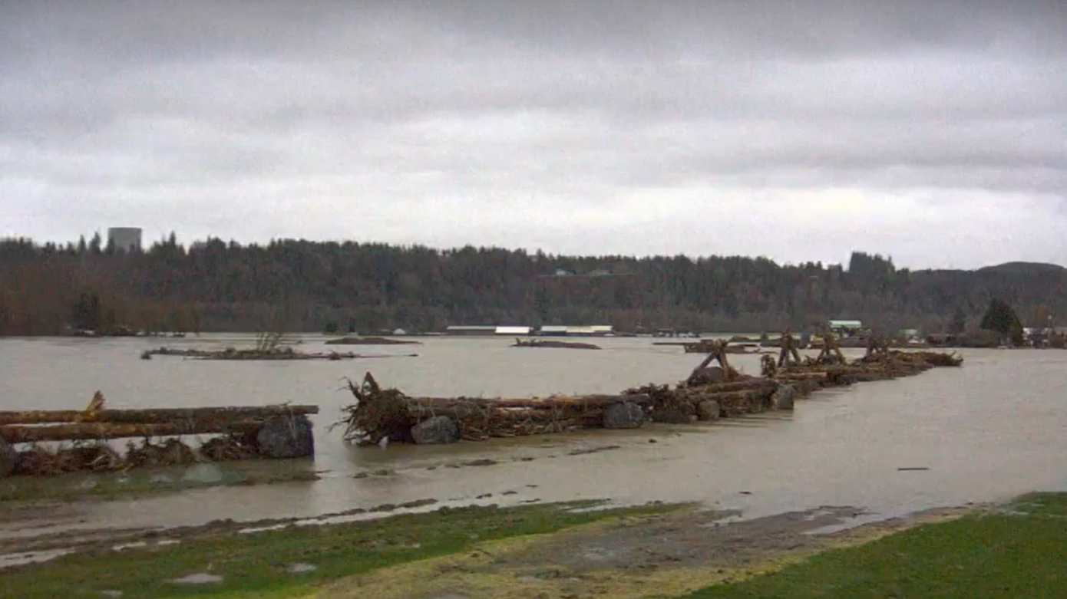
WEB Cams
Chapman Farms

Slide 5
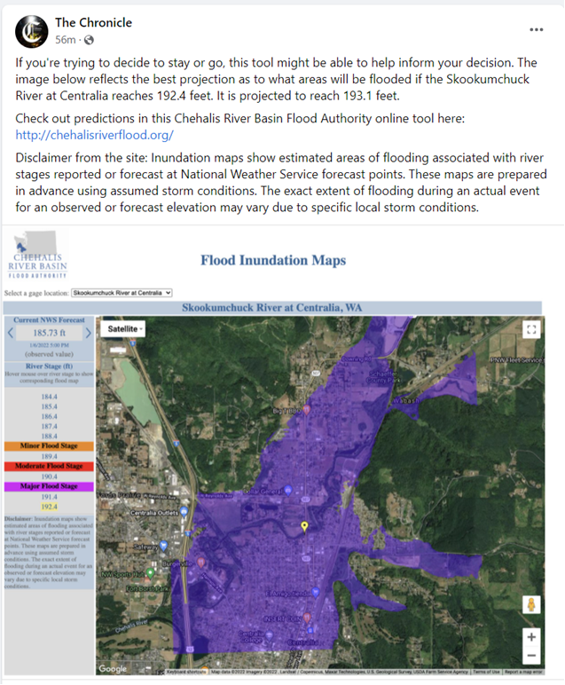
3rd Party Posts

Slide 6
User Survey – High Water Alerts
Positives Needs Improvement
So that I know when the water is high even if I’m not aware that flooding is possible.
I manage the Chehalis-Centralia Airport and I need to be kept up to date on events related to flooding.
I’m a school superintendent. We have to decide on the safe passage of students.
Friends and family in the area
Need earlier alerts. (NF Newaukum)
Accuracy of the forecasts and accuracy of the gauges.
Send alerts more frequently.
Need specific street locations
More user-friendly visuals

Slide 7
User Survey – Inundation Maps
Positives Needs Improvement
These are invaluable when planning a response.
They provide a visual representation of where problems are and are anticipated.
Ability to assess potential damage areas.
Great estimation of current flooding
Great record of past floods
It was very nice to see the information and plan safety routes
The map could use finer detail around the levee at the Chehalis-Centralia Airport.
A gauge closer to my home would be helpful in predicting more accurately what has flooded and when to expect
I wish I could type in various addresses to see those areas in particular.
Need specific street locations
More user-friendly visuals
Update maps

Slide 8
MASTER PLAN 2022-2027
Hydrometeorological Monitoring
  Review current network
  USGS gauge network
  Snow monitoring
Flood Forecast and System Warning System Improvements
  Improved modeling for the Chehalis River from Grand Mound to Grays Harbor
  Improved warning times for spill from Skookumchuck Reservoir
  Review inundation mapping needs
  Identify website improvements
  Outreach and social media

Slide 9
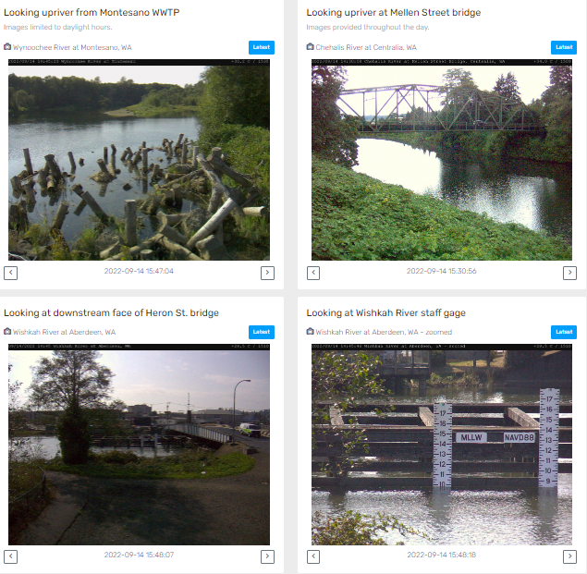
WebCams

Slide 10
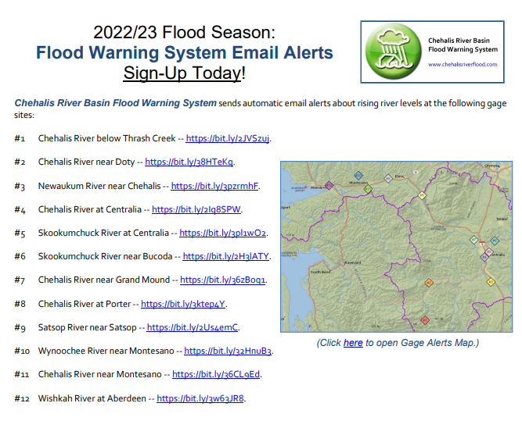

Slide 11
Updates
China Creek Gauge
  Equipment on order
  Rating curve
Flood Warning System Orientation Webinar
  Chehalis Basin Strategy Coordination
Gauge Relocations
  Newaukum rain gage will be moved this fall
  Chehalis River below Thrash Creek gauge
2023 O&M Costs

Slide 12
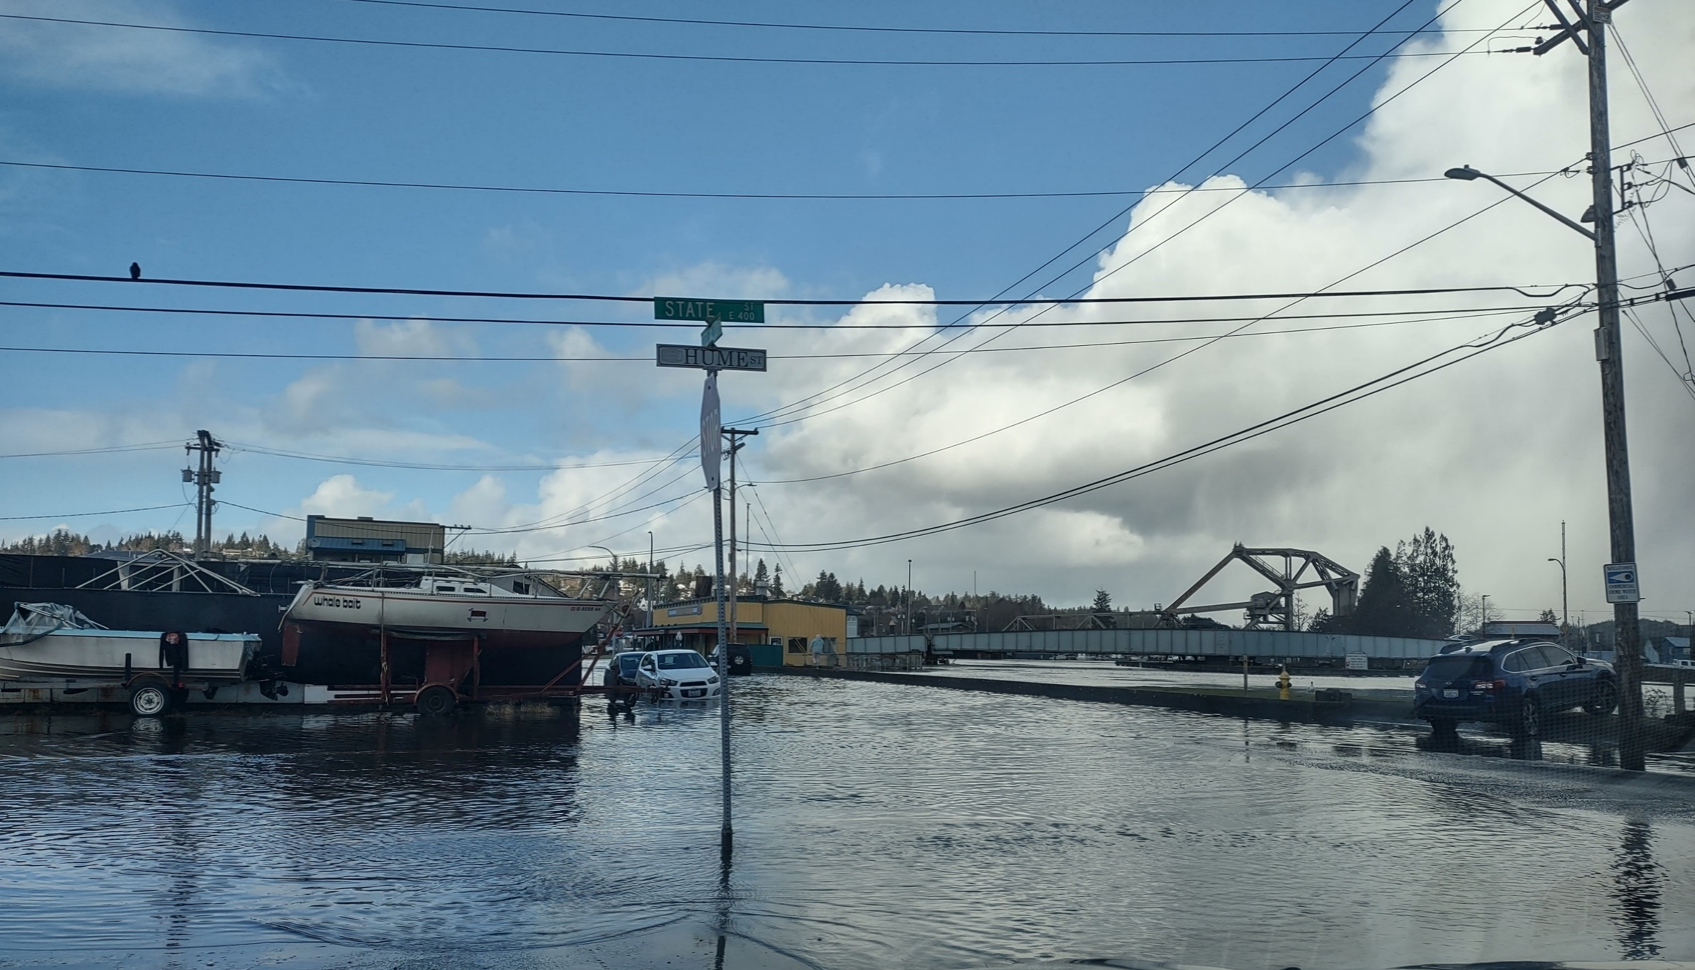
2022-2023 Rainy Season
?
Aberdeen, January 3, 2022. Photo credit: Kris Koski

Slide 13
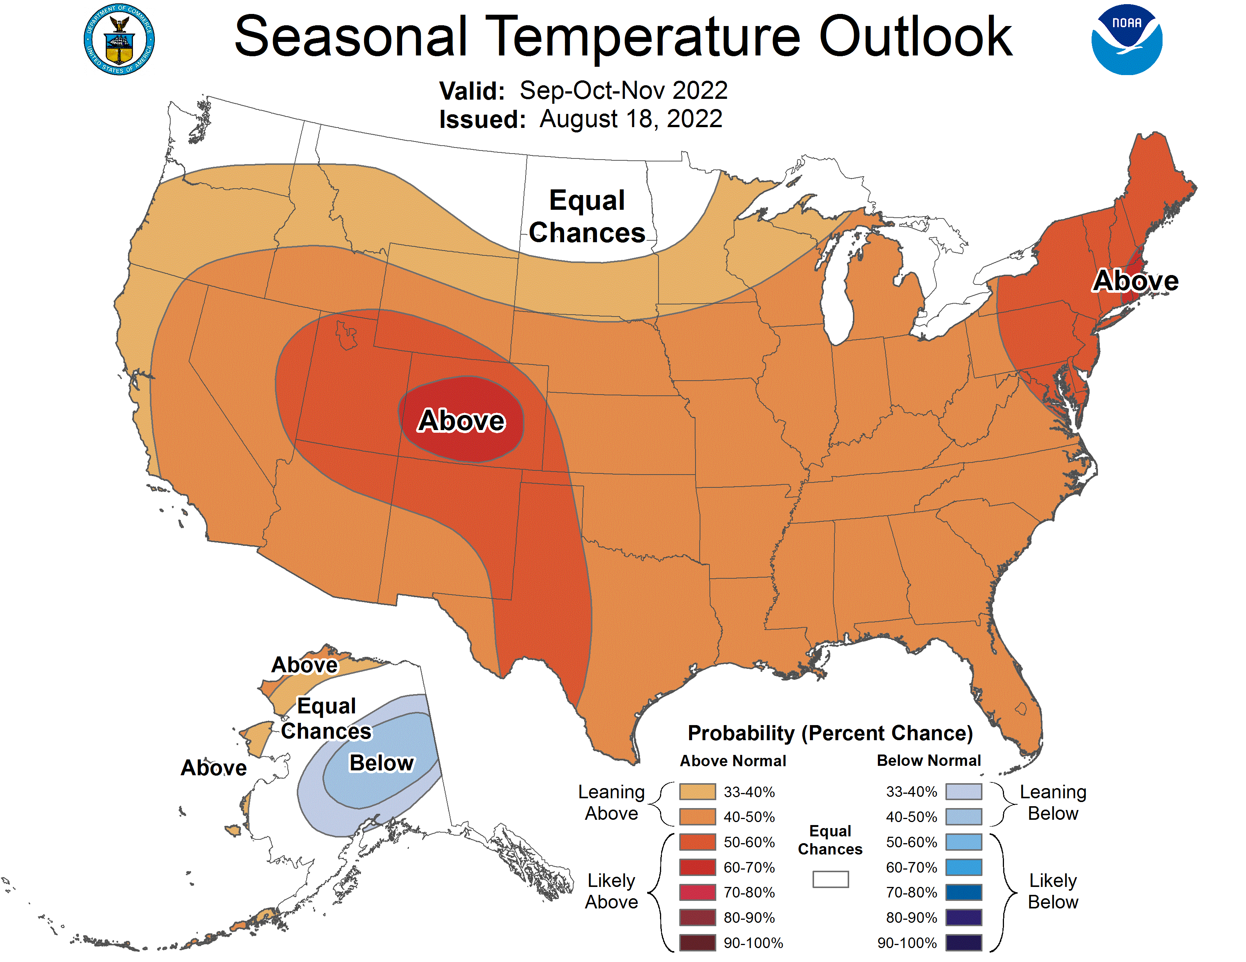

Slide 14
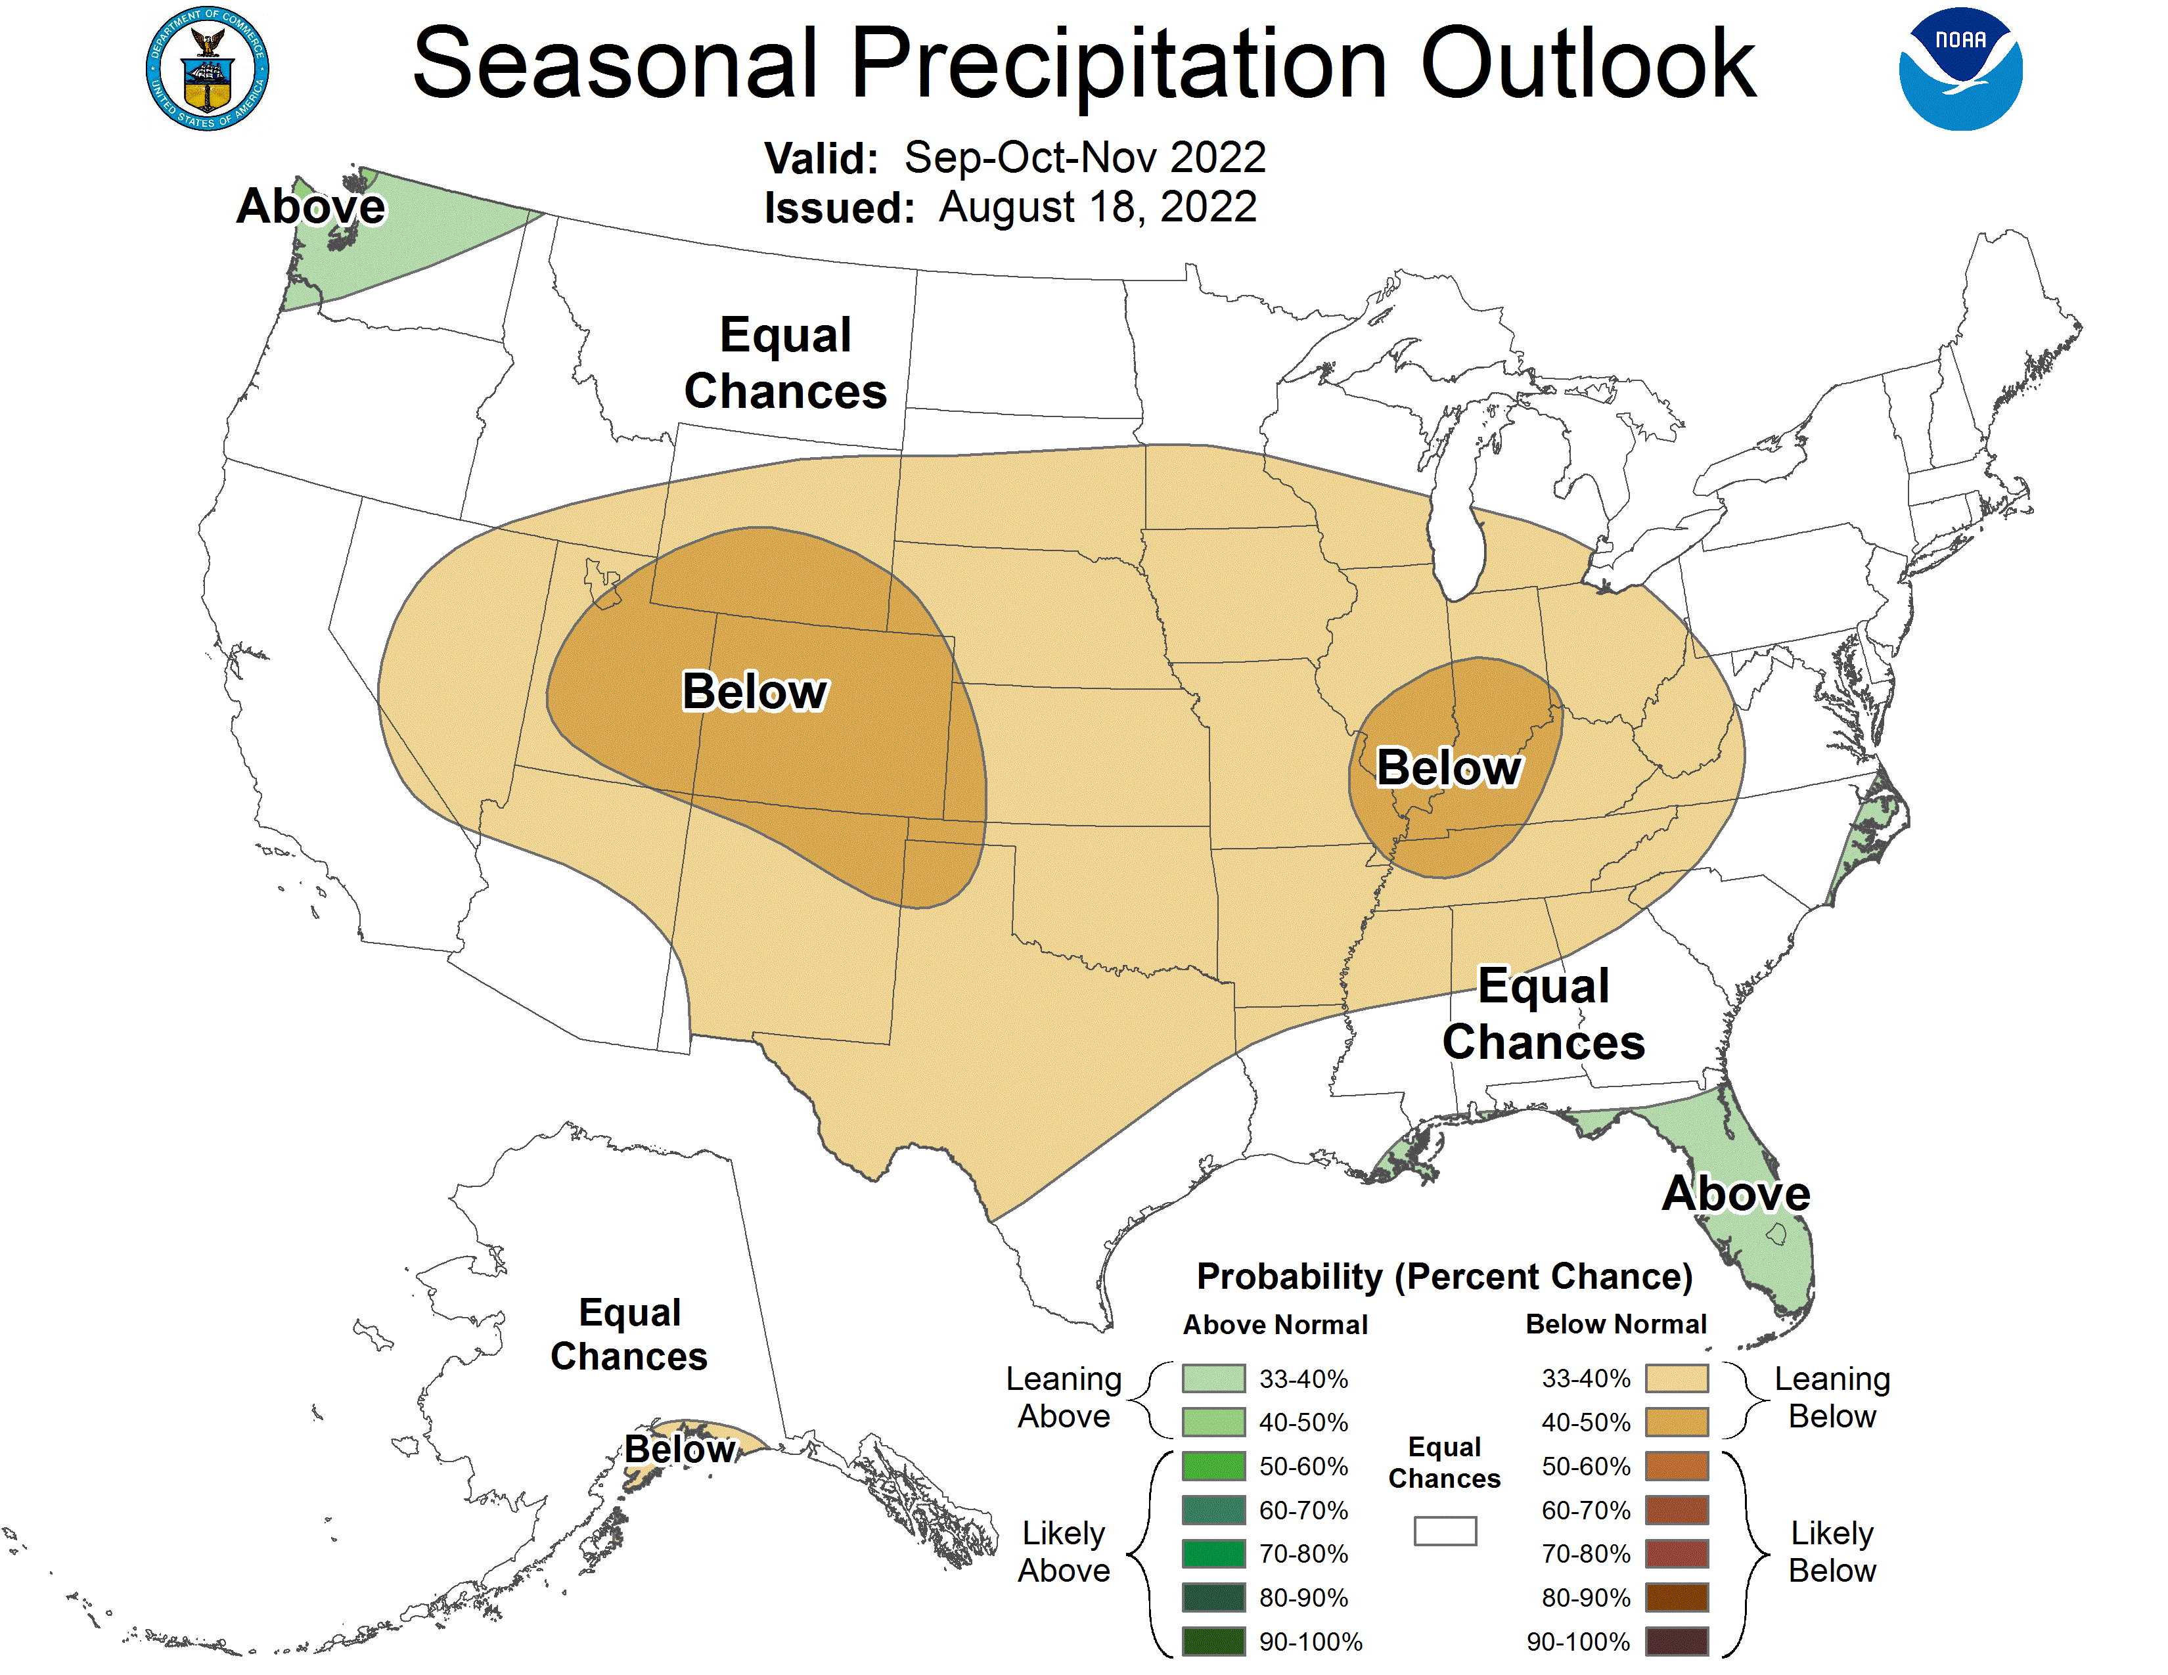

Slide 15
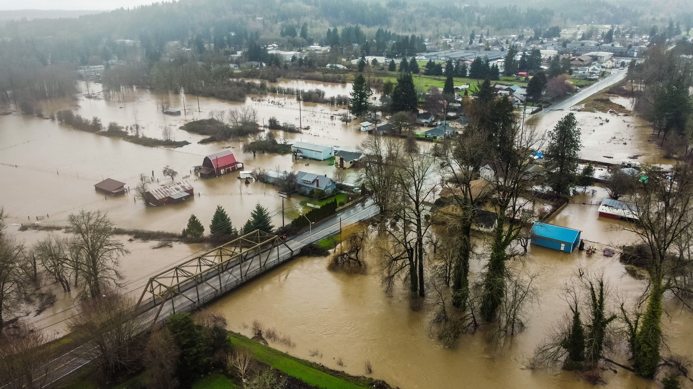
Questions
CHRONLINE.COM Posted Jan 7, 2022

