Slide 1
July 8, 2014
TO:
Centralia City Council Members
FROM:
Scott Boettcher, Staff, CRBFA (360/480-6600, scottb@sbgh-partners.com)
SUBJECT:
Brief Update of Flood Hazard Reduction Activities in the Chehalis Basin
Local Projects Completed (or by flood season): Adna Levee. Bucoda Water Supply Levee. Montesano WWTP Levee. Chehalis Tribe Sickman-Ford Overflow Bridge. 5 Livestock and Equipment Pads. 2 Livestock Evacuation Routes. 10 Additional Livestock/Equipment Pads. 2 Capacity Expansions For Existing Pads. 1 Evacuation Route. Montesano Sheet Pile Wall. Airport Levee Phase IA. Pe Ell WWTP Protection Levee. Map = http://goo.gl/maps/Vq8YY. | Local Projects Proposed for Further Review/Evaluation/Costing**: Kirkland Road Flooding Study. SR6 Bypass and Road Raise. Dillenbaugh Creek Realignment. Chehalis Main Street Regrade. Salzer Creek. Preliminary designs/costs (Summer 2014). Map = http://goo.gl/maps/QqnV5.
Aquatic Species Enhancement**: Salmon populations are 15-25% of historic levels. Evaluating habitat enhancement options, benefits, costs (barrier removal, riparian enhancement, water quantity/quality, etc.). Preliminary plan (Summer 2014). • $63M - $134M. | Upper Basin Retention Structure**: Evaluating options, benefits, costs, impacts: Flood Retention only ($265M - $421M). Multipurpose (fish, water, hydro) ($369M - $708M). Preliminary design (Summer 2014).
I-5 Protection**: Evaluating protecting I-5 w/ walls, levees, berms. Dropped raising or relocating I-5. Preliminary design (Summer 2014). • $80M - $100M. | Flood Proofing**: Evaluating options, benefits, costs of flood proofing residential, commercial, agricultural structures in floodplain. Compare costs w/ and w/out Dam (Summer 2014). • $92M ($57M, $21M, $14M).
Basin Relationships/Partnerships: Very strong. | Looking Ahead: Sept. 2014 – Technical, policy, public workshops. Nov. 2014 – Recommendations to Gov./Leg. • $500M - $1B.
Outreach/Education Presentation: https://www.ezview.wa.gov/site/alias 1492/34490/outreach education.aspx.
May 2014 Public Meeting: https://www.ezview.wa.gov/site/alias 1492/34798/meetings_2013-15.aspx.
Local Project Construction Photos: https://www.ezview.wa.gov/site/alias 1492/35040/Default.aspx.

Slide 2
(Pg. 2)
Salmon Runs
120000
Coho ESC
Coho TR
100000
Fall-run Chinook ESC
Fall-run Chinook TR Spring-run Chinook ESC
80000
Spring-run Chinook TR
Number of Returns
Winter-run Steelhead ESC
Winter-run Steelhead TR
60000
40000
20000
0
1970
1973
1976
1979
1982
1985
1988
1991 1994
Year
1997
2000
2003
2006
2009
2012
11

Slide 3
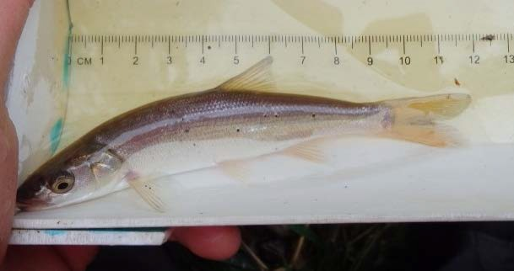
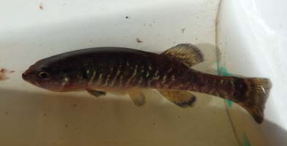

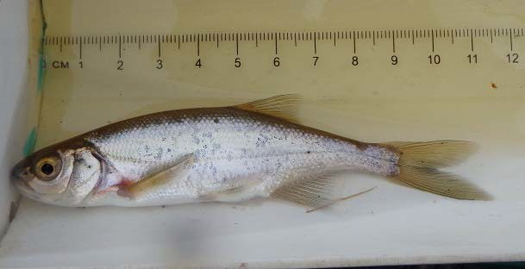
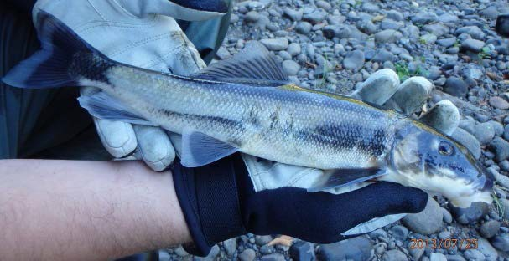
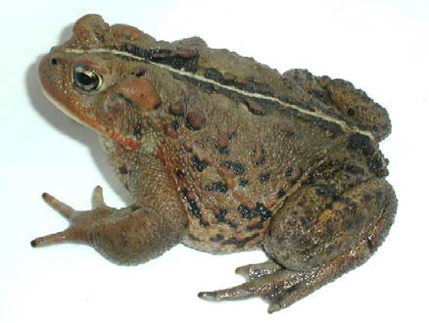
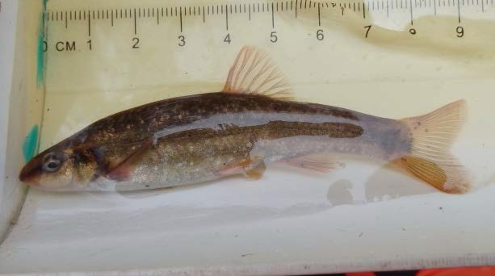
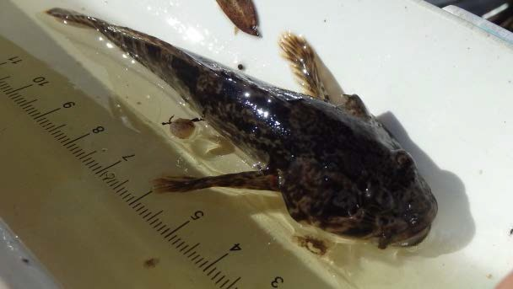
(Pg. 3)
Other Fish and Aquatic Species
Northern Pikeminnow
Olympic Mudminnow
Oregon Spotted Frog
Redside Shiner
Andrew O’Connor
Largescale Sucker
Longnose Dace
Sculpin (6 species)
Western Toad
14

Slide 4
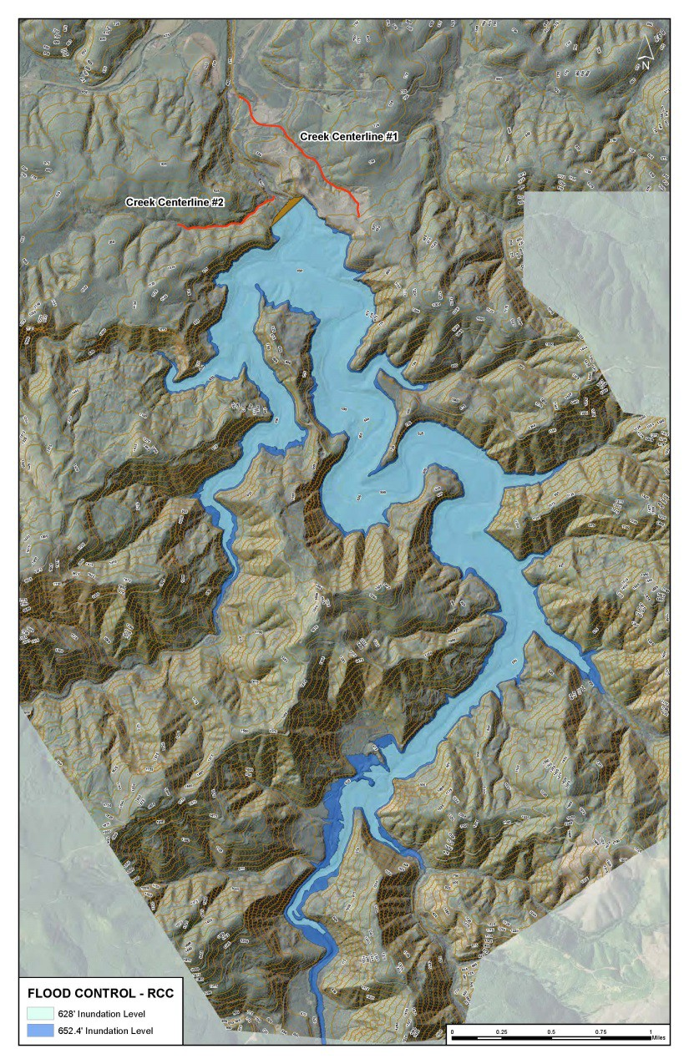
Flood Retention Only Reservoir
(Pg. 4)
Dam Height = 227’
Spillway Crest Elev. = 628
Dam Crest Elev. = 654
Area = 860 Acres
River Inundation Length = 6.8 mi
Maximum Storage = 65K acre/feet
27

Slide 5
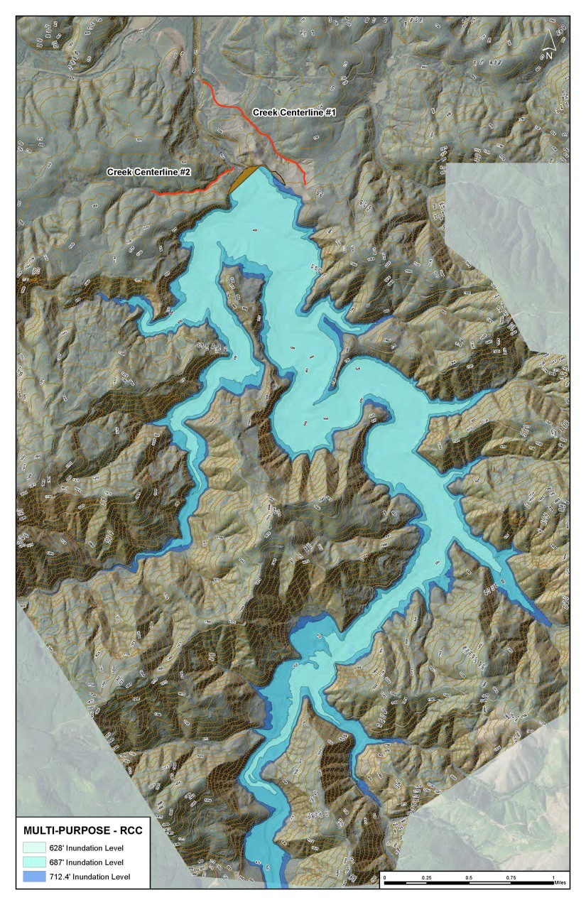
Multi-purpose Reservoir Overview
(Pg. 5)
Dam Height = 287’
Spillway Crest Elev. = 687
Dam Crest Elev. = 714
Area = 1,307 Ac
River Inundation Length = 7.5 mi
Maximum Storage = 130K acre/feet
29

Slide 6
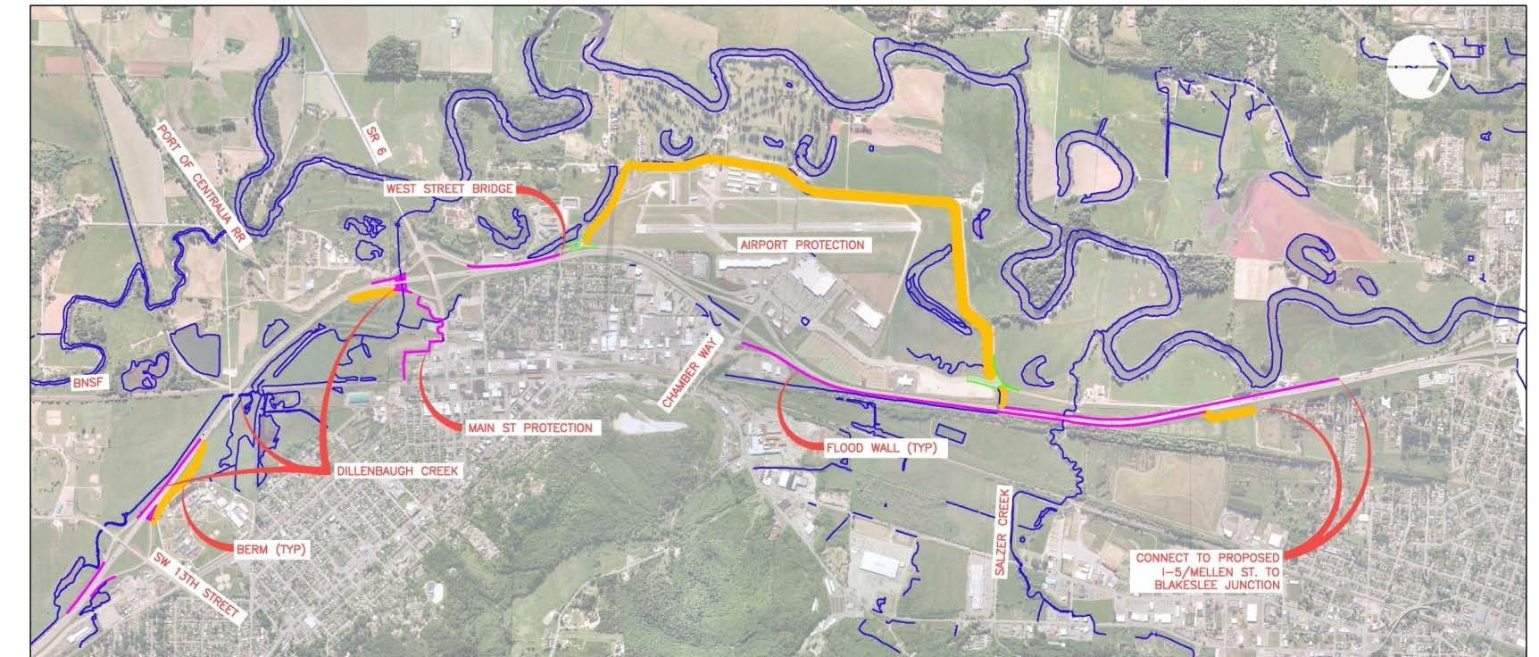
(Pg. 6)
Protect I-5 with walls and levees
Project Cost: $ 80 – 100 Million

Slide 7
(Pg. 7)
Floodproofing - Structures Affected
Summary of Structures At Risk of Flooding in Chehalis River Floodplain
Number of Structures | Baseline |  |  |  |  | With Dam and Airport Levee
 | Dec 07 | 500-Year | 100-Year | 20-Year | 10-Year | Dec 07 | 500-Year | 100-Year
Flooded | 2040 | 3645 | 1384 | 372 | 175 | 753 | 2031 | 821
>1.0 feet | 1368 | 2743 | 829 | 167 | 83 | 432 | 1306 | 459
>2.0 feet | 820 | 1926 | 489 | 76 | 28 | 241 | 762 | 241
>3.0 feet | 470 | 1159 | 293 | 22 | 7 | 139 | 471 | 117
>4.0 feet | 263 | 657 | 155 | 6 | 2 | 65 | 300 | 54
>5.0 feet | 159 | 385 | 76 | 1 | 0 | 28 | 158 | 25
Assessed Value of Improvements Inundated ($Million) | $238 | $411 | $137 | $30 | $13 | $64 | $206 | $73
Cost to Floodproof all Inundated Structures ($Million) | $146 | $273 | $92 | $20 | $9 | $46 | $149 | $50
Residential ($ Mil) | $107 | $205 | $57 | $10 | $4 | $28 | $101 | $28
Commercial ($ Mil) | $26 | $44 | $21 | $6 | $3 | $11 | $26 | $12
Agricultural ($ Mil) | $13 | $24 | $14 | $4 | $2 | $7 | $22 | $10
55

Slide 8







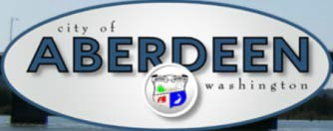












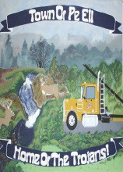
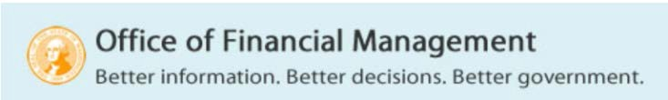
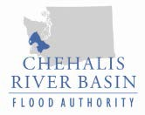
(Pg. 8)
1. Basin-Wide Relationships
12

