Slide 1
“Getting Ready For Flood Season” Chehalis River Basin Flood Warning System Update 9/21/2021
David C Curtis, PhD
WEST Consultants

Slide 2
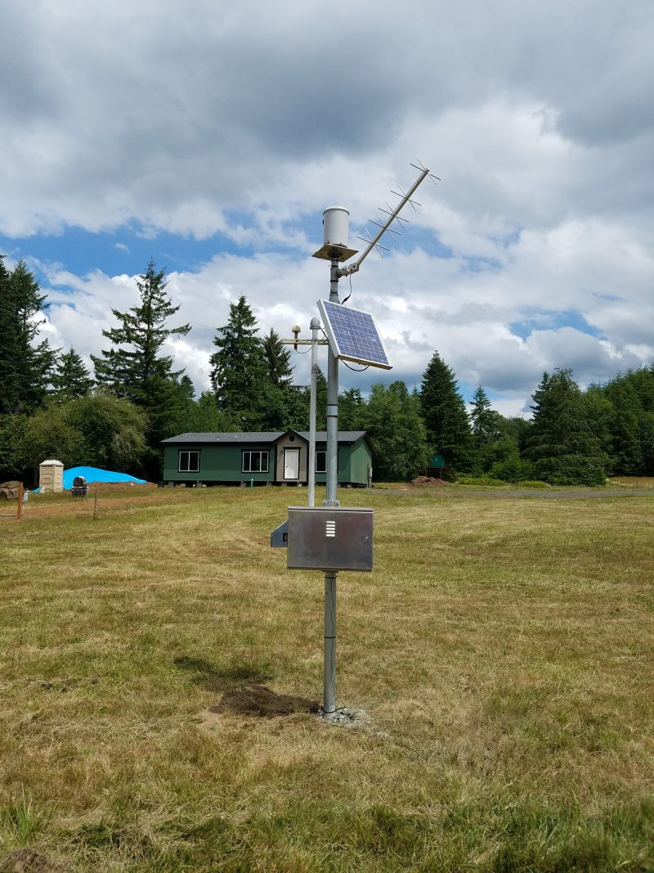
Routine Activities
Weekly remote monitoring of Flood Authority gauges operated by WEST.
Rain, Temperature, Stream, Webcams
Quarterly visits to gauge sites.
Emergency responses as needed.
Low battery
Communication failure
Vandalism
Riverside rain gauge

Slide 3
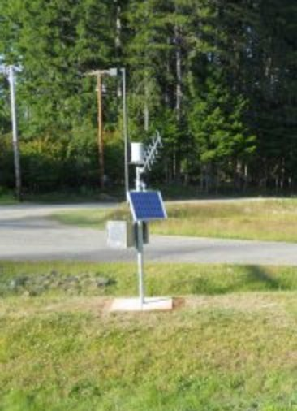
New and Renewed Permits
Cedar Creek (DNR) permit has been secured through 2026
Haywire (Green Diamond) permit has been secured through 2025.
Weyerhaeuser permit for multiple gauges secured until 8/3/2023

Slide 4
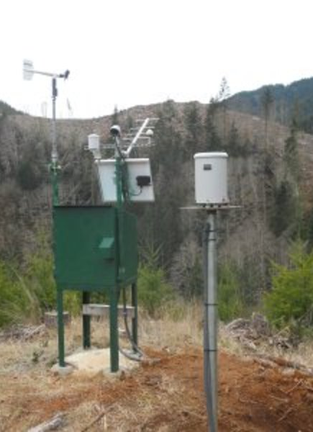
Gauge Relocations
ROCK-WEYCO rain gauge removed
Replaced with MASON FD13 AT CLOQUALLAM
Haywire Ridge rain gauge moved
Next up – Fire conditions permitting
Brooklyn rain gauge
Skookumchuck rain gauge
Chehalis River below Thrash Creek
Notes:
Also, will move after fireseason.

Slide 5
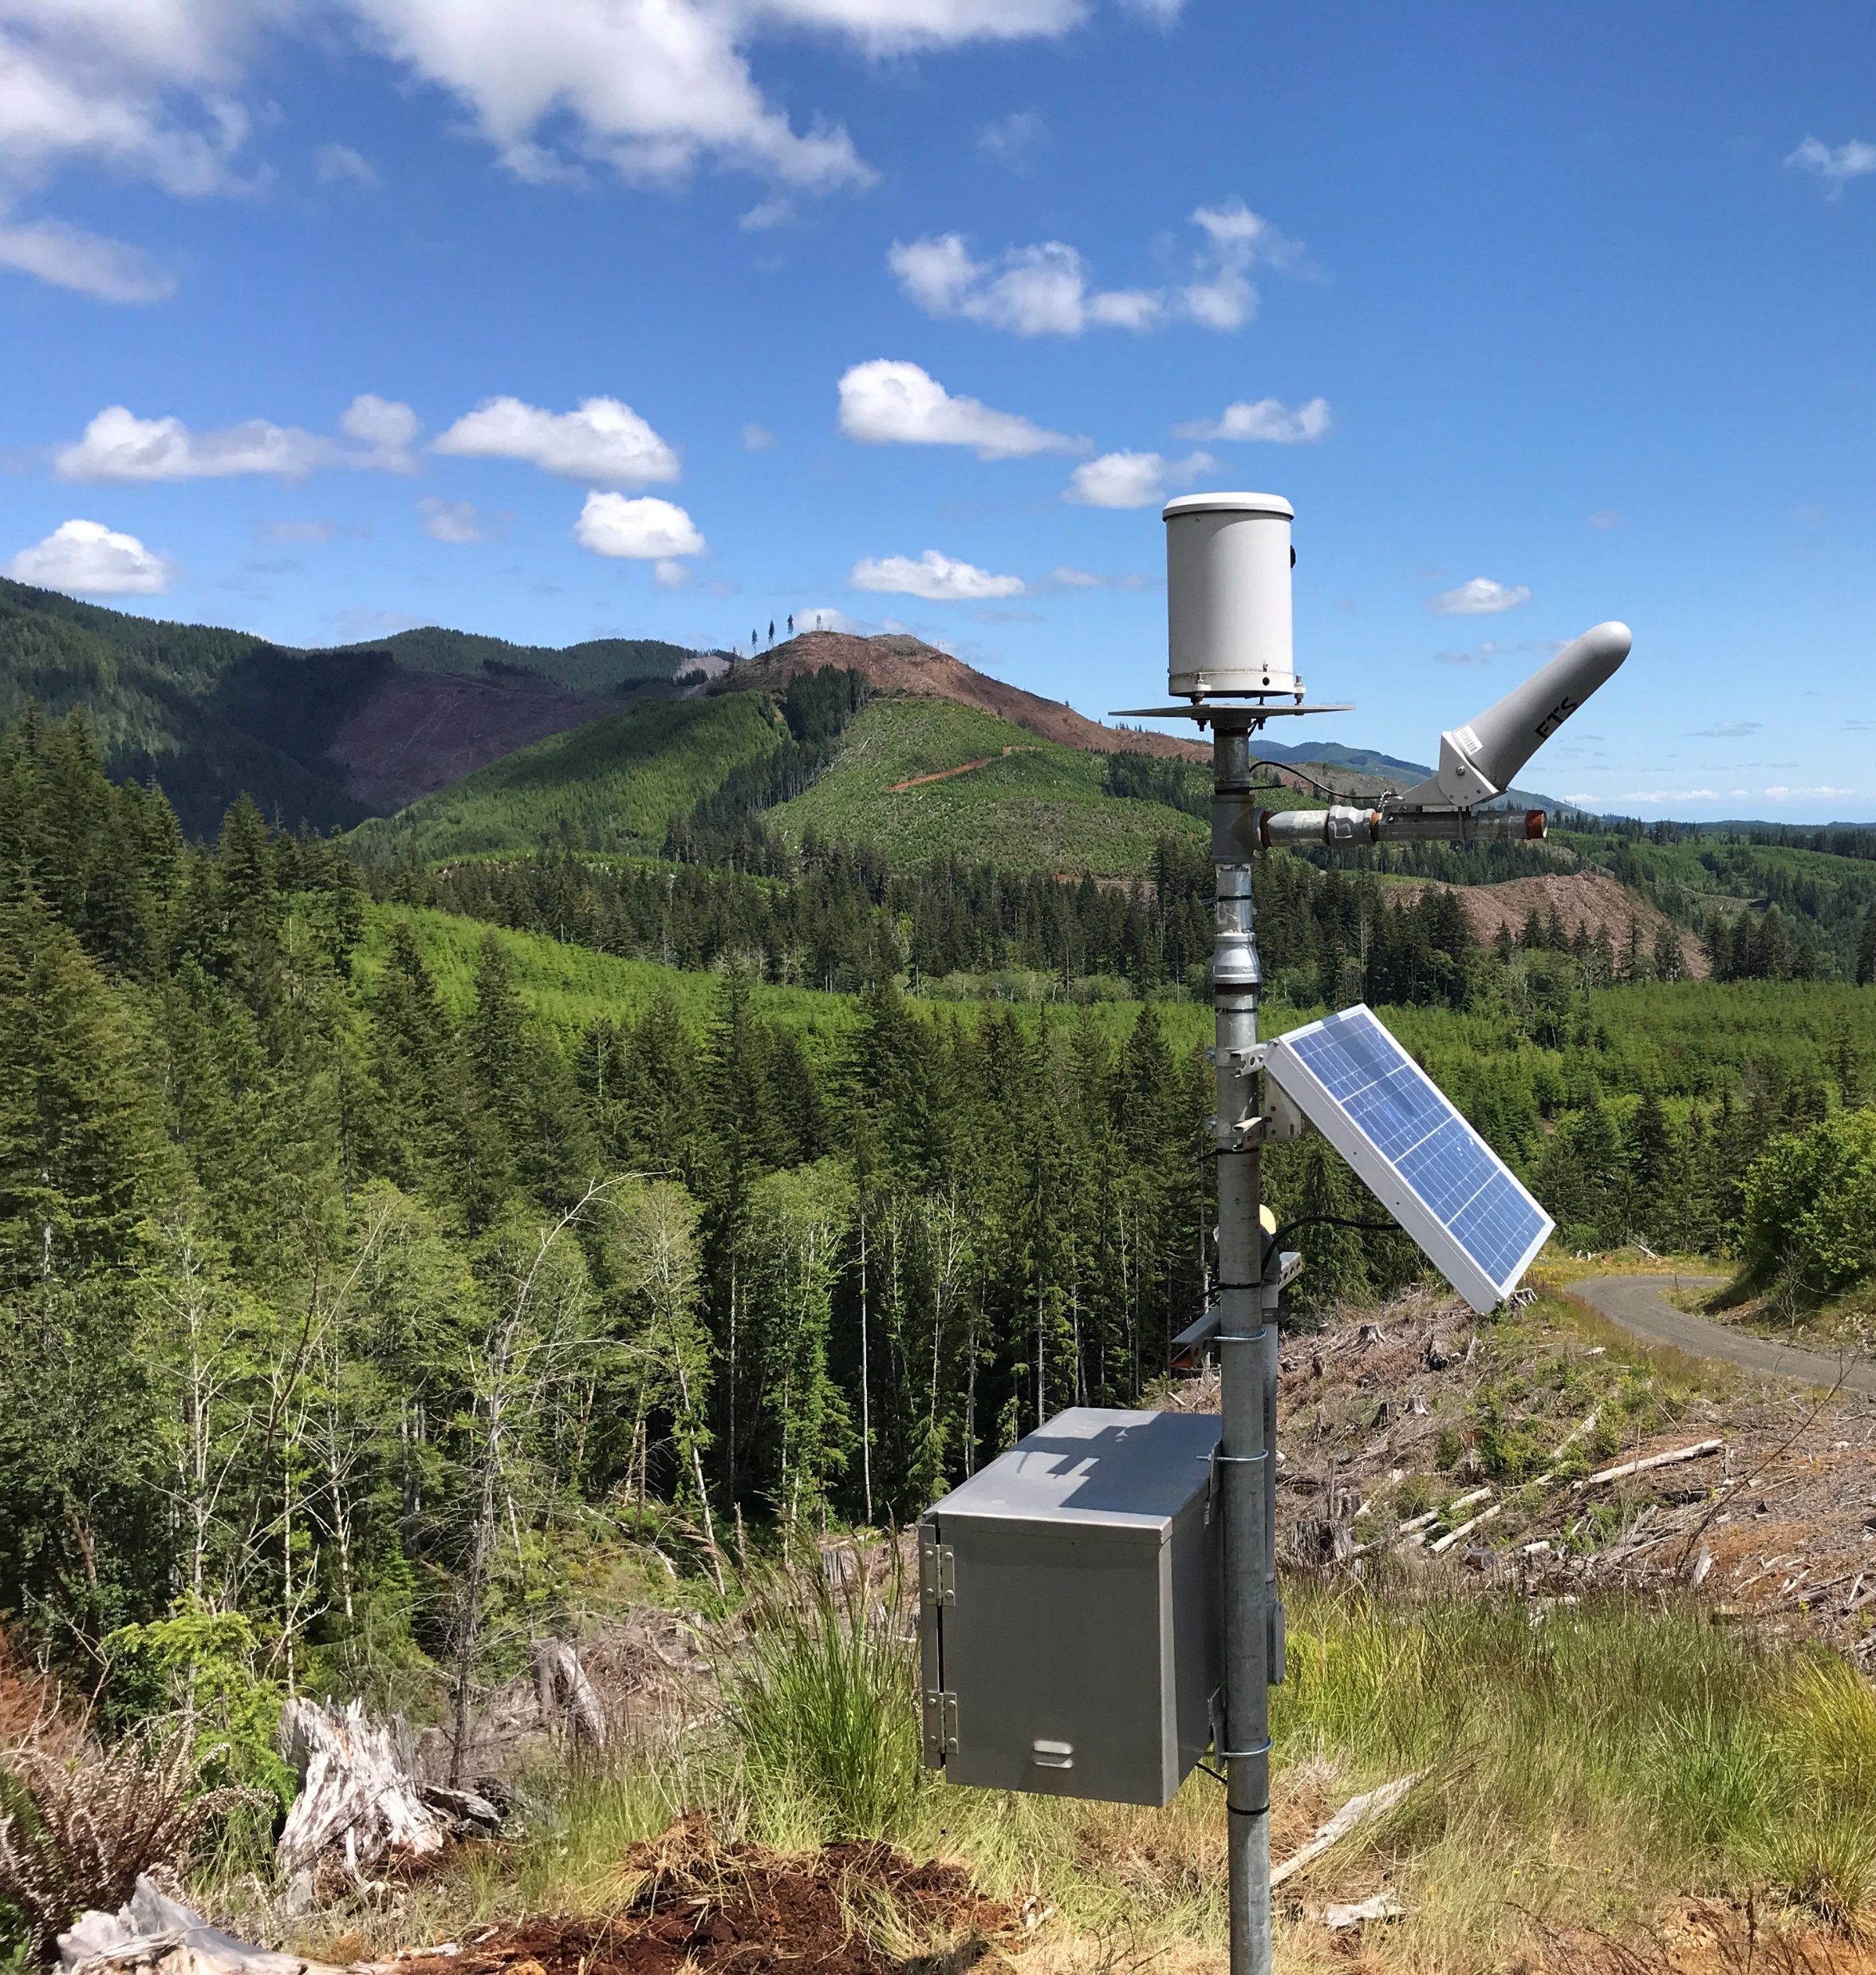
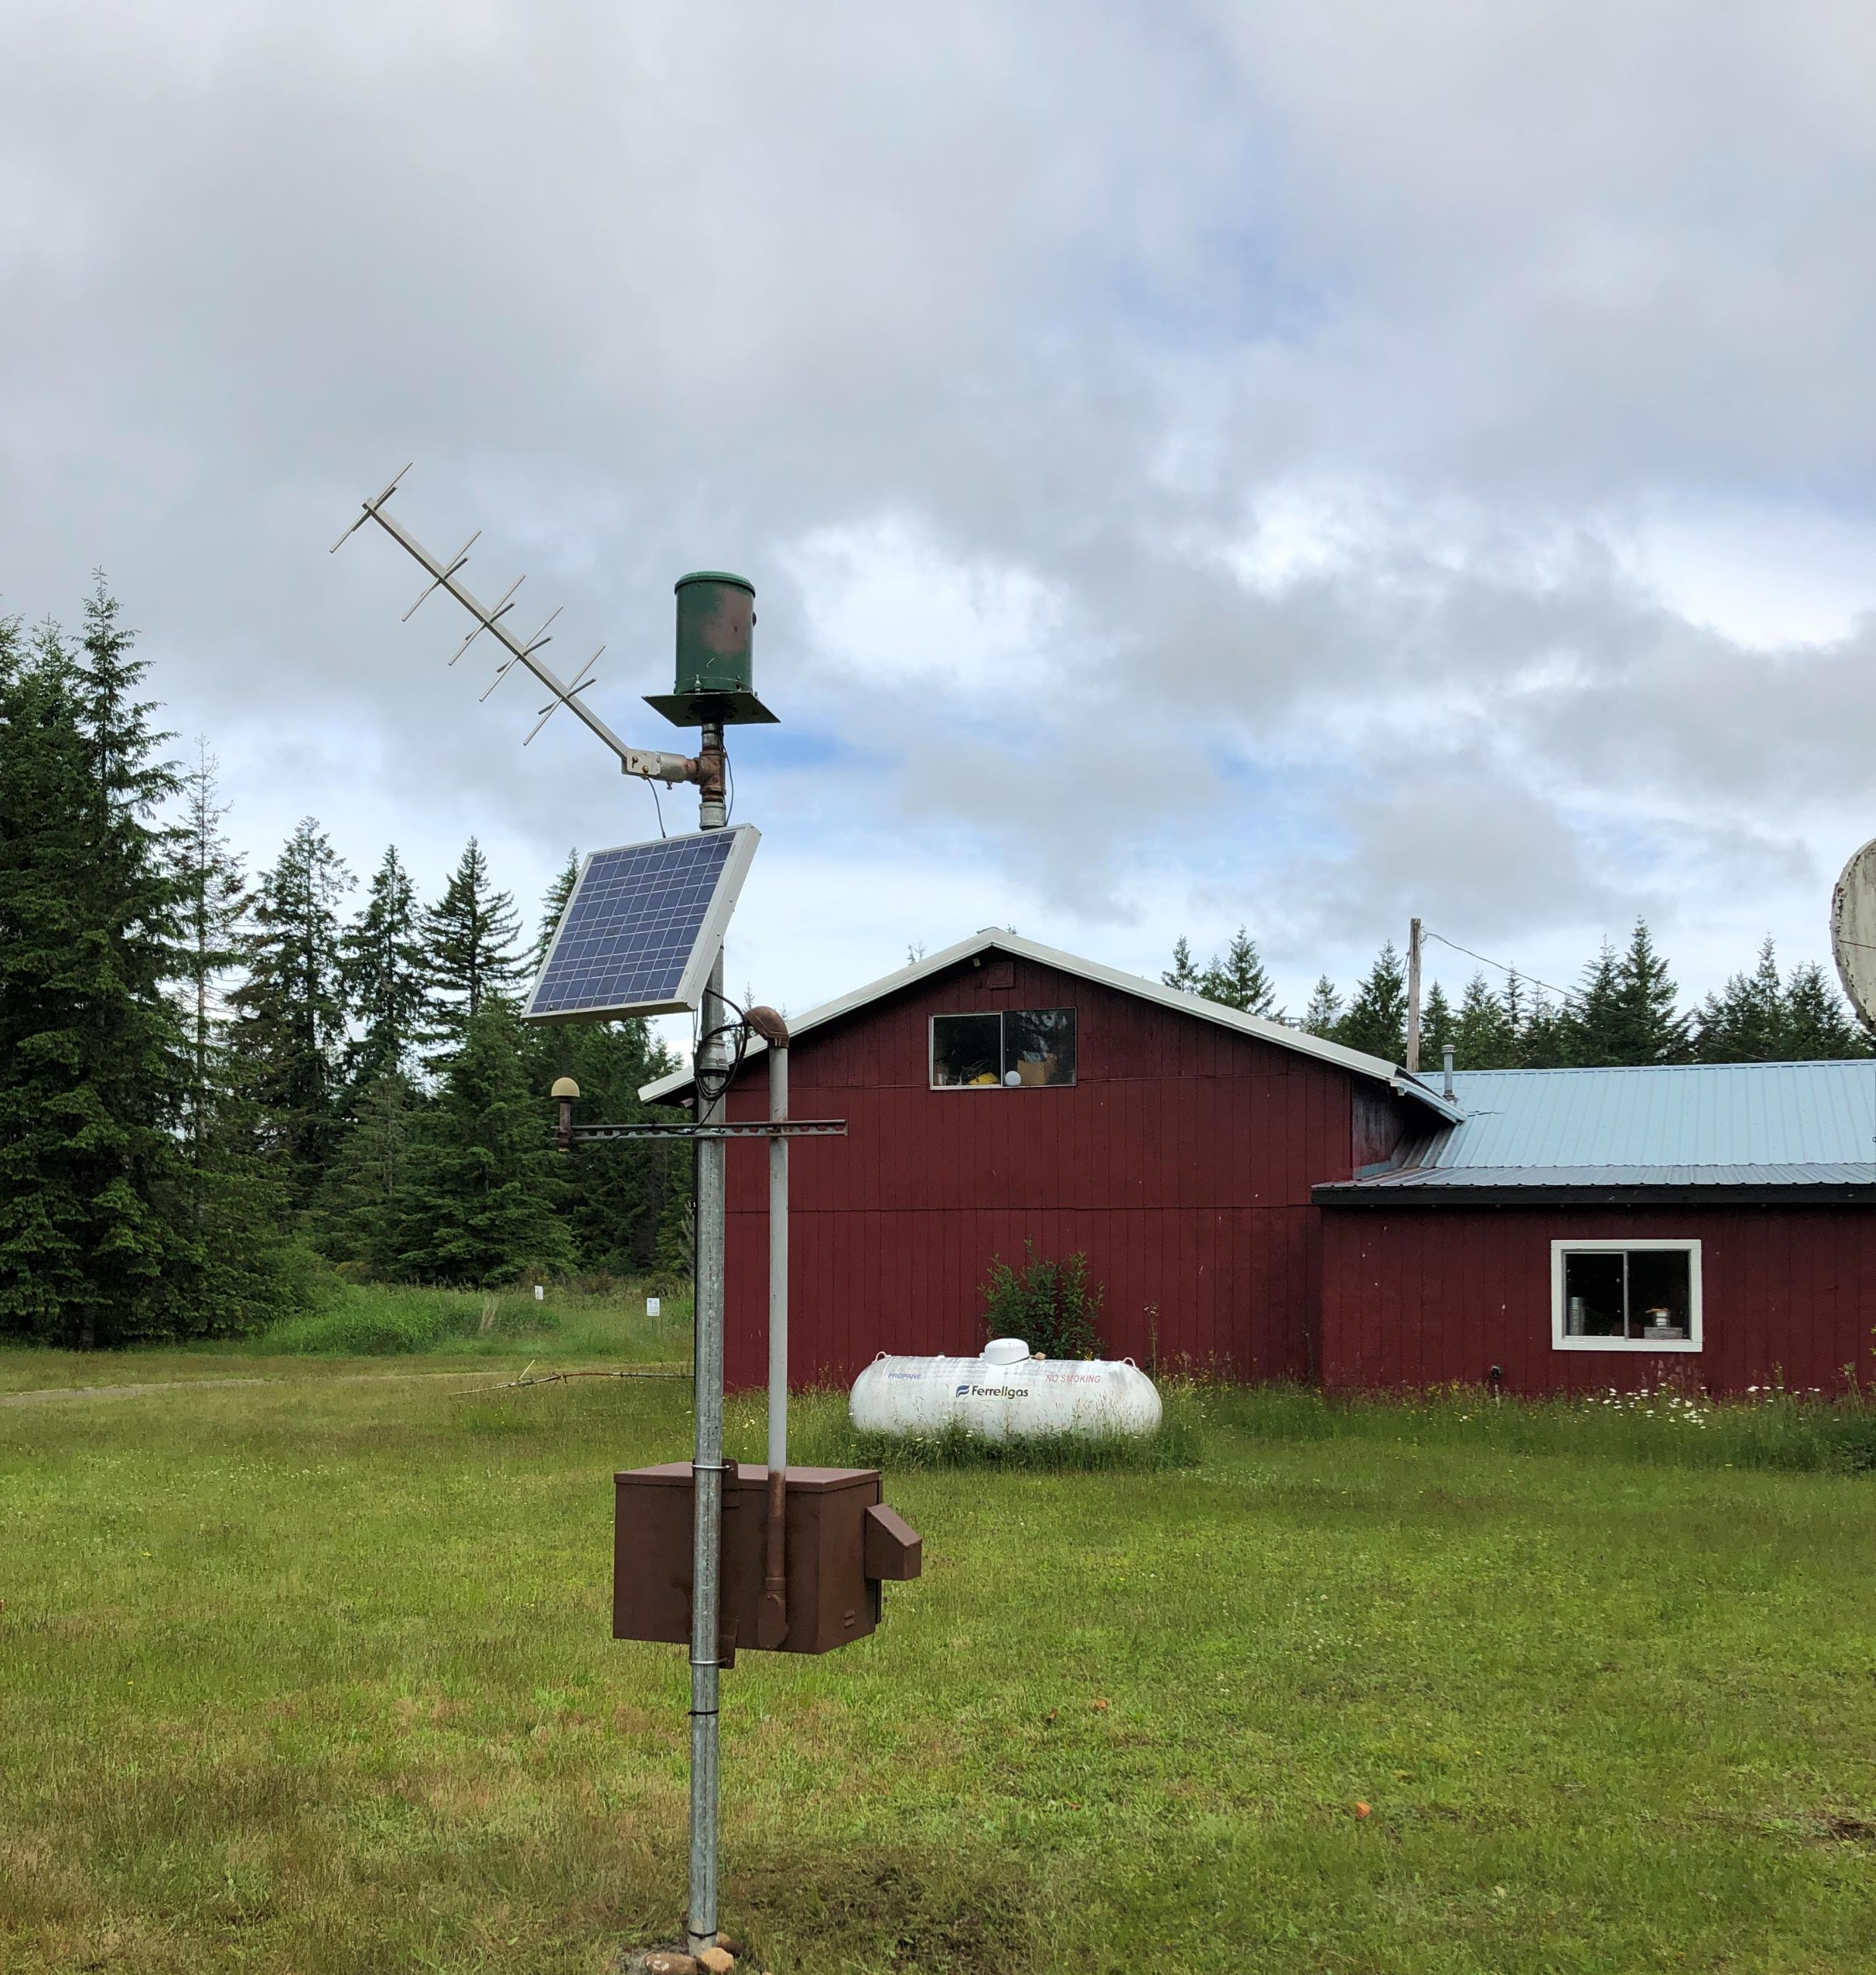
Gauge Relocations
Haywire Gauge
Mason FD Gauge
At Cloquallam
Notes:
Mason is good because no trees. Good for the long haul. Forest lands are good from elevation standpoint; however they are commercial forests that will grow necessitating relocation every 10 years or so.

Slide 6
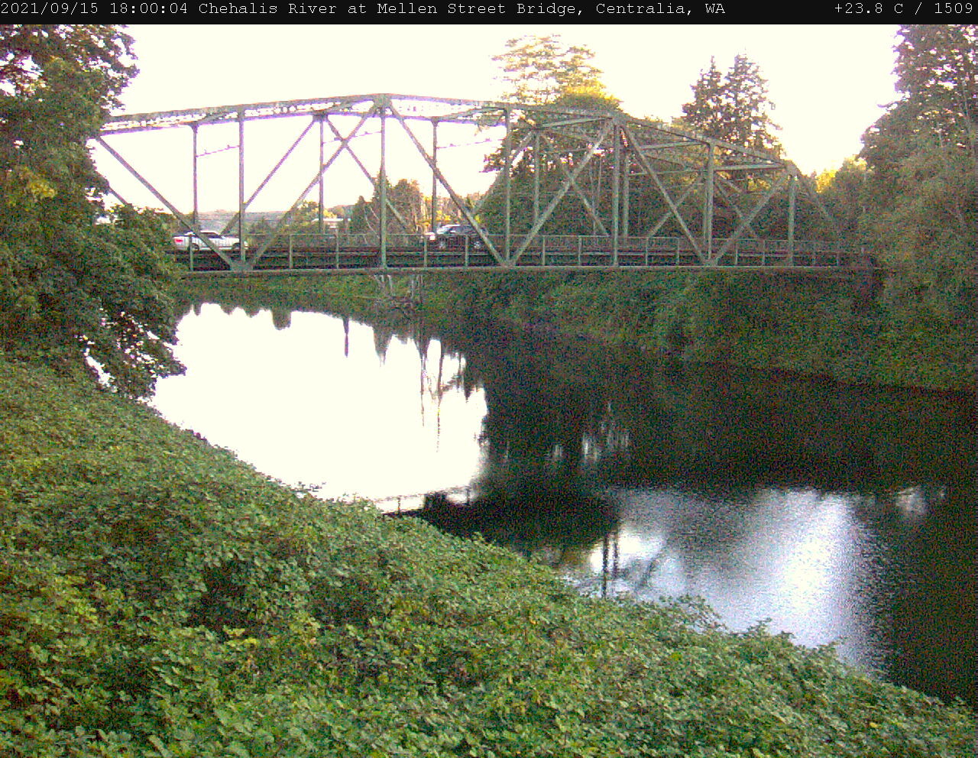
Webcams
Webcam at Monte Elma Rd bridge has been removed due to vandalism. 5/4/2021
A new webcam location on the Lower Satsop has been investigated and is ready for deployment when landowner permission is secured.
Time lapse video at Mellon Street.
Looking upriver at Mellen Street bridge

Slide 7
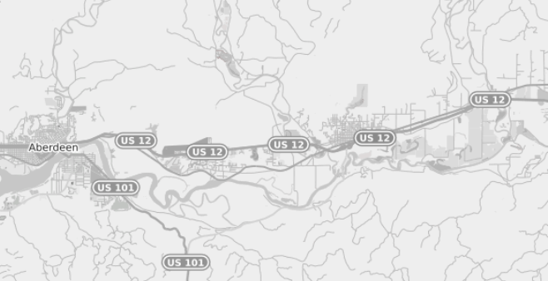
Chehalis River at Montesano Gauge
USGS reports that Montesano will be operational by end of September.

Slide 8
Rainfall Outlook

Slide 9
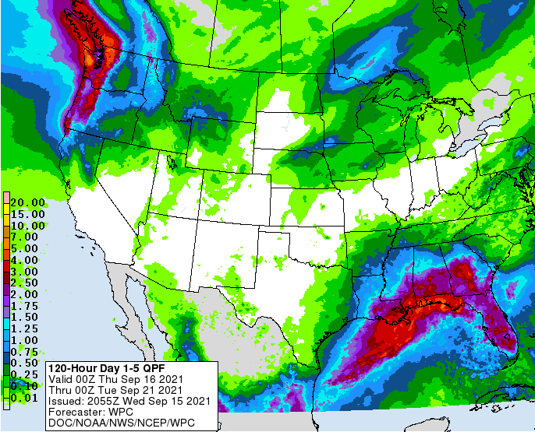
Rainfall this weekend. Atmospheric River!!

Slide 10
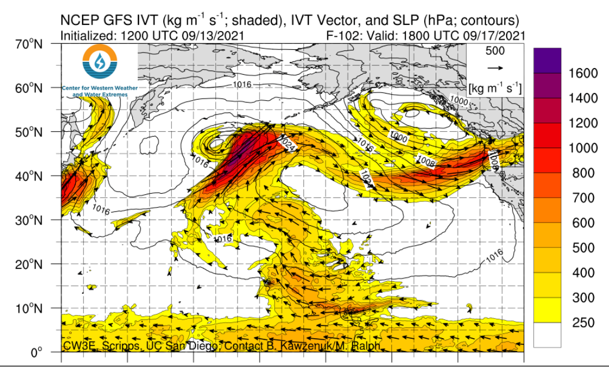
Atmospheric River

Slide 11
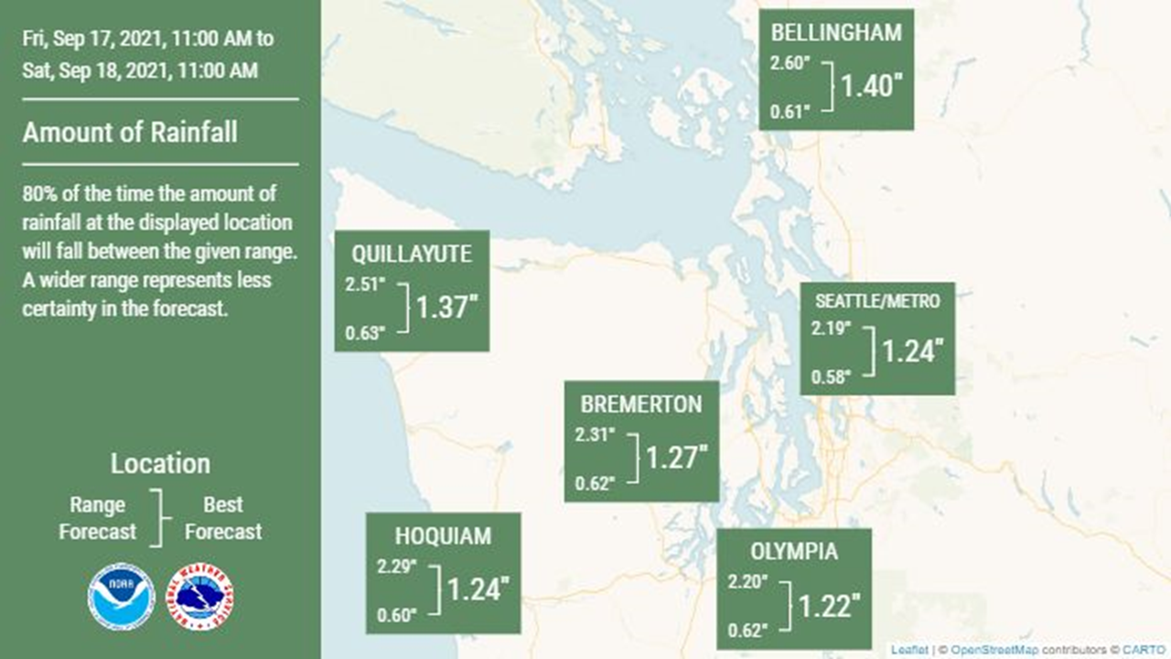

Slide 12
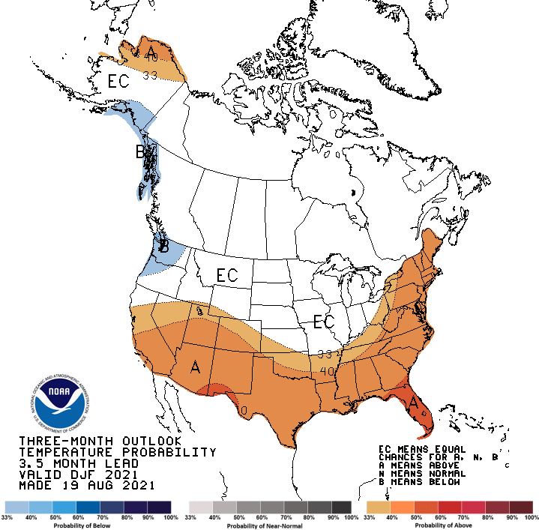
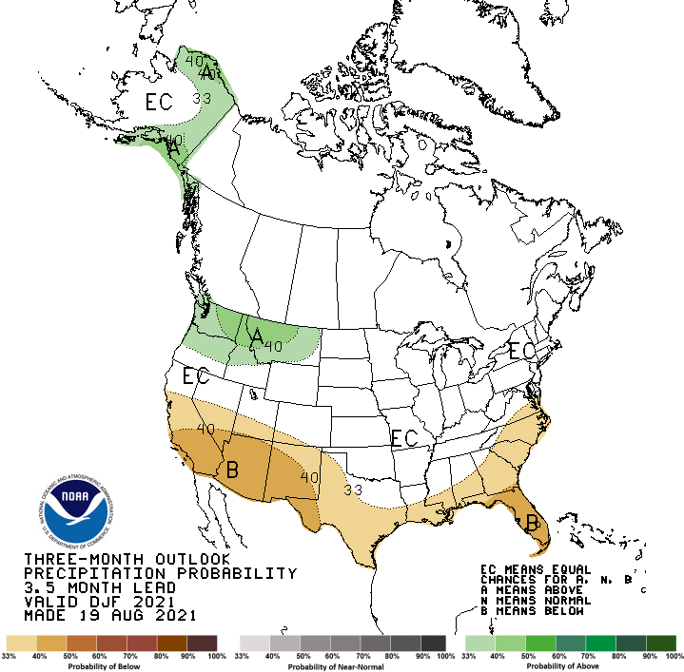
DJF Temperature
DJF Precipitation

Slide 13
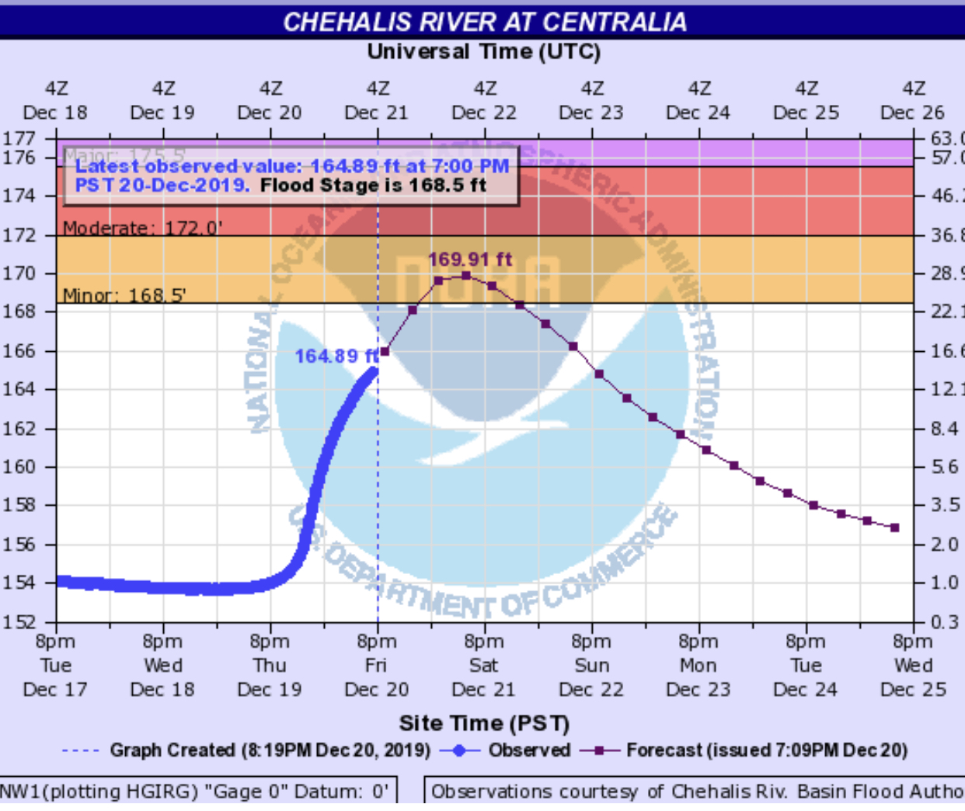
Forecast Highwater Alerts
Example: The Chehalis River at Centralia is expected to exceed flood stage in 11 hours.
Pilot project volunteers?

Slide 14
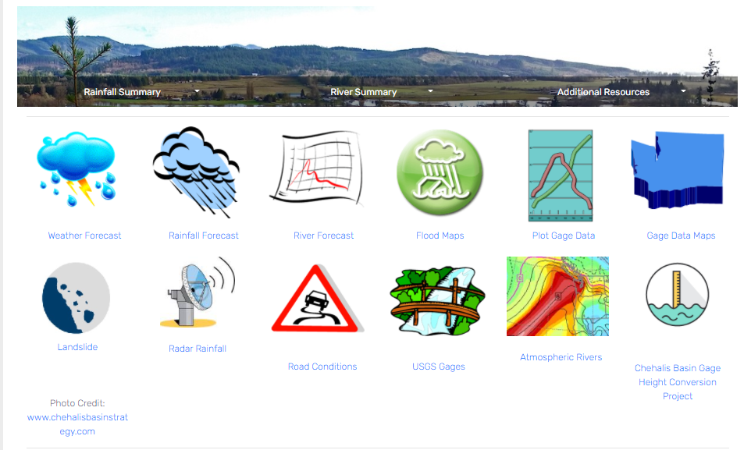
Virtual Training
Notes:
We will send email in a week or so announing a 2021-22 Flood season training

Slide 15
Mark your calendar: 21st Annual Pre-Winter Flood Meeting. Monday, October 25th from 1-5pm Jester Auto Museum

Slide 16
Questions?
Notes:
Discuss:
River forecast pilot
Flood season training
2021-22 email alert sign-ups
How can Flood Authority members help get the word out about this important first line of defense tool
Atmospheric rivers?

