Slide 1


Chehalis River Basin Flood Authority
Recent Flood Event
January 6-9, 2022
Edna Fund, Vice-Chair Chehalis River Basin Flood Authority | Scott Boettcher, Staff Chehalis River Basin Flood Authority

Slide 2
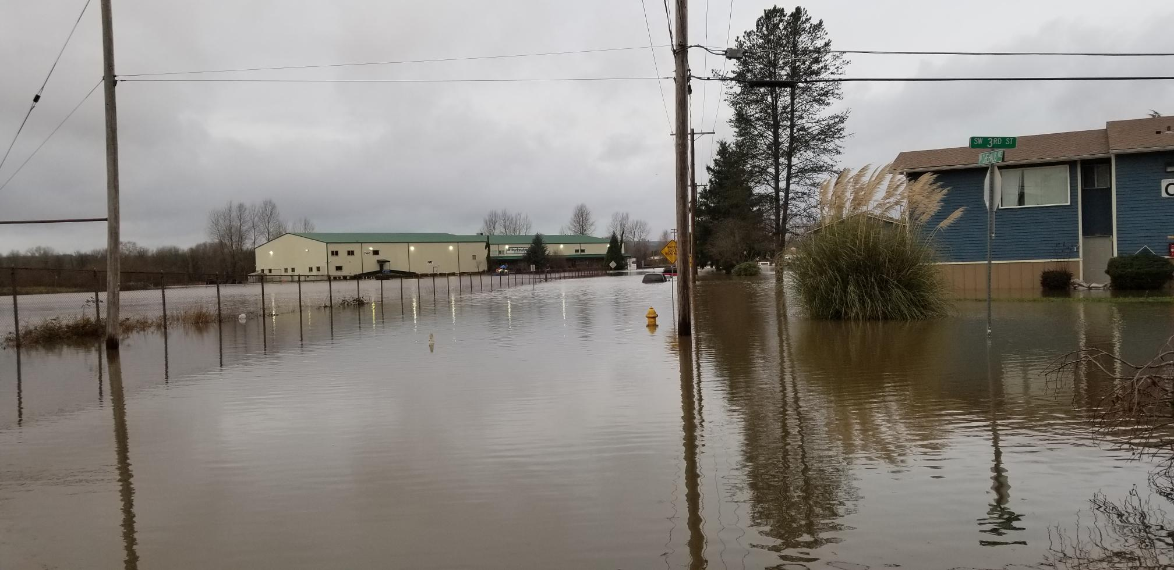

Today’s Presentation . . .
I. The Event . . . Quick look at rainfall, gages, event characteristics.
II. Reflections/Lessons Learned . . . What worked, what did we learn, etc.
Take Aways . . . What
can we conclude?
City of chehalis
.

Slide 3
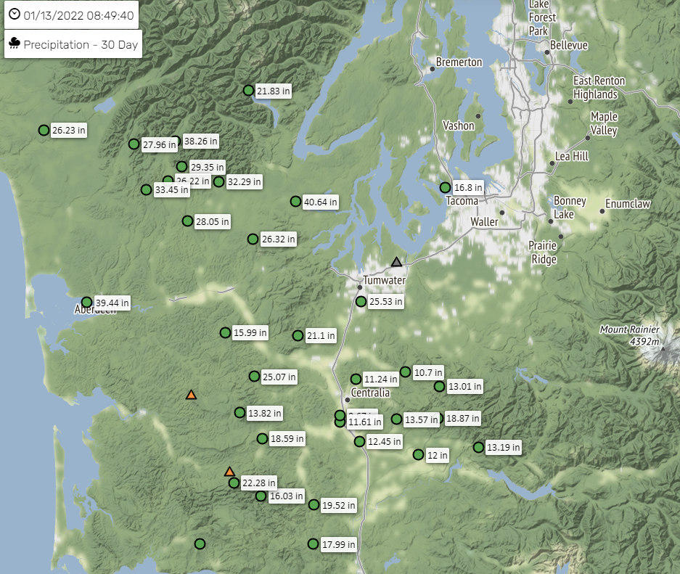
I. The Event . . .
30-Day Rainfall →
Gage Totals Since 10-01-2021:
Hoquiam ~ 96 inches
Beeville (Mason County) ~ 87 inches
Newaukum/Weyco (Lewis County) ~ 58 inches
Huckleberry Ridge (Lewis County) ~ 68 inches
Twin Cities:
8-11 inches snow 12/26-27/2021
4.25 inches rain 1/02-07/2022
.
www.chehalisriverflood.com

Slide 4
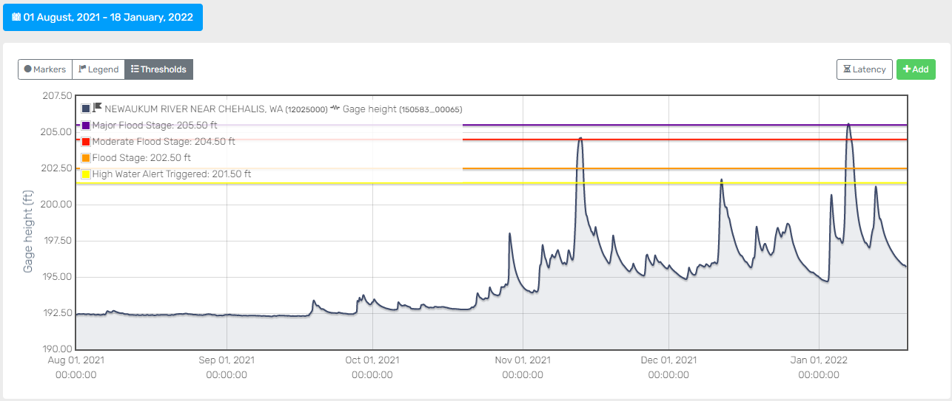
I. The Event . . .
Newaukum River Near Chehalis
Actual 205.59 (2022) Record 205.48 (1996)
New record
www.chehalisriverflood.com
.

Slide 5
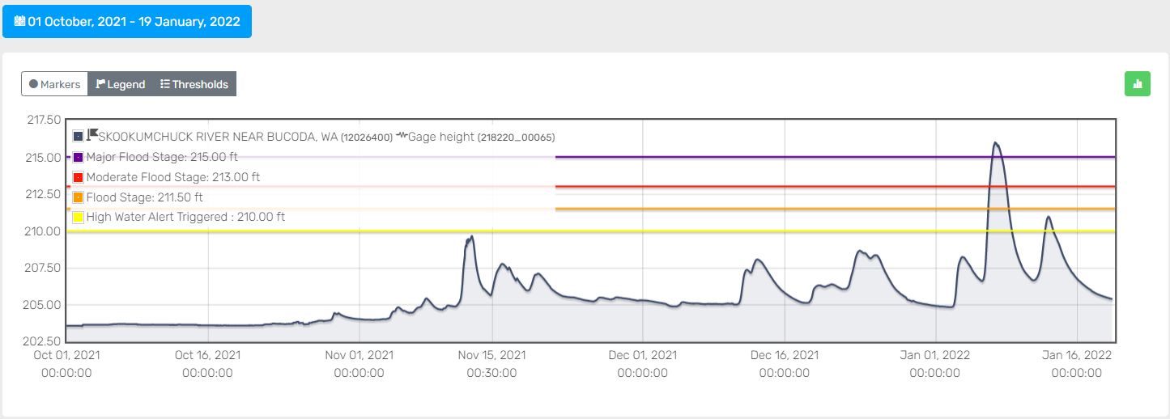
I. The Event . . .
Skookumchuck River Near Bucoda
Actual 215.99 (2022) Record 216.02 (1996)
Near record
www.chehalisriverflood.com
.

Slide 6
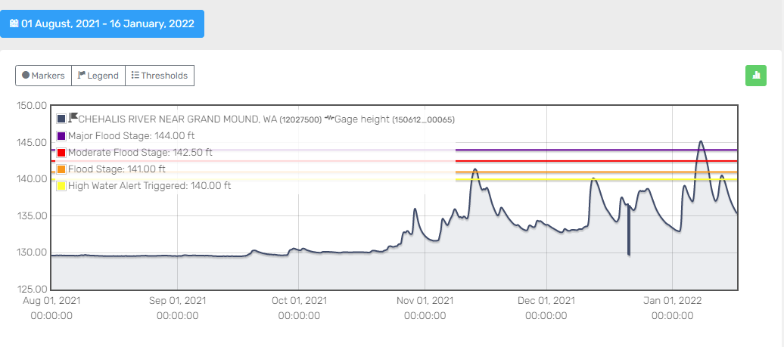
I. The Event . . .
Chehalis River Near Grand Mound
Actual 145.21 (2022) Record 147.26 (2007)
www.chehalisriverflood.com
.

Slide 7
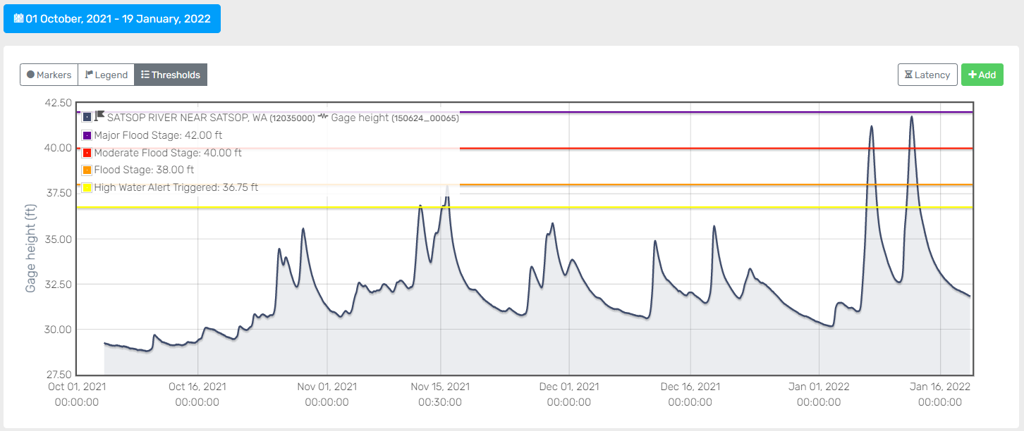
I. The Event . . .
Satsop River Near Satsop
Actual 41.76 (2022) Record 42.79 (1935)
Near record
www.chehalisriverflood.com
.

Slide 8
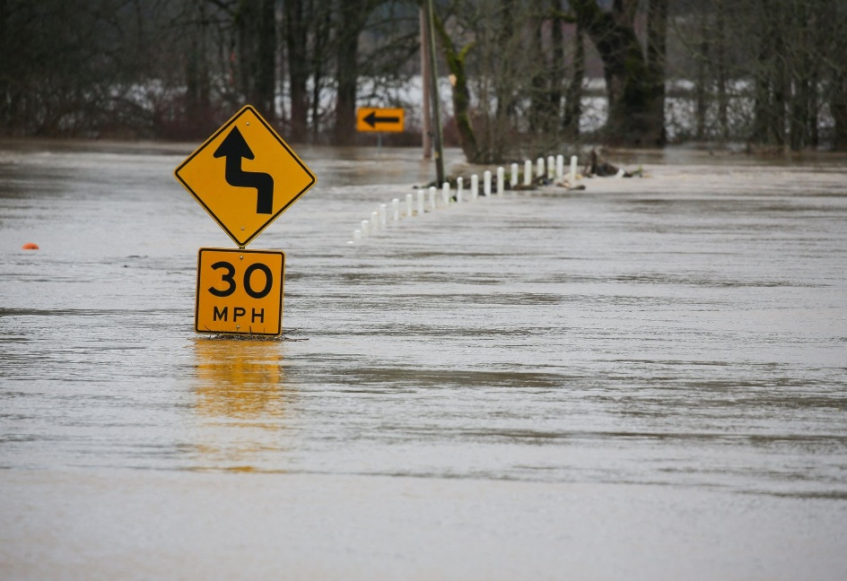
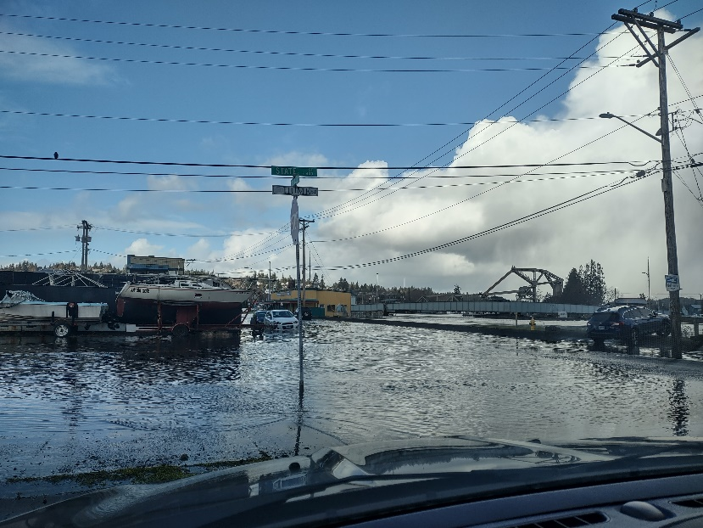
I. The Event . . .
Conspiring Weather Conditions:
  Significant snow on the ground.
  Heavy rain, Warming temperatures.
  Category 4 Atmospheric River (2 ARs).
Very wet!
Basin-wide.
REUTERS PHOTO
.
Kris koski / port of grays harbor

Slide 9
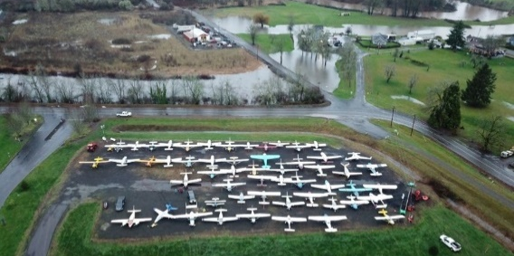
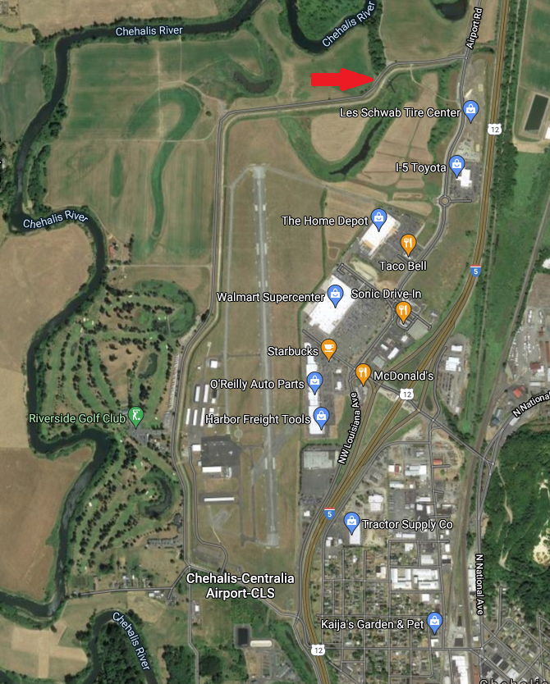
II. Reflections/Lessons Learned . . .
Pumps Work! Chehalis-Centralia Airport Pump:
Pumped continuously for several days at 10,000 gpm.
3 days = ~ 518 million gallons of water!
Area within levee stayed protected, along with millions $ of infrastructure and 1,000+ jobs.
Cost = $1.14M. Value protected = $45M (and $9M annual tax dollars). ROI = 39:1!
Before (1940s to 2015):
Today (2015 forward):
.

Slide 10
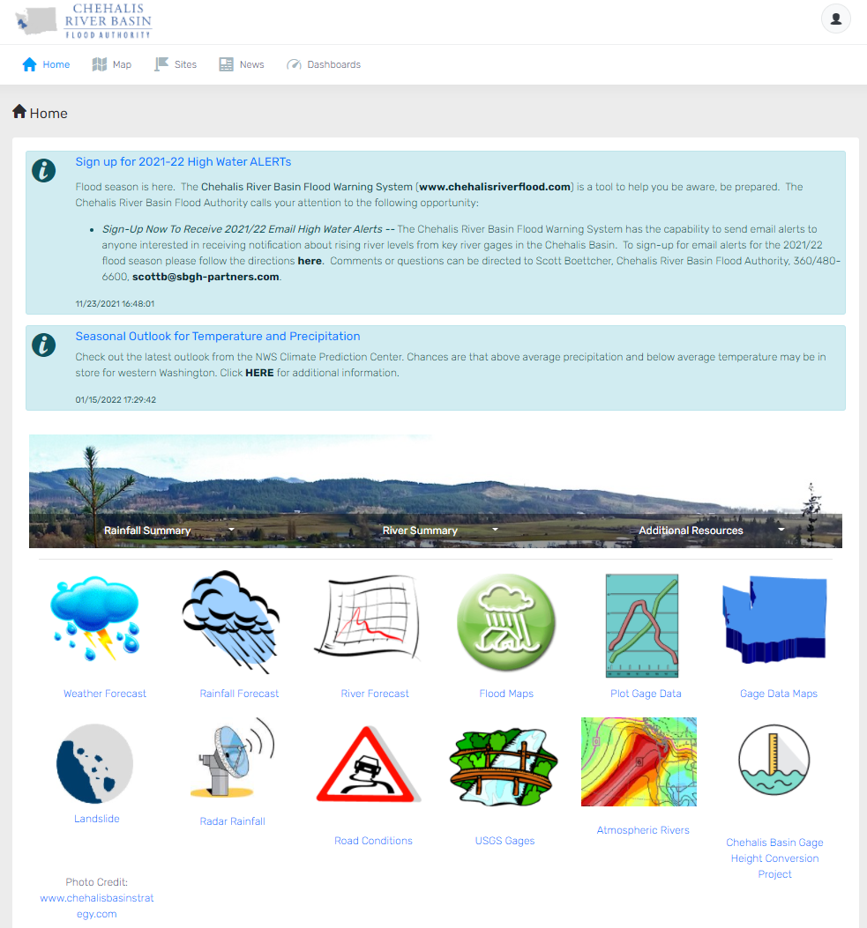
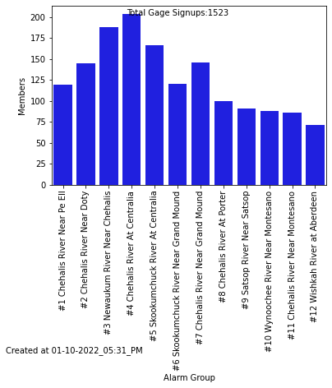
II. Reflections/Lessons Learned . . .
www.chehalisriverflood.com
Flood Warning System Works!
Website -- 25,000 user logins (Jan 1-10)
Inundation Maps -- 73,000 hits (Jan 6-7)
Email alert sign-ups →
Also:
Lewis County Rivers
Lewis County Alert
.

Slide 11
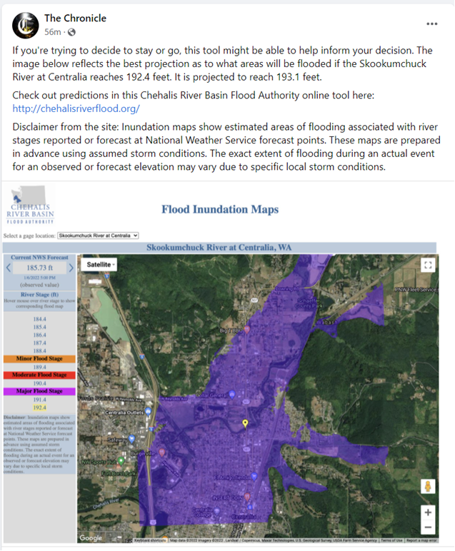
II. Reflections/Lessons Learned . . .
Social Media Works! 3rd party posts drove Flood Warning System volumes.
.

Slide 12
II. Reflections/Lessons Learned . . .
Ranked high flow events (1932 - 2012) . . .
I-5 closed 1990, 1996, 2007, 2009.
Five largest events since 1986.
Recent event (1/07/2022) peaked → 44,600 cfs (9-10 event); Closed I-5 (~5 hours).
90000
Chehalis River Flow Rates near Grand Mound (cubic ft./sec.) ₂
1
80000
3
70000
60000
4
5
50000
9
7
6
10
8
13
13
11
16
12
15
40000
30000
20000
10000
0
.

Slide 13
II. Reflections/Lessons Learned . . .
How Do Previous Events Compare?
Peak Flow (kCFS) | 1996 | 2007 | 2022 | Diff
Newaukum River Near Chehalis | 13.3 | 12.9 | 13.9 | n/a
Skookumchuck River Near Bucoda | 11.3 | 3.6 | 11.0 | n/a
Chehalis River Near Grand Mound | 74.8 | 79.1 | 44.6 | 2022: 60% of 1996 56% of 2007
.

Slide 14
III. Take Aways . . .
For as wet as it was, we were lucky. Even though it wasn’t a 2007 event, it was still a top 10 event.
Positive factors (over 1996 or 2007) include:
  Lower peak flows in the Chehalis.
  Greater on-the-ground flood awareness (Flood Warning System).
  Greater flood protection improvements (Airport Pump).
Lowering peak flows in the Chehalis, through a predictable upper-basin mainstem retention structure (versus relying on luck), is key to limiting significant future flood damage from catastrophic (and top 10) floods.
Continuing support for a basin-wide solution (large and small projects, aquatic species and habitat, early flood awareness) remains critical.
  Local Resolutions -- City of Chehalis (2010, 2016, 2020, 2021).
.

Slide 15
Thank You!
Edna Fund, Lewis County Representative
Vice-Chair, Chehalis River Basin Flood Authority
Member, Chehalis Basin Board
360/269-7515
dutch@localaccess.com
Scott Boettcher
Staff, Chehalis River Basin Flood Authority
360/480-6600
scottb@sbgh-partners.com
.

