Slide 1
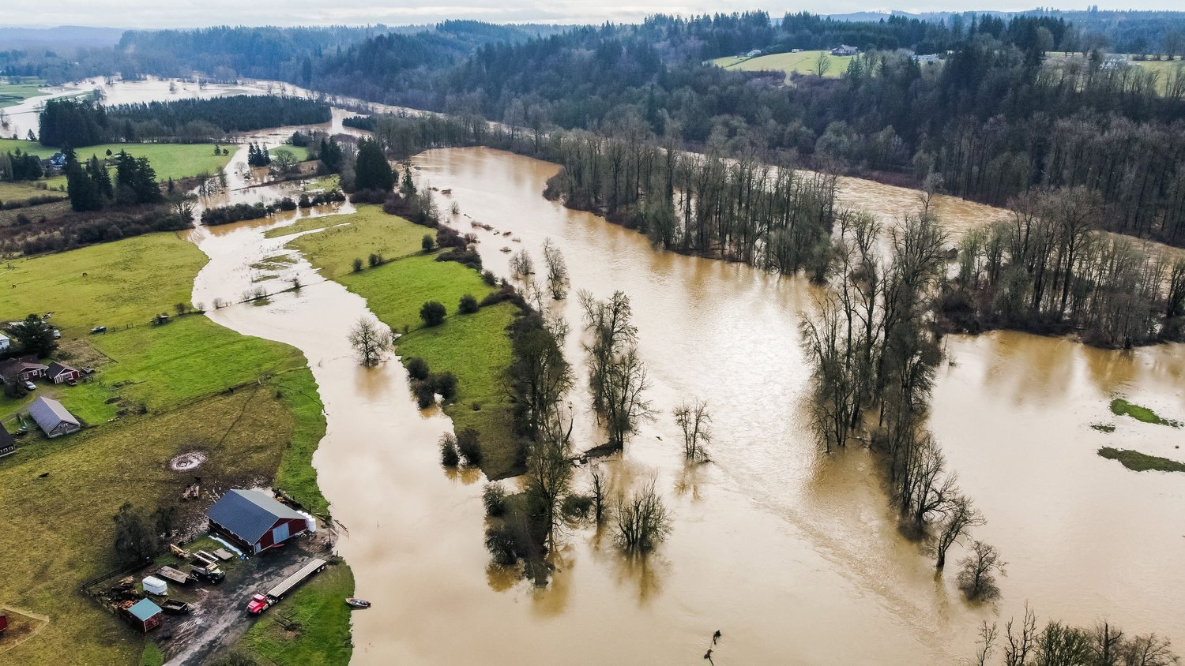
Flood Summary
January 2022
Chehalis River Basin Flood Authority
JARED WENZELBURGER / JARED@CHRONLINE.COM

Slide 2
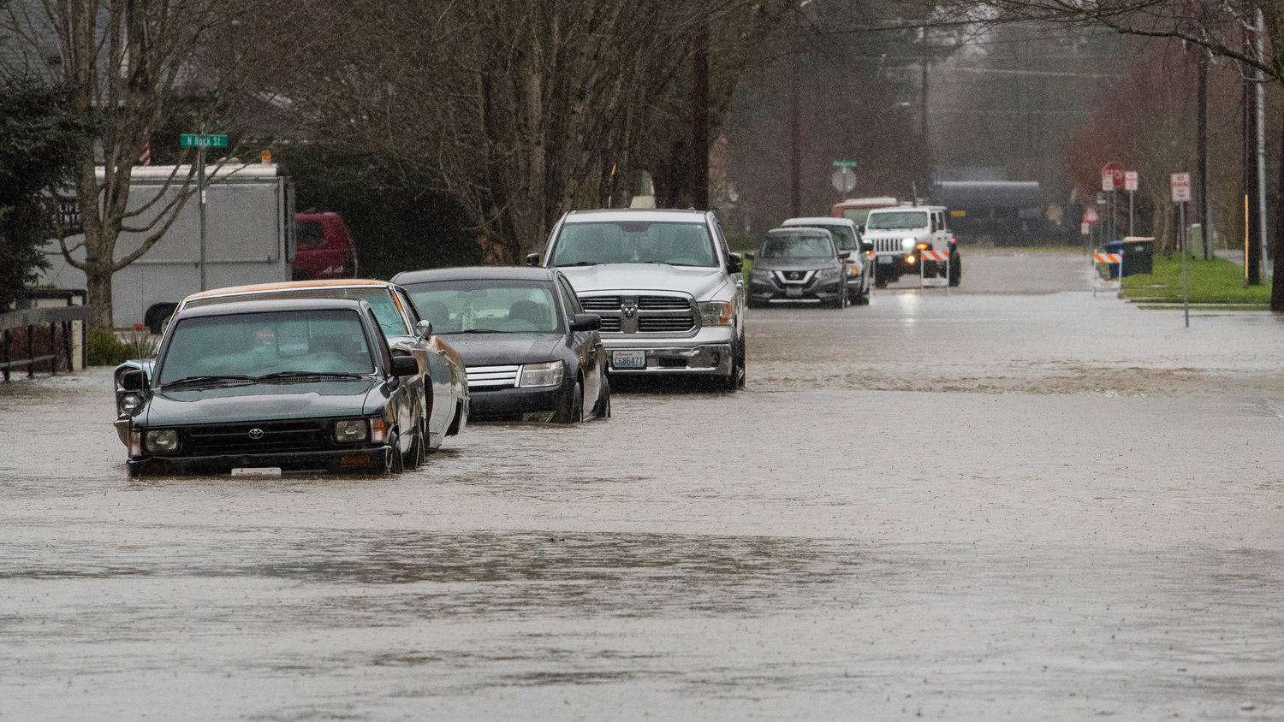
January 2022
Record flood stages
  Newaukum near Chehalis
Major flood stages
  Skookumchuck near Bucoda
  (near record)
  Chehalis River at Porter
  Chehalis River at Grand Mound
Moderate flood stages
  Chehalis at Centralia (near major)
  Satsop near Satsop (near major)
  Skookumchuck at Centralia
Minor flood stages
  Chehalis near Doty
JARED WENZELBURGER / JARED@CHRONLINE.COM

Slide 3
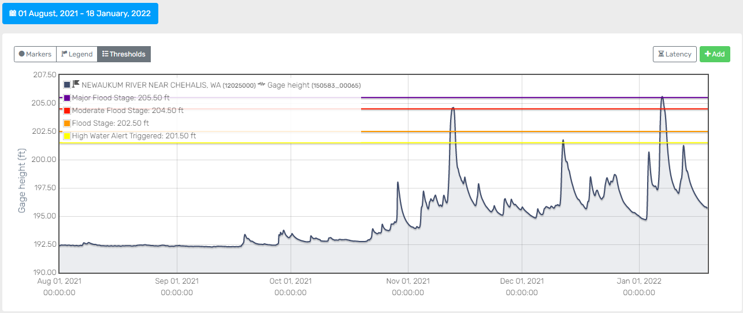
Newuakum River near Chehalis
New record

Slide 4
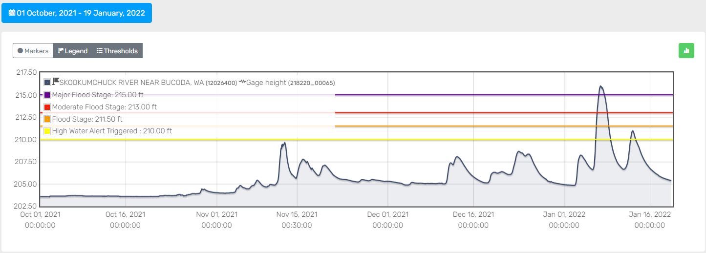
Skookumchuck River at Near Bucoda
Near record

Slide 5
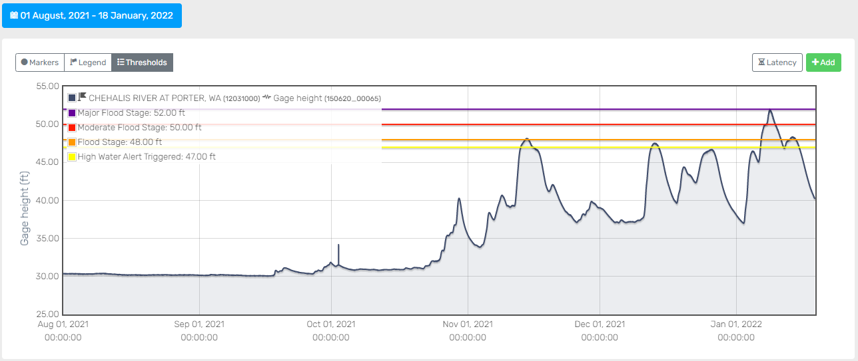
Chehalis River at Porter

Slide 6
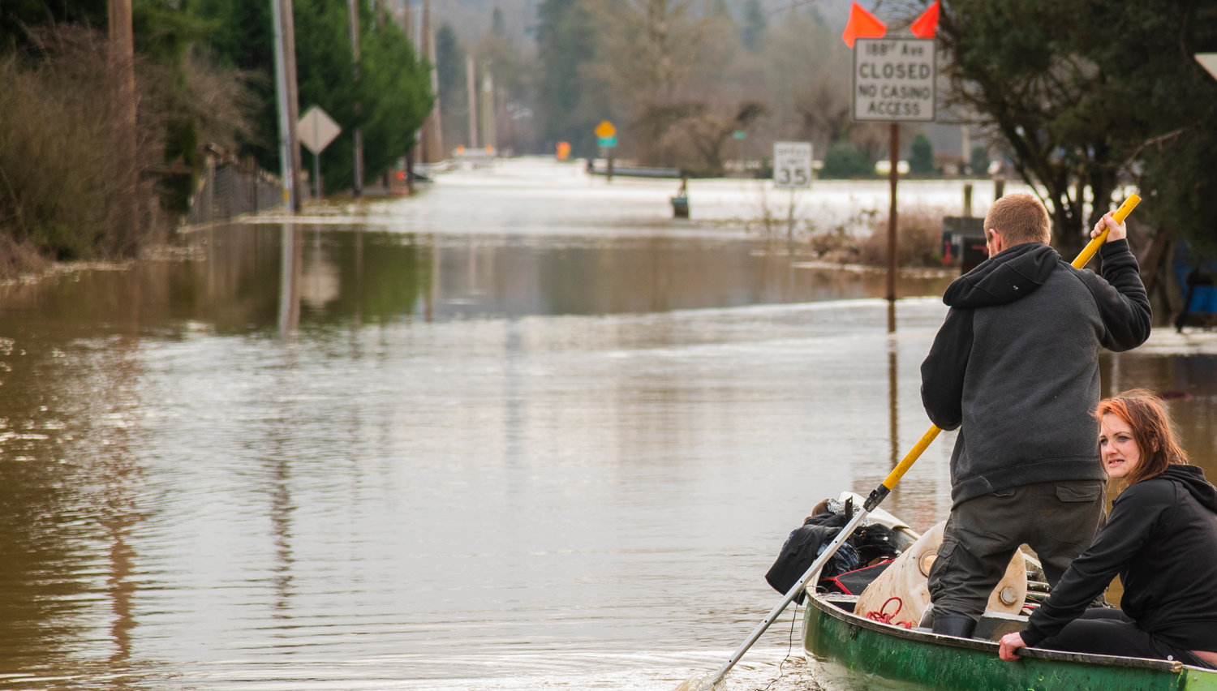
Why?
Very wet antecedent conditions
Significant snow on the ground
Heavy rain
  Category 4 atmospheric River
JARED WENZELBURGER / JARED@CHRONLINE.COM

Slide 7
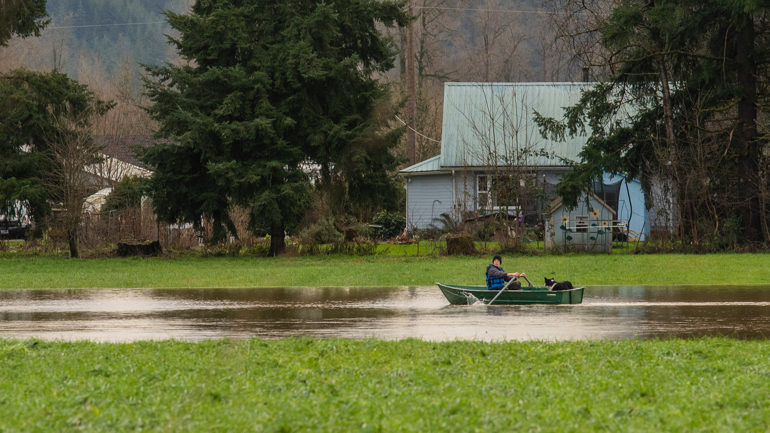
Rainfall Totals Since October 1, 2021
Hoquiam Rain – 95.42 inches
Beeville Rain – 86.98 inches
Newaukum – Weyco Rain – 57.75 inches
Huckleberry Ridge Rain – 67.62 inches
JARED WENZELBURGER / JARED@CHRONLINE.COM

Slide 8
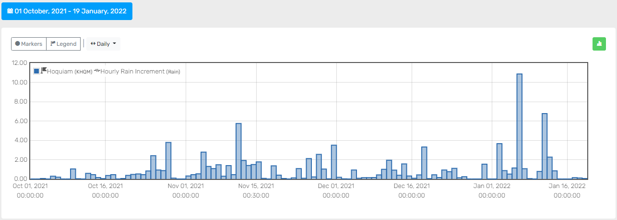
Hoquiam Rain – 95.42 inches

Slide 9
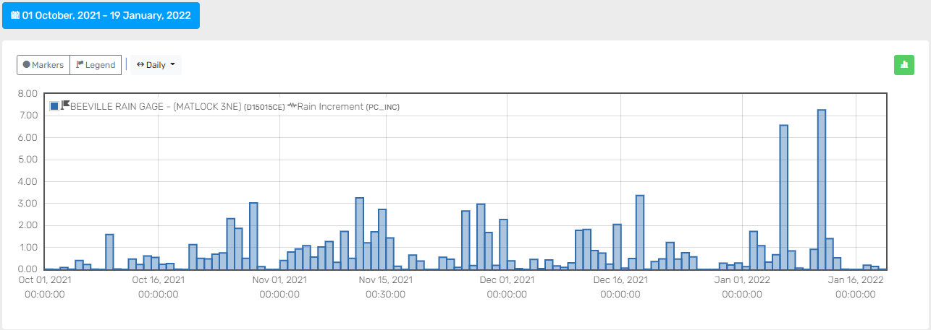
Beeville Rain – 86.98 inches

Slide 10
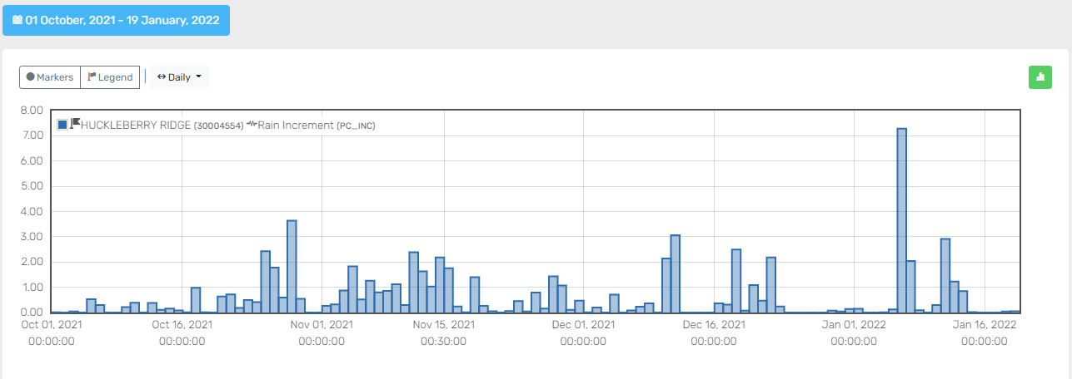
Huckleberry Ridge Rain – 67.62 inches

Slide 11
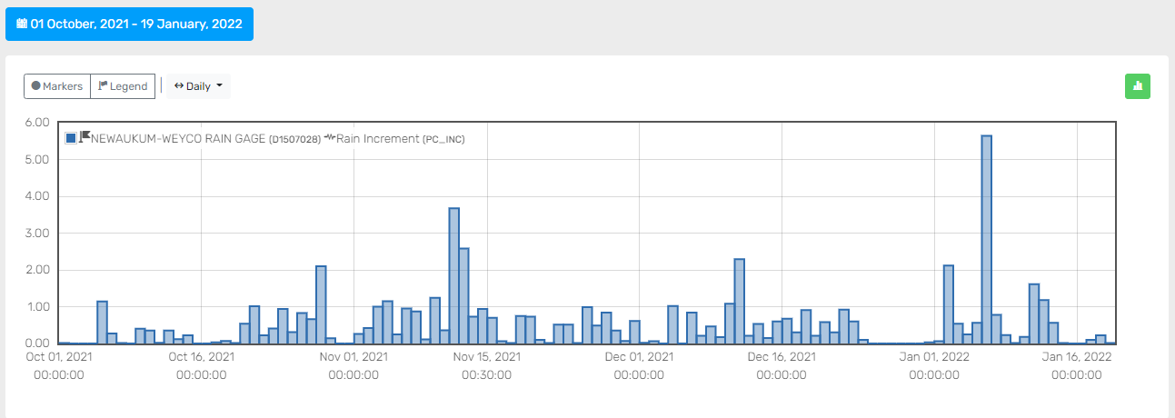
Newaukum – Weyco Rain – 57.75 inches

Slide 12
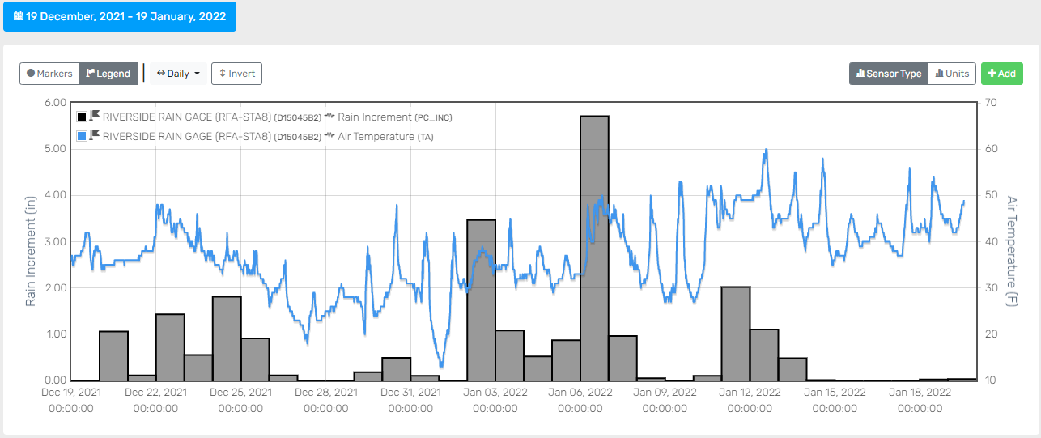
Riverside Rain and Temperature
Snow buildup

Slide 13
NWS Forecasts
Chehalis at Doty
Newaukum near Chehalis
Skookumchuck near Bucoda

Slide 14
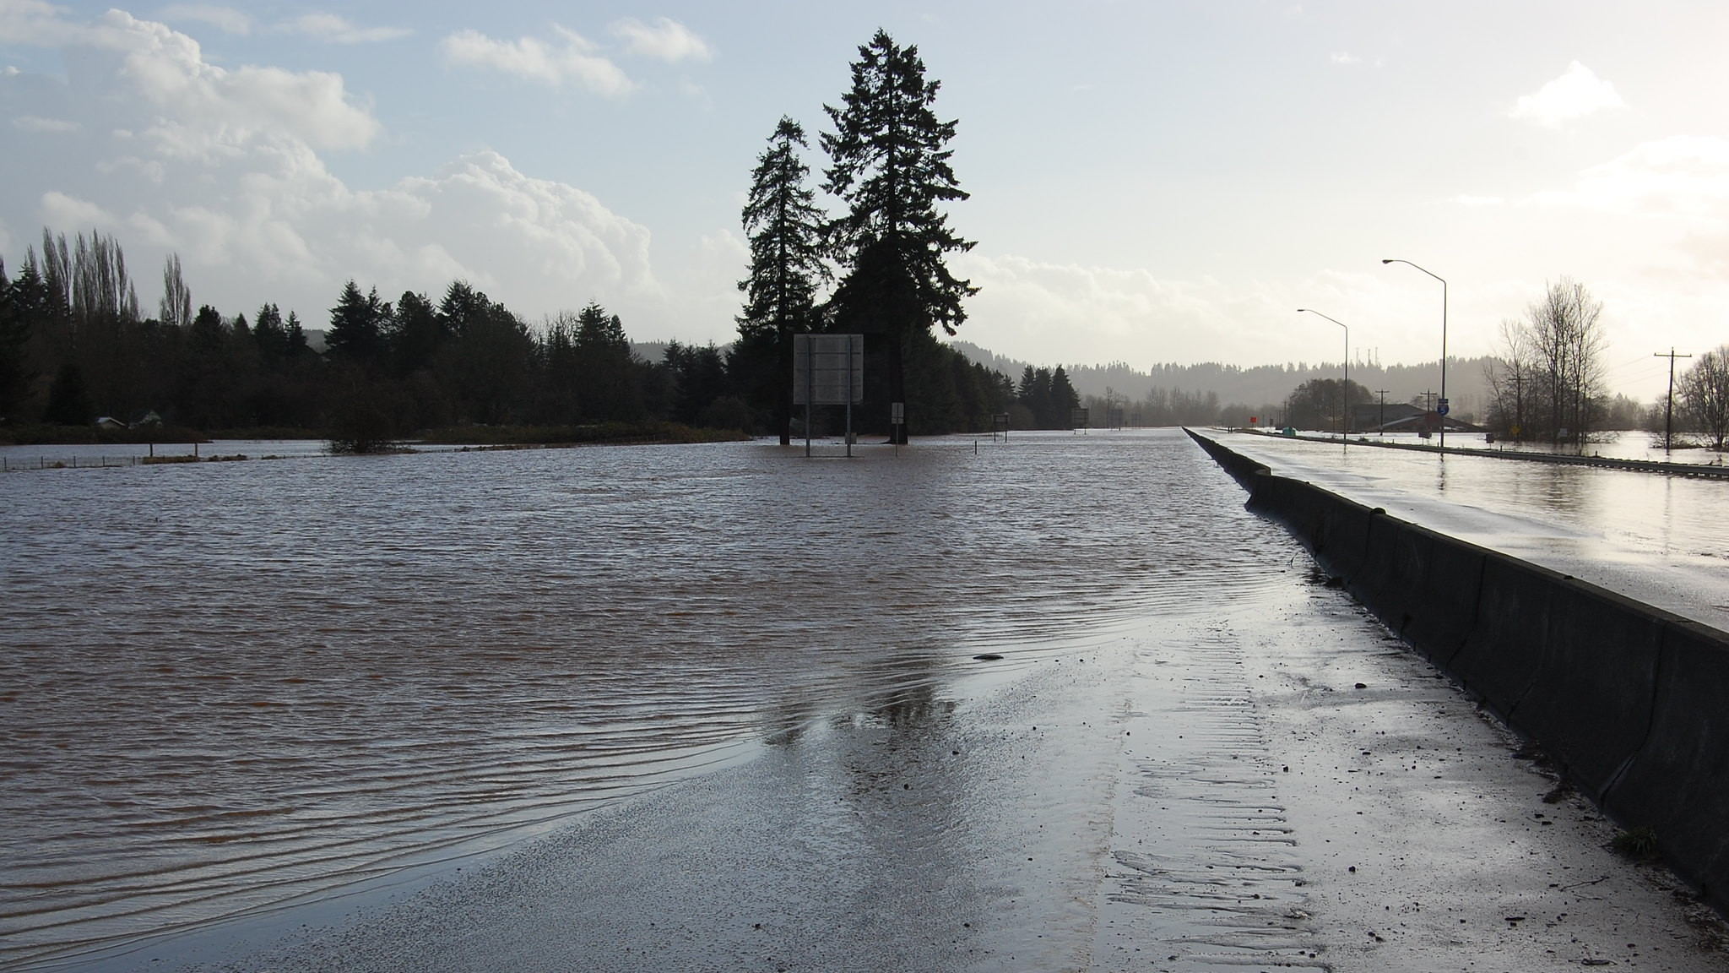
Compare
Standing in the left lane of northbound I-5 in Centralia, Dec. 4, 2007.
WSDOT photo by Jim Culp

Slide 15
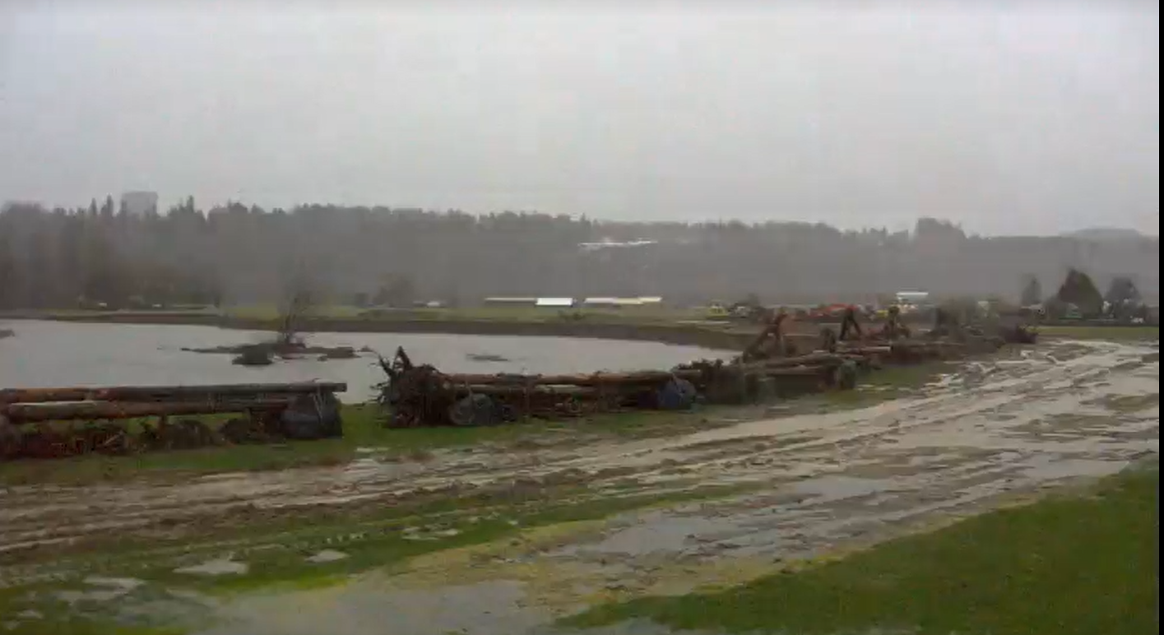
WEB Cams
Chapman Farms

Slide 16
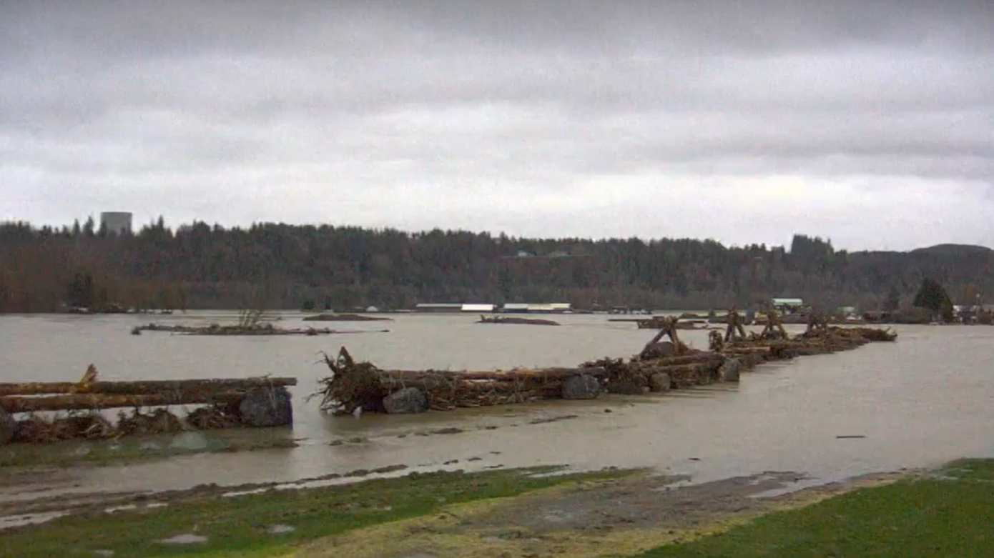
WEB Cams
Chapman Farms

Slide 17
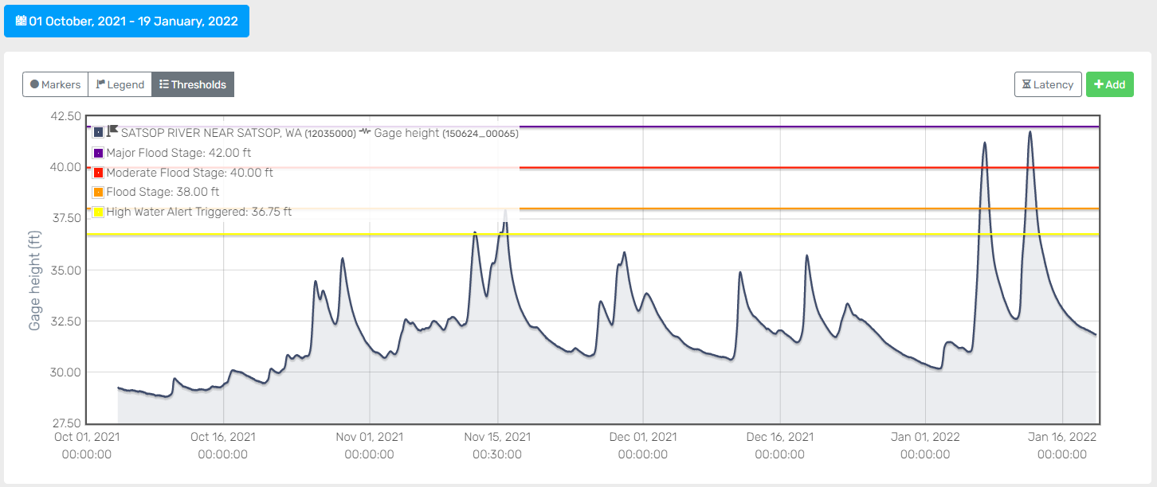
Satsop River near Satsop

Slide 18
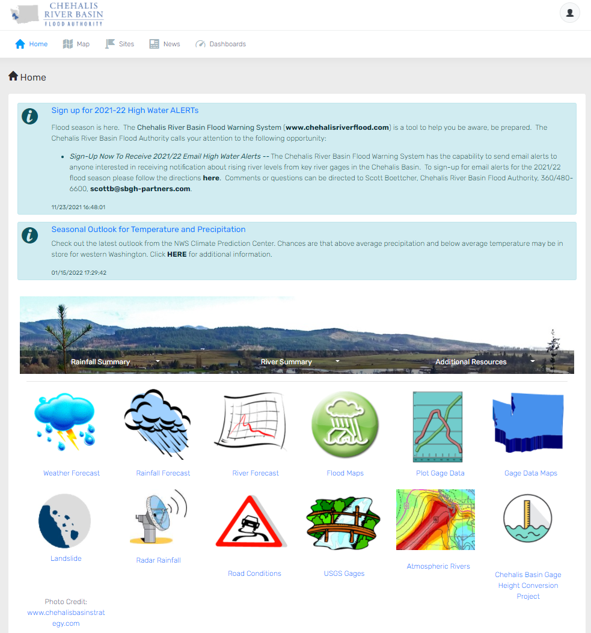
Chehalis River Basin Flood Authority Website
Website
  25,000 User logins – Jan 1-10
Inundation Maps
  73,000 hits Jan 6-7
Third party posts
  The Chronicle
  WA Emergency Management

Slide 19
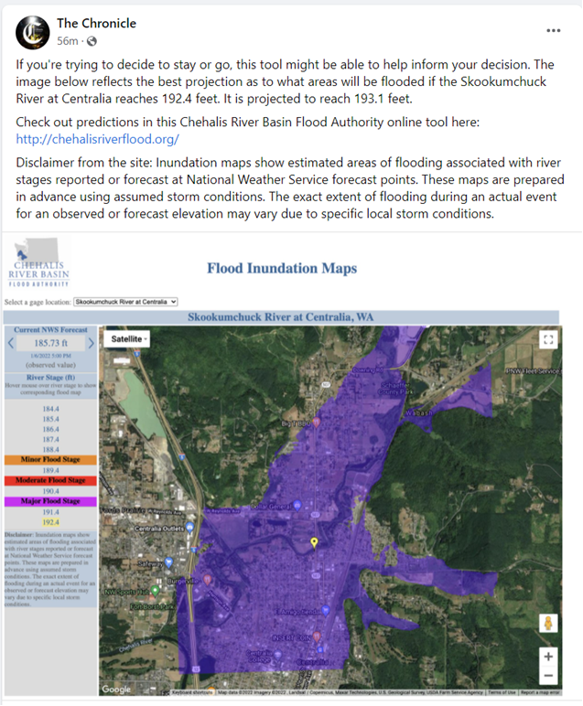
3rd Party Posts

Slide 20
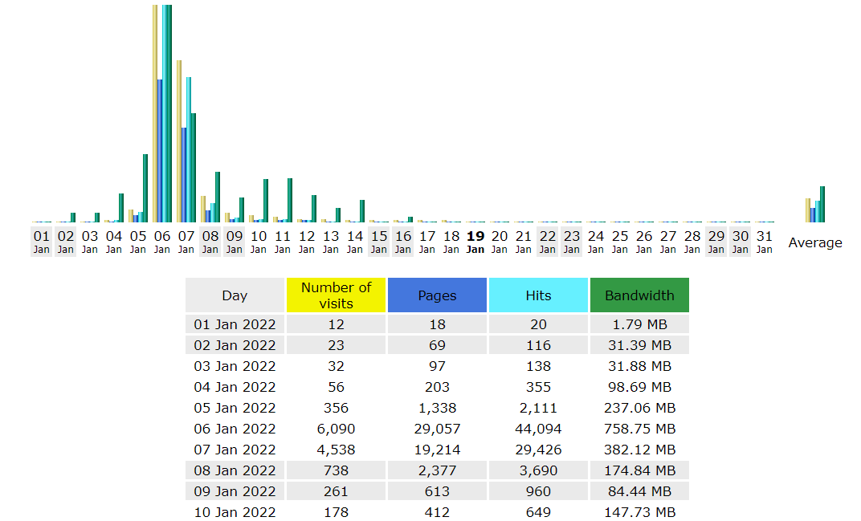
Website Traffic

Slide 21
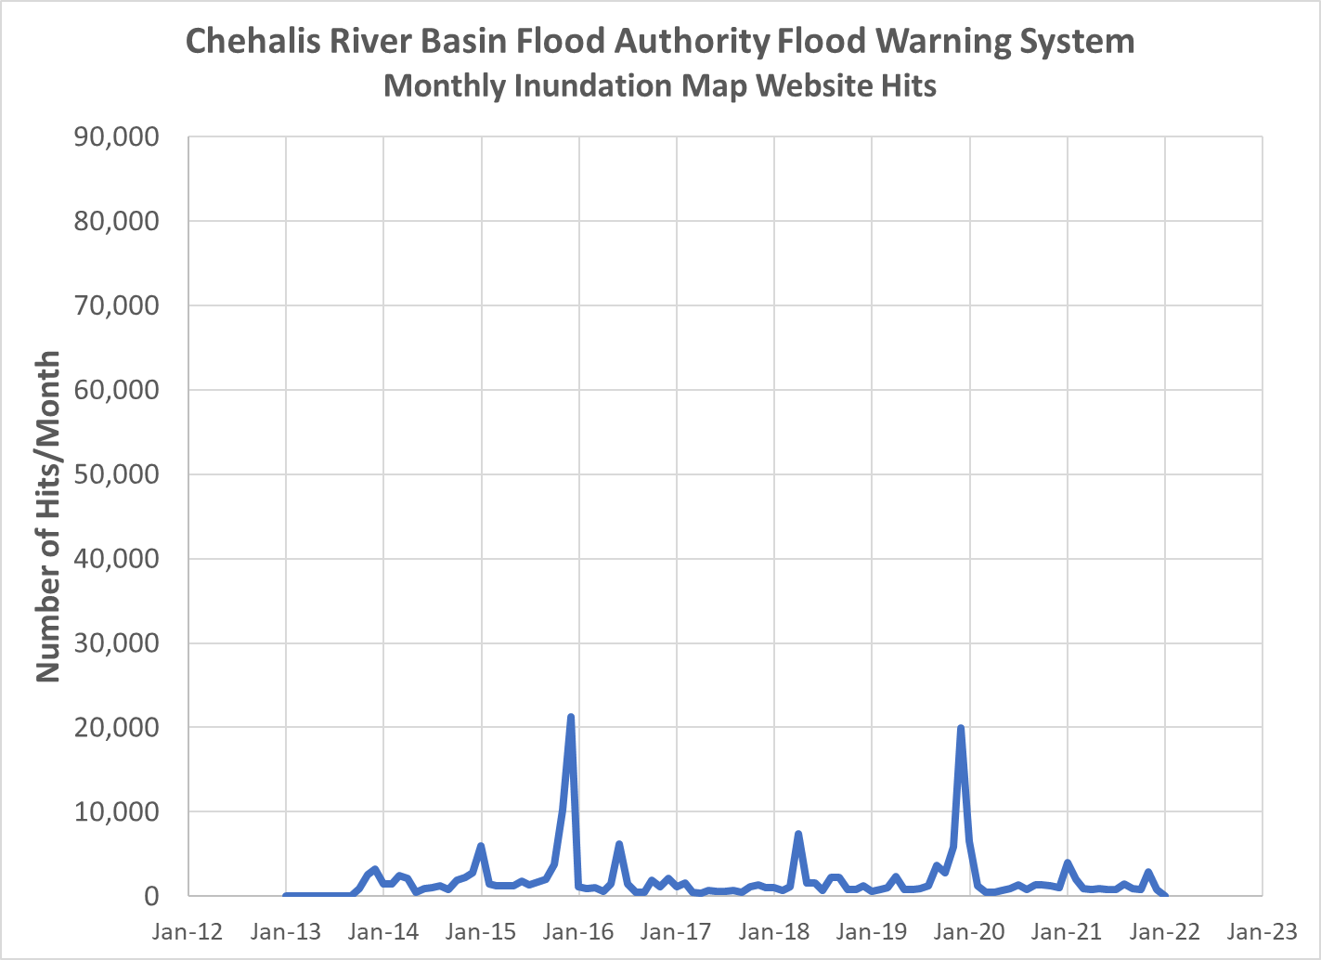
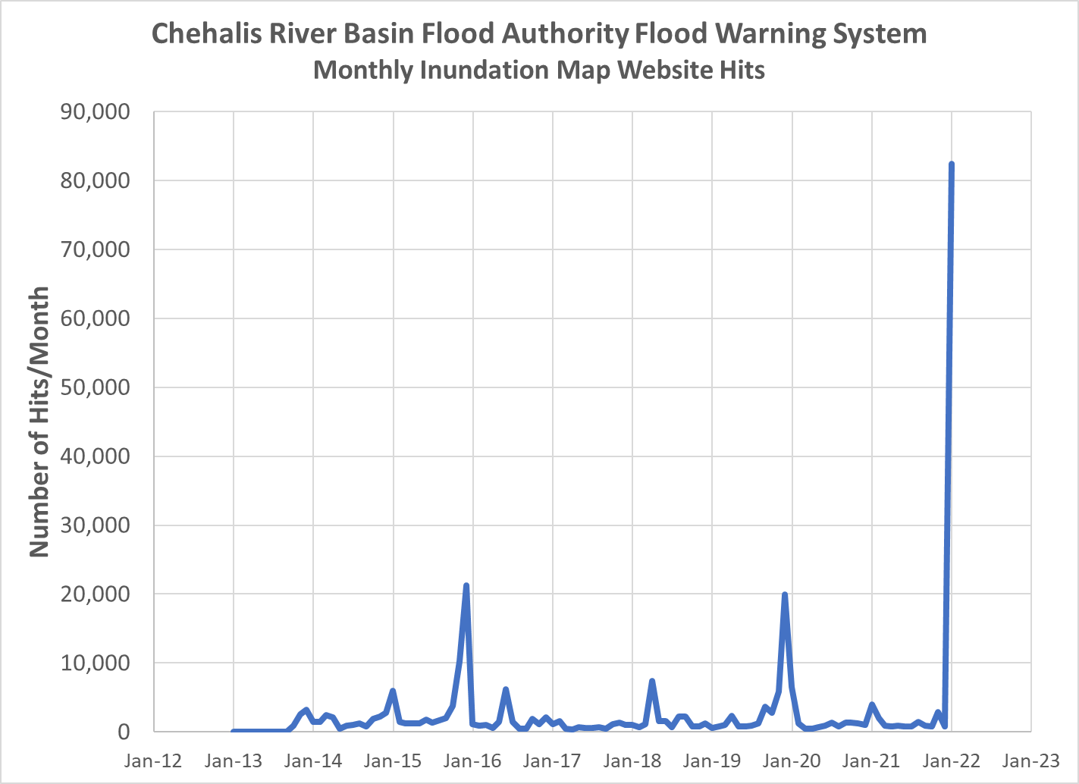

Slide 22
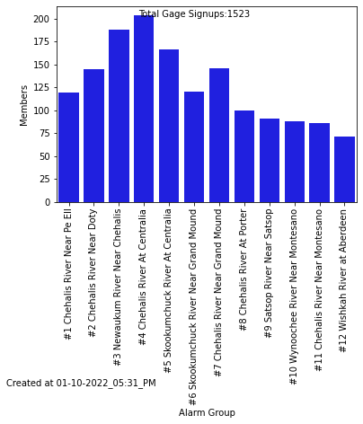
High Water Alerts
↑ 130 since Nov 23, 2021

Slide 23
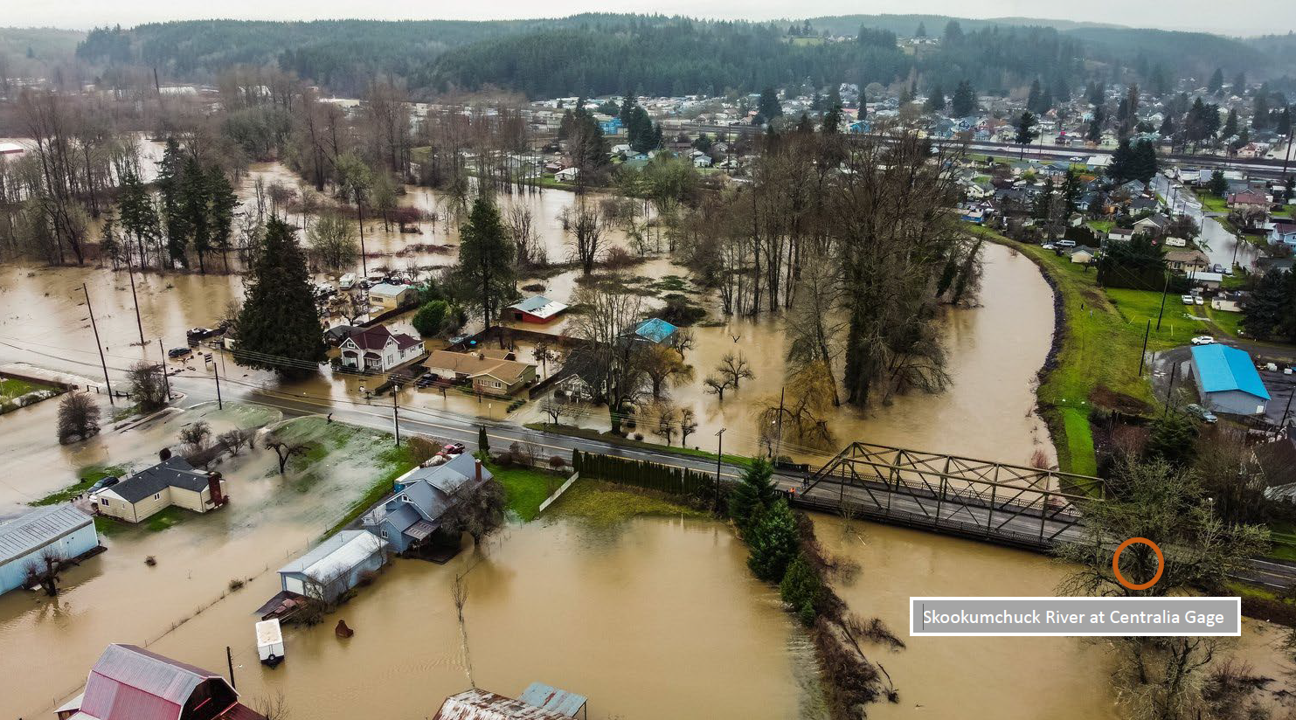
Survey

Slide 24
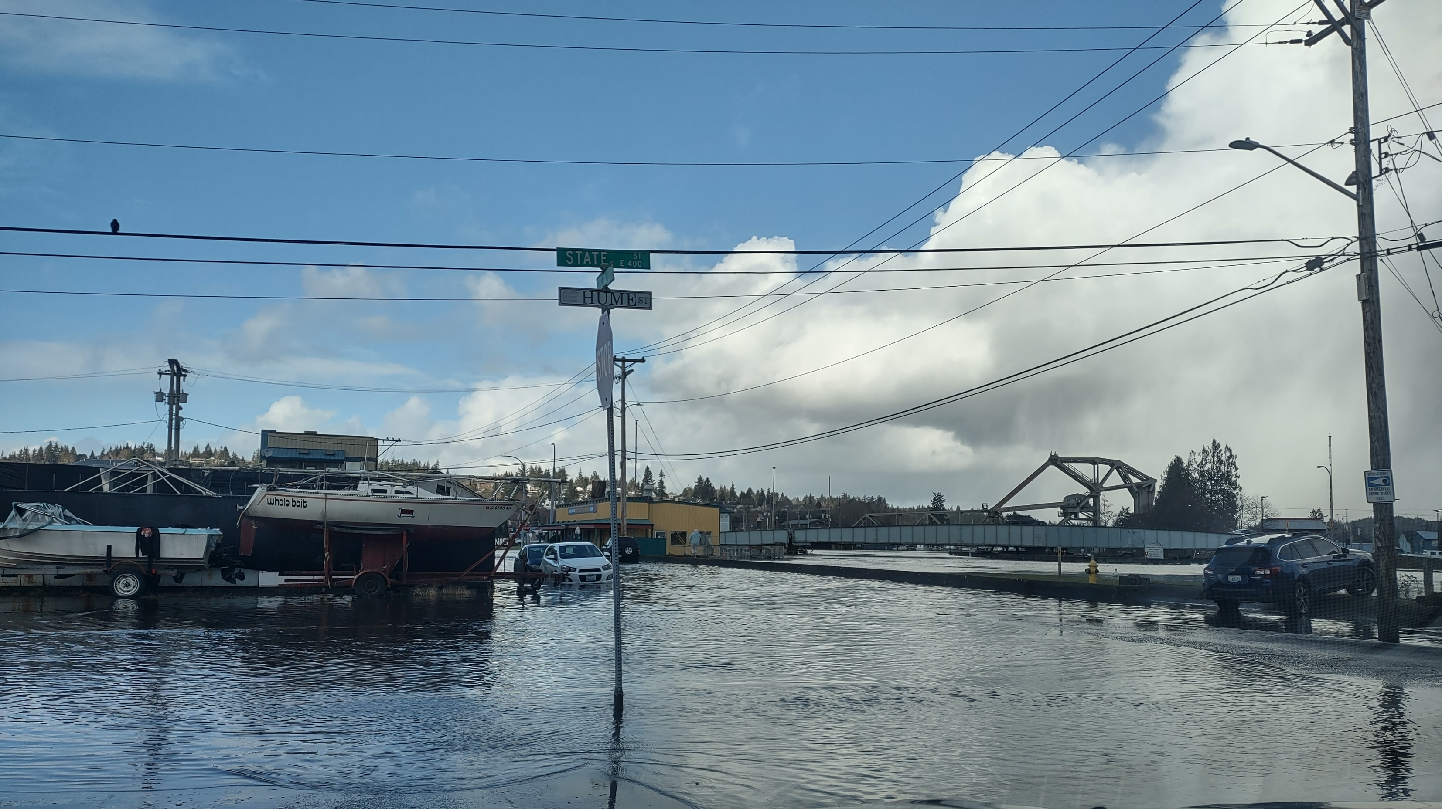
Opportunities?
User Survey
Website Usability Improvements
Improved Forecasting Lower Chehalis
Aberdeen, January 3, 2022. Photo credit: Kris Koski

Slide 25
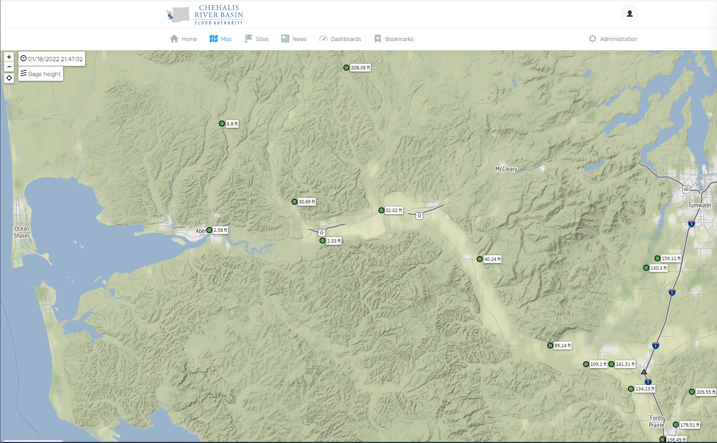
Improved Forecasting – Lower Chehalis River
Aberdeen
Montesano
Porter

Slide 26
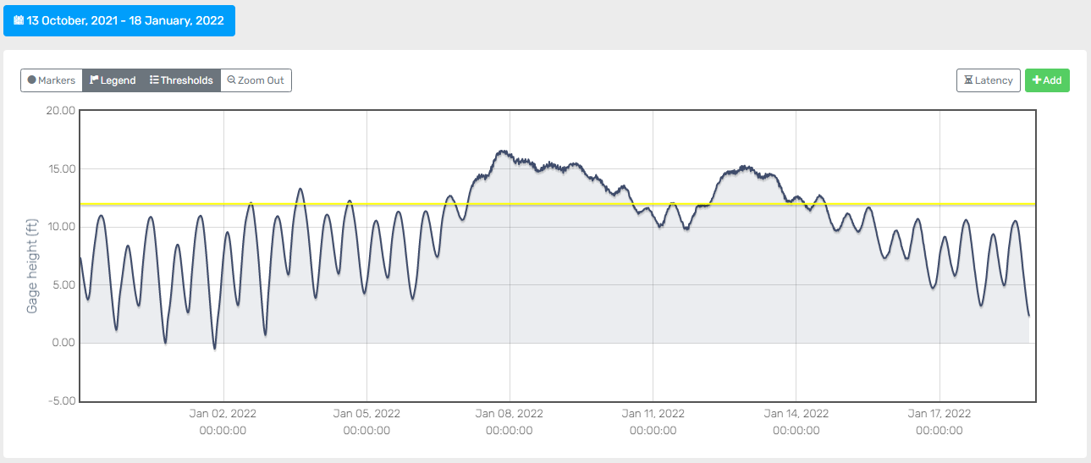
Improved Forecasting – Lower Chehalis River

Slide 27
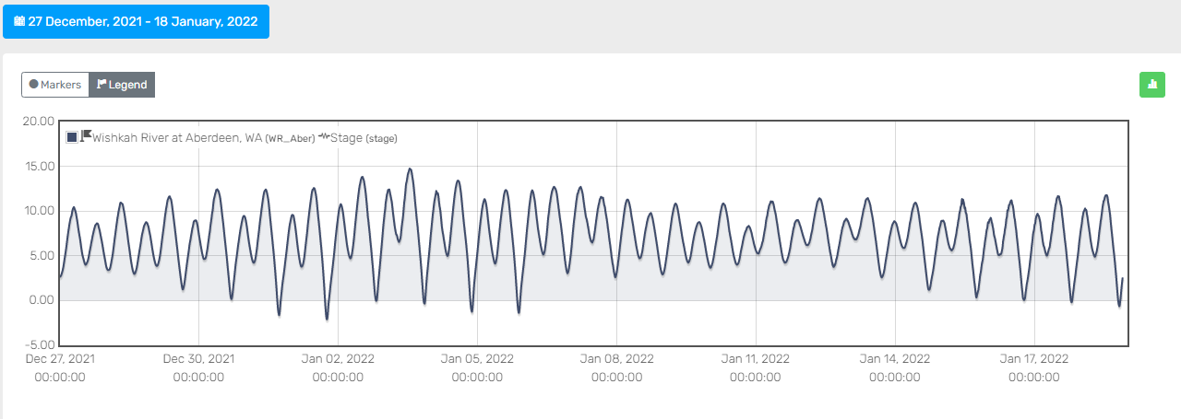
Wishkah River at Aberdeen

Slide 28
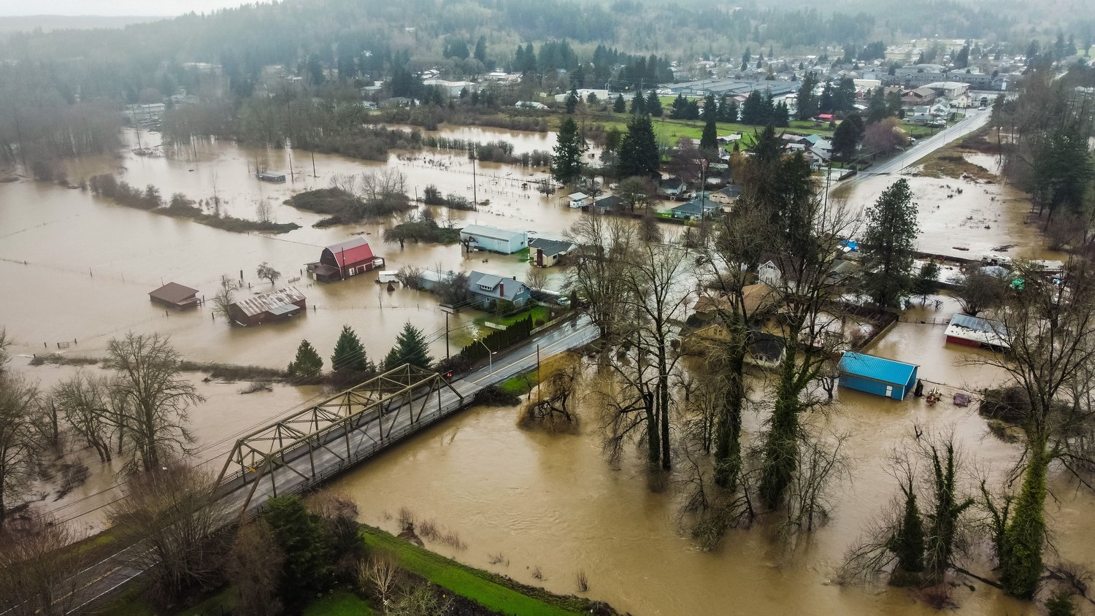
Questions
CHRONLINE.COM Posted Jan 7, 2022

Slide 29
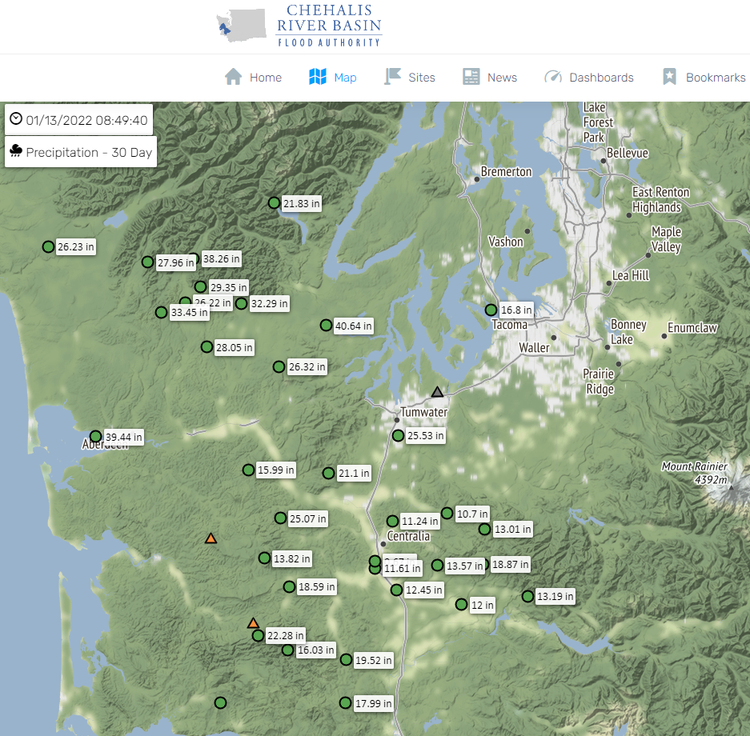
30 Day Rainfall

