Slide 1

Chehalis Basin Strategy
Presentation to the Chehalis River Basin Flood Authority
By Andrea McNamara Doyle, OCB Director
April 18, 2019
Notes:
Relevant Bio
Not a scientist, but worked at the intersection of science, law & policy for 25 years.
Lawyer by training;
Served for decade as staff attorney for legislature, developing policy options & drafting legislation based on scientific & legal considerations in context of political environment.
Served for 6 years as governor-appointed board member on PCHB & SHB, adjudicating legal disputes over environmental issues in administrative hearings, based on science & policy considerations in the context of applying relevant environmental laws & regulations.
Served as Exec Dir of non-profit organization whose mission was to do outreach, education & advocacy on behalf of public investment in land conservation & outdoor recreation for benefit of fish & wildlife & the humans lucky enough to live in & visit Washington State.

Slide 2
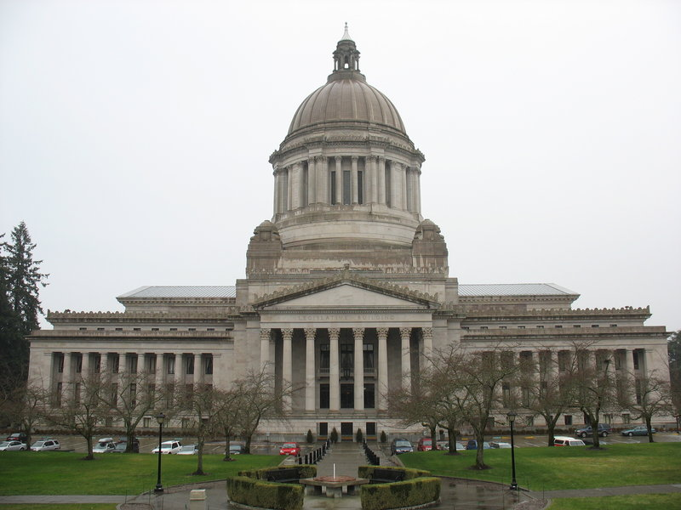

Office of Chehalis Basin’s Origin Story
2017
2016

Slide 3
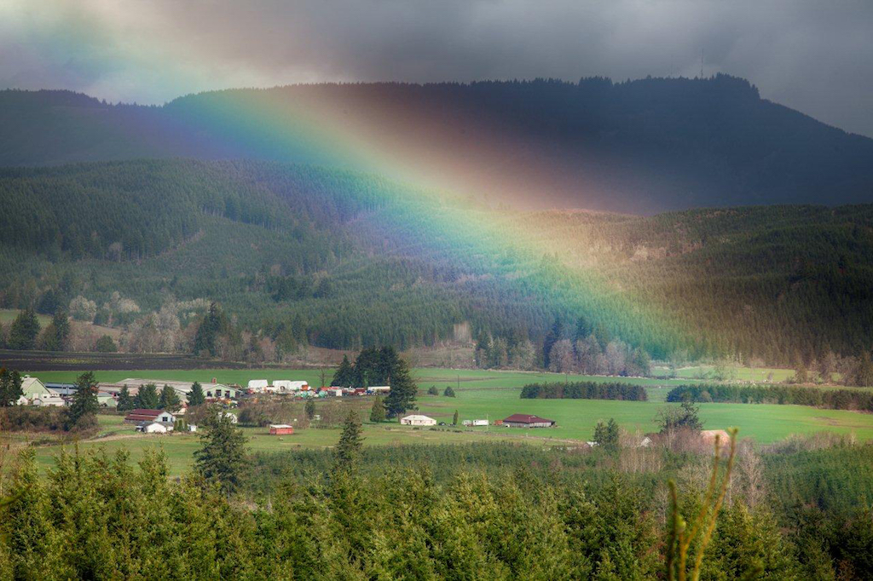
OCB’S LEGISLATIVE DIRECTIVE
To aggressively pursue an integrated strategy & funding for:
long-term flood damage reduction
aquatic species habitat restoration

Slide 4
CHEHALIS BASIN STRATEGY
“…must include a detailed set of actions to reduce flood damage and improve aquatic species habitat.”
“…must include an implementation schedule and quantified measures for evaluating the success of implementation.” RCW 43.21A.732

Slide 5
Additional Legislative Direction
“The board is responsible for…developing biennial and supplemental budget recommendations to the governor.”
RCW 43.21A.731(6)
“For administrative purposes, the board is located within the department (of Ecology).”
RCW 43.21A.731(3)

Slide 6
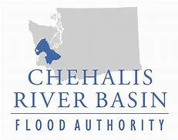




CHEHALIS BASIN BOARD
x3
x2
Notes:
7-member board created by legislature in 2016
3 members appointed by FA
1 rep from each of two Tribes in Basin
2 members appointed by Gov
+ 5 Non-voting, Ex Officio members from state agencies
BOARD & OCB STRUCTURED TO OVERSEE THE DEVELOPMENT & IMPLEMENTATION OF THE ASRP IN COORDINATION W/ FLOOD DAMAGE REDUCTION EFFORTS
OCB STATUTE & LEGISLATIVE SUPPORT HAS HELPED DRIVE THE INVESTMENT IN SCIENTIFIC RESEARCH

Slide 7
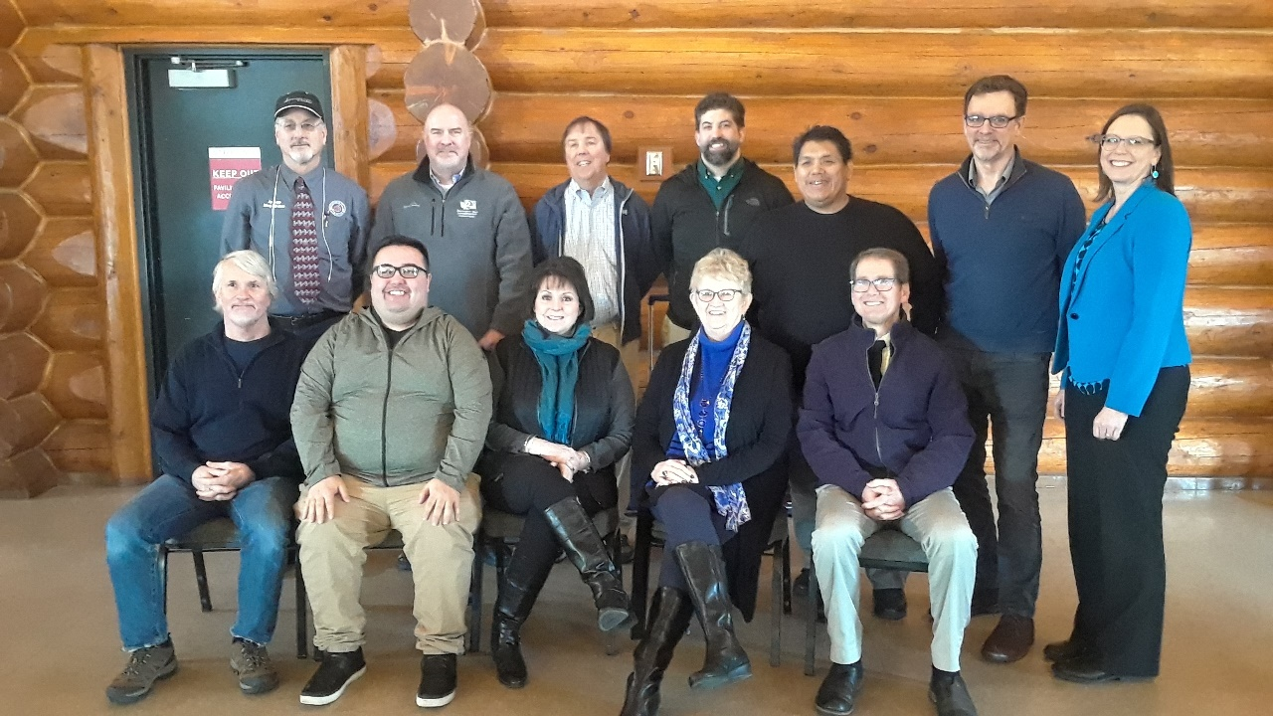
Chehalis Basin Board Members

Slide 8
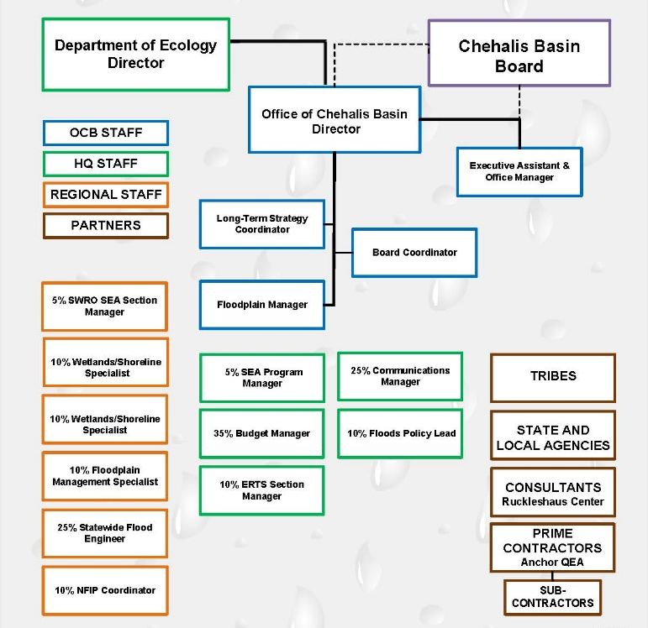
OCB ORG CHART

Slide 9
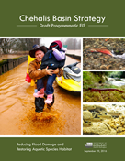
Programmatic EIS
Purpose:
Evaluate potential alternatives and actions for basin-wide flood damage reduction and aquatic species habitat restoration.
Completed: Fall 2017

Slide 10
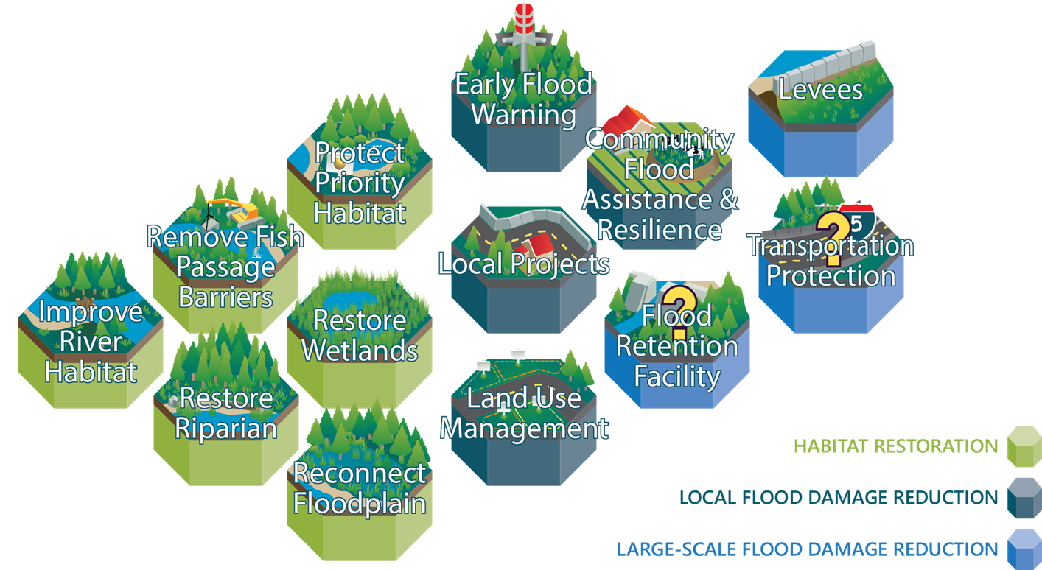
Chehalis Basin Strategy
Mission in Action

Slide 11






Aquatic Species Restoration Plan
Initial ASRP document released late 2017
Early actions now underway
Phase 1 ASRP available for public comment Summer 2019
Seeking $38M in State Capital Funds for 2019-2021
Final Phase 3 ASRP incorporated into Chehalis Basin Strategy in Summer 2020.
ASRP
DOCUMENT

Slide 12

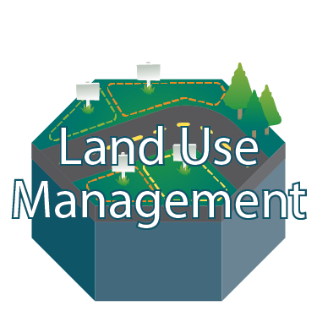
CFAR / Land Use Management
Under development, with dedicated OCB Floodplain Coordinator
Seeking $3 Million State Capital Funds for 2019-2021 CFAR program
Pursuing FEMA Grants
Land use management recommendations will be incorporated within CFAR program
Community Flood Assistance & Resilience/
Land Use Management

Slide 13


Local Projects / Early Flood Warning
Early flood warning system now completed & in-place
Seeking $3.8M State Capital Funds for 2019-2021 local projects
Assume continued flow of local projects based prioritized project lists
Local Projects / Early Flood Warning

Slide 14

North Shore Levee
Early project phases funded through Flood Authority local projects
Currently undergoing environmental review/permitting
OCB seeking $10M State Capital Funds for NSL in 2019-2021
Aberdeen-Hoquiam North Shore Levee

Slide 15

Project-Level SEPA/NEPA EISs
Purpose:
Evaluate environmental impacts of FCZD’s Flood Damage Reduction Project to reduce flood damage in Chehalis & Centralia from storm events originating in the Willapa Hills.
Currently undergoing environmental review through SEPA and NEPA.
Draft EISs expected in 2020
Project-level SEPA/NEPA EISs

Slide 16
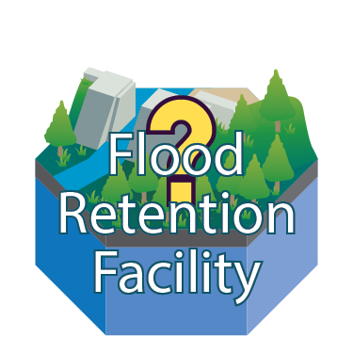
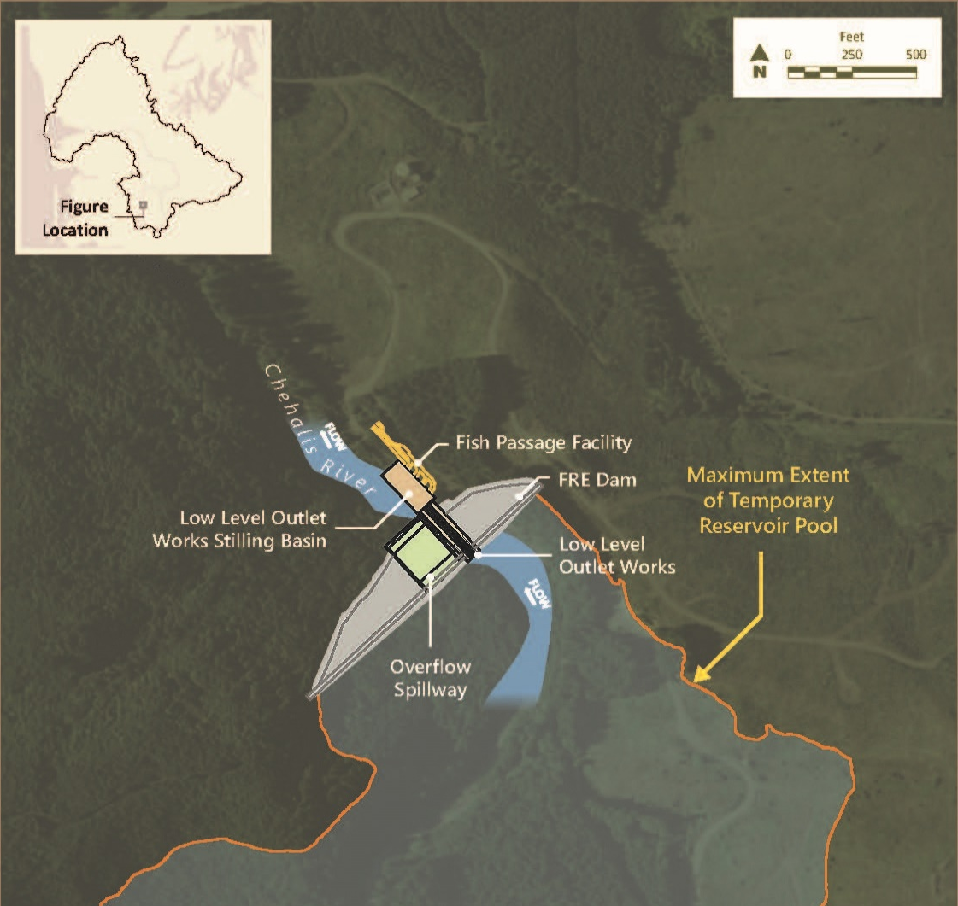
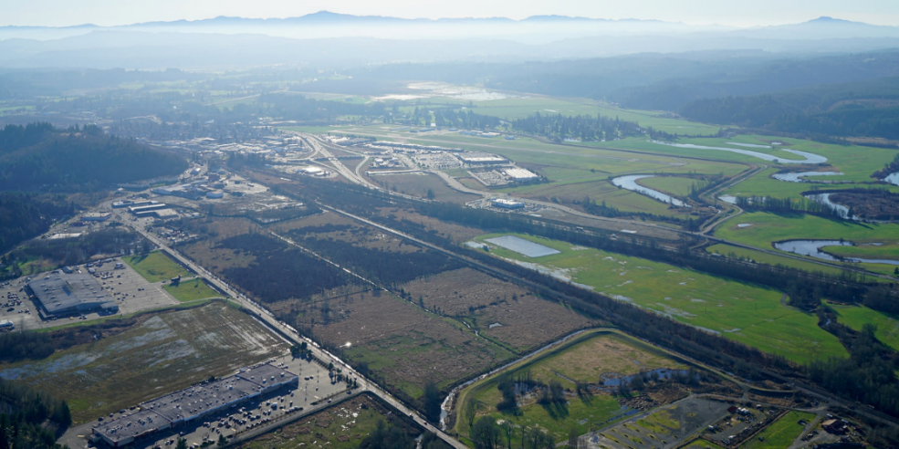
Flood Control Zone District Project
Chehalis/Centralia
Airport Levee

Slide 17
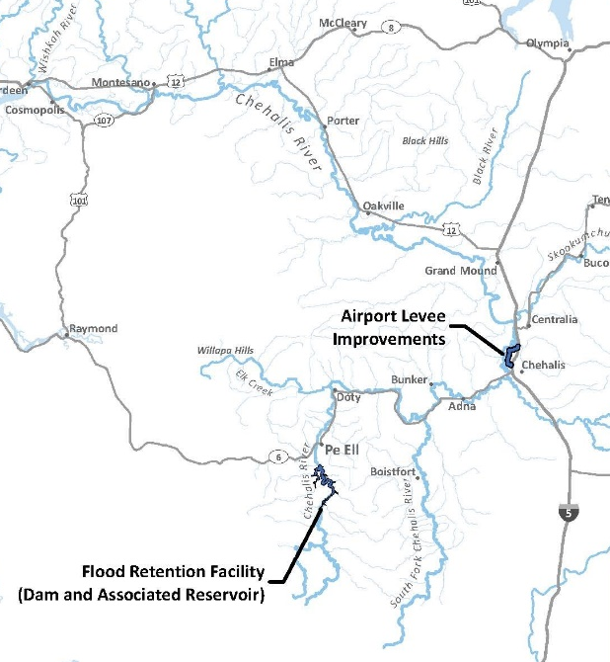
Project-Level SEPA/NEPA EISs
Focus:
Geographic extent of probable significant environmental impacts from proposed project
Reasonable alternatives to meet purpose & need of proposal
Mitigation framework for proposed project

Slide 18
Creating an Integrated Strategy

Slide 19

Integrating All Elements into
Long-Term Strategy Assessment

Slide 20
Purpose of Strategy Assessment
Purpose:
Achieve consensus on a comprehensive, integrated strategy for aggressively pursuing flood damage reduction and aquatic species habitat restoration over the long-term.

Slide 21
Long-Term Strategy & Investment Plan
Focus:
Basin-wide, detailed set of actions to:
Improve aquatic species habitat &
Reduce flood damage
Timeline:
Final Strategy Report Fall 2020, (before 2021 Legislative session)

Slide 22
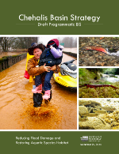














Chehalis Basin Strategy Long-Term Strategy Assessment
Chehalis Basin Strategy SEPA Programmatic EIS
Completed in June 2017
Report
Aquatic species restoration action
Local-Scale Flood damage reduction action
Large-Scale Flood damage reduction action
Aquatic Species Restoration Actions
Local-Scale Flood Damage Reduction Actions
Large-Scale Flood Damage Reduction Actions
Aquatic Species Restoration Plan
Phase I anticipated to be released in Q3 2019
Community
Flood Assistance
& Resilience (CFAR)
Under development
Land Use Management
Ongoing. Additional actions as part of CFAR
Local Projects
Ongoing. Based on biennial project list
Early Flood Warning
Completed/
In-place
Aberdeen/ Hoquiam North Shore Levee
Under Environmental Review
Federal and State Highway Protection
Ongoing as part of SEPA and NEPA EISs and other efforts
SEPA and
NEPA EIS
Under Environmental Review. Draft SEPA EIS anticipated to be released in Q1 of 2020; Draft NEPA EIS tbd
Chehalis Basin Strategy Long-Term Strategy Assessment
Anticipated to be released in
Q2/Q3 2020
Last Revised: February 2019

Slide 23
Integrated Strategy Inputs
Stakeholder Input
Public Input
FA Project Selection Comm
Flood Authority
Local Flood Project Sponsors
Science Review Team
ASRP Coordination Team
Chehalis Basin Board
Project Mgt Team
Scientists & Consultants
ASRP Steering Comm
SEPA & NEPA Reviewers
Large-Scale Flood Project Sponsors
Flood Control Zone Dist
Long Term Strategy

Slide 24
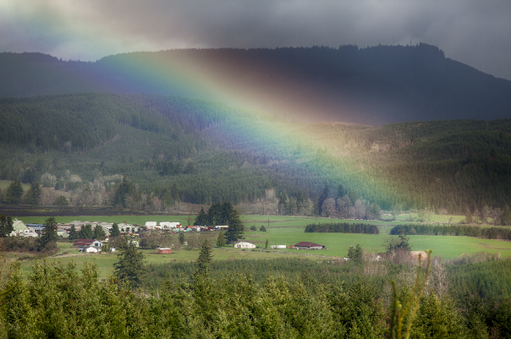

Integrated Strategy Outputs
Long Term Strategy

Slide 25
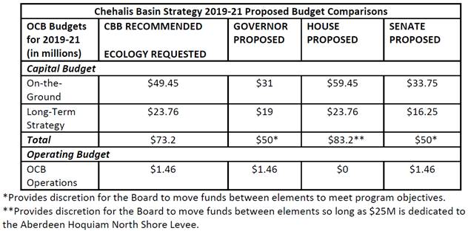
2019-21 Proposed Budgets

Slide 26
Previous Budget Request Process
Governor
Gov’s
Work Group
Legislature
OFM

Slide 27
Current Budget Request Process
CB
Board
Governor
Legislature
OCB
Ecology
OFM

Slide 28
Evolution of Funding Process
& Fiscal Oversight
Legislature
OFM
Flood Authority (Lewis Co as fiscal agent)
Local Project Sponsors

Slide 29
Evolution of Funding Process
& Fiscal Oversight
Legislature
Flood Authority (Lewis Co as fiscal agent)
Local Project Sponsors
RCO
Legislature
OFM
Flood Authority (Lewis Co as fiscal agent)
Local Project Sponsors

Slide 30
Evolution of Funding Process
& Fiscal Oversight
Legislature
Ecology/
OCB
Flood Authority (Lewis Co as fiscal agent)
Local Project Sponsors
RCO
Legislature
Flood Authority (Lewis Co as fiscal agent)
Local Project Sponsors
RCO
Legislature
OFM
Flood Authority (Lewis Co as fiscal agent)
Local Project Sponsors

Slide 31
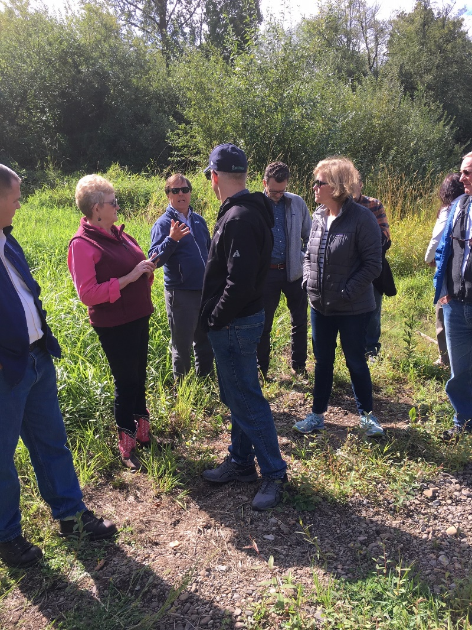
More work ahead needed on…
Feasibility & detailed options for mitigation of flood retention facility
Relationship of EIS mitigation to ASRP projects & results
Landowner willingness (ASRP & CFAR) & community outreach and support
Long-term governance structure & adaptive management
Overall level of investment, sequencing of actions, implementation schedule, quantified measures for evaluating the success of implementation
Making the case for long-term funding

Slide 32
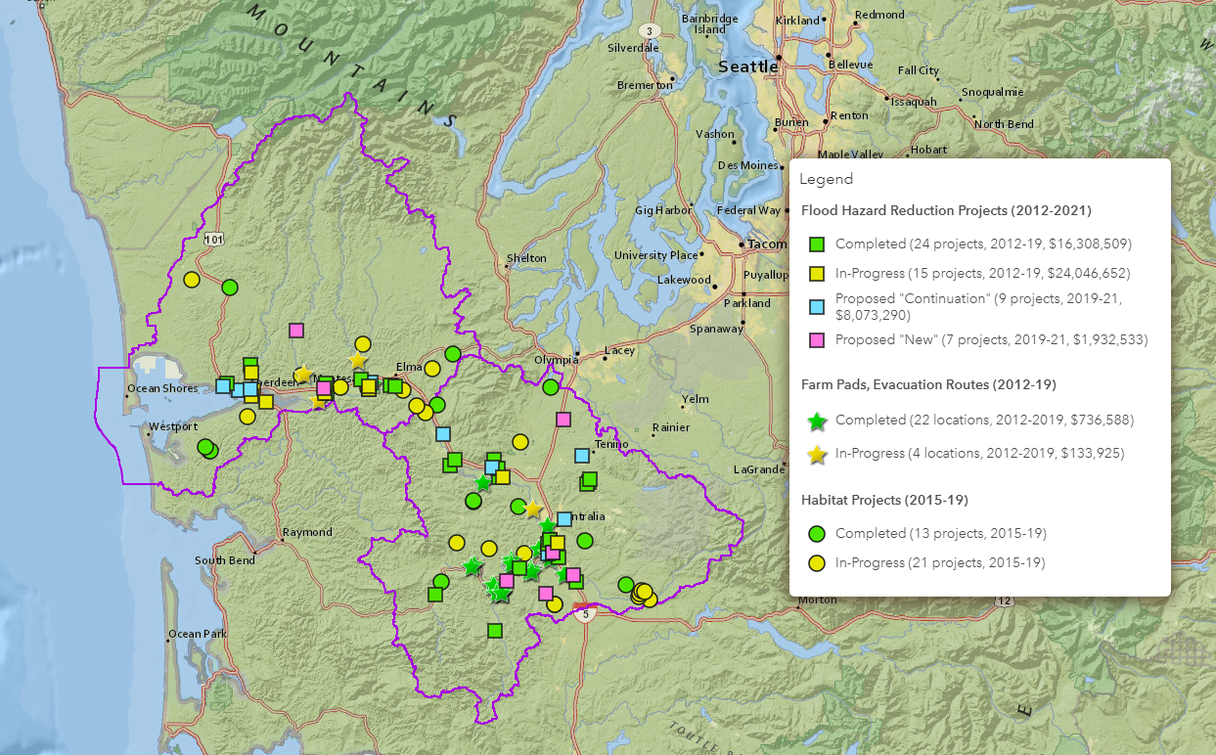
Accomplishments So Far

Slide 33

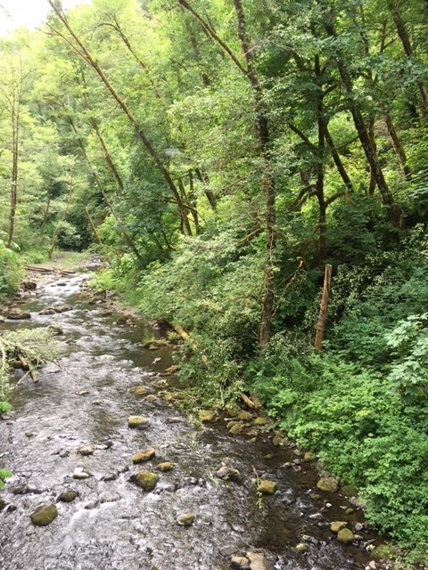

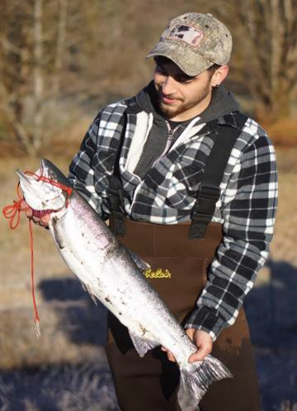
Working Toward a Safer, More Resilient & Prosperous Region

Slide 34

Questions?
Thank you!
Andrea McNamara Doyle, OCB Director
Andrea.Doyle@ecy.wa.gov
360.407.6548
Chehalisbasinstrategy.com

