Slide 1
Chehalis Basin Strategy
Phase 1 Aquatic Species Restoration Plan (ASRP)
January 23, 2020
Notes:
Outline:
- Share what the ASRP is, how it fits into the Chehalis Basin Strategy
Detail the ASRP development process
Share some of the proposed actions and areas
Discuss next steps on plan development and implementation

Slide 2
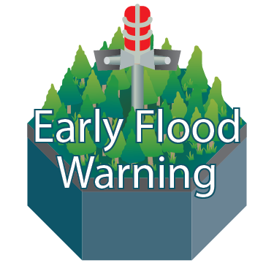
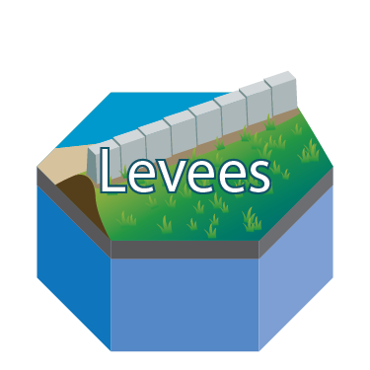
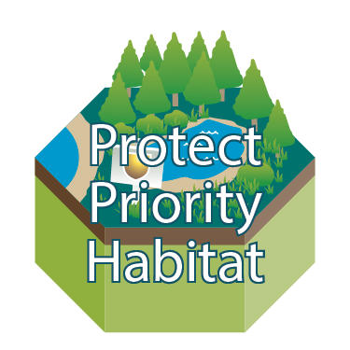
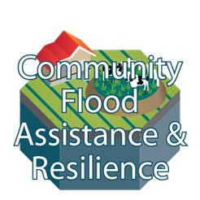
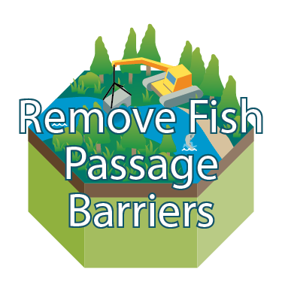
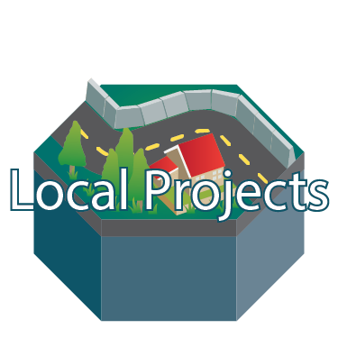
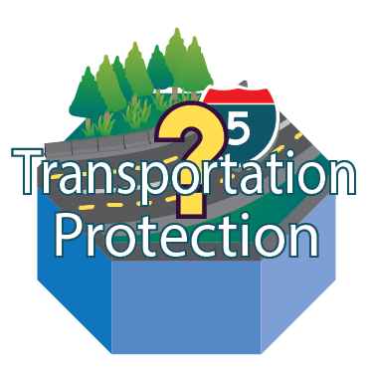
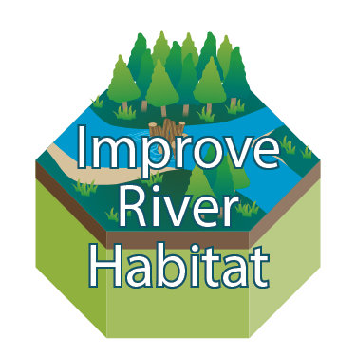
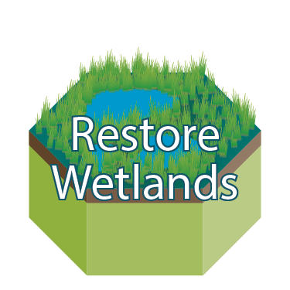
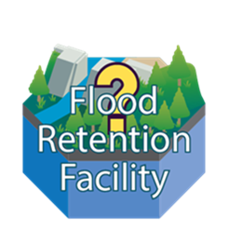
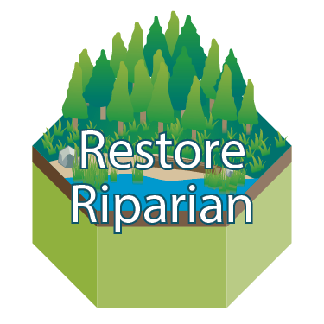
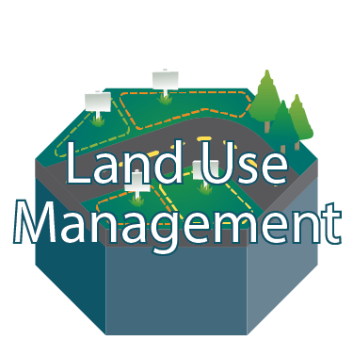
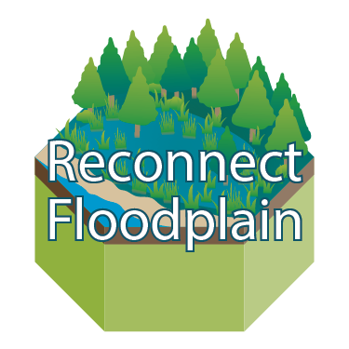



Our Mission in Action
Notes:
On the far right, depicted by lighter blue tiles, are large-scale flood damage reduction actions under consideration as part of the Long-Term Strategy. The yellow question marks over the top of three of these blue tiles, are meant to emphasize that some of the large-scale actions are still being analyzed . Decisions about whether or how to proceed are still being considered.

Slide 3
ASRP Development Roles
Science Review Team
Steering Committee
Chehalis Basin Board
Monitoring & Adaptive Management Team
Notes:
The development and implementation of the plan is a collaborative effort between the Quinault Indian Nation, Chehalis Tribe, and WDFW.
There are several groups working on development of the plan -
The Science Review Team and Monitoring and Adaptive management groups serve an advisory role to the Steering Committee to provide scientific basis and technical expertise on the content of the plan and monitoring success of our actions
The Chehalis Basin Board approves policy and funding decisions, and are comprised of State, Tribal and Local Representatives
The Steering Committee provides policy direction according to their stated goals of the ASRP, as well as informs elements of the plan and implementation

Slide 4
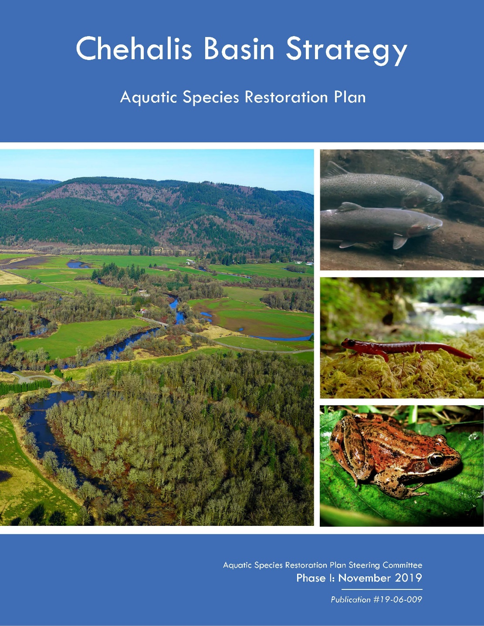
The Plan and Process
Science Based
Directly informs planning
Research informs prioritization
Process focused
Restore habitat forming processes
Support multiple species
Roadmap for future actions
ASRP as a tool for practitioners
and investment
Notes:
The ASRP portrays a comprehensive analysis of necessary actions, which is based on a quantity and quality of coordinated scientific analysis unprecedented anywhere in Washington.
The plan is science based
Fish distribution, habitat surveys, updated fish-barrier knowledge and other data points such as those presented during the technical portion of the symposium are all being used to help inform the plan
In turn, this scientific information informs decisions about where to conduct restoration, and how to do it most effectively.
The plan is aimed at restoring ecological processes.
Restoring Ecological processes means working to enable the river and streams to function on their own through time and provide necessary habitat for fish and other aquatic species.
(ex: Large wood helps to kick-start natural processes by helping create fish habitat, providing bugs and other critters for food, and helps slow the flow of the water, which benefits fish and doesn’t put as much stress on the river banks. Without that large wood in the river, those outcomes will not happen on their own. )
On the ground, this results in projects that stretch lengths of river and apply several restoration practices. large scale restoration projects can address several broken components of the river or habitat at once and give fish a place to live and eat. It also means working with lots of private landowners in partnership to not only get a large scale project on the ground together, but meet the needs of many different stakeholders.
This plan is also not just about salmon. Aquatic and semiaquatic species like frogs or salamanders are also a focus of the plan,
Currently, Oregon spotted frog is on the endangered species list in the basin and we have no salmon species on the list. We can do a lot to help Oregon spotted frog, and benefit other species at the same time.
The plan is a roadmap for helping aquatic species throughout the basin
The ASRP is meant to be a useful tool for practitioners to carry out restoration and protection actions
The actions identified through the ASRP chart a course toward the best chance to support healthy and harvestable salmon populations, robust and diverse populations of native aquatic and semi-aquatic species, and productive ecosystems that are more resilient to climate change and human-caused stressors.

Slide 5
Plan Approach
Habitat and Process Protection
Protect intact ecosystems, unique habitats, and strategic areas that support critical ecosystem functions and priority species.
Restoration
Restore ecosystem functions to support native aquatic and semi-aquatic species.
Community Planning
Effectively plan for current and future conditions in the Chehalis Basin.
Community Involvement
Engage landowners and Chehalis Basin communities to ensure a successful plan and support implementation of actions.
Institutional Capacity
Build institutional capacity of existing organizations for restoration, protection, and planning processes to ensure the ASRP is a community-based restoration program.
Notes:
The Phase 1 ASRP includes the Approach, rationale and recommendations for 5 Strategies:
Habitat and Process Protection
Protect intact ecosystems, unique habitats, and strategic areas that support critical ecosystem functions and priority species.
Restoration
Restore ecosystem functions to support native aquatic and semi-aquatic species.
Community Planning
Effectively plan for current and future conditions in the Chehalis Basin integrated with the vision of the community.
Community Involvement
Engage landowners and Chehalis Basin communities to ensure a successful plan and support implementation of actions where feasible.
Institutional Capacity
Build institutional capacity of existing organizations for restoration, protection, and planning processes to ensure the ASRP is a community-based restoration program.
--
Collectively, the ASRP strives to honor the social, economic, and cultural values of the region and maintain working lands. The importance of community involvement in the ASRP cannot be overstated—most of the actions proposed in the ASRP would occur on private land, and the program relies on landowners willing to collaborate in this important undertaking to be successful.
The prospect for recovery is highly achievable in the Chehalis Basin, largely because much of the land use is still rural agriculture and working forest lands and the basin does not yet have highly developed, sprawling urban centers (as is the case in other regions of the state).
The strategies developed and actions proposed in the ASRP are meant to work with the needs of landowners and working lands and to collaboratively seek onsite solutions that benefit both landowners and aquatic species.
The ASRP honors existing community values, builds on previous actions to protect and restore basin habitat and ecological processes, and complements investments the state has already made in aquatic species habitat restoration and protection.
---
The scope of the ASRP focuses on taking action where the greatest potential exists to provide substantial gains for aquatic species, while recognizing the dynamic uncertainties of external factors such as estuary, ocean, hatchery, harvest, invasive species, and climate change conditions.

Slide 6
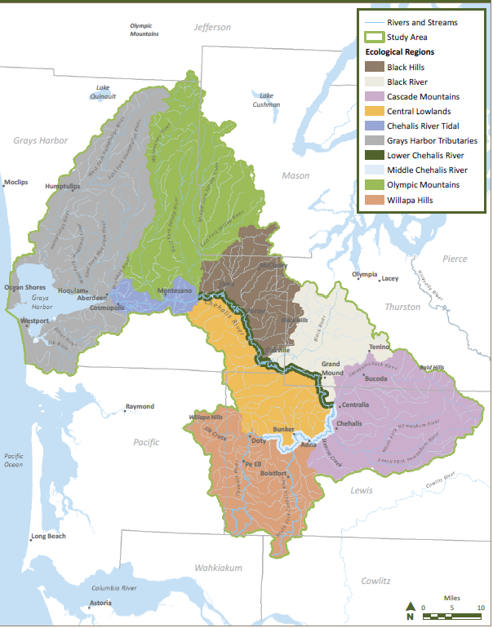
Development Process
Basin examined as 10 ecological regions based on:
Geology
Topography
Climate
Hydrologic regime
Channel characteristics
Aquatic species use
Notes:
A key element necessary for developing the Plan was to strategically prioritize essential actions, including where and when those actions should occur to provide the greatest short-term and long-term habitat benefits.
To support the prioritization process, the basin was examined as 10 ecological regions based on underlying geology, topography, climate and channel characteristics.
The prioritization process identified areas within and accross each of the basin’s ecological regions with the best opportunities to protect and improve species performance and increase spatial distribution and diversity of species.
--
The strategic prioritization was informed by:
Recent scientific studies, mapping, and fish passage barrier assessments
Current and historical knowledge and expertise including mapping of the basin
On-the-ground observations and analyses by the ASRP Science and Technical Review Team
Chehalis Basin-specific climate change modeling projections
The Ecosystem Diagnosis and Treatment (EDT) salmon habitat model
Baseline information from the National Oceanic and Atmospheric Administration (NOAA) salmonid life-cycle model
- We used a two model approach to ensure that the wide variety of actions and areas are encompassed in the analyses. The two models are different in structure and utility and are not meant to compare results, but rather inform two strategies of thinking to refine our recommended actions.

Slide 7
Phase 1 ASRP Includes:
Summaries of historical and existing conditions across the 10 ecological regions
Identification of 3 restoration and protection scenarios
Summary of the potential results for aquatic species and associated costs of enacting any of the scenarios
Recommended actions across each ecological region for all 5 Strategies
Photo courtesy of Lonnie Crumley, Chehalis Basin Fisheries Task Force
Notes:
This Phase 1 ASRP provides:
Summaries of historical and existing conditions for aquatic species across the 10 ecological regions
Descriptions of Three additive potential restoration and protection scenarios, which were built from the prioritization process. These are example levels of effort that the ASRP analyzed for potential benefits to salmon and other aquatic species
The projections of conditions the ASRP could achieve under each additive scenario, along with estimated costs for each scenario. These scenarios have differing goals and outcomes depending on the level of effort included.
Recommended actions across all of the ecological regions defined in the previous slide for each of the 5 strategies developed through the ASRP.
ALL scenarios and recommendations from the ASRP rely on working with landowners on a voluntary basis to develop projects that fit the needs of both the landowner and the aquatic species. The recommendations in the ASRP are not binding or mandatory.
--
The strategic prioritization was informed by:
Recent scientific studies, mapping, and fish passage barrier assessments
Current and historical knowledge and expertise including mapping of the basin
On-the-ground observations and analyses by the ASRP Science and Technical Review Team
Chehalis Basin-specific climate change modeling projections
The Ecosystem Diagnosis and Treatment (EDT) salmon habitat model
Baseline information from the National Oceanic and Atmospheric Administration (NOAA) salmonid life-cycle model
- We used a two model approach to ensure that the wide variety of actions and areas are encompassed in the analyses. The two models are different in structure and utility and are not meant to compare results, but rather inform two strategies of thinking to refine our recommended actions.

Slide 8
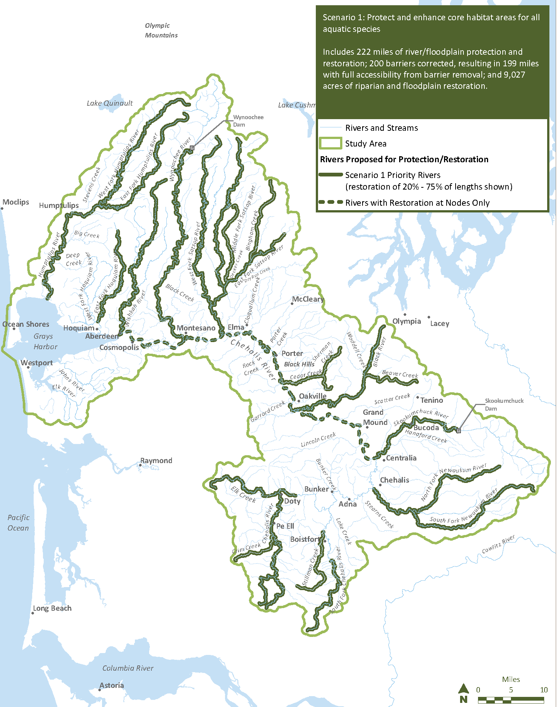
Scenario 1
Goal: Protect and enhance core habitat areas
River Restoration = 222 miles
Riparian/Floodplain Restoration = 9,027 acres
Barriers = 200
Active restoration and protection of 20%-75% of lengths shown depending on landowner partnerships and onsite opportunities
Notes:
Scenario 1 protects and enhances existing core habitats for all aquatic species. It protects and restores more than 200 miles of river/stream habitat; corrects 200 fish passage barriers, improving access to approximately 200 miles of river/tributary habitat; and restores more than 9,000 acres of riparian and floodplain habitats.
Implementing Scenario 1 would generally halt the species declines that are projected to occur from climate change in the mid-century time frame. Compared to a No Action scenario, Scenario 1 would provide substantial gains to salmon and steelhead along with other aquatic species by both mid-century and late century.
All implementation projections assume rapid implementation of the proposed scenario actions. This means, the fast we work, the more sure we are that we can have a positive result for aquatic species. The longer we wait, the harder it will be to dig ourselves out of the hole that climate change and future development, among other stressors will continue to create.

Slide 9

Scenario 2
Goal: Protect and enhance core habitats and expand to best restoration opportunities to benefit multiple species
River Restoration = 316 miles
Riparian/Floodplain Restoration = 10,245 acres
Barriers = 300
Active restoration and protection of 20%-75% of lengths shown depending on landowner partnerships and onsite opportunities
Notes:
Scenario 2 builds on Scenario 1 to protect and enhance existing core habitat areas, with the additional focus of restoring the best opportunities to benefit multiple species and increase spatial distribution.
Adding more enhancement opportunities, this scenario protects and restores more than 300 miles of river/stream habitat; corrects 300 fish passage barriers, improving access to more than 300 miles of river/tributary habitat; and restores more than 10,200 acres of riparian and floodplain habitats.
Scenario 2 would provide modest additional benefits beyond the Scenario 1 projections and focuses on important smaller sub-basins that historically produced healthy runs of coho salmon, chum salmon, and steelhead. In addition, Scenario 2 targets geographic areas that could provide significant available quality habitat for amphibian species, which is not illustrated in these modeling results.

Slide 10
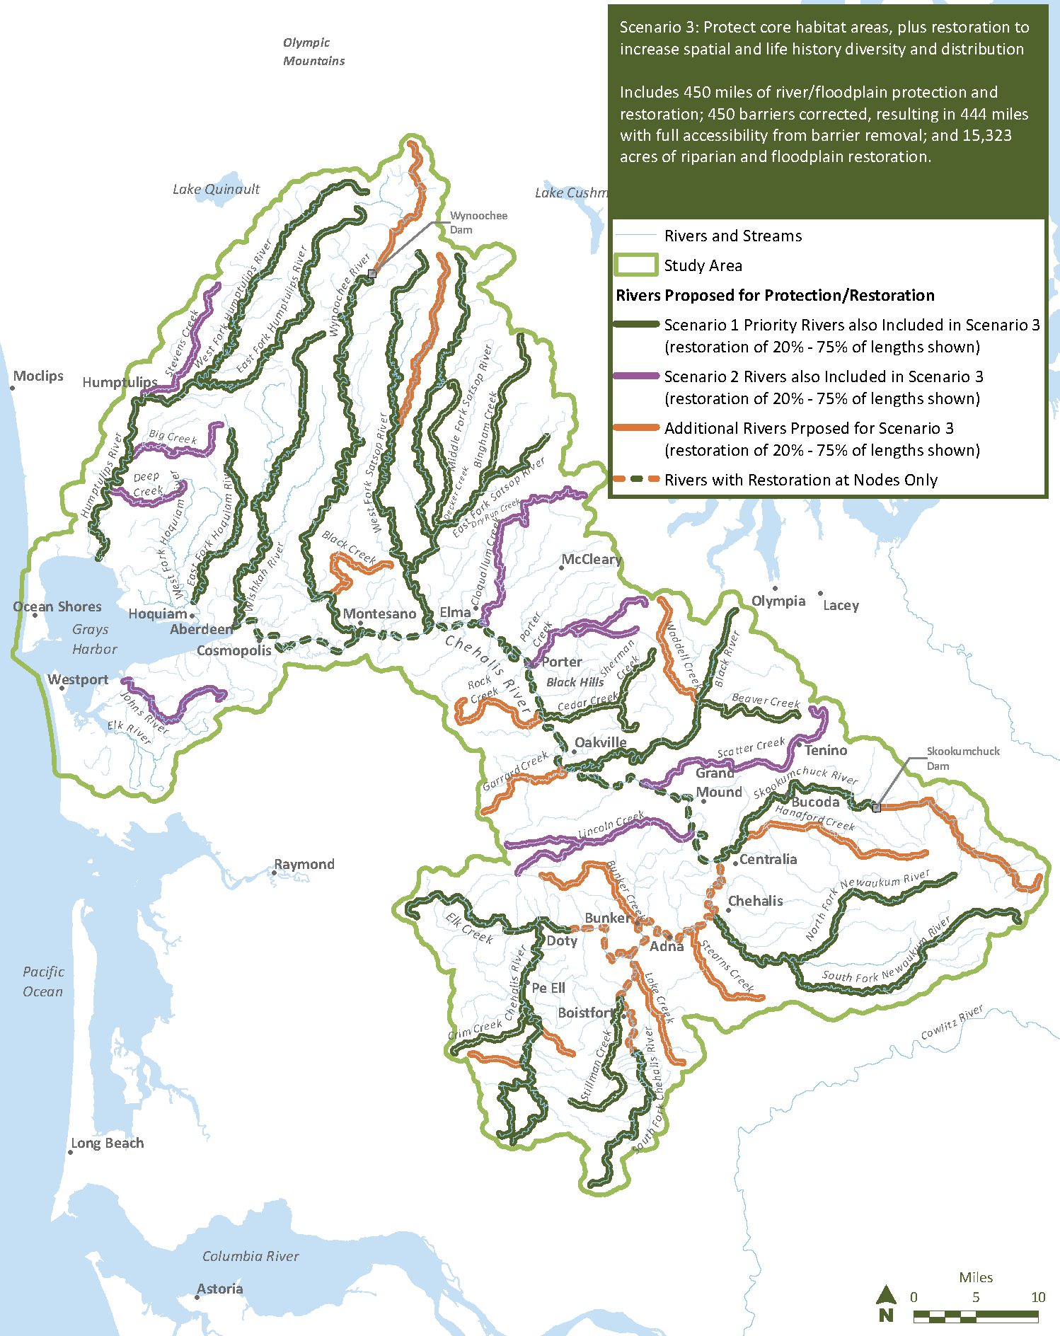
Scenario 3
Goal: Protect and enhance core habitats and increase spatial and life history diversity
River Restoration = 450 miles
Riparian/Floodplain Restoration = 15,323 acres
Barriers = 450
Active restoration and protection of 20%-75% of lengths shown depending on landowner partnerships and onsite opportunities
Notes:
Scenario 3 builds on Scenario 2, with an added focus of increasing spatial and life history diversity and distribution of species throughout more of the basin. It protects and restores 450 miles of river/stream habitats; corrects 450 fish passage barriers, improving access to more than 400 miles of river/tributary habitat; and restores more than 15,300 acres of riparian and floodplain habitats.
Implementing Scenario 3 would provide more substantial habitat gains above both Scenarios 1 and 2 and also expands spatial diversity (or distribution of local populations) for coho salmon, spring- and fall-run Chinook salmon, and steelhead into more geographic areas of the basin.
Scenario 3 is the only scenario of the 3 examples that would significantly increase ecosystem resiliency, therefore reducing the risk of functional extinction for any localized population. Similar to reducing the risk of loss by diversifying a stock portfolio, enabling species to be distributed more broadly throughout the basin through Scenario 3 would reduce the extinction risk to any one localized population.

Slide 11
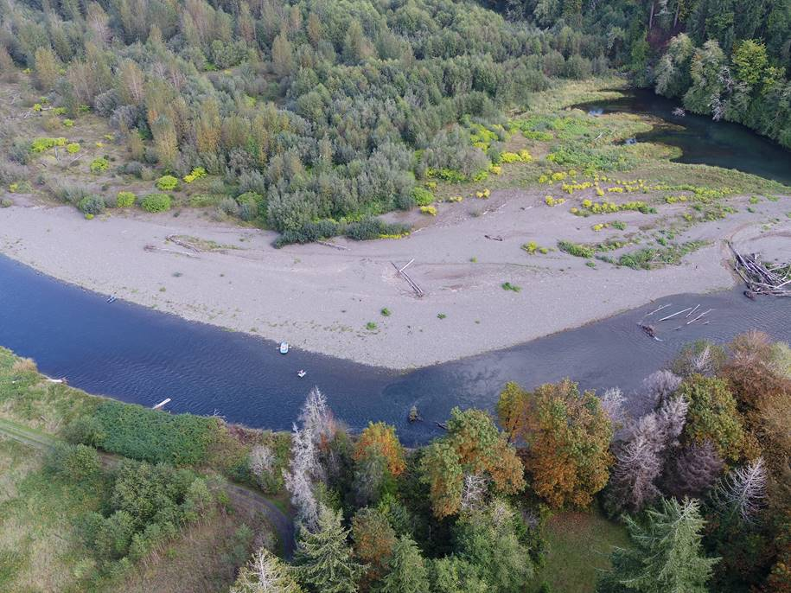
Early Implementation
1st five reach scale projects underway with willing landowners across basin
  Lessons learned informing future projects
Open solicitation for restoration and protection project proposals
  Includes institutional capacity funds
  Due February 5th, 2020
Wynoochee aerial drone footage, WDFW
Notes:
An innovative approach the ASRP is taking is to actively implement while developing the plan. This allows us to learn from early implementation and adapt our strategies to what is feasible on the ground.
have the 1st five reach scale projects underway with willing landowners across basin in 5 different sub-basins
We are currently working to imitate new projects with sponsors, and have an open solicitation for restoration and protection project proposals
Due February 5th, 2020
Early implementation is also informing the development of a monitoring and adaptive management plan, which will help us learn how to conduct more effective and efficient projects with landowners, and communicate our successes over time.

Slide 12
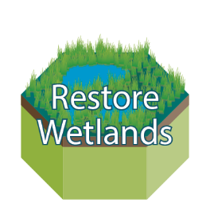
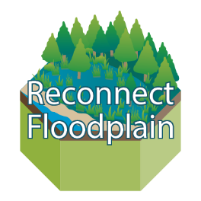
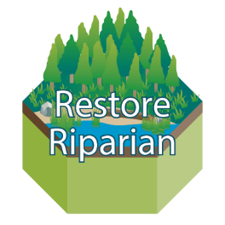
ASRP Development Timeline
Phase 1: published November 15th
  Full document out for public review through Jan 14, 2020
  Outlines approach, strategies and implementation framework
Phase 2: Summer 2020
  Refinement of strategies and implementation planning
Phase 3: Winter 2020
  “Final” ASRP document as part of Chehalis Basin Strategy
ASRP
DOCUMENT
Notes:
We published the phase 1 document
Our next steps include taking the public comments, discussion and feedback from community events and refine our strategies, as well as do some in depth implementation planning with community members and restoration practitioners.
The goal is to have the Chehalis Basin Board recommend an ultimate scenario, whether it be one of the ones currently proposed or a different level of effort in the final ASRP, out next winter. Along with a level of effort will be a funding strategy and timeline to complete the work with willing landowners.

Slide 13
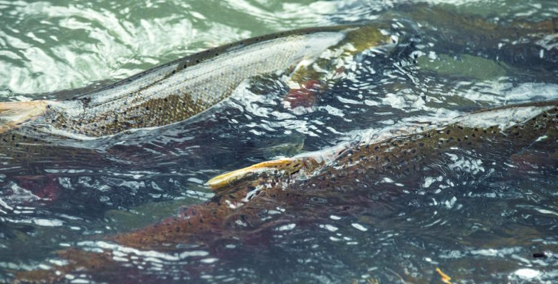
Questions
For more information contact: Emelie McKain, WDFW ASRP Manager
Emelie.McKain@dfw.wa.gov

