Slide 1
Chehalis River Basin
Flood Warning System
October 25, 2021
Scott Boettcher
Chehalis River Basin Flood Authority staff

Slide 2
What?
Chehalis river basin flood warning system
Information System
Alert/notification system
1st line of defense system
www.chehalisriverflood.com (web system)

Slide 3
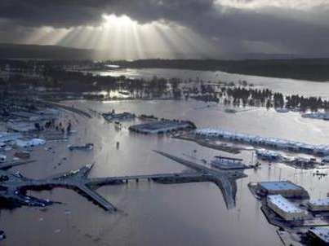
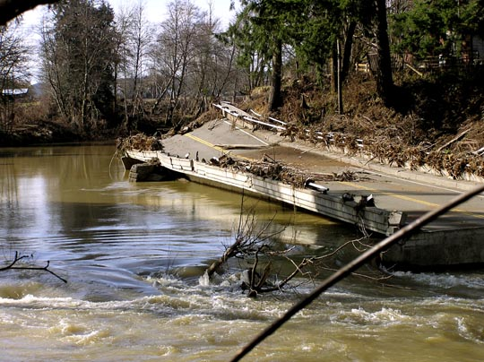
WhY?
December
2007
Photo by Bob Walter
THE OREGONIAN/Bruce Ely

Slide 4
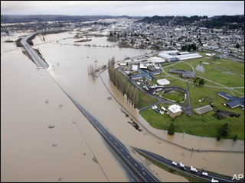
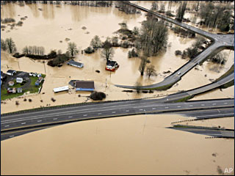
WhY?
January
2009
http://www.katu.com/news/37243024.html
http://www.komonews.com/weather/blogs/scott/37346554.html

Slide 5
WhY?
2007 and 2009 Showed Need for:
Improved access to information
  Accurate
  accessible
  easy-to-understand
No SURPRISES

Slide 6

Build!
Guiding Principles (2011)
  Cost Effective
  Leverage Existing Resources
  Immediate Benefits

Slide 7
Build!
Improve on-the-ground Monitoring Network
  8 Rain/Temperature Stations
  2 Rain/Temperature/Stream Stations
Internet Data and Warning
Inundation Mapping
www.chehalisriverflood.com

Slide 8
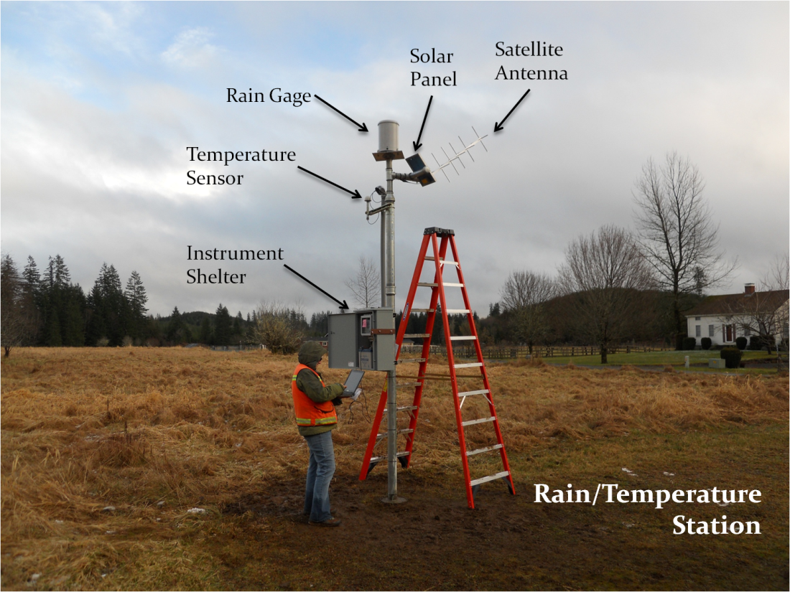
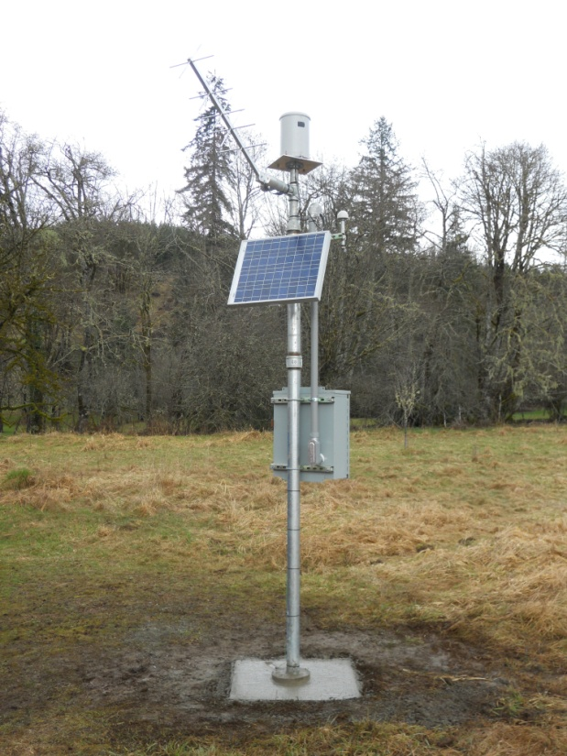
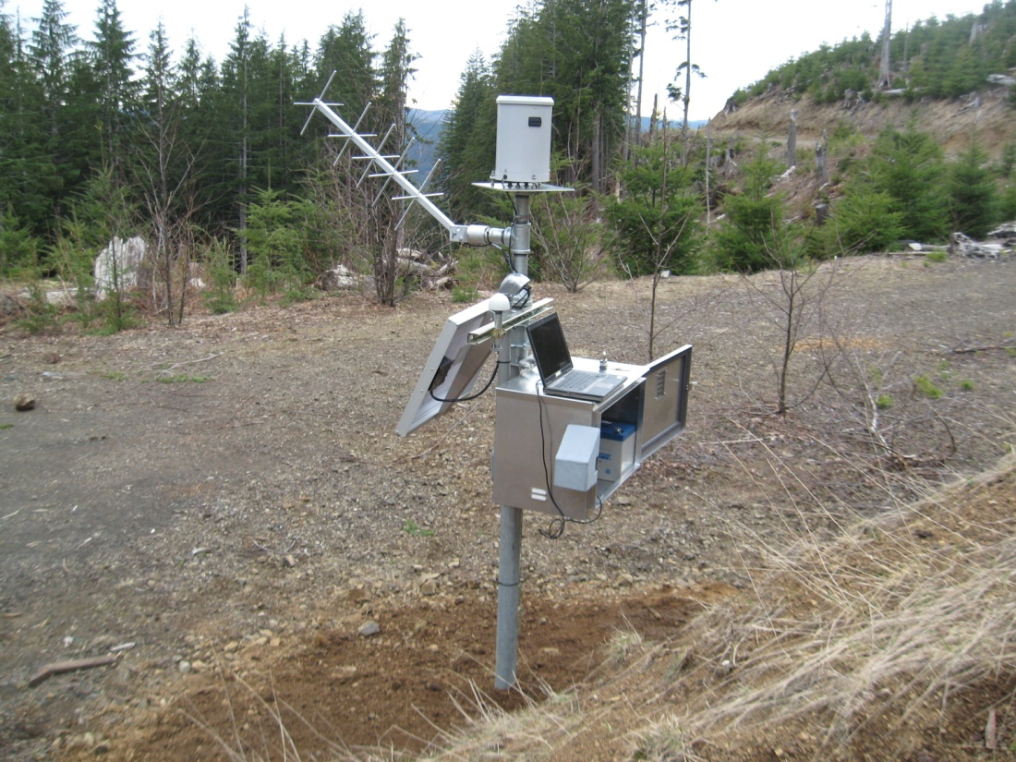
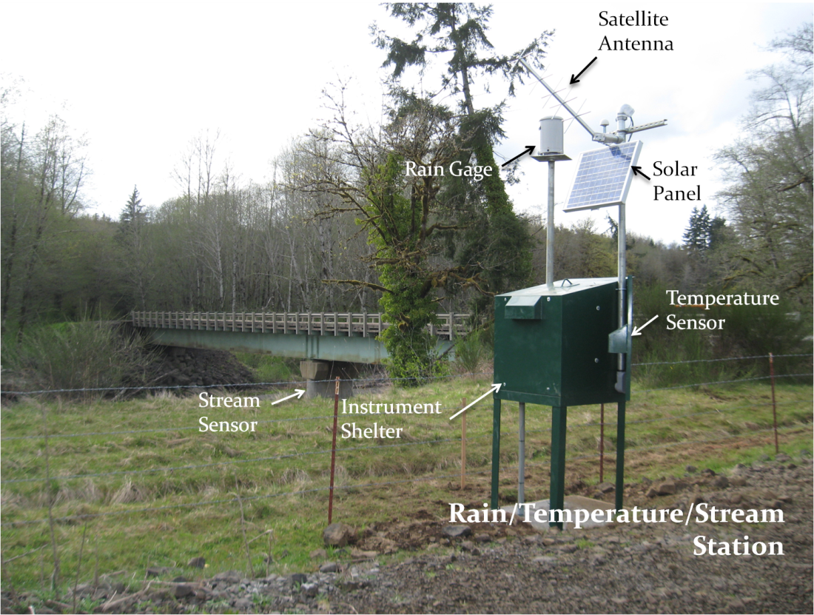
Add new Gage Sites (initially)
Build!

Slide 9
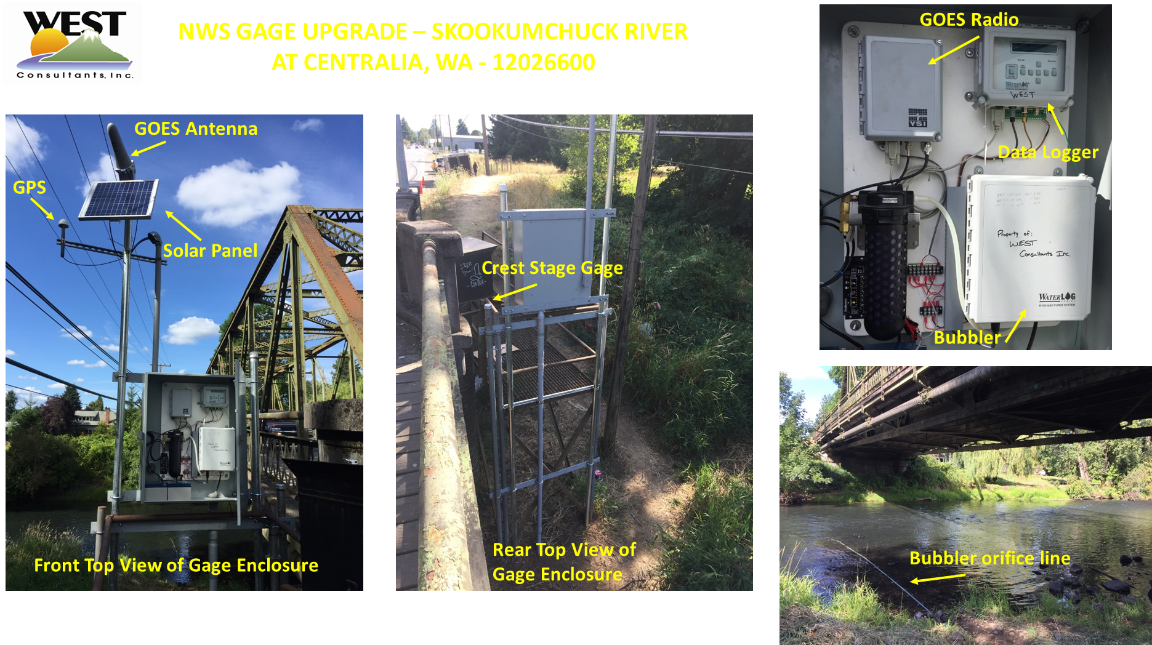
Replace NWS Gages
Build!

Slide 10
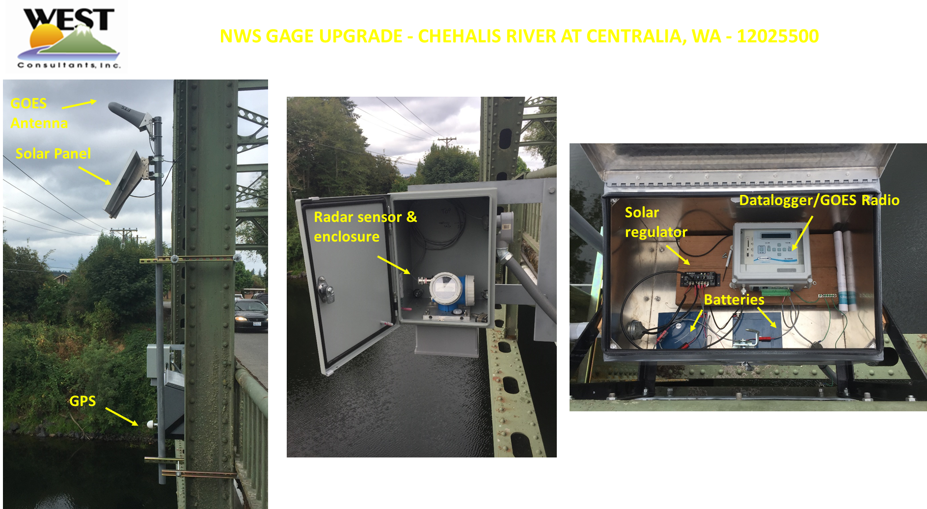
Build!
Replace NWS Gages

Slide 11
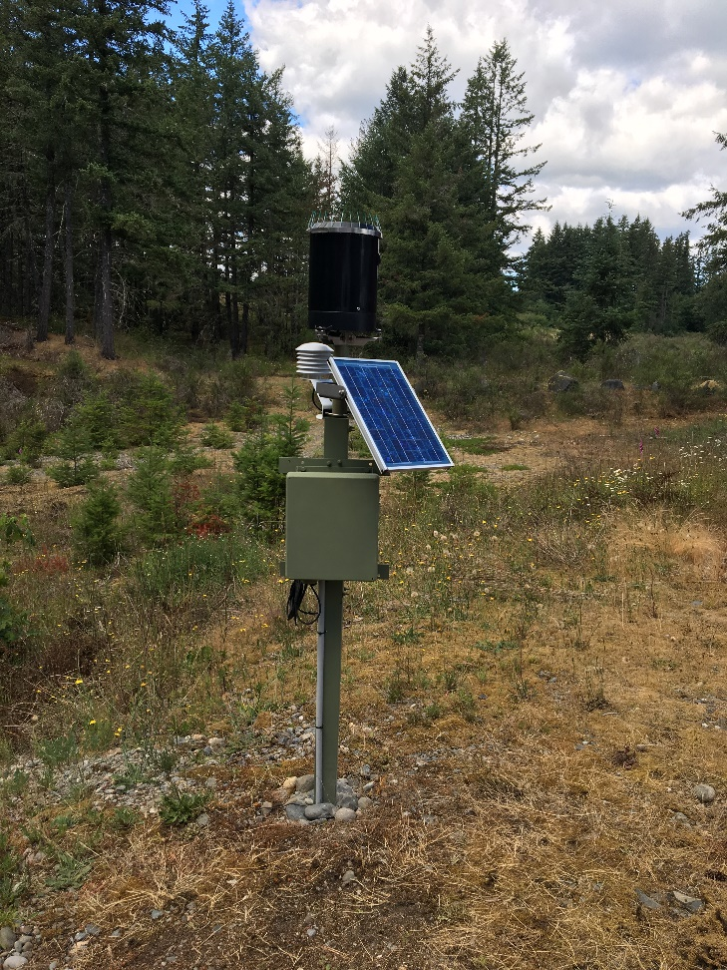
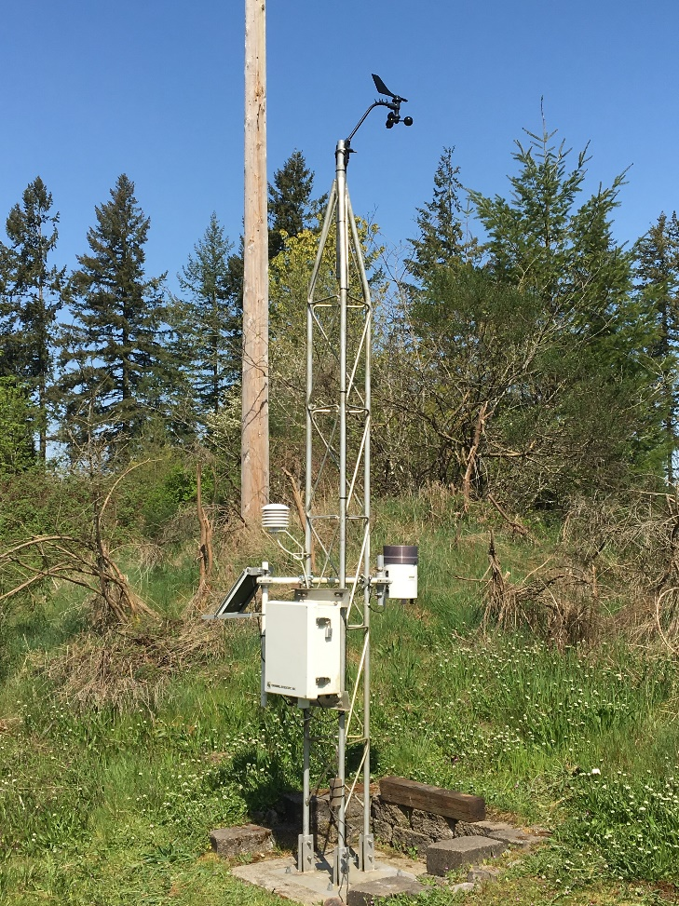
Build!
Add New gage sites, Thurston county (2019/20)

Slide 12
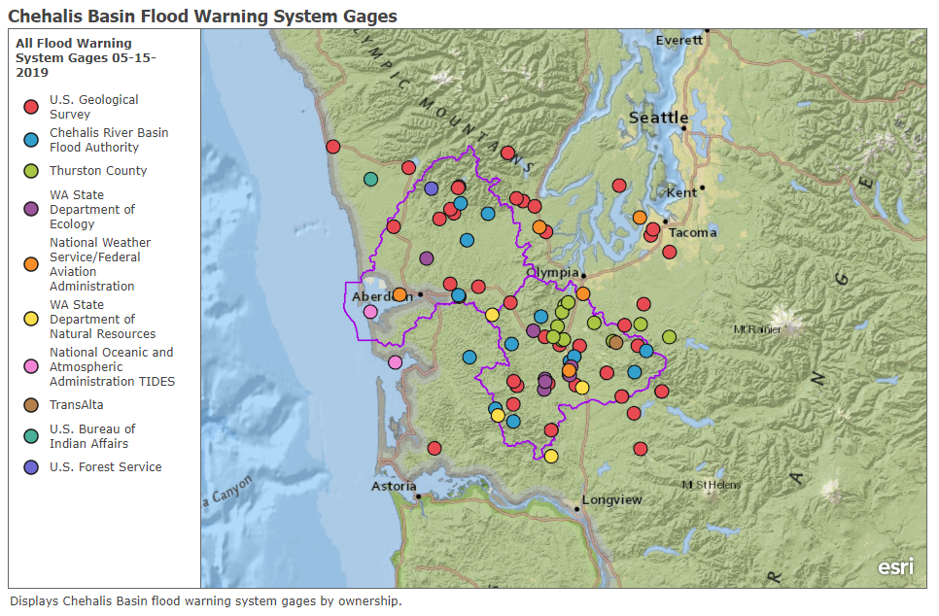
Total= 99 Sites, 285 sensors
Build!

Slide 13
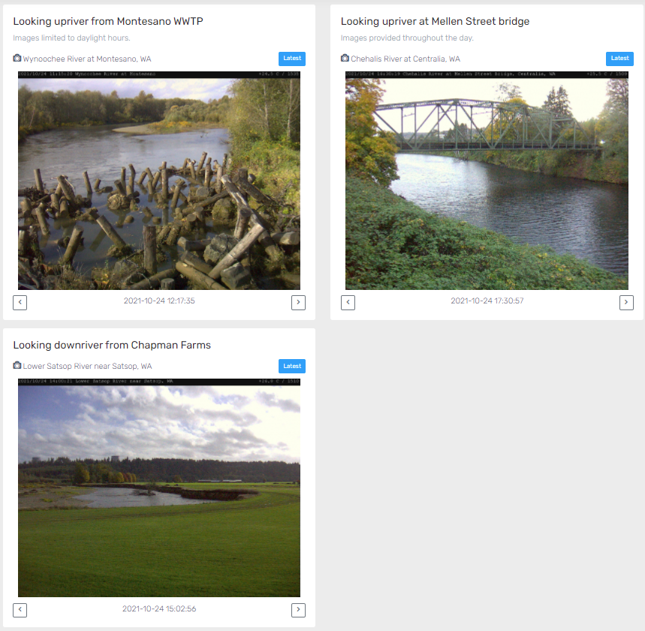
Add three Webcams (2019)
Build!

Slide 14
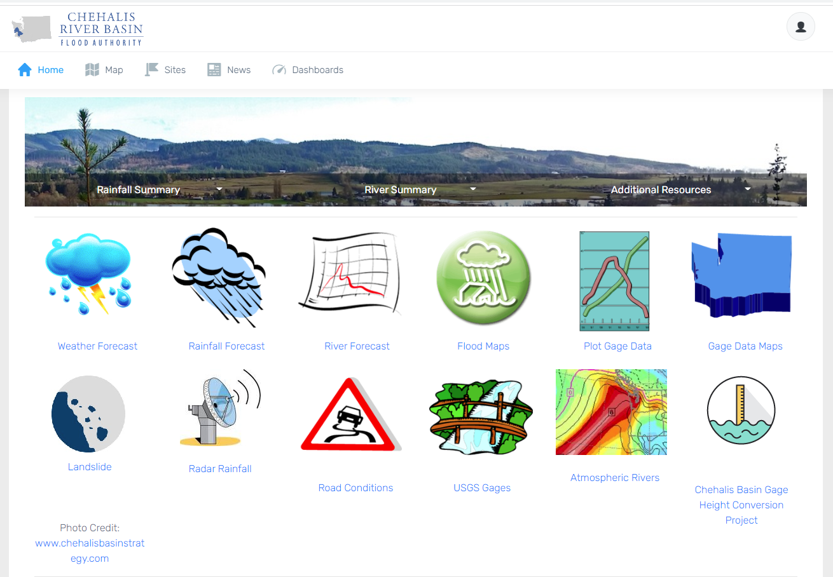
Build!
www.chehalisriverflood.com

Slide 15
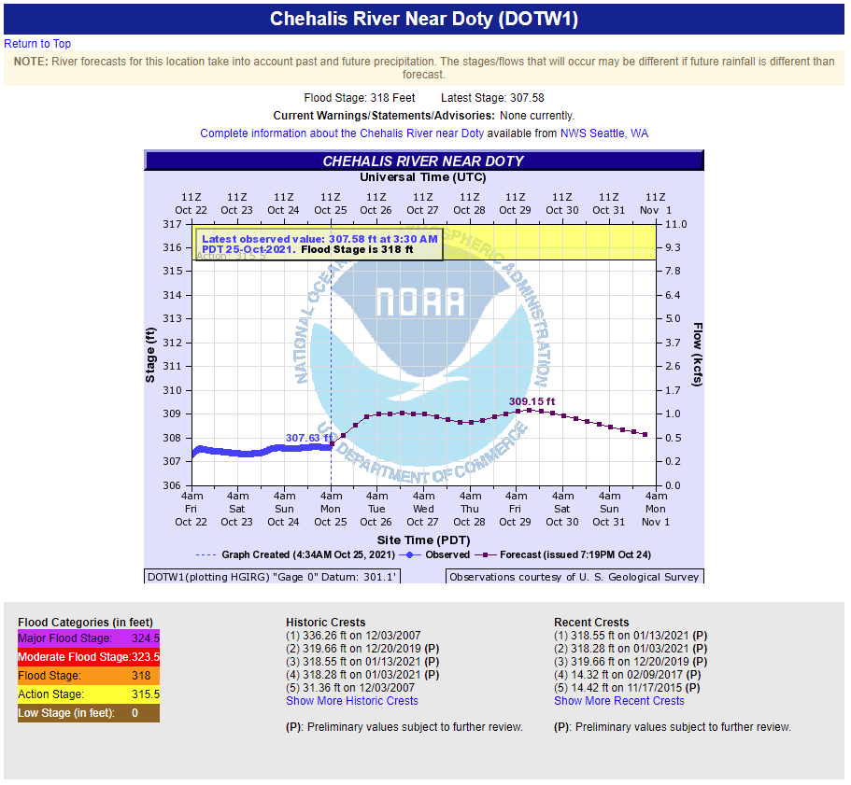
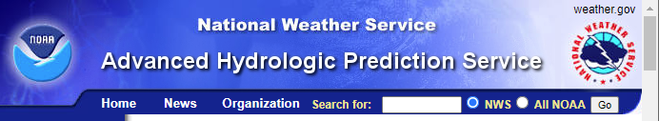
Build!
Email Gage Alerts --
rising river levels

Slide 16
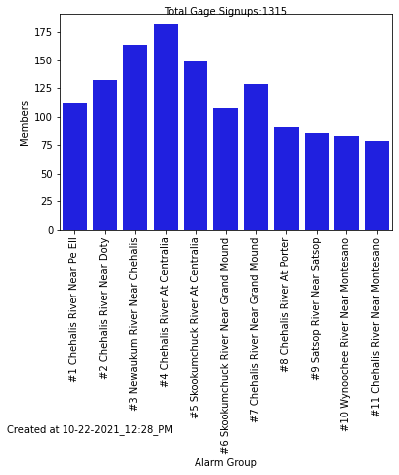
Build!
Email Gage Alerts --
Sign-ups
Situational awareness
Employee/staff safety
Residence safety
Travel planning

Slide 17
Inundation Mapping
Build!
No Flood
Moderate
Action
Major
Minor
Major

Slide 18
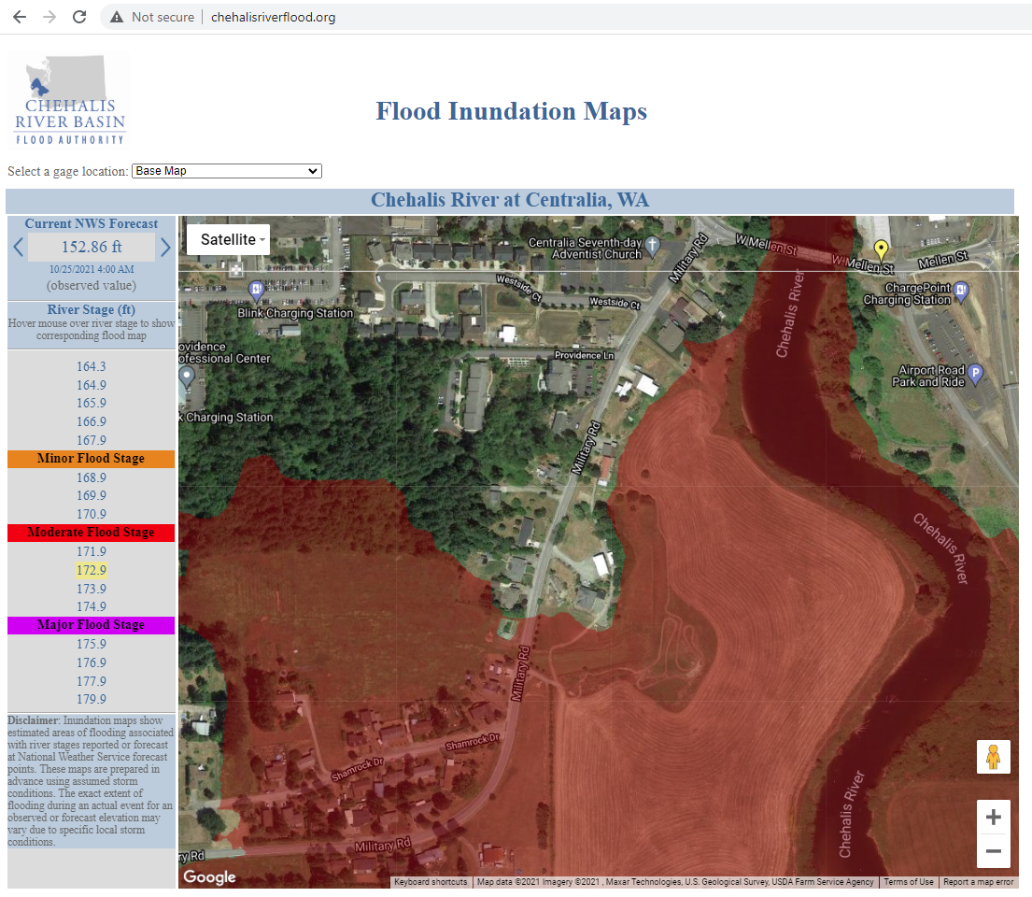
Inundation Mapping
Build!
Example:
Inundated area at 172.9 ft.

Slide 19
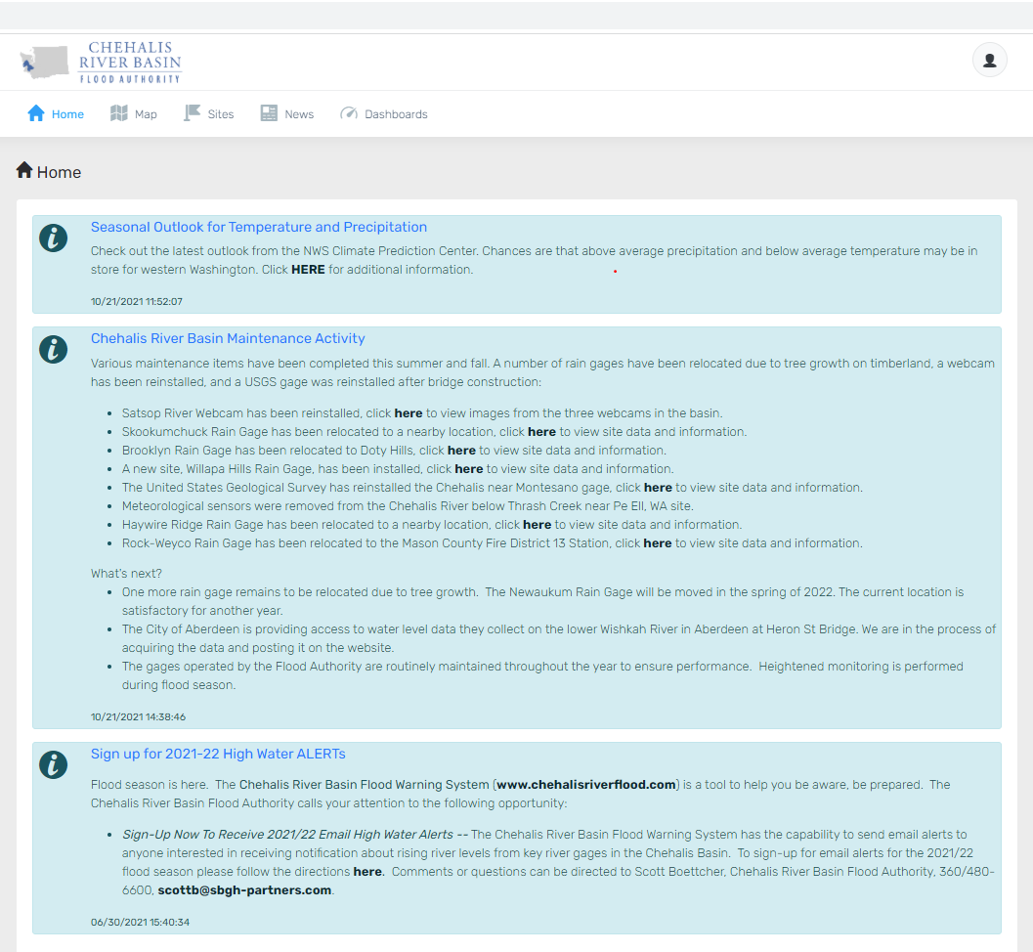
Regular news and communication
Build!
www.chehalisriverflood.com

Slide 20
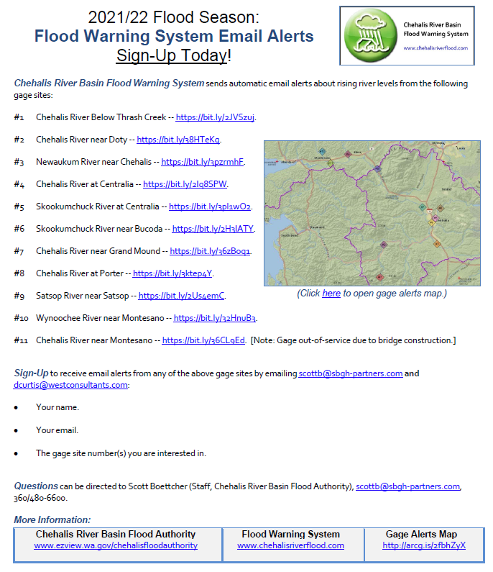
sign-up NOW!
2021/22 flood season
www.chehalisriverflood.com

Slide 21
2021/22 flood season
Chehalis river basin flood warning system training
11/10/2021 (12-1 PST)
11/17/2021 (12-1 PST)
Sign-up at www.chehalisriverflood.com (starting 10/26/2021)

Slide 22
THANK you!
Scott Boettcher
Chehalis River Basin Flood Authority STAFF
360/480-6600
scottb@sbgh-partners.com
Be Aware, Be Prepared

