Slide 1

2023-25 Local Projects Update
Chehalis River Basin Flood Authority
9/15/2022 (update to 9/01/2022 Chehalis Basin Board presentation)

Slide 2
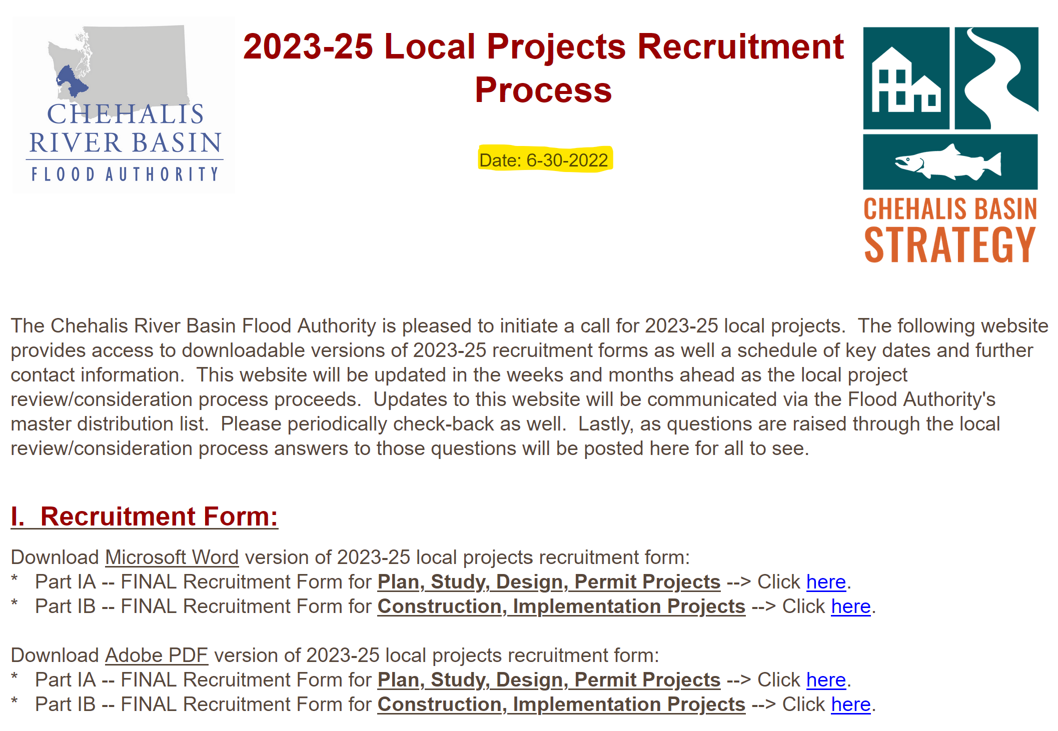
Issued Request for 2023-25 Local Project Proposals

Slide 3
Schedule/PROCESS
Request issued – 6/30/2022 Proposals received – 8/03/2022 Review Team mtg #1 – 8/25/2022 Chehalis Basin Board update – 9/01/2022 Request additional information – 9/15/2022 Flood Authority update – 9/15/2022 | Review Team mtg #2 – early-October Chehalis Basin Board update – 10/06/2022 Flood Authority approve list – 11/17/2022 Chehalis Basin Board approve list – 12/01/2022

Slide 4
15 Proposals Received, 5 Project Types
Sept: 1. Refine costs 2. Refine scopes of work 3. Secure additional information
Oct/Nov: 4. Review, score, rank Nov/Dec: 5. Make recommendation

Slide 5
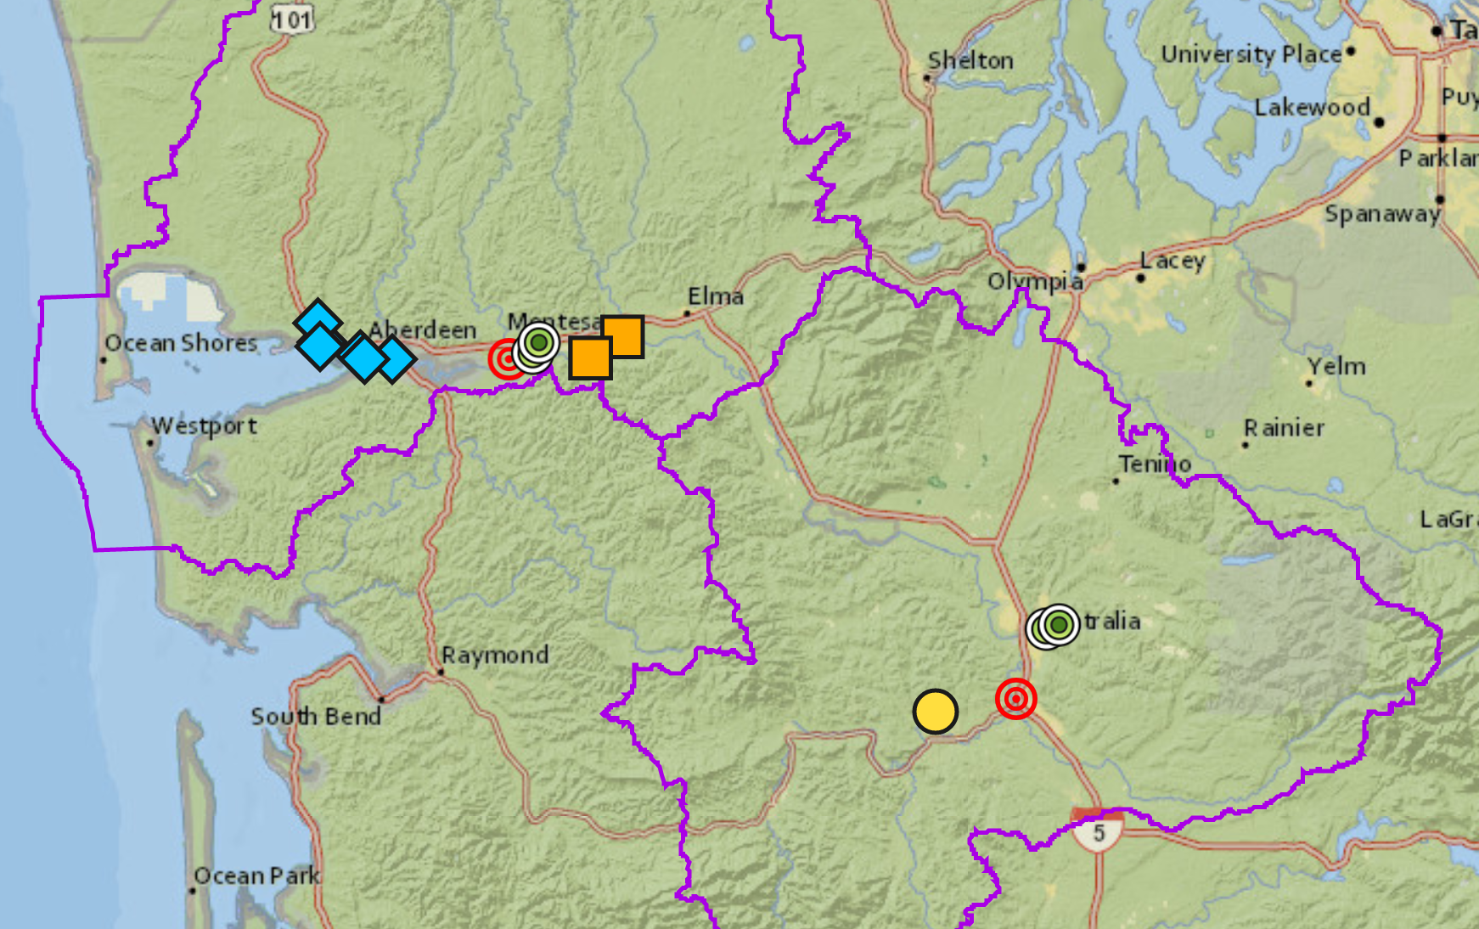
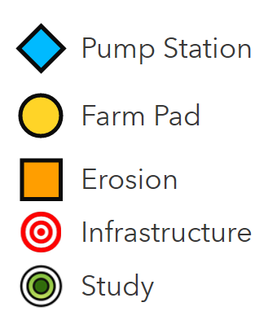

15 Proposals Received, $25,971,170
View interactive map
https://arcg.is/0rOj450
Sept: 1. Refine costs 2. Refine scopes of work 3. Secure additional information
Oct/Nov: 4. Review, score, rank Nov/Dec: 5. Make recommendation

Slide 6
15 Proposals Received -- Continuation, Construction
Sept: 1. Refine costs 2. Refine scopes of work 3. Secure additional information
Oct/Nov: 4. Review, score, rank Nov/Dec: 5. Make recommendation

Slide 7
15 Proposals Received – 9 Entities/Sponsors
Sept: 1. Refine costs 2. Refine scopes of work 3. Secure additional information
Oct/Nov: 4. Review, score, rank Nov/Dec: 5. Make recommendation

Slide 8
15 Proposals Received, $25,971,170

Slide 9
Next Steps
Schedule/Process
Request issued – 6/30/2022 Proposals received – 8/03/2022 Review Team mtg #1 – 8/25/2022 Chehalis Basin Board update – 9/01/2022 Request additional information – 9/15/2022 Flood Authority update – 9/15/2022 | Review Team mtg #2 – early-October Chehalis Basin Board update – 10/06/2022 Flood Authority approve list – 11/17/2022 Chehalis Basin Board approve list – 12/01/2022
Review Team
Flood Authority Projects Committee: Ron Averill, Centralia Steve Lyle, Bucoda Darrin Raines, Cosmopolis Brian Shay, Hoquiam Tony Ketchum, Chehalis | Agency/External Support: Rick Schwartz, DNR Megan Tuttle, WDFW Alex Rosen, Ecology Kirsten Harma, Chehalis Basin Lead Entity Caprice Fasano, QIN Mark Mobbs, QIN Nat Kale, OCB
Sept: 1. Refine costs 2. Refine scopes of work 3. Secure additional information
Oct/Nov: 4. Review, score, rank Nov/Dec: 5. Make recommendation

Slide 10
Key Considerations
Previous funding amounts versus current need.
Maximum cost.
Review/ranking/scoring vis-à-vis current priorities.
Continuing to identify and support projects that deliver:
  the most flood protection
  the soonest
  for the most
  with the least cost
  with the greatest ROI
Early cultural/archaeological screening.
Previous Funding Amounts (State Capital Budget Local Projects Allocation):
  2012-13 -- $ 5.0M
  2013-15 -- $10.7M
  2015-17 -- $15.7M
  2017-19 -- $ 9.6M
  2019-21 -- $ 6.3M
  2021-23 -- $ 4.1M
  $51.4M
Sept: 1. Refine costs 2. Refine scopes of work 3. Secure additional information
Oct/Nov: 4. Review, score, rank Nov/Dec: 5. Make recommendation

Slide 11
Questions or Discussion
Scott Boettcher, Staff
Chehalis River Basin Flood Authority
360/480-6600
scottb@sbgh-partners.com

