Slide 1


Chehalis River Basin
Reducing Flood Damage and
Restoring Aquatic Species
10:30 a.m.
April 3, 2017
City of Chehalis

Slide 2
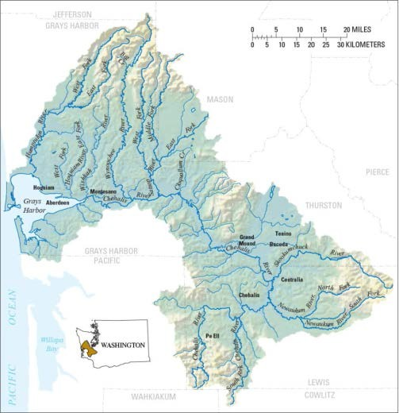

Today’s Presentation . . .
Provide update, encourage discussion.
Key messages . . .
  Broad agreement -- For first time in a century there is progress across the Basin on next steps to reduce flood damage and enhance salmon, aquatic species.
  Basin-wide strategy -- An action-oriented, multi-phased Basin-wide strategy is needed to protect communities along the river and to enhance aquatic species.
  Collaboration is key -- WA Legislature, Governor’s Office, Governor’s Chehalis Basin Work Group, Chehalis River Basin Flood Authority, and WA Agencies all working together = Action!
  4. Fundamental principle -- Solving one’s problems doesn’t increase another’s.
.

Slide 3
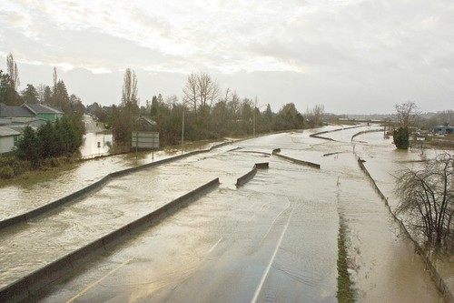
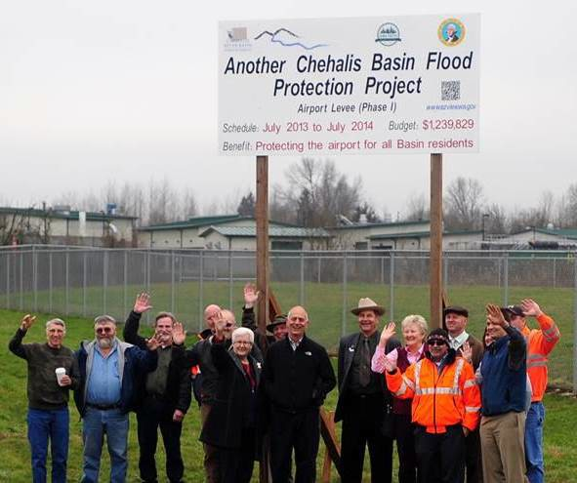
Action . . .
Photo Source: THE CHRONICLE

Slide 4
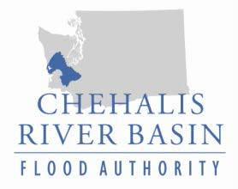
“Chehalis River Basin Flood Authority”
Formed in 2008
Formal body focused on: (1) flood hazard mitigation throughout the Basin; and (2) decision-making that is . . .
  informed by science.
  protective of Basin residents/communities.
  environmentally appropriate.
Basin jurisdictions represented
 Grays Harbor County
City of Aberdeen
City of Cosmopolis
City of Hoquiam
City of Montesano
City of Oakville
 Lewis County
 Thurston County
o Town of Bucoda
o City of Centralia
o City of Chehalis
o City of Napavine
o Town of Pe Ell

Slide 5
“Governor’s Chehalis Basin Work Group”
Appointed by Gov. Gregoire (2012); Re-confirmed by Gov. Inslee (2013).
Role = Develop/oversee Basin-wide strategy, funding authorizations (2017-19).
  Flood Retention Dam in paired with Airport Levee Improvements.
  Basin-wide Aquatic Species Restoration.
  High-priority, small-scale Local Flood Damage Reduction Projects.
  Local Land Use Management and Local Floodproofing.
Members are:
  Vickie Raines (Grays Harbor Commissioner, Chair Flood Authority).
  Karen Valenzuela (Former Thurston County Commissioner, Former Vice-Chair Flood Authority)
  Don Secena (Chair Chehalis Tribe).
  Larry Goodell Jr. (Quinault Indian Nation).
  J. Vander Stoep (Private Attorney, Pe Ell Alternate Flood Authority).
  Steve Malloch (Western Water Futures)
  Jay Gordon (President Washington Dairy Federation and Chehalis Farmer).
  Rob Duff (Governor’s Natural Resources and Environment Advisor).

Slide 6
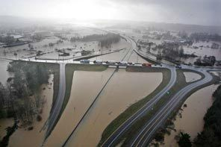
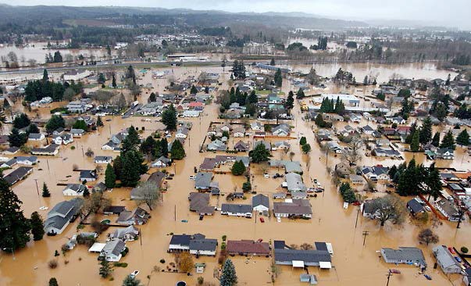
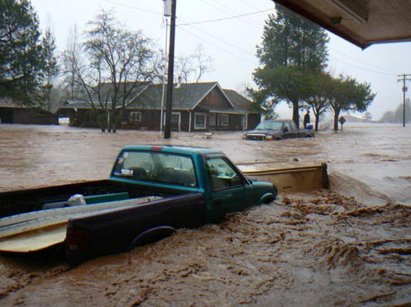
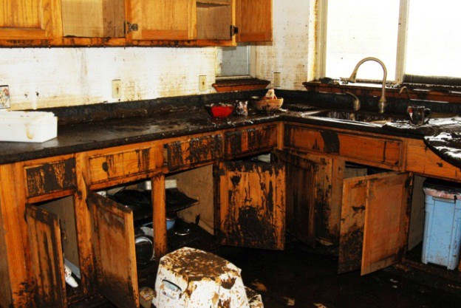
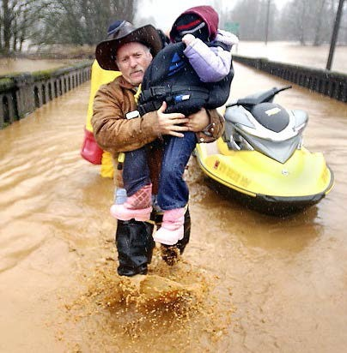
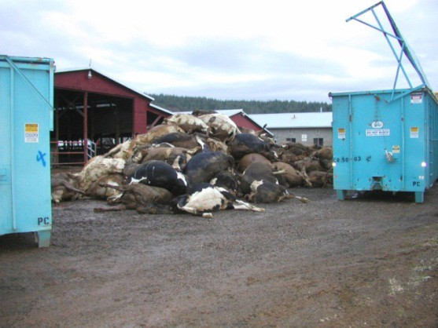
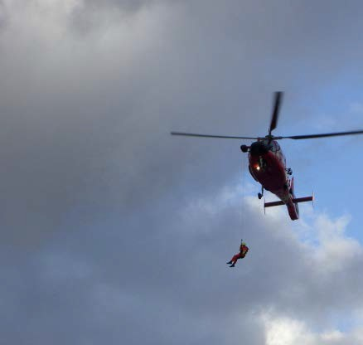
Background . . .
2007 Storm -- $938M Basin-wide damage, $300M lost economic activity (WA).
Exit 77 (I-5) in Chehalis
STEVE RINGMAN / SEATTLE TIMES
City of Centralia
STEVE RINGMAN / SEATTLE TIMES
State Route 6, West of Adna MIKE SALSBURY / AP
Photos Source: LEWIS COUNTY, DIVISION OF EMERGENCY
MANAGEMENT

Slide 7
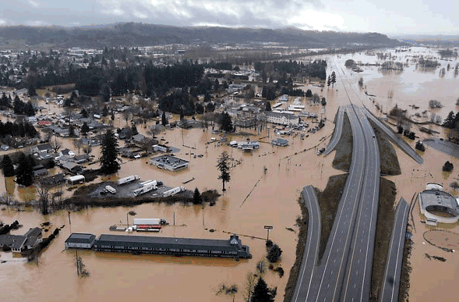
Background . . .
2007 Flood -- I-5 and Hwy 507 Interchange looking South.
City of Centralia and I-5 STEVE RINGMAN / SEATTLE TIMES

Slide 8
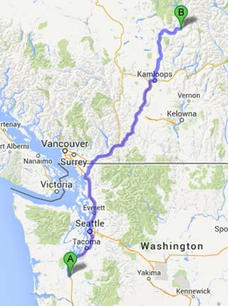
Background . . .
289,983 acre feet of measured water (12/03-08/2007).
Equivalent to covering roadway between Chehalis and North of Kamloops with 1 foot of water 1-mile wide or covering . . .
  80% of Kitsap County.
  69% of Clark County.
  59% of Thurston County.

Slide 9
Background . . .
Ranked high flow events (1932 - 2012) . . .
❑ I-5 closed 1990, 1996, 2007, 2009.
  Five largest events since 1986 -- Frequent floods are getting worse and damage is increasing . . .
  100 year flood estimate -- Increased by 33% in last 30 years.
90000
Chehalis River Flow Rates near Grand Mound (cubic ft./sec.) ₂
1
80000
3
70000
60000
4
5
50000
9
7
6
10
8
13
13
11
16
12
15
40000
30000
20000
10000
0

Slide 10
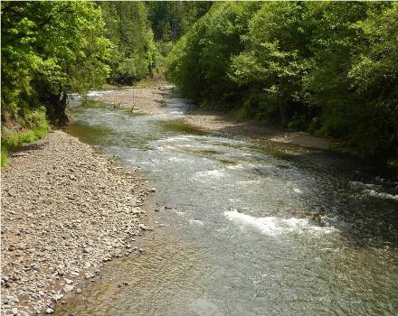
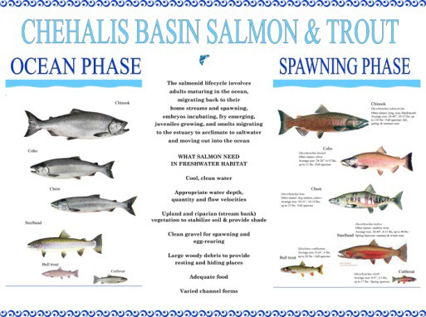
Background . . .
Chehalis is the second largest river basin in the state, rich in natural resources . . .
Salmon populations are 15-25% of historic levels.
TMDL for the basin (http://www.ecy.wa.gov/programs/wq/tmdl/ChehalisRvrTMDLSummary.html).
Upper Chehalis (5/31/2010)
JAMES E. WILCOX / WILD GAME FISH CONSERVATION INTERNATIONAL
www.chehalisbasinpartnership.org
10

Slide 11
Background . . .
Salmon-habitat potential
Species | Current Spawner | Habitat Degradation
Spring Chinook Salmon | 2,300 | 78%
Fall Chinook Salmon | 24,317 | 45%
Coho Salmon | 42,000 | 69%
Winter-run Steelhead | 8,700 | 44%
Source: Chehalis Basin Strategy: Reducing Flood Damage and Restoring Aquatic Species; Pe Ell Public Meeting; 10/14/2014; Page 13.

Slide 12
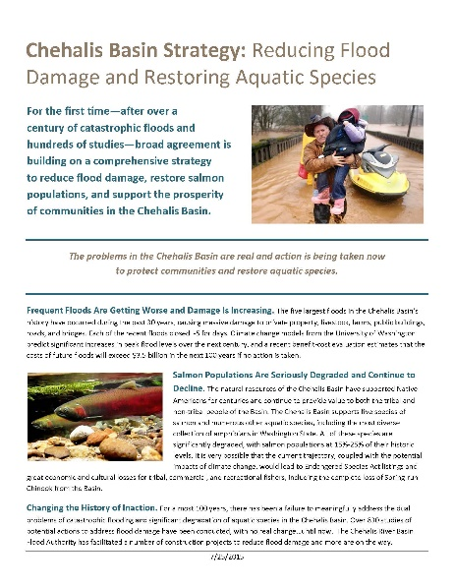
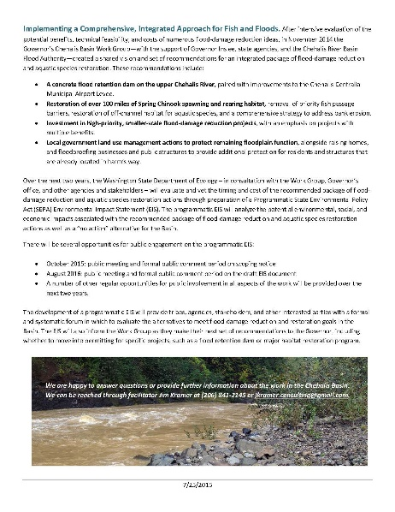
Solution = Basin-wide Approach
Action-oriented, Multi-phased Approach
Basin-Wide Relationships
Hydraulic Understanding
Master Strategy (Game Plan)
Large Capitol Projects
Small-Scale Local Projects
Land Use, Floodplain Management
Restore Salmon and Aquatic Species
Early Flood Warning
Outreach, Education and Communication

Slide 13







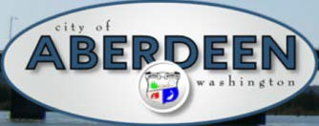










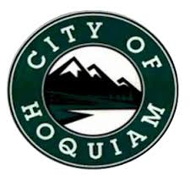


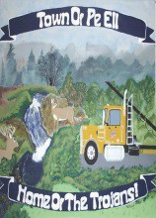

1. Basin-Wide Relationships

Slide 14
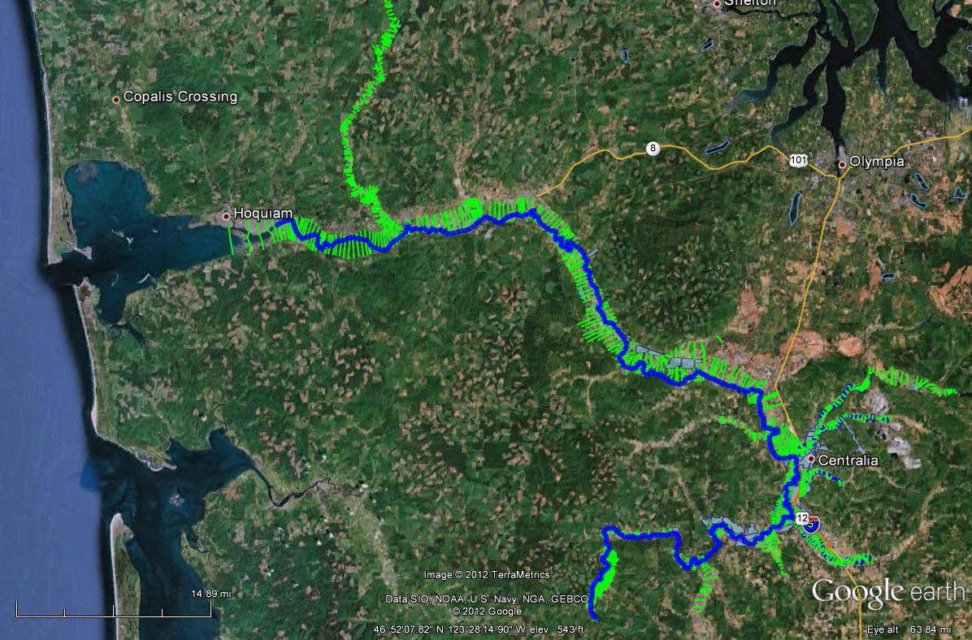
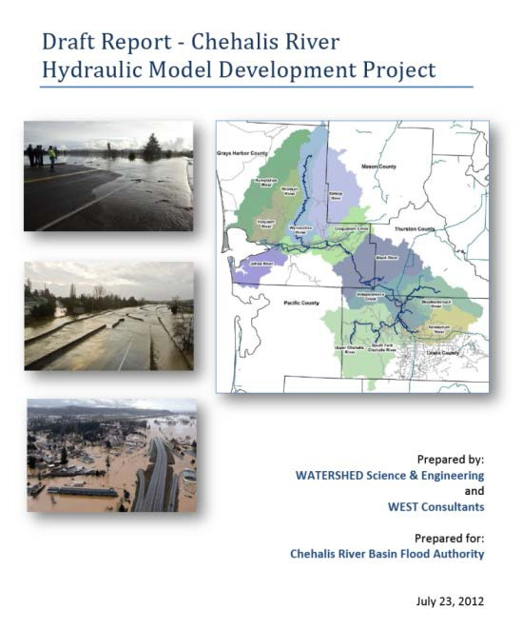
2. Hydraulic Understanding
Science-based model -- To inform decision-makers on hydraulic effects of potential flood relief options (at basin-wide and localized scales).
108 miles -- Mouth of Chehalis River upstream to Pe Ell (108 miles).

Slide 15
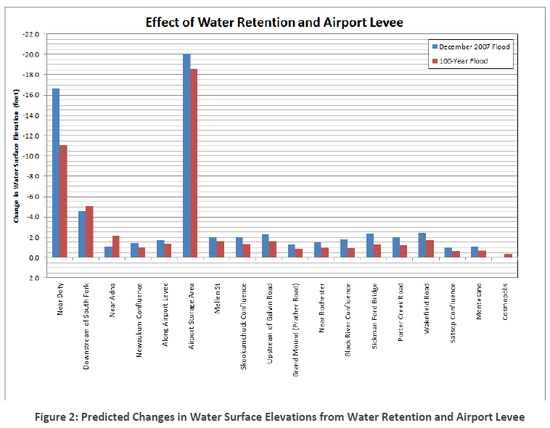
2. Hydraulic Understanding
Example: Basin- wide effects analysis (Governor’s Chehalis Basin Workgroup, 2014 Recommendations Report, 11/25/2014)

Slide 16
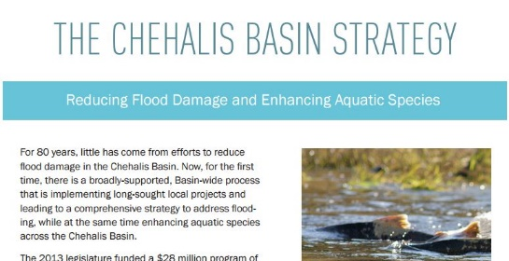
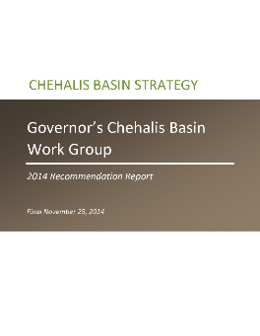
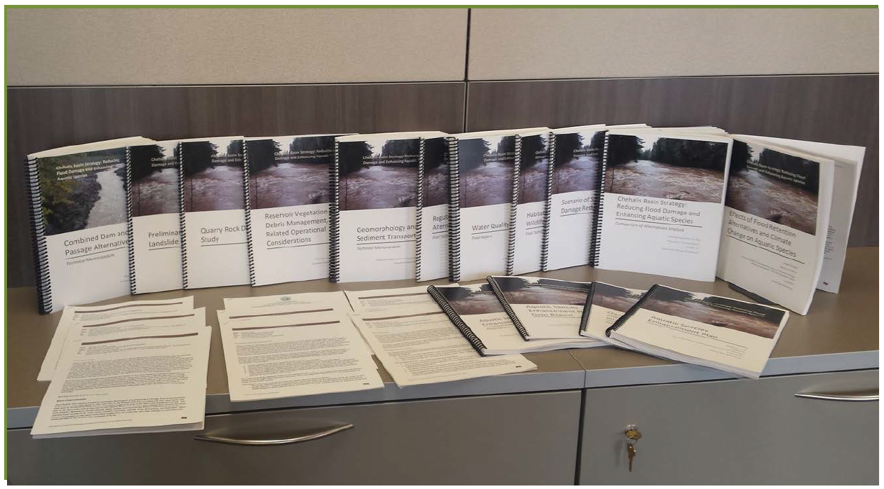
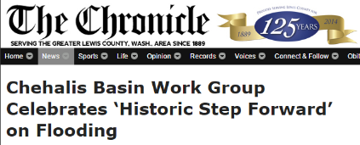
3. Master Strategy (Game Plan)
2012, 2013-15 – Framework and Recommendations.
Key elements:
  Concrete Flood Retention Dam on upper Chehalis River.
  Chehalis-Centralia Municipal Airport Levee Improvements.
  Basin-wide Aquatic Species Restoration (100+ miles spawning/rearing habitat).
  Local Flood-damage Reduction Projects, including raising homes, floodproofing businesses and public structures.
  Local actions to Protect Floodplain Functions, ensure development doesn’t exacerbate harm.
  Cost = $500-600M; Benefit = $720M (100 yrs.); No Action = $3.5B (100 yrs.).
2015-17 -- $50M for formal environmental review, implementation of local early-action (projects, floodproofing, etc.).

Slide 17
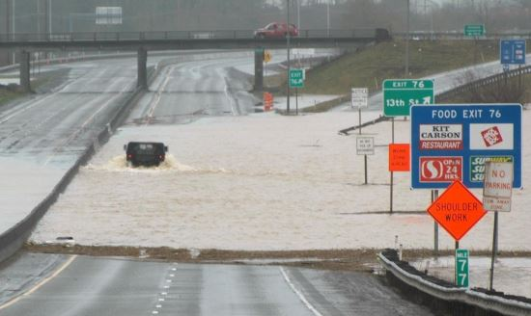
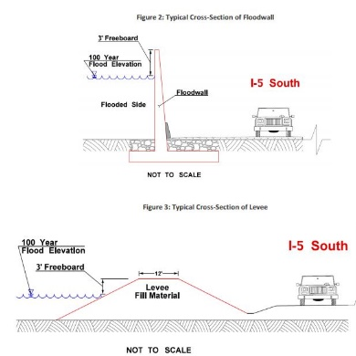
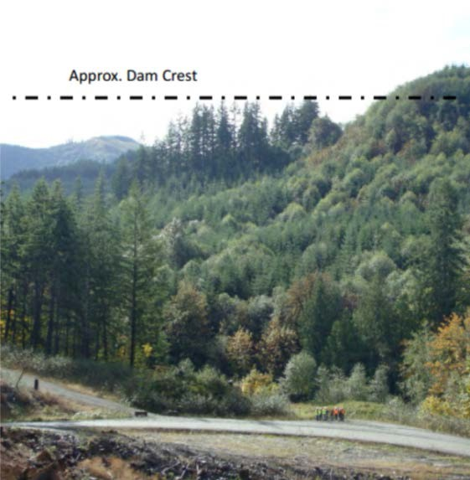
4. Large Capitol Projects
2013-15:
  Technical team developed baseline knowledge on safety, feasibility of Flood Retention Dam alternatives -- field visits, site and design considerations, world-wide research, etc.
    Permanent reservoir (w/ fish passage) or Run-of-the-river (no permanent reservoir).
    Roller compact concrete or Earthen fill.
    Flood-control only or Multi-purpose.
  WSDOT evaluated I-5 Protection alternatives -- levees, walls, raise road, etc.
2015-17:
  Formal environmental review (Programmatic EIS) will be conducted to evaluate alternatives and inform Governor’s Workgroup on next steps – funding, permitting, etc.
Photo source: ANCHOR QEA

Slide 18
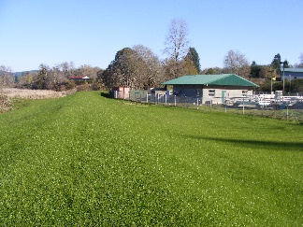
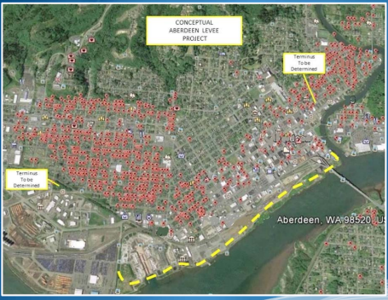
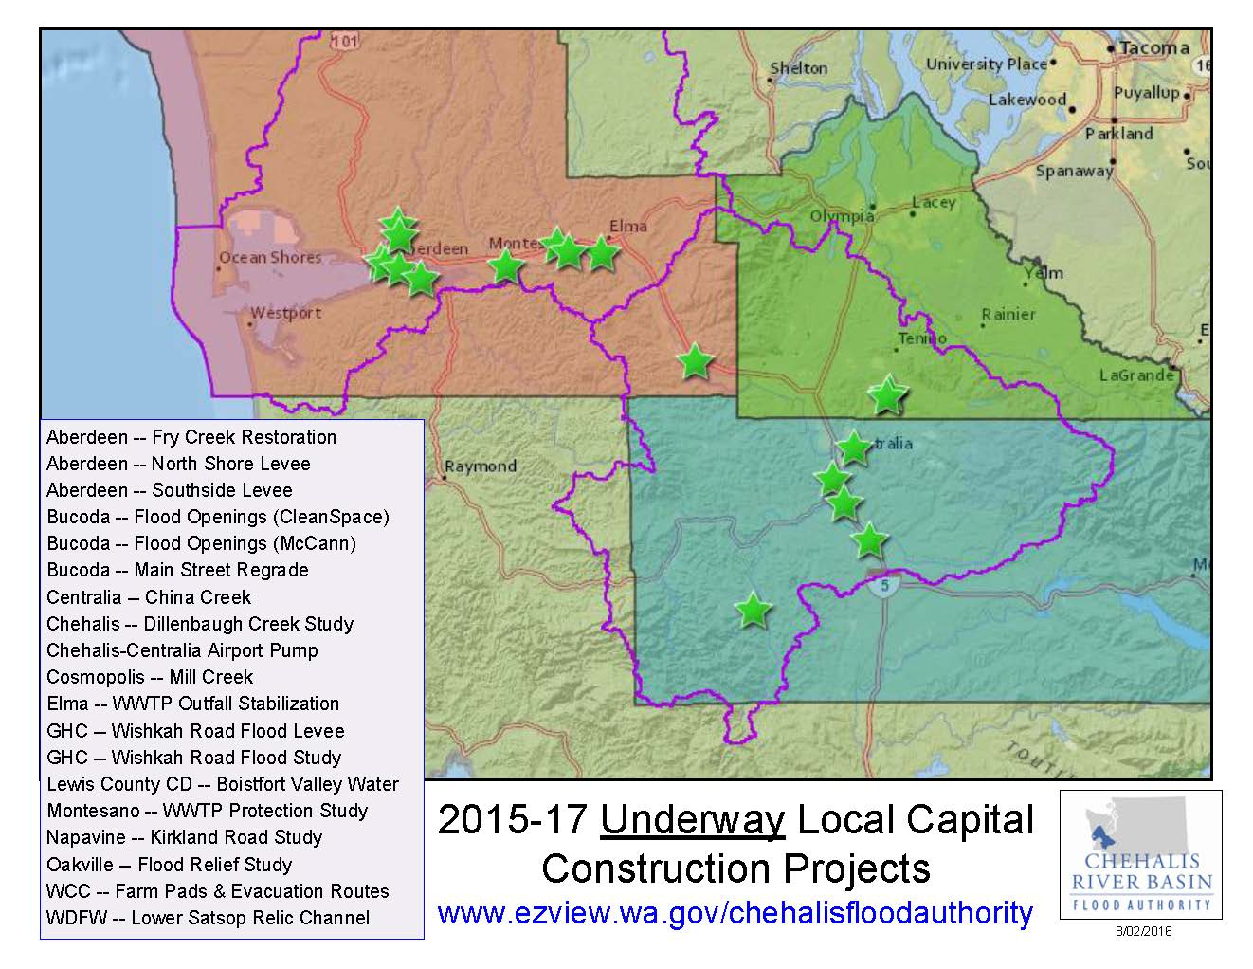
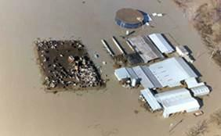
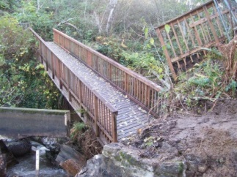

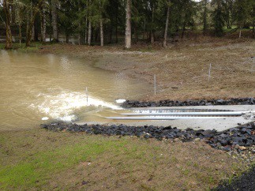
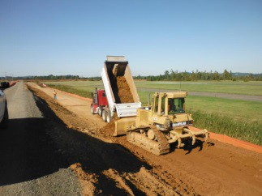
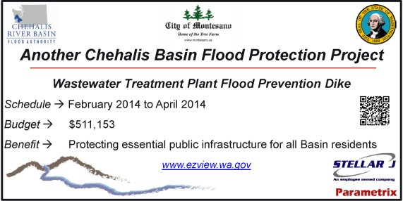
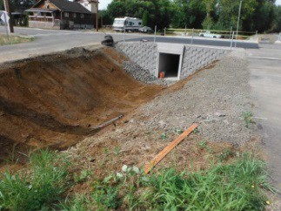
Pe Ell Wastewater Treatment Plant Flood Protection Dike
Aberdeen Proposed Northside Dike/Levee
5. Small-Scale Local Projects
2012 Supplemental Capital Budget:
$5.0M -- Local projects.
2013-15 Capital Budget:
$15.1M -- Local projects, aquatic species enhancement.
2015-17 Capital Budget:
$23.2M -- Local projects, habitat restoration.

Slide 19
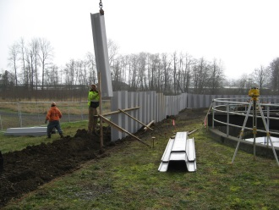
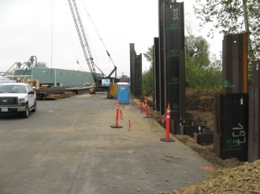
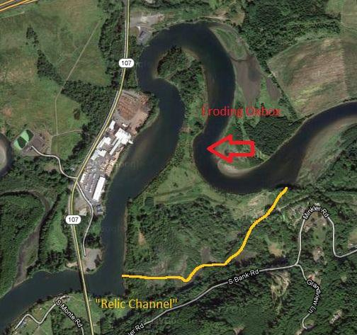
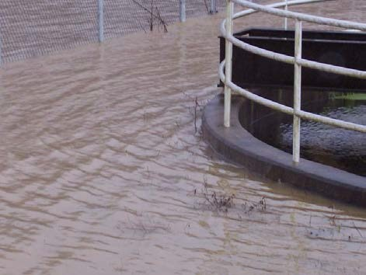
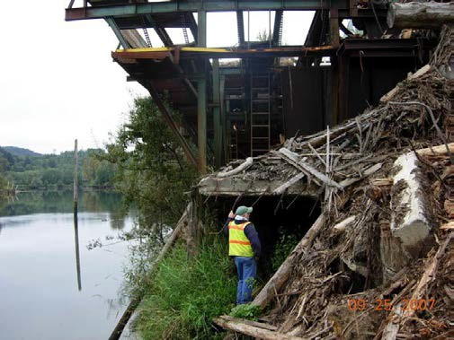

5. Small-Scale Local Projects
Mary’s River Lumber Bank Stabilization Wall and WWTP Flood Prevention Dike
  Mary’s River Lumber = 120 family wage jobs.
  State Highway (SR 107) = At risk of damage.
  Montesano WWTP = Risk of overtopping.
  Solutions and Alternative = Balance time, cost, results.
  Project website.

Slide 20
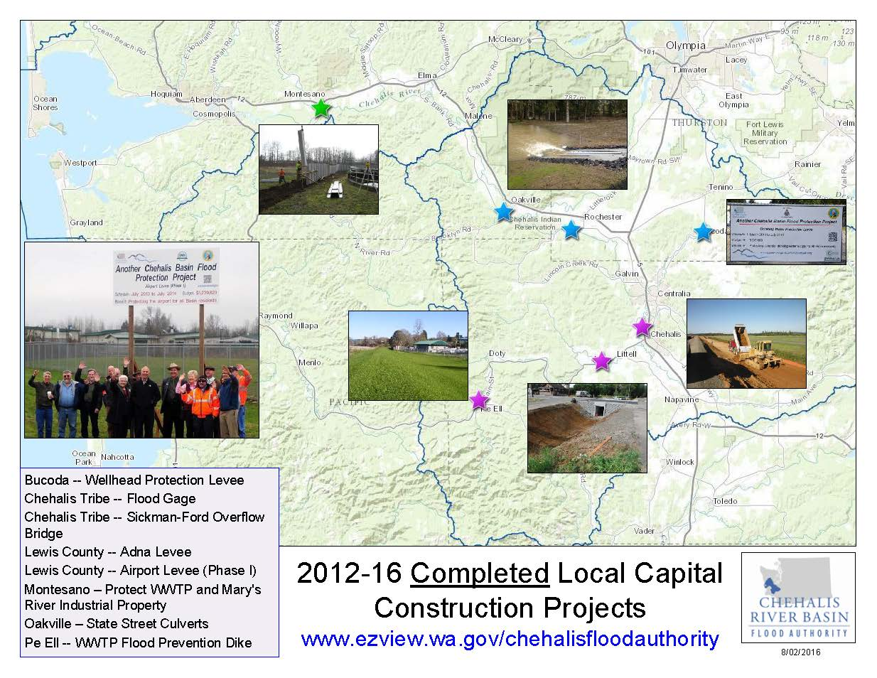
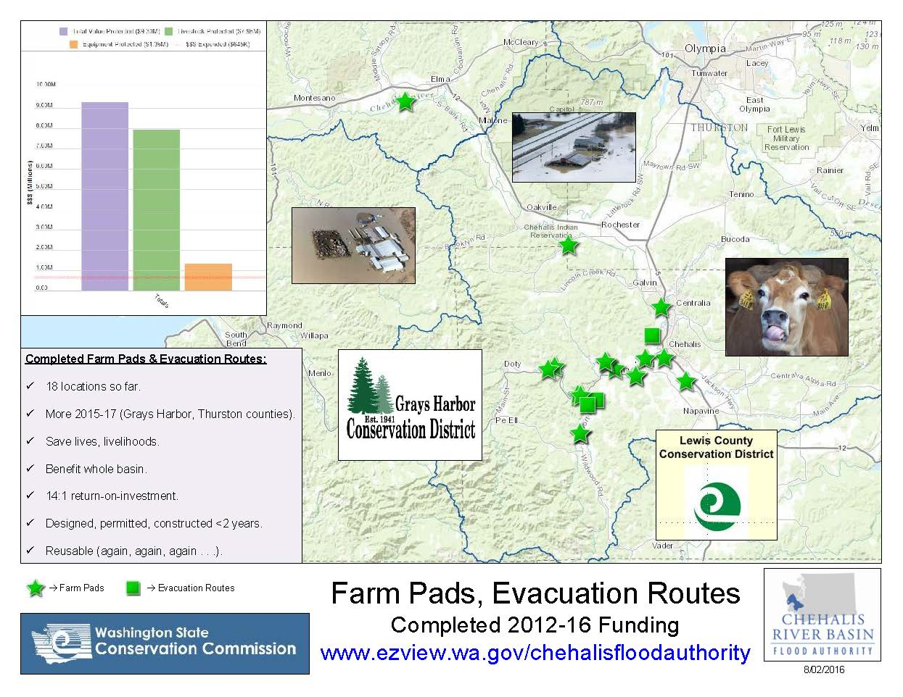
5. Small-Scale Local Projects
Projects Completed
14:1 Return-on-investment!
Projects Completed
Local Protection!

Slide 21
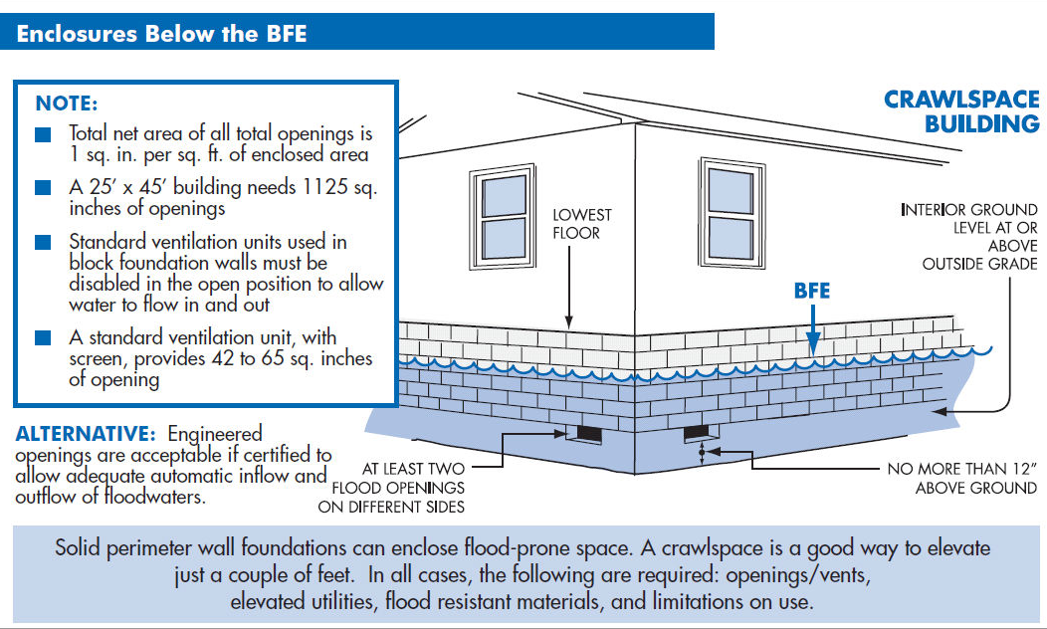
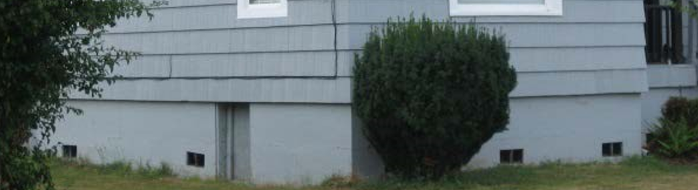
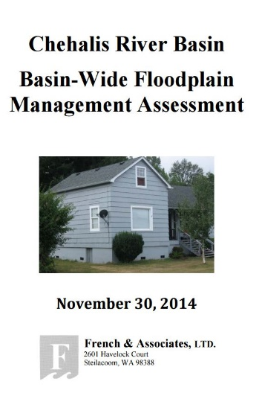
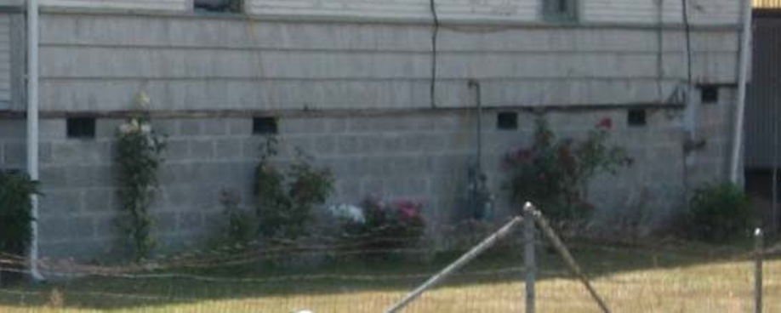
6. Land Use, Floodplain Management
French and Associates under contract.
2013-15: Analyzed local floodplain management programs.
  Do they protect existing homes/businesses?
  Do they ensure new development does not increase flood hazard risk?
  Are there ways to reduce flood insurance rates?
  Are there repeatedly flood damaged properties that should be addressed?
2015-17: Advise Flood Authority, Governor’s Workgroup, and Basin communities on:
  Retrofitting buildings to meet flood opening criteria.
  Identify home elevation projects.
  Improving local floodplain management programs.

Slide 22





7. Restore Salmon and Aquatic Species
Salmon:
  At 15-25% historic levels.
  Habitat substantially degraded.
2013-15:
  Collected data (aquatic species, water quality, hydrologic, etc.).
  Analyzed/modelled data to understand relationships (fish, wildlife, water quality, sediment, streamflow, flooding, etc.).
  Developed “Aquatic Species Enhancement Plan“ (8/29/2014).
2015-17:
  Convene broad group to identify, implement early actions
    Remove barriers to fish passage.
    Restore off-channel habitat.
    Address bank erosion.
Snorkel Surveys
Seine Collections

Slide 23








7. Restore Salmon and Aquatic Species
Other Fish and Aquatic Species
Northern Pikeminnow
Olympic Mudminnow
Oregon Spotted Frog
Redside Shiner
Largescale Sucker
Longnose Dace
Western Toad
Sculpin (6 species)

Slide 24




8. Early Flood Warning
www.chehalisriverflood.com
Front-facing website.
Data collection, data synchronization.
Improved forecasting, early-warning.
http://www.chehalisriverflood.com

Slide 25




8. Early Flood Warning
Localized tracking, forecasting . . .

Slide 26





9. Outreach, Education and Communication
Outreach Visits
Project Signs
Website
Informational Analyses
Chehalis Basin Flood Stories

Slide 27



9. Outreach, Education and Communication
http://ruckelshauscenter.wsu.edu/projects/current-projects/chehalisfloodingfish/du/ChehalisFlooding.html
www.ezview.wa.gov/chehalisfloodauthority
www.chehalisbasinstrategy.com
www.chehalisriverflood.com

Slide 28

Closing – 2007 Flood Damage . . .
Chehalis River near Doty USGS

Slide 29

Closing – 2007 Flood Damage . . .
Clearing Mud in Curtis, WA
STEVE RINGMAN / SEATTLE TIMES

Slide 30

Closing – 2007 Flood Damage . . .
Curtis, WA, Aftermath of 7 Feet of Water STEVE RINGMAN / SEATTLE TIMES

Slide 31

Closing – 2007 Flood Damage . . .
Chandler Road Bridge near Doty, WA
STEVE RINGMAN / SEATTLE TIMES

Slide 32

Closing – 2007 Flood Damage . . .
30

Slide 33

Closing – 2007 Flood Damage . . .

Slide 34

Closing – 2007 Flood Damage . . .
I-5 Under Water BRUCE ELY / OREGONIAN

Slide 35

Closing – 2007 Flood Damage . . .
Chehalis, WA STEVE RINGMAN / SEATTLE TIMES

Slide 36

Closing – 2007 Flood Damage . . .

Slide 37

Closing – 2007 Flood Damage . . .
Jackson Street, Centralia, WA STEVE RINGMAN / SEATTLE TIMES

Slide 38

Closing – 2007 Flood Damage . . .
I-5 Under Water
BRUCE ELY / OREGONIAN

Slide 39

Closing – 2007 Flood Damage . . .
Photos Source:
WSDOT

Slide 40

Closing – 2007 Flood Damage . . .

Slide 41



Closing – 2007 Flood Damage . . .

Slide 42

Closing – 2007 Flood Damage . . .
Wakefield Road, Elma, WA
GREG GILBERT / SEATTLE TIMES
40

Slide 43
For Further Information . . .
Vickie Raines, Grays Harbor County Representative
Chair, Chehalis River Basin Flood Authority
Member, Governor’s Chehalis Basin Work Group
360/249-3731
vraines@co.grays-harbor.wa.us
Edna Fund, Lewis County Representative
Chehalis River Basin Flood Authority
Vice-Chair, Chehalis River Basin Flood Authority
360/740-1283
Edna.Fund@lewiscountywa.gov
Jim Kramer, Facilitator
Chehalis River Basin Flood Authority
Governor’s Chehalis Basin Work Group
206/841-2145
jkramer.consulting@gmail.com
Scott Boettcher, Staff
Chehalis River Basin Flood Authority
360/480-6600
scottb@sbgh-partners.com

Slide 44
Key Links . . .
1. Chehalis River Basin Flood Authority -- www.ezview.wa.gov/chehalisfloodauthority
  Flood Warning System -- www.chehalisriverflood.com
  Sign-Up for Email Gage Alerts -- https://www.ezview.wa.gov/Portals/_1492/images/Print50%20--%20HANDOUT%20--%20Gage%20Alerts%20Sign-Up%2008102016.pdf
  Local Projects -- https://www.ezview.wa.gov/site/alias__1492/34489/local_projects.aspx
2. Chehalis Basin Strategy -- www.chehalisbasinstrategy.com
  Department of Ecology -- http://www.ecy.wa.gov/programs/sea/sepa/chehalisbasin.html
  Ruckelshaus Center -- http://ruckelshauscenter.wsu.edu/projects/current-projects/chehalisfloodingfish/du/ChehalisFlooding.html
Office of Chehalis Basin – https://www.ezview.wa.gov/site/alias__1492/37030/Default.aspx

Slide 45

Organizational Structure . . .

Slide 46
Thank You . . .
Thank You!
Note:
This Presentation is Available at “Chehalis River Basin Flood Authority” Website at www.ezview.wa.gov/chehalisfloodauthority.
Email Distribution List
Pat Anderson
Pat.Anderson@lewiscountywa.gov

