Slide 1


Chehalis River Basin Flood Authority
Reducing Flood Damage and
Restoring Aquatic Species
1:00 p.m. (Bucoda)
3:00 p.m. (Cosmopolis)
February 13, 2020

Slide 2
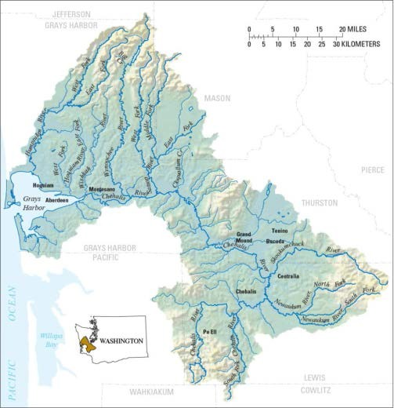

Today’s Presentation . . .
Provide update, encourage discussion.
Key messages . . .
  1. Broad agreement -- For first time in a century there is progress across the Basin on next steps to reduce flood damage and enhance aquatic species.
  2. Basin-wide strategy -- An action-oriented, multi-phased Basin-wide strategy is key to protecting communities along the river and to enhancing aquatic species.
  3. Collaboration is key -- WA Legislature, Governor’s Office, Chehalis Basin Tribes, Office of Chehalis Basin, Chehalis Basin Board, Chehalis River Basin Flood Authority, and many Federal, State and Local Agencies all working together = Action!
  4. Fundamental principle -- Solving one’s problems doesn’t increase another’s.
.

Slide 3
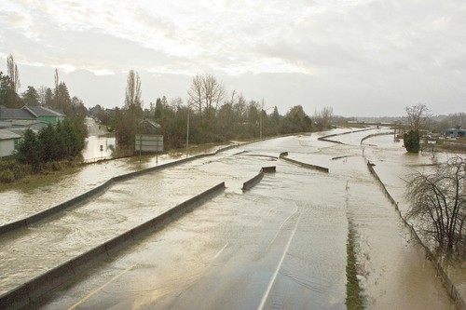
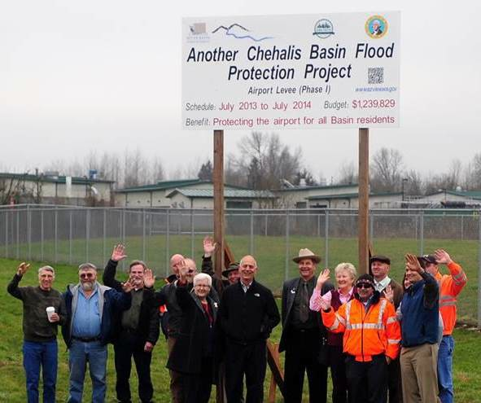
Action . . .
Photo Source: THE CHRONICLE

Slide 4

“Chehalis River Basin Flood Authority”
Formed in 2008
Formal body focused on: (1) flood hazard mitigation throughout the Basin; and (2) decision-making that is . . .
  informed by science.
  protective of Basin residents/communities.
  environmentally appropriate.
Basin jurisdictions represented
 Grays Harbor County
City of Aberdeen
City of Cosmopolis
City of Hoquiam
City of Montesano
City of Oakville
 Lewis County
 Thurston County
o Town of Bucoda
o City of Centralia
o City of Chehalis
o City of Napavine
o Town of Pe Ell

Slide 5
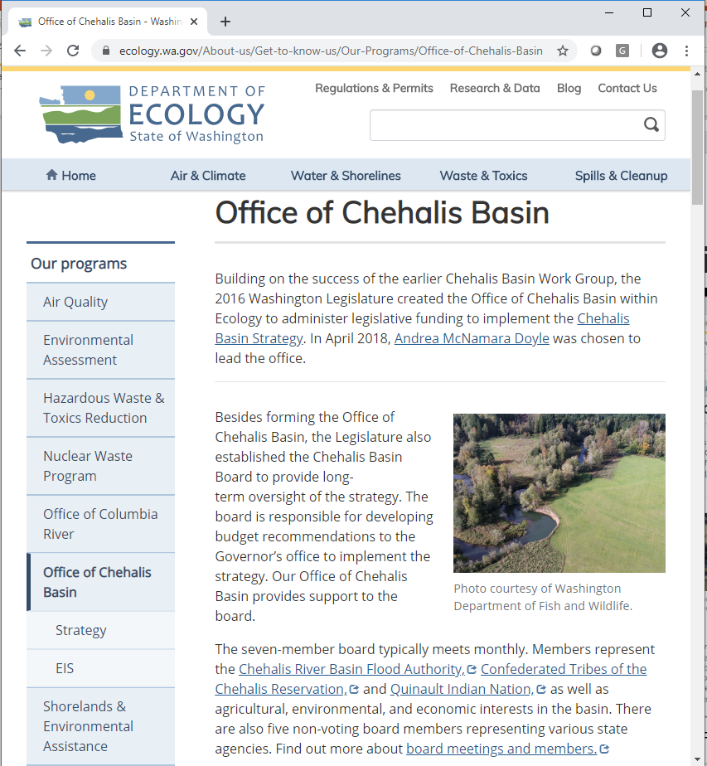
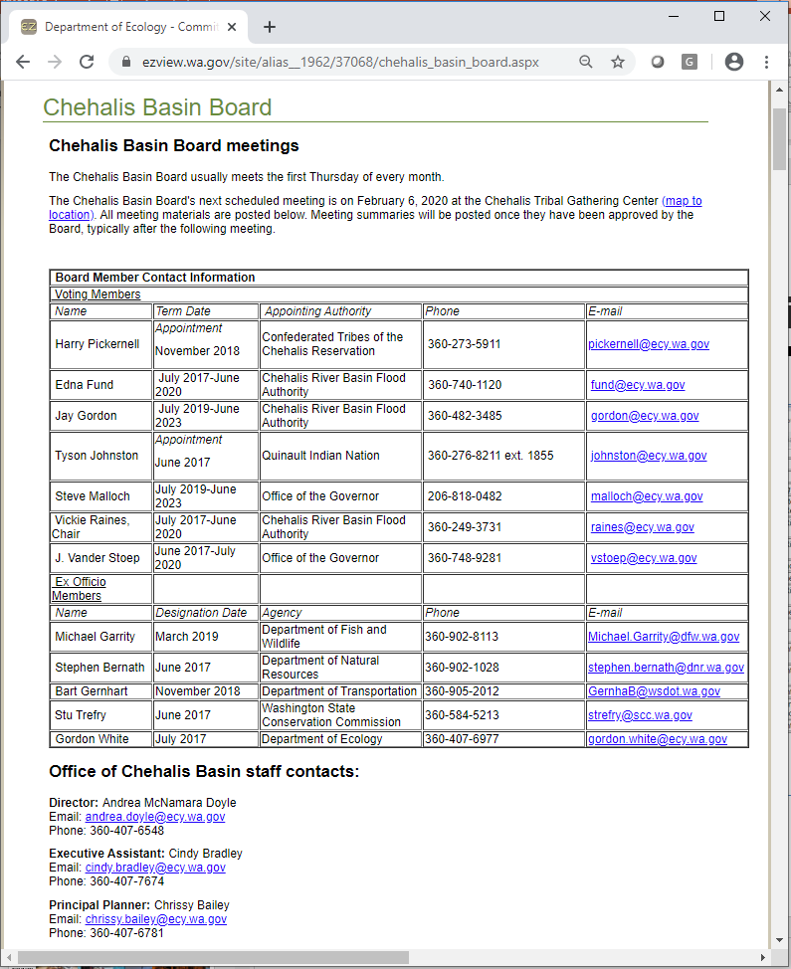
“Office of Chehalis Basin”

Slide 6
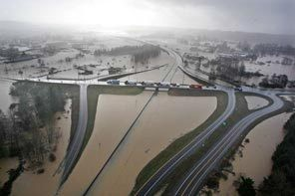
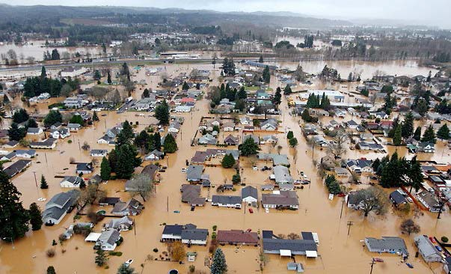
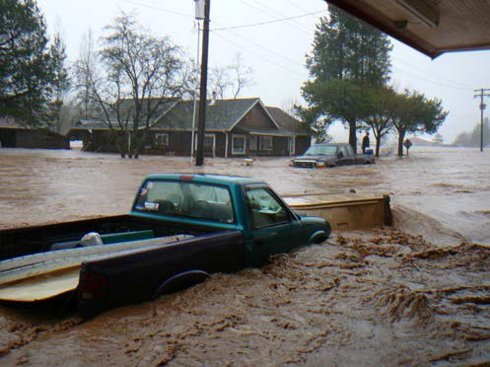
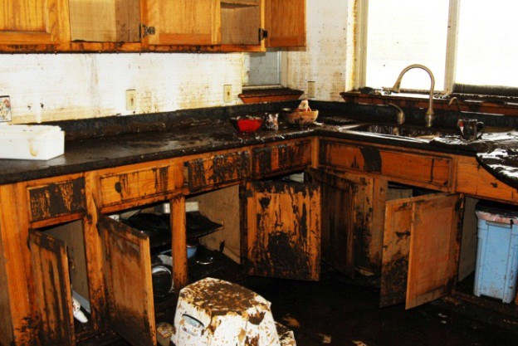
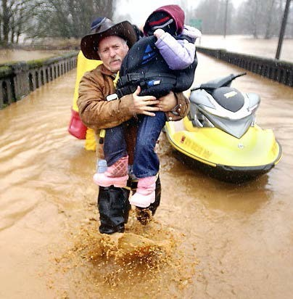
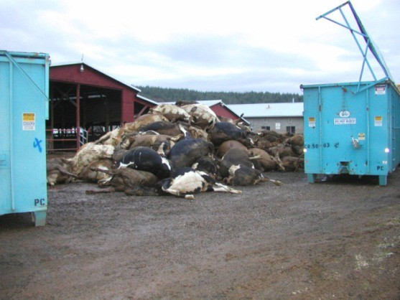

Background . . .
2007 Storm -- $938M Basin-wide damage, $300M lost economic activity (WA).
Exit 77 (I-5) in Chehalis
STEVE RINGMAN / SEATTLE TIMES
City of Centralia
STEVE RINGMAN / SEATTLE TIMES
State Route 6, West of Adna MIKE SALSBURY / AP
Photos Source: LEWIS COUNTY, DIVISION OF EMERGENCY
MANAGEMENT

Slide 7
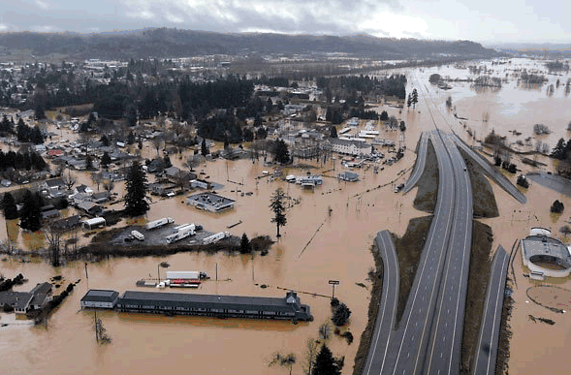
Background . . .
2007 Flood -- I-5 and Hwy 507 Interchange looking South.
City of Centralia and I-5 STEVE RINGMAN / SEATTLE TIMES

Slide 8
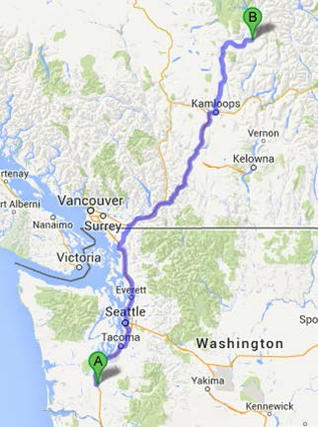
Background . . .
289,983 acre feet of measured water (12/03-08/2007).
Equivalent to covering roadway between Chehalis and North of Kamloops with 1 foot of water 1-mile wide or covering . . .
  80% of Kitsap County.
  69% of Clark County.
  59% of Thurston County.

Slide 9
Background . . .
Ranked high flow events (1932 - 2012) . . .
❑ I-5 closed 1990, 1996, 2007, 2009.
  Five largest events since 1986 -- Frequent floods are getting worse and damage is increasing . . .
  100 year flood estimate -- Increased by 33% in last 30 years.
90000
Chehalis River Flow Rates near Grand Mound (cubic ft./sec.) ₂
1
80000
3
70000
60000
4
5
50000
9
7
6
10
8
13
13
11
16
12
15
40000
30000
20000
10000
0

Slide 10
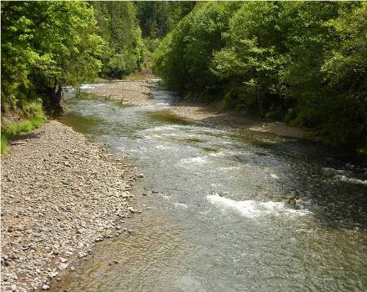
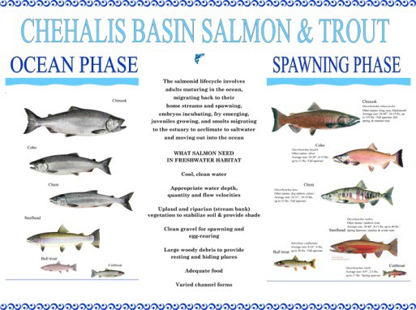
Background . . .
Chehalis is the second largest river basin in the state, rich in natural resources . . .
Salmon populations are substantially below historic levels.
Chehalis River and tributaries face significant water quality issues.
Upper Chehalis (5/31/2010)
JAMES E. WILCOX / WILD GAME FISH CONSERVATION INTERNATIONAL
www.chehalisbasinpartnership.org
10

Slide 11
Background . . .
Salmon-habitat potential
Species | Current Spawner | Habitat Degradation
Spring Chinook Salmon | 2,300 | 78%
Fall Chinook Salmon | 24,317 | 45%
Coho Salmon | 42,000 | 69%
Winter-run Steelhead | 8,700 | 44%
Source: Chehalis Basin Strategy: Reducing Flood Damage and Restoring Aquatic Species; Pe Ell Public Meeting; 10/14/2014; Page 13; https://www.ezview.wa.gov/Portals/_1492/images/Pe%20Ell%20Meeting%2010%2014%2014.pdf.

Slide 12
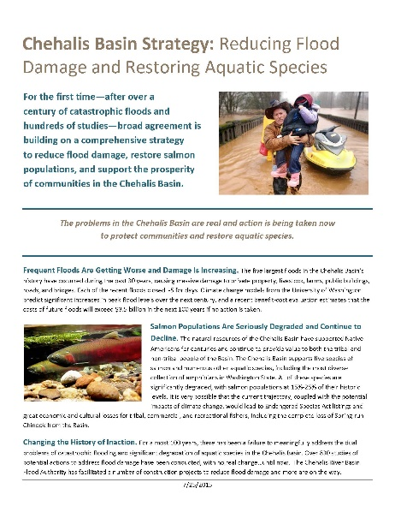
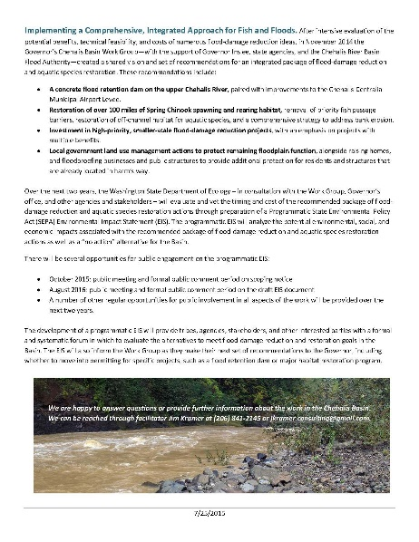
Solution = Basin-wide Approach
Action-oriented, Multi-phased Approach
Basin-Wide Relationships
Hydraulic Understanding
Master Strategy (Game Plan)
Large Capitol Projects
Small-Scale Local Projects
Local Floodplain Management
Restore Salmon and Aquatic Species
Early Flood Warning
Outreach, Education and Communication

Slide 13







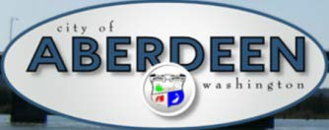













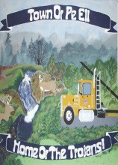

1. Basin-Wide Relationships

Slide 14
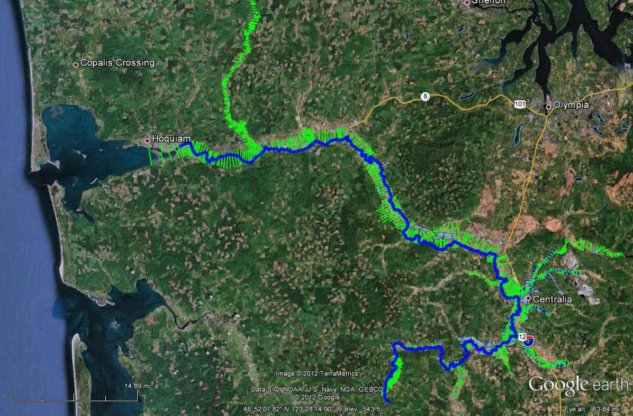
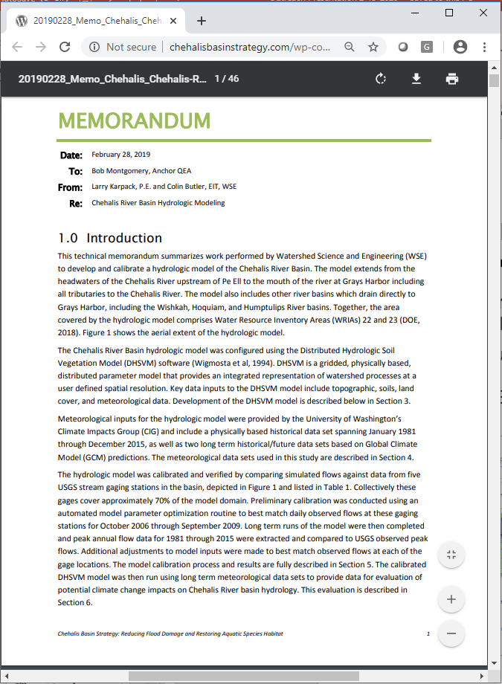
2. Hydraulic Understanding
Science-based model -- To inform decision-makers on hydraulic effects of potential flood relief options (at basin-wide and localized scales).
108 miles -- Mouth of Chehalis River upstream to Pe Ell (108 miles).

Slide 15
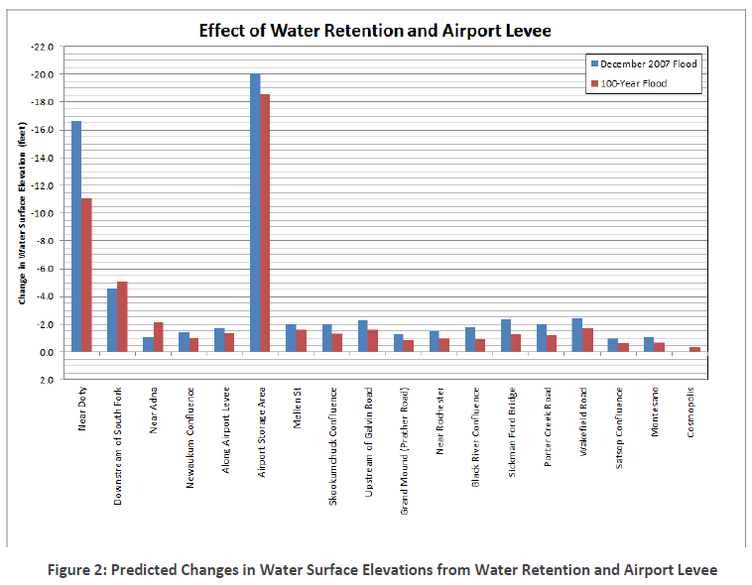
2. Hydraulic Understanding
Example: Basin- wide effects analysis (Source: Chehalis Basin Strategy: Reducing Flood Damage and Restoring Aquatic Species; Pe Ell Public Meeting; 10/14/2014; Page 51; https://www.ezview.wa.gov/Portals/_1492/images/Pe%20Ell%20Meeting%2010%2014%2014.pdf.)

Slide 16
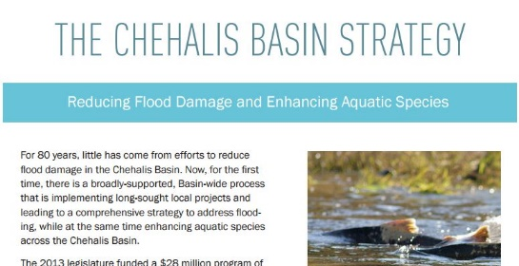
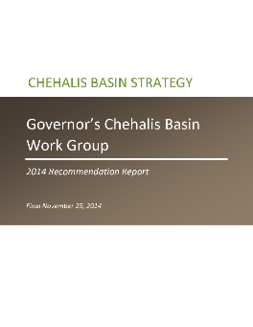
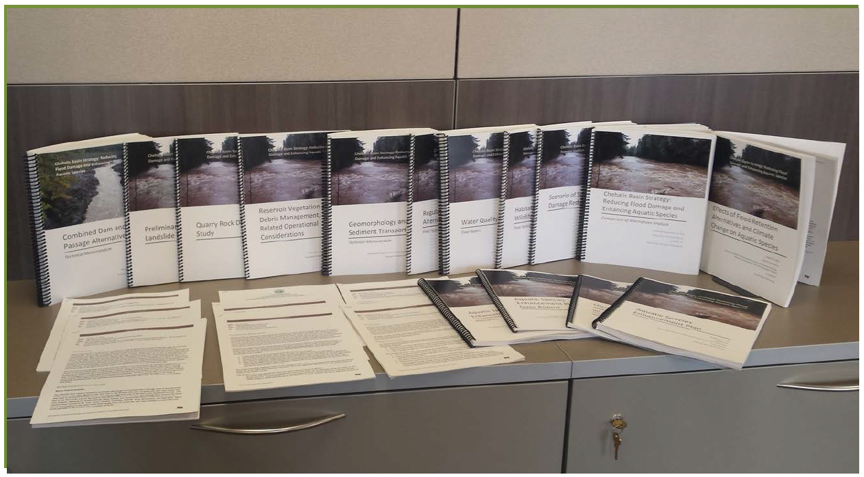
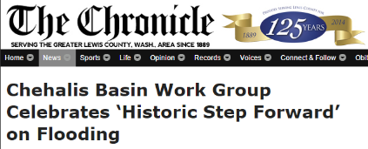
3. Master Strategy (Game Plan)
Evolution (2008 to present):
  Flood Authority → Governor’s Workgroup → Office of Chehalis Basin.
Key Elements:
  Evaluation, implementation of Large Capital Projects:
    Flood Retention Dam on upper Chehalis River.
    Airport Levee Improvements.
    North Shore Levee in Aberdeen, Hoquiam.
  Basin-wide Aquatic Species Restoration (100+ miles spawning/rearing habitat).
  Local Flood-Damage Reduction Projects.
  Local Flood-Proofing, including raising homes, CRS actions, local ordinance improvements, etc.
  Costs/Benefits: Cost = $500-600M; Benefit = $720M (100 yrs.); No Action = $3.5B (100 yrs.).

Slide 17
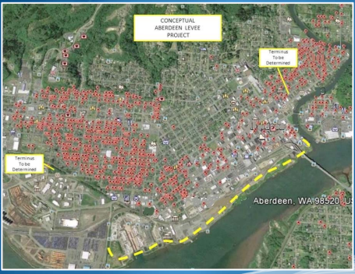
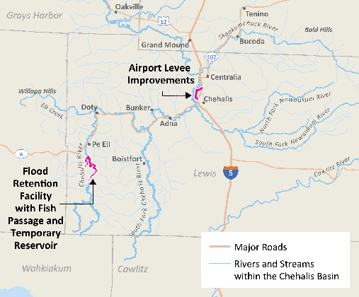
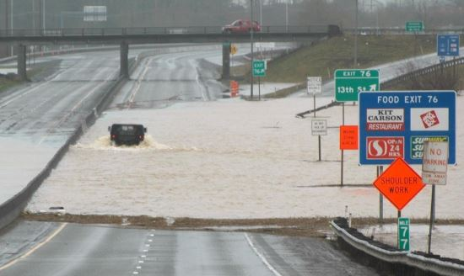
Aberdeen Proposed Northside Dike/Levee
4. Large Capitol Projects
2013-15:
  Technical team developed baseline knowledge on safety, feasibility of Flood Retention Dam alternatives -- field visits, site and design considerations, world-wide research, etc.
    Permanent reservoir (w/ fish passage) or Run-of-the-river (no permanent reservoir).
    Roller compact concrete or Earthen fill.
    Flood-control only or Multi-purpose.
  WSDOT evaluated I-5 Protection alternatives -- levees, walls, raise road, etc.
2015-17:
  Formal environmental review (Programmatic EIS) was conducted to evaluate alternatives.
2017-19:
  CBFCZD Project-level EIS starts.
2019-21:
  CBFCZD Project-level EIS continues.

Slide 18
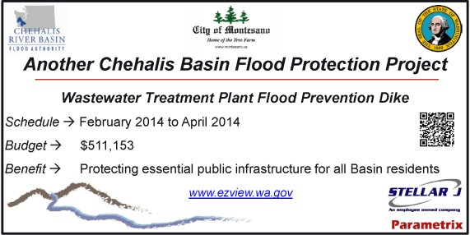
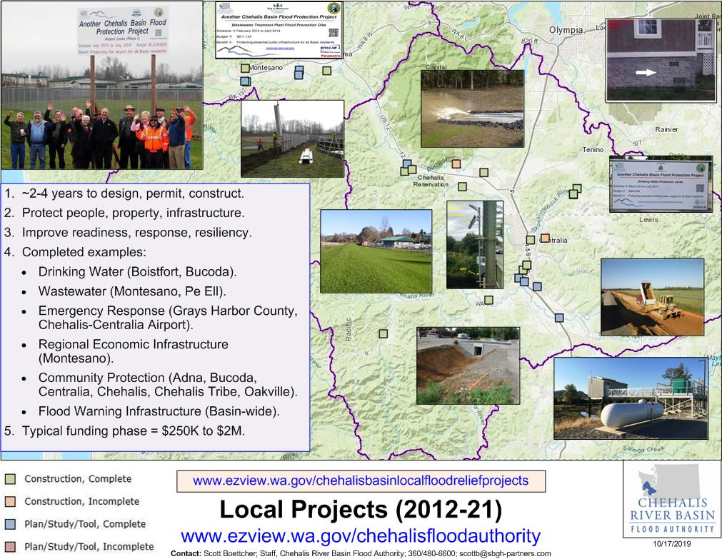
5. Local Projects (Basin-wide)
2012 Sup Capital Budget:
$5.0M
2013-15 Capital Budget:
$10.7M
2015-17 Capital Budget:
$15.7M
2017-19 Capital Budget:
$9.6M
2019-21 Capital Budget:
$6.3M
26 complete
10 underway
$46.7M State (2012-21)
$10.8M Local (2012-21)

Slide 19
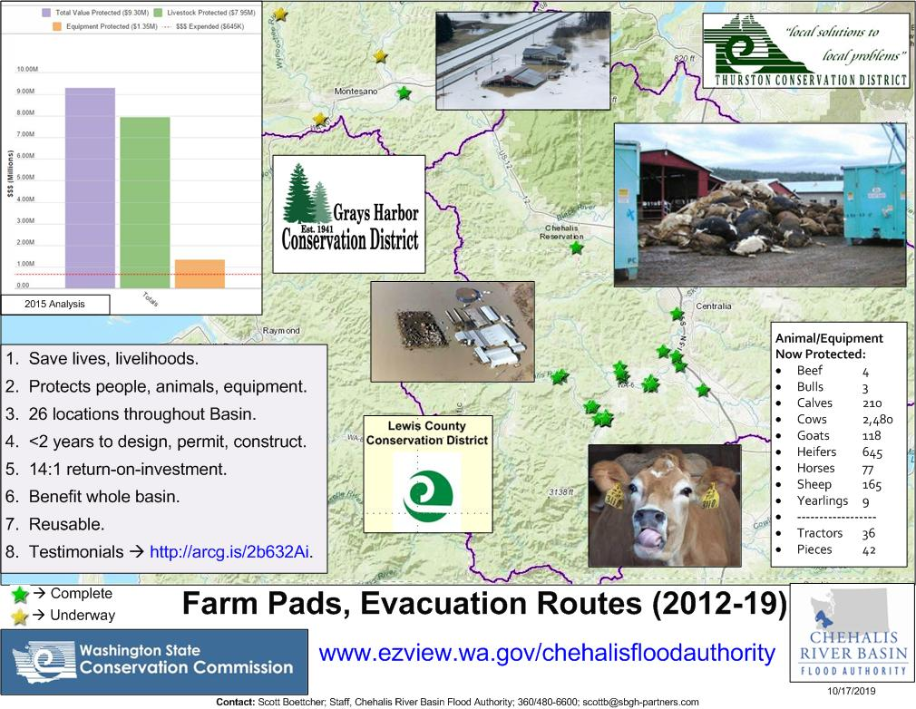
5. Local Projects (Farm Pads)

Slide 20
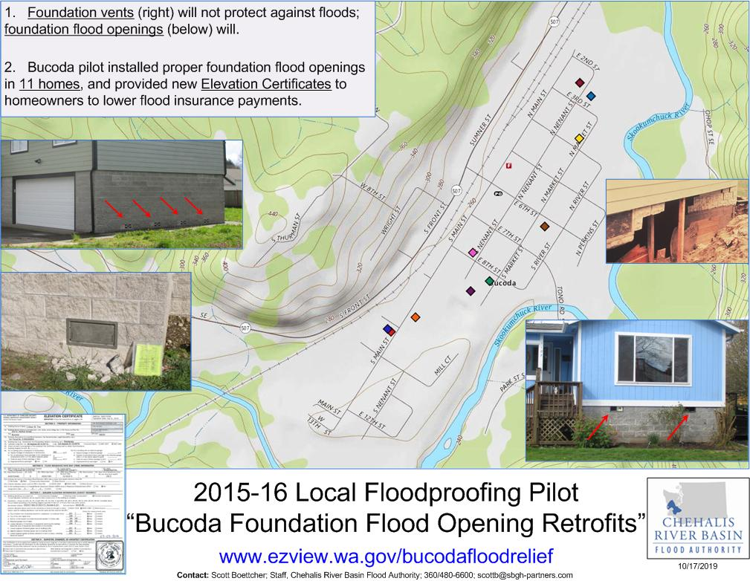
6. Land Use, Floodplain Management (Floodproofing Pilot)

Slide 21
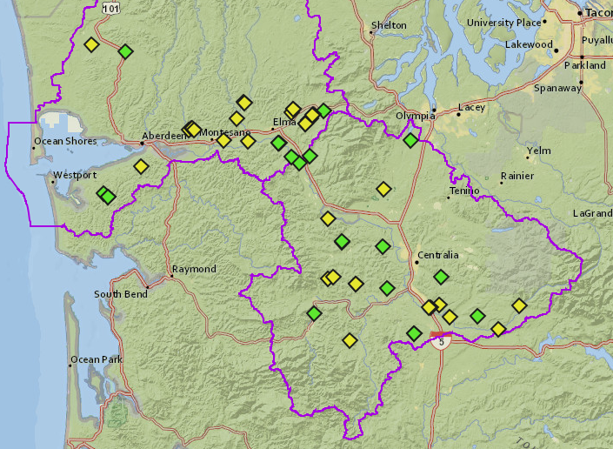
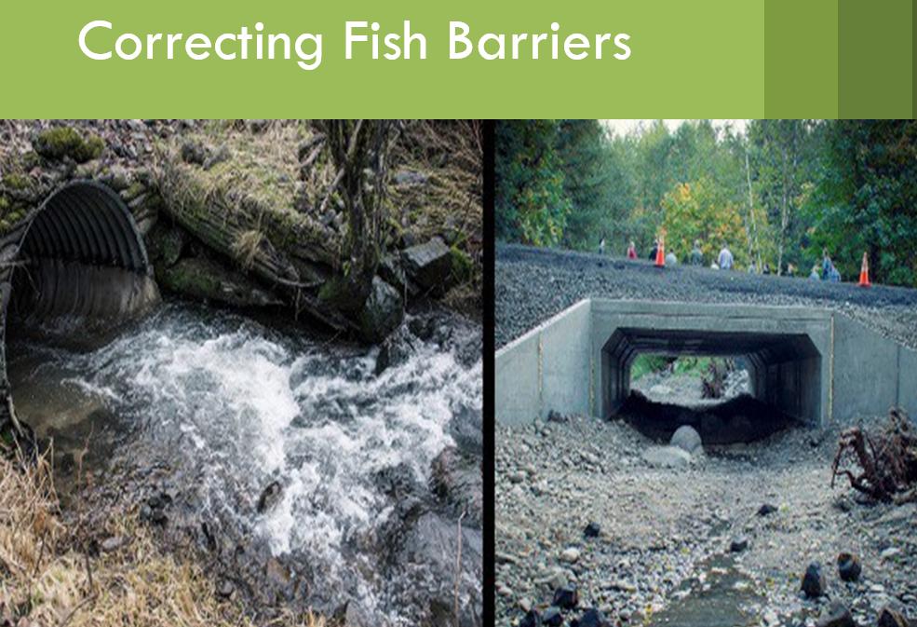
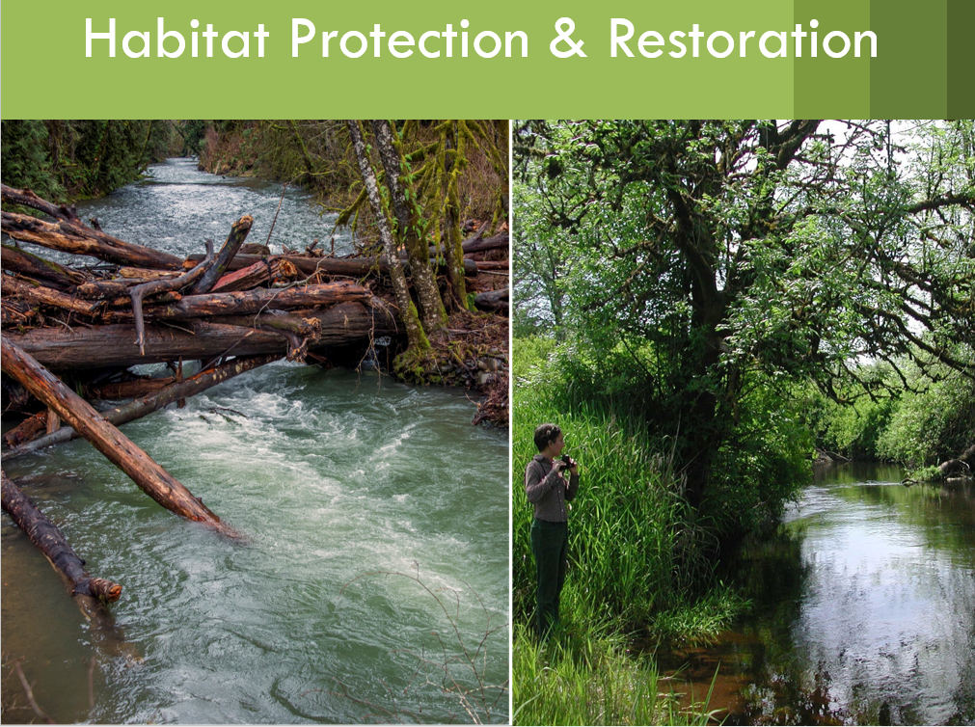
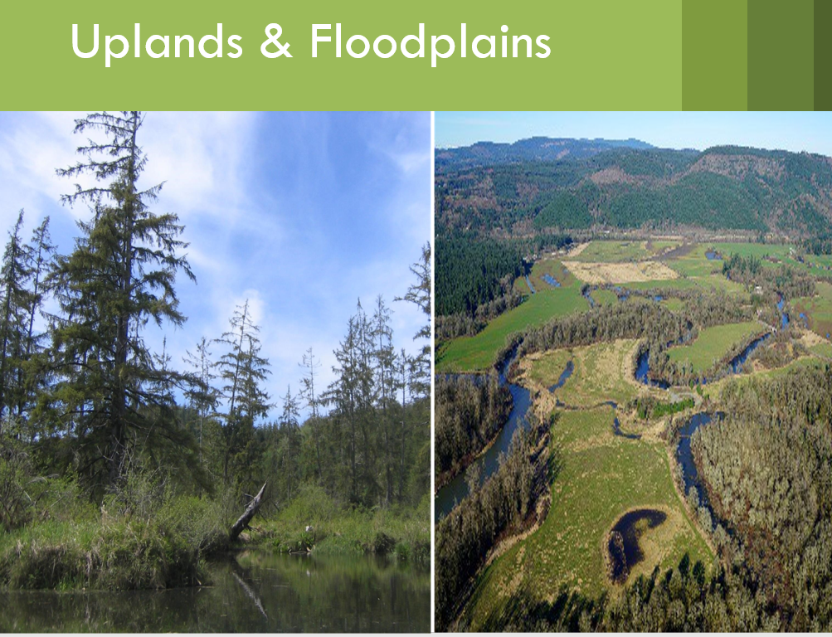
7. Restore Salmon and Aquatic Species
Results so far (2019) . . .
23 Complete ($3.8M)
31 Underway ($7.9)

Slide 22
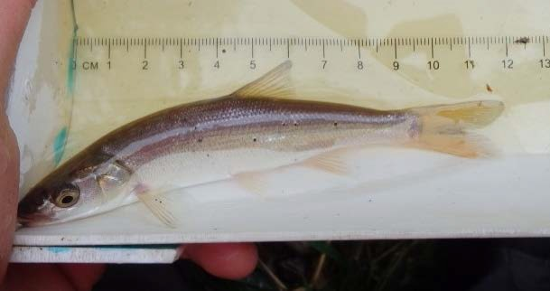
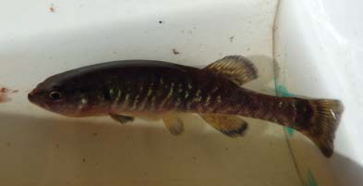
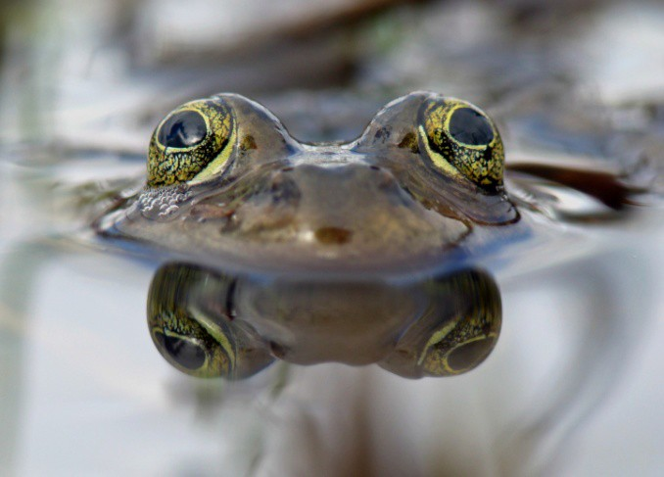
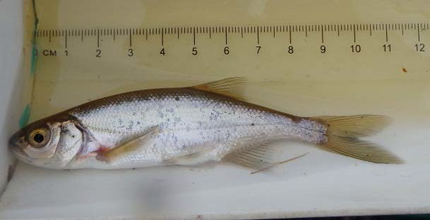
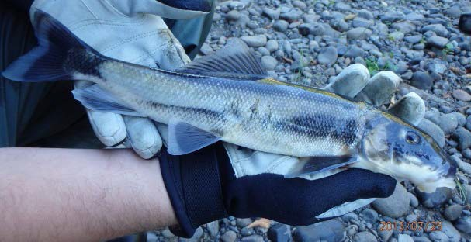
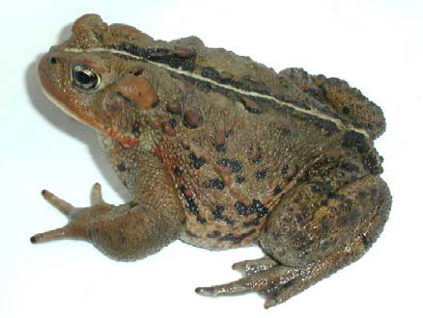
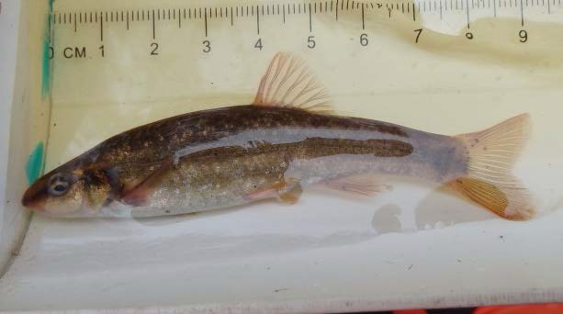
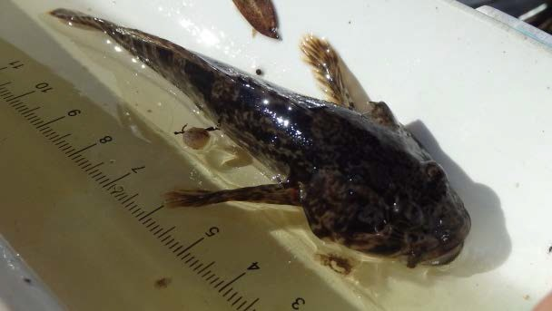
7. Restore Salmon and Aquatic Species
Other Fish and Aquatic Species
Northern Pikeminnow
Olympic Mudminnow
Oregon Spotted Frog
Redside Shiner
Largescale Sucker
Longnose Dace
Western Toad
Sculpin (6 species)

Slide 23
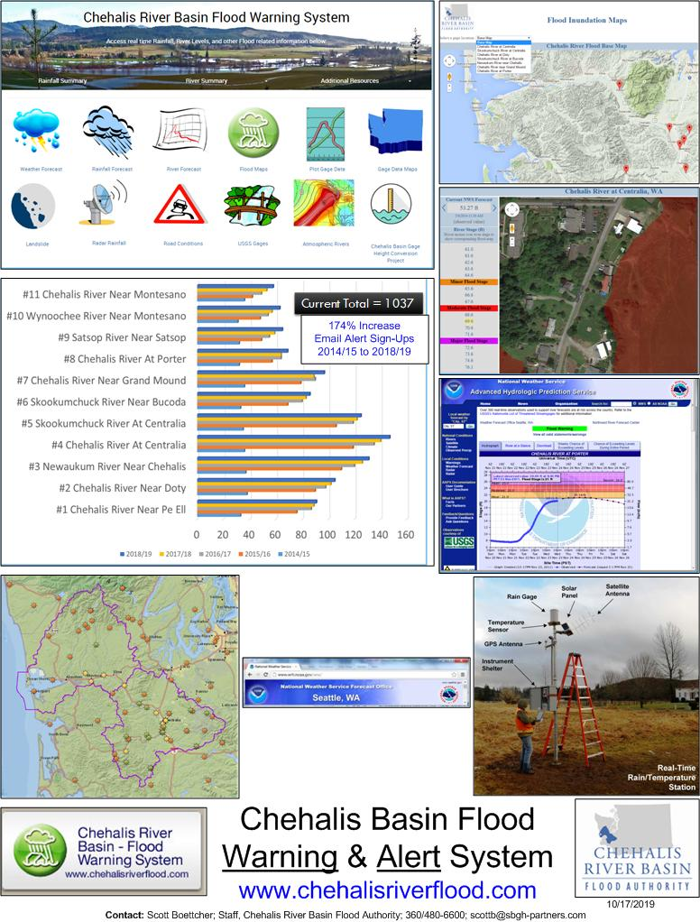
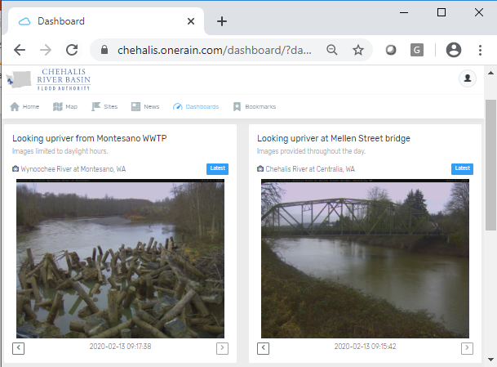
8. Early Flood Warning
www.chehalisriverflood.com
Front-facing website.
Data collection, data synchronization.
Improved forecasting, early-warning.

Slide 24
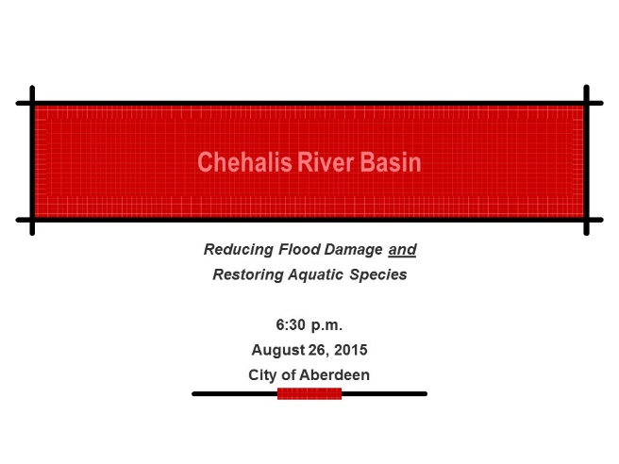
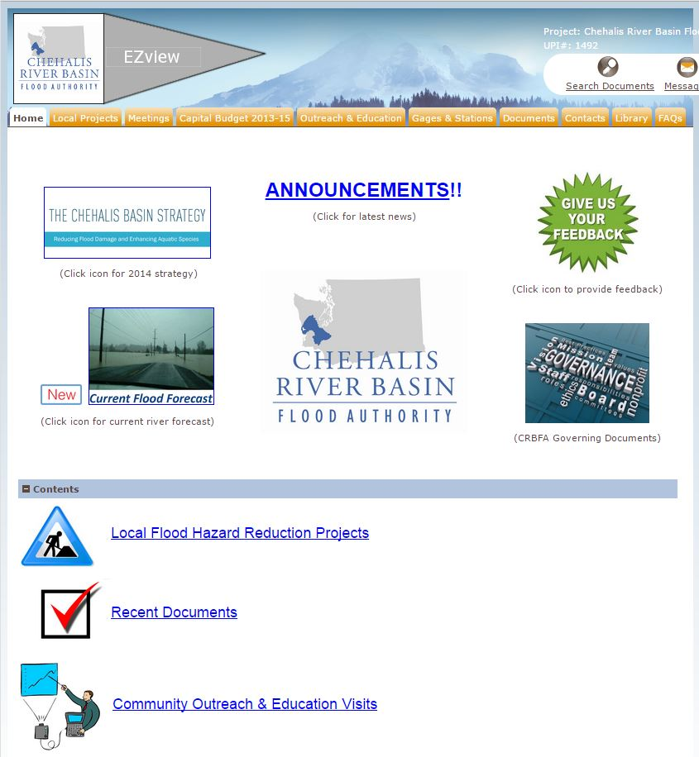
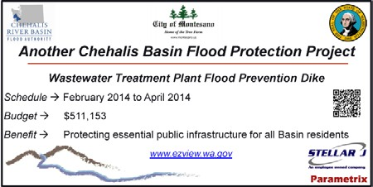


9. Outreach, Education and Communication
Outreach Visits
Project Signs
Website
Informational Analyses
Chehalis Basin Flood Stories

Slide 25



9. Outreach, Education and Communication
www.ezview.wa.gov/chehalisfloodauthority
www.chehalisbasinstrategy.com
www.chehalisriverflood.com

Slide 26

Closing – 2007 Flood Damage . . .
Chehalis River near Doty USGS

Slide 27

Closing – 2007 Flood Damage . . .
Clearing Mud in Curtis, WA
STEVE RINGMAN / SEATTLE TIMES

Slide 28

Closing – 2007 Flood Damage . . .
Curtis, WA, Aftermath of 7 Feet of Water STEVE RINGMAN / SEATTLE TIMES

Slide 29

Closing – 2007 Flood Damage . . .
Chandler Road Bridge near Doty, WA
STEVE RINGMAN / SEATTLE TIMES

Slide 30

Closing – 2007 Flood Damage . . .
30

Slide 31

Closing – 2007 Flood Damage . . .

Slide 32

Closing – 2007 Flood Damage . . .
I-5 Under Water BRUCE ELY / OREGONIAN

Slide 33

Closing – 2007 Flood Damage . . .
Chehalis, WA STEVE RINGMAN / SEATTLE TIMES

Slide 34

Closing – 2007 Flood Damage . . .

Slide 35

Closing – 2007 Flood Damage . . .
Jackson Street, Centralia, WA STEVE RINGMAN / SEATTLE TIMES

Slide 36

Closing – 2007 Flood Damage . . .
I-5 Under Water
BRUCE ELY / OREGONIAN

Slide 37

Closing – 2007 Flood Damage . . .
Photos Source:
WSDOT

Slide 38

Closing – 2007 Flood Damage . . .

Slide 39



Closing – 2007 Flood Damage . . .

Slide 40

Closing – 2007 Flood Damage . . .
Wakefield Road, Elma, WA
GREG GILBERT / SEATTLE TIMES
40

Slide 41

What’s Next – Floodplain Regulations
41

Slide 42

What’s Next – Draft EIS
42

Slide 43

What’s Next – Long-Term Strategy
https://www.ezview.wa.gov/DesktopModules/Documents2/View.aspx?tabID=37068&alias=1962&mid=70197&ItemID=8343
43

Slide 44

What’s Next – 2021-23 Local Projects Solicitation
https://www.ezview.wa.gov/site/alias__1492/37282/2019-21-Local-Projects-Recruitment-Process.aspx
44

Slide 45
For Further Information . . .
Vickie Raines, Grays Harbor County Representative
Chair, Chehalis River Basin Flood Authority
Chair, Chehalis Basin Board
360/249-3731
vraines@co.grays-harbor.wa.us
Edna Fund, Lewis County Representative
Vice-Chair, Chehalis River Basin Flood Authority
Member, Chehalis Basin Board
360/740-1283
Edna.Fund@lewiscountywa.gov
Scott Boettcher
Staff, Chehalis River Basin Flood Authority
360/480-6600
scottb@sbgh-partners.com
Chrissy Bailey
Staff, Office of Chehalis Basin
360/407-6781
chrb461@ECY.WA.GOV

Slide 46
Key Links . . .
Key Organizations:
Chehalis River Basin Flood Authority -- www.ezview.wa.gov/chehalisfloodauthority
Office of Chehalis Basin -- https://ecology.wa.gov/About-us/Get-to-know-us/Our-Programs/Office-of-Chehalis-Basin
Chehalis Basin Board -- https://www.ezview.wa.gov/site/alias__1962/37068/chehalis_basin_board.aspx
Chehalis River Basin Flood Control Zone District -- https://www.chehalisriverbasinfczd.com/
Chehalis Basin Lead Entity -- http://www.chehalisleadentity.org/
Key Activity Areas:
Flood Warning System -- www.chehalisriverflood.com
Local Projects -- https://www.ezview.wa.gov/site/alias__1492/34489/local_projects.aspx
EIS -- https://ecology.wa.gov/About-us/Get-to-know-us/Our-Programs/Office-of-Chehalis-Basin/EIS
Long-Term Strategy -- https://www.ezview.wa.gov/DesktopModules/Documents2/View.aspx?tabID=37068&alias=1962&mid=70197&ItemID=8343
Chehalis Basin Strategy -- www.chehalisbasinstrategy.com
ASRP -- http://chehalisbasinstrategy.com/asrp/
Flood Retention Facility (operation) -- https://www.dropbox.com/s/cnlkmoj3ftw06ag/Chehalis_Final_09.30.2019.mp4?dl=0 (visualization)
Also → Sign-Up for Email Gage Alerts -- https://www.ezview.wa.gov/Portals/_1492/images/2019-20%20Flood%20Warning%20System%20Gage%20Alerts%2010-15-2019.pdf

Slide 47

Key Organizations . . .

Slide 48
Thank You . . .
Thank You!
Note:
This Presentation is Available at “Chehalis River Basin Flood Authority” Website at www.ezview.wa.gov/chehalisfloodauthority.
Email Distribution Lists
Pat Anderson (Flood Authority)
Pat.Anderson@lewiscountywa.gov
Cindy Bradley (Office of Chehalis Basin)
Cindy.Bradley@ecy.wa.gov

