Slide 1
Chehalis Flood Authority Update for 2020
David Curtis and Jeffery Budnick
WEST Consultants, Inc.

Slide 2
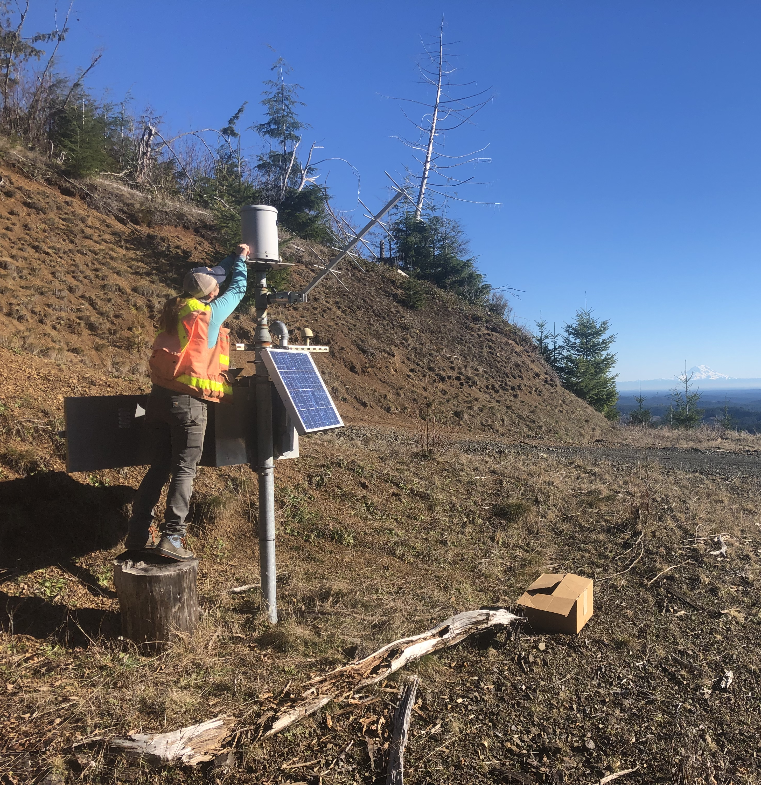
Topics
Precipitation gages
FWS system improvements in 2020
Webcam relocation opportunity
Upcoming weather trends, projections
Notes:
Photo is of routine maintenance at Haywire rain gage on a clear, sunny day. Mt. Rainer in background. Routine maintenance is performed every 3 months or as need by checking real-time telemetry. Rain gages are calibrated in late summer before the rainy season begins.

Slide 3
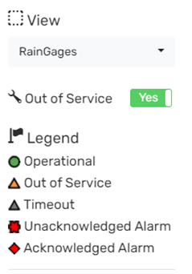
Chehalis Basin Precipitation gages
Notes:
Map of active precip gages in Chehalis Flood Warning System (40). The map provides a quick reference for which gages are operational an up to date. For example you can see 4 gages displayed as gray triangles meaning they are timed out. These are seasonal gages operated by USGS. Quickly accessible via maps on Chehalis.onerain.com

Slide 4
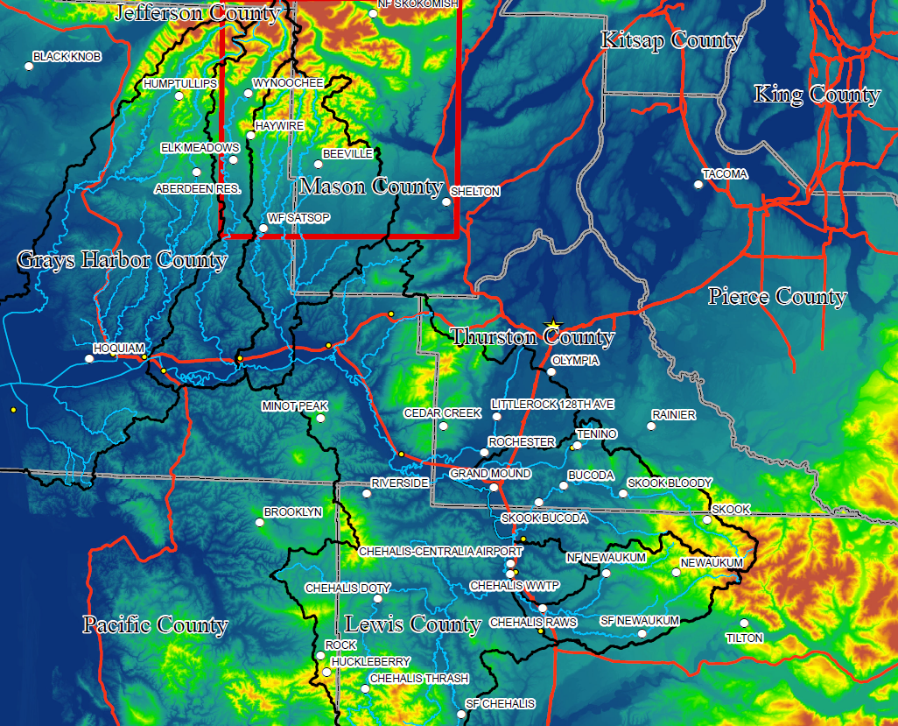
3d Maps of Chehalis Precipitation Gages
Notes:
A colorized elevation map of the Chehalis basin displaying precipitation gages is shown on the left. High elevations in red are over 8000 ft while deep blue is -40 or greater. The map on the right is a 3D representation of a select number of gages shown in the red rectangle on the 2D map. Haywire located on southern front of Olympics and is one of NWS’ favorite gages West of I-5.

Slide 5
Relocation of precipitation gages
Six gage locations on private timberland
Permitting/access issues
Tree growth over last decade
30 degree angle from top of gage
Causes turbulence and eddy currents
Notes:
There are 6 precip gages located on private timberland. Unique access agreements have had to be worked out of the years. This pictures is a panorama of Brooklyn precip gage and shows tree growth in close proximity to the rain gage. Growth over the last decade has infringed on the ideal 30 degree sight angle from the top of the rain gage. Large objects near the gage may cause turbulence and eddy currents reducing precipitation. Severe tree growth over the gage may significantly reduce captured precipitation.

Slide 6
Chehalis Basin Precipitation gages
Haywire
Skookumchuck
Brooklyn
Newaukum
Rock
Chehalis Thrash
Notes:
Map of precip gages in Chehalis Flood Warning System (40) shown on terrain map. There are 6 gages in need of relocation due to tree growth. Haywire is on Green Diamond property while the 5 gages to the south are located on Weyerhaueser land.

Slide 7
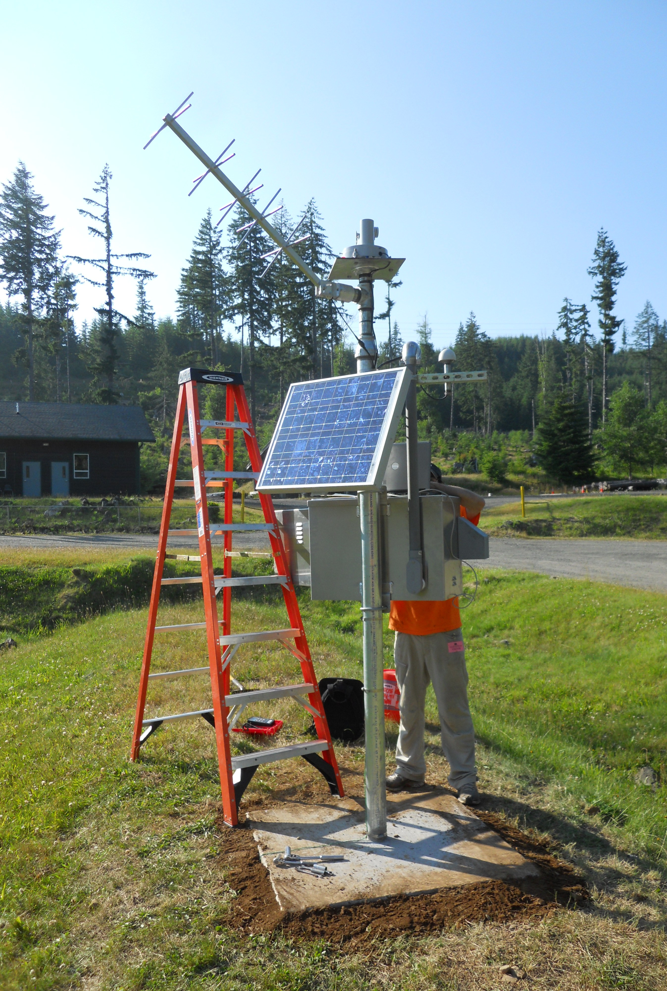
Relocation efforts
Discussion with NWS
Distribution of gages
Public vs. private lands
DNR, County vs. Weyerhaeuser, Green Diamond
Access agreements
Field reconnaissance
Relocations in late spring 2021
Minimal downtime
Reusing equipment
Notes:
This picture is of installation of Cedar Creek Correctional facility rain gage in 2012. This is a really good rain gage location located on pubic property that will be able to collect a long term record. The current distribution of gages is pretty good, however we’ve discussed filling some holes in the network identified by NWS. For future gage locations we will ideally install on public land where long term records can be developed. Examples of public land being researched are land owner by DNR and counties. Higher elevation sites are preferred, however, public property is limited in those locations.

Slide 8
Flood warning system improvements in 2020
Webcams moved to Contrail Camera
https://chehalis.onerain.com/dashboard/?dashboard=4a77124f-3311-4f07-963f-a3f302bf8335
River Cross Section Dashboard
https://chehalis.onerain.com/dashboard/?dashboard=a8b9f8b0-145d-48c3-b666-caee415ca68e
Notes:
Webcams moved to Contrail Camera in early 2020. Users can scroll back in time easily. Benefits of webcams include tracking geomorphic change over time, verifying conditions in the field (especially if a gage were to malfunction), and providing photos which can be very powerful and relate information easier than a timeseries graph.
A river cross section dashboard was developed from surveyed cross section data. This dashboard is a powerful tool to visualize what the current water level looks like in relation to the channel shape. Flood thresholds are also displayed on the graph. HW alert, minor, moderate, major

Slide 9
Webcam Features
Photo
~39 ft NAVD 88
Daily and historical movies
Example: Satsop webcam from January 6, 2020 to January 8, 2020.
Example: Satsop webcam from January 11, 2020 to September 15, 2020
https://www.dropbox.com/s/elz6ku3l5xlpif9/SatsopPP.MP4?dl=0
https://www.dropbox.com/s/1wu7c2f6f54zuvq/Satsop.mp4?dl=0
Notes:
HW alert, minor, moderate, major. Webcam photos are timed stamped allowing us to correlate an image with stage data collected at a gaging station. The photo on the left was take on Jan. 7 @ 930am and the time series graph was output from the Flood Authority website. The image shows flooding extent of the Satsop river jumping its banks and provides a powerful reminder of what minor flooding can look like.
Notices the trees on the left side of the video (right riverbank) as they are taken out by this small flood peak.
In this second video from Jan. to Sept. notice how vegetation reoccupies a gravel bar upstream of the Monte Elma bridge. A tree also becomes lodged in the channel on the right side of the image and continues to produce leaves while living in the channel.

Slide 10
Webcam relocation
Satsop River at Monte Elma Bridge
Lower Satsop River at Port of Grays Harbor Well
Looking upstream
Looking upstream
Notes:
The picture on the left shows the current location of the Satsop webcam which is being considered for relocation. The image on the right shows the potential new location at the Port of Grays Harbor well facility. The new location would have the webcam mounted on an existing tower structure so the viewpoint of the image would be elevated 10-15 feet capturing a good view of the bank protection and restoration project occurring on the lower Satsop. Cost to move an existing webcam is approximately $3000 for a crew of two to remove the camera from the Monte Elma bridge and deploy it at POGH well.
New, 4th camera, would cost $5k for hardware if we can use AC power, $2k install labor, $420/yr Contrail Camera, and $600 in cellular fees/year. Could also research cheaper camera option but might reduce quality and reliability.

Slide 11
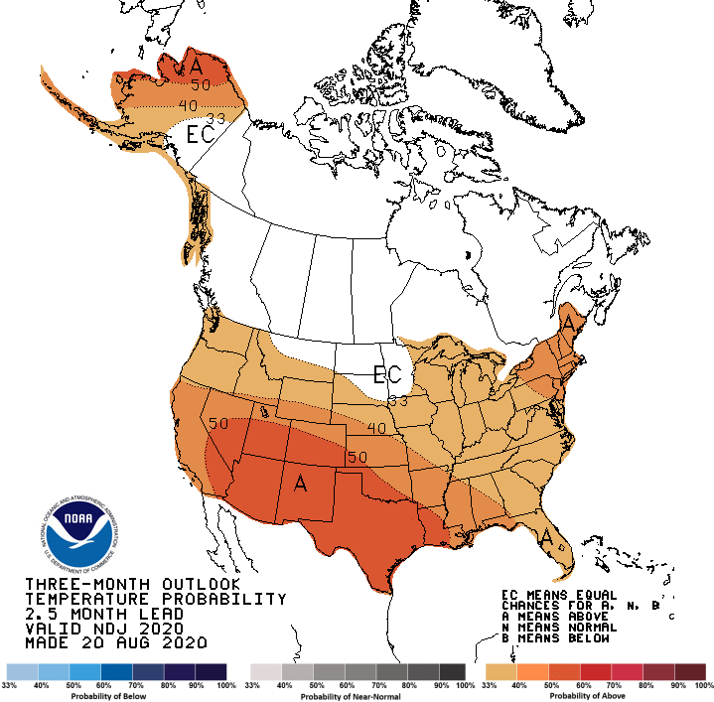
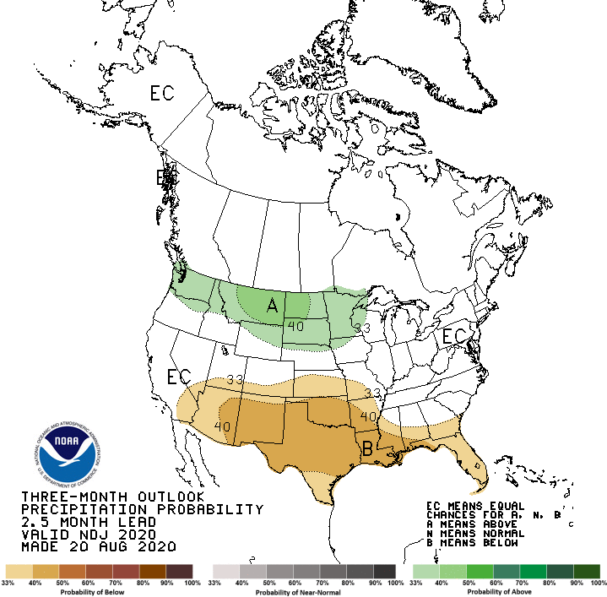
weather trends and projections
November, December, January 2020-21

Slide 12
Questions?
David Curtis dcurtis@westconsultants.com
Jeffery Budnick jbudnick@rivermeasurement.com

