Slide 1
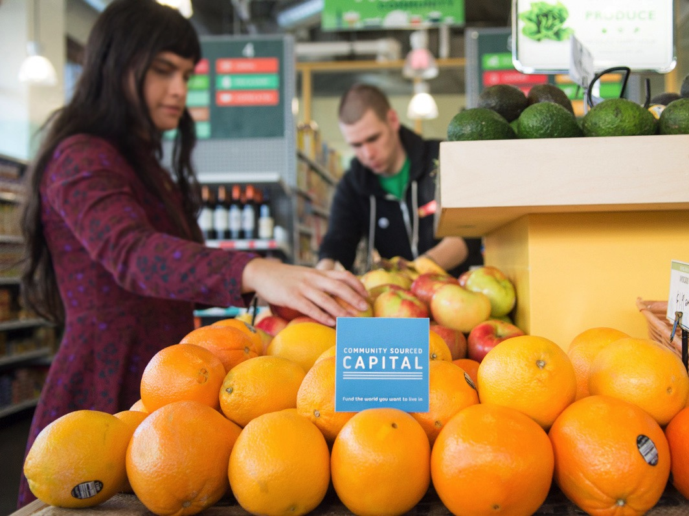
COMMUNITY SOURCED CAPITAL
Let’s build innovative financial systems for communities

Slide 2
Crowdfunding is on the rise
2011
$1.5 Billion
2012
$2.7 Billion
2013
$5.1 Billion

Slide 3
How does it apply to small businesses?
Benefits
Marketing tool to spread the word and build brand awareness
Mechanism to engage community and customers
Faster and more flexible than traditional sources

Slide 4
Local Finance + CSC
Current system is weird
Most small businesses can’t access bank loans
Conscientious citizens ask: how is my money being used?
Small companies matter to economies and livelihoods – yet totally underserved by system
The only people who can access capital don’t need it
The people who want to do something about it… can’t
Notes:
State of the Union example

Slide 5
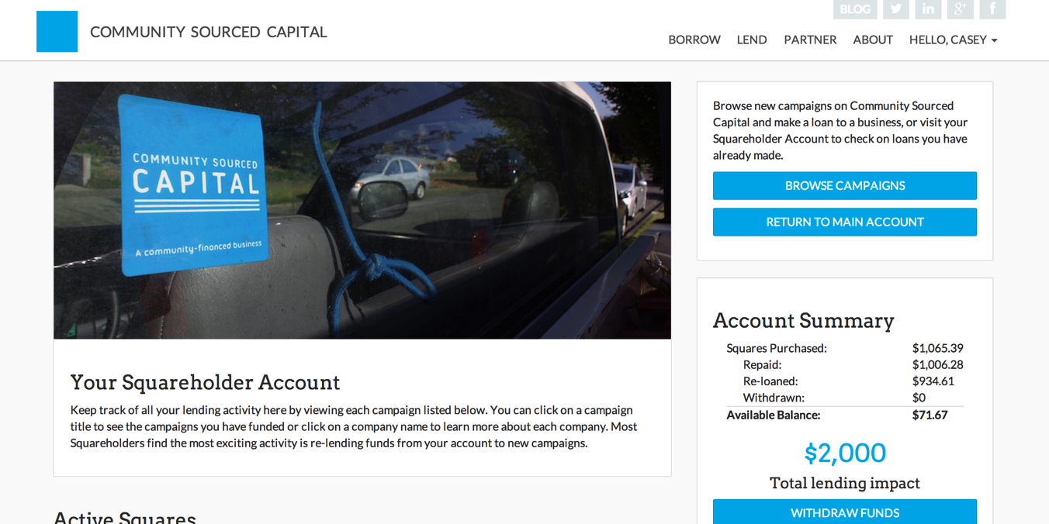
So we build a local lending system

Slide 6
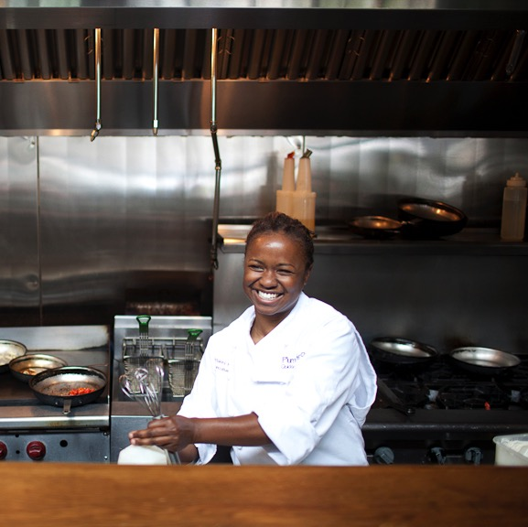
It works for all sorts of businesses
Plum in Seattle, WA
$47,000 raised for new location, half from matching partner
166 Squareholders, 85% local or connected
At $50/month paid to CSC for 36 months, this is an equivalent APR 2.5%

Slide 7
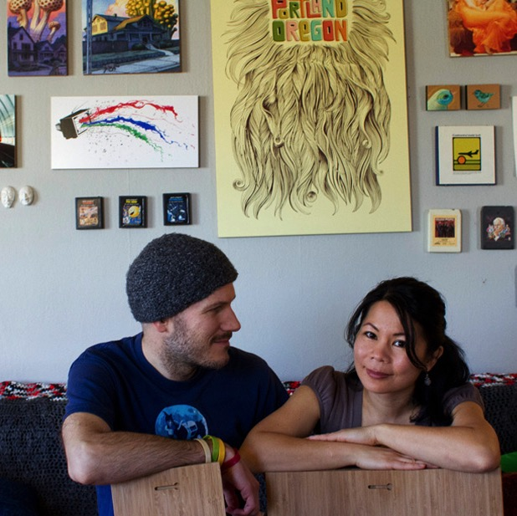
And in many communities
Plywerk in Portland, OR
$21,300 raised for new equipment and product development
196 Squareholders, people contributing between $50 and $1,000
Activated a larger stack of capital from a CDFI lender

Slide 8
It’s Compatible Capital
Partnerships
Co-lending
Formal referrals
Sponsorship programs
In development
Technical assistance
Technology sharing
Marketing local finance
$250K to deploy through CSC
1:1 match for geographic areas or minority-owned
Zero interest / payback terms same as Squareholders
Notes:
CASEY

Slide 9
A right-sized lending mechanism
$50 units of a larger loan
Not a donation
Not an investment
Fair and square
$50
$50
$50

Slide 10
And it keeps money moving
Squareholder repayments
Cash out at any time
Recycle into new loans
25% recycle rate
$50
$50

Slide 11
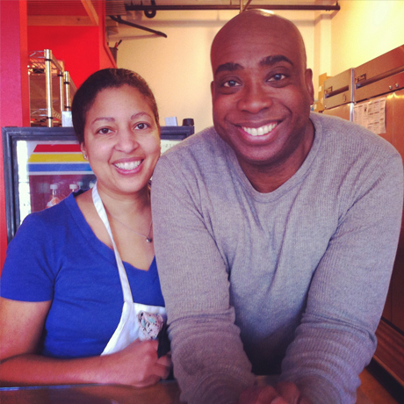
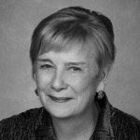
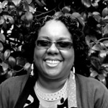
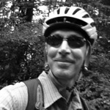
Fund the world you want to live in
“I simply believe in this entrepreneur”
“I love this small company and want to see it flourish”
“This business makes my community a better place”

Slide 12
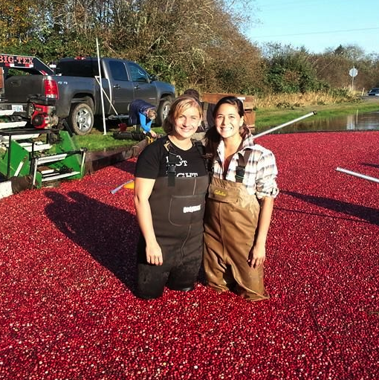
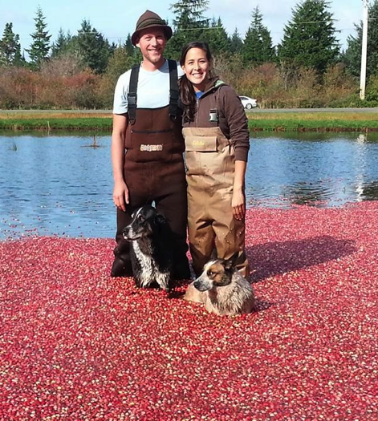
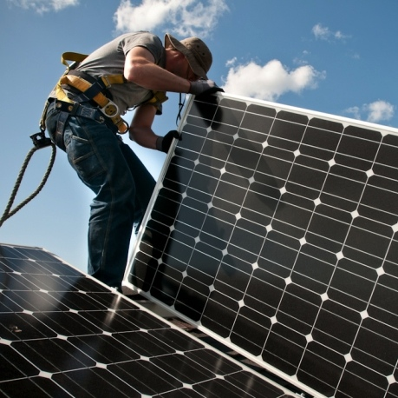
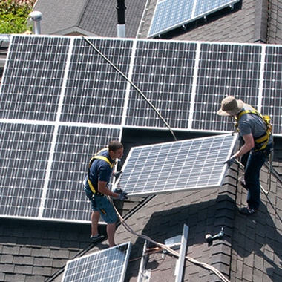
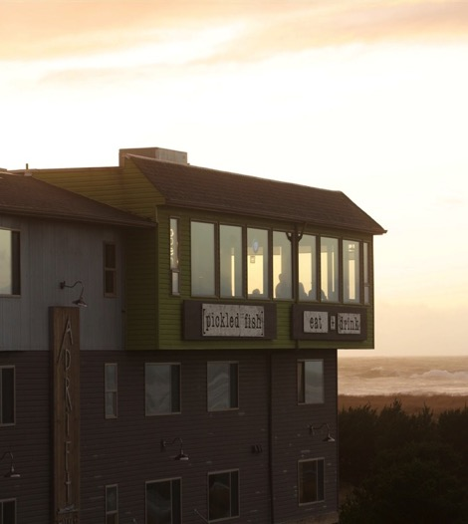
Great loans for great businesses
$12,000 loan
110 Squareholders
$25,000 loan
180 Squareholders
$18,000 loan
175 Squareholders

Slide 13
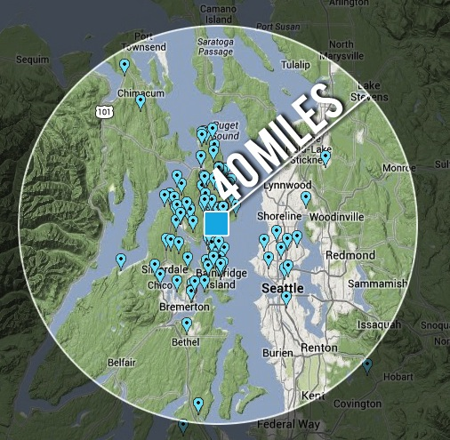
Seriously local finance
The Food Shed in Kitsap
90% from 40 miles
170 new customers
Stronger relationships

Slide 14
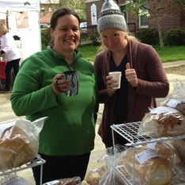
Our structure for success
Campaigns for funding
4 weeks to raise between $5k and $50k for a loan
Toolkits with examples, templates and outreach tools help fundraising (we’re teaching people how to fundraise)
90% of our campaigns are funded, compared with 43% at Kickstarter

Slide 15
Social capital is the core of eligibility
Eligible businesses…
Can use $5k-$50k for a growth project
Have proven revenue
Can repay in 1-3 years
Can connect to their community via email, social media or in-person
Project budget
Financial health
Community connection

Slide 16
Part of the crowdfunding continuum
Funders outright donate money, typically for charitable causes
Donation: Reward or Perk
Funders provide donations in exchange for perks or rewards
Lending: in hopes of repayment
Funders provide capital in exchange for ownership or financial upside
Investing: for pure financial upside
Donation: no return; outright gift
Funders provide money as a loan that can hopefully be repaid
Idea Stage or New
More 1 Year Operation
Mature and Growing
Idea Stage or Nonprofit

Slide 17
We’re part of the capital continuum
Less than $5,000
$5,000 - $50,000
More than $50,000

Slide 18
And we’re just getting started
Our first 42 loans
3,333 Squareholders
All loans in good standing
$225,000 repaid so far
$634,550
capital created by communities for communities
Notes:
CASEY

Slide 19
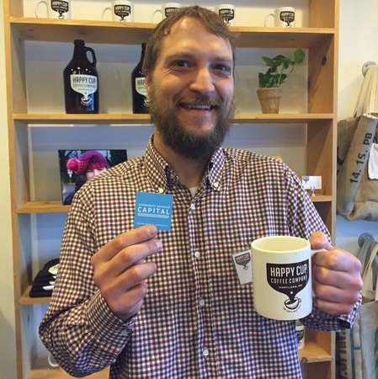
Growing the economy in our backyard
Serving PNW businesses
Simple membership pricing at $250 to launch and $50/month during repayment
Thought-leading content for businesses, investors and partners
Mission-aligned partnerships with local financial institutions

Slide 20
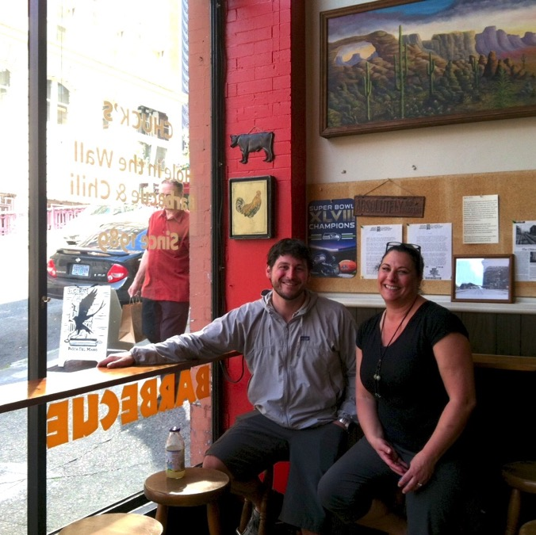
Our own economic growth story
We’re here for a reason
One of the first social purpose corporations
Certified B Corporation
Funded by private impact investors at about $400k so far
We’re between for-profit tech and non-profit microfinance

Slide 21
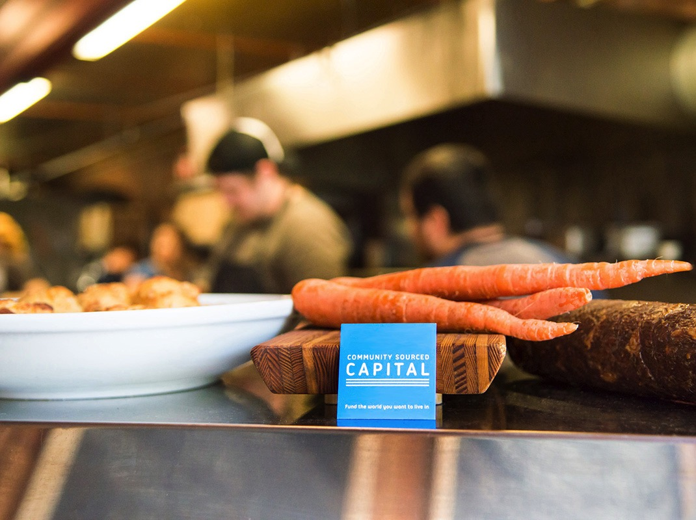
facebook.com/Squareholder
@Squareholder on twitter

