Slide 1
G2: 4.1.a Increased State Certification Utilization
Diversity in Washington State
Contracts, Procurement, Public Works and Transportation
Department of Enterprise Services
Chris Liu
July 29, 2015

Slide 2
G2: 4.1.a Increased State Certification Utilization
What we are hearing from our customers and communities
Barriers to doing business
Difficult and inconsistent processes
Current performance numbers
Notes:
Barriers
Bonding, access to capital
Review state statutes and policies

Slide 3
Current state
G2: 4.1.a Increased State Certification Utilization
Data not standardized
Many independent efforts but no central focus
No common language
No statewide community of practice
Notes:
Opportunities:
Leverage private sector and agency best practices
Broaden training

Slide 4
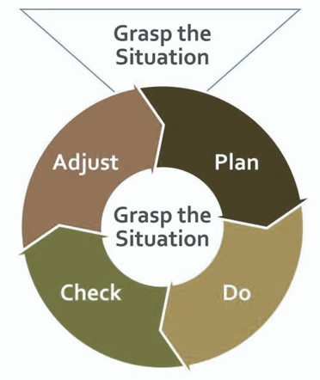
G2: 4.1.a Increased State Certification Utilization
Strategy and next steps
Work with community members to develop a common understanding of the issue.
Form a subcabinet.
Mobilize a team to support the subcabinet (address the “how”).
Lean
Notes:
Subcabinet is a policy making body
Support team tackles the how
Actually working with our “customer group”

Slide 5
G2: 4.1.a Increased State Certification Utilization
Subcabinet Agency Members
Dept. of Transportation, Lynn Peterson
Dept. of Social and Health Services, Kevin Quigley
Health Care Authority, Dorothy Teeter
Dept. of Enterprise Services, Chris Liu
Dept. of Corrections, Bernie Warner
Dept. of Labor & Industries, Joel Sacks
Dept. of Veteran Affairs, Alfie Alvarado-Ramos
Office of Minority & Women’s Enterprises, Alexis Oliver
Commission on African American Affairs, Ed Prince
Commission on Asian Pacific American Affairs, Michael Itti
Commission on Hispanic Affairs, Uriel Iniguez
Attorney General’s Office, Laura Watson
Governor’s Office representative(s)
Represent more than 2/3 of state spending
Community of practice
Community transparency, reporting and communication
Single source legal counsel
Notes:
These agencies were picked on the basis of their volume of contracting, procurement or public works projects
Based on calendar year 2014

Slide 6
G2: 4.1.a Increased State Certification Utilization
Organizational structure
Regular meetings with community members
Subcabinet formed July 15
Subcabinet meets Aug. 4; then every third week
Support team for subcabinet formed July 20; meets daily
Community
Support team
Subcabinet
Governor’s Office
Notes:
Key community member group: Civil Rights Coalition of 25
Other examples: National Association of Minority Contractors, Tabor 100

Slide 7
G2: 4.1.a Increased State Certification Utilization
Anticipated Areas of Focus
1. Contracting and procurement practices
2. Public works / transportation practices
3. Training / education practices
4. Policy / legislative initiatives
5. Data collection / report systems
6. Diversity architecture (community of practice)
7. Communication and outreach
This will not be a linear process – work in focus areas will be concurrent
Notes:
#3. Training and education is both inward facing and outward facing.
#5. Lots of work goes into data. There are many steps, from making sure it gets to the right place to varying processes among agencies for recording and collecting data.

Slide 8
G2: 4.1.a Increased State Certification Utilization
Detailed Action Plan
Task | Task Lead | Partners | Expected Outcome | Status | Due Date
Define immediate, mid- & long- term needs | Support team | Community members | Define and agree on issues and timeframes. | In progress | August 2015
Based on needs, determine the scope of work | Support team and subcabinet | Community members and stakeholders | Common, across the board understanding of issues and how to address them. | In progress | August 2015
Identify barriers / conduct gap & root cause analysis | Support team | Community members | Standardize data, identification of the root cause. | In progress | Sept. 2015 *
Identify funding strategies | DES | Subcabinet, Governor’s Office, OFM | Ensure sustainability for business diversity efforts. | In progress | Sept. 2015 *
* Estimated
Notes:
August 14 date based on 4 weeks from start date (half of the 8 week period)

Slide 9
G2: 4.1.a Increased State Certification Utilization
Detailed Action Plan
Task | Task Lead | Partners | Expected Outcome | Status | Due Date
Create community of practice | Support team | Subcabinet, community members, state agencies | Standardize practices statewide and create diversity architecture. | TBD | Long term
Expand and develop business diversity inclusion plans | Support team | Subcabinet, community members | Increase small and diverse business participation in goods and services and public works contracts. | In progress | On-going
Questions and Inquiries:
BusinessDiversity@des.wa.gov
Notes:
August 14 date based on 4 weeks from start date (half of the 8 week period)

