Slide 1
Cover Option #1
Chehalis Basin Board
Presented by Sam Imperati, ICMresolutions
3/2/2023

Slide 2

Agenda
1
What is Your Final L-T Strategy Selection?
2
Refining the Board’s Charge: “Umbrella Question”
3
4
Where We’ve Been / Where are We Going and When?
5
Preparing for the L-T Strategy Discussion
6
Conceptual L-T Strategy Approach: An Intro to Options
7
L-T Chehalis Basin Strategy and Elements
Next Steps

Slide 3
What is your final L-T Strategy Selection?
A recommendation?
A conditional recommendation?
A binding decision?
Other:

Slide 4
Refining the Board Charge: “Umbrella Question”
(Fleshing Out These Phrases)
“Fish and Flood” and
“Aggressively pursue an integrated long-term strategy”
How can we address __________________
while at the same time addressing _________________
thereby satisfying our______________________ ?
(Set of Interests)
(Other Interests)
(Common Interests)
Review Homework Document
Draft Umbrella Question to Others?
National Coalition Building Institute International

Slide 5
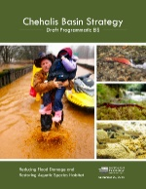















Chehalis Basin Strategy Long-Term Strategy
April 2022 Draft
Updated
Chehalis Basin Strategy SEPA Programmatic EIS
Completed in June 2017
Report
Aquatic species restoration action
Dual Purpose *
Local-Scale Flood damage reduction action
Large-Scale Flood damage reduction action
Categories
Aquatic Species Restoration
Dual Purpose*
Local-Scale Flood Damage Reduction
Large-Scale Flood Damage Reduction
Acquisition Program Design
Skookumchuck Dam
Erosion Management
Work Elements
Community and Landowner Outreach
Land
Use Local Government Group
“Other H-s”
Flood Authority Local Projects
Early Flood Warning System
Community
Flood Assistance
& Resilience (CFAR)
Aberdeen/ Hoquiam North Shore Levee & West Segment
Federal and State Highway Protection
SEPA and NEPA
EIS & Mitigation
for Proposed Flood Retention Facility
Outputs
Aquatic Species Restoration Plan (ASRP-Habitat)
Outputs
Chehalis Basin Strategy Long-Term Strategy
* The term “Integrated” is now reserved for “Integrated Strategy.”

Slide 6
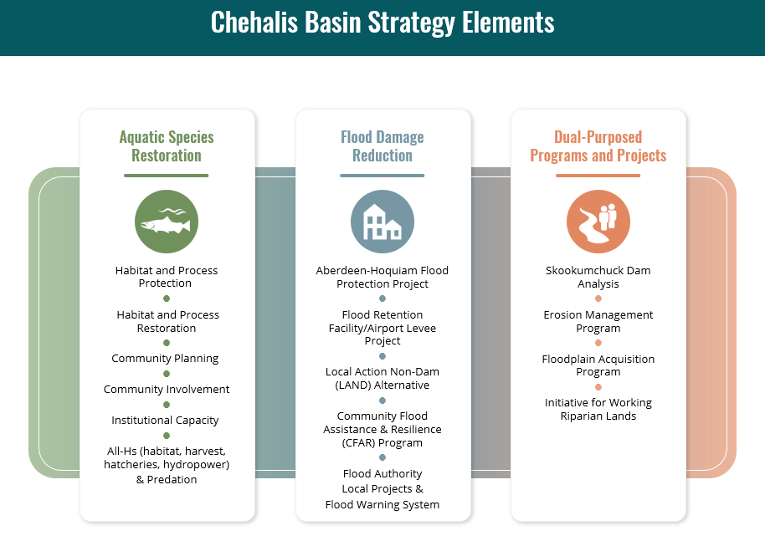

Slide 7
Major Accomplishments To-Date
Long-standing bipartisan legislative support
  Over $200 million in biennial appropriations since 2013
Significant and impactful on-the-ground investments across the basin
  Over $150 million in more than 140 projects
Foundational science and exploration
  Programmatic EIS, ASRP, Draft SEPA and NEPA EISs, LAND, Skookumchuck Dam Analysis
Program development
  ASRP, CFAR, Flood Warning System, Erosion Management Program, Floodplain Acquisition Program

Slide 8
Where We’ve Been: CBS 2017-2023 Timeline
Spring 2019: OCB / Board Recommendations on Long-Term Strategy
Spring 2023: OCB / Board Recommendations on Long-Term Strategy
June 2017: Final Programmatic EIS
August 2017: OCB
Director Hired
July 2017: Office of Chehalis Basin (OCB) Board Established
Winter 2021: OCB / Board Recommendations on Long-Term Strategy Per Legislature
June 2023: HB 1154 report to legislature per OCB/ECY and GOV/OFM
Notes:
.

Slide 9
Where are We Going and When: Phased CBS Strategy
Draft: 2/27/23
2012
2023
Late 2025 (est.)
TBD
Phase 1
Phase 2
Phase 3
Initial Strategy Development and Early Action Implementation
Progress from Governor’s Work Group in 2012 through the 2021-23 biennium
Launch of collaborative decision-making structures
Studies, exploratory processes, and evaluation of options
Preliminary outcomes measures
Program development in anticipation of scaled implementation
Pilot project learning
Early project implementation of near-term priorities
Mid-Term Action Implementation and Release of the Final Integrated Long-Term Strategy across the Basin for the coming decades.
Beginning with the 2023-25 biennium until all final aspects of the Strategy have been decided on and long-term funding sources are identified, estimated late 2025
Integrated Strategy Implementation, Ongoing Monitoring and Adaptive Management
Late 2025 (est.) until TBD

Slide 10
Where are We Going and When: Phased CBS Strategy
Draft: 2/27/23
2012
2023
Late 2025 (est.)
TBD
Phase 1
Phase 2
Phase 3
Initial Strategy Development and Early Action Implementation
All progress from formation of the Governor’s Work Group in 2012 through the 2021-23 biennium
Mid-Term Action Implementation and Release of the Final Integrated Long-Term Strategy across the Basin for the coming decades.
Beginning with 2023-25 biennium until final aspects of the Strategy have been decided on and long-term funding sources are identified
Finalized studies, exploratory processes, and evaluation of options
Board decisions (conditional/provisional as needed) on:
  Aquatic Species Restoration
  Flood damage reduction approach
  Appropriate long-term investment levels
  Implementation prioritization and sequencing
  Finalized outcomes measures
  Identification of possible new governance structures
Funding portfolio identified
Continued program development
Continued and scaled project implementation
Integrated Strategy Implementation, Ongoing Monitoring and Adaptive Management
Late 2025 (est.) until when?

Slide 11
Where are We Going and When: Phased CBS Strategy
Draft: 2/27/23
2012
2023
Late 2025 (est.)
TBD
Phase 1
Phase 2
Phase 3
Initial Strategy Development and Early Action Implementation
All progress from formation of the Governor’s Work Group in 2012 through the 2021-23 biennium
Mid-Term Action Implementation and Release of the Final Integrated Long-Term Strategy across the Basin for the coming decades.
Beginning with the 2023-25 biennium until all final aspects of the Strategy have been decided on and long-term funding sources are identified, estimated late 2025
Integrated Strategy Implementation, Ongoing Monitoring and Adaptive Management
Late 2025 (est.) until TBD
Long-term funding portfolio secured
Formation of new governance structures, as needed
Scaled and accelerated implementation
Monitoring and adaptive management
Periodic reporting on the Strategy’s performance
Ongoing coordination with basin partners
Infrastructure subject to local support & state/federal permitting.

Slide 12
Where are We Going and When: Phased CBS Strategy
2023
Late 2025 (est.)
TBD
Final
EIS?
Political Reality?
As Long as it Takes?
Draft: 2/27/23
Phase 2
Phase 3
Mid-Term Action Implementation and Release of the Final Integrated Long-Term Strategy across the Basin for the coming decades.
Beginning with the 2023-25 biennium until all final aspects of the Strategy have been decided on and long-term funding sources are identified, estimated late 2025
Finalized studies, exploratory processes, and evaluation of options
Board decisions (provisional as needed) on:
  Flood damage reduction approach
  Appropriate long-term investment levels
  Implementation prioritization and sequencing
  Finalized outcomes measures
  Identification of possible new governance structures
Funding portfolio identified
Continued program development
Continued and scaled project implementation
Integrated Strategy Implementation, Ongoing Monitoring and Adaptive Management
Late 2025 (est.) until TBD
Long-term funding portfolio secured
Formation of new governance structures, as needed
Scaled and accelerated implementation
Monitoring and adaptive management
Periodic reporting on the Strategy’s performance
Ongoing coordination with basin partners

Slide 13
Preparing for the L-T Strategy Discussion
Presentations on the current level of detail/depth analysis for each program and when they are expected.
We will ask what else will you need to begin final deliberations, why you need them, (Nice to Have/Have if Practically Doable/Must Have,) and how will these requests impact budget and L-T S completion date, etc.
3) Benefit-Cost for Dam/LAND, Overall Strategy, or Both?
4) Do you need the Final SEPA (non-decisional) and/or the NEPA FEIS/ROD or are you willing to negotiate a conditional strategy based on timing, funding, political realities, etc.
5) Public Outreach for the above steps, ala charettes, open houses, communications, etc.?

Slide 14
Conceptual L-T Strategy Approach: An Introduction to Options
  Each Category Team presents three packages for review (Low – Medium – High)
  Define range of mitigation options for each scenario
  Board creates two or three Option Packages
    Not constrained or burdened by benefit-cost
  Model each of the above scenarios:
  Climate Change b) Hydro (Riverflow 2D) Fish (EDT or EDT/LCM)
  5) Do Preliminary B-C Analysis with EJ/DEI Analysis
  6) Create Draft Working Scenario with Sequencing
  7) Complete B-C Analysis with EJ/DEI Analysis
  8) Final Selection of Integrated L-T Strategy

Slide 15

Next Steps: Tentative April Activities
Continue Long-Term Strategy Preparation and Approach Discussion
Establish clear roles for:
  Ex-officio members, and
  How the OCB Director and the facilitator should assist with the formal long-term strategy discussions

Slide 16
Thank You!

