Slide 1
CRUISE SHIP DISCHARGES MEMORANDUM OF UNDERSTANDING CRUISE OPERATIONS IN WASHINGTON STATE Exhaust Gas Cleaning Systems Washwater Discharges - Evaluation
Amy Jankowiak
Municipal Compliance and Vessel Sewage Prevention Specialist, Water Quality Program
April 2, 2019

Slide 2
Exhaust Gas Cleaning Systems Overview
What they are
Exhaust stream mixed with seawater or fresh water to remove sulfur
Solids separation
Some with additional filtration
Why being installed
Global efforts to reduce air emissions from ocean-going vessels; sulfur content from 3.5% to 0.5% by 2020
Puget Sound is in N. America emission control area has required sulfur content of 0.1% since 2015
Types of systems
Open-loop
Closed - hybrid
Closed

Slide 3
Exhaust Gas Cleaning Systems Washwater Evaluation
SCOPE
Compile & review existing available information:
Operational characteristics
Discharge information
Water quality data
Regulatory context – status, applicability, comparisons
Briefing by CLIA-NWC – Carnival
Summary of information at annual meeting with data gaps and recommendations

Slide 4
Exhaust Gas Cleaning Systems Operational Characteristics
Open loop
Seawater drawn into EGCS; mixed with exhaust gases; buffering of seawater dissolves/removes SOx producing sulfurous acid/sulfuric acid/calcium sulfate; some have additional filtration; addition of seawater for pH buffering. Solids removed, stored, and sent for shoreside disposal.
Closed loop/hybrid
Fresh water and often caustic soda mixed and introduced to exhaust gases to chemically remove SOx; circulated internally; treated to remove some contaminants; bleed-off water sometimes continuously discharged and sometimes held for later discharge; hybrid either open or closed.
Time for changeover from fuel sources – changeover starts to be ready for compliance
Different requirements in different locations

Slide 5
Example Open Loop System and Sampling locations
Provided by Carnival Corporation & PLC.
Notes:
Note that not all open-looped systems use this technology or setup.

Slide 6
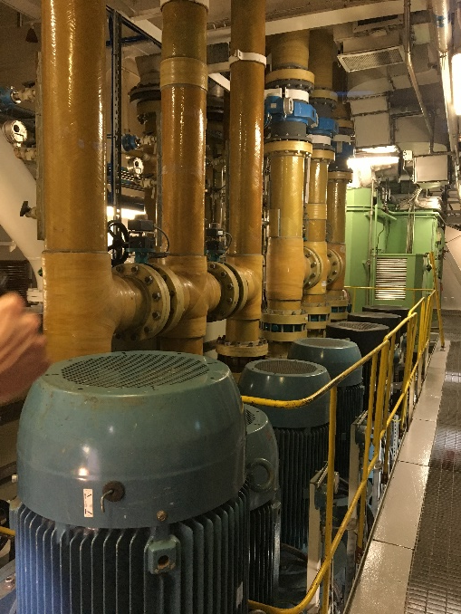
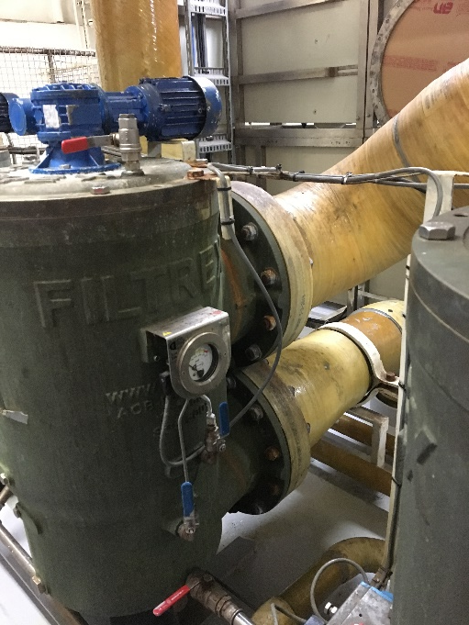
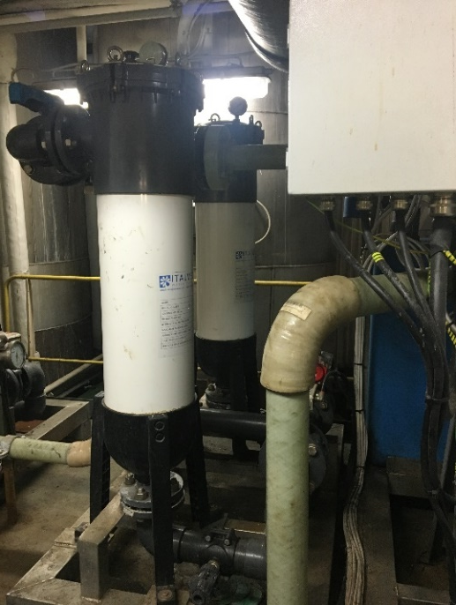
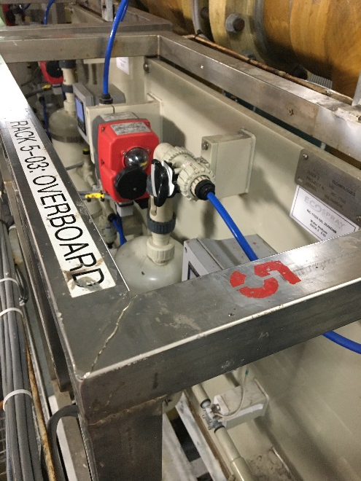
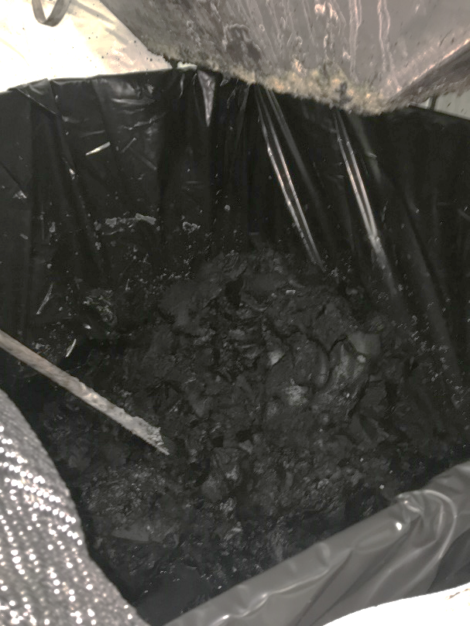
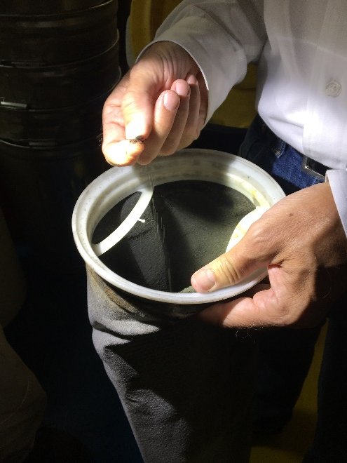
Water feed pumps and mixing/dilution pumps; ZAANDAM 7-30-18 Jankowiak
Intake filter; ZAANDAM 7-30-18 Jankowiak
Bag filters; GRAND PRINCESS 9-26-18 Jankowiak
Monitoring rack; ZAANDAM 7-30-18 Jankowiak
Soot sludge; NORWEGIAN BLISS 9-8-18 Jankowiak
Soot filter; ZAANDAM 7-30-18 Jankowiak

Slide 7
Washington State Specifics
2018 Cruise Ship Statistics
21 cruise ships to Seattle
216 calls
Avg 10.5 hrs at berth ~ 18 hrs in WA waters
Type by calls:
53% open loop
40% hybrid
6% none – low sulfur fuel
1% unknown
Unknown length of time discharges in WA waters
Discharge volume variable and includes seawater
Notes:
Note – many equipped with shore power – discontinue use of engines/EGCS.

Slide 8
Exhaust Gas Cleaning Systems Regulatory Context
Comparisons
International Maritime Organization (IMO) Marine Environmental Protection Committee MEPC 259. (10)
EPA Vessel General Permit (VGP) 2.2.26
WA Surface Water Quality Standards Ch. 173-201A WAC
Notes:
WQ CRITERIA – NOT A COMPLIANCE POINT
Note used “extraordinary” use limits as are vessels in most falls in that category; marine aquatic life criteria and human health criteria
Ug/L unless otherwise noted
Data review for EPA includes all vessels for some parameters and just cruise data for toxics
Note PS/WA criteria protective of unique waterbody, shellfish, poor circulation to open ocean

Slide 9
pH
Parameter | International - IMO MEPC | US EPA VGP | WA WQ Criteria
 | Applicable Discharge Limits |  | Ambient WQ Criteria
pH | ≥6.5 at OB discharge except during maneuvering/transit; max difference inlet/outlet 2 pH units [note IMO 6.5, VGO 6.0] OR The pH discharge limit, at the overboard monitoring position, is the value that will achieve as ≥6.5 at 4 m from the overboard discharge point with the ship stationary; can be calculated. | ≥6.0 at OB discharge except maneuvering and transit max difference b/w inlet and outlet of 2.0 pH allowed. | pH must be within the range of 7.0-8.5 with a human-caused variation within the above range of less than 0.2 units.
WA most stringent; EPA more stringent than IMO
Includes only cruise vessel data
EPA Data Mean | Comparison
6.36 mean of avg 5.77 mean of min* | More acidic than WA criteria

Slide 10
PAH
Parameter | International - IMO MEPC | US EPA VGP | WA WQ Criteria
 | Applicable Discharge Limits |  | Ambient WQ Criteria
Polycyclic Aromatic Hydrocarbons (PAH) | Flow rate (t/MWh) / Discharge Concentration limit (µg/L PAHphe equivalents) 0-1 / 2250 2.5 / 900 5 / 450 11.25 / 200 22.5 / 100 45 / 50 90 / 25 For a 15-min period in any 12-hr period, PAH concerntration may exceed above by 100%. | Flow rate (t/MWh) / Discharge Concentration limit (µg/L PAHphe equivalents) 0-1 / 2250 2.5 / 900 5 / 450 11.25 / 200 22.5 / 100 45 / 50 90 / 25 For a 15-min period in any 12-hr period, PAH concerntration may exceed above by 100%. | Components of PAH are included in human health criteria (6 of 11): benzo(a)anthracene 0.014/0.021/.00016 benzo(a)pyrene 0.0014/0.0021/0.000016 benzo(b)fluroanthene 0.014/0.021/0.00016 chrysene 1.4/2.1/0.016 dibenz(a,h)anthracene 0.0014/0.0021/0.000016 indeno(1,2,3-cd)pyrene 0.014/0.021/0.00016
IMO and EPA match; WA listed differently; includes all vessel data, not just cruise
EPA Data Mean (ug/l) | Comparison
PAH = 25.2 | PAH - Depends on flow rate compared to IMO and EPA limits
Benzo(a)anthracene = 0.454 Benzo(a)pyrene = 0.225 Benzo(b)fluroanthrene = 0.662 Chrysene = 0.699 Dibenzo(a,h,)anthracene = 0.173 Indeno(1,2,3-cd)pyrene = 0.176 | EPA mean concentrations higher than WA or federal Human Health Criteria for certain PAH components (listed parameters are greater than Criteria; 11 PAH parameters have Human Health Criteria)
Notes:
Note data for PAH’s for all vessels, not just cruise ships

Slide 11
Turbidity and Aesthetics
Parameter | International - IMO MEPC | US EPA VGP | WA WQ Criteria
 | Applicable Discharge Limits |  | Ambient WQ Criteria
Turbidity | Turbidity should not be greater than 25 FNU (formazin nephlometric units) or 25 NTU (nephlometric turbidity units) or equivalent units, above the incoming seawater turbidity. | Turbidity should not be greater than 25 FNU (formazin nephlometric units) or 25 NTU (nephlometric turbidity units) or equivalent units, above the incoming seawater turbidity. | Turbidity must not exceed: 5 NTU over background when the background is 50 NTU or less; or a 10% increase in turbidity when the background turbidity is more than 50 NTU.
Aesthetic Value | None Established | None Established | Aesthetic values must not be impaired by the presence of materials or their effects, excluding those of natural origin, which offend the senses of sight, smell, touch, or taste.
Turbidity: IMO and EPA the same; WA depends on background turbidity, more stringent <50 NTU
Aesthetics: no limits in IMO or EPA; WA criteria most stringent
Surface effects occur under some conditions
Turbidity: EPA Data Mean | Comparison
8.2 FNU | Depends on background
Notes:
Note discharge surface effect acknowledged by cruise lines, unsure of discharge/quality; noted in certain port locations

Slide 12
Nitrates+Nitrites
Parameter | International - IMO MEPC | US EPA VGP | WA WQ Criteria
 | Applicable Discharge Limits |  | Ambient WQ Criteria
Nitrates + Nitrites | Flow rate (t/MWh) / Discharge Concentration limit (mg/L nitrate + nitrite) 0-1 / 2700 2.5 / 1080 5 / 640 11.25 / 240 22.5 / 120 45 / 60 90 / 30 | Flow rate (t/MWh) / Discharge Concentration limit (mg/L nitrate + nitrite) 0-1 / 2700 2.5 / 1080 5 / 640 11.25 / 240 22.5 / 120 45 / 60 90 / 30 | No direct WQ criteria, however, affects DO which does have criteria (1-day minimum in mg/l, except by natural conditions, not decrease more than 0.2 mg/l…): Lowest 1-day minimum of 7.0 mg/L Dissolved Oxygen.
IMO and EPA match; WA listed differently
Includes all vessel data, not just cruise

Slide 13
Toxics
Parameter | International - IMO MEPC | US EPA VGP | WA WQ Criteria
 | Applicable Discharge Limits |  | Ambient WQ Criteria
Toxics | None Established | None Established | Toxic, radioactive, or deleterious material concentrations must be below those which have the potential, either singularly or cumulatively, to adversely affect characteristic water uses, cause acute or chronic conditions to the most sensitive biota dependent upon those waters, or adversely affect public health.
Specific Toxics | None Established | None Established | all criteria in µg/l (acute / chronic) Arsenic 69 / 36 Cadmium 42 / 9.3 Chromium (VI) 1,100 / 50 Copper 4.8 / 3.1 Lead 210 / 8.1 Mercury 1.8 / 0.025 Nickel 74 / 8.2 Selenium 290 / 71 Silver 1.9 (acute only) Zinc 90 / 81
no limits in IMO or EPA; WA criteria more stringent
Cruise ship data only
Notes:
Note that human health criteria (not listed) may pertain with accumulative discharges

Slide 14
Toxics cont.
Parameter | EPA Data Mean (ug/l) | WA WQ Criteria (marine aquatic life criteria: acute / chronic) | Comparison
Arsenic | 26.64 | 69/36 | Within WA Aquatic Life Criteria
Cadmium | 10.25 | 42/9.3 | Mean concentrations higher than WA Aquatic Life Chronic Criteria
Chromium | 24.33 | 1,000/50 | Within WA Aquatic Life Criteria
Copper | 63.26 | 4.8/3.1 | Mean concentrations higher than WA Aquatic Life Acute and Chronic Criteria
Lead | 22.64 | 210/8.1 | Mean concentrations higher than WA Aquatic Life Chronic Criteria
Nickel | 80.09 | 74/8.2 | Mean concentrations higher than WA Aquatic Life Acute and Chronic Criteria
Selenium | 42.31 | 290/71 | Within WA Aquatic Life Criteria
Zinc | 67.89 | 90/81 | Within WA Aquatic Life Criteria
Some data is above detection levels that are significantly higher than the criteria.
Total (not dissolved); includes cruise ship only data.
Inlet/background data not evaluated.
Notes:
Cruise ship data only. Didn’t include human health criteria here. Note inlet/background data not taken into account.

Slide 15
Exhaust Gas Cleaning Systems Washwater Research
Studies reviewed from:
Danish Ministry of the Environment 2012
CE Delft 2015
Germany – Federal maritime and Hydrographic Agency 2018 (preliminary findings)
Carnival Corporation DNV/GL 2019
EPA 2011
Japan – Ministry of Land Infrastructure, Transport and Tourism 2019
Generally not a lot of research available
Regulatory agencies and industry have evaluated
Decisions by countries and ports have varied
Industry and science ramifications from IMO policy
Recent submittal to IMO for reconsideration

Slide 16
Exhaust Gas Cleaning Systems Carnival Briefing
Briefing to Ecology/Port of Seattle in December 2018
Based on report “Compilation and Assessment of Lab Samples from EGCS Washwater Discharge on Carnival Ships” 2019
Sampling (EPA approved methods/accredited labs)
281 samples; 53 ships; 54 chemical constituents per sample
Constituent content per liter of water avg flow rate 45t/MWhr; results – averages, post-EGCS minus inlet water values, outliers eliminated
Showed sample avg PAH and nitrate levels below IMO wash-water guidelines; German ordinance and EU’s standards
Notes:
[note WA WQ criteria more stringent than German/EU most parameters]

Slide 17
Exhaust Gas Cleaning Systems Summary
Existing information available on
Operations
Water quality data
Laws, regulations, permits
Available research
Initial data review shows certain parameters at times elevated above WA WQ criteria
Research shows variabilities in the contents of washwater and how ships’ EGCS function

Slide 18
Exhaust Gas Cleaning Systems Data Gaps
Surface effects characterization
Discharge volume and frequency
Bioaccumulation
Loading of the discharges specific to Washington waters
Effect of fuel choices on environmental media
Other international regulations/limits
Whole effluent toxicity testing
Modeled effects of discharges to WA waters
Relationship between system O&M and discharge quality

Slide 19
Exhaust Gas Cleaning Systems Washwater Preliminary Recommendations Port and Ecology Staff
Prioritize data gaps
Potential approach:
Identify a funding mechanism.
Gather additional information to identify EGCS discharges that may require controls in order to protect water quality.
Explore an amendment to the MOU that exceeds regulation.
As funded, develop scope and timeline.
Notes:
Work to continue to to improve technology for both air and water quality

Slide 20
Amy Jankowiak, Municipal Compliance & Vessel Sewage Prevention Specialist, Dept. of Ecology Northwest Regional Office
(425) 649-7195
amy.jankowiak@ecy.wa.gov
Ecology Website: https://ecology.wa.gov/
New Cruise Ship Website: https://ecology.wa.gov/Regulations-Permits/Permits-certifications/Cruise-ship-memorandum-of-agreement-MOU

