Slide 1

PFAS in Food Packaging
Alternatives Assessment
Ken Zarker, Ecology Project Manager & Catherine Rudisill, M.S., Work Assignment Manager, SRC, Inc.
EZView Website: https://www.ezview.wa.gov/site/alias__1962/37610/pfas_in_food_packaging_alternatives_assessment.aspx

Slide 2
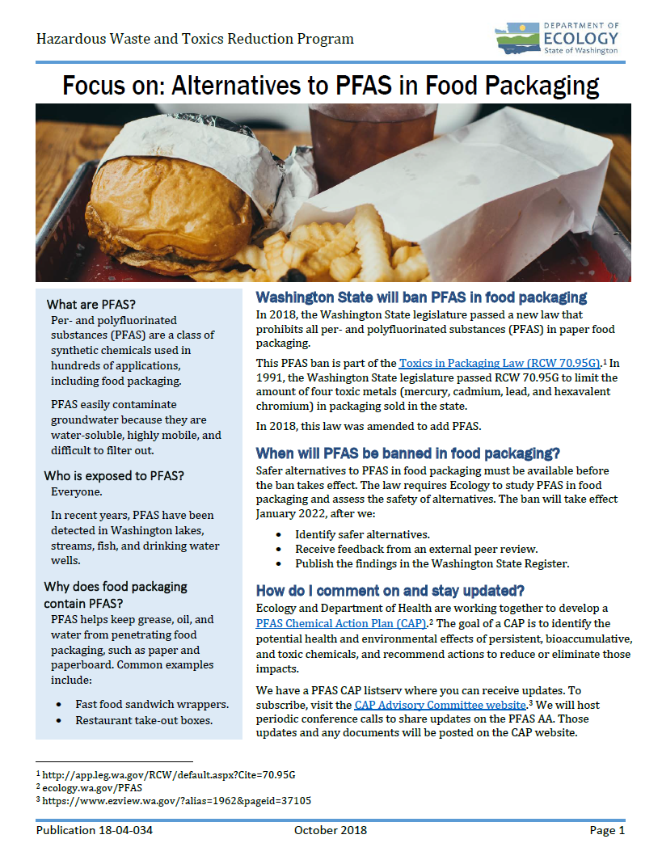
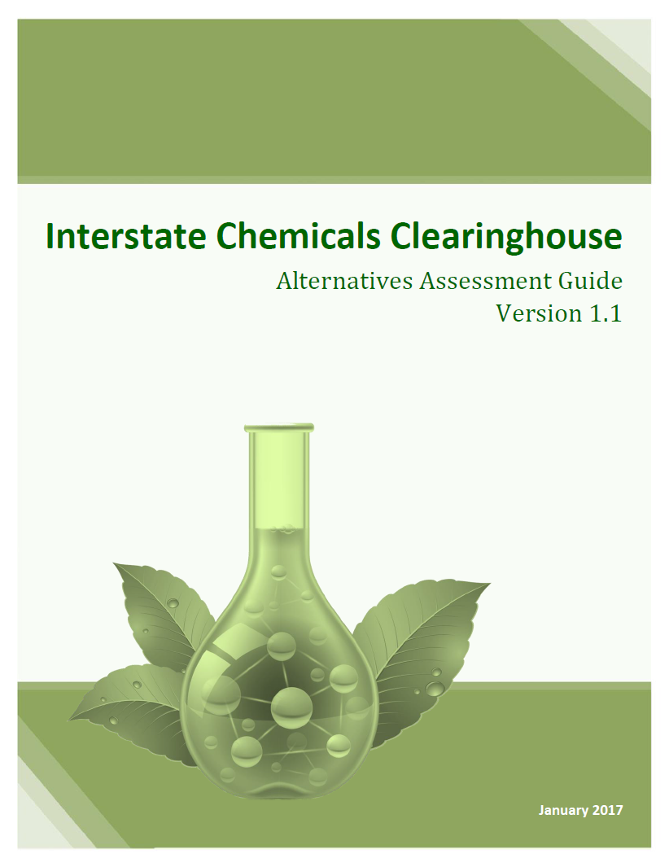
PFAS Food Packaging AA
Agenda
Project Scope & Timeline
User Engagement
Ecology Basic Cost & Availability
Assessment Module
Refining the Hazard Module
Discussion

Slide 3
WA Toxics in Packaging Law
RCW 70.95G.070
Legislature passed toxics law that bans perfluorinated and polyfluorinated substances in paper food packaging.
Ecology will determine there are alternatives available. A peer review process required.
Ecology reports to legislature and ban will take effect two years later.
Based on the Interstate Chemicals Clearinghouse (IC2) modules: Hazard (L2); Exposure (L1); Cost & Availability (L1) & Performance (L1).
Notes:
Definition - “’Perfluoroalkyl and polyfluoroalkyl substances" or "PFAS chemicals" means, for the purposes of food packaging, a class of fluorinated organic chemicals containing at least one fully fluorinated carbon atom.’”

Slide 4
Roles and Responsibilities
SRC’s Role | Ecology’s Role
Use IC2 Guide to develop methodology to assess hazard, exposure, performance. | Approves methodologies. Conducts IC2 Basic Cost and Availability module. Consultation with DoH.
Recommend products and product types for evaluation. | Approves the selection of products and product types.
Evaluates products against the assessment methodologies. | Determines safer alternatives exist.
 | Prepares final report to legislature.

Slide 5
Public Engagement
Current active stakeholders ~60
Chemical Action Plan (CAP) and project listserve membership ~240
Representatives from: government, chemical manufacturers, NGOs, product manufacturers, suppliers, paper producers, trade organizations, purchasers/users, entrepreneurs, academia/research groups, and others.
Current focus on engagement with users.
Integrating environmental justice.

Slide 6
End-user and Consumer Engagement
Increase end-user engagement.
    Brands, retailers, & grocers.
    Consumer & Public Education campaigns.
    WA public health agencies.
King County EJ Partnership (in development).
Engaging individual members of trade organizations.
State purchasing & institutional buyers.

Slide 7
Expanded Product Scoping & Engagement
Initial scope: Wraps/Liners and possibly bags.
Feedback: Stakeholder concerns this was too narrow.
Expanded Scope: Ecology includes more products and leverage alternatives/product types where possible.
Stakeholders: SRC is currently working with stakeholders to identify product overlap and alternatives in use in different products.

Slide 8
Enhanced Product Categories
Category 1: Paper Wraps, Liners, Bags & Sleeves
Category 2: Dinnerware
  Plates, bowls, trays
Category 3: Food Service Containers
  “Take-out” cartons or containers for storage and transport
Note: These categories account for 56% of U.S. market demand for foodservice disposals in 2016 (Freedonia, 2017)

Slide 9
Alternatives & Product Prioritization
From this product scope, we will be prioritizing a select group of alternatives that consider:
  Focus on existing alternatives & known product categories
  Leverage across product categories.
  Looks at most common options (qualitative).
  Alternatives used or produced by our active stakeholders.
  Determine “Low hanging fruit” opportunities.
  Economic availability / current market use.

Slide 10
Upcoming Webinar: Hazard & Exposure Modules
Ecology, DoH and SRC are refining hazard assessment based on comments.
Ecology and DoH currently reviewing draft Exposure Assessment Methodology is currently being finalized.
Will be discussed during next call – February 11th at 11:00 PST/2:00 EST

Slide 11


Contacts:
Ken Zarker, Ecology, ken.zarker@ecy.wa.gov
Cathy Rudisill, SRC, Inc. Rudisill@srcinc.com

