Slide 1
PFAS in Food Packaging Alternatives Assessment Update: 5-26-20
Ken Zarker, Ecology Project Manager & Catherine Rudisill, M.S., Work Assignment Manager, SRC, Inc.
EZView Website: https://www.ezview.wa.gov/site/alias__1962/37610/pfas_in_food_packaging_alternatives_assessment.aspx

Slide 2
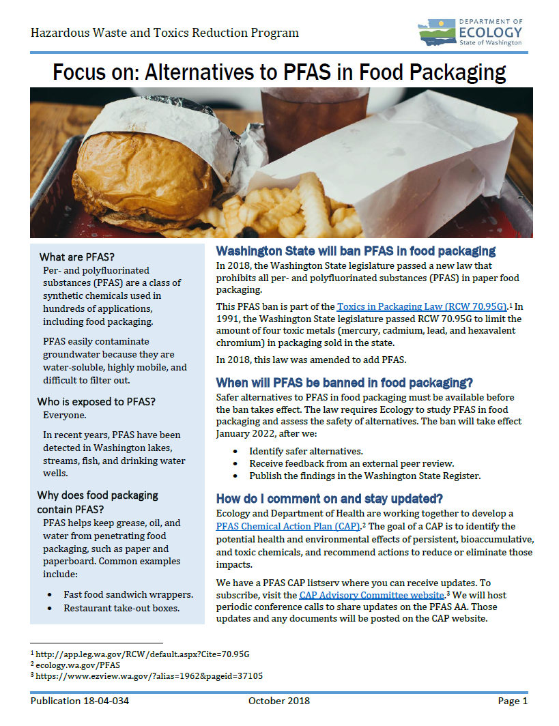
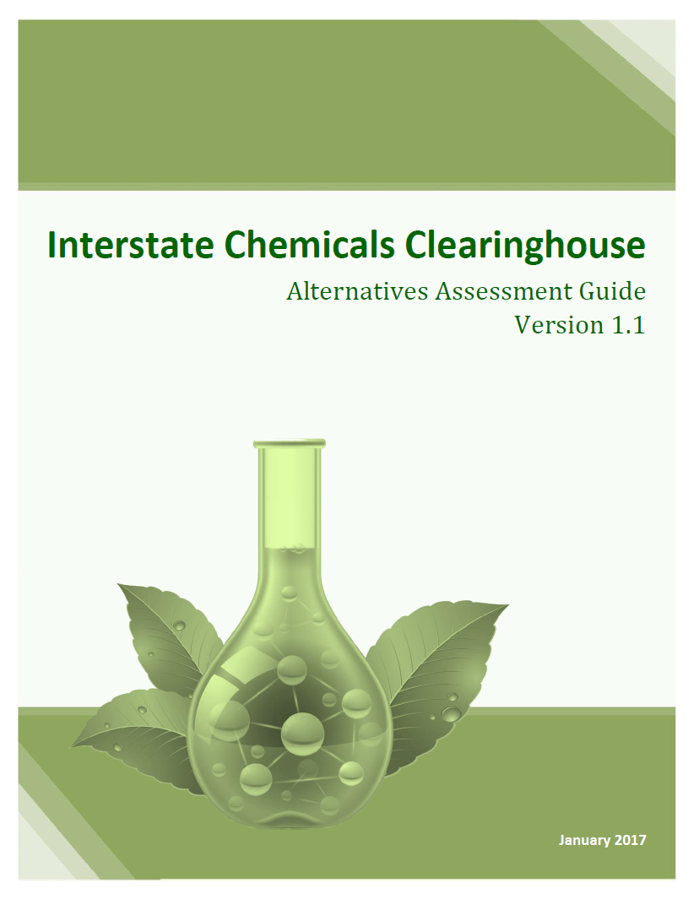
PFAS Food Packaging AA Agenda
Intro/Welcome
COVID-19 Update
Background
Timeline and Contingencies
Performance Assessment Recap & Update
Cost & Availability Update
This webinar is being recorded

Slide 3
COVID-19 Update
PFAS AA team at Ecology and SRC are continuing to work from home.
Some stakeholders have indicated their ability to engage at this time is limited.
We appreciate all of our stakeholders who are supporting our communities.

Slide 4
WA Toxics in Packaging Law RCW 70.95G.070
Legislature passed toxics law that bans perfluorinated and polyfluorinated substances in paper food packaging.
Ecology will determine whether alternatives are available for specific packaging applications. A peer review process is required.
Ecology reports to legislature and ban will take effect two years later.
Based on the Interstate Chemicals Clearinghouse (IC2) modules: Hazard (L2); Exposure (L1); Cost & Availability (L1) & Performance (L1).
Notes:
Definition - “’Perfluoroalkyl and polyfluoroalkyl substances" or "PFAS chemicals" means, for the purposes of food packaging, a class of fluorinated organic chemicals containing at least one fully fluorinated carbon atom.’”

Slide 5
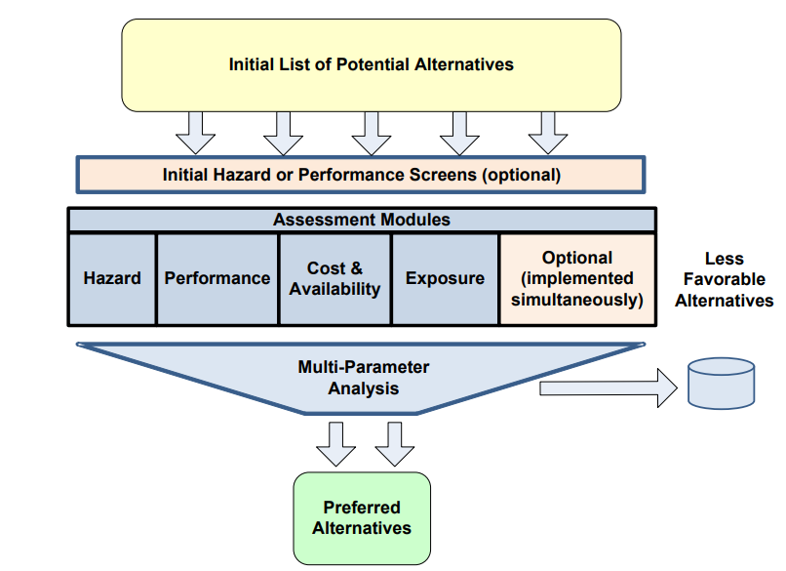
The Interstate Chemicals Clearinghouse (IC2) Alternatives Assessment Guide
Notes:
Definition - “’Perfluoroalkyl and polyfluoroalkyl substances" or "PFAS chemicals" means, for the purposes of food packaging, a class of fluorinated organic chemicals containing at least one fully fluorinated carbon atom.’”

Slide 6
Product Categories in Scope
Category 1: Paper Wraps, Liners, Bags & Sleeves
Category 2: Dinnerware
Plates, bowls, trays
Category 3: Food Service Containers
“Take-out” cartons or containers for storage and transport

Slide 7
Proposed Alternative Chemicals for Hazard Evaluation
Low Concern | EPA Safer Chemical | Hazard Evaluation Candidates
Uncoated paper | Petroleum wax¹ | Silicone coatings
Aluminum foil | Bio-based wax² | Polyvinyl alcohol coatings
 | Kaolin clay (CAS 1332-58-7) | Polylactide (foam, plastic, coating) (CAS 9051-89-2)
 |  | Polyethylene coatings
 |  | Polyethylene terephthalate coatings
 |  | Additives, residuals, contaminants, degradation products
Related EPA SCIL listings may include Paraffin waxes, petroleum, clay-treated (CAS 64742-43-4) and Paraffin waxes, petroleum, hydrotreated (CAS 64742-51-4)
Related EPA SCIL listings may include Soybean oil and soybean oil derivatives that could be hydrogenated to produce waxy substances: soybean oil (CAS 8001-22-7), soybean oil fatty acids (CAS 68308-53-2), soybean oil, methyl esters (CAS 67784-80-9), and soybean oil, sulfated, sodium salt (CAS 61790-16-7)

Slide 8
Technical Documents
New documents have been posted to the website and are available for stakeholder comment:
Product and Alternatives Scoping Paper (2/24/2020)
Hazard Methodology (3/19/2020)
Exposure Methodology (3/19/2020)
CBI Guidance & Template (4/10/2020)
Peer Reviewer NDA (4/3/2020)

Slide 9
Stakeholder Poll #1:
How would you categorize your organization?
Question will appear in the right navigation panel

Slide 10
Clarification on Timeline
June-July 2020 - SRC Final Report & Management Review
Early August 2020 - Ecology/DOH Review
Fall 2020 – Peer Review by WA State Academy of Science
November 2020 – Final AA
December 2020 – Submit potential notice to WA State Register

Slide 11
Confidential Business Information (CBI) Guidance Update
Announcement posted on website 5/14/20
2 options for CBI submissions:
Submit CBI information directly to Ecology using submission templates (Due: June 15, 2020)
Hire your own GreenScreen® to complete the assessment and disclose report to Ecology. (Due: June 30, 2020)
Reach out to ken.zarker@ecy.wa.gov or SRC ASAP

Slide 12
Contingencies for Hazard Assessment
Without CBI disclosures, hazard assessments may have significant data gaps.
Considering the following contingencies:
Used previously published assessments
Conduct GreenScreens® using likely monomers and assuming high residual content.
Use alternatives that are on the EPA Safer Chemical Ingredients List.

Slide 13
Performance Assessment Recap
For those interested in a repeat presentation of 4-14 webinar, please reach out to SRC and Ecology. We will gladly set up a special session.
Slides and recording are also available on the website.
93 call attendees including new end-users, such as restaurant chains and retailers.
Polling results are available on the website.

Slide 14
IC2 Guidelines Overview: Level 1 Performance
Series of questions based on qualitative data and promotional materials:
What are the performance needs at the chemical, material, product, and process level?
Has the alternative already been identified as favorable with respect to performance?
Has an authoritative body demonstrated that the alternative functions adequately for both the process and product?
Is the alternative considered favorable but there are indications that it does not perform as well as the current chemical?
Has the proposed alternative been identified by expert sources as unfavorable?

Slide 15
Question #1: How would you categorize your organization?

Slide 16
Question #2: What are your personal top 3 performance requirements?

Slide 17
Question #3: Have you tested or successfully substituted an alternative for the products categories under this assessment?

Slide 18
Major Take-Homes (as of now)
Key performance requirements:
Oil and grease resistance
Leak resistance
Considering others
Consistent with Food Packaging Institute (FPI) 2019 Survey
800 respondents approximately split between the U.S. and Canada, ranging in a balance of age (18 – 60+), income, education level, gender, and region (FPI, 2019a)
Leak/spill proof (64%) and stopping oil and grease (61%) most important attribute (FPI, 2019b)

Slide 19
Major Take-Homes (as of now)
There appears to be at least some success in substituting PFAS-free products for these categories.
Current, but not comprehensive, inventories of PFAS-free packaging suggests they’re being used and are meeting some customer needs.

Slide 20
Major Take-Homes (as of now)
End-users and product producers are the “expert sources” for determining whether a product meets performance.
30% said “depends on the product”
Lots of customization happening, especially with large buyers

Slide 21
Major Take-Homes (as of now)
PFAS and over-engineering
Described by multiple stakeholders as “bulletproof”
Given complexity in substrates and coating/additive chemistries, not an apples-to-apples comparison
Goal: identify any obvious gaps in performance

Slide 22
Next Steps
Develop performance assessment decision rules and post to website for comment.
Begin conducting hazard assessments or implement contingencies.
SRC will start drafting sections of the final report in June.
Monitor the COVID-19 impacts and adjust strategies as needed.
Next Call: June 30th 11am PT/2 pm ET

Slide 23
Contacts: Ken Zarker, Ecology, ken.zarker@ecy.wa.gov Cathy Rudisill, SRC, Inc. Rudisill@srcinc.com
EZView Website: https://www.ezview.wa.gov/site/alias__1962/37610/pfas_in_food_packaging_alternatives_assessment.aspx

