Slide 1
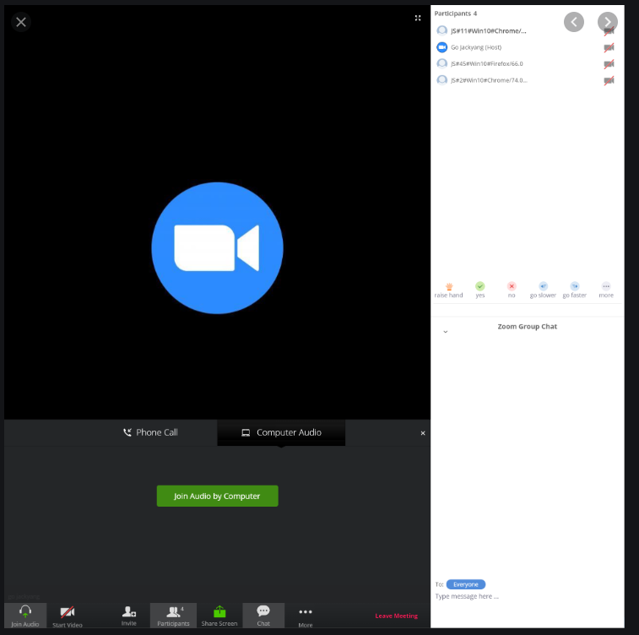
Welcome! Please Sign In
Please help us track stakeholder engagement!
Click on the Participants in your webinar controls (likely in the bottom of your screen)
Please find your name in the participant list. You may be appearing as a phone number.
Hover over your name/number and click Rename
Please “rename” yourself to:
“Full Name, Affiliation”

Slide 2
Stakeholder Discussion: Follow Up to Product Scoping
November 25, 2019
PFAS in Food Packaging Alternatives Assessment
Catherine Rudisill, M.S.
Work Assignment Manager
Lead Chemist
SRC, Inc.
Syracuse, NY
Jenn Rhoades
Stakeholder Outreach Lead
Toxicologist
SRC, Inc.
Syracuse, NY

Slide 3
Outline
Welcome & Roll Call (10 mins)
Background & Overview (5 mins)
Discussion items
Expansion Feedback (10 mins)
Product definitions (15 mins)
Product overlap (15 mins)
Close-Out (5 mins)

Slide 4
Project Overview
WA State Law RCW 70.95G
Bans perfluorinated and polyfluorinated substances from food packaging materials
“Food package" means a package or packaging component that is intended for direct food contact and is comprised, in substantial part, of paper, paperboard, or other materials originally derived from plant fibers.”
“’Perfluoroalkyl and polyfluoroalkyl substances" or "PFAS chemicals" means, for the purposes of food packaging, a class of fluorinated organic chemicals containing at least one fully fluorinated carbon atom.’”
Dept of Ecology will conduct an Alternatives Assessment that considers:
Chemical hazard
Exposure
Performance
Cost & availability
If Ecology determines that there are alternatives that meet the requirements of the law, then ban will take effect
"If the department of ecology does not find that a safer alternative is available for some or all categories of food packaging applications, beginning January 1, 2021, and each year following, the department of ecology must review and report on alternatives…"

Slide 5
Previous Group Interactions
PFAS CAP website link: https://www.ezview.wa.gov/?alias=1962&pageid=37105
Ecology is developing a website dedicated solely to the PFAS in Food Packaging AA that will be separate from the current PFAS CAP
5/15/19 - Alternatives Assessment for PFAS in Food Packaging Stakeholder Webinar #1
https://www.ezview.wa.gov/Portals/_1962/Documents/PFAS/PFAS%20AA%20Webinar_05152019.pdf
7/1/19 - Online Product Scoping Survey
Distributed to all stakeholders via PFAS CAP list-serve and direct email.
Responses accepted through July 31st (extended to allow for additional responses)
9/11/2019 – Product Scoping Discussion
Discussed overview of the scoping survey results
Announced a tentative product scope that would focus on paper wraps, liners, and bags
Follow-up discussions with stakeholder expressed concern that this scope was too narrow
10/2019 – Internal deliberations
SRC and Ecology discussed options for expanding the scope and adding funding

Slide 6
Current Discussion
11/11/2019 – Ecology Announces Update & Opportunity for Comment
Announced that Ecology will be expanding the product scope to also include dinnerware
“Final scope will depend on our ability to leverage overlap between proposed safer alternative technologies across multiple product types. For example, if a wrapper alternative is treated with Formulation A (a substitute for PFAS), it will be more likely that the expanded scope includes a plate where Formulation A is also used to impart oil and grease resistance. Base material changes, for example, plant-fiber to plastic, will also be included among the candidates for alternatives assessment.”
Goals for today’s call:
Address any concerns or feedback concerning the scope expansion
Clarify working definitions of product types
Identify candidate dinnerware/service ware products (including non-chemical alternatives)
Identify any overlap between formulation treatments as suggested in the announcement

Slide 7
Ground Rules
This call will NOT be recorded
Slides will be posted to the invite
Keep discussion focused on product scoping
Select “Raise Hand” in your webinar controls or participant list
I will call on people who raised their hand to speak
You will have to unmute yourself before speaking
Please announce yourself and affiliation before speaking
Hold off on follow-ups or rebuttals until everyone has had a chance to speak
We can follow-up discussions individually, as needed

Slide 8
Discussion: Feedback on Scoping Expansion (10 mins)
Q: Any questions, concerns, or other thoughts on the product scope expansion?

Slide 9
Discussion: Clarifying Product Types (15 mins)
Wraps: a sheet that can be folded (fully or partially) around a food item like a sandwich, burrito, bakery or deli item.
Liners: a sheet that is used to line the bottom of a tray, service ware, or container
Dinnerware/Service ware: plate, bowls, food trays, boats, or any other non-lidded item designed primarily for serving…but not transporting food?
Questions:
Are there established naming conventions that can clarify products under evaluation?
For dinnerware/service ware – should we limit based on holding time or transport?
Any challenges with this grouping from an assessment perspective?

Slide 10
Discussion: Identifying Overlap (15 mins)
“…If a wrapper alternative is treated with Formulation A (a substitute for PFAS), it will be more likely that the expanded scope includes a plate where Formulation A is also used to impart oil and grease resistance.”
Barrier Coating Alternatives
Wax
Clay
PLA (coatings & foam)
PET
PVOH copolymers
Silicon
“Aqueous” coatings
Base Material Alternatives
Mechanically-densified paper
Aluminum foil
Foil-lined paper
PVC cling film
Insulated paper
Q: For the tentative alternatives previously identified above for wraps/liners, where is there overlap with dinnerware/service ware products?

Slide 11
Close-Out
Please reach out with additional insights.
Aim is to have a finalized list of candidate alternatives by the end of December.
Next Call: Early December 2019 –
Topic: Hazard and Exposure Assessment Methodologies
Cathy Rudisill – rudisill@srcinc.com
Jenn Rhoades – rhoades@srcinc.com
Thank you!
This Photo by Unknown Author is licensed under CC BY-NC-ND

