Slide 1
RDA Committee Meeting
March 14, 2018 @ 0900 in R0A-36

Slide 2
Agenda
Ecology Oil Spill Preparedness Geographic Response Plan Presentation
New Business
Preassessement Screenings
Chelan PUD Rocky Reach Dam, January 14, 2018 spill into the Columbia River
P/C Sinbad, January 29, 2018 spill into Sinclair Inlet
Open RDA Case Updates
F/V Haeshin, January 21, 2008 spill into Grays Harbor
F/V Miss Michelle, September 19, 2008 spill into the Pacific Ocean
F/V Deep Sea, May 13, 2012 spill into Penn Cove
Sulphur Creek, March 1, 2015 spill into the Yakima River
La Mexicana, November 6, 2015 spill into White Center Pond
F/V Privateer, April 15, 2016 spill into the Pacific Ocean
Tug Island Wind, February 28, 2017 spill into the Duwamish Waterway
Tug Chief, November 30, 2017 spill into Salmon Bay
Announcements

Slide 3
Special Guest
Washington State Department of Ecology
Oil Spill Preparedness Geographic Response Plans

Slide 4
New Business
Preassessment Screenings

Slide 5
Chelan PUD Rocky Reach Dam spill into the Columbia River
Date of Incident: January 14, 2018
Potentially Liable Party: Chelan PUD
Product Spilled: Turbine Oil
Spill Source: Rocky Reach Dam
Oil Spill Size Estimate: 187 gallons
Water Body Affected: Columbia River
Ecology Region: CRO
County: Chelan
Nearest City: Wenatchee
Location of Spill: Columbia River
Cause: Mechanical Failure
Ecology Responder: Sam Hunn
Notes:
Ecology received a report of an unknown sheen on the Columbia River in Wenatchee. Responders traced the sheen upstream to Rocky Reach Dam and notified Chelan County PUD. The PUD recently conducted routine maintenance on one of their turbines and had returned the unit to service two days prior to the sheen discovery. Shortly after shutting down the turbine, the sheen began to dissipate. PUD staff calculated the spilled volume to be 187 gallons of turbine oil. The turbine was kept offline for ongoing testing.

Slide 6
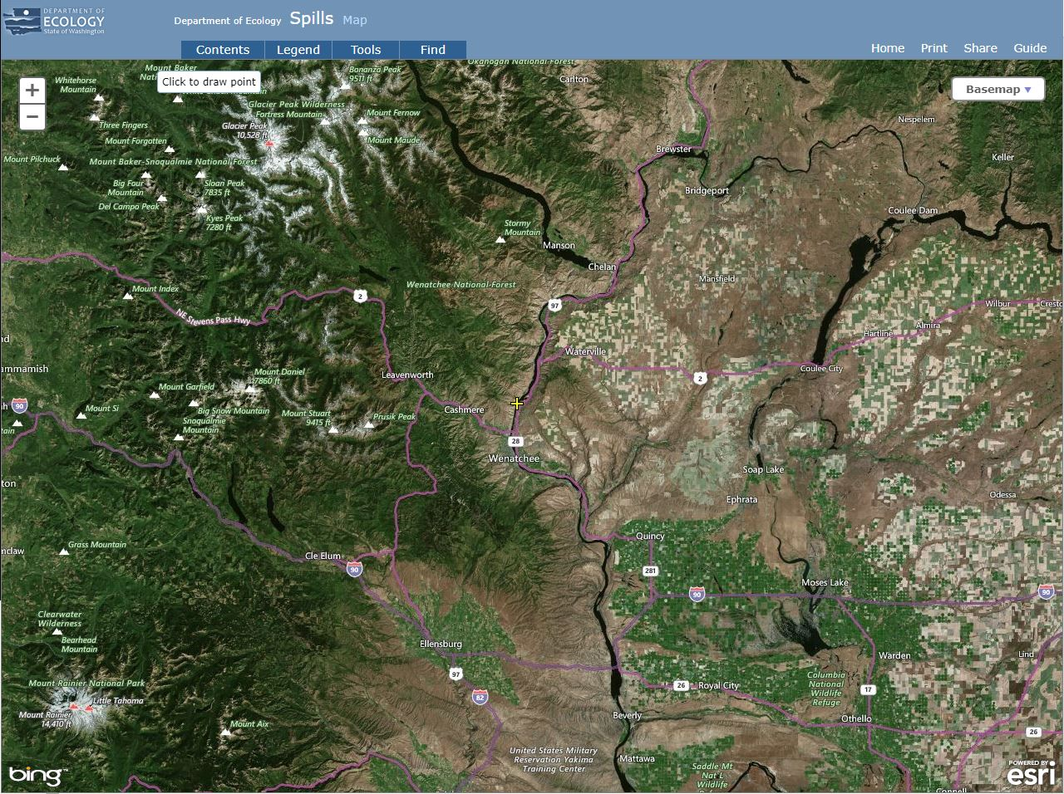
Notes:
Ecology received a report of an unknown sheen on the Columbia River in Wenatchee. Responders traced the sheen upstream to Rocky Reach Dam and notified Chelan County PUD. The PUD recently conducted routine maintenance on one of their turbines and had returned the unit to service two days prior to the sheen discovery. Shortly after shutting down the turbine, the sheen began to dissipate. PUD staff calculated the spilled volume to be 187 gallons of turbine oil. The turbine was kept offline for ongoing testing.

Slide 7
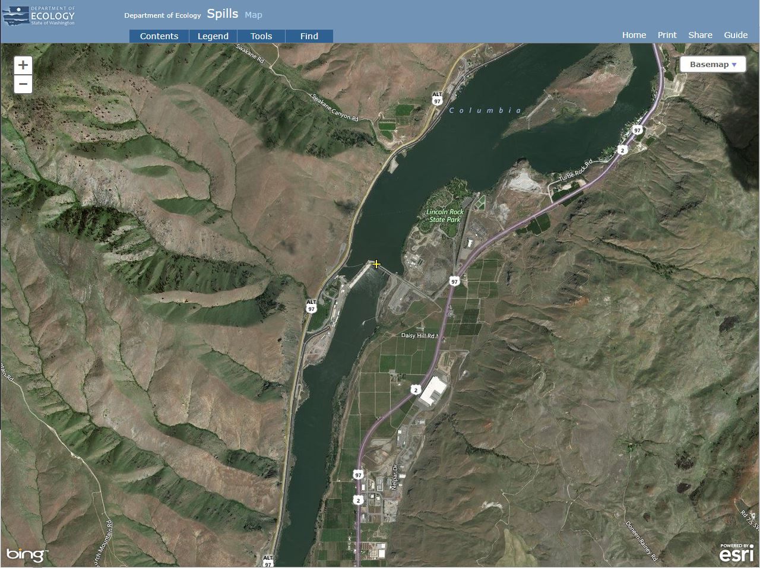
Notes:
Ecology received a report of an unknown sheen on the Columbia River in Wenatchee. Responders traced the sheen upstream to Rocky Reach Dam and notified Chelan County PUD. The PUD recently conducted routine maintenance on one of their turbines and had returned the unit to service two days prior to the sheen discovery. Shortly after shutting down the turbine, the sheen began to dissipate. PUD staff calculated the spilled volume to be 187 gallons of turbine oil. The turbine was kept offline for ongoing testing.

Slide 8
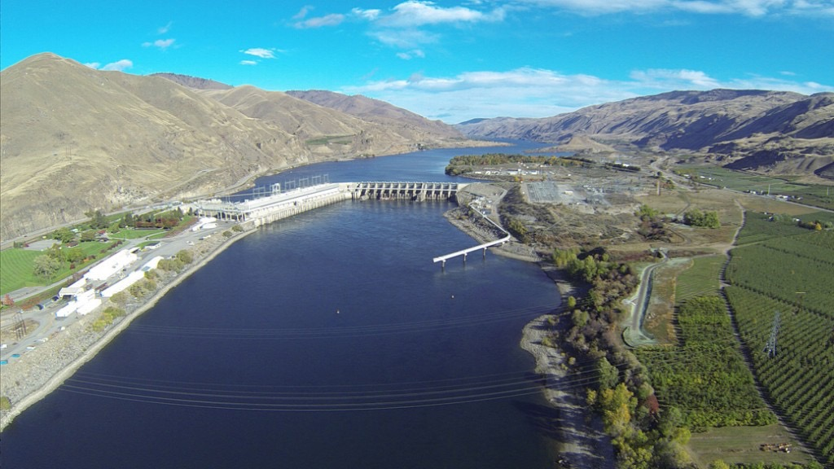
Notes:
Ecology received a report of an unknown sheen on the Columbia River in Wenatchee. Responders traced the sheen upstream to Rocky Reach Dam and notified Chelan County PUD. The PUD recently conducted routine maintenance on one of their turbines and had returned the unit to service two days prior to the sheen discovery. Shortly after shutting down the turbine, the sheen began to dissipate. PUD staff calculated the spilled volume to be 187 gallons of turbine oil. The turbine was kept offline for ongoing testing.

Slide 9
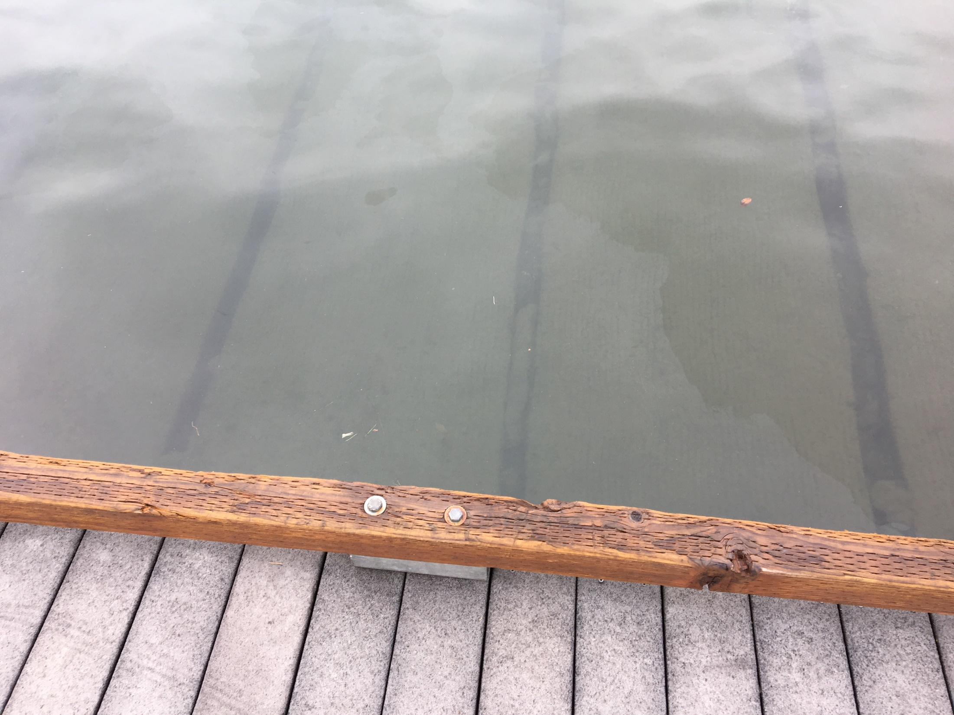
Notes:
Ecology received a report of an unknown sheen on the Columbia River in Wenatchee. Responders traced the sheen upstream to Rocky Reach Dam and notified Chelan County PUD. The PUD recently conducted routine maintenance on one of their turbines and had returned the unit to service two days prior to the sheen discovery. Shortly after shutting down the turbine, the sheen began to dissipate. PUD staff calculated the spilled volume to be 187 gallons of turbine oil. The turbine was kept offline for ongoing testing.

Slide 10
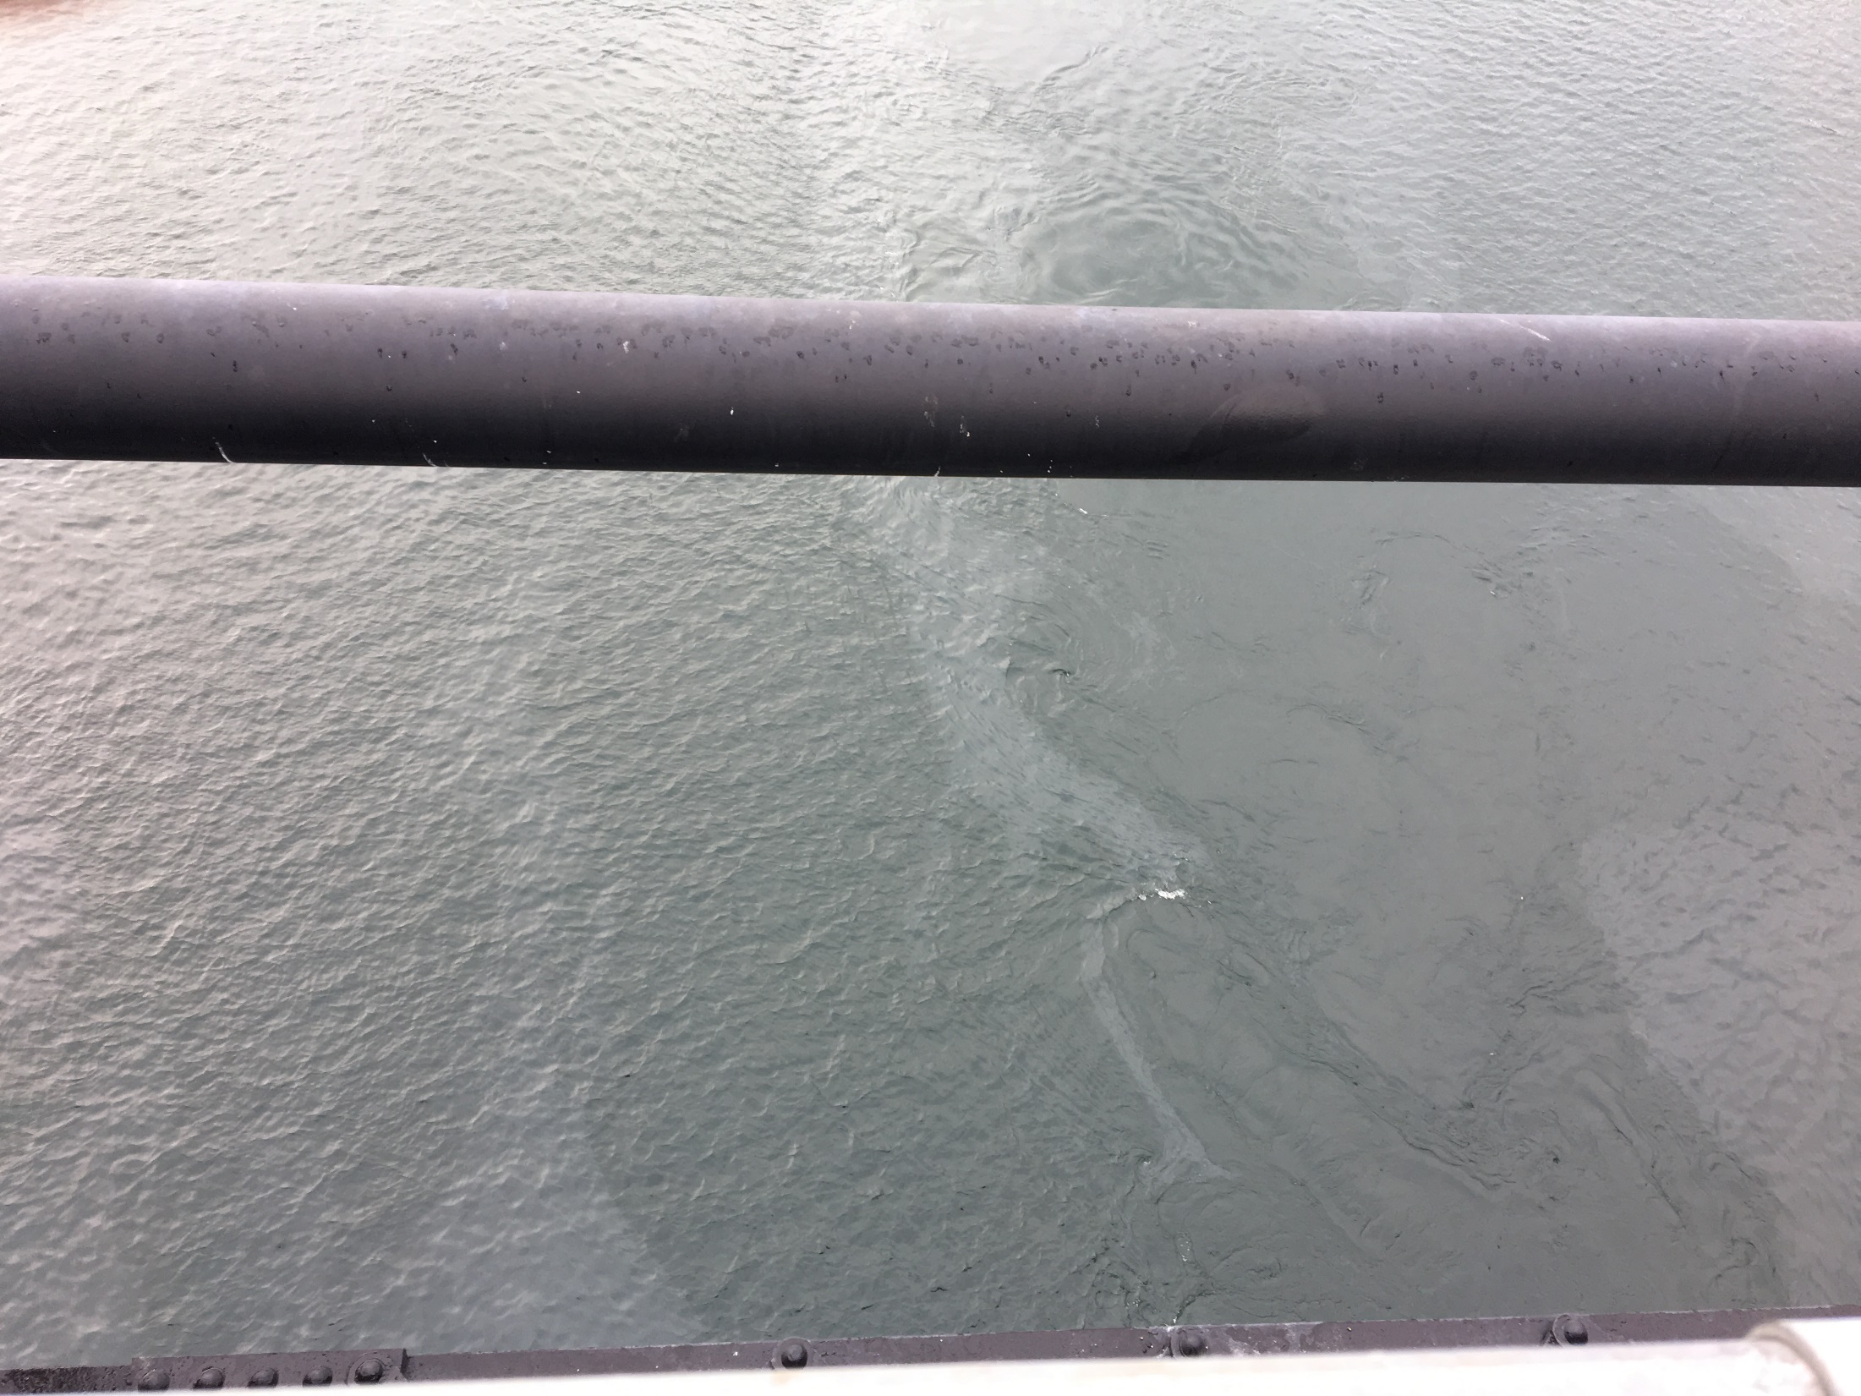
Notes:
Ecology received a report of an unknown sheen on the Columbia River in Wenatchee. Responders traced the sheen upstream to Rocky Reach Dam and notified Chelan County PUD. The PUD recently conducted routine maintenance on one of their turbines and had returned the unit to service two days prior to the sheen discovery. Shortly after shutting down the turbine, the sheen began to dissipate. PUD staff calculated the spilled volume to be 187 gallons of turbine oil. The turbine was kept offline for ongoing testing.

Slide 11
P/C Sinbad sinking and spill into Sinclair Inlet
Date of Incident: January 29, 2018
Potentially Liable Party: Charles Doore
Product Spilled: Diesel
Spill Source: P/C Sinbad
Oil Spill Size Estimate: Under investigation.
Water Body Affected: Sinclair Inlet
Ecology Region: NWRO
County: Kitsap
Nearest City: Bremerton
Location of Spill: Bremerton Marina
Cause: Unknown
Ecology Responder: Corey King
Notes:
The 34’ P/C Sinbad sank while docked at the Bremerton Marina, spilling an as yet to be determined volume of diesel fuel. The vessel owner hired T&C Diving to refloat the vessel. With the vessel raised, NRCES was hired to defuel the boat in case it sank again. An estimated 30 gallons of diesel fuel was pumped from the vessel.

Slide 12
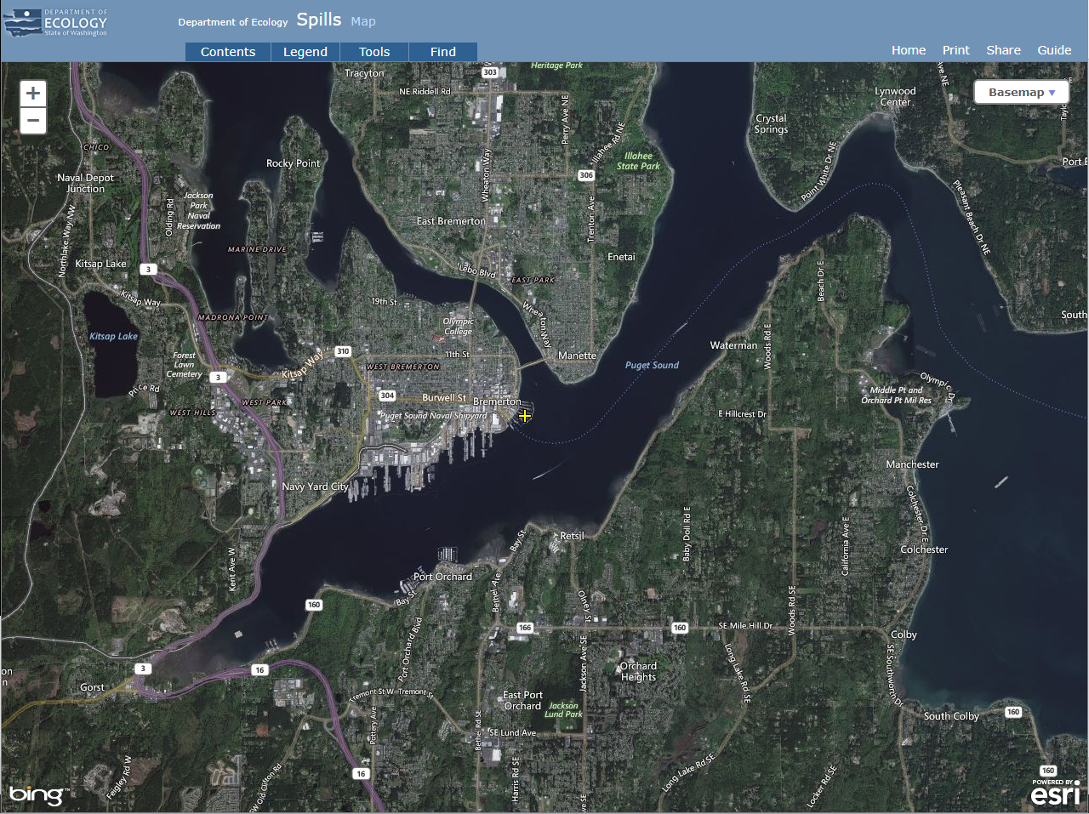
Notes:
The 34’ P/C Sinbad sank while docked at the Bremerton Marina, spilling an as yet to be determined volume of diesel fuel. The vessel owner hired T&C Diving to refloat the vessel. With the vessel raised, NRCES was hired to defuel the boat in case it sank again. An estimated 30 gallons of diesel fuel was pumped from the vessel.

Slide 13
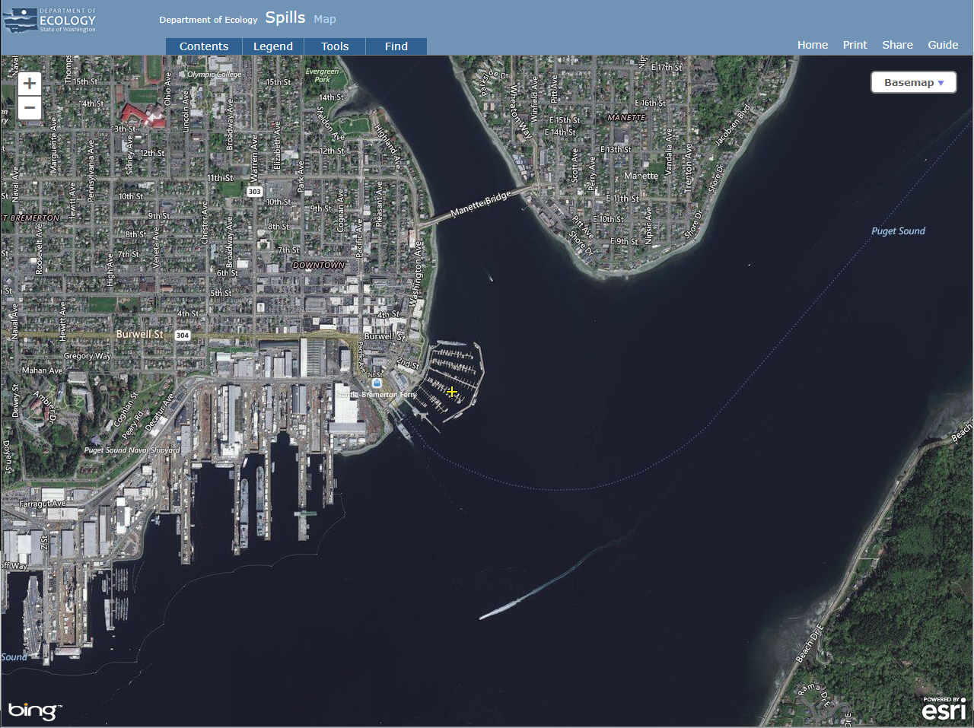
Notes:
The 34’ P/C Sinbad sank while docked at the Bremerton Marina, spilling an as yet to be determined volume of diesel fuel. The vessel owner hired T&C Diving to refloat the vessel. With the vessel raised, NRCES was hired to defuel the boat in case it sank again. An estimated 30 gallons of diesel fuel was pumped from the vessel.

Slide 14
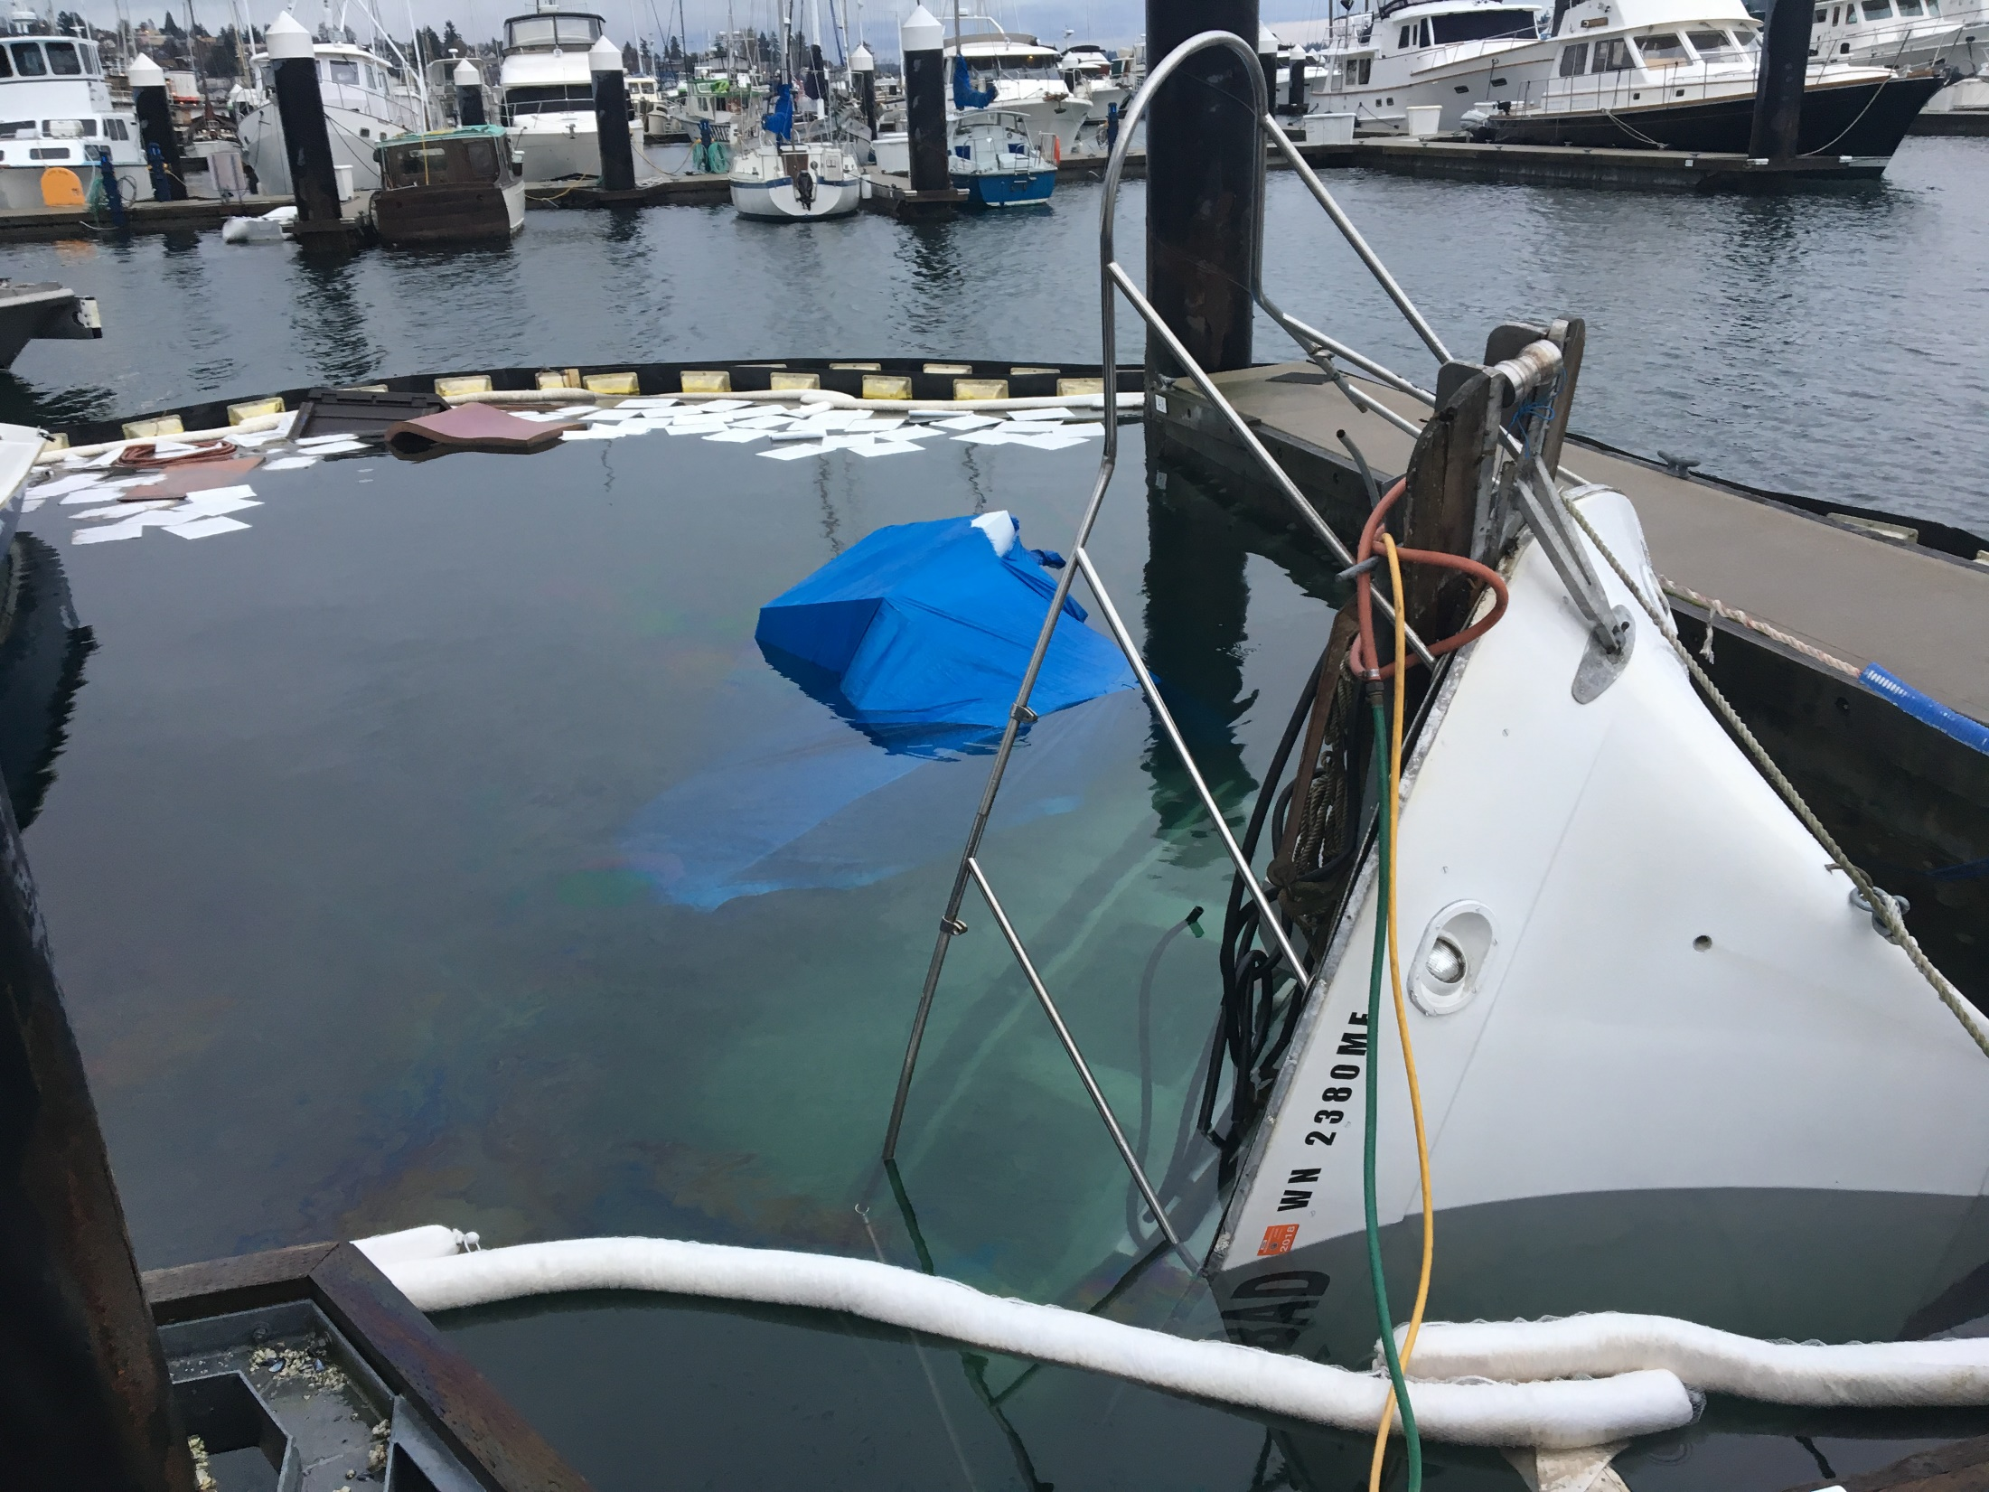
Notes:
The 34’ P/C Sinbad sank while docked at the Bremerton Marina, spilling an as yet to be determined volume of diesel fuel. The vessel owner hired T&C Diving to refloat the vessel. With the vessel raised, NRCES was hired to defuel the boat in case it sank again. An estimated 30 gallons of diesel fuel was pumped from the vessel.

Slide 15
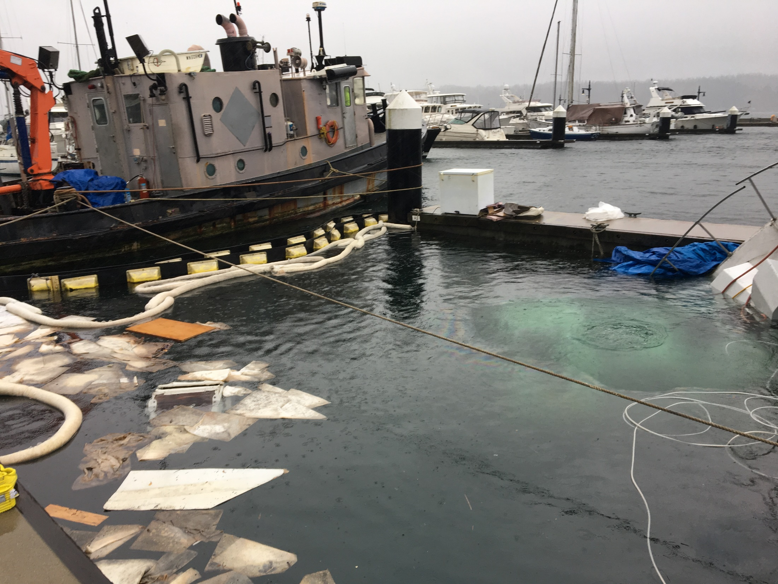
Notes:
The 34’ P/C Sinbad sank while docked at the Bremerton Marina, spilling an as yet to be determined volume of diesel fuel. The vessel owner hired T&C Diving to refloat the vessel. With the vessel raised, NRCES was hired to defuel the boat in case it sank again. An estimated 30 gallons of diesel fuel was pumped from the vessel.

Slide 16
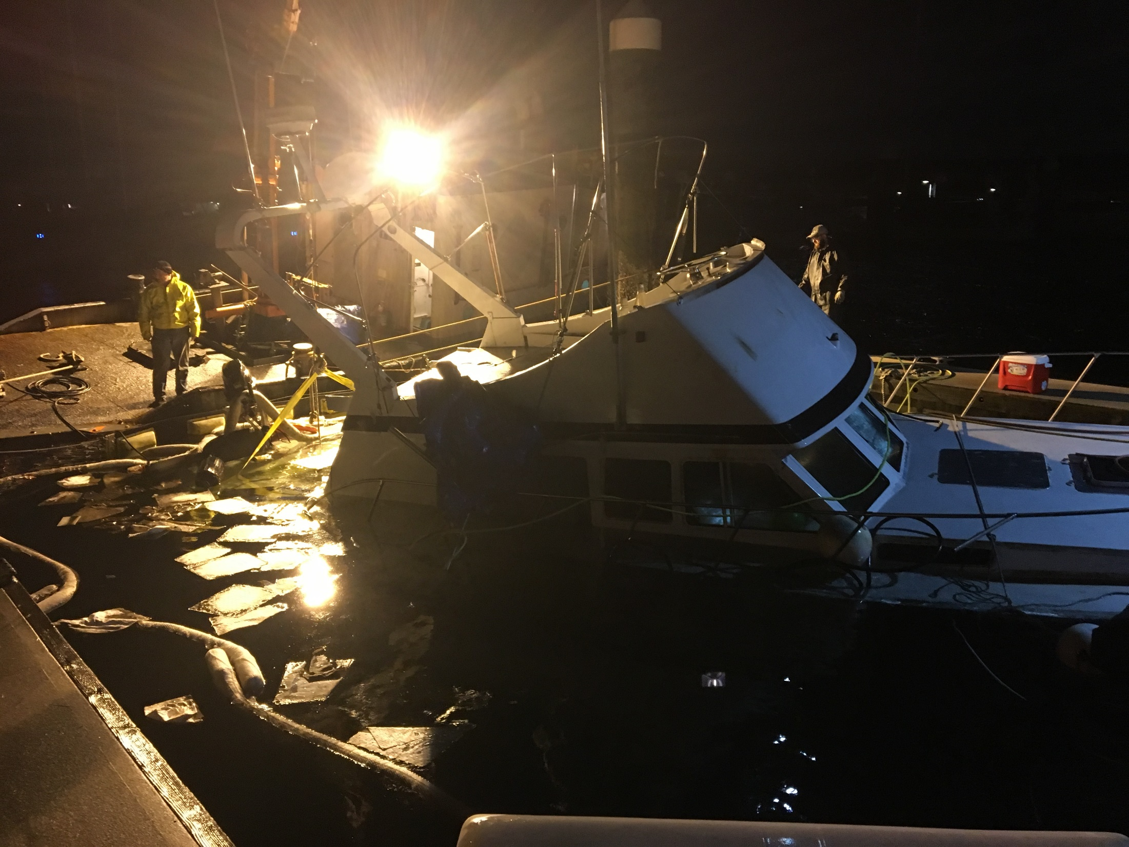
Notes:
The 34’ P/C Sinbad sank while docked at the Bremerton Marina, spilling an as yet to be determined volume of diesel fuel. The vessel owner hired T&C Diving to refloat the vessel. With the vessel raised, NRCES was hired to defuel the boat in case it sank again. An estimated 30 gallons of diesel fuel was pumped from the vessel.

Slide 17
Old Business
Open RDA Case Updates

Slide 18
2008 Cases
F/V Haeshin, January 21, 2008 spill into Grays Harbor
F/V Miss Michelle, September 19, 2008 spill into the Pacific Ocean
Notes:
A few questions came in regarding a couple of older cases. Let’s review them and make a determination of how actively we should pursue these cases, and what posture others offices should take regarding the RDA for these cases.

Slide 19
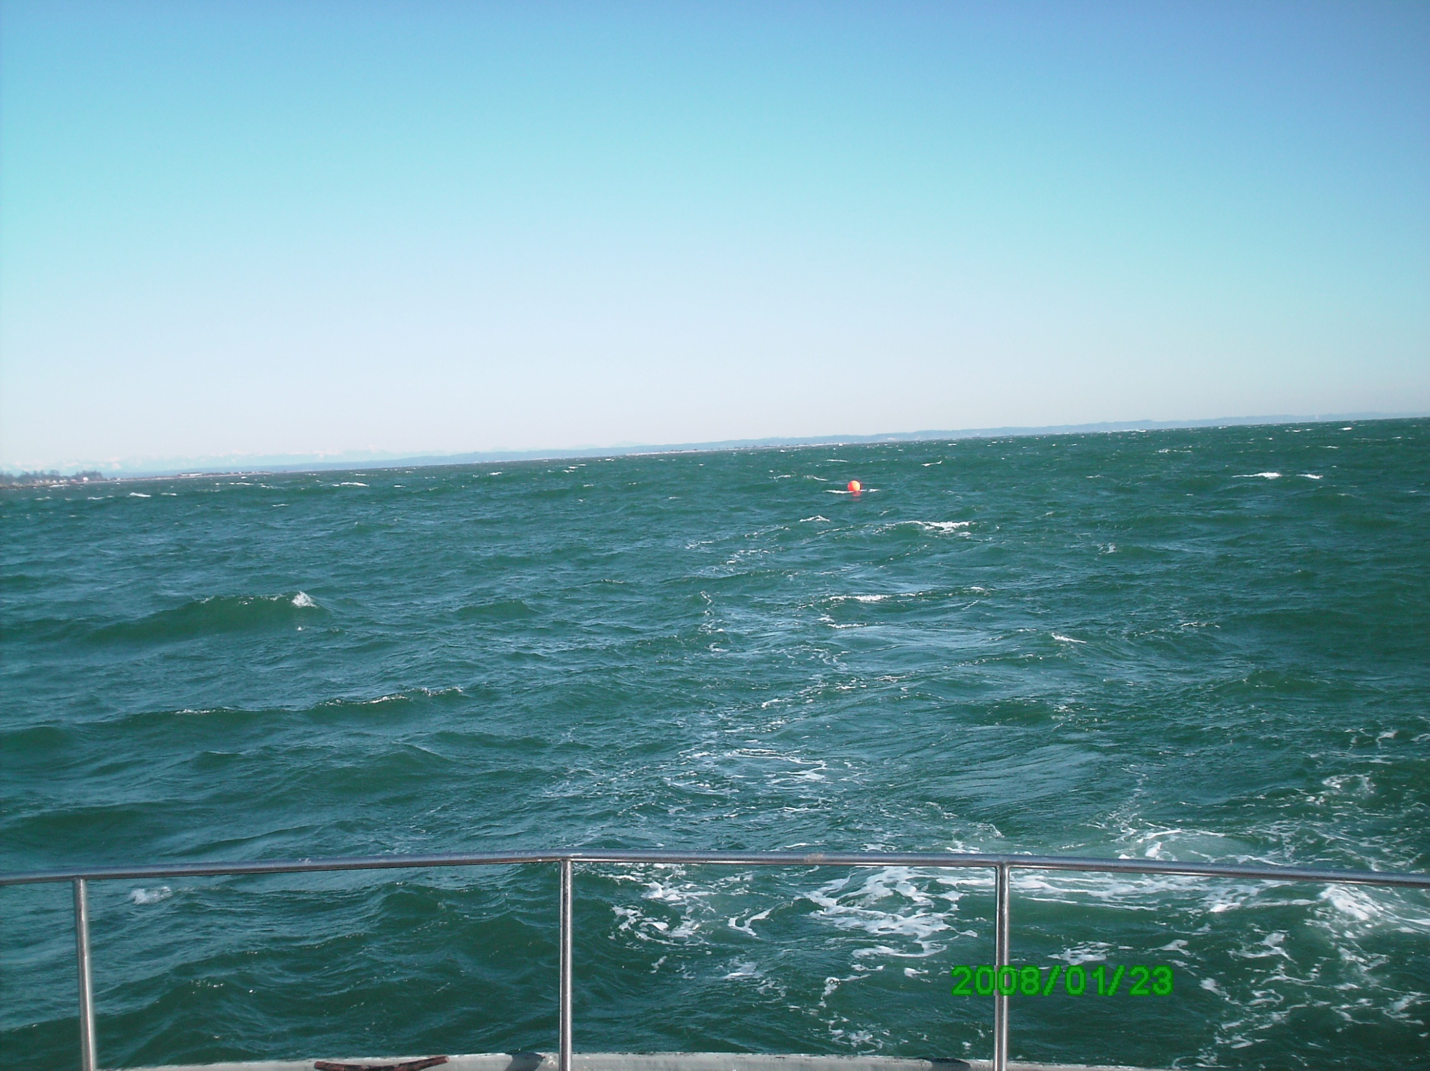
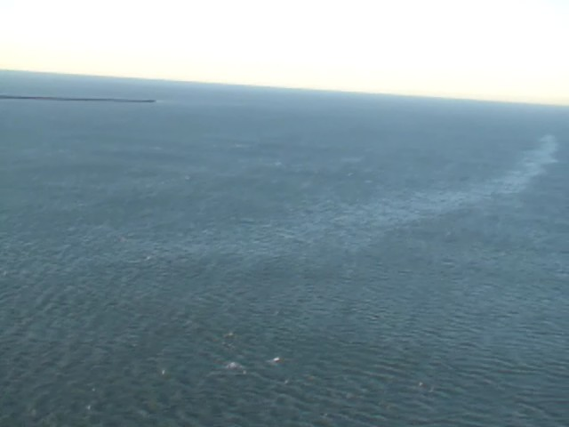
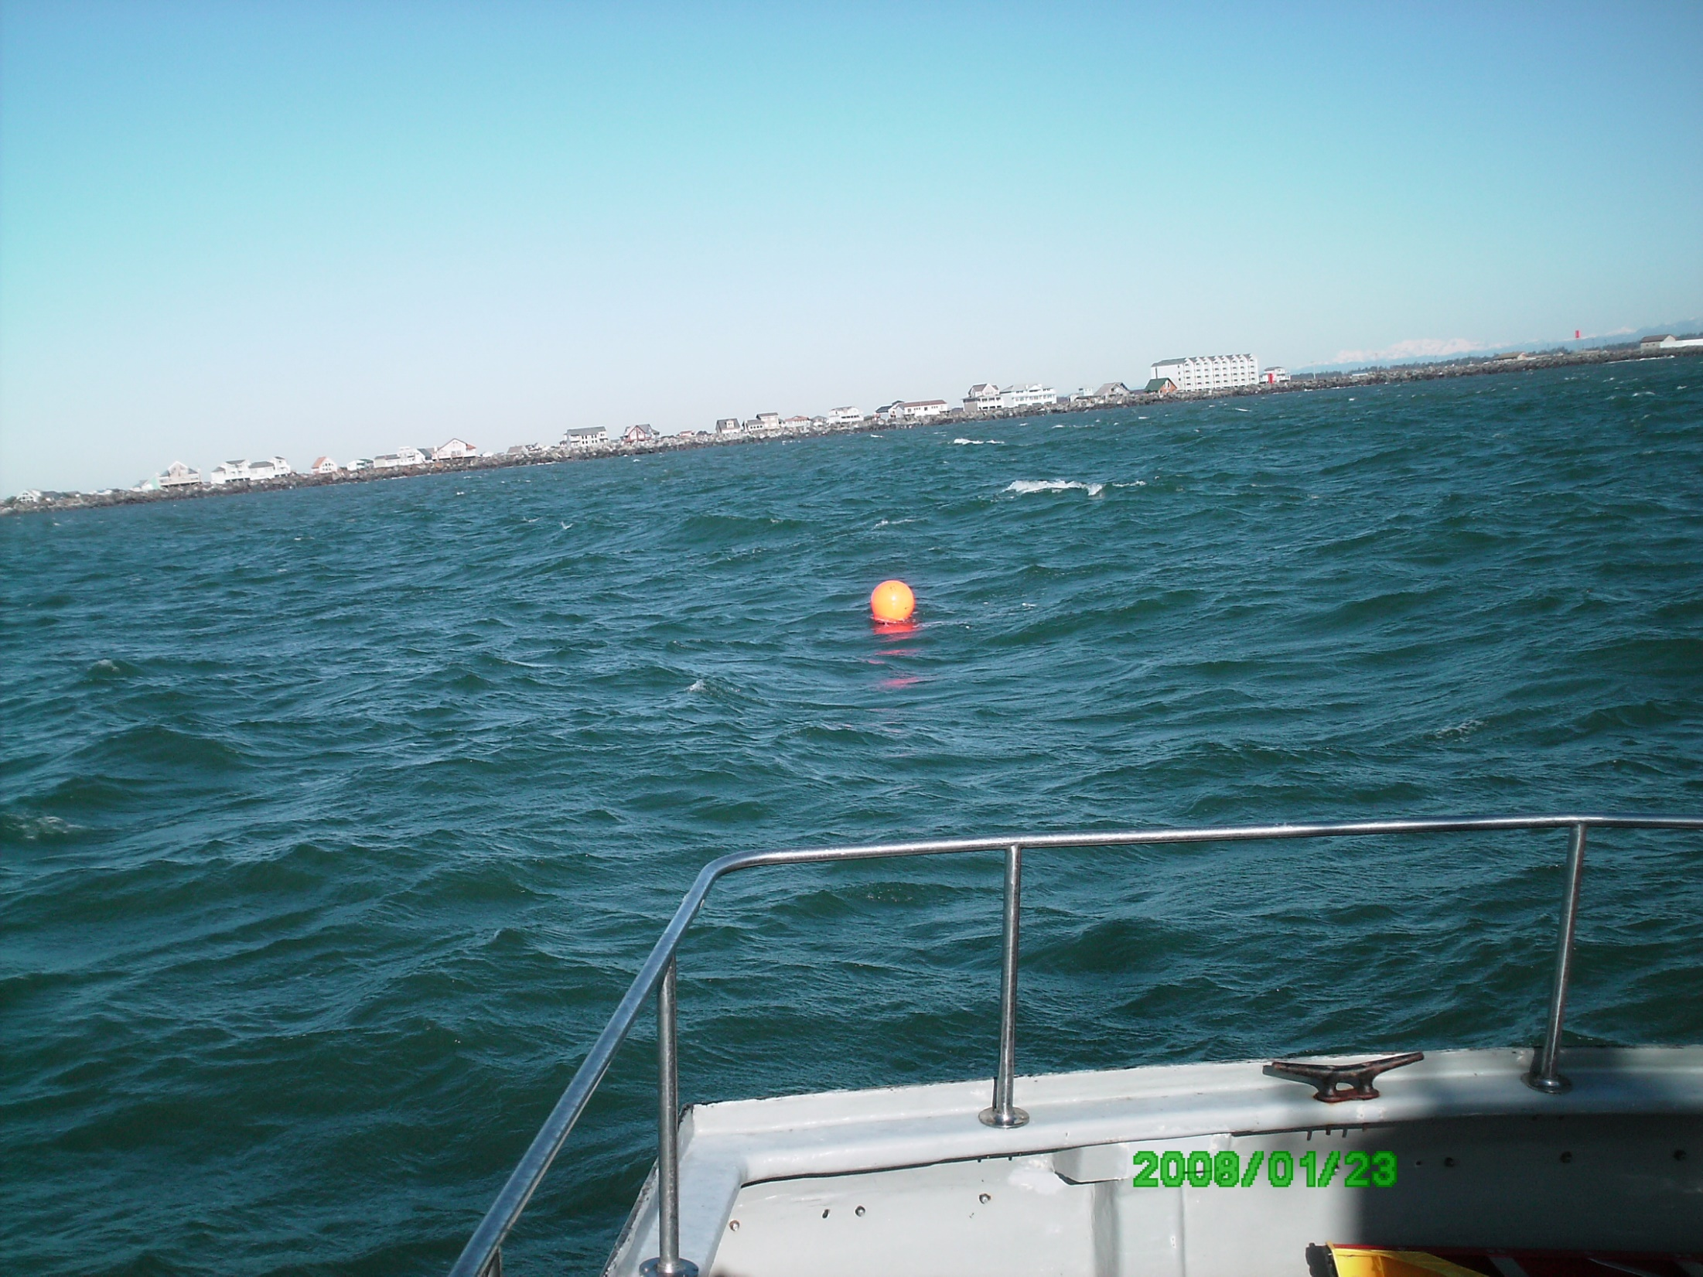
F/V Haeshin
Notes:
Date of Incident: January 21, 2008
Potentially Liable Party: Gary Courtner
Product Spilled: Diesel
Spill Source: F/V Haeshin
Oil Spill Size Estimate: 540 gallons
Field Report: Vessel was coming into Grays Harbor when it struck the south jetty and sank on the north side of the jetty just inside the bar crossing. The vessel was a 69 foot long 1932 wooden hull boat and the owner was not interested in salvaging it. It was sitting in about 30 feet of water and was fairly protected from wave action, and the masts were sticking out of the water. The USCG hired Global Diving to recover the vessel since it was a hazard to navigation and it had 540 gallons of fuel on board. The current was swift in the area and when a diver tried to plug the vents he nearly got tangled in the rigging. When they went back out the next day to try again, the vessel was gone; apparently swept into deeper water by the strong currents. There has been no sign of the vessel and it is assumed that it broke up (some debris was seen) and lost all of the 540 gallons of fuel. No oil was recovered.

Slide 20
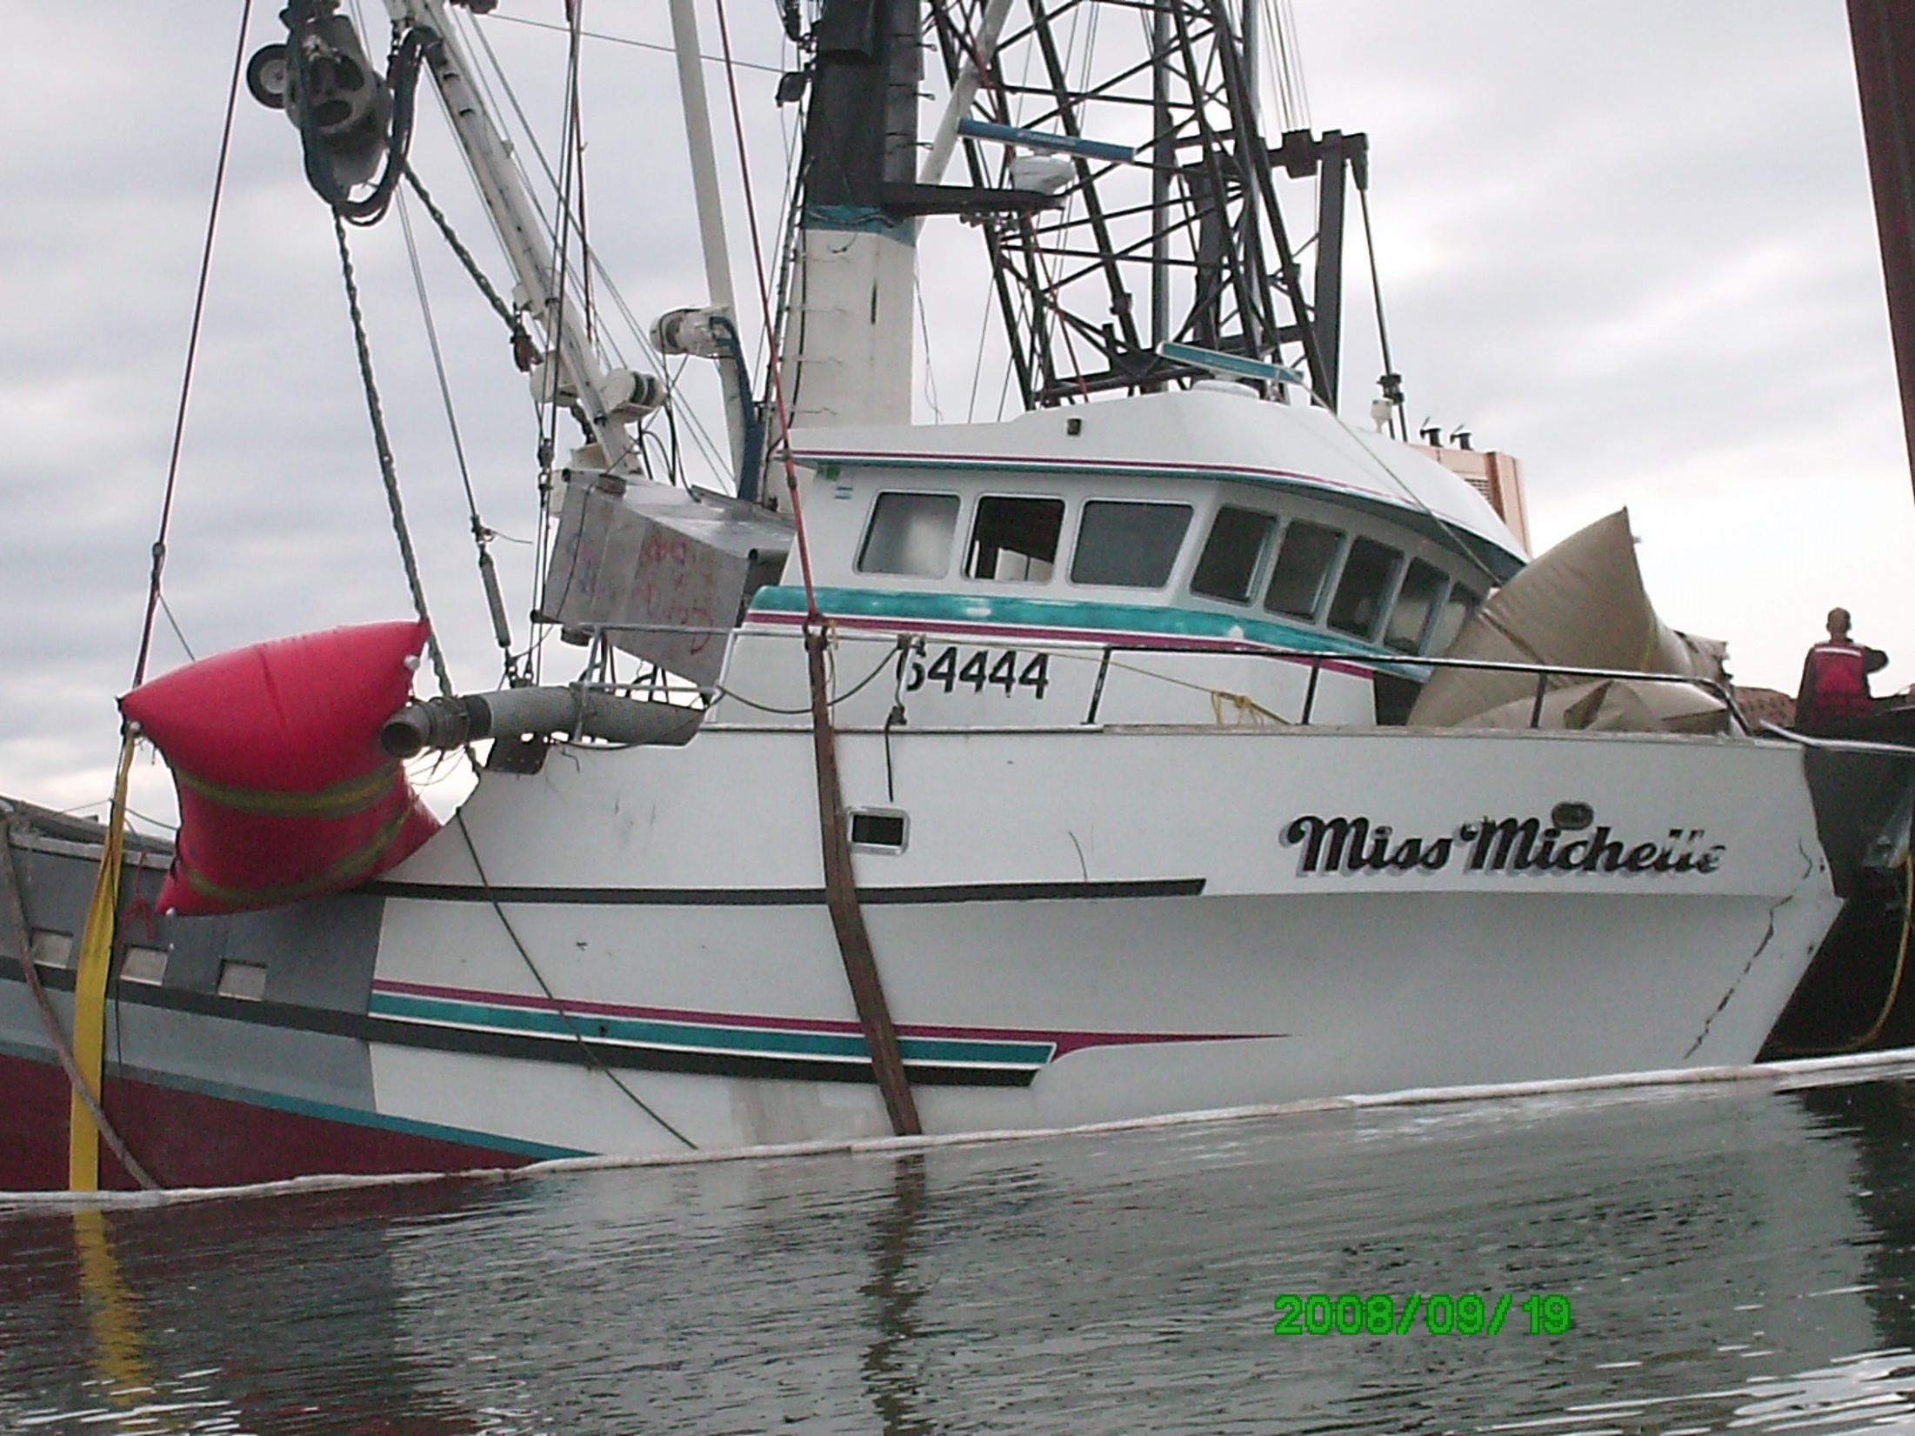
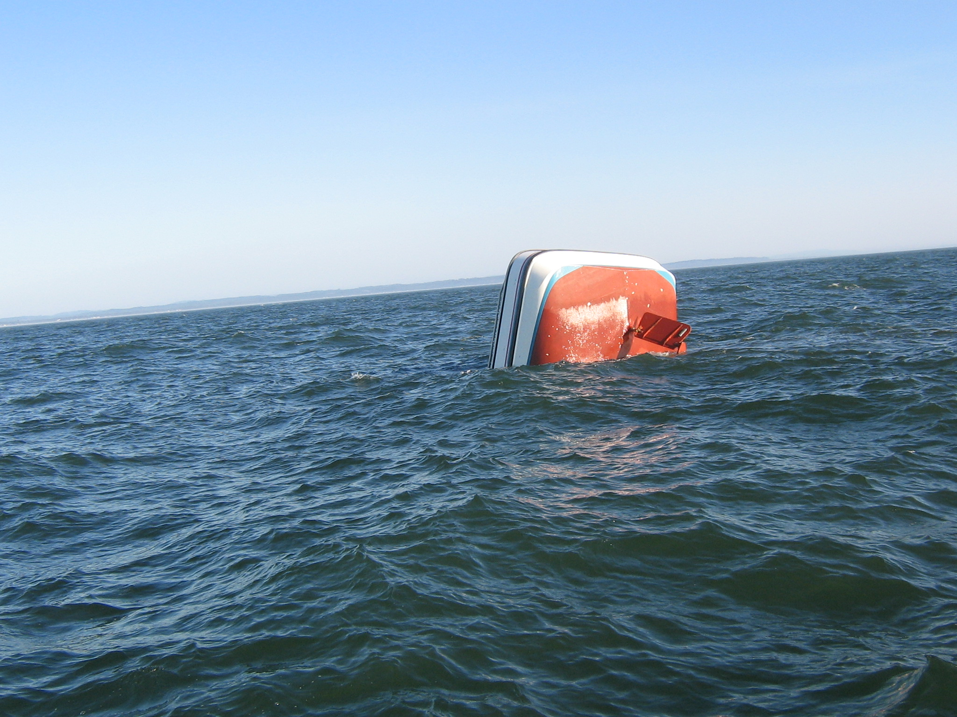
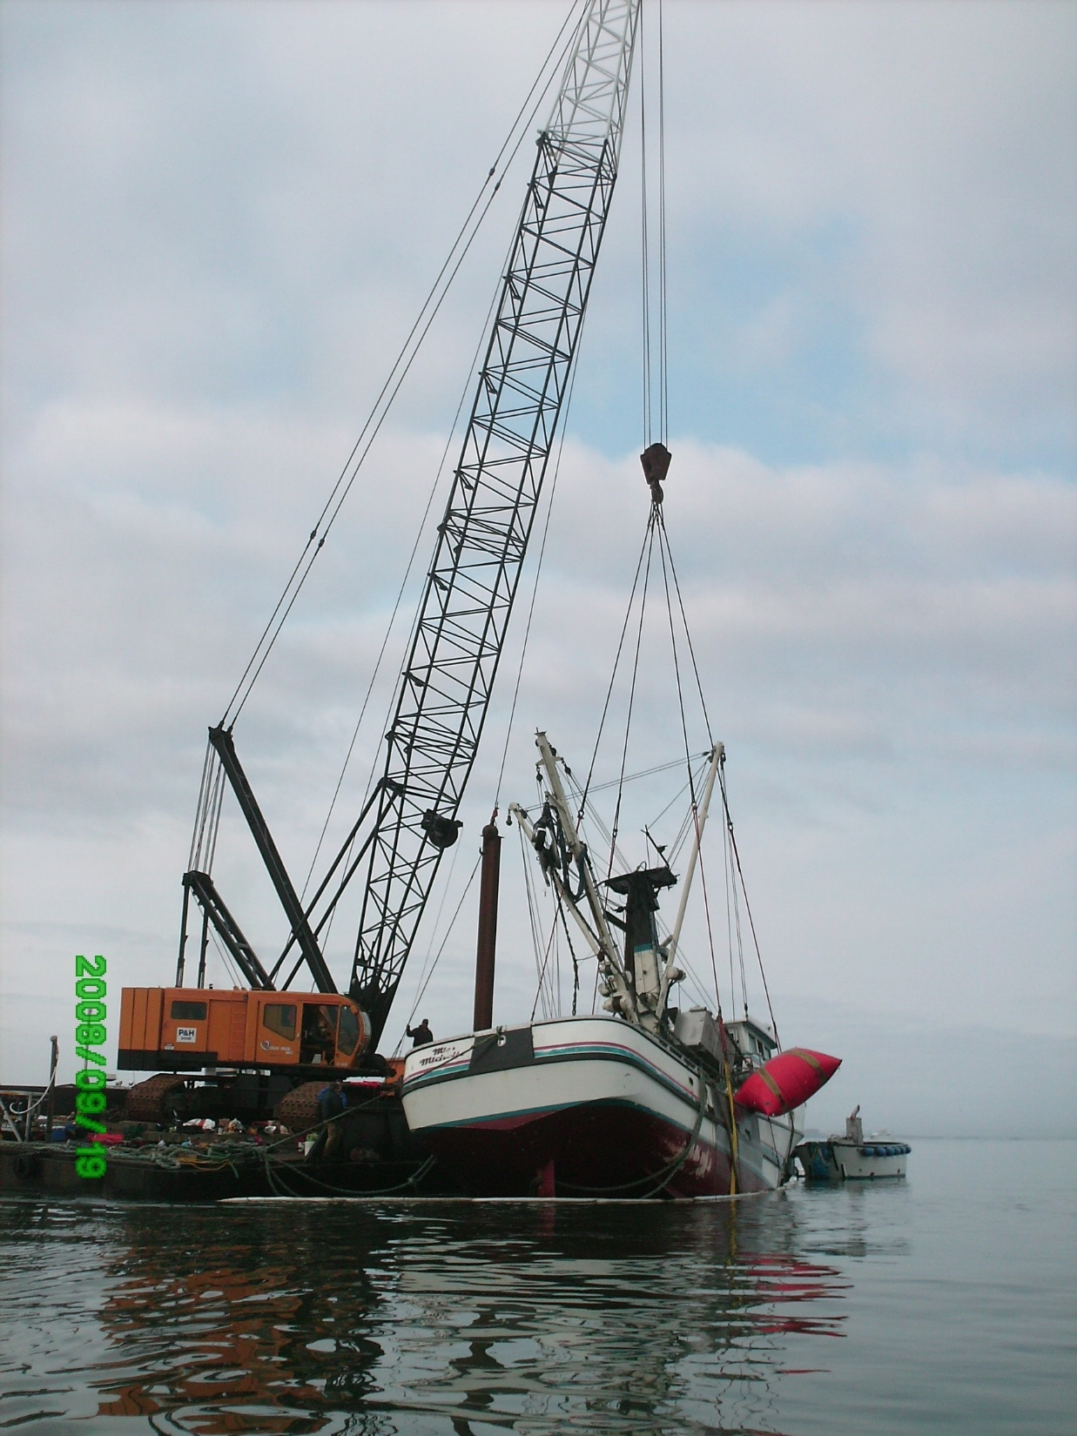
F/V Miss Michelle
Notes:
Date of Incident: September 15, 2008
Potentially Liable Party: MMCB LLC F/V Miss Michelle (Allen Edgar)
Product Spilled: Diesel
Spill Source: F/V Miss Michelle
Oil Spill Size Estimate: 120 gallons
The vessel apparently hit the jetty and partially sank. It floated around the entrance to Grays Harbor for a couple of days with only about five feet of the stern sticking up. Eventually they were able to tow the vessel along-side a crane that lifted it out of the water. They pumped the remaining fuel and oil off, and determined that they had lost about 80 gallons of diesel and about 40 gallons of hydraulic oil. None of that was recovered.
Collection History: AG sent three demand letters, and no response. The associated penalty has already been written off by fiscal. Consider declaring an end to active claim pursuit? Discuss what this means for AG (responsible for collecting the claim) and Ecology’s fiscal department (responsible for tracking all open claims).

Slide 21
F/V Deep Sea spill into Penn Cove
May 13, 2012
Notes:
According to Don, WDFW has been working with the NPFC to answer questions. One was regarding annual totals for harvest, another question related two what type of account the claim would be deposited into… all positive signs.

Slide 22
Sulphur Creek spill into the Yakima River
March 1, 2015
Notes:
According to TCP, the Deaton’s have been very communicative, and doing what they can on site with their own equipment. They’re reaching a point where they will have to take the next step and install some very expensive monitoring wells, which they are apprehensive to do since the department of justice’s cost recovery and the state RDA looming. The Yakama Nation is interested in taking the lead on a claim for bird damages to the National Pollution Fund Center– it would occur over two claims, one to help pay for a resource damage study, and the other to pay for a restoration study at the assessed damages. If they were to do this, we could not pursue a damage claim using the compensation schedule as it already factors in bird population damage (can’t pursue damages on the same resource twice).
We have two options:
Stay the course, work with the Deaton’s to identify a project on their land using their equipment so they can “work off” the damages. Unclear timeframe for when that would happen.
Partner with the Yakama Nation to pursue an RDA for bird damages, and use that claim to fund a potentially higher quality restoration project.

Slide 23
La Mexicana vegetable oil spill into the White Center Pond.
November 6, 2015
Notes:
King County DNRP has officially withdrawn their project proposal. Geoff is currently working on gathering projects for the liable party to consider.

Slide 24
F/V Privateer grounding and spill into the Pacific Ocean
April 15, 2016
Notes:
The consultant for the RP (Greg at Polaris) is working with Ken Graham at WA State Parks to develop the project proposal document. Once a final copy is submitted, the formal project proposal will be submitted.

Slide 25
Tug Island Wind spill into the Duwamish Waterway
February 28, 2017
Notes:
The liable party has reached out asking for project proposals. I have in turn reached out to the committee and others and have received a number of proposals. A small list of potential projects will be submitted to the liable party by the end of the week.

Slide 26
Tug Chief sinking and spill into Salmon Bay
November 30, 2017
Notes:
Interesting developments:
The sample analysis came back from the lab, and the black oil substance appears to be diesel fuel. Apparently this is not uncommon with high-sulfur content diesel fuels in older boats (the Chief was built in 1929). Based on Ecology’s investigation, the estimated spill volume is 110 gallons. +500 gallons in the tank (550 capacity), +5 gallons in the 40-50 gal fuel tank, +5 gallons in the bilge, -400 recovered directly from the fuel tank.
With this determination, the compensation schedule can be calculated. A follow-up letter discussing the variables will be going out to the liable party this week.

Slide 27
Announcements
Notes:
Due to an extended absence in staffing, CPF RDA grants have been unable to progress. The necessary staff members are returning next week, so agreements should be ready for signatures by next week.

