Slide 1
RDA Committee Meeting
April 11, 2018 @ 0900 in R0A-36

Slide 2
Agenda
New Business
  Preassessement Screenings
    F/V Lady Grace, March 2, 2018 spill into the Hoquiam River
    R/V Rachel Carson, March 5, 2018 spill into Salmon Bay
Old Business
  Open RDA Case Updates
    F/V Deep Sea, May 13, 2012 spill into Penn Cove
    Sulphur Creek, March 1, 2015 spill into the Yakima River
    La Mexicana, November 6, 2015 spill into White Center Pond
    F/V Privateer, April 15, 2016 spill into the Pacific Ocean
    F/V Coral Sea, August 8, 2016 spill into the Strait of Georgia
    Tug Island Wind, February 28, 2017 spill into the Duwamish Waterway
    Coleman Oil, March 18, 2017 spill into the Columbia River
    P/C Sinbad, January 29, 2018 sinking and spill into Sinclair Inlet
Announcements

Slide 3
New Business
Preassessment Screenings

Slide 4
F/V Lady Grace sinking and spill into the Hoquiam River
Date of Incident: March 2, 2018
Potentially Liable Party: John Simons, Jr.
Product Spilled: Diesel
Spill Source: F/V Lady Grace
Oil Spill Size Estimate: Yet to be determined
Water Body Affected: Hoquiam River
Ecology Region: SWRO
County: Grays Harbor
Nearest City: Hoquiam
Location of Spill: 220 Monroe St
Cause: Inadequate Maintenance
Ecology Responder: John Diamant
Notes:
Field Report: The 70ft. F/V Lady Grace was reported listing on March 2. Despite Ecology responders’ best efforts to help the owner keep the boat afloat, the vessel took on water and sank, spilling an as yet to be determined volume of diesel fuel into the Hoquiam River. The owner of this vessel is also owns of the F/V Perwyn, another vessel that sank at this location. Response contractors dove on the vessel and removed 890 gallons of oily/water from its tanks. TRAP sampling indicates that the tidal influence from Grays Harbor pushed the spilled diesel over 6 miles up the Hoquiam River.

Slide 5
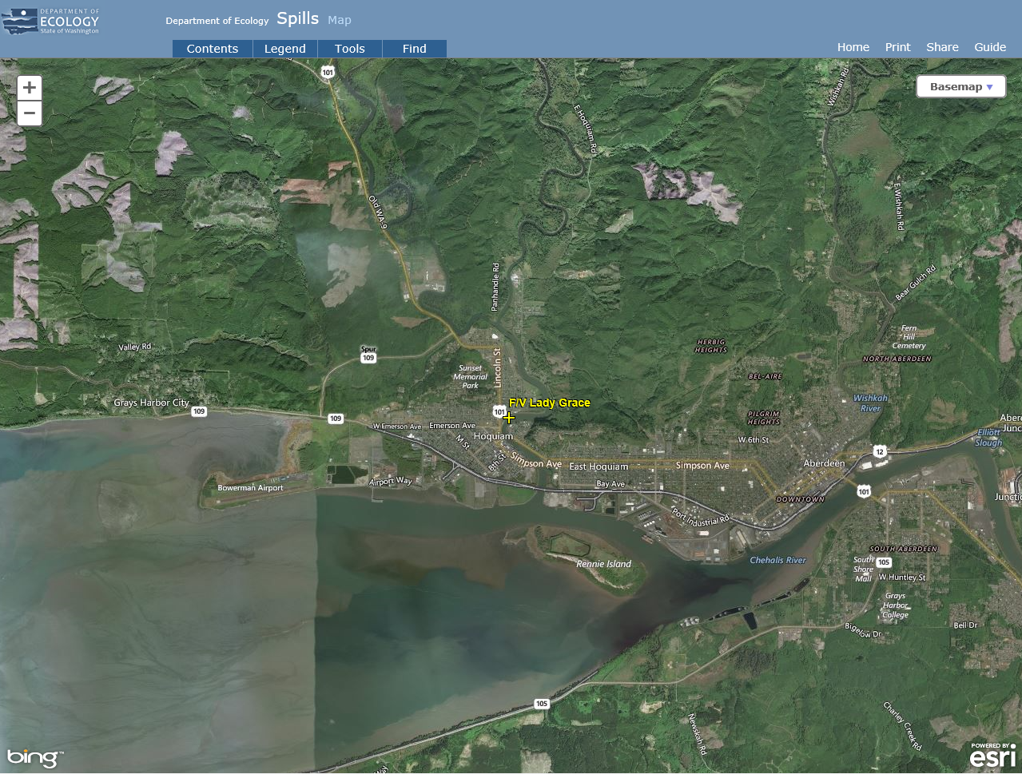
Notes:
Field Report: The 70ft. F/V Lady Grace was reported listing on March 2. Despite Ecology responders’ best efforts to help the owner keep the boat afloat, the vessel took on water and sank, spilling an as yet to be determined volume of diesel fuel into the Hoquiam River. The owner of this vessel is also owns of the F/V Perwyn, another vessel that sank at this location. Response contractors dove on the vessel and removed 890 gallons of oily/water from its tanks. TRAP sampling indicates that the tidal influence from Grays Harbor pushed the spilled diesel over 6 miles up the Hoquiam River.

Slide 6
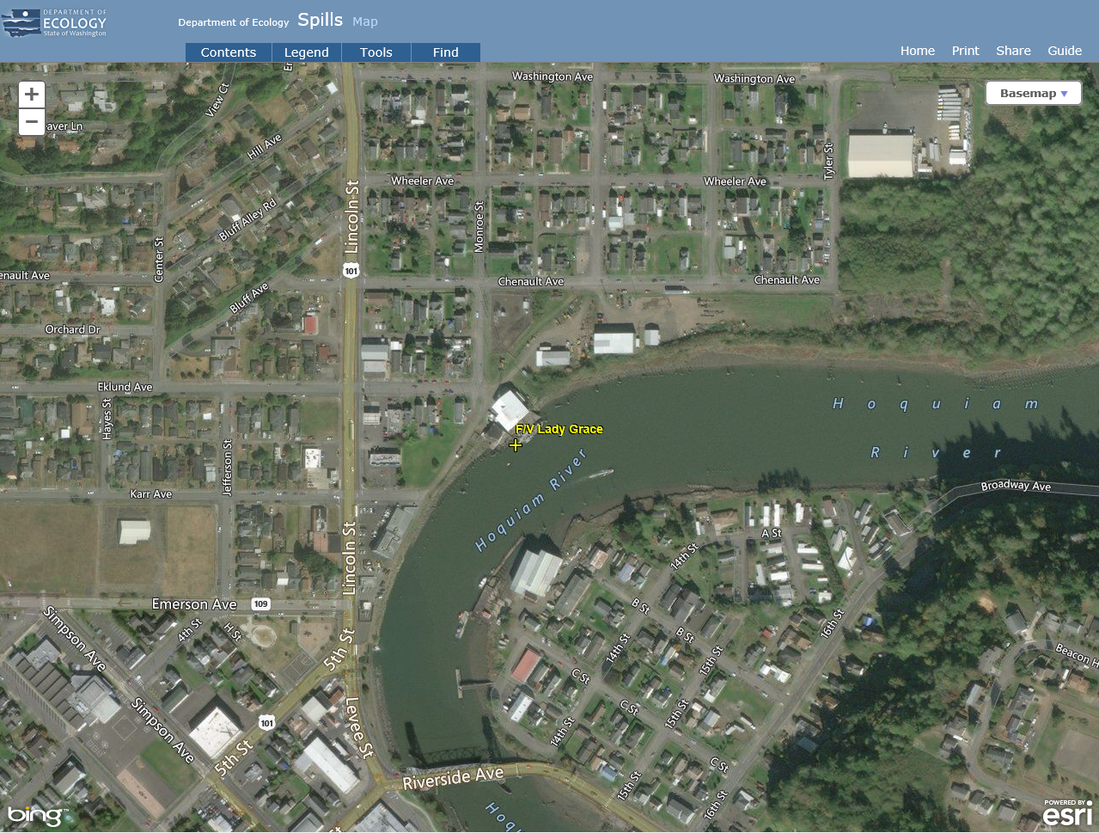
Notes:
Field Report: The 70ft. F/V Lady Grace was reported listing on March 2. Despite Ecology responders’ best efforts to help the owner keep the boat afloat, the vessel took on water and sank, spilling an as yet to be determined volume of diesel fuel into the Hoquiam River. The owner of this vessel is also owns of the F/V Perwyn, another vessel that sank at this location. Response contractors dove on the vessel and removed 890 gallons of oily/water from its tanks. TRAP sampling indicates that the tidal influence from Grays Harbor pushed the spilled diesel over 6 miles up the Hoquiam River.

Slide 7
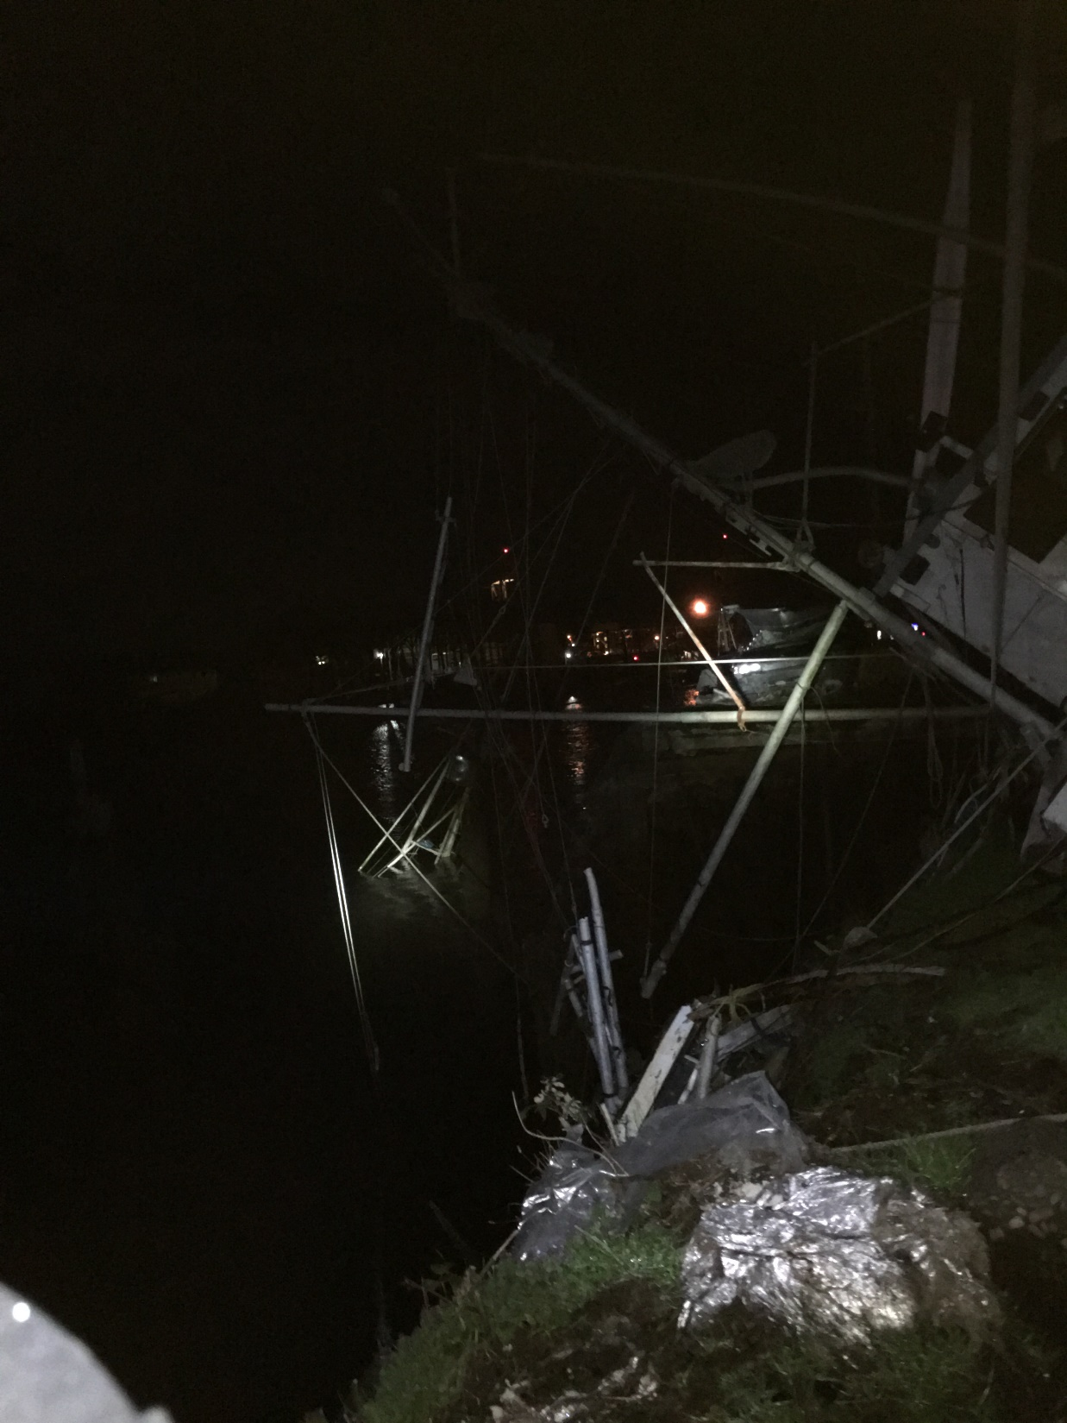

Slide 8
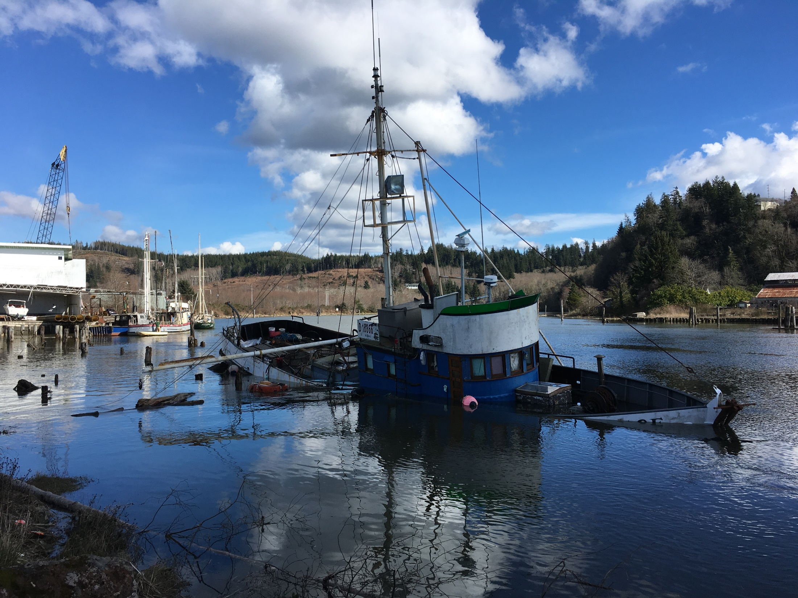

Slide 9
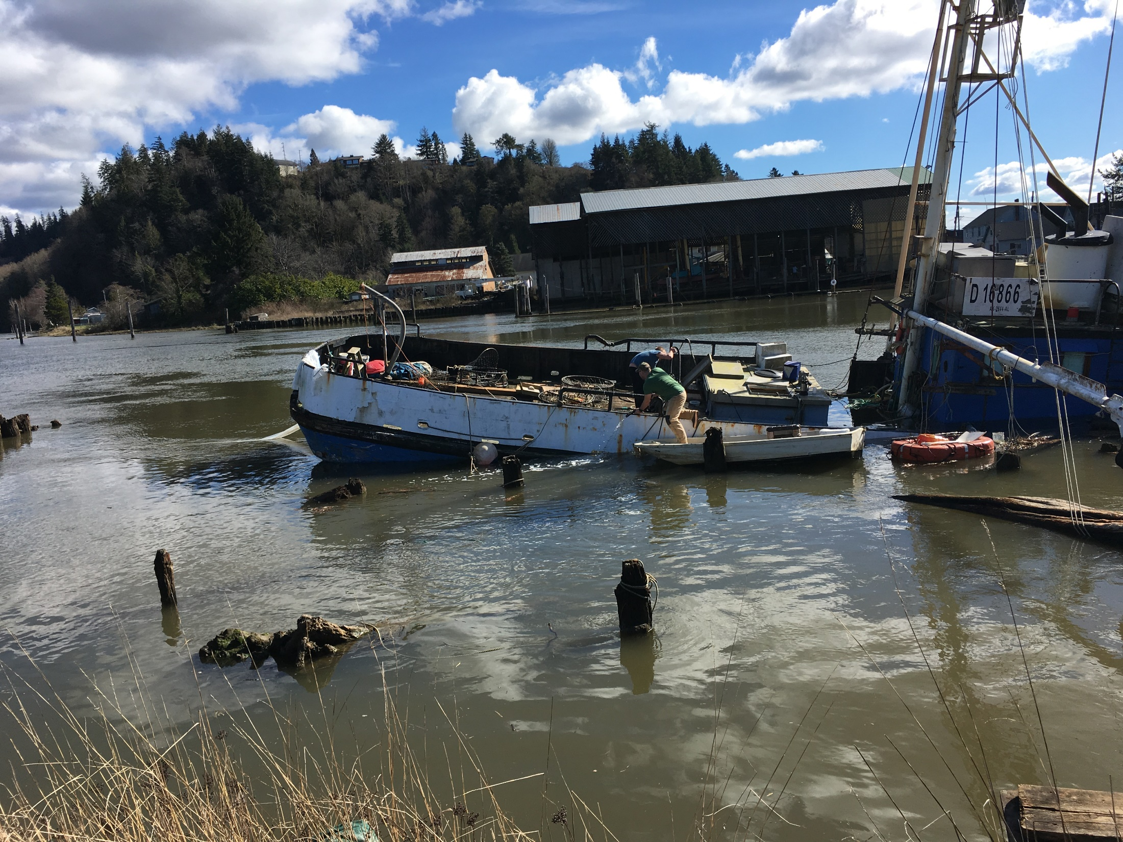

Slide 10
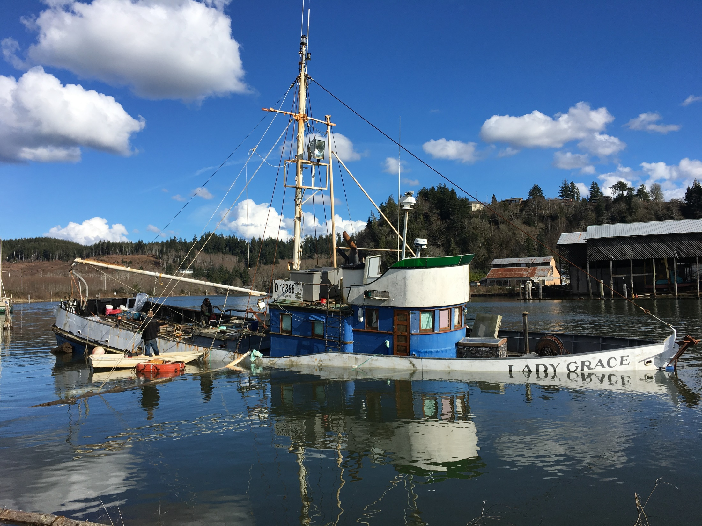

Slide 11
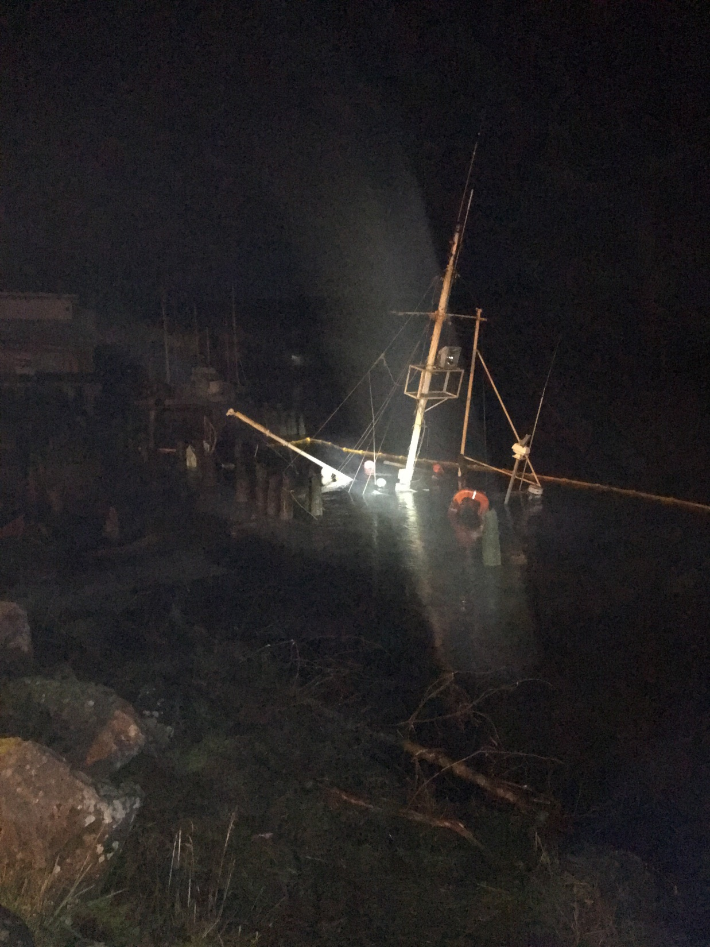
Notes:
Around 22:00, Cody called and said that John Simons had left, the pump died, and the vessel was taking on water, and began releasing diesel fuel into the river.

Slide 12
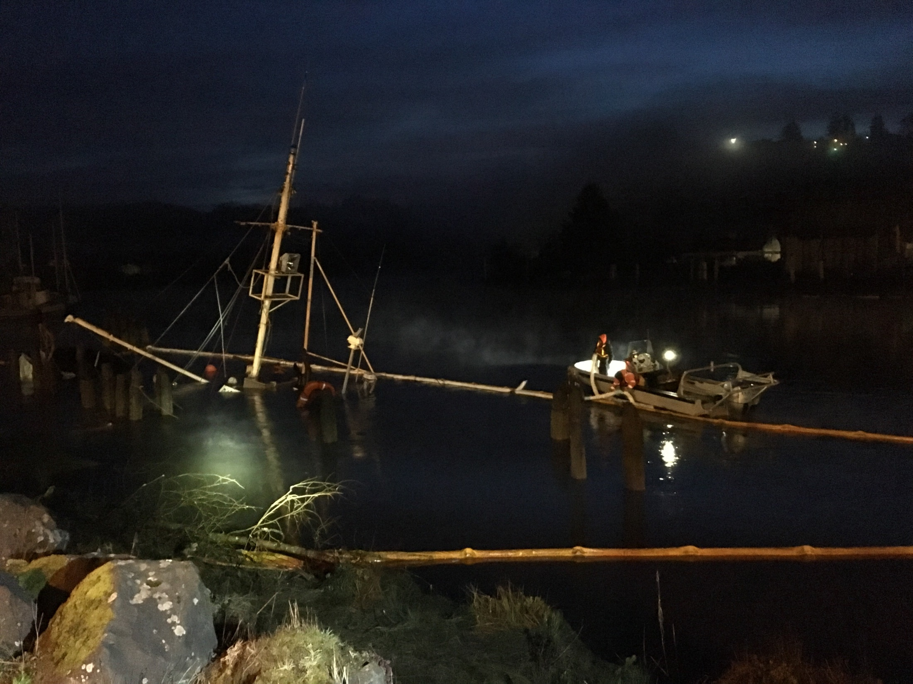
Notes:
Ecology mobilized Global Diving and salvage, who were on site by 0400. The vessel was boomed by 0620.

Slide 13
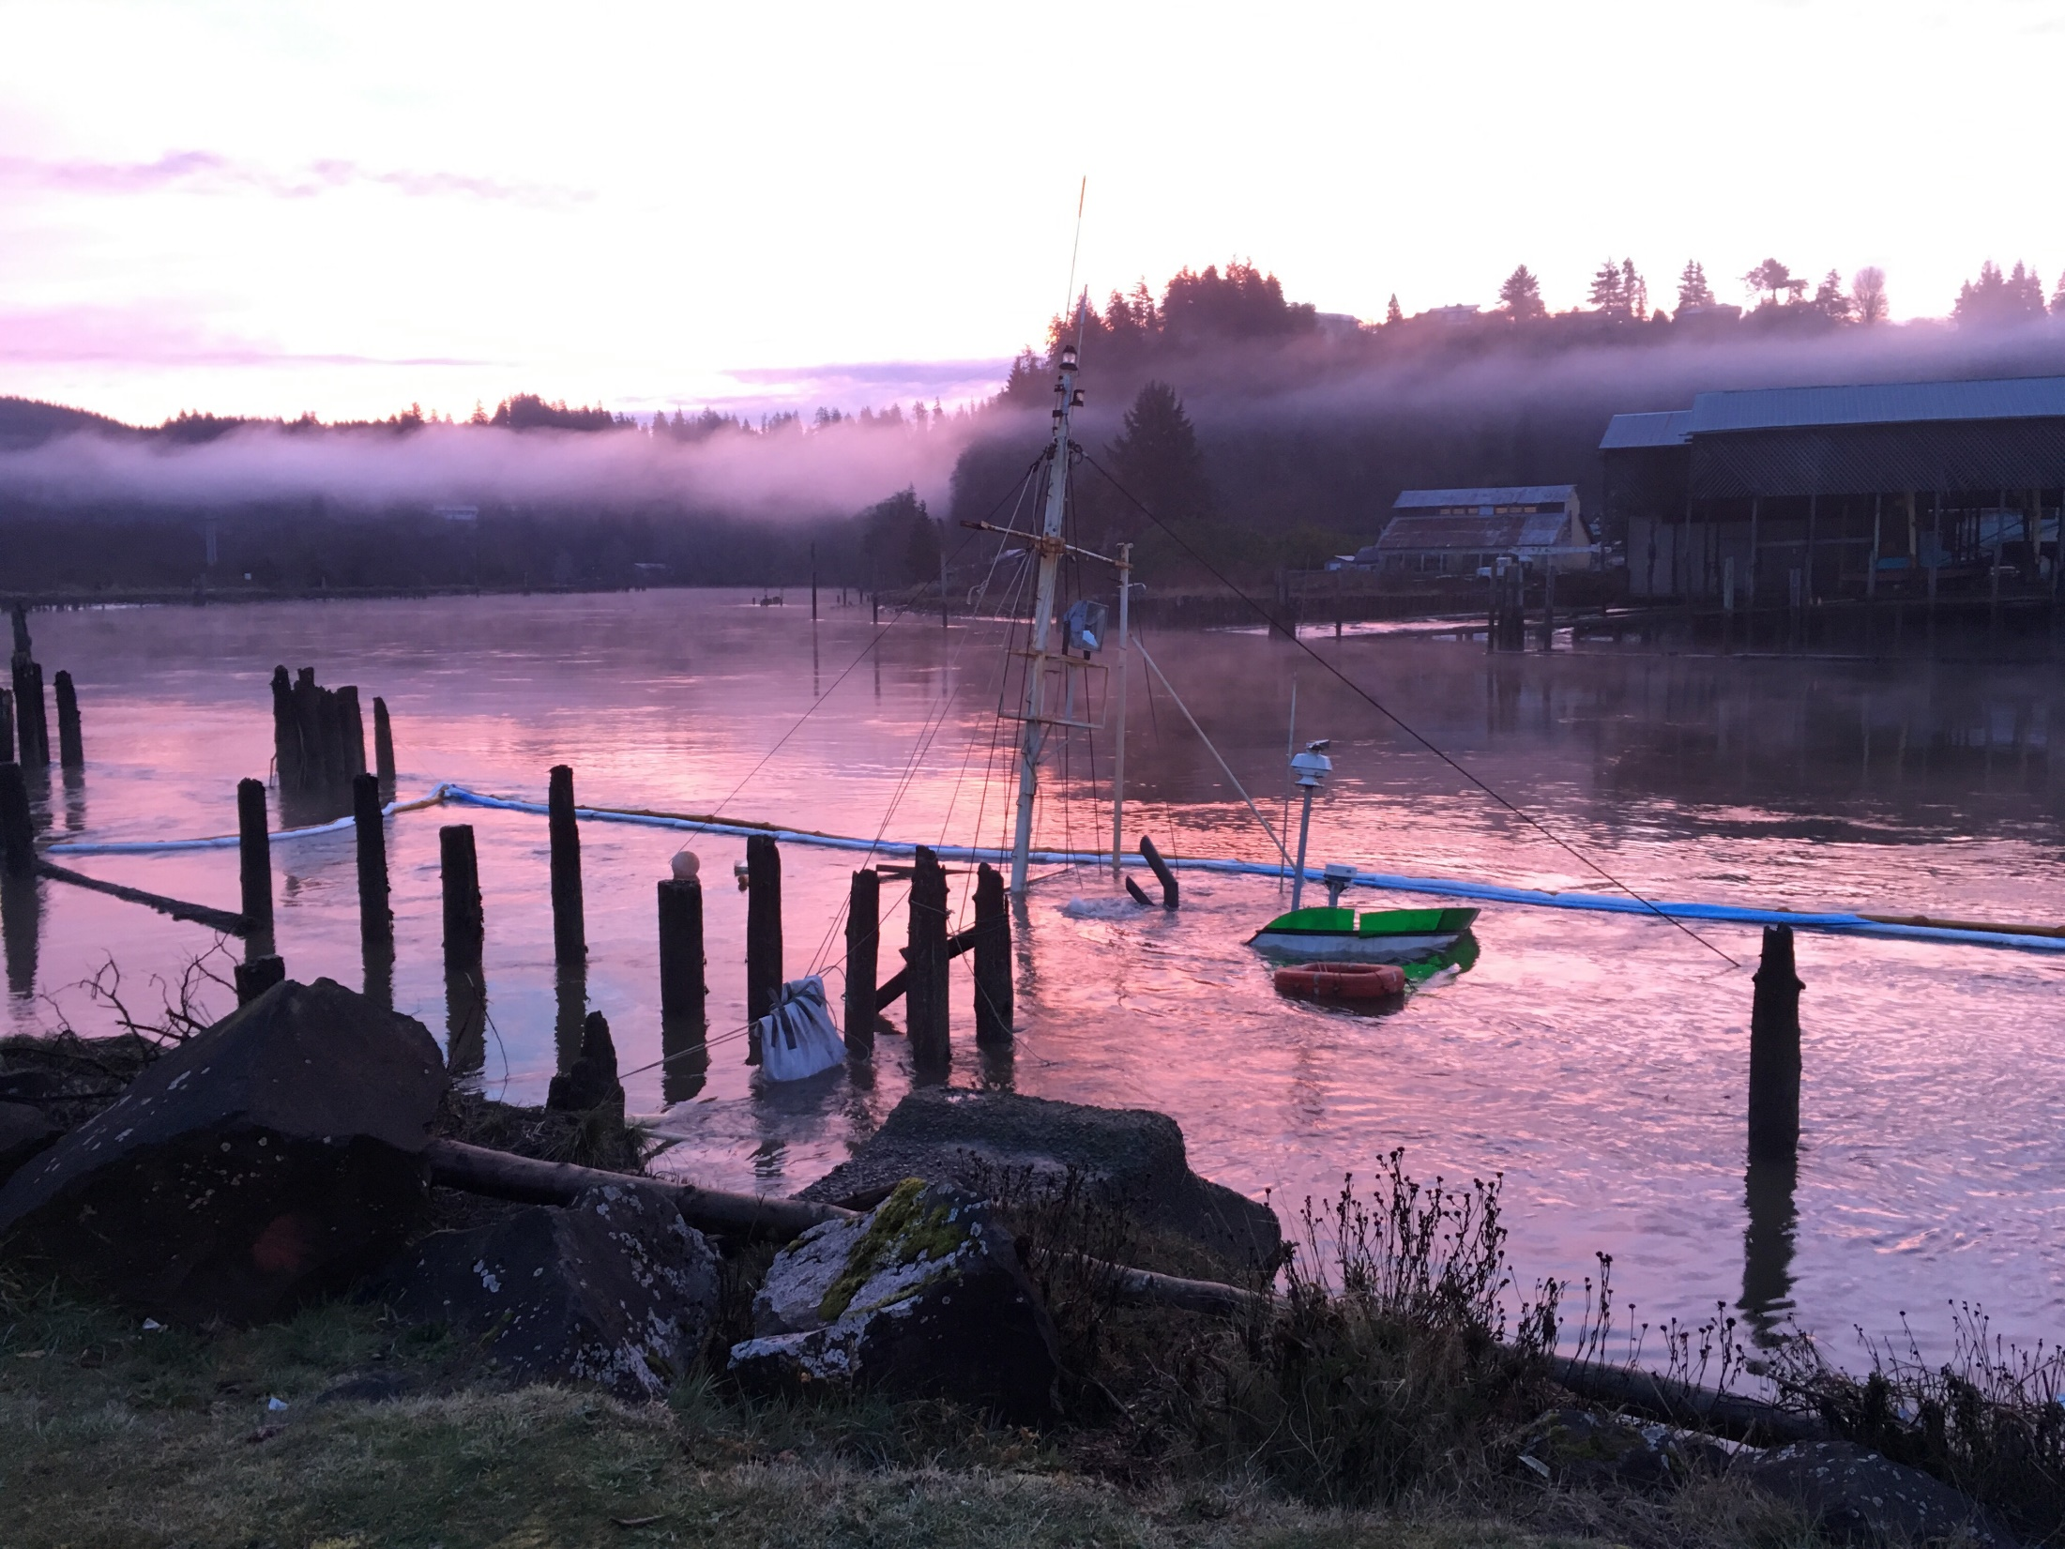

Slide 14
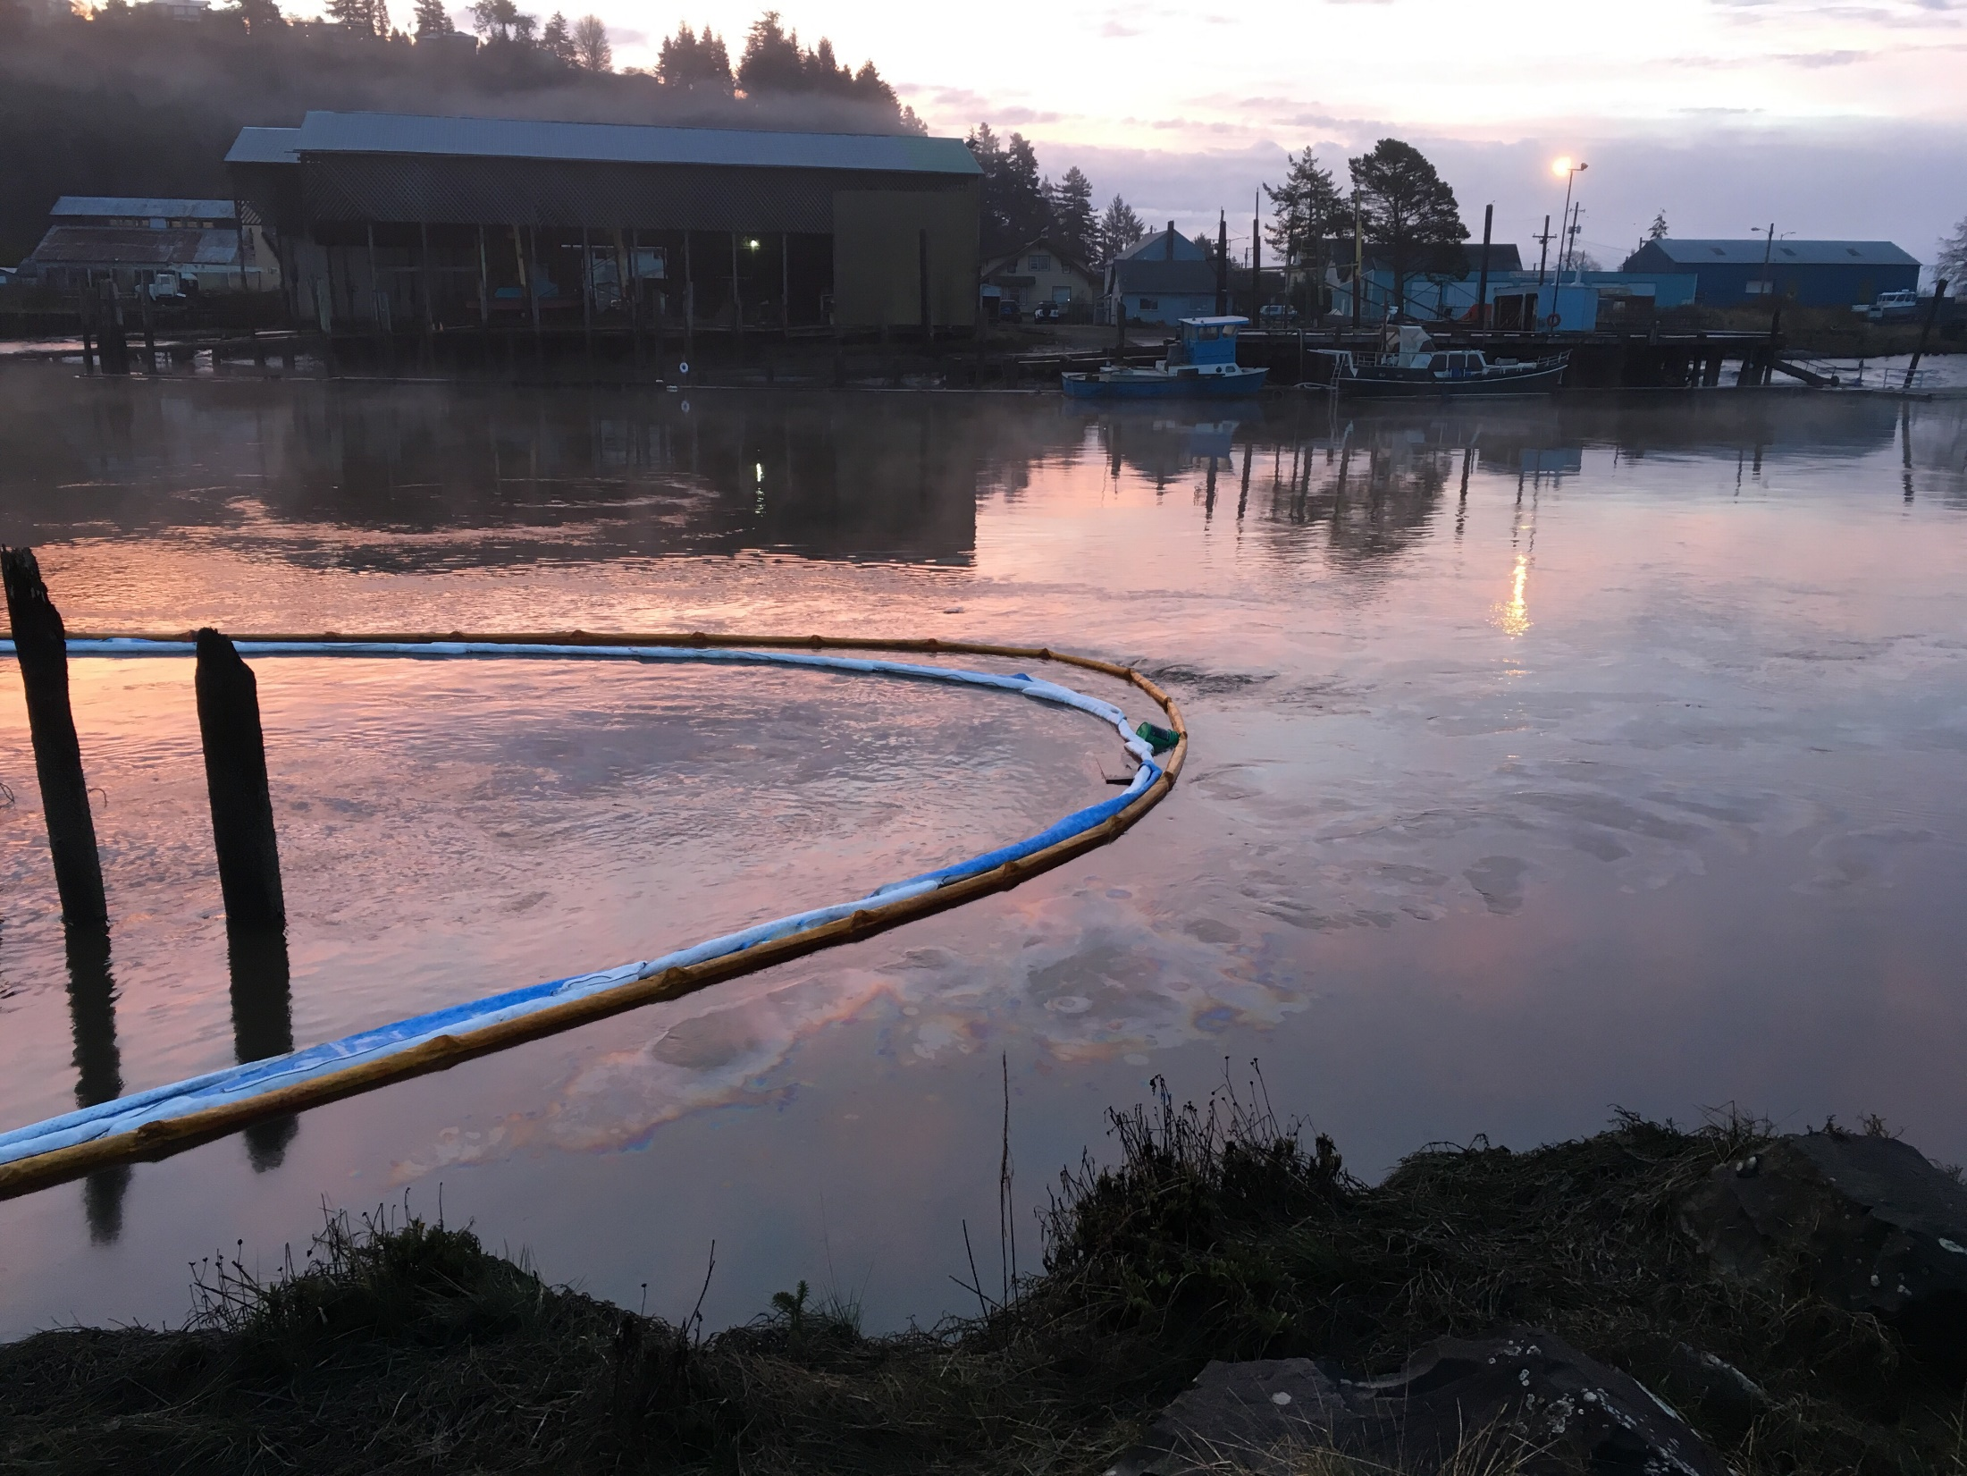
Notes:
By morning it was clear that containment measures were not adequate. More robust sampling required.

Slide 15
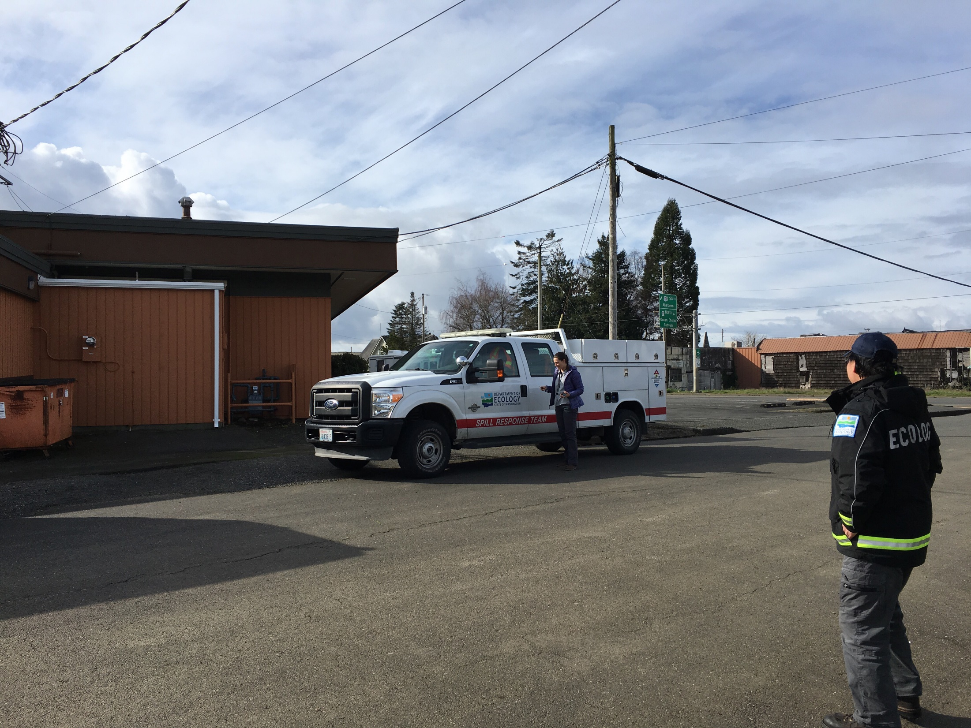
Notes:
Alison arrived to help coordinate the response.

Slide 16
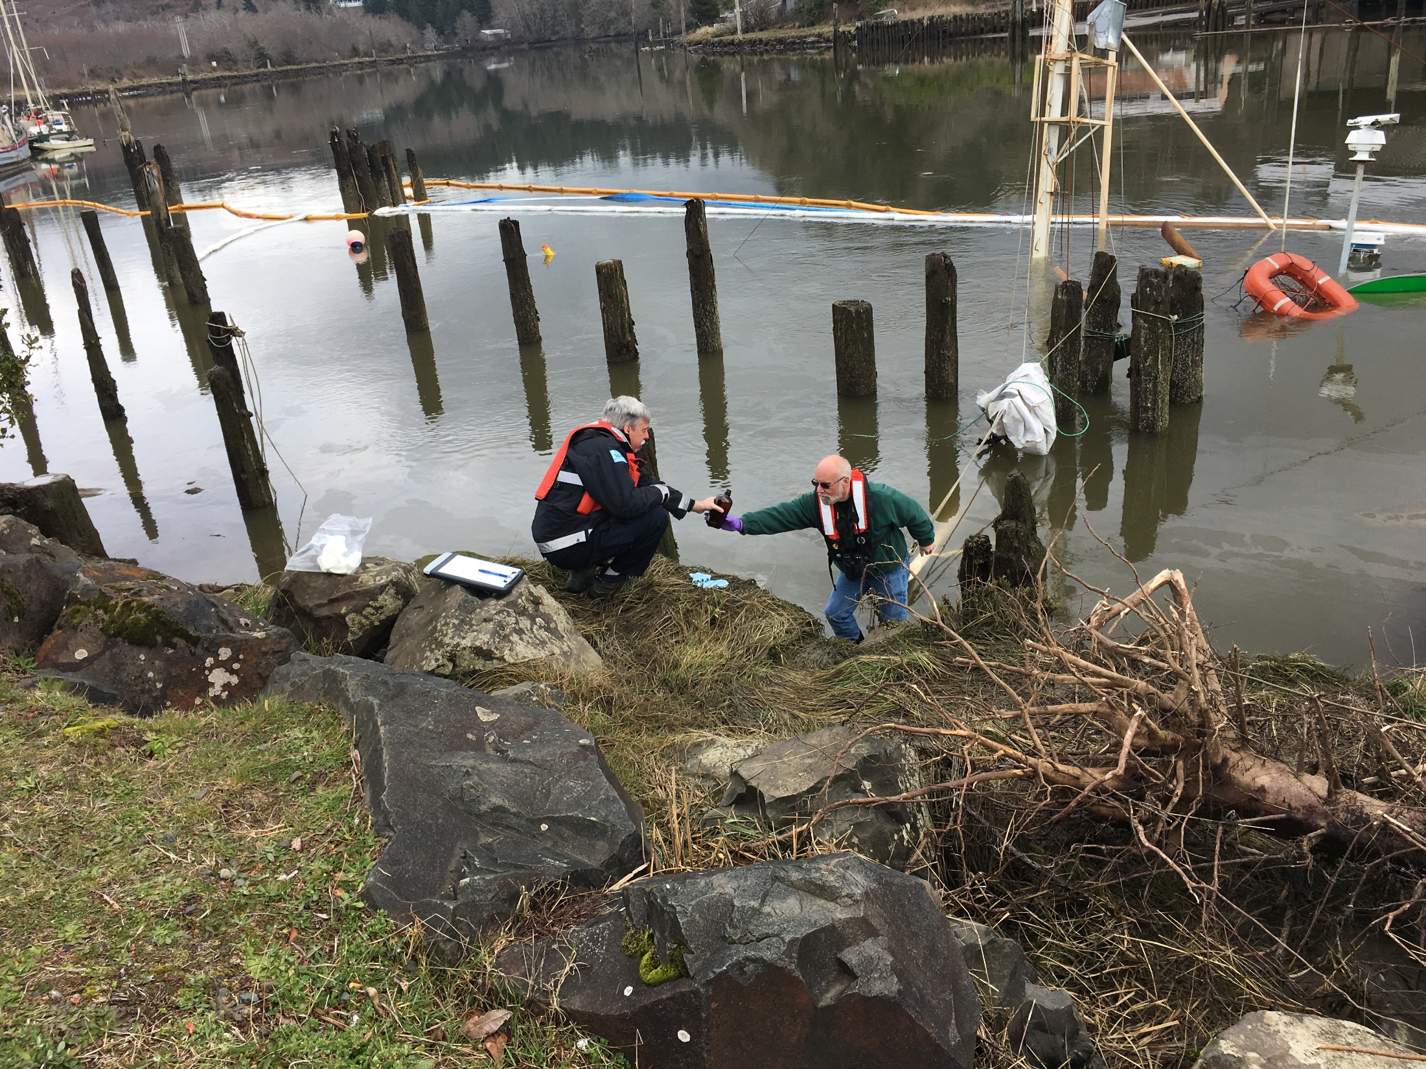
Notes:
Washington State’s TRAP team mobilized to collect samples throughout the impacted area.

Slide 17
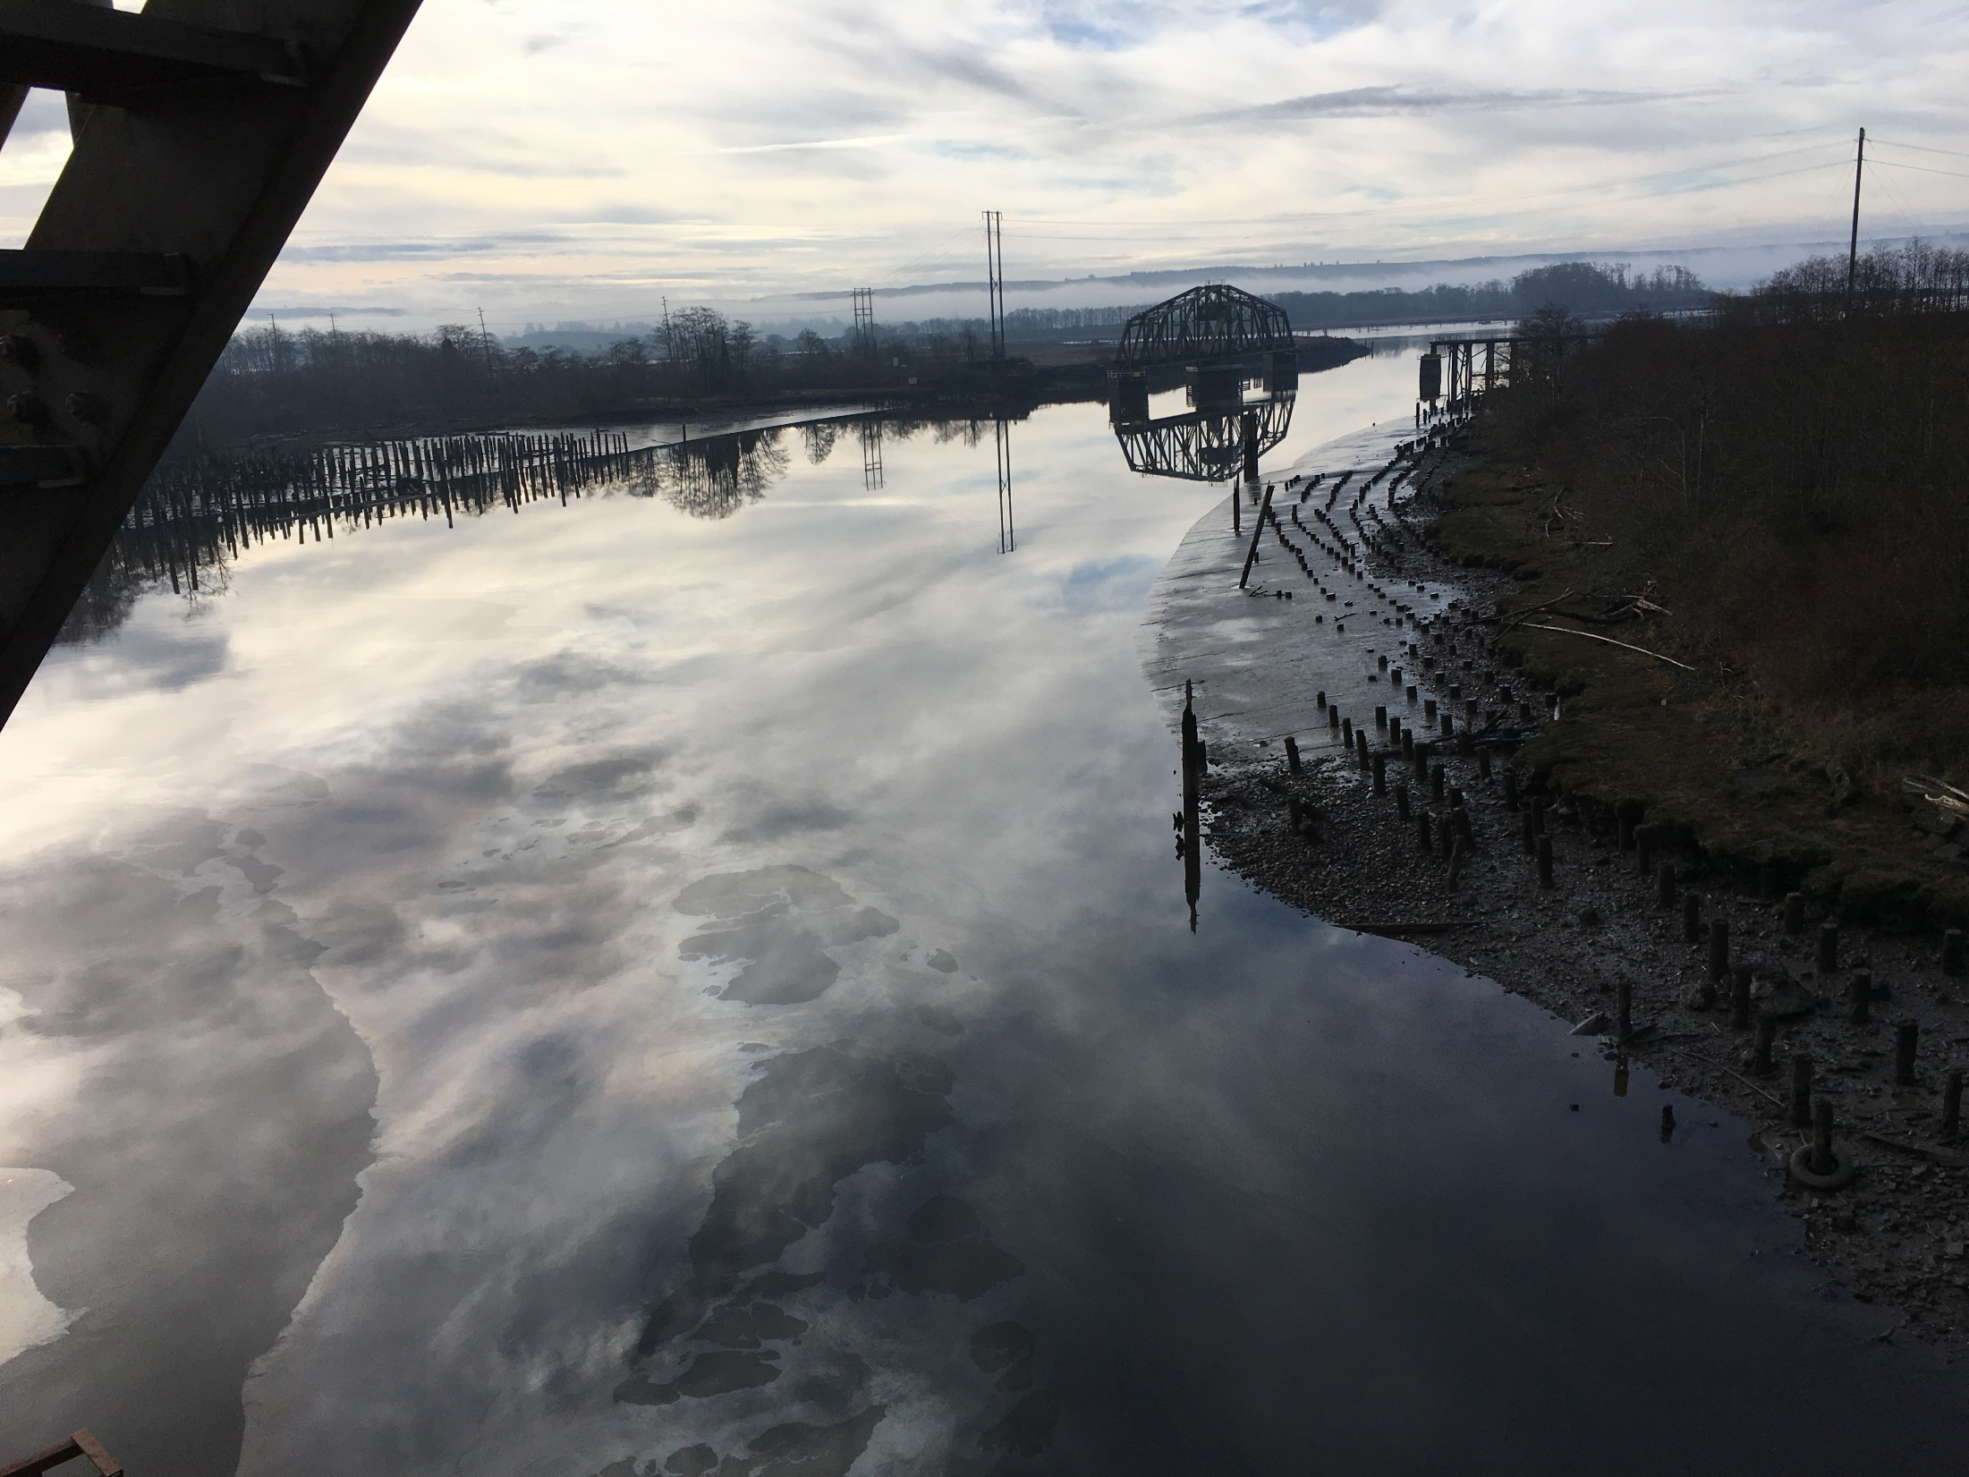
Notes:
Tidal influence from Gray’s Harbor pushed the spilled diesel over 6 miles upstream.

Slide 18
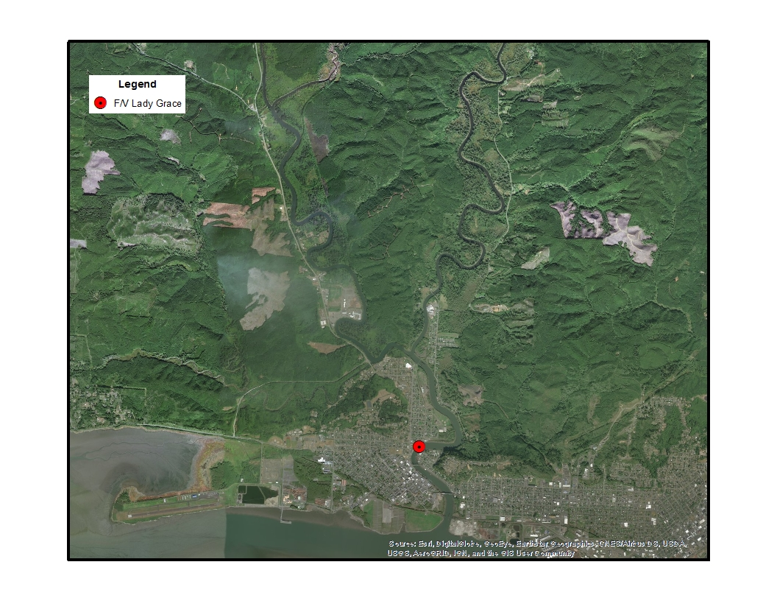
Notes:
Based on sheen volume alone, 236 gallons of diesel fuel spilled. Based on tank volume information, there is still an estimated 652 gallons unaccounted for. Ecology is still investigating this case.

Slide 19
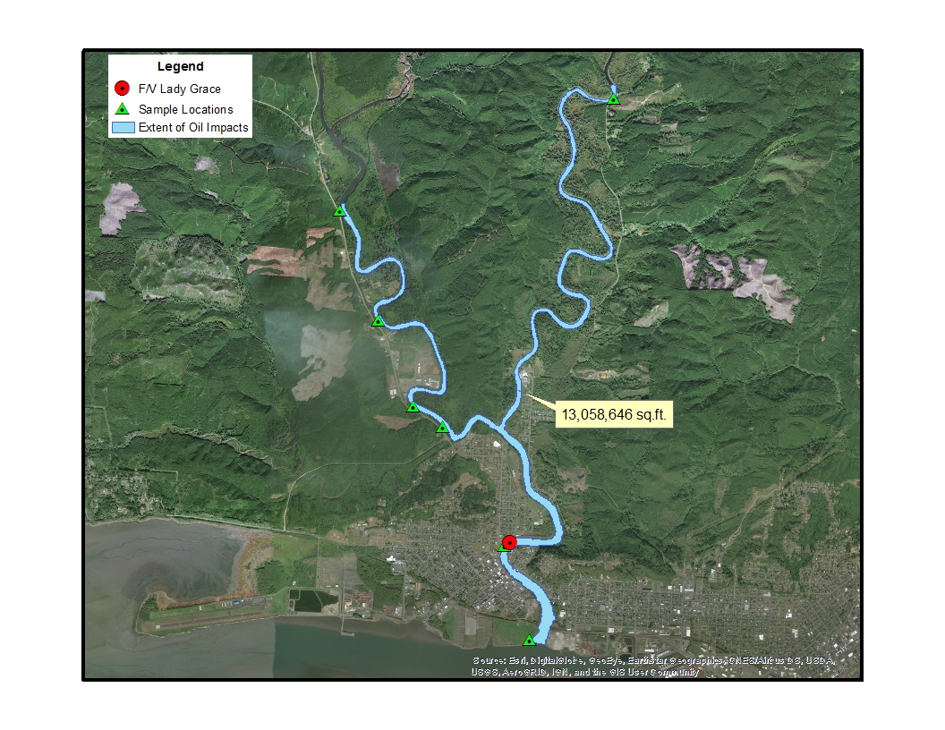
Notes:
Based on sheen volume alone, 236 gallons of diesel fuel spilled. Based on tank volume information, there is still an estimated 652 gallons unaccounted for. Ecology is still investigating this case.

Slide 20
R/C Rachel Carson spill into Salmon Bay
Date of Incident: March 5, 2018
Potentially Liable Party: Bryan Blondeau
Product Spilled: Diesel fuel
Spill Source: R/V Rachel Carson
Oil Spill Size Estimate: Yet to be determined
Water Body Affected: Portage Bay
Ecology Region: NWRO
County: King
Nearest City: Seattle
Location of Spill: Dock at University of Washington Marine Sciences Building
Cause: Inattention
Ecology Responder: Trevor Braund
Notes:
Field Report: While conducting an internal transfer of diesel fuel, the 72’ R/V Rachel Carson (IMO: 8983210, Gross Ton: 430) discharged an as yet to be determined volume of diesel fuel to Portage Bay. The University of Washington owned vessel was docked at the Marine Sciences Building of the university. After about 20 minutes, the mate discovered the spill and ceased transfer operations, placed the on-site boom around the vessel, and made the necessary notifications to Ecology and the NRC. MSRC and Global Diving and Salvage added more boom and continued on water recovery using sorbents and skimmers. An estimated 454 gallons was recovered.

Slide 21
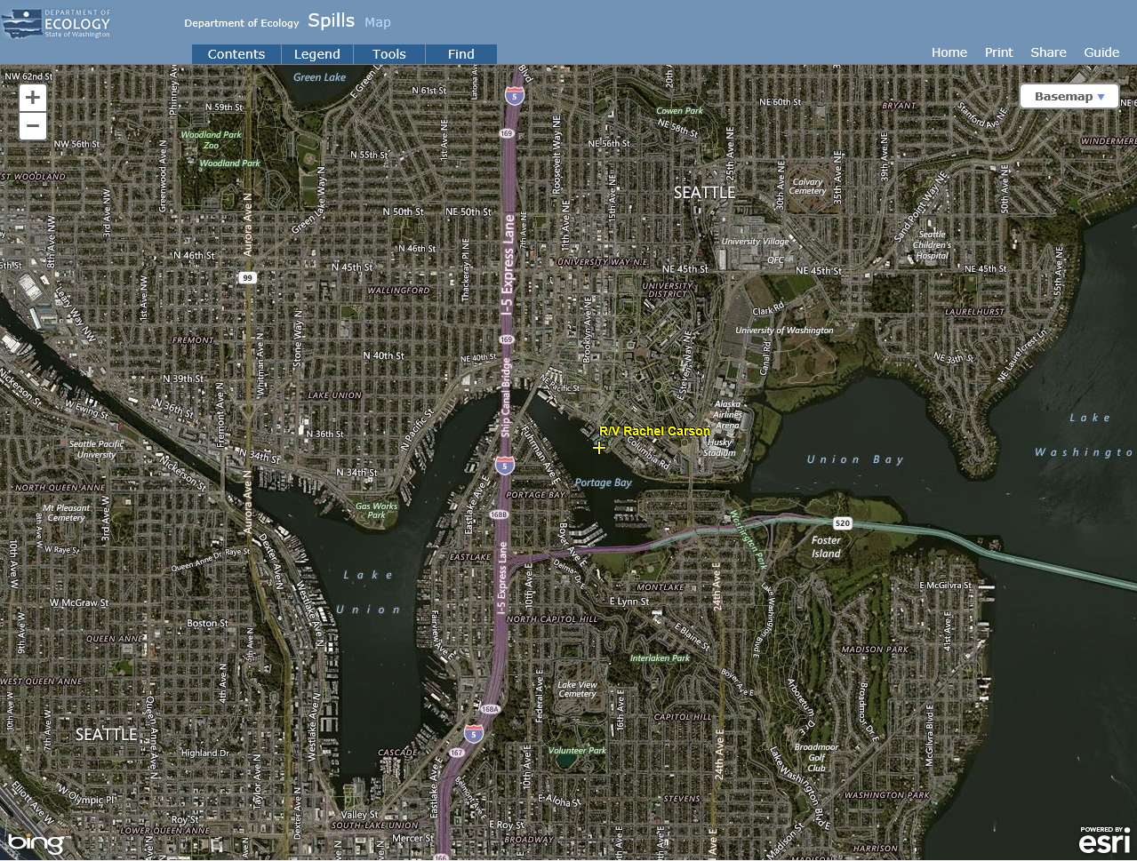
Notes:
Field Report: While conducting an internal transfer of diesel fuel, the 72’ R/V Rachel Carson (IMO: 8983210, Gross Ton: 430) discharged an as yet to be determined volume of diesel fuel to Portage Bay. The University of Washington owned vessel was docked at the Marine Sciences Building of the university. After about 20 minutes, the mate discovered the spill and ceased transfer operations, placed the on-site boom around the vessel, and made the necessary notifications to Ecology and the NRC. MSRC and Global Diving and Salvage added more boom and continued on water recovery using sorbents and skimmers. An estimated 454 gallons was recovered.

Slide 22
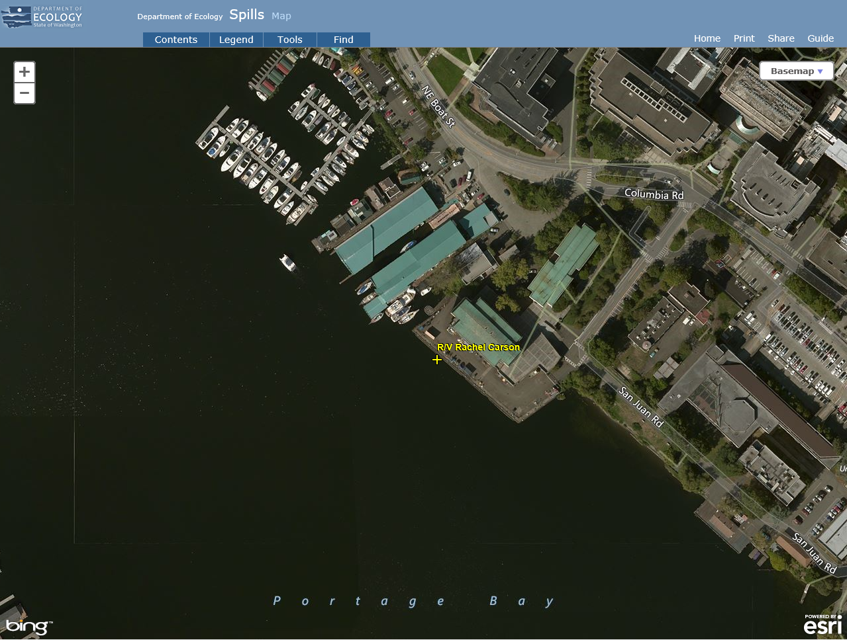
Notes:
Field Report: While conducting an internal transfer of diesel fuel, the 72’ R/V Rachel Carson (IMO: 8983210, Gross Ton: 430) discharged an as yet to be determined volume of diesel fuel to Portage Bay. The University of Washington owned vessel was docked at the Marine Sciences Building of the university. After about 20 minutes, the mate discovered the spill and ceased transfer operations, placed the on-site boom around the vessel, and made the necessary notifications to Ecology and the NRC. MSRC and Global Diving and Salvage added more boom and continued on water recovery using sorbents and skimmers. An estimated 454 gallons was recovered.

Slide 23
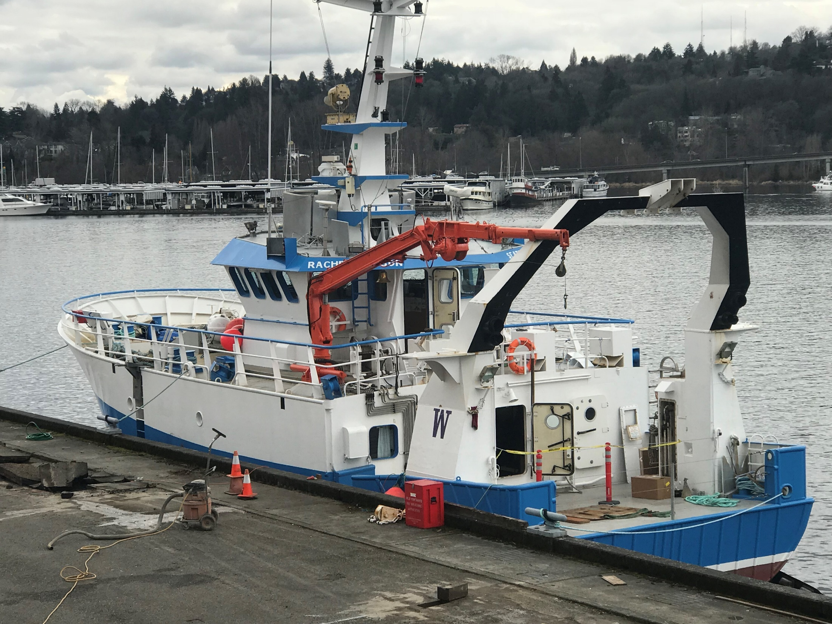
Notes:
Field Report: While conducting an internal transfer of diesel fuel, the 72’ R/V Rachel Carson (IMO: 8983210, Gross Ton: 430) discharged an as yet to be determined volume of diesel fuel to Portage Bay. The University of Washington owned vessel was docked at the Marine Sciences Building of the university. After about 20 minutes, the mate discovered the spill and ceased transfer operations, placed the on-site boom around the vessel, and made the necessary notifications to Ecology and the NRC. MSRC and Global Diving and Salvage added more boom and continued on water recovery using sorbents and skimmers. An estimated 454 gallons was recovered.

Slide 24
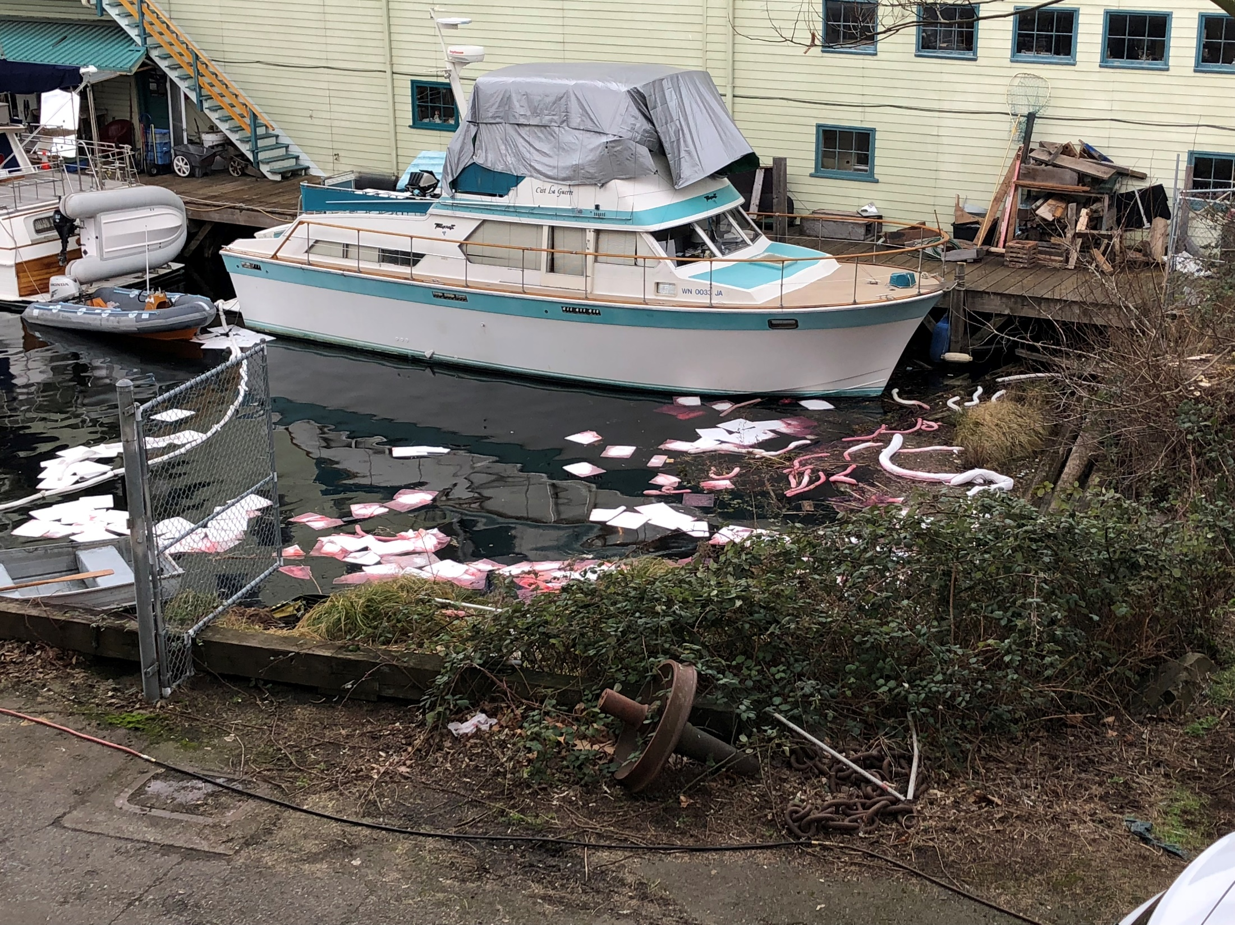
Notes:
Field Report: While conducting an internal transfer of diesel fuel, the 72’ R/V Rachel Carson (IMO: 8983210, Gross Ton: 430) discharged an as yet to be determined volume of diesel fuel to Portage Bay. The University of Washington owned vessel was docked at the Marine Sciences Building of the university. After about 20 minutes, the mate discovered the spill and ceased transfer operations, placed the on-site boom around the vessel, and made the necessary notifications to Ecology and the NRC. MSRC and Global Diving and Salvage added more boom and continued on water recovery using sorbents and skimmers. An estimated 454 gallons was recovered.

Slide 25
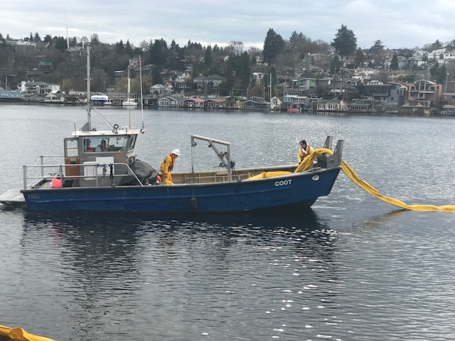
Notes:
Field Report: While conducting an internal transfer of diesel fuel, the 72’ R/V Rachel Carson (IMO: 8983210, Gross Ton: 430) discharged an as yet to be determined volume of diesel fuel to Portage Bay. The University of Washington owned vessel was docked at the Marine Sciences Building of the university. After about 20 minutes, the mate discovered the spill and ceased transfer operations, placed the on-site boom around the vessel, and made the necessary notifications to Ecology and the NRC. MSRC and Global Diving and Salvage added more boom and continued on water recovery using sorbents and skimmers. An estimated 454 gallons was recovered.

Slide 26
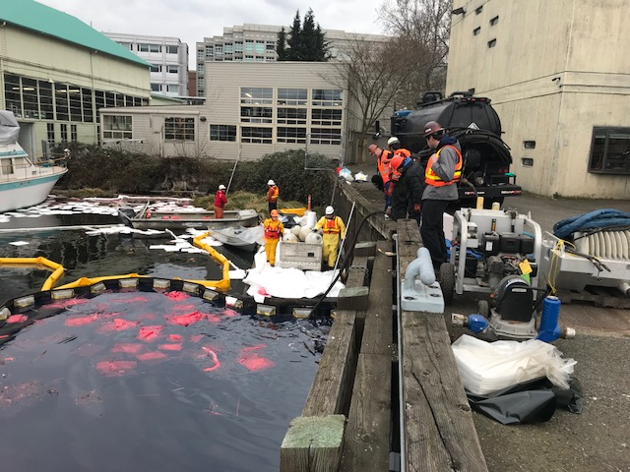
Notes:
Field Report: While conducting an internal transfer of diesel fuel, the 72’ R/V Rachel Carson (IMO: 8983210, Gross Ton: 430) discharged an as yet to be determined volume of diesel fuel to Portage Bay. The University of Washington owned vessel was docked at the Marine Sciences Building of the university. After about 20 minutes, the mate discovered the spill and ceased transfer operations, placed the on-site boom around the vessel, and made the necessary notifications to Ecology and the NRC. MSRC and Global Diving and Salvage added more boom and continued on water recovery using sorbents and skimmers. An estimated 454 gallons was recovered.

Slide 27
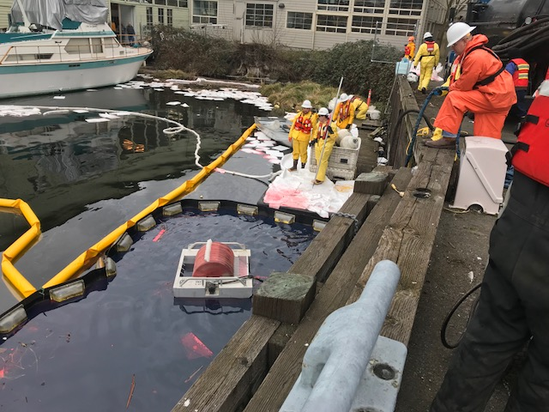
Notes:
Field Report: While conducting an internal transfer of diesel fuel, the 72’ R/V Rachel Carson (IMO: 8983210, Gross Ton: 430) discharged an as yet to be determined volume of diesel fuel to Portage Bay. The University of Washington owned vessel was docked at the Marine Sciences Building of the university. After about 20 minutes, the mate discovered the spill and ceased transfer operations, placed the on-site boom around the vessel, and made the necessary notifications to Ecology and the NRC. MSRC and Global Diving and Salvage added more boom and continued on water recovery using sorbents and skimmers. An estimated 454 gallons was recovered.

Slide 28
Old Business
Open RDA Case Updates

Slide 29
F/V Deep Sea spill into Penn Cove
May 13, 2012

Slide 30
Sulphur Creek spill into the Yakima River
March 1, 2015

Slide 31
La Mexicana vegetable oil spill into the White Center Pond.
November 6, 2015

Slide 32
F/V Privateer grounding and spill into the Pacific Ocean
April 15, 2016

Slide 33
Tug Island Wind spill into the Duwamish Waterway
February 28, 2017

Slide 34
F/V Coral Sea sinking and spill into the Strait of Georgia
August 8, 2016

Slide 35
Coleman Oil spill into the Columbia River
March 18, 2017

Slide 36
P/C Sinbad sinking and spill into Sinclair Inlet
January 29, 2018

Slide 37
Announcements
CPF RDA Grant Update
RDA Committee EZview Page

Slide 38
RDA Committee EZview Page
https://www.ezview.wa.gov/site/alias__1962/37199/resource_damage_assessment_rda_committee.aspx

