Slide 1
RDA Committee Meeting
May 9, 2018 @ 0900 in R0A-36

Slide 2
Agenda
New Business
  Preassessement Screenings
    Chelan PUD Rock Island Dam, January 1-March 19, 2018 spill into the Columbia River
    USACE Dalles Dam, March 22, 2018 spill into the Columbia River
Old Business
  Open RDA Case Updates
    F/V Deep Sea, May 13, 2012 spill into Penn Cove
    Sulphur Creek, March 1, 2015 spill into the Yakima River
    F/V Privateer, April 15, 2016 spill into the Pacific Ocean
    Coleman Oil, March 18, 2017 spill into the Columbia River
Announcements

Slide 3
New Business
Preassessment Screenings

Slide 4
Chelan PUD Rock Island Dam turbine oil spill into the Columbia River
Date of Incident: January 1, 2018 – March 19, 2018
Potentially Liable Party: Chelan PUD
Product Spilled: Turbine oil
Spill Source: Rock Island Dam
Oil Spill Size Estimate: 493 gallons
Water Body Affected: Columbia River
Ecology Region: CRO
County: Douglas
Nearest City: Rock Island
Location of Spill: Turbine B-8
Cause: Mechanical Failure
Ecology Responder: Anna Harris
Notes:
Sometime between January 1 and March 19, 2018, a leaky turbine spilled up to 493 gallons of turbine oil into the Columbia River.
Prior to the spill, water intrusion in this turbine was displacing oil. The turbine was taken offline in July of 2017 for seal replacement, and the turbine went back online in December 2017.
The fix was unsuccessful, and PUD staff chose to drain off the water and replace with oil.
Between January 10 and March 19, 2018, PUD staff discovered that 493 gallons of turbine oil was missing, presumably spilled into the Columbia River.
The turbine unit was taken out of service pending corrective action.

Slide 5
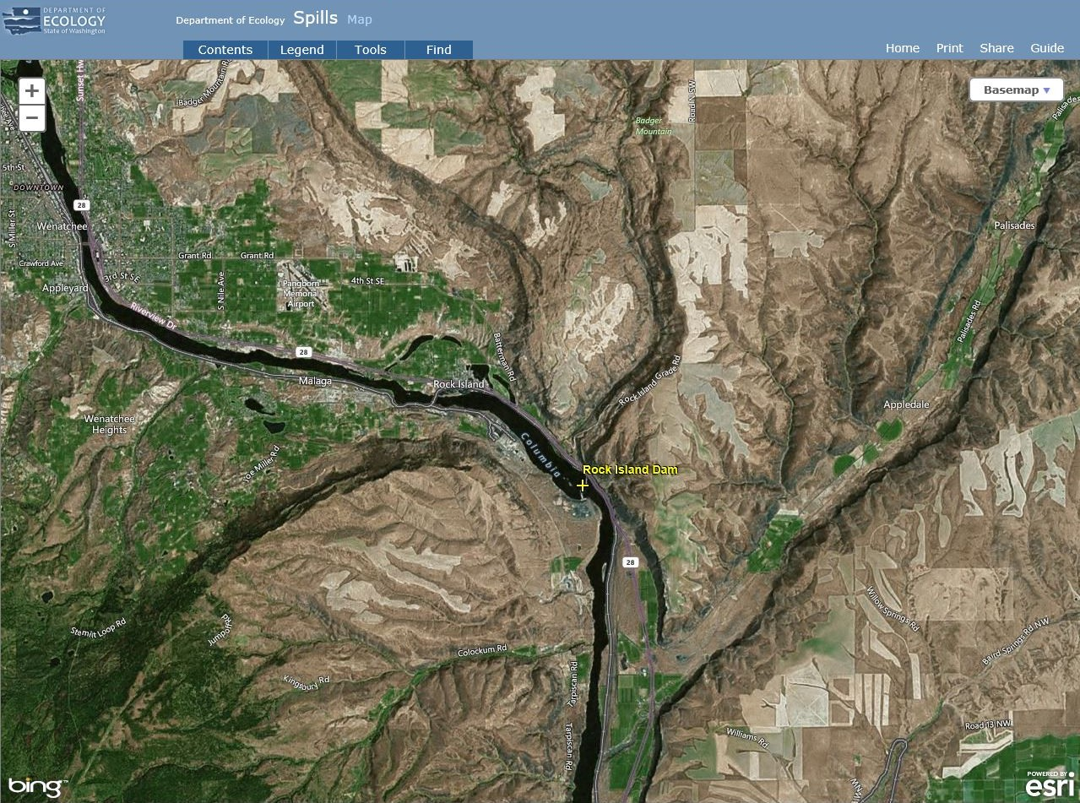
Notes:
Sometime between January 1 and March 19, 2018, a leaky turbine spilled up to 493 gallons of turbine oil into the Columbia River.
Prior to the spill, water intrusion in this turbine was displacing oil. The turbine was taken offline in July of 2017 for seal replacement, and the turbine went back online in December 2017.
The fix was unsuccessful, and PUD staff chose to drain off the water and replace with oil.
Between January 10 and March 19, 2018, PUD staff discovered that 493 gallons of turbine oil was missing, presumably spilled into the Columbia River.
The turbine unit was taken out of service pending corrective action.

Slide 6
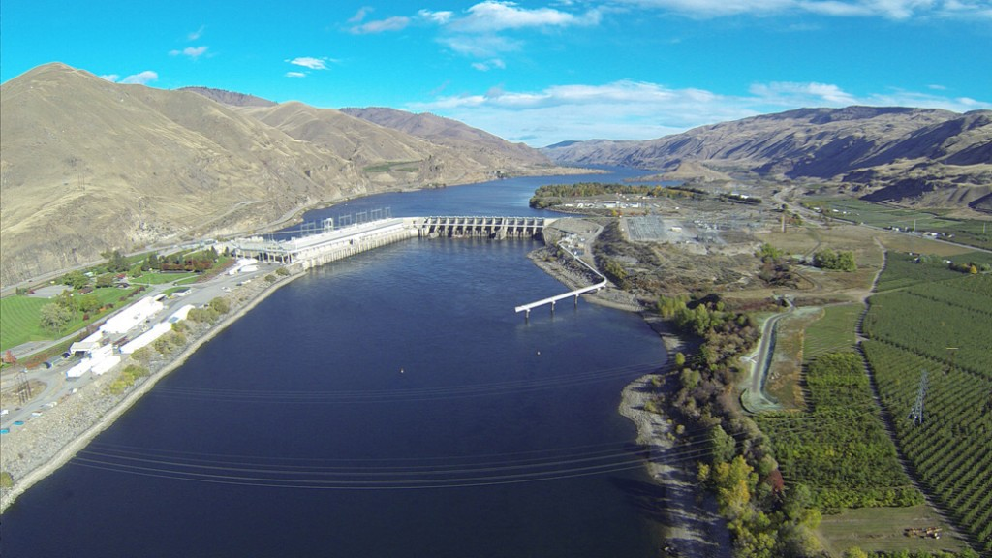
Notes:
Sometime between January 1 and March 19, 2018, a leaky turbine spilled up to 493 gallons of turbine oil into the Columbia River.
Prior to the spill, water intrusion in this turbine was displacing oil. The turbine was taken offline in July of 2017 for seal replacement, and the turbine went back online in December 2017.
The fix was unsuccessful, and PUD staff chose to drain off the water and replace with oil.
Between January 10 and March 19, 2018, PUD staff discovered that 493 gallons of turbine oil was missing, presumably spilled into the Columbia River.
The turbine unit was taken out of service pending corrective action.
Photo courtesy of: Flying M Air, LLC, http://www.flyingmair.com/tag/rock-island-dam/

Slide 7
Dalles Dam turbine oil spill into the Columbia River
Date of Incident: March 22, 2018
Potentially Liable Party: United States Army Corps of Engineers
Product Spilled: Turbine Oil
Spill Source: Dalles Dam
Oil Spill Size Estimate: >474 gallons
Water Body Affected: Columbia River
Ecology Region: CRO
County: Klickitat
Nearest City: The Dalles, OR
Location of Spill: 45.60155, -121.18343
Cause: Unknown
Ecology Responder: Andy Wilson
Notes:
On March 7, dam staff members noticed a low oil level in the sight glass during a monthly turbine oil inventory.
On March 18, the low oil level alarm went off, and maintenance staff refilled the turbine with 474 gallons of oil.
USACE staff cannot account for the missing turbine oil, but it likely spilled into the Columbia River.
On March 22, a low oil level was observed in the sight glass. The next day, the turbine was shut down and isolated for investigation.
Workers did not see an oil sheen on the river throughout this time.
The cause of the spill, and the total volume of oil spilled is still under investigation.

Slide 8
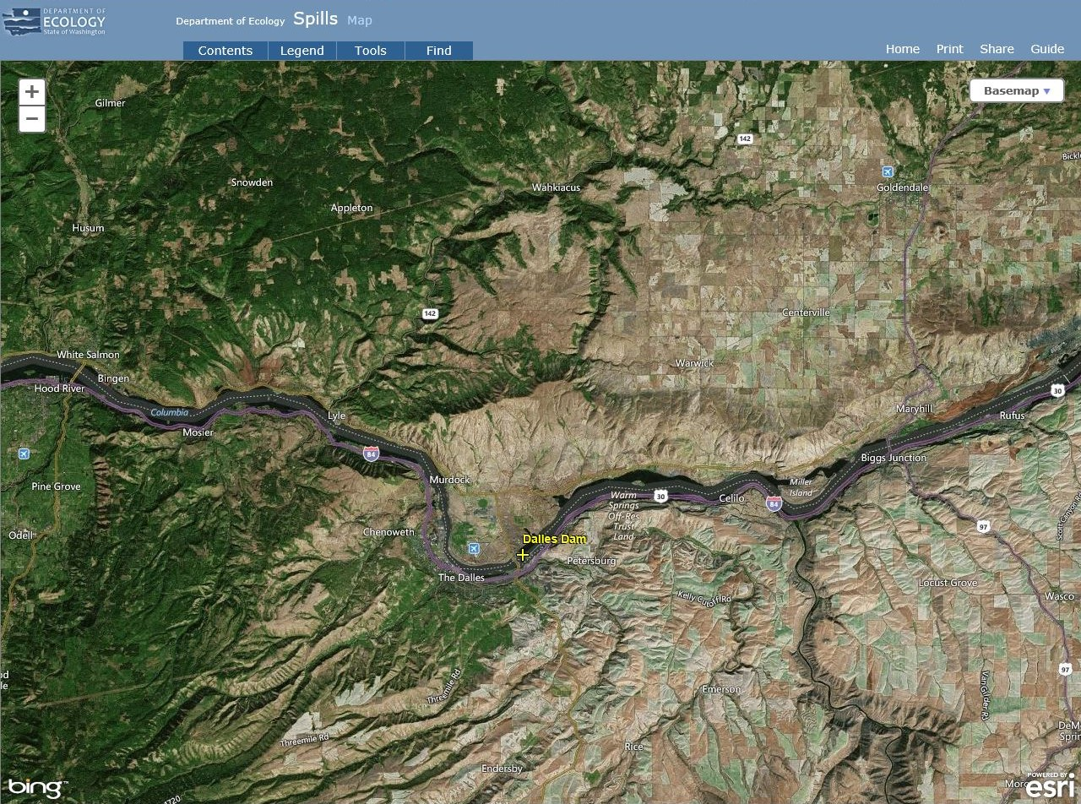
Notes:
On March 7, dam staff members noticed a low oil level in the sight glass during a monthly turbine oil inventory.
On March 18, the low oil level alarm went off, and maintenance staff refilled the turbine with 474 gallons of oil.
USACE staff cannot account for the missing turbine oil, but it likely spilled into the Columbia River.
On March 22, a low oil level was observed in the sight glass. The next day, the turbine was shut down and isolated for investigation.
Workers did not see an oil sheen on the river throughout this time.
The cause of the spill, and the total volume of oil spilled is still under investigation.

Slide 9
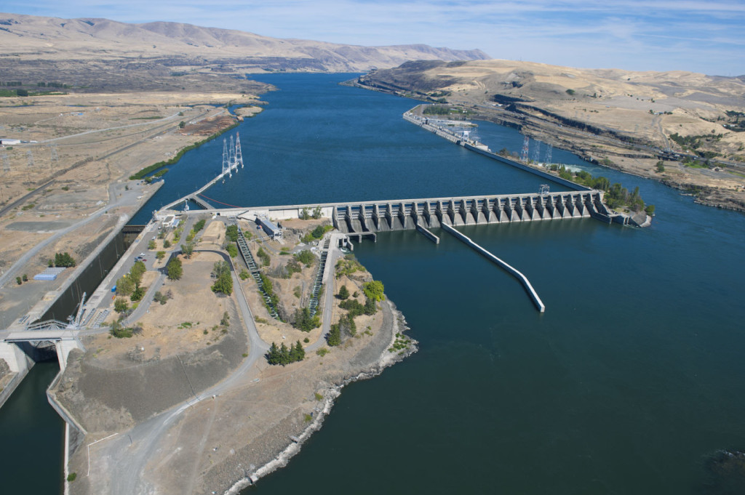
Notes:
On March 7, dam staff members noticed a low oil level in the sight glass during a monthly turbine oil inventory.
On March 18, the low oil level alarm went off, and maintenance staff refilled the turbine with 474 gallons of oil.
USACE staff cannot account for the missing turbine oil, but it likely spilled into the Columbia River.
On March 22, a low oil level was observed in the sight glass. The next day, the turbine was shut down and isolated for investigation.
Workers did not see an oil sheen on the river throughout this time.
The cause of the spill, and the total volume of oil spilled is still under investigation.
Photo courtesy of: The Columbian, http://www.columbian.com/news/2012/nov/22/petroleum-barge-strikes-object-columbia-river/

Slide 10
Old Business
Open RDA Case Updates

Slide 11
F/V Deep Sea spill into Penn Cove
May 13, 2012

Slide 12
Sulphur Creek spill into the Yakima River
March 1, 2015

Slide 13
F/V Privateer grounding and spill into the Pacific Ocean
April 15, 2016

Slide 14
Coleman Oil spill into the Columbia River
March 18, 2017

Slide 15
Announcements
CPF RDA Grant Update

