Slide 1
RDA Committee Meeting
June 13, 2018 @ 0900 in R0A-36

Slide 2
Agenda
New Business
  Preassessement Screenings
    USACE McNary Dam, April 16, 2018 spill into the Columbia River
    P/C Serenity, April 25, 2018 spill into Lake Union
Old Business
  Open RDA Case Updates
    F/V Deep Sea, May 13, 2012 spill into Penn Cove
    Sulphur Creek, March 1, 2015 spill into the Yakima River
    F/V Privateer, April 15, 2016 spill into the Pacific Ocean
    Tug Island Wind, February 28, 2017 spill into Elliot Bay
    Coleman Oil, March 18, 2017 spill into the Columbia River
Announcements

Slide 3
New Business
Preassessment Screenings

Slide 4
USACE McNary Dam spill into the Columbia River
Date of Incident: April 16, 2018
Potentially Liable Party: United States Army Corps of Engineers
Product Spilled: Hydraulic Oil
Spill Source: McNary Dam
Oil Spill Size Estimate: 162 gallons
Water Body Affected: Columbia River
Ecology Region: CRO
County: Benton
Nearest City: North McNary, WA
Location of Spill: 45.937265, -119.299230
Cause: Unknown
Ecology Responder: Andy Wilson
Notes:
Field Report: On April 16, a failure in a headgate hydraulic system caused 522 gallons of hydraulic oil to spill into the headgate slot, an estimated 162 gallons of which eventually released to the Columbia River. The Army Corp investigation revealed that faulty lock washers in the hydraulic system allowed an “o” ring to loosen, releasing hydraulic oil from the pressurized system. The headgate has a capacity of 522 gallons. 360 gallons was recovered from the slot and hydraulic cylinders using their vacuum system and sorbents. The unaccounted for 162 gallons of hydraulic oil was presumably released to the Columbia River.

Slide 5
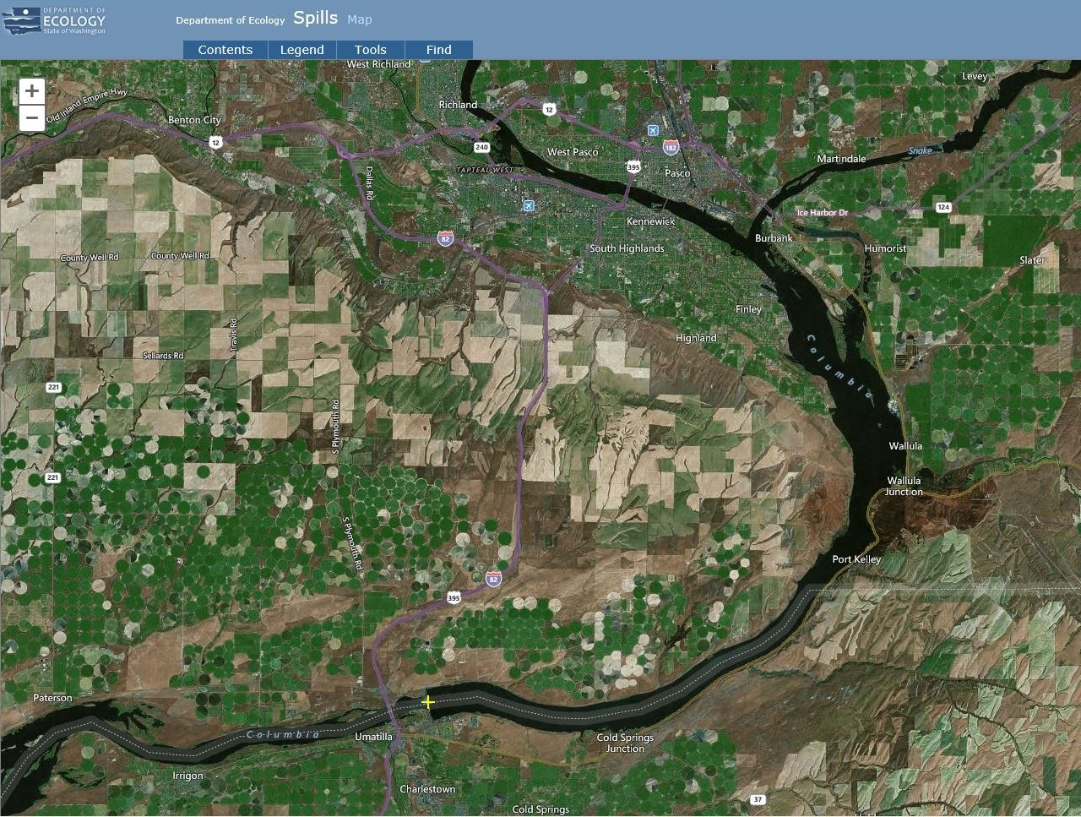
Notes:
Field Report: On April 16, a failure in a headgate hydraulic system caused 522 gallons of hydraulic oil to spill into the headgate slot, an estimated 162 gallons of which eventually released to the Columbia River. The Army Corp investigation revealed that faulty lock washers in the hydraulic system allowed an “o” ring to loosen, releasing hydraulic oil from the pressurized system. The headgate has a capacity of 522 gallons. 360 gallons was recovered from the slot and hydraulic cylinders using their vacuum system and sorbents. The unaccounted for 162 gallons of hydraulic oil was presumably released to the Columbia River.

Slide 6
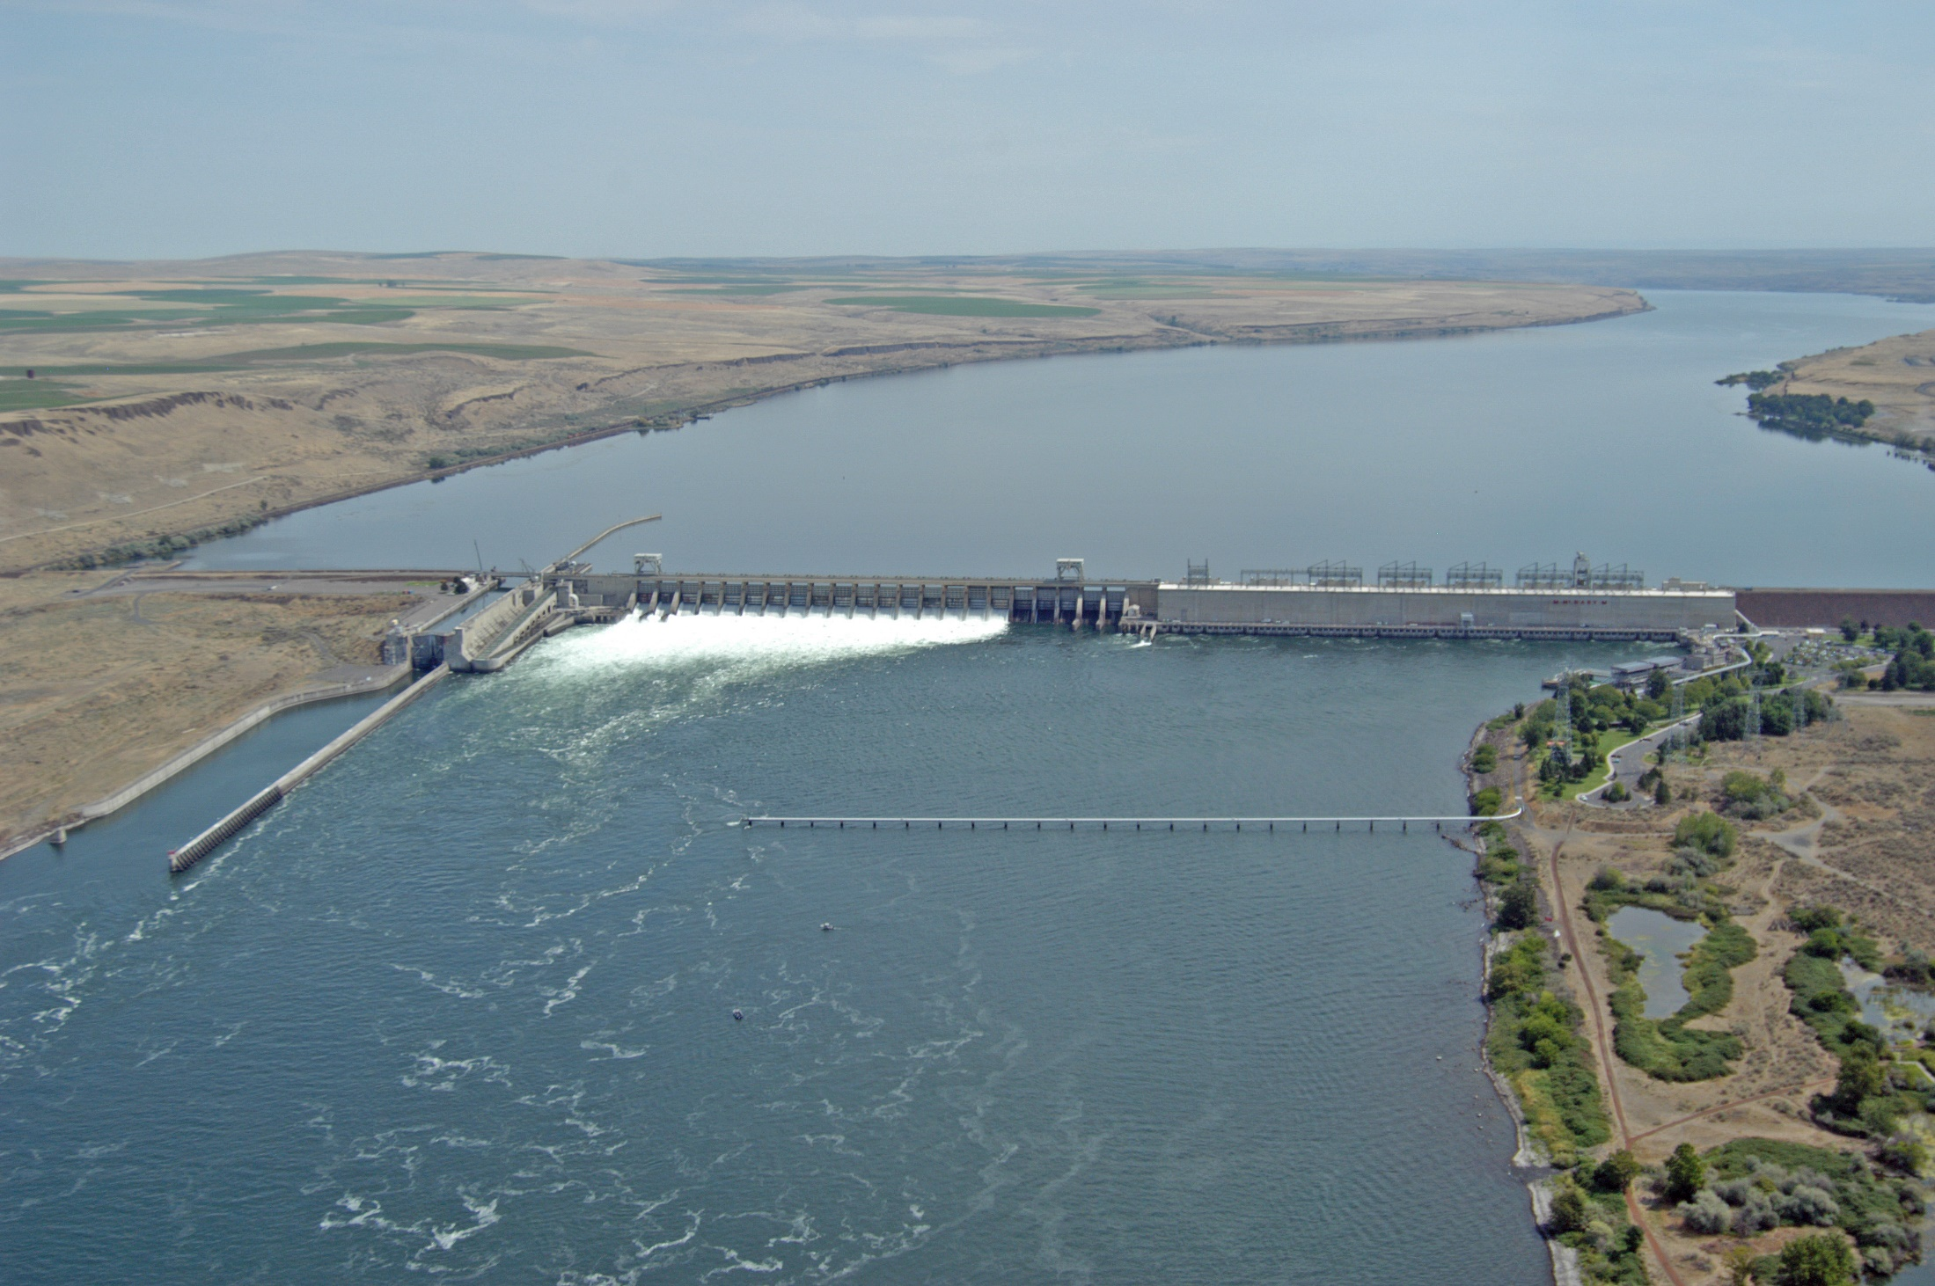
Notes:
Field Report: On April 16, a failure in a headgate hydraulic system caused 522 gallons of hydraulic oil to spill into the headgate slot, an estimated 162 gallons of which eventually released to the Columbia River. The Army Corp investigation revealed that faulty lock washers in the hydraulic system allowed an “o” ring to loosen, releasing hydraulic oil from the pressurized system. The headgate has a capacity of 522 gallons. 360 gallons was recovered from the slot and hydraulic cylinders using their vacuum system and sorbents. The unaccounted for 162 gallons of hydraulic oil was presumably released to the Columbia River.
Photo Courtesy of Wikimedia Commons: https://commons.wikimedia.org/wiki/File:McNary_Dam_(11956465496).jpg

Slide 7
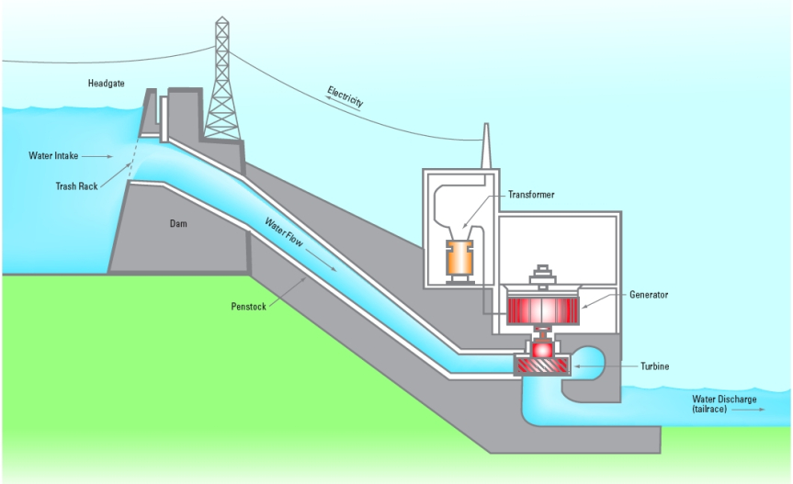
Notes:
Field Report: On April 16, a failure in a headgate hydraulic system caused 522 gallons of hydraulic oil to spill into the headgate slot, an estimated 162 gallons of which eventually released to the Columbia River. The Army Corp investigation revealed that faulty lock washers in the hydraulic system allowed an “o” ring to loosen, releasing hydraulic oil from the pressurized system. The headgate has a capacity of 522 gallons. 360 gallons was recovered from the slot and hydraulic cylinders using their vacuum system and sorbents. The unaccounted for 162 gallons of hydraulic oil was presumably released to the Columbia River.
Photo Courtesy of Eurasia News Online: https://eurasia-news-online.com/2016/10/18/nine-of-the-10-biggest-power-plants-in-the-world-are-hydro-power/

Slide 8
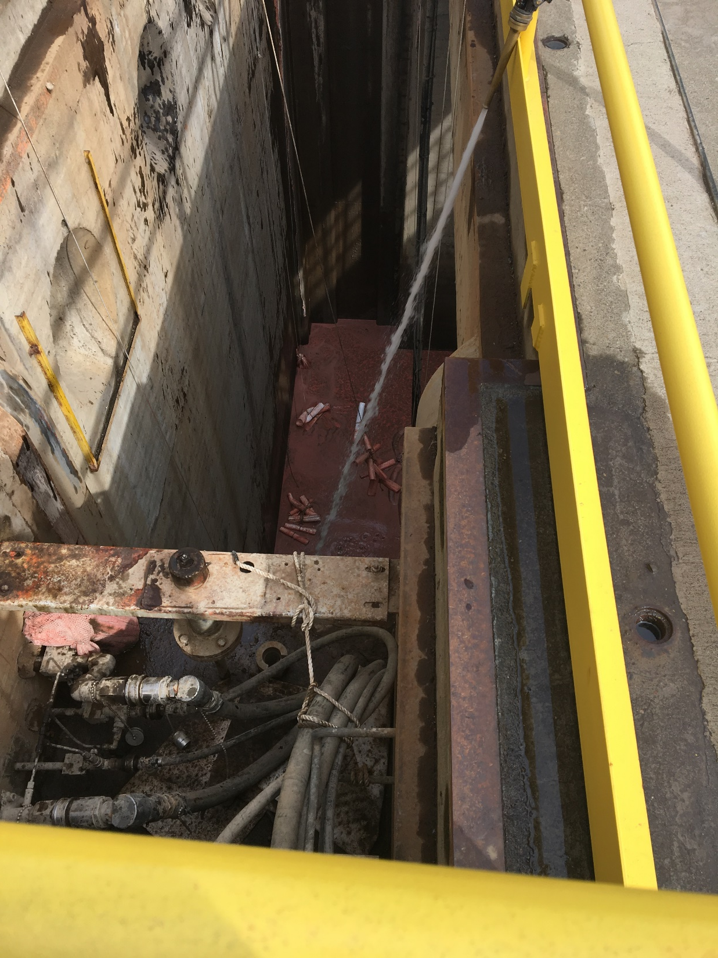
Notes:
Field Report: On April 16, a failure in a headgate hydraulic system caused 522 gallons of hydraulic oil to spill into the headgate slot, an estimated 162 gallons of which eventually released to the Columbia River. The Army Corp investigation revealed that faulty lock washers in the hydraulic system allowed an “o” ring to loosen, releasing hydraulic oil from the pressurized system. The headgate has a capacity of 522 gallons. 360 gallons was recovered from the slot and hydraulic cylinders using their vacuum system and sorbents. The unaccounted for 162 gallons of hydraulic oil was presumably released to the Columbia River.
Photo Courtesy of Eurasia News Online: https://eurasia-news-online.com/2016/10/18/nine-of-the-10-biggest-power-plants-in-the-world-are-hydro-power/

Slide 9
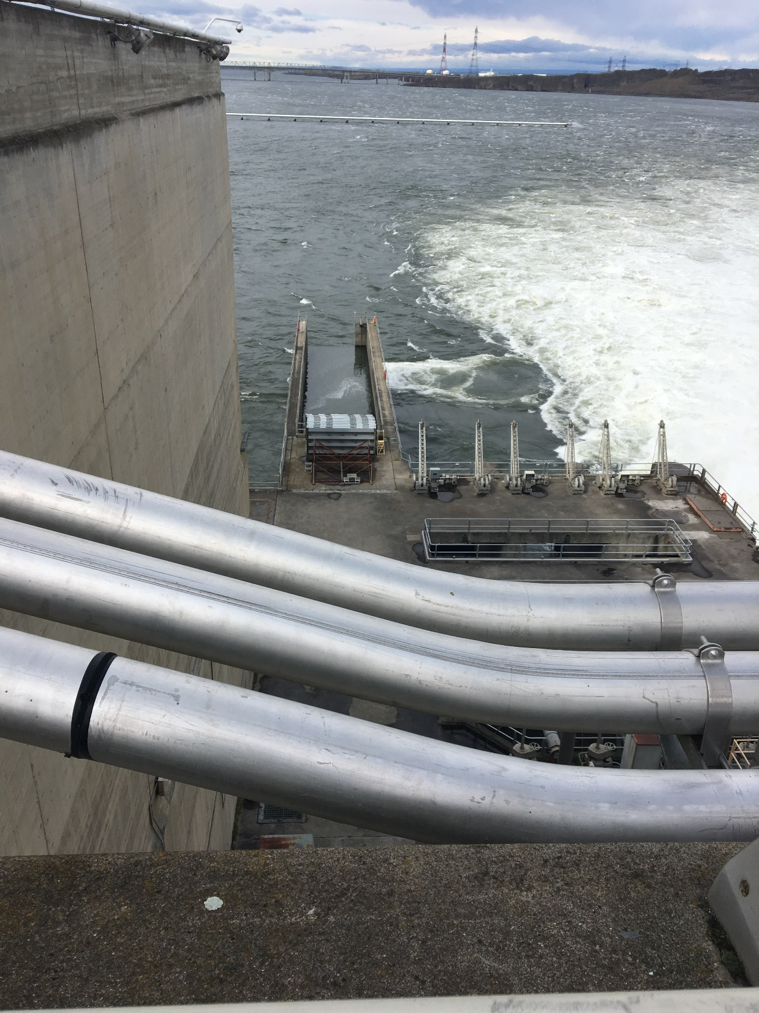
Notes:
Field Report: On April 16, a failure in a headgate hydraulic system caused 522 gallons of hydraulic oil to spill into the headgate slot, an estimated 162 gallons of which eventually released to the Columbia River. The Army Corp investigation revealed that faulty lock washers in the hydraulic system allowed an “o” ring to loosen, releasing hydraulic oil from the pressurized system. The headgate has a capacity of 522 gallons. 360 gallons was recovered from the slot and hydraulic cylinders using their vacuum system and sorbents. The unaccounted for 162 gallons of hydraulic oil was presumably released to the Columbia River.
Photo Courtesy of Eurasia News Online: https://eurasia-news-online.com/2016/10/18/nine-of-the-10-biggest-power-plants-in-the-world-are-hydro-power/

Slide 10
Notes:
Field Report: On April 16, a failure in a headgate hydraulic system caused 522 gallons of hydraulic oil to spill into the headgate slot, an estimated 162 gallons of which eventually released to the Columbia River. The Army Corp investigation revealed that faulty lock washers in the hydraulic system allowed an “o” ring to loosen, releasing hydraulic oil from the pressurized system. The headgate has a capacity of 522 gallons. 360 gallons was recovered from the slot and hydraulic cylinders using their vacuum system and sorbents. The unaccounted for 162 gallons of hydraulic oil was presumably released to the Columbia River.
Photo Courtesy of USACE investigation report

Slide 11
Notes:
Field Report: On April 16, a failure in a headgate hydraulic system caused 522 gallons of hydraulic oil to spill into the headgate slot, an estimated 162 gallons of which eventually released to the Columbia River. The Army Corp investigation revealed that faulty lock washers in the hydraulic system allowed an “o” ring to loosen, releasing hydraulic oil from the pressurized system. The headgate has a capacity of 522 gallons. 360 gallons was recovered from the slot and hydraulic cylinders using their vacuum system and sorbents. The unaccounted for 162 gallons of hydraulic oil was presumably released to the Columbia River.
Photo Courtesy of USACE investigation report

Slide 12
P/C Serenity spill into Lake Union
Date of Incident: April 25, 2018
Potentially Liable Party: Stan Glover
Product Spilled: Diesel fuel
Spill Source: P/C Serenity
Oil Spill Size Estimate: 277 gallons
Water Body Affected: Lake Union
Ecology Region: NWRO
County: King
Nearest City: Seattle
Location of Spill: Seattle Nautical Landing, Lake Union
Cause: Unknown
Ecology Responder: Trevor Braund
Notes:
Field Report: The 105’ P/C Serenity was conducting a fuel transfer from an APP tank truck into their fuel tanks when diesel began spilling from the starboard vent into Lake Union. APP was filling the center tank at the time of the spill, and according to their gauges a total of 5,552 gallons of diesel was transferred to the vessel. According to the gauges on the Serenity, 5,275 gallons of fuel was received, leaving 277 gallons of diesel unaccounted for, and likely spilled into Lake Union. NRC-ES was hired for the cleanup and recovered 135 gallons of fuel using sorbents.

Slide 13
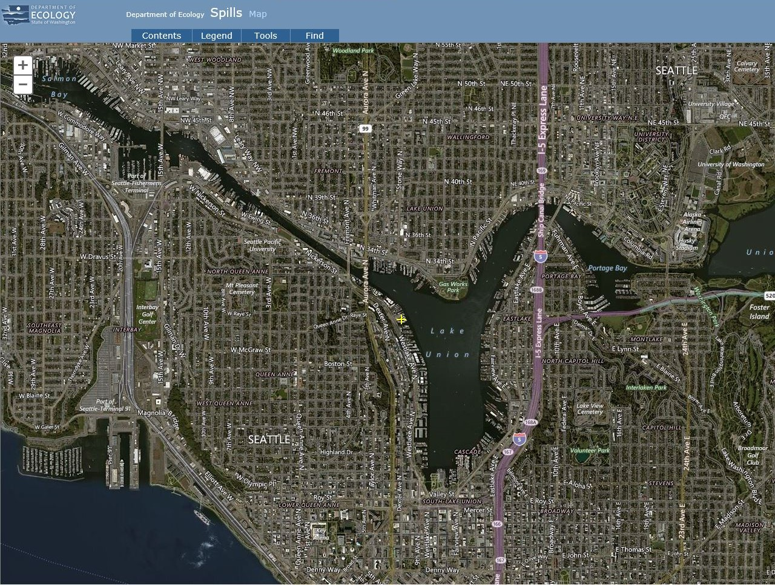
Notes:
Field Report: The 105’ P/C Serenity was conducting a fuel transfer from an APP tank truck into their fuel tanks when diesel began spilling from the starboard vent into Lake Union. APP was filling the center tank at the time of the spill, and according to their gauges a total of 5,552 gallons of diesel was transferred to the vessel. According to the gauges on the Serenity, 5,275 gallons of fuel was received, leaving 277 gallons of diesel unaccounted for, and likely spilled into Lake Union. NRC-ES was hired for the cleanup and recovered 135 gallons of fuel using sorbents.

Slide 14
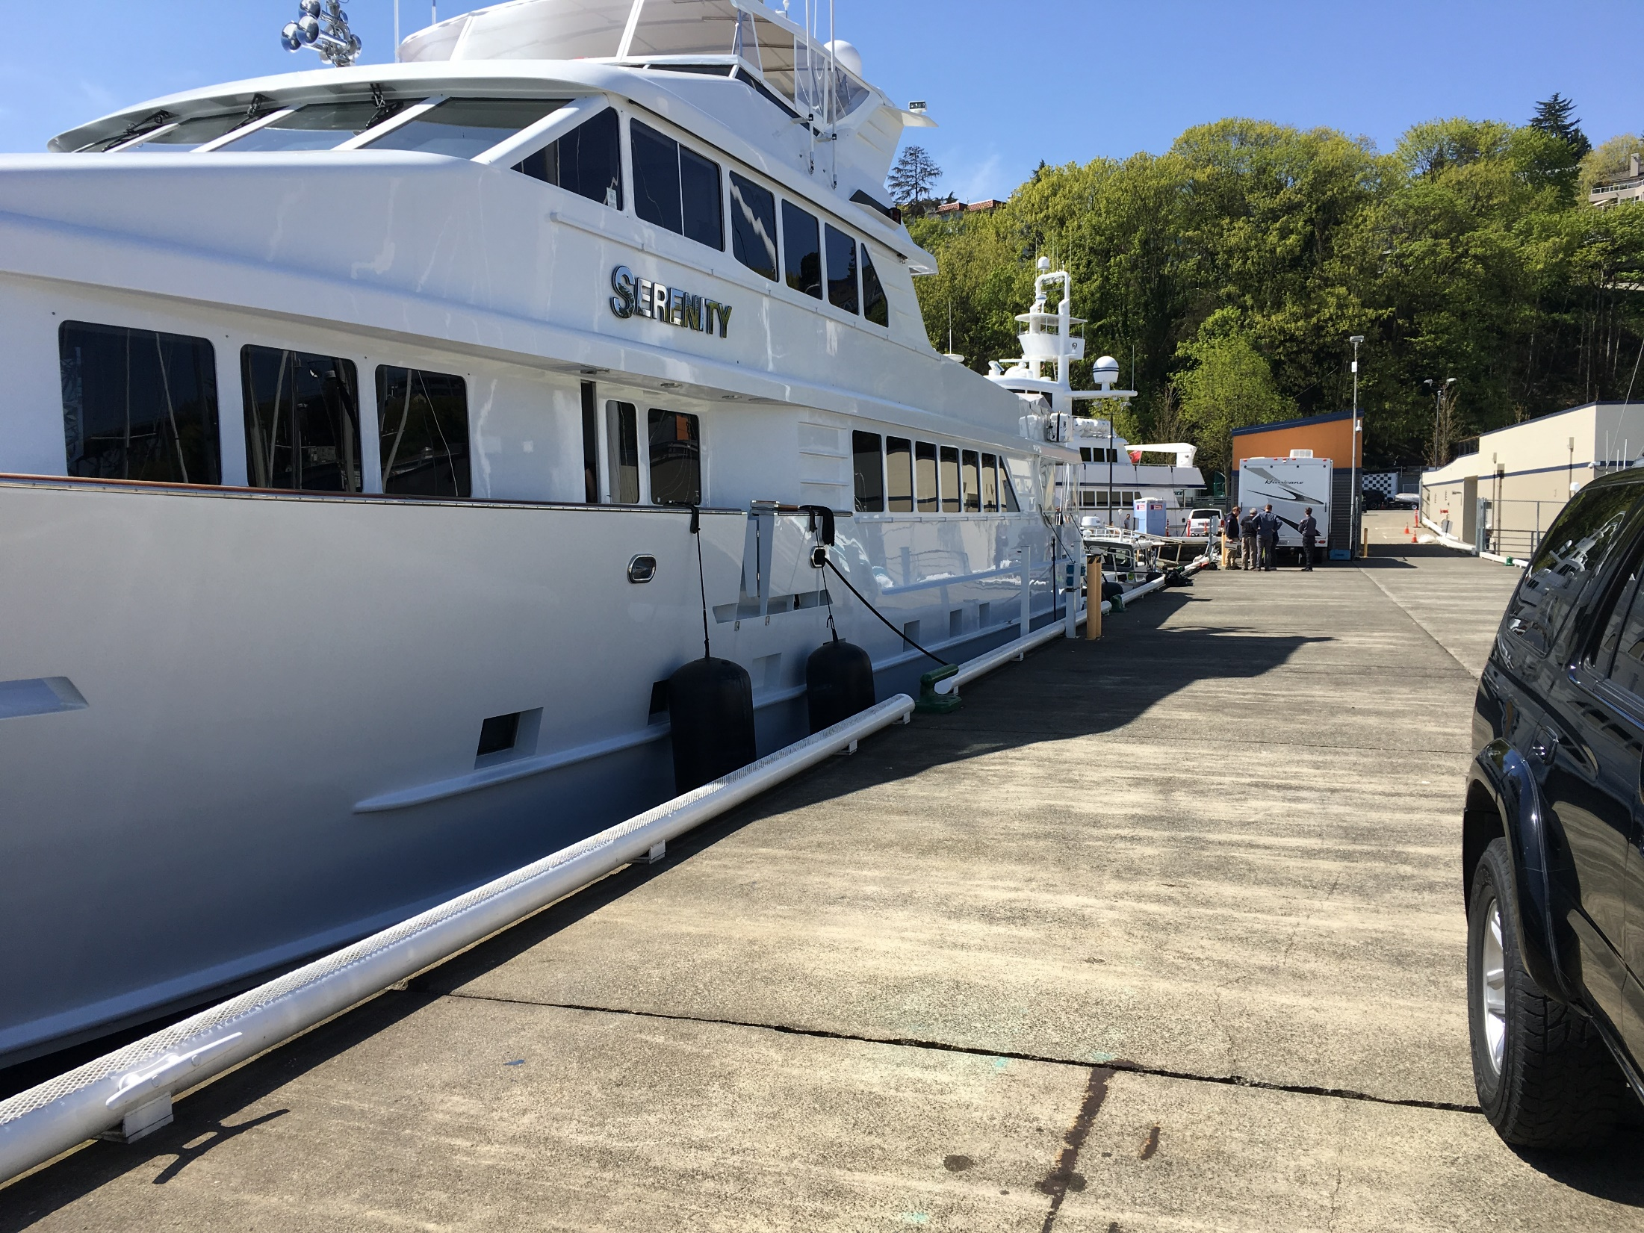
Notes:
Field Report: The 105’ P/C Serenity was conducting a fuel transfer from an APP tank truck into their fuel tanks when diesel began spilling from the starboard vent into Lake Union. APP was filling the center tank at the time of the spill, and according to their gauges a total of 5,552 gallons of diesel was transferred to the vessel. According to the gauges on the Serenity, 5,275 gallons of fuel was received, leaving 277 gallons of diesel unaccounted for, and likely spilled into Lake Union. NRC-ES was hired for the cleanup and recovered 135 gallons of fuel using sorbents.

Slide 15
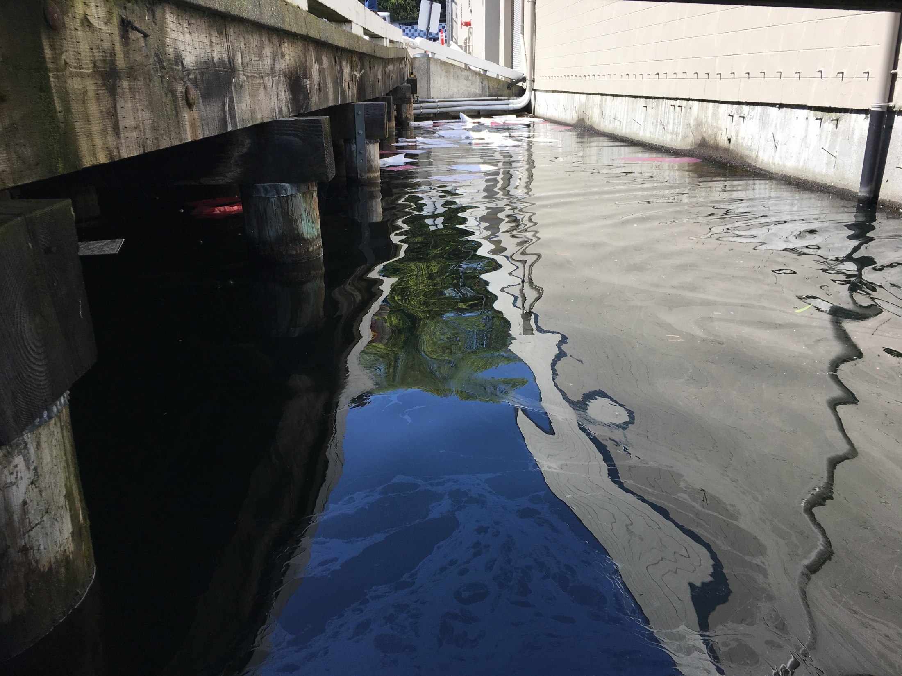
Notes:
Field Report: The 105’ P/C Serenity was conducting a fuel transfer from an APP tank truck into their fuel tanks when diesel began spilling from the starboard vent into Lake Union. APP was filling the center tank at the time of the spill, and according to their gauges a total of 5,552 gallons of diesel was transferred to the vessel. According to the gauges on the Serenity, 5,275 gallons of fuel was received, leaving 277 gallons of diesel unaccounted for, and likely spilled into Lake Union. NRC-ES was hired for the cleanup and recovered 135 gallons of fuel using sorbents.

Slide 16
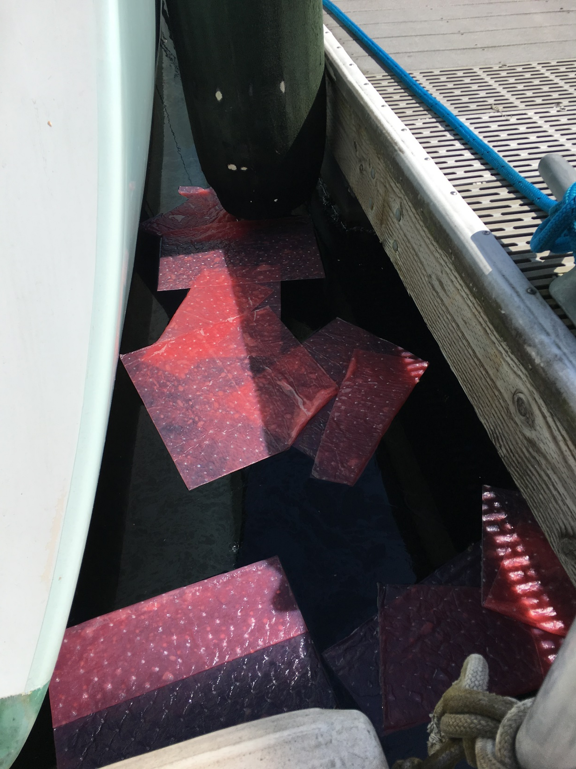
Notes:
Field Report: The 105’ P/C Serenity was conducting a fuel transfer from an APP tank truck into their fuel tanks when diesel began spilling from the starboard vent into Lake Union. APP was filling the center tank at the time of the spill, and according to their gauges a total of 5,552 gallons of diesel was transferred to the vessel. According to the gauges on the Serenity, 5,275 gallons of fuel was received, leaving 277 gallons of diesel unaccounted for, and likely spilled into Lake Union. NRC-ES was hired for the cleanup and recovered 135 gallons of fuel using sorbents.

Slide 17
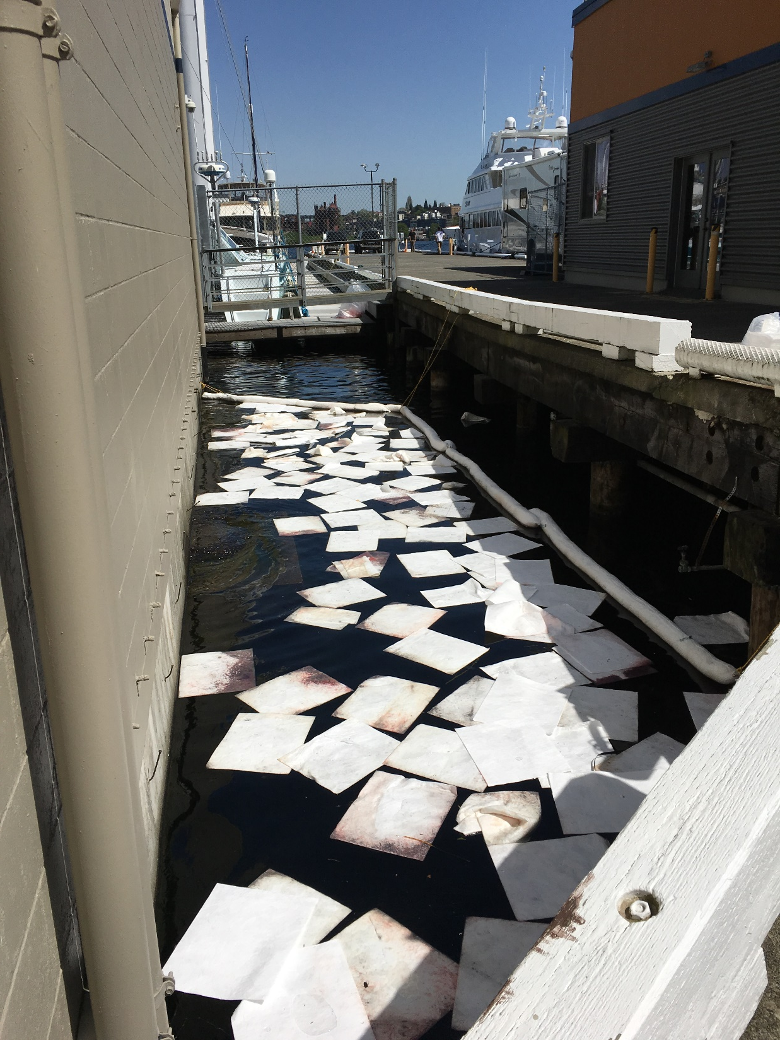
Notes:
Field Report: The 105’ P/C Serenity was conducting a fuel transfer from an APP tank truck into their fuel tanks when diesel began spilling from the starboard vent into Lake Union. APP was filling the center tank at the time of the spill, and according to their gauges a total of 5,552 gallons of diesel was transferred to the vessel. According to the gauges on the Serenity, 5,275 gallons of fuel was received, leaving 277 gallons of diesel unaccounted for, and likely spilled into Lake Union. NRC-ES was hired for the cleanup and recovered 135 gallons of fuel using sorbents.

Slide 18
Old Business
Open RDA Case Updates

Slide 19
F/V Deep Sea spill into Penn Cove
May 13, 2012

Slide 20
Sulphur Creek spill into the Yakima River
March 1, 2015

Slide 21
F/V Privateer grounding and spill into the Pacific Ocean
April 15, 2016

Slide 22
Tug Island Wind spill into Elliot Bay
February 28, 2017

Slide 23
Coleman Oil spill into the Columbia River
March 18, 2017

Slide 24
Announcements
CPF RDA Grant Update

