Slide 1
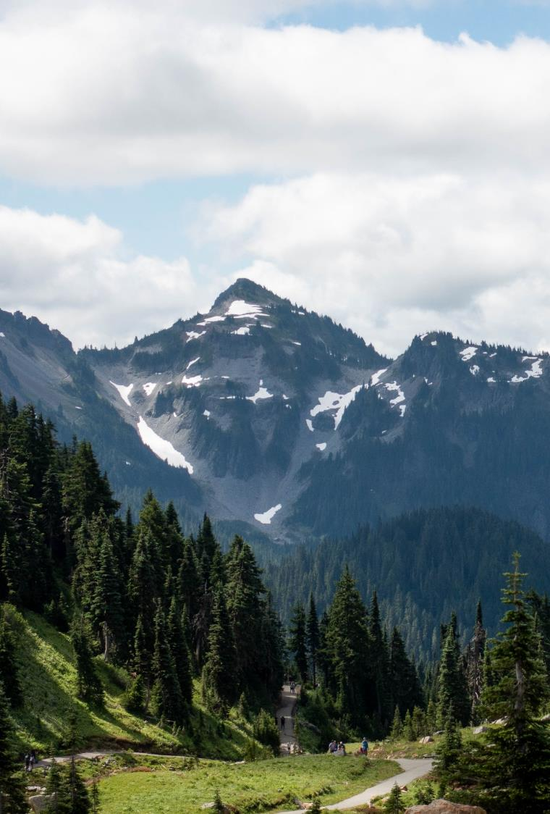
The meeting will begin shortly
Resource Damage Assessment Committee Meeting
Please keep your microphone muted unless speaking
Webcam is optional
Notes:
*Friendly idle chit-chat*

Slide 2
Resource Damage Assessment Committee Meeting
Geoff Baran
April 12, 2023
Notes:
Welcome to the RDA Committee Meeting. Today’s date is April 12, 2023.

Slide 3
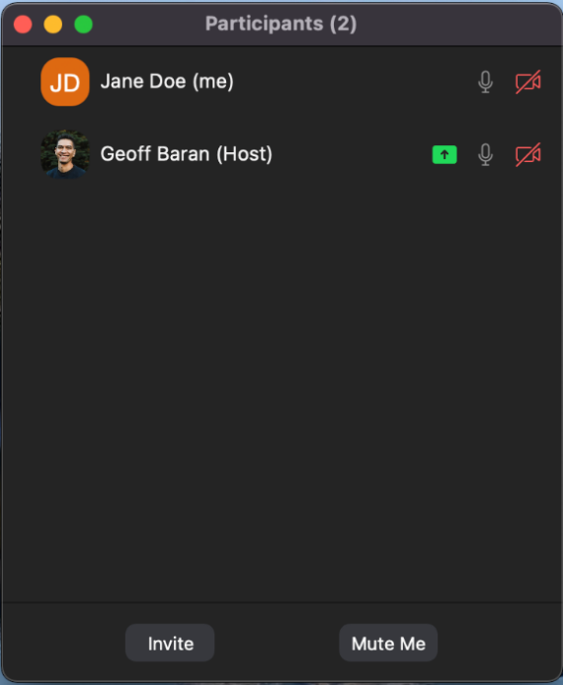
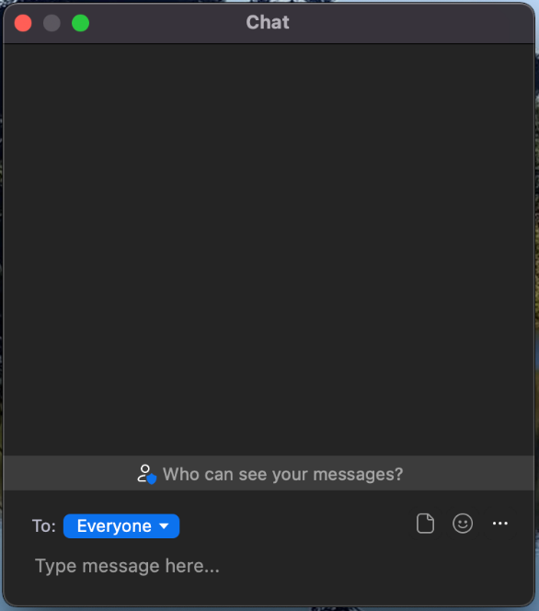
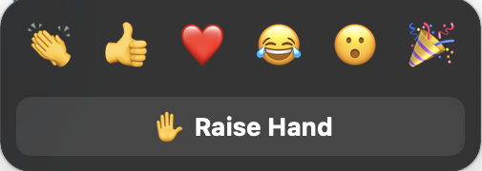
Welcome to Zoom
Please mute your microphone to reduce background noise
Callers:
Dial *6 to mute and unmute
Dial *9 to Raise Hand
Online attendees please use the mute button
Notes:
Provide basic Zoom instructions.

Slide 4
Table of Contents
1
Welcome, Roll Call, Agenda Review
2
Introduction
3
New Business
4
Old Business
6
Announcements
Notes:
Brief Agenda Review
Roll Call
Agenda Review
Intro: Review the purpose of our meeting today and the rules of this committee

Slide 5
Resource Damage Assessment Committee
Notes:
INTRODUCTION
Purpose:
This committee is responsible for conducting preassessment screenings for natural resource damage assessments for oil spill that impact the waters of Washington State.
The committee is defined in statute, and comprised of representatives of the Washington State Department of Fish and Wildlife, The Department of Natural Resources, Department of Archeology and History Preservation, Department of Health, and the Washington State Parkas and Recreation Commission
We are NOT assigning liability at this meeting. The purpose of this meeting is to evaluate the natural resource injuries from the spill, review available data, and work cooperatively with potentially liable parties to assess the harm to the environment from oil spills.
Goal:
Work cooperatively with the potentially liable party to determine whether detailed damage assessment studies should be conducted, or whether the compensation schedule will be used to assess the damages.
The ultimate goal of this process is to restore publicly-owned resources that have been damaged by oil spills.
Objectives:
Conduct preassessment screenings of all oil spills that impact Washington State waters.
Evaluate each case and consider whether damages are quantifiable at a reasonable cost
Whether restoration or enhancement is technically feasible.
Evaluate any projects proposed in lieu of a damage claim.
The committee will vote yes or no on those questions, and if the answer is no, the Compensation Schedule is authorized to assess damages
Rules
Committee bylaws state the meeting will be carried out under parliamentary procedure. Motion, second, all in favor.
After hearing discussion from the attendees, the each present RDA Committee Member will vote on two things:
Whether damages are quantifiable at a reasonable cost
And whether restoration or enhancement is technically feasible

Slide 6
New Business
Preassessment Screenings
ERTS #720141 Washington Compost Semi-Truck Diesel Spill
ERTS #720275 P/C Sea Otter Sinking and Diesel Spill
ERTS #720788 Mejia Rental Truck Spill

Slide 7
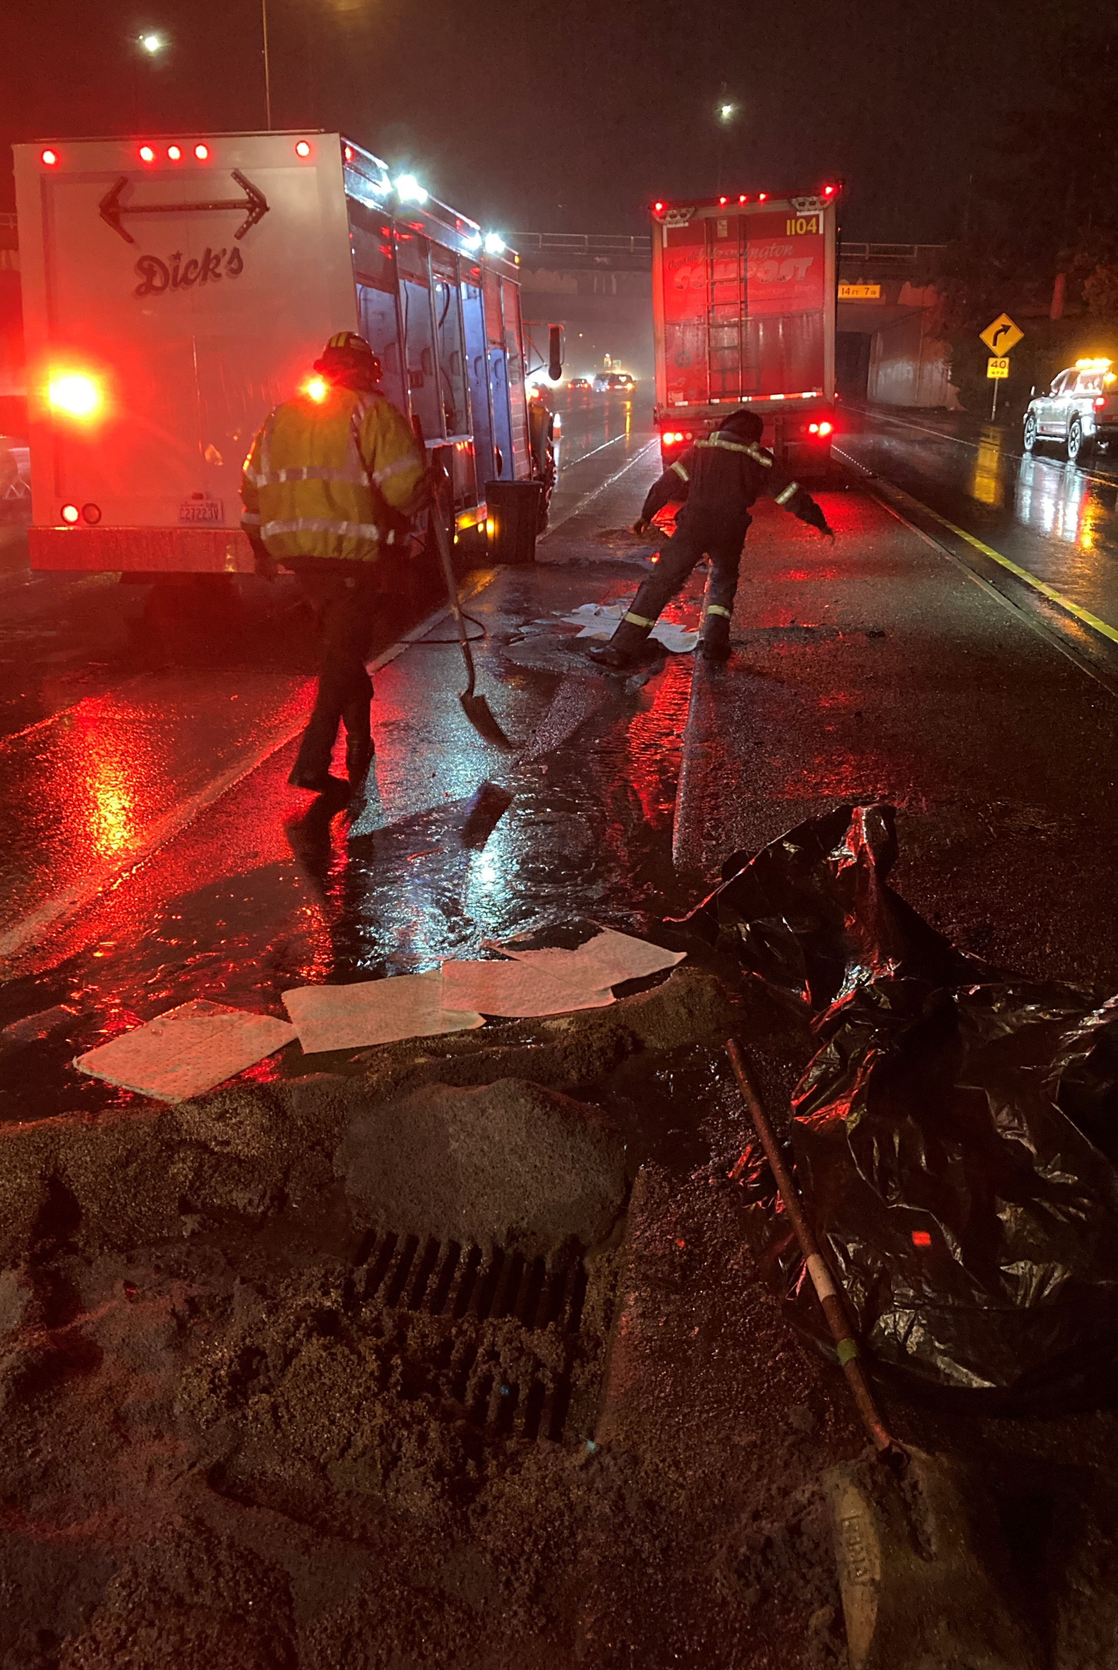
ERTS #720141 Washington Compost Semi-Truck Diesel Spill
January 12, 2023 vehicle accident and spill to Lake Union

Slide 8
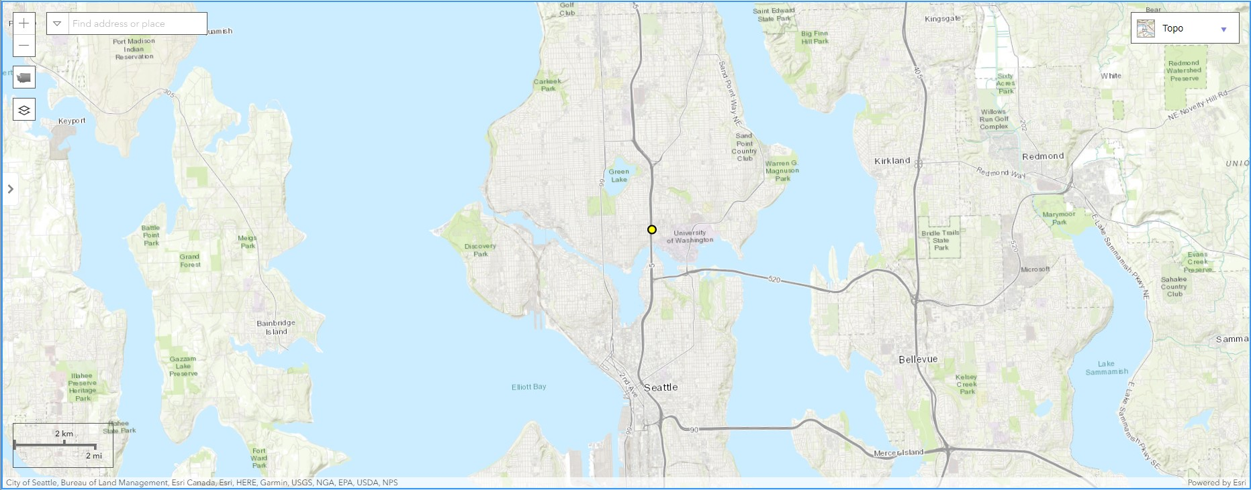
Spill Location

Slide 9
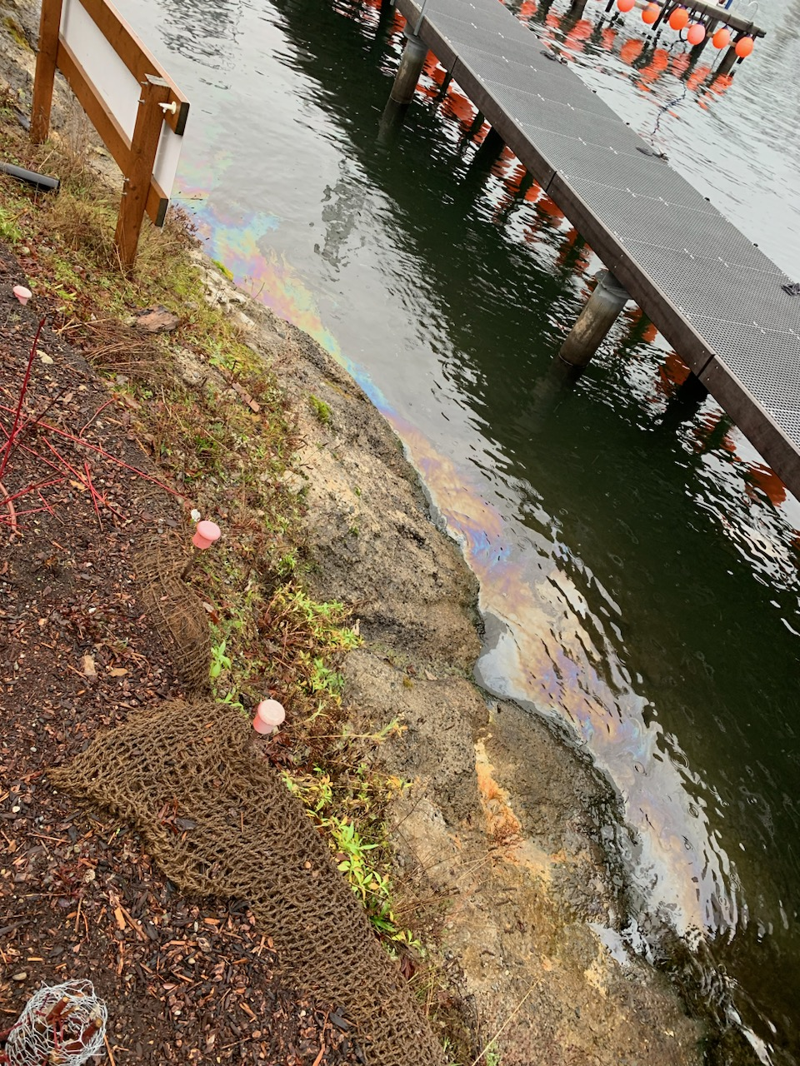
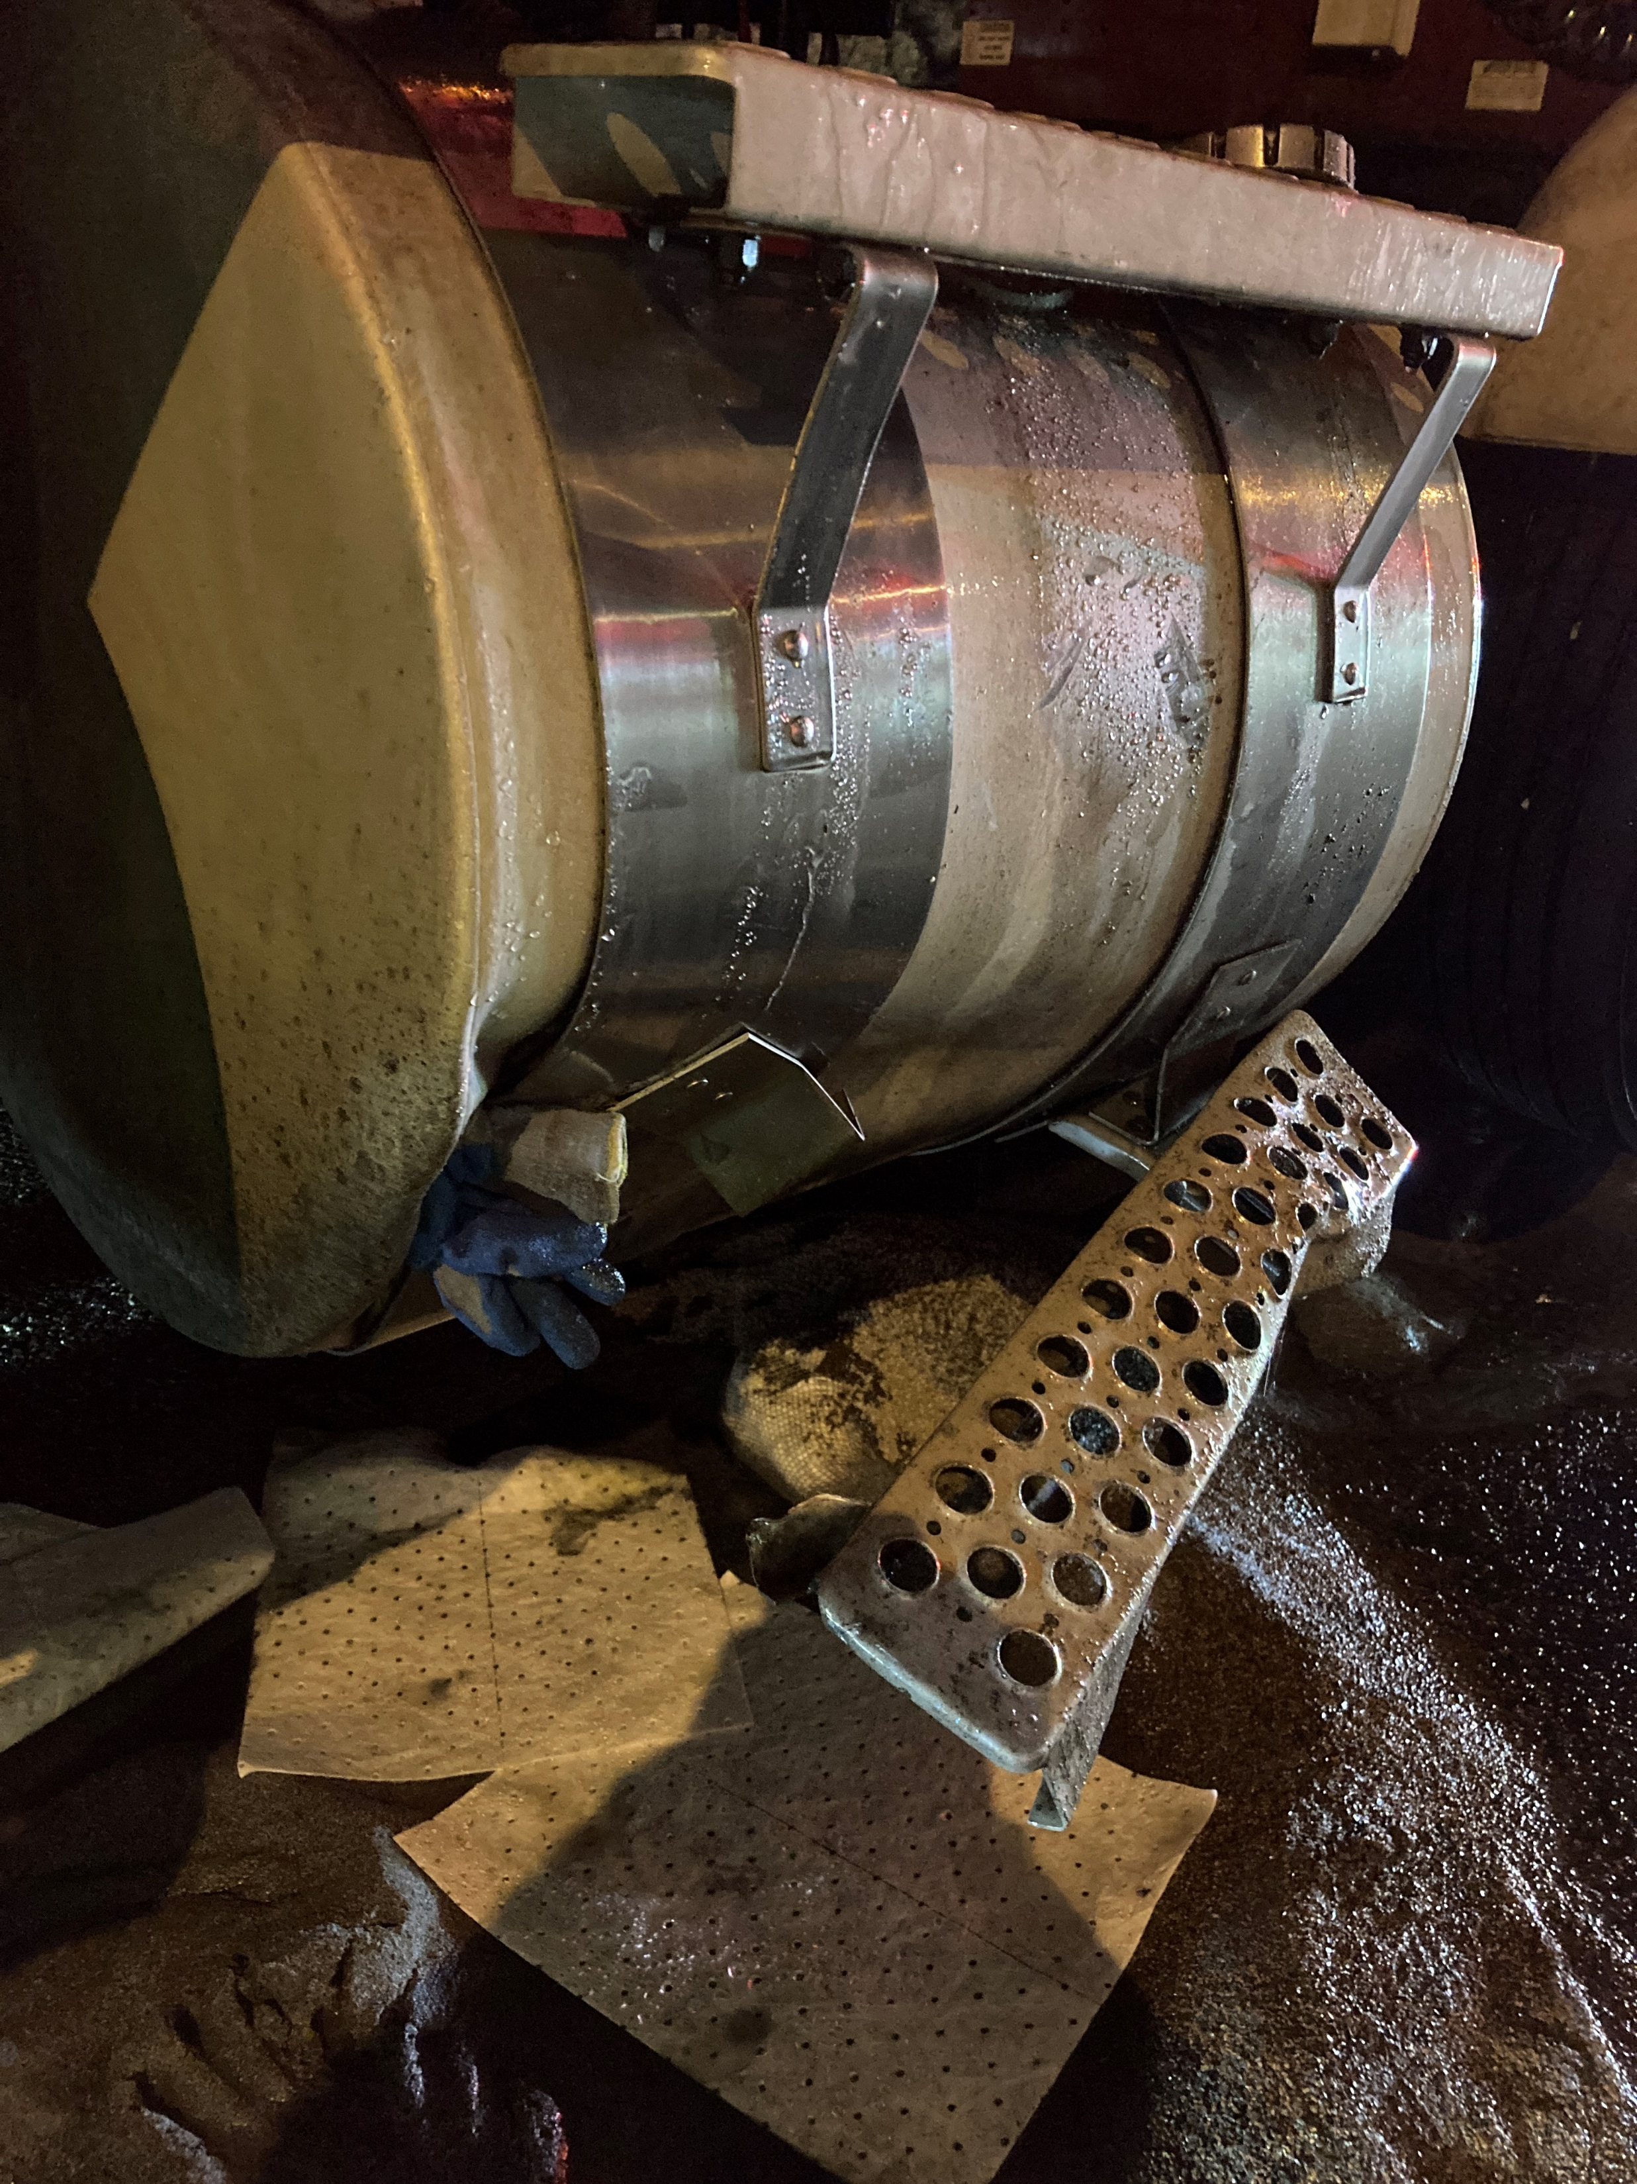
ERTS #720141 Washington Compost LLC

Slide 10
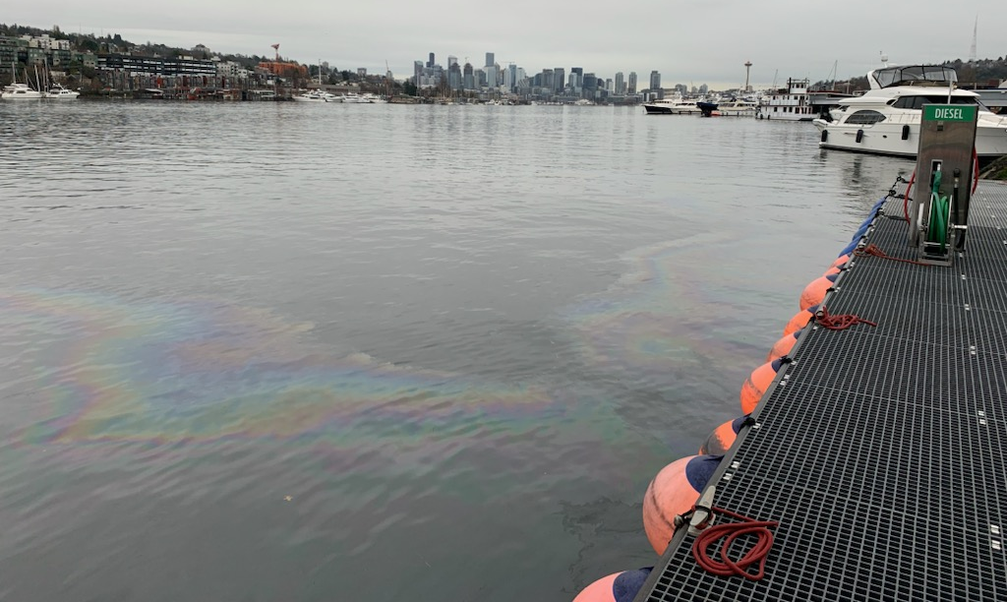

Slide 11
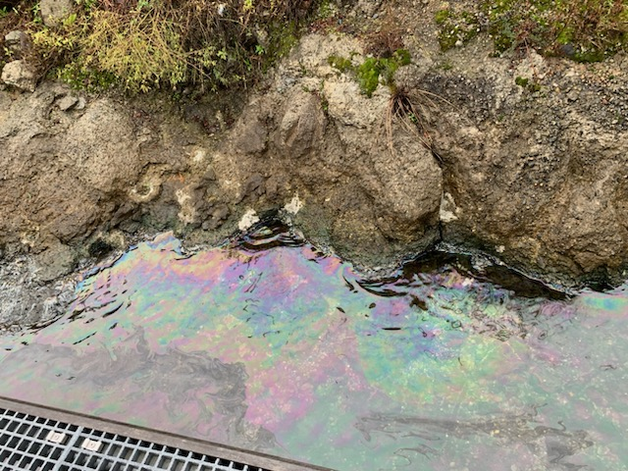
Preassessment Screening
ERTS #720141 Washington Compost LLC
Estimated spill to water volume: 50 gallons
Oil Type: Diesel Low Sulphur (ULSD)
Geographic Extent of Impacts: Lake Union
Volume of oil recovered within the first 24-hours: None

Slide 12
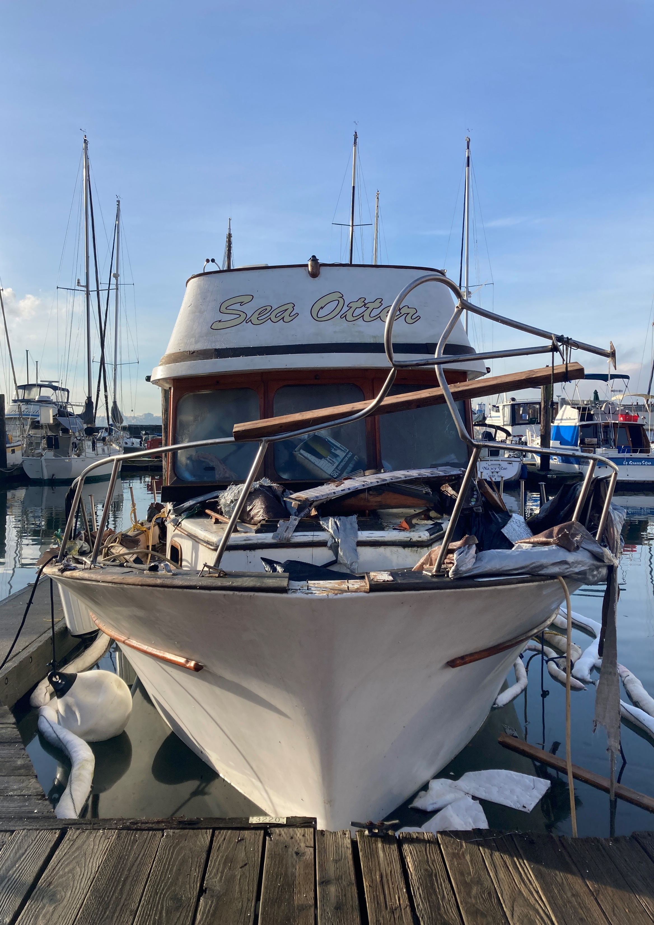
ERTS #720275 P/C Sea Otter Sinking and Diesel Spill
January 18, 2023 vessel sinking and spill
to Commencement Bay

Slide 13
Spill Location

Slide 14
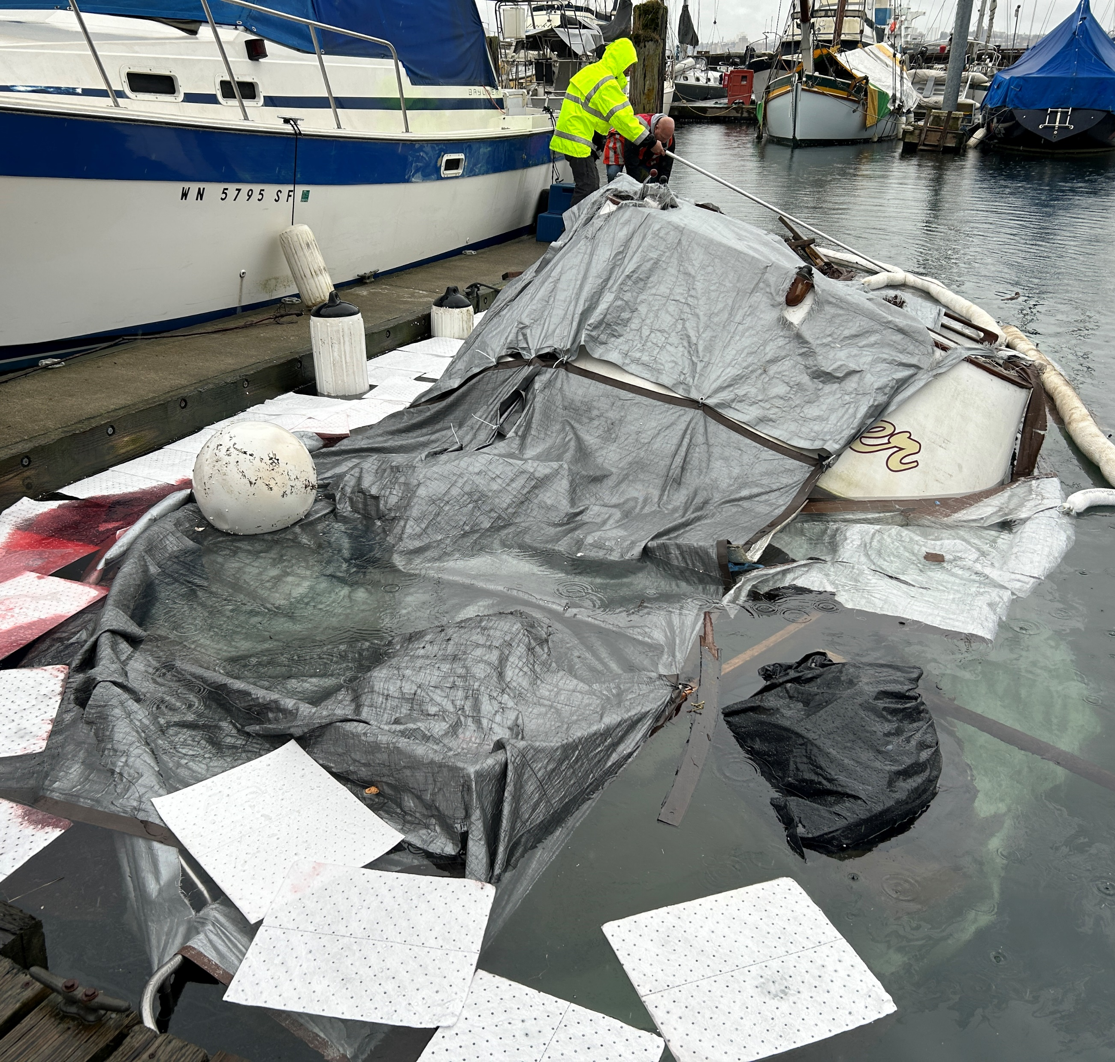
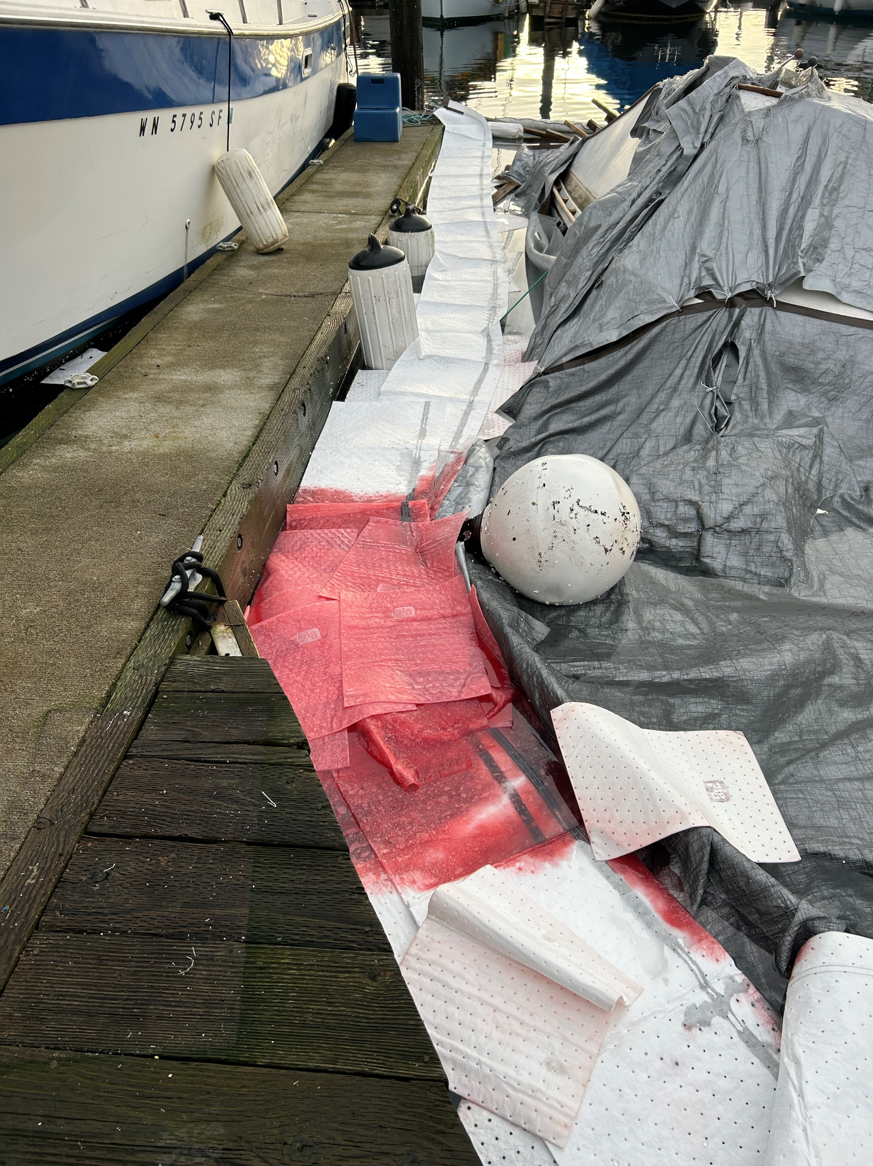
ERTS #720275 P/C Sea Otter

Slide 15
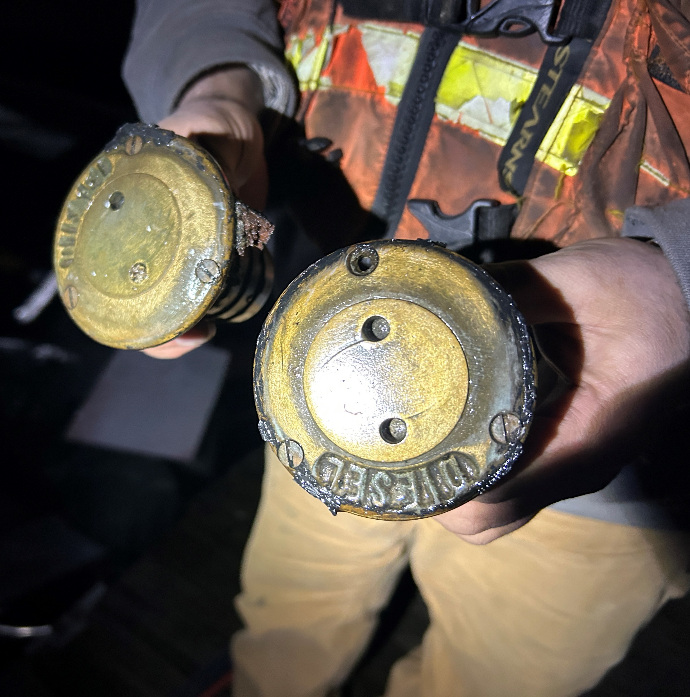
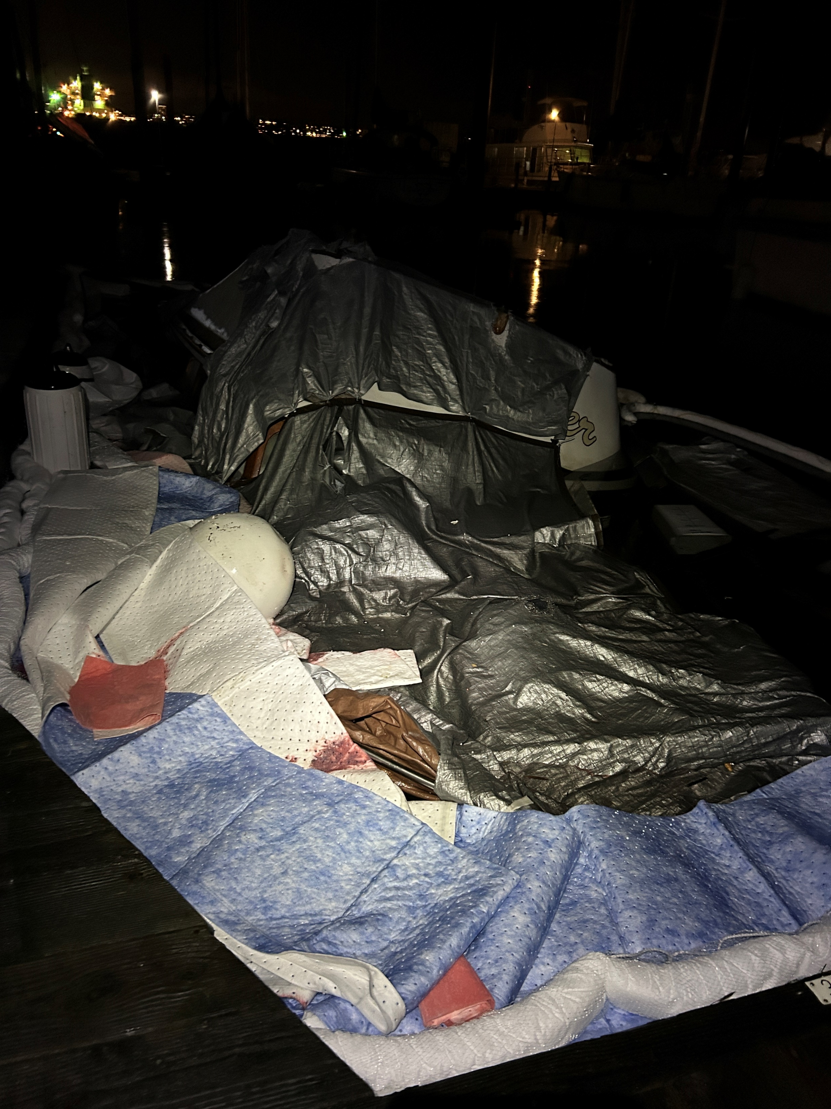
ERTS #720275 P/C Sea Otter

Slide 16
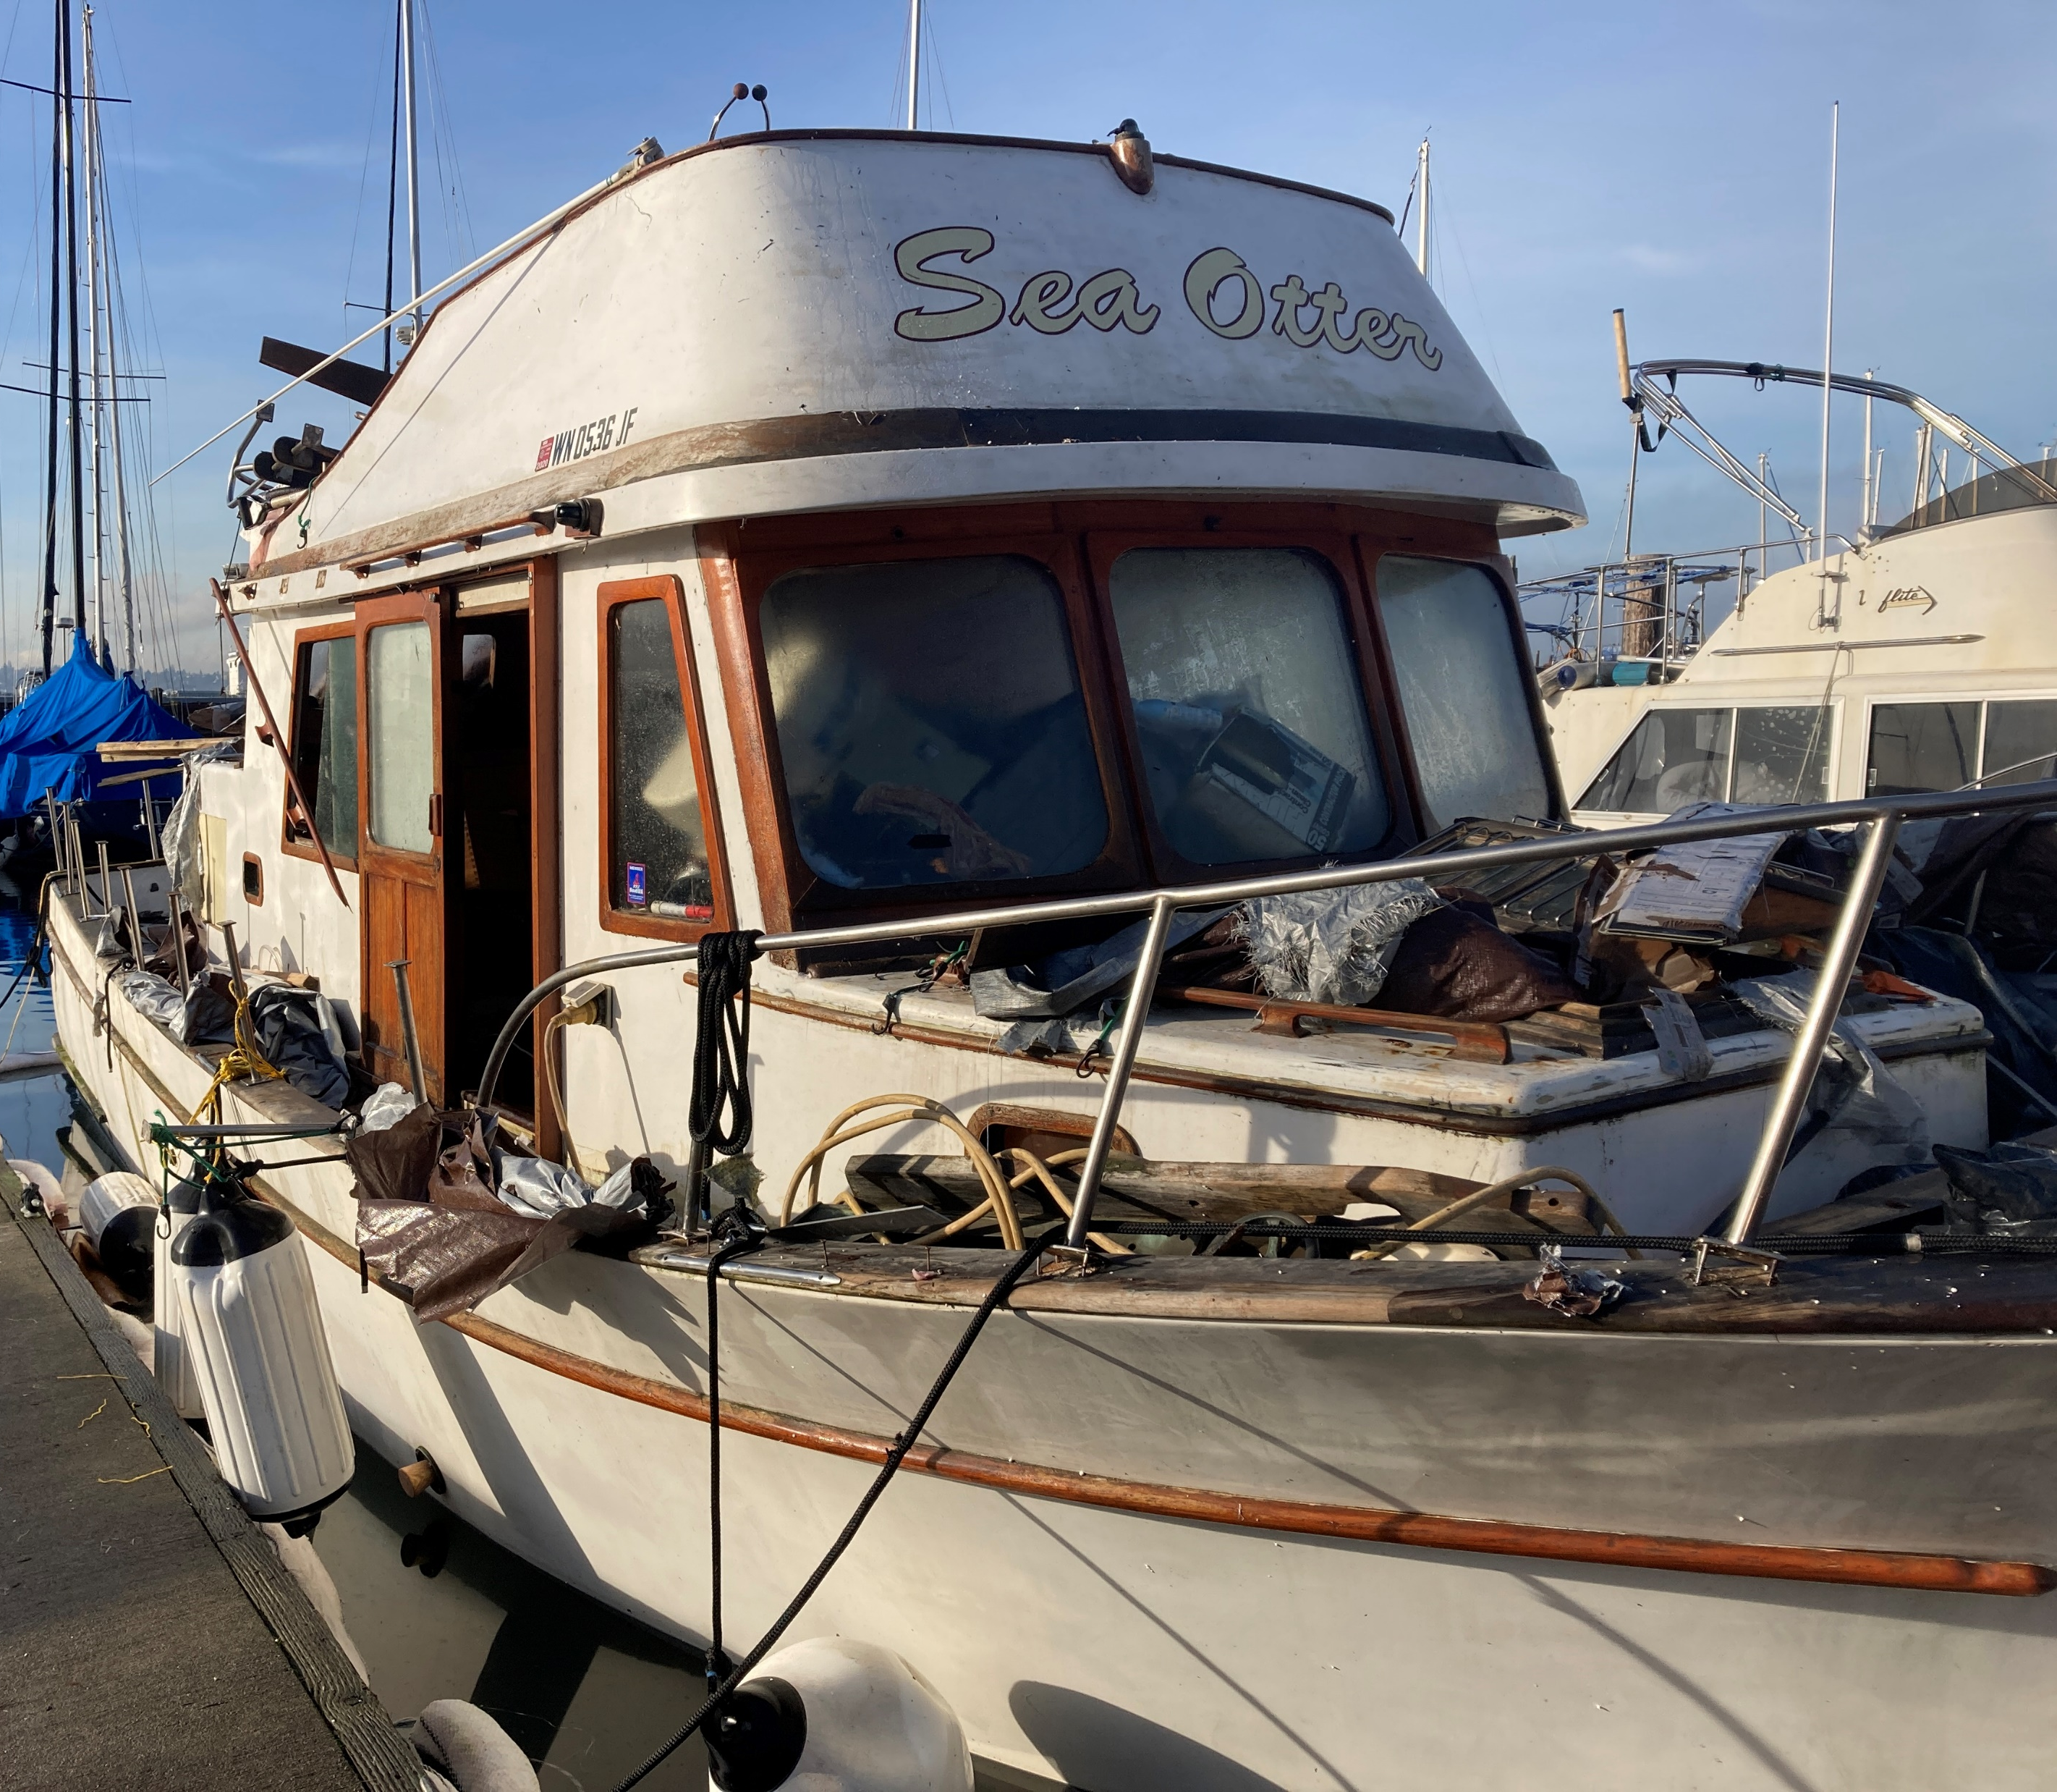
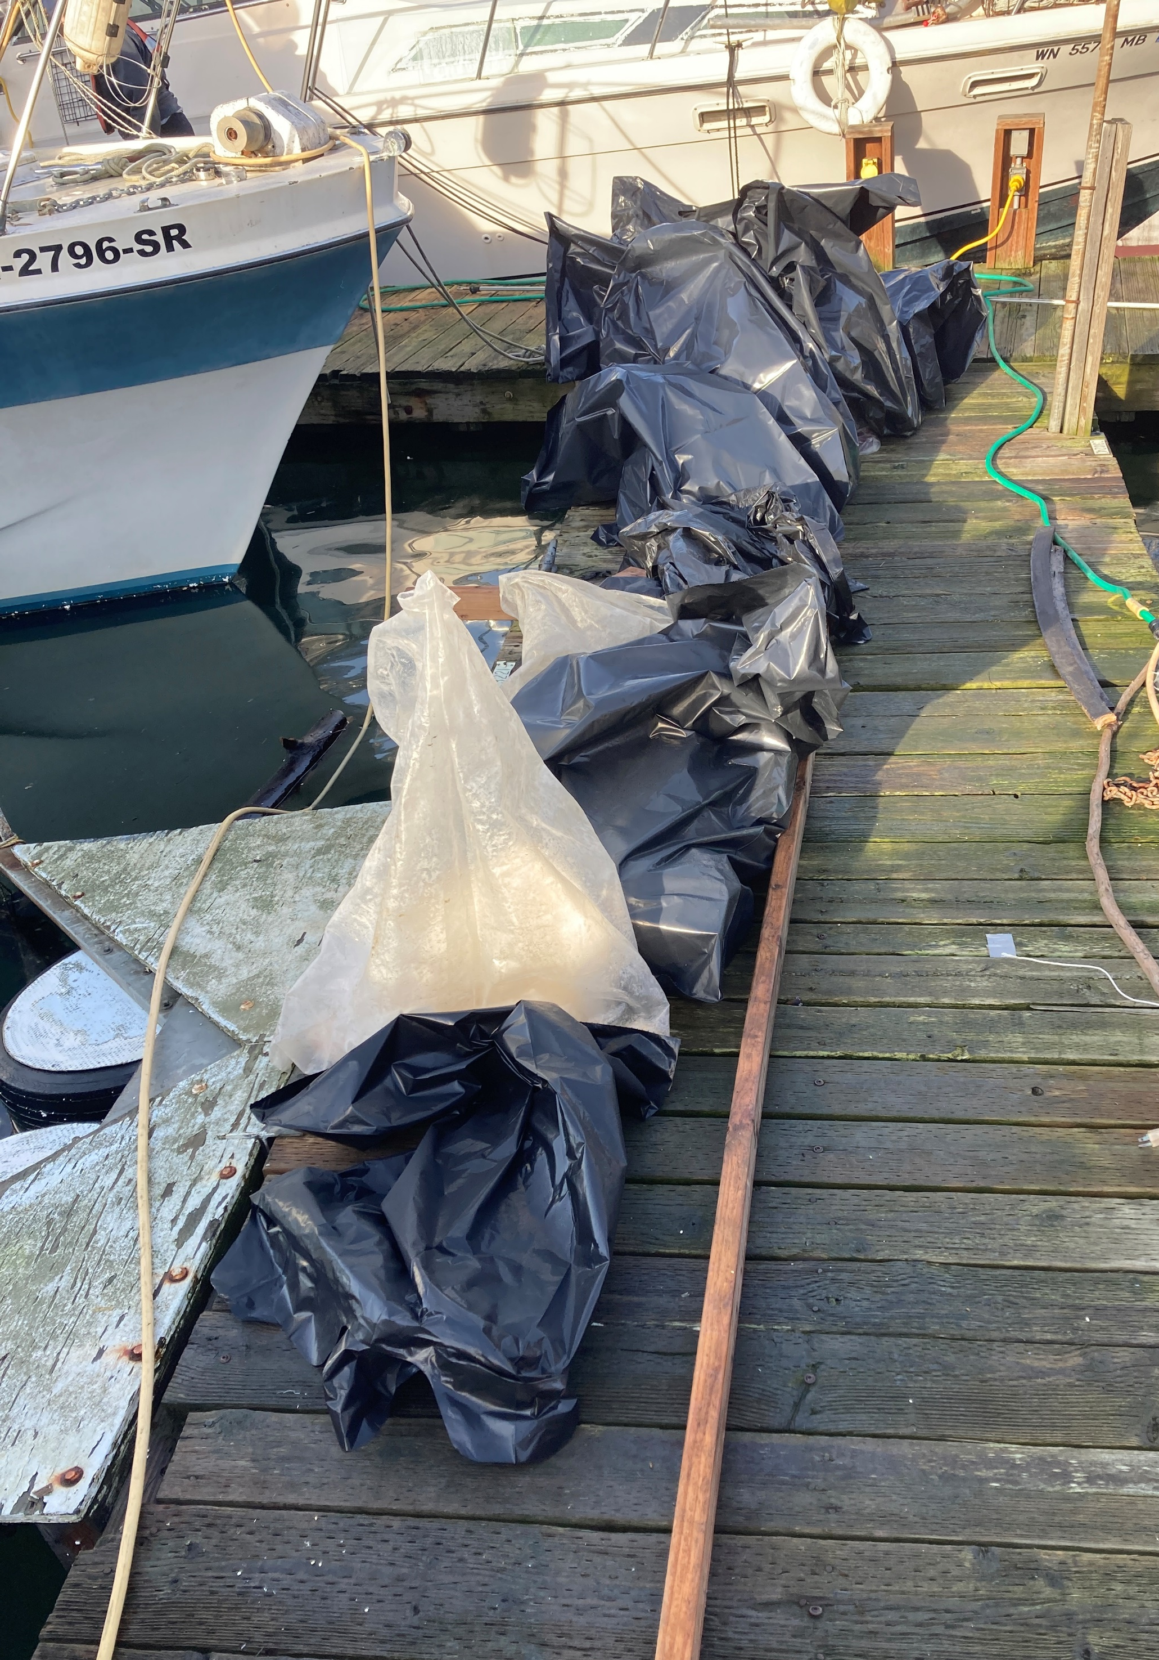
ERTS #720275 P/C Sea Otter

Slide 17
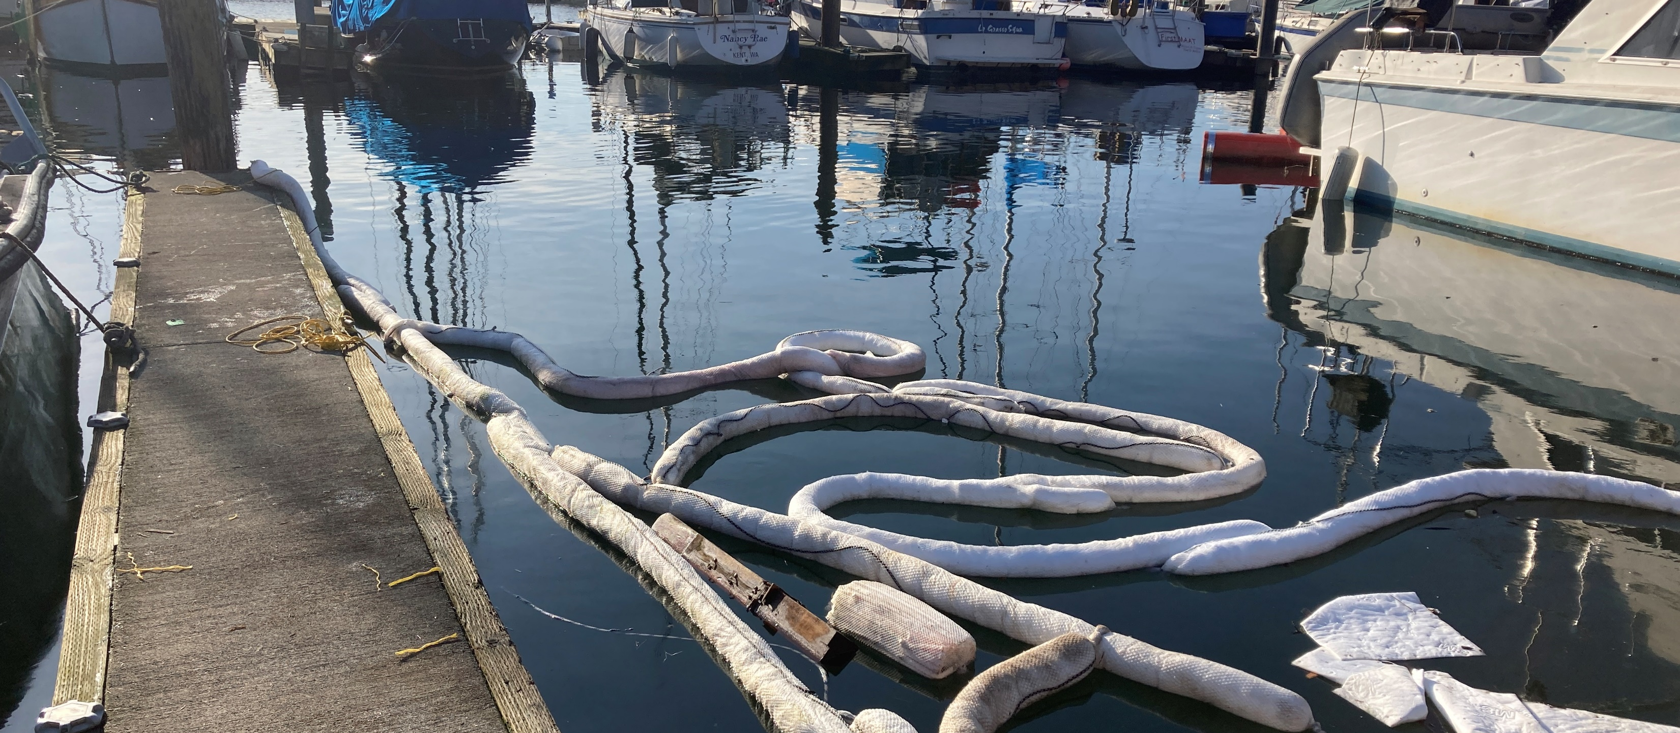
Preassessment Screening
ERTS #720275 P/C Sea Otter
Estimated spill to water volume: 55 gallons
Oil Type: Diesel Low Sulphur (ULSD)
Geographic Extent of Impacts: Puget Sound – Commencement Bay
Volume of oil recovered within the first 24-hours: 52 gallons

Slide 18
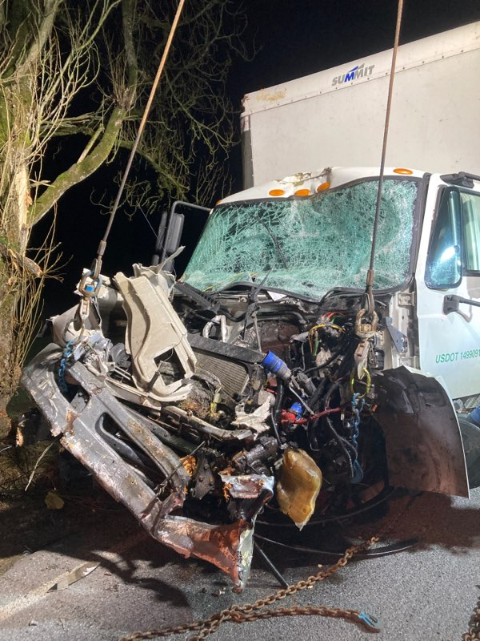
ERTS #720788 Mejia Rental Truck Spill
February 11, 2023 Enterprise rental
truck accident and spill to Portage Creek

Slide 19
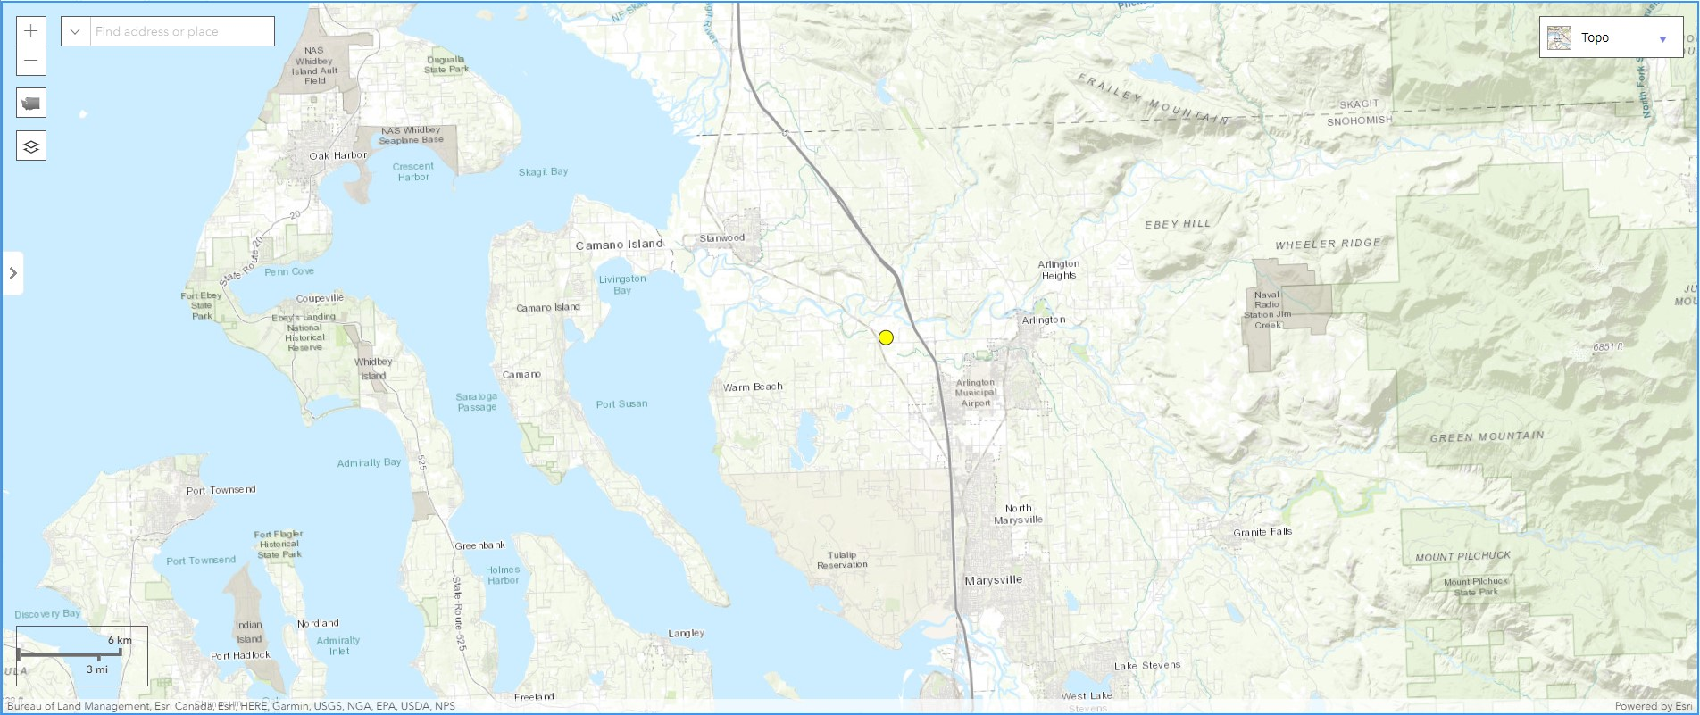
Spill Location
Notes:
Portage Creek feeds into the South Slough of the Stillaguamish River.

Slide 20
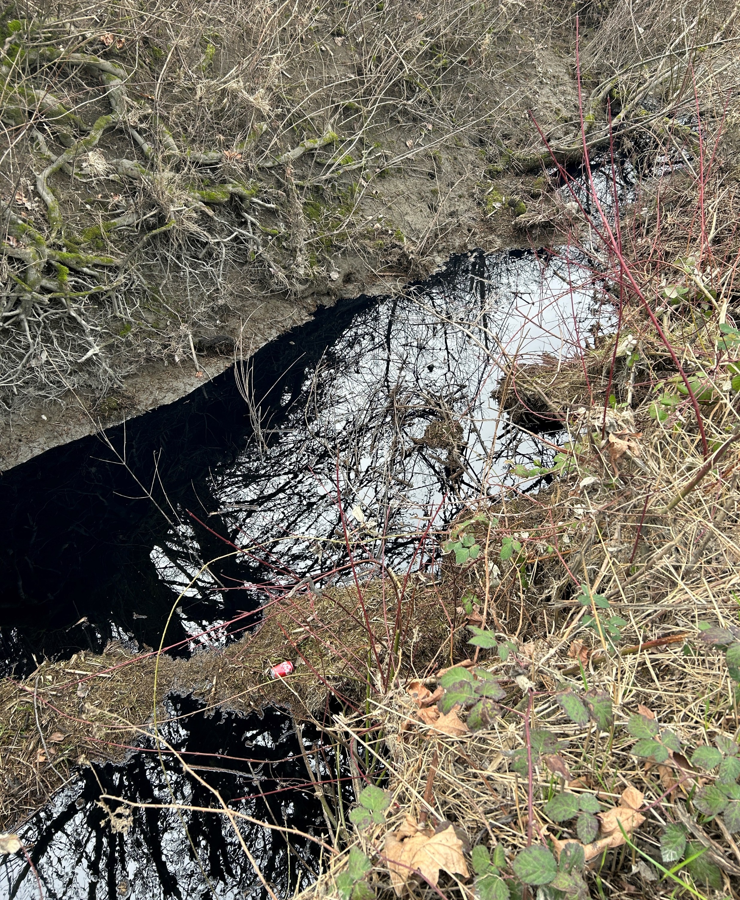
ERTS #720788 Mejia Rental Truck

Slide 21
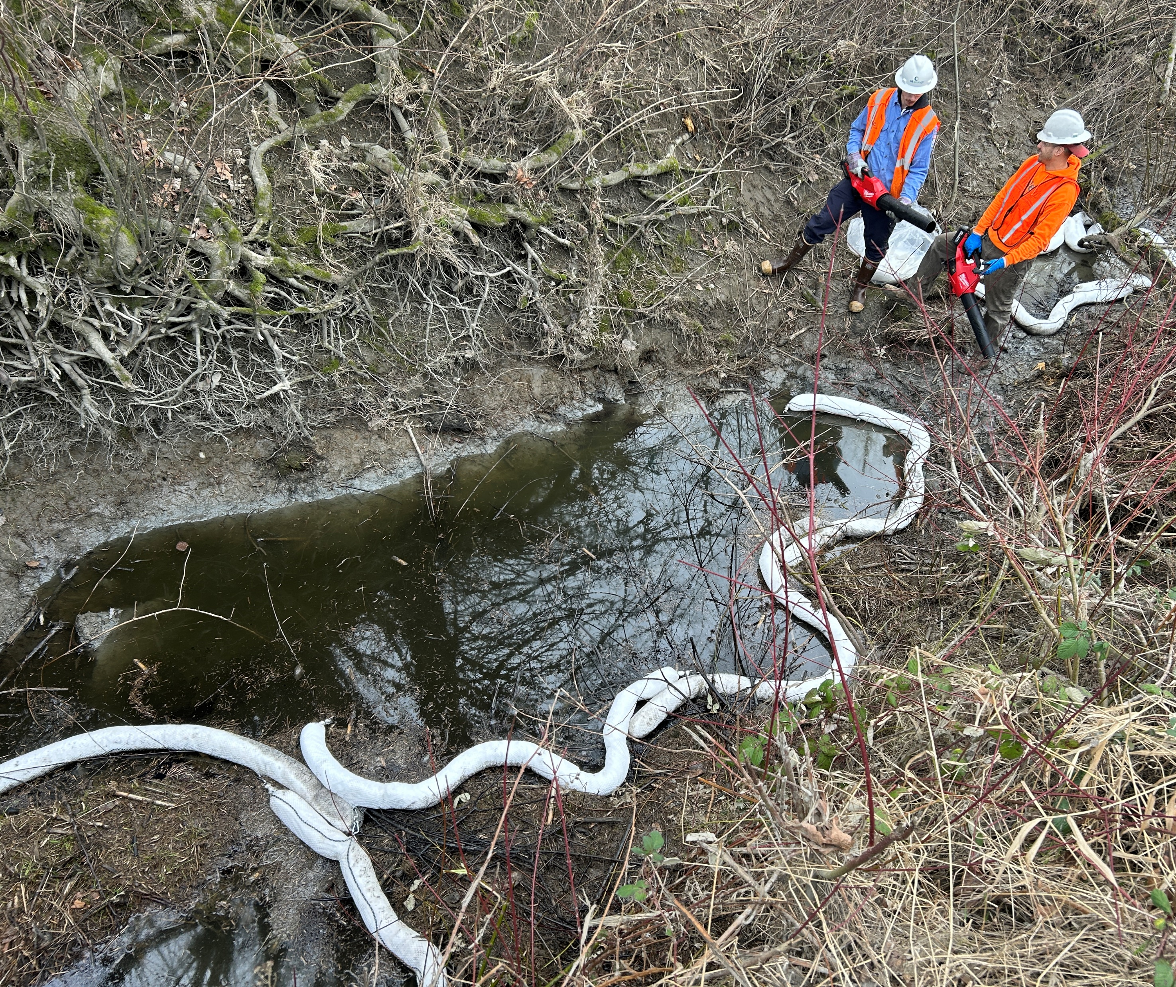
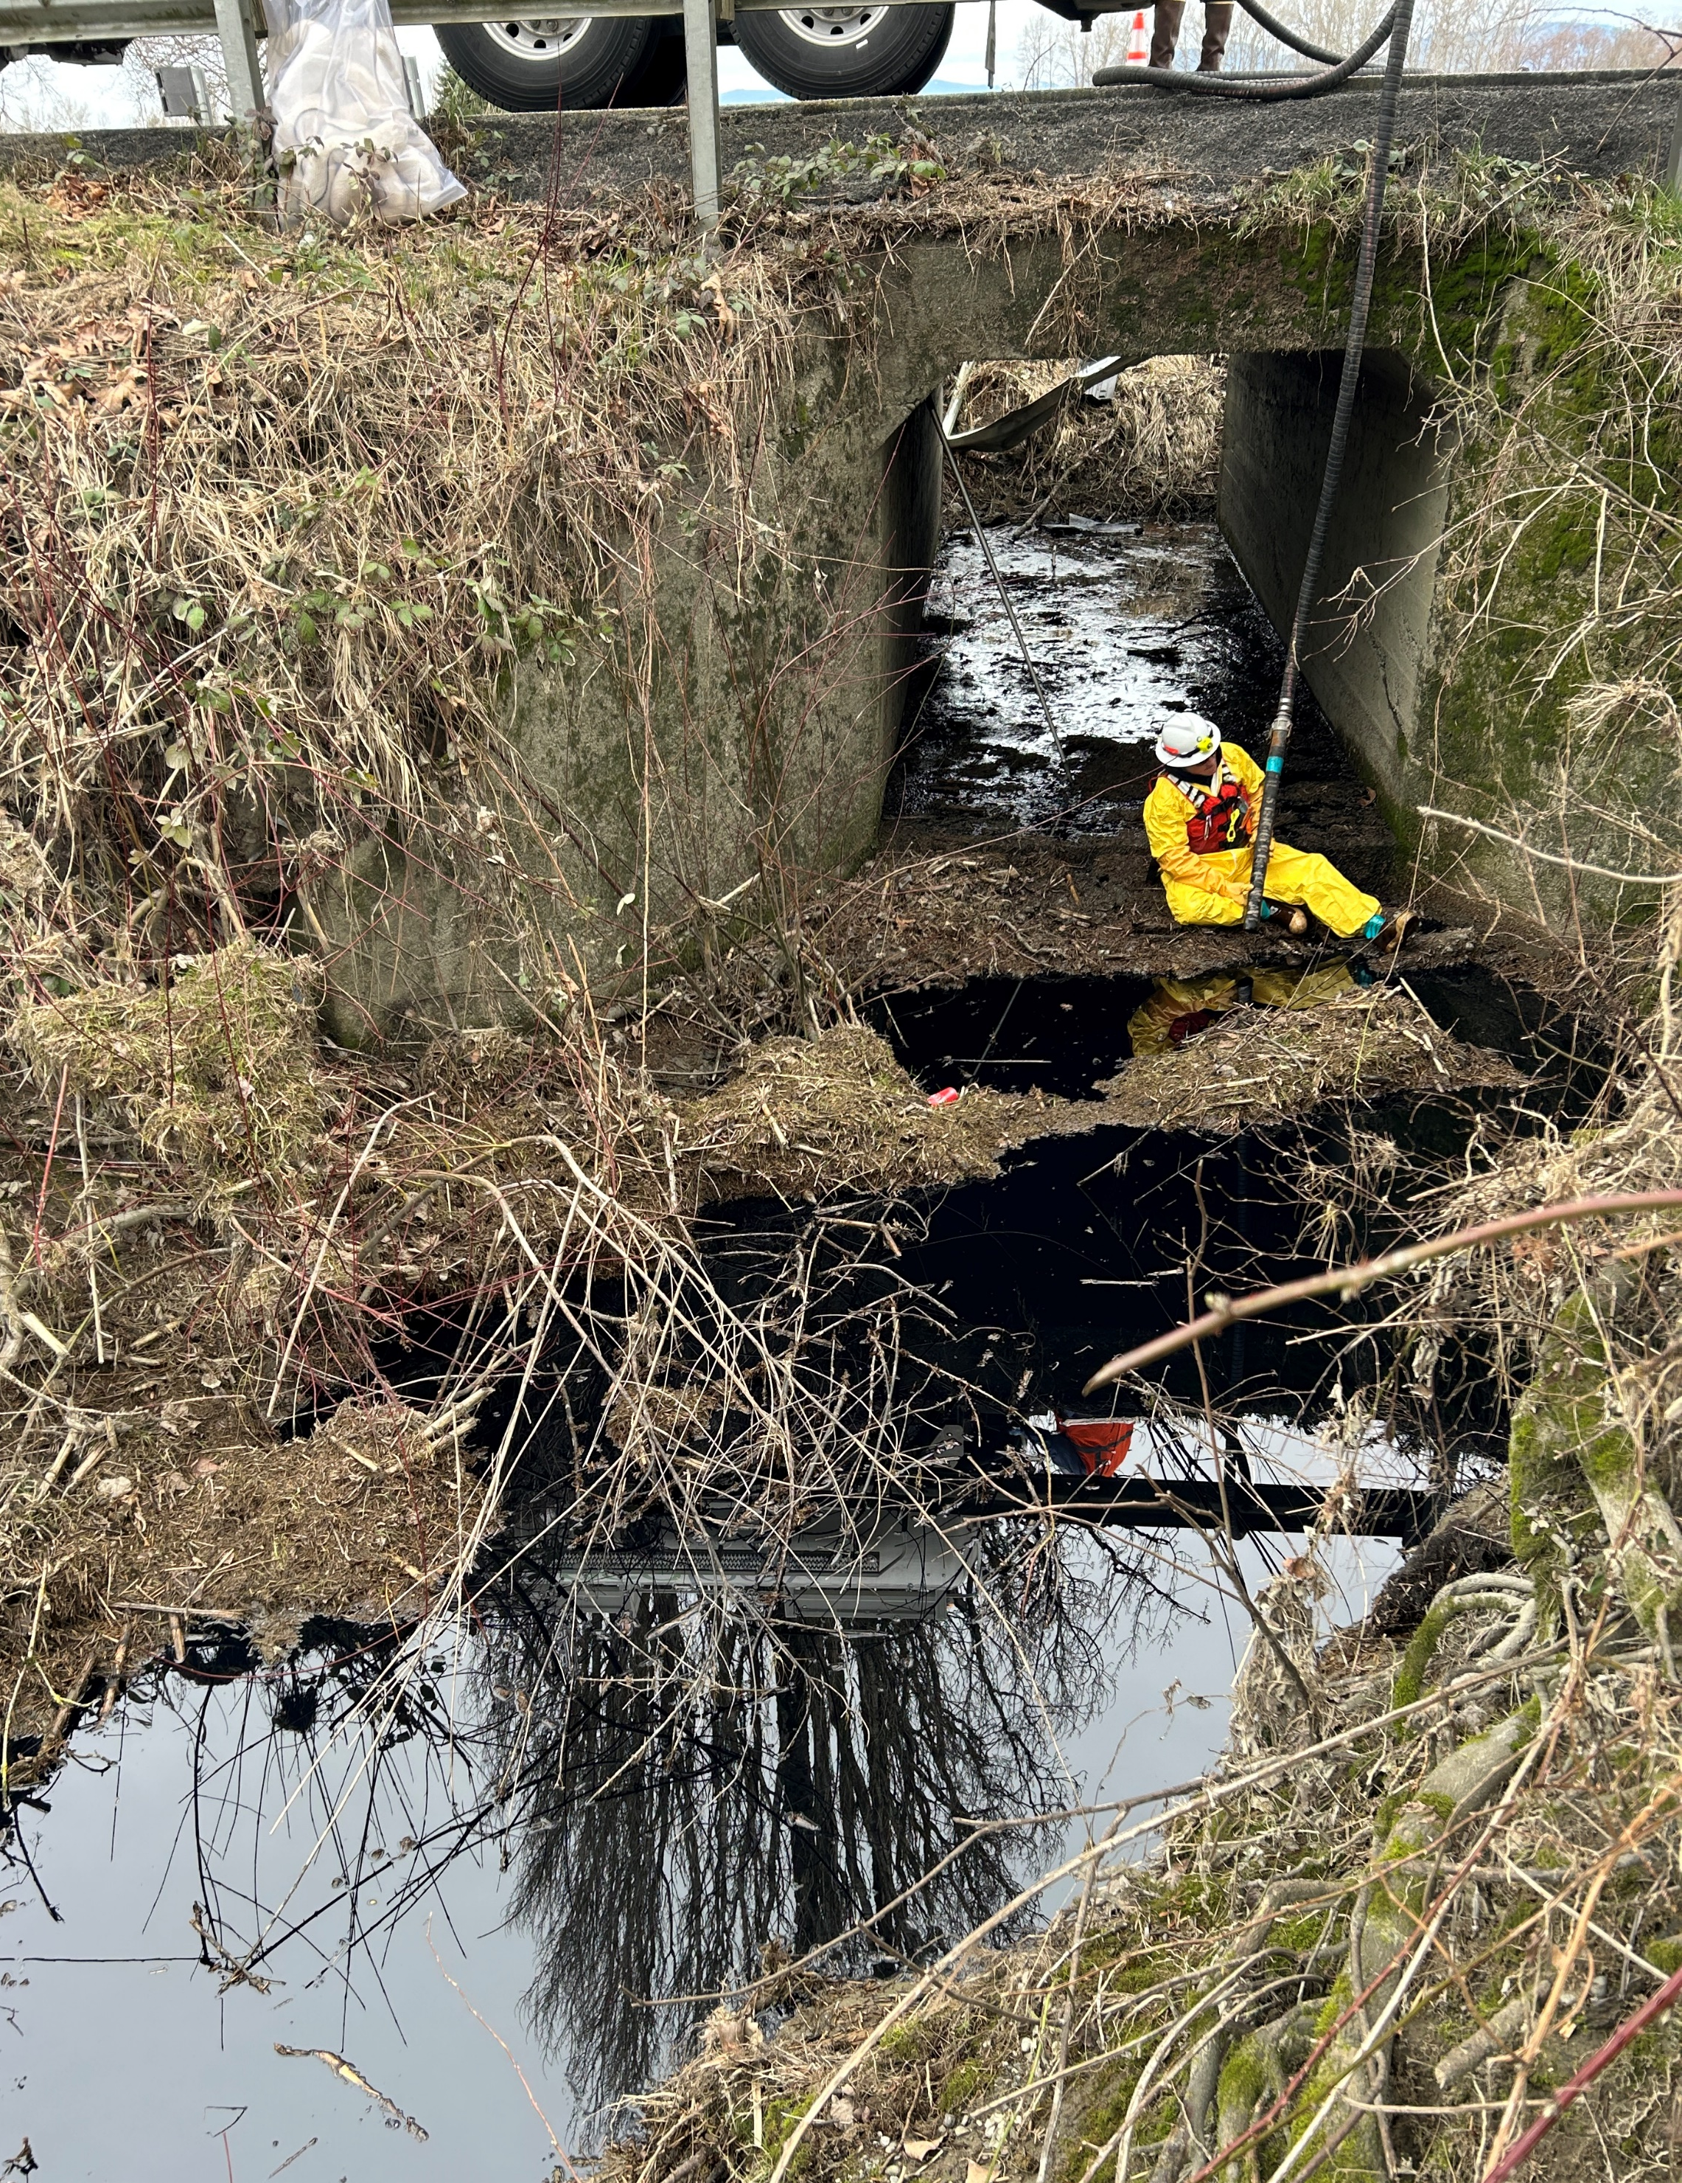
ERTS #720788 Mejia Rental Truck

Slide 22
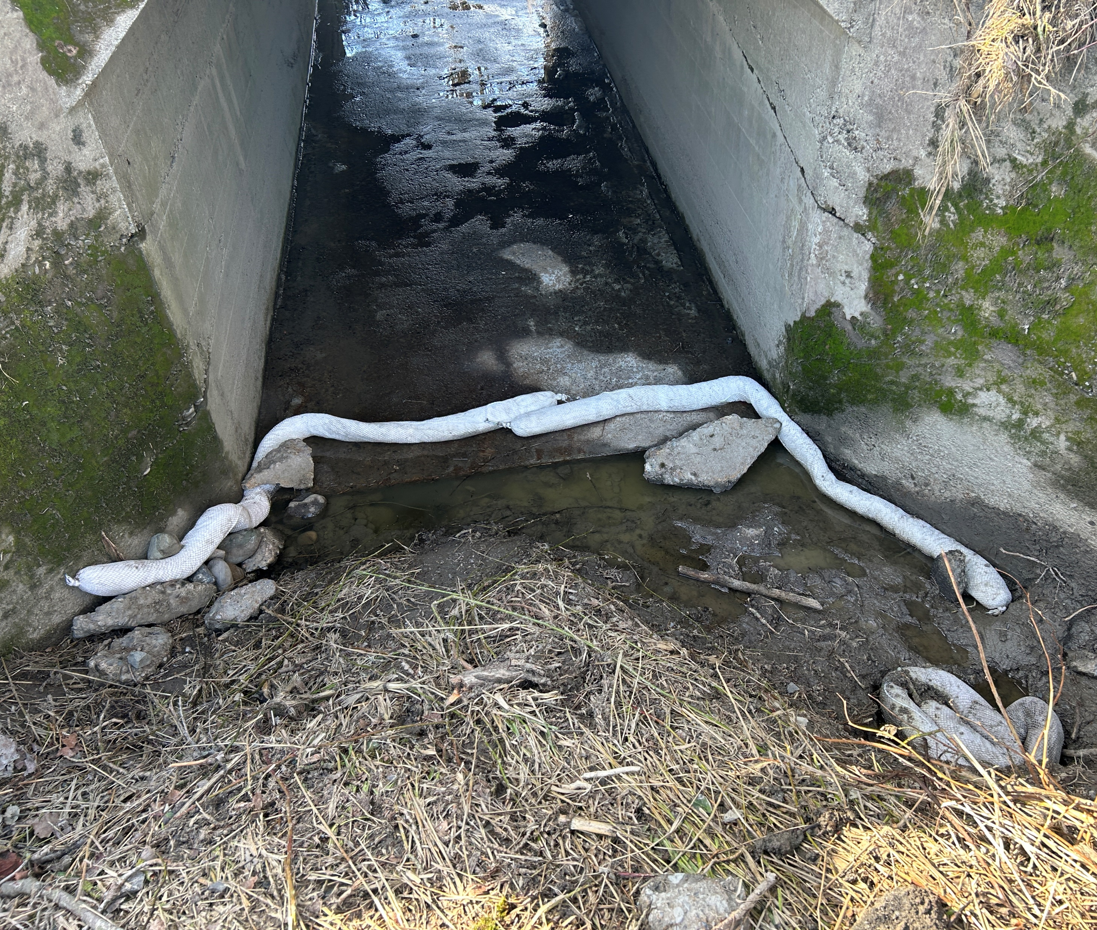
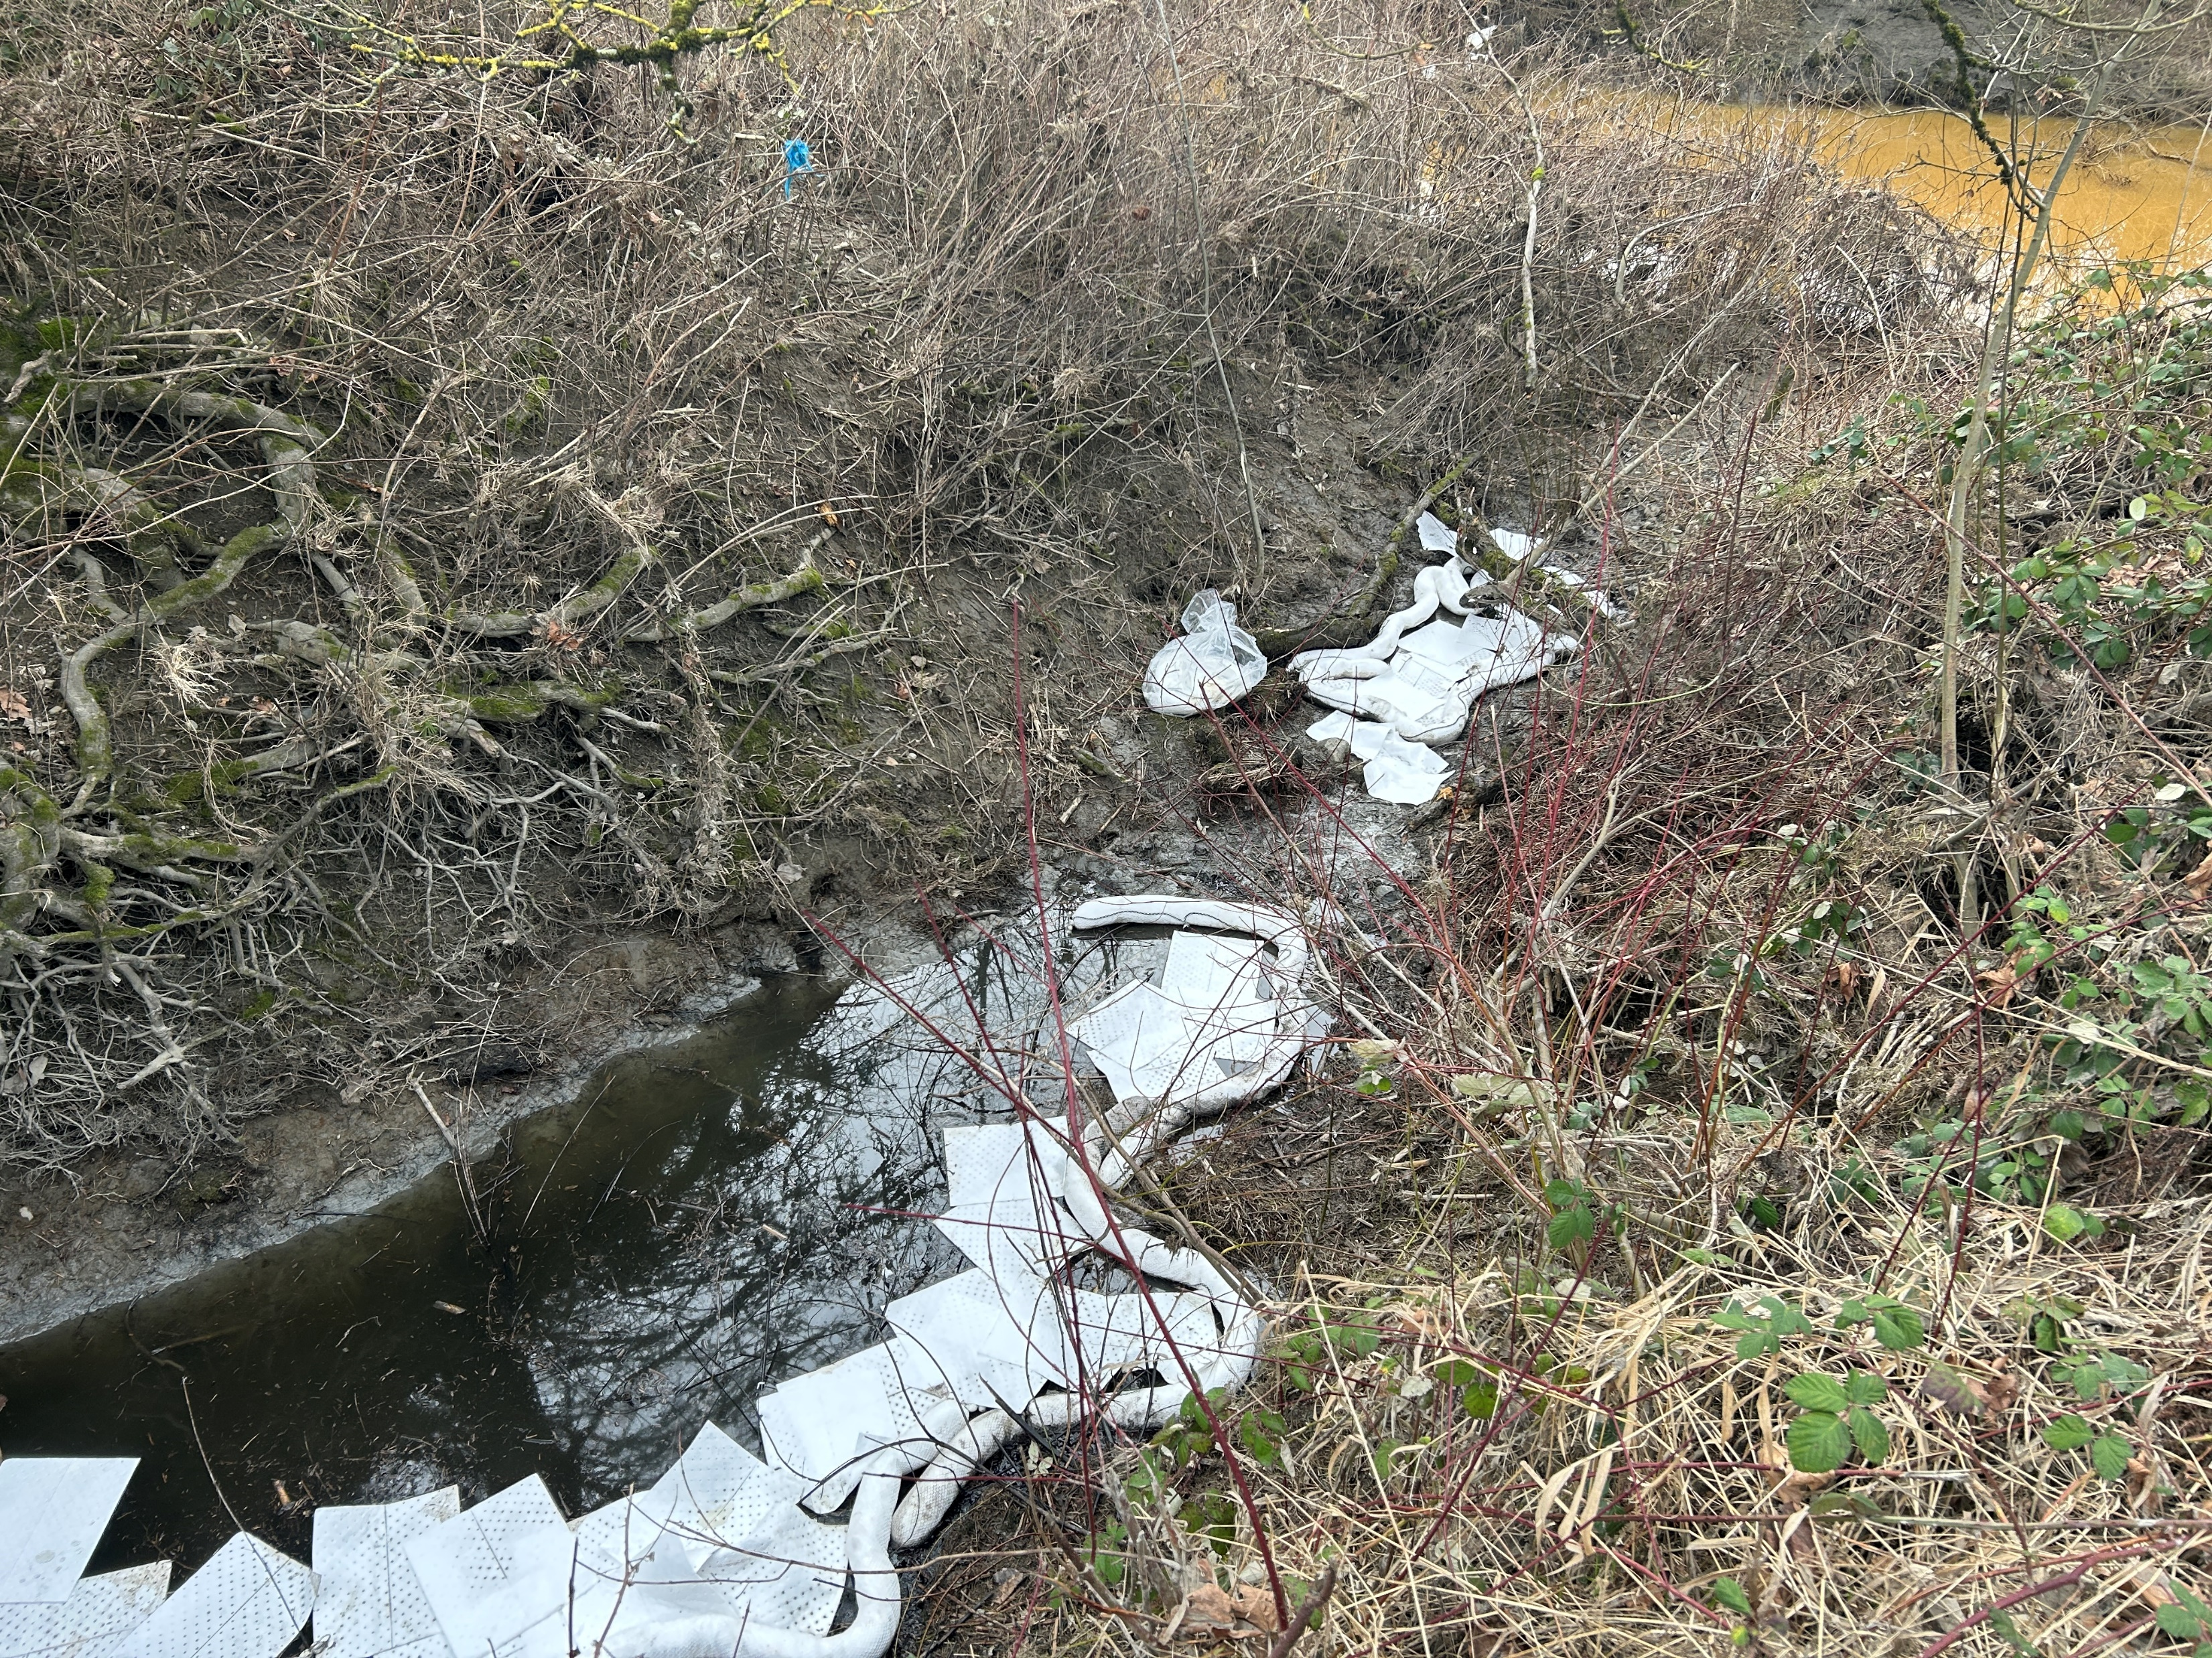
ERTS #720788 Mejia Rental Truck
Notes:
Brown water of Portage Creek in upper right corner.

Slide 23
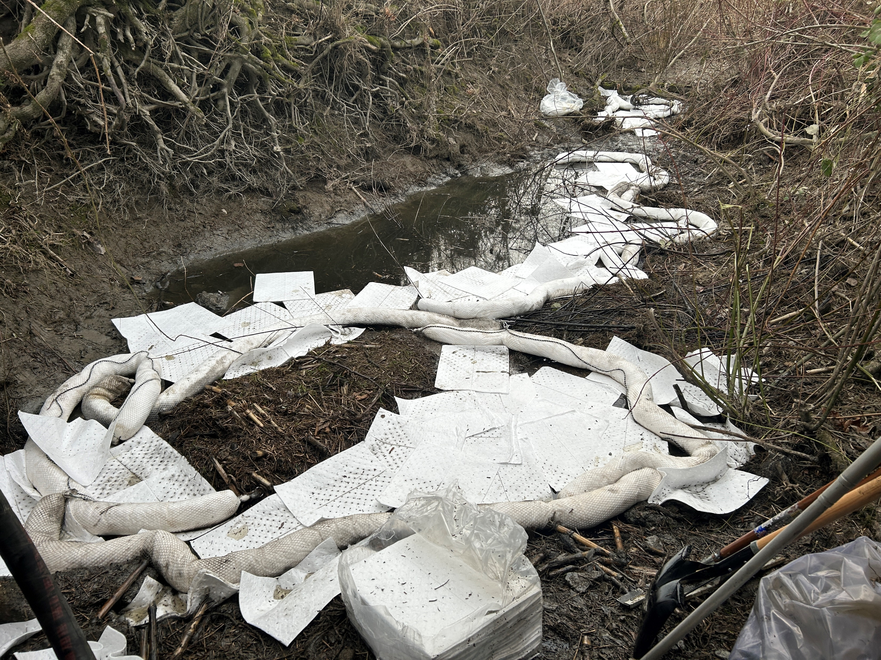
Preassessment Screening
ERTS #720788 Mejia Rental Truck
Estimated spill to water volume: between 25–50 gallons total
Oil Type: estimate of at least 20 gal diesel, 10 gal of motor oil,
5 gal of transmission fluid
Geographic Extent of Impacts: Portage Creek
Volume of oil recovered within the first 24-hours: 5 gallons

Slide 24
Old Business
Open Case Updates
ERTS #721597: Seattle Boat Company Boat Storage Facility Fire
ERTS #721564: Core-Mark Diesel Spill Spokane
Notes:
ERTS # 721597: Seattle Boat Company Boat Storage Facility Fire
o Estimated 3,000 gallons fuel potential between 60 vessels lost to fire.
o No sheen observed, unknown if fuel burned off or covered by firefighting foam.
ERTS # 721564: Core-Mark Diesel Spill Spokane
Semi-truck accident resulting in an estimated 200 gallons of diesel oil spilled to roadway and into a storm drain system to a retention pond that empties into Latah Creek.
No sheen observed in Latah Creek.

Slide 25
Announcements
Coastal Protection Fund Grant now open for applications!
Application deadline: May 4, 2023
Ecology in initial stages of automating damages calculation
Next meeting Wednesday, May 10, 2023 in Room R0A-32 (Zoom)

Slide 26
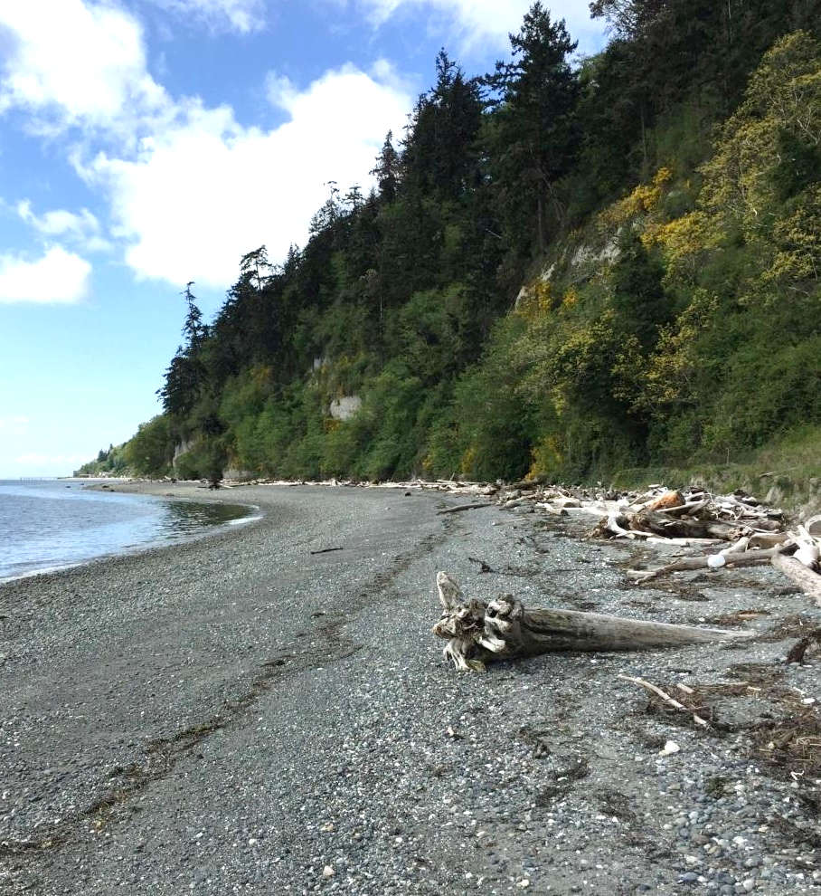
Meeting Adjourned
Geoff Baran Washington State Department of Ecology
360-790-9725
Geoff.Baran@ecy.wa.gov

Slide 27
Lake Chelan GRP Update
Washington State Department of Ecology
Kaitlin Lebon and David Prater

Slide 28
Comparison Slide headline
Column 1
Column 2
Bullet items
Bullet items
Bullet items
Bullet items
Bullet items
Bullet items
Bullet items
Bullet items

Slide 29
Chart slide title 2
Optional summary or explanation of chart

Slide 30
Ecology’s strategic priorities
Support and engage our communities, customers, and employees
Reduce and prepare for climate impacts
Prevent and reduce toxic threats and pollution
Protect and manage our state's waters
Protect and restore Puget Sound

Slide 31
Presentation Title Option 2
Name
Date

Slide 32
Timeline slide title
Optional summary or explanation of timeline information
Year
Year
Year
Year
Event description or information
Event description or information
Event description or information
Event description or information

Slide 33
Table slide title
Optional summary or explanation of table information
Heading | Heading | Heading | Heading | Heading
Content | Content | Content | Content | Content
Content | Content | Content | Content | Content
Content | Content | Content | Content | Content
Content | Content | Content | Content | Content
Content | Content | Content | Content | Content
Content | Content | Content | Content | Content

Slide 34
Chart slide title
Optional summary or explanation of bar chart

Slide 35
Chart slide title 2
Optional summary or explanation of chart

Slide 36
Venn diagram title
Optional text explanation
Category 1
Category 2
Item 1
Item 1
Item 1
Item 2
Item 2
Item 2
Item 3
Item 3
Item 3
Item 4
Item 4

