Slide 1
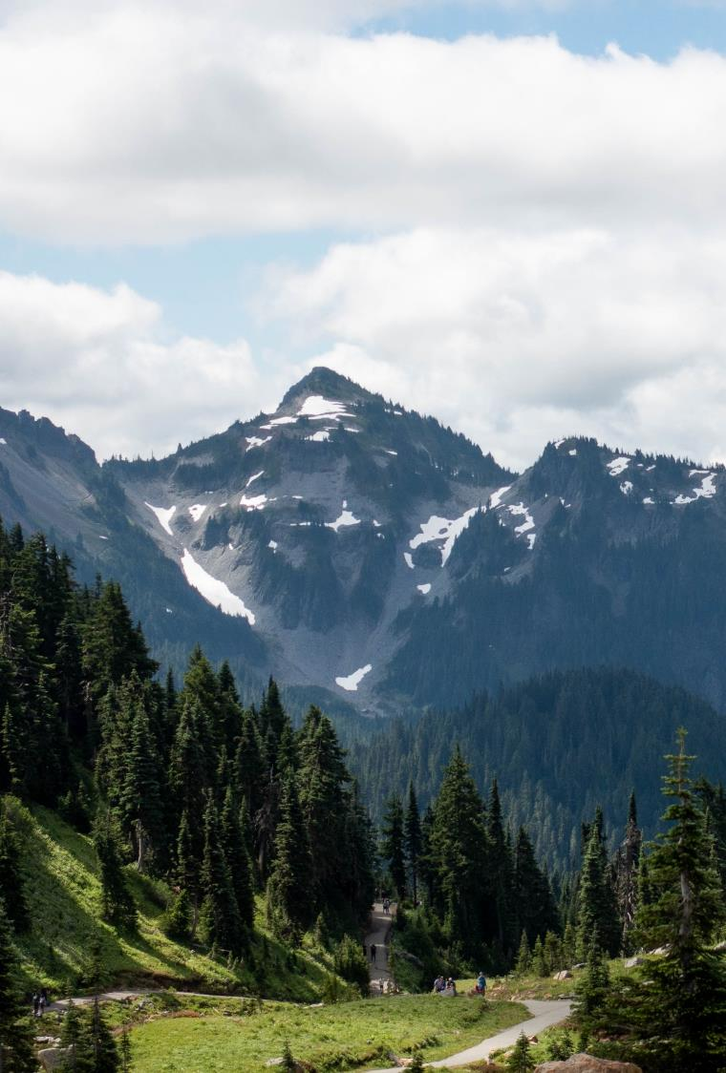
The meeting will begin shortly
Resource Damage Assessment Committee Meeting
Please keep your microphone muted unless speaking
Webcam is optional
Notes:
*Friendly idle chit-chat*

Slide 2
Resource Damage Assessment Committee Meeting
Geoff Baran
May 10, 2023
Notes:
Welcome to the RDA Committee Meeting. Today’s date is May 10, 2023.

Slide 3
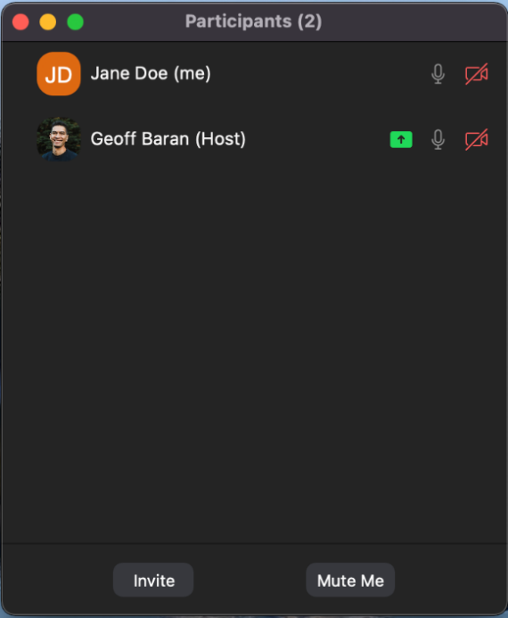
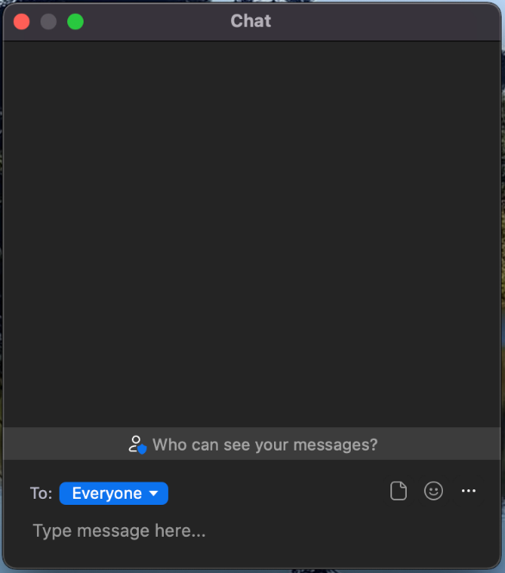
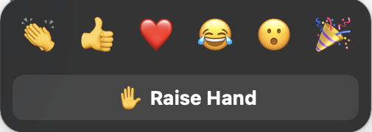
Welcome to Zoom
Please mute your microphone to reduce background noise
Callers:
Dial *6 to mute and unmute
Dial *9 to Raise Hand
Online attendees please use the mute button
Notes:
Provide basic Zoom instructions.

Slide 4
Table of Contents
1
Welcome, Roll Call, Agenda Review
2
Introduction
3
New Business
4
Old Business
6
Announcements
Notes:
Brief Agenda Review
Roll Call
Agenda Review
Intro: Review the purpose of our meeting today and the rules of this committee

Slide 5
Resource Damage Assessment Committee
Notes:
INTRODUCTION
Purpose:
This committee is responsible for conducting preassessment screenings for natural resource damage assessments for oil spill that impact the waters of Washington State.
The committee is defined in statute, and comprised of representatives of the Washington State Department of Fish and Wildlife, The Department of Natural Resources, Department of Archeology and History Preservation, Department of Health, and the Washington State Parkas and Recreation Commission
We are NOT assigning liability at this meeting. The purpose of this meeting is to evaluate the natural resource injuries from the spill, review available data, and work cooperatively with potentially liable parties to assess the harm to the environment from oil spills.
Goal:
Work cooperatively with the potentially liable party to determine whether detailed damage assessment studies should be conducted, or whether the compensation schedule will be used to assess the damages.
The ultimate goal of this process is to restore publicly-owned resources that have been damaged by oil spills.
Objectives:
Conduct preassessment screenings of all oil spills that impact Washington State waters.
Evaluate each case and consider whether damages are quantifiable at a reasonable cost
Whether restoration or enhancement is technically feasible.
Evaluate any projects proposed in lieu of a damage claim.
The committee will vote yes or no on those questions, and if the answer is no, the Compensation Schedule is authorized to assess damages
Rules
Committee bylaws state the meeting will be carried out under parliamentary procedure. Motion, second, all in favor.
After hearing discussion from the attendees, each present RDA Committee Member will vote on two things:
Whether damages are quantifiable at a reasonable cost
And whether restoration or enhancement is technically feasible

Slide 6
New Business
Preassessment Screenings
ERTS #721010 Kenan Advantage Semi-Truck Collision and Spill
ERTS #721193 P/C Dan Cameron Diesel Spill

Slide 7
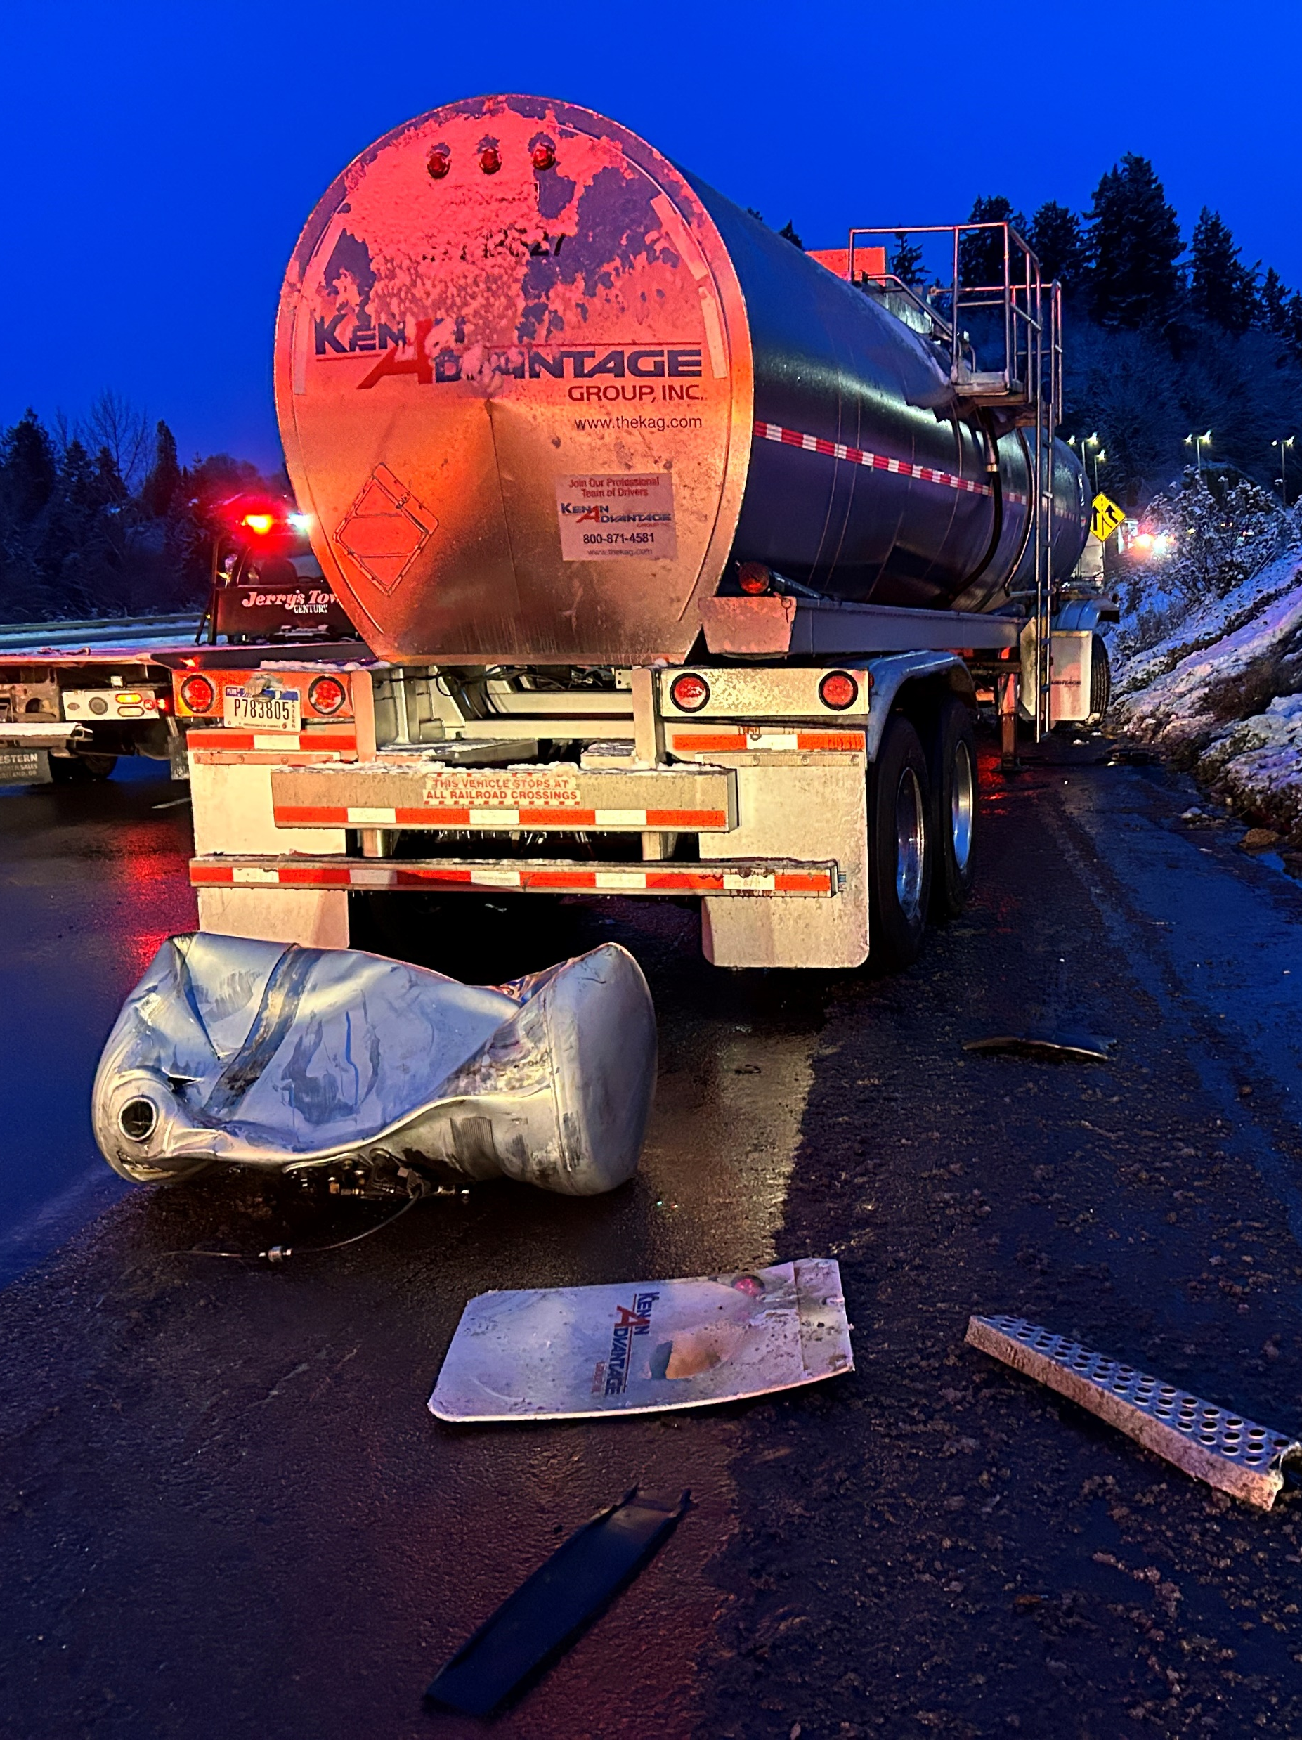
ERTS #721010 Kenan Advantage Group Semi-Truck Collision and Spill
February 23, 2023, semi-truck accident
and spill to lower Deschutes River

Slide 8
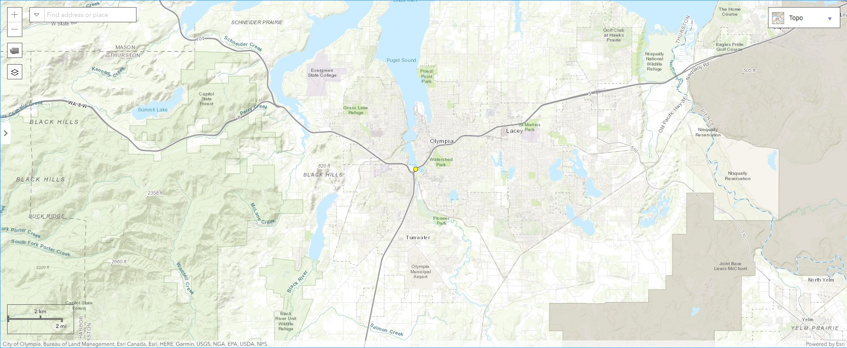
Spill Location

Slide 9
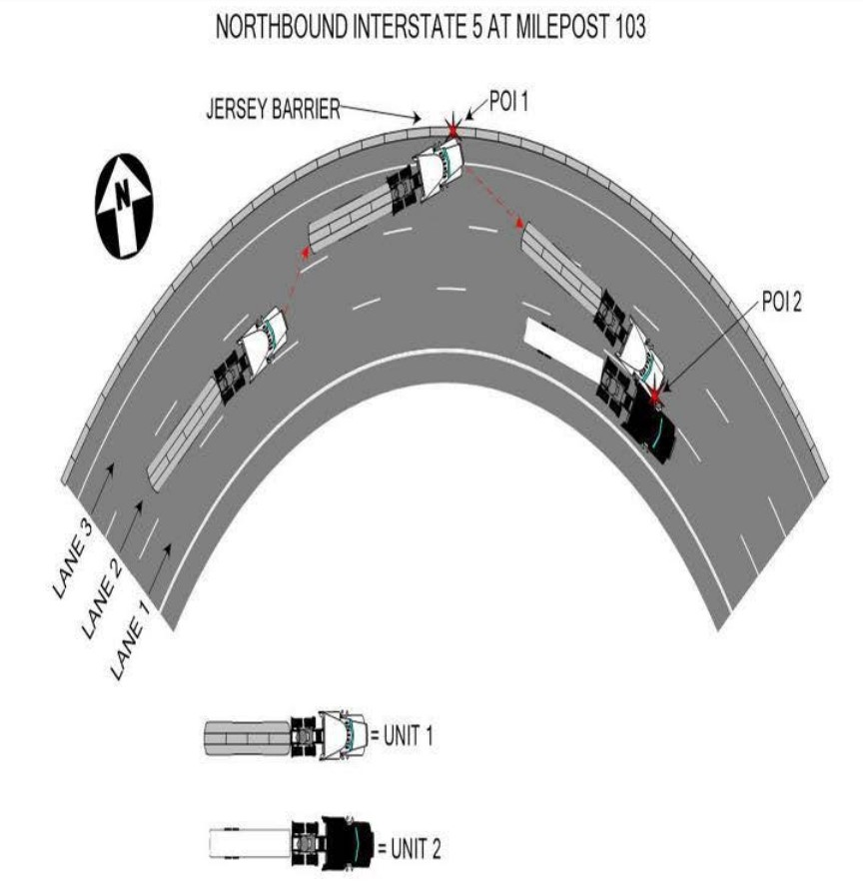
ERTS #721010 Kenan Advantage
Notes:
From WSP accident report.

Slide 10
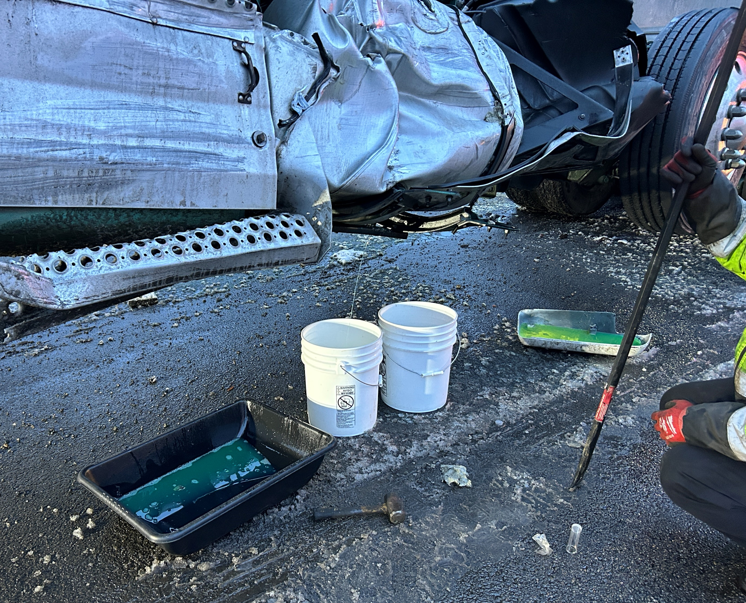
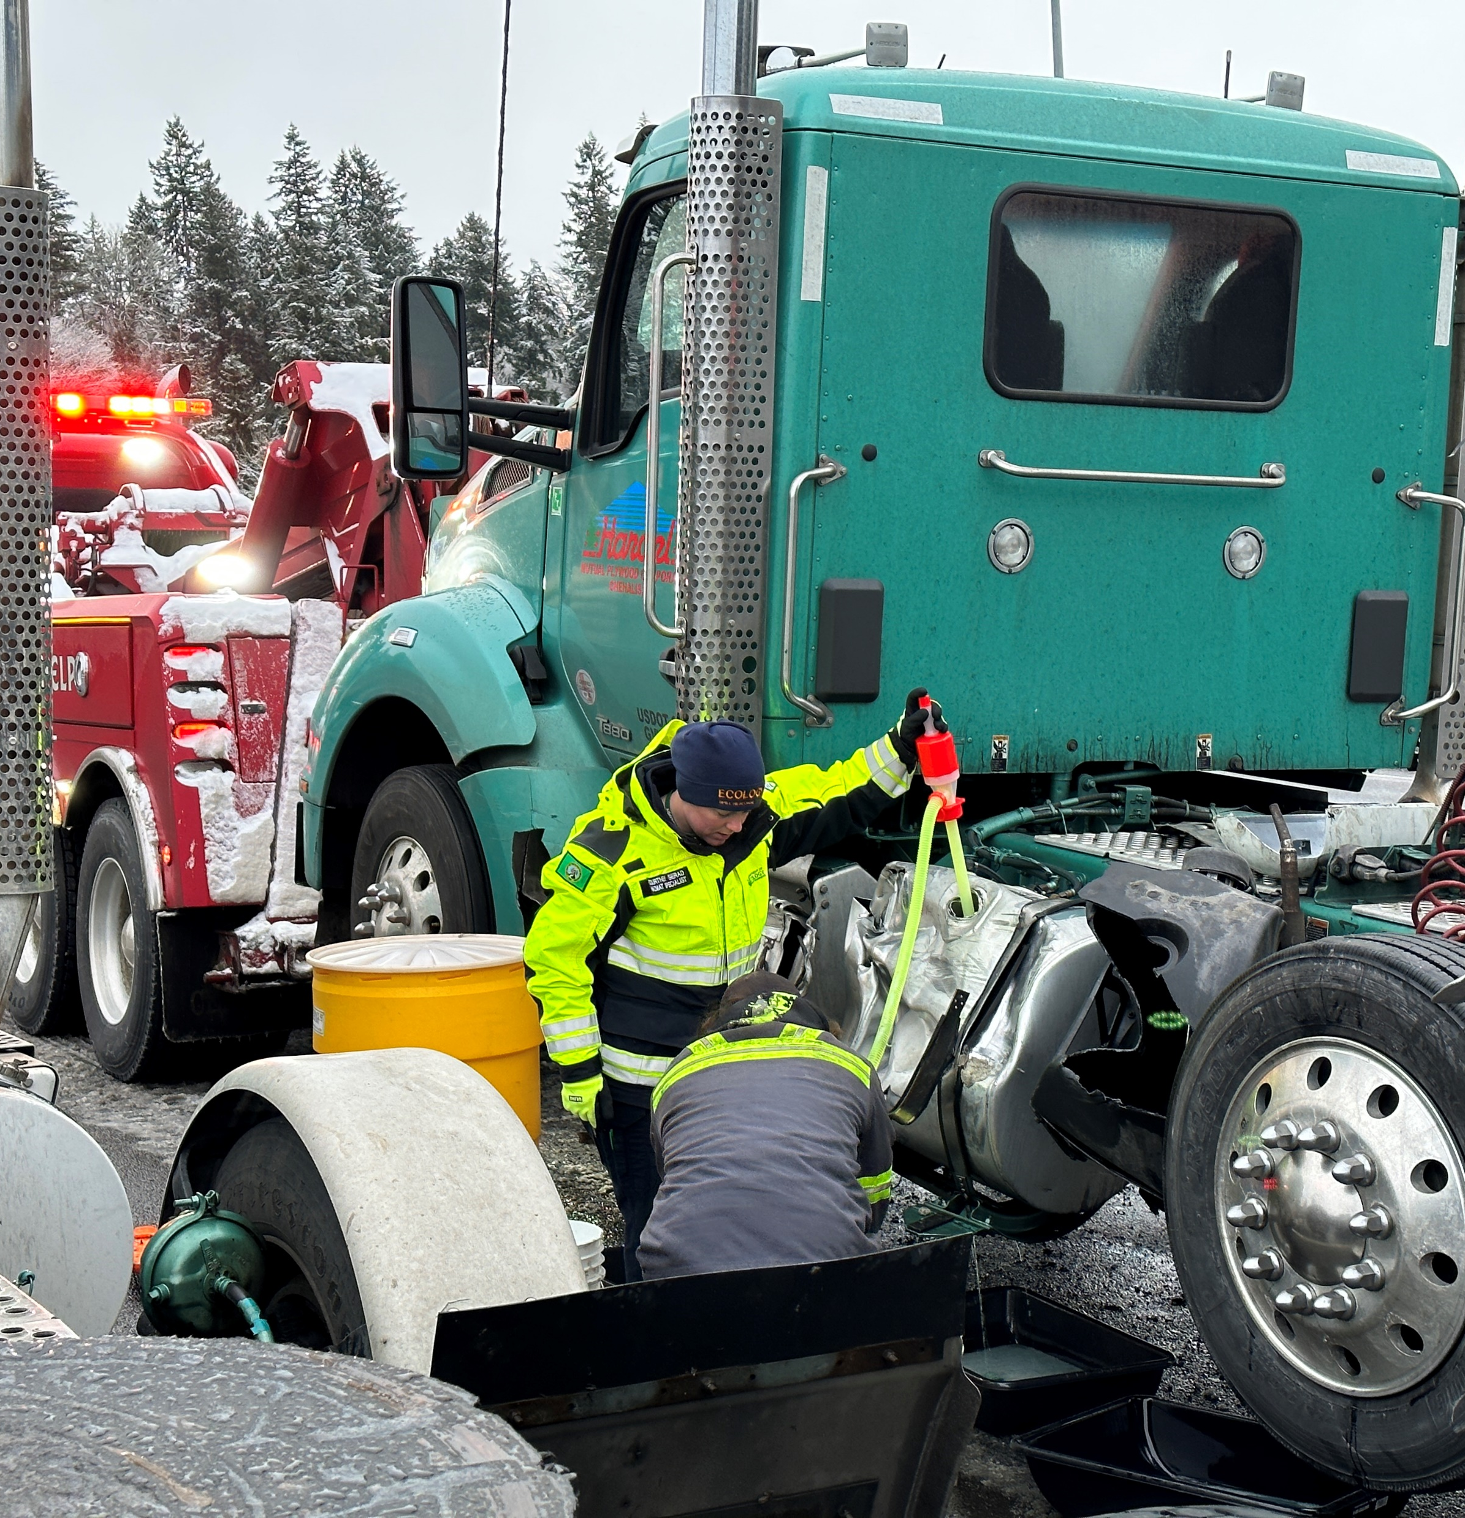
ERTS #721010 Kenan Advantage

Slide 11
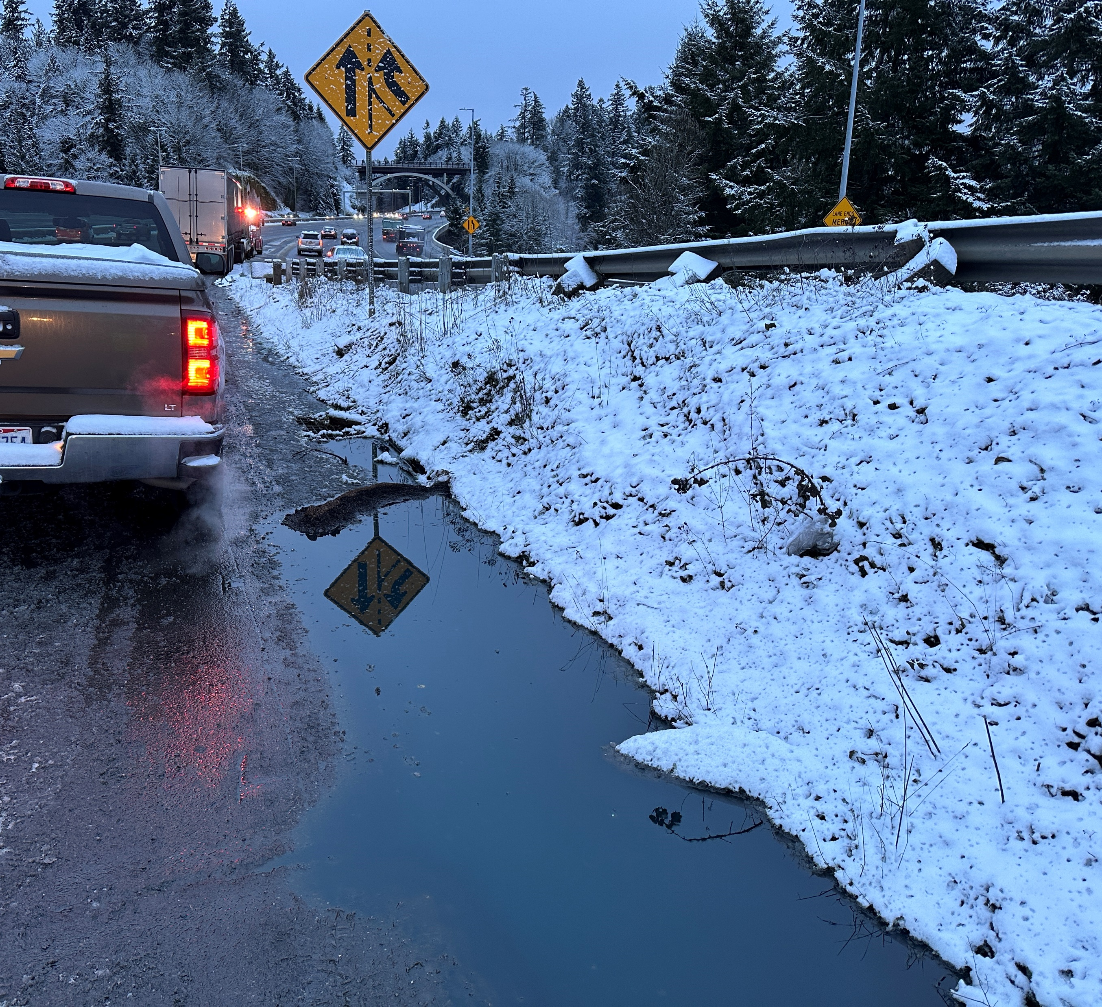
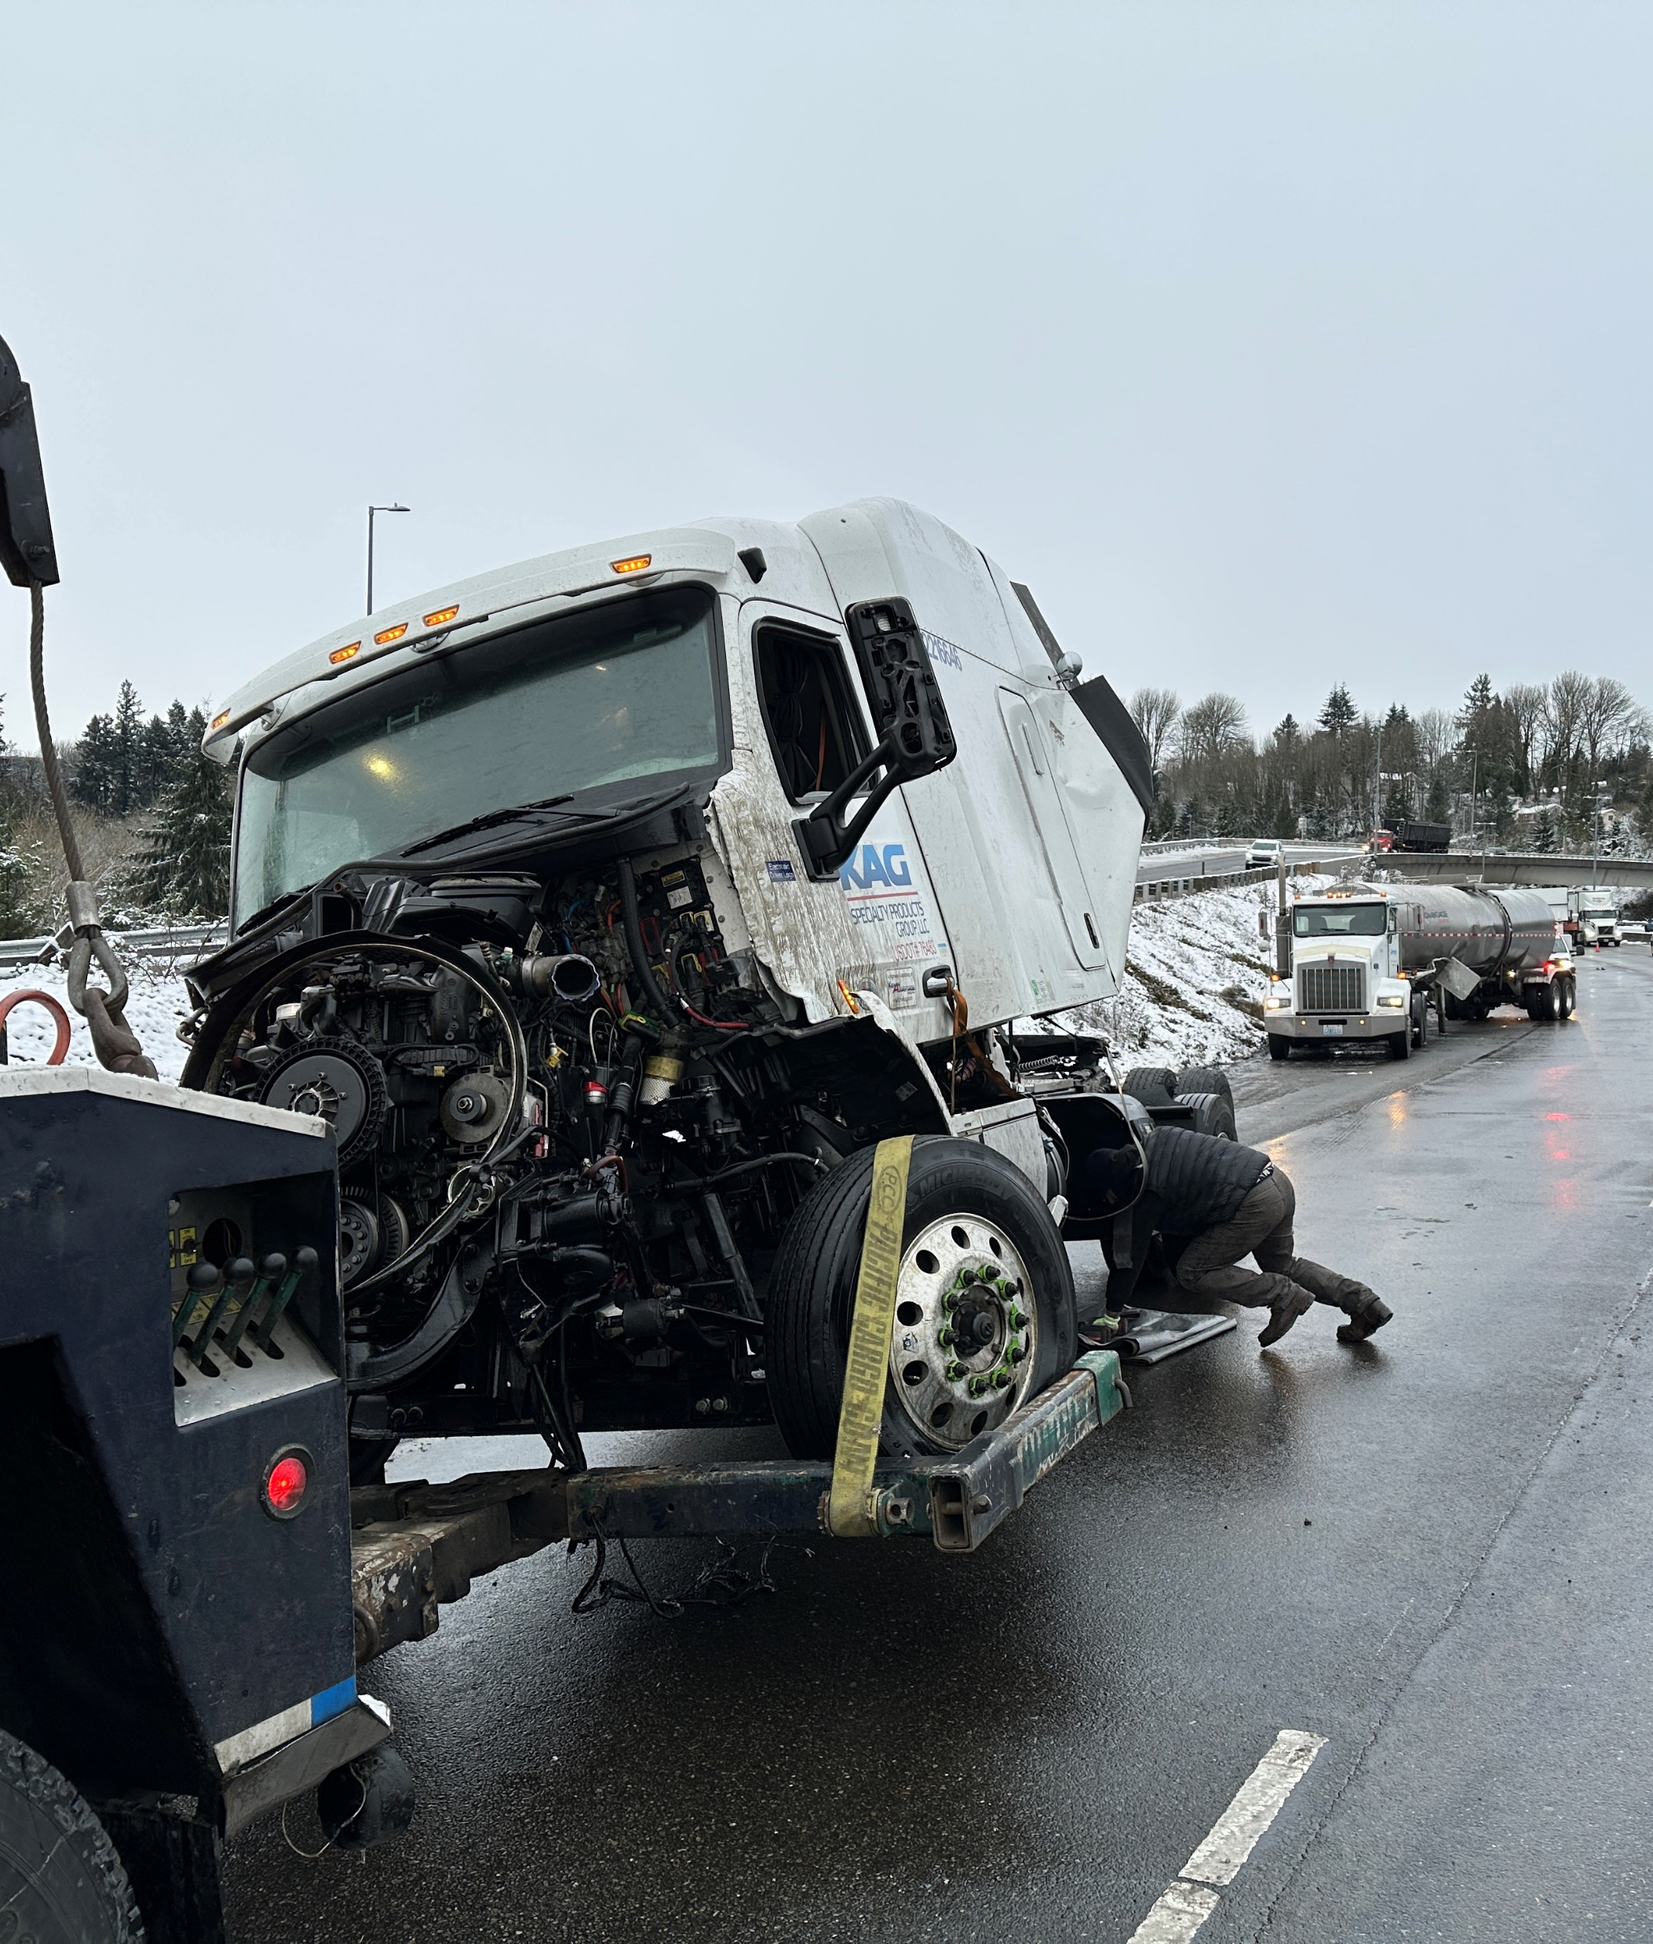
ERTS #721010 Kenan Advantage

Slide 12
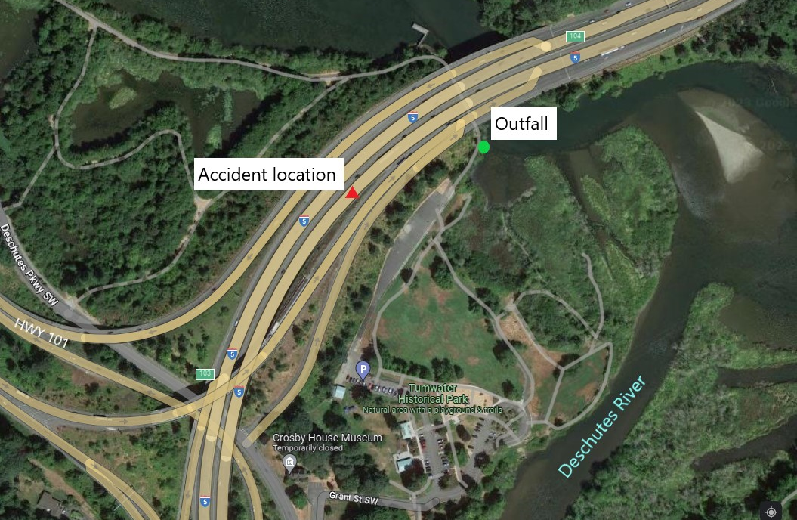
ERTS #721010 Kenan Advantage

Slide 13
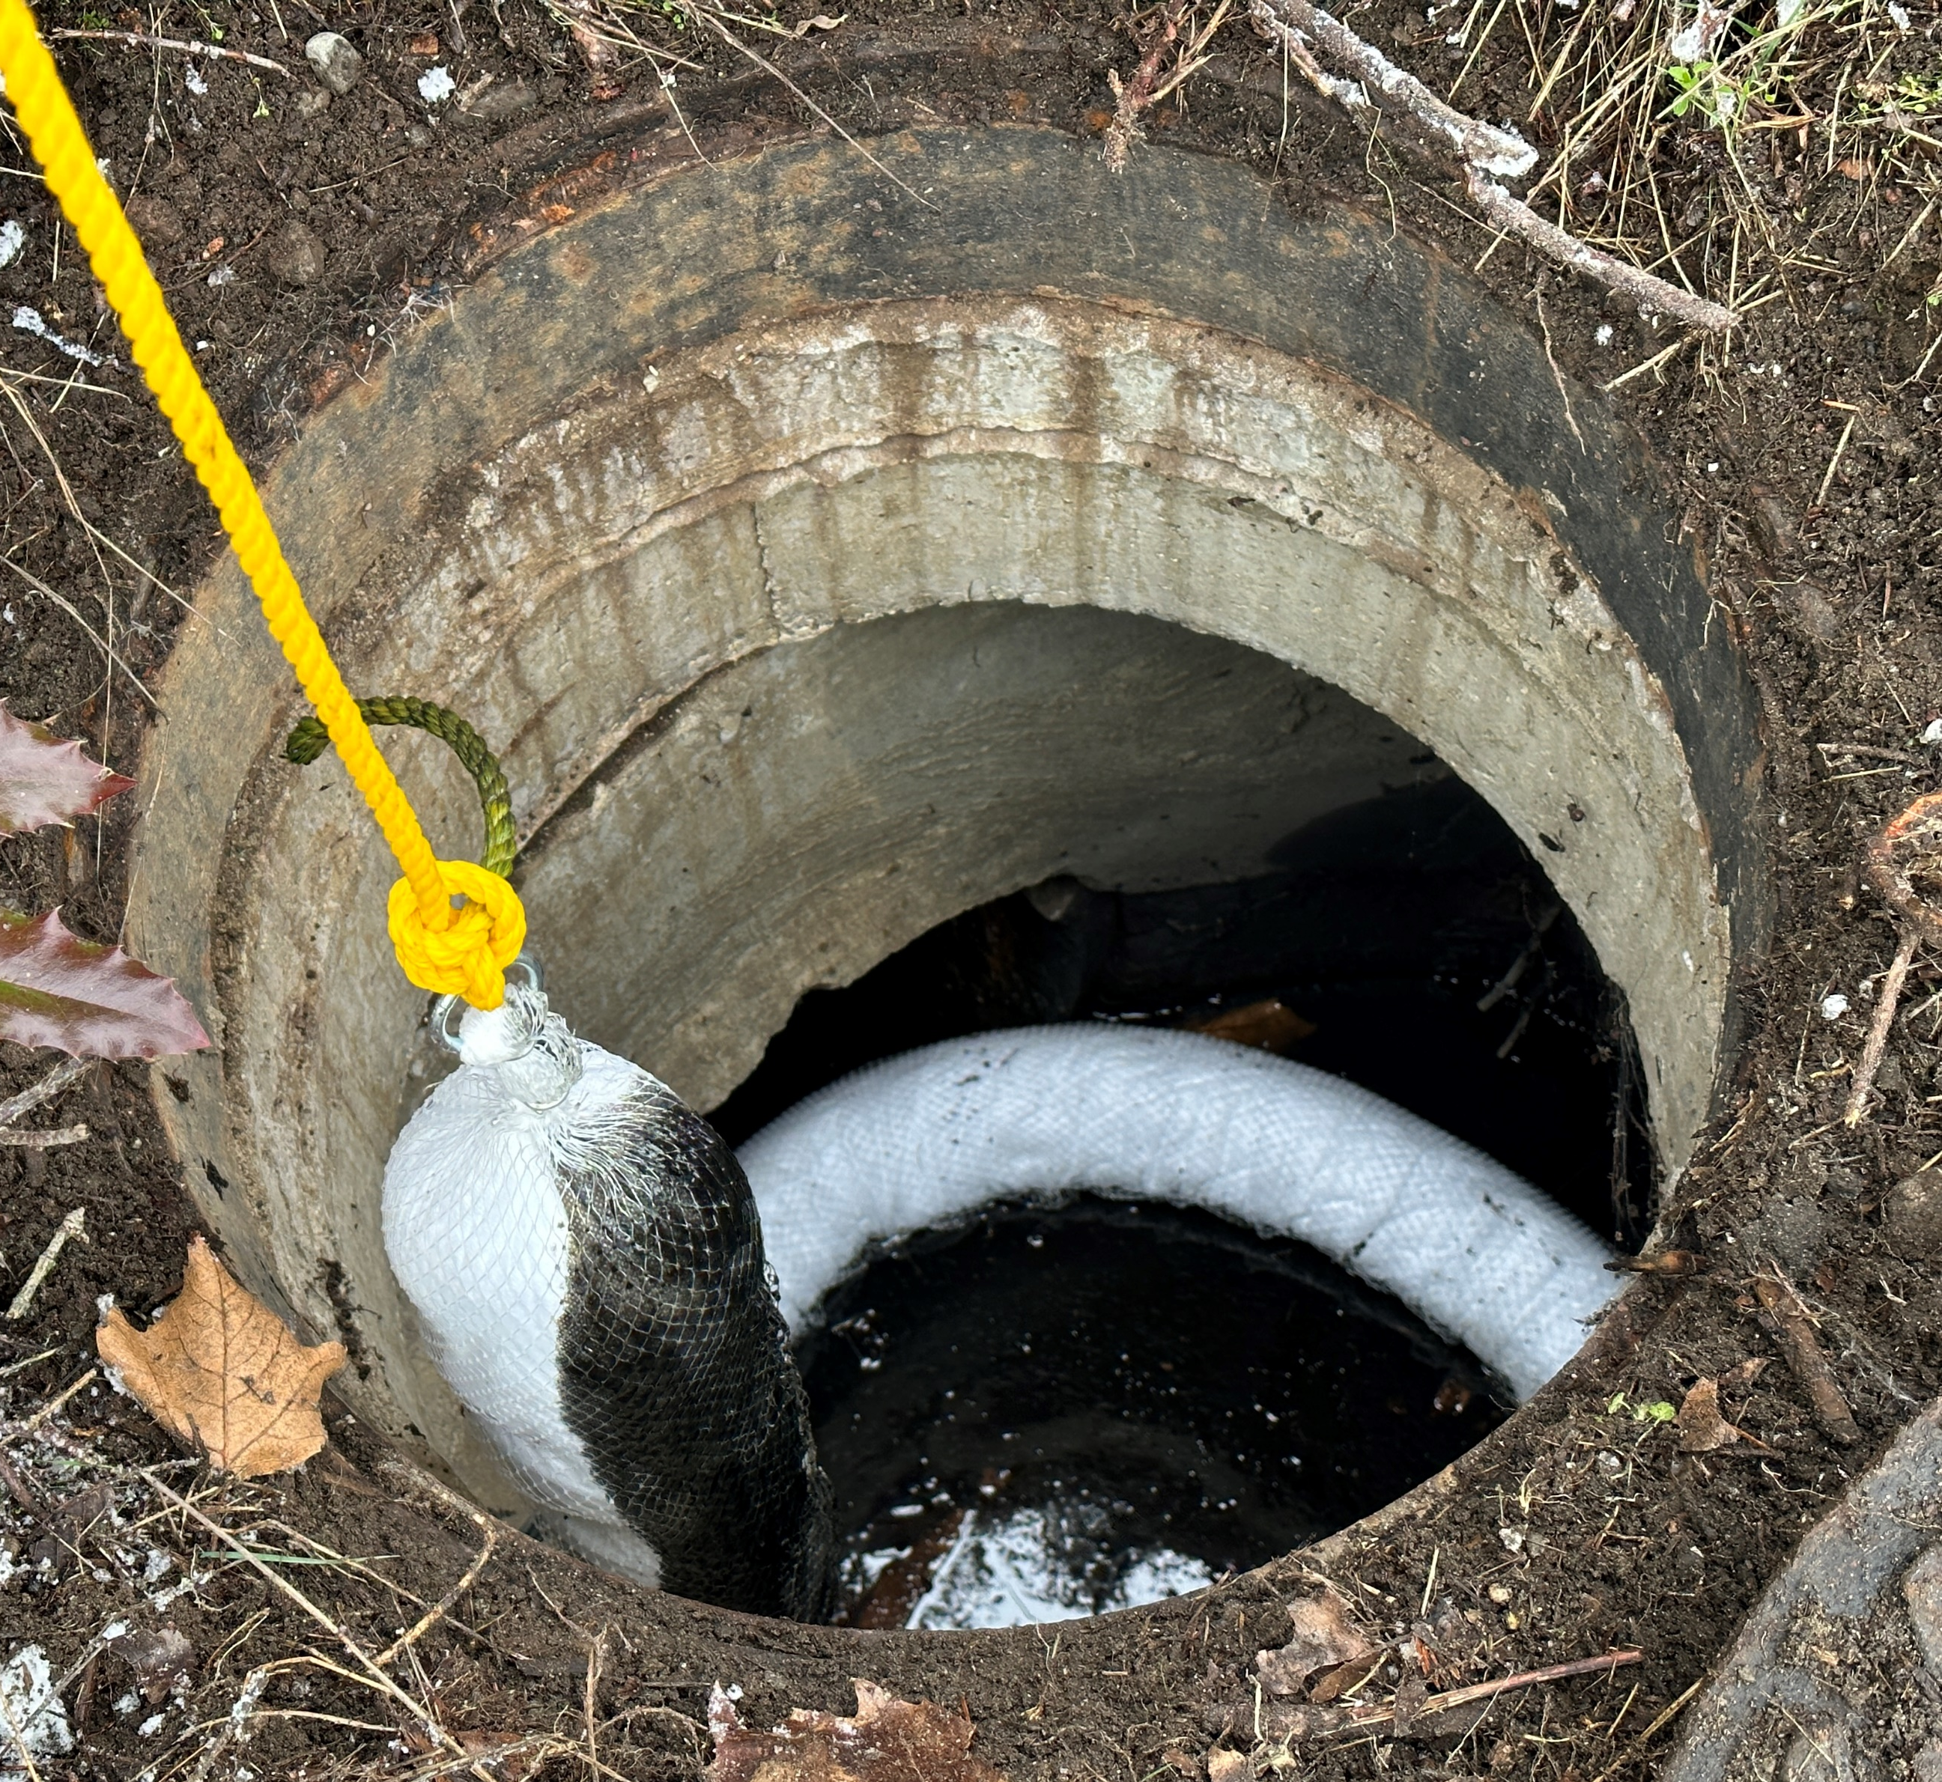
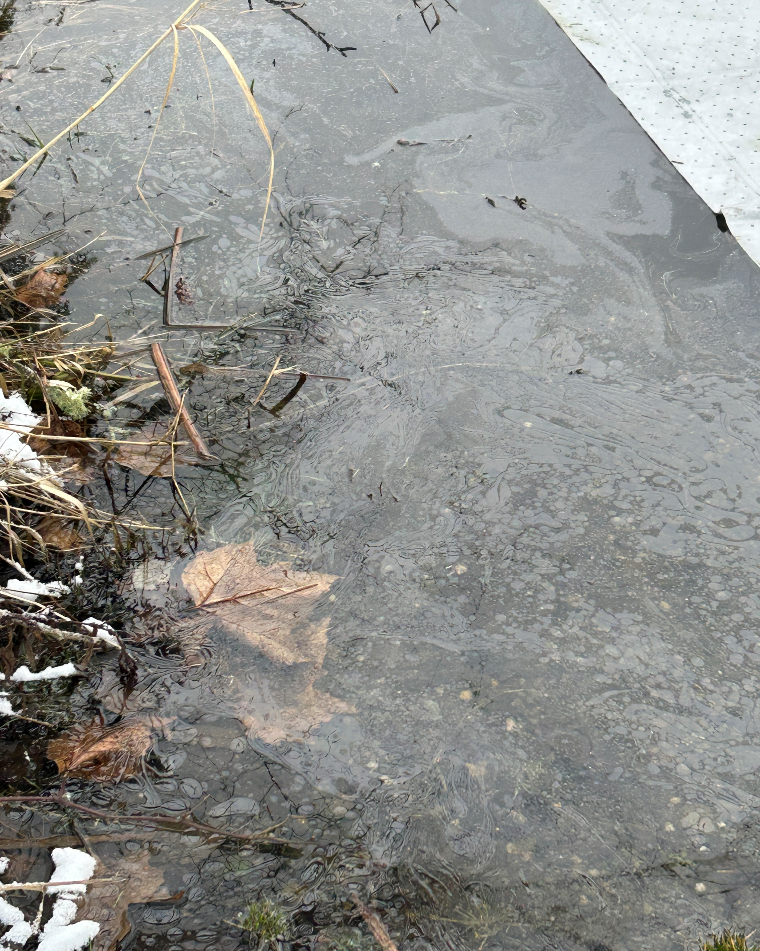
ERTS #721010 Kenan Advantage

Slide 14
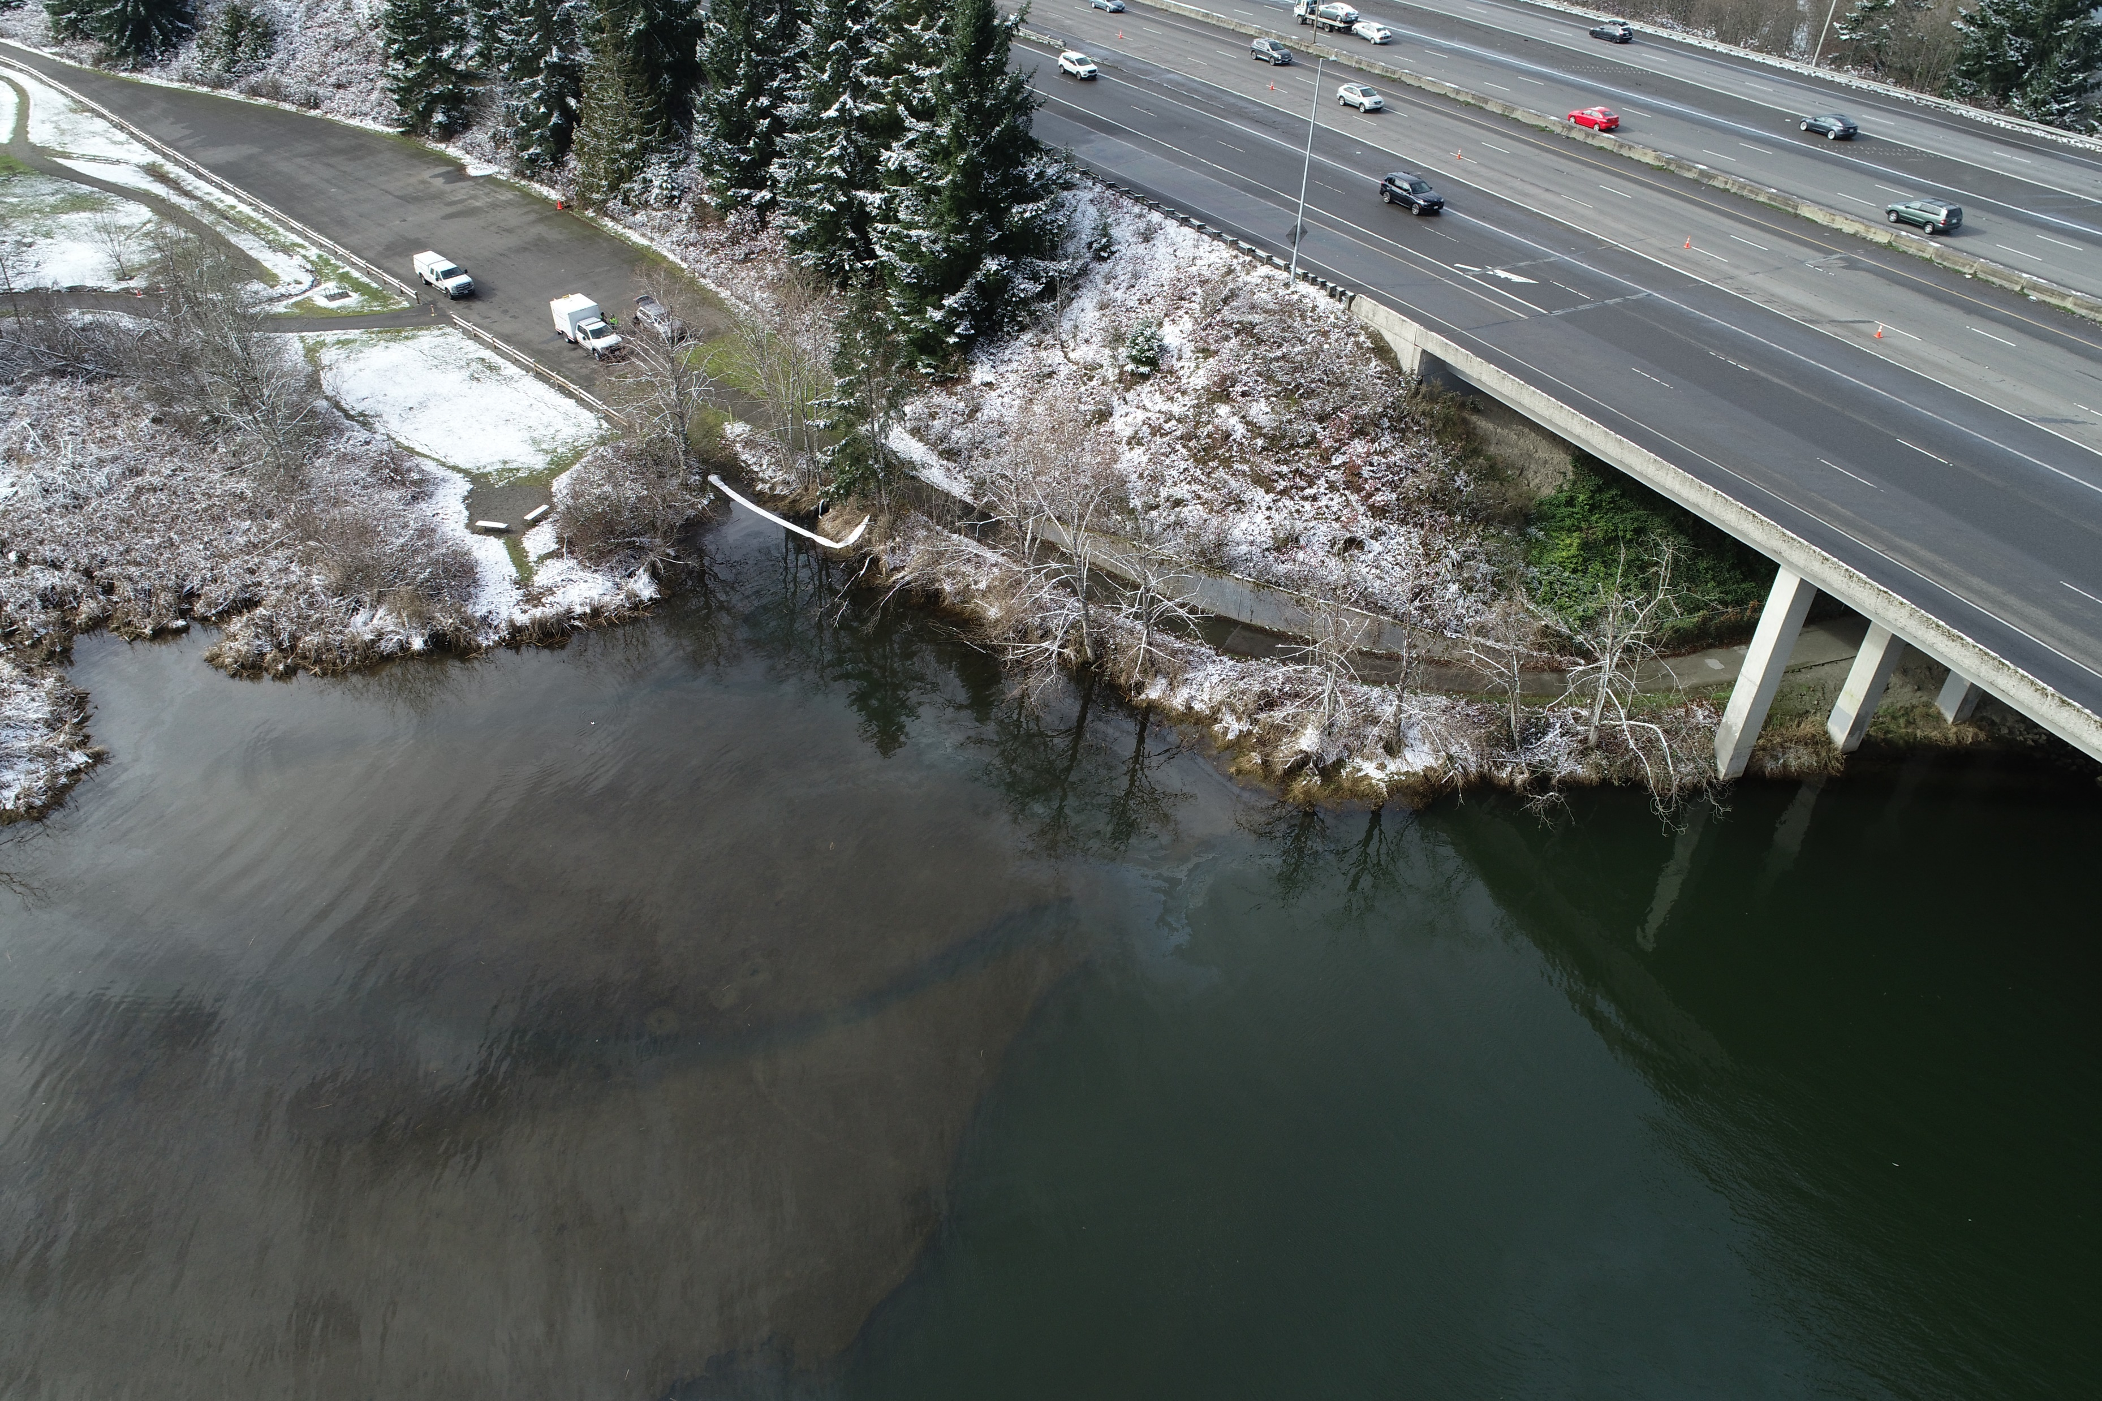
ERTS #721010 Kenan Advantage

Slide 15
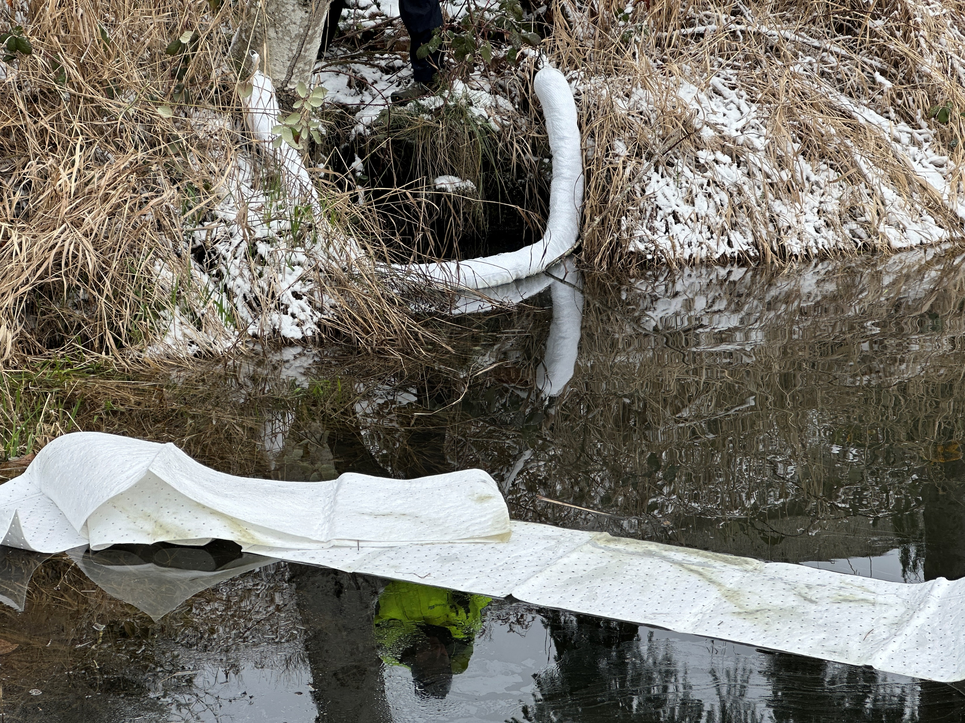
Preassessment Screening
ERTS #721010 Kenan Advantage Spill
Estimated spill to water volume: 75 gallons (mostly to drainage system)
Oil Type: Diesel Low Sulphur (ULSD)
Geographic Extent of Impacts: Lower Deschutes River
Volume of oil recovered within the first 24 hours: ~70 gallons

Slide 16
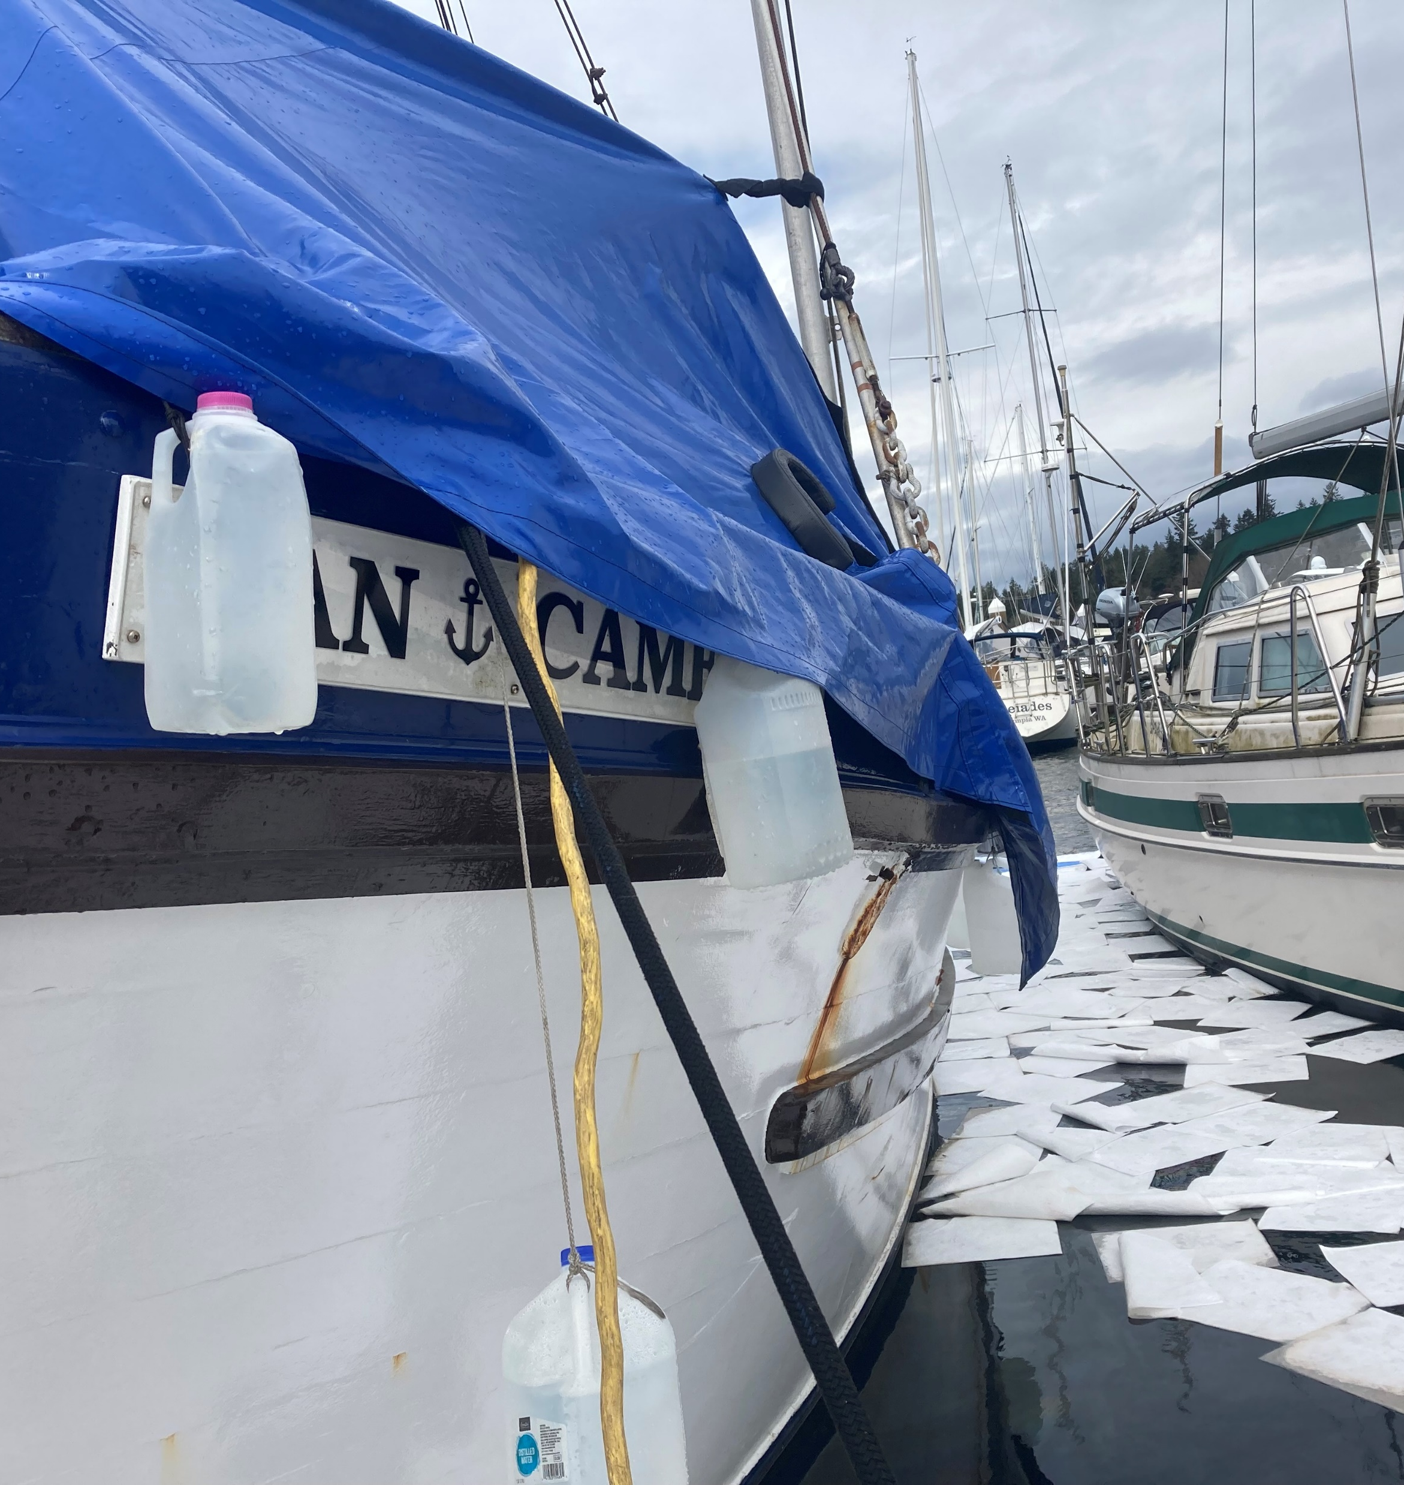
ERTS #721193 P/C Dan Cameron Diesel Spill
March 4, 2023, Spill to
Swantown Marina, Budd Inlet

Slide 17
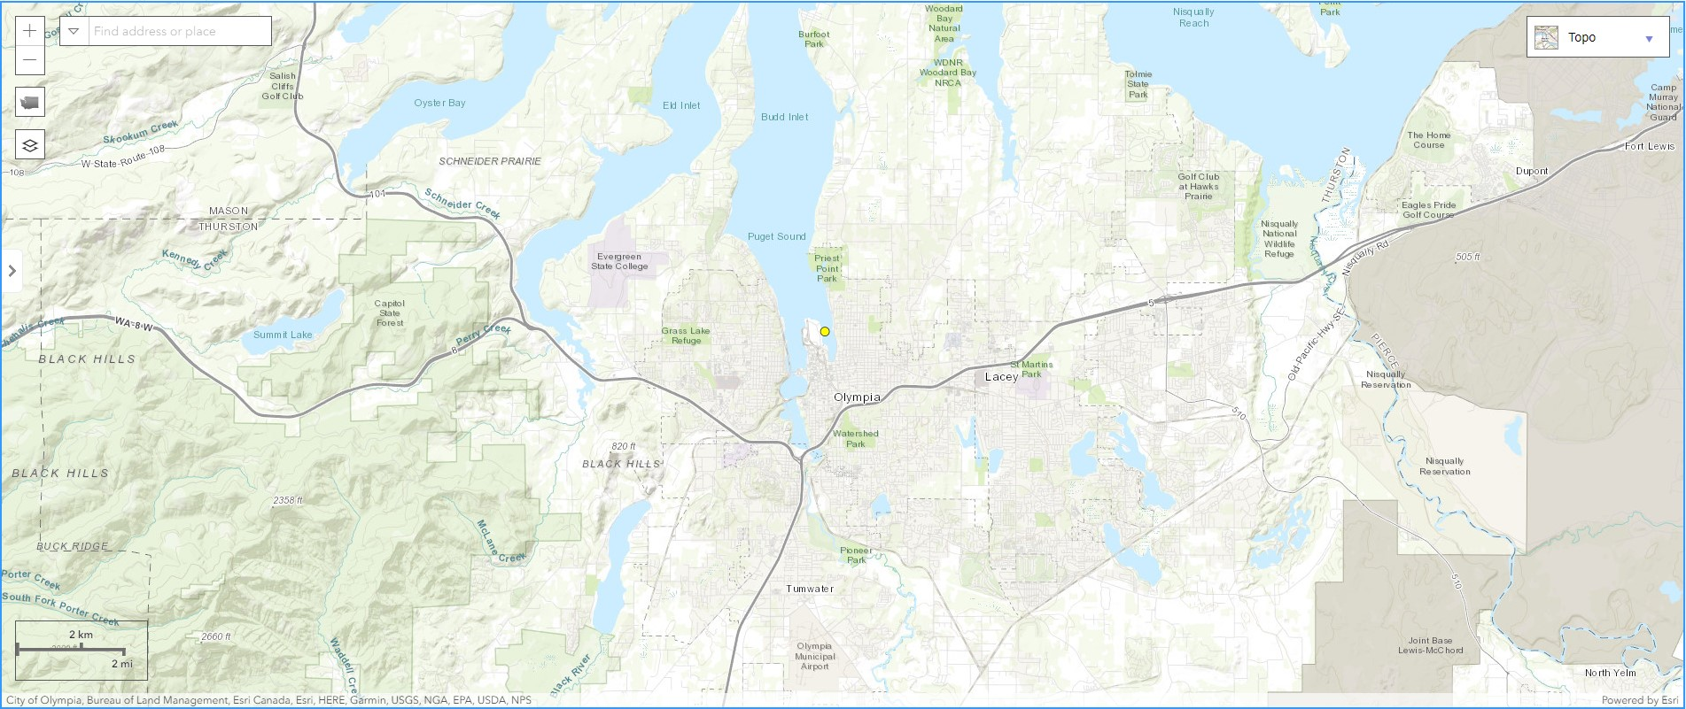
Spill Location

Slide 18
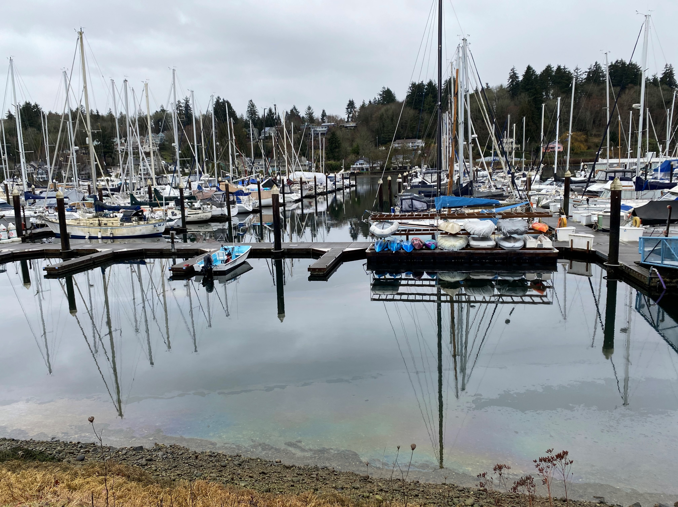
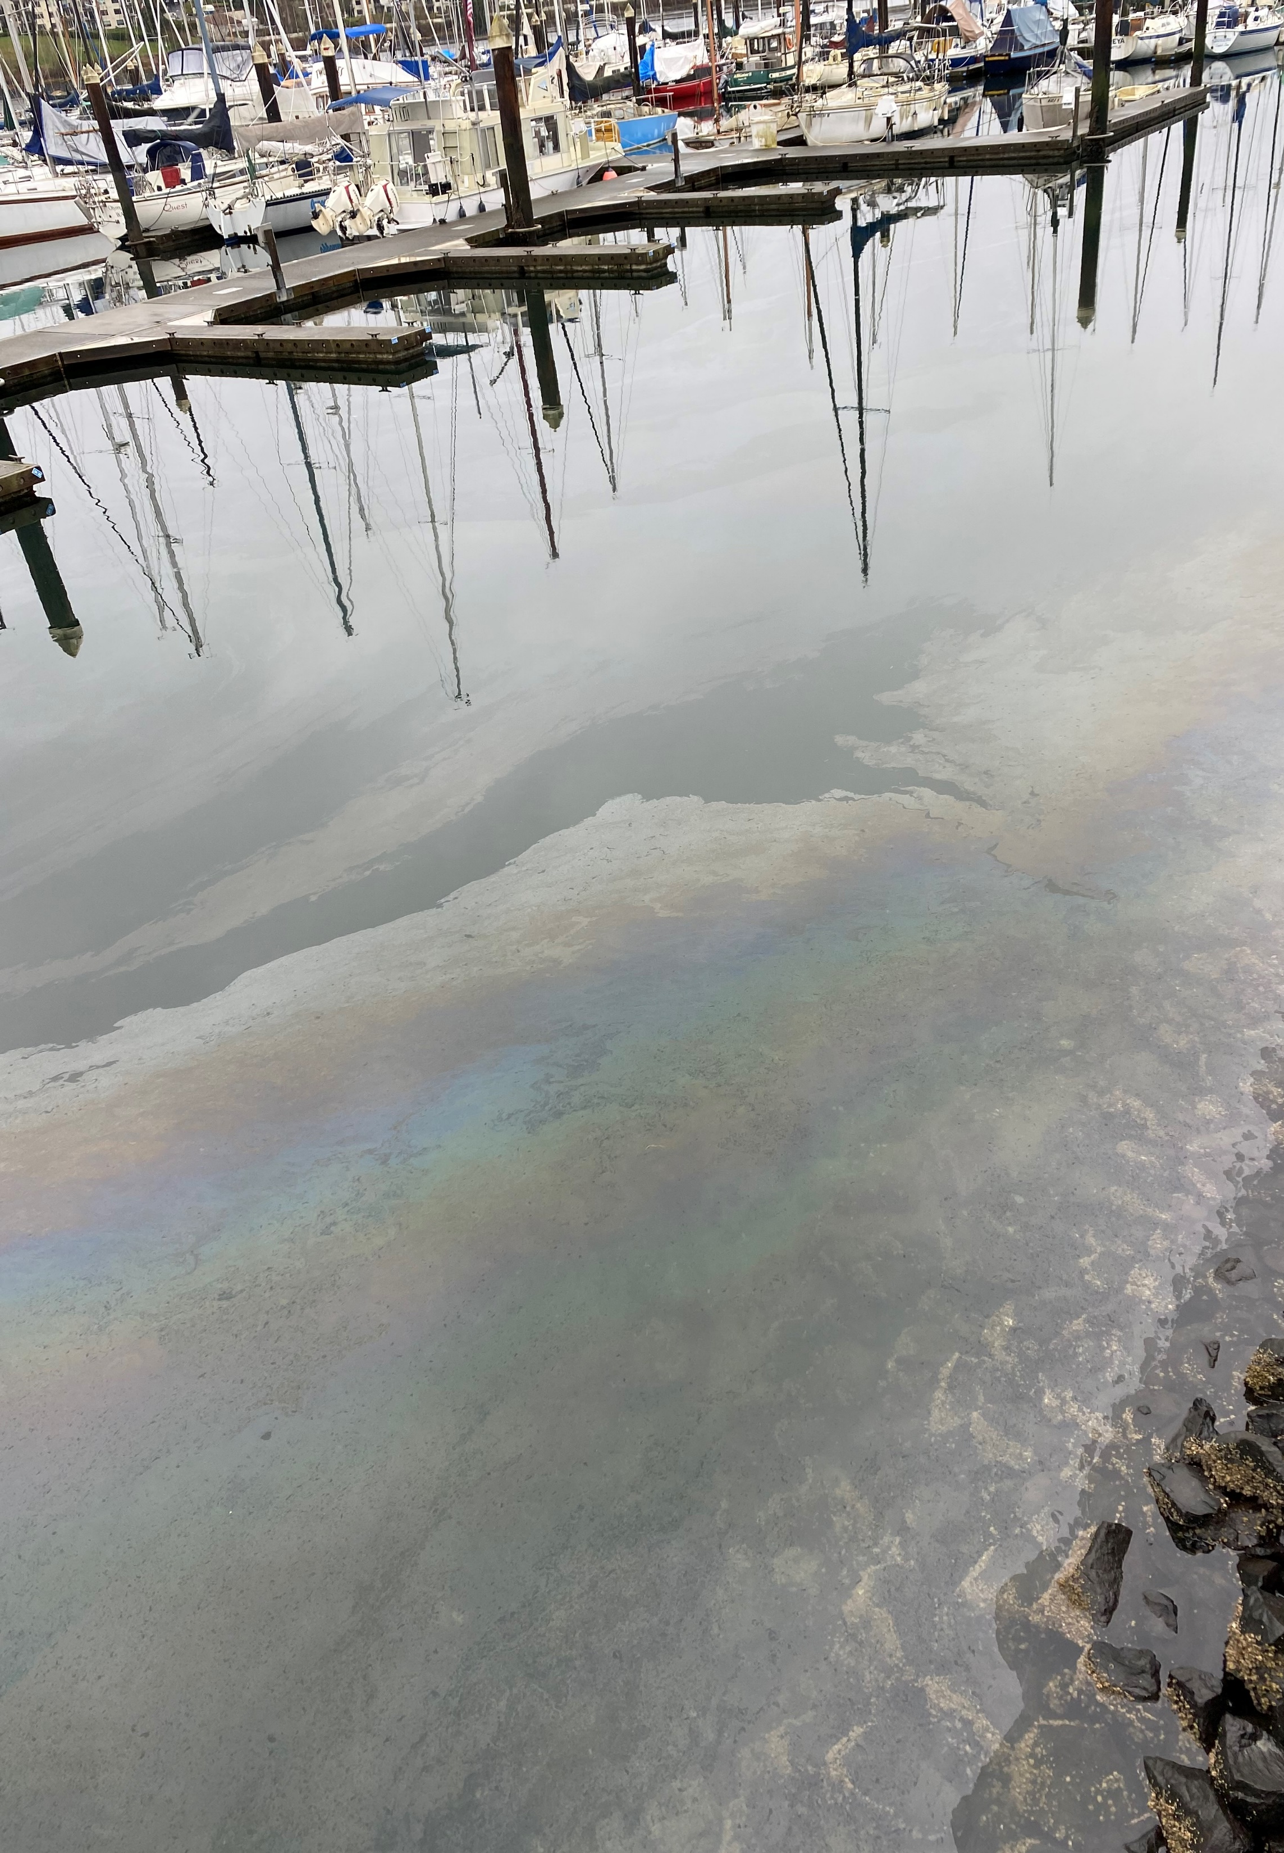
ERTS #721193 P/C Dan Cameron

Slide 19
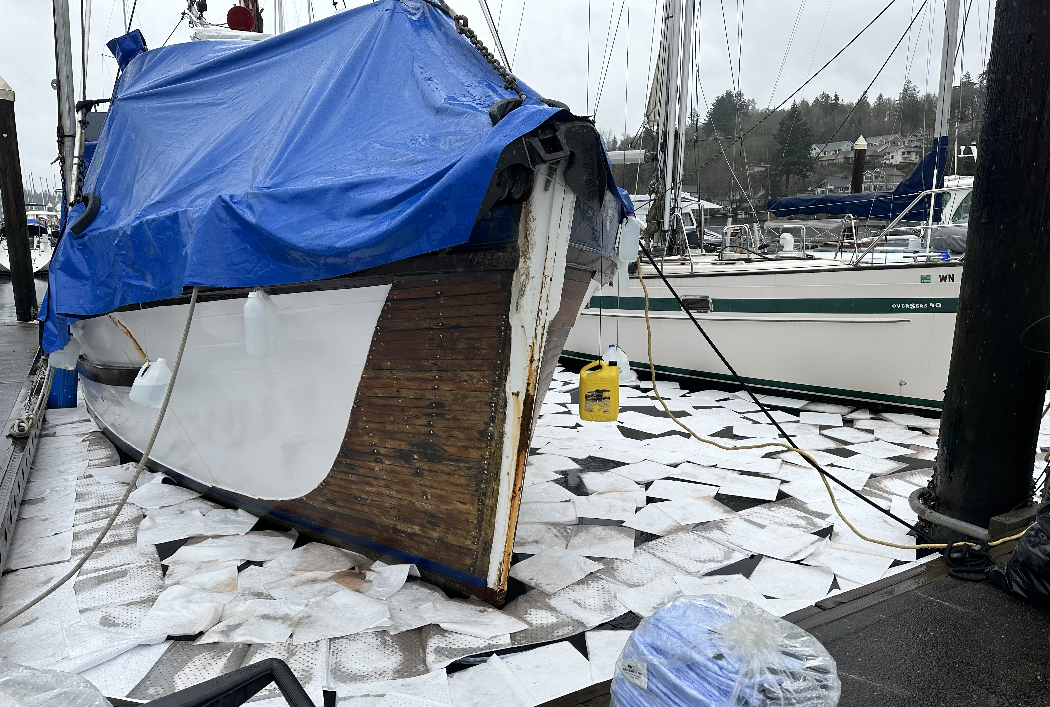
ERTS #721193 P/C Dan Cameron

Slide 20
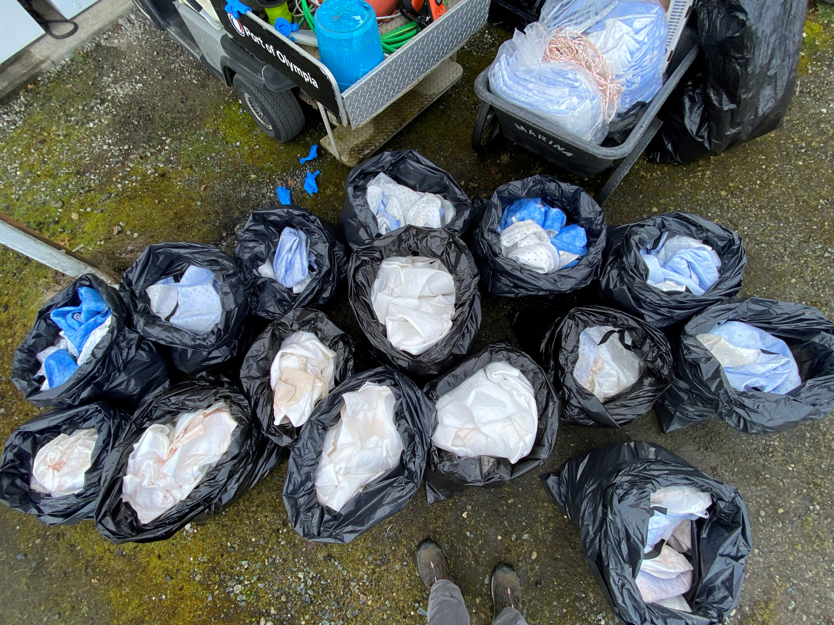
ERTS #721193 P/C Dan Cameron

Slide 21
Preassessment Screening
ERTS #721193 P/C Dan Cameron
Estimated spill to water volume: 30 gallons
Oil Type: Diesel Low Sulphur (ULSD)
Geographic Extent of Impacts: Puget Sound – Budd Inlet
Volume of oil recovered within the first 24-hours: 25 gallons*
Notes:
*Limited information on actual amount spilled to the marina. Amount spilled based on known amount recovered.

Slide 22
Old Business
Open Case Updates
ERTS #719397 Clover Island Marina Fire and Spill
ERTS #721564 P/C Crab N Jazz Vessel Fire and Gasoline Spill
ERTS #709331 F/V Laura Marie Sinking and Spill
Notes:
719397 Clover Island: Further investigation determined that an estimated 18-20 gal spilled, less than 25-gal NRDA threshold - dropping case.
721564 Crab N Jazz: Vessel owner recently deceased - dropping case.
709331 Laura Marie: Vessel owner deceased – dropping case.

Slide 23
Announcements
2023 Coastal Protection Fund Grant application period now closed
17 applications submitted
Evaluation team assembling
Ecology IT getting closer to creating automated damages calculation
Next meeting Wednesday, June 14, 2023 in Room R0A-32 (and Zoom)

Slide 24
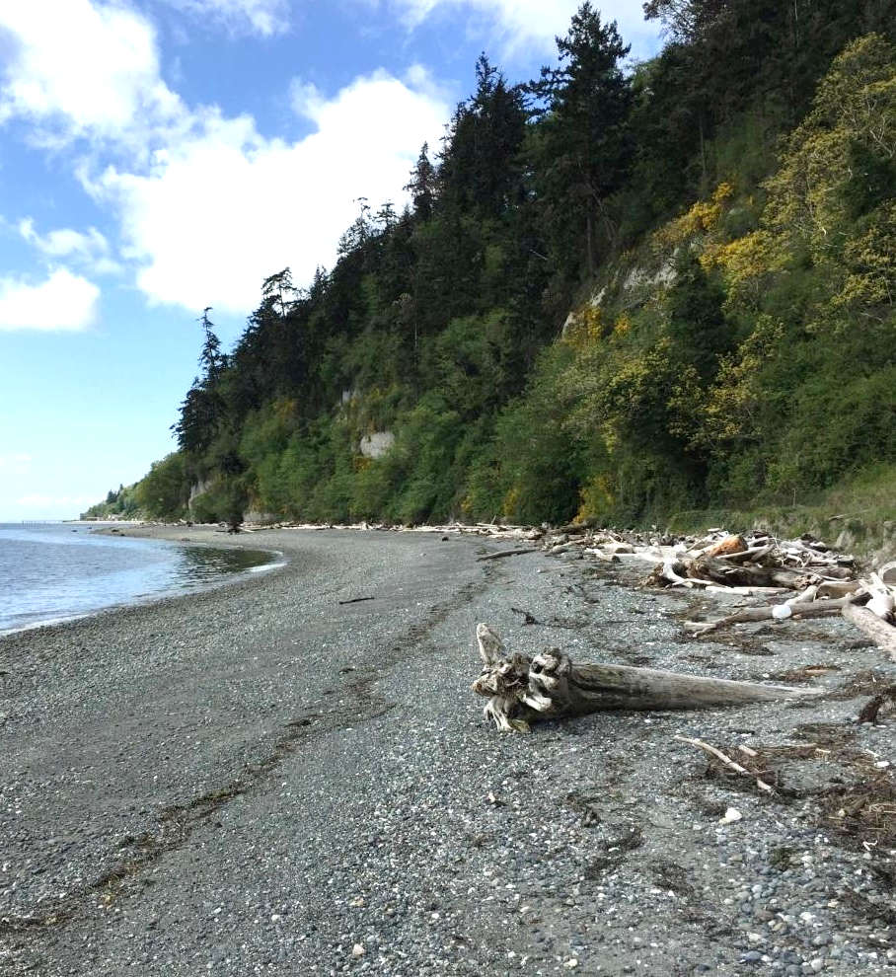
Meeting Adjourned
Geoff Baran Washington State Department of Ecology
360-790-9725
Geoff.Baran@ecy.wa.gov

Slide 25
Lake Chelan GRP Update
Washington State Department of Ecology
Kaitlin Lebon and David Prater

Slide 26
Comparison Slide headline
Column 1
Column 2
Bullet items
Bullet items
Bullet items
Bullet items
Bullet items
Bullet items
Bullet items
Bullet items

Slide 27
Chart slide title 2
Optional summary or explanation of chart

Slide 28
Ecology’s strategic priorities
Support and engage our communities, customers, and employees
Reduce and prepare for climate impacts
Prevent and reduce toxic threats and pollution
Protect and manage our state's waters
Protect and restore Puget Sound

Slide 29
Presentation Title Option 2
Name
Date

Slide 30
Timeline slide title
Optional summary or explanation of timeline information
Year
Year
Year
Year
Event description or information
Event description or information
Event description or information
Event description or information

Slide 31
Table slide title
Optional summary or explanation of table information
Heading | Heading | Heading | Heading | Heading
Content | Content | Content | Content | Content
Content | Content | Content | Content | Content
Content | Content | Content | Content | Content
Content | Content | Content | Content | Content
Content | Content | Content | Content | Content
Content | Content | Content | Content | Content

Slide 32
Chart slide title
Optional summary or explanation of bar chart

Slide 33
Chart slide title 2
Optional summary or explanation of chart

Slide 34
Venn diagram title
Optional text explanation
Category 1
Category 2
Item 1
Item 1
Item 1
Item 2
Item 2
Item 2
Item 3
Item 3
Item 3
Item 4
Item 4

