Slide 1

The meeting will begin shortly
Resource Damage Assessment Committee Meeting
Please keep your microphone muted unless speaking
Webcam is optional
Notes:
*Friendly idle chit-chat*

Slide 2
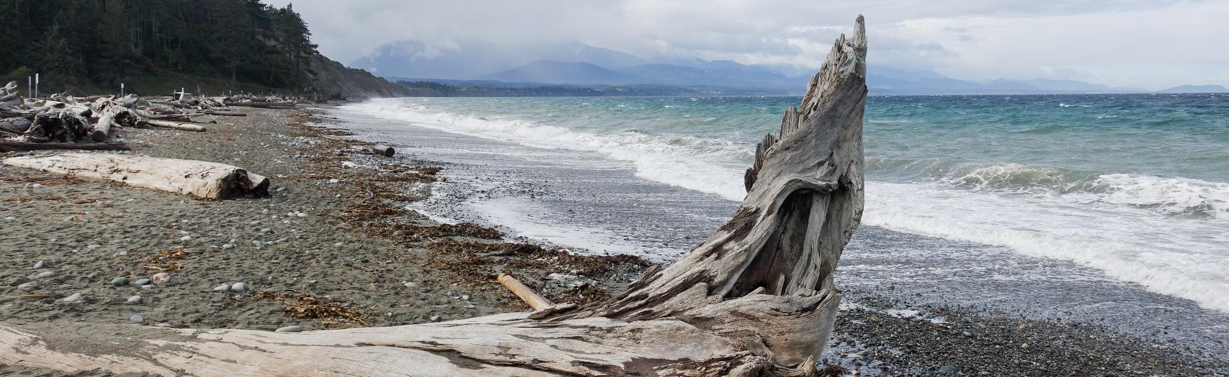
Resource Damage Assessment Committee Meeting
Geoff Baran
June 14, 2023
Notes:
Welcome to the RDA Committee Meeting. Today’s date is May 10, 2023.

Slide 3
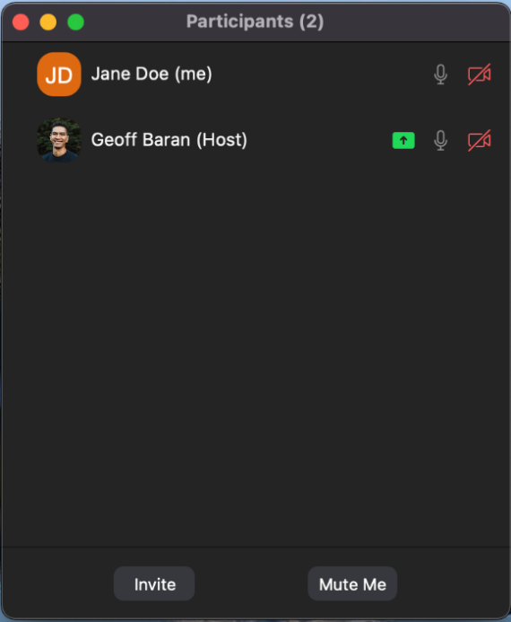
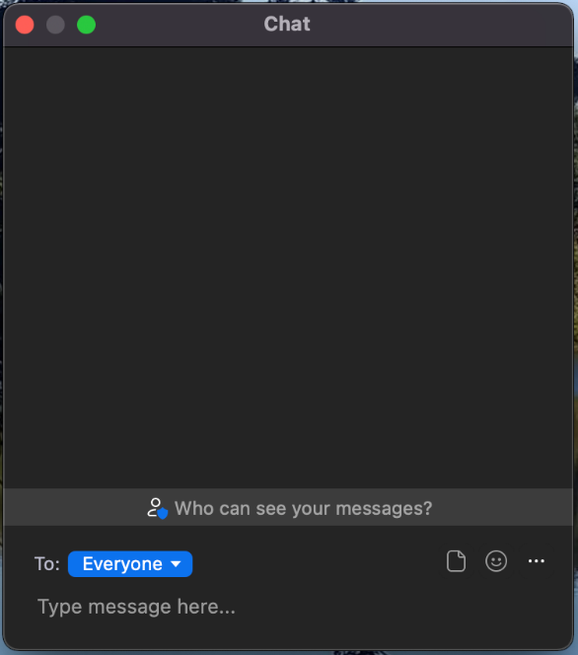
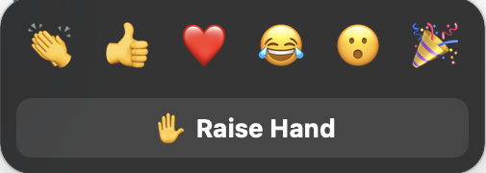
Welcome to Zoom
Please mute your microphone to reduce background noise
  Callers:
    Dial *6 to mute and unmute
    Dial *9 to Raise Hand
  Online attendees please use the mute button
Notes:
Provide basic Zoom instructions.

Slide 4
Table of Contents
1
Welcome, Roll Call, Agenda Review
2
Introduction
3
New Business
4
Old Business
6
Announcements
Notes:
Brief Agenda Review
Roll Call
Agenda Review
Intro: Review the purpose of our meeting today and the rules of this committee

Slide 5


Resource Damage Assessment Committee
Notes:
INTRODUCTION
Purpose:
This committee is responsible for conducting preassessment screenings for natural resource damage assessments for oil spill that impact the waters of Washington State.
The committee is defined in statute, and comprised of representatives of the Washington State Department of Fish and Wildlife, The Department of Natural Resources, Department of Archeology and History Preservation, Department of Health, and the Washington State Parkas and Recreation Commission
We are NOT assigning liability at this meeting. The purpose of this meeting is to evaluate the natural resource injuries from the spill, review available data, and work cooperatively with potentially liable parties to assess the harm to the environment from oil spills.
Goal:
Work cooperatively with the potentially liable party to determine whether detailed damage assessment studies should be conducted, or whether the compensation schedule will be used to assess the damages.
The ultimate goal of this process is to restore publicly-owned resources that have been damaged by oil spills.
Objectives:
Conduct preassessment screenings of all oil spills that impact Washington State waters.
Evaluate each case and consider whether damages are quantifiable at a reasonable cost
Whether restoration or enhancement is technically feasible.
Evaluate any projects proposed in lieu of a damage claim.
The committee will vote yes or no on those questions, and if the answer is no, the Compensation Schedule is authorized to assess damages
Rules
Committee bylaws state the meeting will be carried out under parliamentary procedure. Motion, second, all in favor.
After hearing discussion from the attendees, each present RDA Committee Member will vote on two things:
Whether damages are quantifiable at a reasonable cost
And whether restoration or enhancement is technically feasible

Slide 6

New Business
Preassessment Screening
ERTS #722807 P/C South Sound Fire and Diesel Spill

Slide 7
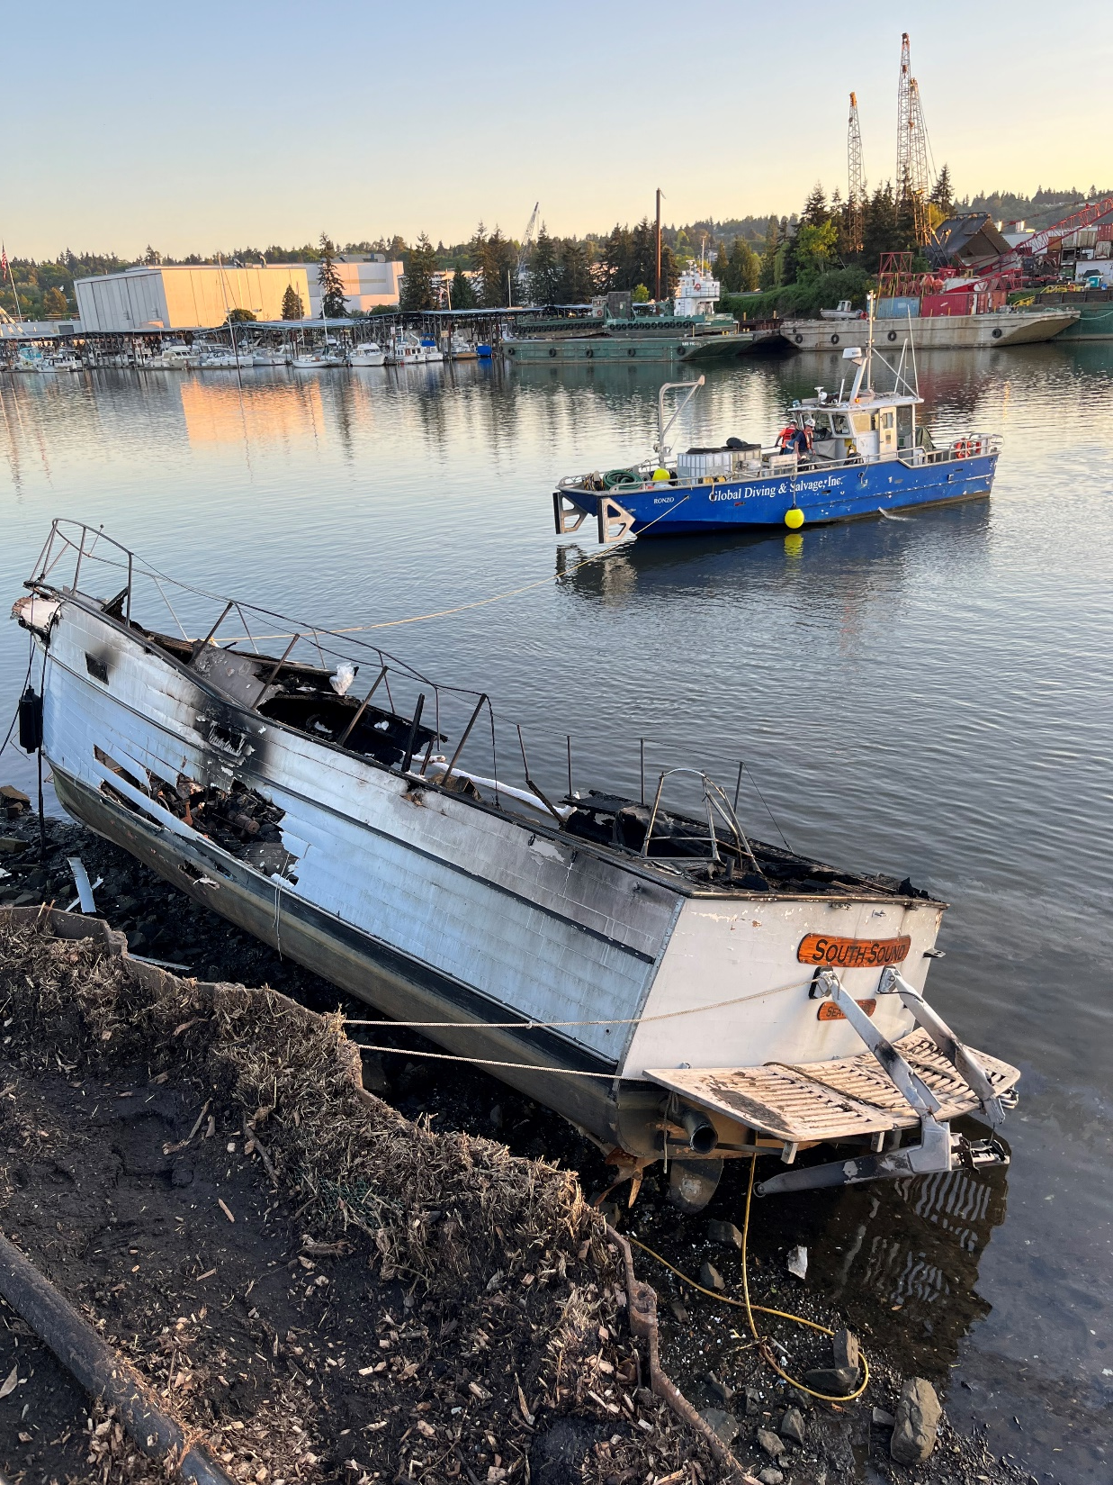
ERTS #722807
P/C South Sound Fire and Diesel Spill
May 13, 2023, vessel fire and diesel spill to Duwamish Waterway

Slide 8
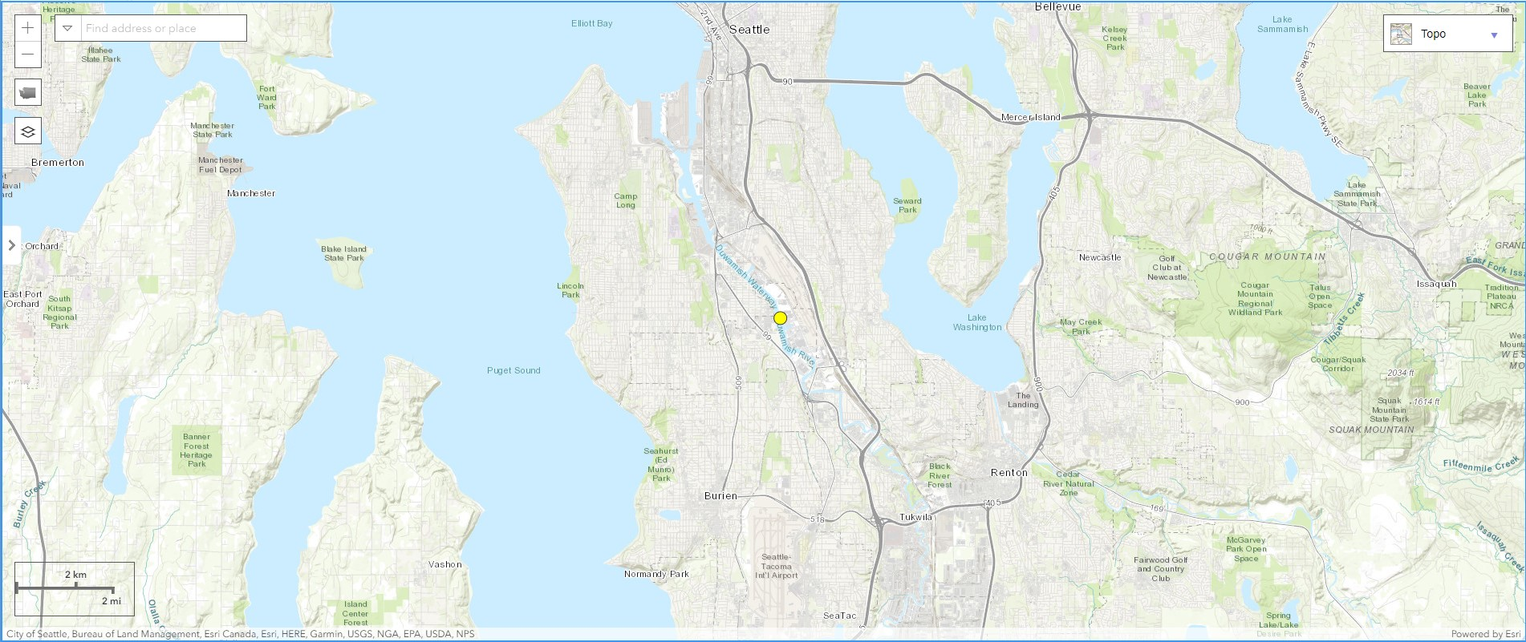
Spill Location

Slide 9
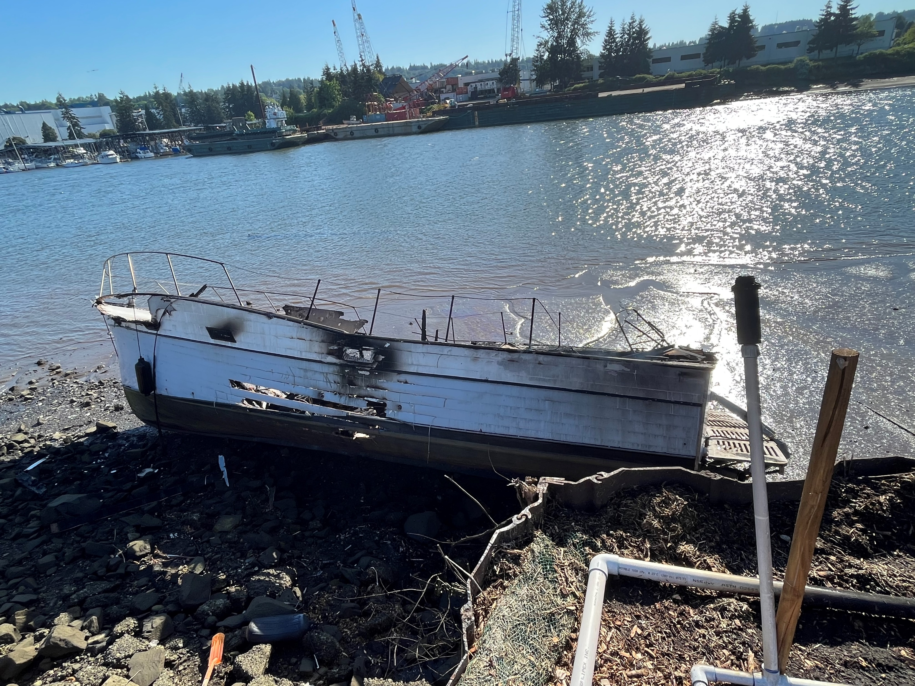
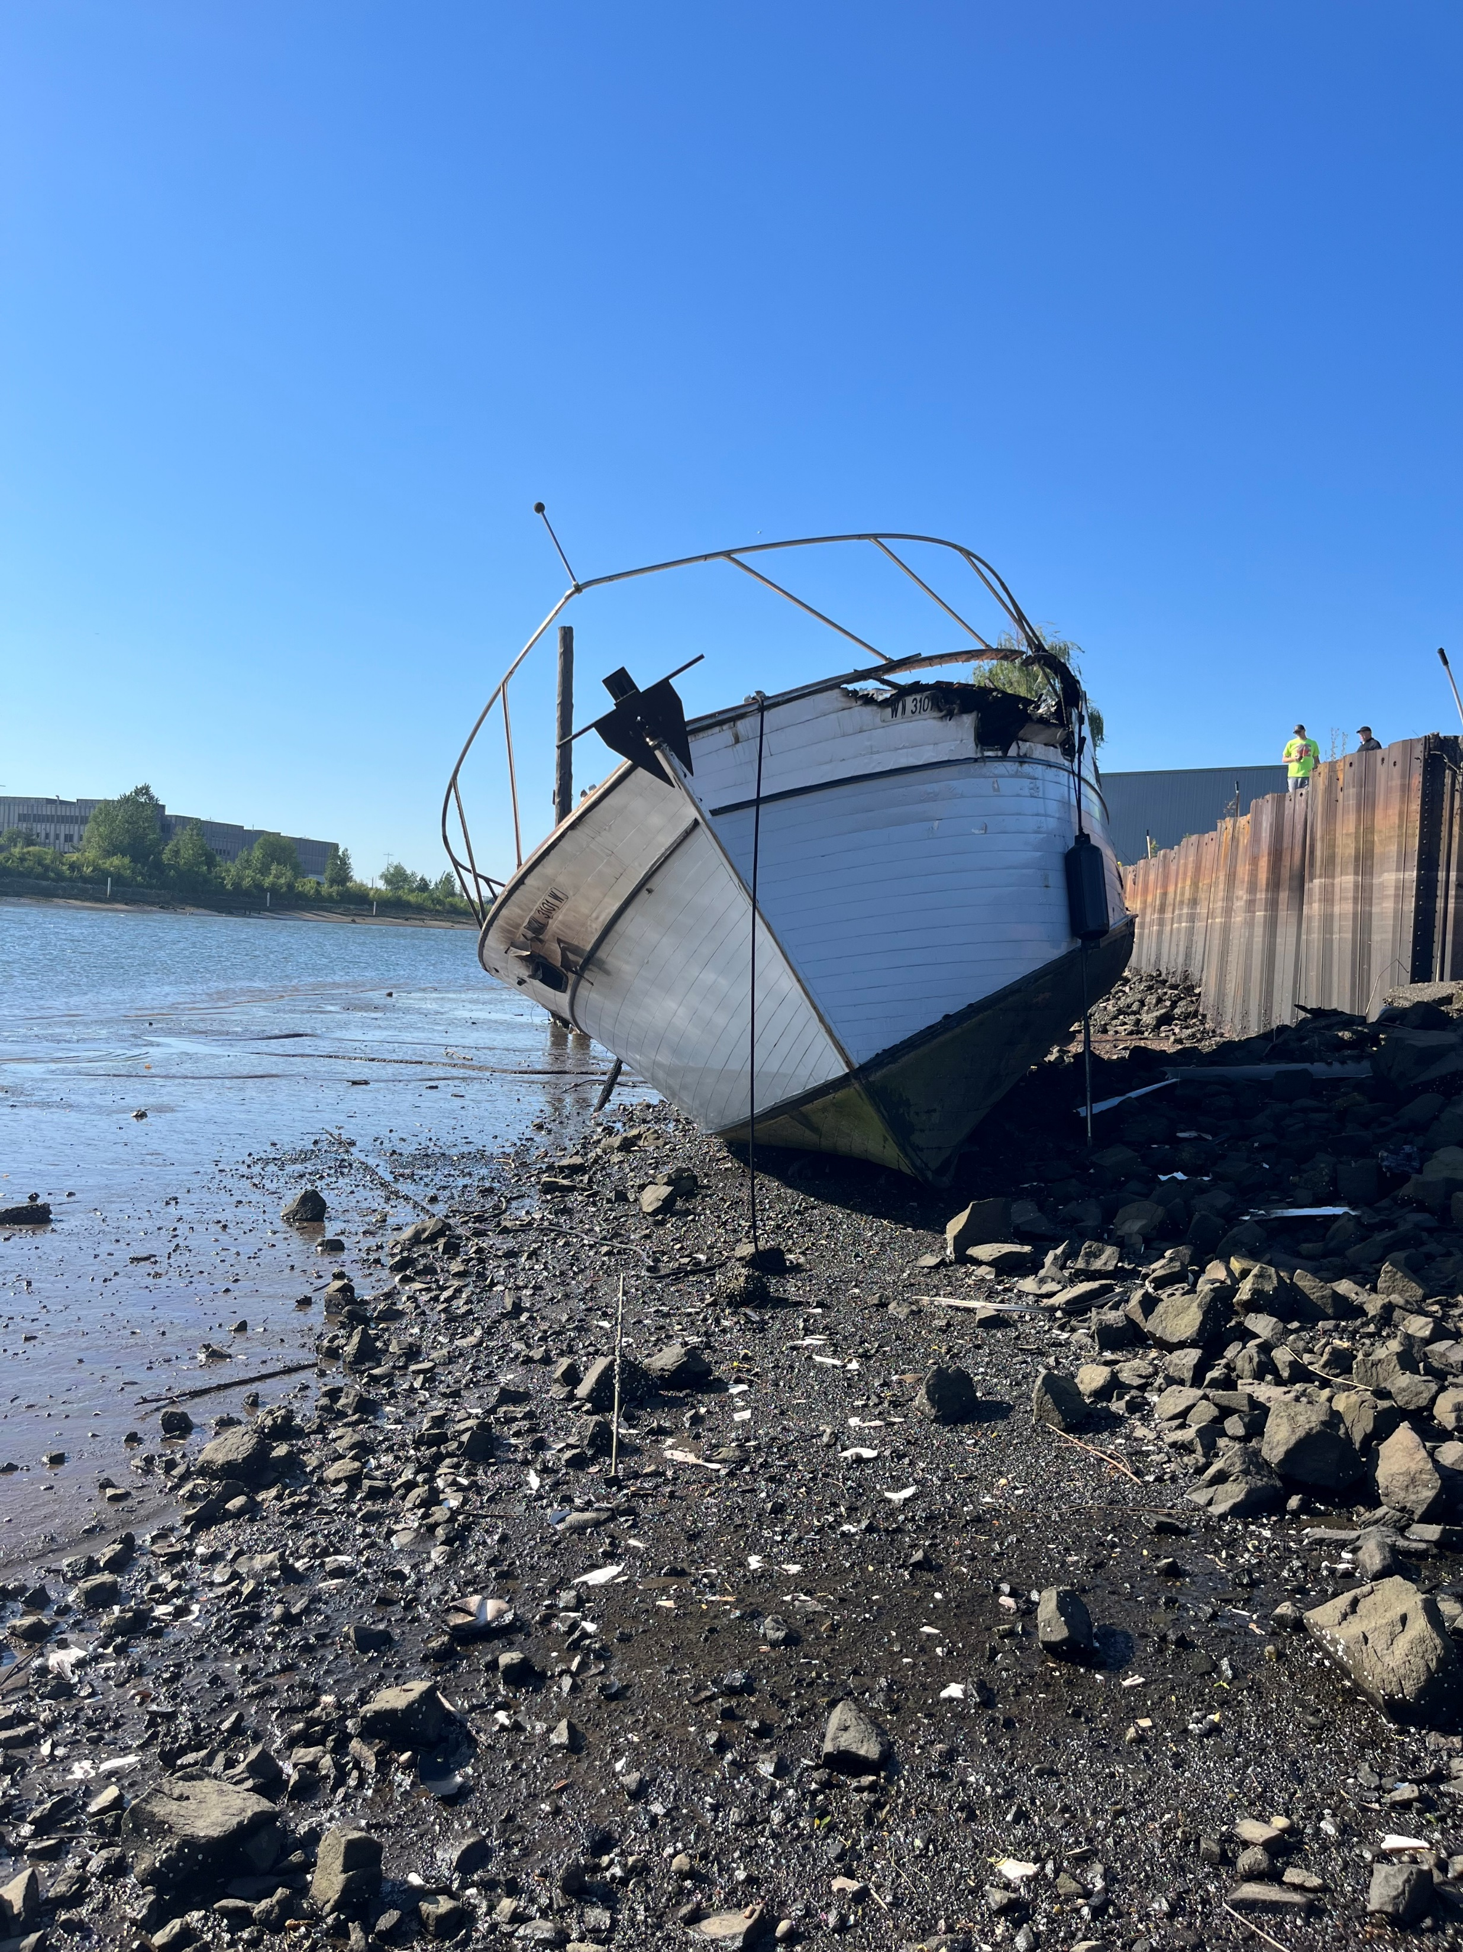
ERTS #722807 P/C South Sound
Notes:
From WSP accident report.

Slide 10
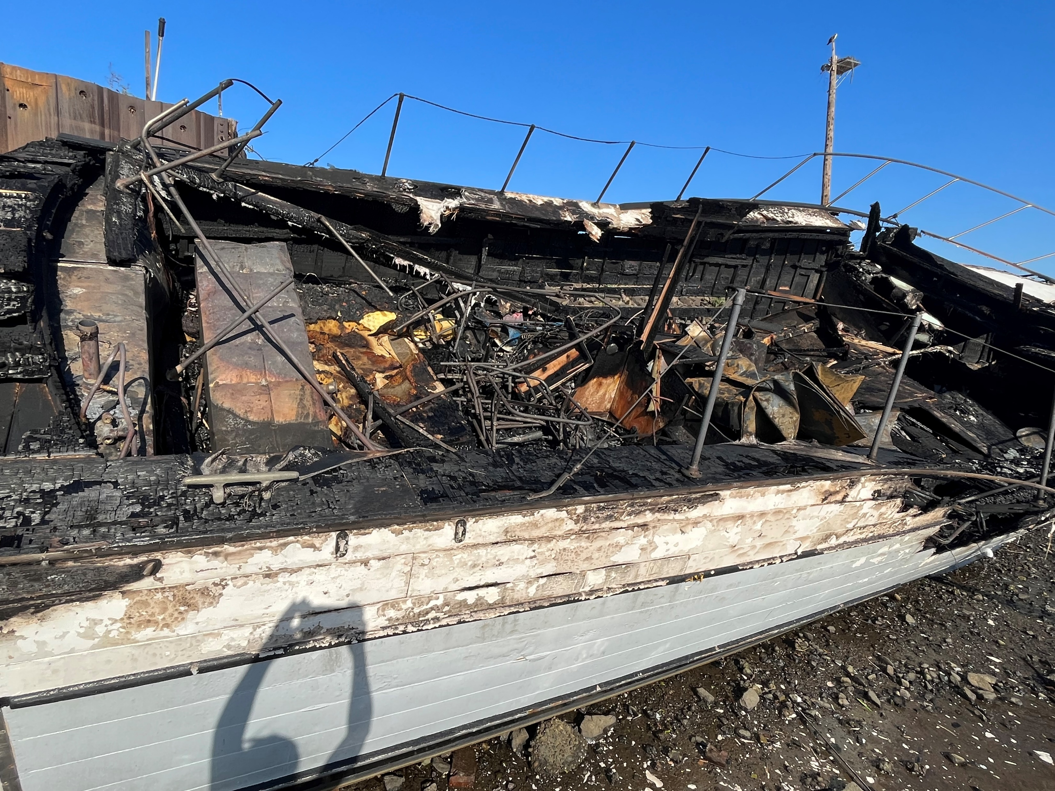
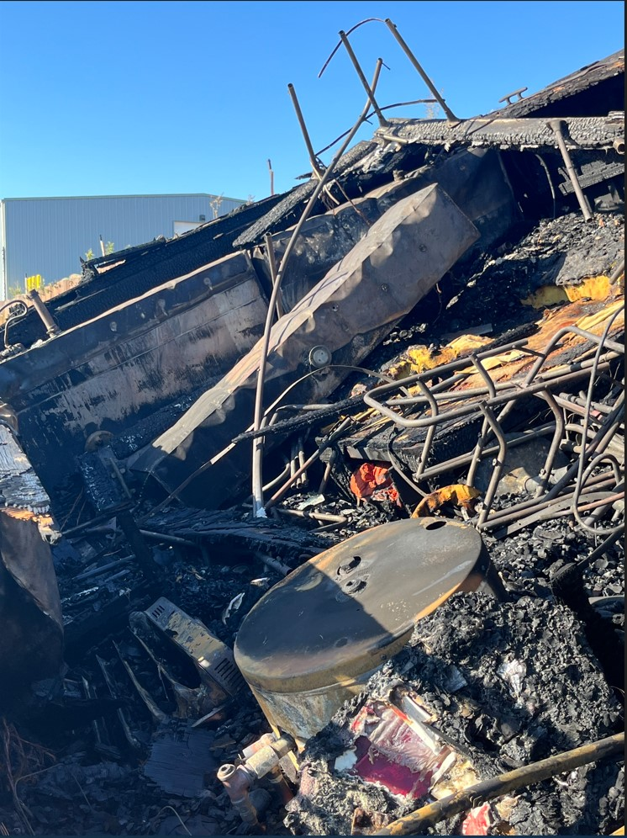
ERTS #722807 P/C South Sound
Notes:
From WSP accident report.

Slide 11
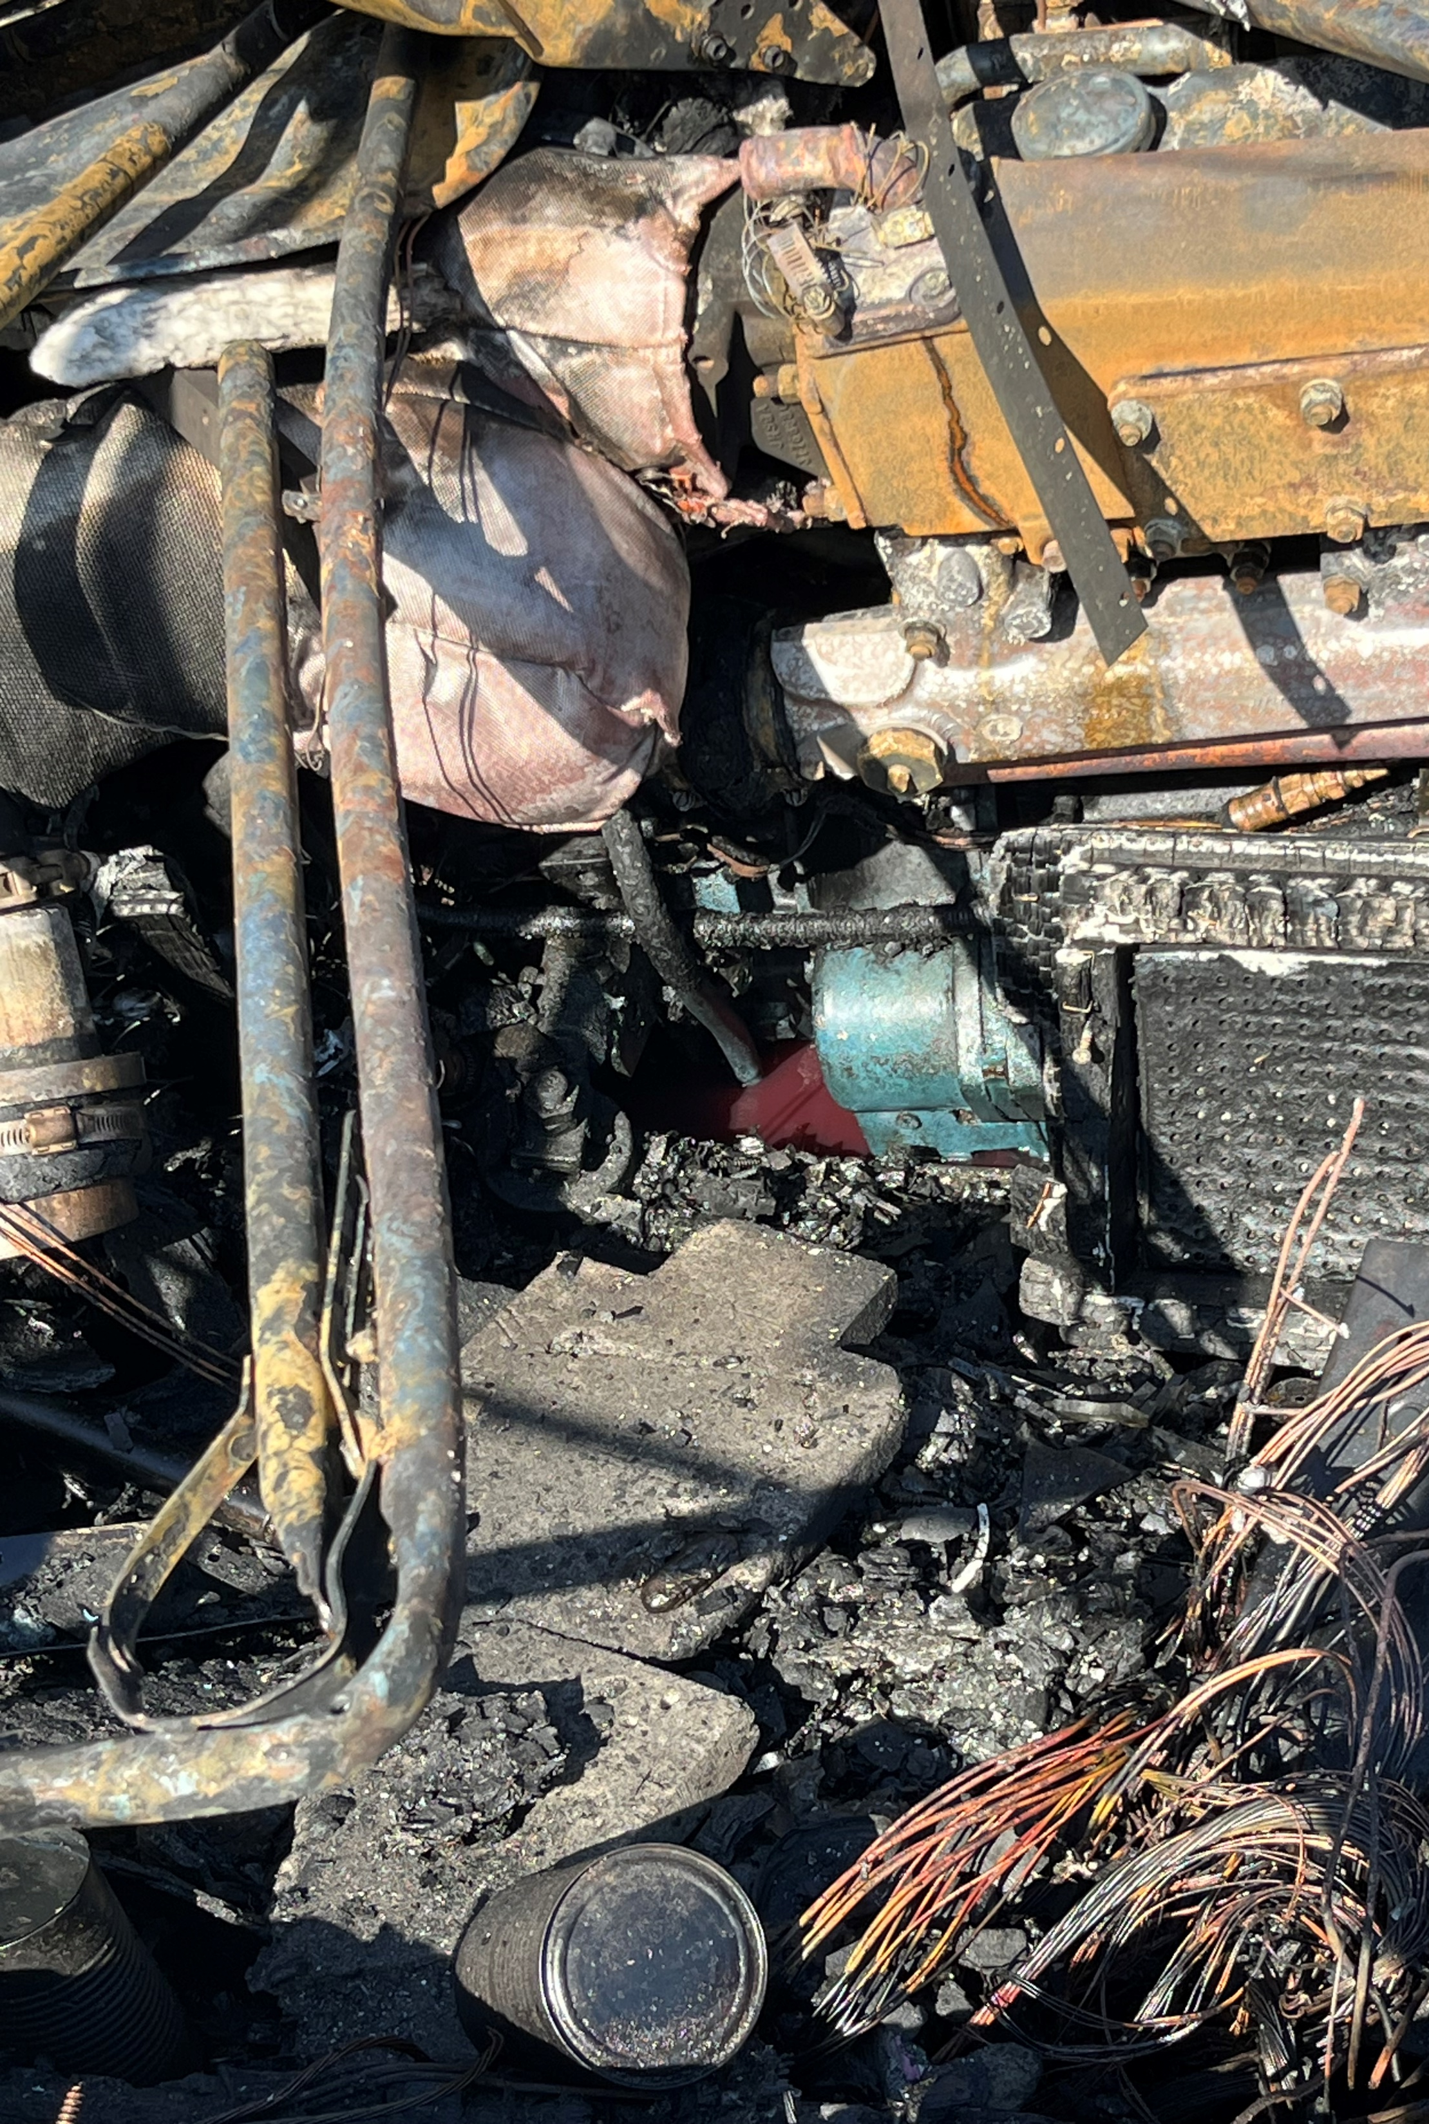
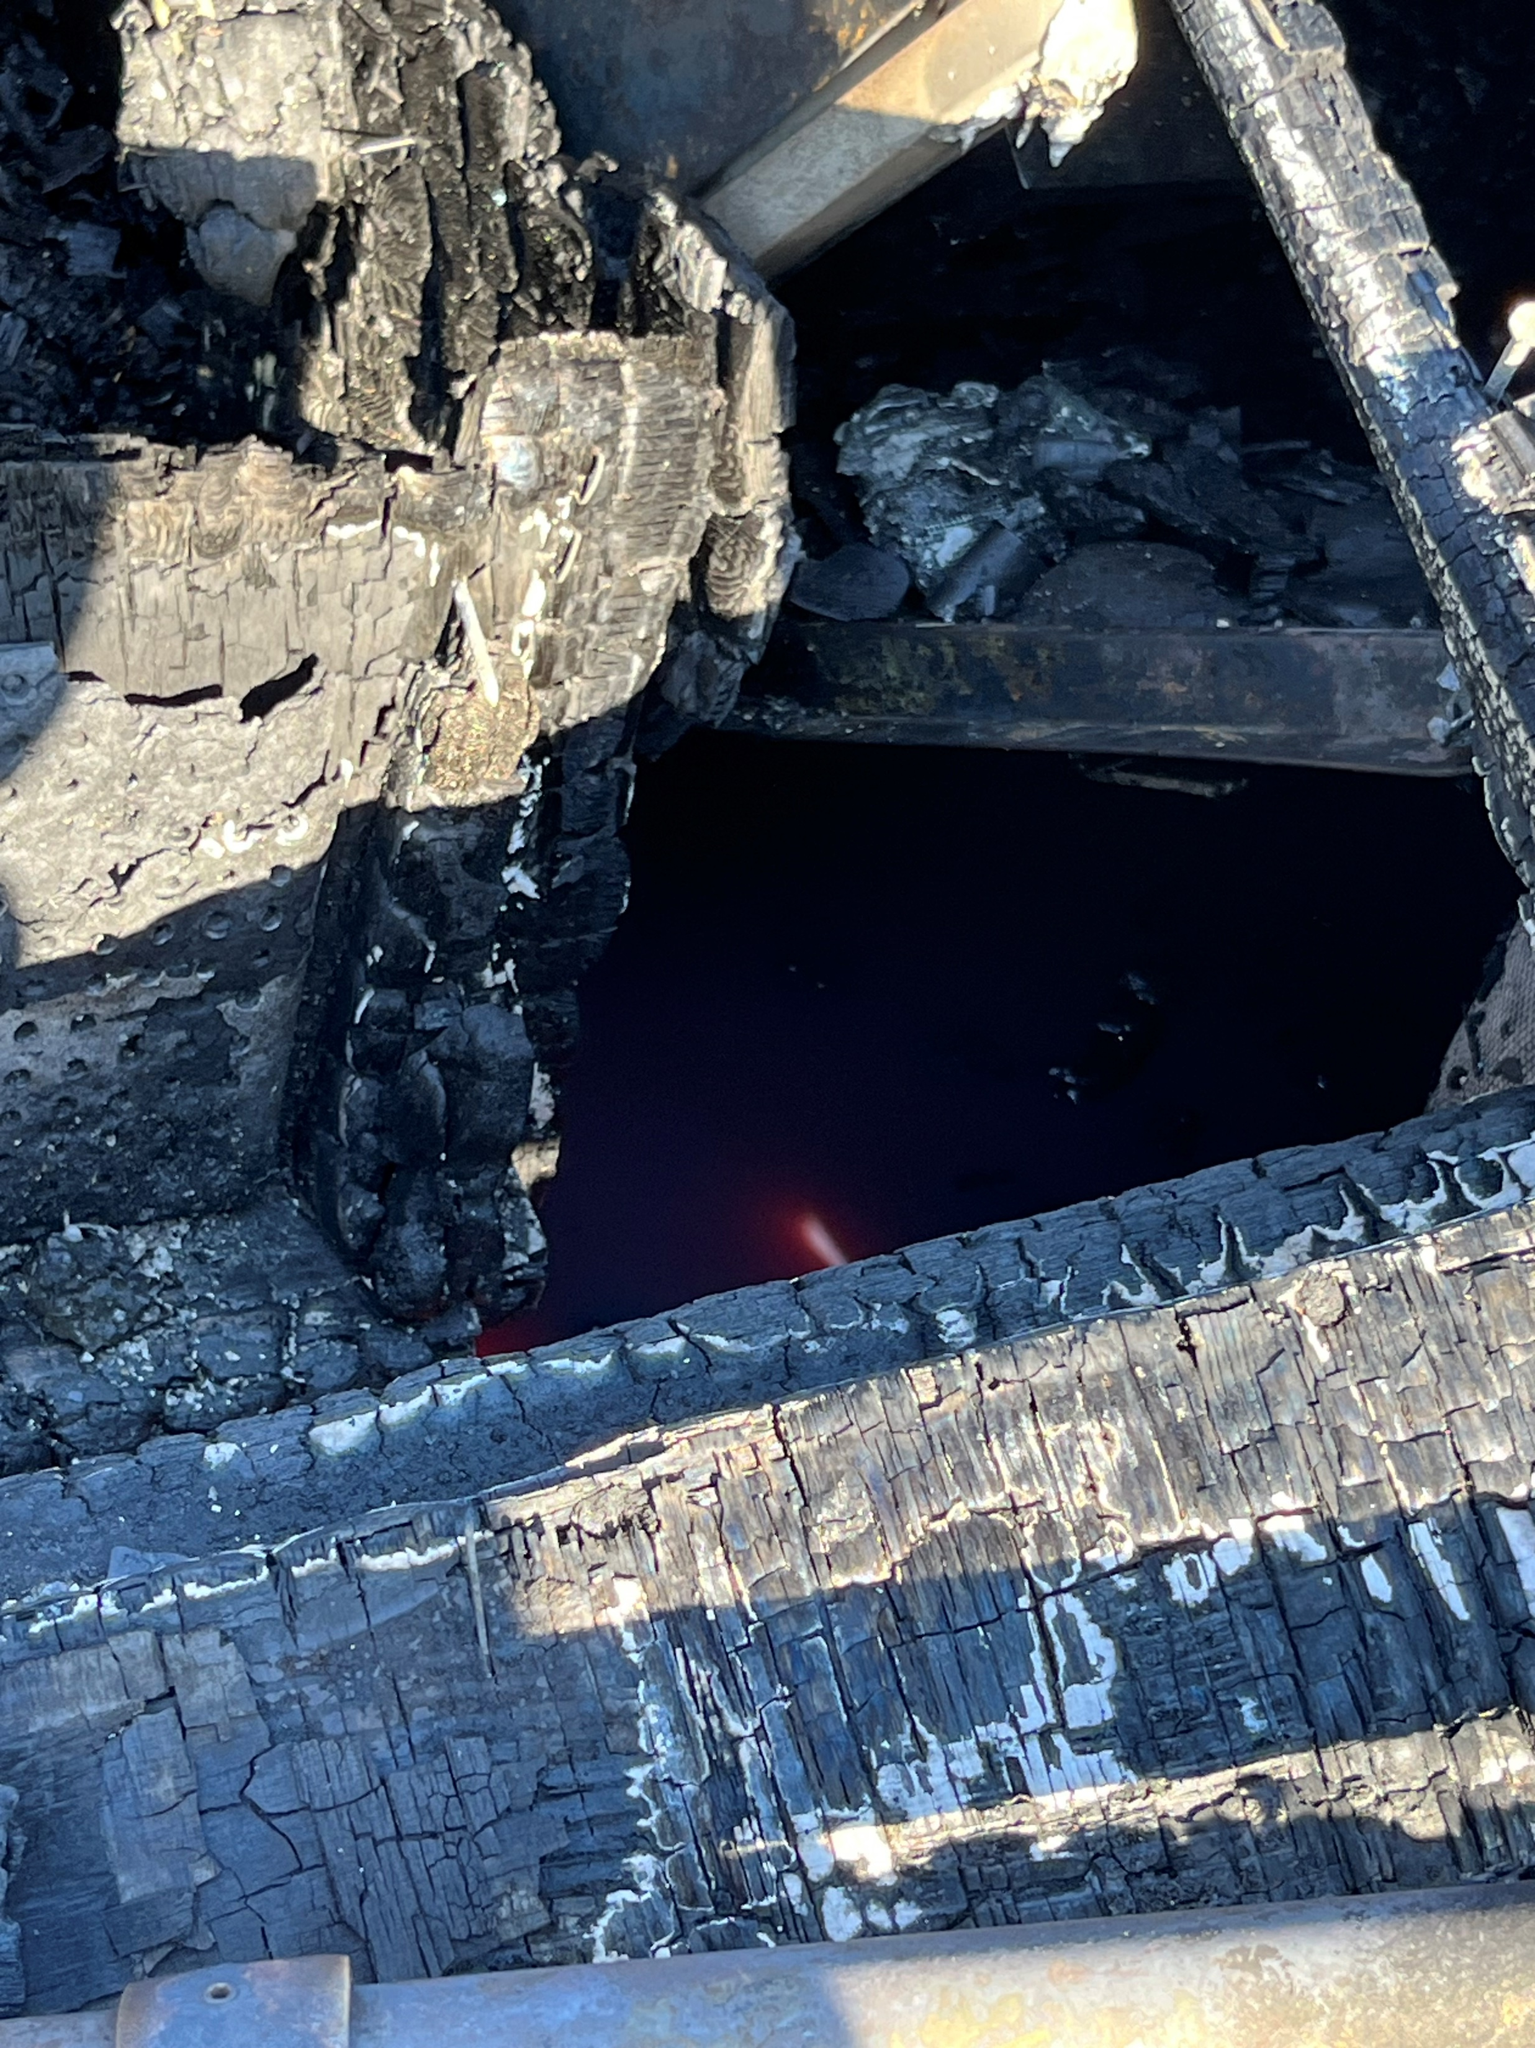
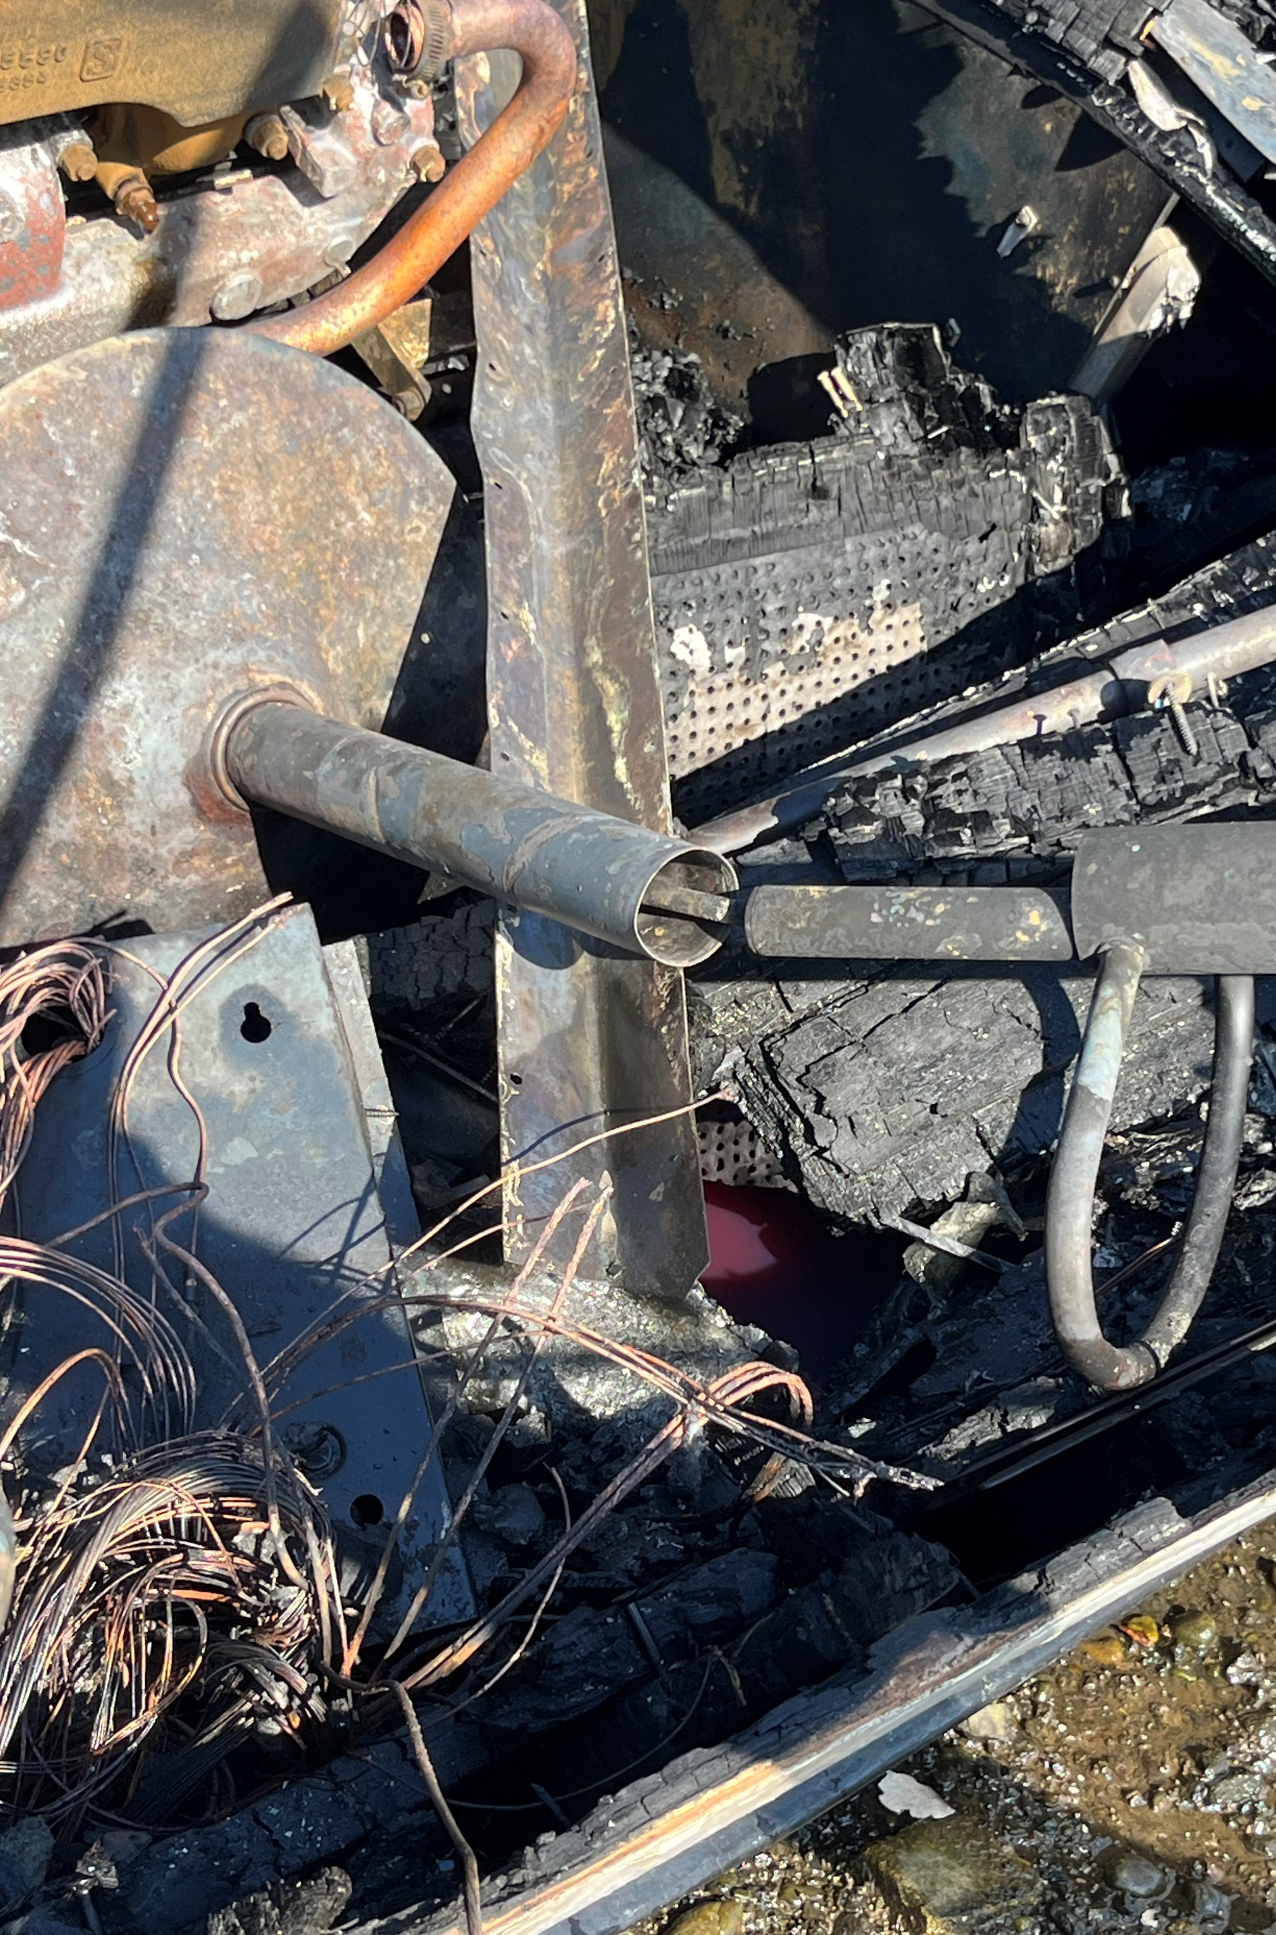
ERTS #722807 P/C South Sound
Notes:
From WSP accident report.

Slide 12
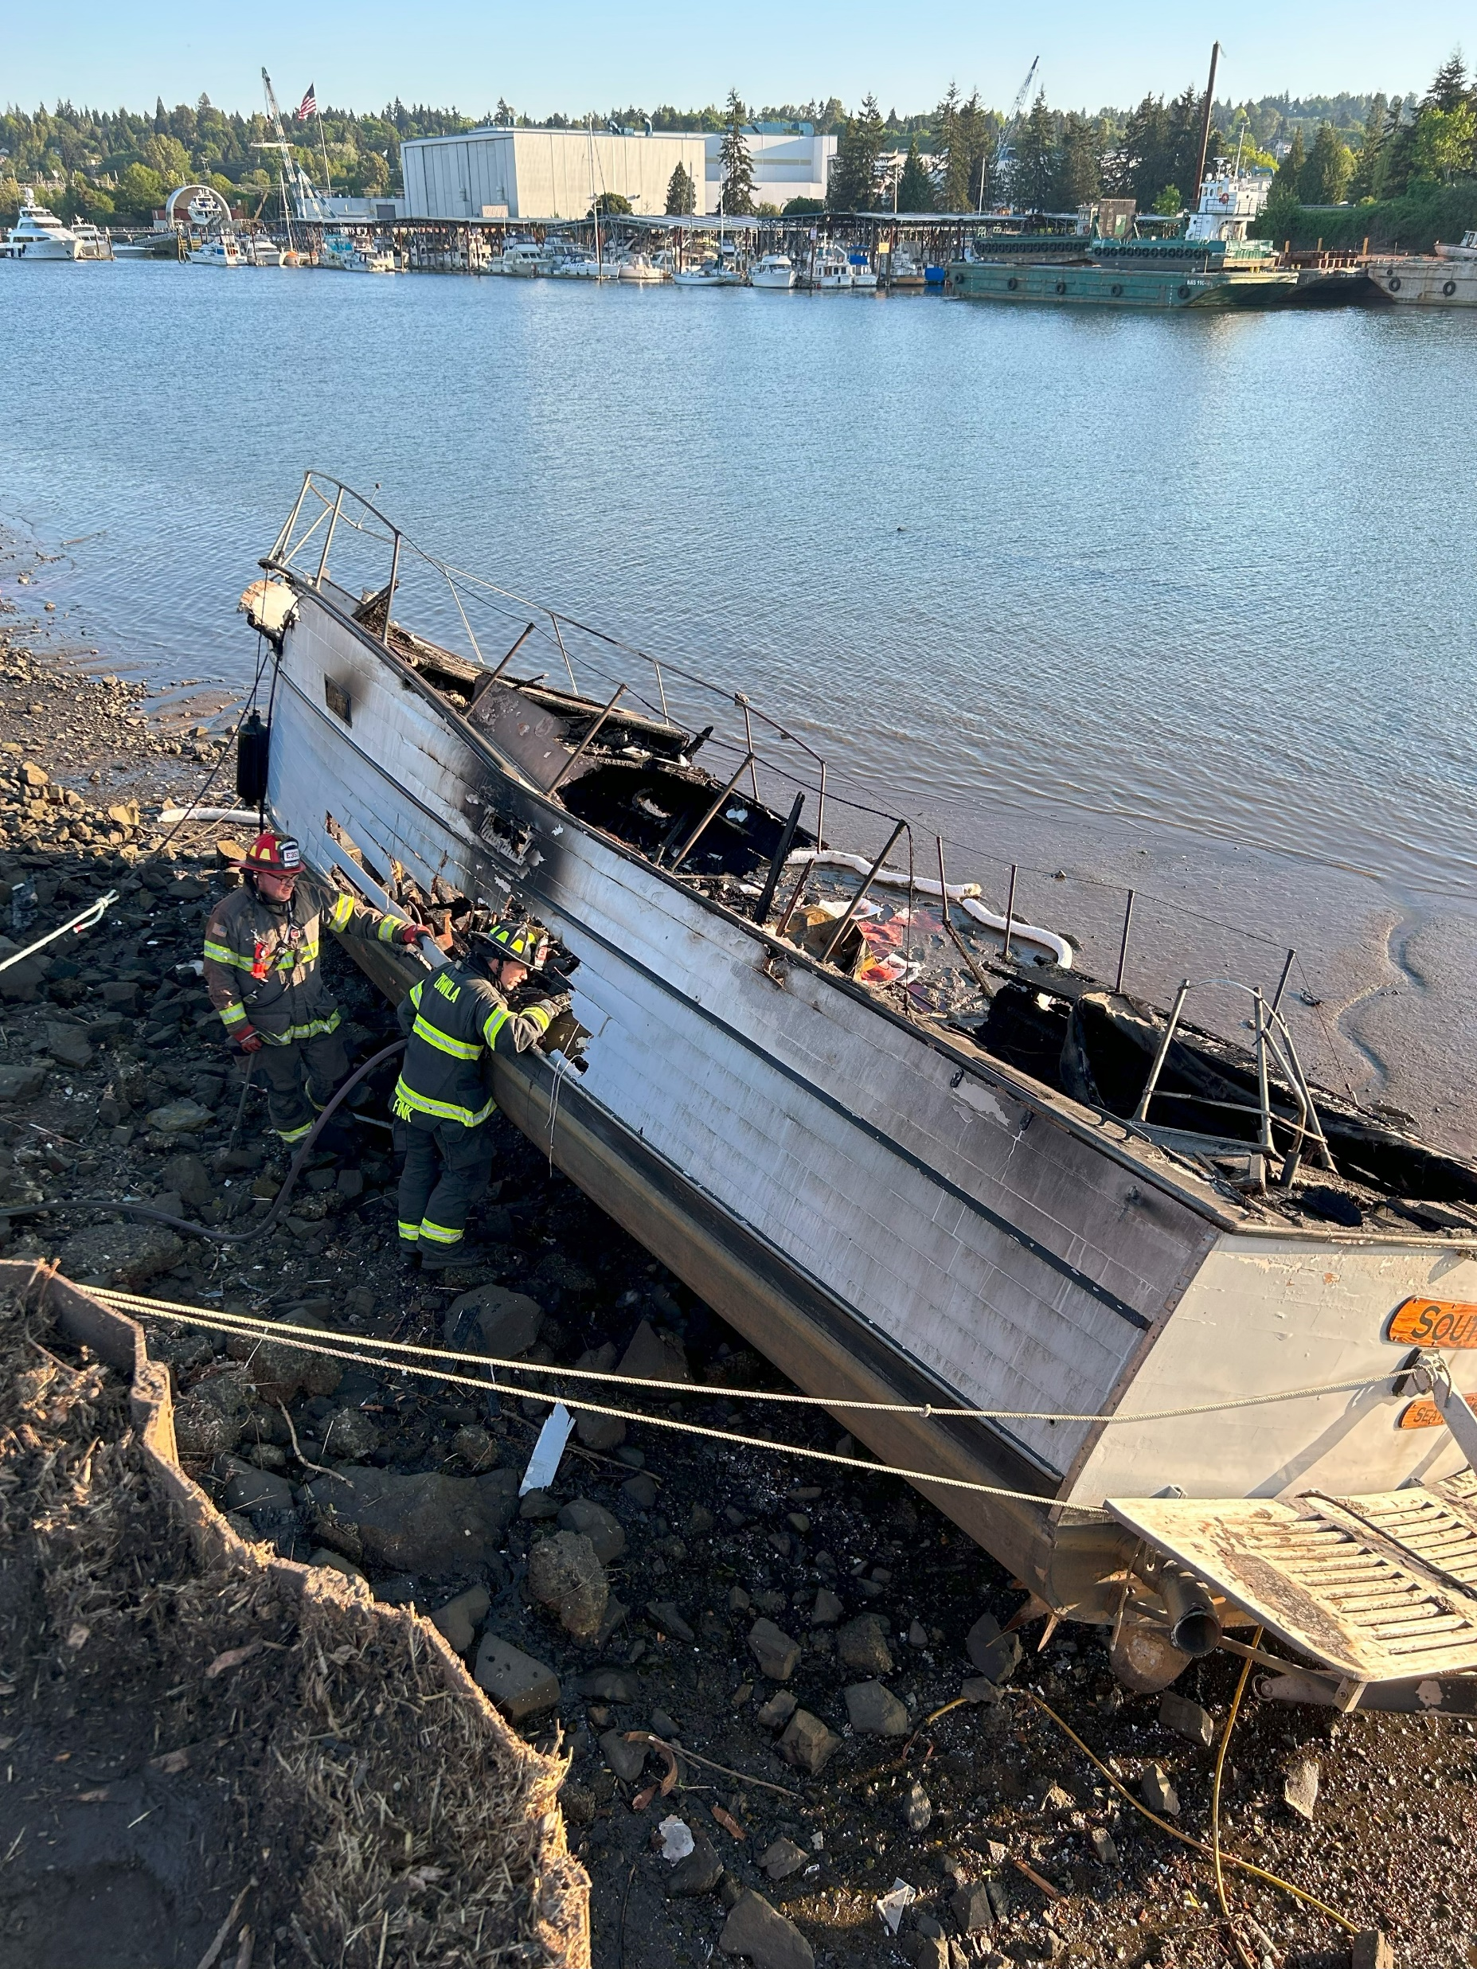
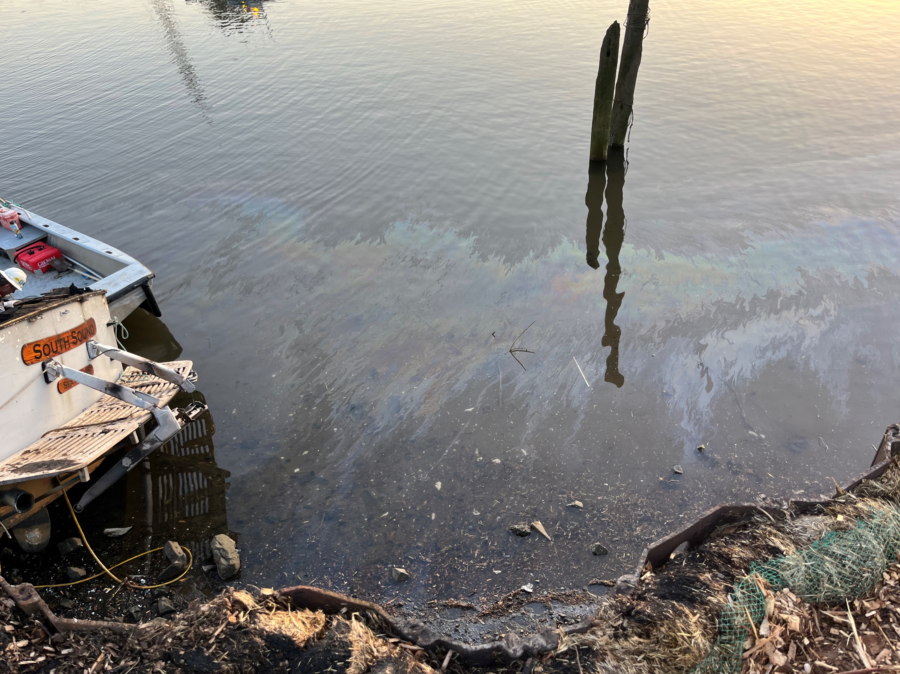
ERTS #722807 P/C South Sound

Slide 13
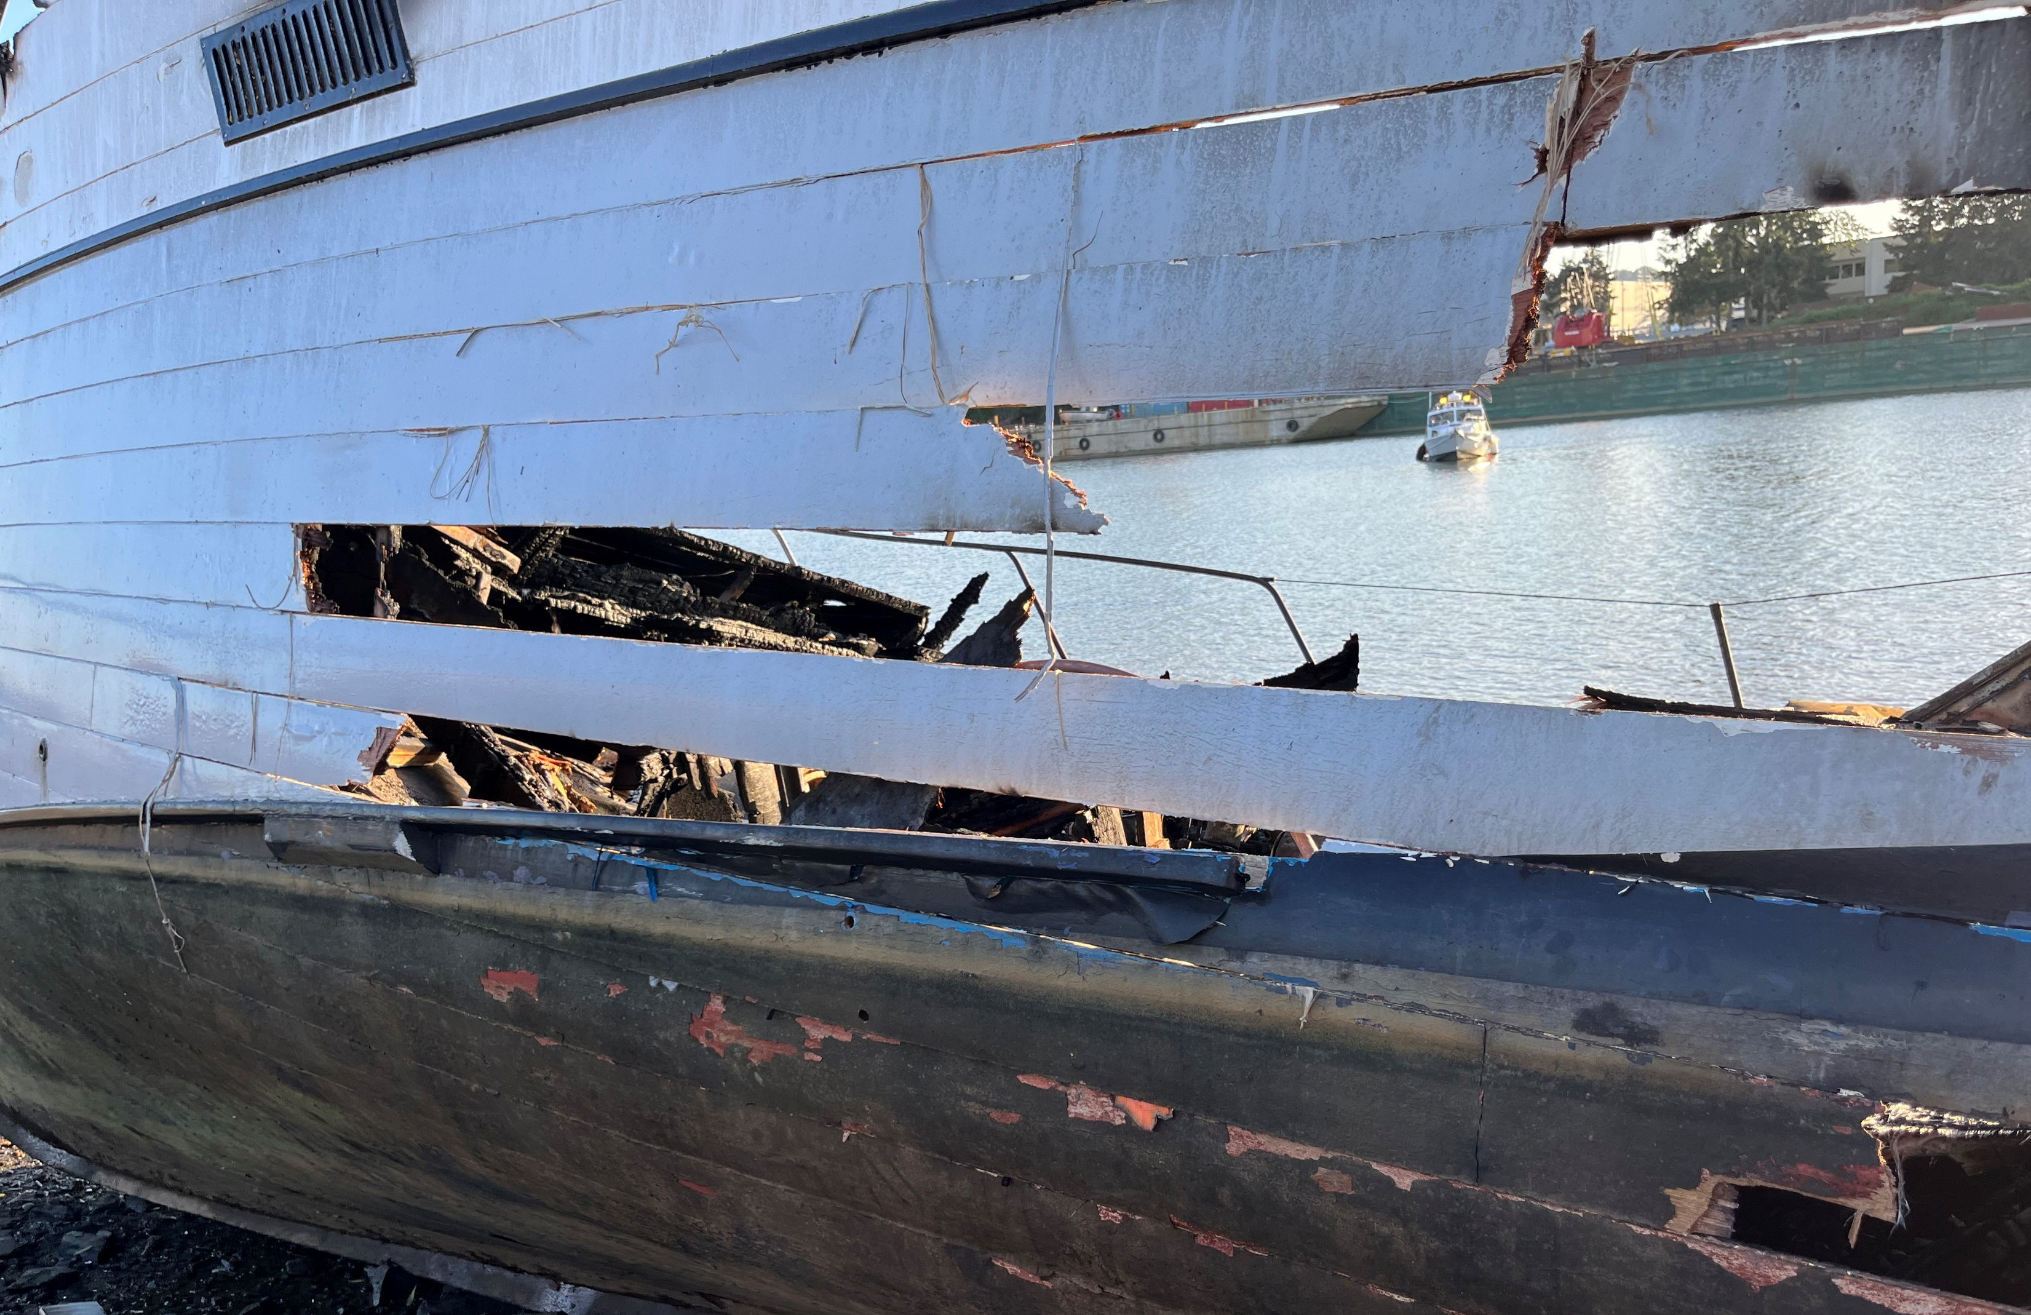
Preassessment Screening
ERTS #722807 P/C South Sound
Estimated spill to water volume: 50 to 150 gallons
Oil Type: Diesel Low Sulphur (ULSD)
Geographic Extent of Impacts: Duwamish Waterway
Volume of oil recovered within the first 24 hours: 80+ gallons (depending on recovered sorbent weight)

Slide 14
Old Business
Open Case Updates
ERTS #720988 Tug Tulalip Sinking and Oil Spill
Notes:
Investigation under review. Estimated spill volume between 19-27 gallons.

Slide 15
Announcements
2023 Coastal Protection Fund Grant evaluations completed (this afternoon)
Ecology IT continues to develop automated damages calculation
  Working on freshwater vulnerability data
Next meeting Wednesday, July 12, 2023 in Room R0A-32 (and Zoom)

Slide 16
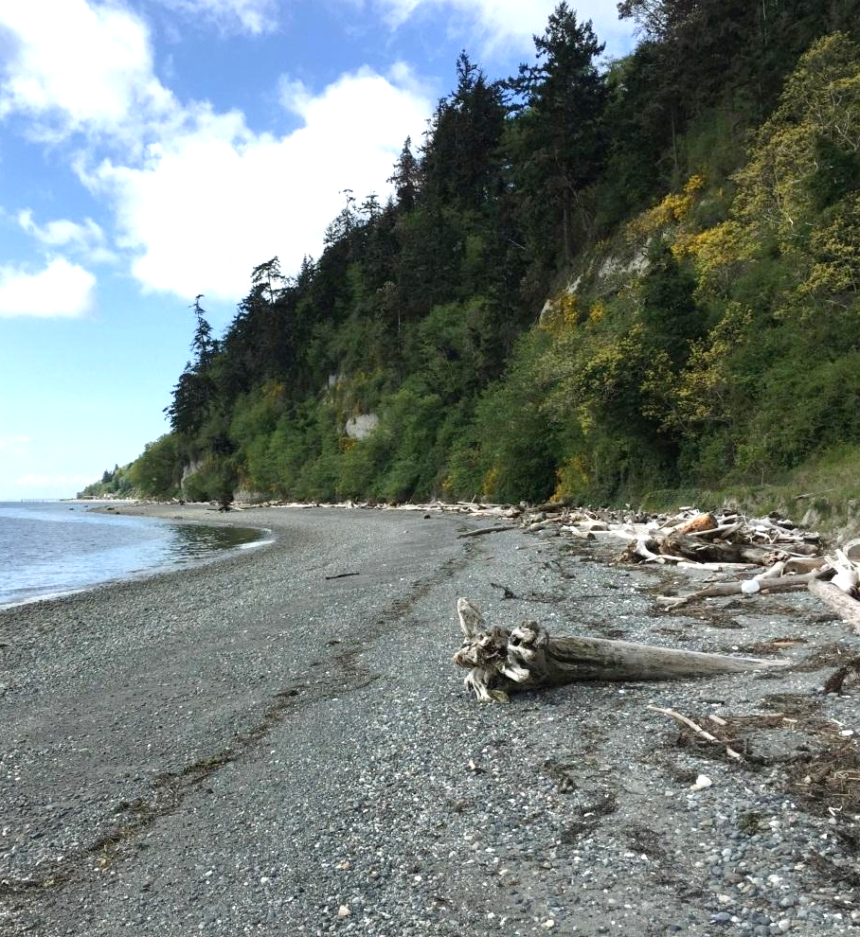

Meeting Adjourned
Geoff Baran
Washington State Department of Ecology
360-790-9725
Geoff.Baran@ecy.wa.gov

Slide 17
Lake Chelan GRP Update
Washington State Department of Ecology
Kaitlin Lebon and David Prater

Slide 18
Comparison Slide headline
Column 1
Column 2
Bullet items
Bullet items
Bullet items
Bullet items
Bullet items
Bullet items
Bullet items
Bullet items

Slide 19
Chart slide title 2
Optional summary or explanation of chart

Slide 20





Ecology’s strategic priorities
Support and engage our communities, customers, and employees
Reduce and prepare for climate impacts
Prevent and reduce toxic threats and pollution
Protect and manage our state's waters
Protect and restore Puget Sound

Slide 21
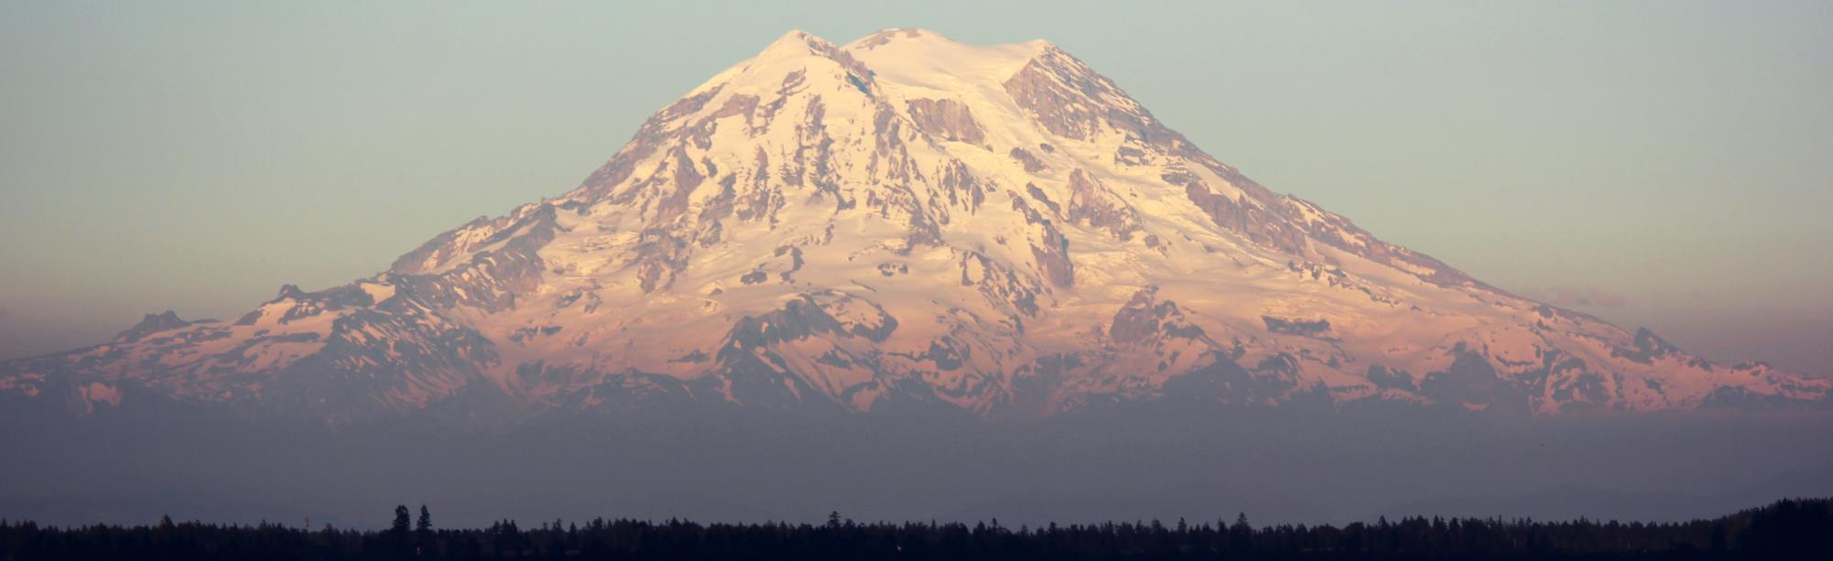
Presentation Title Option 2
Name
Date

Slide 22
Timeline slide title
Optional summary or explanation of timeline information
Year
Year
Year
Year
Event description or information
Event description or information
Event description or information
Event description or information

Slide 23
Table slide title
Optional summary or explanation of table information
Heading | Heading | Heading | Heading | Heading
Content | Content | Content | Content | Content
Content | Content | Content | Content | Content
Content | Content | Content | Content | Content
Content | Content | Content | Content | Content
Content | Content | Content | Content | Content
Content | Content | Content | Content | Content

Slide 24
Chart slide title
Optional summary or explanation of bar chart

Slide 25
Chart slide title 2
Optional summary or explanation of chart

Slide 26
Venn diagram title
Optional text explanation
Category 1
Category 2
Item 1
Item 1
Item 1
Item 2
Item 2
Item 2
Item 3
Item 3
Item 3
Item 4
Item 4

