Slide 1
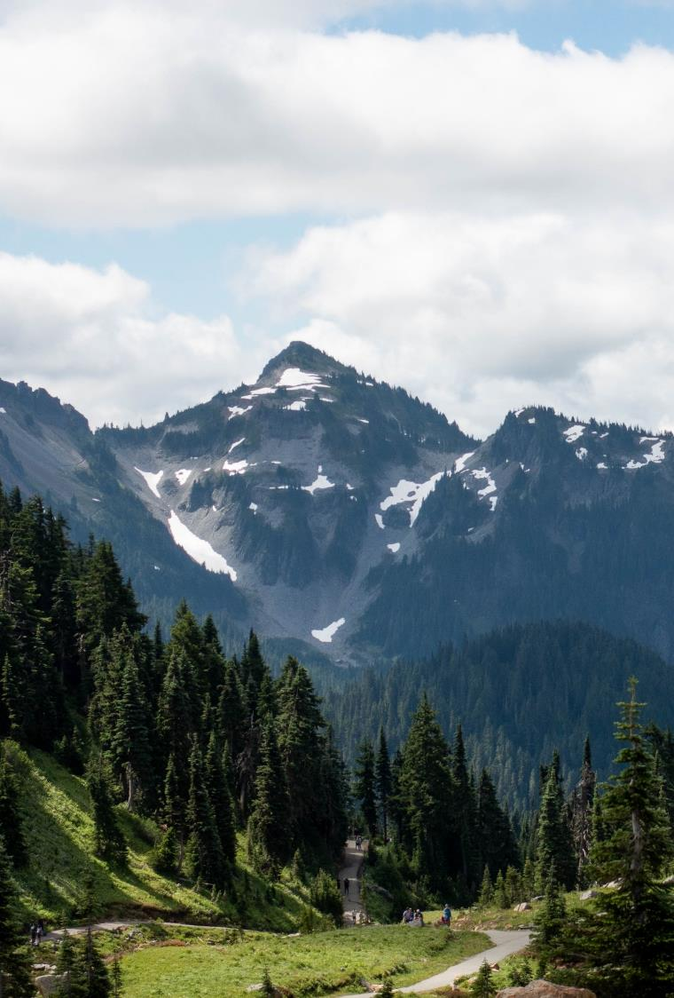
The meeting will begin shortly
Resource Damage Assessment Committee Meeting
Please keep your microphone muted unless speaking
Webcam is optional
Notes:
*Friendly idle chit-chat*

Slide 2
Resource Damage Assessment Committee Meeting
Geoff Baran
March 13, 2024

Slide 3
Welcome to MS Teams
Webcam is optional
Please mute your microphone to reduce background noise
For immediate questions or comments, please raise your hand
Please use the chat function
Notes:
Provide basic Zoom instructions.
If there are in-person attendees, identify fire extinguisher, AED, and restroom location.

Slide 4
Ecology Building
AED located at Security Desk
Fire Extinguisher
We are in R1S-16
Restrooms are located down the hall
Fire Extinguisher is outside the door
An AED is available at the Security Desk
In the event of an evacuation, our exit door is across the hall into the field
Evacuation
Route
R1S-16
Restrooms

Slide 5
Ecology NRDA Team
Geoff Baran
Committee Chair
Host, facilitator
Josh Weide
Committee Executive Director
Note taker, moderator

Slide 6
Table of Contents
1
Call to Order
Roll Call, Introduction, Agenda Review
2
New Business
3
Old Business
4
Announcements
6
Adjourn
Notes:
Rough overview of today’s proceedings

Slide 7
Welcome, Roll Call
Notes:
WELCOME
ROLL CALL
INTRODUCTION
Purpose:
This committee is responsible for conducting preassessment screenings for natural resource damage assessments for oil spill that impact the waters of Washington State.
The committee is defined in statute, and comprised of representatives of the Washington State Department of Fish and Wildlife, The Department of Natural Resources, Department of Archeology and History Preservation, Department of Health, and the Washington State Parkas and Recreation Commission
We are NOT assigning liability at this meeting. The purpose of this meeting is to evaluate the natural resource injuries from the spill, review available data, and work cooperatively with potentially liable parties to assess the harm to the environment from oil spills.
Goal:
Work cooperatively with the potentially liable party to determine whether detailed damage assessment studies should be conducted, or whether the compensation schedule will be used to assess the damages.
The ultimate goal of this process is to restore publicly-owned resources that have been damaged by oil spills.
Objectives:
Conduct preassessment screenings of all oil spills that impact Washington State waters.
Evaluate each case and consider whether damages are quantifiable at a reasonable cost
Whether restoration or enhancement is technically feasible.
Evaluate any projects proposed in lieu of a damage claim.
The committee will vote yes or no on those questions, and if the answer is no, the Compensation Schedule is authorized to assess damages
Rules
Committee bylaws state the meeting will be carried out under parliamentary procedure. Motion, second, all in favor.
After hearing discussion from the attendees, each present RDA Committee Member will vote on two things:
Whether damages are quantifiable at a reasonable cost
This means whether the anticipated cost of a damage assessment is expected to be less than the anticipated damage that may have occurred.
And whether restoration or enhancement is technically feasible
Project to return lost function successfully at a cost that is not disproportionate to the value of the public resource before the injury.

Slide 8
New Business
Preassessment Screenings
ERTS #727657 Inland Empire Paper Lube Oil Spill
ERTS #727699 P/C Maiad II Sinking and Diesel Spill
ERTS #727754 Complete Office Truck Diesel Spill
ERTS# 728009 Port of Everett Vessel Fire and Fuel Spill

Slide 9
ERTS# 727657
Inland Empire Paper Lube Oil Spill to Spokane River
December 26, 2023

Slide 10
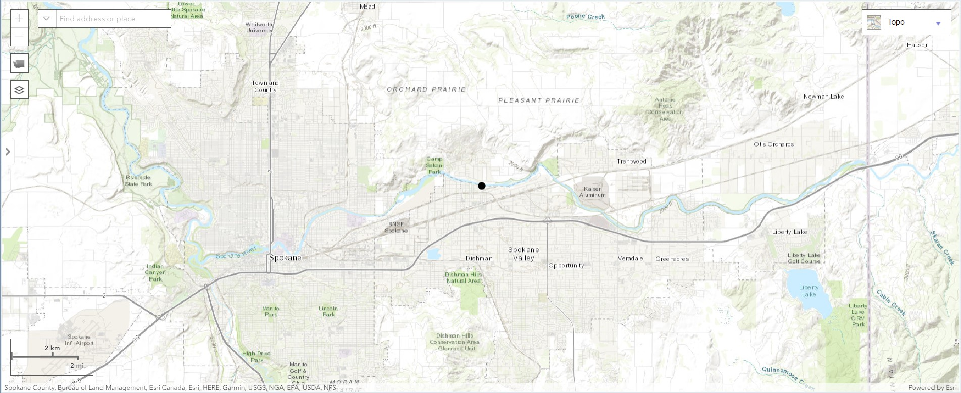
Spill Location

Slide 11
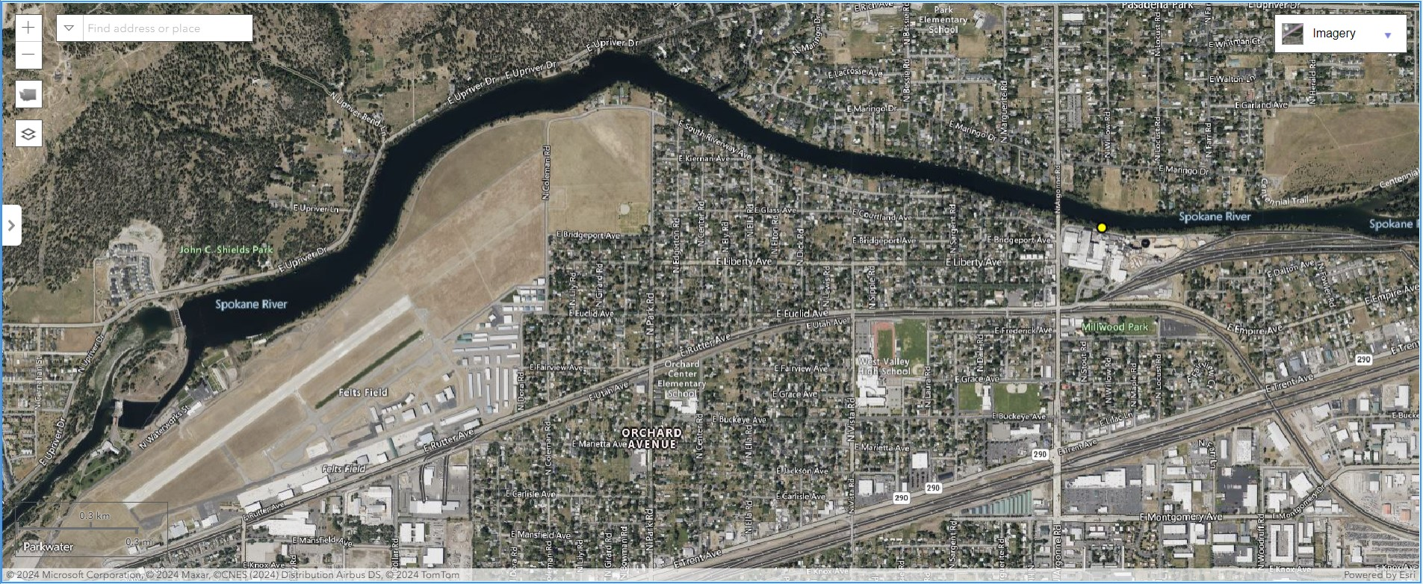
Spill Location
Notes:
Commercial Marine, family-owned marina on Westlake Avenue in Lake Union.

Slide 12
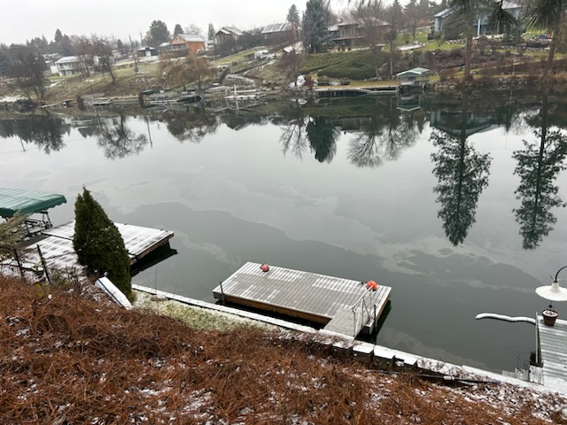

Slide 13
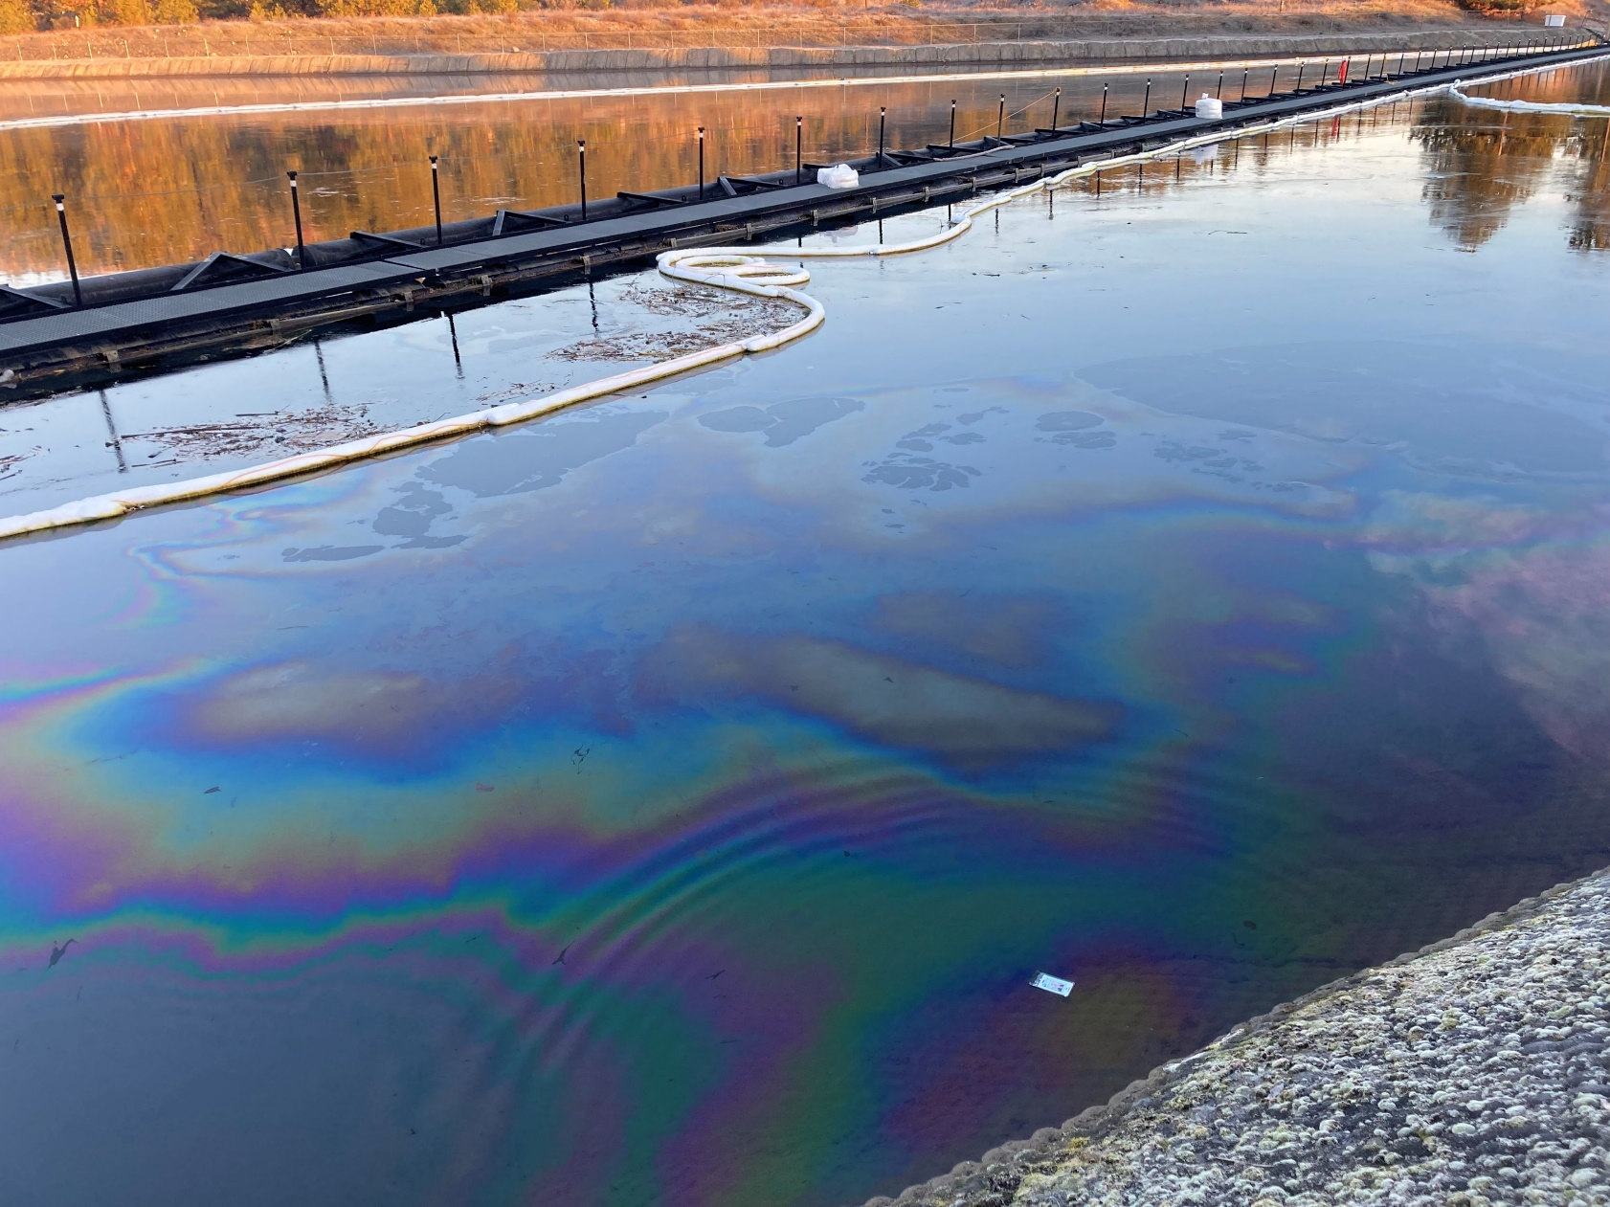
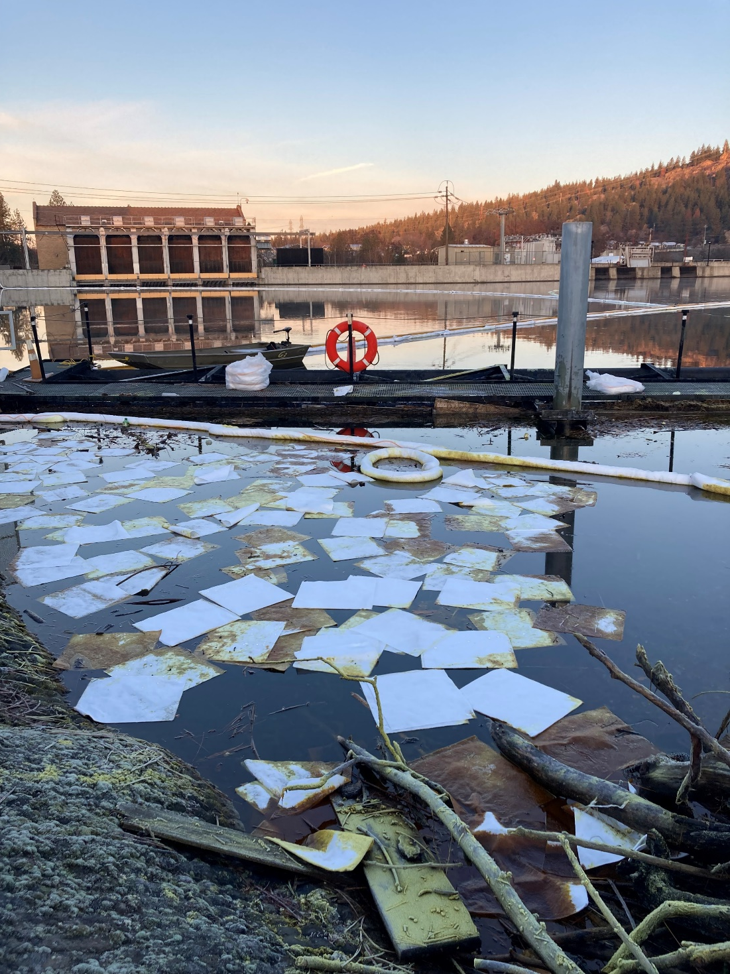

Slide 14
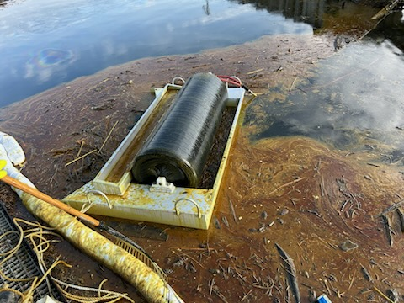
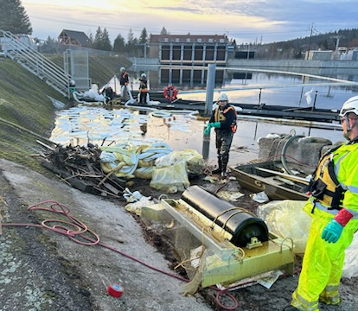

Slide 15
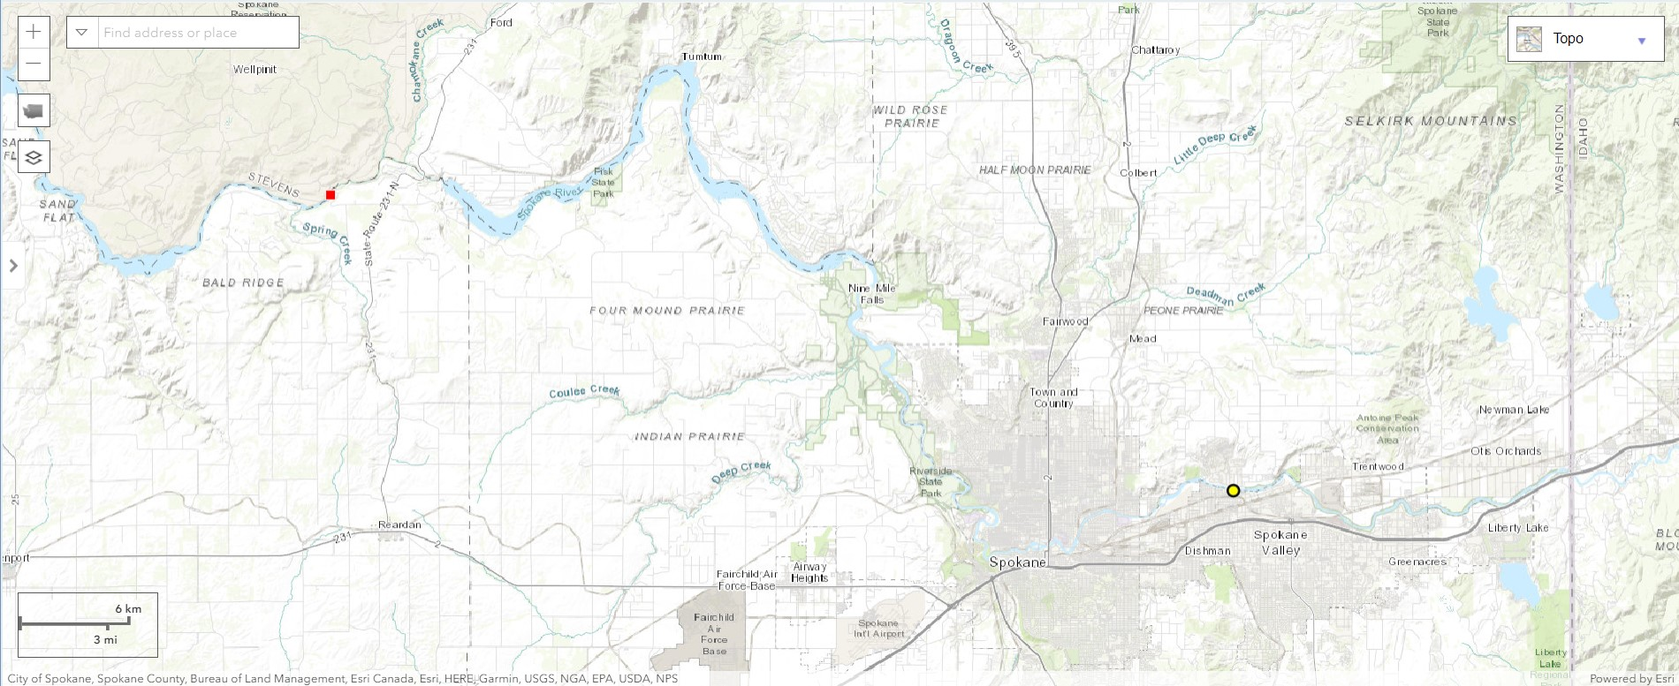
Spill Location
Notes:
Commercial Marine, family-owned marina on Westlake Avenue in Lake Union.

Slide 16
ERTS# 727657
Preassessment Screening
Incident Information
Are the damages quantifiable at a reasonable cost?
Is restoration or enhancement technically feasible?
Estimated spill to water volume:
To be determined
Oil Type
Lube/Mineral Oil
Geographic Extent of Impacts
Spokane River
Volume of oil recovered within the first 24 hours:
None

Slide 17
ERTS# 727754
Complete Office Truck Diesel Spill
December 31, 2023

Slide 18
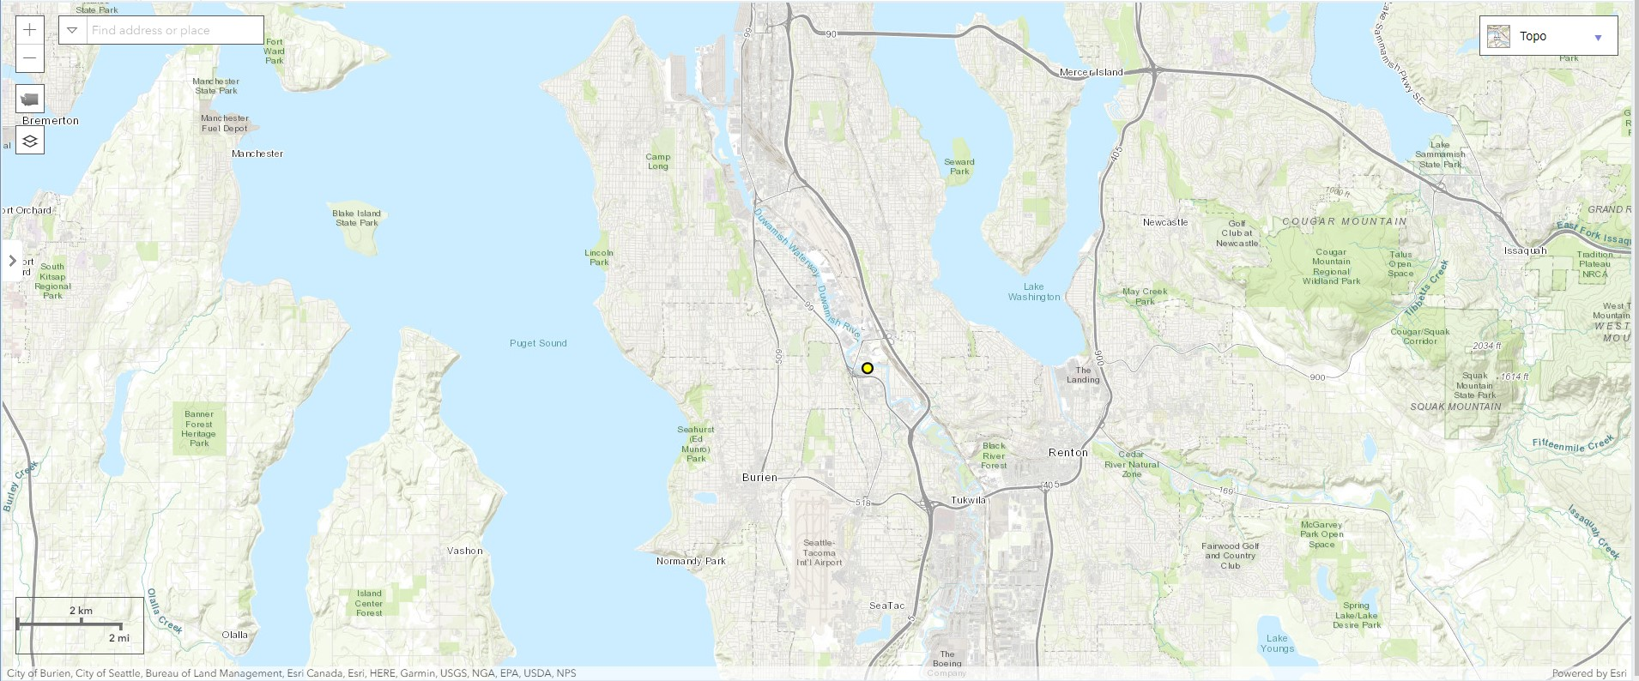
Spill Location

Slide 19
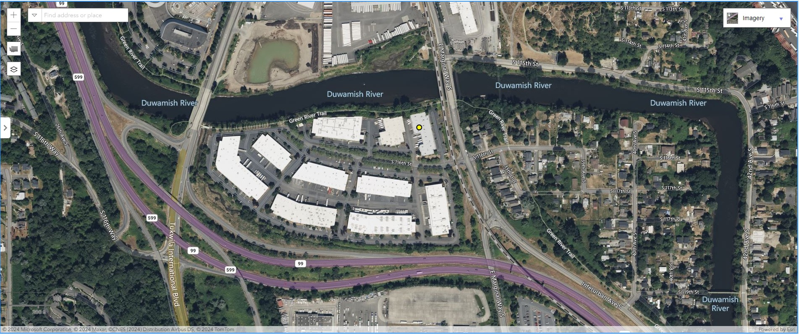
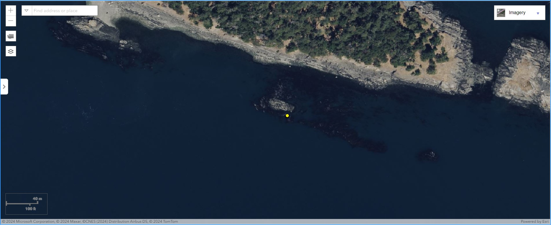
Spill Location

Slide 20
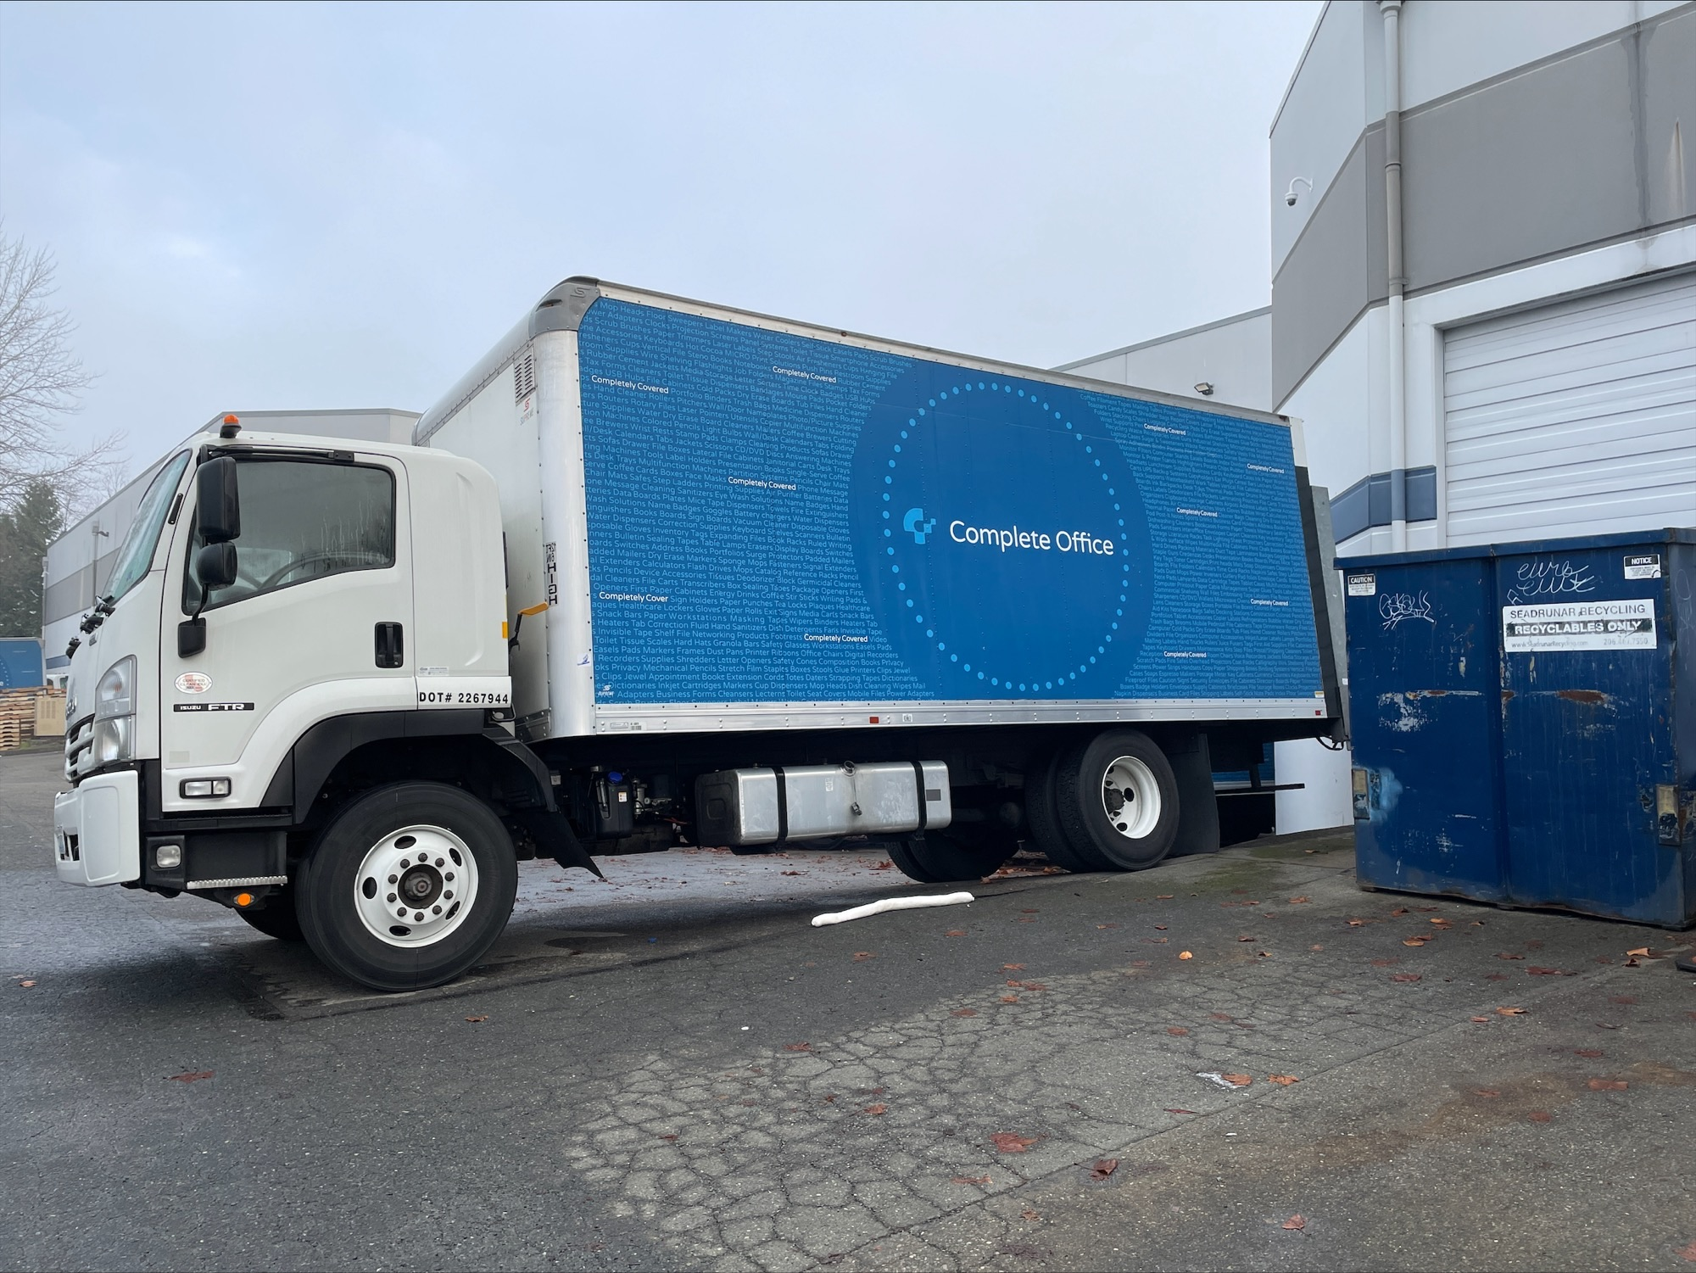
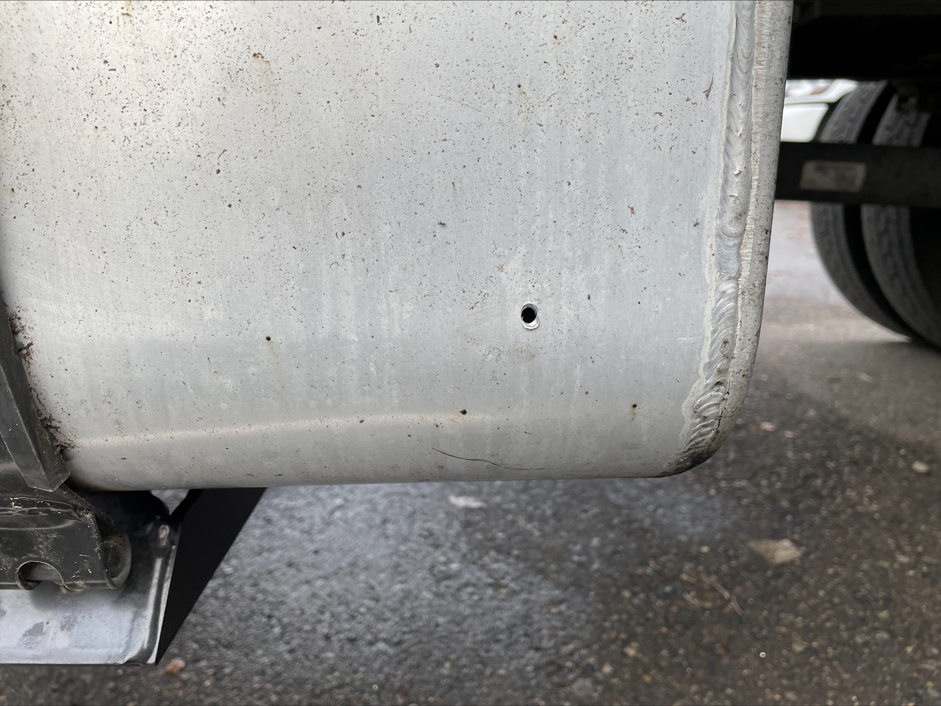

Slide 21
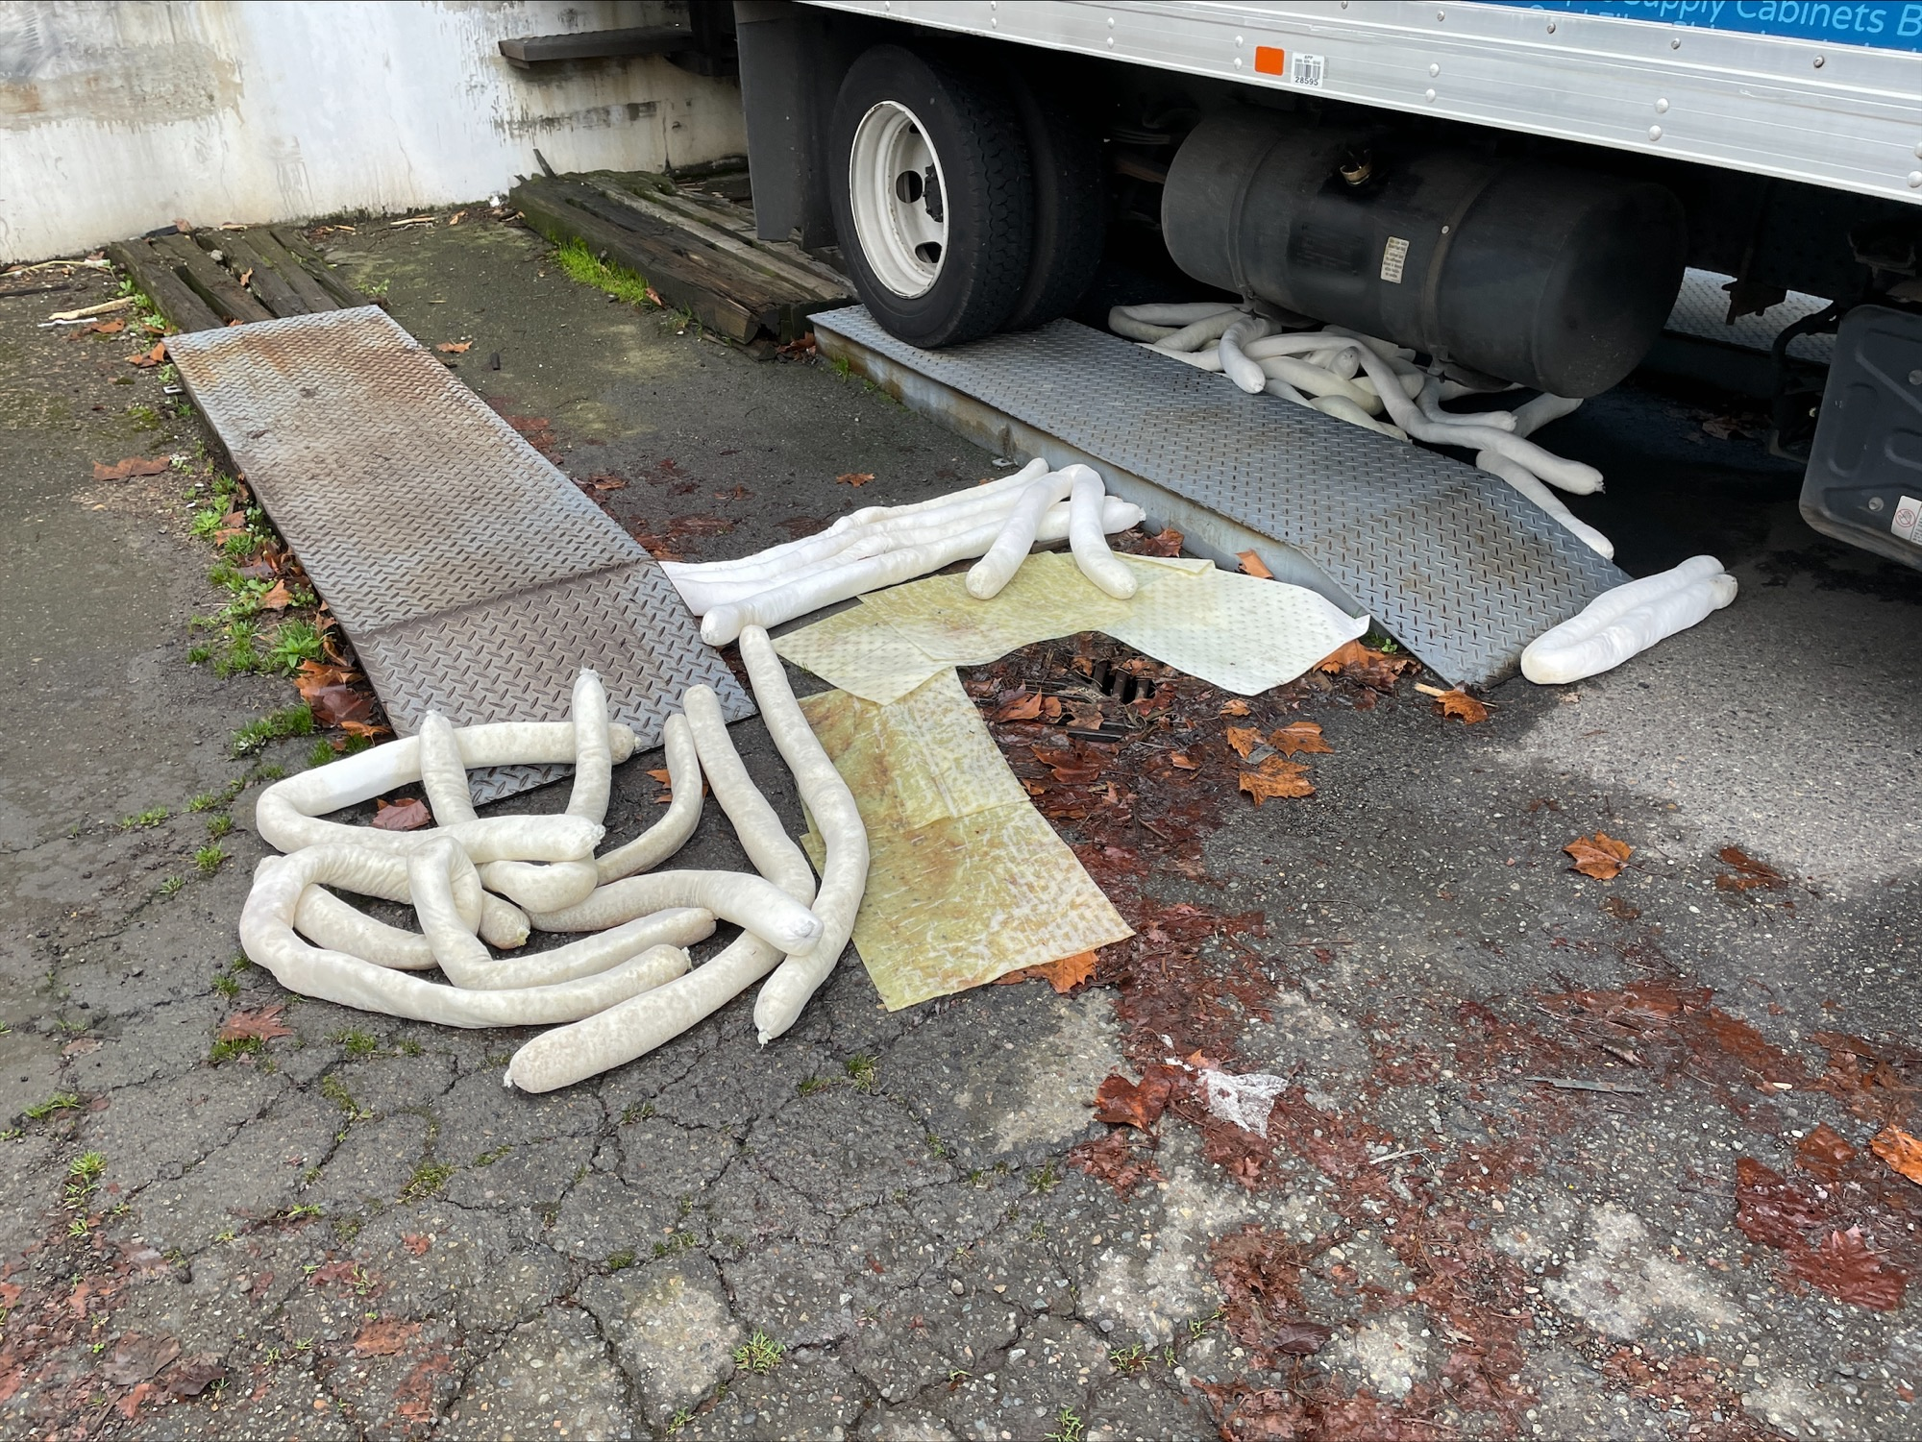

Slide 22
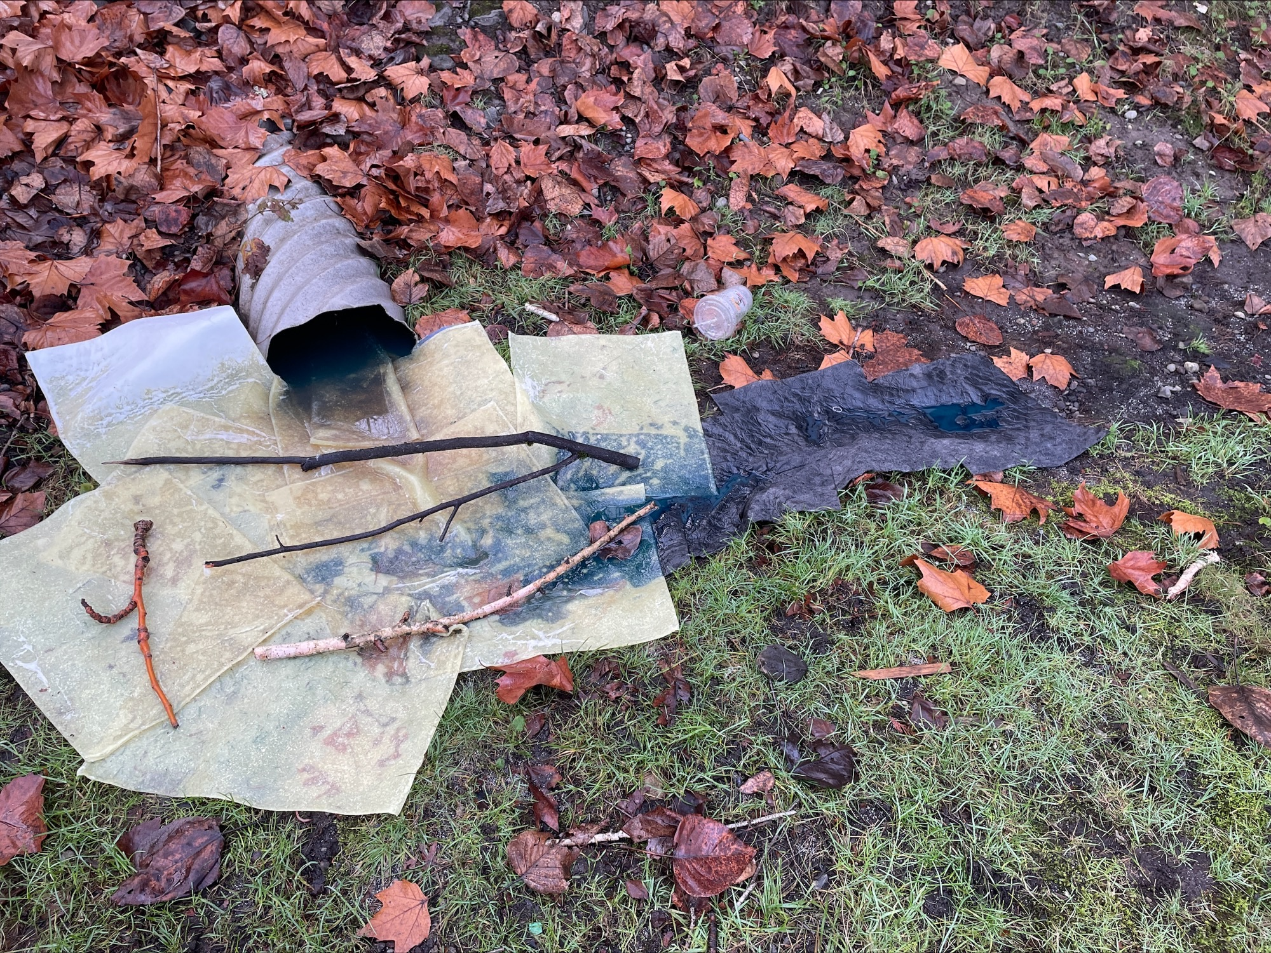

Slide 23
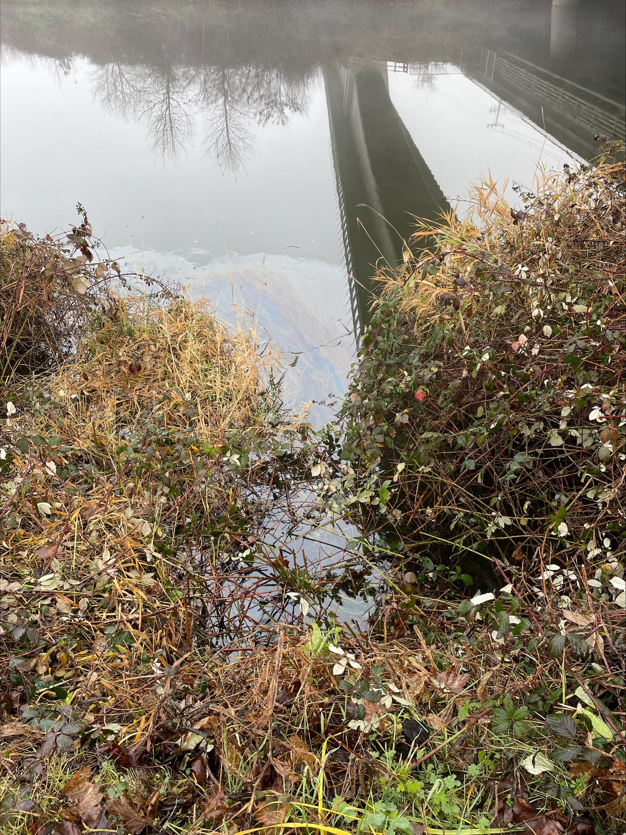
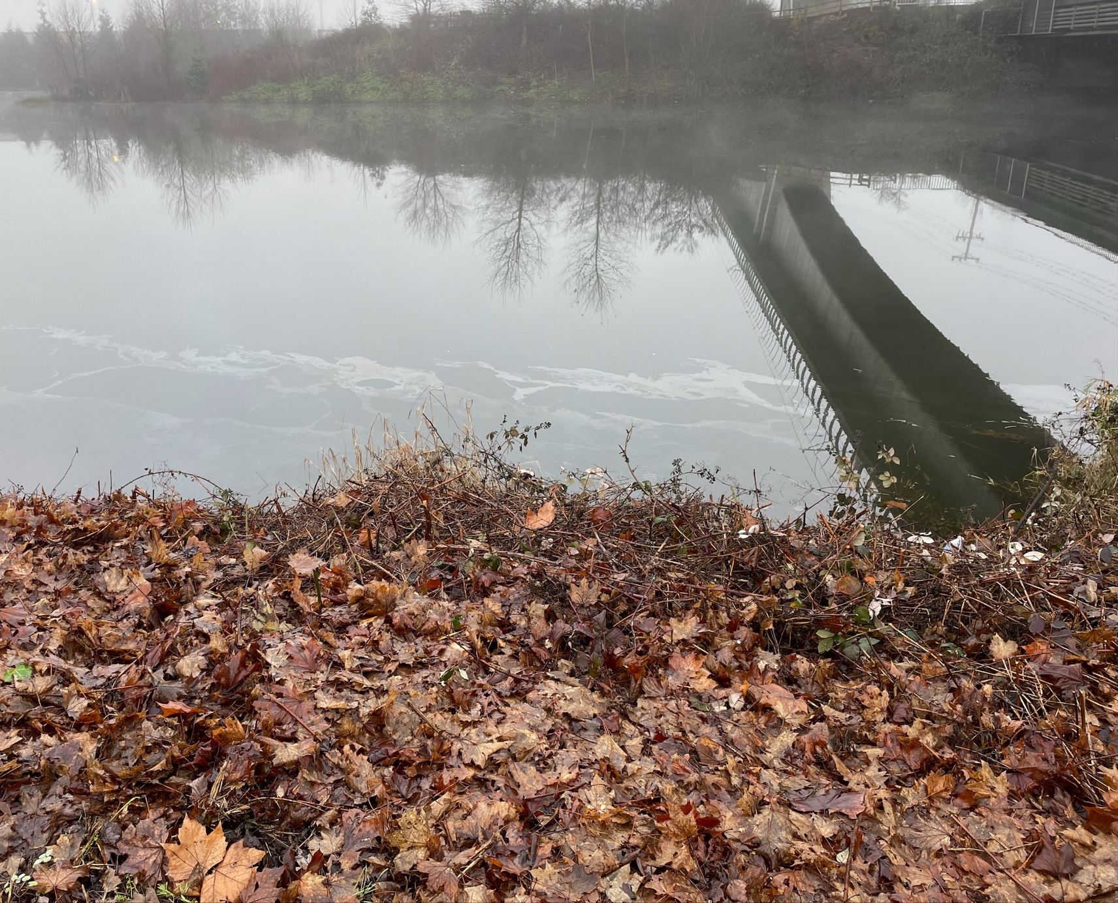

Slide 24
ERTS# 727754
Preassessment Screening
Incident Information
Are the damages quantifiable at a reasonable cost?
Is restoration or enhancement technically feasible?
Estimated spill to water volume:
30 gallons
Oil Type
Gasoline
Geographic Extent of Impacts
Duwamish Waterway
Volume of oil recovered within the first 24 hours:
None

Slide 25
ERTS# 727699
P/C Maiad II Sinking Diesel Spill into the Lewis River
December 28, 2023

Slide 26
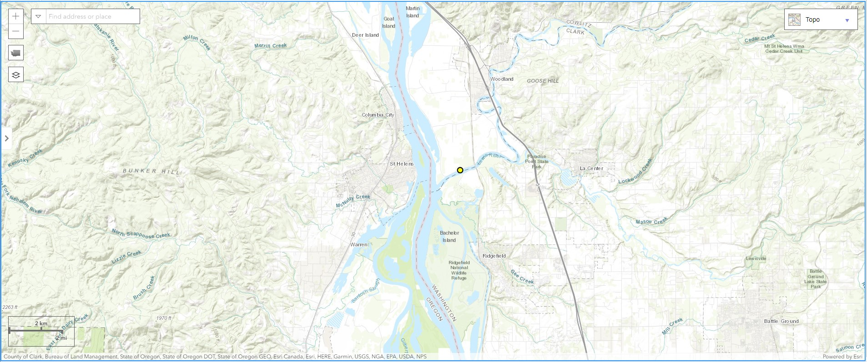
Spill Location

Slide 27
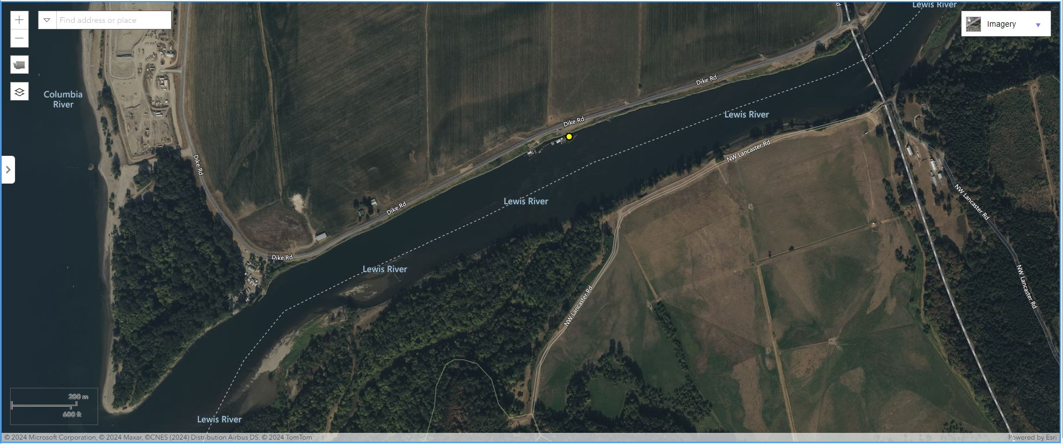
Spill Location

Slide 28
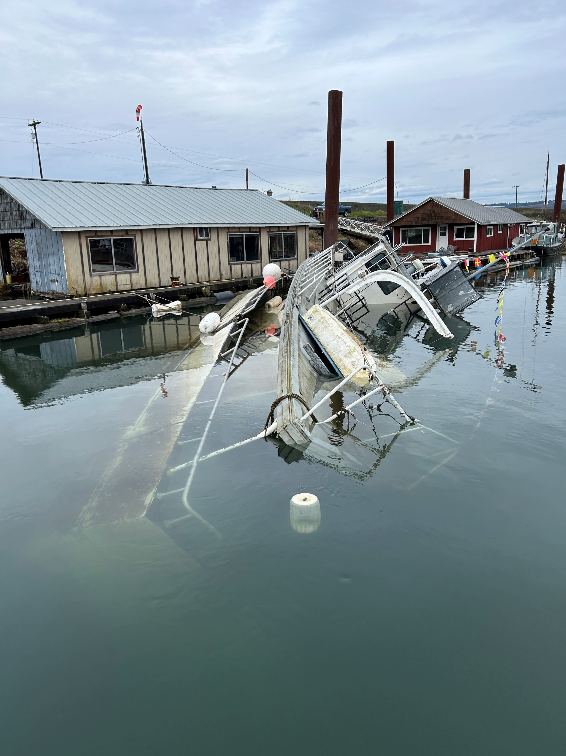
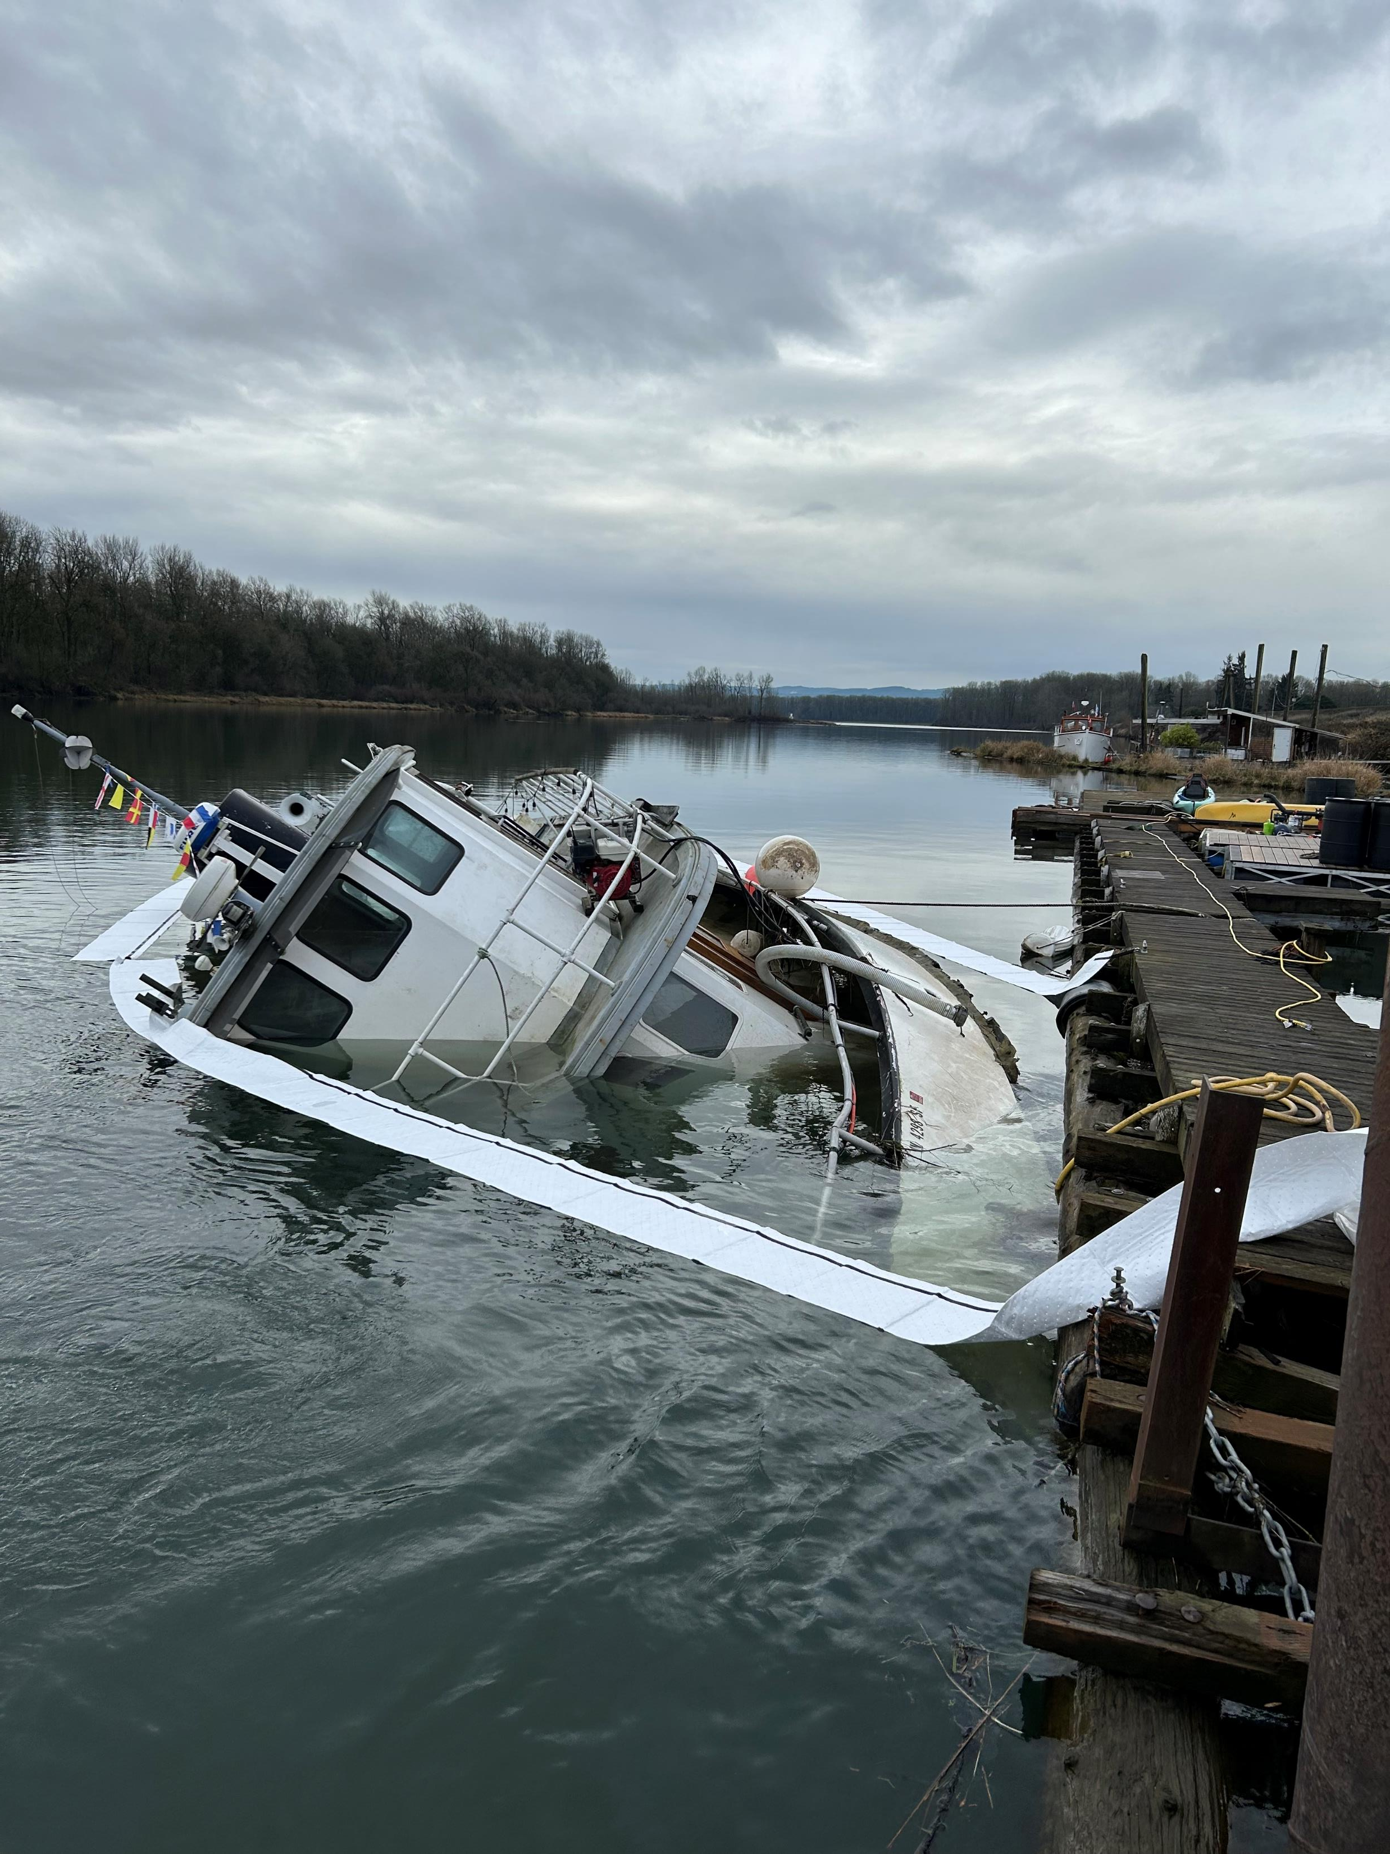

Slide 29
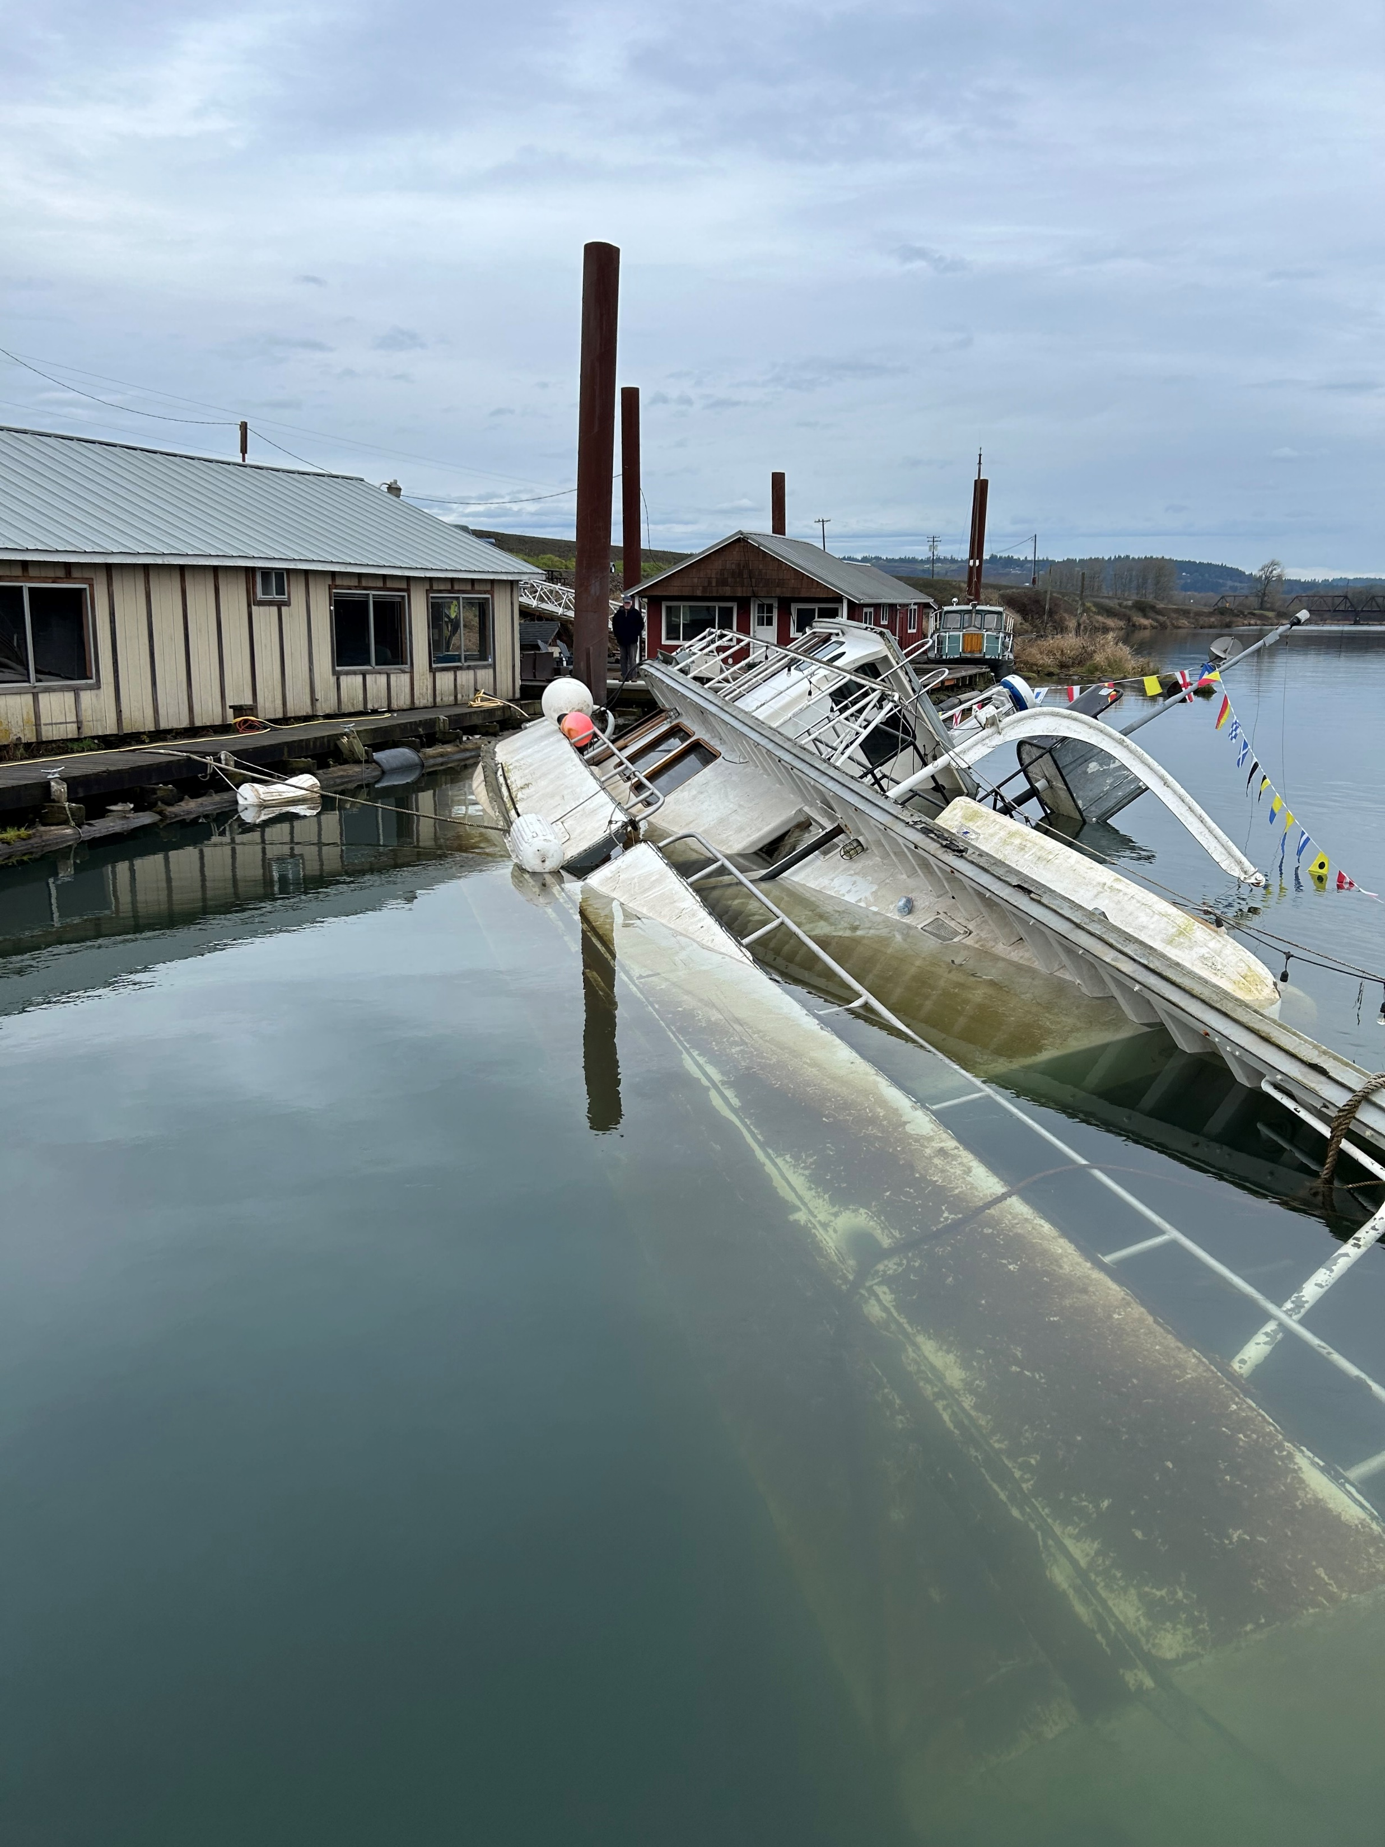
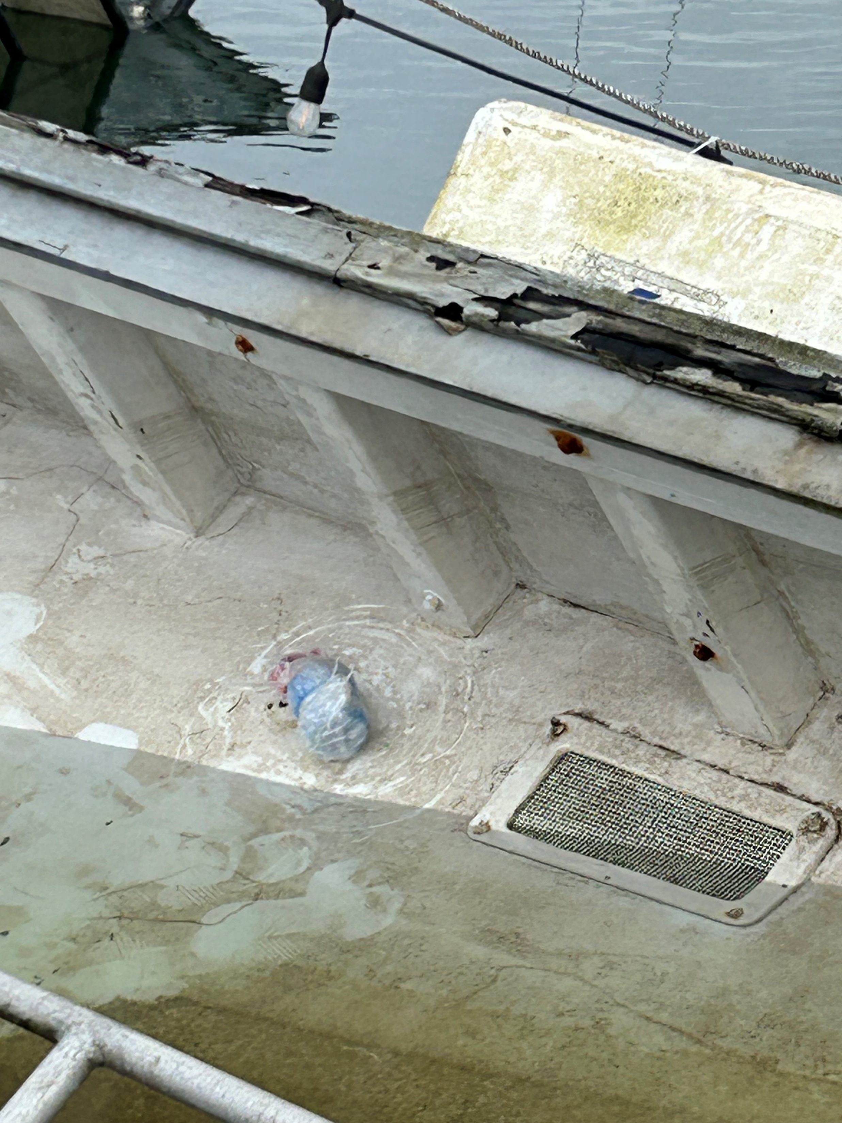

Slide 30
ERTS# 727699
Preassessment Screening
Incident Information
Are the damages quantifiable at a reasonable cost?
Is restoration or enhancement technically feasible?
Estimated spill to water volume:
65 gallons
Oil Type
Diesel
Geographic Extent of Impacts
Lewis River
Volume of oil recovered within the first 24 hours:
None

Slide 31
ERTS# 728009
Port of Everett Vessel Fire and Fuel Spill
January 14, 2024

Slide 32
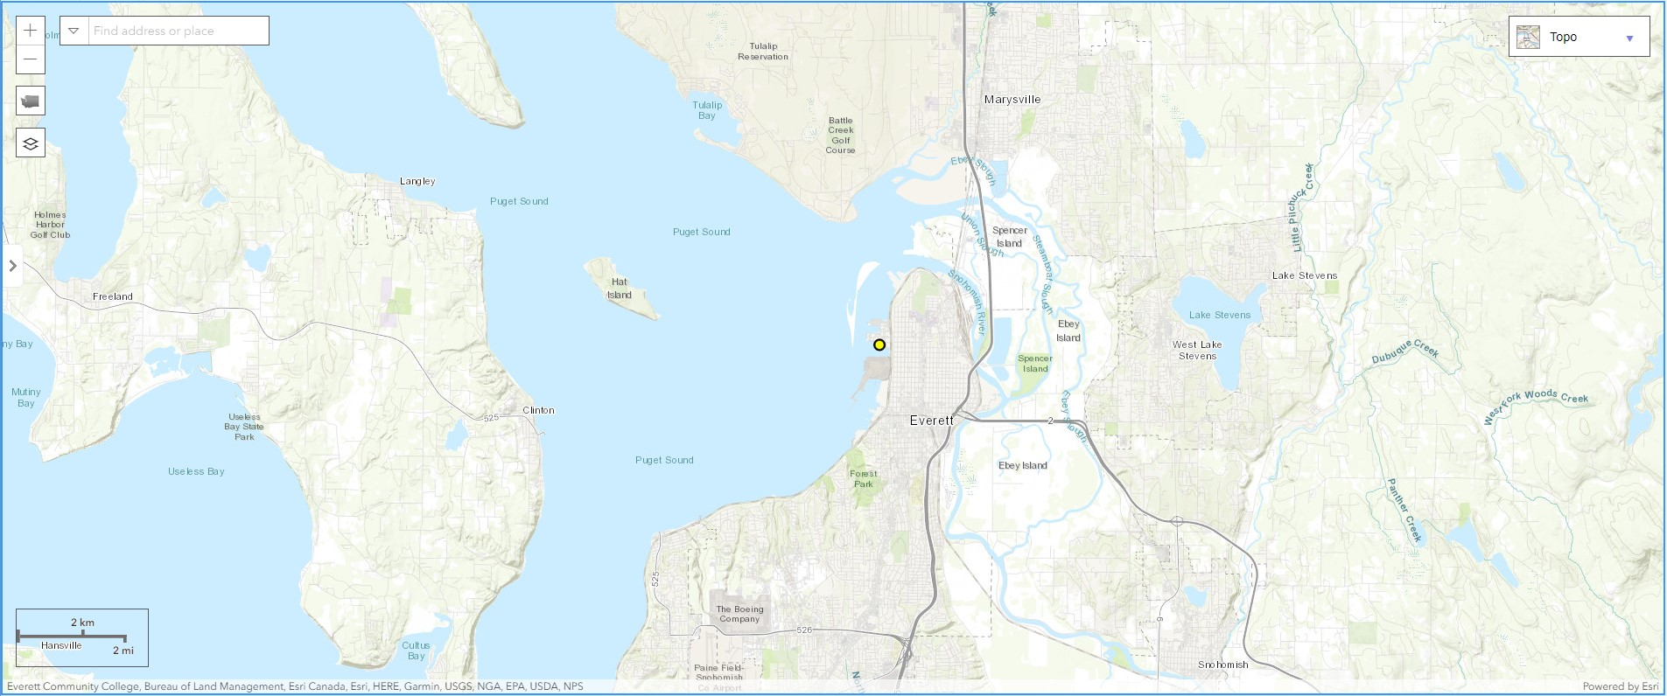
Spill Location

Slide 33
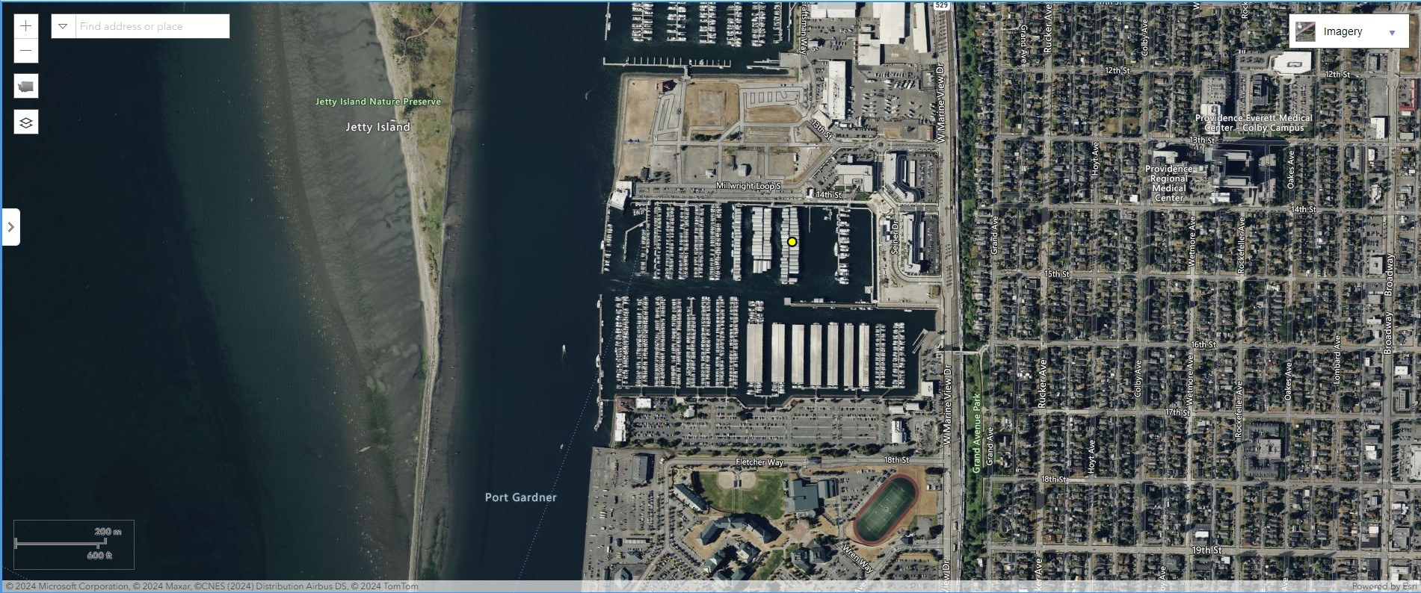
Spill Location

Slide 34
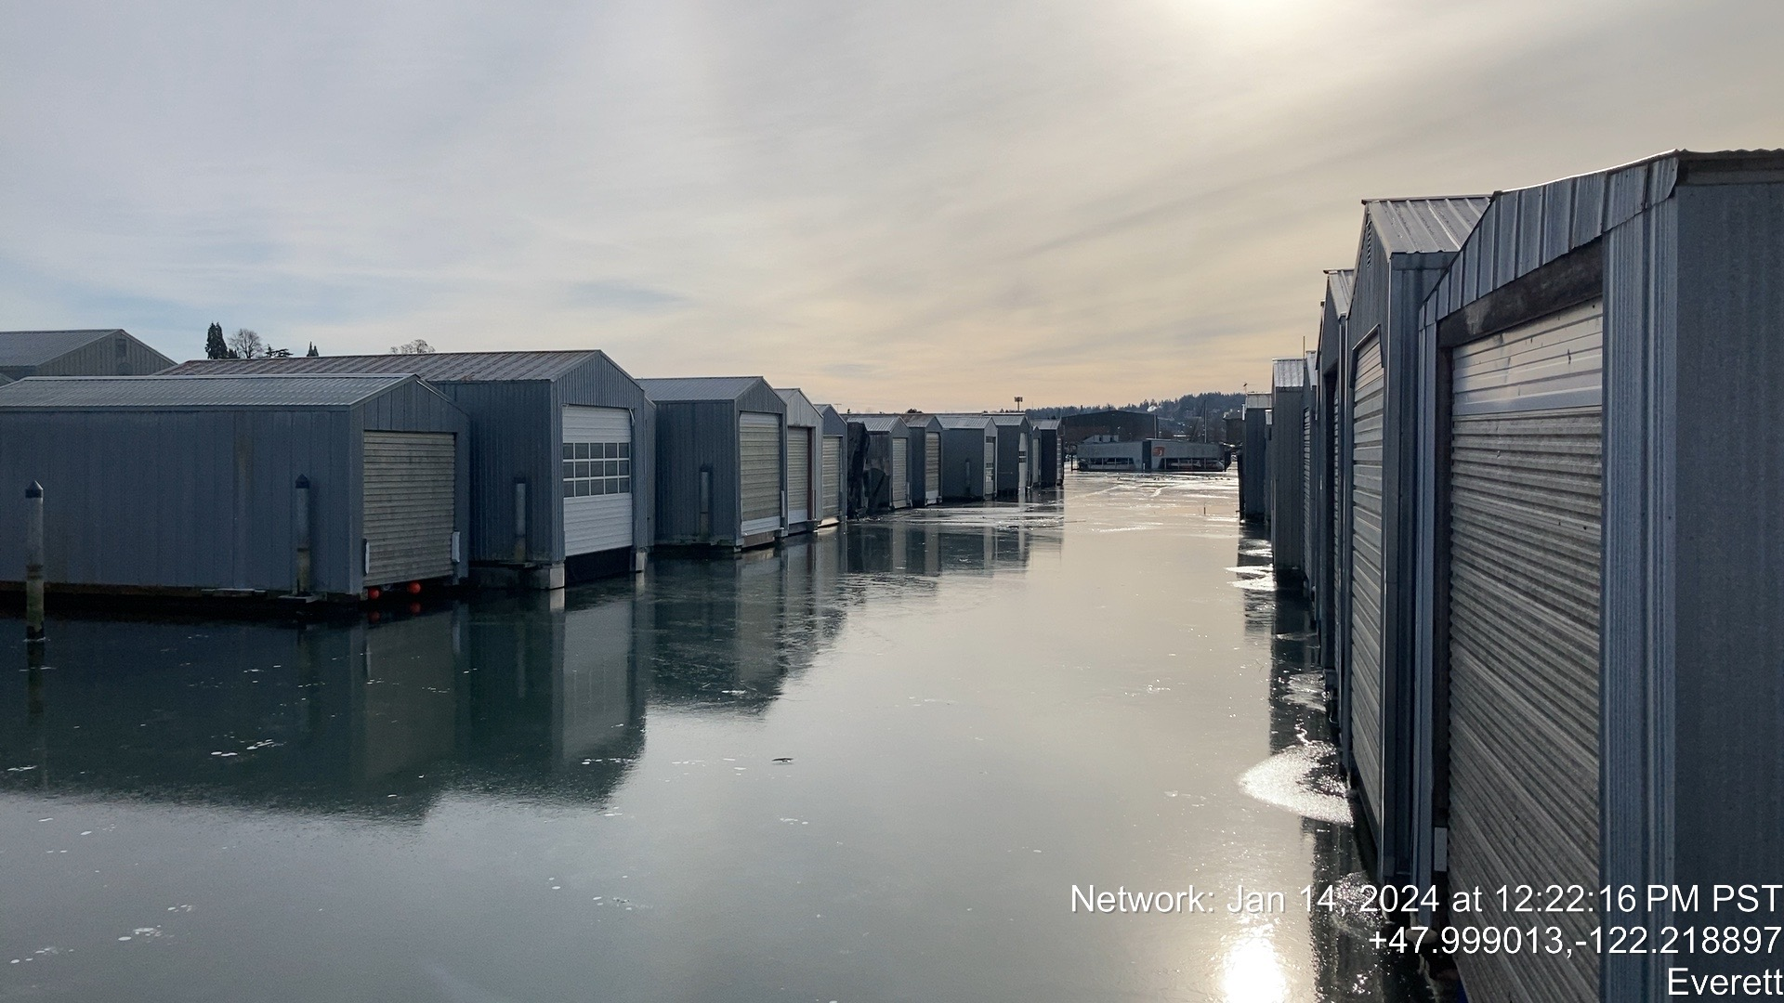

Slide 36
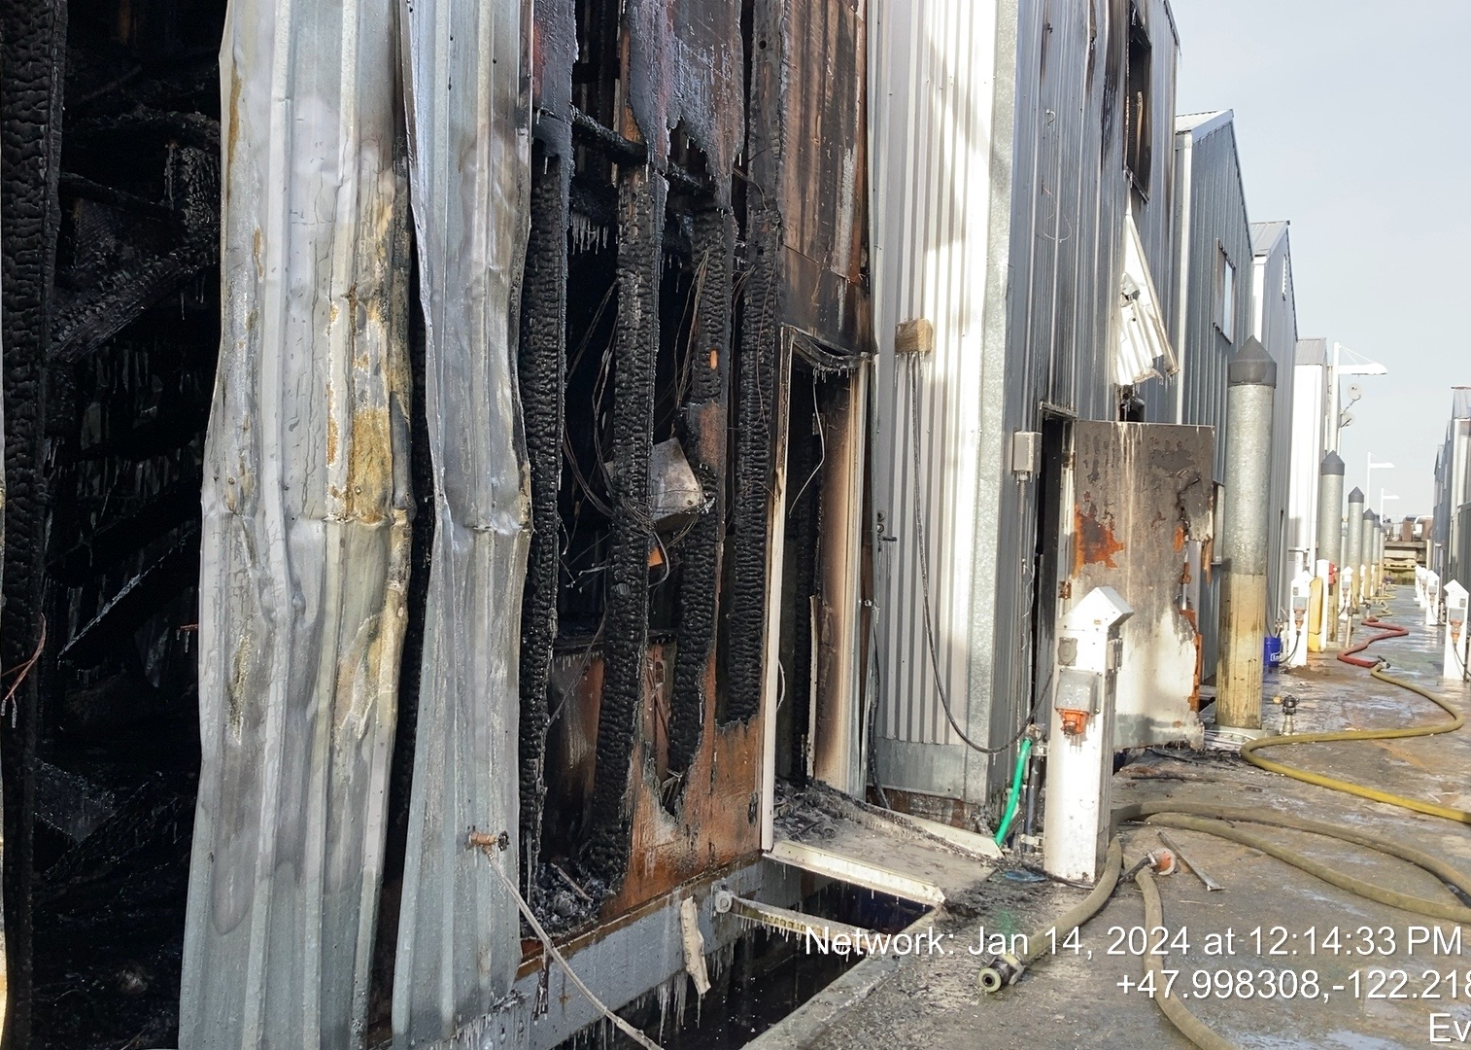
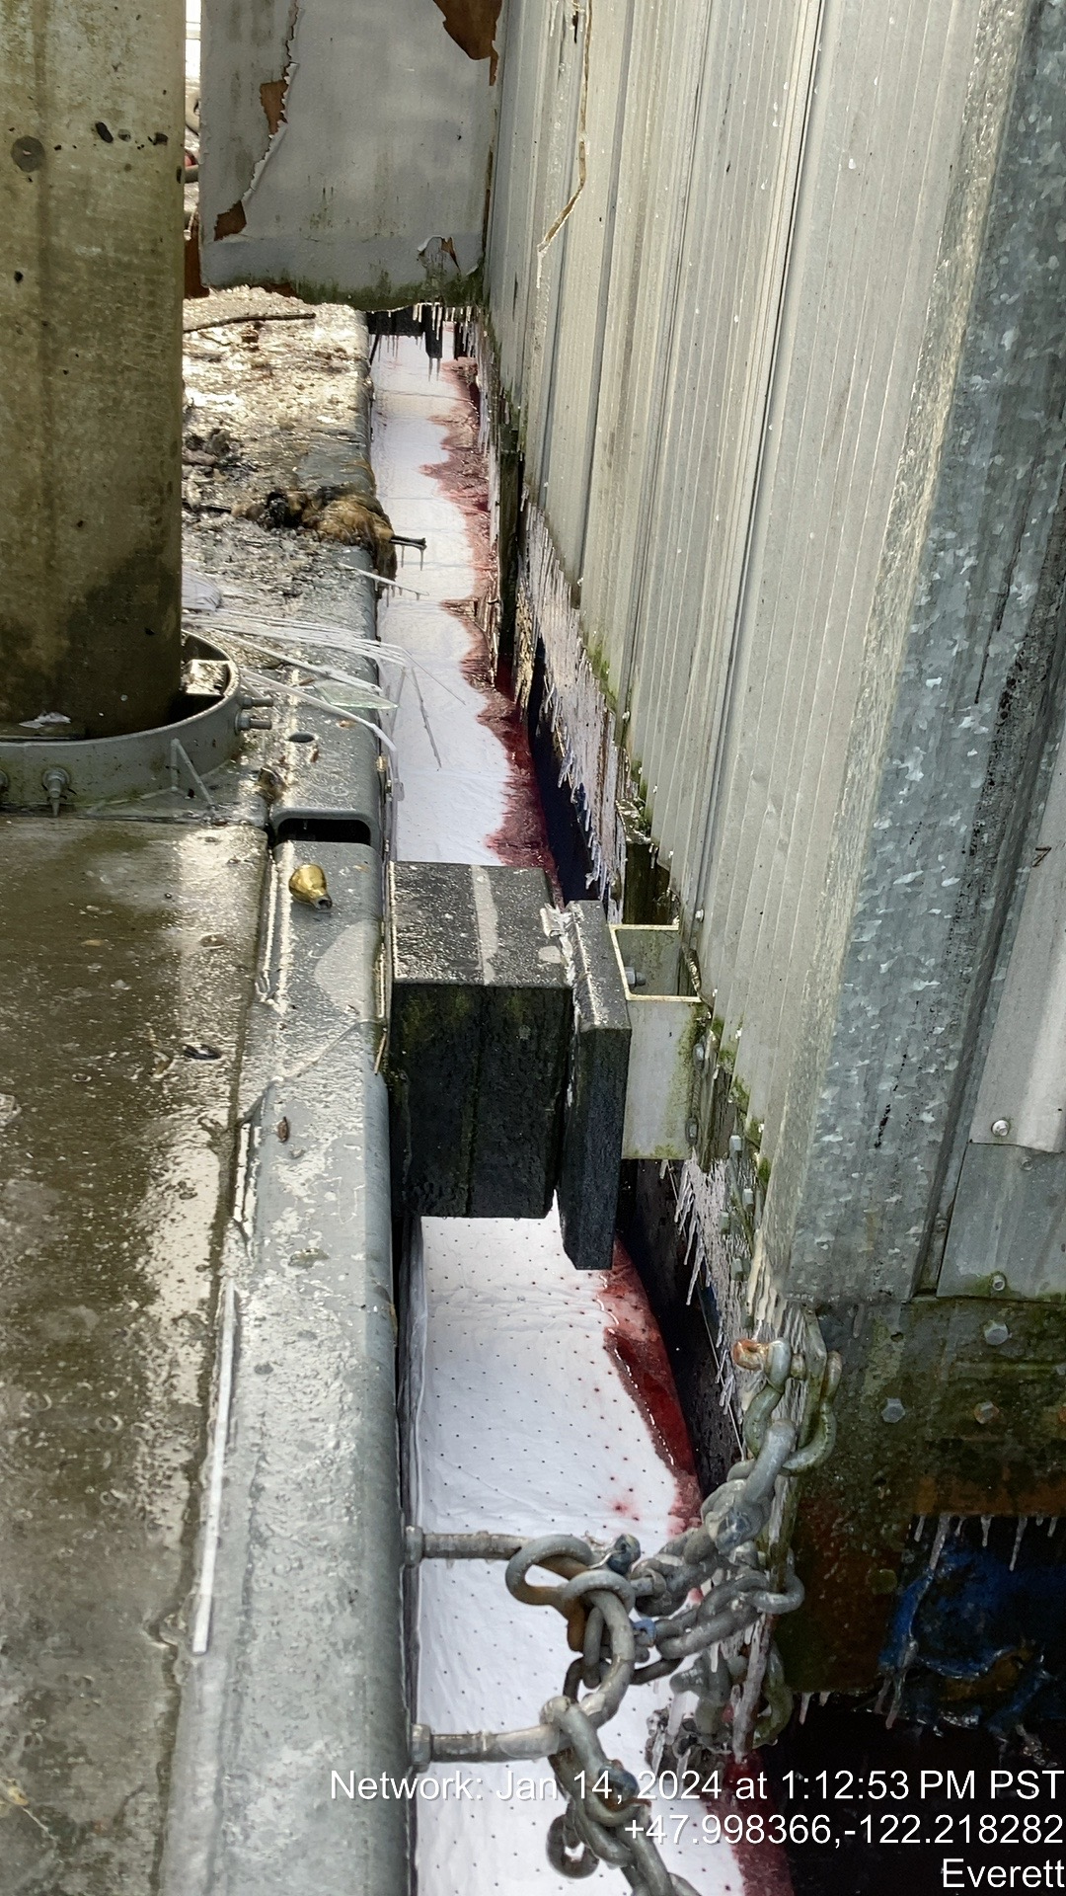

Slide 37
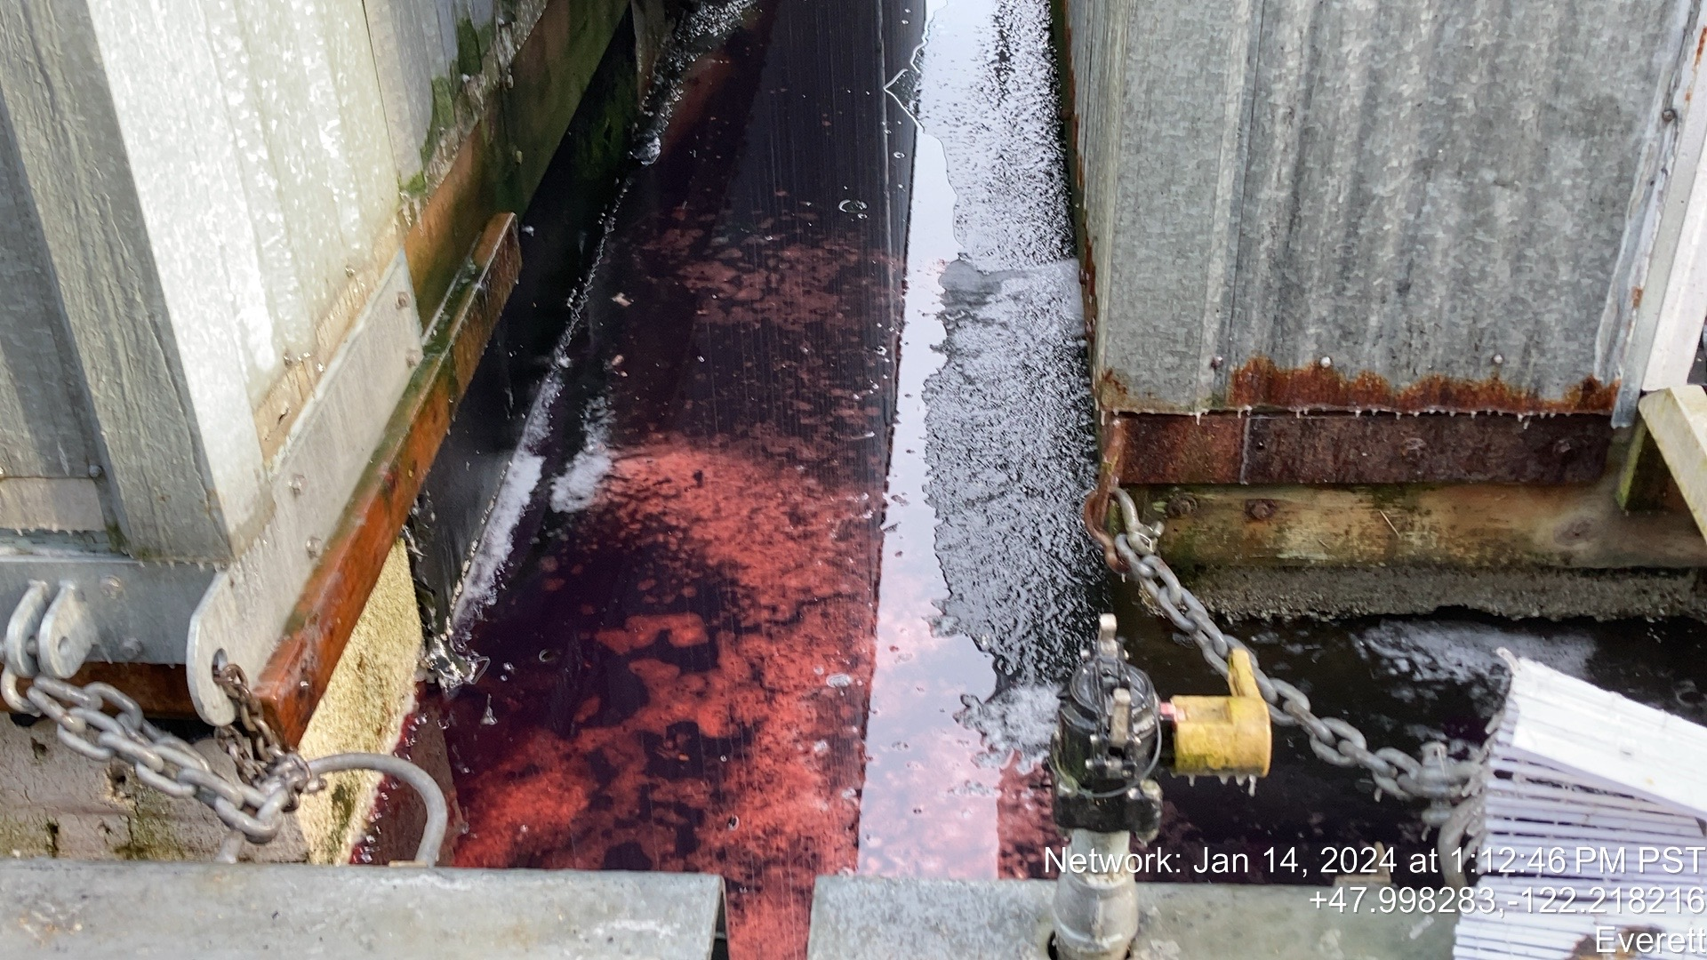

Slide 38
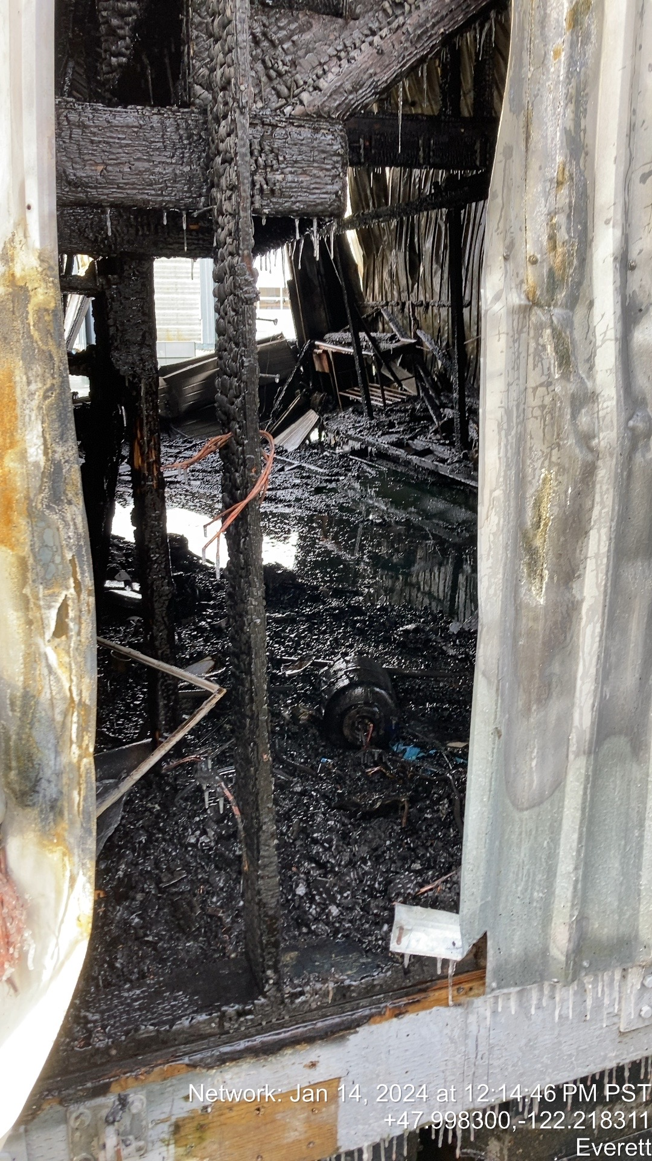
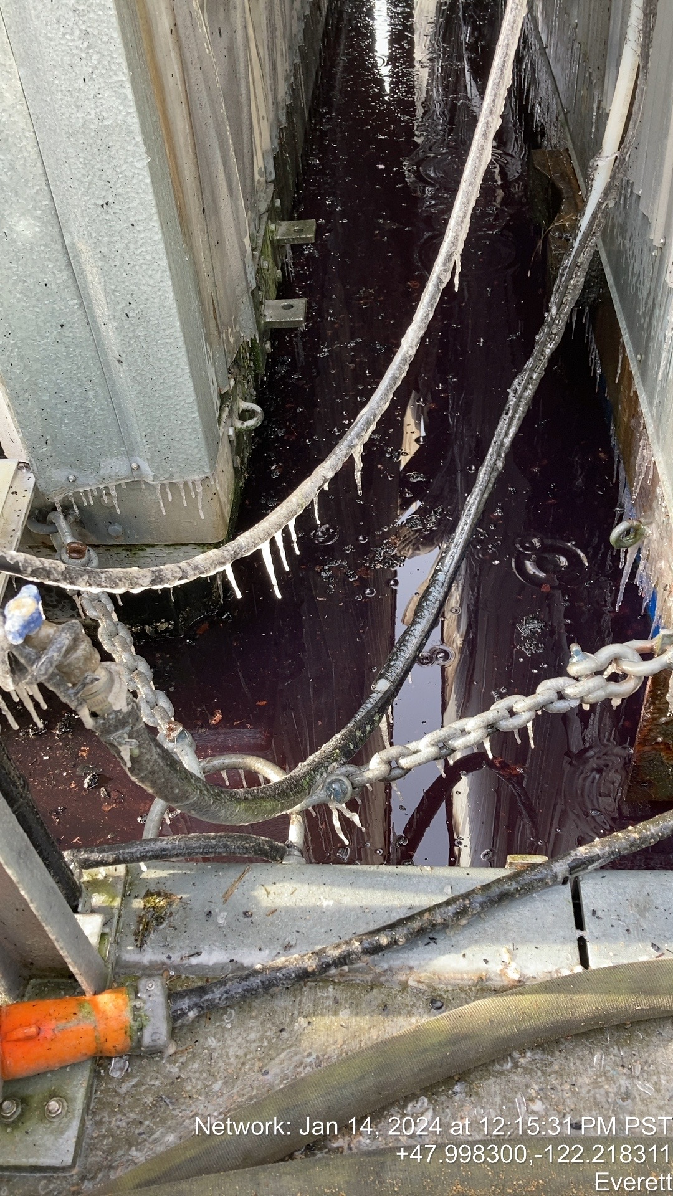
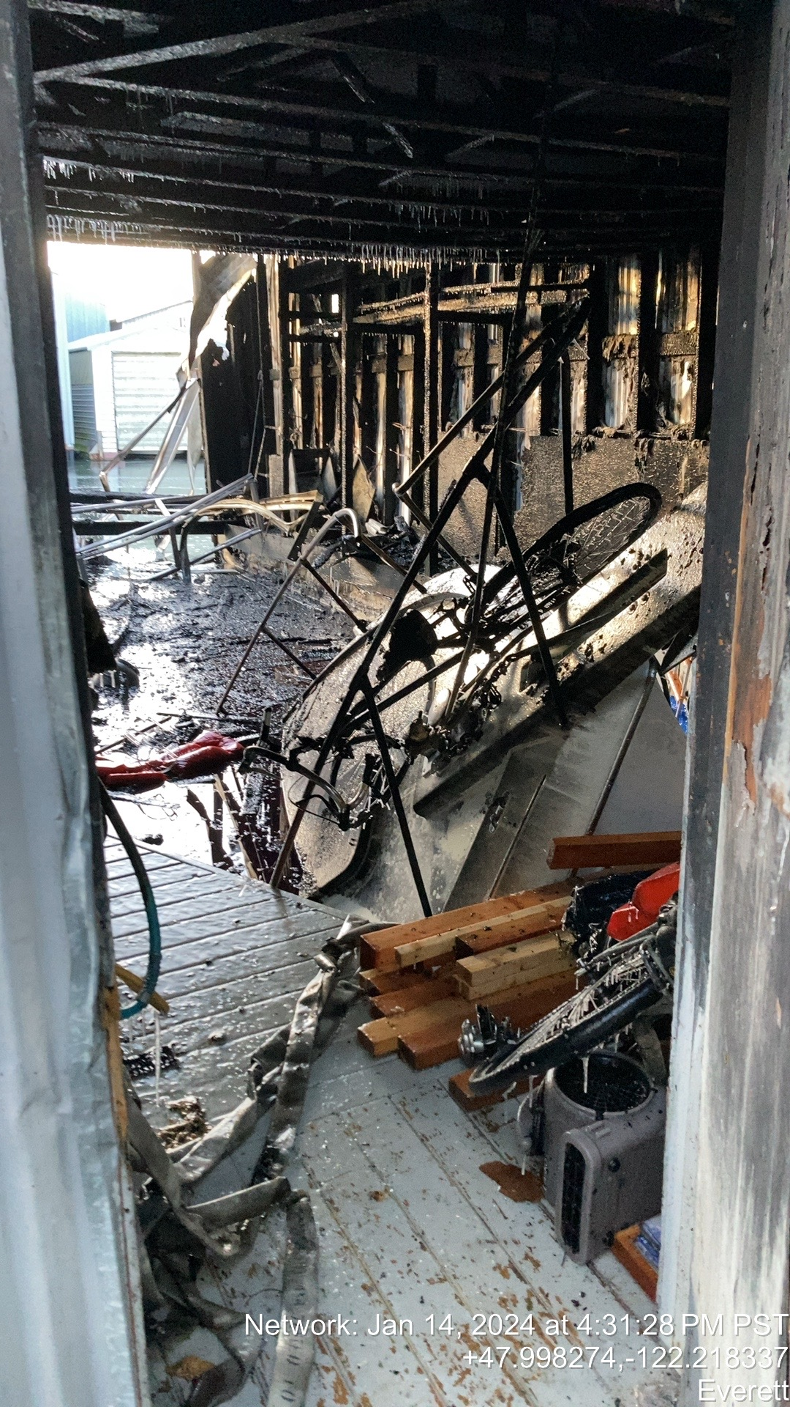

Slide 39
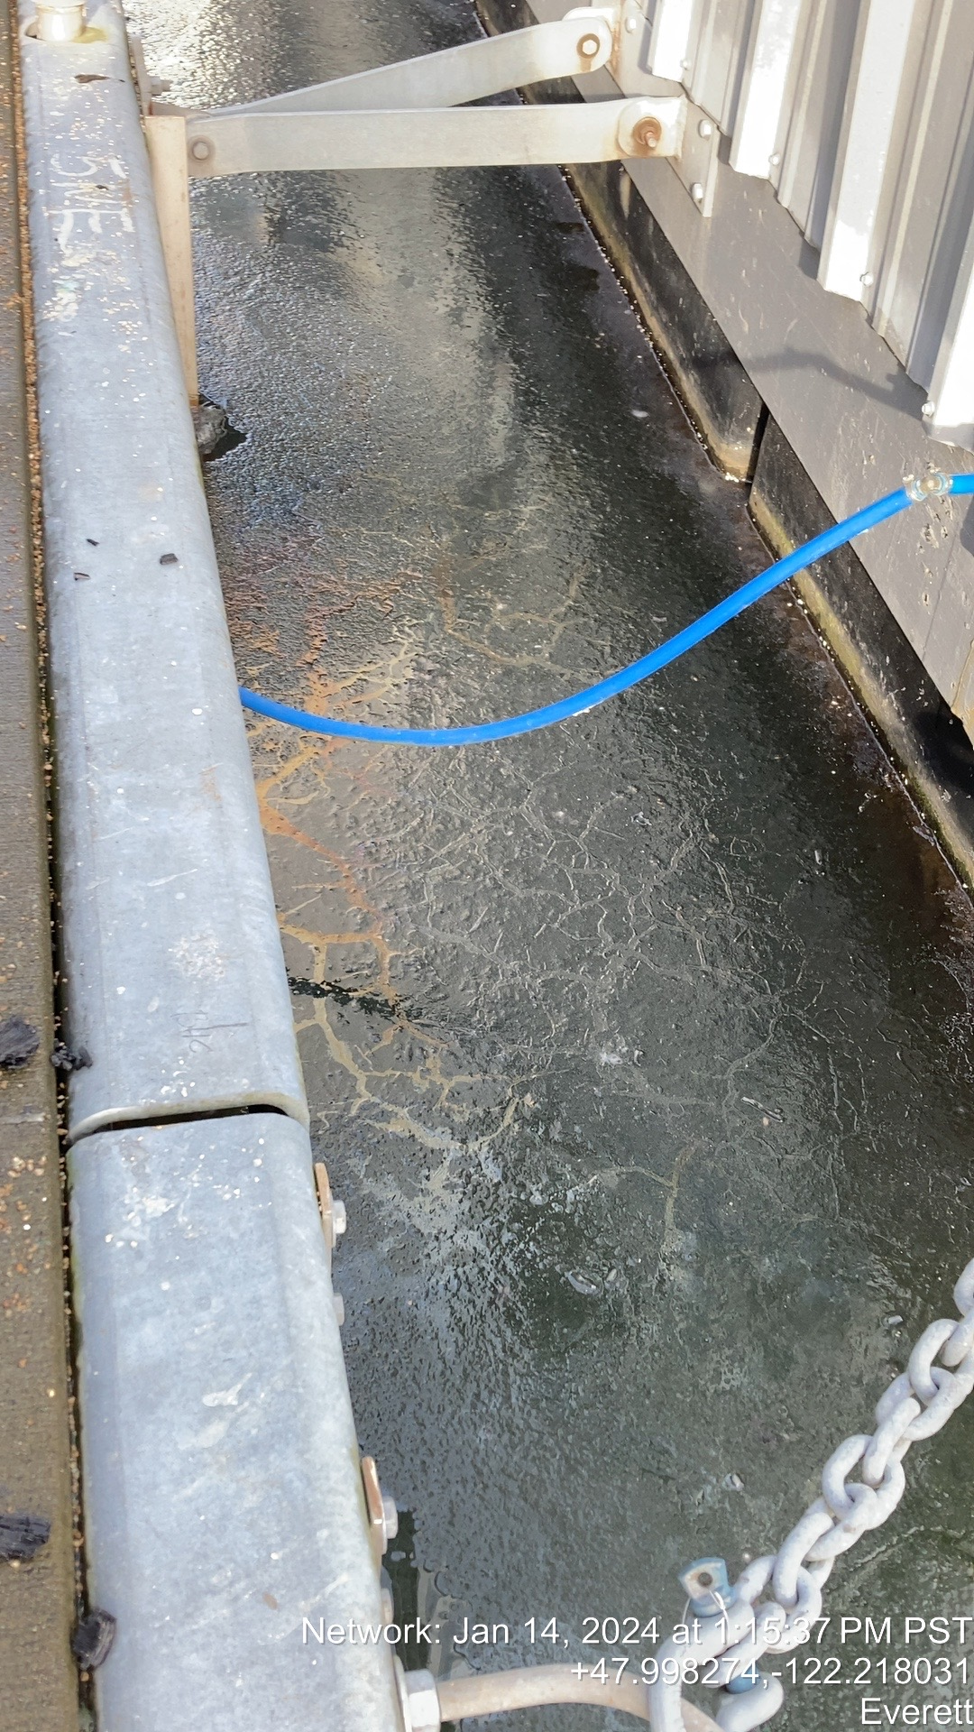
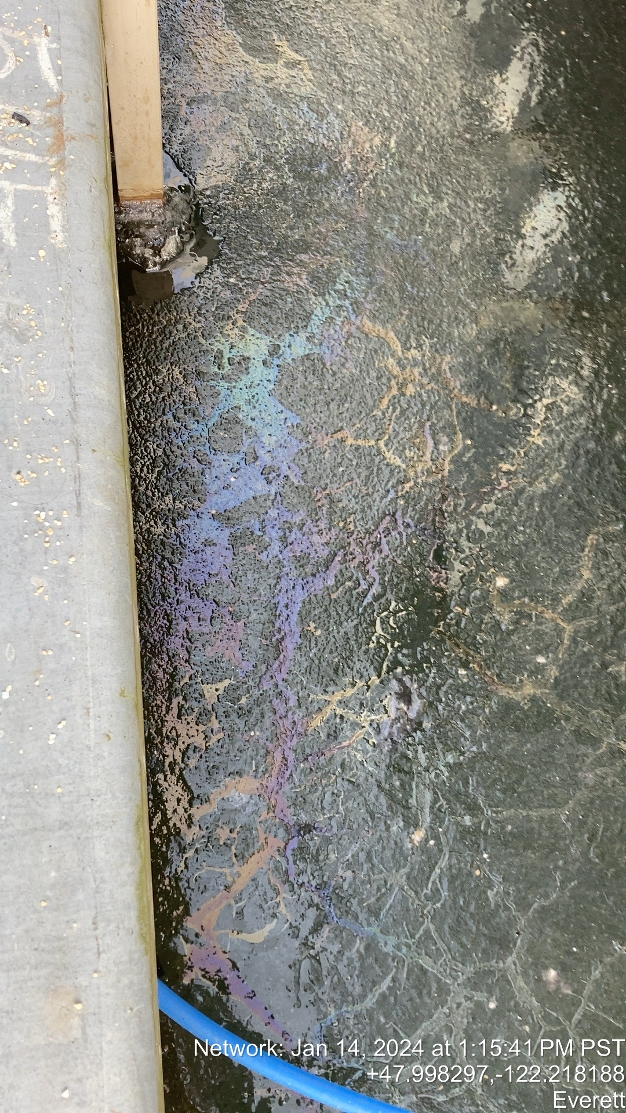

Slide 40
ERTS# 728009
Preassessment Screening
Incident Information
Are the damages quantifiable at a reasonable cost?
Is restoration or enhancement technically feasible?
Estimated spill to water volume:
As much as 150 gallons
Oil Type
120 gallons diesel fuel and 30 gallons gasoline
Geographic Extent of Impacts
Possession Sound
Volume of oil recovered within the first 24 hours:
None

Slide 41
Old Business
Open Case Updates
ERTS #727283 Olympic Pipeline Gasoline Spill
Conway 12/10/2023

Slide 42
Announcements
Next meeting Wednesday, April 10, 2024
Room R1S-16 (and Teams)

Slide 43
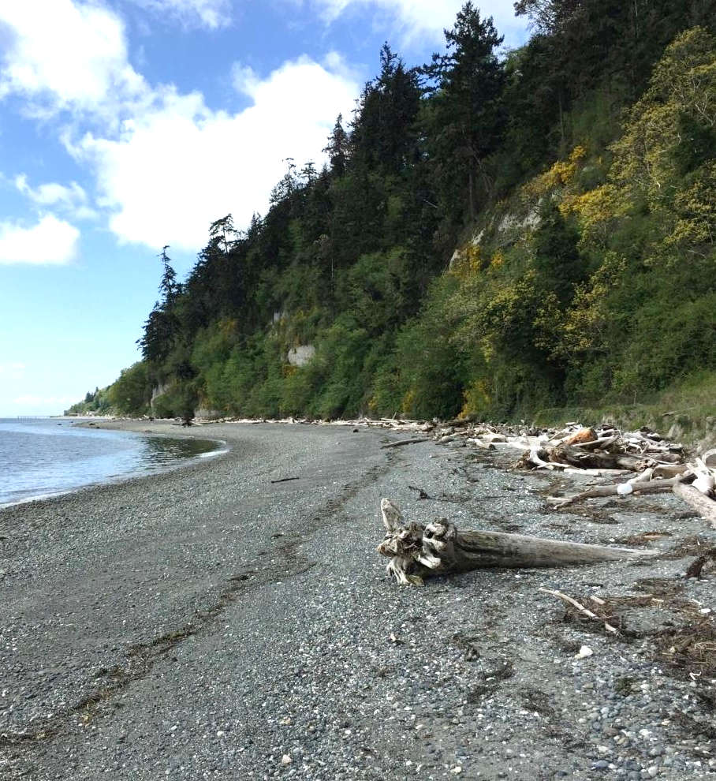
Meeting Adjourned
Geoff Baran Washington State Department of Ecology
360-790-9725
Geoff.Baran@ecy.wa.gov

