Slide 1


The meeting will begin shortly
Resource Damage Assessment Committee Meeting
Please keep your microphone muted unless speaking
Webcam is optional
Notes:
*Friendly idle chit-chat*

Slide 2
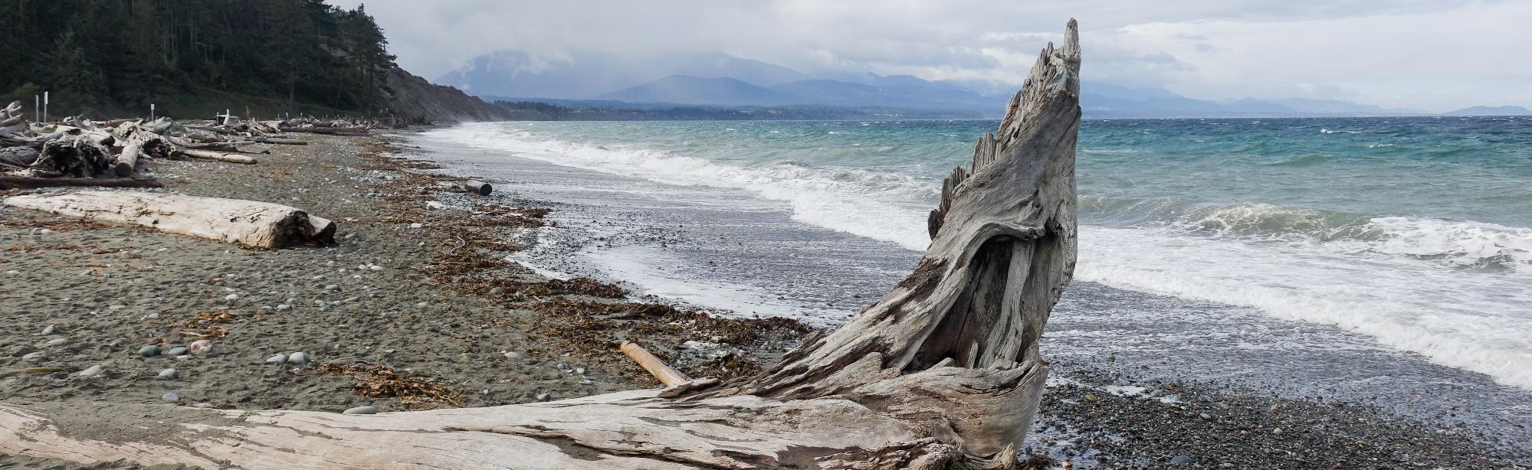
Resource Damage Assessment Committee Meeting
Geoff Baran
April 10, 2024

Slide 3
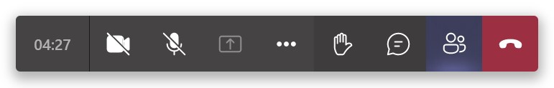
Welcome to MS Teams
Webcam is optional
Please mute your microphone to reduce background noise
For immediate questions or comments, please raise your hand
Please use the chat function
Notes:
Provide basic Zoom instructions.
If there are in-person attendees, identify fire extinguisher, AED, and restroom location.

Slide 4
Ecology Building
AED located at Security Desk
Fire Extinguisher
We are in R1S-16
Restrooms are located down the hall
Fire Extinguisher is outside the door
An AED is available at the Security Desk
In the event of an evacuation, our exit door is across the hall into the field
Evacuation
Route
R1S-16
Restrooms

Slide 5
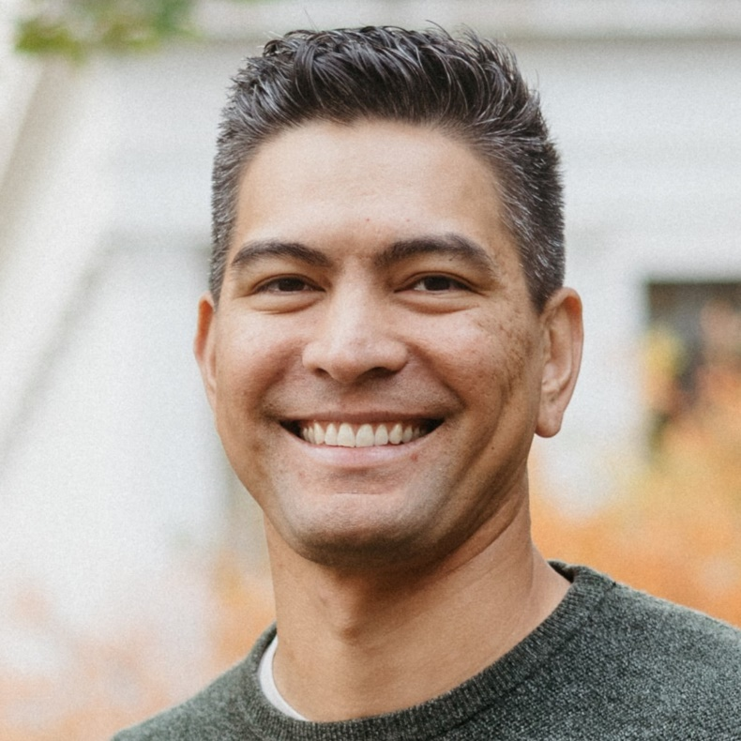
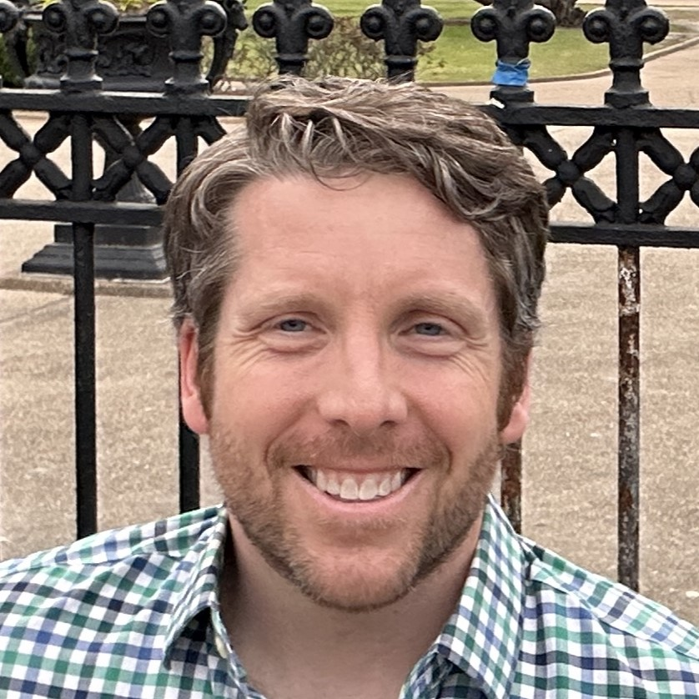
Ecology NRDA Team
Geoff Baran
Committee Chair
Host, facilitator
Josh Weide
Committee Executive Director
Note taker, moderator

Slide 6
Table of Contents
1
Call to Order
Roll Call, Introduction, Agenda Review
2
New Business
3
Old Business
4
Announcements
6
Adjourn
Notes:
Rough overview of today’s proceedings

Slide 7



Welcome, Roll Call
Notes:
WELCOME
ROLL CALL
INTRODUCTION
Purpose:
This committee is responsible for conducting preassessment screenings for natural resource damage assessments for oil spill that impact the waters of Washington State.
The committee is defined in statute, and comprised of representatives of the Washington State Department of Fish and Wildlife, The Department of Natural Resources, Department of Archeology and History Preservation, Department of Health, and the Washington State Parkas and Recreation Commission
We are NOT assigning liability at this meeting. The purpose of this meeting is to evaluate the natural resource injuries from the spill, review available data, and work cooperatively with potentially liable parties to assess the harm to the environment from oil spills.
Goal:
Work cooperatively with the potentially liable party to determine whether detailed damage assessment studies should be conducted, or whether the compensation schedule will be used to assess the damages.
The ultimate goal of this process is to restore publicly-owned resources that have been damaged by oil spills.
Objectives:
Conduct preassessment screenings of all oil spills that impact Washington State waters.
Evaluate each case and consider whether damages are quantifiable at a reasonable cost
Whether restoration or enhancement is technically feasible.
Evaluate any projects proposed in lieu of a damage claim.
The committee will vote yes or no on those questions, and if the answer is no, the Compensation Schedule is authorized to assess damages
Rules
Committee bylaws state the meeting will be carried out under parliamentary procedure. Motion, second, all in favor.
After hearing discussion from the attendees, each present RDA Committee Member will vote on two things:
Whether damages are quantifiable at a reasonable cost
This means whether the anticipated cost of a damage assessment is expected to be less than the anticipated damage that may have occurred.
And whether restoration or enhancement is technically feasible
Project to return lost function successfully at a cost that is not disproportionate to the value of the public resource before the injury.

Slide 8
New Business
Preassessment Screenings
  ERTS #729220 PC Merjan Diesel Spill
  ERTS #729408 Navy Bangor Waste Oil Transfer Spill

Slide 9
ERTS# 729220
P/C Merjan diesel spill to Puget Sound
March 2, 2024

Slide 10
Spill Location

Slide 11
Spill Location
Notes:
Commercial Marine, family-owned marina on Westlake Avenue in Lake Union.

Slide 12
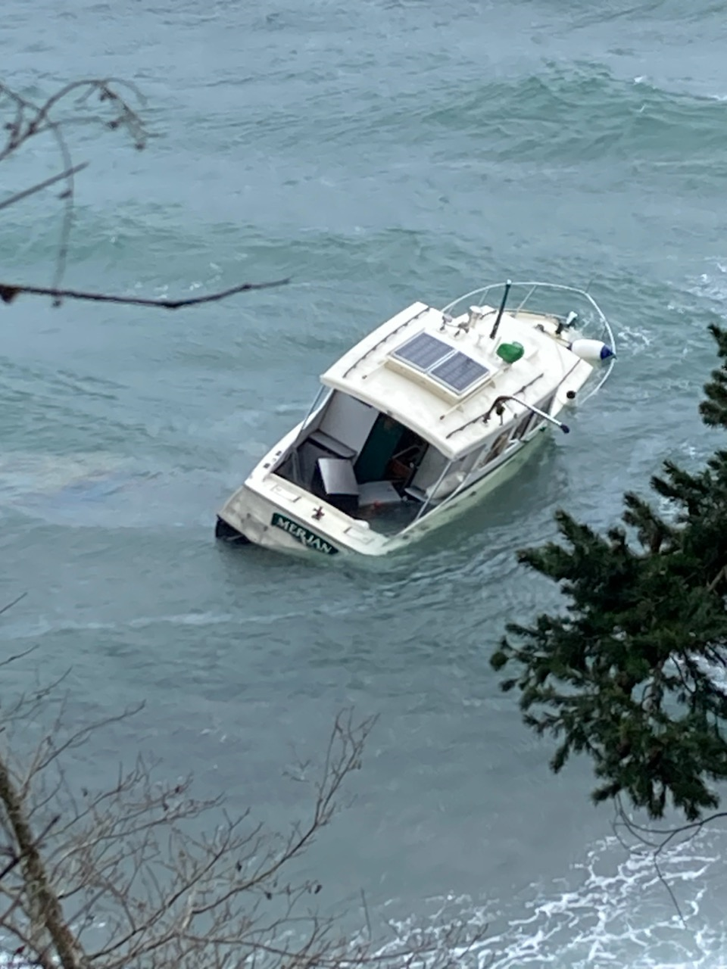

Slide 13
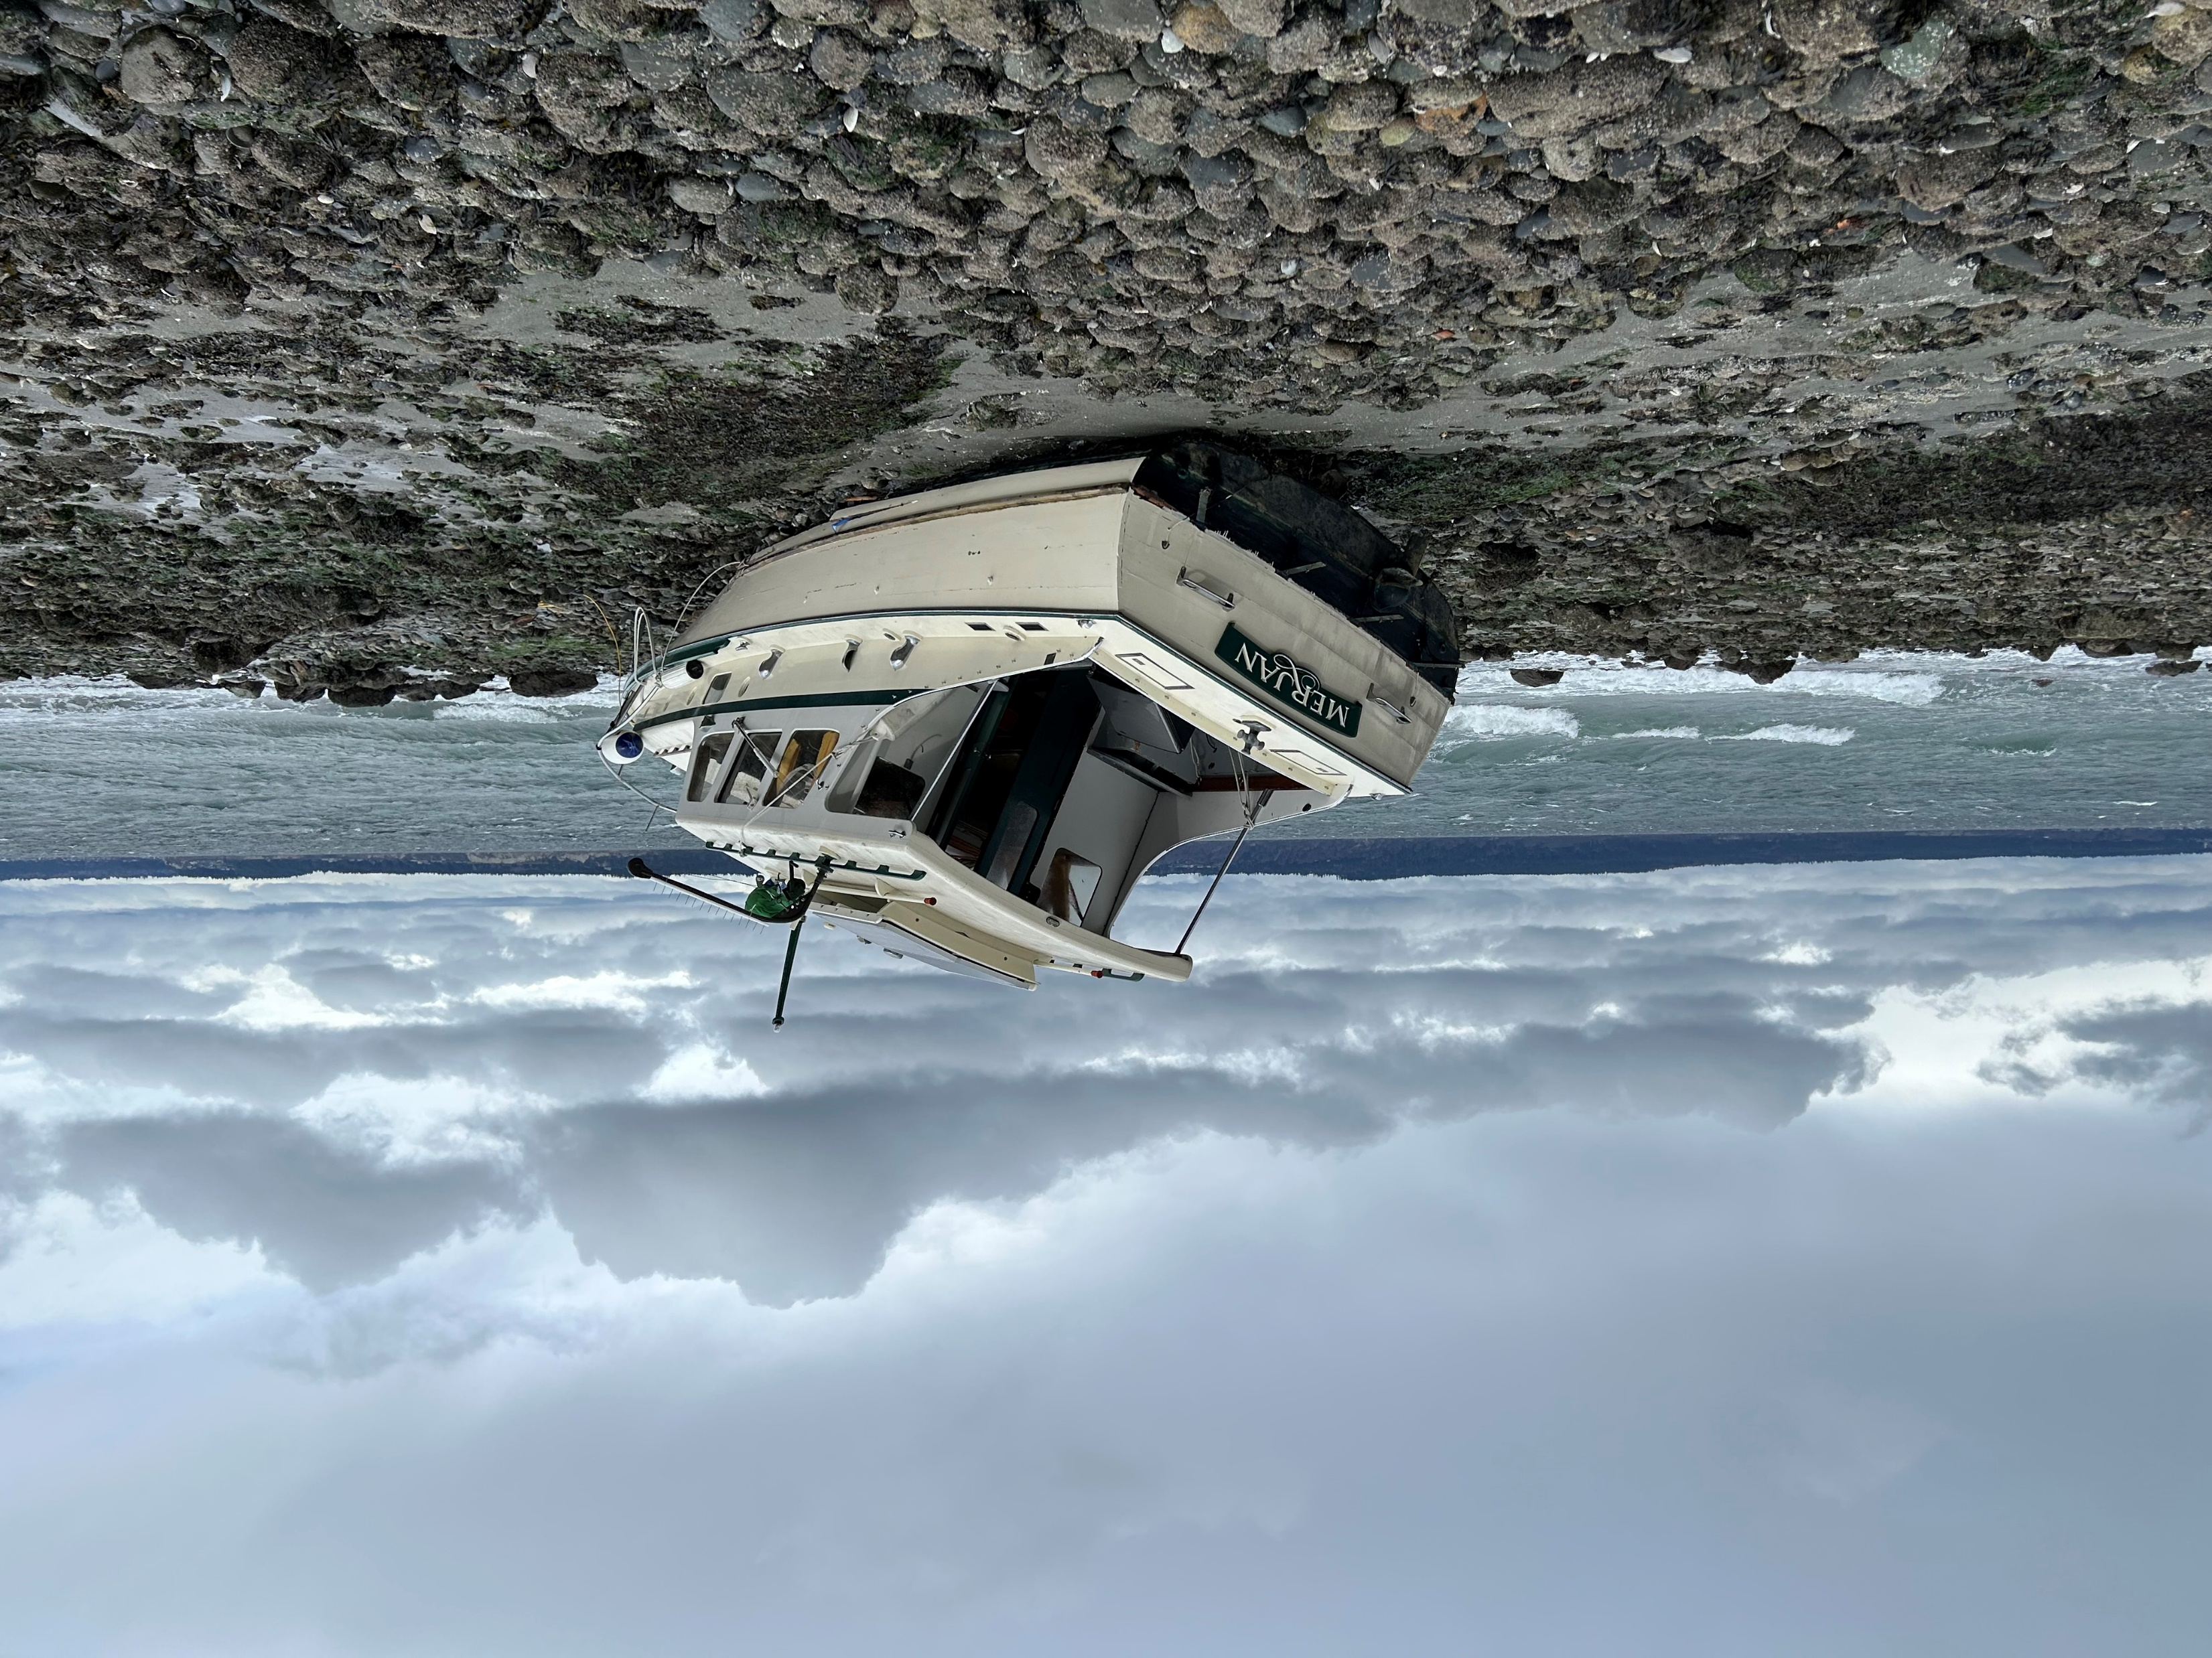

Slide 14
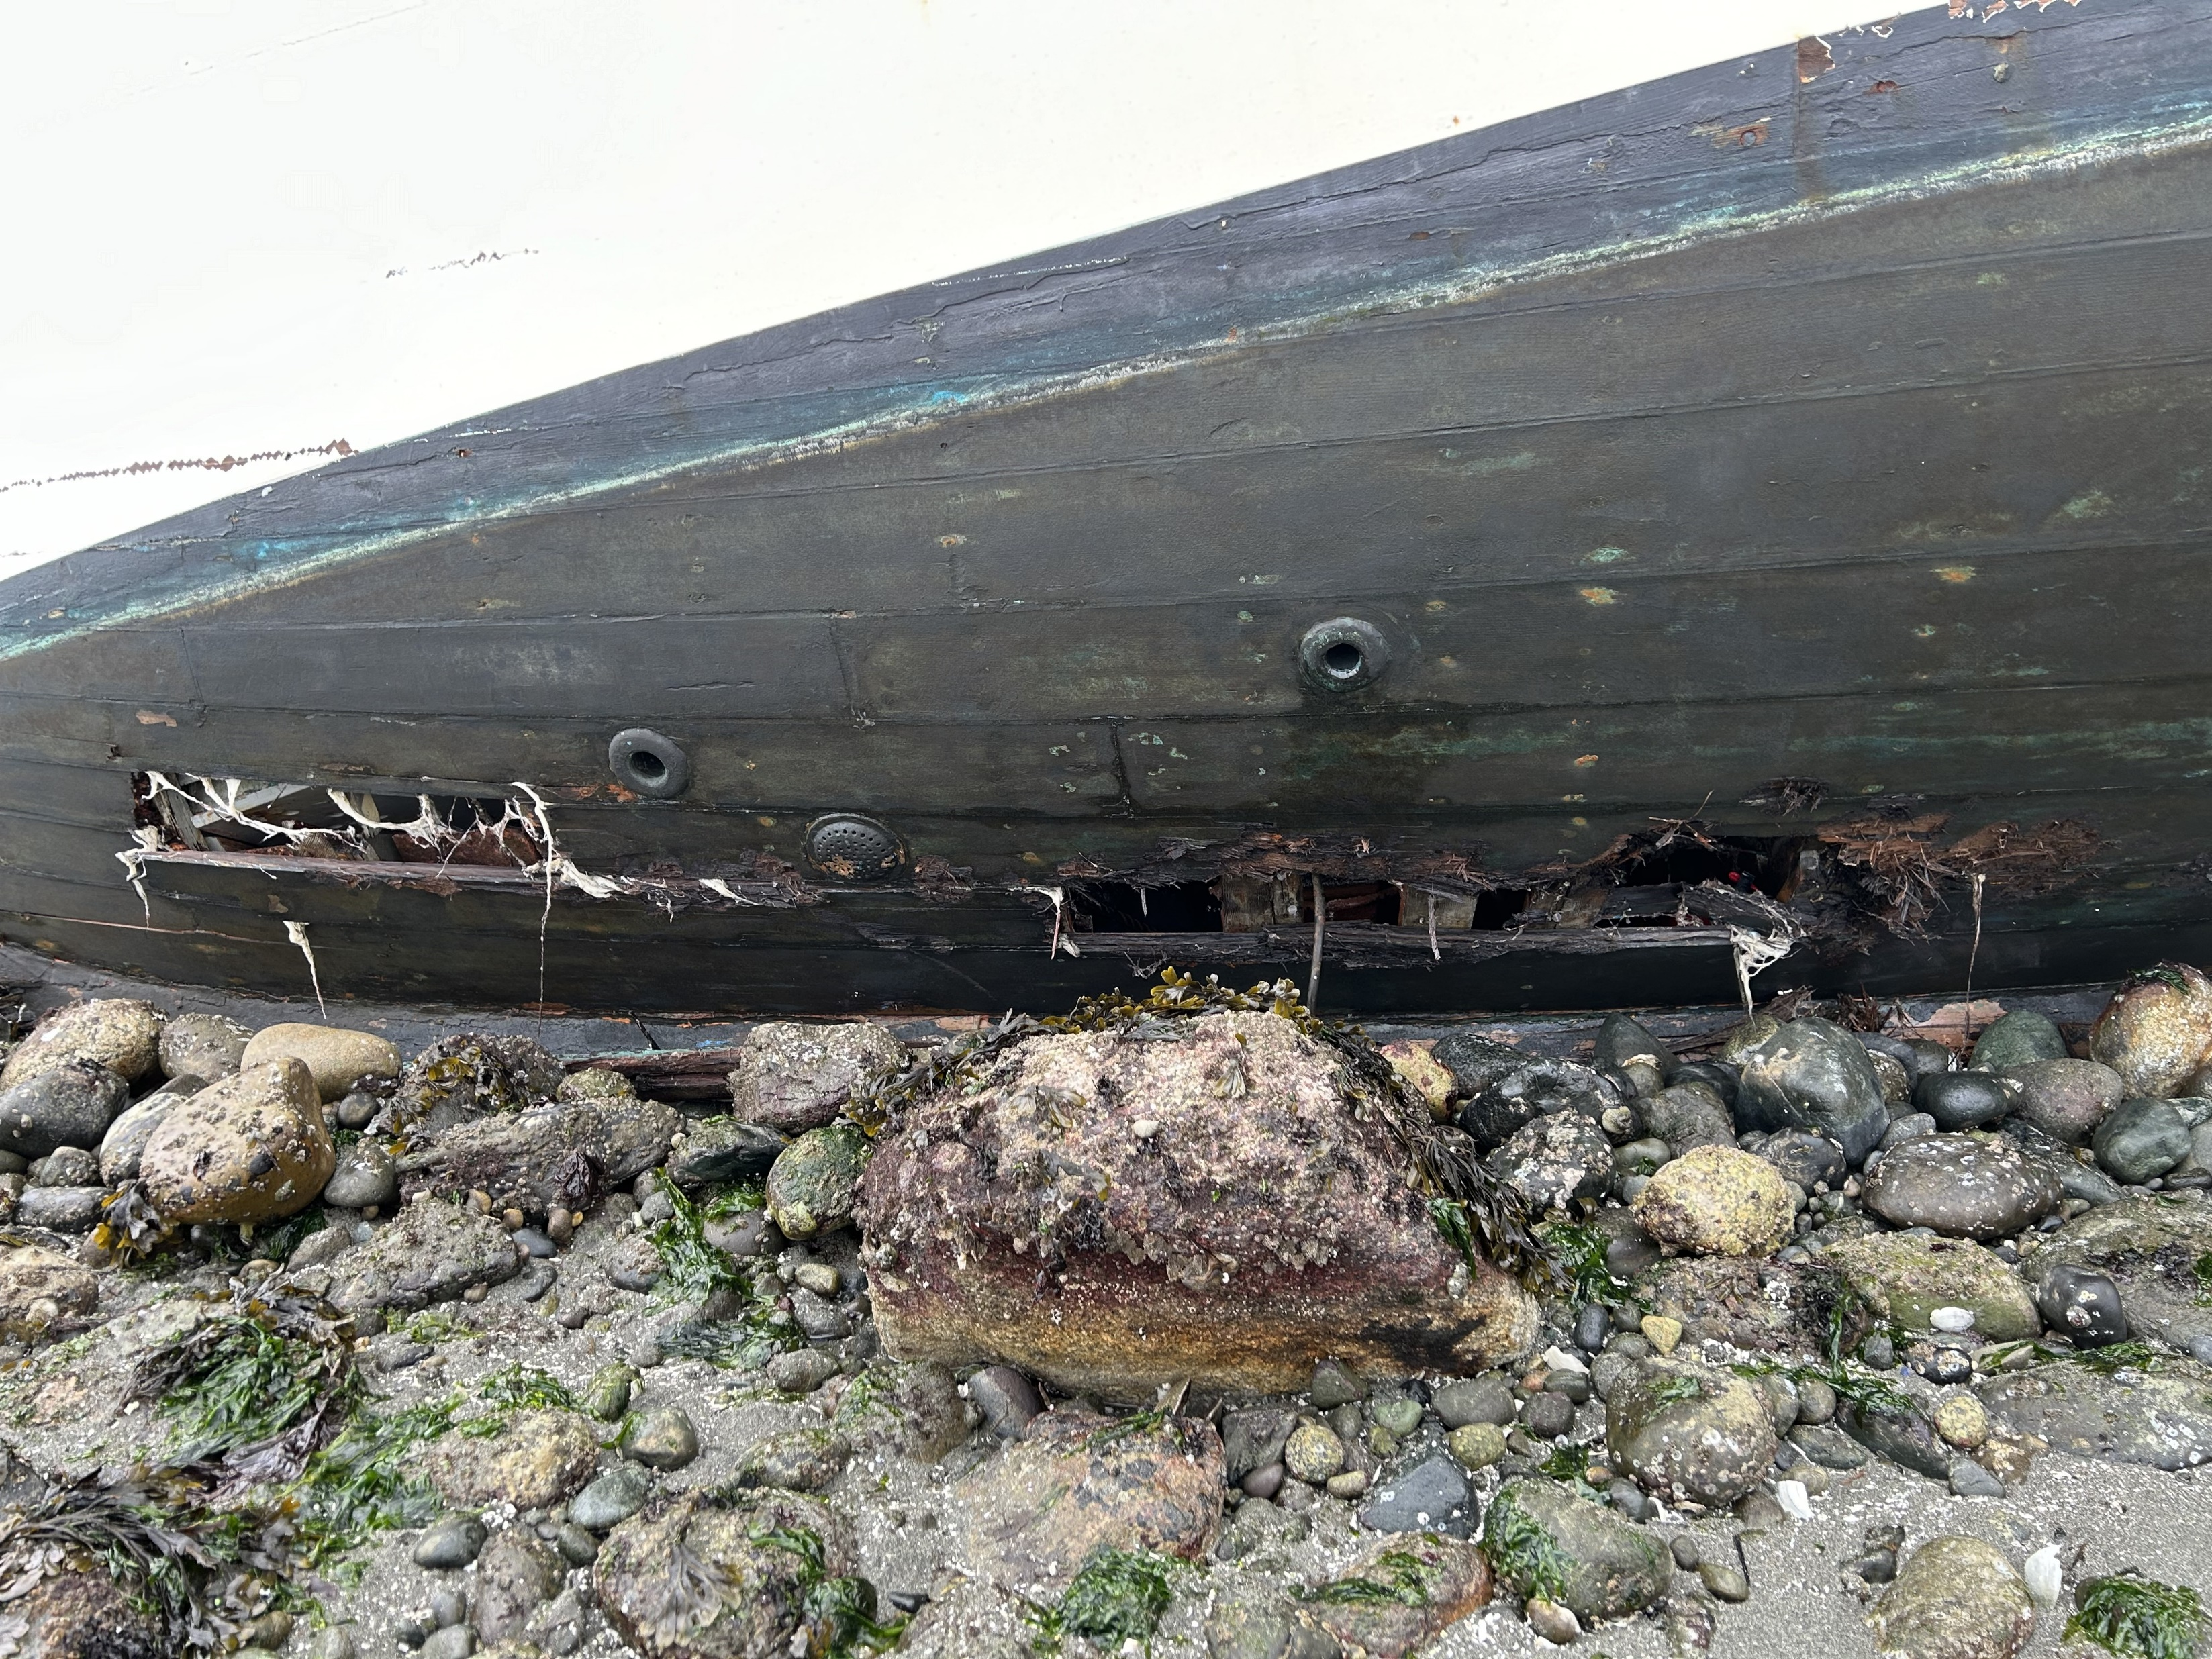

Slide 15
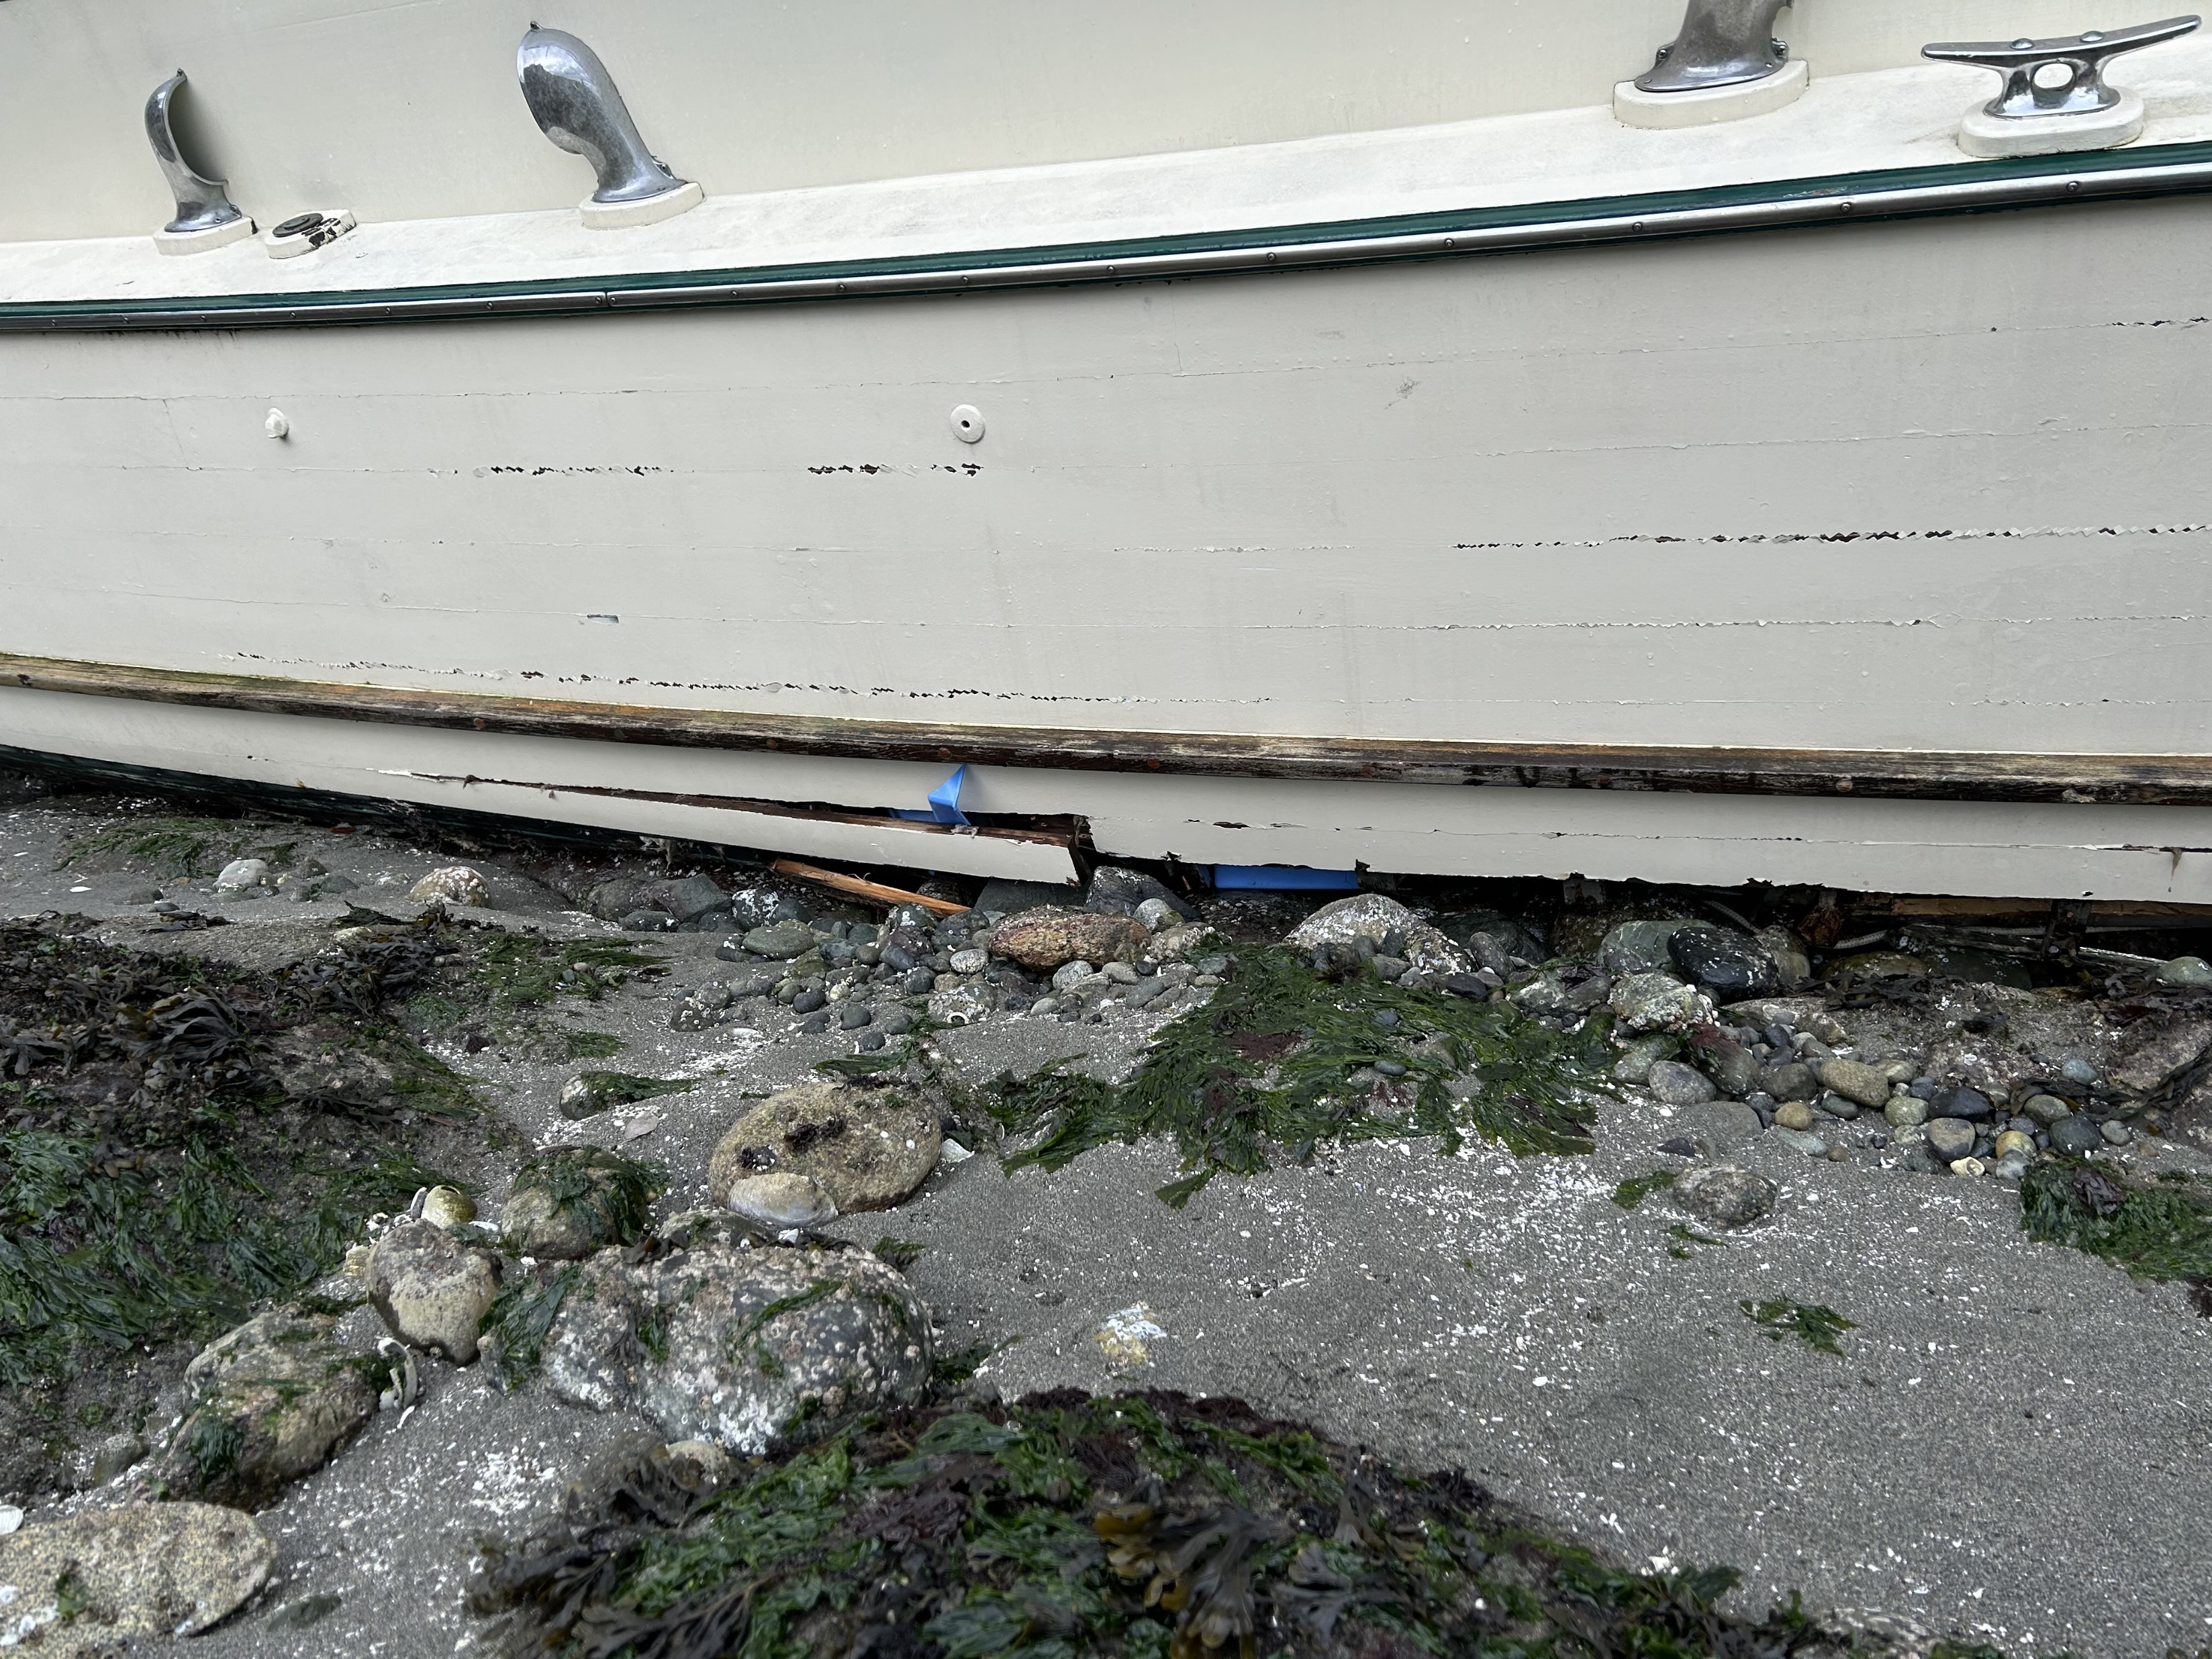

Slide 16
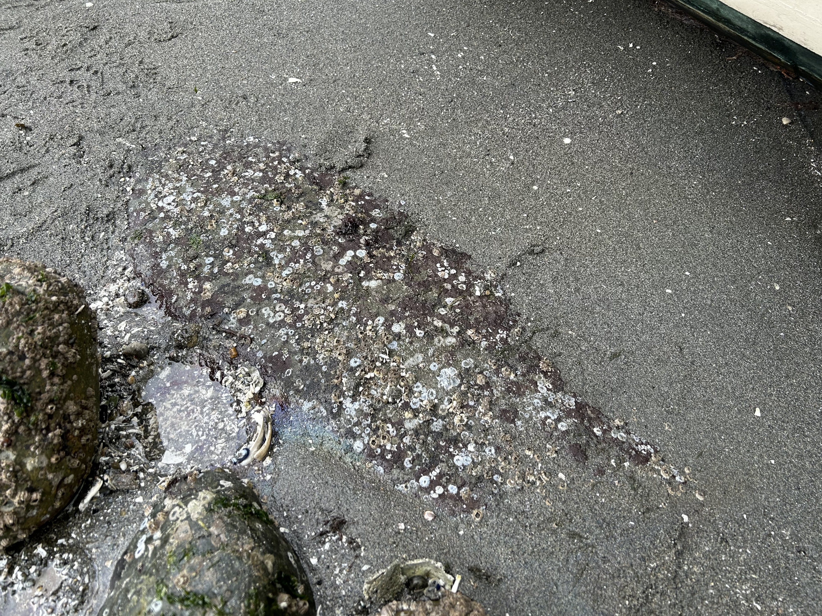
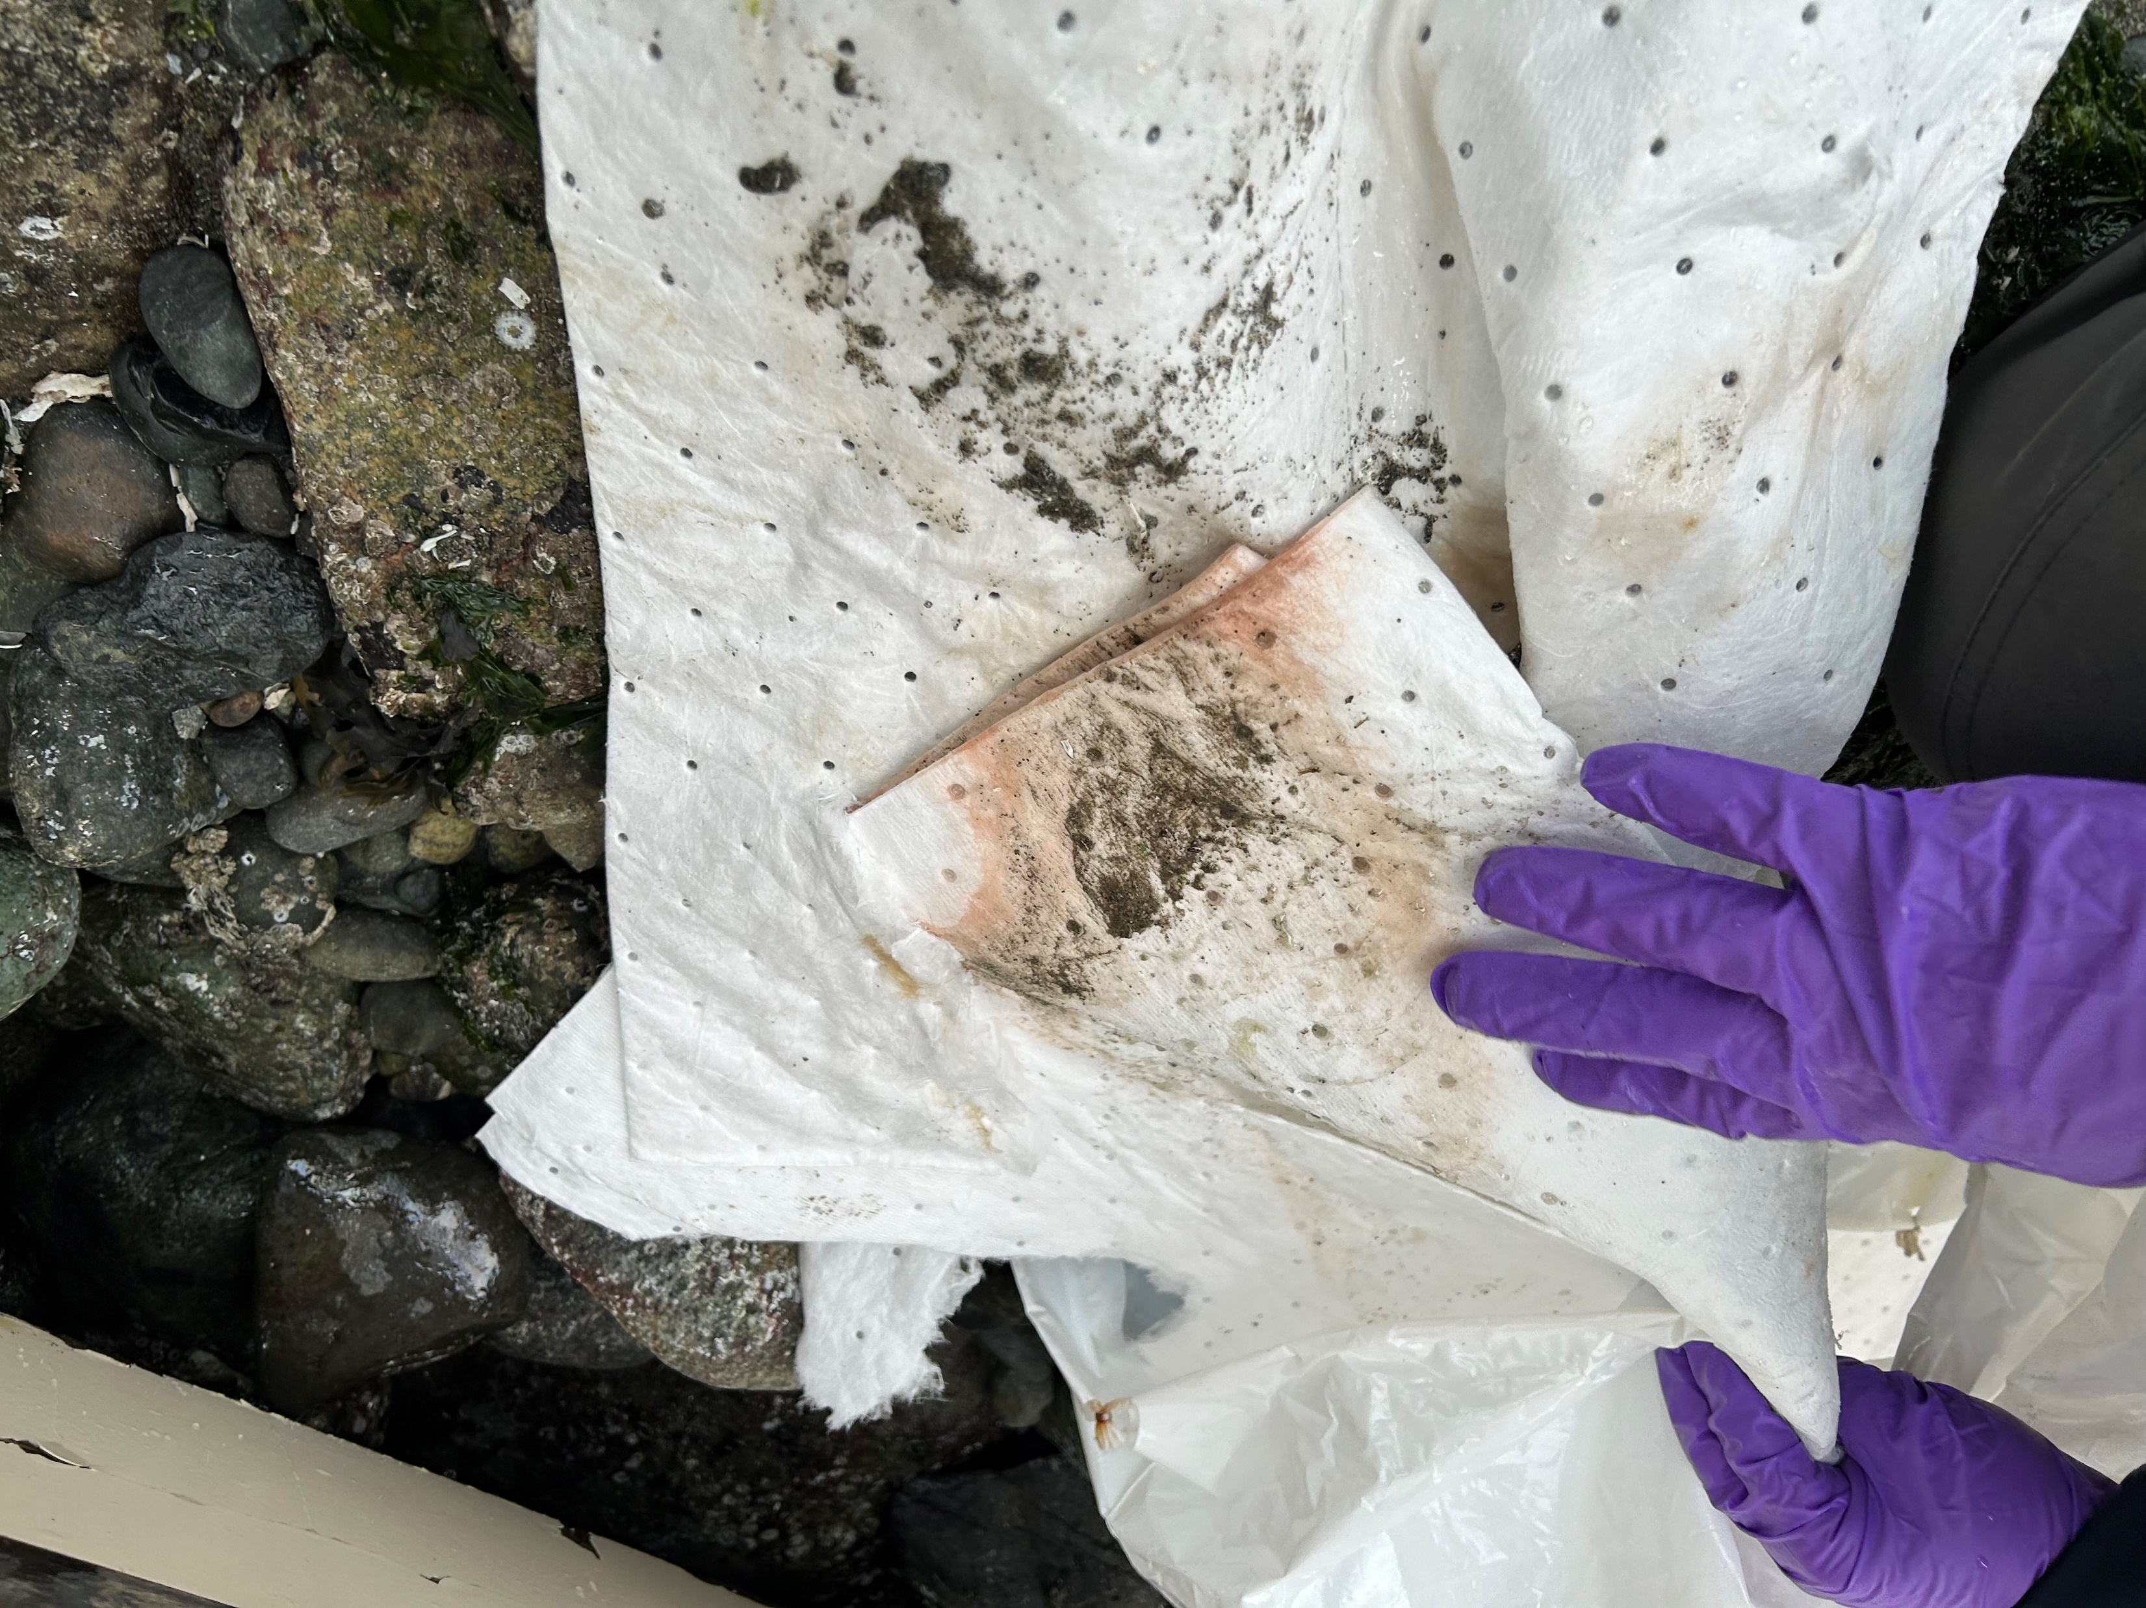

Slide 17
ERTS# 729220
Preassessment Screening
Incident Information
Are the damages quantifiable at a reasonable cost?
Is restoration or enhancement technically feasible?
Estimated spill to water volume:
  48 gallons
Oil Type
  Diesel fuel
Geographic Extent of Impacts
  Puget Sound near Marrowstone Island
Volume of oil recovered within the first 24 hours:
  None

Slide 18
ERTS# 729408
Navy Bangor Waste Oil Transfer System Spill
March 11, 2024

Slide 19
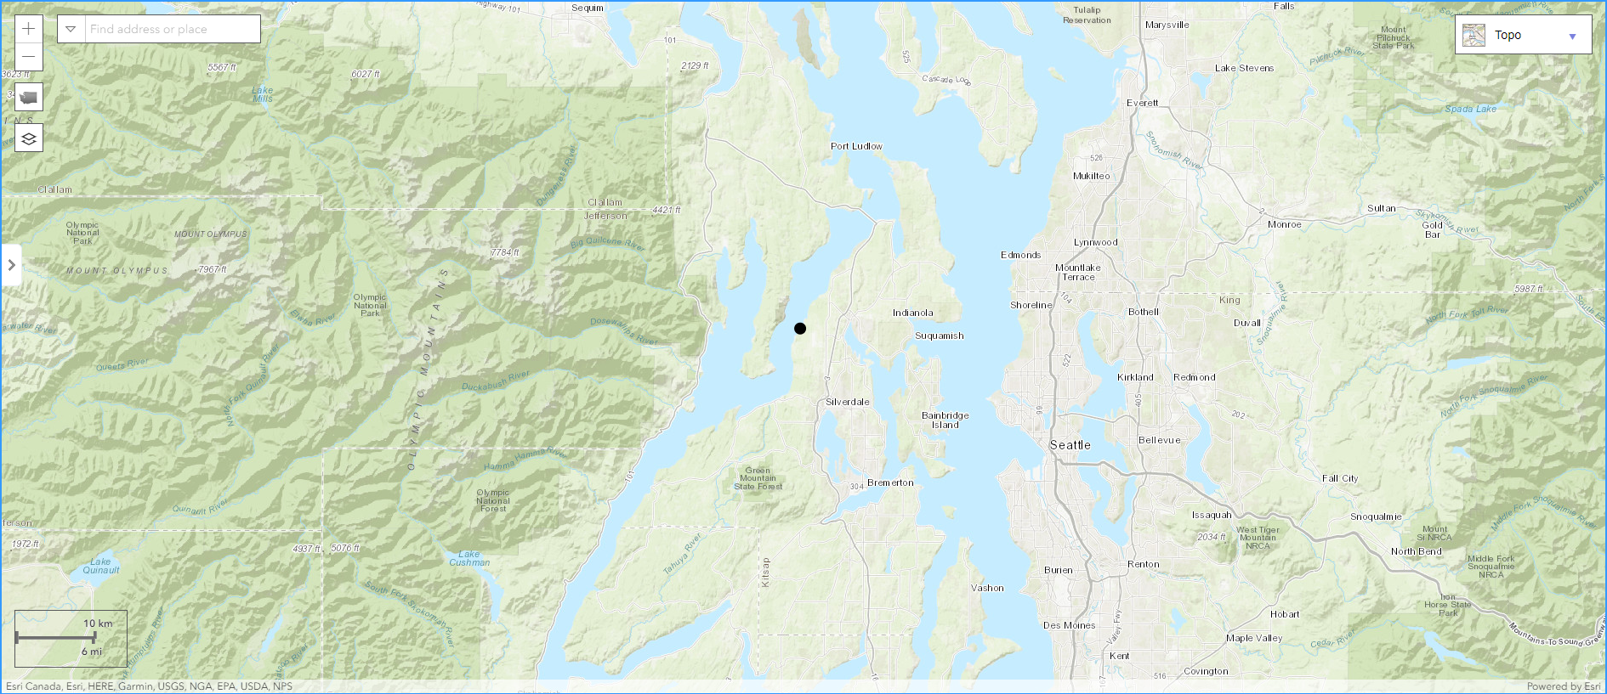
Spill Location

Slide 20
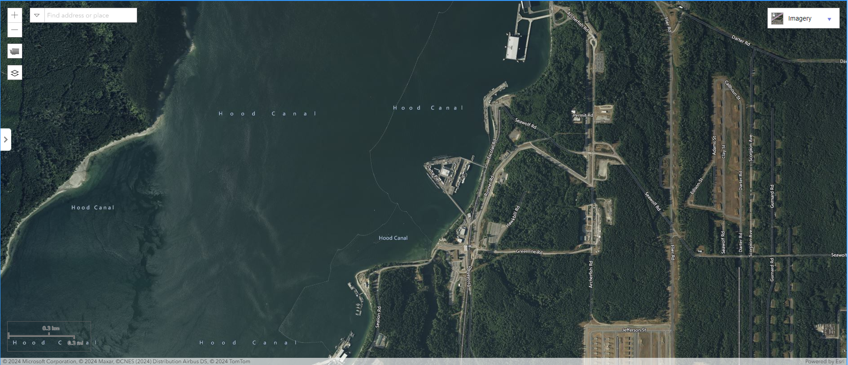
Spill Location

Slide 21
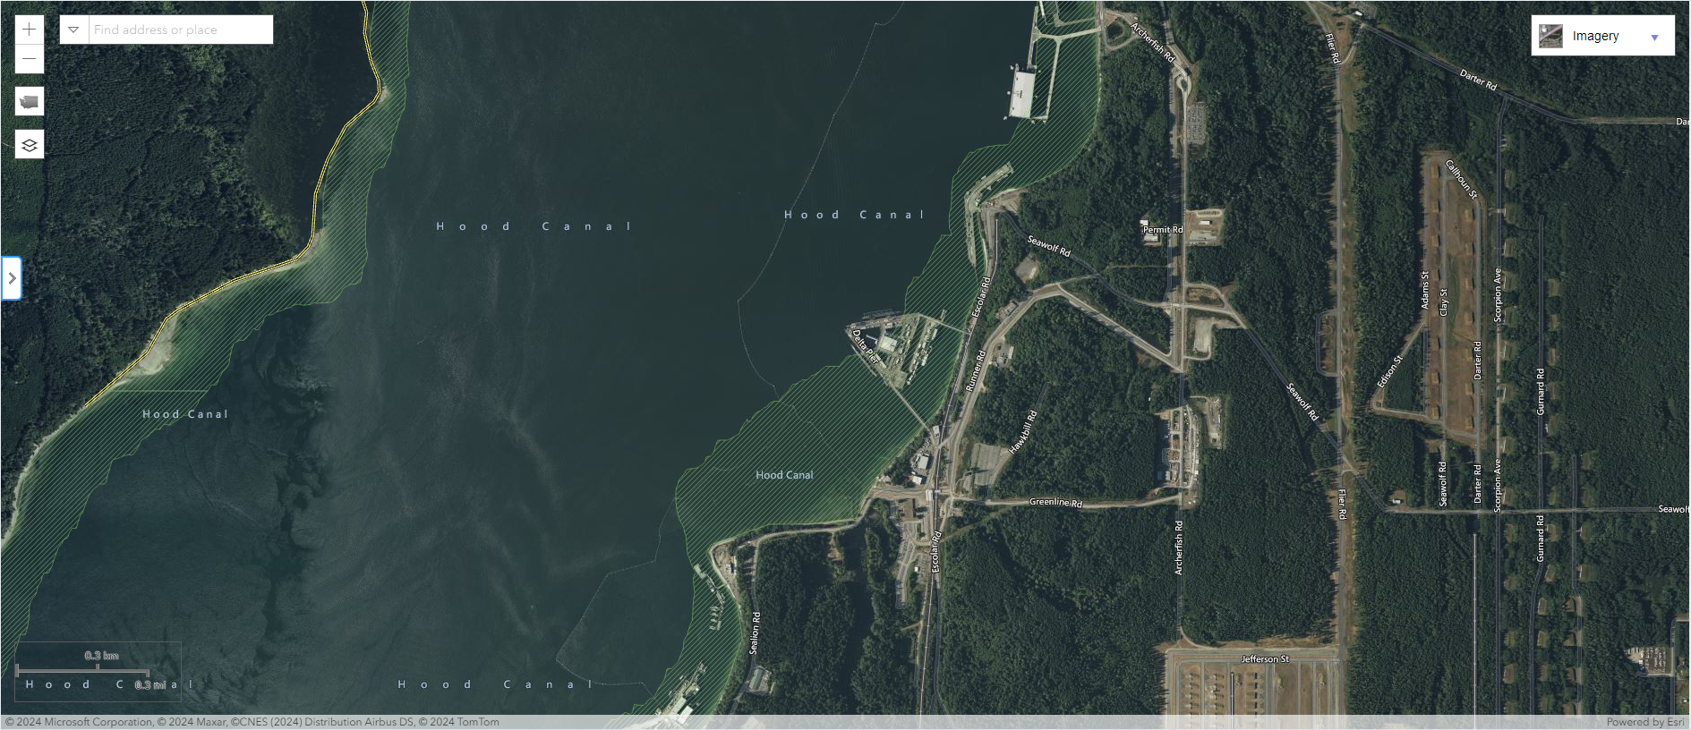
Spill Location

Slide 23
ERTS# 727754
Preassessment Screening
Incident Information
Are the damages quantifiable at a reasonable cost?
Is restoration or enhancement technically feasible?
Estimated spill to water volume:
  Up to 595 gallons
Oil Type
  Waste oil
Geographic Extent of Impacts
  Hood Canal
Volume of oil recovered within the first 24 hours:
  None

Slide 24
Old Business
Open Case Updates
ERTS #727283 Olympic Pipeline Gasoline Spill
  Conway 12/10/2023

Slide 25
Announcements
Migrating meeting notice e-mails to a listserv
Next meeting Wednesday, May 8, 2024
Room R1S-16 (and Teams)

Slide 26
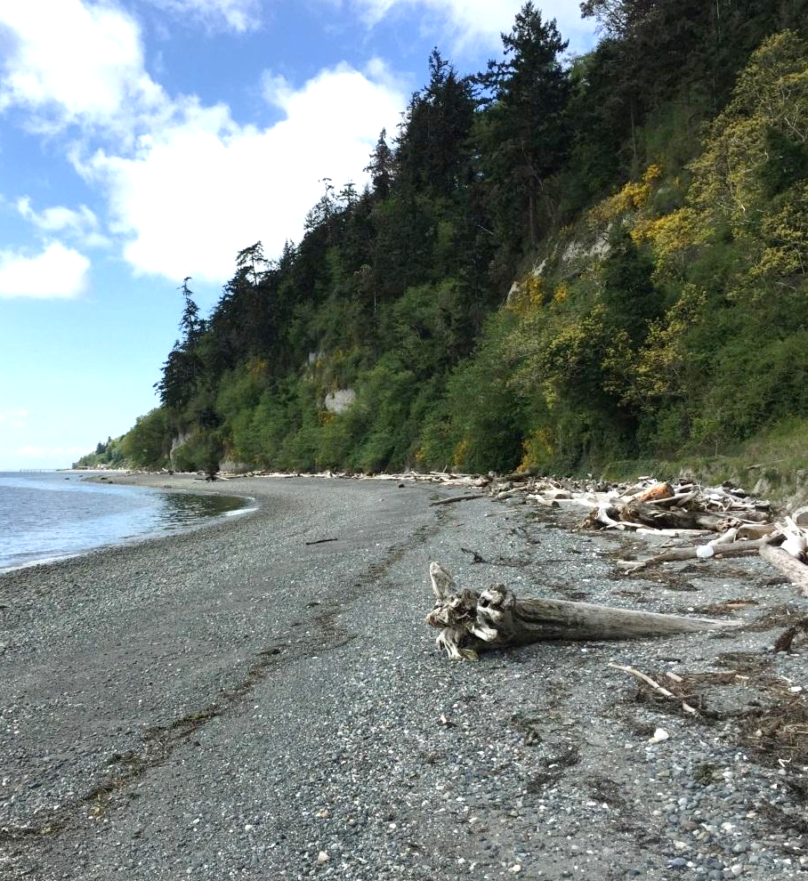

Meeting Adjourned
Geoff Baran
Washington State Department of Ecology
360-790-9725
Geoff.Baran@ecy.wa.gov

