Slide 1
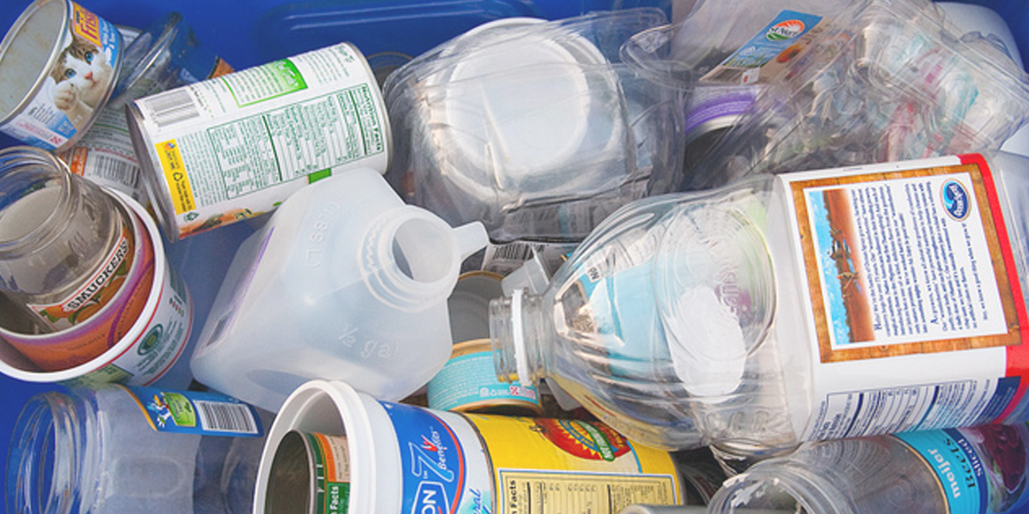
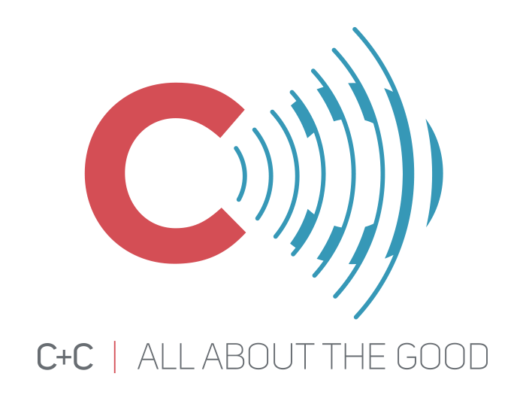
Reducing recycling contamination in WA
March 28, 2019

Slide 2
ECOLOGY Outreach overview
11:30 – 11:35
AUDIENCE RESEARCH
11:35 – 11:40
MEDIA Campaign development
11:40 – 12:00
Toolkit & future planning
12:00 – 12:05
Questions & Feedback
12:05 – 12:15

Slide 3
Ecology Outreach plan overview

Slide 4
Addressing Residential Contamination
Focus on what Washington residents can do to improve recycling practices at home in order to reduce contamination in the residential stream
Project includes:
  Audience research
  Statewide media campaign (leveraging existing campaign elements developed in King County)
  Local government agency toolkit
  Social marketing plan
  Evaluation plan

Slide 5
Audience research

Slide 6

Quantitative Survey: The Why
Partnering with Ask Your Target Market (AYTM) to conduct statewide survey to understand:
  Attitudes/awareness re: recycling best practices
  Behaviors leading to contamination
  Barriers and benefits/motivators to change behavior
Key insights will be used in media campaign and to inform future efforts
Notes:
In order to develop the campaign, C+C will leverage consumer research to better understand the following:
Attitudes and awareness regarding recycling best practices
Behaviors that lead to contamination in the recycle bin
Benefits and motivators that may compel consumers to change contamination behaviors
Scope of Survey:
To achieve the objectives and optimize design considerations, we recommend that the scope of this project include the exploration of behaviors, beliefs and the barriers to changing behaviors that lead to curbside recycling contamination based on what goes into the recycling bin. C+C recommends that this survey focus on the top priority contamination issues from the list below:
Recyclables that are not empty, clean & dry
Putting recyclables in plastic bags and then putting them in the recycle cart
Putting loose plastic bags in the recycle cart
Non-recyclables ending up in the recycle bin when people aren’t certain whether or not the items are recyclable
In addition, the survey will explore accepted consumer beliefs regarding:
The degree to which recycling has a positive influence on environmental issues that are important to them
Their understanding of the recycling process as a whole
Motivations for changing the way they recycle
Analysis of Results:
C+C will analyze the results of the survey to understand:
Contamination behaviors that are reported as most common among the target audience.
Beliefs associated with contamination behaviors that are driving those behaviors.
Barriers to changing the contamination behaviors.
Benefits, beliefs and motivations that may compel the target audience to change their contamination behaviors.
This portion of the analysis will help us to identify:
Key problem areas: behaviors and associated beliefs and barriers that should be the subject of the campaign
Key solution areas: Benefits, beliefs and motivations that should be the basis for key messages in the campaign
In addition to the above analysis, C+C will be using AYTM’s PersonalityRadar market intelligence tool to understand if/how relevant consumers segments emerge. This portion of the analysis will enable us to:
Understand similarities and differences between various sub-segments of the target audience
Generate personas associated with unique problem and solution areas

Slide 7
Quantitative Survey: The How
Statewide online survey
Target audience:
  People who recycle at home
  ~550 English speakers, 100 Spanish speakers
  Geographic representation throughout WA
  Mix of household demographics such as income, age, gender, education, family status, employment and ethnicity
Survey went live March 20; expect 3 weeks of data collection
Analysis and reporting through mid-April
Notes:
As the survey is designed, C+C will be balancing the following objectives to create an optimal design within the current budget:
Achieve adequate geographic representation to determine whether or not there is a directional difference in results between Eastern & Western Washington.
Achieve enough completed surveys such that our results will be statistically valid.
Analyze results from the English and Spanish versions such that we are able to understand the multicultural nuances that are pertinent to the campaign design.
Manage respondent fatigue by crafting efficient questions, limiting the length of the survey and minimizing the complexity of the questions.
Designing survey questions to minimize bias and maximize the ability to identify key insights.

Slide 8
Media Campaign development

Slide 9
Background: Responsible Recycling Group in King County
King County Responsible Recycling Task Force (RRTF):
RRTF Communications Consortium Members:
Recology
WM
Republic Services
City of Bellevue
City of Seattle
King County Solid Waste
Sound Cities Association
2019: Washington Department of Ecology
Seattle University
City of Redmond
City of Bellevue
Republic Services
City of Bothell
City of Shoreline
City of Kent
Waste Management
Seattle Public Utilities
KCSWD
City of SeaTac
City of Lake Forest Park
Recology
City of Renton
WUTC
City of Kirkland
City of Auburn
KC SWAC
KC MSWMAC

Slide 10


Campaign Development Process
Consortium named effort “Recycle Right”
Late 2018, consortium brought in C+C to develop and audience test Recycle Right logos and campaign concepts
Notes:
Add Spanish
Media campaign through June 2019
Leverage creative to build out statewide campaign
logo

Slide 11
Recycle Right Campaign Foundation
Awareness | Desired Behavior | Barriers | Motivator
Audience is receptive: people in King County want to recycle, believe it is important and that it is the right thing to do | Keep recyclables empty, clean and dry | Believe I’m already do a good job recycling – no reason to pay attention Unaware that liquid or food left in containers or on paper can spoil a whole load of recyclables. | I don’t want to spoil/ruin recyclables for everyone
11
Notes:
Sully

Slide 12
We Want the Audience To…
THINK: | Recycling is important. I need to do it right, because doing it wrong can ruin/spoil a whole load of recyclables.
FEEL: | By recycling right (empty, clean and dry), I feel good that I’m helping ensure materials can be recycled into new products.
DO: | Put only empty, clean and dry recyclables in my recycling bin
12
Notes:
Sully

Slide 13
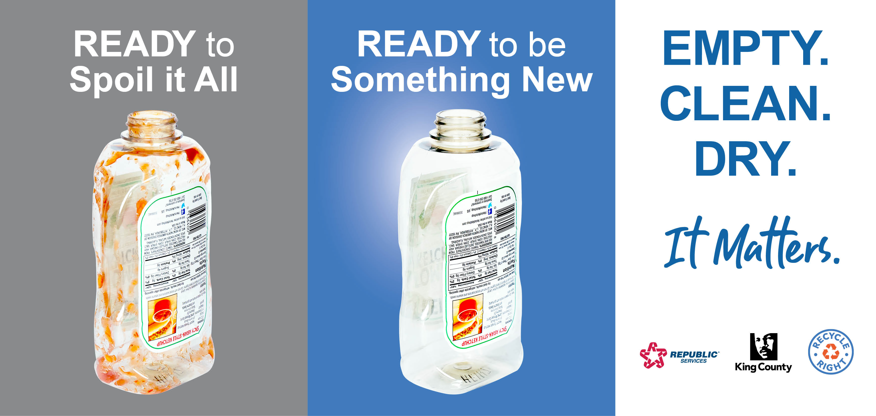
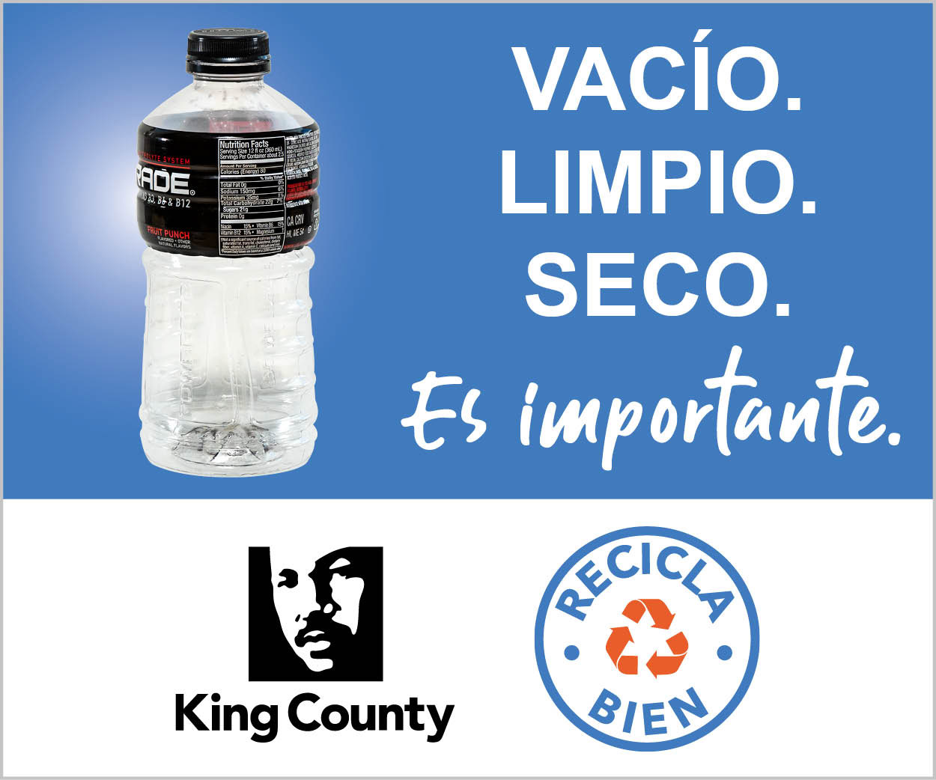
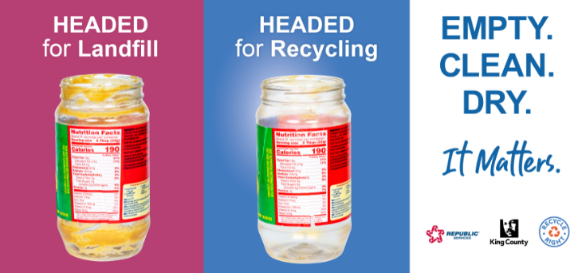
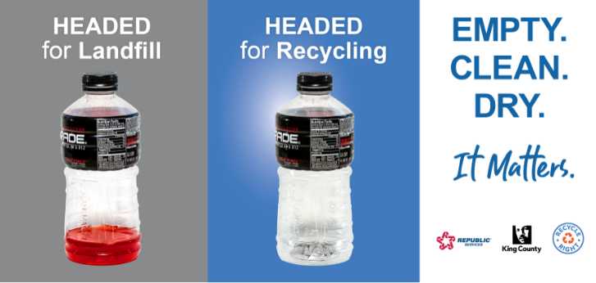
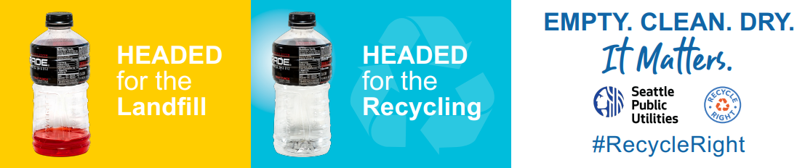

Slide 14
2019 Recycle Right Media
Sponsoring Agency | Media | 2019 Timing
City of Seattle and City of Bellevue – Transit ad campaign | Transit | Jan-Feb
King County Solid Waste | Broadcast and online TV Radio traffic sponsorships Digital video ad campaign 10 billboards in unincorporated areas (funding from Republic Services) | March 25 – April 21 and May 20-June 16
WA Dept of Ecology - Statewide | Broadcast TV Radio (broadcast and Pandora) Digital video ad campaign Facebook/Instagram Billboard | May 27 – June 16

Slide 15
Ecology Media Plan
Audience: Residents statewide who recycle at home
Geography: statewide with more focus outside King County
Message and Creative:
  Focus on “Empty, Clean and Dry”
  Leverage Recycle Right/Recicla bien mark and “Empty. Clean. Dry. It Matters” messaging and creative look and feel
  Expand creative assets for Ecology’s campaign – new video and radio spots
Languages: English and Spanish
In future, campaign can extend to other behaviors (over-recycling, bagging recyclables, etc.)

Slide 16
Budget Allocation
Timing: 5/27 - 6/16/19
Tactic | Description | Est Impress. | Budget
TV | :30-second video spots across WA. 4 regional markets: Seattle, Spokane, Yakima/Tri-Cities, & SW Washington | 2.2 million | $75,000
Radio | :30-second audio spots across WA. 7 regional markets include: Seattle, Spokane, Yakima, Tri-Cities, Wenatchee, Olympia, SW Washington. | 4.4 million | $58,000
Digital | Incorporates 3 approaches, all across Washington: Video network partner (tbd) Audio partner (Pandora) Facebook/Instagram | 4.9 million | $79,000
Billboard | Large billboard strategically placed along I-5 near Tacoma on way to Olympia | 2.6 million | $8,000
 | TOTAL: | 14.2 million | $220,000

Slide 17
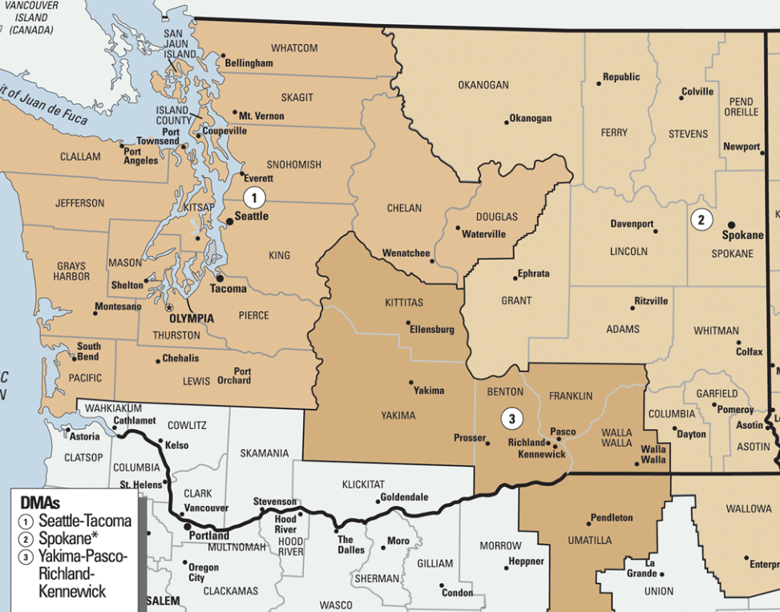
Washington Media Coverage
Online Market Coverage
TV Market Coverage
Radio Market Coverage
Zoned Cable TV only to avoid PDX market

Slide 18
Toolkit & future planning

Slide 19
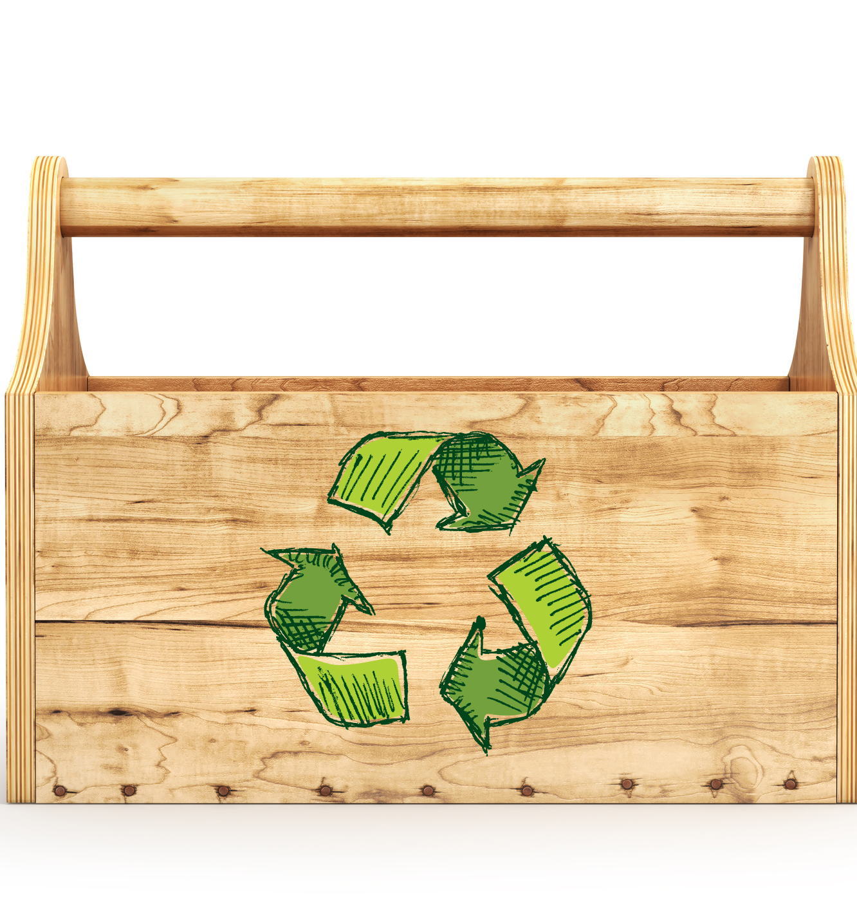
Other Campaign Materials
Customizable outreach toolkit for local government agencies
Social marketing plan for local program implementation and future statewide efforts
Evaluation plan

Slide 20
Questions & Feedback

Slide 21
THANK YOU!

