Slide 1
Bioretention Hydrologic Performance Study
Bill Taylor, Taylor Aquatic Science
Doug Beyerlein, PE, Clear Creek Solutions, Inc.
Jenny Saltonstall, Associated Earth Sciences
Bryan Berkompas, Aspect Consulting
Anne Cline, Chris Wright, Raedeke Associates, Inc.

Slide 2
Bioretention Hydrologic Performance Study
Funded by the Dept of Ecology SAM Program
Brandi Lubliner, SAM Coordinator Ecology
Sponsored by the City of Bellingham
Eli Mackiewicz, City Bellingham

Slide 3
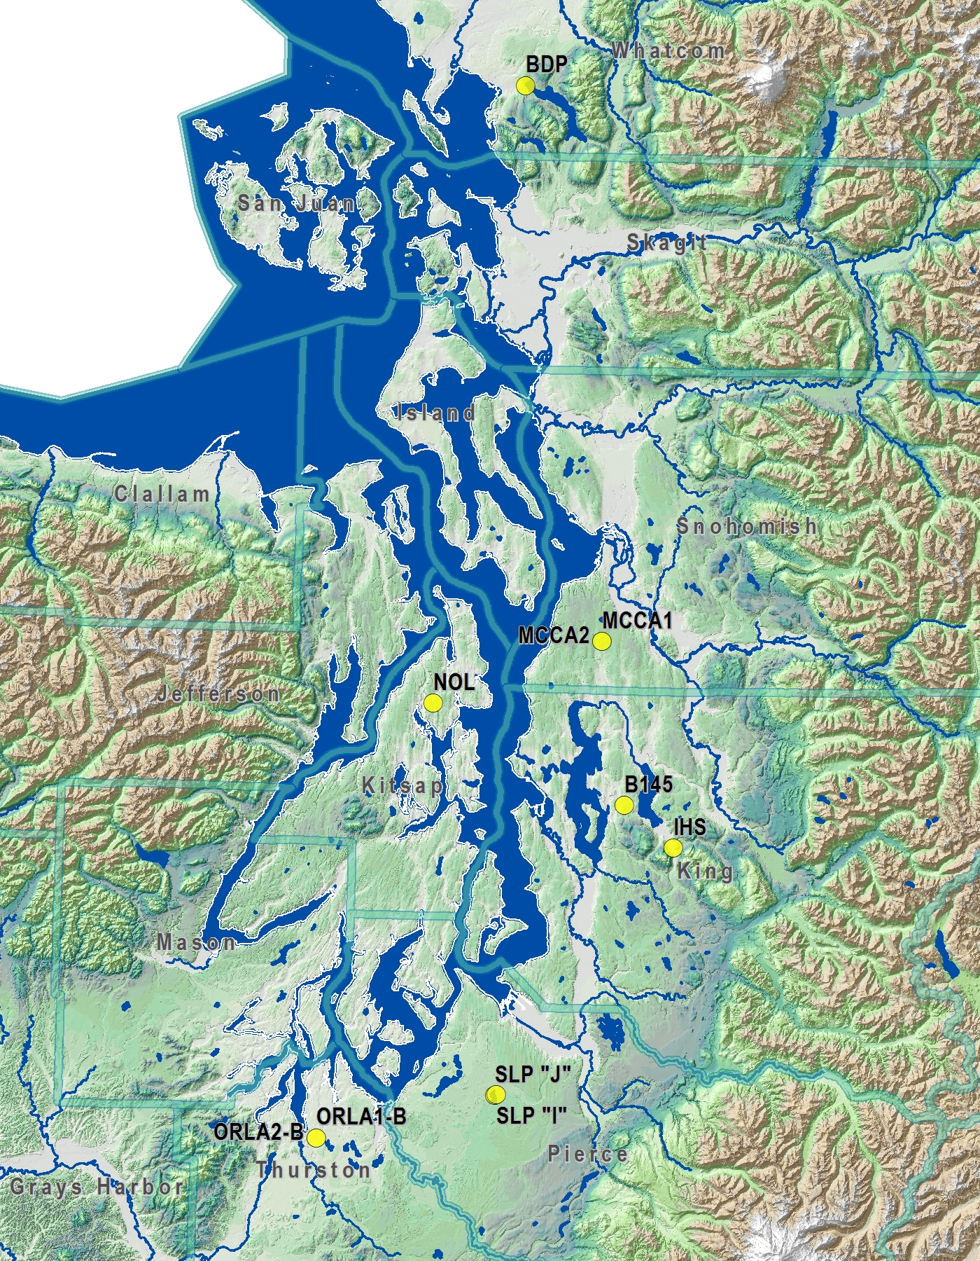
Bellingham
Poulsbo
Issaquah
Olympia

Slide 4
How are constructed bioretention facilities performing hydrologically?
What design elements may be affecting their performance?
What are some recommendations to engineers and plan reviewers for future designs?

Slide 5
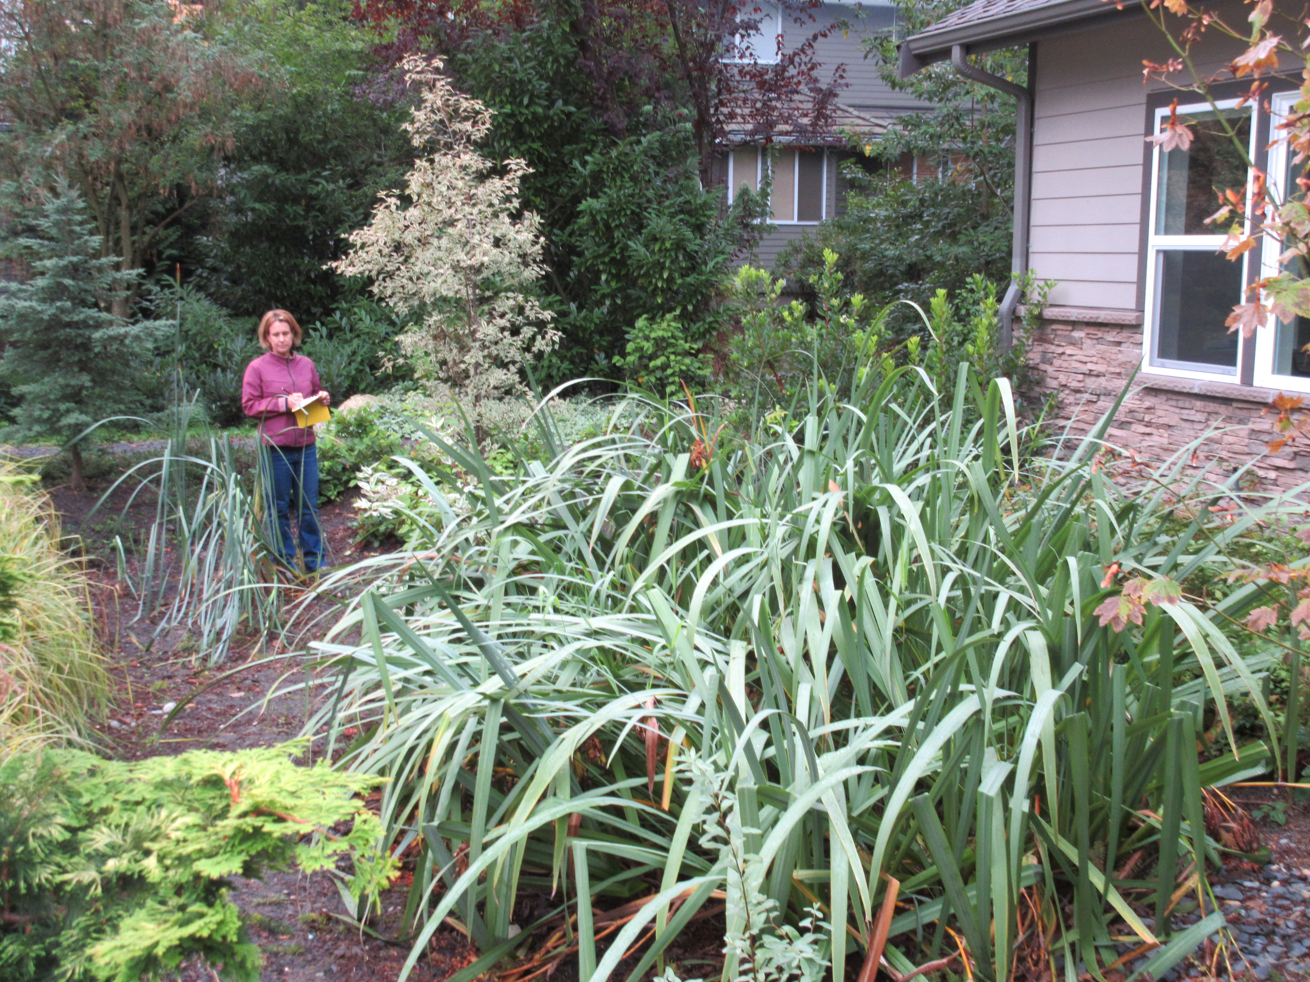

Slide 6
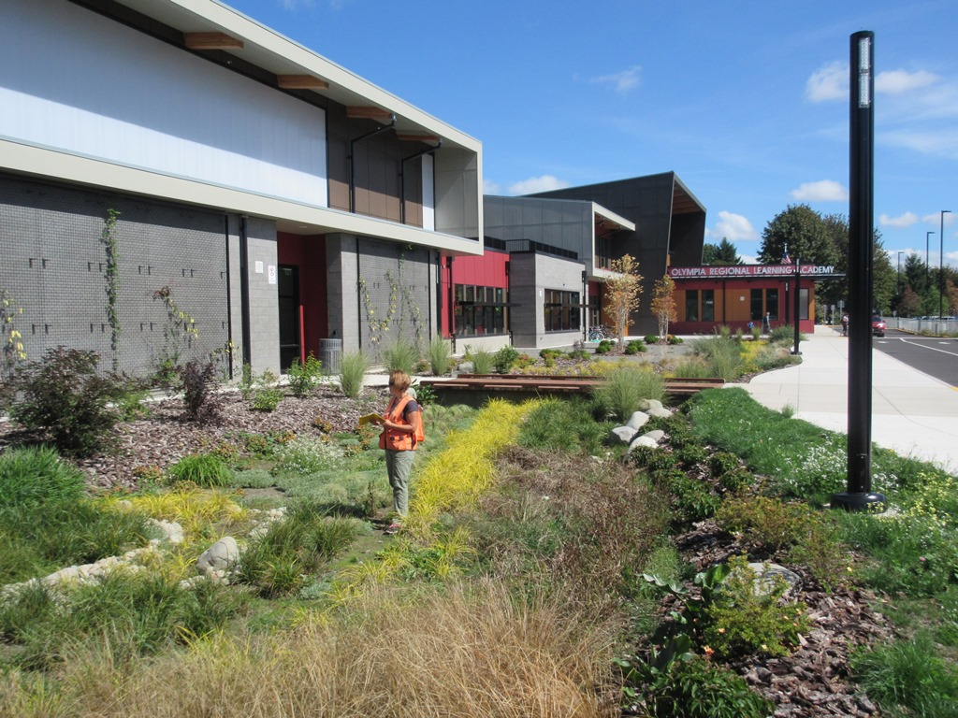

Slide 7
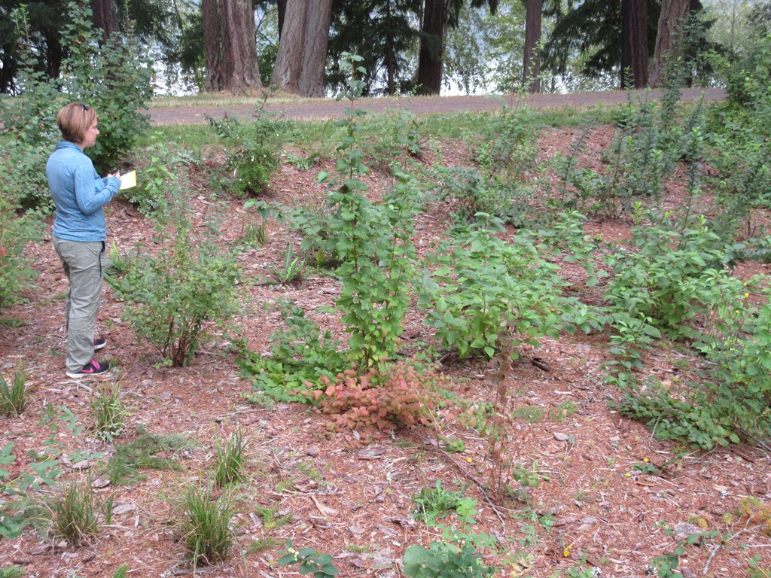

Slide 8
Evaluate Site Components
Facility dimensions and contributing areas
Bioretention soil and subsurface composition; infiltration tests
Hydrology – rainfall, inflow, outflow, ponding and groundwater
Vegetation – herbaceous and shrub composition

Slide 9
Analyze All the Component Data for Design Improvements

Slide 10
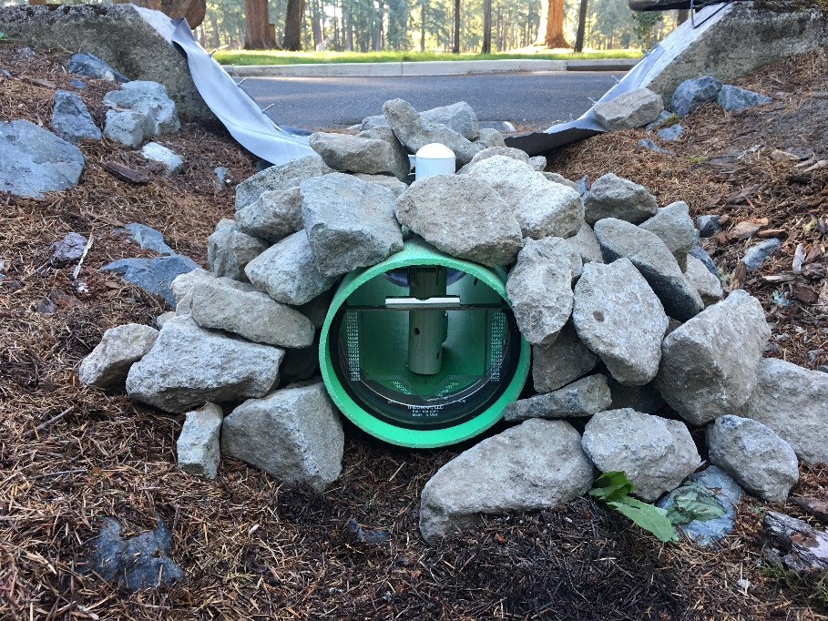

Slide 11
Findings - Hydrologic Response
9 months of continuous wet season monitoring (October – June)
All the sites infiltrated all the inflows for the entire monitoring period except for one underdrain
Variable response depending on subsurface conditions
  Evidence of oversizing in highly infiltrating sites
  Evidence of shallow groundwater mounding
  Evidence of possible lateral subsurface flow
  Evidence of subsurface leakage to an overflow outlet
  Evidence of short circuiting through soil directly to underdrain

Slide 12
Findings - Dimensions and Inflows
Cells were generally sized to original design size
Contributing areas can show variable runoff generation for given storm events – which is recognized in the literature

Slide 13
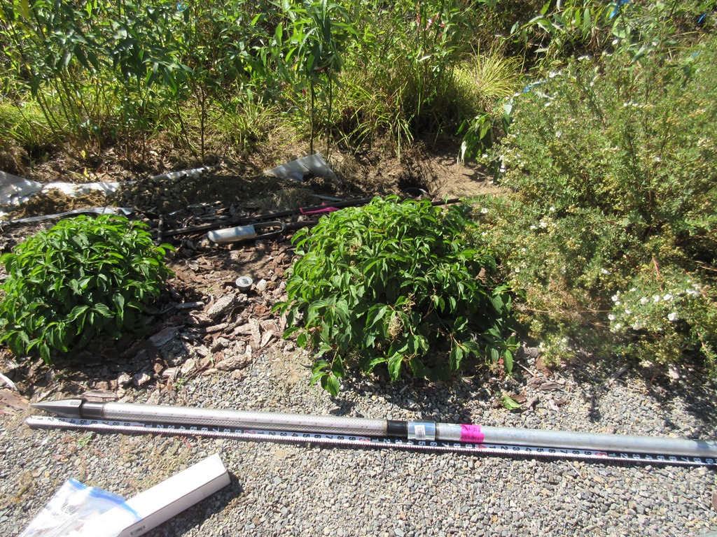
Well Hole
Excavated Soil Profile
Well Casing

Slide 14
Findings – HydroGeo and Geotechnical
Sites covered a wide range of geotechnical and infiltration conditions
Bioretention soil texture generally coarser than guidelines
Wide range of infiltration rates
Little site specific hydro-geo data; analyses sometimes “borrowed” from adjacent infrastructure testing

Slide 15
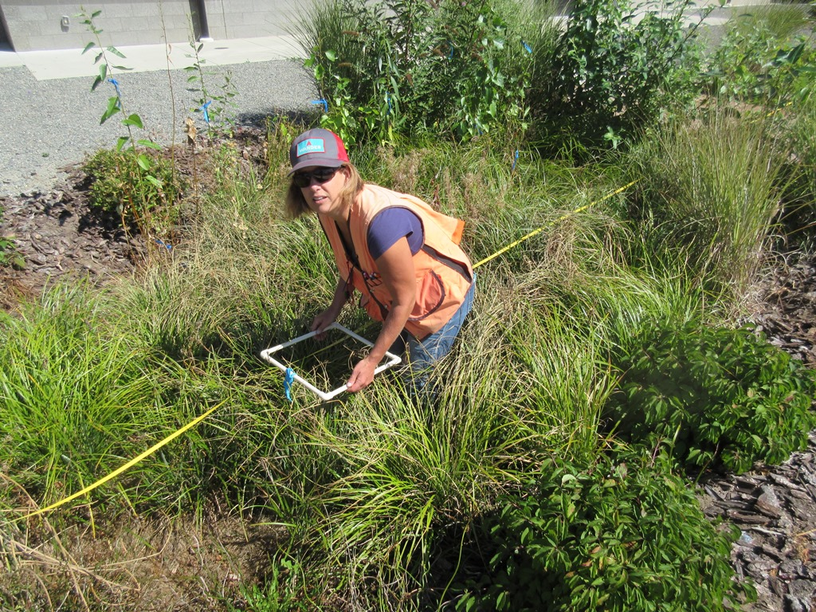

Slide 16
Findings - Vegetation
Shrub species surviving well
Herbaceous species less adaptable – depends on irrigation and species selected
Multiple herbaceous species in a site design tend to transition to a less diverse herbaceous community
Recurring issues include plant die-off, invasive species, replanting, and lack of maintenance staff capacity

Slide 17
Findings - Modeling used in Original Site Designs
Wide variety of computer models used for design
Approach to modeling was often not set up properly
Hydrologic performance of the facilities was more due to facilities’ safety factors for infiltration, masking design errors or incorrect assumptions

Slide 18
Summary of model results
Bioretention facilities (using long-term site-specific rainfall data)
  Passed MR #5 (LID flow control standard)
  Passed MR #6 (Water Quality standard)

Slide 19
Summary of model results
WWHM2012 accurately models bioretention facilities (within the range of expected error)
Possible improvements to WWHM2012
  Add vegetative litter cover to reduce the infiltration of the ponded water into the bioretention soil mix.
  Increase the evapotranspiration rate from the bioretention soil mix

Slide 20
Use of this Information to
Improve Stormwater Management
Design Guidance for Design, Plan Review, and Construction
  Confirm the site dimensions and inflow and overflow structures are at proper elevations
  Use more site-specific hydro-geologic analyses for infiltration rates
  Confirm media is consistent with the Ecology specifications
  Select plant species that have proven high survival rates
  Use current WWHM2012 modeling methods

Slide 21
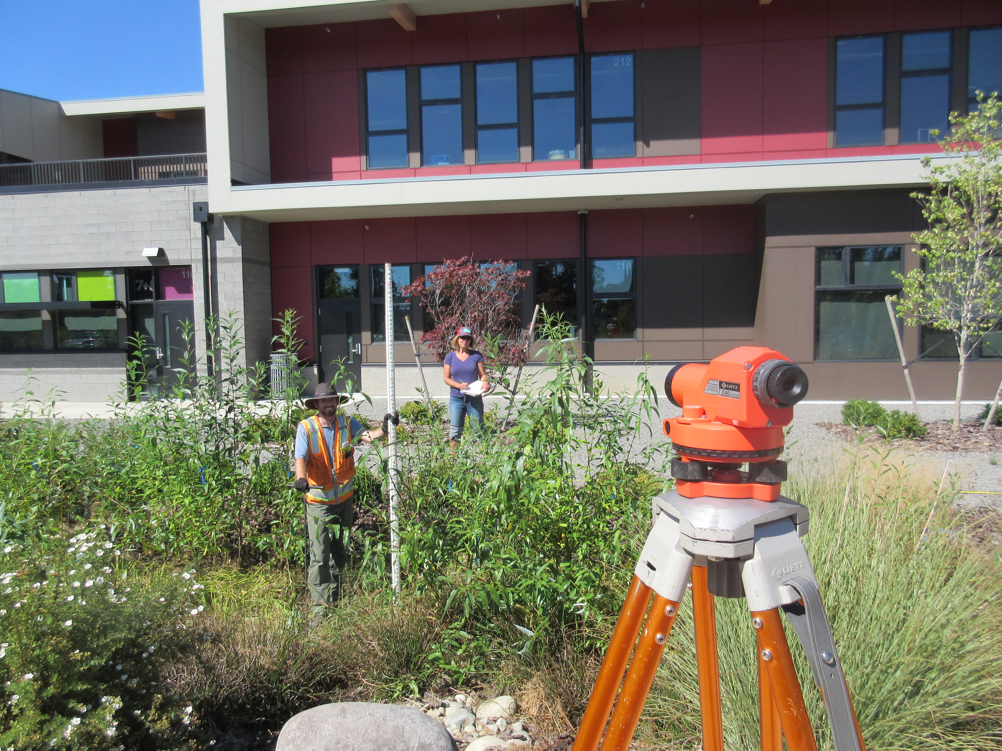

Slide 22
Bioretention Hydrologic Performance Study
Bill Taylor, Taylor Aquatic Science and Policy, Principal Investigator
Doug Beyerlein, Clear Creek Solutions, Project Manager

Slide 23
Purpose of Study
Provide adaptive management feedback from actual hydrologic performance of bioretention facilities
Evaulate hydrologic performance based on SWMMWW design guidelines as they relate to the Western Washington Hydrology Model (WWHM) 2012

Slide 24
Bioretention Background
Stormwater Management Manual for Western Washington
(SWMMWW) guides LID design
Bioretention facilities are designed under the SWMMWW using the Western Washington Hydrology Model (WWHM) 2012

Slide 25
Ten Selected Site Locations
Wide Range of Subsurface Conditions

Slide 26
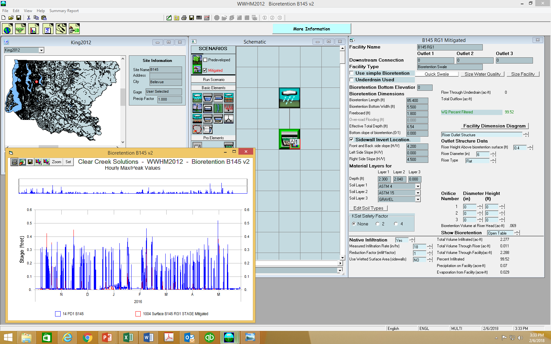
Bioretention Computer Modeling: WWHM2012

Slide 27
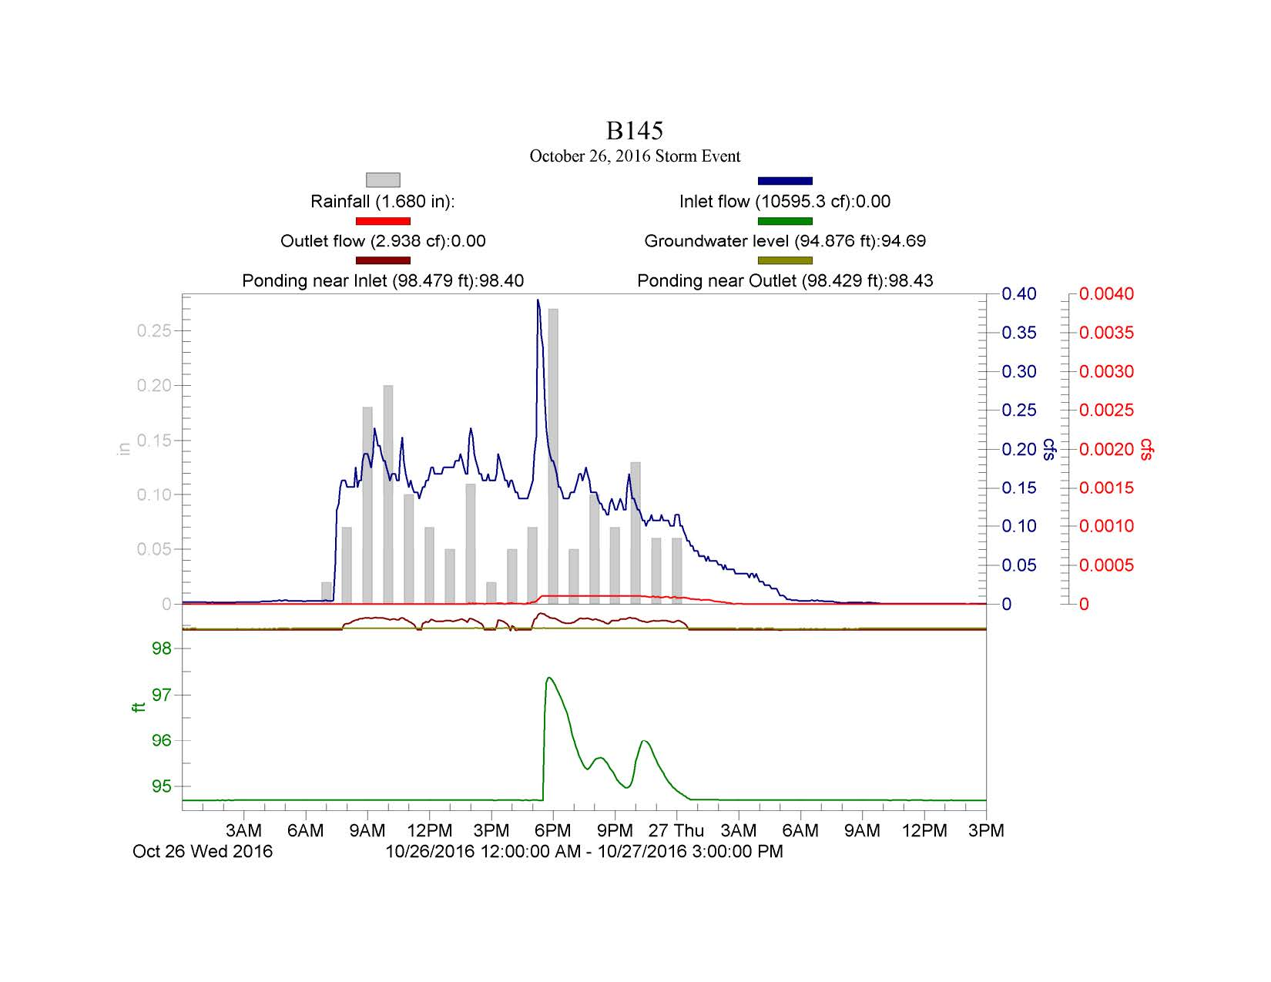
Bellevue site
Ponding at the inlet
No ponding at the outlet
Infiltrating in upstream area
Small outflow occurring suggesting bypass leakage to overflow structure

Slide 28
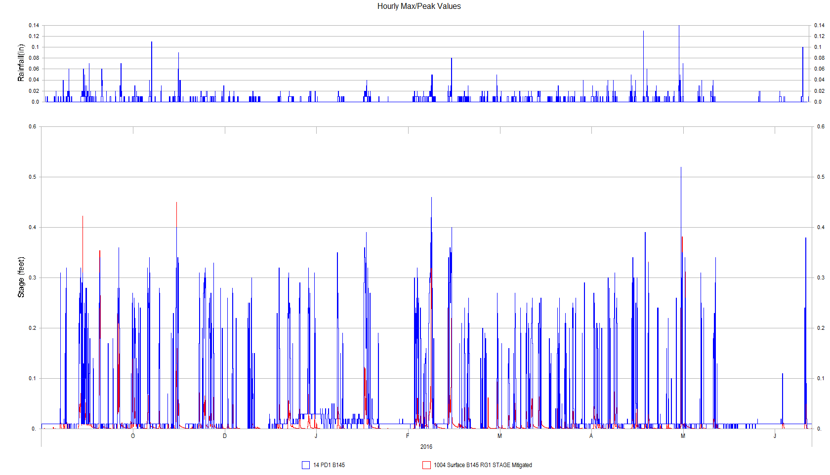
Bellevue site
Rainfall
Ponding
  Red (model)
  Blue (monitored)

Slide 29
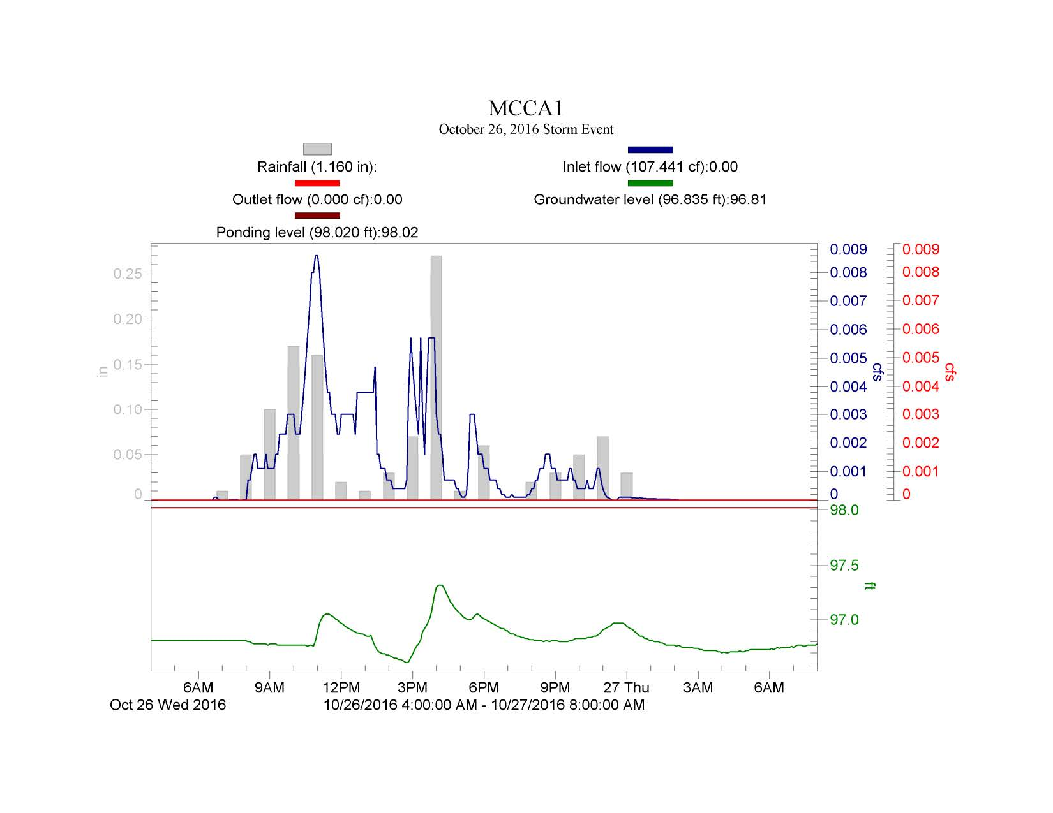
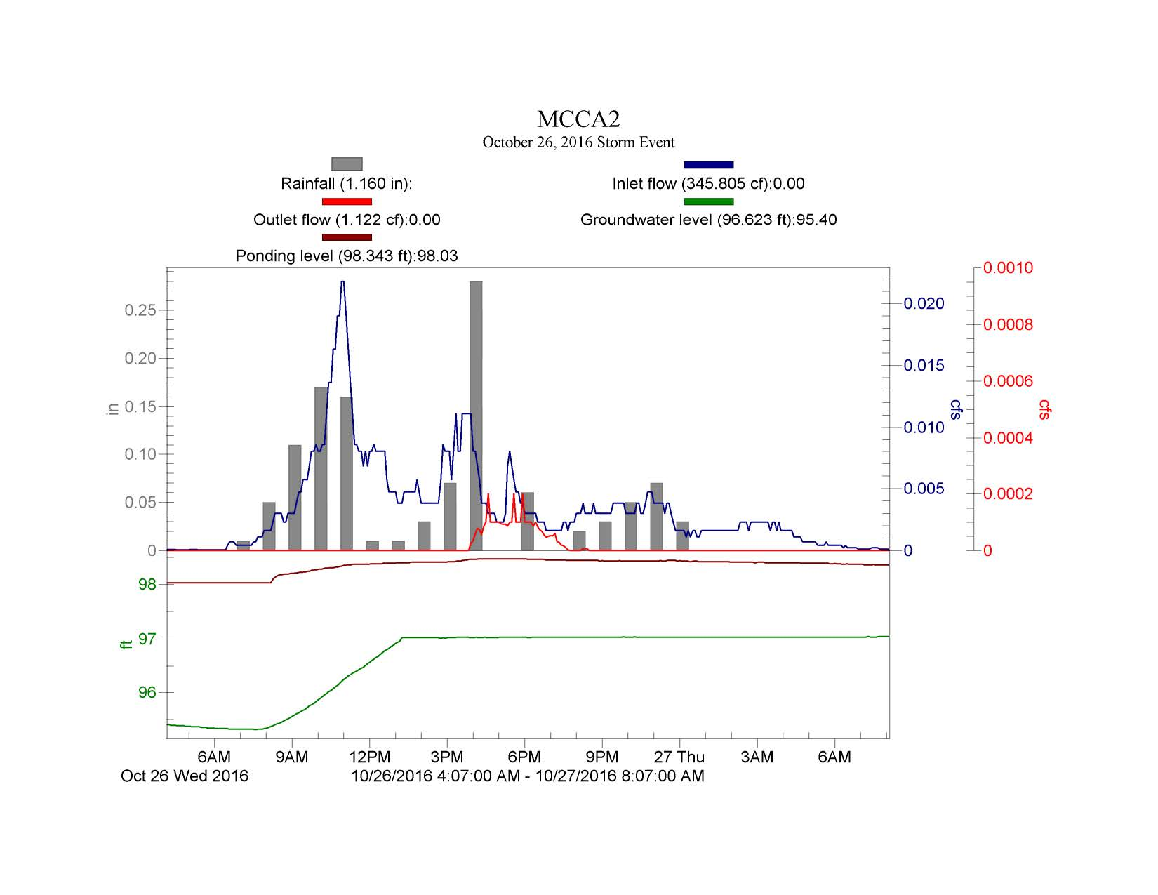
Mill Creek
Two cells adjacent to each other:
        Minimal ponding with subsurface groundwater receding
        Maximum ponding with continuous elevated groundwater

Slide 30
PRELIMINARY FINDINGS – HYDROGEOLOGIC SETTINGS
Geomorphic and Hydrogeologic Setting
Glaciated Upland – 4 cells
  1 in advance outwash, deep ground water
  2 in weathered till, perched ground water
  1 in unweathered till, but with underdrain
Outwash Plain – 5 cells
  2 in gravel, deep ground water
  2 in sand, moderate ground water
  1 in gravel, shallow ground water
Alluvial Valley – 1 cell, recent alluvium, shallow ground water
Flow Control Performance
Relative to Design?
  Yes, high performing outwash
  ? – Uncertain, lateral flow
  ? – Unlikely, short circuiting to underdrain, no retention
  Yes, high performing outwash
  Yes, high performing outwash
  Yes, high performing outwash
  ? – Uncertain, shallow ground water mounding influence

Slide 31
Recommended Grain Size Envelope
Imported Soil
Grain Size
Distribution
Fine Sand and Silts Outside Envelope
Notes:
The soil grain size distribution results show many of the facilities were outside the recommendation for fine sands and silts, resulting in generally more coarse soil and greater infiltration rates than designed.

Slide 32
BIORETENTION SOIL
Ecology 2014 / Site | Bioretention Soil Characteristics |  |  |  | Coefficient of Uniformity
 | Average | Average Grain Size, % Passing
 | % OM | #200 | #100 | #40 | Cu
 | 5 to 8 | 2 - 5 | 4 - 10 | 25 - 40 | 4 or greater
B145 | 3.9 | 0.4 | 1.7 | 15 | 3.9
BBD | 5.3 | 0.7 | 2.2 | 14 | 3.5
IHS#24 | 5.8 | 5.0 | 7.6 | 23 | 7.1
MCCA1 | 4.2 | 0.3 | 1.1 | 11 | 3.2
MCCA2 | 5.1 | 1.2 | 4.3 | 37 | 3.0
NOL | 3.6 | 0.6 | 1.6 | 14 | 3.7
ORLA1B | 6.2 | 2.5 | 6.5 | 23 | 3.6
ORLA2B | 4.2 | 2.5 | 7.7 | 40 | 3.4
SLP I | 2.5 | 1.0 | 3.5 | 33 | 2.7
SLP J | 2.6 | 0.2 | 0.8 | 18 | 3.0
Recommended Grain Size Envelope
 | Out of Spec

Slide 33
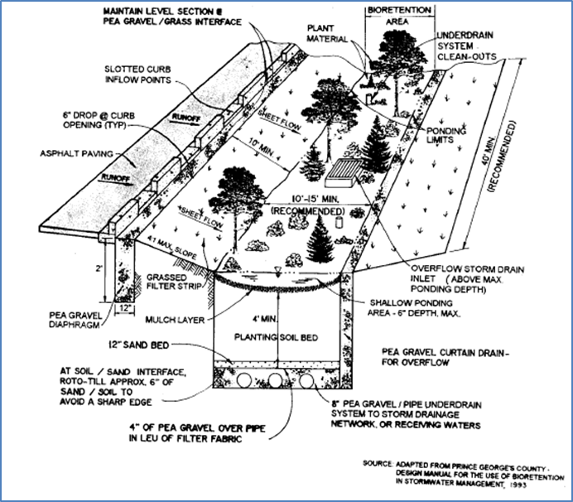
Bioretention Hydrologic Performance
Bioretention can meet both flow control and water quality goals – if designed correctly.
But you can’t design it correctly if you can’t model its hydrologic performance correctly.

Slide 34
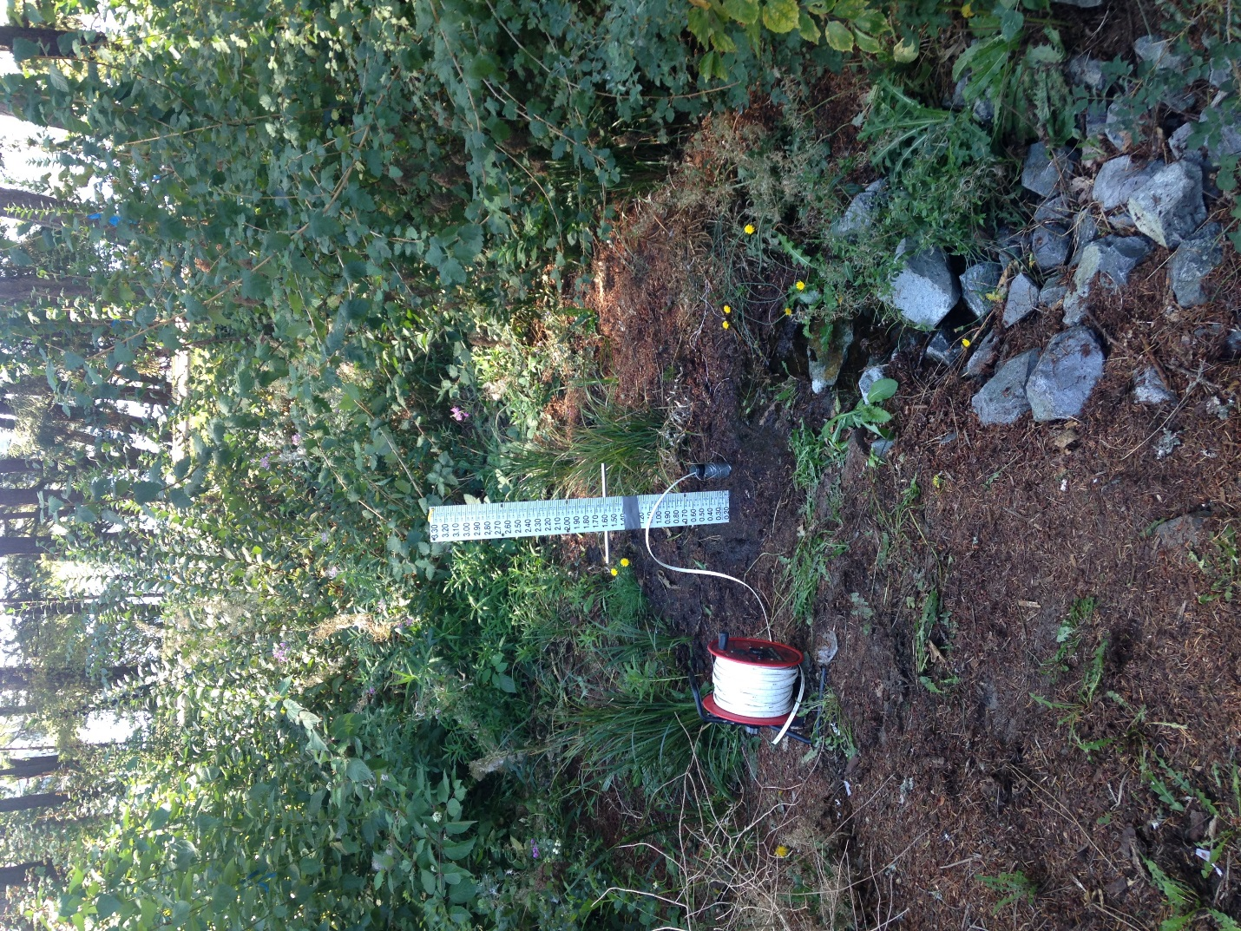
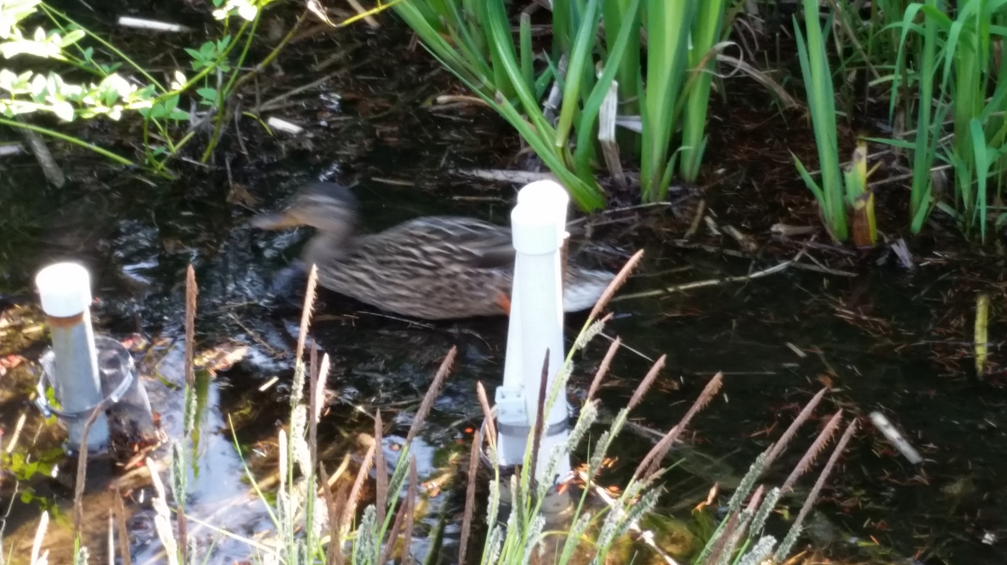
#2: Maximum ponding
#1: Minimal ponding

Slide 35
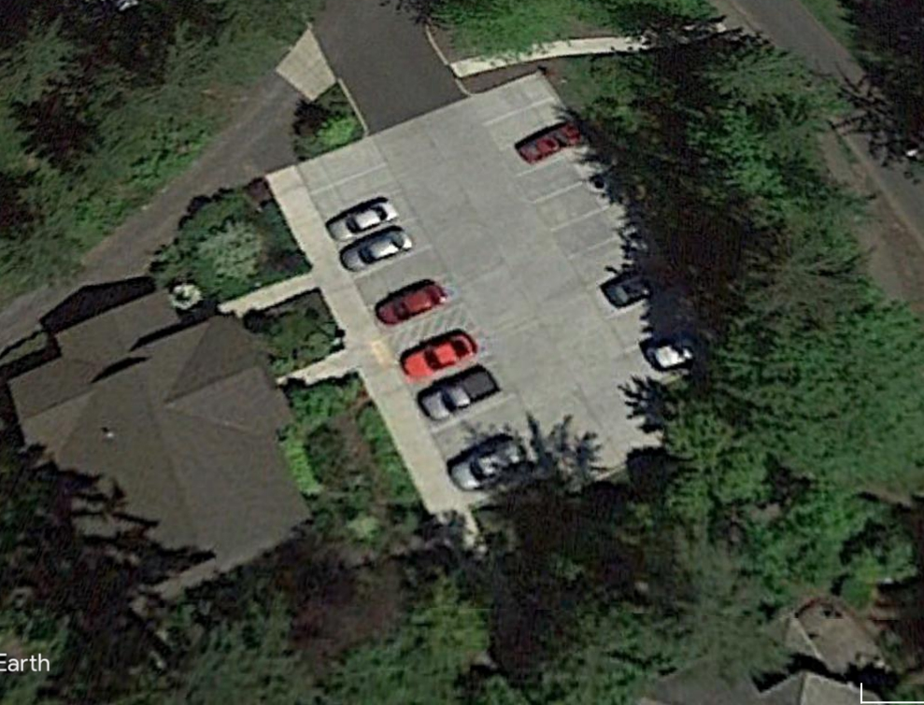
Mill Creek
#1: Minimal ponding
#2: Maximum ponding
(due to unintended inflow from permeable pavement parking lot)

Slide 36
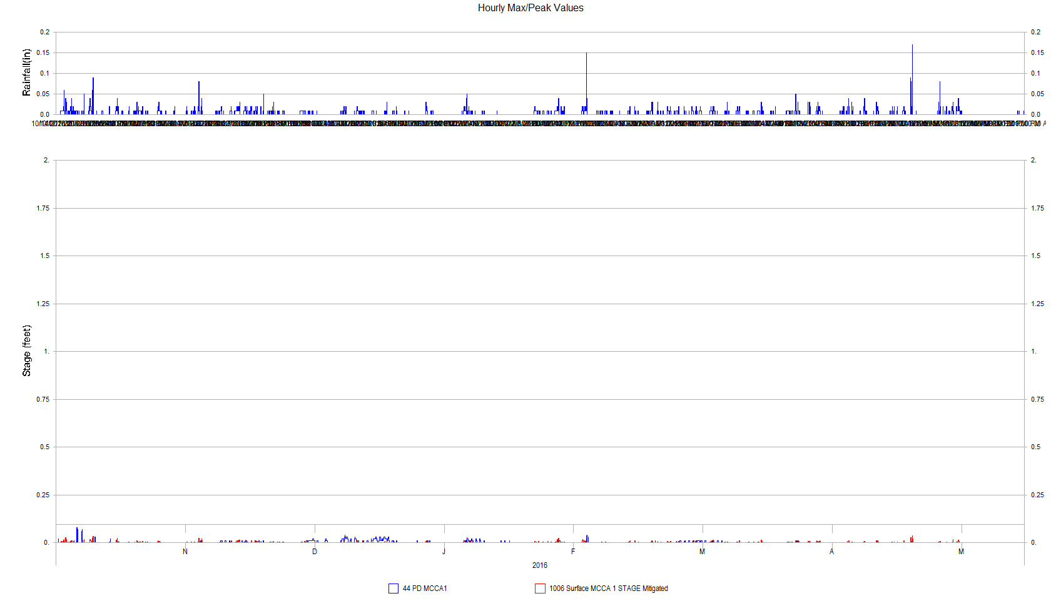
Mill Creek site #1: Minimal Ponding
Rainfall
Minimal Ponding
  Red (model)
  Blue (monitored)

Slide 37
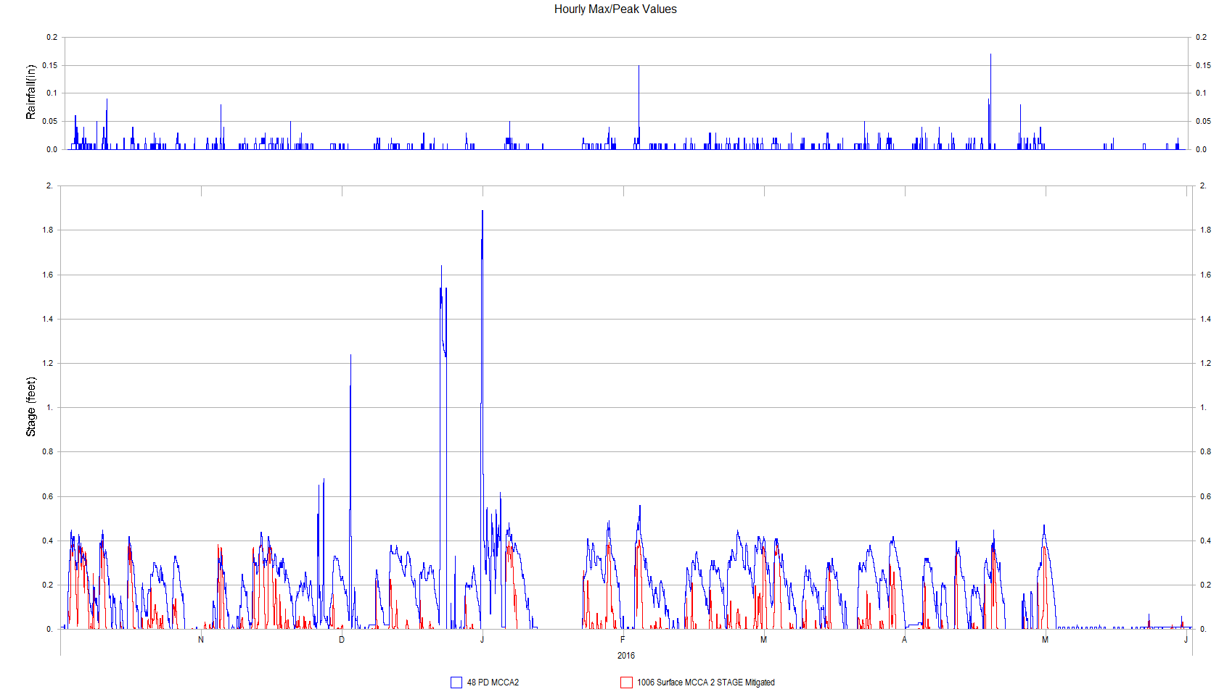
Mill Creek site #2: Maximum Ponding
Rainfall
Maximum Ponding
  Red (model)
  Blue (monitored)

Slide 38
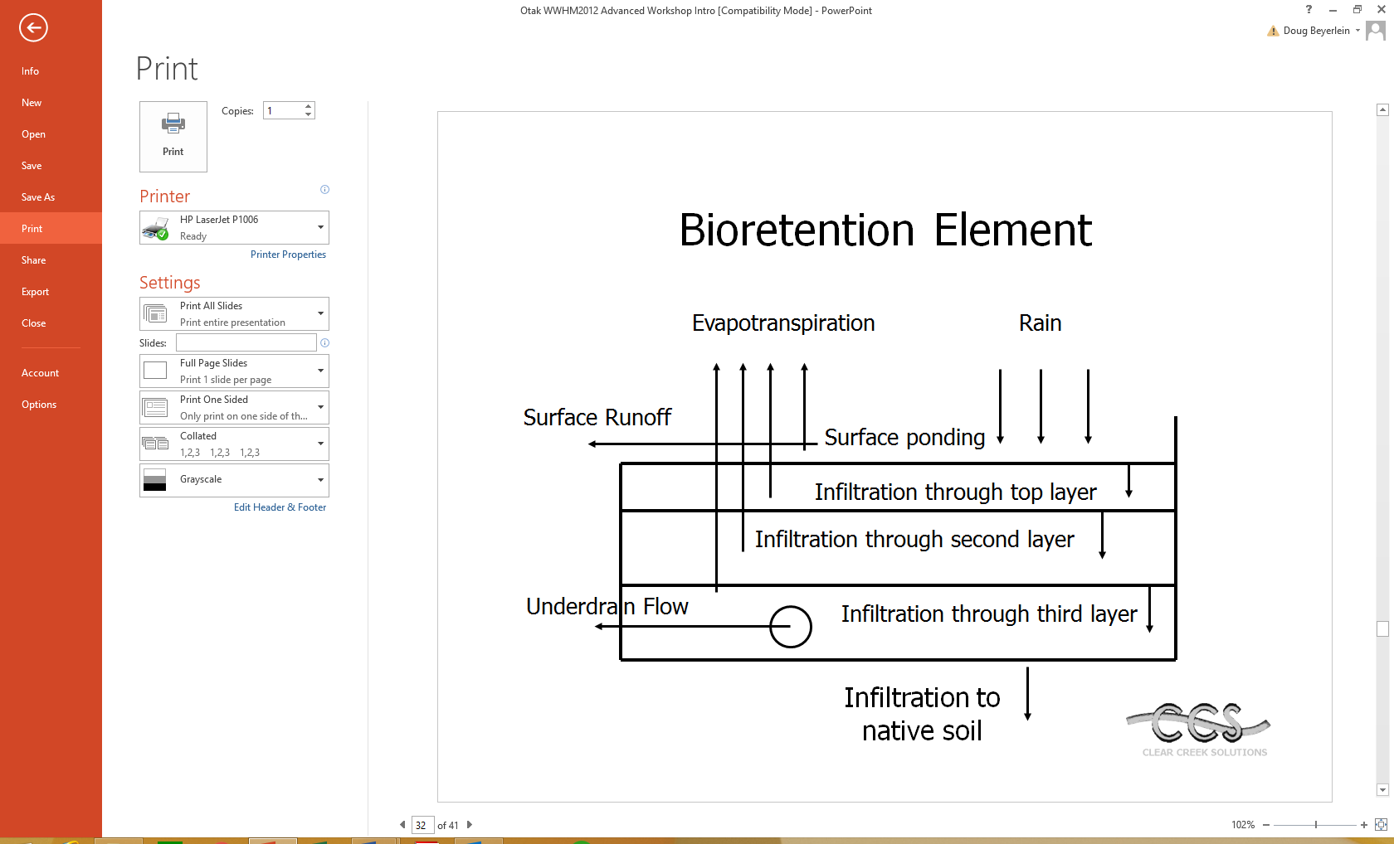
WWHM2012

Slide 39
Summary of model results
Bioretention facilities failed MR #7 (Stream Protection flow control standard) because their surface ponding overflow control structure(s) release too much water too quickly.
Can be fixed by installing graduated outlet control structures.

